Slide 1
AMERICAN WOMEN POETS OF THE 20TH & 21ST CENTURY
Dr. VASILEIOS N. DELIOGLANIS
BLACK VOICES
Department of English Language and Literature, National & Kapodistrian University of Athens

Slide 2
The Harlem Renaissance (1920-1930)
Main themes
Main Topics
Africa as a source of race pride
Black American heroes
Racial political propaganda
The black folk tradition
Candid self-revelation
Confession
Feeling of grief
Sadness
Motherhood
Relationships
Families
Injustices

Slide 3
Interracial movement of white patrons and black artists
Promoted collaboration between the two races
The New Negro poets expressed a deep pride in being black.
HR is more political than Modernism
New York City as the center of African American art
Du Bois: “Souls of Black Folk” – Double consciousness
Alain Locke: “New Negro” (book)
Harlem Renaissance

Slide 4
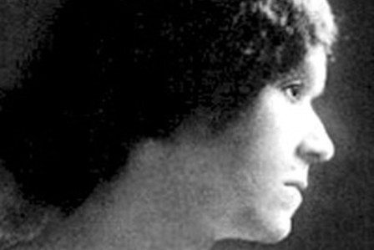
Georgia Douglas Johnson (1880-1966)

Slide 5
“The Heart of a Woman” (1918)
“womanist” poem: plight of women
Openly condemns racism and speaks on behalf of women
Autobiographical information
World War I: New opportunities for (black) women
Bondage of domesticity
Post WWI: Anti-black sentiments

Slide 6
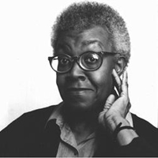
Gwendolyn Brooks (1917-2000)

Slide 7
“the mother” (1945)
topic of abortion
description of the fetuses
lost possibilities/opportunities of unborn children
Imagery
Lyrical apostrophe
Ode
Repetition of “you” and “I”
Anaphora
Repetition (“yours,” “or”)
Tenses
Rhetorical Questions
Use of Imperative

