Slide 1
AMERICAN WOMEN POETS OF THE 20TH & 21ST CENTURY
Dr. VASILEIOS N. DELIOGLANIS
CIVIL RIGHTS / WOMEN’S RIGHTS
Department of English Language and Literature, National & Kapodistrian University of Athens

Slide 2
The Women’s Movement
Civic Death (19th century)
Equality of opportunity
Feminization of poverty
Male gaze / Voyeurism

Slide 3
The Women’s Movement
19th Century: New Woman
1920: right to vote
WWII: women do men’s jobs
1950s and 1960s: married women entered the labor force
1963: the average working woman earned 63% of what a man made

Slide 4
The Women’s Movement
Betty Friedan – The Feminine Mystique: explosive critique of middle-class living patterns that articulated a pervasive sense of discontent felt by women. She encouraged women to seek new roles and responsibilities and find their own personal identities, instead of have them defined by a male-dominated society.

Slide 5
The Women’s Movement
1960s and 1970s: Women’s movement
1964 Civil Rights bill: outlaw discrimination on the basis of gender
1966: National Organization for Women (NOW): “to take action to bring American women into full participation in the mainstream of American society now.”
Counter-feminist groups: Phyllis Schlafly – more “traditional” gender roles
1972: Equal Rights Amendment: “Equality of rights under the law shall not be denied or abridged by the United States or by any State on account of sex.”
1973: Abortion legalized vs. anti-abortion movement
Late-1970s: the women’s movement stagnation
1980s: sexual harassment, looking for better jobs and childcare centers
1990s: fight for financial equality and against poverty

Slide 6
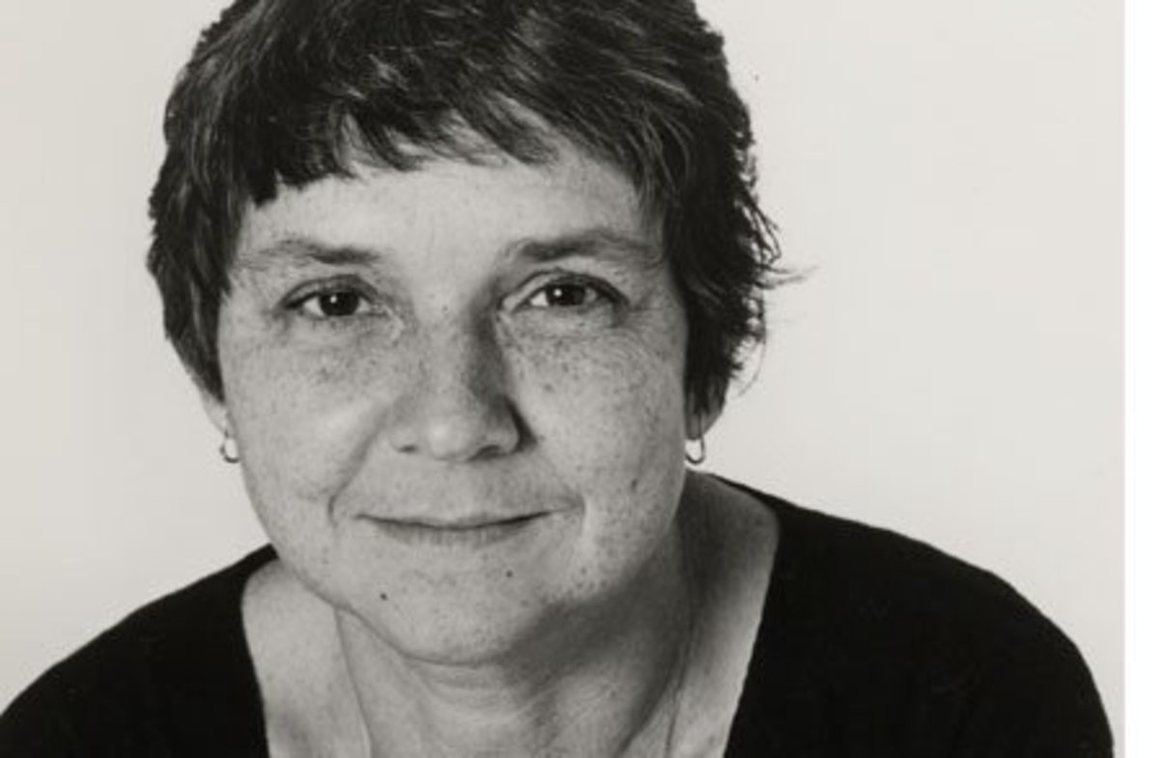
Adrienne Rich (1929-1912)

Slide 7
Adrienne Rich
When we are governed by external appearances, we cannot think clearly
Women’s body: not as a means of reproduction
Women should love their body
Women: not objects of desire, but intellectuals too.
Female body: dynamism, energy, not passivity

Slide 8
“Aunt Jennifer’s Tigers” (1951)
Gender
Power or lack thereof
Marriage
Oppression of patriarchy.
Female Role in Home
Female Role in Marriage
Animals as Symbols
Women and Nature
Patriarchal Power
Individual Freedoms
Political Issues
Art as escapism

Slide 9
Gender
Power or lack thereof
Marriage
oppression of patriarchy.
Female Role in Home
Female Role in Marriage
Animals as Symbols
Women and Nature
Patriarchal Power
Individual Freedoms
Political Issues
Art as escapism
“Aunt Jennifer’s Tigers” (1951)

Slide 10
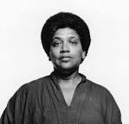
Audre Lorde (1934-1992)

Slide 11
Audre Lorde
black feminist
lesbian
poet
cancer survivor
social activist

Slide 12
“Coal” (1968)
“coal”: Black / Diamonds
Theme: African American identity
racial oppression
slave imagery

