Slide 1
AMERICAN WOMEN POETS OF THE 20TH & 21ST CENTURY
Dr. VASILEIOS N. DELIOGLANIS
Electronic Poetry
Department of English Language and Literature, National & Kapodistrian University of Athens

Slide 2
Chris Funkhouser describes digital poetry as “not a singular ‘form’ but rather a conglomeration of forms that now constitutes a genre even though the creative activity itself
Time and movement
The materiality of language
interactive dimension & kinetic dimension
Concrete Poetry
Lettrism
Futurism
Visual Poetry
Sound Poetry
Moving letters in film
Holopoetry
ELECTRONIC POETRY

Slide 3
reconceptualization of the relationship between lines, words, letters, space, time, motion, and semantics
transition from print and film to computer screen
multimedia capacities of the contemporary computer
software platforms – for example BASIC, HyperCard, Shockwave, Flash, and Processing
ELECTRONIC POETRY

Slide 4
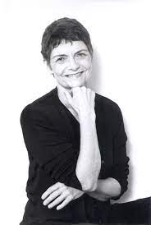
Stephanie Strickland (1942-)

Slide 5
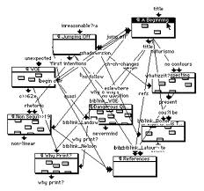
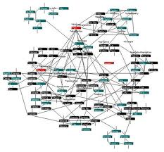
Database map / hypertextual map

Slide 6
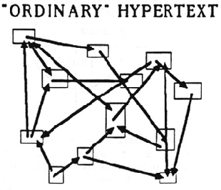
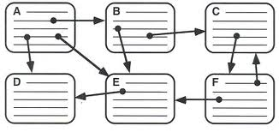
Database map / hypertextual map

Slide 7
Hypertext
“network of fragments connected by links” (Ryan et al. 2016)
“[T]ext composed of blocks of words (or images) linked electronically by multiple paths, chains, or trails in an open-ended, perpetually unfinished textuality described by the terms link, node, network, web, and path” (Landow 2)
Vannevar Bush’s “As We May Think” (1945) – “memex”
Theodore H. Nelson (1963) – “non-sequential writing”
Internet (1993) - World Wide Web
Michael Joyce: “Father” of hypertext fiction

Slide 8
“V: Vniverse” (2002)
intermedia project: print & digital
rethink the sonnet
four sections: “Draw,” “Constellations,” “WaveTercets” and “Oracle.”
verbal and visual components
tercets in linear order & sonnets
Espen Aarseth’s book Cybertext: Perspectives on Ergodic Literature (1997)
Ergodic literature
practices of reading and writing would change when moving to different media

Slide 9
“V: Vniverse” (2002)
multiple entry points
text compiled and assembled by the reader
palimpsest – constellational thinking
WaveSon.nets: unrhymed fifteen-line poems, each consisting of three quatrains and a tercet (activated by passing the cursor over one of the star-like points)
a color-coded keyword
a constellational diagram
a tercet of poetry

Slide 10
“V: Vniverse” (2002)
whose body?
There is a woman in a conical hat.
When we chain her waist
with dice and cards
a punished witch. The Jack of Knaves
comes up at 128, the one
who stole
her tart. She will sit
on a bird
or a broom. Or an axle-tree.
Or a mill wheel grinding.
She keeps time
timely, and you know her: Green, Great Circle, Noon.
whose body?
or was an inner sense of hearing-counting lost,
when the children stopped coming together
in a brood, in the easy spring, conceived at Midsummer,
whose body?
Screech owl nailed to the barnhouse door,
blows raining down on her,
faggots heaped. The persecutor's desire

Slide 11
“V: Vniverse” (2002)
Looping structure:
Entering a number in the upper right circle releases a keyword and a poem tercet.
Alternatively, a variety of hand gestures interrupt ordinary surfing to distinct effect:
mousing in a sweep over the screen,
holding the mouse over a star
single clicking to stabilize a constellation
double-clicking to release larger text units
clicking again to toggle between Son.nets and sets of tercets.

Slide 12
“V: Vniverse” (2002)
Gentle Reader, begin anywhere. Skip anything. This text
is framed
fully for the purposes of skipping. Of course,
it can
be read straight through, but this is not a better reading, not a better life.
Leaping progress
will consist
in considering this and closing the book. Anything
else will represent a settled course.

Slide 13
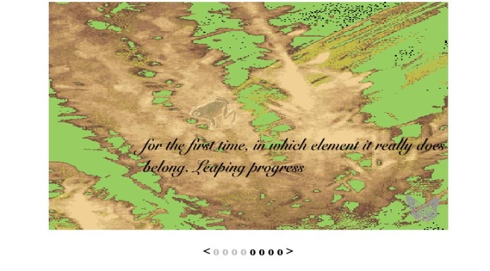
“V: Vniverse” (2002)

Slide 14
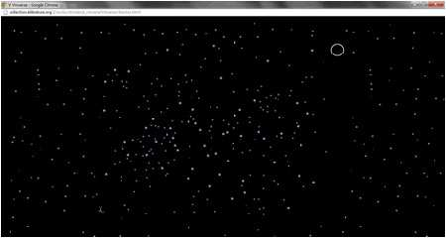
“V: Vniverse” (2002)

Slide 15
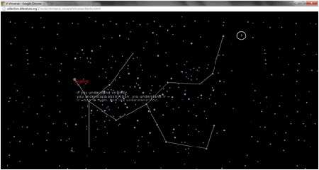
“V: Vniverse” (2002)

Slide 16
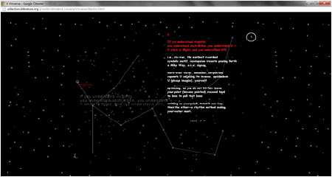
“V: Vniverse” (2002)

Slide 17
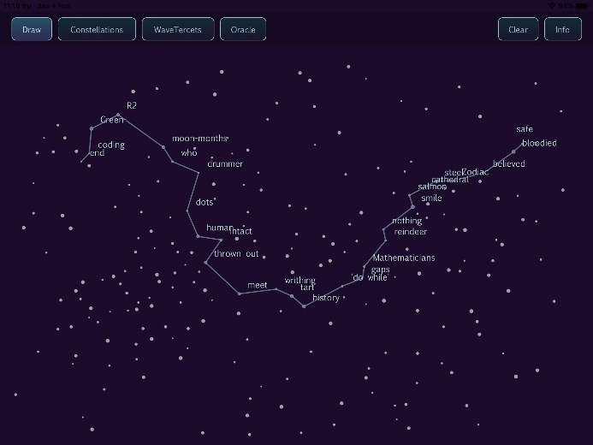
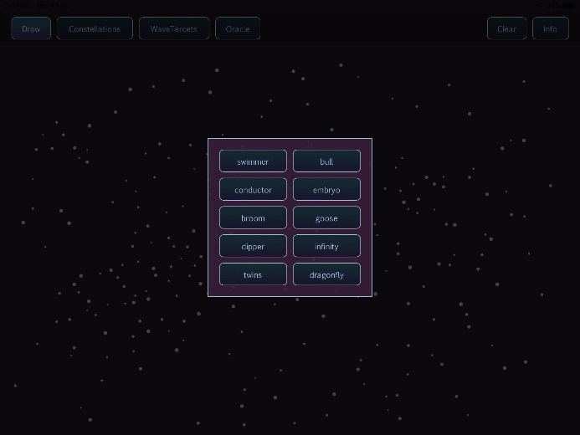
“V: Vniverse” (2002)

