Slide 1
AMERICAN WOMEN POETS OF THE 20TH & 21ST CENTURY
Dr. VASILEIOS N. DELIOGLANIS
ENVIRONMENTAL CONCERNS
Department of English Language and Literature, National & Kapodistrian University of Athens

Slide 2
ENVIRONMENTALISM
Rachel Carson’s book Silent Spring (1962)
April 22, 1970 – Earth Day
pollution (chemical pesticides, automobile emissions, industrial wastes, oil spills)
Clean Air Act (1967)
Water Quality Improvement Act
Environmental Protection Agency (EPA)
Poetry of Nature

Slide 3
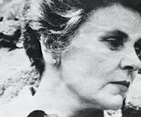
Elizabeth Bishop (1911-1979)

Slide 4
Elizabeth Bishop
Worcester, Massachusetts
Pulitzer Prize in Poetry (1956)
National Book Award in Poetry (1970)
Neustadt International Prize for Literature (1976)
Teaching at Harvard

Slide 5
“The Moose” (1972)
26 years to write the poem
minute detail of the natural world
details the geography surrounding the animal in the spotlight
descriptions of the Nova Scotia scenery
ballad form
travel theme
sense of movement through the landscape
Moose: embodiment of primal nature

Slide 6
“The Moose” (1972)
Discussion Questions
How do Bishop’s stanzas work in this poem? How do the stanzas generate momentum and even suspense? Think especially about her use of rhyme: is it consistent? Inconsistent? Is there a rhyme scheme at work in this poem, or simply rhyming? What might the difference mean?
How does perspective work in “The Moose”? That is, who seems to be doing the looking and experiencing throughout the many stanzas? A single person? A group of people? Try to chart the perspective through the poem. How does it move, and why might Bishop have wanted to not fix the poem on any one subject or speaking voice?
What happens once the poem moves “inside” the bus? What do you make of the extended sequence recounting the “old conversation”? How do those five stanzas (the same number spent on the encounter with the moose) connect with or complicate the poem?

Slide 7
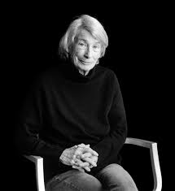
Mary Oliver (1935-2019)

Slide 8
“The Black Snake” (1979)
imagery
symbol (snake)
Similes: “looped and useless / as an old bicycle tire,” “as cool and gleaming / as a braided whip,” “as beautiful and quiet / as a dead brother”
Metaphors: “It is the story of endless good fortune,” “It is the light at the center of every cell”
Theme: death
First person narrative poem: human vs. nature
Metaphor about how fragile life is and how suddenly death can happen
celebrate the simple yet transcendent fact of being alive

