Slide 1
AMERICAN WOMEN POETS OF THE 20TH & 21ST CENTURY
Dr. VASILEIOS N. DELIOGLANIS
IMAGISM
Department of English Language and Literature, National & Kapodistrian University of Athens

Slide 2
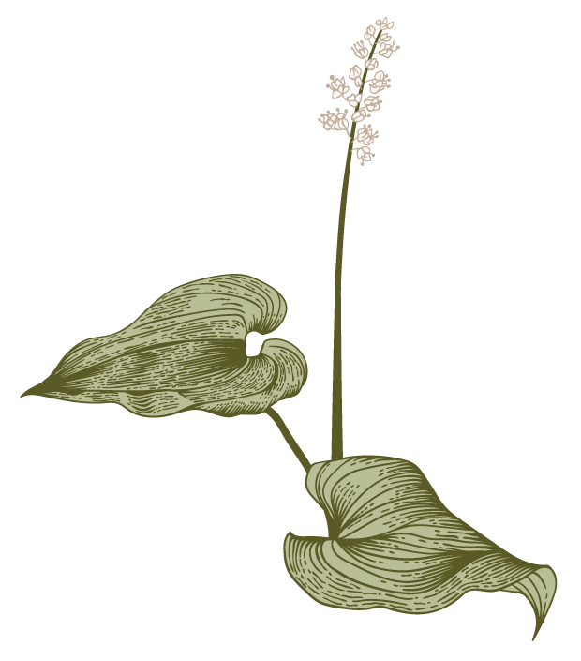

Direct treatment of the object
All words have something to say
Rhythm: sequence of the musical phrase / emotions
Sense of sudden liberation
No space/time limitations
No abstractions
Writing poetry is a kind of art
Need for movement & fluidity
If there is rhyme, it should give an element of surprise
Symbols: natural objects
Images are not merely physical description but containers for ideas and feelings.
Imagism (Ezra Pound)

Slide 3
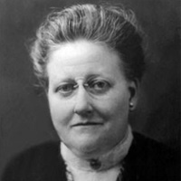
Amy Lowell (1874-1925)

Slide 4
To use language of common speech and employ always the exact word which fits the description.
To create new rhythms in poetry.
To allow absolute freedom in the choice of subject.
To present an “image” (hence the name: Imagist).
To produce poetry that is hard and clear, never blurred nor indefinite.
Concentration is the essence of poetry.
(Coffman 28-29)
Imagism (Amy Lowell)

Slide 5
Exactness
Conciseness
Free inquiry
Opposition to vague generalities
Cosmic expansiveness
Imagism (Amy Lowell)

Slide 6
Amy Lowell (1874-1925)
“Amygist” movement.”
“polyphonic prose”: ignores traditional line breaks, metaphor, alliteration, repetitive sound patterns, and particularly striking images.

Slide 7
“Patterns” (1915)
one of the best known Imagist poems
imagery to convey emotional states
Longer narrative form and fictionalized persona
dramatic monologue
historical setting
Speaker: aristocratic woman of the Queen Anne period
Free-verse rhythms
Effective use of image and color to convey emotion
Variable meters and line lengths
Frequent enjambment and irregular rhymes

Slide 8
“Patterns” (1915)
Gender-marked Imagery
Patterns
stiff brocaded gown
garden paths
changing seasons
the war
the dress of the speaker
the blooming flowers
the falling water

Slide 9
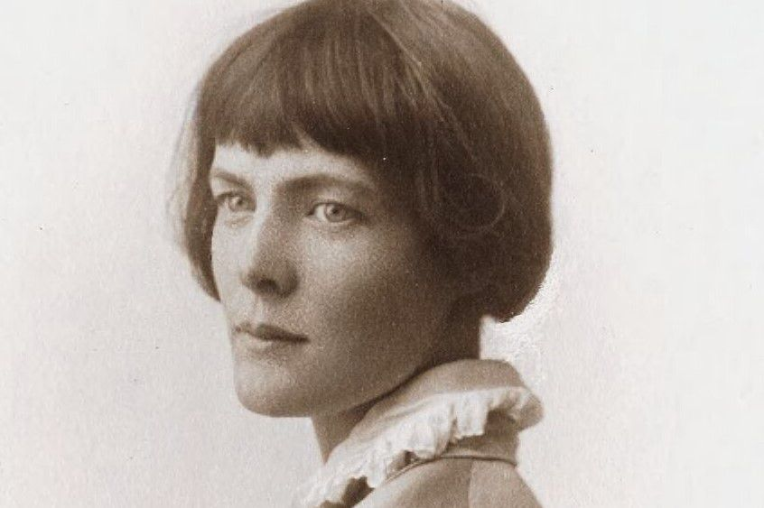
H.D. (Hilda Doolittle) (1886-1961)

Slide 10
H.D. (Hilda Doolittle)
allusions to Greek gods and goddesses
blending mythology with an imagistic conception of the natural world
renewal of myths of the ancient world
lesbian lyrics of Sappho
Revisionist mythmaking: challenge patriarchal traditions

Slide 11
H.D. (Hilda Doolittle)
For her, the ideal Imagist poem:
emotionally austere and highly concentrated in its use of language
concrete description of the world
clear, unadorned visual images
free from all abstraction, banality or sentimentality

Slide 12
“Sheltered Garden” (1916)
indirect language of flowers: new femininity
against traditional image of femininity
flight from the confinements of the suppressed, “model” femininity
objects of nature, flowers, herbs, bark, weed, fruit, frost and wind to express her idea of a real and new beauty

Slide 13
“Sheltered Garden” (1916)
Softness
Hardness
Pink
Sweet cress
Scented pinks
Bark
Sharp branch
Coarse weeds

