Slide 1
AMERICAN WOMEN POETS OF THE 20TH & 21ST CENTURY
Dr. VASILEIOS N. DELIOGLANIS
Multi-Ethnic Voices in the New Century
Department of English Language and Literature, National & Kapodistrian University of Athens

Slide 2
No established canons of major authors
No standardized historical narratives
reevaluate, revise, and rewrite the frameworks that dominated the discussion of American poetry
broad scope of the term “contemporary American poetry”
binaries between the “mainstream” and the “experimental”
changing historical, social, and literary contexts
more vocal and activist efforts to diversify the main currents of American culture
diverse range of African American, Asian American, Latinx, and Native poets
poets of color front and center
reexamination of African American history and heritage
in favor of a poetics that is deeply implicated in the social and historical structures and conflicts that have characterized the early twenty-first-century
CONTEMPORARY POETRY

Slide 3
shifting discourses of gender and sexuality
geopolitical upheavals (9/11 attacks, ongoing US wars in the Middle East)
renewal of protest and political resistance (Occupy Wall Street, Black Lives Matter)
environmental crisis and catastrophe (climate change, the Anthropocene)
beyond the traditional printed page and into new media
the rise of spoken word
a new mode of poetry, grounded in oral performance, aimed at younger audiences, and led by poets of color
“flarf”: response to the cultural shift toward online media
poetry culture whose “death” was decried in the 1980s and 1990s
New contexts and content
new feminist trajectories
intersection of poetics and disability
CONTEMPORARY POETRY

Slide 4
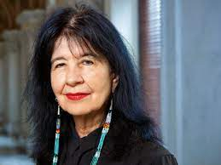
Joy Harjo (1951-)

Slide 5
Joy Harjo
Native American activist and poet
Academy of American Poets 2022 Leadership Award
mixed Cherokee, French, and Irish blood
theme of traveling
mythic, feminist, and cultural perspectives
prose poems - Native American storytelling

Slide 6
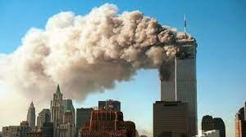
“When the World As We Knew It Ended—” (2003)
negative aspects of the terrorist attacks (World Trade Center, NYC, September 9, 2001)
traumatic relationship between Native American identity and Euro-American politics
breaking down boundaries that existed between ethnic groups of Americans
Tone: from oncoming devastation to feminine aspects of the attack
historical acts of genocide perpetrated upon Native Americans
transcendence of boundaries between identity groups
Native American tradition is not fixed but evolves and changes
femininity and Native American cultural history
future of reconciliation
https://archive.org/details/911#videosummary & https://www.youtube.com/watch?v=7YLm3pkAiJQ&ab_channel=LetUsJoke

Slide 7
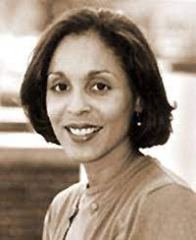
Natasha Trethewey (1966-)

Slide 8
Natasha Trethewey
born in Gulfport, Mississippi, in 1966 to a white father and a black mother
BA in University of Georgia
MFA in poetry from the University of Massachusetts
first collection of poems, Domestic Work (2000)
2001 Mississippi Institute of Arts and Letters Book Prize
2001 Lillian Smith Award for Poetry
second collection, Bellocq's Ophelia (2002)
2003 Mississippi Institute of Arts and Letters Book Prize
2006 collection, Native Guard, won the 2007 Pulitzer Prize for Poetry

Slide 9
“Native Guard” (2006)
racial legacy of America’s Deep South
Setting: American Civil War (1861-1865), Fort Massachusetts, Louisiana Native Guards
Tone: reflective, tragic
Sonnet
Repetition
Fictional character as speaker

Slide 10
“Native Guard” (2006)
Themes:
Death
Prejudice
Captivity vs. Freedom
Remembrance
Motifs:
Writing
Symbols:
Corpses
Letters

