Slide 1
AMERICAN WOMEN POETS OF THE 20TH & 21ST CENTURY
Dr. VASILEIOS N. DELIOGLANIS
New Feminisms & Queer Identities
Department of English Language and Literature, National & Kapodistrian University of Athens

Slide 2
1990s: from poetry movements to more dispersed networks and affiliations
critique of the nation-state and colonialism
“gurlesque” & Third-wave feminism
Second-wave feminism: earnestness, sensitivity, self-seriousness
Third-wave feminism: playful with traditionally feminine identity and sexuality
fourth-wave feminism (mid-2000s): self-agency, use of humor, political
Post-Language Poetics: new lyricism or hybrid poetry
social media platforms have created new poetic forms and audiences
continuing growth in feminist and women-run journals and presses
twenty-first-century poetry by women: multiplicity of perspectives, connection and loss, and continuing revolutions across the borders of gender and genre
New Feminisms & American Women’s Poetry

Slide 3
Gurlesque
Sexual agency and pleasure
gender as social construction
artifice and performance
attention to the gendered body on display
reverses gendered power relations
gender as contingent and performative
cultural fashioning of gender
gurlesque poetics break taboos
critique of heteronormativity

Slide 4
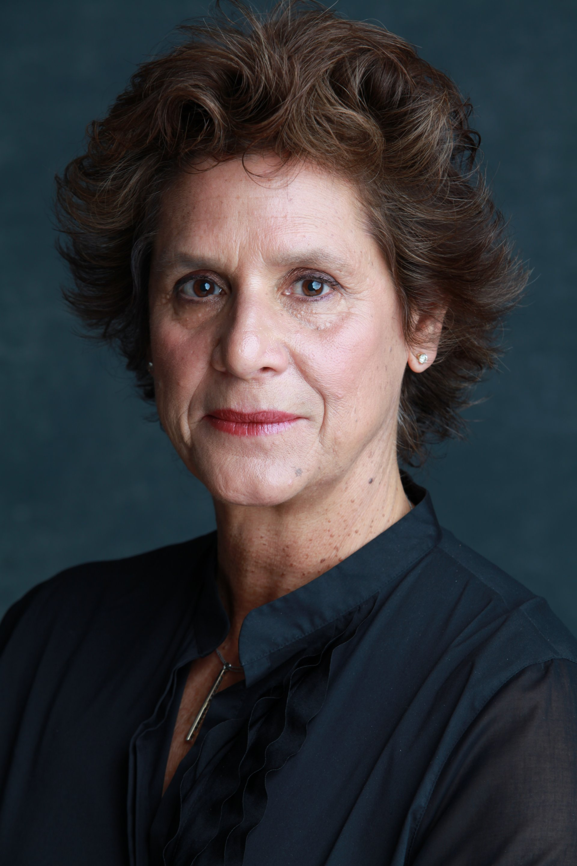
Catherine Wagner (1969-)

Slide 5
Catherine Wagner
experimental poetry
“This Is a Fucking Poem”: available in third collection My New Job (2009)
Macular Hole (2004) and Miss America (2001)
associate professor in the MA program in Creative Writing at Miami University in southwest Ohio

Slide 6
“This Is A Fucking Poem” (2009)
child sexualization
(self-) cannibalism or body mortification
brutal socialization
two types of profanity: non-propositional (involuntary response to surprise or pain) and propositional (deliberate)
disapproval of profanity in poetry: lazy, irreverent, or evidence of a meager vocabulary
Until about the second half of the 20th century, profanity was regarded as dirty and lowly
“fucking”: transgressiveness, dirty word, profane, provocation, taboo, deliberate, premeditated
sexualized female body as an alien-like reproductive space
the girl-insect is potentially self-consuming, vulnerable to abuse

Slide 7
Patricia Lockwood (1982-)

Slide 8
“Rape Joke” (2013)
published in the general interest website The Awl in July 2013: it became viral
contemporary rape culture
Poetry Foundation declared the poem as “world-famous.”
selected for The Best American Poetry, 2014 edition
won a Pushcart Prize
translated into more than 20 languages
subjective poem: memory of an incident of rape that happened with herself.
prose form: not any specific rhyme scheme or metrical scheme
internal rhyming
conversational style
dramatic monologue

Slide 9
Lesbian
Gay
Bisexual
Trans+
Queer or Questioning
Intersex
Asexual
Demisexual
Graysexual
Cisgender
Gender Nonconforming
Genderqueer
Genderfluid
Gender-Neutral
M.A.A.B./F.A.A.B./U.A.A.B. Male-assigned at birth/female-assigned at birth/unassigned at birth
LGBT+

Slide 10
Sexuality & the LGBT+ Community
Gender: How we understand masculinity and femininity, according to cultural stereotypes
Sex: Biological/Chromosomic differences
Sexuality: has to do with sexual attraction and orientation

Slide 11
Deborah A. Miranda (1961-)

Slide 12
“Love Poem to a Butch Woman” (2005)
lesbian love
problems that queer people face on a regular basis
female desire to have children with a female partner
sexuality: desires and passions
nature of creation is contested
idea that love on its own should create a life

Slide 13
Trace Peterson (1978-)

Slide 14
“Exclusively on Venus” (2016)
playful yet poignant poem
juxtaposes casual, mundane lines with sharp and specific experiences
experience all aspects of the speaker’s life—beyond being trans
our expression of who we are as individuals matter
queer theory’s origins: in LGBT studies (sexuality and gender)
Sources of pain of transgender people: homelessness, lack of legal production, discrimination, violence, health disparities, lack of love, acceptance, and marriage rights

