Slide 1
American Literature of the 19th Century
Dr. VASILEIOS N. DELIOGLANIS
INTRODUCTION
Department of English Language and Literature, National & Kapodistrian University of Athens

Slide 2
Early American Literature
Orally Transmitted Myths (Native American Culture)
Legends
Tales
Lyrics
Literature of Exploration

Slide 3
The American Enlightenment (1776-1820)
Rationality
Representative Government
Justice, Liberty and Equality
Genres:
The Political Pamphlet (Thomas Paine – Common Sense (1776))
The Epic (Timothy Dwight – The Conquest Of Canaan (1785))

Slide 4
Democratic origins and Revolutionary writing (1776-1820)
American Revolution against Britain (1775-1783) vs. Dependence on English literary models (Sir Walter Scott)
Lack of audience
Inferiority of American output
Absence of adequate copyright laws
Literary stagnation
National obsession: Search for a native literature - A distinctive voice

Slide 5
Charles Brockden Brown – Wieland (1798)
Washington Irving – The Sketch Book of Geoffrye Crayon (1819-20)
James Fenimore Cooper – The Pioneers (1823)
First Important Fiction Writers Widely Recognized Today

Slide 6
Washington Irving (1783-1859)
James Fenimore Cooper (1789-1851)
Ralph Waldo Emerson (1803-1882)
Henry David Thoreau (1817-1862)
Herman Melville (1819-1891)
Nathaniel Hawthorne (1804-1864)
Edgar Allan Poe (1809-1849)
Emily Dickinson (1830-1886)
First generation of American Writers

Slide 7
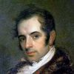
Washington Irving (1783-1859)

Slide 8
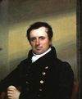
James Fenimore Cooper (1789-1851)

Slide 9
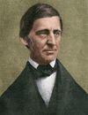
Ralph Waldo Emerson (1803-1882)

Slide 10
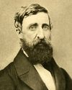
Henry David Thoreau (1817-1862)

Slide 11
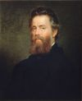
Herman Melville (1819-1891)

Slide 12
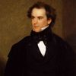
Nathaniel Hawthorne (1804-1864)

Slide 13
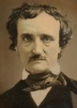
Edgar Allan Poe (1809-1849)

Slide 14
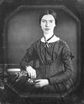
Emily Dickinson (1830-1886)

Slide 15
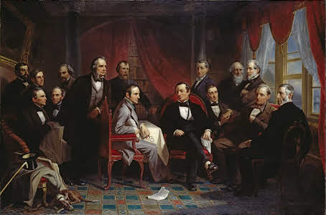
Washington Irving and his Literary Friends at Sunnyside - Christian Schussele, 1864

Slide 16
19th Century Movements

Slide 17
The Romantic Movement
First mature phase of novel creativity
Distinctive emergence of various genres
New England: Center of American thought
Remarkable works:
Emerson – “NATURE” (1836), “The American Scholar” (1837)
Nathaniel Hawthorne – The scarlet letter (1850), The House of the seven Gables (1851)
Herman Melville – Moby Dick (1851)
Henry David Thoreau – Walden (1854)
Walt Whitman – Leaves of Grass (1855)
ROMANTICISM / TRANSCEDENTALISM / AMERICAN RENAISSANCE (1820-1865)

Slide 18
Literary Nationalism (1820s)
War of 1812
Calls for a New American Culture & distinctively American works
The Romantic Period (1820-1865)

Slide 19
The Romantic Period (1820-1865)
Conflicts and Contradictions
democratic ideals:
freedom
Equality
Justice
“We hold these truths to be self-evident, that all men are created equal, that they are endowed by their Creator with certain unalienable Rights, that among these are Life, Liberty and the pursuit of Happiness.” (Declaration of Independence)
ongoing national crimes:
near-genocide of native Americans (Indian Removal Act of 1830)
enslavement of black people
vs

Slide 20
The Romantic Period (1820-1865)
TRANSCENDENTALISM
Individualism: The idea of “Self”: Redefined
Creative powers of the Individual
Regenerative value of nature

Slide 21
Romantic Literature
American Literary Nationalism
American Literary Traditions
Link 19th-century writings to the colonial past
Sense of a continuously unfolding national history and literature
Invention of new forms
The Old and Traditional gets left behind
The New, Innovative force is the center of attention
Quest for American distinctiveness / American exceptionalism:
What is an American?
In what ways the American national identity is distinguished from other nations?
What constitutes the “Americanness” of the United States?
The American writers and the American Hero: “Loners”
Pressure to discover an authentic literary form, content and voice
Romance

Slide 22
The Rise of Realism (1865-1914)
Civil War (1861-1865)
Emancipation Proclamation (1863): Abolition of Slavery
“This is not the republic I came to see […]. in everything of which it has made a boast […] it sinks immeasurably below the level I had placed it upon” (Charles Dickens, 1841-42).
Period of Reconstruction
American Idealism: Progress & The self-made man
“The Gilded Age”
Nation undergoing changes:
Rail system
Telegraph
Materials
Markets
Communications
Influx of immigrants
Urbanization
Industrialization
Alienation
Rise of population
The frontier vanished

Slide 23
The Rise of Realism (1865-1914)
American Realist Literature:
Presents distasteful truths
Responds to the social problems of its time
Local Colorists
Samuel Langhorne Clemens (Mark Twain):
The Adventures of Huckleberry Finn (1884)
Sarah Orne Jewett:
“A White Heron” (1886)
The “Woman” Question
Kate Chopin:
The Awakening (1899)

Slide 24
Naturalism
Extreme form of realism
Relation of individual to society.
Exposes social problems
Darwinian thought – Charles Darwin’s On The Origins Of Species (1859)
Literary expression of determinism
Biology, Environment, Psychological Drives, and Chance
Stephen Crane:
Maggie: A Girl Of The Streets (1893)

Slide 25
Literary Genres
American novel
American poetry
A distinctive literary form
Shaped identities
Single most popular literary genre of its day
Variety of political and social topics
Shaping the new nation
Paradigmatic democratic form
A form of education
A means of access to social and political events
Expression of national identity
Offered visions of a developing new nation
Reassessment of the role of the “average” American
Questioning of authorities
Defying established social and literary tradition
short history / complex heritage
Walt Whitman and Emily Dickinson
“America”: a new-found land of pure potential
“Poetry”: a literary genre defined over hundreds of years of European civilization
determine their relation to English and other European poetic traditions

