Slide 1
American Literature of the 19th Century
Dr. VASILEIOS N. DELIOGLANIS
Native Americans: Conquest, Removal & the Myth of the Noble-Savage
Department of English Language and Literature, National & Kapodistrian University of Athens

Slide 2
America: from colony to colonizing empire that destroyed the indigenous population
imperialistic nation within its own borders
New concepts: National identity, Nationality, Republic, Americanness
Denial of the multicultural reality of America
WASP identity
Republicanism: liberty equality, pursuit of happiness, progress, dynamic development
fear of social and political disruption
The Naturalization Law (1790)
The Alien Act (1798)
HISTORICAL CONTEXT

Slide 3
Andrew Jackson - Indian Removal Act (1830)
Myth of the Indian: The “Noble Savage”
Noble: freedom, innocence, nature, virgin land
Savage: Uncivilized, non-Christian
Motto in boarding schools: “Kill the Indian…and save the man”
Paradox: Americans build their national identity on Indian identity
Myth: Assimilation / Enculturation vs. Reality: Extinction
The Vanishing Indian: Civilizing the Indian = corruption, destruction & cultural genocide
HISTORICAL CONTEXT

Slide 4
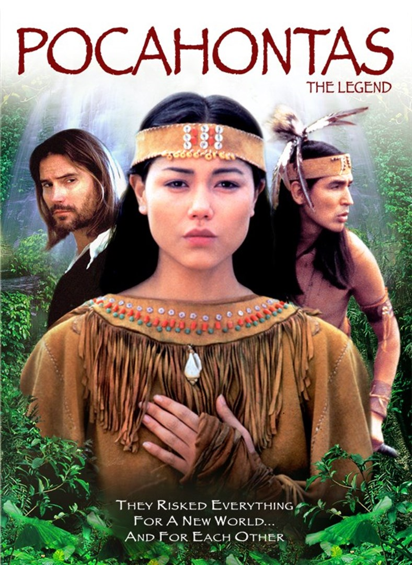
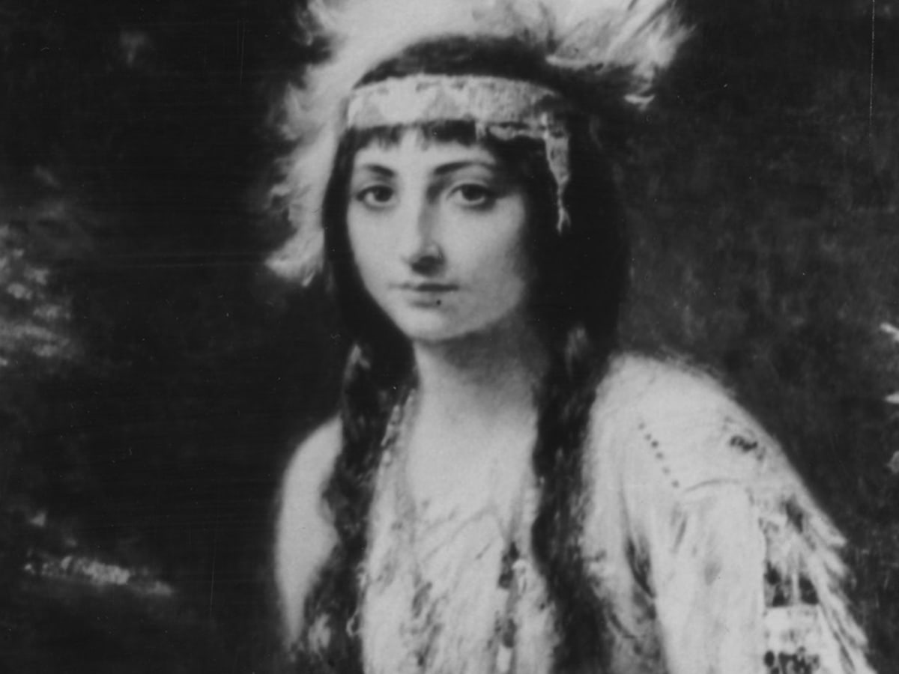
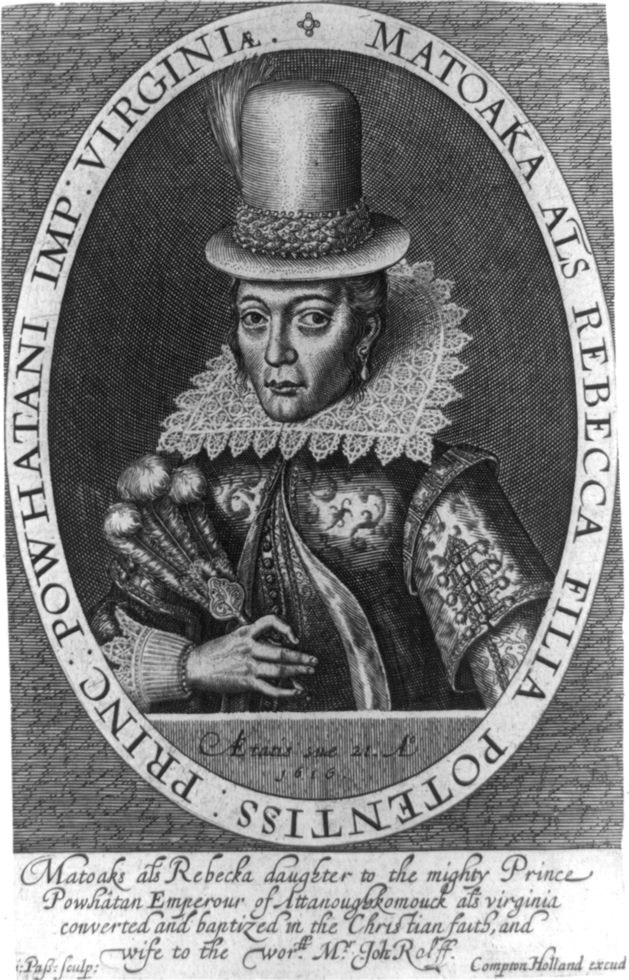
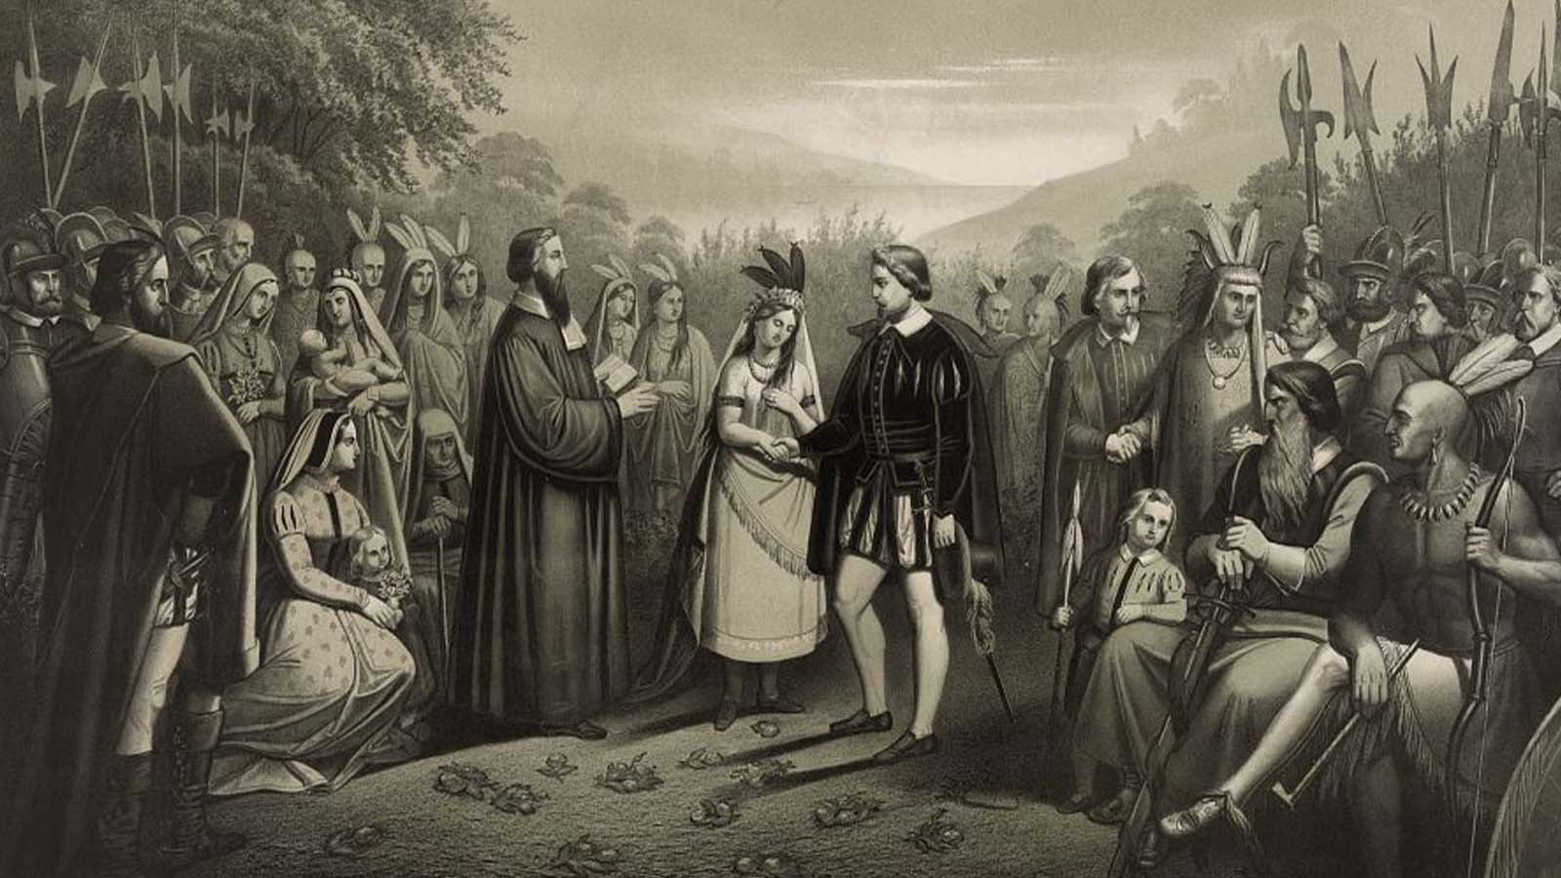
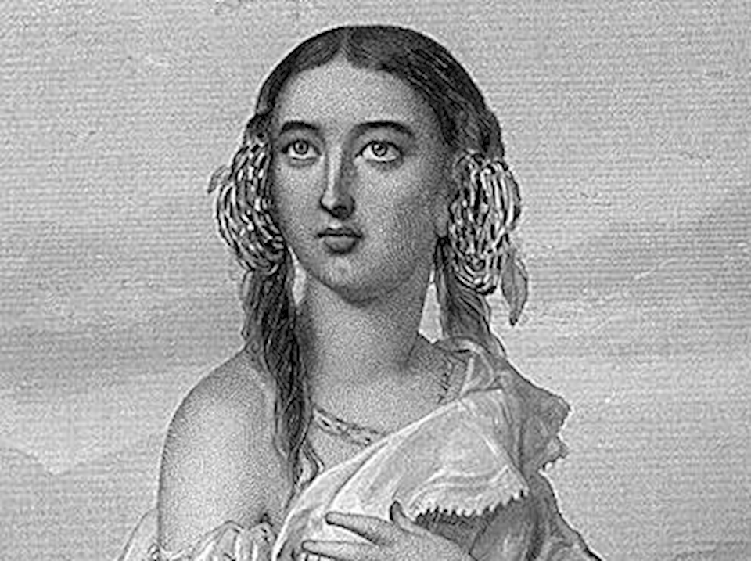
Pocahontas (1596-1617)

Slide 5
George Washington Parke Custis – Pocahontas, or The Settlers of Virginia (1830)
Expansion, colonization, imperialism
Melodrama
Matacoran vs. Pocahontas
Pocahontas: Miscegenation / symbolic body / cultural orphan
Elimination of the “savage” aspect of the Indian
American fear of national disruption

Slide 6
William Apess – “An Indian’s Looking-Glass for the White Man” (1833)
Rhetoric (myth of the noble savage) vs. Reality (civic death)
Apess connects American national identity and skin color

Slide 7
Sarah Winnemucca – Life Among the Piutes (1883)
Storytelling: shapes Native American cultures and societies & reestablishes lost bond with heritage, culture, language, history
Language as a tool of empowerment
Memoir: cultural record - cultural preservation and promotion
Recollection / Memory: Creation of emotional space
Trail of Tears (1838)

Slide 8
Sarah Winnemucca – Life Among the Piutes (1883)
Emotional space: characters linked to certain places within space on the basis of stories, memories, and lived experience / emotional attachment to the landscape
Process of land dispossession and relocation evokes feelings of despair
Use of language:
“Oh, how sad they were. Women cried and blamed their husbands for going with the Bannocks” (506)
“The blood ran out of her mouth” (507)
“She had great suffering during our journey” (507)
“tears of love” (507)
“My people threw their arms round him and his wife, crying, ‘Oh, our father and mother, if you had staid with us we would not suffer this’” (507)
“…could not stop their tears at seeing the people who once loved her” (507)
“They all cried out to him and his wife.” (507)

Slide 9
General Allotment Act of 1887 / Dawes Act
Surveyors of Indian tribal land
Tribal land was divided into allotments for individual Native Americans
In order to preserve this land, Indians were obliged to pay taxes to the government.
Due to this policy, many Indians lost their piece of land, ending up destitute and landless, since they were not able to pay their taxes.
Members of the selected tribe or reservation were either given permission to select pieces of land – usually around 40 to 160 acres in size – for themselves and their children, or the tracts were assigned by the agency superintendent
“surplus lands”: If the amount of reservation land exceeded the amount needed for allotment, the federal government could negotiate to purchase the land from the tribes and sell it to non-Indian settlers (https://iltf.org/land-issues/history/).
Land Tenure

Slide 10
Zitkala-Ša (Gertrude Simmons Bonnin)– The School Days of an Indian Girl (1900)
Processes of:
Acculturation: cultural estrangement
Transition
Transformation
Enculturation

