Slide 2
“Dramatis Personae” – A Key
Mr. O. Fearmax: The Spiritualist
Mr. V. Truman and Mrs. Elsie Truman: A Couple of Married Eccentrics
Miss Virginia Dale: The Pretty Convalescent
Captain J. Baird: The Soldier with Guilty Memories of the Cretan Resistance
Lord Graecen: The Antiquarian Peer and Minor Poet (Dicky)
Miss Dombey: The Protestant Spinster with a Fox Terrier
Campion: The Extrovert Painter
Böcklin: The Buried German
Sir Juan Axelos: The Archaeologist
Mr. Howe: The American Journalist
Hogarth: The Psychologist

Slide 3
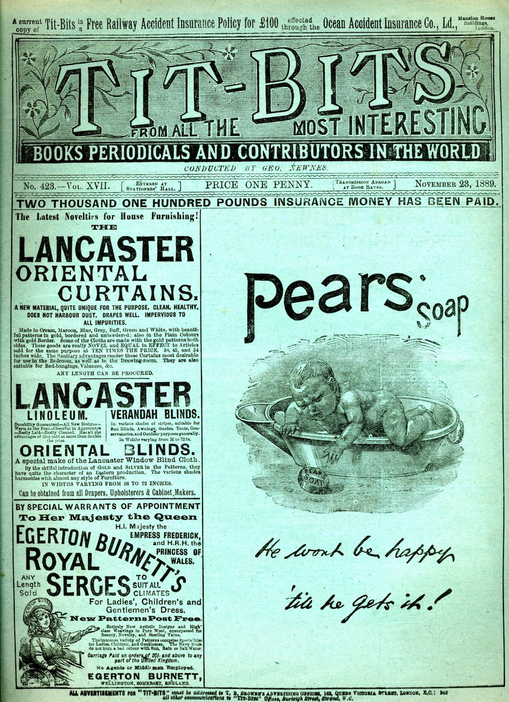
But perhaps the seal was set upon their eccentricity when one day the stewardess found them sitting naked, side by side on the bunk, playing noughts and crosses. ‘Come in, dear, Mrs. Truman had said with pleasant unconcern, and then, seeing her consternation, ‘John, out of sight with you.’ She heard Truman laughing immoderately as he struggled into a shirt. She confided this adventure to the steward, asking him very seriously whether old people like that still made love: it seemed faintly indecent. They were old enough to have children. The steward stifled a smile and said he didn’t know — they were probably eccentric. She was thoroughly satisfied with this proposition. Eccentric, that’s what they were. But they were good-humoured and undemanding, and she had a little wave of pity in her heart as she packed the ill-fitting cheap dresses, the old wire-hair-brush, and the copies of Tit-Bits in the trunk which, according to the metal stamp, had been made by a Mr. Stevens in Peckham Rye.
The Dark Labyrinth, 16

Slide 4
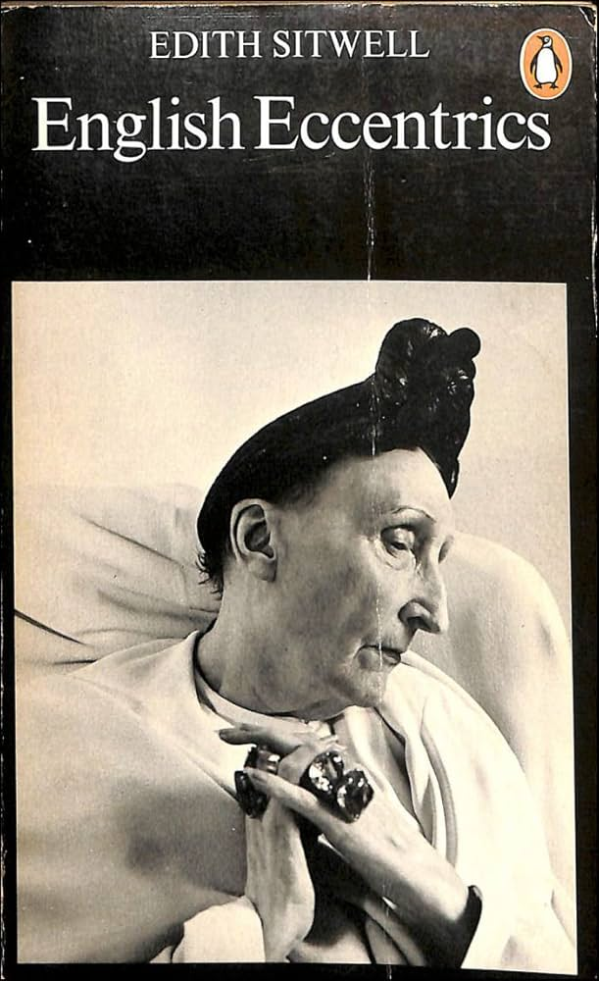
“…they were probably eccentric. She was thoroughly satisfied with this proposition. Eccentric, that’s what they were.” (16)

Slide 5
“It was not till some days later, when Graecen's escape was announced in the Press, that the purser discovered that he was a poet. 'England's Foremost Poet-Peer,' said one paper and gave a brief outline of his history, his Scottish title, his M.C. and Mention, and his brilliant batting for the Gentlemen ver­sus Players at Lord's in 1936. Everyone felt that they wished they had known at the time; he had been so quiet and unobtrusive - so like a middle-aged stockbroker. It is true that he had once been seen sketching in a book, and that he read to Miss Dale once or twice on A deck - but whether it was poetry or not they could not tell. It seemed, however, no less than poetic justice that he should be saved. Later still the purser was to see in The Times the poem of Graecen's, begin­ning: 'When death like the sundial casts his shadow.' The

Slide 7
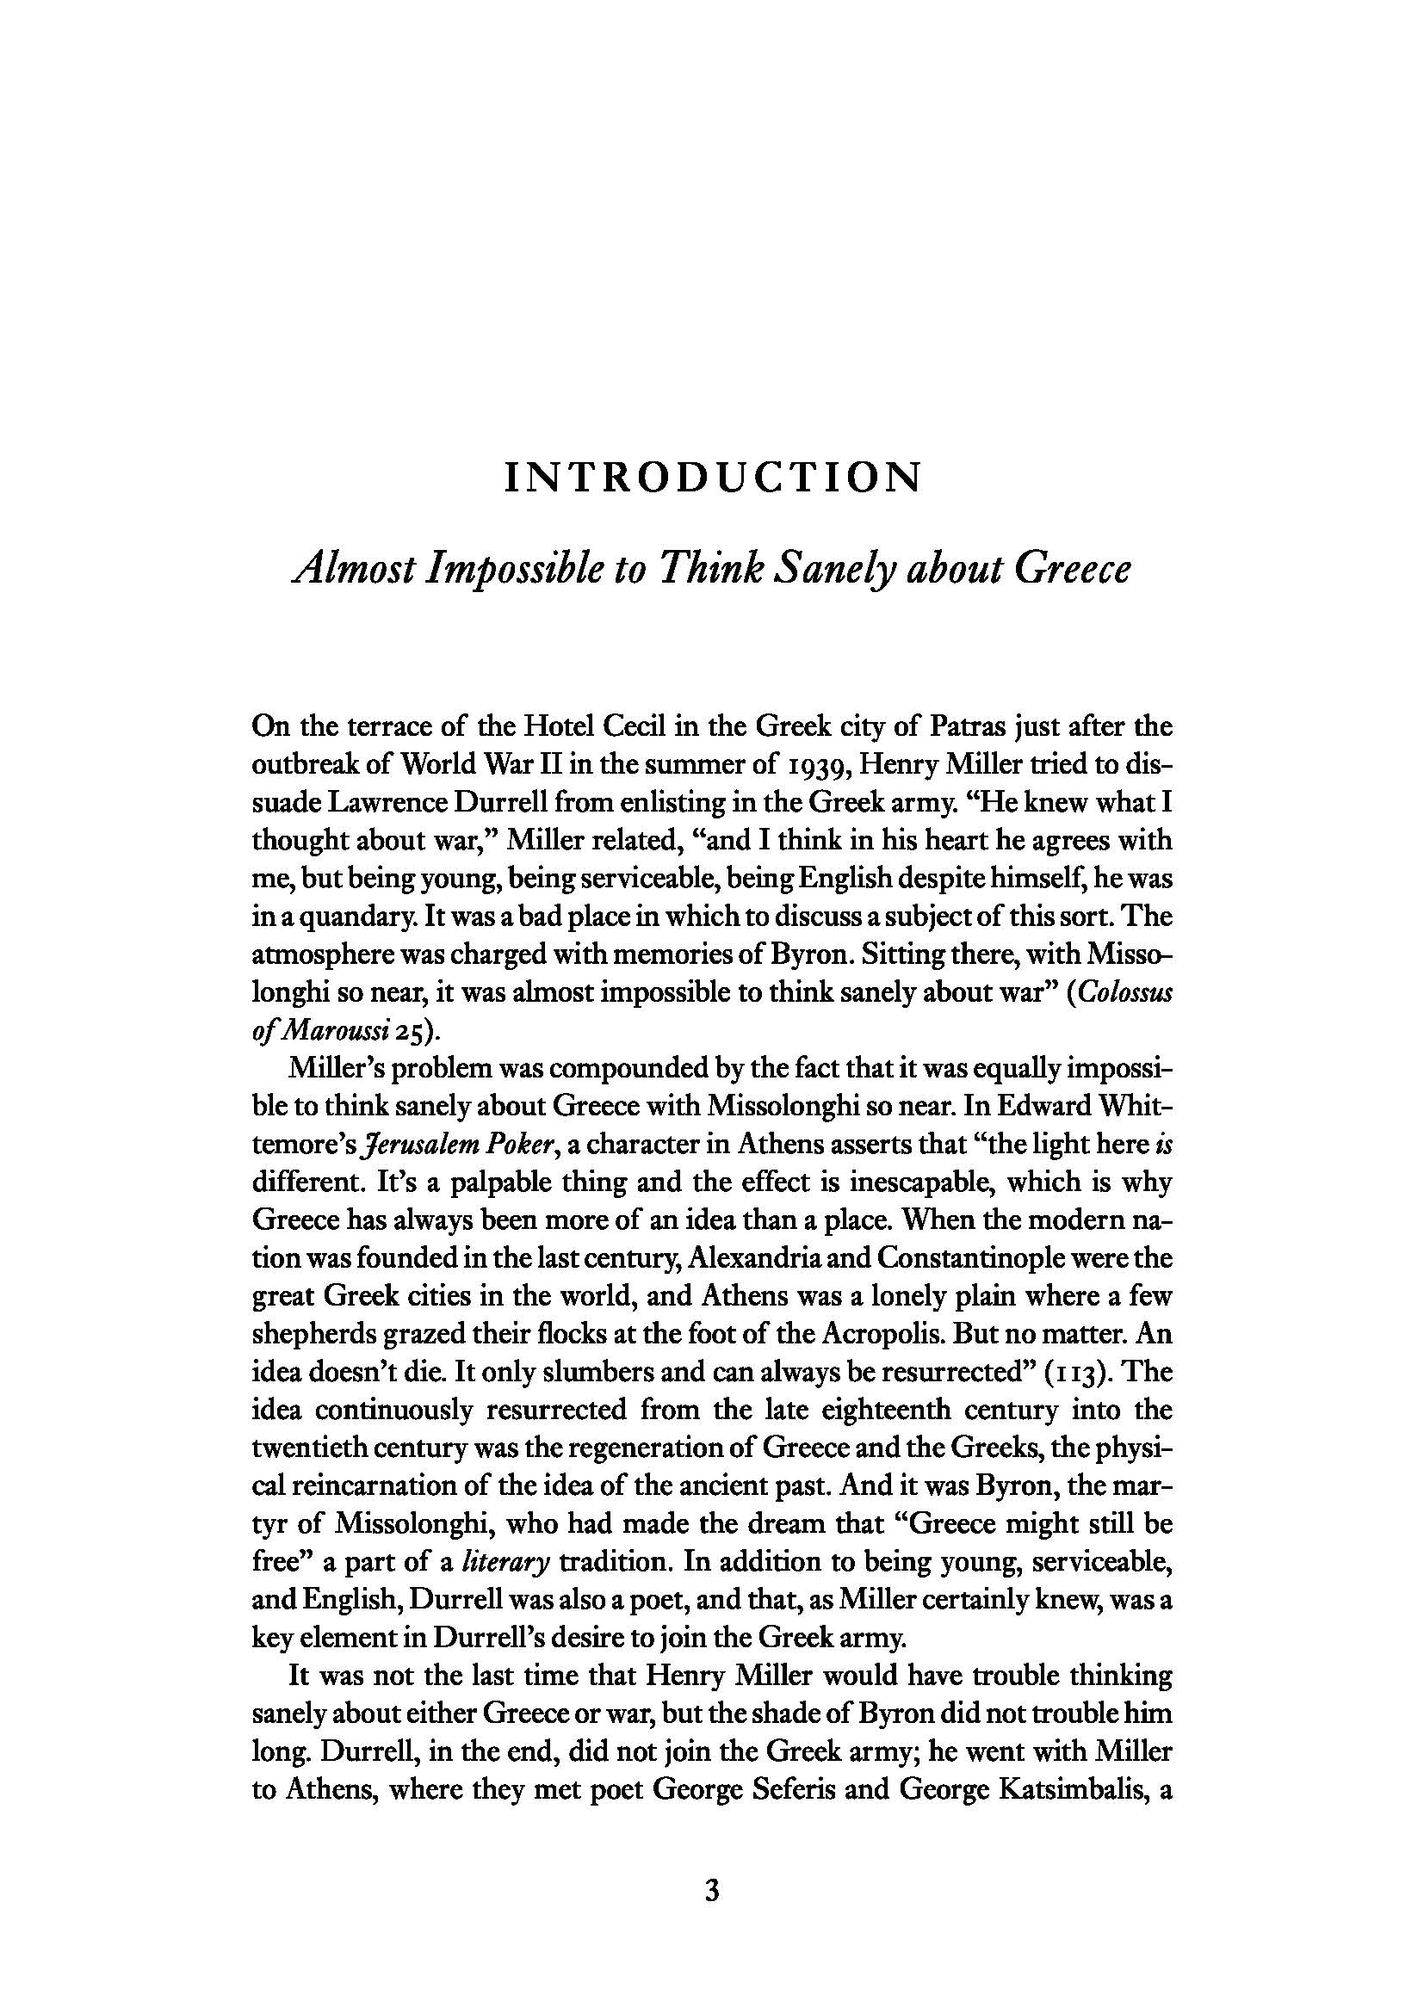

Slide 8
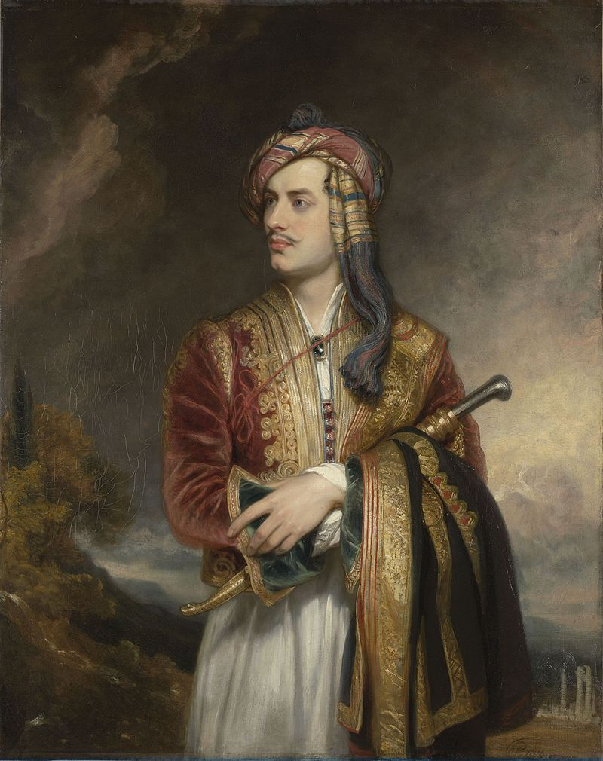
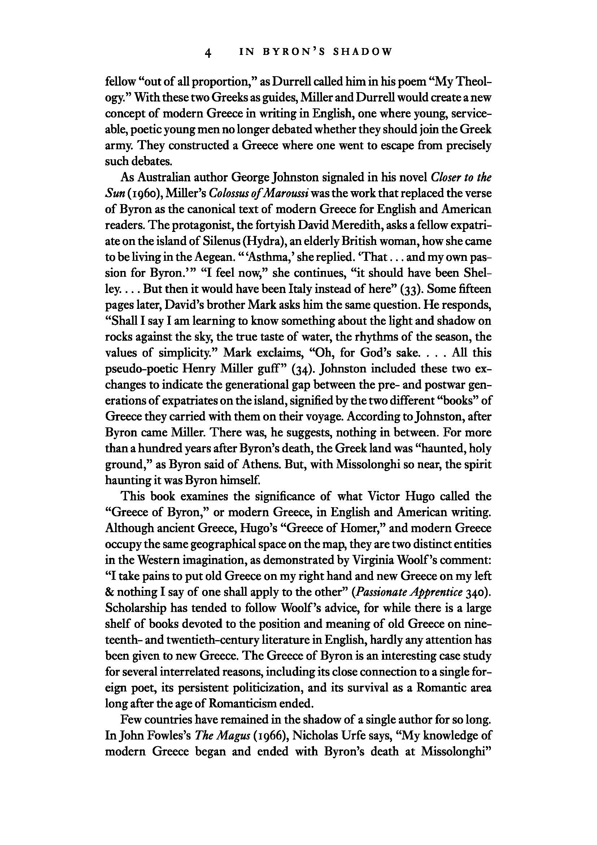
Lord Byron in Albanian Dress; an 1813 portrait painting by Thomas Phillips. Part of the Governent Art Collection, The British Embassy, Athens.

Slide 9
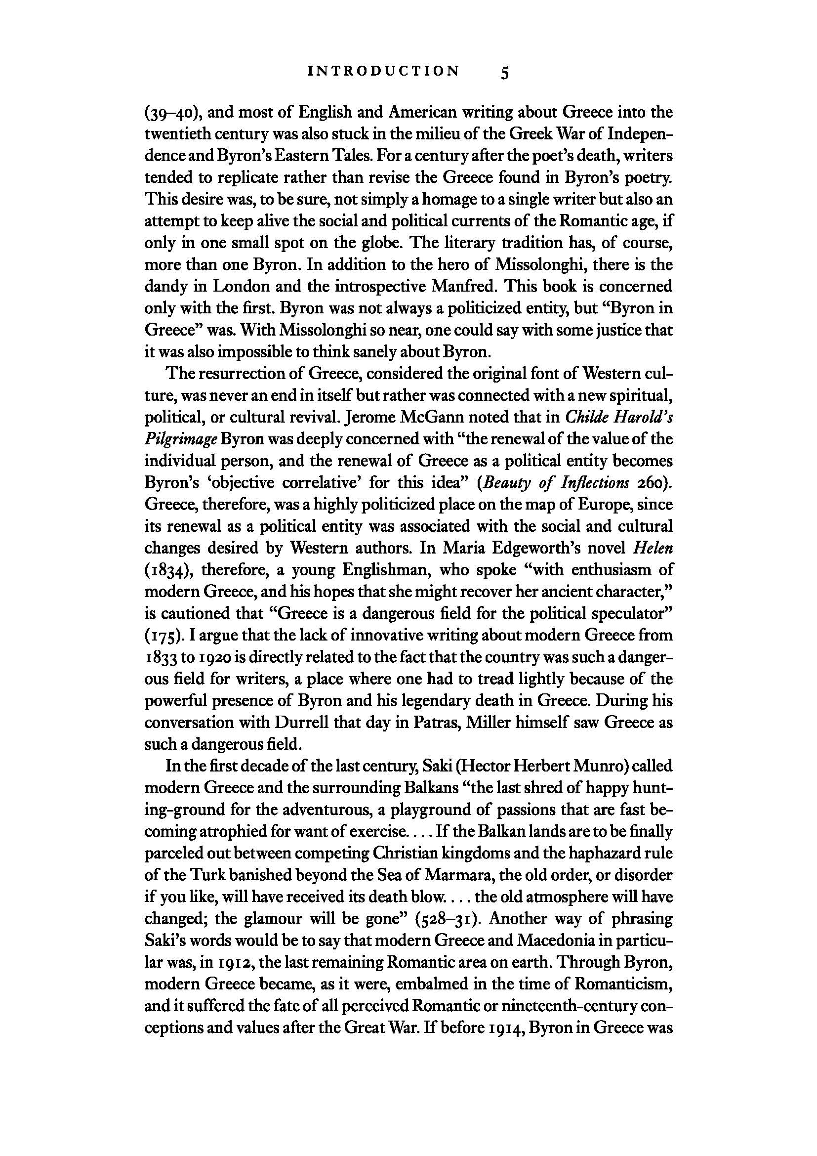
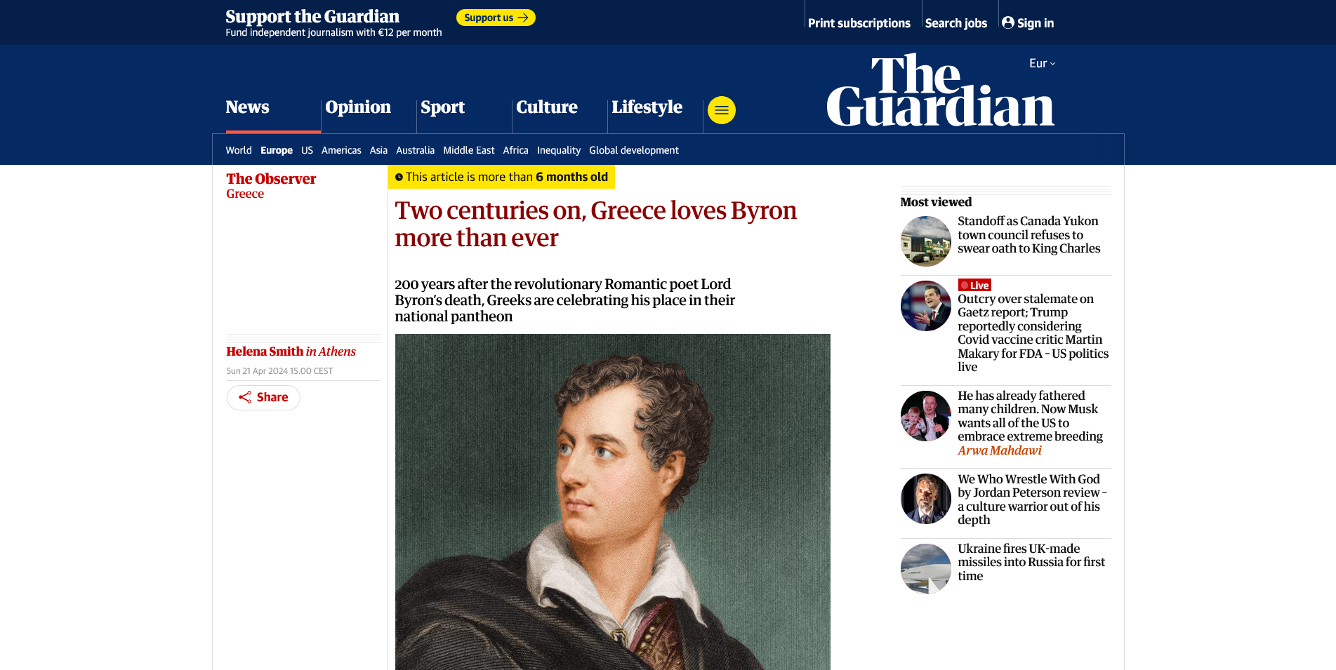

Slide 10
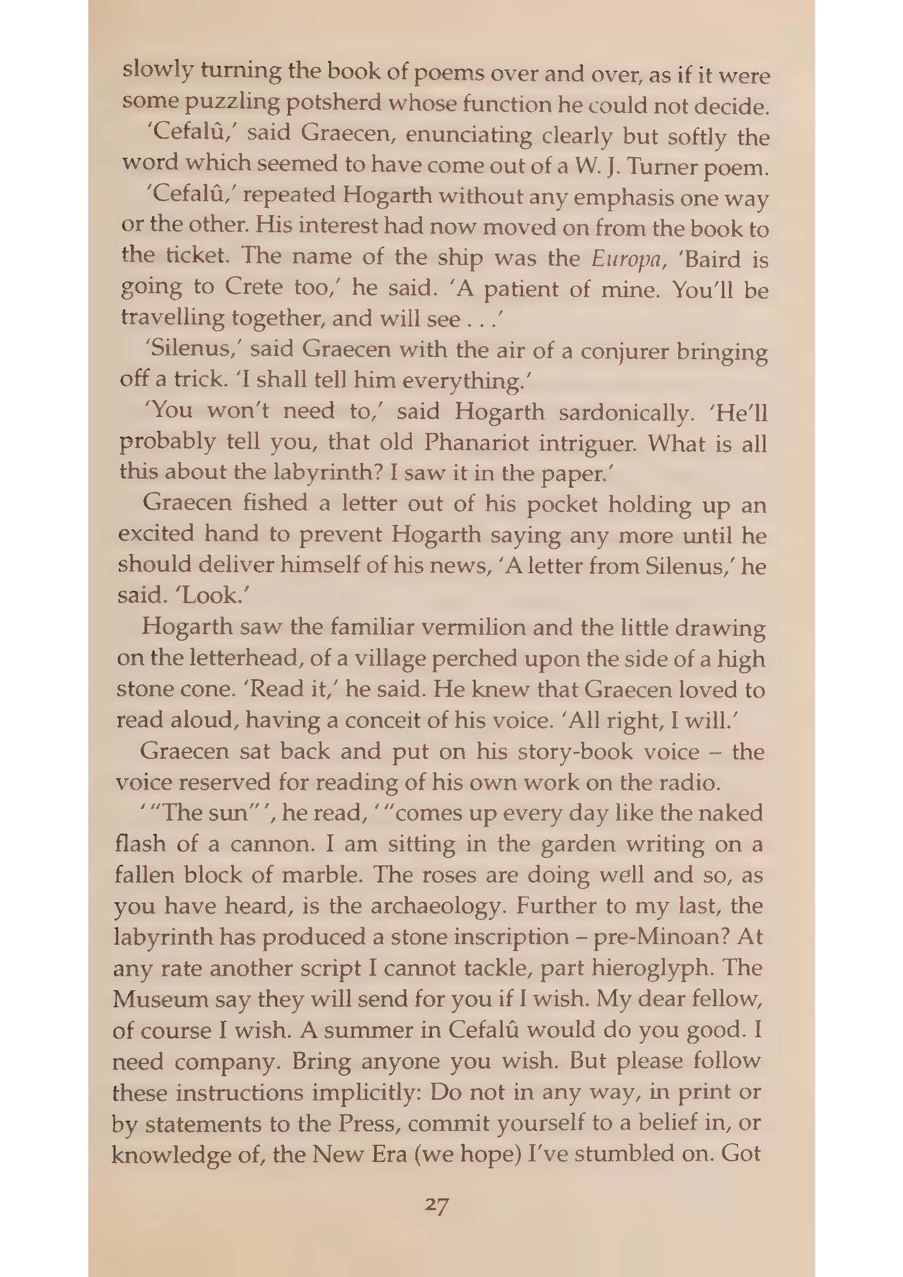
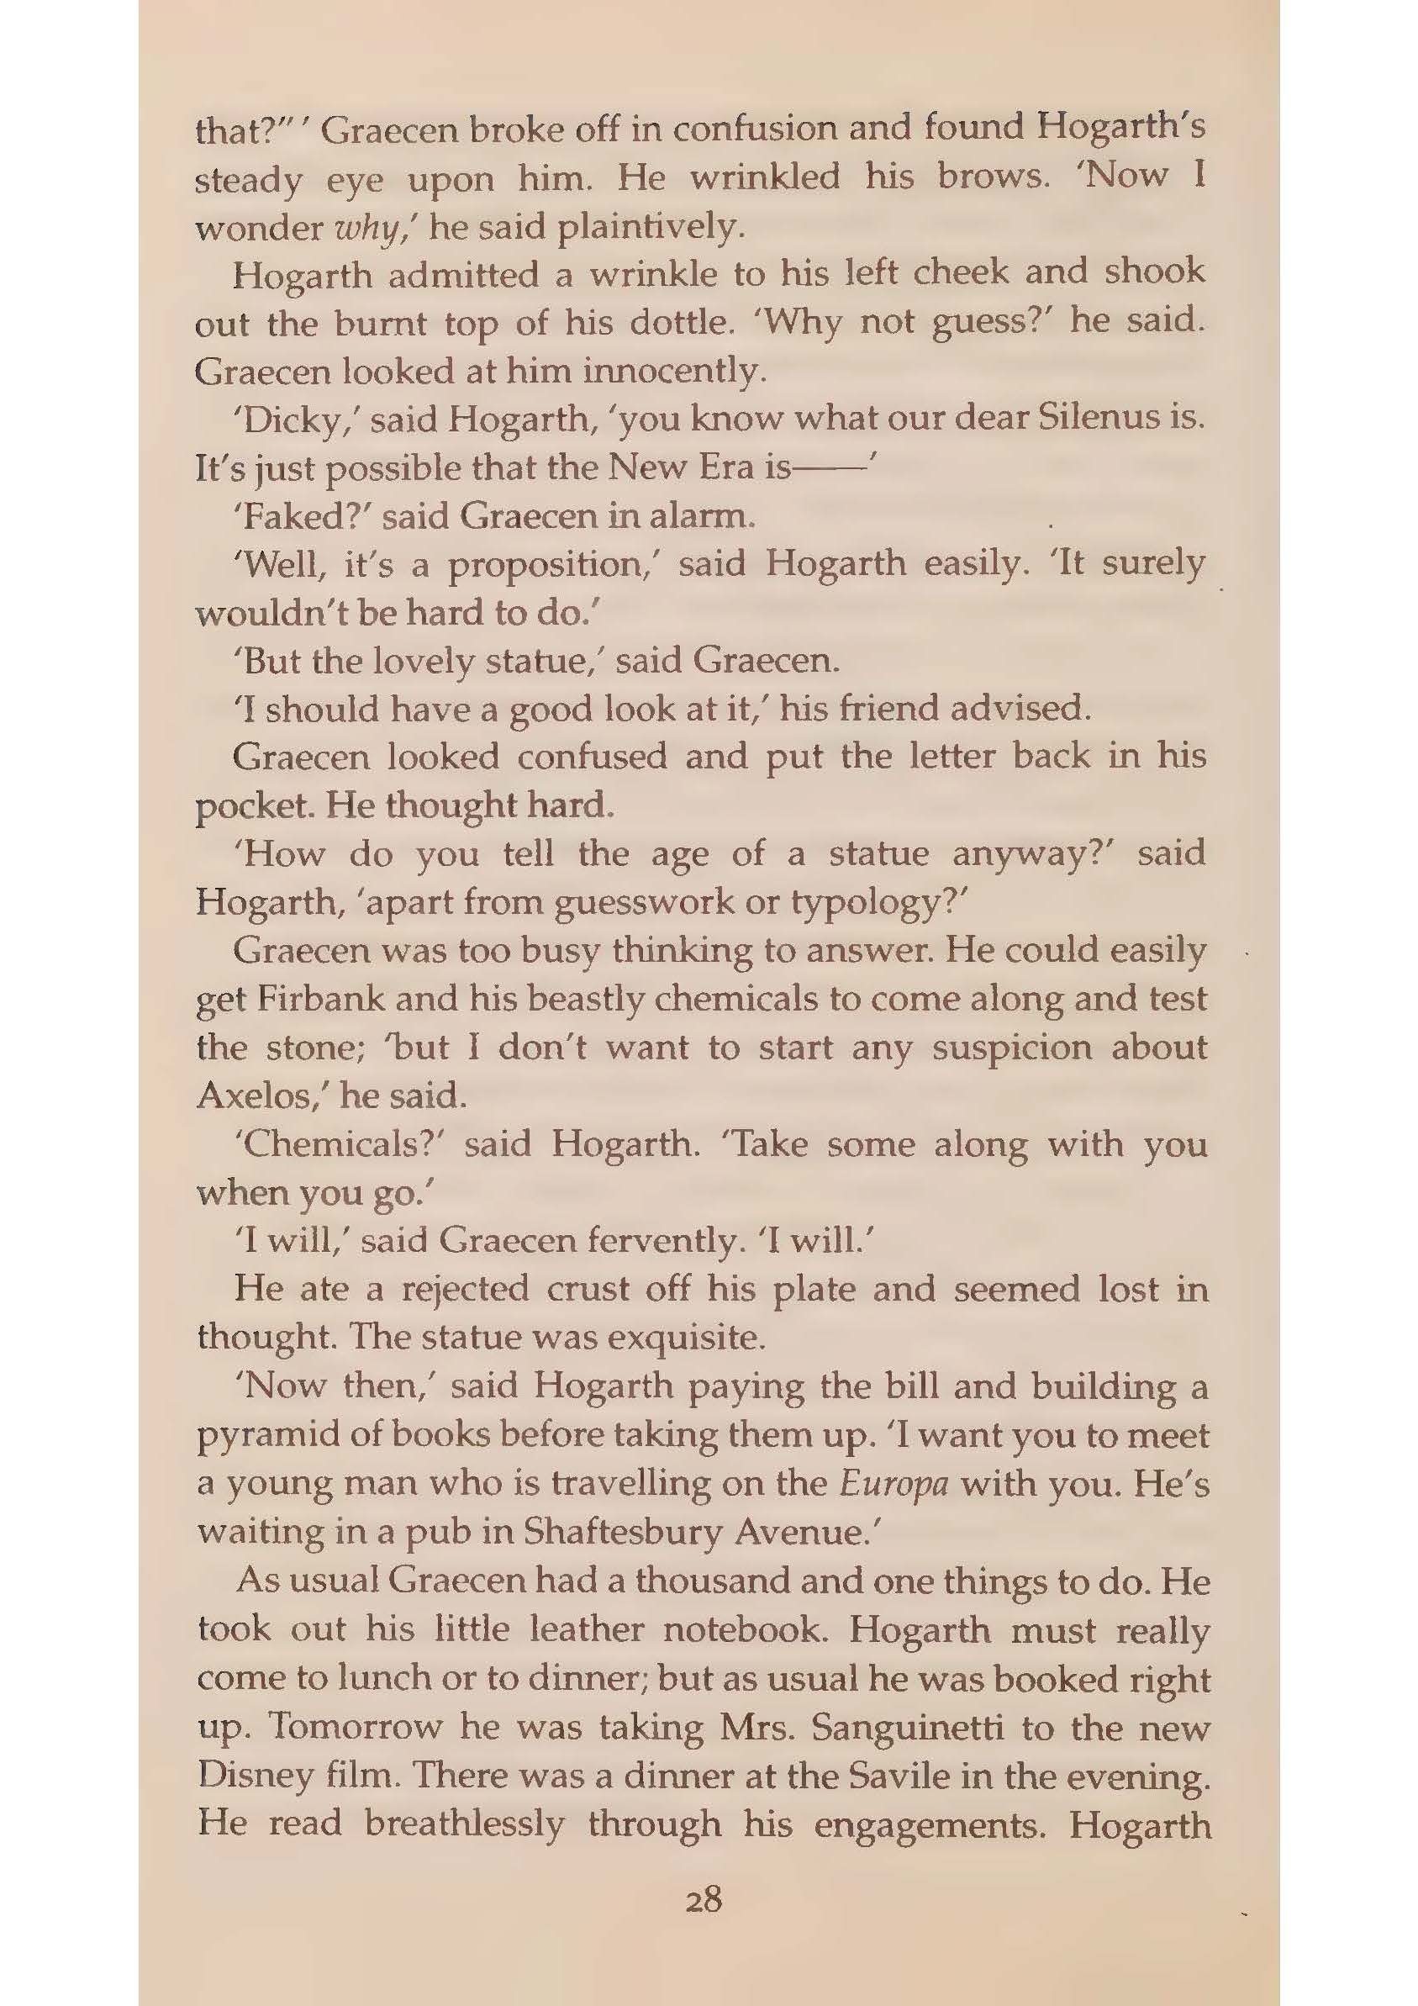

Slide 11
Campion had been patronized by a gentleman and he was reacting to it now. His description of Lady Sholter barking like a shotgun and dropping her monocle to shake hands with him, was a masterpiece of ferocious miming. ‘The Eng­lish, my God, the English,’ he said, pleased to have found an audience that did not contest his opinions. ‘The granite­ bound idiocy and moral superiority. The planetary atmosphere of self-satisfaction each of them carries around, to look at himself through. It is staggering.' He moved his toes in his sandals as he talked with exquisite pleasure. He was enjoy­ing himself. ‘The sense of ritual they had evolved to cover their disastrous negation - their impotence.’ (44)
Miss Dombey had been sent east upon what she described as 'the Lord's business'. Leaving England had been a revelation. She had always heard of the 'backward' races, she said, but had never realized how backward and savage they were. 'The filth, ' she said challengingly, when he tried to defend Cairo and Jerusalem. […] On another occasion, travelling third the better to observe her quarry (the fellah), she had noticed that a strange smell of burning was emanating from the man seated next to her. He had a lighted cigarette in his hand which had burnt down to the flesh of the finger. He felt noth­ing. She realized that the smell was that of burnt flesh. The man was a leper! She recounted these ancedotes with tri­umphant gestures and Baird had to admit that his Middle East was dirty; but how varied, and how delightful. 'It's the same everywhere,' said Miss Dombey, 'same people saying the same things.’ (50)

Slide 12
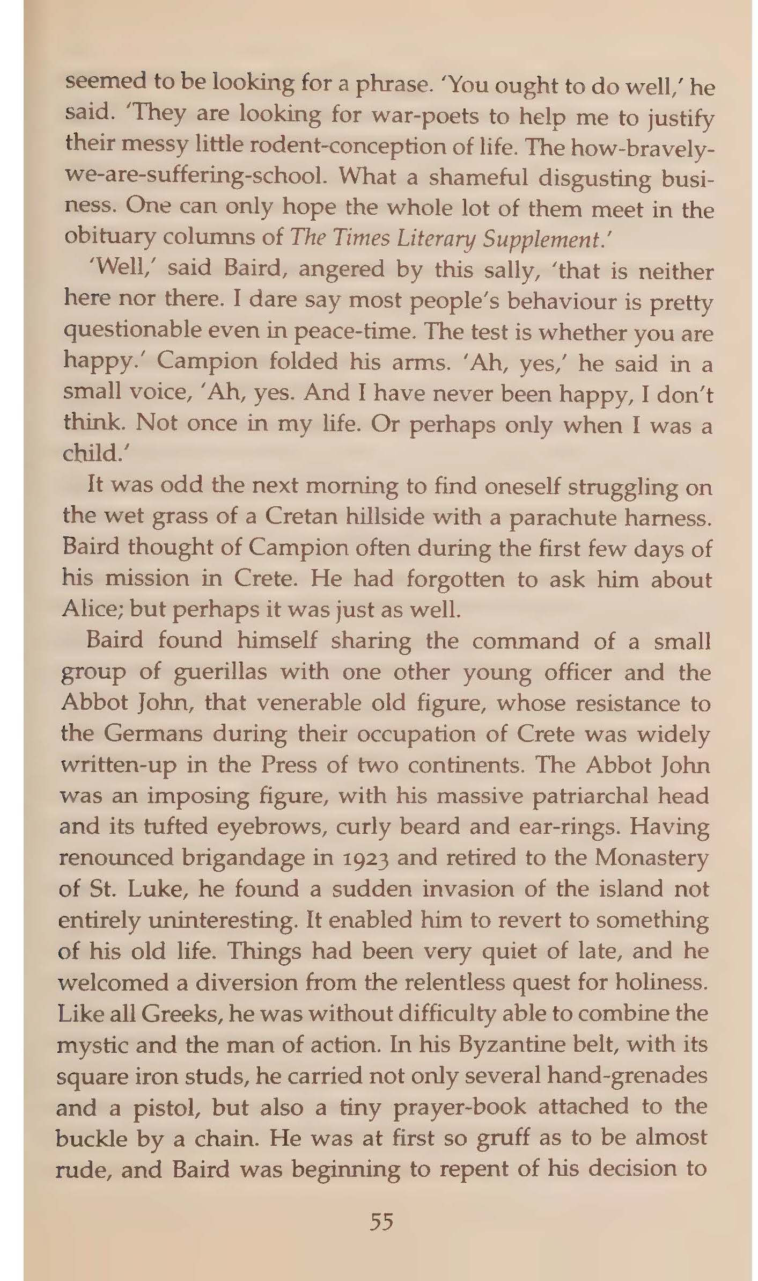
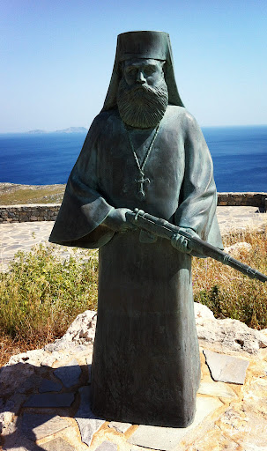
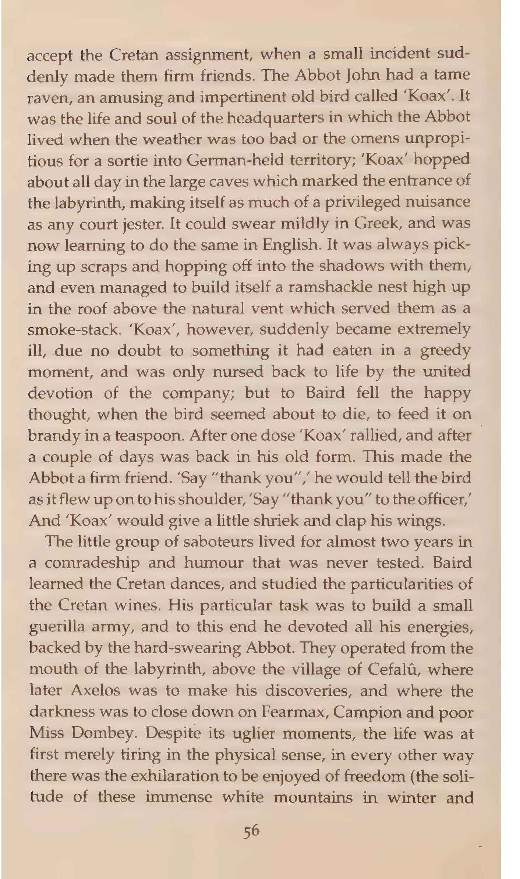

Slide 13
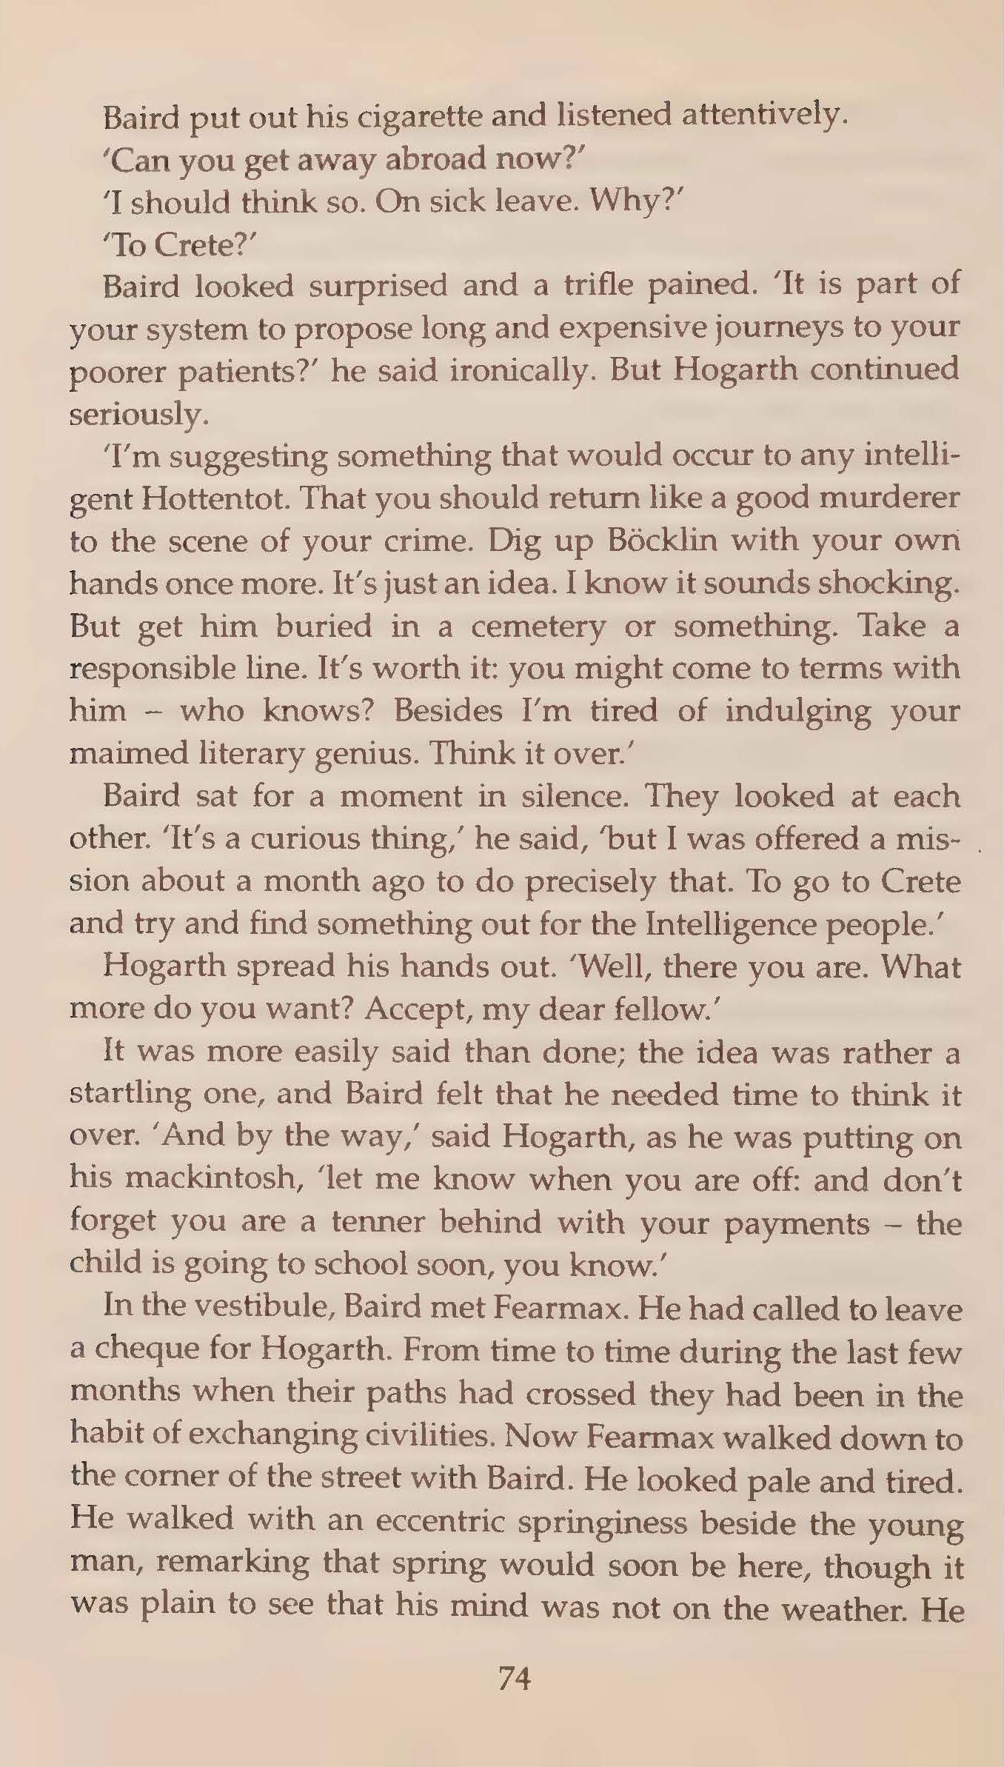
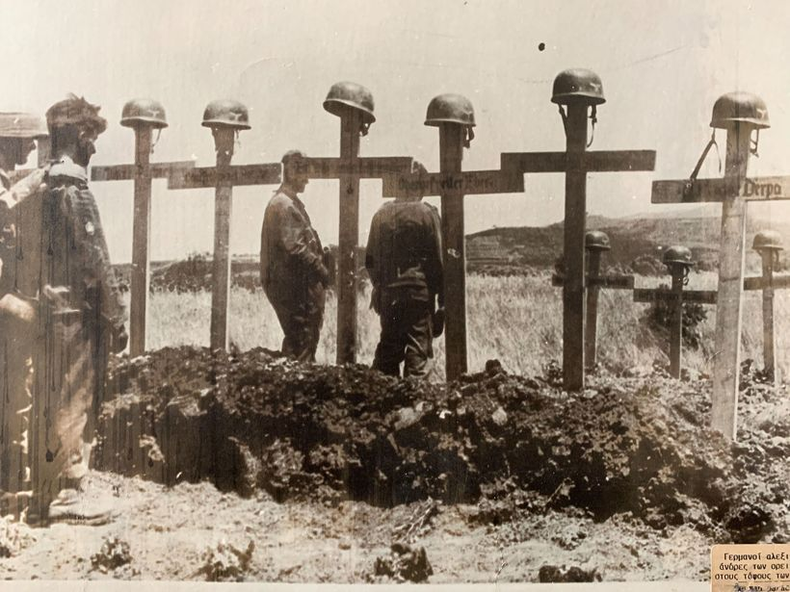
The mad Greeks, with their irrepressible friendliness and naiveté, would be the death of them all. They liked Böcklin and immediately accepted him as one of them. Well, come to think of it, why not? (58)

Slide 14
