Slide 1
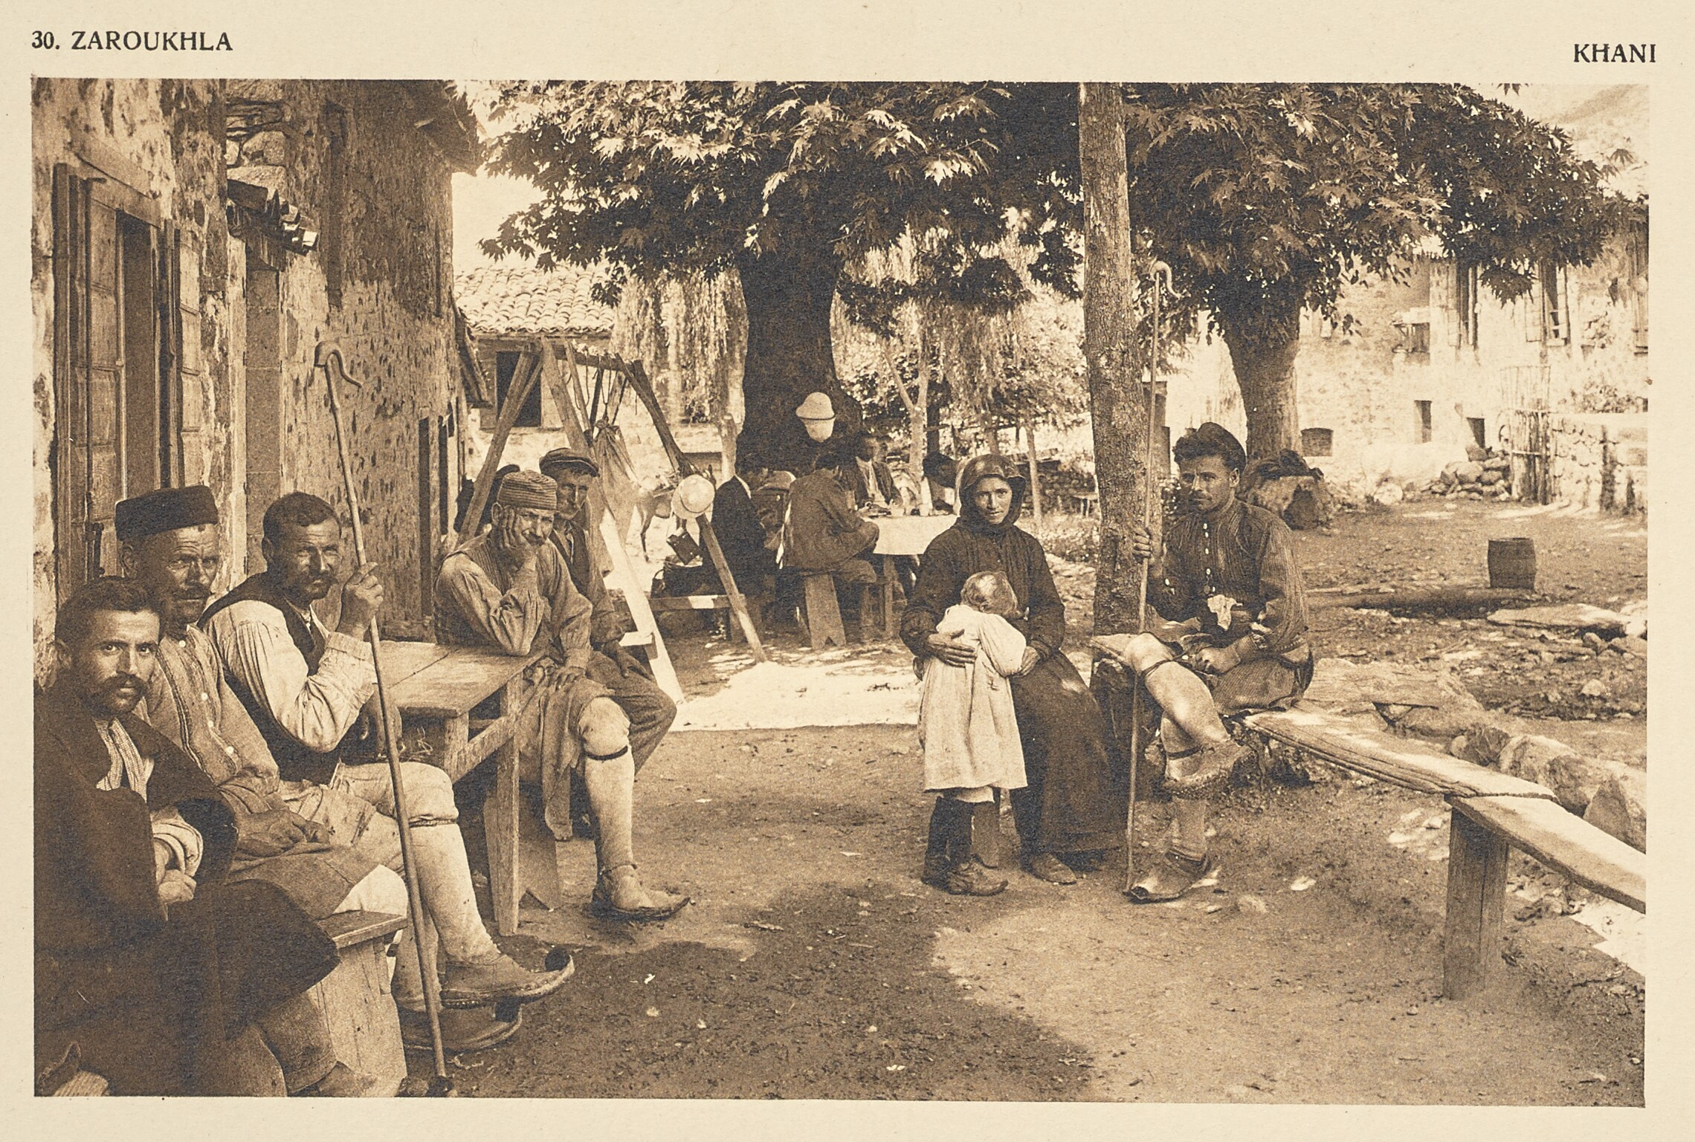
E.M. Forster and The Questionable Modernity of Greece
Frédéric Boissonnas
Zaroukhla. Khani, 1910
Heliogravure / Photolithograph
The J. Paul Getty Museum,
Los Angeles https://www.getty.edu/art/collection/object/108MQC
E. M. Forster by Edward Gooch © Edward Gooch/Getty Images
British Library: https://www.bl.uk/people/e-m-forster

Slide 2
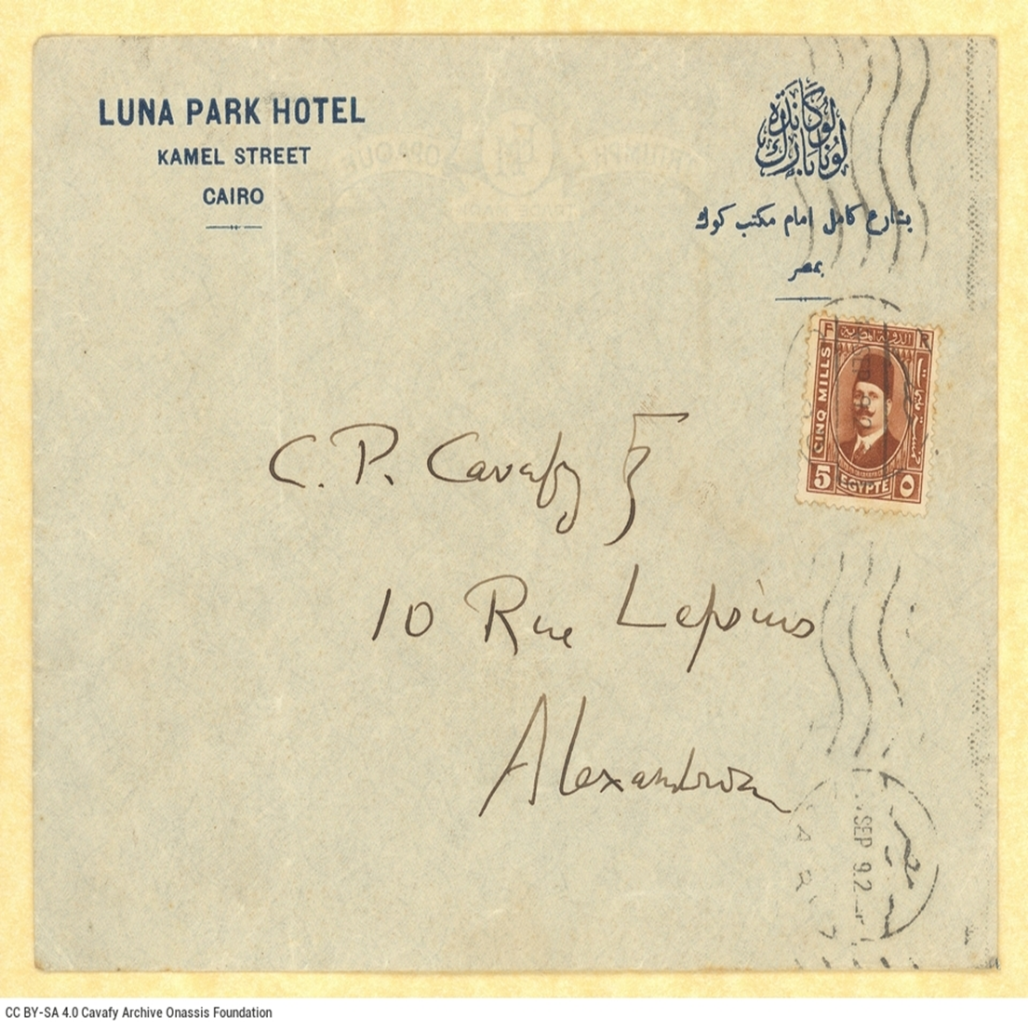

Slide 3
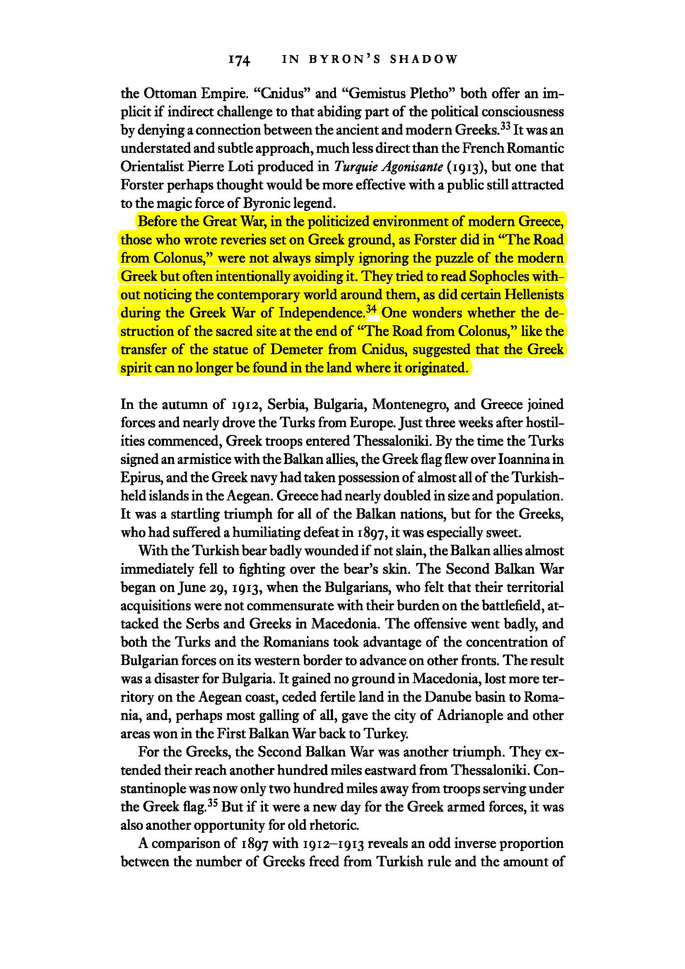

Slide 4
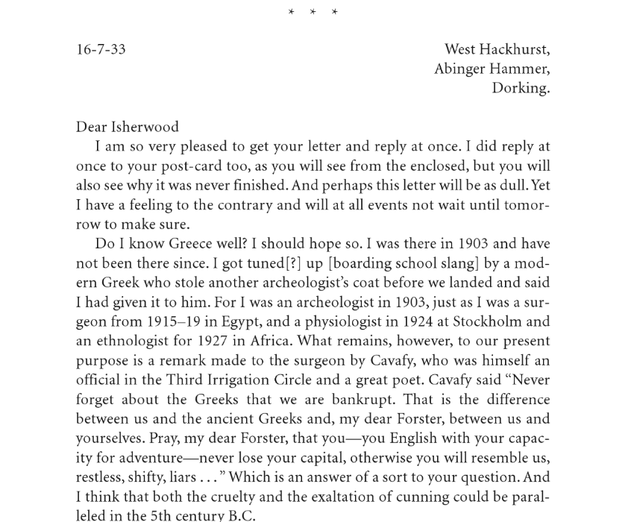
“Do I know Greece well? I should hope so. I was there in 1903 and have not been there since. I got tuned[?] up [boarding school slang] by a modern Greek who stole another archaeologist’s coat before we landed, and said I had given it to him […] ‘restless, shifty, liars…’ Which is an answer to your question.”
(Selected Letters II. 118).

Slide 5
“From Chateaubriand’s necrophilic gaze to the antiquarian chastity in the philological and archaeological laboratory to the latter-day tourist invasion, it has always been a matter of a sun-drenched, clear-cut, postcard Greece.”
Stathis Gourgouris, “DeLillo in Greece Eluding the Name,” Sandra Bermann and Michael Wood (eds.,) Nation, Language, and the Ethics of Translation. (Princeton 2005: Princeton UP) p. 291.

Slide 6
1903
“Albergo Empedocle”
1904
“The Road from Colonus”
(written in 1903)
1904
“The Story of a Panic”
1920
“The Story of the Siren”
1930–1931
“The Classical Annex” (written in 1930-31; published posthumously in The Life to Come (and Other Stories) in 1972.)
1971
Maurice (first draft in 1913-14; published posthumously in 1971)

Slide 7
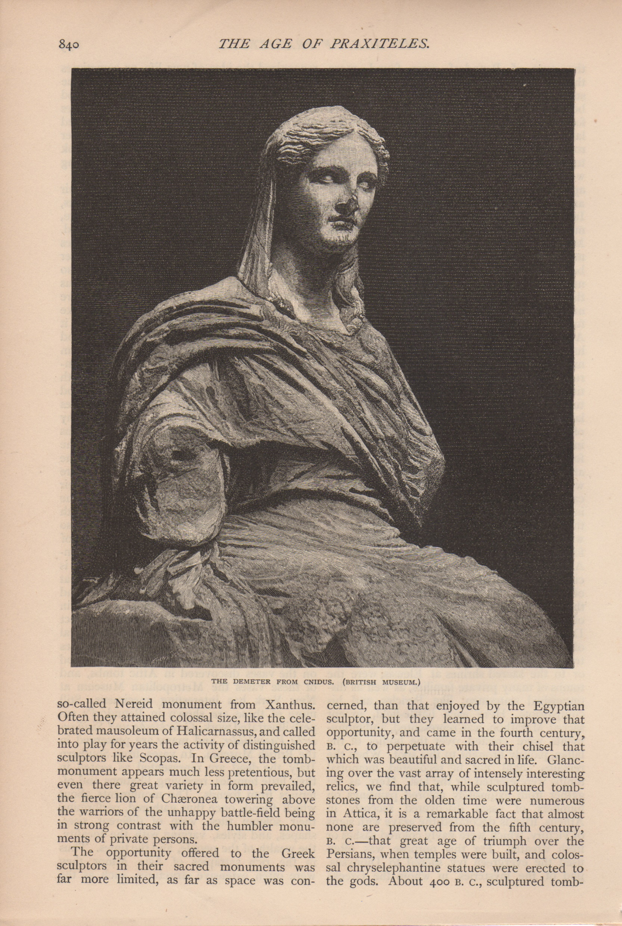
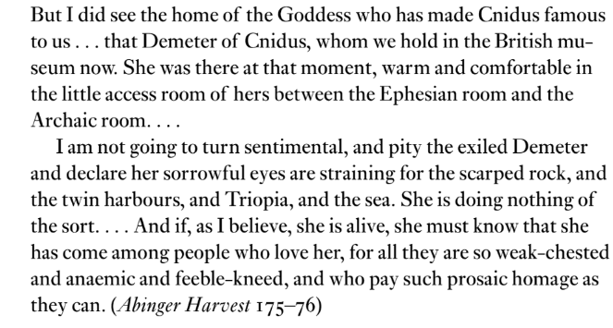
The Demeter of Cnidus, The Century, Vol. 23, 1881-2

Slide 8
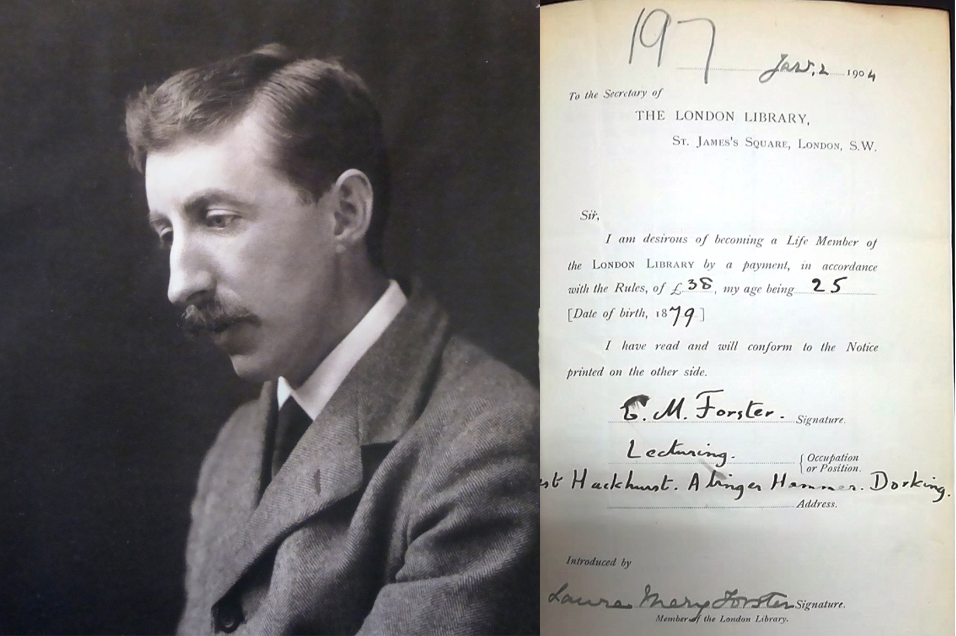
“Greece is just a spirit which can appear, not only at any time, but also in any land.”
E. M. Forster, “Gemistus Pletho,” Abinger Harvest pp. 86-87
“I haven’t been to Greece myself, and don’t mean to go, and I can’t imagine any of my friends going. It is altogether too big for our little lot. Don’t you think so? Italy is just about as much as we can manage. Italy is heroic, but Greece is godlike or devilish - I am not sure which, and in either case absolutely out of our suburban focus.”
E. M. Forster, A Room with a View p. 197
“In the evening she looked again. They were crossing a golden sea, in which lay many small islands and one peninsula. She repeated, ‘No ideas here,’ and hid Greece behind a metal blind.”
E. M. Forster, “The Machine Stops” p. 103
“[H]e saw only dying light and a dead land.”
E. M. Forster, Maurice p. 101
“Maurice had no use for Greece. His interest in the classics had been slight and obscene, and had vanished when he loved Clive. […] Italy had been very jolly – as much as one wants in the way of sight-seeing surely – but in these latter days Greece had cropped up again. Maurice hated the very word, and by a curious inversion connected it with morbidity and death. Whenever he wanted to plan, to play tennis, to talk nonsense, Greece intervened.”
E. M. Forster, Maurice pp. 96-97

Slide 9
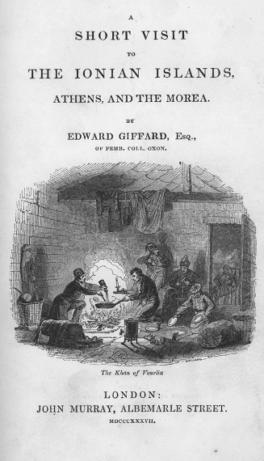
“Forty years ago he had caught the fever of Hellenism, and all his life he had felt that could he but visit that land, he would not have lived in vain. But Athens had been dusty, Delphi wet, Thermopylae flat, and he had listened with amazement and cynicism to the rapturous exclamations of his companions.”
E. M. Forster, “The Road from Colonus” p. 80
“Forster visited Greece and wrote the story in 1903. It was published in June 1904. The action takes place on Tuesday, 18 April. If this conjunction of day and date is accurate, the year must be 1899.”
Thomson, George H., “Where was the Road from Colonus?”, In G.K. Das and John Beer (eds.), E.M. Forster: A Human Exploration, London 1979: Palgrave Macmillan), p. 28, https://doi.org/10.1007/978-1-349-04359-0_4.
The Khan of Vourlia, Peloponnese
Giffard, Edward, Esq. A short Visit to the Ionian Islands, Athens, and the Morea.
London, John Murray, MDCCCXXXVII [1837].
Title page: The author and his companions prepare their dinner at Vourlias, a famous inn on the route from Tripolis to Sparta, close to Mystras.

Slide 10
Characters
The British:
Mr. Lucas
Ethel
Mr. Graham
Mrs. Forman
The Greeks:
The Dragoman
An old woman (Maria Rhomaides)
A middle-aged woman (daughter of Rhomaides)
A young man and two children (grandchildren of Rhomaides).

Slide 11
“For the enormous plane that leant towards the Khan was hollow—it had been burnt out for charcoal—”
E. M. Forster, “The Road from Colonus” p. 80

Slide 12
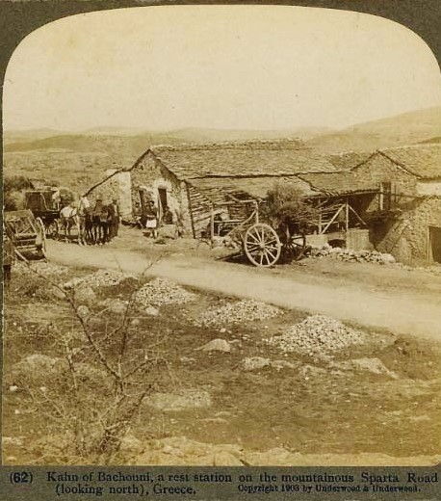
“In their midst was hidden a tiny Khan or country inn, a frail mud building with a broad wooden balcony in which sat an old woman spinning, while a small brown pig, eating orange peel, stood beside her. On the wet earth below squatted two children, playing some primaeval game with their fingers; and their mother, none too clean either, was messing with some rice inside. As Mrs. Forman would have said, it was all very Greek […].”
E. M. Forster, “The Road from Colonus” pp. 79-80

Slide 13
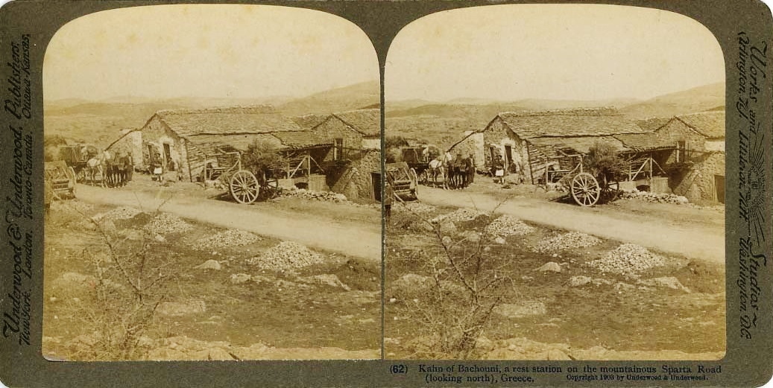
Kahn of Bachouni, a rest station on the mountainous Sparta Road (looking north), Greece
Underwood, Elmer & Bert (Underwood & Underwood), UND. 062 Courtesy of ELIA/MIET

Slide 14
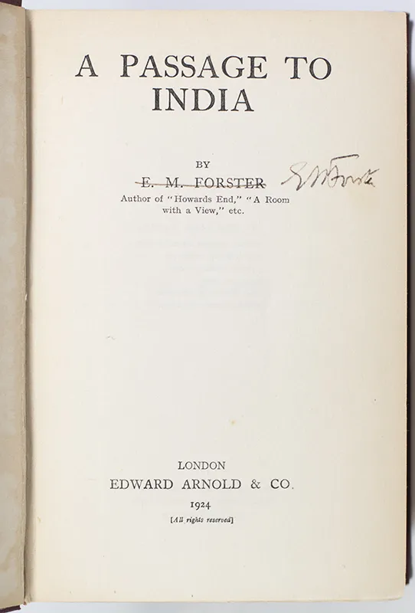
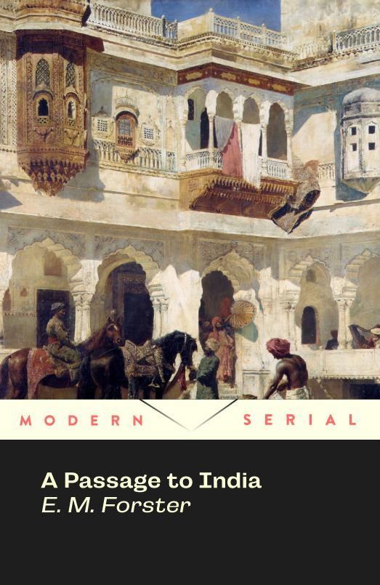

Slide 15
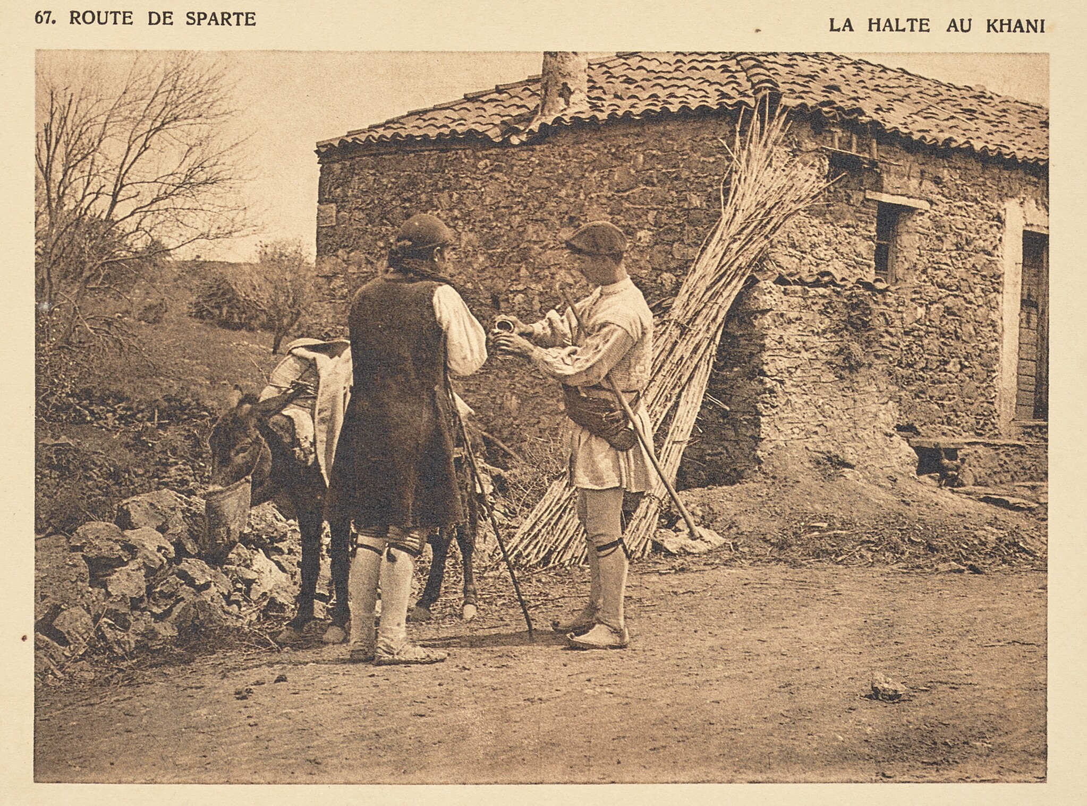
“At last Ethel, to humour him, and not disinclined to air her modern Greek, went into the Khan with the astonished dragoman to look at the rooms. The woman inside received them with loud welcomes, and the young man, when no one was looking, began to lead Mr. Lucas’ mule to the stable.
‘Drop it, you brigand!’ shouted Graham, who always declared that foreigners could understand English if they chose. He was right, for the man obeyed, and they all stood waiting for Ethel’s return.
She emerged at last, with close-gathered skirts, followed by the dragoman bearing the little pig, which he had bought at a bargain.
‘My dear papa, I will do all I can for you, but stop in that Khan—no.’
‘Are there—fleas?’ asked Mrs Forman.
Ethel intimated that ‘fleas’ was not the word. […]
‘They might knife you,’ was Mr. Graham’s contribution.”
E.M. Forster, “The Road from Colonus” pp. 85-86

Slide 16
Route de Sparte.
La halte au khani (1910)
Frédéric Boissonnas
(Swiss, 1858 - 1946)
Heliogravure/Photolithograph 9.9 × 13.7 cm (3 7/8 × 5 3/8 in.)
84.XB.584.82
The J. Paul Getty Museum, Los Angeles
https://www.getty.edu/art/collection/objects

Slide 17
A stone had caught him in the middle of the back. It was thrown by the little boy, who was pursuing them along the mule track. He was followed by his sister, also throwing stones.
Ethel screamed to the dragoman, who was some way ahead with Mrs. Forman, but before he could rejoin them, another adversary appeared. It was the young Greek, who had cut them off in front, and now dashed down at Mr. Lucas’ bridle. Fortunately Graham was an expert boxer, and it did not take him a moment to beat down the youth’s feeble defence, and to send him sprawling with a bleeding mouth into the asphodel. By this time the dragoman had arrived, the children, alarmed at the fate of their brother, had desisted, and the rescue party, if such it is to be considered, retired in disorder to the trees.
“Little devils!” said Graham, laughing with triumph. “That’s the modern Greek all over. Your father meant money if he stopped, and they consider we were taking it out of their pocket.”
“Oh, they are terrible—simple savages! I don’t know how I shall ever thank you. You've saved my father.”
E. M. Forster, “The Road from Colonus” p. 87 (emphasis added)

Slide 18
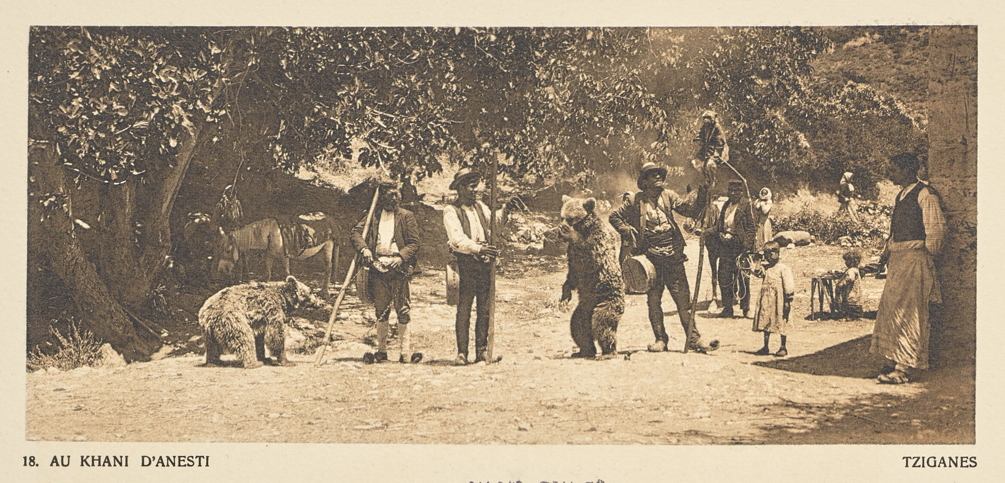
Au khani d'Anesti. Tziganes (1910)
Frédéric Boissonnas (Swiss, 1858 - 1946)
Medium: Heliogravure / Photolithograph
Anestias, Kavala, Greece (Place Depicted)
The J. Paul Getty Museum, Los Angeles
https://www.getty.edu/art/collection/objects

Slide 19
To sleep in the Khan with the gracious, kind-eyed country people, to watch the bats flit about within the globe of shade, and see the moon turn the golden patterns into silver—one such night would place him beyond relapse, and confirm him for ever in the kingdom he had regained. But all his lips could say was: “I should be willing to put in a night here.” […] The inmates of the Khan only consisted of an old woman, a middle-aged woman, a young man and two children, and to none of them had he spoken, yet he loved them as he loved everything that moved or breathed or existed beneath the benedictory shade of the planes. […] He would be a fool as well as a coward if he stirred from the place which brought him happiness and peace.
E. M. Forster, “The Road from Colonus” pp. 83-85
‘Listen to me! “A rural disaster.” Oh, I’ve hit on something sad. But never mind. “Last Tuesday at Plataniste, in the province of Messenia, a shocking tragedy occurred. A large tree”—aren’t I getting on well?— “blew down in the night and”—wait a minute—oh, dear! “crushed to death the five occupants of the little Khan there, who had apparently been sitting in the balcony. The bodies of Maria Rhomaides, the aged proprietress, and of her daughter, aged forty-six, were easily recognizable, whereas that of her grandson”—oh, the rest is really too horrid; I wish I had never tried it, and what’s more I feel to have heard the name Plataniste before. We didn’t stop there, did we, in the spring?’
E. M. Forster, “The Road from Colonus” p. 89

Slide 20
“A young man came singing over the streams on a mule, and there was beauty in his pose and sincerity in his greeting.”
E. M. Forster, “The Road from Colonus” p. 82

Slide 21
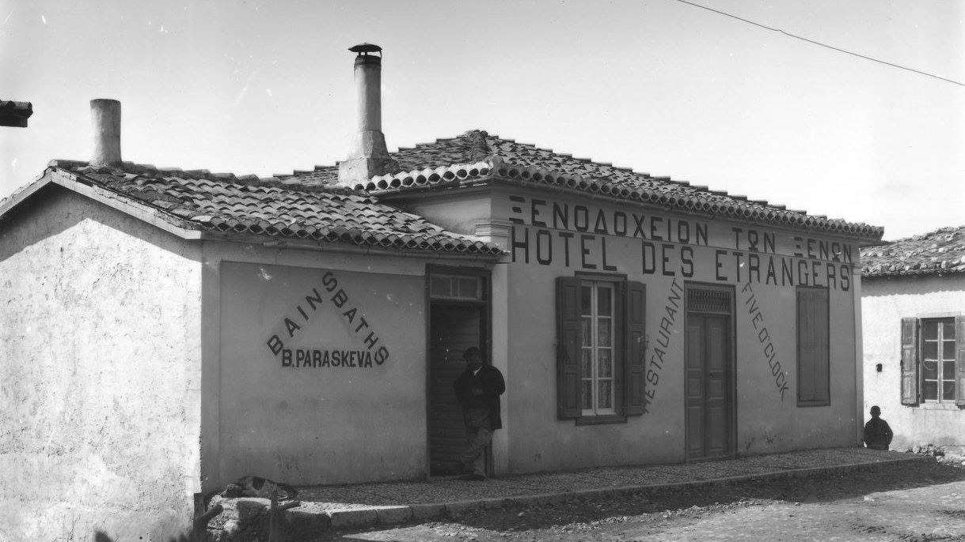
Photo taken by Nicholson Museum curator William J Woodhouse in Delphi between 1890 and
1935 (Woodhouse Archive, NM2007.105.3) https://www.sydney.edu.au/museum/our-research/woodhouse-archive-flickr-project.html

