Slide 2

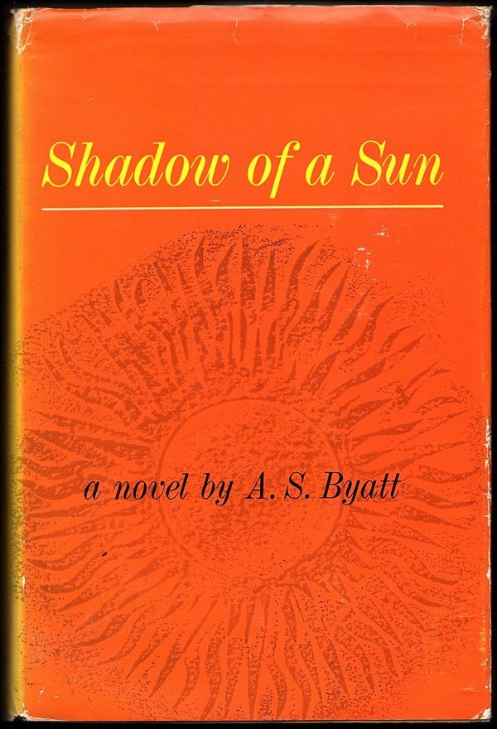

Slide 3
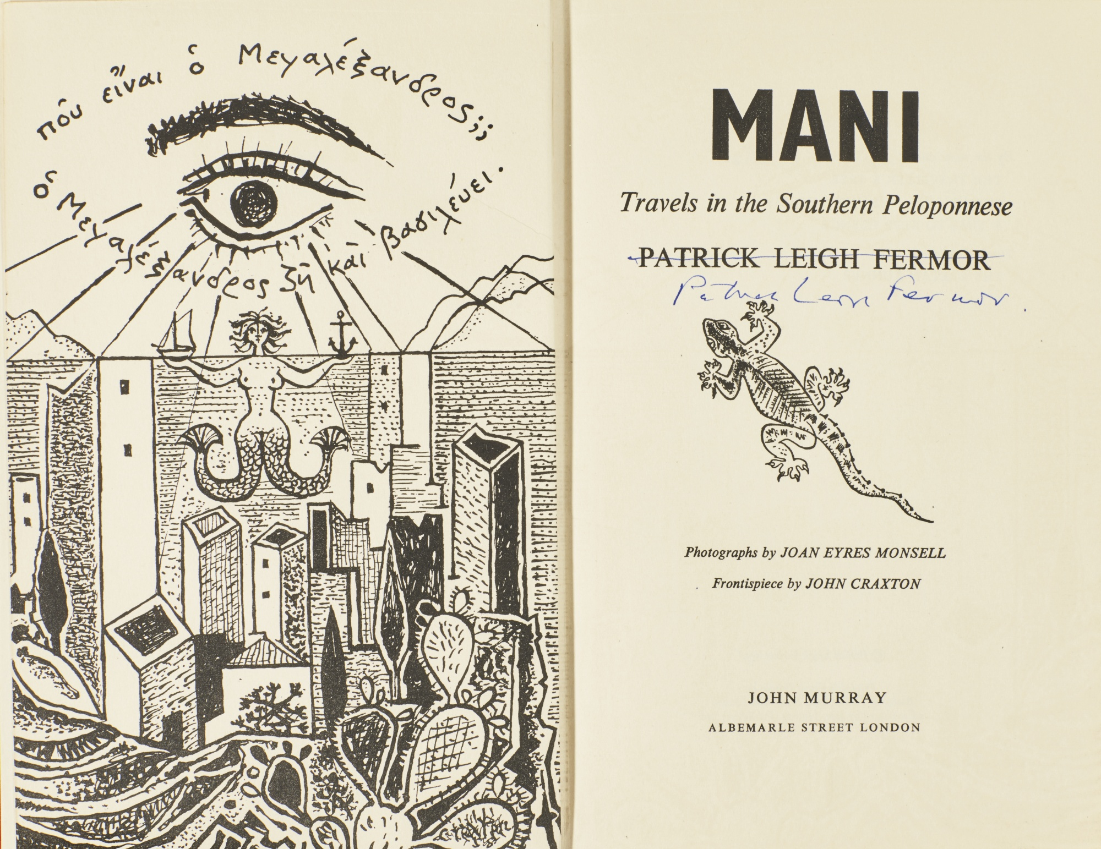

Slide 4
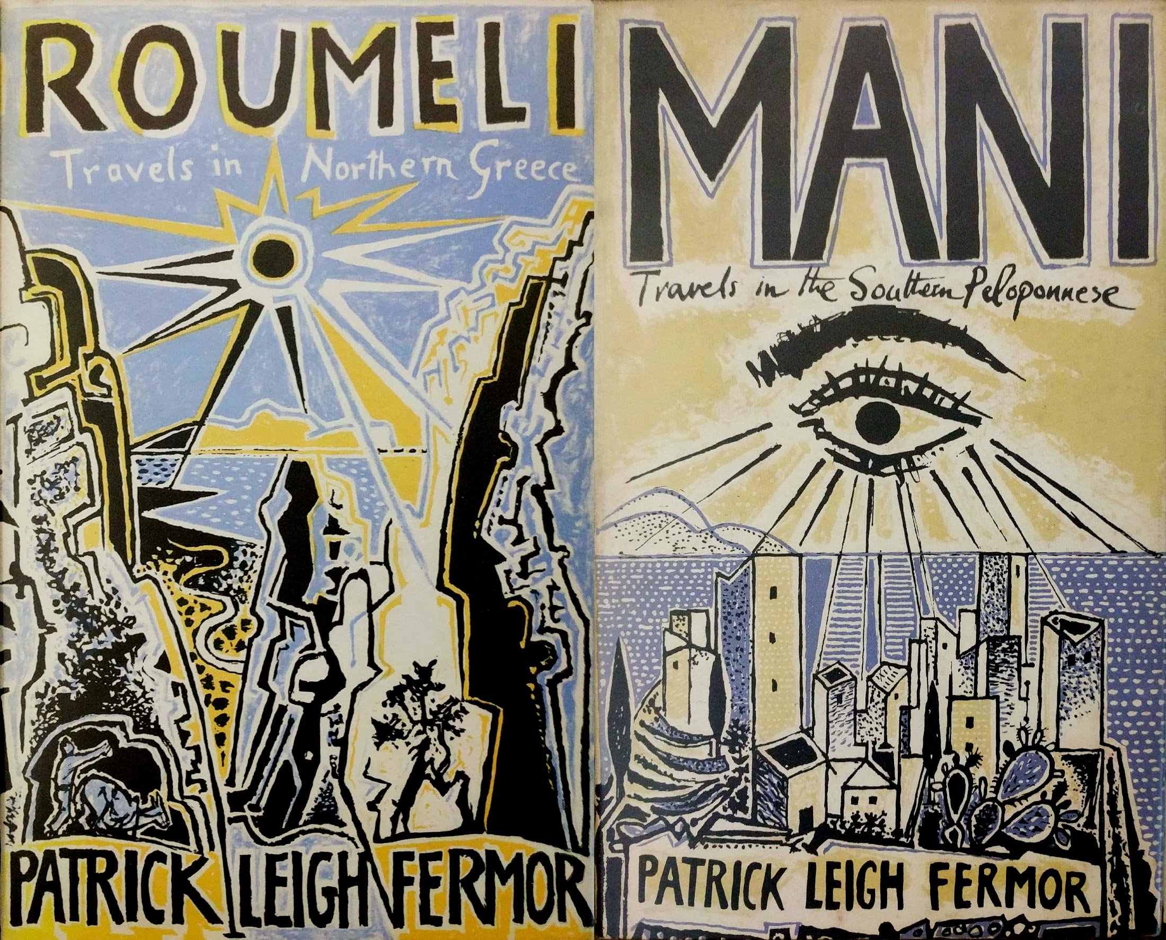

Slide 5
The sightless Pharos [Lighthouse] turns its blind eye upon a coast, featureless, level and sandy … Here we miss Greece as a living body; a landscape lying up close against the sky, suspended on the blue lion-pads of mountains. And above all, we miss the Eye [Greece]: for the summers of indolence and deduction on the northern beaches of our island—beaches incessantly washed and sponged by the green Ionian—taught us that Greece was not a country but a living eye. “The Enormous Eye” Zarian used to call it. Walking in those valleys you knew with complete certainty that the traveller in this land could not record. It was rather as if he himself were recorded. The sensation of this immense hairless recording eye was everywhere; in the ringing blue sky, the temples, the supple brushes of cypresses, the sun beating in a withering hypnotic dazzle on the statues with curly stone hair and blunt sagacious noses. Everything was the subject of the Eye. It was like a lens fitting into the groove of the horizon. Nowhere else has there ever been a landscape so aware of itself, conforming so marvellously to the dimensions of a human existence. (Durrell, Prospero’s Cell emphasis added; 131)

Slide 6
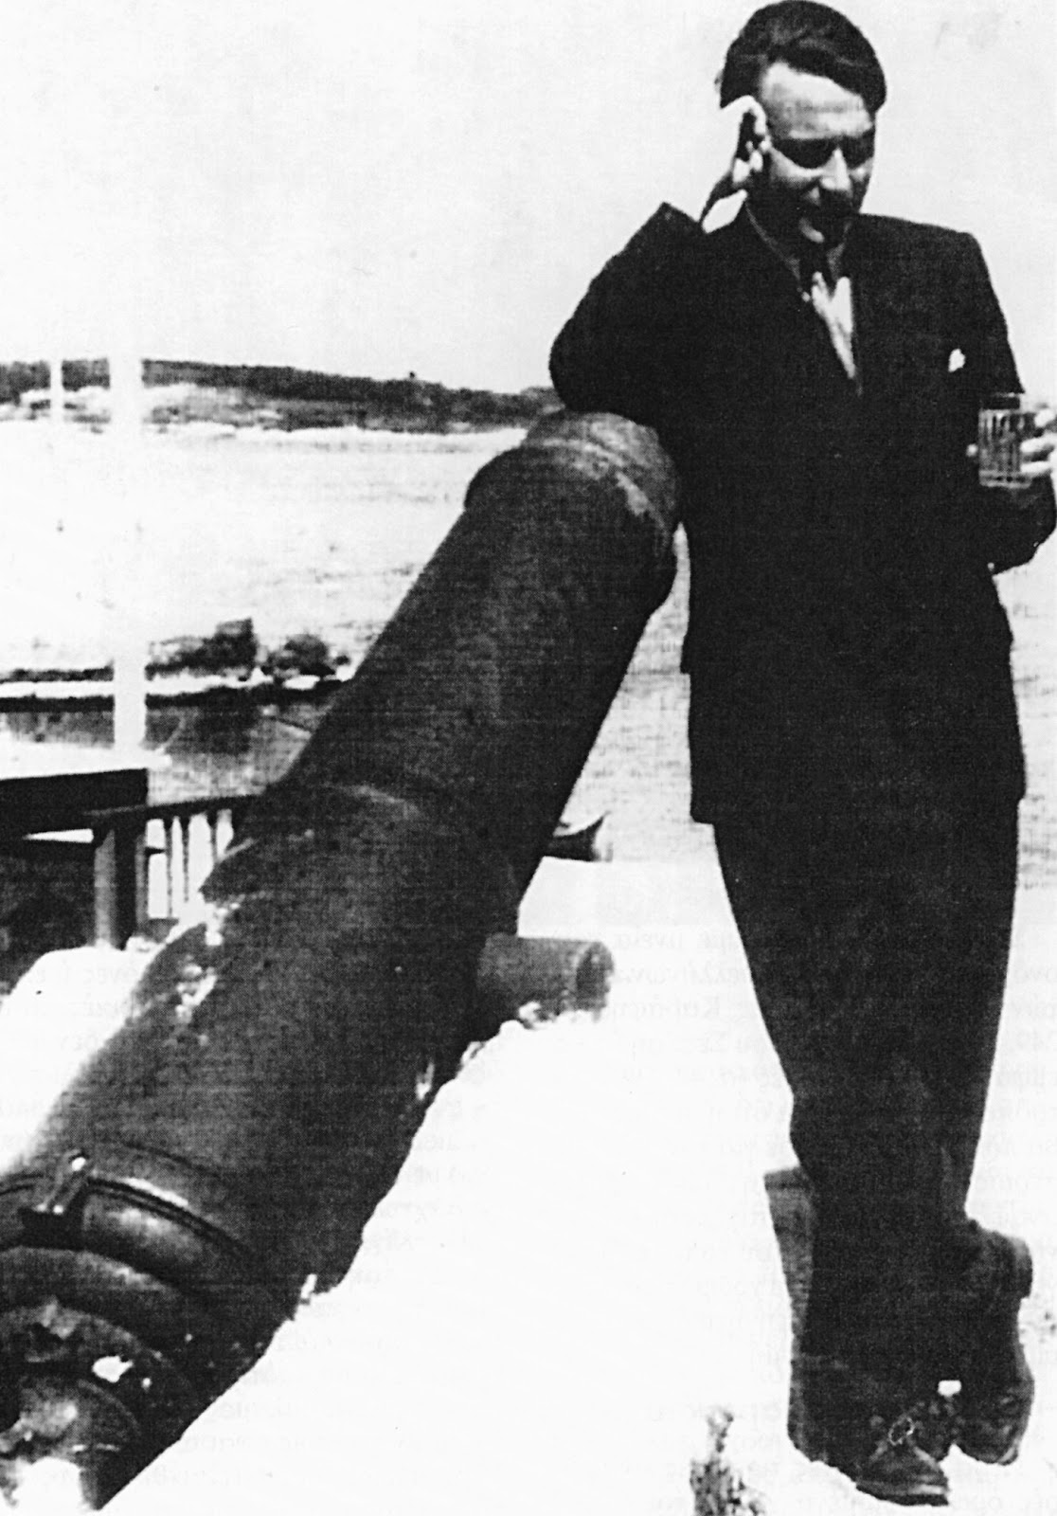
John Fowles, Spetses 1953

Slide 7
Some thirty years or more later my translator into Modern Greek, Phaidon Tamvakakis, very kindly gave me a book by Nikos Demou: The Light of the Greeks (To Phos ton Ellenon). It was not until I read the powerful essay and quotations that accompany the photographs there that I began to understand what had happened to me on that then long past January day in 1952. The Greeks see, feel, apprehend light not as others do, and from the beginning of history to its end … No other race feels this quite as sharply as the Greeks; so intensely, so all-consumingly … On holiday from the school in 1953 I climbed Mount Parnassus alone; … The clouds had cleared, all was sun, the view sublime, this was certainly the loveliest moment of my life. Inside the crown of violets, beside the cairn on the very peak, was a word traced in pebbles in Greek. For all Greeks always, and for all of us who truly love their land, it was the only word: φῶς. (Fowles, “Behind the Magus” 67–68)

Slide 9
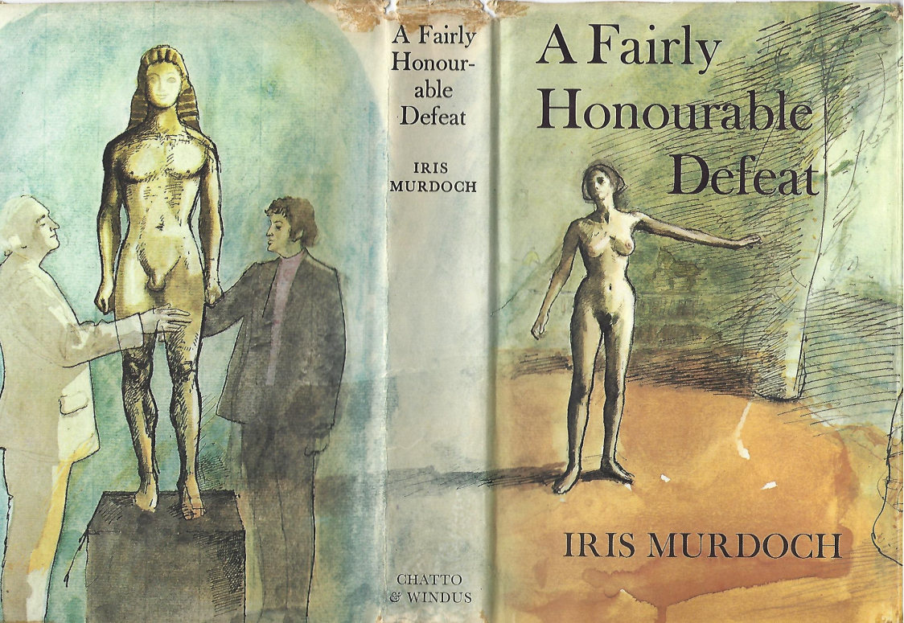

Slide 10
The next moment she was lying full length in the long grass and there was a great deal too much light. Light was vibrating inside her eyes and she could see nothing but dazzling and pale shadows as if the whole scene had been bleached and then half blotted out by a deluge of light … Rays from very far away were being focused through her flesh. Her head fell down into deep grass and she fought for breath. The blazing light was rhythmically changing into luminous flashes of black, tugging the visible world away from her … the sky above her through the dome of grass was lurid and brilliant and dark. … She told herself, and hung desperately onto the thought, I have got sunstroke that is what it is, it must be. She got herself onto her knees, panting, gasping, keeping her head down. She did not know whether her eyes were closed or not. She seemed to see the expanse of green floor … The great ray from afar was pinning her between the shoulder blades and trying to force her down again … Saliva was dripping from her mouth … She felt the sun burning into the back of her neck as if it was directed through a prism … Gasping and sobbing for breath she got to her feet and as if still blind and yet seeing began to run as fast as she could along the level floor of the cutting … Her heart was pounding violently but her vision seemed to have returned and the awful light was gone. She wiped her mouth (Murdoch, Defeat 177–178; emphasis added).

Slide 11
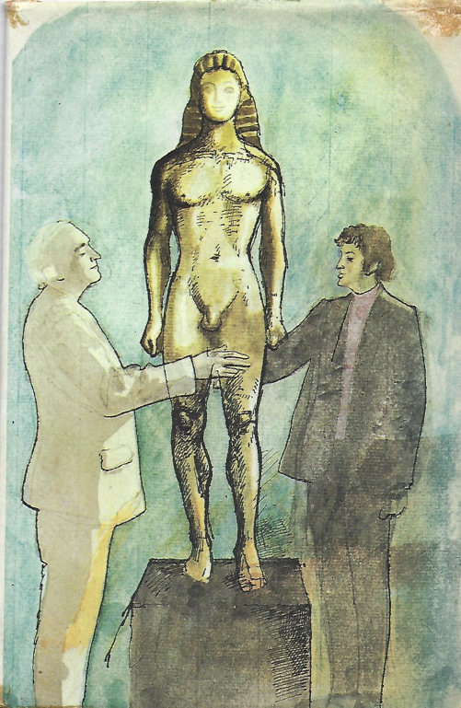
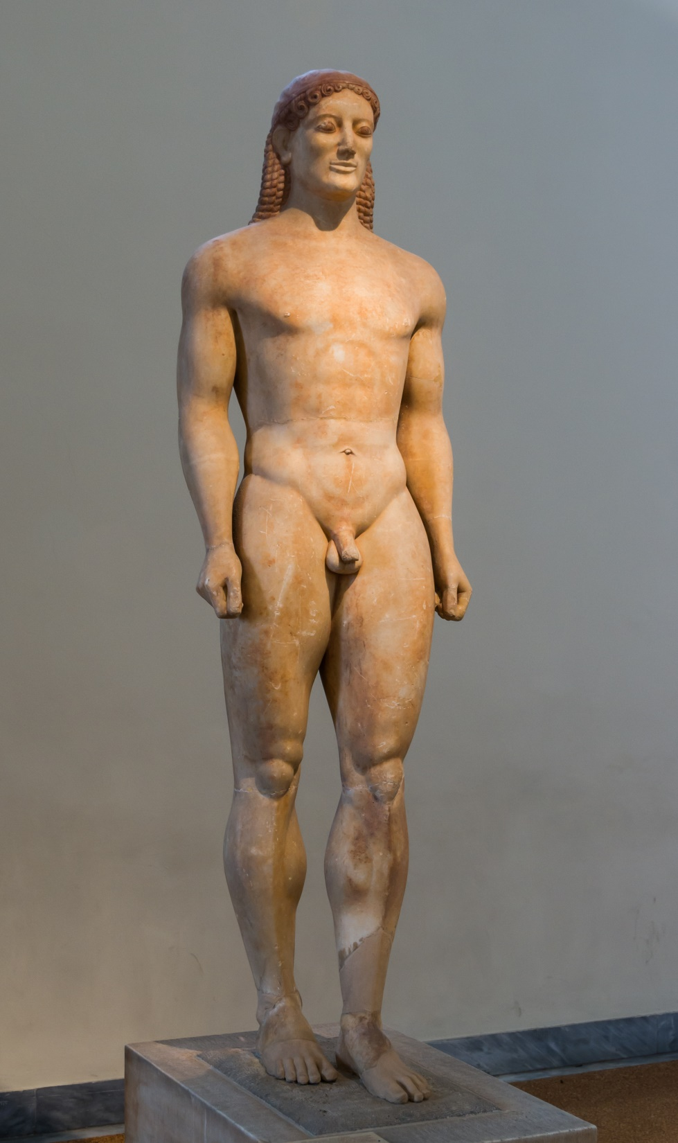

Slide 12
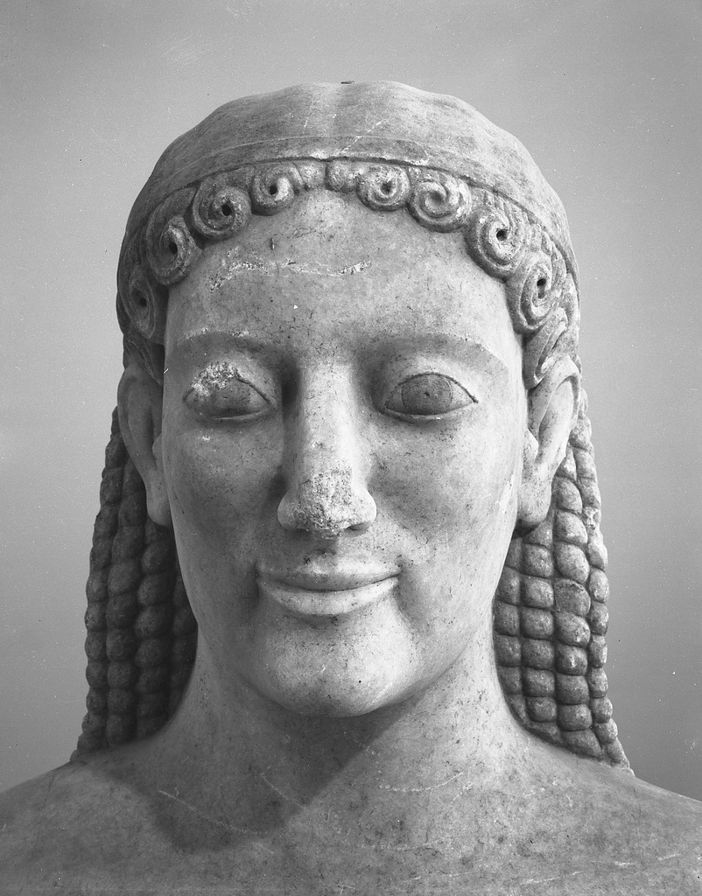
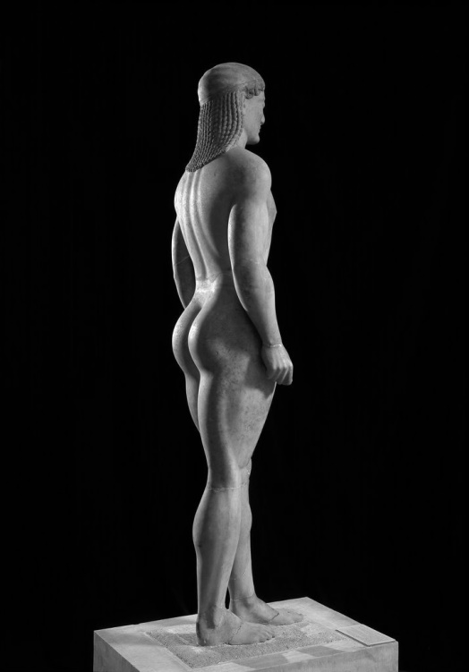
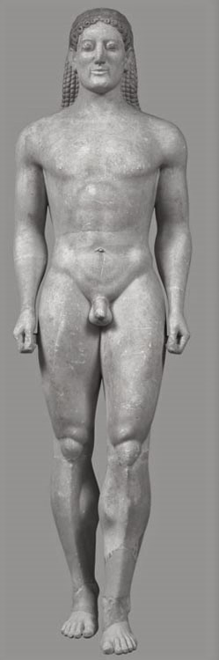

Slide 13
The kouros, which was about six feet high, stood on a pedestal with its navel just about level with Simon’s eyes. ... His fingers explored the bones of the long straight legs, the hollow of the thigh, the heavenly curve of the narrow buttocks, the flat stomach and the noble pattern of the rib cage, the pretty eye-shaped navel, the nipples of the breasts, the runnel of the back, the shoulder blades. He lightly stroked the feet, probing between the long separated toes, he reverently touched the penis. He looked up into the serene divine countenance, huge-eyed, long-nosed, so enigmatically smiling. After a while fingers were not enough. He had to worship the statue with his lips, with his tongue. He kissed the buttocks, the thighs, the hands, the penis, first hastily and then with slow adoration. (Murdoch, Defeat 191)
He walked round to the side of the statue and laid his hand lightly in the small of the back. Then he drew it downward very slowly, outlining the curve of the buttock, and led his fingers gently in onto the interior of the thigh. At that moment he realized that someone was watching him. It was Axel … regarding the little love scene with gravity … After a moment Axel moved forward and with great deliberation and absolute solemnity laid his hand on top of Simon’s (Murdoch, Defeat 191–192).

Slide 14

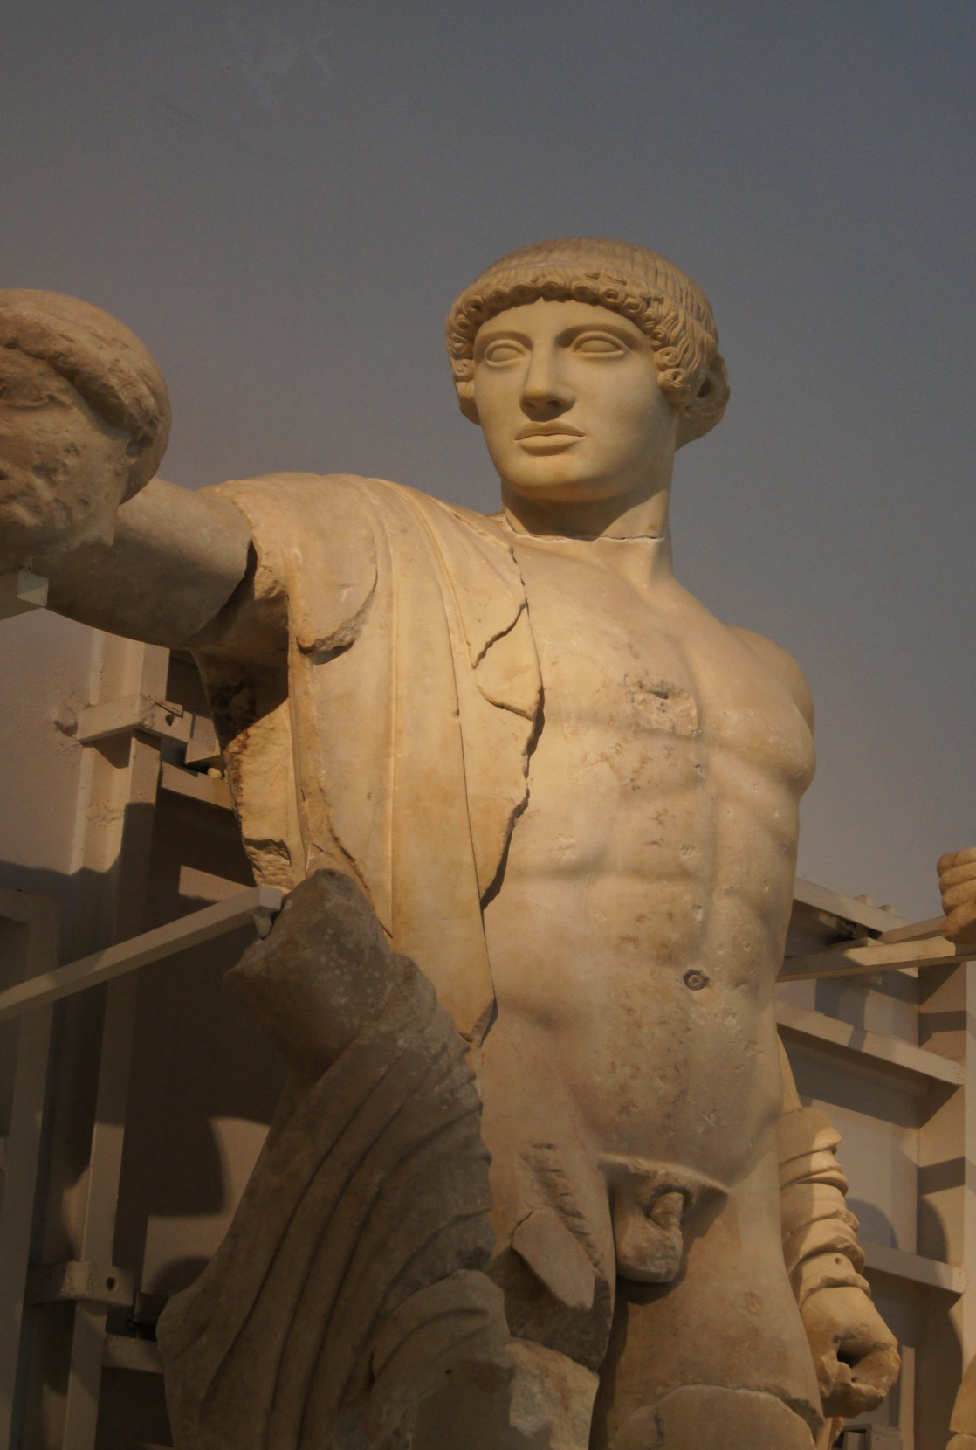

Slide 15
