Slide 2
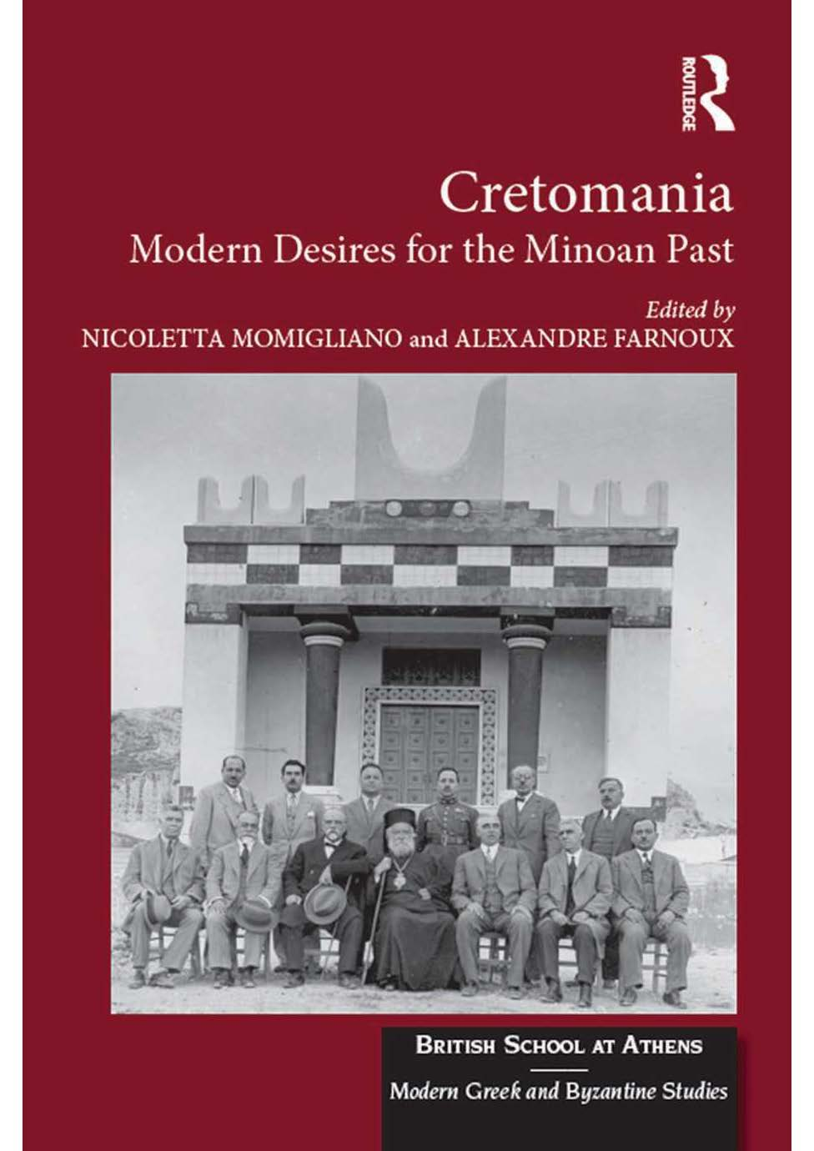
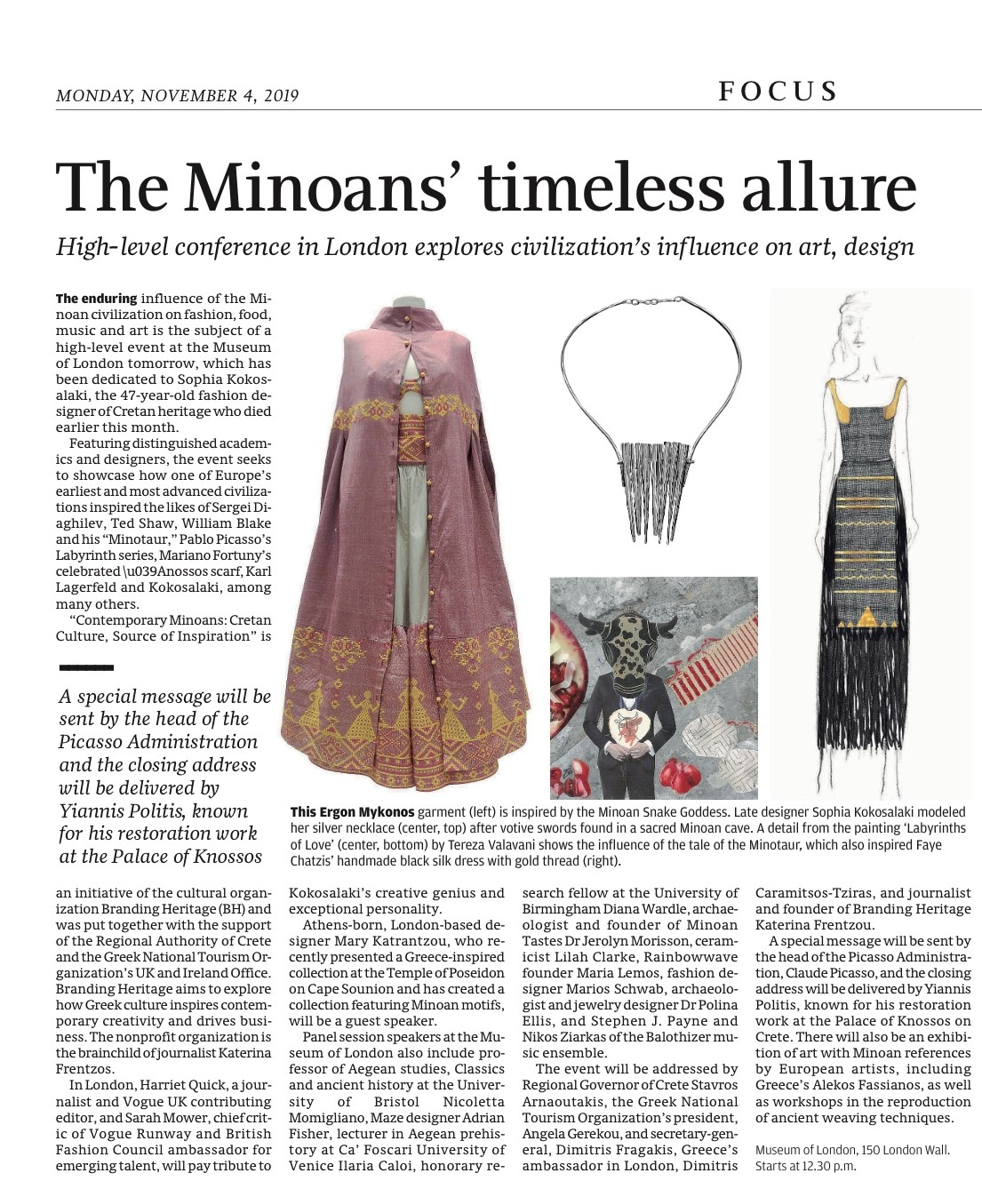

Slide 3
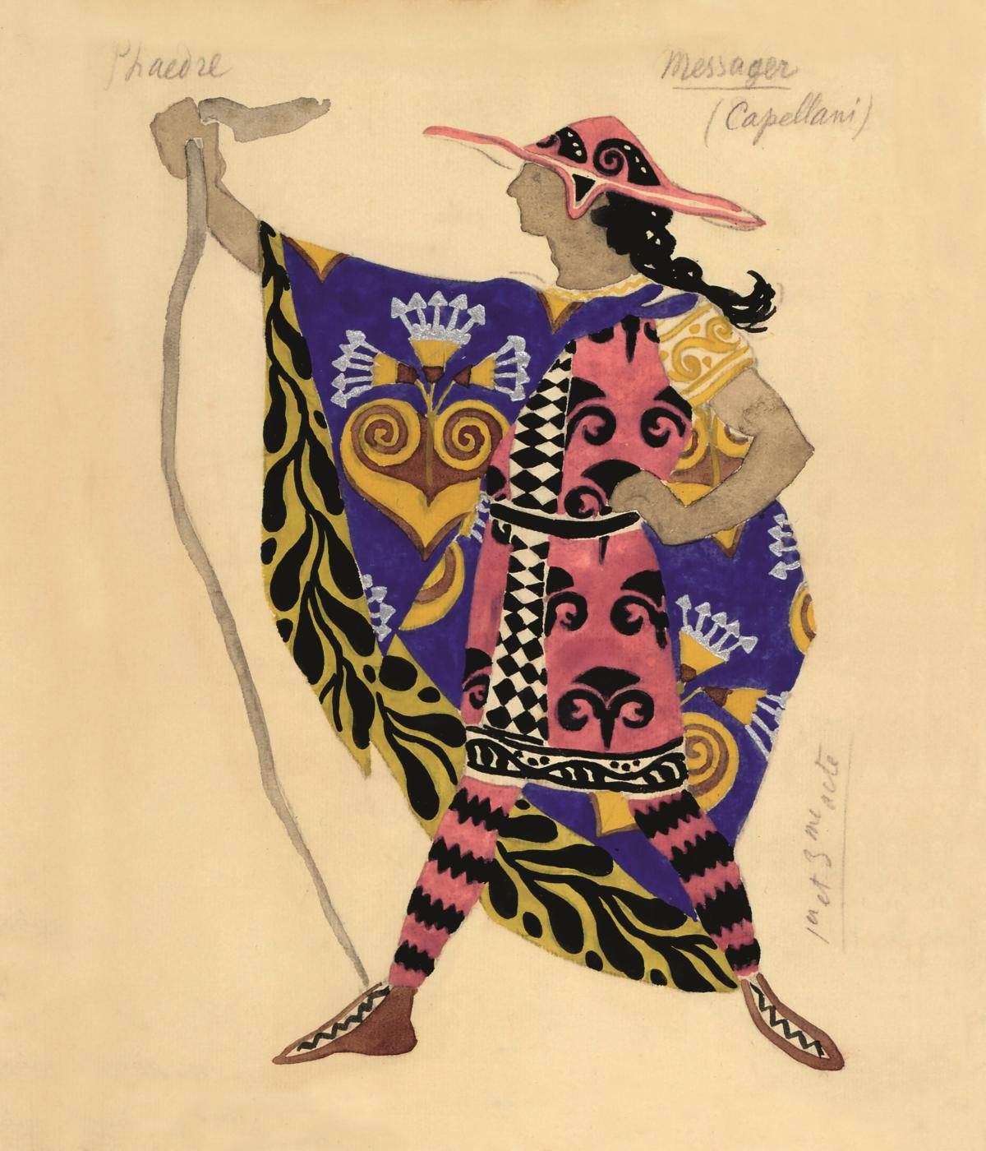
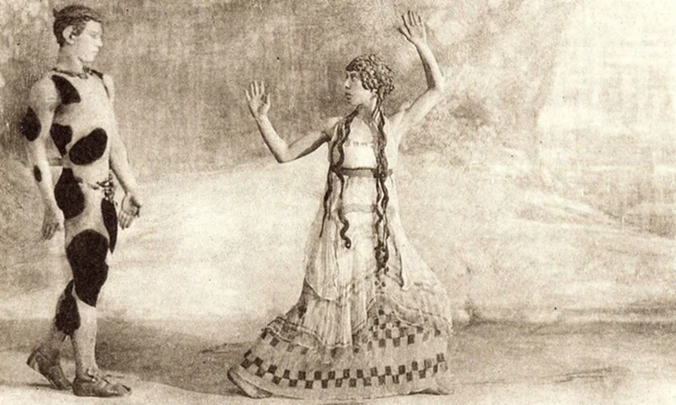
The Afternoon of a Faun (L'Après-midi d'un faune) Choreographed by Vaslav Nijinsky for the Ballets Russes
First performed in the Théâtre du Châtelet in Paris on 29 May 1912. Nijinsky danced the main part himself.

Slide 4
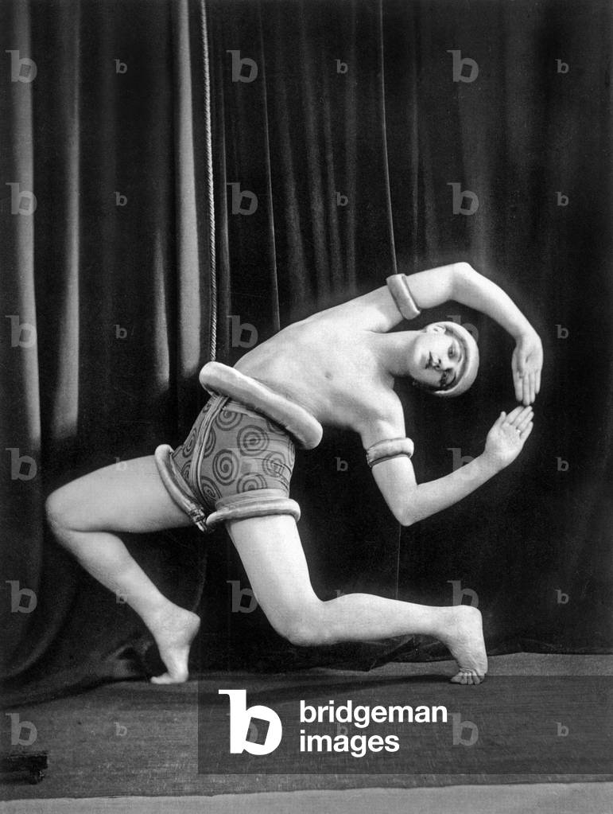
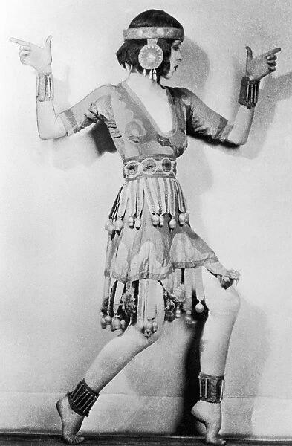
Ted Shawn's 1919 solo GNOSSIENNE (A PRIEST OF KNOSSOS) and Martha Graham

Slide 5
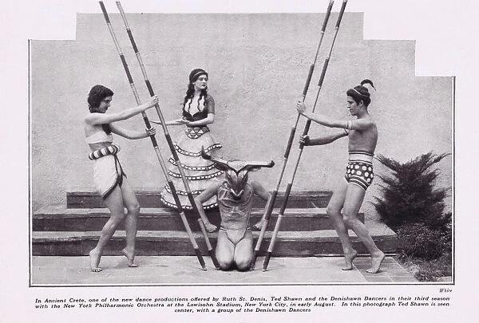

Slide 6
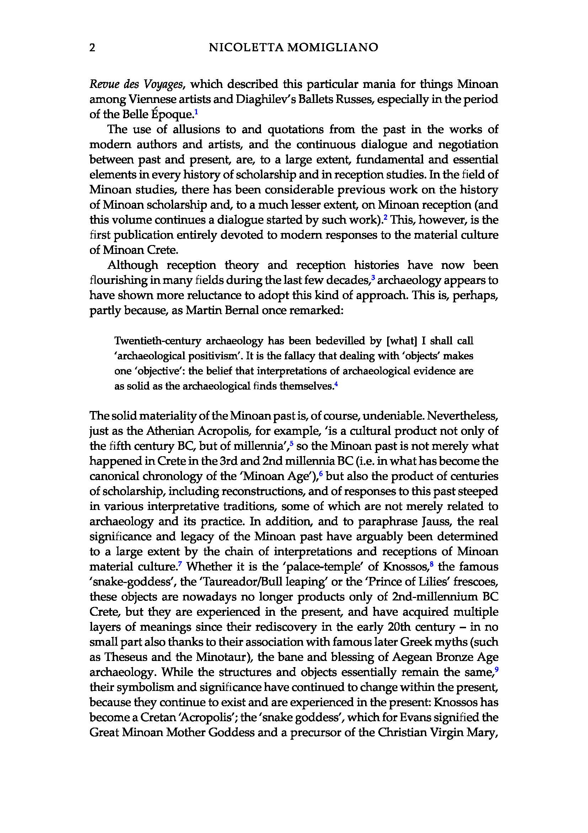
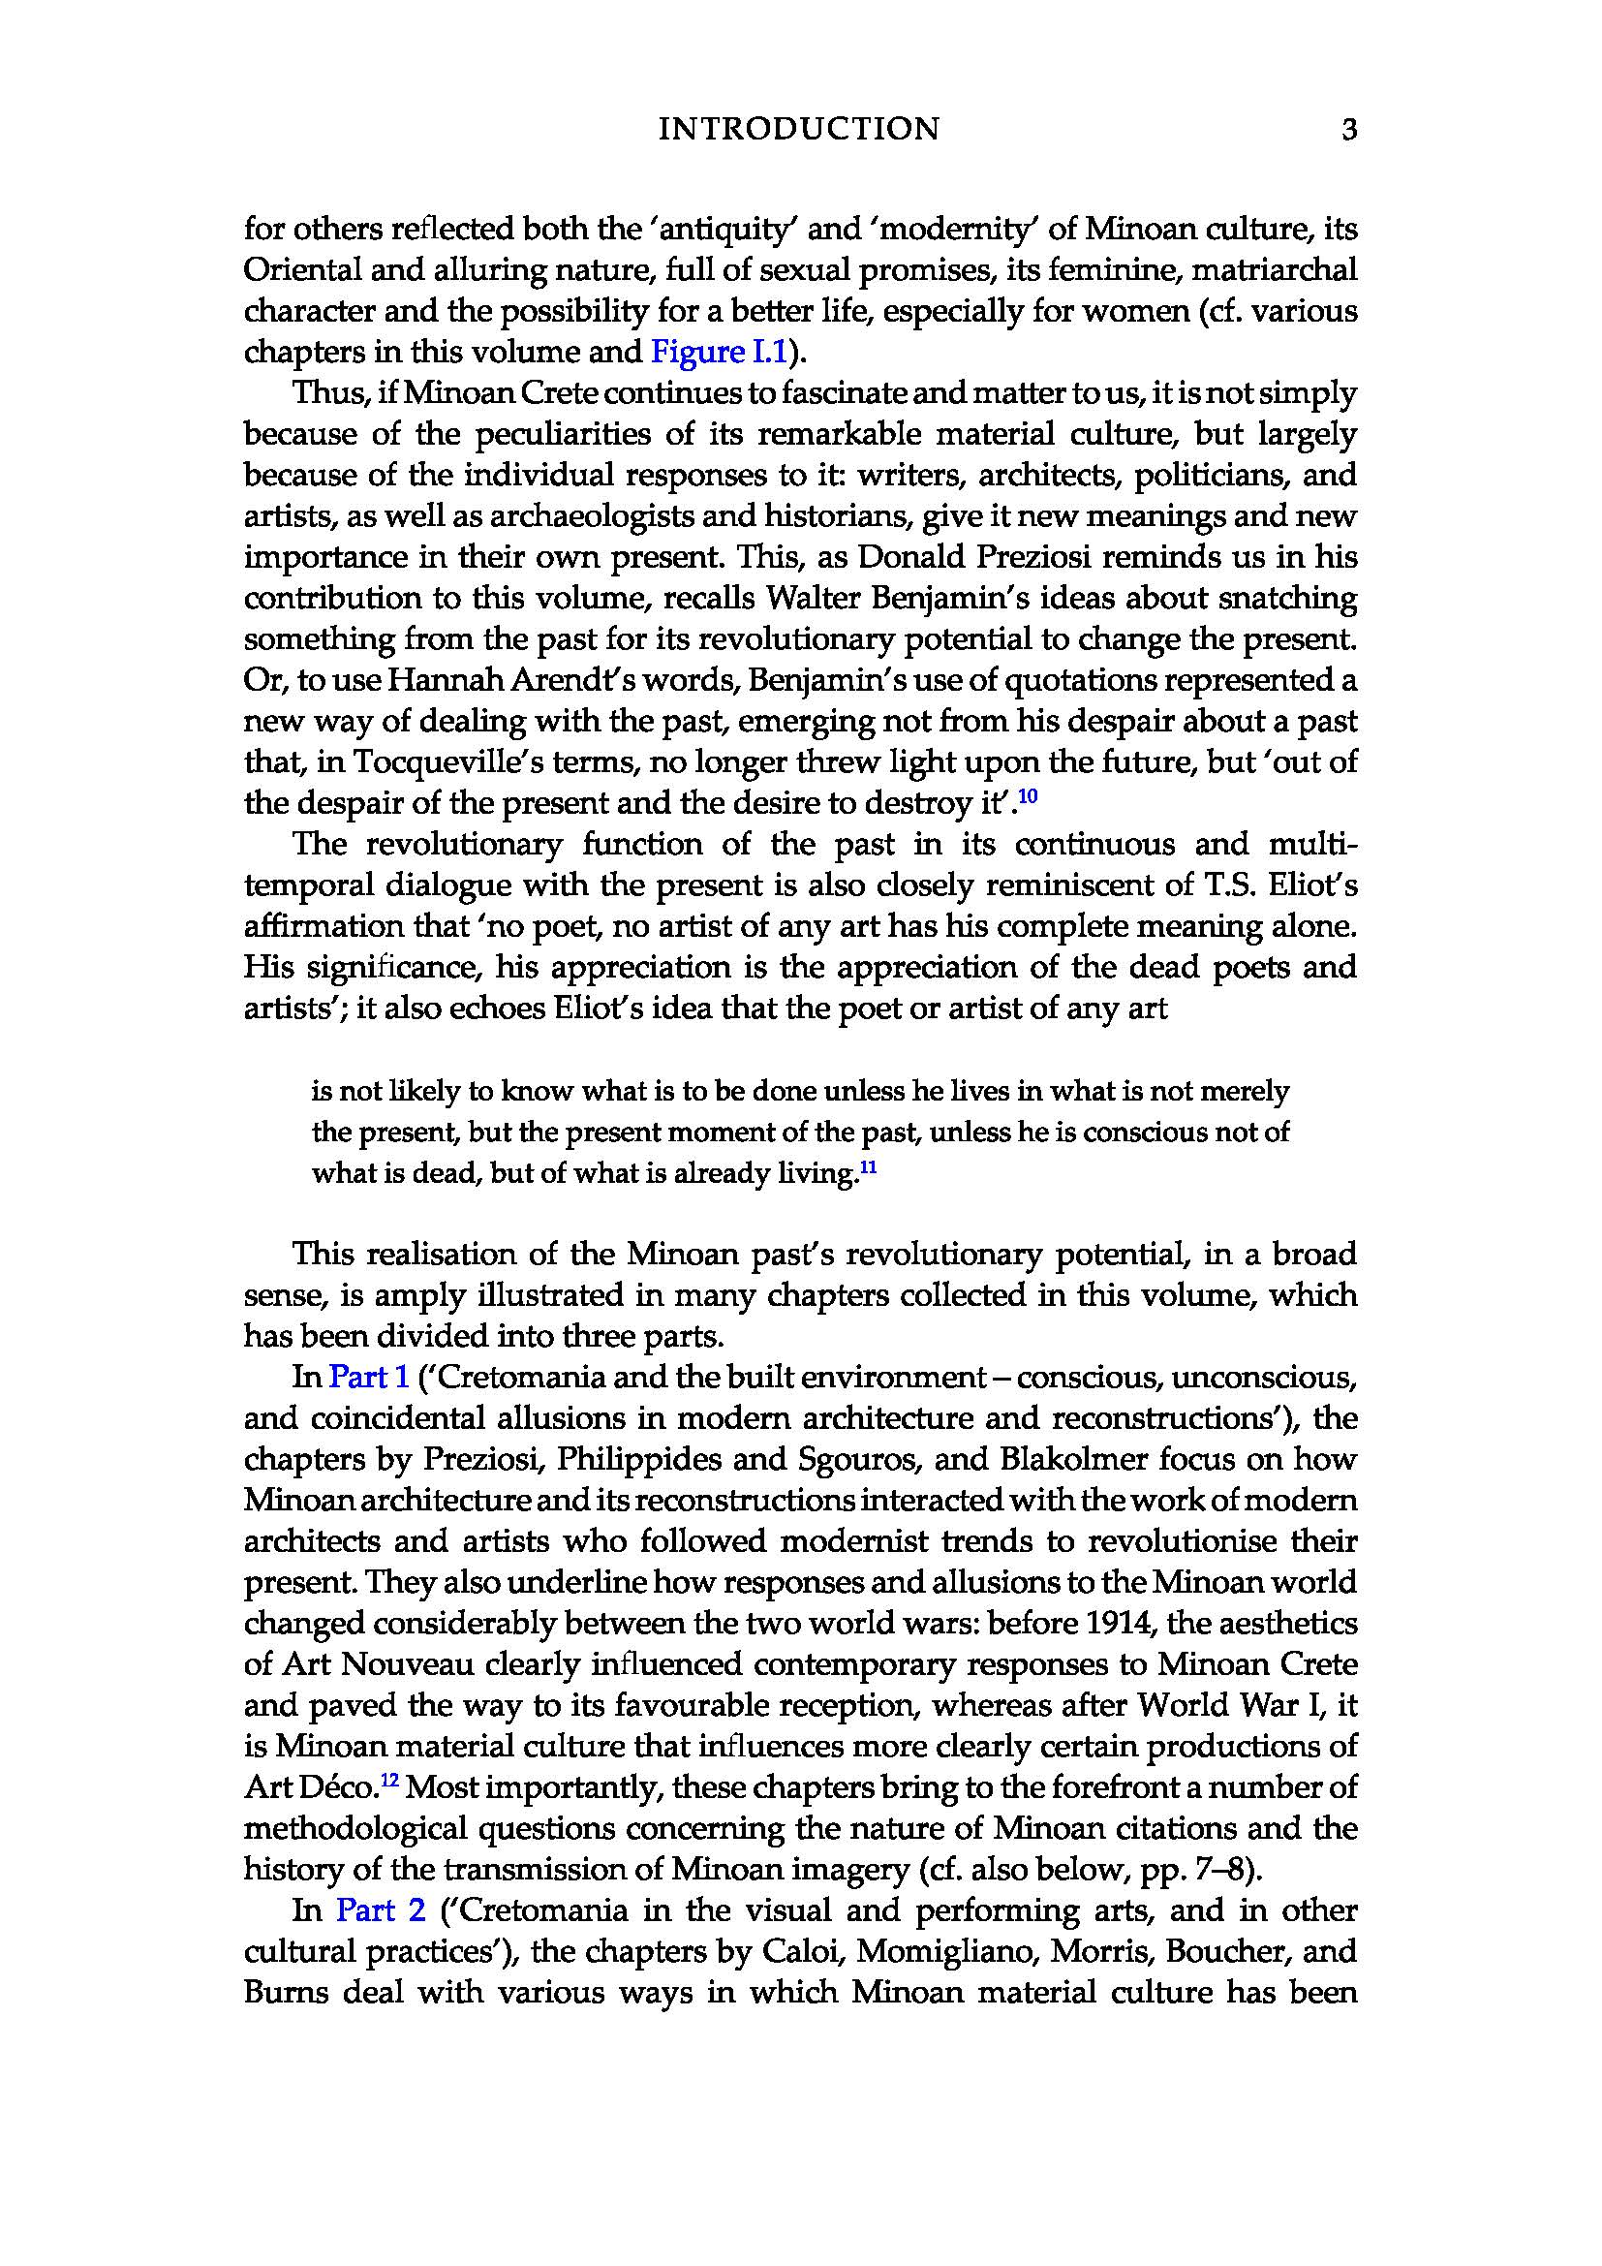

Slide 8
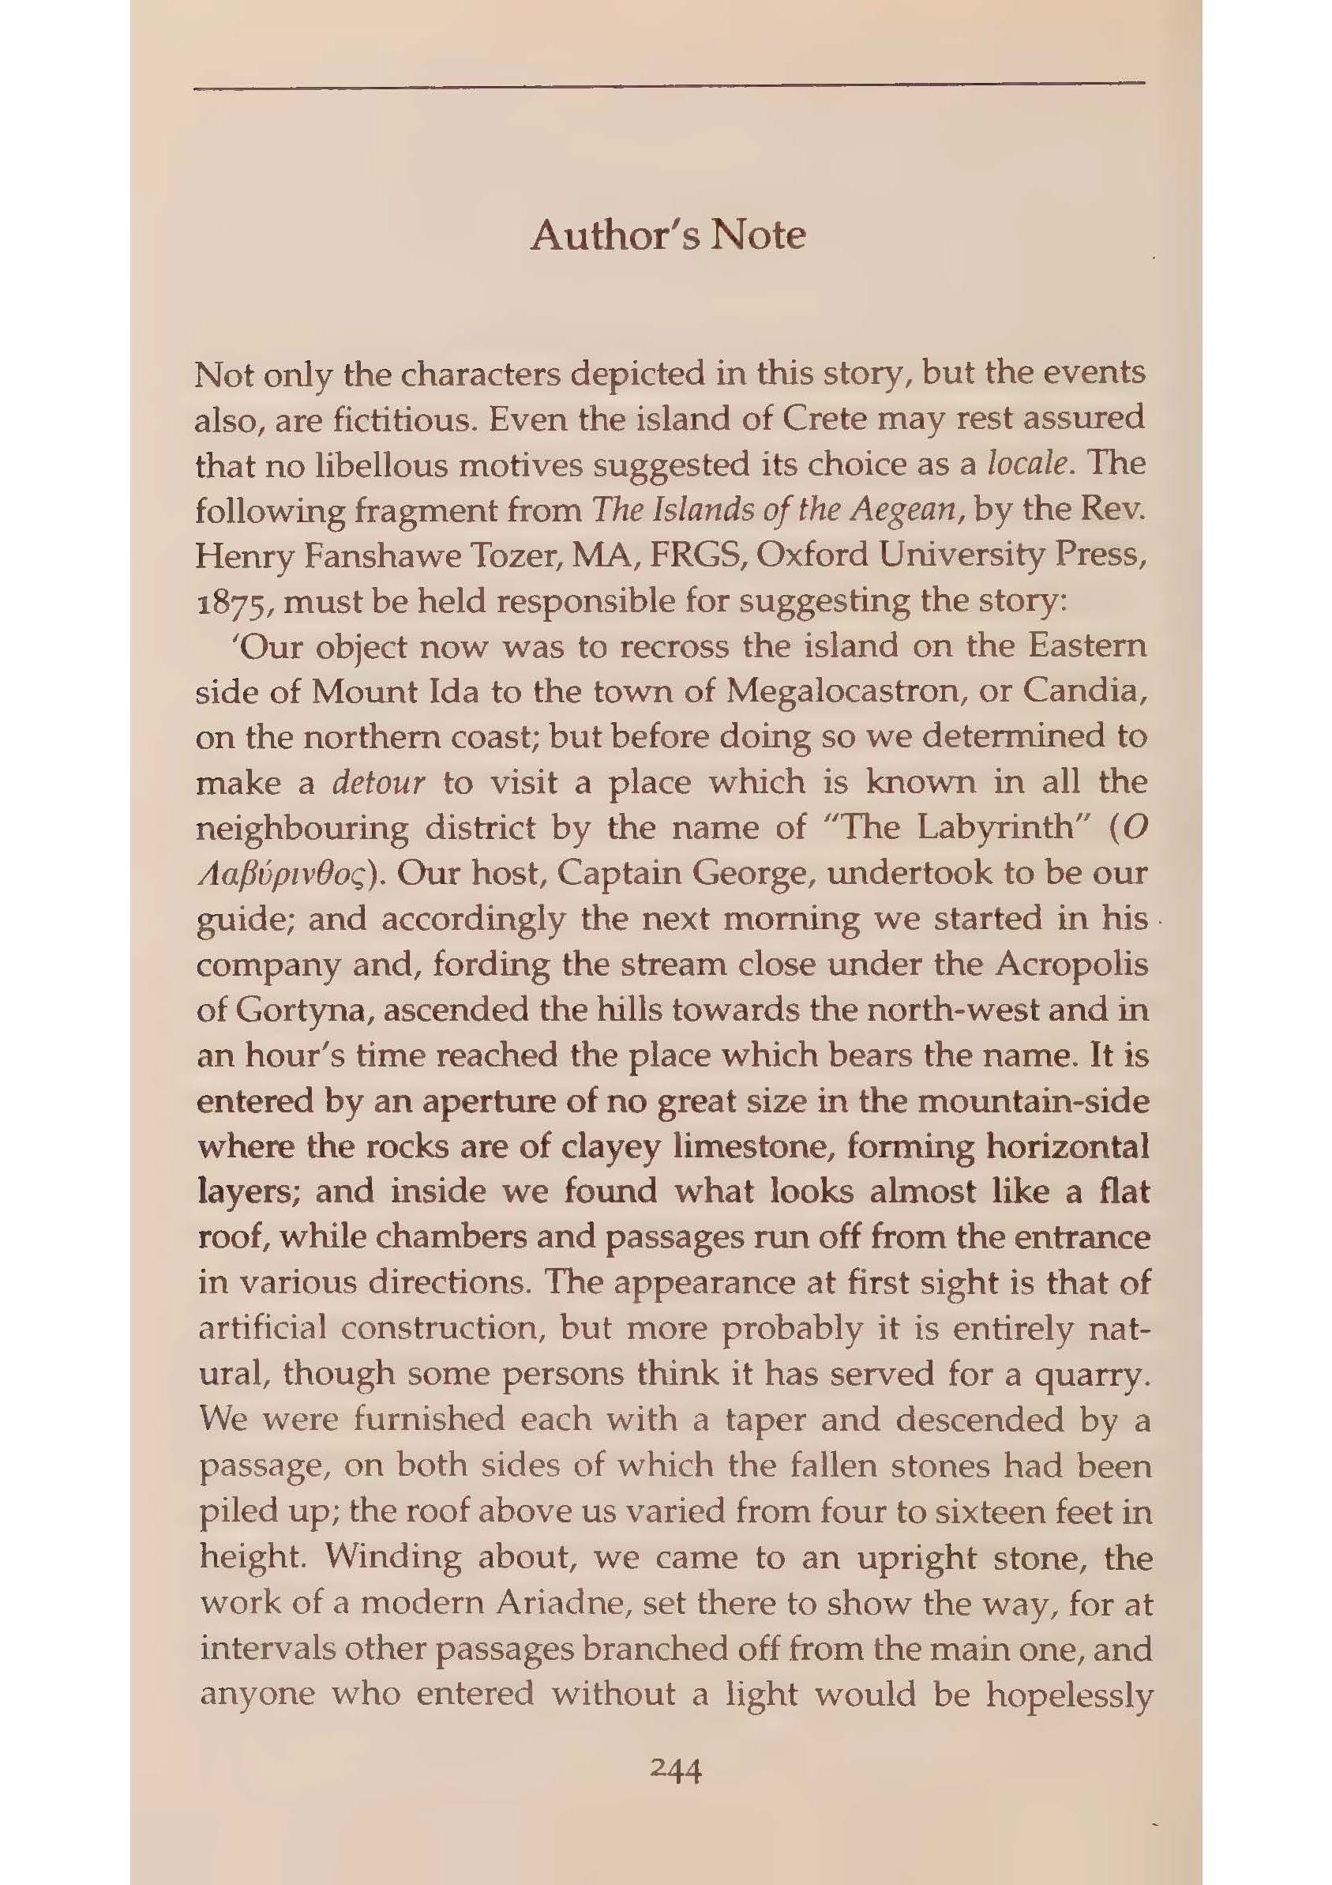
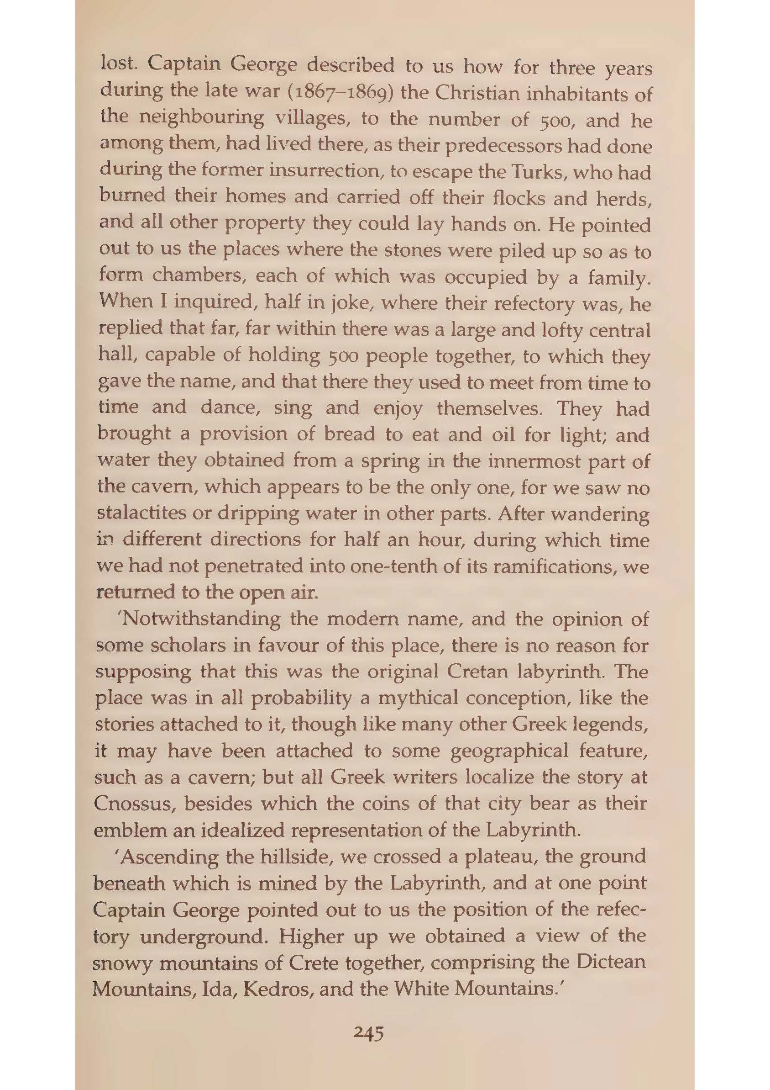

Slide 9
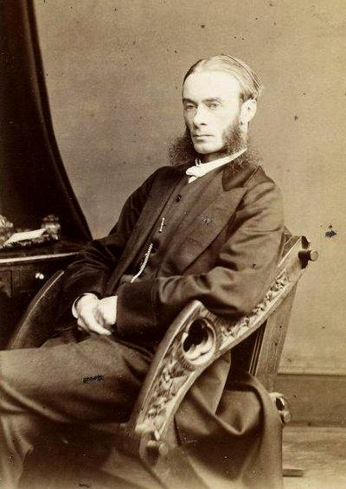
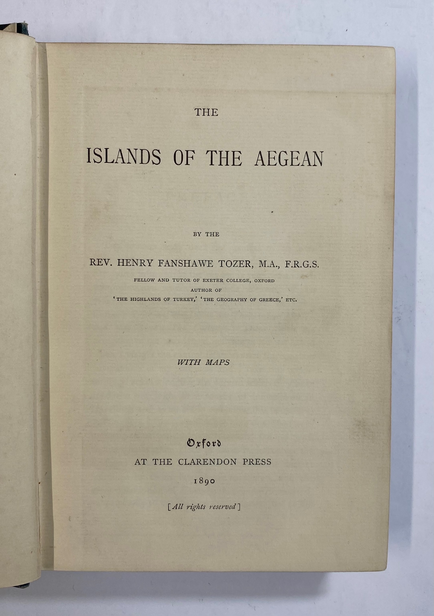
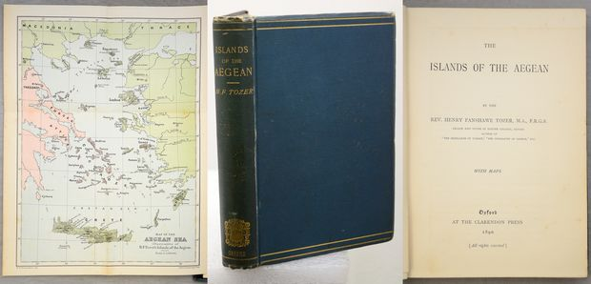

Slide 10
“Dramatis Personae” – A Key
Mr. O. Fearmax: The Spiritualist
Mr. V. Truman and Mrs. Elsie Truman: A Couple of Married Eccentrics
Miss Virginia Dale: The Pretty Convalescent
Captain J. Baird: The Soldier with Guilty Memories of the Cretan Resistance
Lord Graecen: The Antiquarian Peer and Minor Poet (Dicky)
Miss Dombey: The Protestant Spinster with a Fox Terrier
Campion: The Extrovert Painter
Böcklin: The Buried German
Sir Juan Axelos: The Archaeologist
Mr. Howe: The American Journalist
Hogarth: The Psychologist

Slide 11
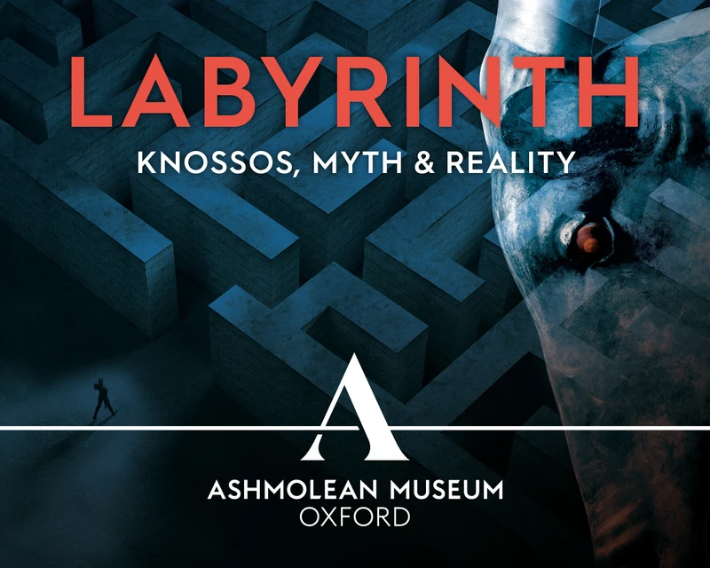

Slide 12
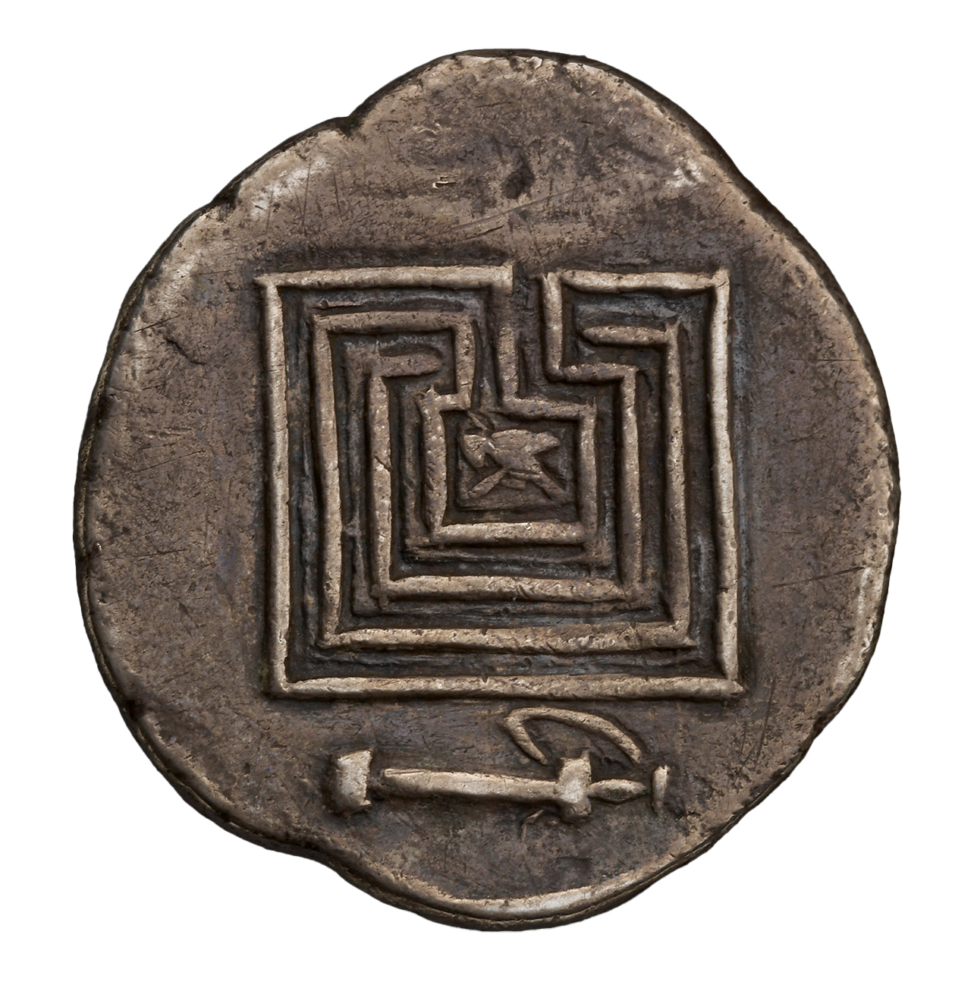
Coin minted at Knossos depicting the Cretan Labyrinth, silver, 300–270 BCE © Ashmolean Museum

Slide 13
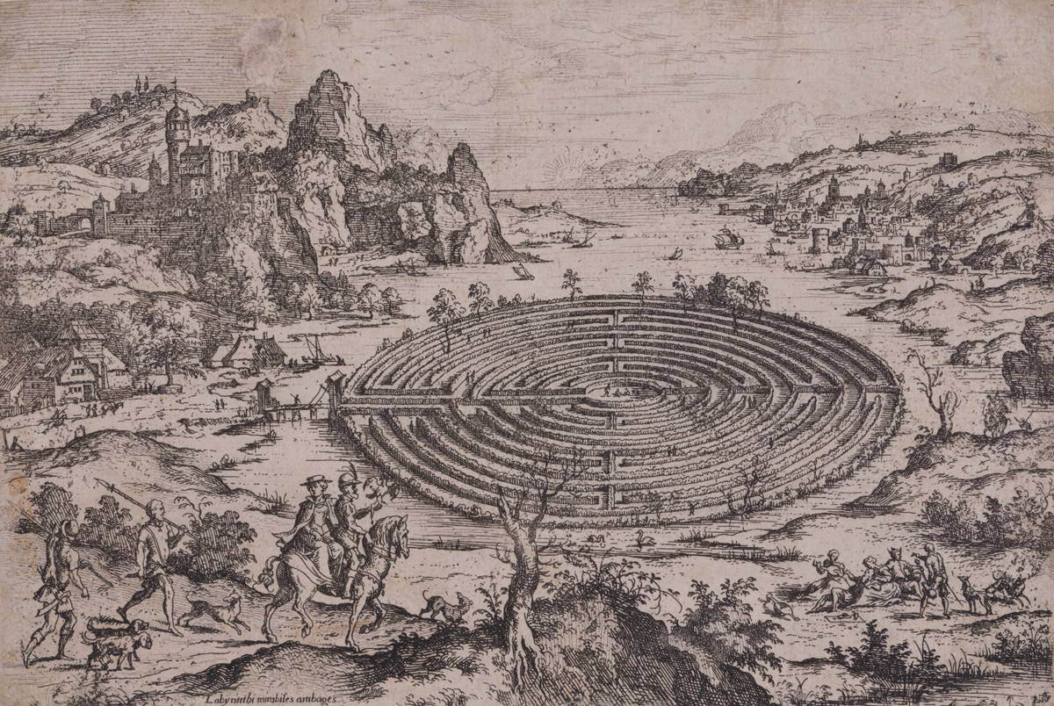
The Cretan Labyrinth,
1558, after Mathjis Cock drawing © Ashmolean Museum

Slide 14
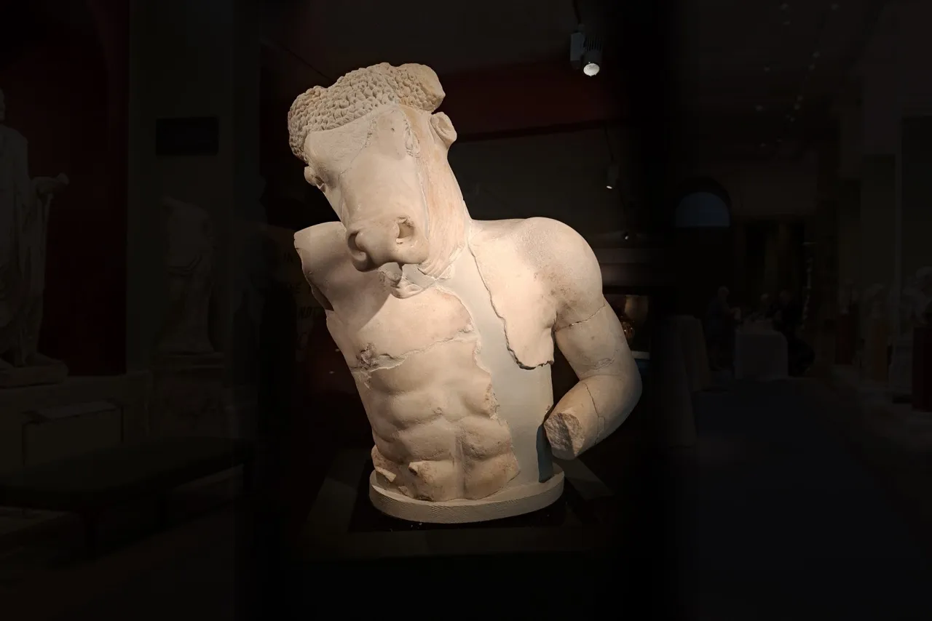
Bust of the Minotaur; 5th century BC, Marble statue. Found in the Plaka Athens. erected on a fountain in Athens near St Demetrios Katephoris in Plaka. It is a Roman copy of the famous, lost statuary group attributed to Myron erected on the acropolis that represented Theseus fighting the Minotaur.

Slide 15
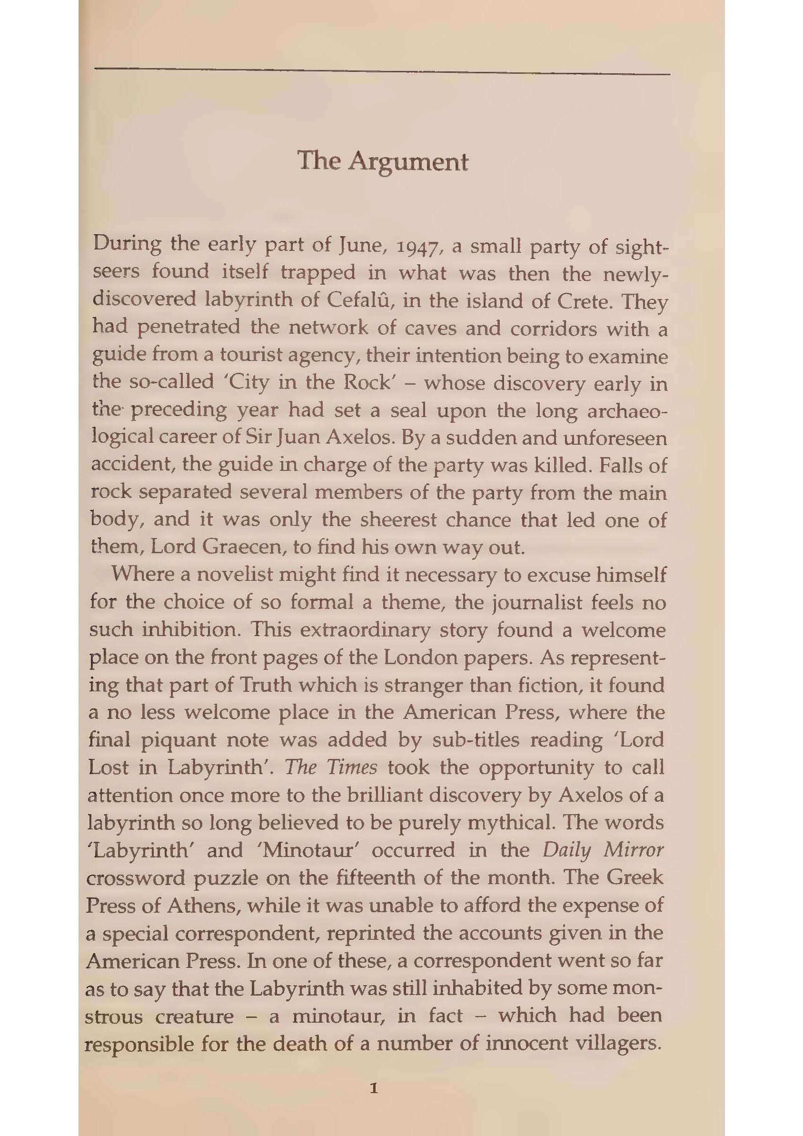
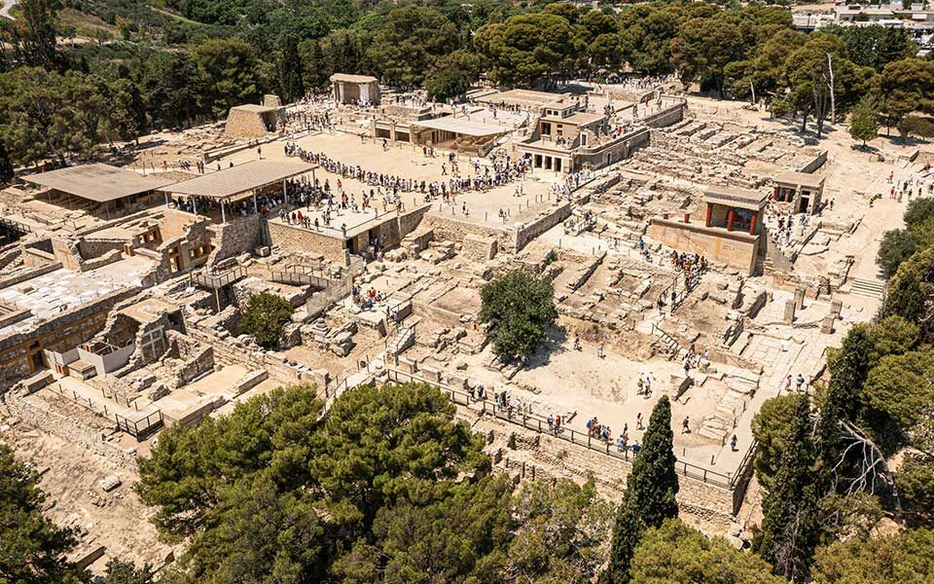
“During the early part of June, 1947, a small party of sightseers found itself trapped in what was then the newly-discovered labyrinth of Cefalù, in the island of Crete. They had penetrated the network of caves and corridors with a guide from a tourist agency, their intention being to examine the so-called ‘City in the Rock.’” (1)

Slide 16
“The Times took the opportunity to call attention once more to the brilliant discovery by Axelos of a labyrinth so long believed to be purely mythical.” (1)
“At the old Wembley Fun Fair there had been a water-labyrinth. You sailed through the darkness in a small boat, passing at last through a corridor of mirrors and lighted panoramas” (9)
“Benjamin Haydon and Van Gogh are equals in suffering if in nothing else. Each was lost in the labyrinth of his own spiritual discoveries.” (35)
“In a sense she was no longer afraid of the labyrinth, since it was no longer the labyrinth that was killing her.” (171)
Or was this whole place merely a mad exteriorization of his inner confusion; his feet walking slowly down metaphoric corridors of his own subconscious — in which only the roar of the sleep-ing monster gave him a clue to his primal guilt? It was a pretty fancy. If he ever got out he would have the pleasure of sharing it with Hogarth. The work of Rank on the symbolic significance of labyrinths, and their connexion with divination by entrails. (176)

Slide 17
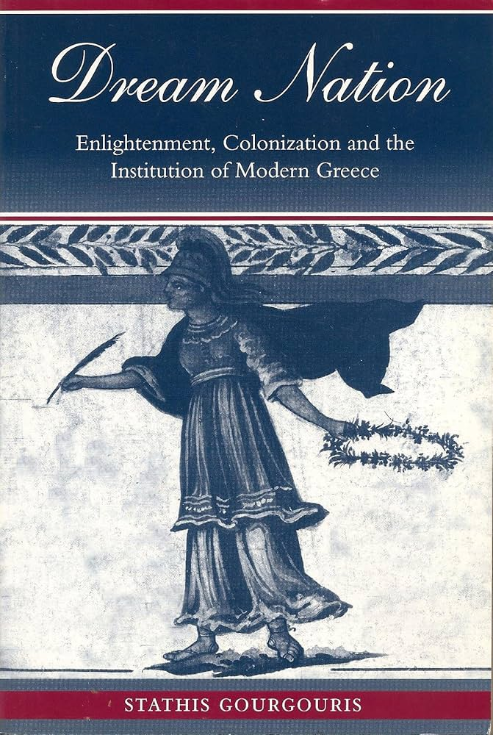
[…] “because Philhellenism—being, I would argue, an Orientalism in the most profound sense—engages in the like activity of representing the other culture, which in effect means replacing the other culture with those self-generated, projected images of otherness that Western culture needs to see itself in: the mirrors of itself.!? This is to return to the identification of Philhellenism in Humboldt as a particular kind of colonial mimicry inherent in the colonization of the ideal, an intercourse that can only be autoscopic. Were we, like good philologists, to unearth from the word autoscopic its etymological presence, we would have to add to its meaning of “looking at one’s self” its other meaning: aiming at one’s self, making the self one’s own teleology. From this identitary archaeological terrain, it is but a step to the death of the Other, to the philological autopsy, to Chateaubriand’s idealist necrophilia. Hence, from the point of view now of Neohellenic reality, the inevitability of what I have named “the punishment of Philhellenism.” (140)
“This is a concrete example of the absurdity of the notion of national sovereignty. What we have here is none other than a perfectly colonial condition. We need only remember Fanon’s words: ‘Colonialism is not simply content to impose its rule upon the present and the future of a dominated country. . .. By a kind of perverted logic, it turns to the past of the oppressed people, and distorts, disfigures, and destroys it’ (1968: 210).” (152)
Gourgouris, Stathis. Dream Nation: Enlightenment, Colonization, and the Institution of Modern Greece. Stanford: Stanford University Press, 1996.

Slide 18
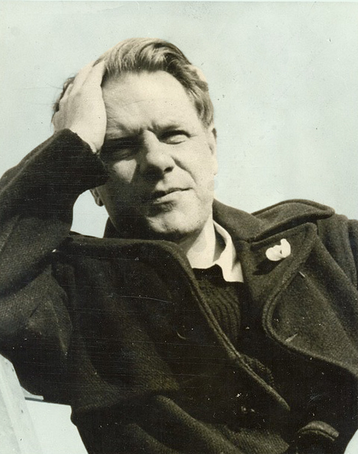
“[W]hether we had simply invented it [Greece] for ourselves in the old days, living comfortably on foreign exchange, patronizing reality with our fancies and making bad literature from them” (Durrell, Reflections on a Marine Venus: A Companion to the Landscape of Rhodes, 1953, 17).
“Other countries may offer you discoveries in manners or lore or landscape; Greece offers you something harder—the discovery of yourself." (Prospero’s Cell: A Guide To The Landscape And Manners of The Island Of Corfu, 1945, 11).
And when hemp sings of murder bless your boy,
The double fellow in the labyrinth,
Whose maps were stifled with him in the maze,
Whose mother dropped him like the seedless pod.
Durrell, “A Soliloquy of Hamlet” 1943

Slide 19
These legends, with their graphic symbolism to which unfortunately the key has been lost — or not yet recovered — are sometimes more irritating than enlightening. The Minotaur is one of the puzzles; his existence and habits have given rise to numberless differing explanations, but there is no single one which answers all the questions. Equally full of enigma is the maze — did it have a ritual function, a religious function? Did it symbolize the evolution of the individual personality into maturity — after conquering all the stresses ‘and fears of life? Otto Rank, the psychoanalyst, seemed to think the maze was a symbol of the loops of the big intestine of a sheep or a cow — the standard form of divination. Myself, I think that a man sentenced to death was given an outside chance of redeeming his life by crossing the labyrinth and avoiding the Minotaur if he could. Somewhere I have read that, in the old Roman arenas, where so many Christians were fed to the lions, not all the cages surrounding the arena were full of wild animals; and that a slave thrown into the pit was pardoned if he twice opened an empty cage. Maybe the labyrinth worked like this; maybe the trick was to sneak through without waking the monster?
Durrell, The Greek Islands, 63-64.

Slide 20
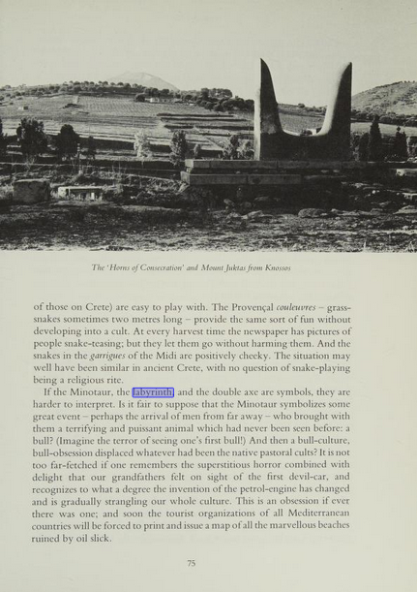
If the Minotaur, the labyrinth, and the double axe are symbols, they are harder to interpret. Is it fair to suppose that the Minotaur symbolizes some great event — perhaps the arrival of men from far away — who brought with them a terrifying and puissant animal which had never been seen before: a bull? (Imagine the terror of seeing one’s first bull!) And then a bull-culture, bull-obsession displaced whatever had been the native pastoral cults? It is not too far-fetched if one remembers the superstitious horror combined with delight that our grandfathers felt on sight of the first devil-car, and recognizes to what a degree the invention of the petrol-engine has changed and is gradually strangling our whole culture. This is an obsession if ever there was one; and soon the tourist organizations of all Mediterranean countries will be forced to print and issue a map of all the marvellous beaches ruined by oil slick.
Durrell, The Greek Islands, 75.

Slide 21
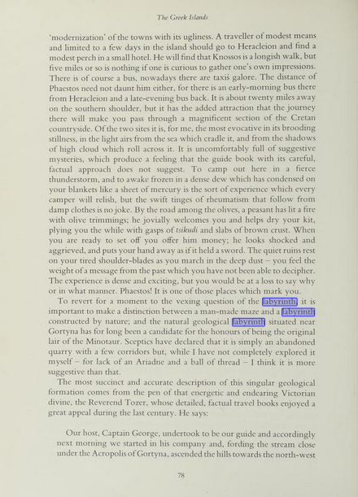
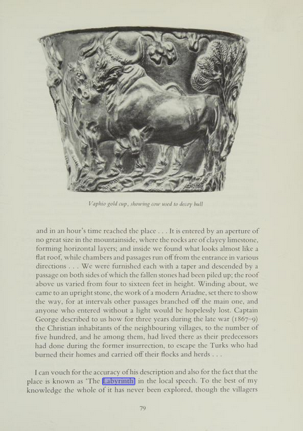
“To revert for a moment to the vexing question of the labyrinth, it is important to make a distinction between a man-made maze and a labyrinth constructed by nature; and the natural geological labyrinth situated near Gortyna has for long been a candidate for the honours of being the original lair of the Minotaur. Sceptics have declared that it is simply an abandoned quarry with a few corridors but, while I have not completely explored it myself — for lack of an Ariadne and a ball of thread — I think it is more suggestive than that.”
“I can vouch for the accuracy of his description and also for the fact that the place is known as ‘The Labyrinth’ in the local speech. To the best of my knowledge the whole of it has never been explored”
Durrell, The Greek Islands, 78-79

Slide 22
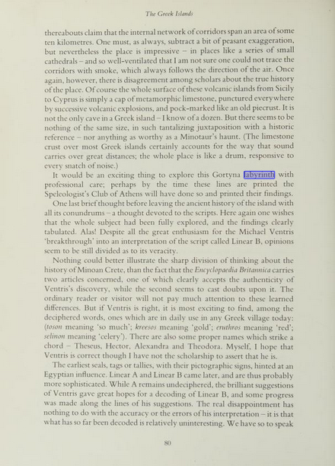
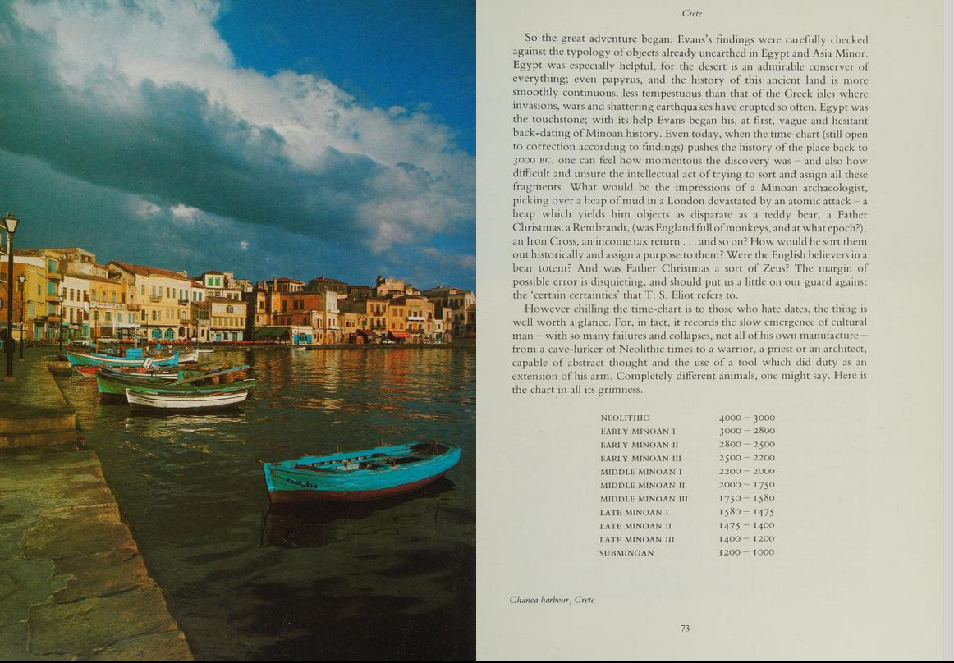
“It would be an exciting thing to explore this Gortyna labyrinth with professional care; perhaps by the time these lines are printed the Speleologist’s Club of Athens will have done so and printed their findings.” Durrell, The Greek Islands, 80

Slide 23
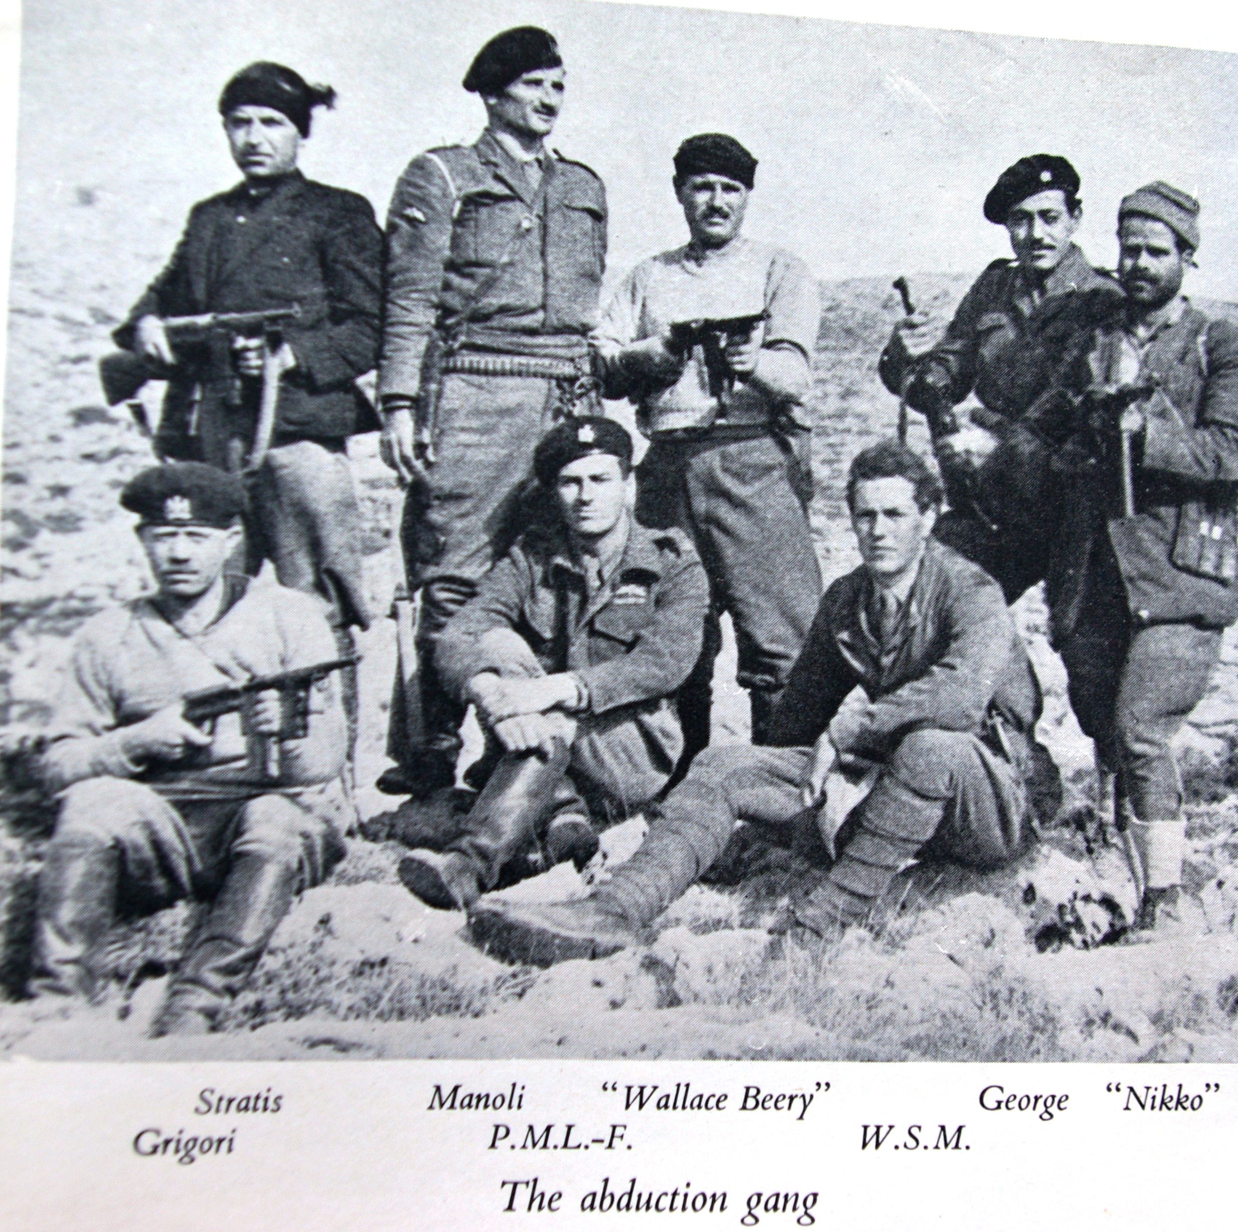
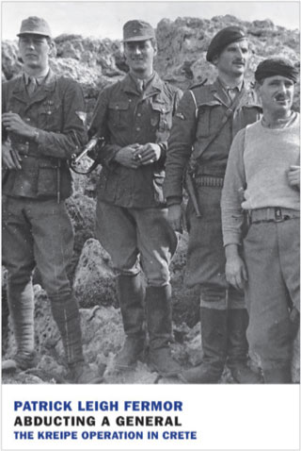

Slide 24
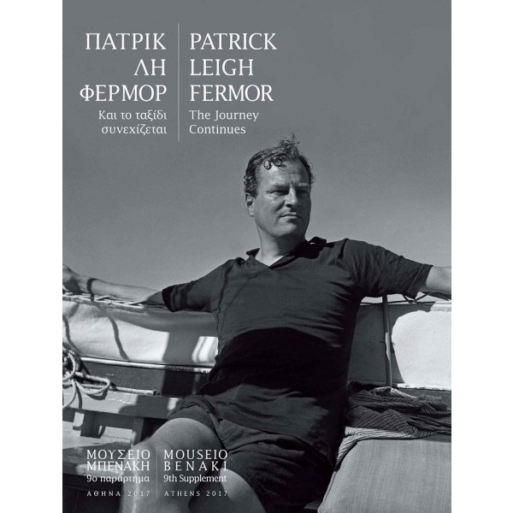
The kidnapping of Heinrich Kreipe was an operation executed jointly by the British Special Operations Executive (SOE) and local resistance members in Crete in German-occupied Greece during the Second World War. Operation 'BRICKLAYER' was launched on 4 February 1944, when SOE officer Patrick Leigh Fermor landed in Crete with the intention of abducting notorious war criminal and commander of 22nd Air Landing Division, Friedrich-Wilhelm Müller. By the time of the arrival of the rest of the abduction team, led by William Stanley Moss, two months later, Müller had been succeeded by Heinrich Kreipe, who was chosen as the new target.
On the night of 26 April, Kreipe's car was ambushed while en route from his residence to his divisional headquarters. Kreipe was tied and forced into the back seat while Leigh Fermor and Moss impersonated him and his driver respectively. Kreipe's notorious impatience at roadblocks enabled the car to pass numerous checkpoints before being abandoned at the hamlet of Heliana. The abductors continued on foot, continuing to evade thousands of Axis soldiers sent to stop them, with the help of guides from the local resistance. On 14 May, the team was picked up by a British motorboat from the Rodakino beach and transported to British-held Egypt.

Slide 25
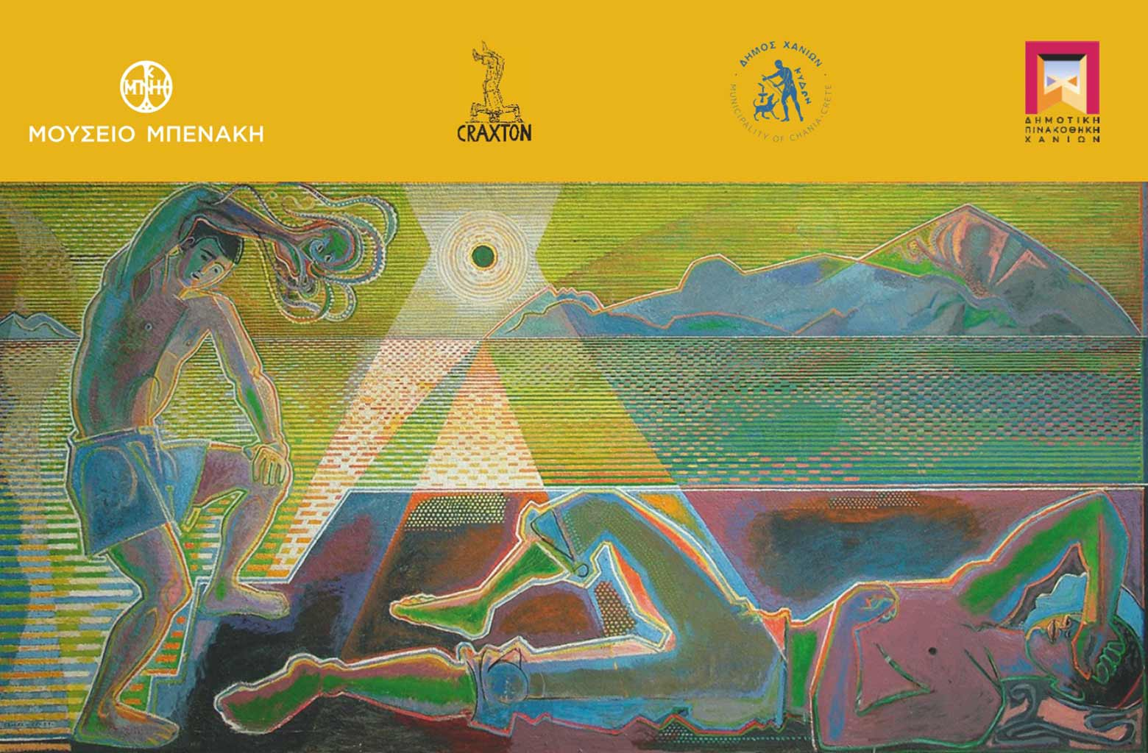

Slide 26
