Slide 1
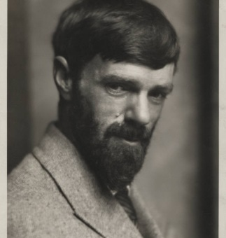
The “Snake” by D.H. Lawrence

Slide 2
Brief Biography of D.H. Lawrence (1885-1930).
David Herbert Lawrence was born in 1885 in Eastwood. He won a scholarship to Nottingham High School. In 1906, he took up a teacher-training scholarship at University College, Nottingham. After qualifying in 1908 he took up a teaching post at the Davidson School in Croydon, remaining there until 1912. In early 1912, after a period of serious illness, Lawrence left his teaching post at Croydon to return to Nottingham, shortly afterwards eloping to Germany with Frieda Weekley, the wife of Professor Ernest Weekley. They returned to England in 1914 prior to the outbreak of war and were married at Kensington Register Office on 14 July. Confined to England during the war years, the Lawrences spent much of this time in Cornwall. In 1919 they left England once more, embarking on a period of extensive travelling within Europe and then further afield to Australia, Mexico and New Mexico. His health continued to deteriorate and Lawrence returned to Europe with Frieda in 1925. During his last years, Lawrence spent much of his time in Italy making only brief visits to England, the last in 1926. He died on 2 March 1930 in the south of France.
Lawrence was a prolific writer - of poetry, novels, short stories, plays, essays, and criticism. His works are heavily autobiographical and the experiences of his early years in Nottingham continued to exert a profound influence throughout his life.
Source: The University of Nottingham Manuscripts and Special Collections: Brief
Biography of D. H. Lawrence. (abridged) Web. 17 Jun 2018. Full Url:
https://www.nottingham.ac.uk/manuscriptsandspecialcollections/collectionsindepth/lawrence/biography.aspx

Slide 3
D.H. Lawrence’s prolific and diverse output included novels, short stories, poems, plays, essays, travel books, paintings, translations, and literary criticism. His collected works represent an extended reflection upon the dehumanizing effects of modernity and industrialization. In them, Lawrence confronts issues relating to emotional health and vitality, spontaneity, human sexuality and instinct. His later poems embrace organic attempts to capture emotion through free verse. In his prime he was arguably the foremost writer of fiction in the English speaking world. Quite a feat for the son of a coalminer from the coalfields of Nottingham!
Major Novels:
The White Peacock (1911)
Sons and Lovers (1913)
The Rainbow (1915)
Women in Love (1920)
The Boy in the Bush (1924)
The Plumed Serpent (1926)
Lady Chatterley’s Lover (1928)
Source: The Poetry Foundation: D. H. Lawrence 1885–1930 (abridged) Web. 17 Jun 2018. Full Url: https://www.poetryfoundation.org/poets/d-h-lawrence

Slide 4
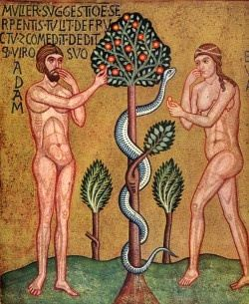

Slide 5
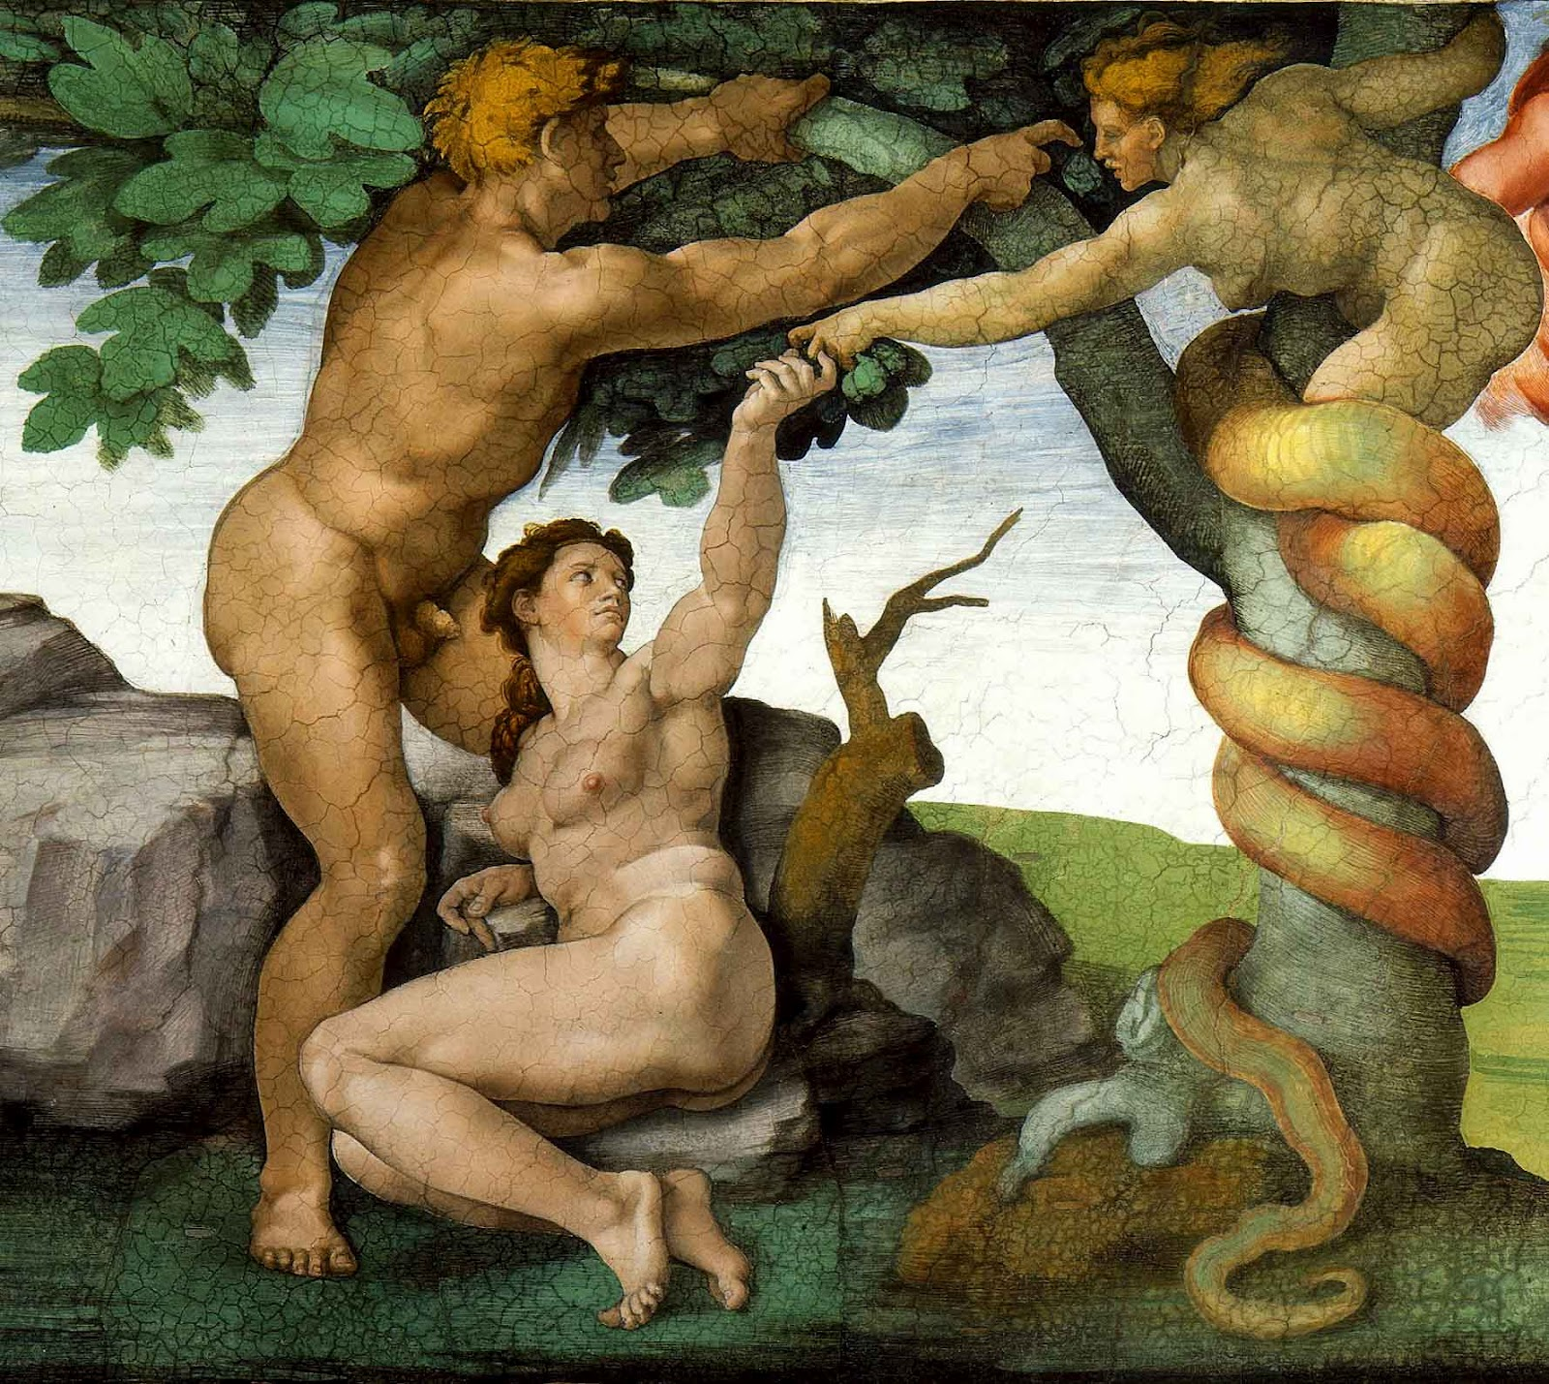

Slide 6
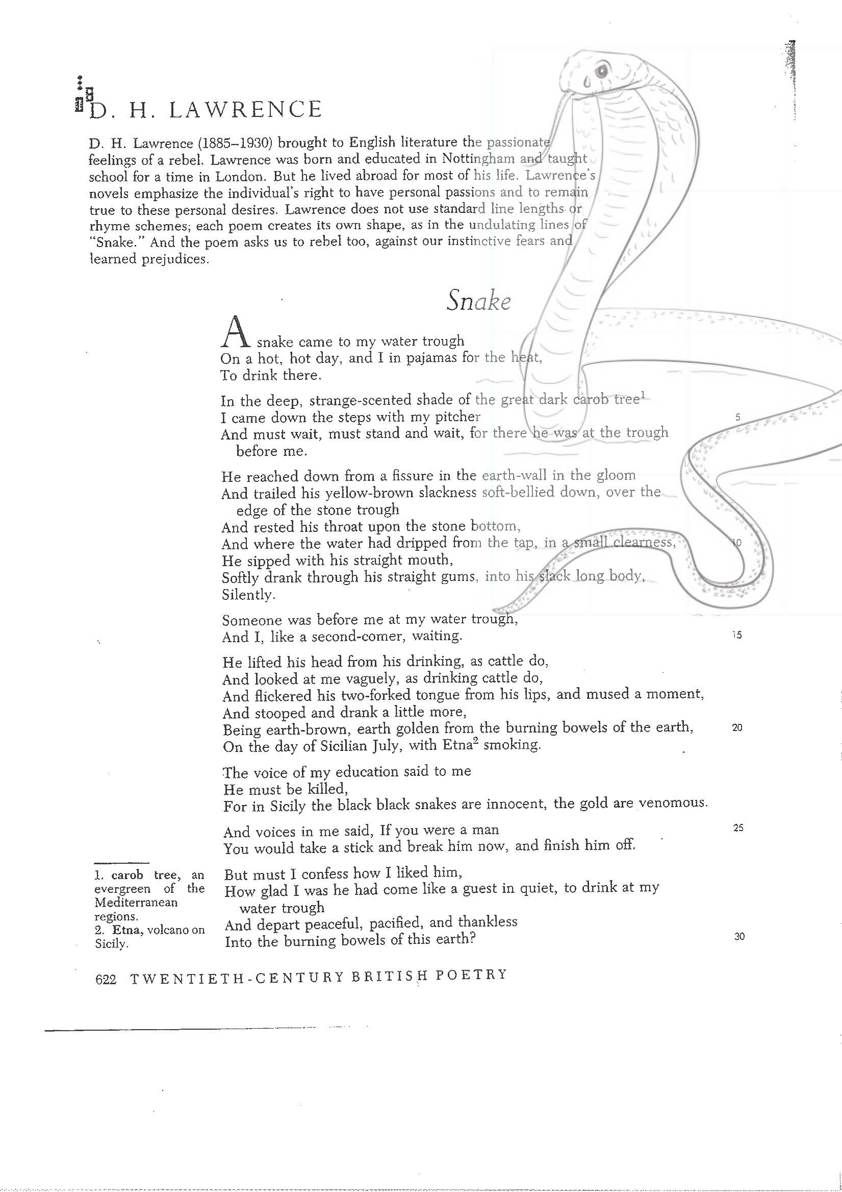

Slide 8
• A. Stylistics: i) Form
The poem is marked by its varying meter and line length. The selected length of line within a series of free verse lines forces the reader to slow down, builds up tension and rounding corners, and reflects the unusually strong yet flowing movement of the snake. A more formal rhyming scheme would not have really worked. The free verse – vers libre chosen is particularly effective. The sketch that I have drafted presents how the poem itself ultimately comes to resemble the form of a snake recoiling alluding to the snake’s very physiology.

Slide 9
A. Stylistics: ii) Style Devices: 1) Alliteration / Assonance
Alliteration is the pairing of identical or similar consonant sounds (repetition of consonants)
Assonance is the pairing of vowel sounds (repetition of vowels).
Example of Alliteration (lines 55-60):
In the deep, strange-scented shade of the great dark carob tree
I came down the stairs with my pitcher
And must wait, must stand and wait, for there he was at the trough
before me.

Slide 10
In the deep, strange-scented shade of the great dark carob tree I came down the stairs with my pitcher And must wait, must stand and wait, for there he was at the trough before me. Alliteration: strange scented shade (mirrors the slow movement of a slithering, sliding, whistling snake)
Stylistics: ii) Style Devices: 2) Enjambment
Enjambment: In poetry, enjambment describes the phenomenon of having incomplete syntax at the end of a line. Thus, the meaning runs over from one poetic line to the next, without terminal punctuation.
Example of Enjambment (lines 55-60):
I looked round, I put down my pitcher,
I picked up a clumsy log
And threw it at the water trough with a clatter.
I think it did not hit him;
But suddenly that part of him that was left behind convulsed in,
undignified haste,
Writhed like lightning, and was gone.

Slide 11
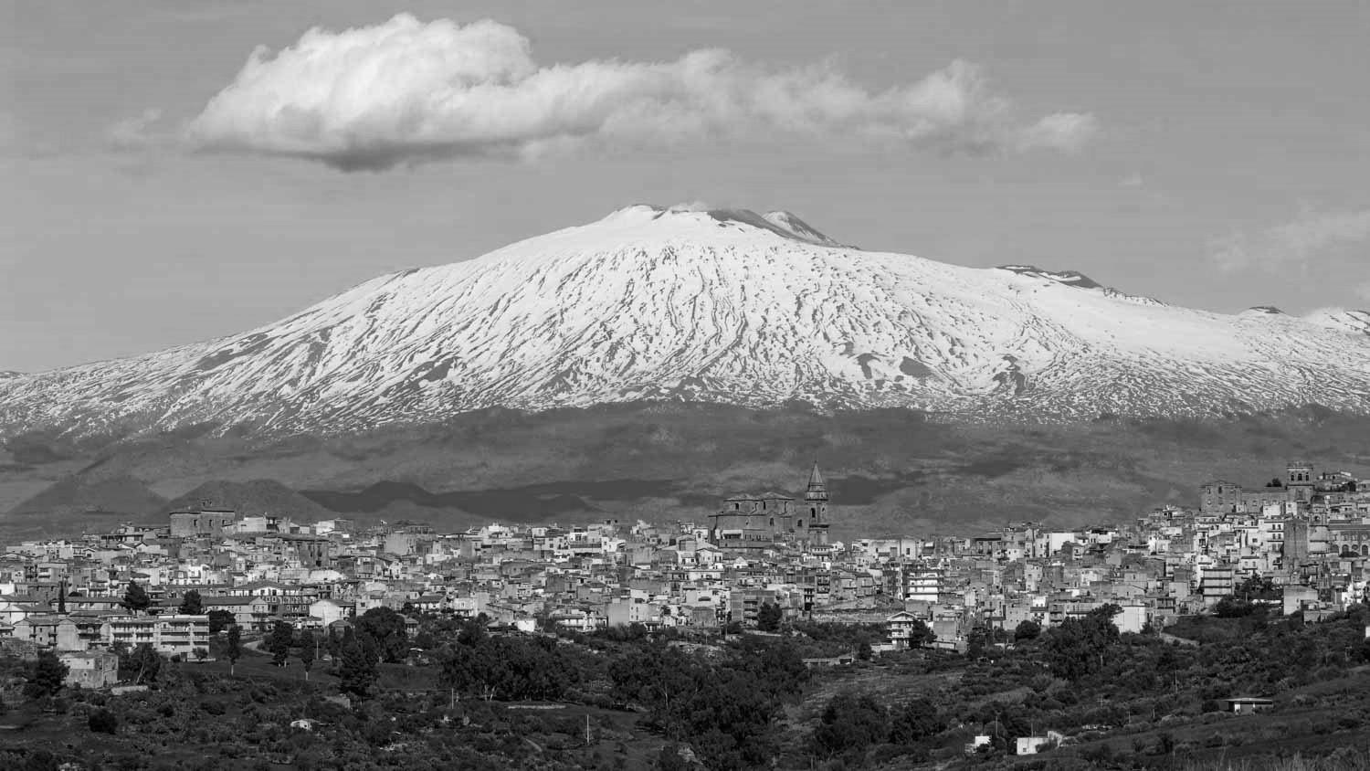
B. Content: i) Setting
By setting we refer to the time and place in which the action of the narrative takes place.
A snake came to my water-trough
On a hot, hot day, and I in pyjamas for the heat,
To drink there…
In the deep, strange-scented shade of the great dark carob tree…
He reached down from a fissure in the earth-wall in the gloom…
On the day of Sicilian July, with Etna smoking.

Slide 12
B. Content: ii) Themes
The voice of my education said to me
He must be killed,
For in Sicily the black black snakes are innocent, the gold are venomous.
And voices in me said, If you were a man
You would take a stick and break him now, and finish him off.
(Lines 22-26).
Why thechange in narrative in these lines?
Main themes of the poem?

Slide 13
• B. Content: iii) Symbolism / Allusions
Symbolism is the use of symbols to signify ideas and qualities, by giving them symbolic meanings that are different from their literal sense.
He drank enough
And lifted his head, dreamily, as one who has drunken,
And flickered his tongue like a forked night on the air, so black,
Seeming to lick his lips,
And looked around like a god, unseeing, into the air,
(Lines 40-45)
And immediately I regretted it. I thought how paltry, how vulgar, what a mean act! I despised myself and the voices of my accursed human education. And I thought of the albatross And I wished he would come back, my snake.
(Lines 63-67).

Slide 14
Figures of Speech
Simile
1 “Lifted his head, dreamily, as one who has drunken” (42)
2 “For he seemed to me again like a king” (68)
Metaphor
1 “The dark door of the secret earth” (40)
2 “The voice of my education” (22)
Alliteration- Assonance
1 “peaceful, pacified” (29)
2. “burning bowels” (20)
Personification
1 “He sipped with his straight mouth” (11)
Repetition / Emphasis
1 “On a hot, hot day” (2)
2 “Must Wait” (6)
Rhetorical Question
1 “Was it perversity, that I long to talk to him?” (32)
Enjambment
1 A sort of horror, a sort of protest against his withdrawing into that
horrid black hole, (52-53)

