Slide 1

CSR a new philosophy

Slide 2

AGENDA
Agenda
Introduction : What is CSR? From a philosophy to a new necessity
The new regulatory framework around the world
The example of LEVI’s strauss company

Slide 3

What is CSR?

Slide 4

What is csr?
Corporate social responsibility is a new philosophy or a business approach that emphasizes ethical behavior, social responsibility and environmental sustainability.
It involves companies voluntarily taking actions that benefit society beyond their financial and legal obligations.

Slide 5
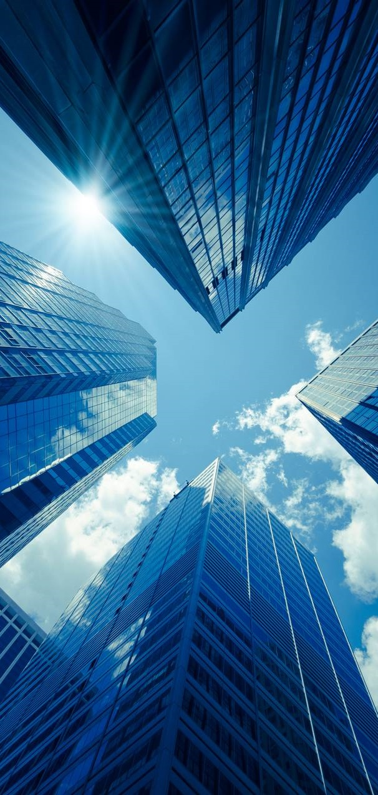
Key areas of csr
Environmental responsibility
Reducing carbon footprint
Waste management
Social responsibility
Fair labor practices
Diversity (different backgrounds, identities and perspectives, gender, race, ethnicity, age, disability, nationality, varied backgrounds in education, career paths, etc.)

Slide 6
Key areas of csr
Economic responsibility
Ethical business practices
Fair trade
Responsible investments (long term value while promoting ethical and sustainable business practices)
Philanthropy
Donations
Charity work
Supporting education and healthcare

Slide 7
The regulatory reporting framework
Reporting standards
From a philosophy to a new necessity

Slide 8
Csr reporting framework
European sustainability reporting standards
National directives through the enacted law 5164/2024 as of December 2024
Global reporting initiative
Sustainability accounting standards board (LEVI’S)
IFRS sustainability standards
Task force on climate related financial disclosures (LEVI’S)
United nations global impact (LEVI’S)
Carbon disclosure project (LEVI’S)
Iso 26000 social responsibility
B Corp certification

Slide 9

Levi’s
One of the world’s largest brand name apparel companies.
Listed in NYSE
Products:
Jeans, casual and dress pants, tops, shorts, skirts, dresses, jackets, activewear, footwear, and related accessories for men, women, and children around the world

Slide 10
Levi’s
BETTER CLOTHES
BETTER CHOICES
BETTER PLANET

Slide 11
LEVI’S
Stetement from their web site
“Α lot of people throw around the word sustainable, so we think it s important to be super straightforward in exactly how we use it.
For us at Levi’s, it s about making better choices like sourcing more sustainable materials and finding ways to use less water. It s about making better clothes like Wellthread, our most sustainably designed collection.
And its about bettering the planet and the communities that share it at every step along the way.
We’ve always stood up for what’s right – and creating sustainable clothing is no different.”

Slide 12
LEVI’S
Sustainability strategy
To be a leader in transparency and impact
To accelerate the circular economy ecosystem
To increase collaboration in the apparel industry
To treat all people with dignity and respect
Committed to 16 goals in 3 sustainability pillars of
climate, consumption and community.

Slide 13
Impact on climate

Slide 14
Levi’s goals on climate, consumption and community
CLIMATE
• Net-zero emissions of greenhouse gases by no later than 2050
• 42% absolute reduction in supply chain greenhouse gas (GHG) emissions from purchased goods and services by 2030
they reduced supply chain GHG emissions by 8% from the base year..
Year Ended 2022 2023 2030 Metric Tons CO2e
Base Target
1,944,947 1,785,400 1,128,069
(8) % (42)%

Slide 15
Levi’s goals on climate, consumption and community
CLIMATE
• 90% absolute reduction in GHG emissions
They reduced GHG emissions associated with all company-operated facilities by 77% from the base year.
Year Ended 2016 2021 2022 2023 2025
Base Target
Metric Tons CO2e
49,947 16,956 14,674 11,685 4,995
Cumulative (Decrease)
From Base Year (66) % (71) % (77) %

Slide 16
Levi’s goals on climate, consumption and community
CLIMATE
• 100% renewable electricity in all company operated facilities by 2025
Their renewable electricity consumption in company-operated facilities was 108,384 megawatt hours (MWh), or 97% of the total electricity used in those facilities.
Year
Ended 2021 2022 2023 2025
Target
Percent 85% 90% 97 % 100%
renewable
electricity

Slide 17
Levi’s goals on climate, consumption and community
CLIMATE
• Reduce freshwater use in manufacturing by 50% in areas of high-water stress by 2025
Cumulative reduction in freshwater used by wet finishing key suppliers in manufacturing in areas of highwater stress from the 2018 base year are as follows:
Year Ended December 31
2021 2022 2023 2025
Percent Reduction 14% 12 % 27 % 50%
Million Liters 15,030 22,574 18,722

Slide 18
Impact on consumption

Slide 19
Levi’s goals on climate, consumption and community
Consumption
• Key markets to introduce or increase resale and upcycling initiatives to extend the life of our products by 2025
They currently offer resale and upcycling programs like Levi’s® Tailor Shop and Levi’s® SecondHand recommerce platform, which is available to customers in the United States. Through the Levi’s® SecondHand recommerce platform they have reclaimed or extended approximately 20,000 units of clothing and resold 10,000 units, serving around 7,000 customers.
The below table represents an estimate of items sent for a second life (including consumer trade-ins, vintage products, and damaged returns), shown as net items fulfilled.
Year Ended 2021 2022 2023 Units of clothing reclaimed or extended 28,000 18,000 20,000 Number of units resold 14,000 13,000 10,000 Number of consumers purchasing secondhand items 10,000 9,000 7,000

Slide 20
Levi’s goals on climate, consumption and community
Consumption
• Eliminate plastics in consumer-facing packaging by shifting to 100% reusable, recyclable or home compostable plastics by 2030

Slide 21
Levi’s goals on climate, consumption and community
Consumption
• Strategic garment wet finishing manufacturing and fabric mills use 100% certified Screened Chemistry by 2026
Year Ended 2023
% of chemicals purchased for production in
conformance with ZDHC MRSL 75 %
% of screened chemicals in inventory
used for LS&Co. production 28 %
The ZDHC MRSL provides a clear framework for identifying and eliminating hazardous chemicals from our supply chain, ensuring that our products are safer for both people and the environment. Using chemical formulations that conform to the ZDHC MRSL allows suppliers to assure themselves, and their customers, that banned chemical substances are not intentionally used during production and manufacturing processes.
Meanwhile, Screened Chemistry allows our suppliers to go a step further by proactively evaluating, tracking, and selecting safer chemical alternatives, enhancing the overall safety and sustainability of our supply chain. Screened Chemistry covers all auxiliary and polymer chemicals used for production, and helps suppliers to meet future hazard assessments and traceability regulatory requirements.

Slide 22
Levi’s goals on climate, consumption and community
Consumption
• Use only third-party preferred or certified more sustainable primary materials by 2030
Fibers used in LS&Co. products as a percentage of all fibers sourced:
Year Ended 2021 2022 2023
Cotton 89 % 88% 89%
Polyester 5 % 7% 7%
Manmade cellulosics 4 % 4% 3%
Elastane 1 % 1% 1%
Other (wool, leather, hemp, etc.) <1% <1% <1%

Slide 23
Levi’s goals on climate, consumption and community
Consumption
• Use only third-party preferred or certified more sustainable primary materials by 2030
Their fiber goal defines primary materials as cotton, manmade cellulosic fibers (MMCs), leather and polyester. These were selected either based on the high percentage of fibers used in our products, or the overall risk surrounding the raw material. They define “more sustainable” materials as those that have achieved third-party verification or certification based on the Textile Exchange, which defines a preferred fiber or material as “one which results in improved environment and/or social sustainability outcomes and impacts in comparison to conventional production”.

Slide 24

Levi’s goals on climate, consumption and community
Consumption
• Use only third-party preferred or certified more sustainable primary materials by 2030
Percent of fibers sourced that are more sustainable:
Year Ended 2021 2022 2023
More sustainable cotton
(i.e., cotton that was organic,
recycled or Better Cotton) 95% >99% 96 %
Manmade cellulosic fibers
sourced from Canopy Green
Shirt-rated suppliers 100% 100% 100 %
Leather products sourced from
Leather Working Group (LWG)-
rated suppliers >35% >60% 78%
Recycled polyester 8% 11% 10 %

Slide 25
Impact on community

Slide 26
Levi’s goals on climate, consumption and community
Community
• Continually improve apparel worker health, satisfaction, and engagement
• Ensure competitiveness and equity in total rewards
• Ensure that LS&Co. remains a dynamic and inclusive career destination
In 2020, LS&Co. announced its goal to recruit, hire, and promote more people of color at all levels, and to increase the number of women in executive positions

Slide 27
A look on its financials (quick shot)
Year | 2015 | 2016 | 2021 | 2022
Revenue mio dollars | 4,495 | 4,553 | 5,764 | 6,169
Net profit mio dollars | 210 | 291 | 554 | 569
Net profit as % on revenue | 4.7 | 6.4 | 9.6 | 9.2

Slide 28

THANK YOU
Dimitris Dervos

