Slide 1
DIVERSITY – EQUITY - INCLUSION
Eleni alexopoulou
Athens, 19th April 2024

Slide 2
OUTILNE of presentation
Introduction of DEI
Definition
Benefits of DEI
Challenges and barriers
Enhancing DEI
Conclusion
Notes:
jbdkjbkdjb

Slide 3
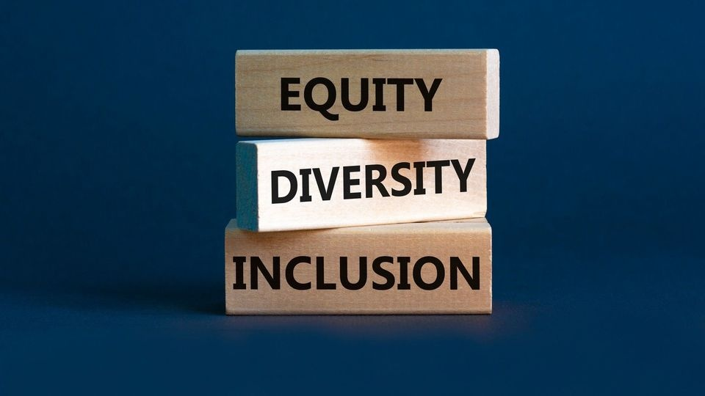
DIVERSITY-EQUITY-INCLUSION
D.E.I. is the framework which seeks to promote the fair treatment and full participation of all people.
Notes:
D.E.I. is the framework which seeks to promote the fair treatment and full participation of all people.
DEI refers to creating environment where everyone regardless their background, identity or circumstances feels valued, respected and supported.

Slide 4
DIVERSITY
Each person is unique!
It means embracing the range of human differences, including people’s beliefs, abilities, preferences, backgrounds, color, sex, values, gender expression and identities etc.
Notes:
Diversity involves recognizing and embracingthe range of human differences, including people’s beliefs, abilities, preferences, backgrounds, color, sex, values, gender expressionand identities etc.

Slide 5
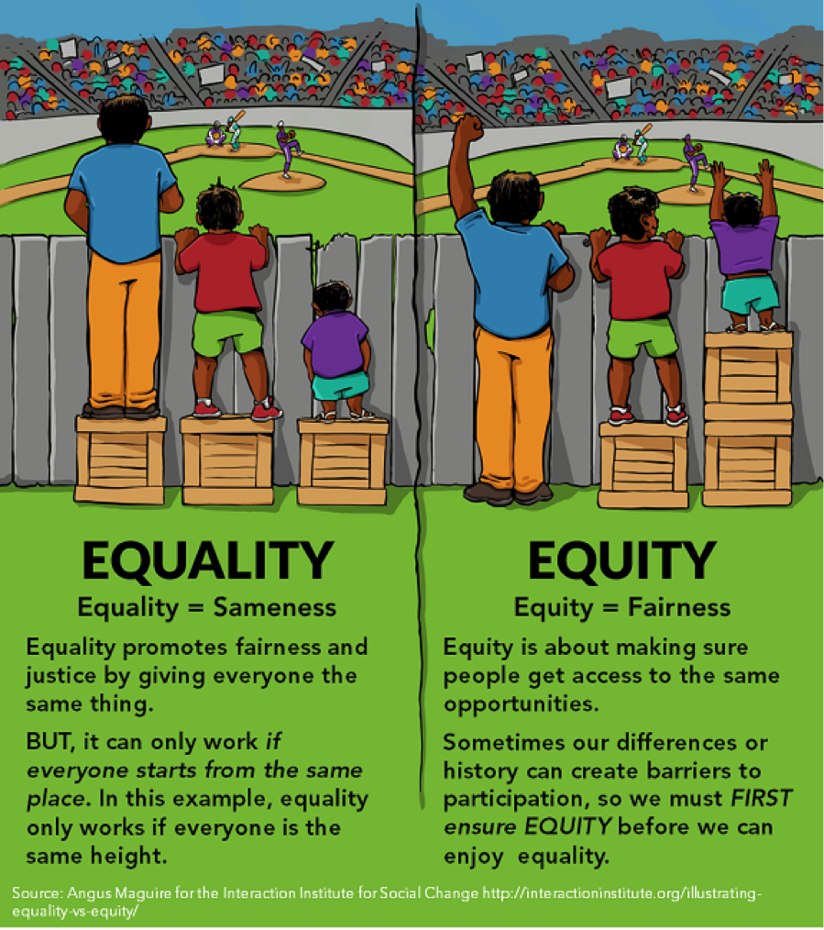
equity
Offering rights and opportunities fairly, this means catering to people’s differences, so they are given fair access to the opportunities.
Notes:
Equity focuses on ensuring fairness and impartially in rights and opportunities. This means catering to people’s differences, so they are given fair access to the opportunities.

Slide 6
Inclusion
All have the right to be included, respected and appreciated as equal and valuable numbers of the community.
Notes:
Inclusion aims to foster a sense of belonging and involvement of all.
All have the right to be included, respected and appreciated as equal and valuable numbers of the community.

Slide 7
Understanding DEI
Diversity, equity and inclusion are interconnected concepts that refer to the variety of unique individuals that make up a group of people and the environment that allows them to work together as equally valued contributors.
Notes:
Diversity, equity and inclusion are interconnected concepts that refer to the variety of unique individuals that make up a group of people and the environment that allows them to live or work together as equally valued contributors.

Slide 8
Importance OF DEI
DEI brings numerous benefits to organizations and society as a whole.
It contributes to a more equitable society by reducing discrimination and creating opportunities for all individuals to thrive.
It fosters innovation by bringing together diverse perspectives, increases employee engagement and satisfaction, enhances decision-making by considering a wider range of viewpoints.
DEI efforts have been proven to be safer, happier and more productive work environments.
Notes:
DEI brings numerous benefits to organizations and society as a whole. They contribute to a more equitable society by reducing discrimination and creating opportunities for all individuals to thrive.

Slide 9
BENEFITS OF DIVERSITY
Investing in a diverse workforce can deliver promising returns for businesses:
Increased innovation and creativity
Better decision-making
Higher recruitment
Notes:
Diverse teams brings together a wide range of perspectives, experiences and ideas, leading to innovative solutions and approaches.
Diversity enhance decision making processes by encouraging critical thinking considering multiple viewpoint
A commitment to diversity attracts a wider range of talent enabling organization to recruit and retain top performers

Slide 10
BENEFITS OF EQUITY
Businesses that cultivate equitable environments can enjoy major advantages:
Increase productivity and potential
Enhanced employee morale and satisfaction
Enhance reputation
Notes:
When people feel that their contributions are valued and rewarded fairly they are motivated top perform their best which leading to higher productivity and lower turnover rates.
Positive work environment where employees feel appreciated resulting in higher satisfaction.
More attractive to employees and investors enhance reputation and the competitive advantage in market place.This encourages the recruitment and retention of diverse talent.

Slide 11
BENEFITS OF INCLUSION
Developing inclusive workplaces can have lasting effects for employers
Increase employment engagement
Improve team work
Reduce turnover and absenteeism
Notes:
Less likely to experience burnout or absenteeism

Slide 12
Challenges and barriers
RESISTENCE TO CHANGE - NO ACTION
UNCONSCIOUS BIAS
LACK OF REPRESENTATION
TOKENISM
Notes:
-Fear of losing privileges, power or comfort
-lack of representation in leadership position can hinder progress
-Superficial efforts to promote diversity or token hiring

Slide 13
STRATEGIES FOR ADVANCING DEI
Education and training
Recruitment and hiring practices
Promotion and advancement
Continuous evaluation and improvement

Slide 14
CALL for ACTION
We all should get involved in prompting equity, diversity and inclusion in our spheres of influence!

Slide 15
Thank you for your attention..

