Slide 1

Understanding Environmental, Social and Governance (ESG)
A presentation about ESG investing

Slide 2
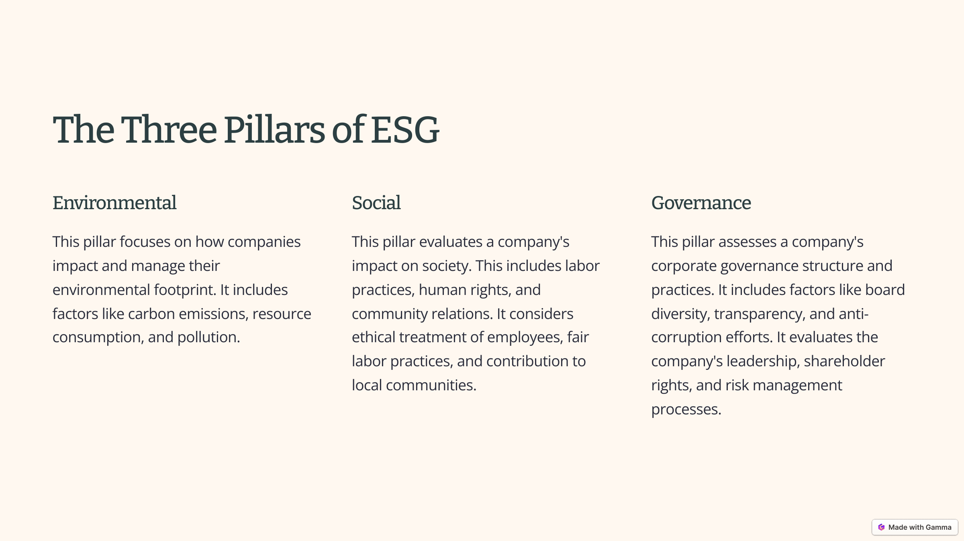

Slide 3
Environmental Factors in ESG
Renewable Energy
Emissions Reduction
Waste Management
Companies are increasingly investing in renewable energy sources like wind and solar power.
Reducing greenhouse gas emissions is a key environmental factor, with many companies setting targets and implementing initiatives.
Sustainable waste management and recycling practices are becoming increasingly important for businesses.
Water Conservation
Conserving water resources is crucial for companies operating in water-stressed areas.

Slide 4




Social Factors in ESG
Labor Standards
Human Rights
Companies are adopting fair labor practices, ensuring decent wages, safe working conditions, and fair treatment of employees.
Respecting human rights across the supply chain is a crucial social responsibility for businesses.
Community Engagement
Diversity and Inclusion
Companies are increasingly involved in their local communities, supporting social causes, and creating positive social impact.
Companies are promoting diversity and inclusion in their workplaces and fostering a culture of respect and equality.

Slide 5
Governance Factors in ESG
1
2
3
4
Board Independence
Transparency and Disclosure
Anti-Corruption Measures
Shareholder Rights
Having a board that is independent and accountable is crucial for good governance.
Respecting shareholder rights and providing clear communication with investors are essential for good governance.
Companies are expected to be transparent about their ESG performance and to disclose relevant information to stakeholders.
Companies should have robust anti-corruption policies and practices to ensure ethical conduct.

Slide 6







ESG Examples in Greece
National Bank
Piraeus Bank
Novartis Hellas Α.Ε.Β.Ε.
Athens Medical Group “HYGEIA” Α.Ε.
Lidl Hellas και ΣΙΑ Ο.Ε.
ION A.E.

Slide 7
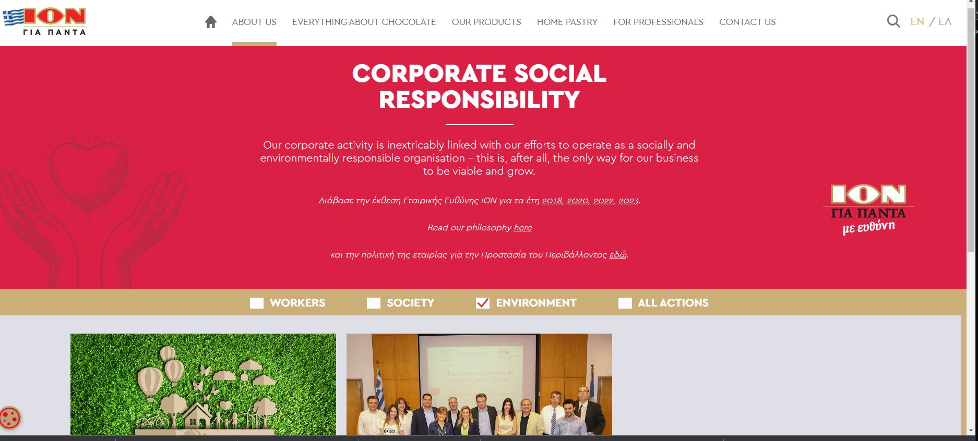

Slide 8
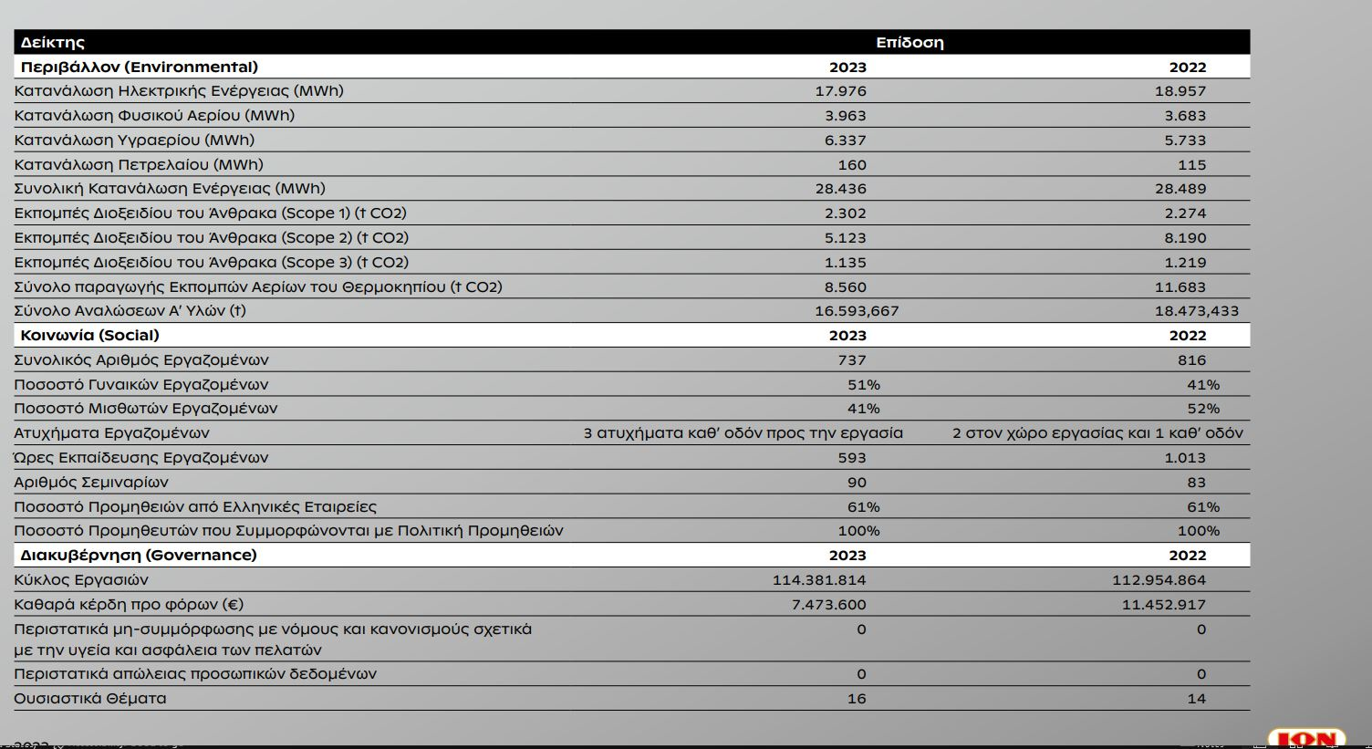

Slide 9
Challenges in Implementing ESG
1
2
3
Data Availability
Standardization
Greenwashing
A lack of consistent and reliable ESG data can make it difficult to assess company performance.
There are no universally accepted standards for ESG reporting and measurement, leading to inconsistencies.
Some companies may engage in greenwashing, claiming to be ESG-compliant when their practices are not truly sustainable.
4
Integration
Integrating ESG considerations into investment decisions can be challenging for traditional investment managers.

Slide 10
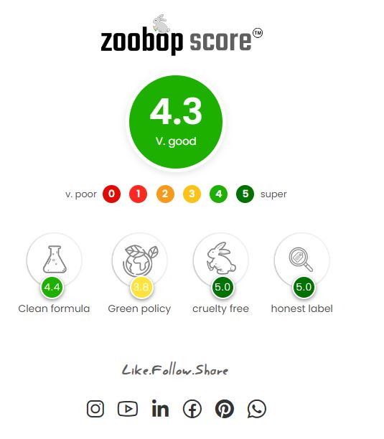
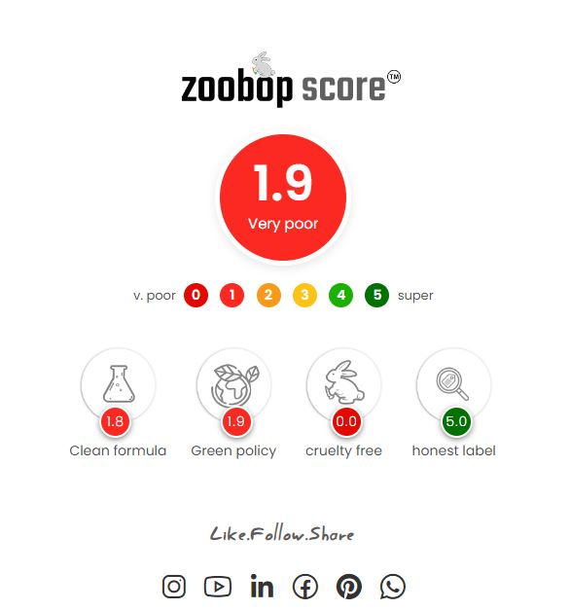

Slide 11
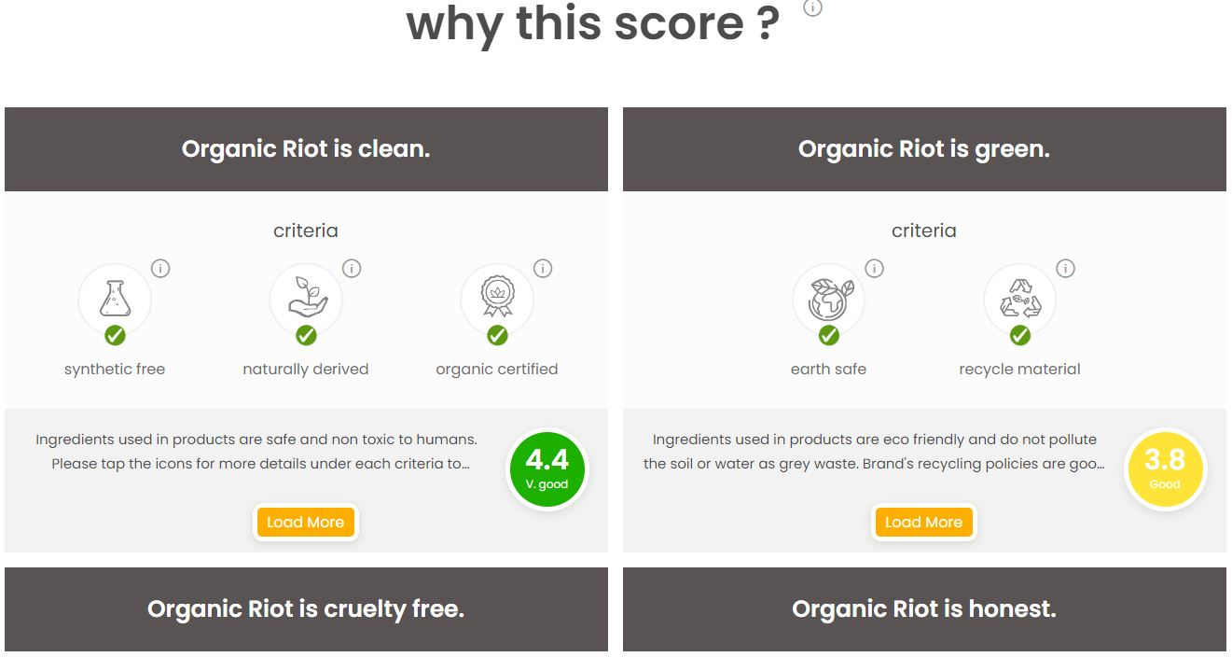

Slide 12
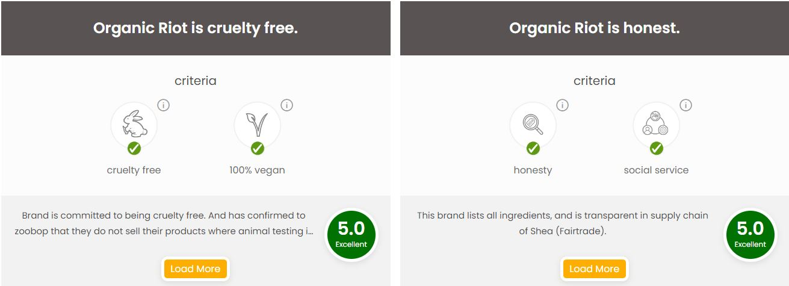

Slide 13
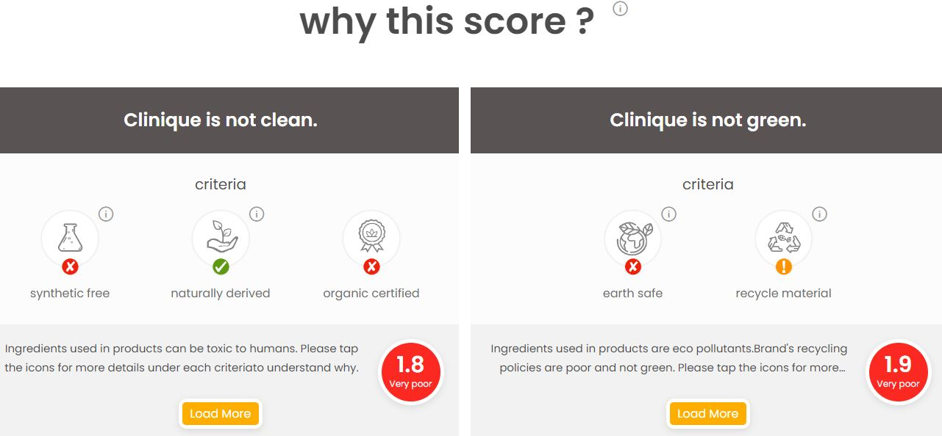

Slide 14
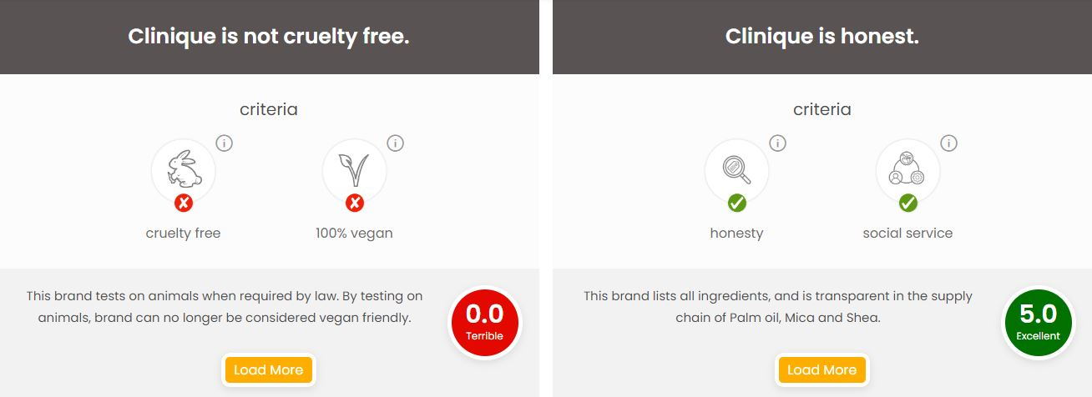

Slide 15
Sources
Σύνδεσμος Ελλήνων Βιομηχάνων, Εταιρική Υπευθυνότητα: Βιώσιμη ανάπτυξη στην πράξη, https://www.sev.org.gr/arthografia_mme/etairiki-ypefthynotita-viosimi-anaptyxi-stin-praxi/
Touro University Worldwide, The Importance of Leading a Sustainable Business, https://www.tuw.edu/business/leading-a-sustainable-business-2/
https://csrnews.gr/
https://www.ion.gr/en/eke-list?cat=64
https://www.zoobop.com/
https://gamma.app/

