Slide 1


The Strategic Role of Outdoor Experiential Learning
Cultivating Organizational Cohesion and Performance in the Modern Era

Slide 2

The Shift in Corporate Team Dynamics
Moving Beyond the Silos
Transition: Corporate structures are shifting from rigid, siloed hierarchies to fluid, collaborative networks.
The Necessity of "Team Spirit": In high-pressure and remote- work environments, a cohesive sense of unity and shared purpose is now a strategic necessity rather than a peripheral byproduct.
Evolution of Outdoor Learning: Outdoor team building activities have evolved from "corporate jollies" of the 1990s to evidence-based interventions rooted in environmental psychology and organizational theory.

Slide 3

Psychological Foundations
Why the Outdoor Activities Work
Authentication: Removing employees from the controlled, hierarchical environment of the office and place them in dynamic settings demands authentic interaction and mutual dependency.
Psychological Safety: Outdoor challenges create a "secure and respectful" environment where conflicts can be explored as differing perspectives rather than personal failures. In high-psychological-safety teams, members feel comfortable engaging in respectful disagreements without fear.
Leveling the Playing Field: Professional titles vanish when a manager and junior associate face the same physical challenge, such as a ropes course, fostering mutual respect.

Slide 4
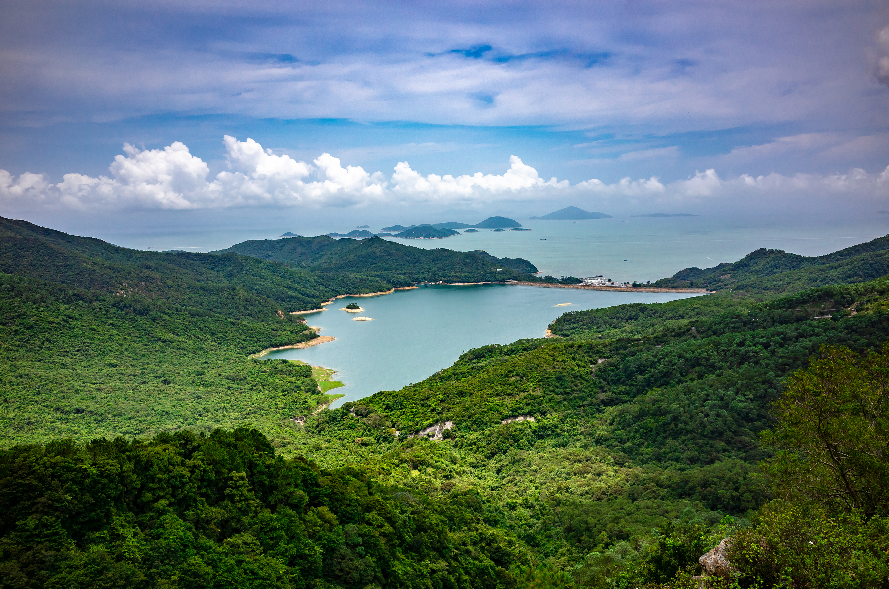
Environmental Psychology & Cognitive Recovery
Attention Restoration Theory (ART)
Combating Fatigue: Modern office environments demand constant "directed attention," leading to cognitive fatigue, increased stress, and "brain fog".
Nature’s Impact: Natural settings provide a "soothing contrast," triggering serotonin and endorphins while slashing cortisol (stress) levels.
Creative Reset: High "naturalness" in environments is proven superior for fostering creative performance. Employees can approach complex projects with innovative strategies.

Slide 5

Comparing Environments
Office vs. Outdoor Impact
Cognitive Process | Impact of Office Environment | Impact of Outdoor Environment | Organizational Outcome
Attention | Directed attention fatigue | Attention restoration | Improved focus and clarity
Stress Levels | High cortisol, mental fatigue | Reduced cortisol, serotonin boost | Enhanced Employee well-being
Problem Solving | Rigid, siloed thinking | Thinking "outside the box" | Innovative solutions
Interaction | Mediated by hierarchy/screens | Authentic, face-to-face connection | Increased psychological safety

Slide 6

Trust and Shared Stories From Abstract to Tangible
Mutual Dependency: Activities like scavenger hunt or ropes courses provide "trust signals" that a colleague is reliable and supportive.
Collective Confidence: Overcoming controlled risks together builds a shared story and a "collective confidence" that translates back to the office as a greater willingness for collaboration.
Empathy: Informal settings allow "new sides" of colleagues to emerge—such as a quiet employee might shine as a strategist or a senior leader might show vulnerability.

Slide 7


Historical Evolution Timeline of Team Building
1920s–1940s (Origins): a) The "Hawthorne Effect": productivity improved not because of physical changes, but because workers felt seen, supported, and part of a cohesive team (social and emotional factors are primary drivers of business performance). b) Kurt Hahn’s Outward Bound training: In 1941, Hahn, the father of "experiential education", helped launch the first Outward Bound school in Wales. The program was designed to train British sailors not just in physical skills, but in the "will to survive" through camaraderie.
1980s–1990s (The "Corporate Jolly"): Focus on unstructured fun rewards and morale (e.g. raft building).
2000s–2010s (Strategic Learning & Development): Emphasis on a “return on investment” (ROI), business simulations, and measurable outcomes.
2020s–Present (Holistic & Hybrid Approach): Focus on well-being, sustainability, and tech-enhanced inclusion.

Slide 8

Global Trends for 2025 The "Glow-Up" of Outdoor Activities
Sustainable Adventure: Eco-retreats focusing on "regenerative tourism" (e.g. beach clean-ups or urban gardening or building schools for local communities). This shift aligns team building with Corporate Social Responsibility (CSR).
Wellness-Infused Challenges: Influence of Gen Z has led to "mindfulness tasks," forest-bathing, and outdoor yoga. Having witnessed parental burnout, 70% of Gen Z employees prioritize flexibility and mental health support.
Technology -Enhanced & Hybrid Models: Use of "AppMazing Races" (GPS-based), Virtual Reality (VR) missions, and AI-powered simulations for remote, “out of town” employees.

Slide 9

The Greek Corporate Sector A Premier Destination for Team Building
High Adoption: Over 500 companies utilize outdoor programs in Greece. This includes a broad spectrum of industries, ranging from technology to pharmaceuticals and banking, including Google, Pfizer, Eurobank, and Coca-Cola HBC etc.
Popular Activities and Local Settings: Athens and its surrounding regions serve as a vibrant setting for these activities:
- Cultural Quests: "The Battle of the Gods" in Athens. - Beach Olympics: Coordination games on the Athenian Riviera.
- Urban Adventures: Street art and food challenges in
Plaka and Monastiraki
Thematic Focus: This thematic approach helps teams connect with the local culture while discovering "undiscovered parts of their own selves".

Slide 10


Pros and Cons Analysis Balancing Benefits and Risks
Key "Pros":
Silo Breaking: Mixing departments in outdoor tasks replaces stereotypes with real relationships.
Leadership Discovery: Outdoor scenarios often reveal "real leadership" traits in unexpected employees.
Employee Retention: Shared wins and "shared stories" create a sense of belonging. When employees feel the company invests in humans, their pride and loyalty increase.
Key "Cons":
Risk of Exclusion: This is the most significant drawback. Physical "heroics" may alienate introverts or those with physical limitations.
"Forced Fun": Mandatory activities can cause resentment and disrupt work-life balance (e.g. holding events outside of work hours can disrupt family time).
Financial and Time Investment: High-quality team building requires a significant investment of both money and time away from core tasks

Slide 11

Strategies for Success
Align Activity with Team Maturity: Planners should use models like Tuckman’s Stages of Group Development (Forming, Storming, Norming, Performing) to select appropriate interventions.
The Crucial Debrief: Use models like SBI (Situation-Behavior-Impact) to translate what happened on the trail into habits that improve office performance.
Inclusivity and "Universal Design: Ensure "Everyone Plays, No More Spectators" by offering tiered difficulty and multiple roles (strategist, builder, storyteller).

Slide 12

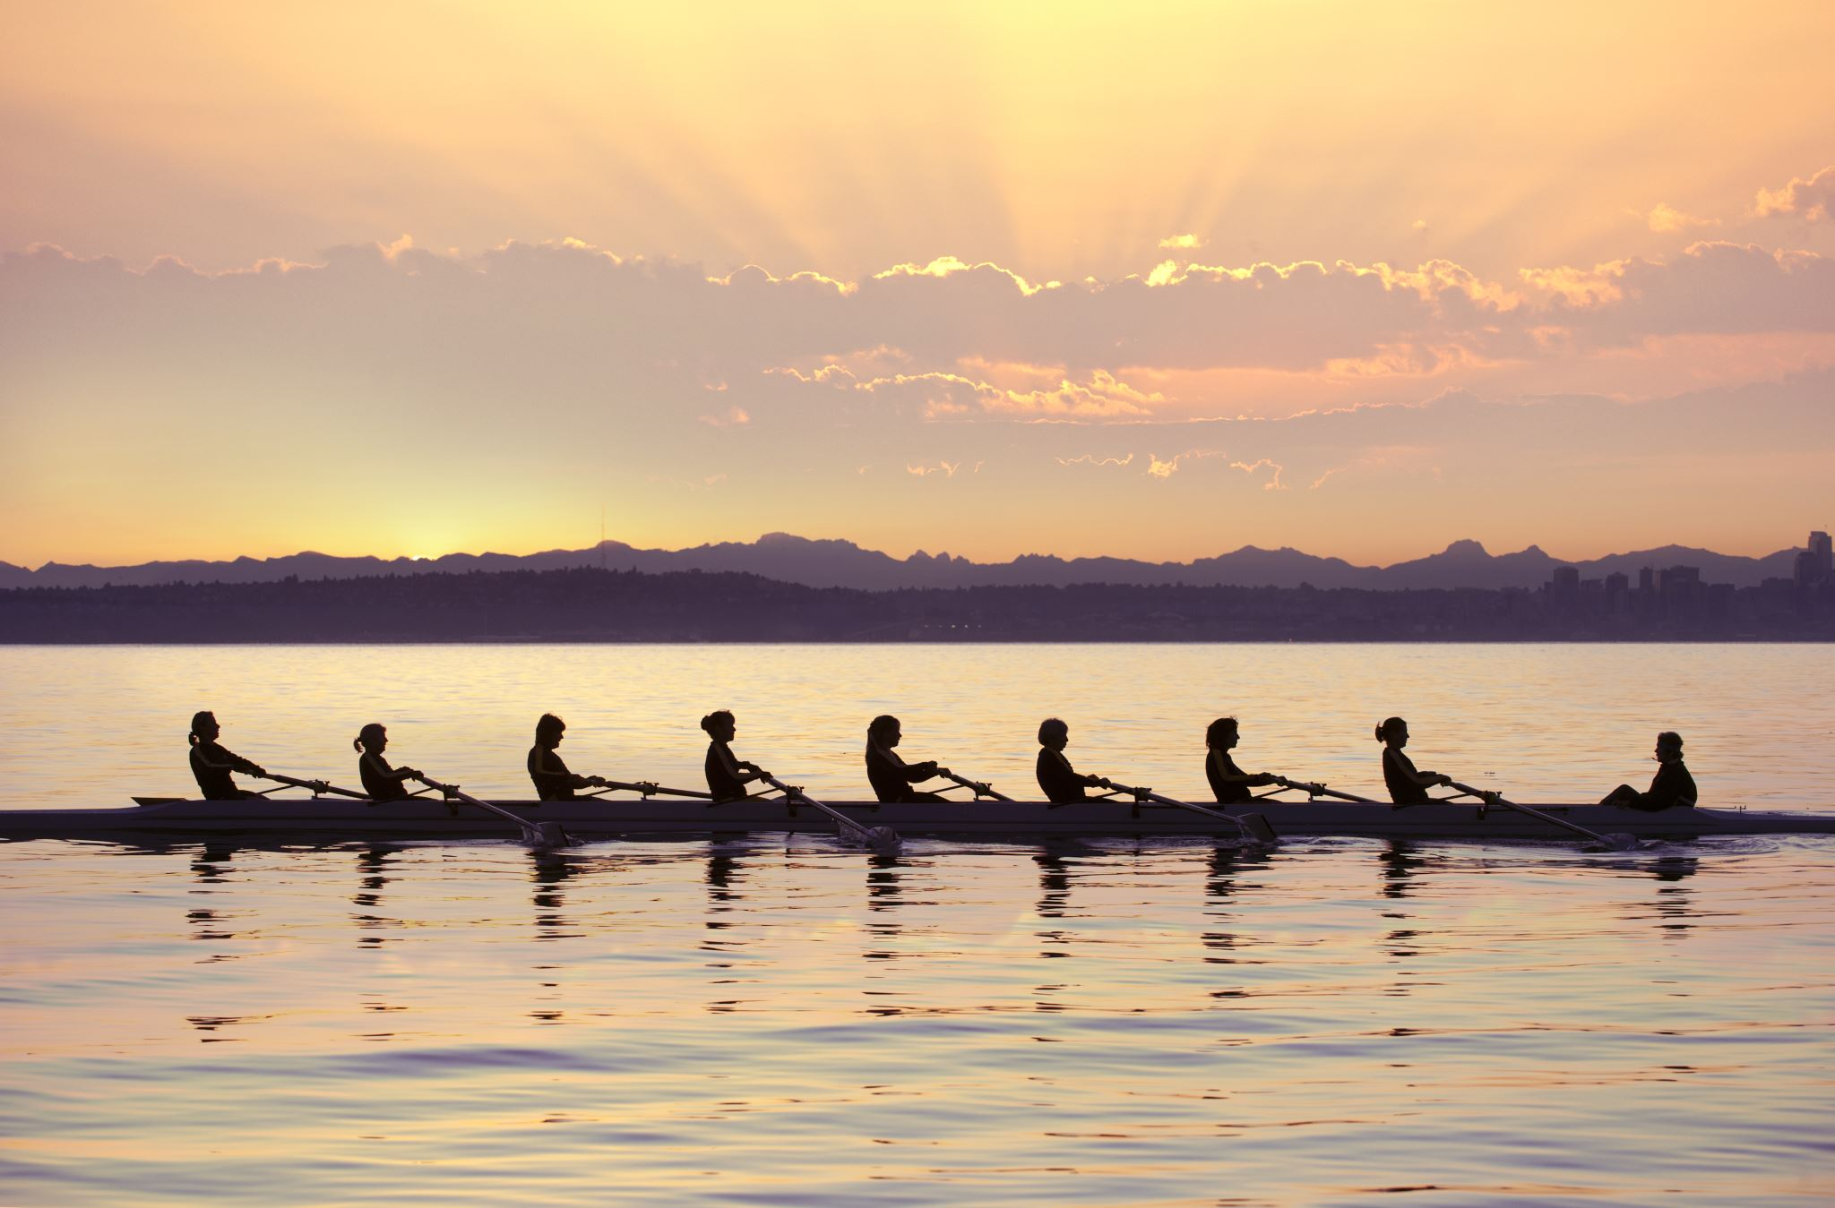
Relationship Quality: A company's greatest asset is the quality of relationships between its employees. 2025 and Beyond: Success hinges on personalized experiences, sustainability, and inclusivity. The Catalyst: When executed with purpose, inclusivity, and professional facilitation, outdoor team building transforms individuals into a resilient, innovative and spirited team.
Conclusion & Future Outlook

