Slide 1
ARTIFICIAL RECHARGE OF THE UNDERGROUND KARSTIC AQUIFER IN FARSALA AREA (THESSALY, CENTRAL GREECE)
NATIONAL AND KAPODISTRIAN UNIVERSITY OF ATHENS
FACULTY OF GEOSCIENCES
DEPARTMENT OF DYNAMIC, TECTONIC AND APPLIED GEOLOGY
Introduction
Water Shortage in Western Thessaly
Phases of the Research
The karstic aquifer of Phylliion Mt.
Prospects for artificial recharge
Suggested works
Conditions for the protection of the aquifer system
Conclusions
MARIOLAKOS I., FOUNTOULIS I., SPYRIDONOS E., MARIOLAKOS D., ANDREADAKIS EM.
TUCSON, ARIZONA
JUNE 2001

Slide 2
Introduction
National
Kapodistrian
University of
Athens
The area of Farsala (Thessaly) is a representative case of overexploitation of groundwater resources, leading to the continuous exhaustion of the grained, as well as the karstic aquifers.
The Hellenic Ministry of Agriculture appointed the University of Athens to examine the possible solutions to the problem.
The application of the internationally accepted method of artificial recharge on the karstic aquifer was decided to be the most effective for the restoration of balance of the hydrogeological system.
Deep knowledge of the details of the geological structure and the hydrogeological conditions of the area was necessary for the success of the method, whose planning was done within the framework of environmental protection and sustainable development.
State-of-the-art technology and estimation of all the parameters involved, have been taken into account.
Introduction
Water Shortage in Western Thessaly
Phases of the Research
The karstic aquifer of Phylliion Mt.
Prospects for artificial recharge
Suggested works
Conditions for the protection of the aquifer system
Conclusions

Slide 3
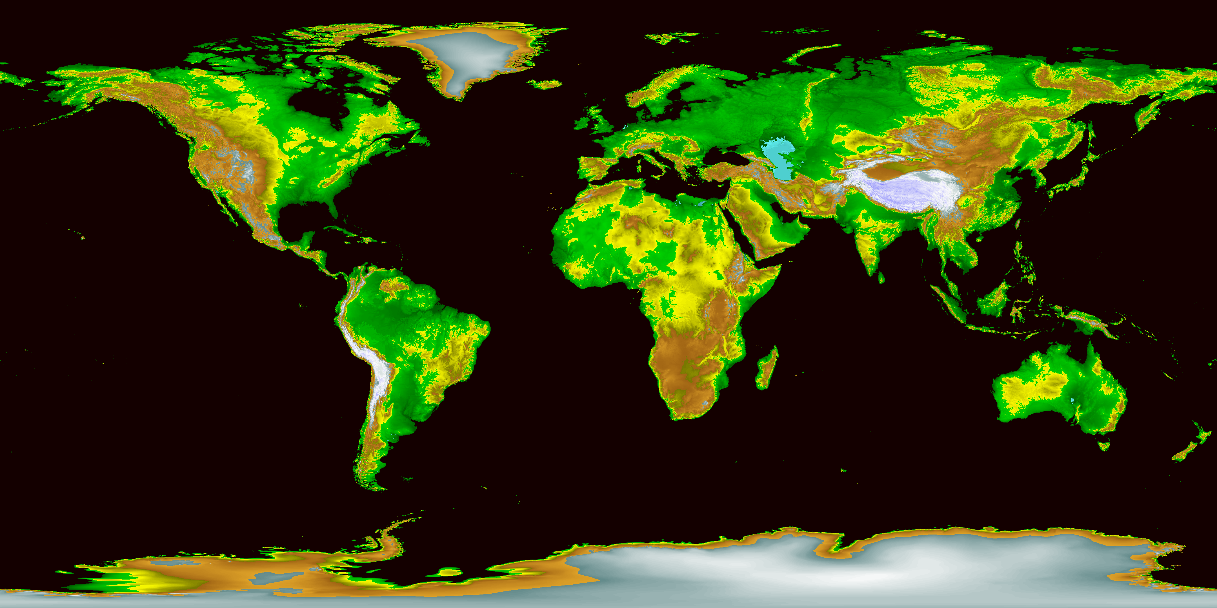
Introduction
National
Kapodistrian
University of
Athens
Introduction
Water Shortage in Western Thessaly
Phases of the Research
The karstic aquifer of Phylliion Mt.
Prospects for artificial recharge
Suggested works
Conditions for the protection of the aquifer system
Conclusions

Slide 4
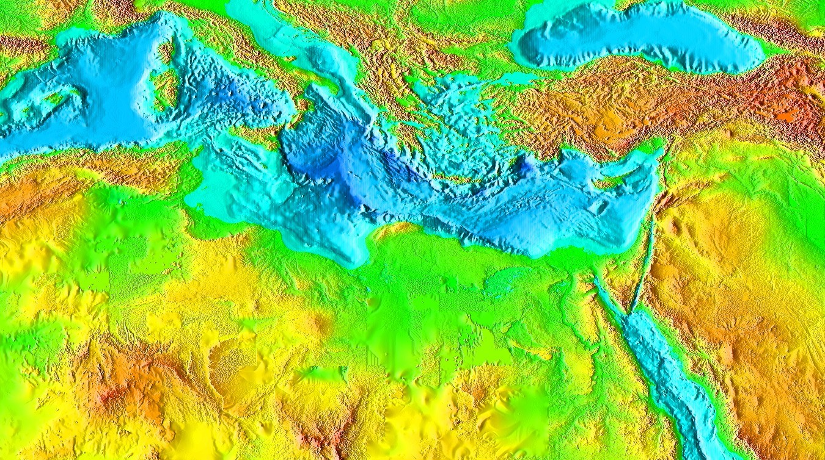
Introduction
National
Kapodistrian
University of
Athens
Introduction
Water Shortage in Western Thessaly
Phases of the Research
The karstic aquifer of Phylliion Mt.
Prospects for artificial recharge
Suggested works
Conditions for the protection of the aquifer system
Conclusions

Slide 5
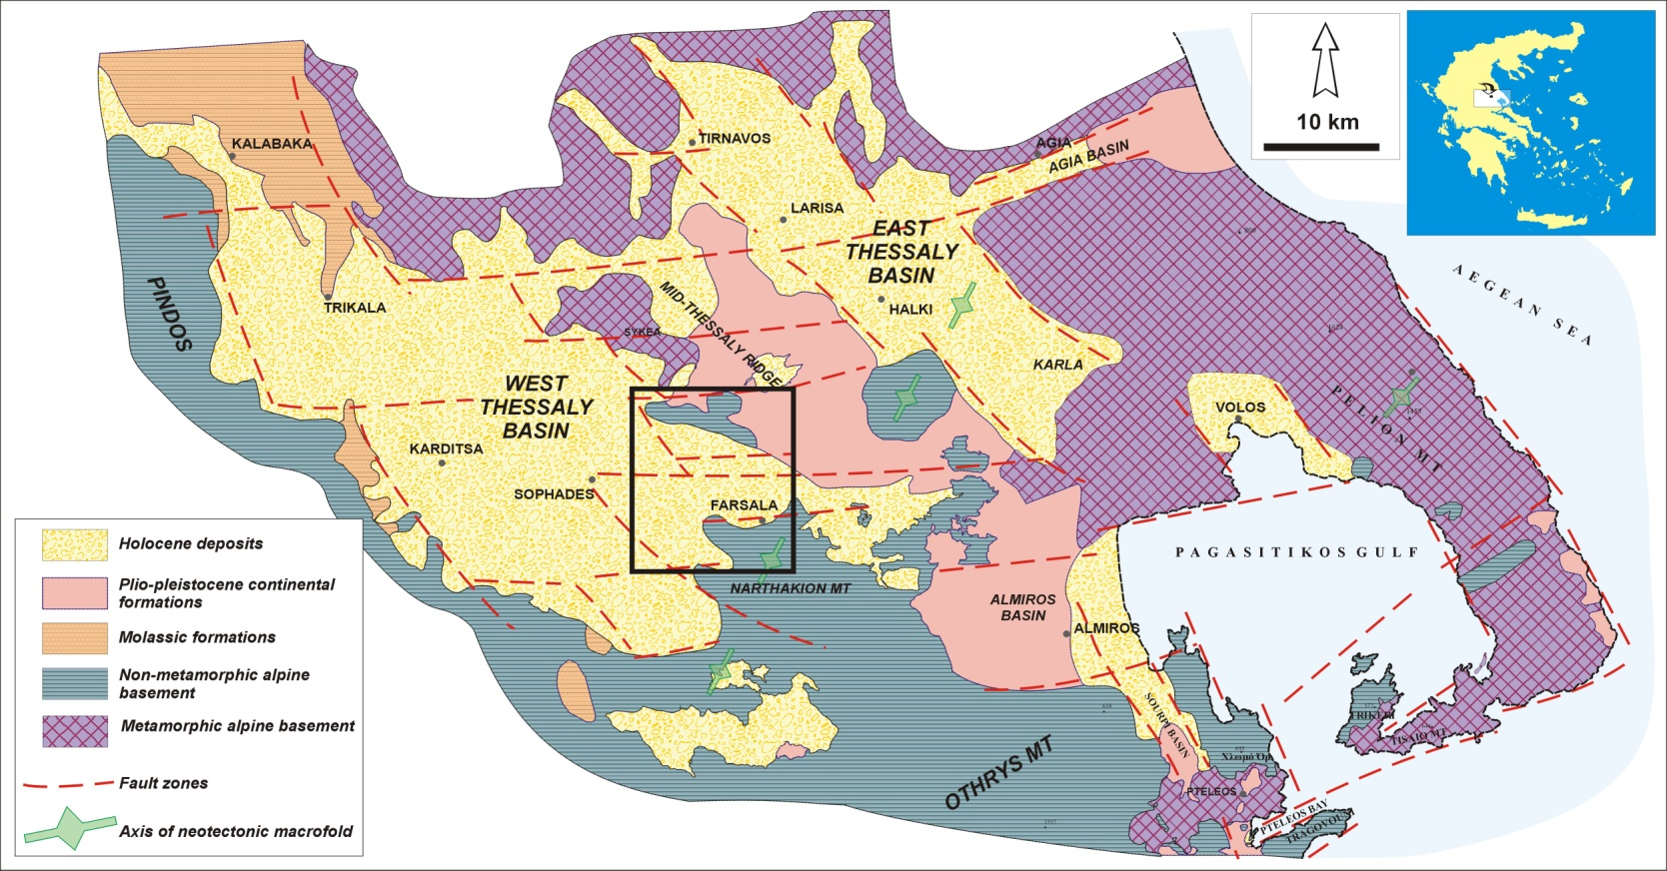
Introduction
National
Kapodistrian
University of
Athens
Introduction
Water Shortage in Western Thessaly
Phases of the Research
The karstic aquifer of Phylliion Mt.
Prospects for artificial recharge
Suggested works
Conditions for the protection of the aquifer system
Conclusions
The research team of the University of Athens, conducted a large scale research for more than two years, before proposing to the Hellenic Ministry of Agriculture, the method of artificial recharge as a solution to the water shortage of Farsala area.

Slide 6
Water Shortage in Western Thessaly
National
Kapodistrian
University of
Athens
Introduction
Water Shortage in Western Thessaly
Phases of the Research
The karstic aquifer of Phylliion Mt.
Prospects for artificial recharge
Suggested works
Conditions for the protection of the aquifer system
Conclusions
Water table level has been dropping off rapidly in the aquifers of the study area, because of their overexploitation. In the diagram, the yearly drop is shown (measured in August).

Slide 7
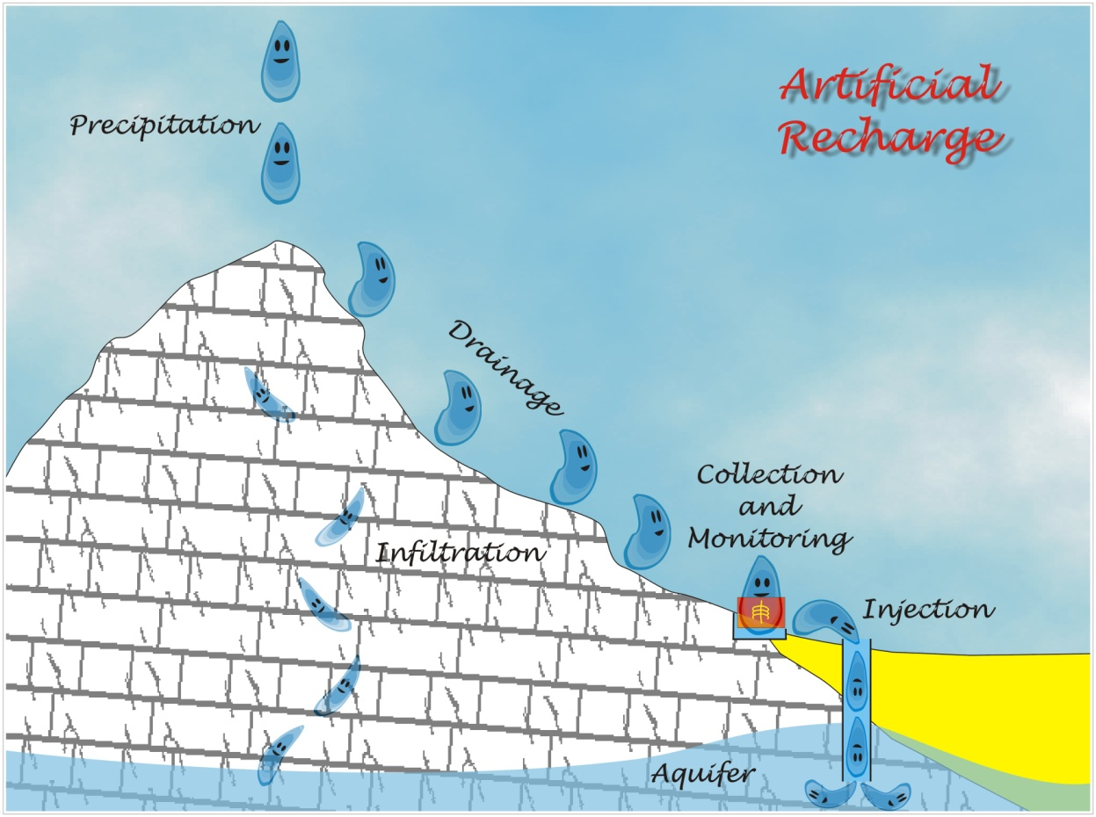
Phases of the Research
National
Kapodistrian
University of
Athens
Artificial recharge of karstic aquifers may be a simple idea, but in fact, it requires a very thorough and interdisciplinary research, so that the method can be applied safely and with positive prospects.
Introduction
Water Shortage in Western Thessaly
Phases of the Research
The karstic aquifer of Phylliion Mt.
Prospects for artificial recharge
Suggested works
Conditions for the protection of the aquifer system
Conclusions

Slide 8
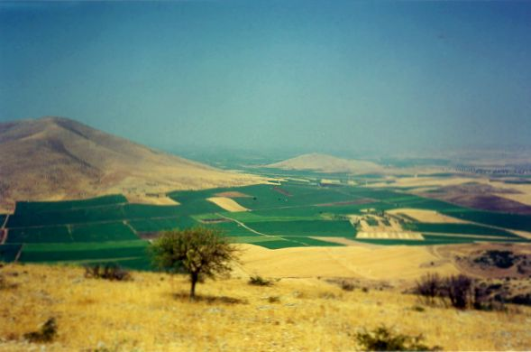
Phases of the Research
National
Kapodistrian
University of
Athens
Introduction
Water Shortage in Western Thessaly
Phases of the Research
The karstic aquifer of Phylliion Mt.
Prospects for artificial recharge
Suggested works
Conditions for the protection of the aquifer system
Conclusions
View of the north part of the study area.

Slide 9
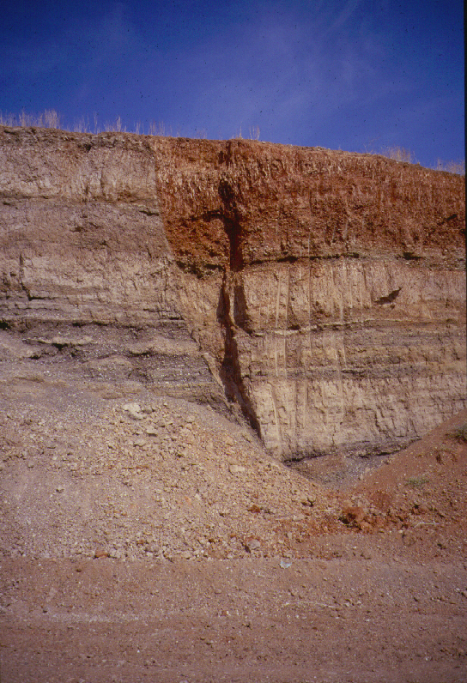
Phases of the Research
National
Kapodistrian
University of
Athens
Introduction
Water Shortage in Western Thessaly
Phases of the Research
The karstic aquifer of Phylliion Mt.
Prospects for artificial recharge
Suggested works
Conditions for the protection of the aquifer system
Conclusions
Hidden faults like this were discovered in the plains of the study area, during the interpretation of geological, hydrogeological and geophysical data.

Slide 10
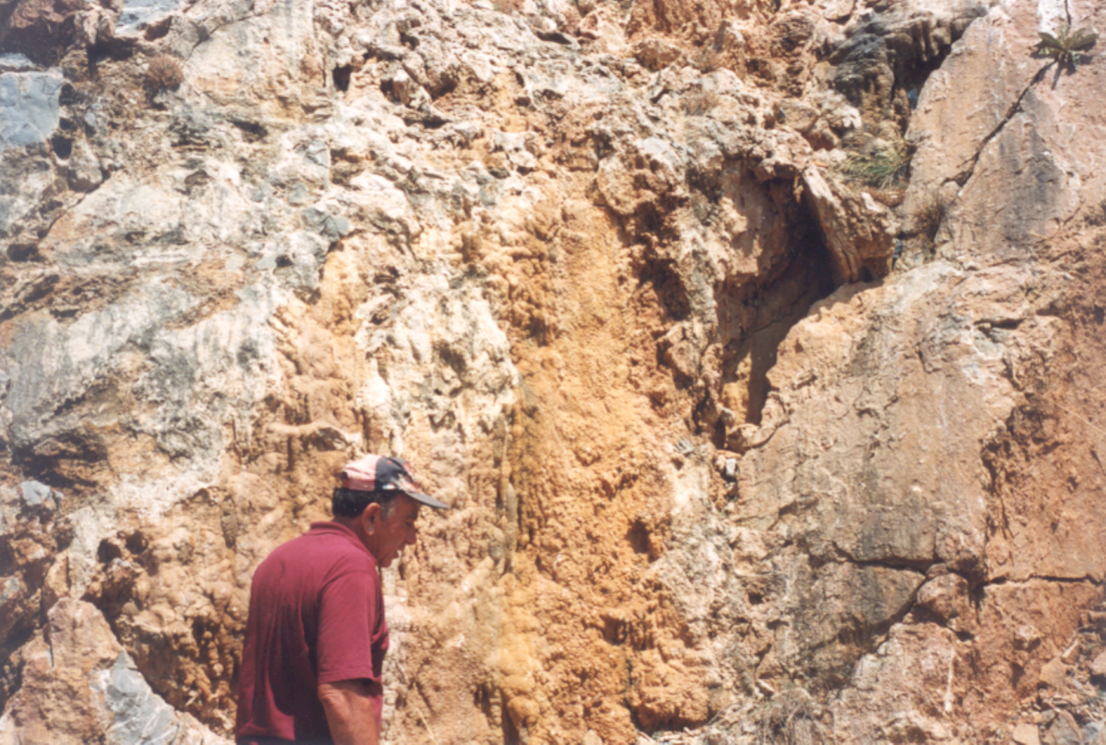
Phases of the Research
National
Kapodistrian
University of
Athens
Introduction
Water Shortage in Western Thessaly
Phases of the Research
The karstic aquifer of Phylliion Mt.
Prospects for artificial recharge
Suggested works
Conditions for the protection of the aquifer system
Conclusions
Fieldwork - Mapping - Tectonic Analysis. Karst develops preferably along tectonic surfaces like faults and thrusts.

Slide 11
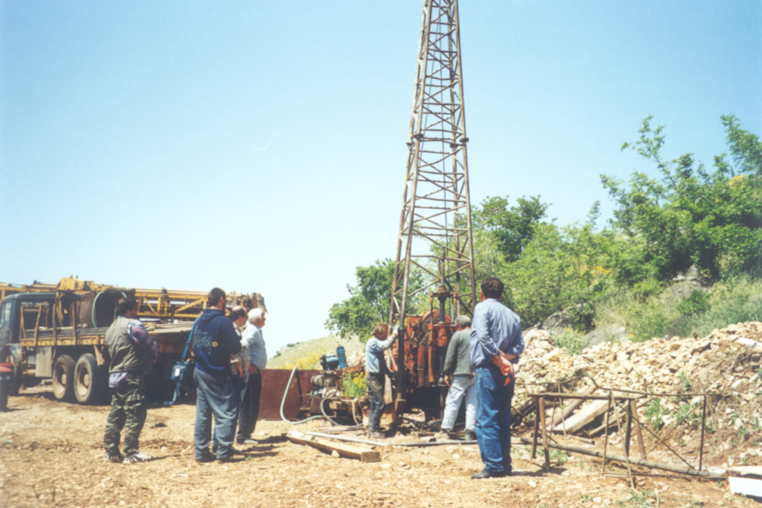
Phases of the Research
National
Kapodistrian
University of
Athens
Introduction
Water Shortage in Western Thessaly
Phases of the Research
The karstic aquifer of Phylliion Mt.
Prospects for artificial recharge
Suggested works
Conditions for the protection of the aquifer system
Conclusions
Sampling and observation wells in the study area. Monitoring of the seasonal fluctuation of the water table and estimation of the karst development in depth.

Slide 12
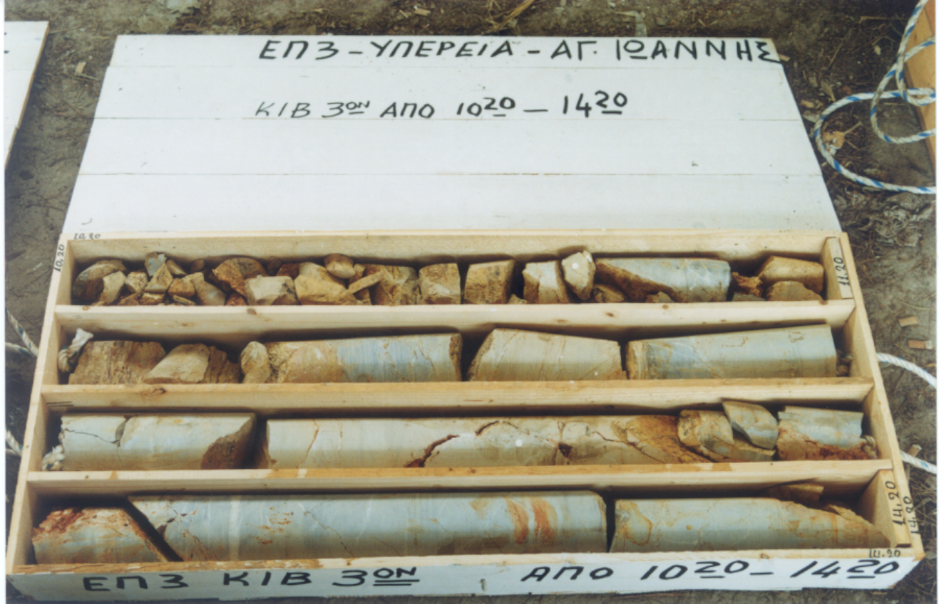
Phases of the Research
National
Kapodistrian
University of
Athens
Introduction
Water Shortage in Western Thessaly
Phases of the Research
The karstic aquifer of Phylliion Mt.
Prospects for artificial recharge
Suggested works
Conditions for the protection of the aquifer system
Conclusions
Thorough examination of the sample cores.

Slide 13
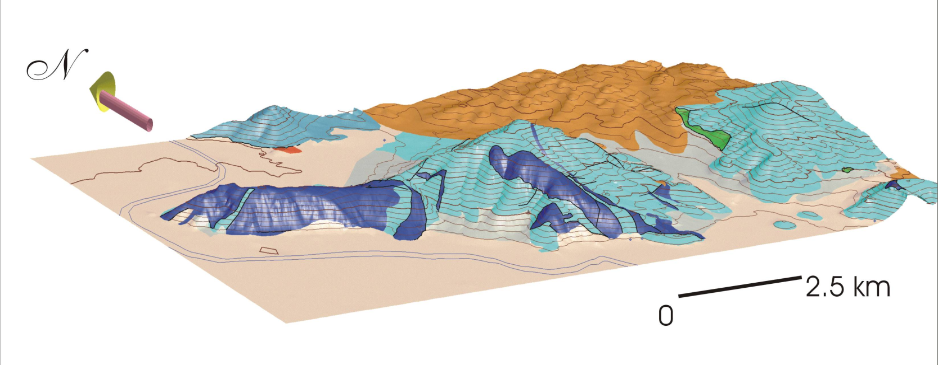
Phases of the Research
National
Kapodistrian
University of
Athens
Introduction
Water Shortage in Western Thessaly
Phases of the Research
The karstic aquifer of Phylliion Mt.
Prospects for artificial recharge
Suggested works
Conditions for the protection of the aquifer system
Conclusions
Tri-dimensional geological model of Phylliion mountain. Apart from that, the research team simulated the 3D geometry of the geological structure, as well as the geometry of the karstic aquifer.

Slide 14
Phases of the Research
National
Kapodistrian
University of
Athens
Introduction
Water Shortage in Western Thessaly
Phases of the Research
The karstic aquifer of Phylliion Mt.
Prospects for artificial recharge
Suggested works
Conditions for the protection of the aquifer system
Conclusions
Annual fluctuation of the water table in the wells around Phylliion mountain (December 1997-December 1998).

Slide 15
Phases of the Research
National
Kapodistrian
University of
Athens
Introduction
Water Shortage in Western Thessaly
Phases of the Research
The karstic aquifer of Phylliion Mt.
Prospects for artificial recharge
Suggested works
Conditions for the protection of the aquifer system
Conclusions
The drainage of the river should not be disturbed during the summer (dry) period, during the months May to September. Instead, the surplus of the wet period can provide large quantities of water.

Slide 16
Phases of the Research
National
Kapodistrian
University of
Athens
Introduction
Water Shortage in Western Thessaly
Phases of the Research
The karstic aquifer of Phylliion Mt.
Prospects for artificial recharge
Suggested works
Conditions for the protection of the aquifer system
Conclusions
Quality control of the river water before the experimental injection. According to the European legislation, this water is suitable for irrigation purposes.

Slide 17
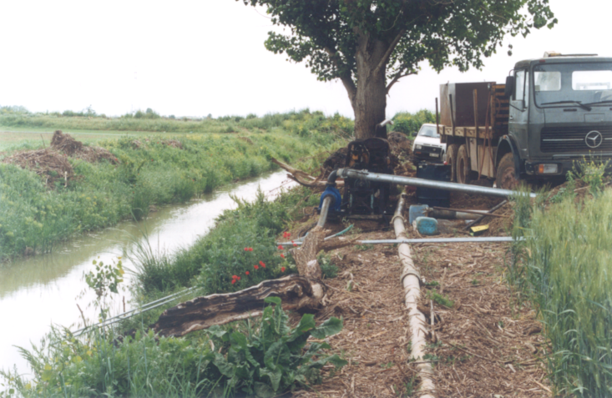
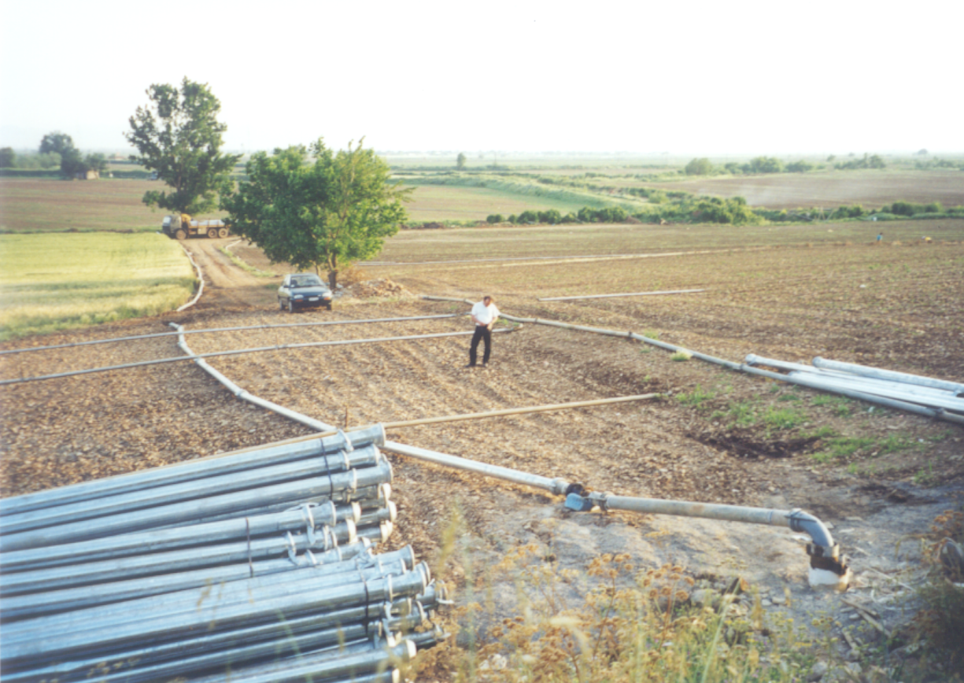
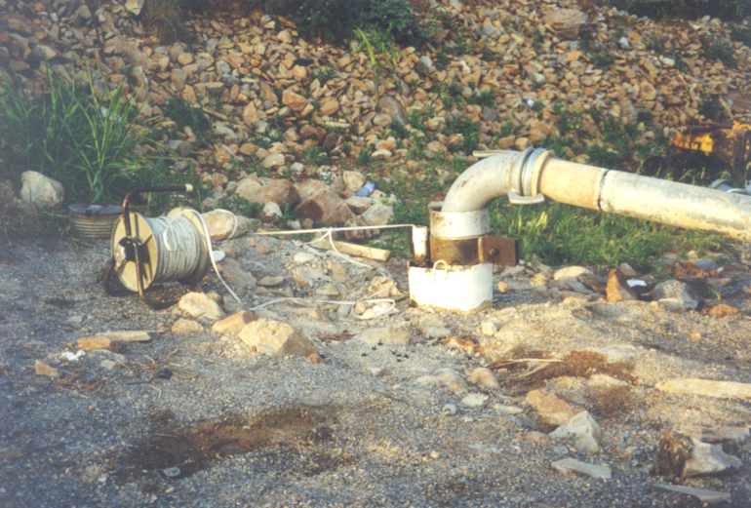
Phases of the Research
National
Kapodistrian
University of
Athens
Introduction
Water Shortage in Western Thessaly
Phases of the Research
The karstic aquifer of Phylliion Mt.
Prospects for artificial recharge
Suggested works
Conditions for the protection of the aquifer system
Conclusions
Experimental pumping from Enipeas River and injection into the karstic aquifer.

Slide 18
The karstic aquifer of Phylliion Mt.
National
Kapodistrian
University of
Athens
The present groundwater level of the karstic aquifer at the Phylliion Mt is fluctuating several tens of meters below the level of the springs of Mikro Vouno, where the aquifer used to discharge before the overexploitation took place.
The objective of the calculations was to approach with accuracy
the volume of water represented by this level drop and stands for the water deficiency that needs to be replaced, as well as
the potential of Enipeas River towards this direction.
Introduction
Water Shortage in Western Thessaly
Phases of the Research
The karstic aquifer of Phylliion Mt.
Prospects for artificial recharge
Suggested works
Conditions for the protection of the aquifer system
Conclusions

Slide 19
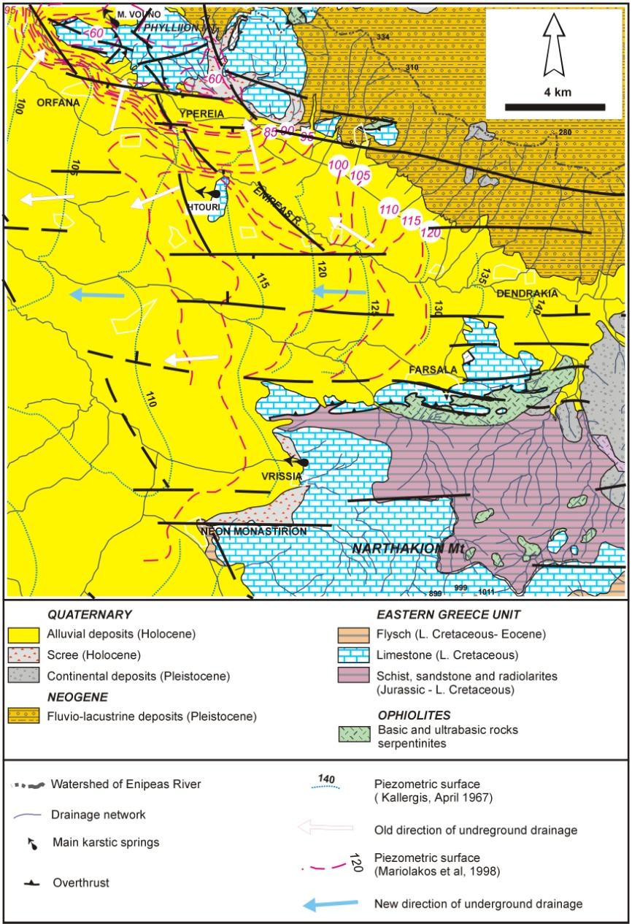
The karstic aquifer of Phylliion Mt.
National
Kapodistrian
University of
Athens
Introduction
Water Shortage in Western Thessaly
Phases of the Research
The karstic aquifer of Phylliion Mt.
Prospects for artificial recharge
Suggested works
Conditions for the protection of the aquifer system
Conclusions
Hydrogeological map of the study area.

Slide 20
The karstic aquifer of Phylliion Mt.
National
Kapodistrian
University of
Athens
Regarding the hydrogeological system of Phylliion Mt. the following conclusions have been extracted:
The limestone mass of Phylliion Mt., together with the smaller mass of Htouri hill to the south, represent two isolated karstic tanks, which under normal conditions are connected to the aquifer that develops in the unconsolidated post alpine material.
The development of springs west of Htouri hill and north of Phylliion (Mikro Vouno) is the result of the altitudinal difference of the free surface of the unconsolidated material on either side of the limestone masses, in combination with the sudden water velocity reduction at the front of the substratum contact between the limestone and the granular material.
Introduction
Water Shortage in Western Thessaly
Phases of the Research
The karstic aquifer of Phylliion Mt.
Prospects for artificial recharge
Suggested works
Conditions for the protection of the aquifer system
Conclusions

Slide 21
The karstic aquifer of Phylliion Mt.
National
Kapodistrian
University of
Athens
At Htouri hill, under normal conditions water flows from the east through the unconsolidated aquifer and discharge to the west, while the same phenomenon is observed at Phylliion mt., but with a south towards north direction.
Practically, the two limestone masses are just two open tanks of high water conductivity that intercalate in the continuous underground draining of the plain surface through the unconsolidated aquifer.
The charging quantities of the karstic aquifers are mainly controlled by the unconsolidated aquifer and in a smaller scale by the atmospheric precipitation.
Before overexploitation, the piezometry of the unconsolidated aquifer presented a double function. During the dry period the aquifer was charged by the karstic aquifer, due to the use of water from the post-alpine table, while during the wet period the karstic aquifer was replenished by the unconsolidated aquifer.
Introduction
Water Shortage in Western Thessaly
Phases of the Research
The karstic aquifer of Phylliion Mt.
Prospects for artificial recharge
Suggested works
Conditions for the protection of the aquifer system
Conclusions

Slide 22
The karstic aquifer of Phylliion Mt.
National
Kapodistrian
University of
Athens
Today, taking into account the disturbance of this balance and the fact that the water loss in the karstic aquifer is not replaced but increases annually, its double function and the charging route from the karstic aquifer towards the unconsolidated aquifer has stopped, as we are going through a period of low water supply.
The replacement of the Phylliion karstic tank supplies is expected to restore the reverse flow direction towards the unconsolidated aquifer (this time during the wet period where the recharge will take place), from the moment that the level in the limestone will reach the level of the unconsolidated aquifer and until the operation of the Mikro Vouno springs is restored. This fact will have as a result the reduction of the rate of rise of the water table in the limestone, since the inflowing quantities will also have to cover the loss within the unconsolidated aquifer.
Introduction
Water Shortage in Western Thessaly
Phases of the Research
The karstic aquifer of Phylliion Mt.
Prospects for artificial recharge
Suggested works
Conditions for the protection of the aquifer system
Conclusions

Slide 23
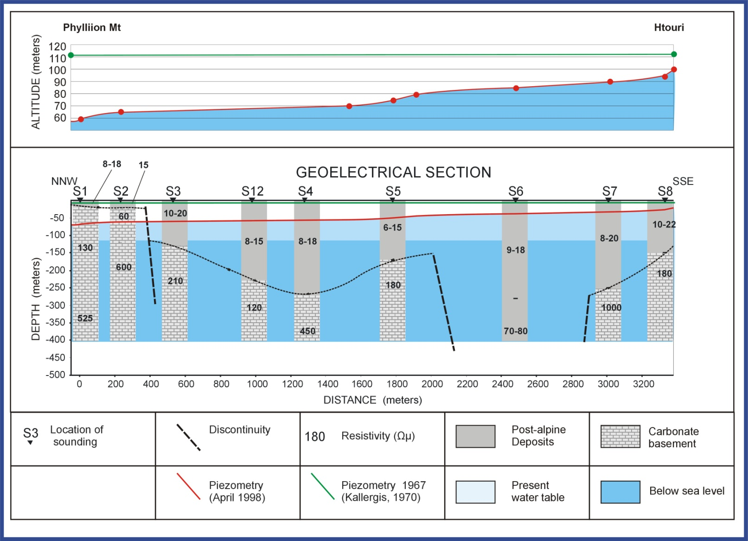
The karstic aquifer of Phylliion Mt.
National
Kapodistrian
University of
Athens
Introduction
Water Shortage in Western Thessaly
Phases of the Research
The karstic aquifer of Phylliion Mt.
Prospects for artificial recharge
Suggested works
Conditions for the protection of the aquifer system
Conclusions

Slide 24
Prospects for Artificial Recharge
National
Kapodistrian
University of
Athens
Taking into account Agenda 21 (Rio) and mainly the point that every human attempt of intervention to the various physicogeological systems must keep within the frames of sustainable development, the management of the problem and the application of the calculations in relation to the quantities of Enipeas River that could be used for artificial re-charge, should follow the next pattern:
In any case, the charging of Enipeas should not be disturbed during the summer (dry) period, during the months May to September. During these months the charge of Enipeas is less than 1m³/sec at the Dendrakia measuring station.
During the wet period water should be extracted only when the river charge is greater than 1m³/sec.
Introduction
Water Shortage in Western Thessaly
Phases of the Research
The karstic aquifer of Phylliion Mt.
Prospects for artificial recharge
Suggested works
Conditions for the protection of the aquifer system
Conclusions

Slide 25
Prospects for Artificial Recharge
National
Kapodistrian
University of
Athens
The necessary quantities for the recharge can be seen in the following table, and by the comparison to the useful supplies of Enipeas River, it is clear that the available quantities are sufficient for the balancing of the annual increase of the deficiency of the karstic aquifer and for its gradual counterbalance of the total deficiency.
Introduction
Water Shortage in Western Thessaly
Phases of the Research
The karstic aquifer of Phylliion Mt.
Prospects for artificial recharge
Suggested works
Conditions for the protection of the aquifer system
Conclusions
Storability(%) | Volume of voids (water deficiency) between boundary levels (million m³) |  | Mean annual increase of deficiency (million m³) | Mean annual infiltration of lime-stones (million m³) | Expected annual charge by the unconsolidated aquifer (million m³) | Annual available water quantities by Enipeas (million m³)
 | +102m -+65m | +65m -+38m
4.22 | 27.2 | 25.6 | 2.1 | 4.5 | 19.0 | Mean | 16.7

Slide 26
Suggested Works
National
Kapodistrian
University of
Athens
For the selection of the appropriate method and the design of the artificial recharge works in the specific area, the following factors have been taken into account:
The geological – tectonic – neotectonic structure and evolution of the area.
The karstification of the carbonate formations.
The geometry of the deep karstic aquifers and mainly those that develop west of the imaginary line between Htouri and Yperia.
The fact that the karstified limestone of Phylliion Mountain has a lateral hydraulic connection with the underground karstic aquifers.
The fact that the lateral and underground karstified aquifers are hydraulically connected to the unconsolidated aquifers.
Introduction
Water Shortage in Western Thessaly
Phases of the Research
The karstic aquifer of Phylliion Mt.
Prospects for artificial recharge
Suggested works
Conditions for the protection of the aquifer system
Conclusions

Slide 27
Suggested Works
National
Kapodistrian
University of
Athens
For the recharge, part of the winter discharge of Enipeas River will be used. The main works will be as follows:
Small retaining dam at the watercourse of the river. From this point the water will be directed straight to the precipitation basin.
Precipitation basin that will have such dimensions in order to cover the supplies that are going to be used for the recharge.
Transport channels from the precipitation basin to the recharge location through which the free from suspended material water in the precipitation basin will be directed through a channel to a rest tank.
Rest tank, which can be a well of relatively small depth.
Access tunnel within the limestone, which must have a crosscut of at least 3m x 3m and initial length of 30m and a dip allowing the movement of special vehicles, such as small drilling vehicles, vehicles carrying excavation material, vehicles for filter cleaning etc.
Wells within the access tunnel that will be constructed every five meters and will have small dimensions (1mx1mx1m).
Piezometers with 100m mean depth in various locations around the supply area for the monitoring of the aquifer response to the recharge.
Automatic digital recording and transmission stations of the qualitative and quantitative characteristics of the water for the recharge at the point of supply and uphill and downhill of this point.
Introduction
Water Shortage in Western Thessaly
Phases of the Research
The karstic aquifer of Phylliion Mt.
Prospects for artificial recharge
Suggested works
Conditions for the protection of the aquifer system
Conclusions

Slide 28
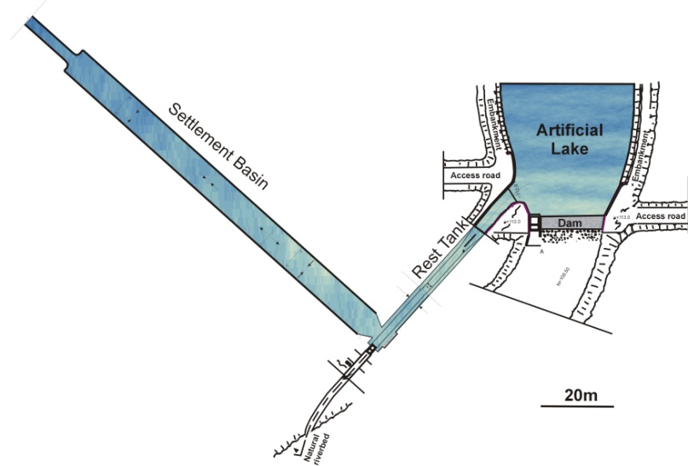
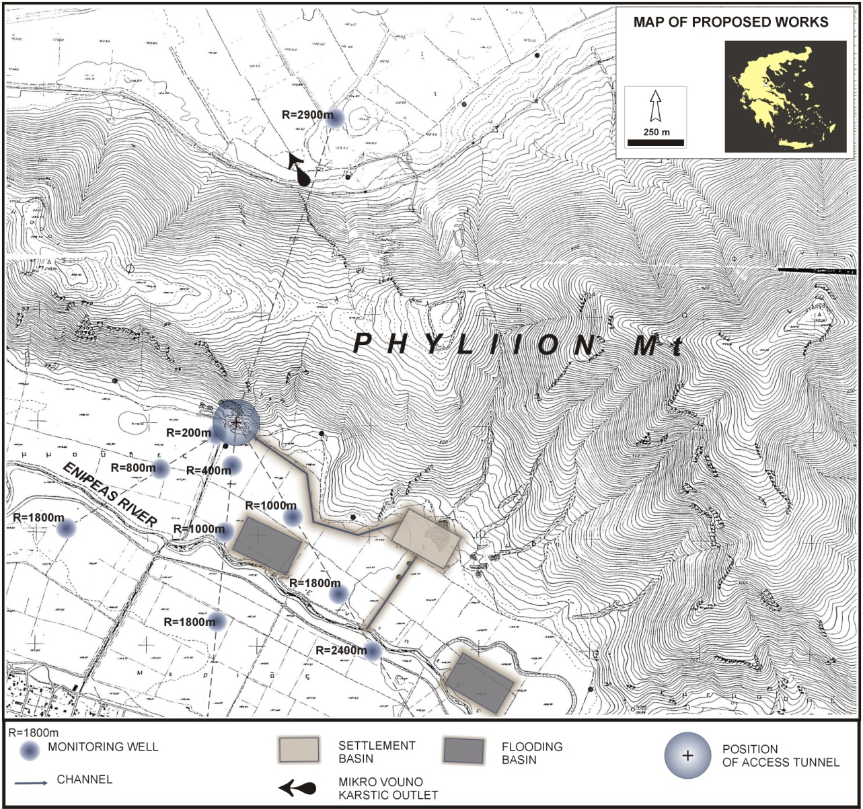
Suggested Works
National
Kapodistrian
University of
Athens
Introduction
Water Shortage in Western Thessaly
Phases of the Research
The karstic aquifer of Phylliion Mt.
Prospects for artificial recharge
Suggested works
Conditions for the protection of the aquifer system
Conclusions
General map of the suggested works for the artificial recharge (right) and part of the suggested works for the artificial recharge in detail (above).

Slide 29
Conditions for the protection of the aquifer system
National
Kapodistrian
University of
Athens
The recharge of the karstic aquifer is not to be done in expense of the natural recharge of the unconsolidated aquifer. The volume and the quality of Enipeas water that will reach the lowlands of the interest areas should not affect negatively the existing eco-systems and hydrogeological conditions.
Therefore, a necessary condition for the operation of the project, together with the construction of the recharge works, is the installation and the equipment of certain monitoring stations and measurements with autographic instruments, for the parameters that it is technologically possible. At those stations there will be continuous monitoring of the supply and the level of Enipeas, continuous analysis of specific pollutants in order to avoid recharge with polluted water, and measurements of the solid load of Enipeas.
In the downhill station the continuous monitoring of the supply and the level of Enipeas will record any losses from the recharge location until this point.
Finally, the piezometry must be perimetrically and systematically monitored in the recharged karstic and unconsolidated aquifer in various locations from the recharge location.
When the measurements exceed specific crucial limits for the supply, the pollutants and the solid load, the recharge will automatically be interrupted until the end of the unfavourable conditions.
Introduction
Water Shortage in Western Thessaly
Phases of the Research
The karstic aquifer of Phylliion Mt.
Prospects for artificial recharge
Suggested works
Conditions for the protection of the aquifer system
Conclusions

Slide 30
Conclusions
National
Kapodistrian
University of
Athens
According to the calculations and the obtained data, the mean yearly amounts that can be received from Enipeas River in the future, in order to recharge the underground aquifer and the micro-permeable aquifer, is far more than 6.3 million m³ per year.
This means that the potential of the underground aquifers in the greater area of Yperia - Orfana basin can increase by at least 6.3 million m³ per year, without disturbing the natural recharge.
Introduction
Water Shortage in Western Thessaly
Phases of the Research
The karstic aquifer of Phylliion Mt.
Prospects for artificial recharge
Suggested works
Conditions for the protection of the aquifer system
Conclusions

Slide 31
Conclusions
National
Kapodistrian
University of
Athens
It is clear that the available quantities are sufficient for the balancing of the annual increase of the deficiency of the karstic aquifer and for its gradual counterbalance of the total deficiency.
Introduction
Water Shortage in Western Thessaly
Phases of the Research
The karstic aquifer of Phylliion Mt.
Prospects for artificial recharge
Suggested works
Conditions for the protection of the aquifer system
Conclusions

Slide 32
References
National
Kapodistrian
University of
Athens
Kallergis, G., Morphis, A., Papaspyropoulos, Ch., Christodoulou, Th. 1973. Hydrogeological survey of West Thessaly basin. IGME. Hydrological and hydrogeological syrveys. 8:166.
Mariolakos I., Fountoulis I., Spyridonos E., Andreadakis Emm., 2001. A holistic methodology for sustainable water management in karstic circum-mediterranean regions, 10th Biennial Symposium on the Artificial Recharge of Groundwater, Tucson, AZ, (in this vol.).
Mariolakos I., Fountoulis I., Spyridonos E., Badekas, I., Andreadakis Emm., 2000. Geometry of groundwater table in Narthakion Mt (Thessaly) as a result of neotectonic deformation. 1st Panhell. Congr. Ass. Hellen. Hydrotech. Union, Athens:343-350.
SOGREAH GRENOBLE, 1974. Study for the development of groundwater in the Thessaly plain, Final report. R 11971. Hellenic Ministry of Agriculture, Gen. Dir. Hydrol..
Introduction
Water Shortage in Western Thessaly
Phases of the Research
The karstic aquifer of Phylliion Mt.
Prospects for artificial recharge
Suggested works
Conditions for the protection of the aquifer system
Conclusions

