Slide 1
Socio-Cultural Aspects in Multilingual Texts:
English Education for Chinese Young Learners

Slide 2
Abstract
Introduction
Role of Teachers
Cultural Shock
English in China
Teaching Strategy
Potential Meaning

Slide 3
Introduction
English education is now compulsory in most regions of China. With the enforcement of the official document in 2001, early English education is gradually on the upsurge in China.
The official document identifies early English education as an important action to promote the development of cultural diversity and social cohesion and to bring a sense of national identity.

Slide 4
European Policy for Learning
Chinese Policy for Learning
In Europe, some countries, e.g. Malta, Norway, Belgium (German-speaking community), Germany (Baden-Württemberg), Italy and Austria, set out the government's policy framework on foreign language education, in which the first foreign language is compulsory from age one.
Government intents to develop English education from the third grade of primary education (between 9 and 11) throughout China except some specific region where Russian and Japanese education were traditionally regarded as the first foreign language education.

Slide 5
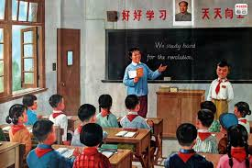
English Boom
A great boom in English education in China has been accompanied by large claims for English teachers even though it is sometimes considered that the primary and natural educator of the child is the family.

Slide 6
Sufficient contact time is necessary in language education. Chinese parents try their best to make their children taught as young as possible.
The average time of learning increases due to lowered starting-ages in China. Even though sometimes the increase of absolute time develops the language skill, the young pupils feel under very high overburden pressure.
English Learning Trend

Slide 7
Parental pressure advances English education further in China. It is acknowledged that parental pressure in mainland is one of the key factors to foster the expansion of English education.
Parental Pressure

Slide 8
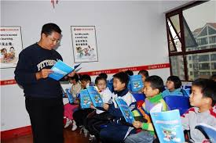
For the Future
If English at school is to be dropped, some people will worry over the ability of the students and over whether they are able to hold their own in the jungle of career-making since modern economies place a premium on educated employees who need retain a thirst for knowledge of English.

Slide 9
Role of Teachers
The principle of empty vessel, as a traditional one, is created to serve English teaching in China. According to empty vessel principle, the young learners are considered to be empty vessels.
Good principles should focus on both aims for and reasons behind.

Slide 10
Positive feedback is helpful for students. The praise from the teachers can enhance the attractiveness of English and boost students' self-esteem, which will bring the sense of pride and joy for learners.

Slide 11
Chinese educators encourage the students apply what they have learned in classroom in settings outside of school. If young learners cannot appropriately apply the linguistic knowledge to real situation and real world, the ultimate goal of learning policy fails to be achieved.

Slide 12
An effective educator can support students to achieve their ultimate goals.
As a good teacher, you have to help the students understand the cultural difference and avoid the cultural shock.
Cultural Focus

Slide 13
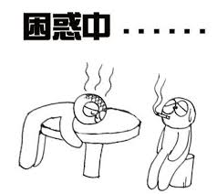
Cultural Shock
Chinese and European students are influenced by their respective cultures and the foreign language learning is obviously the competition and combination of the native language and alien language.

Slide 14
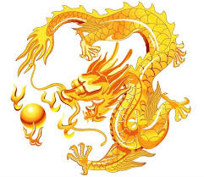
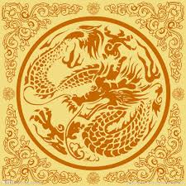
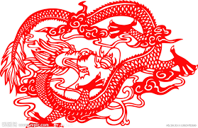
The Potential Meaning of Animal Words
Dragon is a totem in China rather than an evil animal in Europe.
Only the Emperor or the King can be called the son of great dragon.
The common persons in ancient time mustn't use the design related to dragon.

Slide 15
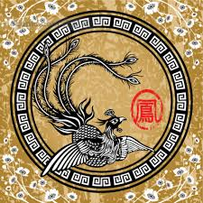
Phoenix
Phoenix is another holy animal in China.
Just as dragon is generally used to show hearty good wishes to man, phoenix is applied to offer earnest prayers to woman.

Slide 16
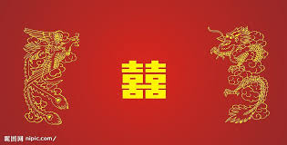
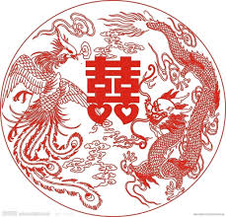
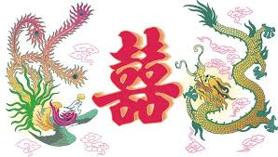
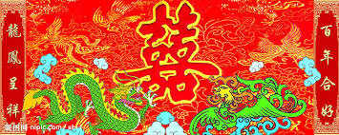
Dragon and Phoenix
for Bride and Groom
Chinese dragon and phoenix are considered to be a pair of holy animals.
People provide the goods with the symbols of dragon and phoenix to bride and groom to bless them on the wedding day.

Slide 17
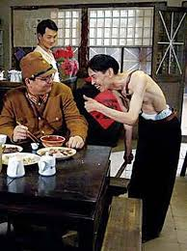
Dirty Dog
In Chinese culture, a person who always remains entirely subservient to his boss or the purple robe of power with a servile attitude is called a dog.
A few Chinese people who served Japanese invaders in second world war are called Running Dogs, which means they have lost their Chinese spirits and traditional faith just like a running dog begging for a bone.

Slide 18
Tigress, a female tiger, is a negative word for a woman who has short temper.
If a woman’s nature is fiery and impetuous, she obviously brings considerable pressure to the people surrounding her.
Tigress

Slide 19
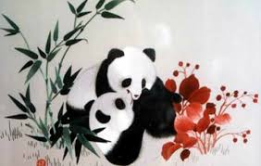
Color Words
Chinese culture is closely related to different colors. With the help of color, people express their hidden feeling. The wrong choice for the right color obviously brings embarrassment to you.

Slide 20
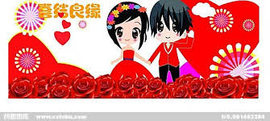
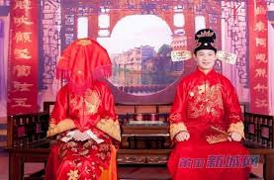
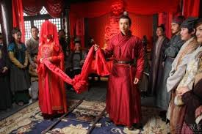
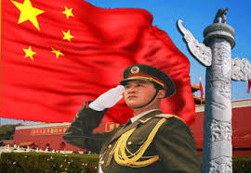
Red
Red in China is the symbol of good wishes or happiness.
In Chinese traditional wedding, it is common to see the bride wears the red coat, red skirt, red shirt, red socks, red shoes and even red underwear.

Slide 21
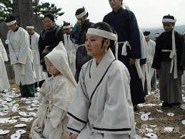
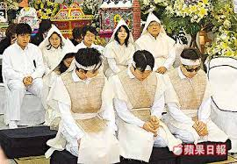
White
White is closely related to death in China.
The traditional funeral for the dead is called “white affairs".
The children or grandchildren of the dead are asked to wear the white traditional linen robes and white hat, and to cry for the dead.

Slide 22
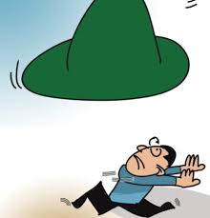
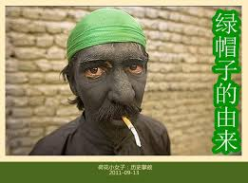
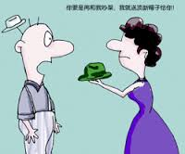
Green
A husband whose wife was not virtuous and committed adultery will be given a “Green Hat” by people.
He will be laughed or ridiculed for he is wearing a “shining green hat on the head”.

Slide 23
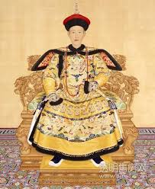
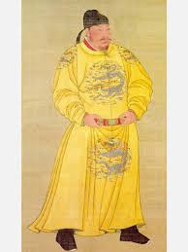
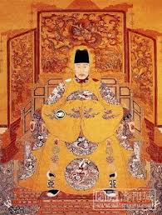
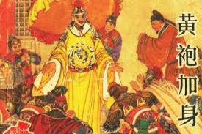
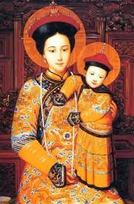
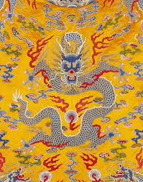
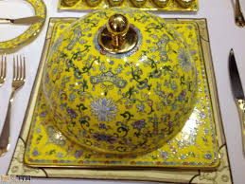
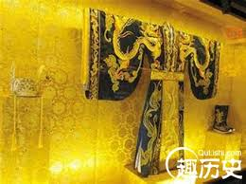
Yellow
Only the emperors or the family of emperors have the right to wear the yellow clothes, use the yellow porcelain, and enjoy the palace with yellow roofs.
Yellow has the same color with gold, and therefore, it represents wealth and power.

Slide 24
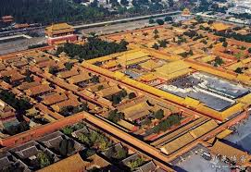
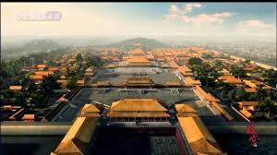
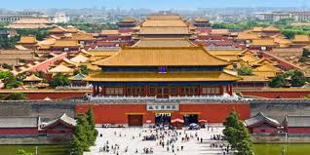
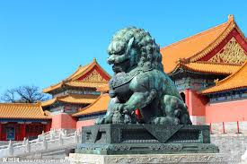
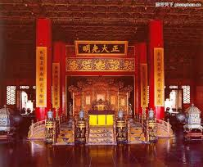
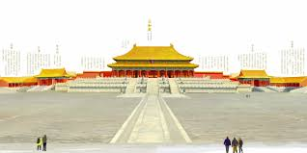
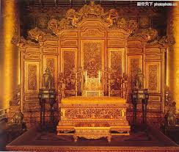
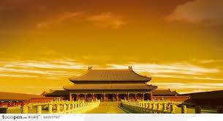
Forbidden City for Emperors

Slide 25
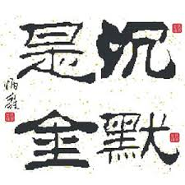
Silence =Gold
Keeping silence all the time shows your modesty, and speaking aloud leads to your pride.
Most Chinese students keep silence in classroom because they think being silence is the symbol of humility and modest, and speaking loudly to express their feelings is self pride.

Slide 26
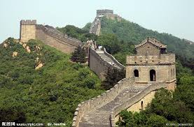
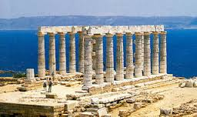
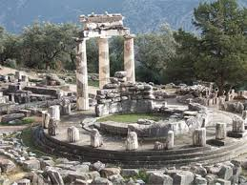
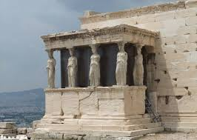
Conclusion
Cultural shock can be resolved by respect and admiration to alien cultures.
The basic function of language education is to help students establish clear and certain individual and national identity.

Slide 27
Thank you!

