Slide 1
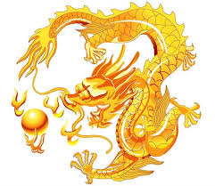
Die Chinesischen Schriftzeichen
Struktur

Slide 2
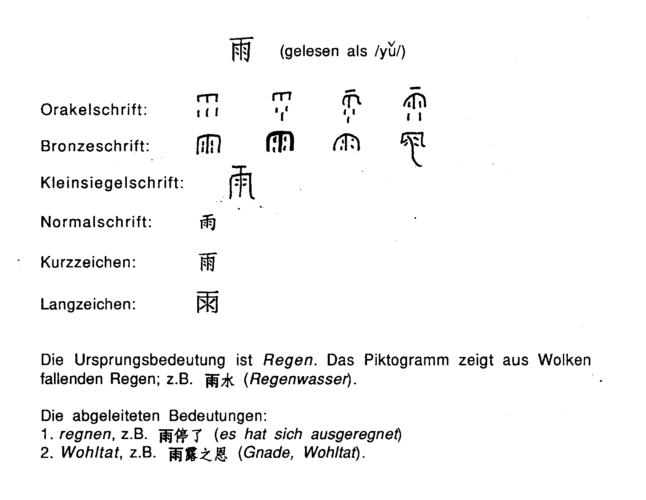

Slide 3
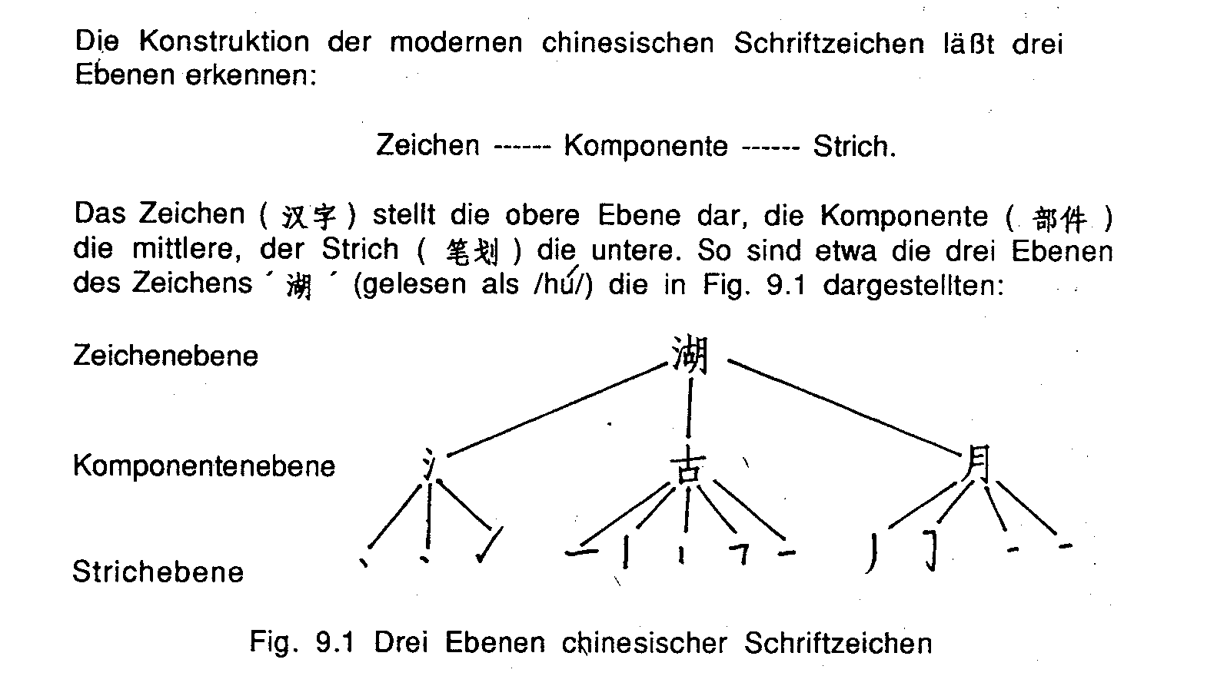

Slide 4
Die Chinesischen Schriftzeichen
Inhalt und Konnotative Bedeutung

Slide 5
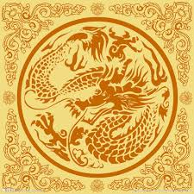
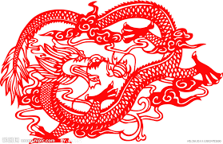
The Potential Meaning of Animal Words
Dragon is a totem in China rather than an evil animal in Europe.
Only the Emperor or the King can be called the son of great dragon.
The common persons in ancient time mustn't use the design related to dragon.

Slide 6
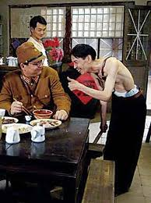
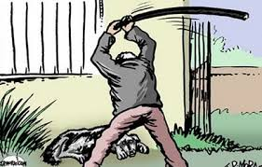
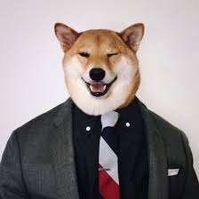
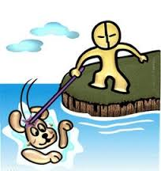
In Chinese culture, a person who always remains entirely subservient to his boss or the purple robe of power with a servile attitude is called a dog.
A few Chinese people who served Japanese invaders in second world war are called Running Dogs, which means they have lost their Chinese spirits and traditional faith just like a running dog begging for a bone.
Dirty Dog

Slide 7
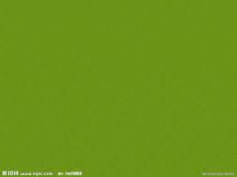
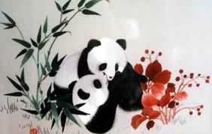



Color
Words
Chinese culture is closely related to different colors. With the help of color, people express their hidden feeling. The wrong choice for the right color obviously brings embarrassment to you.

Slide 8
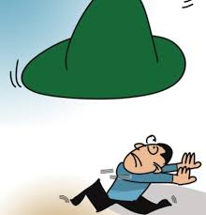
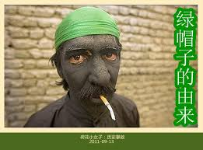
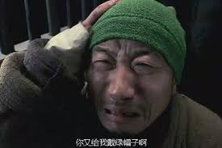
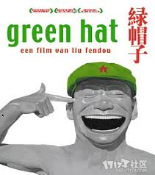
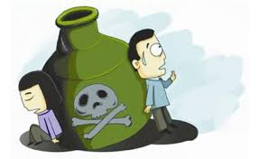
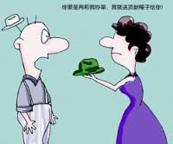
Green
A husband whose wife was not virtuous and committed adultery will be given a “Green Hat” by people.
He will be laughed or ridiculed for he is wearing a “shining green hat on the head”.

