Slide 1
ΜετεγγρΑΦη (Τranscription) εισαγωγη
Χριστίνα Αλεξανδρή
Πανεπιστήμιο Αθηνών
calexandris@gs.uoa.gr

Slide 2
paralinguistic features
Παραγλωσσικά Χαρακτηριστικά

Slide 3
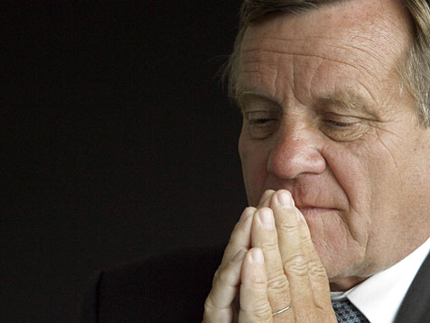
PARALINGUISTIC FEATURES
Prosody –Tone
Gestures –Movement
Objects of focus –Zoom-in/Zoom-out
Hartmut Mehdorn hat sich beim Bahn-Betriebsrat für die konzernweie Rasterfahndung entschuldigt. Die Gewerkschaften verlangen jedoch nach mehr. (sat-1)

Slide 4
χαρακτηριστικα παραδειγματα
Αναπνοή [BREATH]
Αναστεναγμός [SIGH]
Καθάρισμα λαιμού [CLEAR-THROAT]
Βήχας [COUGH]
Γέλιο [LAUGHTER]
Επιφώνημα Αμηχανίας [AH] [EH] (GR: [IH])
Θόρυβος <BACKGROUND-NOISE>

Slide 5
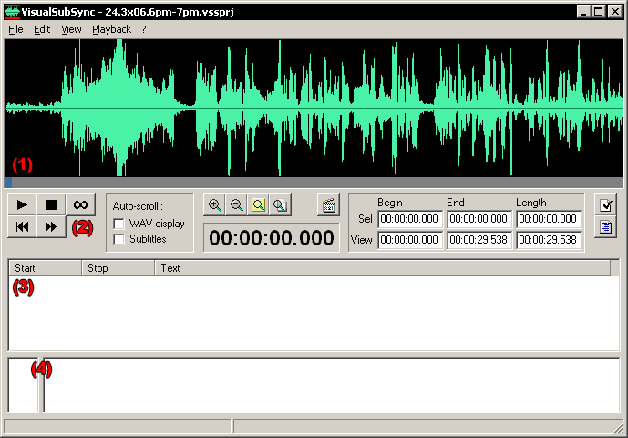
Example of a transcription tool: www.visualsubsync.org

Slide 6
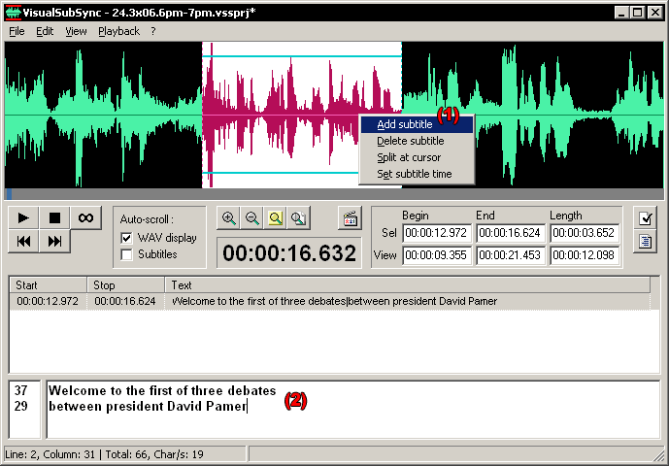
Adding subtitles

Slide 7
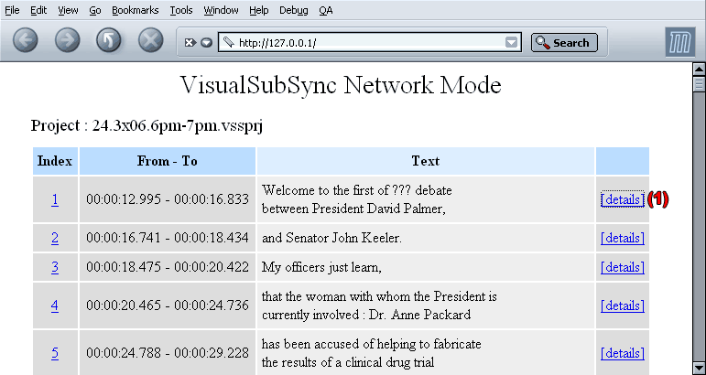
“special feature for people who's native language is different from the original video”

Slide 8
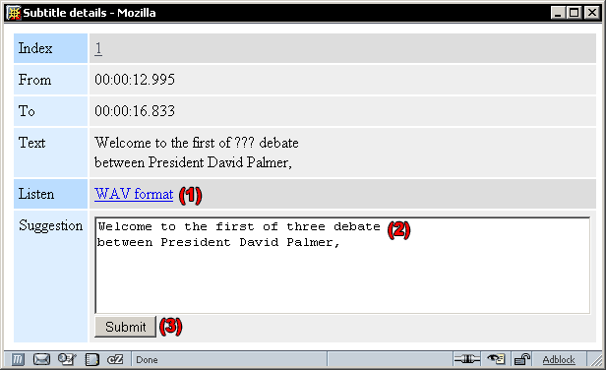
“special feature for people who's native language is different from the original video”

Slide 9
διαδικασια μετεγγραφησ
Βασικά Βήματα:
Τεμαχισμός σήματος (Segmentation)
Μετεγγραφή προφορικού κειμένου (Text Transcription)
Επισημείωση γλωσσικών και παραγλωσσικών στοιχείων (Annotation)
Καταγραφή/Επισημείωση φωνητικών/φωνολογικών ή/και κοινωνιογλωσσολογικών χαρακτηριστικών (ανάλογα με την εφαρμογή)

Slide 10
παραδειγμα
Τεμαχισμoς σhματος (Segmentation)
http://trans.sourceforge.net/en/presentation.php
Transcriber 1.4.2
Transcriber - Copyright (C) 1998-2008, DGA

Slide 11
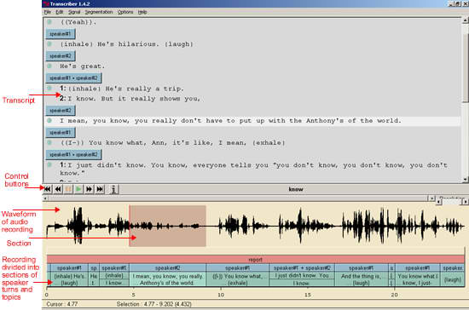

Slide 12
διαδικασια μετεγγραφησ-2
Τεμαχισμός σήματος (Segmentation)
Αποκοπή και διαχωρισμός μεγαλύτερων διαστημάτων θορύβων, παύσεων, μουσικής, διαφημιστικών κλπ.
Διαχωρισμός προτάσεων (και ομιλητών)

Slide 13
διαδικασια μετεγγραφησ-3
Μετεγγραφή προφορικού κειμένου (Text Transcription)
Εγγραφή προφορικού κειμένου
Διόρθωση προφορικού κειμένου
Επισημείωση δυσνόητων λέξεων, λέξεων που έχουν εκφωνηθεί λάθος (σαρδάμ), λέξεων που δεν έχουν εκφωνηθεί ολόκληρες
Επισημείωση ξένων λέξεων, αλλαγή γλώσσας (codeswitching)

Slide 14
Επισημεiωση ξeνων λeξεων, αλλαγh γλΩσσας (codeswitching)
http://www.dailynterpreter.com/archives/1860 (italian/french)

Slide 15
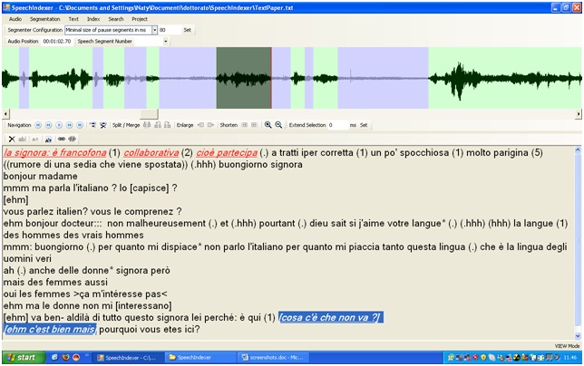

Slide 16
διαδικασια μετεγγραφησ-4
Επισημείωση γλωσσικών και παραγλωσσικών στοιχείων (Annotation)
Επισημείωση βασικών παραγλωσσικών στοιχείων
Επισημείωση λοιπών θορύβων
Επισημείωση προσωδίας (ανάλογα με την εφαρμογή)

Slide 17
διαδικασια μετεγγραφησ-5
Επισημείωση βασικών παραγλωσσικών στοιχείων
      Επιφώνημα Αμηχανίας [AH] [EH] (GR: [IH])
      Προσωδιακή έμφαση
      Αλλαγή τόνου φωνής (ψίθυρος)
Επισημείωση λοιπών θορύβων
    Αναπνοή [BREATH]
    Αναστεναγμός [SIGH]
    Καθάρισμα λαιμού [CLEAR-THROAT]
    Βήχας [COUGH]
    Γέλιο [LAUGHTER]
    Θόρυβος <BACKGROUND-NOISE>

Slide 18
Προσωδιακή έμφαση
Επισημείωση βασικών παραγλωσσικών στοιχείων

Slide 19
προσωδια
Πηγές:
Chaida, Α. (2007), Tonal Structures of Complex Sentences in Greek, in Proceedings of the 8th International Conference of Greek Linguistics (ICGL), University of Ioannina, 30 August-2 September 2007, pp 61-69.
Carr, P. (1993), Phonology, New York: St. Martin’s Press
Ladefoged, P. (2006), Εισαγωγή στη Φωνητική, μετάφαση Μπαλταζάνη, Μ., Αθήνα: Πατάκης.
http://idiom.ucsd.edu/~arvaniti/grtobi.html

Slide 20
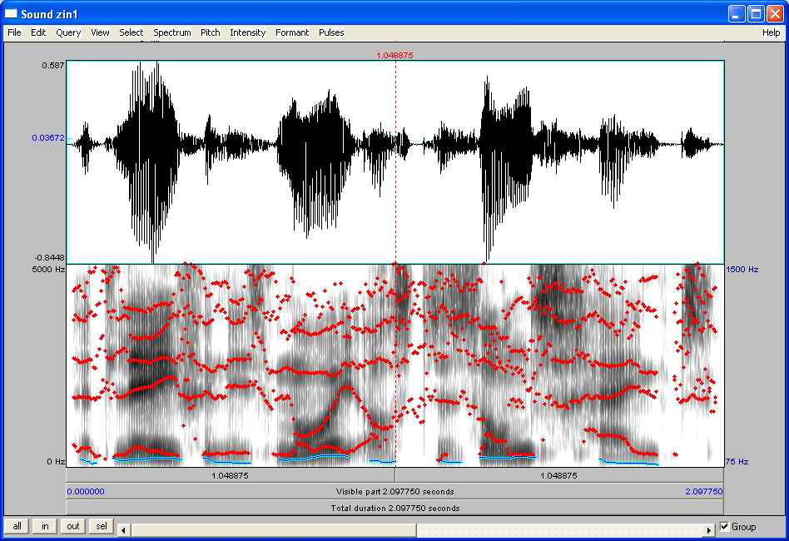

Slide 21
ορισμοι: προσωδια / επιτονισμοσ
Προσωδία = η μελωδία της πρότασης, η οποία εξαρτάται κυρίως (1) από τον επιτονισμό και (2) από τον γενικότερο τρόπο ομιλίας μιας συγκεκριμένης γλώσσας (παράμετροι) και συχνά και (3) από την ψυχική διάθεση/πρόθεση του ομιλητή
Επιτονισμός = οι λέξεις / σημεία της πρότασης που τονίζονται περισσότερο από τον ομιλιτή

Slide 22
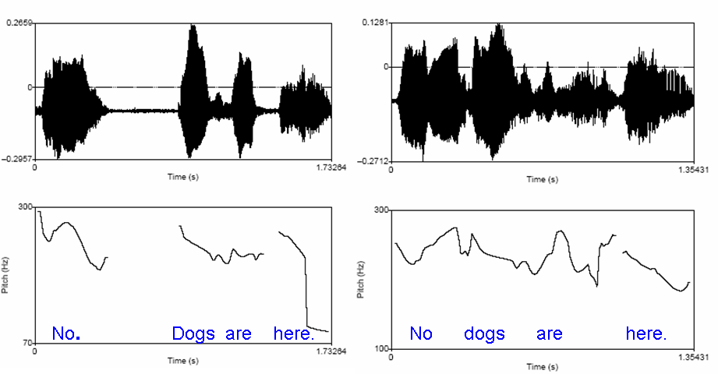
σημα και προσωδια

Slide 23
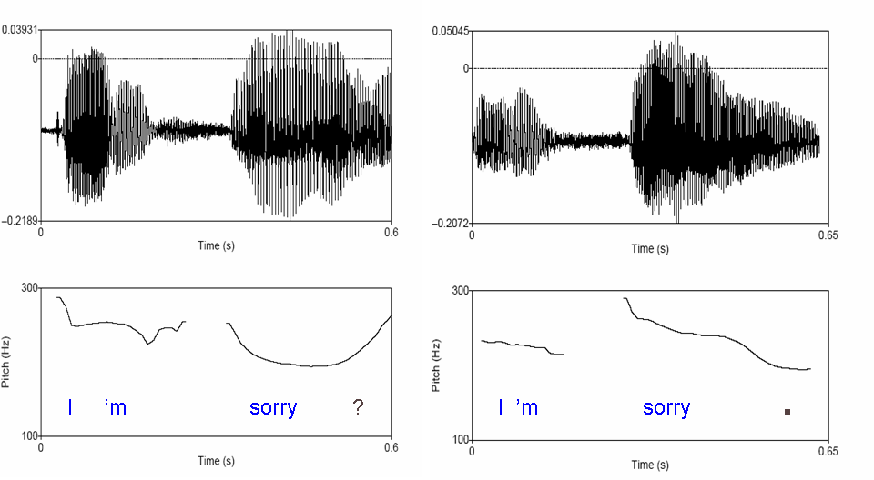
σημα και προσωδια-2

Slide 24
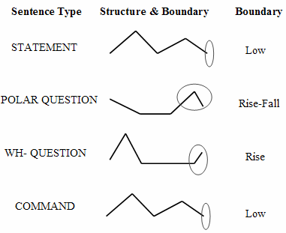
Stylised (typical) tonal structures and boundaries, as a function of different sentence types in Greek (simple sentences) (Chaida, 2007)

Slide 25
STATEMENT O Manólis mazévi lemónia ce i María mirázi balónia.
(Manolis is picking lemons and Maria is distributing balloons.)
O Manólis mazévi lemónia ótan i María mirázi balónia.
(Manolis is picking lemons when Maria is distributing balloons.)
O Manólis mazévi lemónia parólo pu i María mirázi balónia.
(Manolis is picking lemons although Maria is distributing balloons.)
COMMAND Manóli mázeve lemonia ce María míraze balónia!
(Manolis pick lemons and Maria distribute balloons!)
Manóli mázeve lemonia ótan i María mirázi balónia!
(Manolis pick lemons when Maria is distributing balloons!)
Manóli mázeve lemonia parólo pu i María mirázi balónia!
(Manolis pick lemons although Maria is distributing balloons!)
POLAR QUESTION (Yes/No) O Manólis mazévi lemónia ce i María mirázi balónia?
(Manolis is picking lemons and Maria is distributing balloons?)
O Manólis mazévi lemónia ótan i María mirázi balónia?
(Manolis is picking lemons when Maria is distributing balloons?)
O Manólis mazévi lemónia parólo pu i María mirázi balónia?
(Manolis is picking lemons although Maria is distributing balloons?)
WH-QUESTION Jatí o Manólis mazévi lemónia ce i María mirázi balónia?
(Why is Manolis picking lemons and Maria is distributing balloons?)
Jatí o Manólis mazévi lemónia ótan i María mirázi balónia?
(Why is Manolis picking lemons when Maria is distributing balloons?)
Jatí o Manólis mazévi lemónia parólo pu i María mirázi balónia?
(Why is Manolis picking lemons although Maria is distributing balloons?)
Chaida, 2007

Slide 26
Επιφωνημα Αμηχανιας [AH] [EH] (GR: [IH])
Επισημειωση λοιπων θορυβων
Επισημείωση βασικών παραγλωσσικών στοιχείων

Slide 27
Figure 1: Speech Corpus example
(Translation parallel to the Greek Text)
(Alexandris and Fotinea, 2004)
ERT_20020510_1958_Net.trs, CIMWOS Project
SPEAKER[Minister Georgios Floridis] :
What we decided about recruitments is that [PAUSE] they will obey to two rules, first {of all} to the necessity [BREATH] of an [EH] effective operation of the [AH] government. And to offer better services to the citizens. And, second[Mispronounced] {of all}, that {all} these recruitements [PAUSE] should be [EH] according to the possibilities of the budget {in question}.

Slide 28
Classifying Extra-Linguistic Markers in the Spoken Corpus
We divided the extra-linguistic markers into three categories, according to their corresponding type of speech signal.
The first category of extra-linguistic markers (Type 1) consists of a pause before the word or phrases uttered by the speaker. The pause the speaker makes is transcribed as SKIP(PAUSE) or SKIP(OTHER), if there is background noise.
The second category (Type 2) involves the emphasis of the word or phrase where, among other prosodic characteristics, an increase of the volume intensity of the speaker’s voice is recorded.
The third category of extra-linguistic markers (Type 3) consists of the sounds “Ah”, “Eh” and “Ih”, transcribed as [AH], [EH] and [IH]. The “Ih” sound is typical of Modern Greek.
(Alexandris and Fotinea, 2004)

Slide 29
Figure 3: Distribution of Type of Extra-Linguistic Markers (E: Emphasis, H: Hesitation, P: Pause) in Respect to Speech Act and Speaker Category (Alexandris and Fotinea, 2004)
Speech Act Speakers | Announce | Describe | Declare | Express
Journalist Anchor | E | - | - | -
Journalist Correspondent | E | H | - | -
Politician | - | - | P H | -
Non-trained Speakers Category 1 | - | H | P H | H P
Non-trained Speakers Category 2 | - | H | - | H E

Slide 30
διαδικασια μετεγγραφησ-6
Καταγραφή/Επισημείωση φωνητικών /φωνολογικών ή/και κοινωνιογλωσσολογικών χαρακτηριστικών (ανάλογα με την εφαρμογή):
    διάλεκτος
    ξενική προφορά
    χαρακτηριστικά κοινωνικών ομάδων (π.χ. γυναικών, «μάγκικη» προφορά κ.α.)
    ψεύδισμα/ τραύλισμα
    συναισθηματική κατάσταση

Slide 31
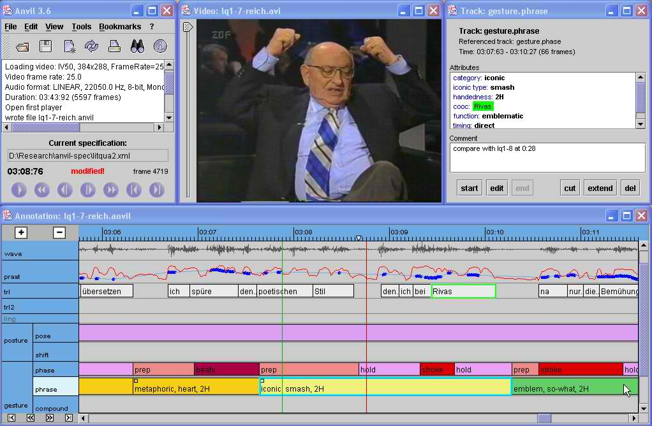

Slide 32
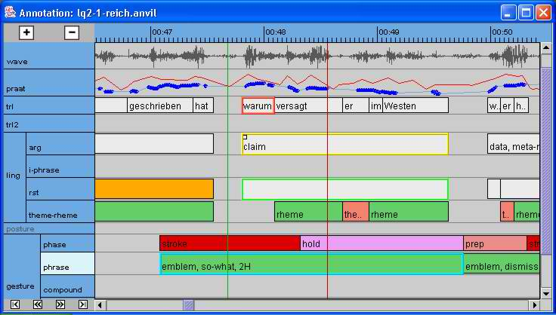

Slide 33
προφορικοσ λογος και φυλο
Κοινωνιογλωσσολογικά Χαρακτηριστικά

Slide 34
Gender- Gender in Doctor-Patient Dialogues [Forrester (1996)].
(West 1990, p. 91)
(example 1) – male doctor
(1) Patient: So, if I fe-ee:l this coming on, an’ I’m sidding up in a pla:ne, r’ I;m out
(2) somewhere in a car., h’n I can’t lie dow-
(3) Doctor: LIE DOW:N
(example 2) – female doctor
(1) Patient: I’m trying’ tuh (0.2) sid o::n this tailbone duh tyr and get it bedder
(2) an eviry chance I could try duh
(3) Doctor: oh:: don’ even try….if it hurts when yuh sid on it, stay
(4) off of it

Slide 35

Phonology-Prosody
Women use certain patterns associated with surprise and politeness more often than men (Brend, 1975)
May make statements with prosody of a question (Brend, 1975)
Tag questions: “They caught the robber last week, didn’t they?” (Lakoff , 1973)
Journalist Cheryl Casone

Slide 36
“…a woman being advised to speak more like a man…”
Margaret Thatcher was told that her voice did not match her position as British Prime Minister:
she sounded too ‘shrill’.
She was advised to lower the pitch of her voice,
diminish its range,
and speak more slowly,
and thereby adopt an authoritative, almost monotonous delivery to make herself heard.
She was successful to the extent that her new speaking style became a kind of trademark, one either well-liked by her admirers or detested by her opponents.” (Wardhaugh, 1998)

Slide 37
ταυτοτητα ομιλητη και φωνολογικα χαρακτηριστικα
Κοινωνιογλωσσολογικά Χαρακτηριστικά
Κοινωνικά, Εθνικά

Slide 38
African American Vernacular English (AAVE)
AAVE speakers may not use the dental fricatives [θ] (the th in thin) and [ð] (the th of then) that are present in SE. The actual alternative phone used depends on the sound's position in a word.^{[25]}
  Word-initially, /θ/ is normally the same as in SE (so thin is [θɪn]).
  Word-initially, /ð/ is [d] (so this is [dɪs]).
  Word-medially and -finally, /θ/ is realized as either [f] or [t] (so [mʌmf] or [mʌnt] for month); /ð/ as either [v] or [d] (so [smuːv] for smooth).
Realization of final ng /ŋ/, the velar nasal, as the alveolar nasal [n] in function morphemes and content morphemes with two syllables like -ing, e.g. tripping is pronounced as trippin. This change does not occur in one-syllable content morphemes such as sing, which is [sɪŋ] and not *[sɪn]. However, singing is [sɪŋɪn]. Other examples include wedding → [wɛɾɪn], morning → [mɔɹnɪn], nothing → [ˈnʌfɪn]. Realization of /ŋ/ as [n] in these contexts is commonly found in many other English dialects.^{[26]}
http://en.wikipedia.org/wiki/African_American_Vernacular_English

Slide 39
African American Vernacular English (AAVE)
AAVE grammatical Aspects
Aspect | Example | SE Meaning
Habitual/ continuative aspect^{[54]} | He be workin' Tuesdays. | He works frequently or habitually.
Intensified continuative (habitual) | He stay workin'. | He is always working.
Intensified continuative (not habitual)^{[55]} | He steady workin'. | He keeps on working.
Perfect progressive | He been workin'. | He has been working.
I

Slide 40
Russian (Moscow)
Typical Examples:
- Almost all consonants come in hard/soft pairs. Exceptions are consonants that are always hard /t͡s/, /ʂ/, and /ʐ/; and consonants that are always soft /t͡ɕ/, /ɕɕ/, /ʑʑ/, and /j/.
Hard /t/ /d/ /n/ /l/ and soft /rʲ/ are both dental [t̪] [d̪] [n̪] [l̪] [r̪ʲ] and apical [t̺] [d̺] [n̺] [l̺] [r̺ʲ] while soft /tʲ/ /dʲ/ /nʲ/ and /lʲ/ are alveolar and laminal [t̻ʲ^{sʲ}] [d̻ʲ^{zʲ}] [nʲ̻] [lʲ̻]. Note that, for /tʲ/ and /dʲ/, the tongue is raised enough to produce slight frication.
Hard /l/ is typically pharyngealized ([ɫ], "dark l"). (π.χ. [ˈbaɫa], Βόρεια Ελλάδα)
/v/ and /vʲ/ are unusual in that they seem transparent to voicing assimilation; in the syllable onset, both voiced and voiceless consonants may appear before /v(ʲ)/:
тварь [tvarʲ] ('the creature')
два [dva] ('two')
световой [sʲvʲɪtɐˈvoj] ('luminous')
звезда [zʲvʲɪˈzda] ('star')
http://wapedia.mobi/en/Russian_phonology

Slide 41
Arabic Speakers
Arabic: Emphatic consonants are pronounced with the back of the tongue approaching the pharynx (see pharyngealization).
Example: /lˤ/ الله / ʔalˤˈlˤaːh/, the name of God, q.e. Allah
Arabic and TV
(Egyptian linguist, Al-Said Badawi): 'levels of speech':
Classical Arabic: mosque or in religious programmes on TV
Modern Standard Arabic spoken in extremely formal contexts
vernacular language influenced by Modern Standard Arabic used for serious discussion but is generally not written, used by well-educated people, principally on the TV
‘colloquial of the basically educated’: This is the everyday language that people use in informal contexts, and that is heard on TV when non-intellectual topics are being discussed.
āmiyya al-'ummiyyīn, ‘colloquial of the illiterates’: This is very colloquial speech characterized by the absence of influence from by Modern Standard Arabic
        http://en.wikipedia.org/wiki/Varieties_of_Arabic

