Slide 1
ECONOMIC ANALYSIS
OF PATENT LAW
Christos Chrysanthis

Slide 2
PUBLIC GOODS
Non-rival in consumption
Non – excludable : Difficult or impossible to exclude them
Examples:
parks
national defense, policing
knowledge

Slide 3
PROBLEMS OF PUBLIC GOODS
Over -exploitation (destruction) : “tragedy of commons”
Parasitism – productivity lag (under production)
MARKET FAILURE
Example:
free fishing or free forestry
A solution:
privatization

Slide 4
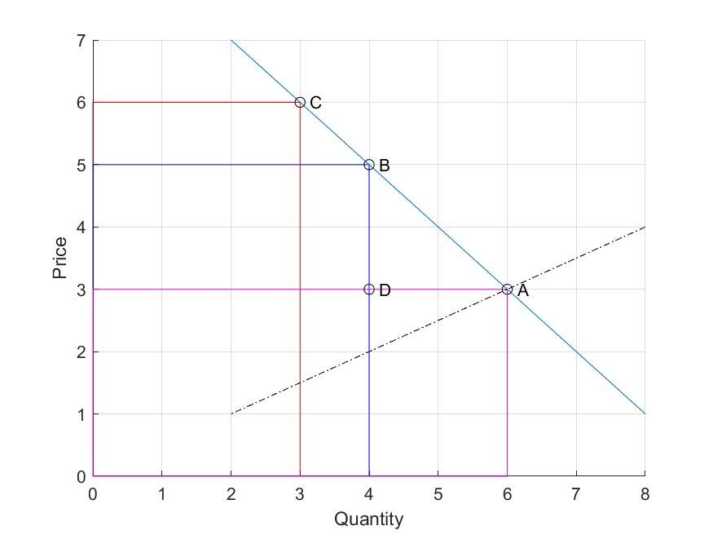
Notes:
4

Slide 5
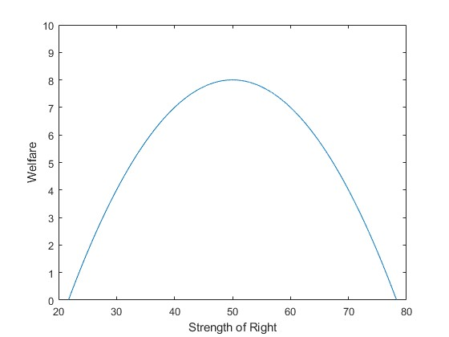
Notes:
5

Slide 6
SIDE EFFECTS OF PATENTS
Increase of prices – loss of economic efficiency
Restriction of competition
Rent Seeking
Limitation of diffusion of knowledge - technological progress
Transaction costs
Costs of legal prosecution of infringements
Duplication costs
Vexatious litigation

Slide 7
BENEFITS OF PATENTS
Incentives for research – technological progress
Spreading knowledge through publicity
New Products
Investing in research

Slide 8
ALTERNATIVES
IN LIEU OF PATENTS
Nothing
Trade secrets
State funding of research
Rewards - Grants
Why are patents better than alternatives?
Because the price mechanism works to show us what we need
Because the costs are borne by those who are interested in goods with patents and not by everyone

