Slide 1
Towards a circular economy: legal bottlenecks in the EU market
Prof. dr. Bernard Vanheusden
Faculty of Law, Hasselt University (Belgium)

Slide 2
Introduction
What?

Slide 3
Introduction

Slide 4
Introduction
Necessary?
Between 8.3 and 10.9 billion people by 2050
Global Soil Biodiversity Atlas, 2016

Slide 5
Introduction

Slide 6

Introduction
Hot topic at international level

Slide 7
Introduction
Hot topic in EU
  2013: 7th Environment Action Programme: “promote resource efficiency and the circular economy”
  2015: Circular economy action plan → 54 actions
  2019: Implementation report → all actions implemented or being implemented, e.g.
    EU Strategy for Plastics
    Directive on Single-Use Plastics
    Revision of waste legislative framework

Slide 8
Introduction
Hot topic in Member States/regions, such as Flanders
  → ‘Circular Flanders’ (https://vlaanderen-circulair.be/en)
  Initiated by the Flemish Public Waste Agency (OVAM)
BUT: transition towards CE not evident
  And regulations often form bigger challenge than technical design

Slide 9
Introduction
Overview of presentation
  Examples of initiatives
  Legal bottlenecks

Slide 10
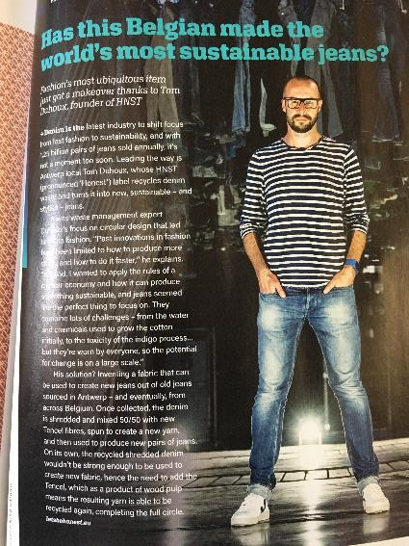
Examples
HNST

Slide 11

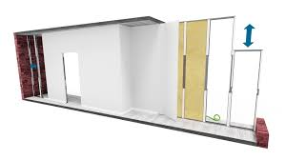

Examples
JuuNoo
Rotor

Slide 12

Examples
Cozy car

Slide 13
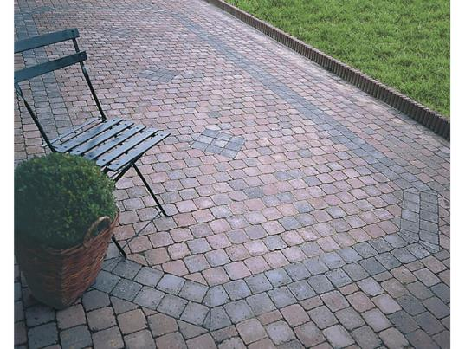
Examples
Circular insulation, bricks, road bricks

Slide 14
Legal bottlenecks

Slide 15
Waste / product
Waste Framework Directive 2008/98/EC (first one of 1975)
! + Whole range of other directives/regulations
  on landfill of waste;
  on incineration of waste;
  on shipments of waste;
  on packaging and packaging waste;
  on disposal (batteries, end-of-life vehicles, electrical and electronic equipment,…))

Slide 16
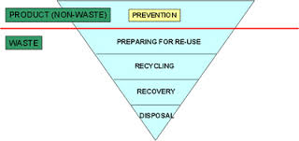
Waste / product
! Waste hierarchy

Slide 17
Waste / product
! Waste:
  “any substance or object which the holder discards or intends or is required to discard” (art. 3 WFD)
  ≠ resource, ≠ product
  Two big issues:
    Initial qualification
      Holder → clear
      Discard → unclear
    End-of-waste
      Recovery
      European and national end-of-waste criteria

Slide 18

Waste / product
Initial qualification
  To discard + intention to discard → subjective → case by case
  Regulation of by-products
    “A substance or object, resulting from a production process, the primary aim of which is not the production of that item”
    ≠ waste
  Regulation of re-use
    “any operation by which products or components that are not waste are used again for the same purpose for which they were conceived”
    ≠ waste

Slide 19
Waste / product
End-of-waste
  Recovery: “any operation the principal result of which is waste serving a useful purpose by replacing other materials which would otherwise have been used to fulfil a particular function, or waste being prepared to fulfil that function, in the plant or in the wider economy”
    Preparing for re-use
    Recycling
    Other useful purpose
    → subjective

Slide 20
Waste / product
End-of-waste
  End-of-waste criteria
    Only for a limited amount of materials (iron, steel and aluminium scrap; glass cullet; copper scrap)
    Otherwise market player has to assess
      the substance or object is commonly used for specific purposes;
      there is an existing market or demand for the substance or object;
      the use is lawful (substance or object fulfils the technical requirements for the specific purposes and meets the exisitng legislation and standards applicable to products);
      the use will not lead to overall adverse environmental or human health impacts
    Flanders: certificate of raw material (only valid in Flanders)

Slide 21
Waste / product
! Shipments of waste
  Basel Convention + Waste shipments Regulation
  CJEU Tronex case of 2019 (C-624/17)
    Facts
      ship electrical or electronic appliances (electric kettles, steam irons, fans and shavers) to Tanzania
      mainly packed in original boxes, but some unpacked
      on the one hand, appliances returned by consumers under the relevant product guarantee and, on the other hand, articles which, for example, had left the product range following a change in that range
      some appliances were defective
      no notification or consent referred to in Regulation No 1013/2006

Slide 22
Waste / product
    Judgment:
    “The shipment to a third country of a consignment of electrical and electronic appliances (…), which had been initially intended for retail sale but which were returned by the consumer or which, for various reasons, were sent back by the retailer to its supplier, is to be regarded as a ‘shipment of waste’ (…) where that consignment contains appliances the good working condition of which has not been previously ascertained or which are not adequately protected from transport damage.
    Such goods which have become redundant in the seller’s product range and which are in their unopened original packaging, on the other hand, must not, without indications to the contrary, be regarded as waste.”

Slide 23

Waste / product
Some other legal issues:
  Collection of
    Old shoes, matrasses,…
    Old textile
    Pruned Taxus baccata (yew)
    How far?
  Extended producer responsibility
    Already for WEEE, batteries,…
    Soon also for single-use plastics (Dir. 2019/904)
    How to organise, can taxes help, and what about online sales?

Slide 24
Waste / product
Part of the solution: tracing
  Flanders
    For soil: ‘Grondbank’
    For demolition waste: ‘Tracimat’

Slide 25
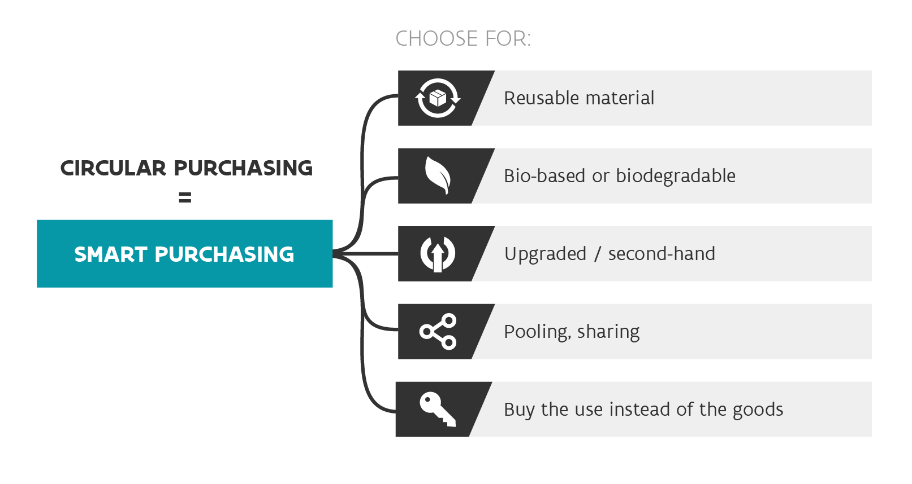
Other legal bottlenecks

Slide 26
Other legal bottlenecks
Products-as-a-service
  Often you need a function instead of property
    Do we need light armatures or just light?
    Do we need a car or just transportation from a to b?
    Do we need a central heating system or just a certain temperature?
  → Sharing platforms
“Uber, the world’s largest taxi company, owns no vehicles. Facebook, the world’s most popular media owner, creates no content. Alibaba, the most valuable retailer, has no inventory. And Airbnb, the world’s largest accommodation provider, owns no real estate. Something interesting is happening”

Slide 27
Other legal bottlenecks
  Product-as-a-service as a special form
    User pays for use of product or fulfilment of need, and service provider remains owner
      “Light as a service” (Philips)
      “Furnishing as a service” (Ikea)
    ! Contract
    ! Insurance
  Can mean shift in public procurement to become more sustainable/circular

Slide 28
Other legal bottlenecks
Regulations on product norms
  ~ Intellectual property law
  ‘Experiment legislation’ / ‘low regulations zone’?

