Slide 1

Erasmus+ Programme
2025-2026 winter semester
Climate change litigation: A single threat,
different jurisdictions, multiple doctrines of judicial review
Ioannis Angelou
Assistant Professor, NKUA Law School
Judge at the Administrative Court of First Instance of Athens

Slide 2
The problem
- Climate crisis→ Not just another topic on the evening news or at scientific conferences
- It has now become noticeable in the everyday lives of all citizens of the world
A result of human activity, which has affected about 83% of the planet’s surface (the composition and functioning of ecosystems, to the geochemistry of the planet, and the composition of its atmosphere)
Root cause: The development of Western civilization, from the industrial revolution era and thereof, has been based mainly on the extraction and combustion of fossil fuels. The emissions produced thereof leads (at a rate of approximately 75%) to excessive atmospheric concentrations of carbon dioxide and other greenhouse gases

Slide 3
Defining the notion of climate change (1)
Global warming A long-term increase in the temperature of the Earth’s climate, caused by human activities, mainly by the burning of fossil fuels, which increase the levels of greenhouse gases in the planet’s atmosphere
As a result of the greenhouse gases emissions, global temperature had increased, already by 2017, by about one degree Celsius (0.8°C-1.2°C) compared to the pre-industrial period (1850-1900)

Slide 4
Defining the notion of climate change (2)
Weather → atmospheric conditions (rain/snow/sunshine etc.) at a local level over a short period of time (days, or a few months)
Climate → the pattern of regional or global averages over a long period of time over seasons, years or decades
- Climate change → (broader concept:) a long-term change in the weather patterns which determine the Earth’s climate at a local, regional or global level, not only because of human activity, but also owing to natural causes – mainly related to global warming
- Our analysis focuses on anthropogenic climate change, i.e. the significant alterations in Earth's climate resulting from human activities

Slide 5
Characteristics of the climate crisis
A vicious circle Due to the disturbed environmental balance, the climate crisis is fed back and intensified by widespread forest fires, excessive drought, the melting of polar ice caps, and excessive hurricanes
A growing problem Carbon dioxide emissions have increased by 60% compared to 1990; over the last 25 years, the rate of global warming has increased by about 0.2°C per decade
Irreversible damage There is no scientifically proven way to reverse the effects of the climate crisis, within a reasonable time

Slide 6
Aspects of the climate crisis
Beyond its impact on the natural environment, the climate crisis constitutes a social debate, a political issue, and the subject of legislation and judicial proceedings
Between 1986 and 2014, courts worldwide ruled on approx. 830 cases on issues related to the climate crisis; this number skyrocketed to over 1000 between 2015 and 2020
At least 230 new climate cases were filed only during 2023, and have continued to spread to new countries (cases filed for the first time in Panama and Portugal)

Slide 7
Aspects of the climate crisis
However, the number of cases is now expanding less rapidly than previously, which may suggest a concentration of strategic litigation efforts, and in areas anticipated to have high impact
Just 5% of climate cases have been brought before international courts, but many of these cases have significant potential to influence domestic proceedings
Subject of the disputes: Holding governments and/ or private polluting companies accountable for climate action

Slide 8
Law and climate crisis
The type and specificities of each climate crisis legislation allow us to better understand the relevant case law
Policy objectives of the climate laws →
(a) Attribution of liability to the polluters
(b) Compensation claims to those affected
(c) Changing the economic growth model towards a zero-carbon economy and ensuring climate resilience (promotion economy’s adaptation to zero or low emissions model)

Slide 9
Law and climate crisis
Means of implementation →
(a) State intervention in the economy to enhance a different economic model
(b) Setting of statutory emission reduction targets
(c) Medium and long term planning of the national economic activity towards the goal of achieving energy and climate targets (via National Energy and Climate Plans)

Slide 10
Law and climate crisis
Examples of climate crisis legislation
At EU level
Clean Energy Package (2019) → adaptation of the EU energy policy framework to facilitate the transition away from fossil fuels towards cleaner energy
European Green Deal (2019) → the EU’s growth strategy; it consists of a package of policy initiatives, which set the EU on the path to a green transition, with the goal of reaching climate neutrality by 2050
‘European Climate Law’ → Regulation (EU) 2021/1119 establishing a framework for achieving climate neutrality
REPowerEU → a European Commission plan to end reliance on Russian fossil fuels before 2030

Slide 11
Law and climate crisis
Examples of climate crisis legislation
At international level
Notably, the ‘Paris Climate Agreement’ (2015)
A legally binding international treaty on climate change. It was adopted by 195 Parties at the UN Climate Change Conference (COP21) in Paris. In force as of 4 November 2016
Goal → to hold the increase in the global average temperature to well below 2°C above pre-industrial levels, and pursue efforts to limit the temperature increase to 1.5°C above pre-industrial levels
To achieve these goals, gge must have peaked before 2025 at the latest and decline 43% by 2030
A landmark in the multilateral climate change process → for the first time, a binding agreement brings all nations together to combat climate change and adapt to its effects

Slide 12
In today’s lecture
Look into typical case law examples from various jurisdictions worldwide, where courts have been called upon to rule on climate change issues
Highlight the issues arising in the context of climate change disputes, and the plurality of solutions provided by the courts, considering the particularities of each jurisdiction
Analyze the relevant judicial review techniques (distinction between cases decided on remedies seeking annulment of a legal act, or adjudicating on lawsuits of a compensatory nature)
Demonstrate that courts tend to focus on the common characteristics of the climate crisis disputes
    Draw conclusions about the role of the judiciary in times of climate crisis

Slide 13

National Courts - Europe

Slide 14
Luciano Lliuya v RWE AG (a. facts)
A notable case of bringing an action for damages allegedly caused in another country
The plaintiff, a Peruvian farmer, claimed that his hometown was threatened by floods caused by the melting of a nearby glacial lake. The defendant (the Germany’s largest electricity producer), allegedly bared responsibility, due to its significant contribution to the global emissions of greenhouse gases
In support of his claim, Lliuya cited a scientific study by a US NGO, according to which RWE had caused 0.47% of all greenhouse gas emissions since the industrial revolution; on this basis, the plaintiff requested that he be awarded the corresponding percentage of the estimated cost of mitigating the effects of climate change in his hometown

Slide 15
Luciano Lliuya v RWE AG (b. District Court of Essen )
The case was dismissed at first instance by the District Court of Essen (2016), on the grounds that (a) it could not provide the plaintiff with effective redress (Lliuya's situation would not change even if RWE ceased emitting), and (b) no ‘linear causal chain’ could be discerned amid the complex components of the causal relationship between particular greenhouse gas emissions and particular climate change impacts)

Slide 16
Luciano Lliuya v RWE AG (c. the Higher Regional Court of Hamm )
On November 30, 2017, the appellate court recognized the complaint as well-pled and admissible
Into the evidentiary phase, it was to be determined (a) whether Lliuya’s home is threatened by floodings of the glacial lake, and (b) how RWE’s greenhouse gas emissions contribute to that risk
‘Law of evidence’ The court reviewed expert opinions submitted by the parties, on (a) RWE’s CO2 emissions, (b) the contribution of those emissions to climate change, (c) the resulting impact on the glacier lake, and (d) RWE’s contributory share of responsibility for causing the resulting effects
A site visit by judges of the Higher Regional Court of Hamm took place in the Andean city of Huaraz in May 2022, along with court-appointed experts and lawyers for both parties

Slide 17
Luciano Lliuya v RWE AG (d. the final judgment)
On May 28, 2025, the Higher Regional Court of Hamm dismissed the appeal
The court found that evidence demonstrated no concrete danger to the plaintiff’s property
The likelihood of water from a nearby glacier lake reaching his home within the next 30 years was assessed at only about one percent-a probability deemed too low to justify legal intervention
Even if such an event were to occur, the projected flood would reach the house with a height of just a few centimeters and a flow speed insufficient to compromise the building’s structural integrity

Slide 18
Luciano Lliuya v RWE AG (e. the case’s legacy)
The ruling established important legal principles for climate litigation
Major greenhouse gas emitters can, in principle, be held accountable for the impacts of their emissions under German civil law [Section 1004 of the German Civil Code (‘BGB’)]
If an impairment of property appears imminent, a CO₂ emitter may be obligated to take preventive action. Should the emitter refuse to do so definitively, liability for future costs could be established in advance-based on the emitter’s proportional contribution to global emissions
The geographical distance between the defendant’s power plants and the plaintiff’s home in Peru does not, by itself, render the claim unfounded – however: the court’s reasoning does not open the door to lawsuits against every individual emitter, on the grounds that ‘the emissions of a single person are typically so minor that they do not give rise to liability’

Slide 19
Neubauer, et al. v. Germany (a. facts)
In February 2020, a group of German youth challenged the German Federal Climate Protection Act (‘Bundesklimaschutzgesetz’, ‘KSG’) before the Federal Constitutional Court
The law provided for a target of reducing green house gas emissions from 1990 levels by 55% until 2030
The petitioners argued that this target was insufficient, because it did not consider Germany’s and the EU’s obligation under the Paris Agreement to limit global temperature rise to ‘well below 2 degrees Celsius’. Instead, the complainants argued that Germany would need to reduce GHGs by 70% from 1990 levels by 2030

Slide 20
Neubauer, et al. v. Germany (a. facts)
The petitioners claimed that the KSG allowed for climate impacts which violated their human rights as protected by the Basic Law [right to a future consistent with human dignity enshrined [Art. 1(1), 2 (2) (right to life and physical integrity), in conjunction with Art. 20(a) of the Basic Law, which binds the political process to protect the natural foundations of life in responsibility for future generations]
The complainants asked the Federal Constitutional Court to declare that the German legislature violated the Basic Law, and to declare that the legislature was required to issue new reduction quotas to ensure that Germany’s emissions are kept as low as possible, under the proportionality principle

Slide 21
Neubauer, et al. v. Germany [b. The Court’s ruling (Apr 29, 2021)]
Specific obligations of the State, deriving from the Constitution
‘Article 20a of the Basic Law not only obliges the legislature to protect the climate and aim towards achieving climate neutrality, but ‘also concerns how environmental burdens are spread out between different generations […]’
Fundamental rights in times of climate crisis
‘[T]he fundamental rights - as intertemporal guarantees of freedom - afford protection against the greenhouse gas reduction burdens imposed by Art. 20a of the Basic Law being unilaterally offloaded onto the future’

Slide 22
Neubauer, et al. v. Germany [b. The Court’s ruling (Apr 29, 2021)]
Proportionality and intergenerational equality
The KSG’s emission provisions constituted an ‘advance interference-like effect’, which possibly violates the complainants’ fundamental rights. The legislature had not proportionally distributed the budget between current and future generations, while ‘one generation must not be allowed to consume large portions of the CO2 budget while bearing a relatively minor share of the reduction effort, if this would involve leaving subsequent generations with a drastic reduction burden and expose their lives to serious losses of freedom’
The Court’s declaration (for first time in the BVerfG jurisprudence)
‘[N]o state can resolve the problems of climate change on its own; [nevertheless, this] does not invalidate the national obligation to take climate action’

Slide 23
Neubauer, et al. v. Germany [b. The Court’s ruling (Apr 29, 2021)]
The BVerfG (i) ruled that the KSG has failed to set sufficient provisions for emission cuts beyond 2030, (ii) declared parts of the law as incompatible with fundamental rights, and (iii) ordered the legislature to set clear provisions for reduction targets from 2031 onward by the end of 2022
The federal lawmakers passed a bill approving an adapted KSG that requires, at a minimum, reduction of 65% in GHGs from 1990 levels by 2030 (in effect since August 31, 2021)
Law of evidence: The Court recognized a wide margin of appreciation for the Legislator, as regards the assessment of the measures that must be enforced, but always based on recent and valid scientific data

Slide 24
‘Friends of the Irish Environment v. Ireland’ (a. facts)
In 2017 the Irish government approved the National Mitigation Plan, aiming to limit the burning of fossil fuels
An advocacy group, Friends of the Irish Environment, filed a suit in the High Court of Ireland, arguing that the Plan was not designed to achieve substantial short-term carbon emissions reduction
The petitioners alleged that the Plan violated Ireland’s low carbon national legislation, the Constitution of Ireland, and the right to life and private and family life under the ECHR

Slide 25
‘Friends of the Irish Environment v. Ireland’ (b) The High Court of Ireland (2019)
The High Court ruled in favor the Plan, on the grounds that superior legal rules do not require particular targets for carbon emissions reduction
The Plan was considered by the Court as an initial step for carbon emissions reduction by 2050 [‘one, albeit extremely important, piece of the jigsaw’]. So, the government was considered to have appropriately exercised its policy making discretion
Friends of the Irish Environment appealed the ruling to the Court of Appeal; the case leapfrogged the traditional appeal route, and was submitted directly to the Supreme Court

Slide 26
‘Friends of the Irish Environment v. Ireland’ (c) Supreme Court of Ireland (2020)
The Supreme Court reversed the first-instance decision, and quashed the National Mitigation Plan (2017), because
‘a reasonable reader of the Plan would not understand how Ireland would achieve its 2050 goals [while] a compliant plan must be sufficiently specific as to policy over the whole period to 2050’
Transparency and public participation were emphasized as statutory goals, as the public must be able to assess and critique the government’s plan effectively.

Slide 27
‘Friends of the Irish Environment v. Ireland’ (c) Supreme Court of Ireland (2020)
The Court rejected the Government’s argument that the Plan was a purely political or policy document and therefore non-justiciable, because since the Plan was adopted under legislation, it was subject to judicial review to ensure compliance with statutory obligations. Even if the Plan was considered as a policy choice, the fall within government discretion, but they must still comply with legal obligations.
The Court did not recognize an unenumerated right to a healthy environment, separate from the rights expressly conferred by the Irish Constitution, ‘[w]hile not ruling out the possibility that constitutional rights and obligations may well be engaged in the environmental field in an appropriate case’

Slide 28
Urgenda Foundation v. Kingdom of the Netherlands (a. relevant facts and the law)
The Dutch legislation had set a target to limit green house gas emissions to 25% below 1990 levels by 2020
The Dutch government pledged (2015) to reduce emissions by 17%
Urgenda Foundation (a Dutch environmental group) and 900 Dutch citizens sued the Dutch government before the District Court of Hague – they claimed that the government had to do more to prevent global climate change, given the higher limit set thereof by the relevant national legislation

Slide 29
Urgenda Foundation v. Kingdom of the Netherlands (b. opposing claims)
The petitioners claimed that the relevant government programme had to be evaluated under the goals set by the ‘Conference of the Parties’ (‘COP’) of the ‘United Nations Framework Convention on Climate Change’ (‘UNFCCC’); according to this goal, global temperature increases must be kept within two degrees Celsius of pre-industrial conditions
The Kingdom of the Netherlands was a contracting party to the Conference of the Parties, so it was bound by the UNFCCC

Slide 30
Urgenda Foundation v. Kingdom of the Netherlands (c. The District Court of Hague )
The Court ruled that the State has a duty to take climate change mitigation measures considering the ‘severity of the consequences of climate change’
The court cited (without directly applying) Article 21 of the Dutch Constitution; EU emissions reduction targets; principles under the European Convention on Human Rights; the ‘no harm’ principle of international law; the doctrine of hazardous negligence and the principle of fairness (general principles of law), the precautionary principle, and the sustainability principle embodied in the UN Framework Convention on Climate Change; and the principle of a high protection level, the precautionary principle, and the prevention principle embodied in the European climate policy

Slide 31
Urgenda Foundation v. Kingdom of the Netherlands (c. The District Court of Hague )
The court did not specify how the government should meet the reduction mandate, but offered several suggestions, including emissions trading or tax measures
The first decision in the world ordering states to limit greenhouse gas emissions for reasons other than statutory mandates

Slide 32
Urgenda Foundation v. State of the Netherlands (d. the Hague Court of Appeal)
The Dutch government submitted 29 grounds of appeal against the first-instance decision
Urgenda submitted a cross-appeal, contesting the court’s decision that Urgenda cannot directly invoke Articles 2 and 8 of the ECHR
The Hague Court of Appeal upheld the District Court's ruling (2018), concluding that by failing to reduce greenhouse gas emissions by at least 25% by end-2020, the Dutch government does not fulfil its duty of care under Articles 2 and 8 of the ECHR
The Court of Appeal recognized Urgenda’s claim (directly) under Articles 2 (right to life) and 8 (right to private life) of the ECHR

Slide 33
Urgenda Foundation v. State of the Netherlands (d. the Hague Court of Appeal)
The government argued that the District Court’s judgment ‘create[d] legislation’ rather than checking the legality of the government’s acts, alleging violation of the separation of powers doctrine
The Court of Appeal affirmed that Dutch courts are also bound by treaties to which the Netherlands is party, including the ECHR. Further, the Court ruled that Article 193 of the TFEU does not prohibit a member state from taking more ambitious climate action than the EU, nor that the global nature of the problem excuses the Dutch government from action

Slide 34
Urgenda Foundation v. State of the Netherlands (e. the Supreme Court of the Netherlands)
The Dutch government appealed the Hague Court of Appeal’s judgment
The Supreme Court of the Netherlands (December 20, 2019) upheld the appellate court’s judgment, directly applying Articles 2 and 8 of the ECHR. Nevertheless, the Supreme Court acknowledged the Government’s discretion as to the measures it would take to comply with the decision
Following the Supreme Court’s judgement, the Dutch government announced a series of measures to reduce green house emissions, while also establishing investment packages for the development of alternative forms of energy

Slide 35
Notre Affaire à Tous and Others v. France (‘L’affaire du siècle’) (a) The administrative proceedings against the French government for inadequate action on climate change (‘recours en carence fautive’ / ‘action for failure to act’)
In December 2018, four nonprofits sent a ‘lettre préalable indemnitaire’ (letter of formal notice) to the French government, alleging that the French government has violated a statutory duty to effectively address climate change
The French government rejected these claims
In March 2019, the plaintiffs initiated a lawsuit before the Administrative Court of Paris;

Slide 36
Notre Affaire à Tous and Others v. France (b. Judicial proceedings before the Administrative Court of Paris)
Mainly, the plaintiffs requested the court to order France to:
Take proper measures to reduce greenhouse gas emissions in the atmosphere - in due proportion considering global emissions, and considering the responsibility accepted by developed countries - at a level compatible with the objective to contain the rise of the average temperature of the planet below the threshold of 1.5 °C compared to pre-industrial levels
Take, at least, all necessary measures to achieve France's targets for reducing greenhouse gas emissions, developing renewable energies and increasing energy efficiency
Take the necessary measures to protect citizens’ lives and health from the risks of climate change
Compensate the plaintiffs for the damages suffered because of the State’s failure to tackle climate change, by awarding ‘the symbolic sum of 1 euro for their moral prejudice’

Slide 37
Notre Affaire à Tous and Others v. France (b. Judicial proceedings before the Administrative Court of Paris)
The plaintiffs invoked
the French Charter for the Environment,
the European Convention for the Protection of Human Rights, and
the general principle of law providing the right of every person to live in a preserved climate system
This general principle allegedly derives from French national law (the Charter for the Environment, the French Environment Code, etc.) and international law (the Stockholm Declaration, the World Charter for Nature, the Rio Declaration, the United Nations Framework Convention on Climate Change, the Kyoto protocol, the Paris Agreement, the Climate action and renewable energy package for 2020, etc.)

Slide 38
Notre Affaire à Tous and Others v. France (c. the Administrative Court of Paris’ judgement of February 3rd, 2021)
The Court recognized that France’s inaction has caused ecological damage from climate change
The Court awarded the plaintiffs the requested compensation for moral prejudice caused by this inaction
The Court deferred the decision on whether to issue an injunction to order the French government to take stronger climate measures; it ordered the Government to disclose steps it was taking to meet its climate targets within two months
The Court rejected that the government could be forced to meet more specific renewable energy and energy efficiency targets, on the grounds that such sectoral measures cannot be independently directly linked to ecological damage (failure to establish causal link)

Slide 39
Notre Affaire à Tous and Others v. France (d. the Administrative Court of Paris’ judgement of October 14, 2021)
Monitoring the State’s compliance with its decision, the Court
ordered the Government to take immediate and concrete actions to comply with its commitments on cutting carbon emissions and repair the damages caused by its inaction by December 2022
rejected a request to have France to pay 78 million euros per semester of delay in meeting the emissions goals, ruling it is up to the Prime minister and the government to establish the appropriate measures to fix the problem

Slide 40
Notre Affaire à Tous and Others v. France (d. the Administrative Court of Paris’ final judgement of 2023)
Finally, the Court ruled that the State had complied with the 2021 judgment (the surplus of greenhouse gas emissions had been compensated)
The plaintiffs appealed to the Council of State, requesting the supreme court to examine the lawful execution of the 2021 judgement
In May 2024, the NGOs submitted their brief to the Council of State, arguing that the Administrative Court of Paris neither took the time nor the resources necessary to properly examine the implementation of the 2021 judgment, denying them the right to a fair trial

Slide 41
national Courts - USA

Slide 42
The US legal order and climate change: pioneers full of contradictions
The US legal order acts a guide for many of its counterparts worldwide
As in many issues of principle, US legislation and jurisprudence are contradictory concerning environmental protection and climate crisis
On the one hand, US federal legislation recognized the importance of environmental protection on time [see the provisions of the ‘National Environmental Policy Act’ (‘NEPA’) , and the ‘Clean Air Act’ (‘CAA’) , enacted as early as 1969 and 1970]

Slide 43
The US legal order and climate change: pioneers full of contradictions
This stance of the US legal system varies depending on the political affiliations at the time;
→ the ‘Trump Administration’ has sought, since the first year of the new President’s election (2017), to review almost every political effort that had been launched in previous years to address energy production practices that tend to increase greenhouse gas emissions
see Presidential Executive Order on Promoting Energy Independence and Economic Growth, 28 Mar. 2017· at https://www.whitehouse.gov/the-press-office/2017/03/28/presidential-executiveorder-promoting-energy-independence-and-economi-1

Slide 44
The US courts jurisprudence on environmental protection
Innovative in terms of implementing traditional rights in the light of environmental protection, under the ‘doctrine of public trust’ applied by the Supreme Court, since the ‘Illinois Central R. Co. v. Illinois’ (1892) case law
However, the US case law tends to defend in principle ‘traditional’ individual rights (especially economic freedom and property) over environmental protection, directly or indirectly
[see American Electric Power v. Connecticut’ (2011), US Supreme Court, ‘Kivalina Village v. ExxonMobil Corp.’ (2012), United States Court of Appeals for the Ninth Circuit]
In the era of climate change: A new area of environmental law referred to as ‘atmospheric trust litigation’, a concept based on the public trust doctrine and international responsibility related to natural resources

Slide 45
The US courts jurisprudence on environmental protection
See American Electric Power v. Connecticut’ (2011), US Supreme Court, ‘Kivalina Village v. ExxonMobil Corp.’ (2012), US Court of Appeals for the 9th Circuit:
Private polluters can’t be sued before the courts for emitting greenhouse gases beyond the established limits, because the relevant administrative authority (the ‘Environmental Protection Agency’, ‘EPA’) enjoys exclusive jurisdiction to regulate the issue
Interpretation limiting private polluter’s liability regime, in contrast to the ‘polluter pays’ principle

Slide 46
US courts on climate change Juliana v. United States (US Court of Appeals for the Ninth Circuit)
A climate-related lawsuit filed in 2015 by youth plaintiffs against the US and several executive branch officials
The lawsuit was initially filed with the District Court of Oregon
The plaintiffs asserted that the government had violated (a) their due process rights of life, liberty, and property, and (b) the government’s sovereign duty to protect public grounds, by encouraging and permitting the combustion of fossil fuels
They called for the government to offer ‘both declaratory and injunctive relief for their claim’ (→ a declaration of the federal government's fiduciary role in preserving the atmosphere, and an injunction of its actions which contravene that role)

Slide 47
US courts on climate change Juliana v. United States [947 F.3d 1159 (9th Cir. 2020)]
Central doctrinal suggestion of the Court’s judgment
Courts lack the ‘Article III authority’ to issue injunctions in ‘complex policy decisions’, unless ‘limited and precise legal principles’ occur
Article III authority refers to the powers granted by the US Constitution, which establish the federal judiciary and define the scope of its judicial power
The Court’s doctrinal suggestion may exclude from judicial review, large-scale structural-reform cases
Conflict between separation of powers and effective judicial protection in times of climate crisis

Slide 48
US courts on climate change West Virginia v. Environmental Protection Agency Et Al. [Supreme Court of the US, Certiorari to the US Court of Appeals for the District of Columbia Circuit, 985 F. 3d 914.]
The US 2015 Clean Power Plan was a rule by the US Environmental Protection Agency (EPA), establishing guidelines for all federal states to limit carbon dioxide emissions from power plants
The Clean Power Plan was enacted by virtue of the Clean Air Act
The US 2015 Clean Power Plan followed the ‘generation shifting approach’ → a strategy to reduce pollution by changing the sources of electricity generation from higher-emitting to lower-emitting ones

Slide 49
US courts on climate change West Virginia v. Environmental Protection Agency Et Al. [Supreme Court of the US, Certiorari to the US Court of Appeals for the District of Columbia Circuit, 985 F. 3d 914.]
North American Coal Corporation challenged the Environmental Protection Agency’s authority to so broadly regulate greenhouse gas emissions
The issue raised: Does the Environmental Protection Agency have the authority to regulate greenhouse gas emissions in any industry, under the Clean Air Act?

Slide 50
US courts on climate change West Virginia v. Environmental Protection Agency Et Al. [Supreme Court of the US, Certiorari to the US Court of Appeals for the District of Columbia Circuit, 985 F. 3d 914.]
Central doctrinal suggestion: The ‘major questions doctrine’ →
there are ‘extraordinary cases’ in which the ‘history […], the breadth, […] the ‘economic and political significance’ of the authority that [the independent agency] has asserted’, provide a reason to hesitate before concluding that Congress meant to confer such authority’
So, the Court ruled that EPA needed a ‘clear congressional authorization’ to regulate greenhouse gas emissions under the ‘generation shifting approach’

Slide 51
US courts on climate change West Virginia v. Environmental Protection Agency Et Al. [Supreme Court of the US, Certiorari to the US Court of Appeals for the District of Columbia Circuit, 985 F. 3d 914.]
The EPA admitted that issues of electricity transmission, distribution, and storage are not within its traditional expertise – yet, claimed that Congress implicitly tasked it with the regulation of how Americans get their energy
The Supreme Court ruled (via certiorari) that Congress did not grant the Environmental Protection Agency the authority to devise emissions caps based on the generation shifting approach; so, EPA lacked a ‘clear congressional authorization’ to implement the Clean Power Plan under the Clean Air Act

Slide 52
US courts on climate change West Virginia v. Environmental Protection Agency Et Al. [Supreme Court of the US, Certiorari to the US Court of Appeals for the District of Columbia Circuit, 985 F. 3d 914.]
Issues raised
The Supreme Court’s decision might have severely restrict environmental regulations and the broader notion of ‘administrative state’ (conferral of power to administrative agencies)
However, the Court’s decision is written in narrow terms, emphasizing the unique facts of the case and suggesting that the ruling could be distinguished in future contexts
The decision should not be seen as a definitive blow to greenhouse gas regulation or environmental protections in general

Slide 53
national Courts - Rest of the World

Slide 54
EarthLife Africa Johannesburg v. Minister of Environmental Affairs and Others (High Court of South Africa, 2015)
South Africa’s government launched plans for a new coal-fired Power Project. The latter would operate until about 2060
EarthLife Africa Johannesburg appealed to the High Court of South Africa, challenging the adequacy of the considerations for environmental review of the Power Project under the South Africa’s National Environmental Management Act 107/1998
EarthLife argued that the environmental review was invalid because it ignored issues related to climate mitigation and adaptation. The government answered that the environmental review was legally valid, even though it would have to be supplemented by a climate change analysis

Slide 55
EarthLife Africa Johannesburg v. Minister of Environmental Affairs and Others (High Court of South Africa, 2015)
The court observed that the statute coal-fired Power Project does not expressly contemplate climate change; this absence from the Project’s environmental review made its approval unlawful. So, the Power Project was declared unlawful
To declare the illegality of the Project, South Africa’s High Court cited several reasons, including South Africa’s commitments under the Paris Agreement
After the decision of the High Court, the Minister of Environmental Affairs reconsidered the permit application, under a new climate change impact assessment, and again approved of the environmental authorization for the Power Plant Project on January 30, 2018. The Minister reasoned that, despite having significant green house gases emissions, and therefore cause climate change impacts, the financial benefits of the power plant outweighed the harms
On November 19, 2020, the High Court issued an order setting aside all governmental authorizations for the coal-fired power plant

Slide 56
Lahore High Court, Ashgar Leghari v. Federation of Pakistan (2015)
Asghar Leghari is a Pakistani farmer. He sued the government for failure to carry out the National Climate Change Policy (2012) and the Framework for Implementation of Climate Change Policy (2014-2030)
Leghari argued that the government had failed to meet its climate change adaptation targets, and this had resulted in immediate impacts on Pakistan’s water, food, and energy security; such impacts allegedly offended Leghari’s fundamental right to life
The Lahore High Court accepted the Leghari’s claims (2015), describing climate change as a defining challenge of our time

Slide 57
Lahore High Court, Ashgar Leghari v. Federation of Pakistan (2015)
The Court ruled that, although the government had formulated a climate change policy and implementation framework, there had been no real progress with implementation
The Government’s failure to consistently and effectively implement the legislative framework for climate change violates the citizens’ rights to life and dignity, as guaranteed by the Pakistani Constitution. It was ruled that these rights include the right to a healthy and clean environment, under the international environmental principles of sustainable development, precautionary principle, intergenerational and intragenerational equity, and the doctrine of public trust

Slide 58
Lahore High Court, Ashgar Leghari v. Federation of Pakistan (2015)
The court (i) directed the government to nominate ‘a climate change focal person’ to help ensure the implementation of the Framework, and to present a list of action points in a six-month period; and (ii) created a Climate Change Commission composed of representatives of key ministries, NGOs, and technical experts to monitor the government's progress
Two years later The Climate Change Committee submitted a report to the Court, noting that 66% of the priority actions from the Framework for Implementation Climate Change Policy have been implemented
The court constituted another standing committee, creating an ongoing link between the court and the executive

Slide 59
Lahore High Court, Ashgar Leghari v. Federation of Pakistan (2015)
In its final order, the court nominated climate justice as the successor to environmental justice, because
‘environmental justice revolved around national laws, with decisions informed by international legal principles. It focused on shifting or stopping pollutive industries. Climate justice […] adopted a human-centered approach. It linked human rights with development. It sought to safeguard the rights of vulnerable peoples and share “the burdens and benefits of climate change and its impacts equitably and fairly.” Climate justice was informed by science, responds to science and acknowledges the need for equitable stewardship of the world’s resources’

Slide 60
Do-Hyun Kim et al. v South Korea (Law and facts)
South Korea's Framework Act on Low Carbon was amended in December 2019; it committed to reducing annual nationwide greenhouse gases to 536 million tons by 2030, a 24% cut from 2017
South Korean youth activists filed suit against the government, arguing that this target is insufficient to keep global warming below 2 degrees Celsius
The petitioners alleged that the government’s insufficient action on climate change violates their fundamental rights, mainly their right to life and a clean environment

Slide 61
Do-Hyun Kim et al. v South Korea (Constitutional Court of Korea, Aug 9, 2024)
Korea’s Constitutional Court first acknowledged that the right to healthy environment under Article 35 of the Constitution addresses the harm and risks related to climate change
Interpreting this provision, the Court found that the Korean State is obliged to protect such rights by mitigating the cause of climate change and reducing the harm by adapting to climate change
To fulfill this obligation, the State’s measures on climate change (i) must be based on South Korea’s share of the global efforts based on scientific facts and international standards, (ii) should not impose excessive burden to the future, and (iii) must be based on legal framework that ensures continuous reduction of greenhouse gas emissions

Slide 62
Do-Hyun Kim et al. v South Korea (Constitutional Court of Korea, Aug 9, 2024)
Korea’s national Framework Act on Carbon Neutrality and Green Growth was not prescribing any targets or plans between the period 2031-2049 for reducing greenhouse gas emissions
The Court unanimously ruled that this omission inevitably results in postponing of reduction efforts; so, it was ruled that the Act violates the right to healthy environment under Article 35 of the Korean Constitution

Slide 63
Do-Hyun Kim et al. v South Korea (Constitutional Court of Korea, Aug 9, 2024)
Judicial control tools → Hierarchy of norms
The Court ruled that the provision violated the ‘principle of legislative reservation’ → subordinate statutes must not contradict the rules they are meant to enforce
The Court stated that the framework of the reduction pathway up to 2050 must be set by the Legislature, considering its implications on various fundamental rights, and the fact that the future generation has limited opportunity to present its interest in the process
On the 2030 reduction target set by the Enforcement Decree → the Court ruled that it is unable to identify a single standard or criteria to determine the appropriate share of South Korea in the global efforts and therefore cannot conclude that the target is in violation of the State's obligation; however, this does not mean that Korea is doing its best on climate mitigation

Slide 64
Do-Hyun Kim et al. v South Korea (Constitutional Court of Korea, Aug 9, 2024)
On these grounds
The Court ordered the National Assembly to amend national Framework Act on Carbon Neutrality and Green Growth by February 28, 2026

Slide 65
International Courts

Slide 66
Duarte Agostinho and Others v. Portugal and 32 Other States (ECtHR, Grand Chamber)
In 2020, six minors from Portugal filed with the European Court of Human Rights the first climate change complaint against 33 countries
The complainants alleged that the respondent states have violated human rights by failing to take sufficient action that will keep temperature rise to 1.5 Co, under the Paris Agreement, and seeked an order requiring the respondents to take more action
The complainants invoked Articles 2, 8, and 14 of the ECHR (right to life, right to privacy, and right to not experience discrimination)
They claimed that their right to life is threatened by the effects of climate change in Portugal; that their right to privacy includes their physical and mental wellbeing, which is threatened by heatwaves; and that as young people, they will experience the worst effects of climate change

Slide 67
Duarte Agostinho and Others v. Portugal and 32 Other States (ECtHR, Grand Chamber)
Among other seven third-party intervention, the European Commission intervened in the case, supporting the claimants' position:
‘International environmental law - especially the Paris Agreement- and children’s rights law requires states to not harm, and to not allow companies within their jurisdiction to harm the human rights of people outside their borders’

Slide 68
Duarte Agostinho and Others v. Portugal and 32 Other States (ECtHR, Grand Chamber)
The Court declared the application inadmissible (April 9, 2024)
The Court ruled that the applicants are under the jurisdiction of Portugal, while no jurisdiction has been established as regards the other respondent States; so, the complaint was declared inadmissible against other respondent States [article 35(3) of the ECHR]
The complaint against Portugal was also deemed inadmissible, because the applicants had failed to exhaust domestic remedies in Portugal [article 35(1),(4) of the ECHR]

Slide 69
Carême v. France (ECtHR, Grand Chamber)
Similar case, same judgement
In this case, the application was introduced by the former mayor of the city of Grande-Synthe in France
The municipality of Grande-Synthe is located in an area considered at very high risk of exposure to climate risks
The applicant, acting in his capacity of Grande-Synthe Mayor and of a private resident, asked the Council of State to cancel the French Government's refusal to take additional measures to meet the Paris Agreement objective of reducing GHG emissions by 40% by 2030
This application was also declared inadmissible (April 2024)
The applicant had moved away from France and no longer had relevant links with Grande-Synthe. Therefore, he could no longer claim victim status under the ECHR

Slide 70
Verein KlimaSeniorinnen Schweiz and Others v. Switzerland (ECtHR, Grand Chamber - Facts)
At the end of 2020, an association of senior women filed with the ECtHR a climate change complaint against the Swiss government, complaining that their health is threatened by heat waves worsened by the climate crisis
The application listed, as the main complaint, that Switzerland's inadequate climate policies violate their right to life and health under Articles 2 and 8 of the ECHR
The Grand Chamber of the ECtHR took up the case, due to the serious question raised affecting the interpretation of the Convention (Art. 30 of the ECHR)

Slide 71
Verein KlimaSeniorinnen Schweiz and Others v. Switzerland (ECtHR, Grand Chamber’s Judgment, April 2024)
The Court found a violation of the right to respect for private and family life (Article 8) and access to court (Article 6§1)
Article 8 of the ECHR encompasses a right to effective protection by State authorities from the serious effects of climate change on life, health, and well-being
Switzerland was condemned for failing to comply with its positive obligations under the ECHR concerning climate change → (a) critical gaps in establishing a relevant domestic regulatory framework, including a carbon budget or national greenhouse gas emissions limitations (b) failure to meet its past green house gas emission reduction targets
National authorities enjoy wide margin of appreciation concerning the way greenhouse gas emissions limitations will be implemented. Ηowever, the Court held that the Swiss authorities had not acted in time and in an appropriate way to implement relevant measures

Slide 72
Verein KlimaSeniorinnen Schweiz and Others v. Switzerland (ECtHR, Grand Chamber’s Judgment, April 9, 2024)
In March 2025, the Committee of Ministers of the Council of Europe decided that Switzerland is not yet complying with the requirements of the ECtHR judgment
Switzerland has yet to prove that it is doing enough to align its policy with a maximum global warming limit of 1.5°C
The Committee of Ministers
‘invited […] the Swiss authorities to further demonstrate that the methodology used to devise, develop and implement the relevant legislative and administrative framework responds to the ECHR requirements as detailed by the Court and relies on a quantification, through a carbon budget or otherwise, of national greenhouse gas emissions limitations’

Slide 73
Armando Ferrão Carvalho and Others v. The European Parliament and the Council of the EU (General Court of the European Union)
The EU’s existing target is to reduce domestic green house gas emissions by 40% by 2030, as compared to 1990 levels
Ten families alleged before the General Court of the EU that this target is insufficient to avoid dangerous climate change, and threatens their rights of life, health, occupation, and property
They invoked the EU Charter of Fundamental Rights, the Treaty on the Functioning of the European Union (TFEU), the United Nations Framework Convention on Climate Change (UNFCCC), and the Paris Agreement

Slide 74
Armando Ferrão Carvalho and Others v. The European Parliament and the Council of the EU (General Court of the European Union)
At issue→ annulment and compensatory legal aid
(a) The applicants seeked to compel the EU (by asking the Court to declare three EU legal acts as void) to take more stringent greenhouse gas emissions reduction
(b) The second action concerns non-contractual liability, by virtue of Article 340 of the TFEU (providing a mechanism for injunctive relief to those who have suffered harm from actions or omissions of the EU institutions

Slide 75
Armando Ferrão Carvalho and Others v. The European Parliament and the Council of the EU (General Court of the European Union)
The Court did not rule on the merits, but dismissed the case on procedural grounds, finding that the plaintiffs did not have standing to bring the case since they are not sufficiently and directly affected by the EU gas emission policies
(‘climate change affects every individual in one manner or another; case law requires that plaintiffs are affected by the contested act in a manner that is peculiar to them or by […] circumstances in which they are differentiated from all other persons’ – cf. Article 263 TFEU

Slide 76
Armando Ferrão Carvalho and Others v. The European Parliament and the Council of the EU (Court of Justice of the European Union)
The plaintiffs appealed to the CJEU
The CJEU upheld the General Court’s decision, ruling that the plaintiff's claims are inadmissible on standing grounds for failing to demonstrate that they were individually impacted by EU’s climate policy
‘the effects of climate change may be different for one person than they are for another does not mean that […] there exists standing to bring an action against a measure of general application; this would render standing limitations meaningless […] since a fundamental right is always likely to be concerned in one way or another by measures of general application such as those contested in the present case’

Slide 77
Greek Courts

Slide 78
Greek courts and climate change case law
The jurisprudence of the Greek Council of State has been a key pillar for environmental protection in the Greek legal order for almost half a century
The Council of State has not heard cases directly related to climate change
However, the Court has over time ruled on cases related to the climate crisis

Slide 79
C.f. Judgements No 424/2025, 524/2021, 3367/2015 (Plenary), 1421/2013 of the Greek Council of State
The Court touched on the issue of the climate crisis by ruling on the legality of aspects of the national strategy to reduce pollution by changing the sources of electricity generation from higher-emitting to renewable energy sources
The Court ruled that producing electricity from renewable energy sources needs to be accelerated and enhanced, as climate protection is an environmental and energy priority of utmost importance for the Country

Slide 80

comments and analysis

Slide 81
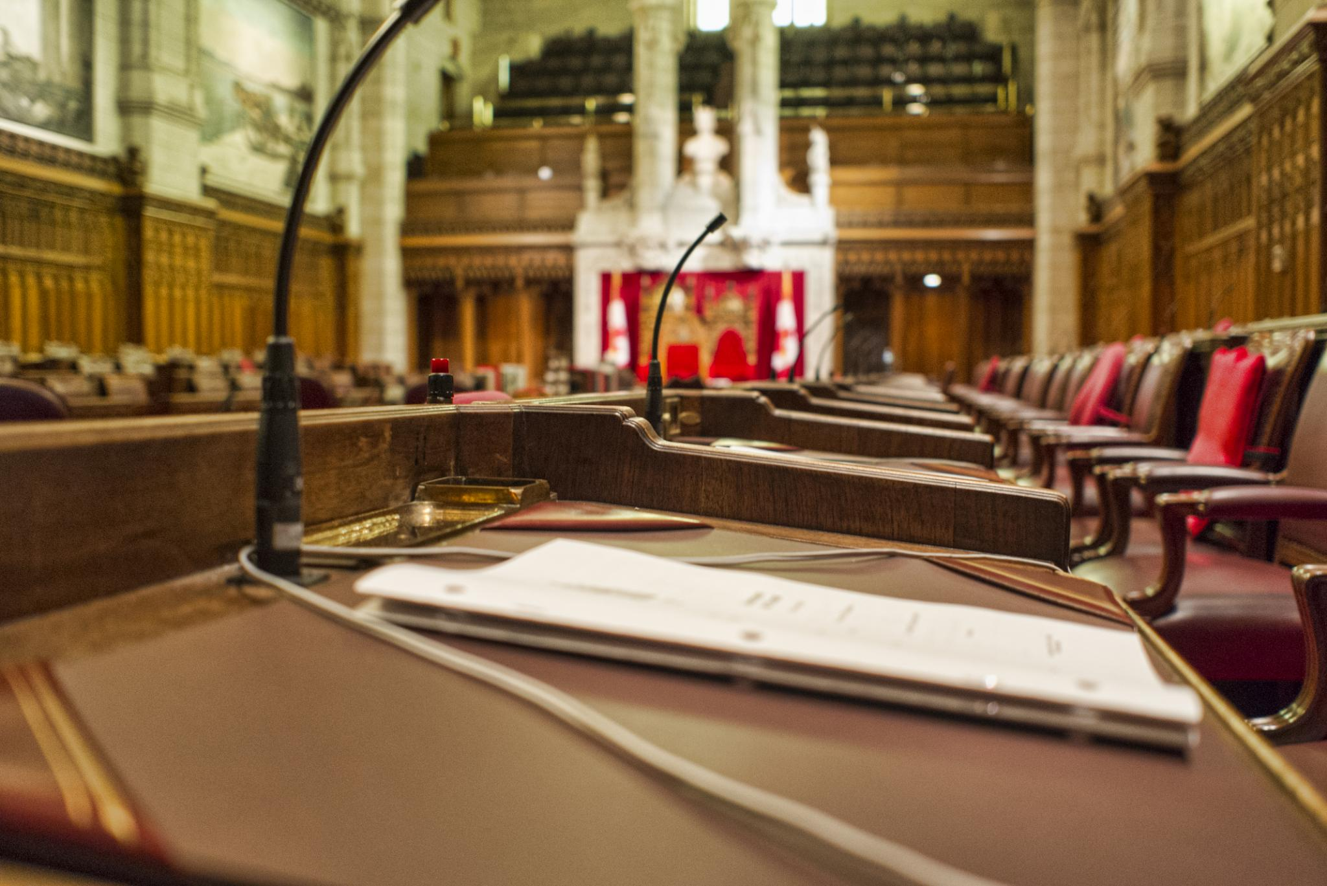

Global climate change litigation
A worldwide landscape
  Federal Court of Australia Sharma and others v. Minister for the Environment (2022)
  Oslo District Court/ Borgarting Court of Appeal/ Norwegian Supreme Court Greenpeace Nordic Association v. Ministry of Petroleum and Energy (‘People v Arctic Oil’) (2018, 2020, 2020)
  Spanish Supreme Court Greenpeace v. Spain I (2020), Greenpeace v. Spain II (2021)
  Canada’s Federal Court of Appeal Lho’imggin et al. v. Her Majesty the Queen (2023, 2025)
  … to be continued
Notes:
Image source: Microsoft 365 content library
Climate change litigation is rising globally, with cases challenging governments and corporations on climate policies. Courts have been pivotal in driving climate action, often compelling stricter emission targets. The landscape is diverse, with cases focusing on human rights, environmental protection, and holding parties accountable for climate impacts.

Slide 82
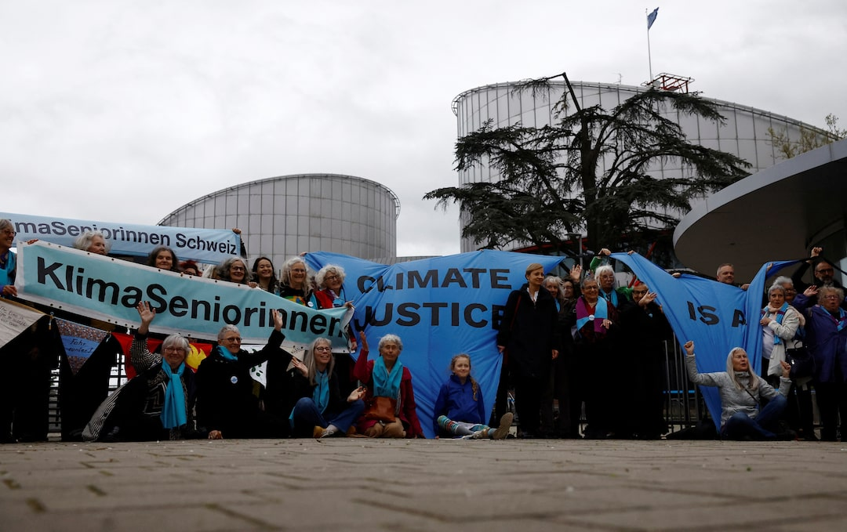
Climate change cases
  Climate cases vary [depending on the legal order within which the dispute arises], but also have a lot in common [debate on whether a new right of a constitutional nature emerges, difficulties in the evidentiary process, debate on whether cross-border dimensions of pollutant emissions set aside the locus standi requirements]
  Judicial review exercised over disputes as such has been shaped accordingly
  The judicial review applied differs depending on:
  the applicable provisions of law [procedural (more likely to be influenced by the national legal order) or substantive law (more likely to be influenced by international rules and principles of environmental and climate law)]
Notes:
Image source: Microsoft 365 content library
Climate change litigation is rising globally, with cases challenging governments and corporations on climate policies. Courts have been pivotal in driving climate action, often compelling stricter emission targets. The landscape is diverse, with cases focusing on human rights, environmental protection, and holding parties accountable for climate impacts.

Slide 83
Climate change cases
  The judicial review exercised over such disputes differs depending on:
  (b) the stage of judicial protection (the granting of a temporary court order is usually oriented towards the applicant’s harm, while a decision on the merits rests upon the law applied to the particular facts of the case)
  (c) the type of legal remedy filed with the court
  (an action for annulment of a state act or omission is mostly oriented towards the principle of legality – when deciding a claim for damages, the trial focuses on the evidentiary process, the distribution of burden of proof, and the establishment of a causal link between emissions and the alleged harm)
Notes:
Image source: Microsoft 365 content library
Climate change litigation is rising globally, with cases challenging governments and corporations on climate policies. Courts have been pivotal in driving climate action, often compelling stricter emission targets. The landscape is diverse, with cases focusing on human rights, environmental protection, and holding parties accountable for climate impacts.

Slide 84
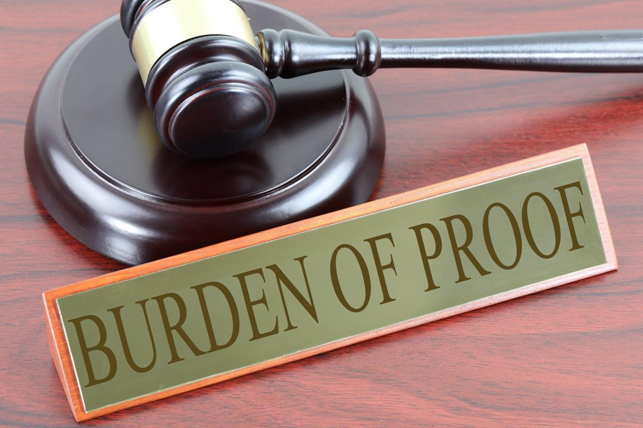
Climate change cases
  Procedural rules (1)
  Legitimate interest, locus standi, distribution of burden of proof: adapting to the specificities of climate disputes
  Clash between effective judicial protection (via climate crisis mitigation), and traditional procedural requirements
  Should climate change disputes turn into an ‘actio popularis’? (→ should these cases be brought by a member of the public, for the sake of public interest?)
Notes:
Image source: Microsoft 365 content library
Climate change litigation is rising globally, with cases challenging governments and corporations on climate policies. Courts have been pivotal in driving climate action, often compelling stricter emission targets. The landscape is diverse, with cases focusing on human rights, environmental protection, and holding parties accountable for climate impacts.

Slide 85

Climate change cases
  Procedural rules (2)
  Special legal remedies or not?
  The Supreme Court of the Philippines has provided for the ‘Kalikasan appeal’
  → a special remedy for temporary judicial protection, exercised free of charge by every applicant who claims that his constitutional right to the environment has been violated
  → the Court is obliged to decide on the appeal within three days
Notes:
Image source: Microsoft 365 content library
Climate change litigation is rising globally, with cases challenging governments and corporations on climate policies. Courts have been pivotal in driving climate action, often compelling stricter emission targets. The landscape is diverse, with cases focusing on human rights, environmental protection, and holding parties accountable for climate impacts.

Slide 86
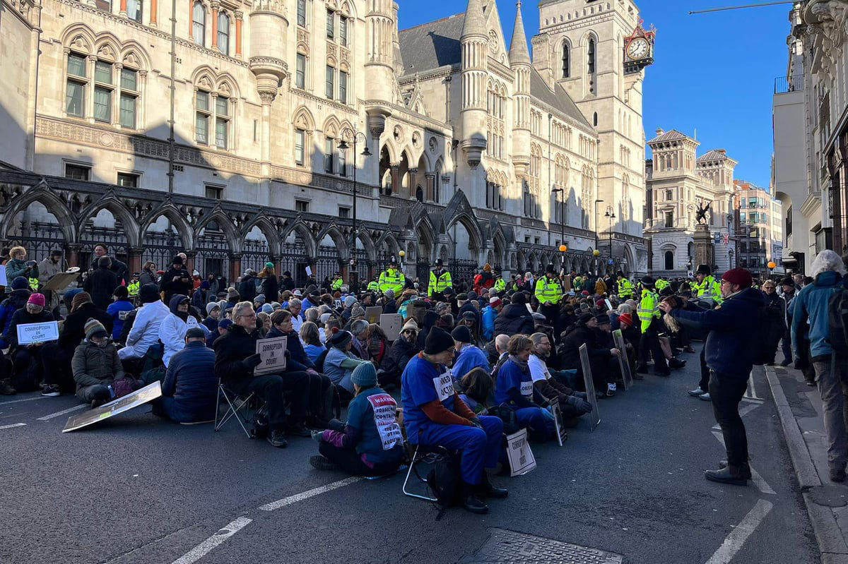
Climate change cases
  Procedural rules (3)
  Adopt ad hoc legislation for the protection of strategic litigation, or not?
  Strategic litigation: bringing selected court cases, to create broader political and social change, legally empower marginalized groups, raise public awareness, help to quickly secure protection and remedies for individuals and communities, challenge impunity of powerful polluters
  SLAPP (Strategic Lawsuit Against Public Participation): a baseless lawsuit filed by powerful individuals or corporations, intended to intimidate and silence strategic litigators by burdening them with the high cost of legal defense
Notes:
Image source: Microsoft 365 content library
Climate change litigation is rising globally, with cases challenging governments and corporations on climate policies. Courts have been pivotal in driving climate action, often compelling stricter emission targets. The landscape is diverse, with cases focusing on human rights, environmental protection, and holding parties accountable for climate impacts.

Slide 87
Climate change cases
  Substantial rules (1)
  Adopt ad hoc legislation for the protection of strategic litigation, or not?
  Anti-SLAPP laws have already been adopted in many jurisdictions to protect those targeted
  For instance: see the Canadian Protection of Public Participation Act (2015)
  Already applied by the Supreme Court of Canada (Ontario Ltd v Pointes Protection Association, 2020)
Notes:
Image source: Microsoft 365 content library
Climate change litigation is rising globally, with cases challenging governments and corporations on climate policies. Courts have been pivotal in driving climate action, often compelling stricter emission targets. The landscape is diverse, with cases focusing on human rights, environmental protection, and holding parties accountable for climate impacts.

Slide 88

Climate change cases
  Substantial rules (2)
  A distinct constitutional right?
  → adapting to the specificities of the climate crisis (establishing causality, cross-border nature), enhancing effective judicial protection
  …or interpret traditional constitutional rights likewise? (right to life, to health, to protection of housing or family life, etc)
  → easier enforcement of traditional jurisprudence
  - Over 150 countries have introduced a constitutional provision especially regarding the protection of the environment
Notes:
Image source: Microsoft 365 content library
Climate change litigation is rising globally, with cases challenging governments and corporations on climate policies. Courts have been pivotal in driving climate action, often compelling stricter emission targets. The landscape is diverse, with cases focusing on human rights, environmental protection, and holding parties accountable for climate impacts.

Slide 89

Climate change cases
  Constitutional mechanics
  ‘Separation of powers’, but also ‘checks and balances’
  Does the role of the judiciary in a liberal democracy justify the extent of their involvement in mitigating the climate crisis?
  Limits of judicial review of the legality of state acts and omissions to mitigate greenhouse gas emissions: How far can Judges deviate from the limits set by the (legitimate) Legislator and the (technocratically expert) Executive?
  Can these limits be softened (a) by international environmental law and (b) by the dangerous evolution of the climate crisis?
Notes:
Image source: Microsoft 365 content library
Climate change litigation is rising globally, with cases challenging governments and corporations on climate policies. Courts have been pivotal in driving climate action, often compelling stricter emission targets. The landscape is diverse, with cases focusing on human rights, environmental protection, and holding parties accountable for climate impacts.

Slide 90

For any further information:
Ioannis S. Angelou

Slide 91


Thank you for your attention!

