Slide 1
The Integration Principle (Article 11 TFEU): Εvolution and regulative context also in the light of new developments (EU Green Deal)
Vasiliki (Vicky) Karageorgou
Assistant Professor
Panteion University, Athens, Greece
e-mail: v_karagiorgou@panteion.gr

Slide 2
The origins and the evolution of the principle in International Law-1
The first appearance of the principle in Αrticle 13 of the 1972 Stockholm Declaration: “In order to achieve a more rational management of resources and thus to improve the environment, States should adopt an integrated and coordinated approach to their development planning, so as to ensure that development is compatible to protect and improve the environment for the benefit of their population”.
The principle emerged also in the 1987 Brutland Report and was linked to the implementation of the concept of sustainable development (p. 40)
The strong link between the integration principle and the principle of sustainable development was reaffirmed in the Article 4 of the 1992 Rio Declaration:
“In order to achieve sustainable development, environmental protection shall constitute an integral part of the development process and cannot be considered in isolation from it”

Slide 3
The origins and the evolution of the principle in International Law-2
The key role of the integration principle in achieving sustainable development was restated in the Johanessburg Plan of Implementation (para. 2) and in the Declaration adopted in the Rio +20 Conference entitled
“The future we want” (para.10).
The ICJ recognized the principle rather implicitly in the Nabcikovo-Nagimaros Case.
The principle was recognized explicitly by the PCA in the Iron Rhine Case (para. 59).
The principle of Integration in the SDGs: The 2030 Agenda for Sustainable Development which was adopted in the form of Resolution by the UN General Assembly, contains 17 goals, 169 targets and 244 indicators
The principle of integration underpins the Sustainable Development Goals (SDGs), as their implementation requires the integration of the three dimensions of sustainable development (economic, social, environmental) in a balanced manner (See Preamble, p. 1, Declaration, para. 5 and 10 : “They are integrated and indivisible and balance the three dimensions of sustainable development: economic, social and environmental).

Slide 4
The evolution of the integration principle in EU Law-1
-The integration principle was first inserted in the EC Treaty by means of the Single European Act (Art. 130r2):
-Τhe content of the principle was amended several times through the subsequent Treaty amendments
-Since the Amsterdam Treaty the integration principle is closely related to the principle of sustainable development
-The current version of the principle enshrined in Article 11 TFEU reads as follows: “Environmental protection requirements must be integrated into the definition and implementation of the Union policies and activities, in particular with a view to promoting sustainable development”

Slide 5
The evolution of the integration principle in EU Law-2
The principle of integration with a rather limited scope is also enshrined in Article 37 EUCFR, which reads as follows: “A high level of environmental protection and the improvement of the quality of the environment must be integrated into the policies of the Union and ensured in accordance with the principle of sustainable development.”
It is argued that two drawbacks concerning the role of the principle can be referred after the amendments introduced by the Treaty of Lisbon: a) The fact that the principle lost its special status as a “general principle of EC Law” and was included in the “provisions of general application”. b) The proliferation of the integration clauses under the Lisbon Treaty, so that the integration duty does not exclusively refers to the environmental protection requirements (See J. Jans, Stop the Integration Principle, Fordam International Law Journal 2013, p. 1533)

Slide 6
The addressees of the duty to integration: The EU Institutions
The duty of integration set in Article 11TFEU is placed upon the EU Institutions. The EU Law-makers (Council and Parliament) have the duty to integrate environmental concerns into other EU policies, to seek a balance and to promote sustainable development
The Integration of environmental concerns in the secondary legislation in the various fields of the EU policy has to take place in the early planning stage. Commission which has direct competence to propose legislative initiatives is subject to this rule.
Definition includes every stage of the legislative process, namely from the definition of the policy objectives to the adoption of the concrete piece of legislation or its revision
The duty does not directly affects MS. It may be argued that MS have an obligation to respect the environmental integration principle, when they implement EU policies (application of the principle of sincere cooperation-Art.4 (3))

Slide 7
The material scope of the integration duty
The environmental integration duty applies to all policies and activities in the various sectoral policies, such as the Common Agricultural Policy, the Common Fisheries Policy and the policies related to the internal market
What precisely has to be integrated?”
Article 11 TFEU speaks of the environmental protection requirements. This includes all the environmental policy objectives listed in Article 191. 1 TFEU (e.g. preventing, protecting and improving the quality of the environment, protecting human health, prudent and rational use of natural resources, promoting measures at international level to deal with regional or worldwide environmental problems, and in particular climate change),
the environmental principles (the prevention principle, the precautionary principle, the polluter pays principle and the rectification at source principle) and the environmental policy aspects listed in Article 191.3 TFEU

Slide 8
Legal status of the environmental integration clause
How can the environmental integration clause be classified?
Principle, rule or objective?
Reasons speaking for its classification as a principle:
a) Its strong wording in relation to other integration clauses (“Environmental considerations must be integrated”)
b) The establishment of a clear cut obligation for the incorporation of the environmental considerations in the EU sectoral policies
c) Its association with a fundamental EU Objective : Sustainable Development
d) its contribution to the infusion of environmental protection requirements in the sectoral policies

Slide 9
The principle of sustainable development in EU Law-1
Τhe legal nature of sustainable development :There is an intense legal debate on whether sustainable development constitutes a legal principle , an objective or a mere political concept
Its content is connected to international legal developments than any other environmental principle
A. It is established as a general objective of the EU (Art. 3.3, 3.5).
  “DETERMINED to promote economic and social progress for their peoples, taking into account the principle of sustainable development [...]” (TEU, Preamble)
  “The Union [...] shall work for the sustainable development of Europe […]” (TEU, Art. 3.3)
  “[…] the Union […] shall contribute to peace, security, the sustainable development of the Earth [...]” (TEU, Art. 3.5)
  B. Sustainable (“prudent and rational use”) Use of natural Resources and sustainable management of global natural resources are objectives for the EU as a whole (Article 21.2.f and 191, 2)

Slide 10
Τhe principle of sustainable development in EU Law-2
--The three pillar structure constitutes the dominant view [e.g. seeking synergies among the third pillars (economic development, social cohesion, environmental protection)]
-Due to its ambiguity, the principle has not given rise to significant jurisprudence by the EU Courts ( Case C-371/98, First Corporate Shipping, Case 91/05, Commission v. Council, Case 43/10 Nomarchiaki Aftodioikisi Aitoloakarnanias, para. 139, Case C-66/13, Green Network)
-Other relevant developments : a) The EU Sustainable Development Strategy is a programmatic document that aims at combining a dynamic economy with social cohesion and high environmental standards. It also places emphasis on policy coordination and integration.
b)The EU Green Deal is a comprehensive Initiative which aims at reshaping the policies of the European Union towards sustainable development. It is centered on actions based on EU secondary law
-The central question remains: Which economic development is sustainable?

Slide 11
The dimensions of the environmental integration principle
A central issue is whether the environmental integration principle has only a procedural or also a substantive dimension
Procedural dimension: The environmental considerations are taken into account in the decision-making process, irrespective to the substantial outcome
Substantive dimension: The incorporation of the environmental considerations exert influence to the outcome of the relevant decisions
The linkage to sustainable development speaks for the recognition of a substantive dimension
If more options are available, the most environmentally friendly should be chosen

Slide 12
The strength of the integration duty
Another central question concerns whether the integration duty requires that environmental protection should be given priority over other policy areas or whether it requires that environmental protection is considered and duly taken into account in the definition and implementation of the other EU policies. Dominant position in the legal theory: The integration principle does not assign a priority to environmental protection over other EU policy objectives.
It requires instead that wherever a Union policy or activity is planned, the environmental considerations must be taken into account in an integrated and balanced way. See Opinion of AG Geelhoed in Case C-161/04 (Austria v. Parliament and the Council, para. 59.)
The integration principle does not provide any guidance with regard to the extent to which environmental considerations have to been into account and how the conflicts with competing interests can be resolved

Slide 13
The functions of the integration principle-1
a)The enabling function: Under the enabling function, the EU is empowered to take action to pursue environmental objectives within the framework of other non-environmental policies, such as the common commercial policy, the internal market and the public procurement.
This approach is confirmed by the CJEU. See Case C-62/88 Greece v.Council, paras.19-20; Case C-336/00, Huber, para. 36 (Environmental protection measures can be validly adopted under any legal basis of the Treaties as long as the relevant requirements are fulfilled)
The Court also applied the integration principle, in order to justify the use of EU secondary law provisions in the field of criminal law, if their introduction is necessary to achieve effective environmental protection. (Case C-176/03, Commission v. Council, para. 42;Case C-440/05, Commission v. Council)

Slide 14
The functions of the integration principle-2
a) the enabling function (continue):
The Court referred to the integration principle to justify that an International Trade Agreement based on a legal basis which does not focus on environmental protection, pursues the objective of sustainable development (Opinion 2/15 on the Free Trade Agreement between the European Union and the Republic of Singapore of 16 May 2017, para.146)
Joinced Cases C-626/15 to 659/15, paras. 90-101.
Interim Conclusion: The principle contributes, at least to some extent, to the greening of the EU sectoral policies

Slide 15
The functions of the integration principle-3
b)the guidance function: It refers to the possibility to interpret eu law, outside the environmental field towards such a direction, in order to promote the environmental objectives.
Such an approach was followed by the CJEU in the Danish bottle case (Case C-302/86, Commission v. Denmark), as the Court applied the integration principle in order to include environmental protection among the list of mandatory requirements, as foreseen by the Cassis de Dijon jurisprudence, which may invoked by Member States in order to justify national measures aimed at protecting important environmental interests, in spite of their restrictive effects on the free movement of goods. In the same direction see Case C-379/98, Preussen Electra, paras.73-76.See also Case C-573/12, Ålands Vindkraft AB, ECLI:EU:C:2014:2037, paras. 77-80
Case C-513/99 Concordia Bus Finland ECLI:EU:C:2002:495 para. 57, (justification of environmental requirements in the public procurement procedure”

Slide 16
The functions of the integration principle-3
b) the guidance function(continue)
The same applies to the Artedogan Case in which the Court applied the integration principle, in order to justify the application of the precautionary principle, outside the environmental sphere, with the aim to protect public health. (Joined Cases T-74, 76, 83, 85, 132, 137, 141/00 (Artegodan GmbH/Commission), [2002] ECR II-4945, para. 183 and Case T-817/14, Zoofachhandel Züpke GmbH, ECLI:EU:T:2016:157, para. 51.)
State Aid and Environmental Protection :Case C-594/18, Austria v. Commission (Hickley Point C)-By applying the environmental integration principle in conjunction with art. 37 EUChFR and art. 194 (1) TFEU and the EU rules on the environmental protection, the Court recognized an obligationof the European Commission when assessing whether state aid is intended to “facilitate the development of an economic activity” (art. 107(3) (c)TFEU), to examine whether the activity for which aid is granted, does not contravene the EU environmental legislation.

Slide 17
The justiciability of the environmental integration principle
According to the Opinion of the AG Jacobs “Integration is not programmatic but imposes legal obligations” (Opinion in Case C-379/98, Preussen Elektra).
The integration principle can be used as a standard to review the validity of the EU measures.
It is recognized that the EU organs enjoy a wide margin of discretion in shaping their environmental policy by balancing between different requirements and interests.
The EU courts check only whether there is a manifest error of appraisal regarding the application of the Treaty objectives and principles (ECJ Judgment, Case C-341/95, Gianni Bettati)
So far no EU act has been declared void by the CJEU due to the violation of the integration principle

Slide 18
Assessment of the contribution of the integration principle to achieve sustainable development-1
A. The effects of the proliferation of the integration clauses
The proliferation of the integration clauses under the Lisbon Treaty does not only lead to the relativisation of the environmental integration principle, so that it has effect of reducing of the environmental protection requirements (J.Jans, Stop the Integration Principle?).
As Prof. Jans rightly pointed out the multiplication of the integration duties may also lead to the so-called “minestrone effect” in the sense that the presence of many integration duties might cause “an inherent danger that under the disguise of integration certain environmental standards will be diluted or offset against others interests or policy considerations”
Interim Conclusion : The principle can contribute to a mild “greening” of the sectoral policies
Question : Is that sufficient considering the extent and the intensity of the environmental problems?

Slide 19
Assessment of the contribution of the integration principle to achieve sustainable development-2
B. The relationship between the environmental integration principle and the principle of conferral of powers and its impact on achieving sustainable devleopment
Article 7 TFEU sets out that the integration of all the EU objectives, including that of sustainable development, presupposes that the principle of conferral of powers (Article 5.2TEU) is respected. (Squintani, 2021)
In accordance with the CJEU case-law with regard to the principle of conferral, the principle is respected when the Union act aims at achieving the goals set out in the chosen legal basis (Case C-376/98, Federal Republic of Germany v. European Parliament and Council)
Opinion 2/2015 : Trade Agreements fall under the EU exclusive competence even if they include sustainability chapters to the extent that the chapter limits itself to referring the respective environmental commitments
Question: How this can affect the integration of environmental concerns in the conclusion of Free Trade Agreements?

Slide 20
The environmental integration principle and the EU Green Deal-1
The EU Green Deal and the Integration principle: The EU Green Deal constitutes an integral part of the strategy to implement the United Nation’s 2030 Agenda and the sustainable development goals “with the aim of putting the sustainable development goals at the heart of the EU policy-making”
It aims to transform the EU by 2050 to the state of “fair and prosperous society, with a modern, resource efficient and competitive economy”
It is acknowledged that the transformation to a green economy requires significant public and private investment

Slide 21
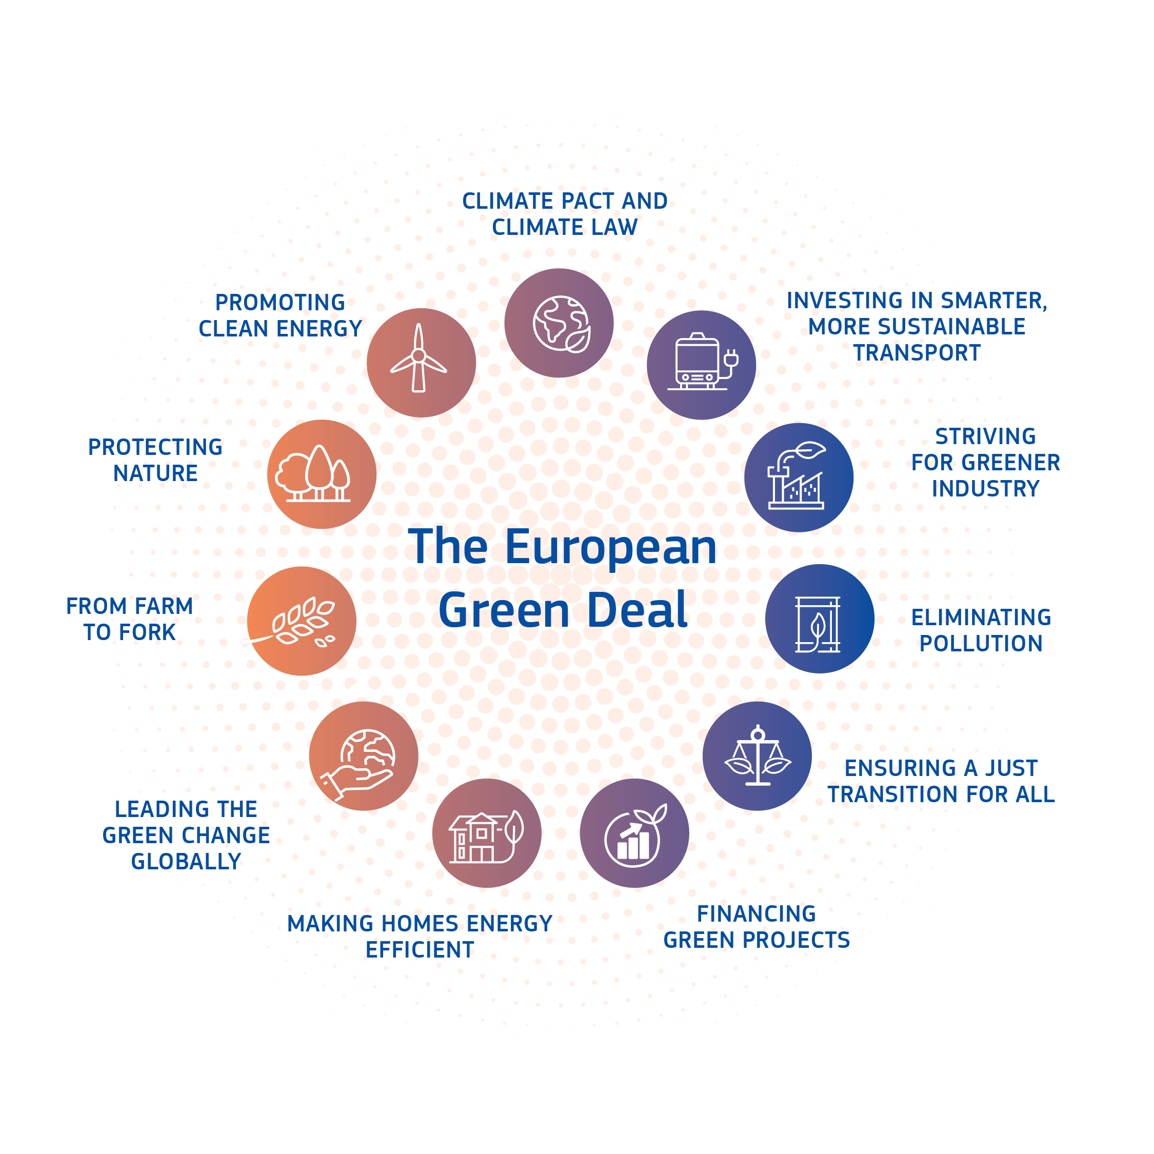

Notes:
The Green Deal is a big policy package of various different policies that interconnect – just like all of us must work together to make these policies work.
Climate change and environmental degradation are an existential threat to Europe and the world. To overcome these challenges, Europe needs a new growth strategy that will transform the Union into a modern, resource-efficient and competitive economy, where
-there are no net emissions of greenhouse gases by 2050
-economic growth is decoupled from resource use
-no person and no place is left behind
The European Green Deal is our plan to make the EU's economy sustainable. We can do this by turning climate and environmental challenges into opportunities, and making the transition just and inclusive for all.
The European Green Deal provides an action plan to
-boost the efficient use of resources by moving to a clean, circular economy
-restore biodiversity and cut pollution
The plan outlines investments needed and financing tools available. It explains how to ensure a just and inclusive transition. The EU aims to be climate neutral in 2050. We proposed a European Climate Law to turn this political commitment into a legal obligation.
Reaching this target will require action by all sectors of our economy, including
-investing in environmentally-friendly technologies
-supporting industry to innovate
-rolling out cleaner, cheaper and healthier forms of private and public transport
-decarbonising the energy sector
-ensuring buildings are more energy efficient
-working with international partners to improve global environmental standards
The EU will also provide financial support and technical assistance to help those that are most affected by the move towards the green economy. This is called the Just Transition Mechanism. It will help mobilise at least €100 billion over the period 2021-2027 in the most affected regions.

Slide 22
The environmental integration principle and the EU Green Deal-2
The Eu Green Deal sets 10 areas of action:
a) Climate ambition 2) clean affordable and secure energy 3)industrial strategy for a clean and circular economy 4) sustainable and smart mobility 5)greening the Common Agricultural Policy 6)preserving and protecting biodiversity 7) towards a zero pollution ambition for toxic free environment 8)mainstreaming sustainability in all EU policies 9)the EU as a global leader 10)working together-a European Climate Pact

Slide 23
The environmental integration principle and the EU Green Deal-3
The principle of Integration is not explicitly mentioned in the Commission Communication launching the EU Green Deal.
The integration principle is though implemented though the EU Green Deal

Slide 24
The environmental integration principle and the EU Green Deal-4
Examples of the implementation of the integration principle through the EU Green Deal:
a) With regard to climate ambition: aa) the EU Climate Law that establishes the goal of climate neutrality by 2050 ( Regulation (EU) 2021/1119 of the European Parliament and of the Council of 30June 2021 establishing the framework for achieving climate neutrality and amending Regulations (EC) No 401/2009 and (EU) 2018/1999 (‘European Climate Law’)
bb) the fit for 55% legislative package: https://ec.europa.eu/info/strategy/priorities-2019-2024/european-green-deal/delivering-european-green-deal_en
extension of the emission trading scheme to the aviation sector
-establishing a separate emissions trading scheme for building and road transport

Slide 25
The environmental integration principle and the EU Green Deal-5
Furthermore, the integration principle is also promoted by the “Industry Strategy for Clean and Circular Economy” and the accompanying “New Circular Economy Action Plan” which aims to improve resource efficiency and circular economy.
Indicative measures and Initiatives:
a) to substantially extend the 2009/125 Ecodesign Directive, so that it can be applicable to the broadest possible range of products
b)to revise EU Consumer Law and labelling rules
c)to propose mandatory green public procurement (minimum) criteria and targets in sectoral legislation

Slide 26
The environmental integration principle and the EU Green Deal-6
The environmental integration principle is implenented through the reforms to the Common Agricultural Policy
a) The Farm to Folk Strategy aims making food systems fair, healthy and environmentally-friendly to reverse biodiversity loss and keep food affordable while generating fairer economic returns
b)The reform of the CAP 2023-2027
CAP National Plans: 40% of the financial ressources of the green cap goes for ficancing actions dealing with climate change
Strict Conditiononality rules which have to be set in the CAP National Plans (Conditionality : compliance with the EU Environmental Law)
Eco-schemes : a novel instrument to reward farmers who manage their land in an environmental and climate-friendly manner

Slide 27
The environmental integration principle and the EU Green Deal-7
Just Transition Mechanism, aims to alleviate the economic and social impacts of those affected by the transition to climate neutrality
At least EUR 100 billion investments to support and finance regions most exposed to transition challenges in all Member States
It consists of three pillars: a) The Just Transition Fund-It provides financing to the regions which have to deal with the serious consequences of the transition to climate neutrality (high dependance on the use of fossil fuels)
(Regulation (EU) 2021/1056 of the European Parliament and of the Council of 24 June 2021 establishing the Just Transition Fund, OJ L 231, 30.6.2021). It finances : a) Economic diversification and reconversion b)Re-skilling and job seeking assistance for workers c)Support to climate transition and environmental sustainability

Slide 28
The environmental integration principle and the EU Green Deal-8
Second Pillar of the Just Transition Mechanism: Invest EU Programme-dedicated just transition scheme- attracting private investors for projects promoting the just transition by providing an EU budget guarantee.
Third Pillar of the Just Transition Mechanism: Public Loan Facility with the EIB so that public authorities can finance projects which would not generate revenues and would not be otherwise financed
Enabling sustainable investments through state aid:
Revision of relevant state aid rules to support cost-effective and socially-inclusive transition to climate-neutrality by 2050

Slide 29
The environmental integration principle and the EU Green Deal-8
Regulation (EU) 2020/852 of the European Parliament and of the Council of 18 June 2020 on the establishment of a framework to facilitate sustainable investment and amending Regulation 2019/1088 (EU Taxonomy Regulation)
It Provides clarity on what is an environmentally sustainable activity.
It Provides the market and the public with the necessary confidence on environmental performance
An activity can be qualified as environmentally sustainable if it fulfills the following standards: a) It substantially contributes at least to one of the six environmental objectives (climate change mitigation, climate change adaptation, transition to a circular economy, pollution prevention and control, sustainable use and protection of water and marine resources and protection and restoration of biodiversity and eco-systems b)It does not do significant harm to any of the above-mentioned objectives (the do not significant harm principle) c) It complies with the minimum standards

Slide 30
Concluding Remarks-1
The environmental Integration principle has played a key role to the transformation of the European Communities from a customs union into a political entity (J.Jans, Stop the Integration principle?)
Due to the proliferation of the integration clauses in conjunction with the obligation to ensure policy coherence and the inherent limitations due to the observance of the principle of the conferral of powers, the application of the environmental integration principle results in a rather limited “greening” of the existing sectoral policies
The EU Green Deal, although not explicitly referred, implements the environmental integration principle by promoting, inter alia, a framework for mandatory product design standards, a more regulated circular economy and sustainable investments. It remains to be seen how the new legal framework is going to be implemented

Slide 31
Concluding Remarks-2
The environmental integration principle could have a stronger role in contributing to the transformation to a sustainable path in a coherent manner provided that it is strongly linked to the purpose of promoting sustainable development as a fundamental objective of the EU

