Slide 1










NATIONAL AND KAPODISTRIAN UNIVERSITY OF ATHEΝS
LIBRARY OF THE SCHOOL OF LAW
LIBRARY
SERVICES
Seminars

Slide 2
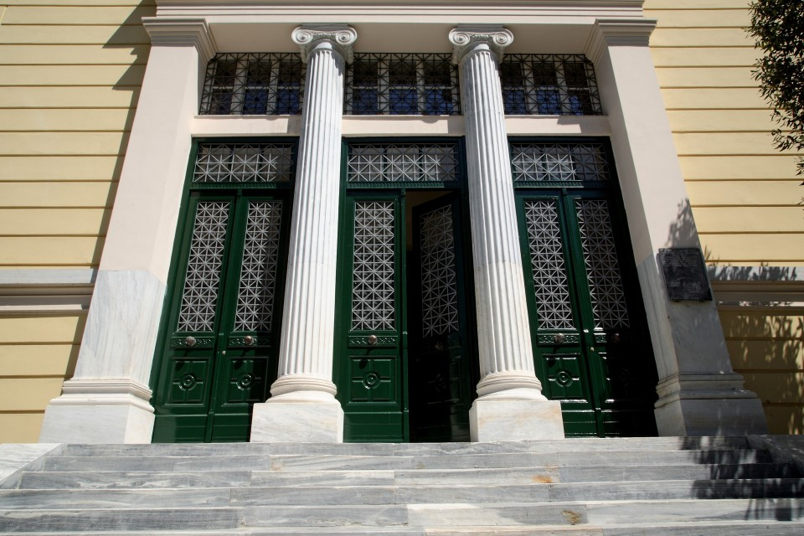
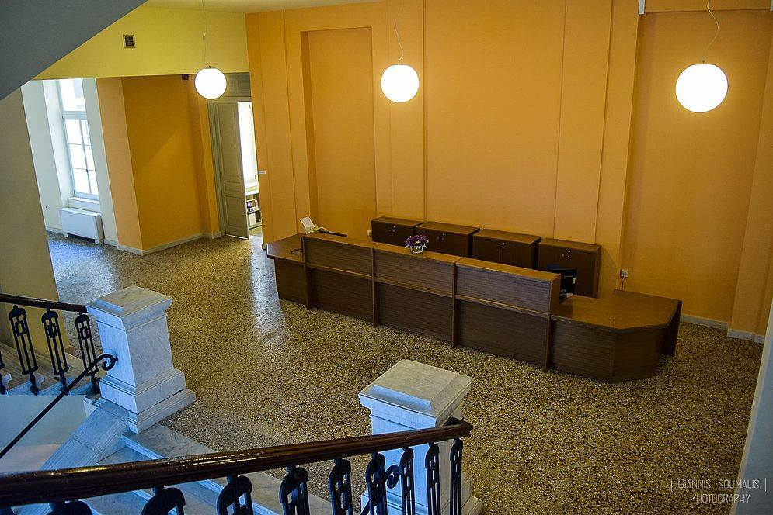
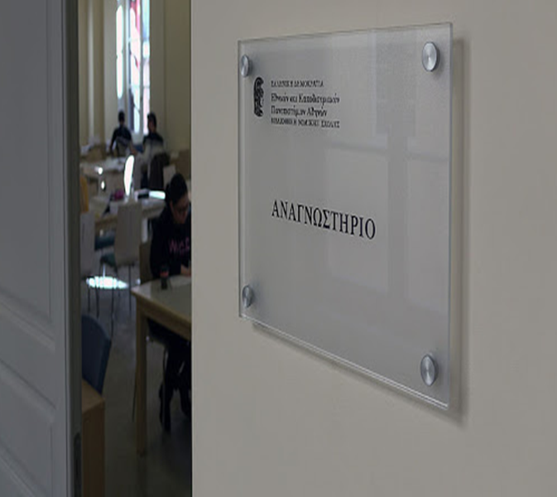
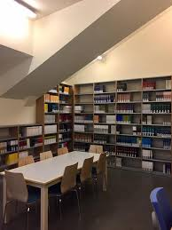
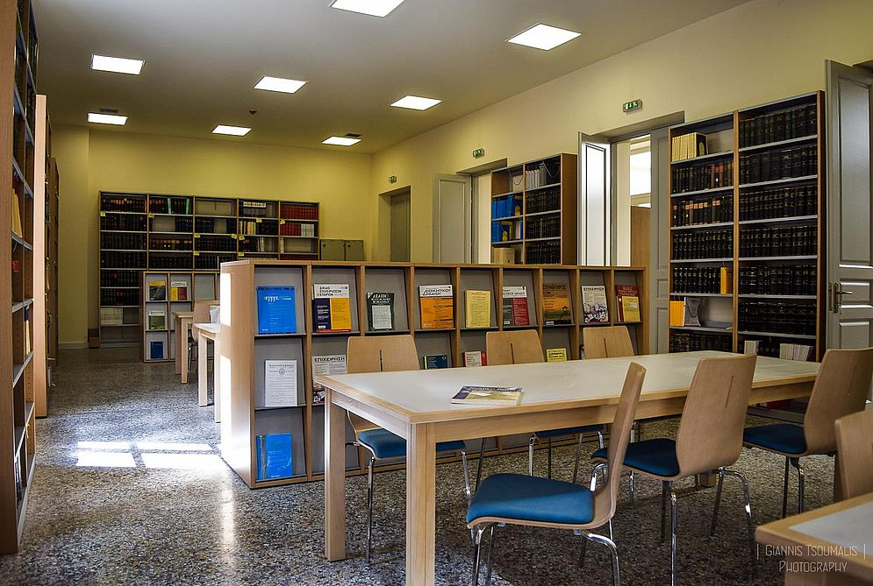
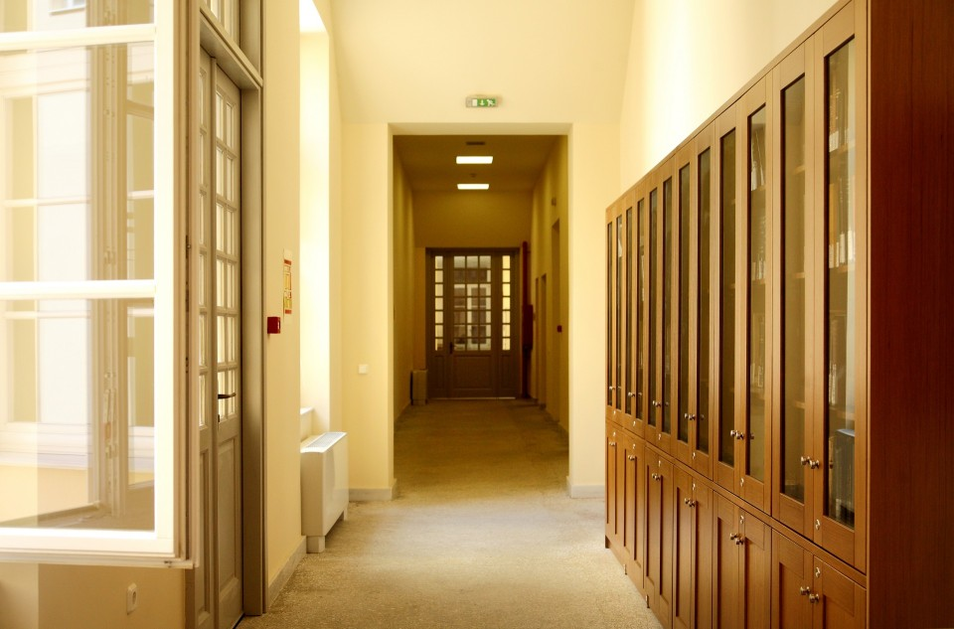
1st Floor
Information Desk Services
Academic textbooks "Eudoxos" collection
Archive of journals from 2000-
Reading rooms and group rooms
Collection of Honorary Volumes and Collective Works
Archive of Doctoral & Postgraduate Theses of Law School
2nd Floor
Main reading room
Multimedia room
Rare Books collection
Ground Floor
Information Desk Services
Archive of journals up to 1999
Books collection by subject of law
Notes:
The Unified Law Library of the National and Kapodistrian University of Athens, a library boasting one of the most exhaustive law collections in Greece and abroad, opened to the public in October 2016. It is situated at the Old Chemistry Laboratory, occupying several areas on the ▀ground floor, ▀first floor and ▀second floor of the historic building.

Slide 3
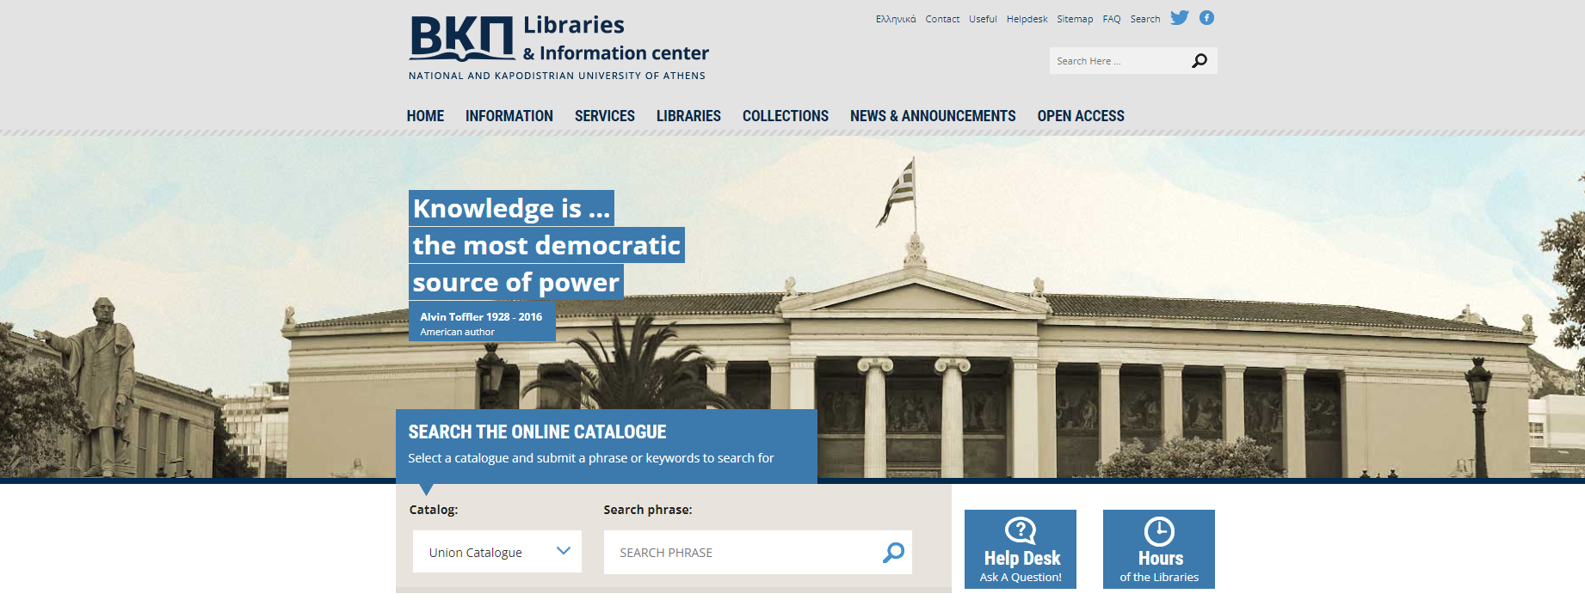
www.lib.uoa.gr
Notes:
The collections have been catalogued in their entirety and all bibliographic records and other relevant data are available on the Library's website www.lib.uoa.gr.

Slide 4
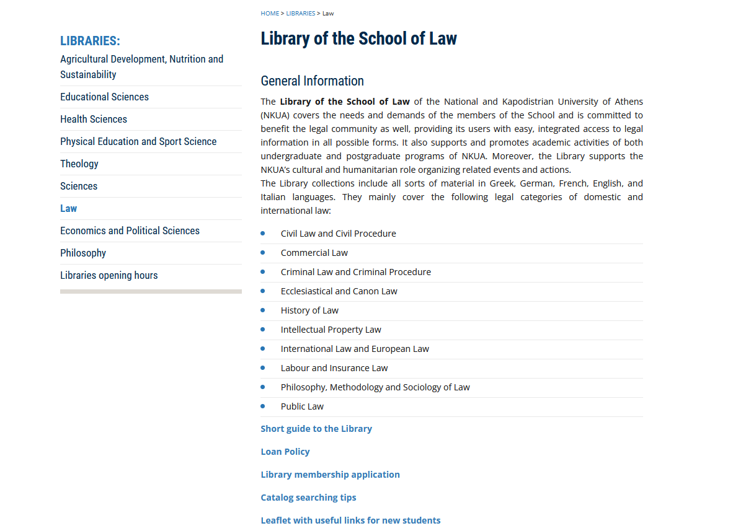
http://www-en.lib.uoa.gr/libraries/law.html
Notes:
The English version of the Libraries website.

Slide 5
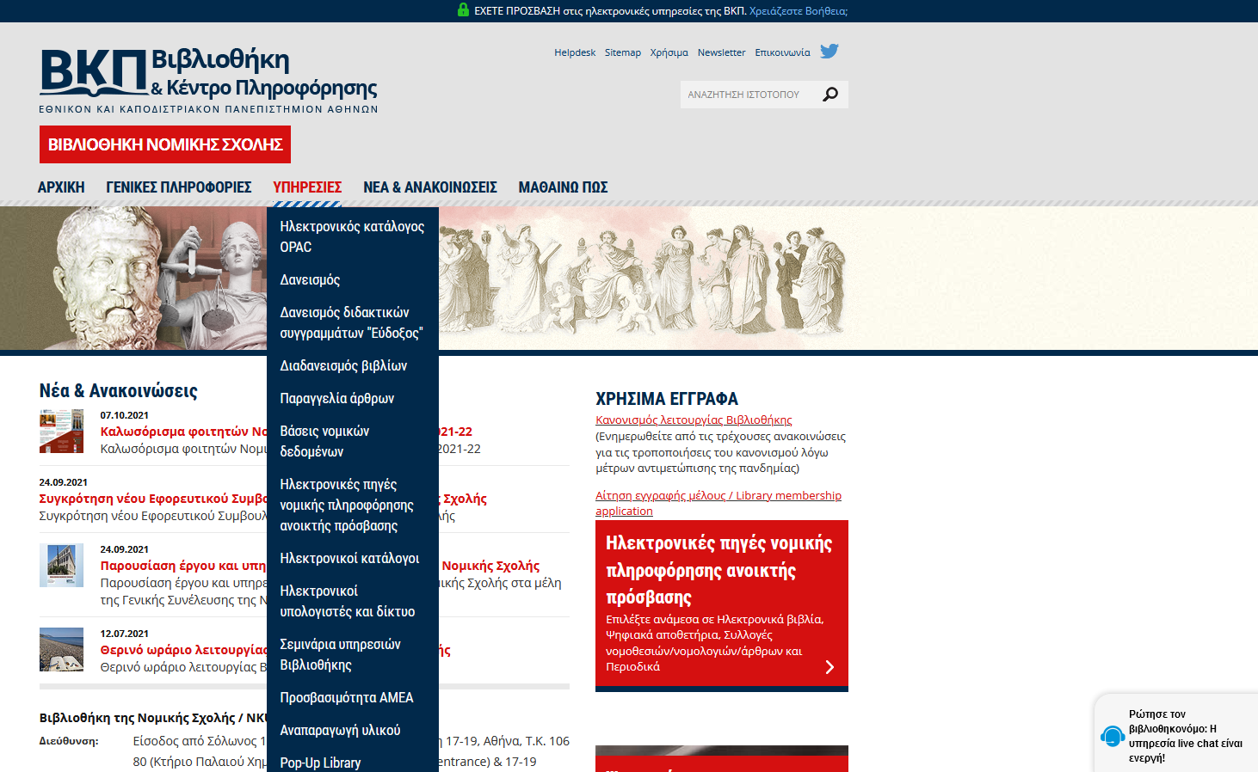
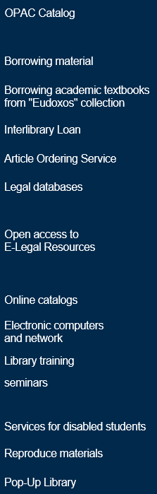
http://law.lib.uoa.gr/
Ask the Librarian
Notes:
If you have any questions, feel free to contact us either by phone or by e-mail, or just use our “Ask the Librarian” chat service!

Slide 6
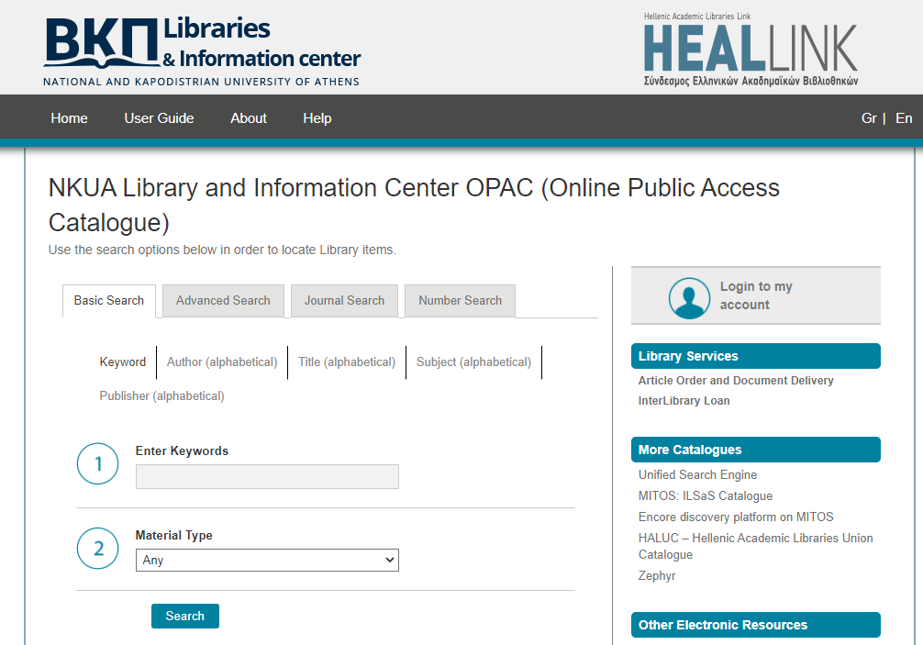
OPAC Catalog
https://opac.seab.gr/search~S6*gre
Open Access
Search the Cooperative Catalog
Search options
  Basic
  Advanced
  Journal Search
  Number Search
Notes:
The collection is fully automated and you can trace any material that interests you via the Online Public Access Catalog (ΟPAC), performing a simple or more advanced search.

Slide 7
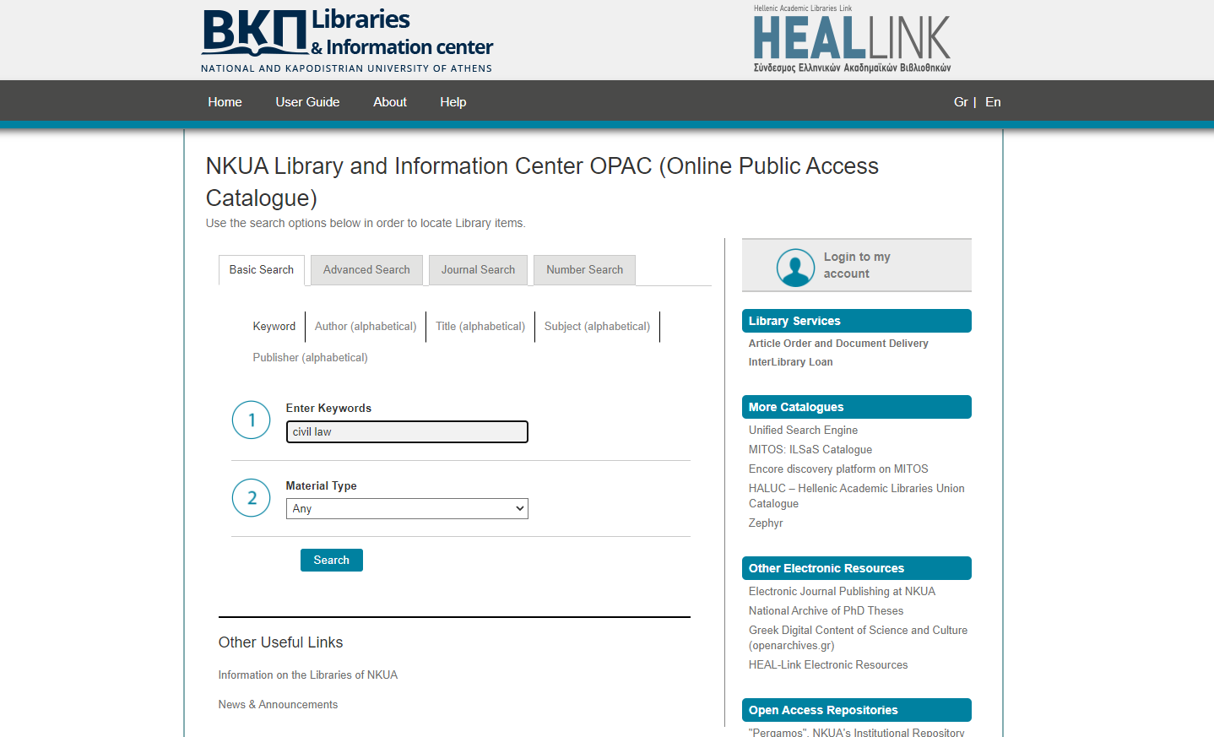
Keyword Search may return numerous results
Notes:
Keyword Search provides a search box to find words and phrases anywhere in the Catalog record, so it may return numerous results.
Title Search will return a list of titles in alphabetical order beginning with the entered word(s). If you know the book's author, you can enter their name in the Author Search. If you are interested in retrieving material on a specific subject (for instance Marriage), you can use the Subject Search.

Slide 8
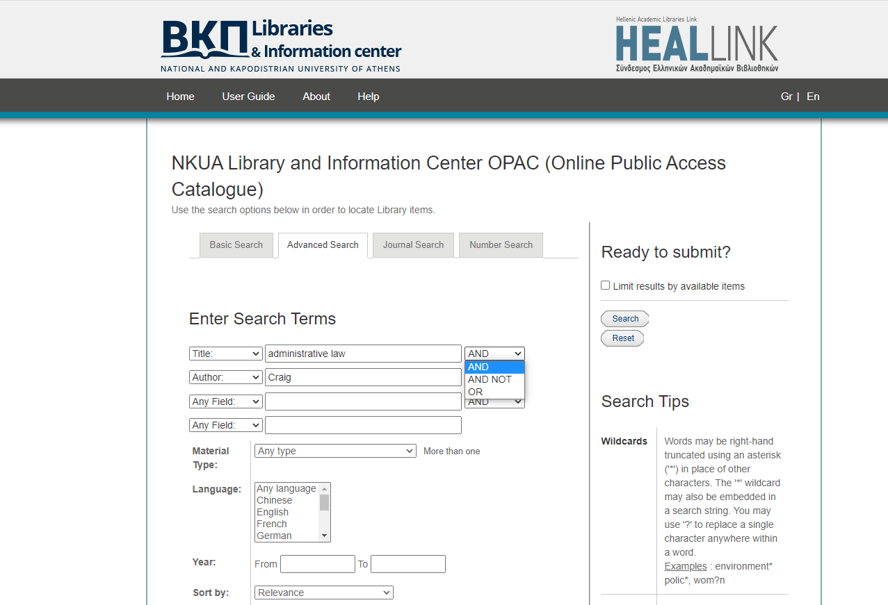
Use Boolean Operators
“AND“, “AND NOT”, “OR" to specify or exclude multiple words in any field
Notes:
Advanced Search provides a guided search template that helps you combine keywords found anywhere in the record or in specific record areas with the use of Boolean operators so as to limit your research even further. For example, if you are looking for Craig’s administrative law, you enter the words in the corresponding search fields, selecting the AND operator and then press Submit.

Slide 9
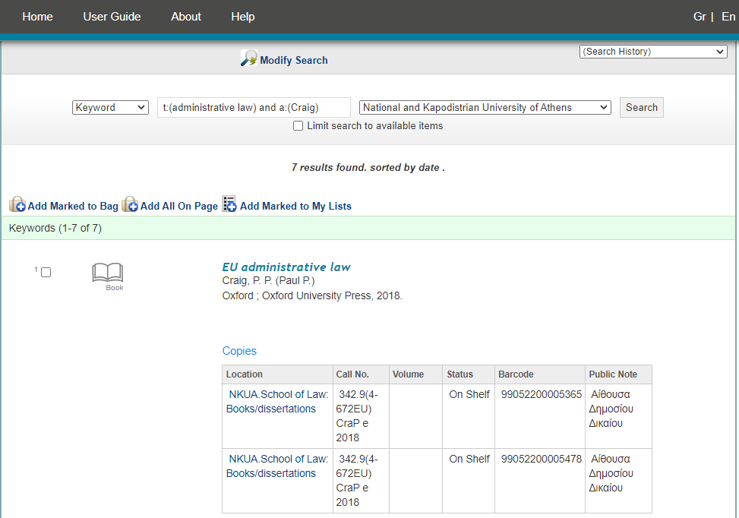
you can search outside the NKUA, in the catalogs of other academic libraries of the network
Check location & item availability Write down the Call No.
Notes:
The search results appear on the next page. After checking the item's location and availability (status), you will need the Call Number to retrieve it. The catalog comprises the collections of all NKUA libraries. Moreover, it is part of a broader co-operative academic library scheme, which allows you to perform searches outside the NKUA , in the catalogs of other academic libraries of the network. Don’t forget to log in to “my account” to check your book return dates and borrowing history, or renew library items.

Slide 10
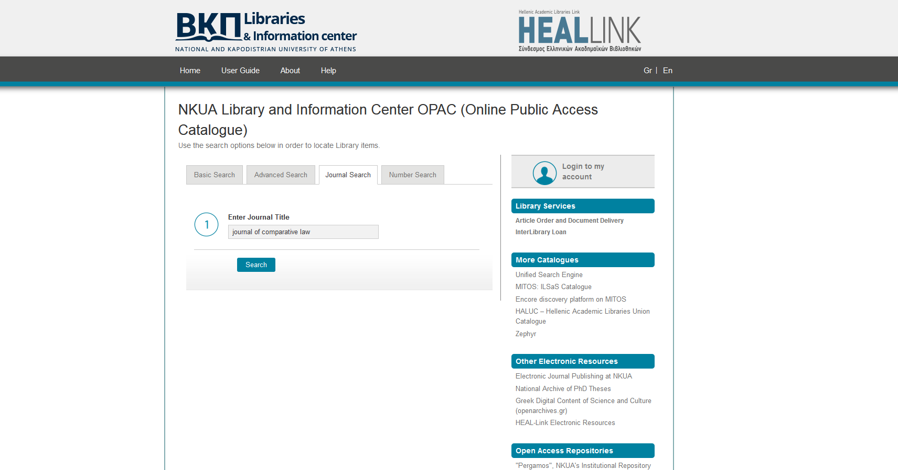
You can also enter the abbreviated title of the journal
Notes:
If you are interested in Journals from the library collection, use the Journal Search, by entering the journal title▀ or the abbreviation.

Slide 11
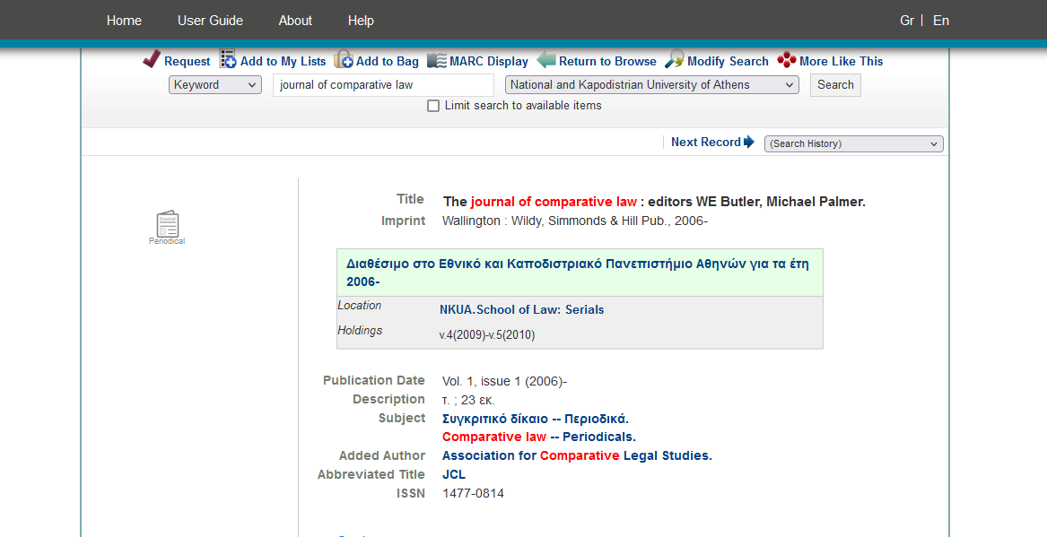
If the journal is available online, a hyperlink will lead you to the full text article, accessible via the NKUA network at the library premises or via VPN
Notes:
The results include info on the journal's location and issue availability. If the journal is available online, a hyperlink will lead you to the full text article, accessible via the NKUA network at the library premises or via VPN.

Slide 12
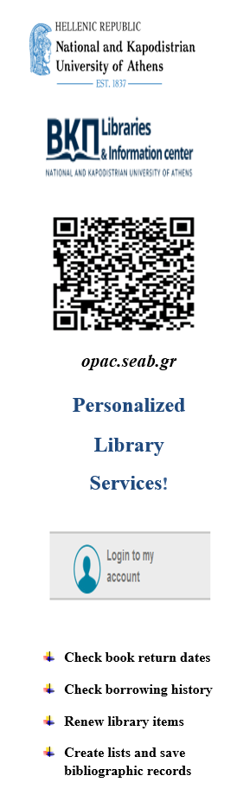
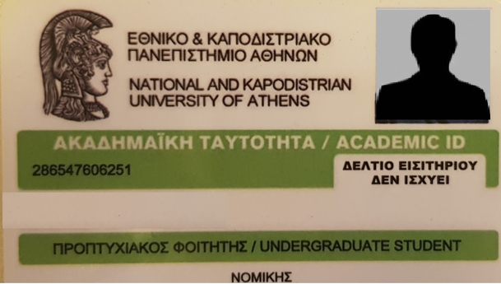
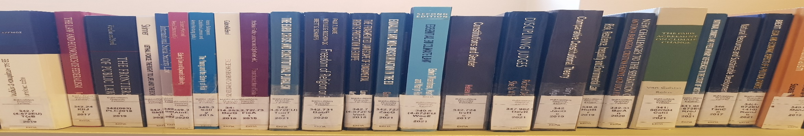
Borrowing & Returning Books http://law.lib.uoa.gr/ypiresies/daneismos.html
Unified Library guidelines and policies
Undergraduate students can borrow up to 5 items at once for 5 days
1 renewal for 5 days
  Some items are for use only in Library and may not be borrowed
  If your books become overdue there are fines
Article ordering service and Interlibrary loan
Notes:
Undergraduate students can borrow 5 items for a period of 5 days, which can be renewed for 5 days.

Slide 13
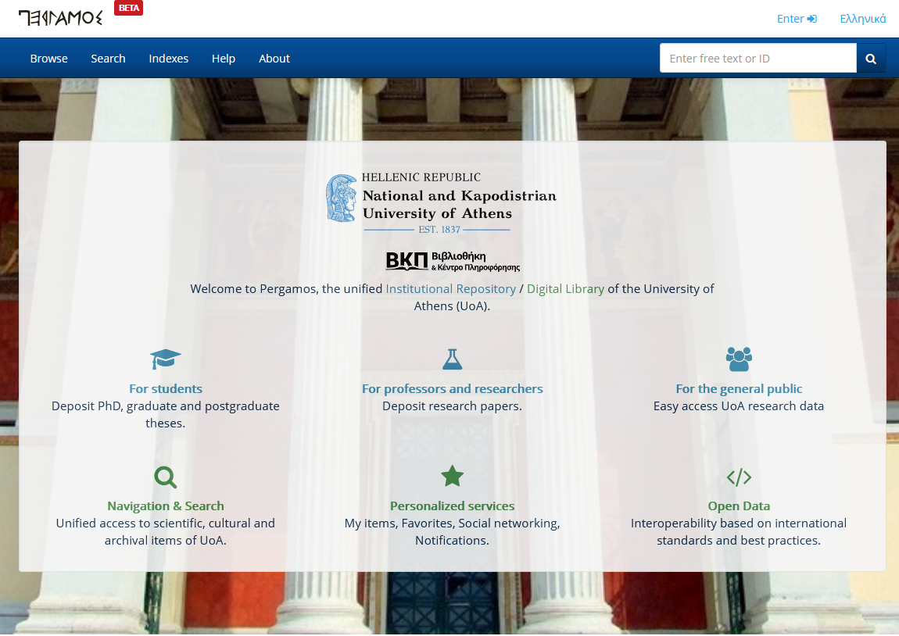
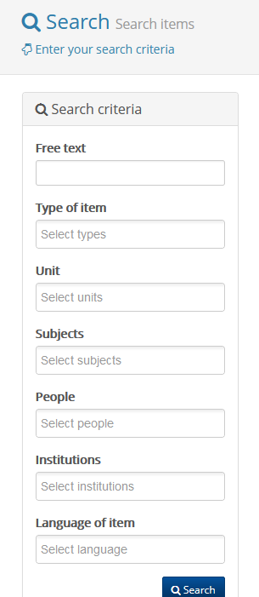
https://pergamos.lib.uoa.gr/uoa/dl/frontend/index.html
Notes:
Pergamos is the unified Institutional Repository and Digital Library platform of the NKUA, which integrates both the self-deposit workflow of postgraduate dissertations and doctoral theses, as well as various new digital collections. You can browse the contents or search for specific keywords appearing in the archives.

Slide 14
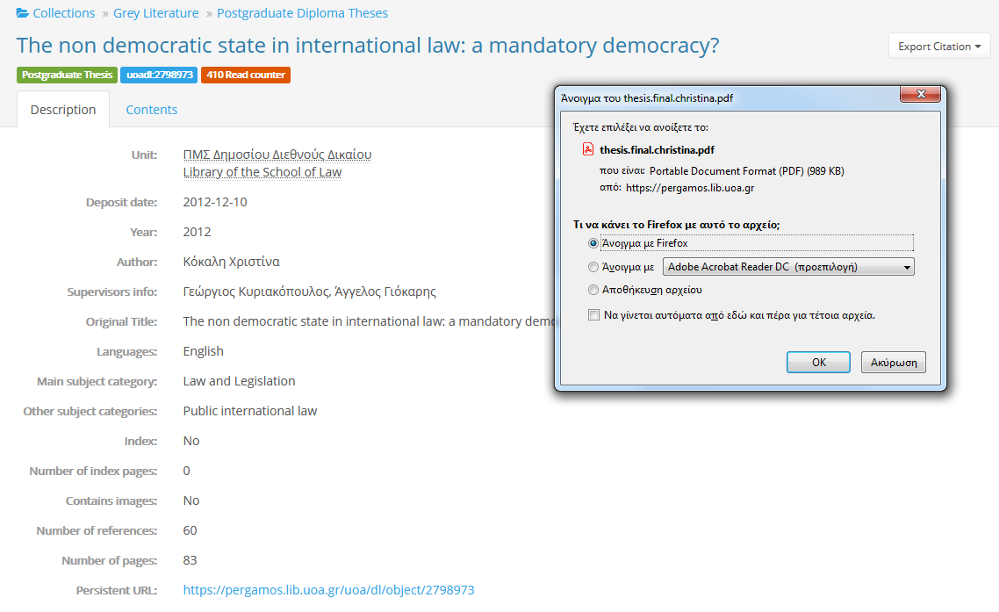
Notes:
Once you have found a result of your interest, the dissertation or thesis is available in pdf format.

Slide 15
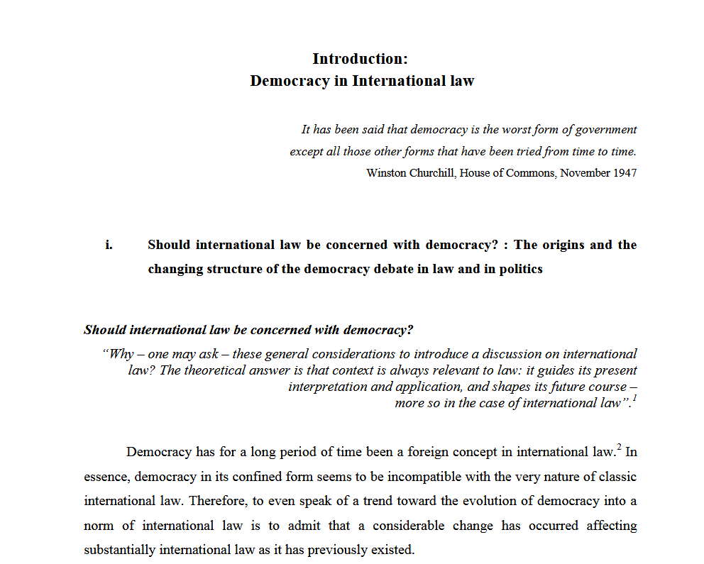
In some cases the digital file of the thesis remains offline for a period of time determined by the author
Notes:
It is possible that there may be access restrictions though. In such case the digital file of the dissertation remains offline for a period of time determined by the author (6 months, 1 year or even 5 years in the case of a doctoral thesis).

Slide 16











Legal Databases
(library’s subscriptions)
https://www.qualex.gr/
https://www.sakkoulas.com
https://www.sakkoulas-online.gr/
http://www.dsanet.gr/1024x768.htm
https://lawdb.intrasoftnet.com/index.php
https://beckonline.beck.de/Modul/50910/Inhalt
https://www.dalloz.fr/dalloz
https://www.heinonline.org
https://www.jstor.org/
https://oxford.universitypressscholarship.com/
https://1.next.westlaw.com
Notes:
The Library provides access to online content available on Greek and international legal databases either via the NKUA network at the library premises or via VPN/Proxy Server.

Slide 17
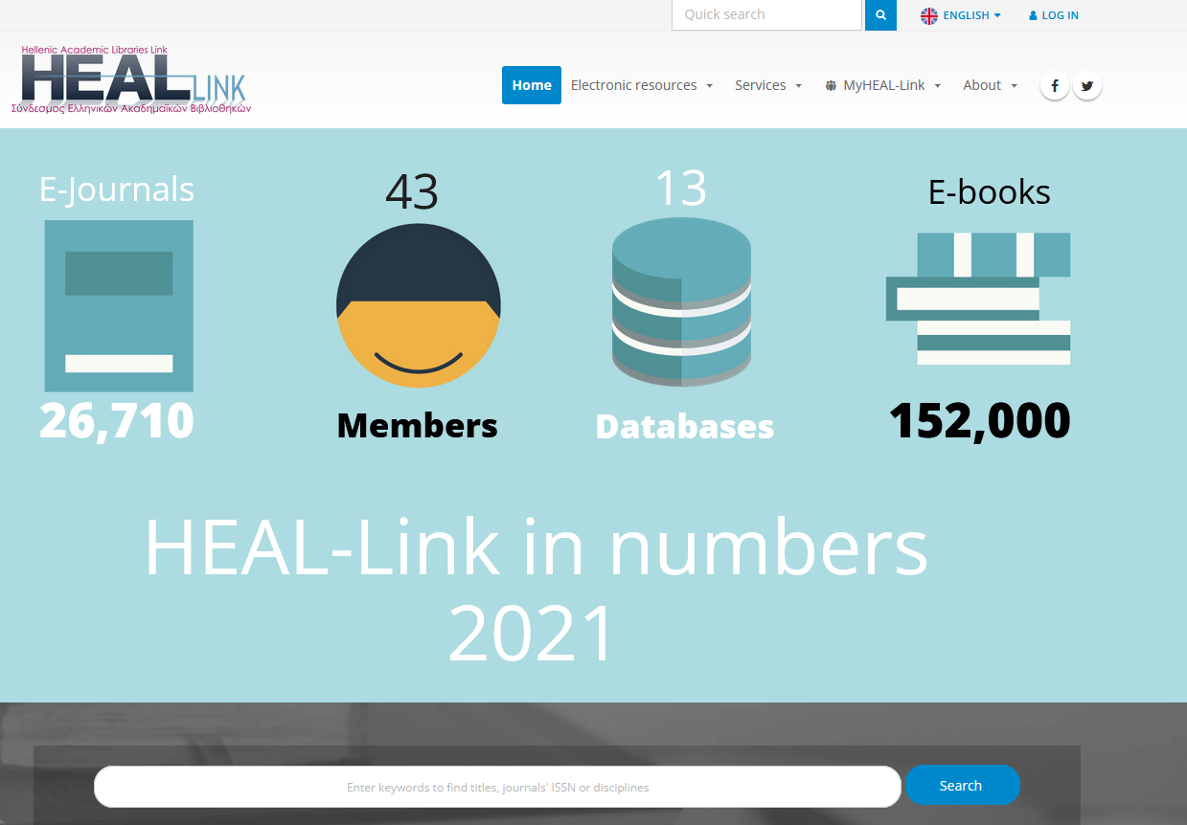
Electronic journals and e-books (HEAL-LINK) http://www.heal-link.gr/
Hellenic Academic Libraries Link (HEAL-LINK)
Full text access to electronic journals and e-books and bibliographic databases
Notes:
HEAL-Link is the Association of Greek Academic Libraries that operates in the form of a consortium and consists of 43 Institutions/Members. Through the HEAL-Link portal, the members have access to electronic material that is covered by the agreements that HEAL-Link has signed with several publishers and distributors. Access to electronic sources and bibliographic databases is also possible via the NKUA network.

Slide 18
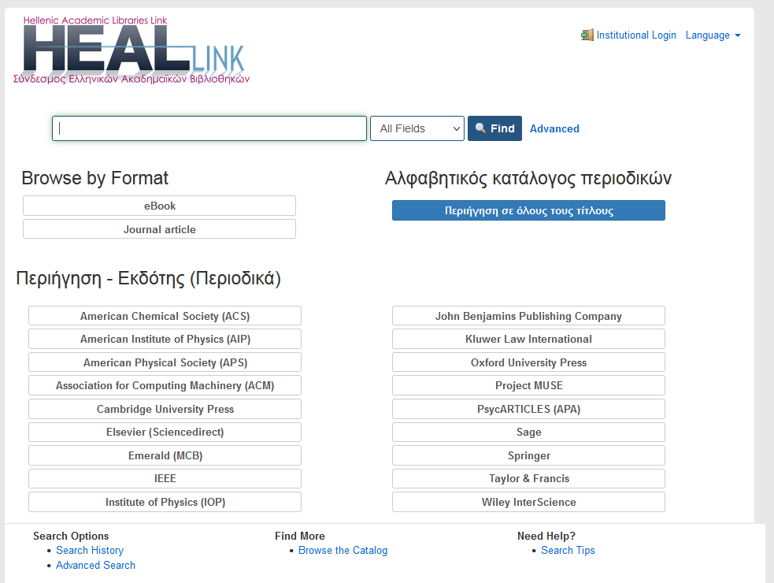
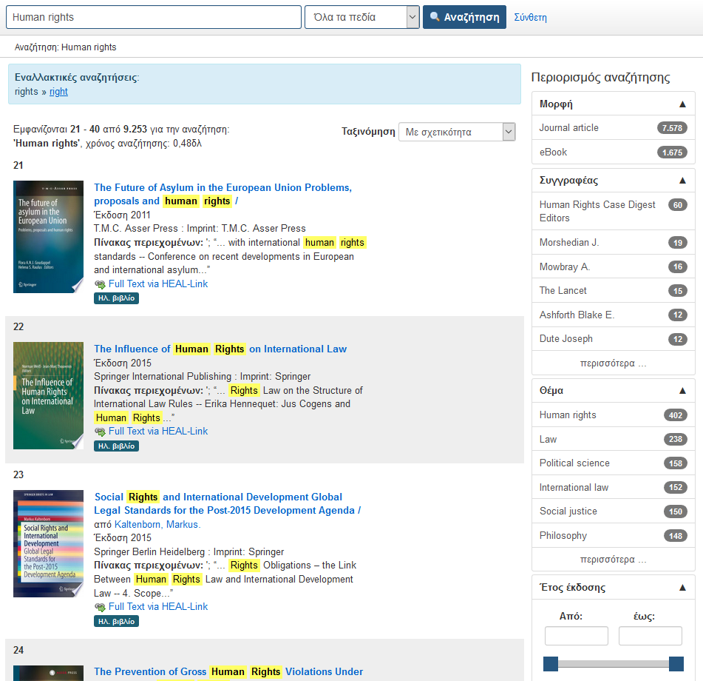
Title
Journal title
Author
Subject
ISBN/ISSN
Format
Notes:
HEAL-Link Unified search engine performs simultaneous search in e-journals (article level) and in e-books (title level). At the same time, it is possible to limit search results through multiple metadata filters.

Slide 19
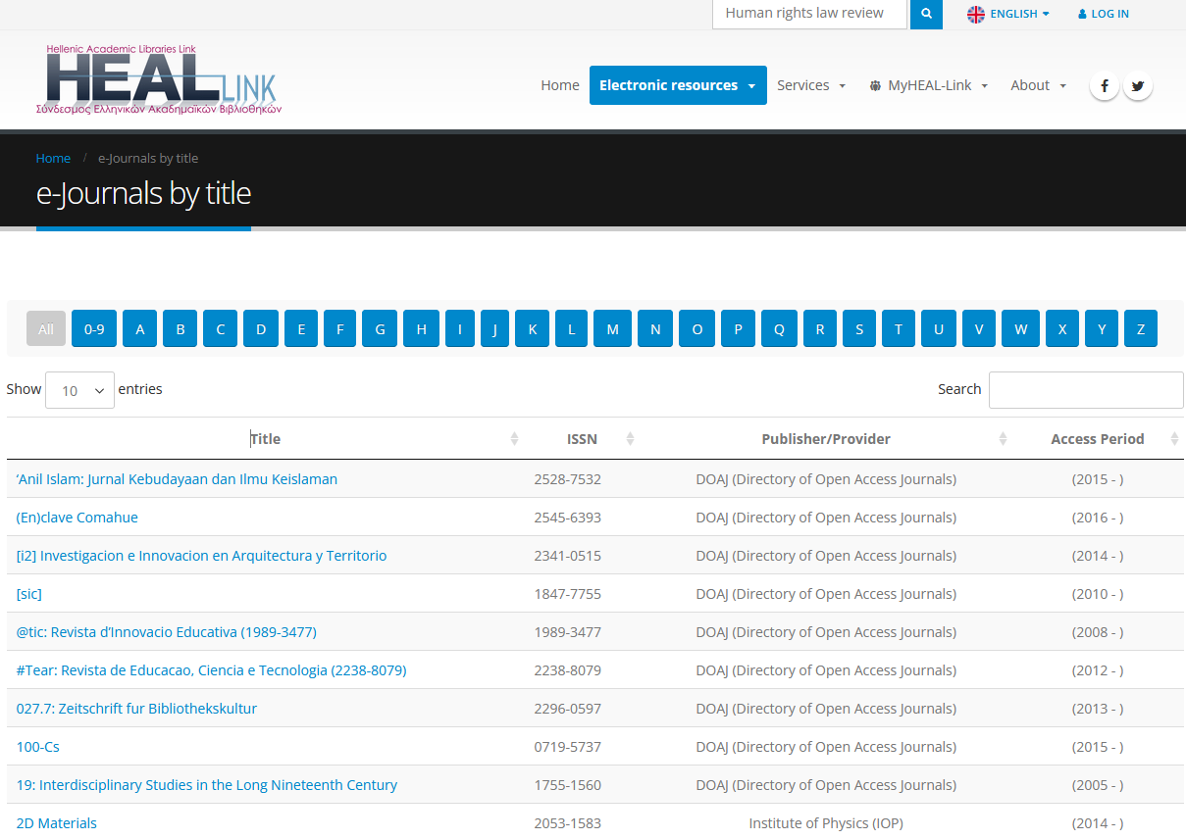
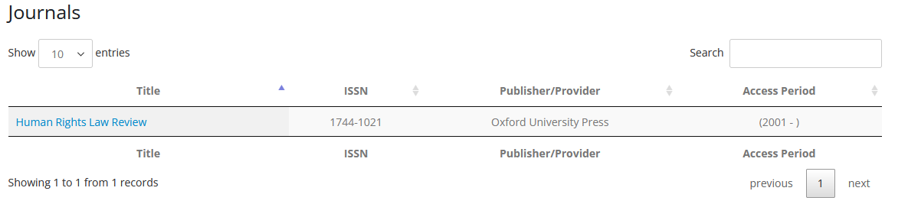
Notes:
By selecting menu “Electronic resources” and then submenu “E-journals”, you are able to browse the electronic journals that are covered by the HEAL-Link agreements and also a large number of open access journals: through alphabetical browsing by title, through subject indexing of the electronic journals, through the indexing of the electronic journal by publisher. Also, you can locate the journal you are interested in by typing all or part of its title in the “Quick search” field at the top right of the HEAL-Link portal.
Access to the full text is granted only for the years listed in the column “Access Period”.

Slide 20
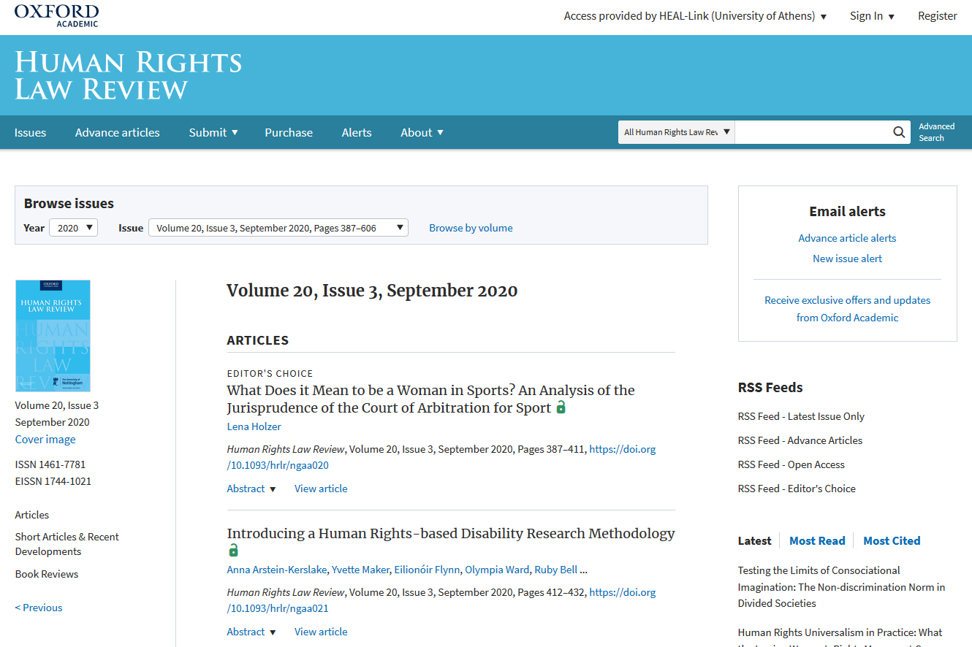
Notes:
Once you have selected the title of your interest, you are directed to the publisher’s/distributor's website to view the full text of the articles.

Slide 21
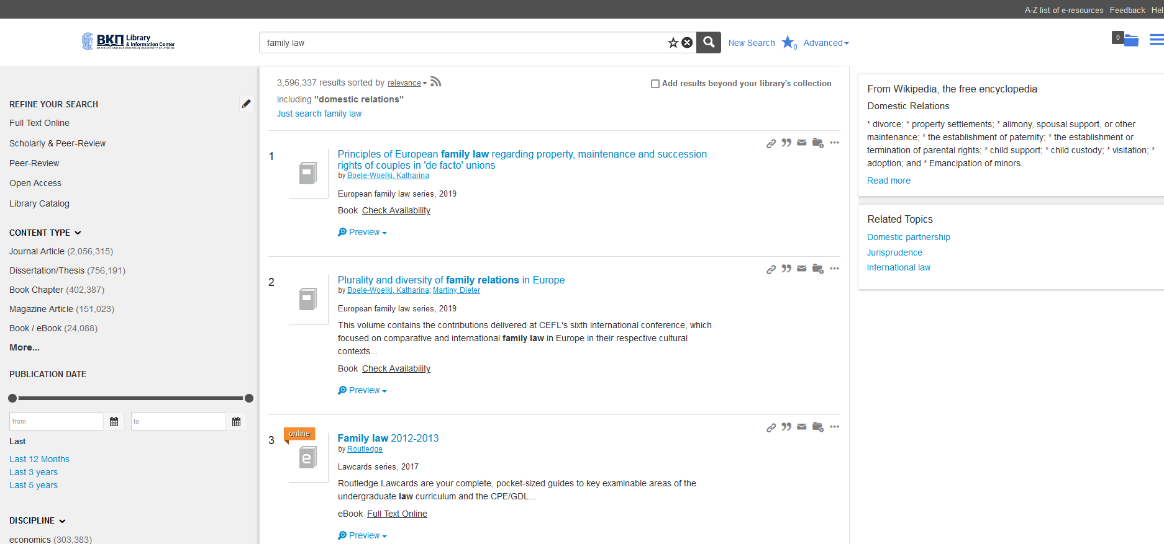
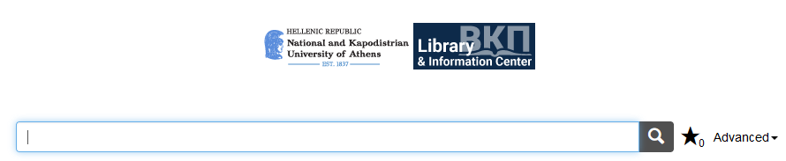
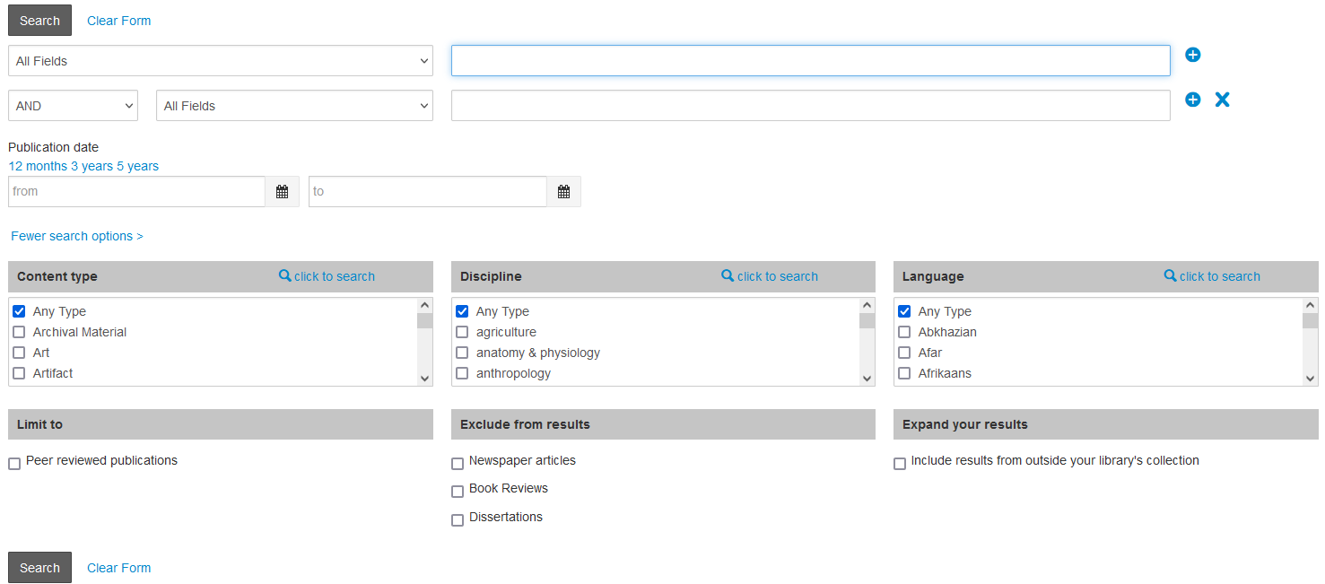
Unified Search Engine
Summon Discovery Service
www.lib.uoa.gr/summon
Includes :
NKUA Library & Information Center OPAC
NKUA Pergamos Institutional Repository
NKUA e-publishing
Bibliographic databases, eBooks & eJournals that NKUA subscribes to
HEAL-Link e-resources (nearly all journals and a big percentage of eBooks and bibliographic databases)
Open Access e-resources
Notes:
Last but not least, the Library and Information Center of NKUA, uses the Summon Discovery Service, in order to provide a Unified Search Engine for its e-resources. Summon performs a unified search in a multitude of online e-resources including: OPAC, Pergamos, HEAL-Link etc. The user can intervene in the search results with a range of filters and tools, but also expand the search to collections beyond the library.

Slide 22
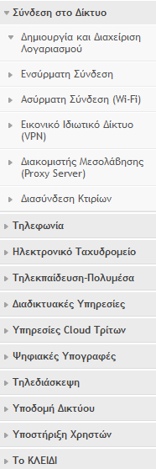
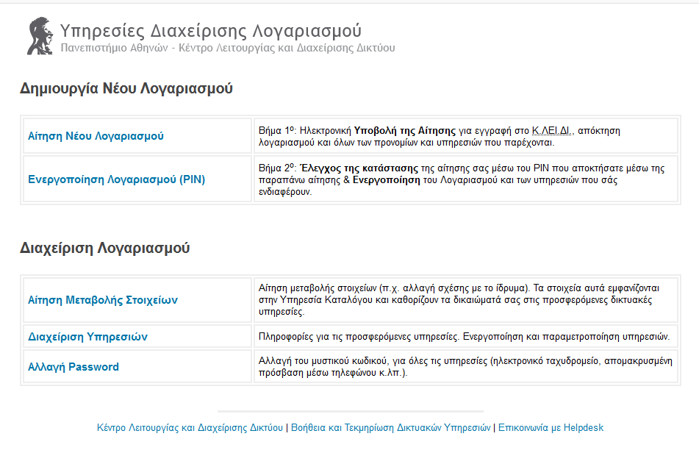
Access the NKUA Network via VPN Connection
or via Proxy Server
http://www.noc.uoa.gr
Network Operation Center (NOC)
Detailed Setup instructions
  Proxy Server
  VPN
Notes:
The NKUA offers two means of remote access. First, you can install the VPN software on your device, so that the connection can be achieved via a Virtual Network. Second, you can connect via a proxy server, without the use of additional software. In either case you will be asked to log in using CAS.

Slide 23

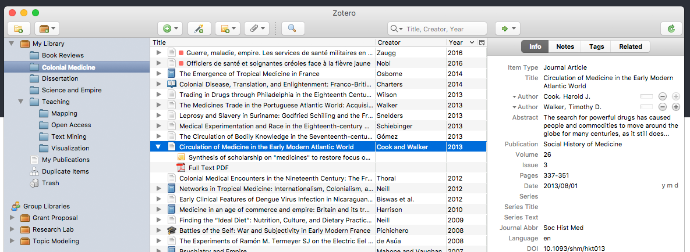
Reference Manager Software
Bibliographic software management tool
Insert references and bibliographies into documents
Supports many citation styles (e.g. APA and Harvard formats)
Read, highlight and annotate PDFs
Web Library
Notes:
NKUA provides its members with tools for better organization of their research. Mendeley and Zotero are online reference manager software which helps simplify the referencing workflow.
With these tools the user can store, organize and search all references from just one library. The user can also insert bibliographies into documents, read, highlight, annotate PDFs
and even collaborate with others by sharing references. The library organizes every year a workshop for their use.

Slide 24

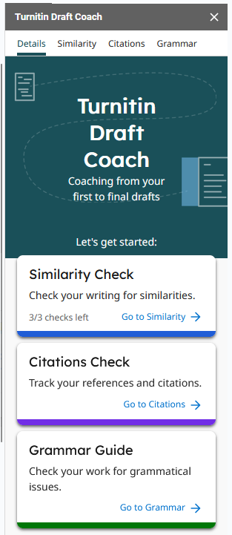
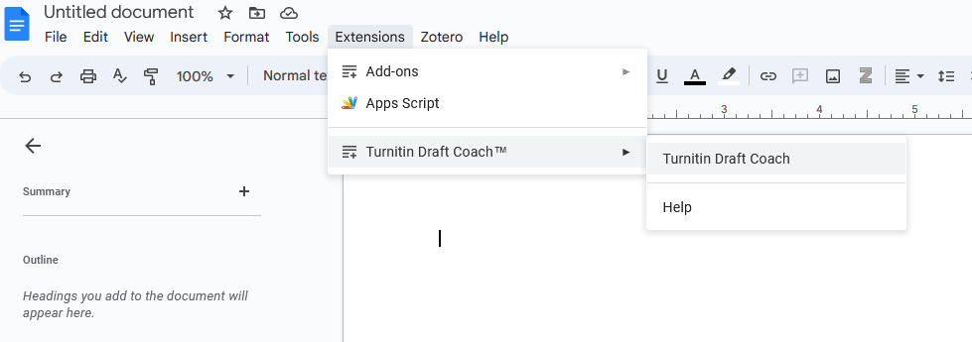

Plagiarism detection system http://www.lib.uoa.gr/ypiresies/apotropi-logoklopis-turnitin.html
Turnitin Draft Coach:
Connect to a Google account, by using a username@uoa.gr type
of account login
Similarity checks are only allowed
up to 3 times per document
Feedback Studio:
(student access relies on the instructors)
Upload assignments
Similarity check
Notes:
The National & Kapodistrian University of has annual subscription to Turnitin Plagiarism Detection System. Usage of Turnitin is intended for professors, instructors and faculty members, who can create an account at the software platform, via web based access, that will enable them to run an originality and plagiarism check to the papers submitted by their students in the course of their assignments/studies.

Slide 25



Services for Disabled students
ERMOFILOS http://access.uoa.gr/ERMOFILOS/
  Ensures equal access to knowledge
  Provides Digital Accessible Academic Textbook Services for students with disabilities
  Supports various formats (according to the type of disability)
  ERMOFILOS and Pergamos platforms are interoperable
  Students may address the Accessibility Unit of NKUA in order to search for or create texts they are interested in
Accessible Multi-modal Electronic Library AMELiB https://amelib.seab.gr/
Cooperating agencies:
  National Library of Greece
  Center for Education and Rehabilitation for the Blind
  Lighthouse for the Blind
  Panhellenic Association of the Blind HEAL-Link
  Volunteer Nonprofit Organization “Διαβάζω για τους άλλους”
Notes:
The Accessibility Unit of NKUA, manages the ERMOFILOS Information System, which provides Digital Accessible Academic Textbook Services for students with disabilities. Students may address the unit in order to search for or create texts they are interested in, in accessible formats that are appropriate for them. AMELib has been developed as part of the services offered by the "Hellenic Academic Libraries Association " and aims to provide accessible (online) books to all beneficiary print disabled students of Greek academic libraries.

Slide 26
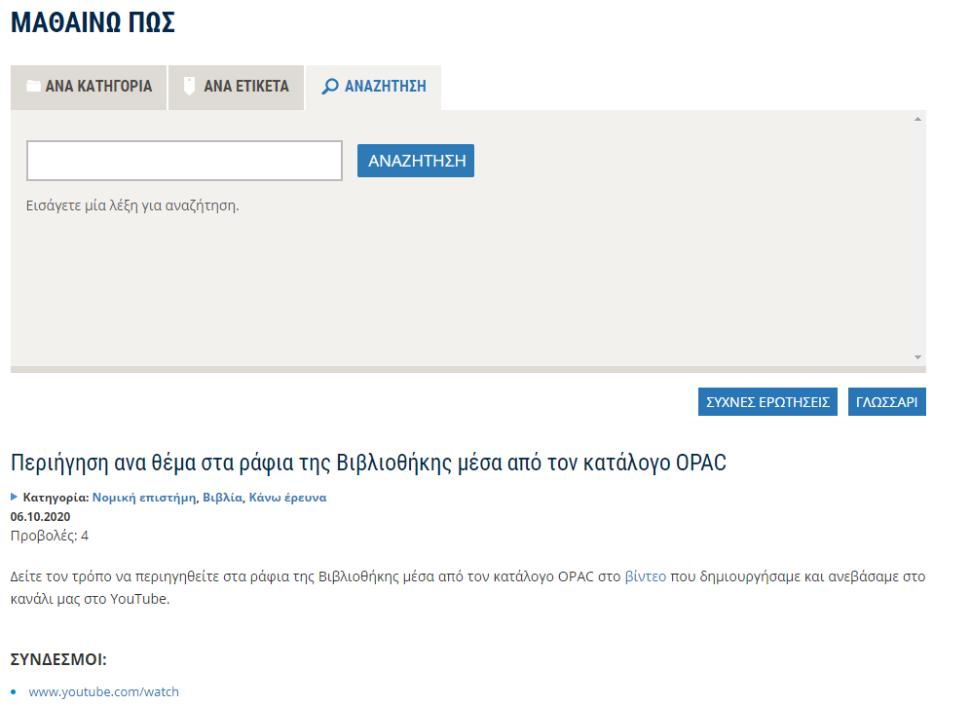
Knowledge base of Libraries and Information Center http://www.lib.uoa.gr/nc/mathaino-pos.html
Notes:
The section “LEARN HOW” includes guides in order to help users make use of the various library and other resources.

Slide 27
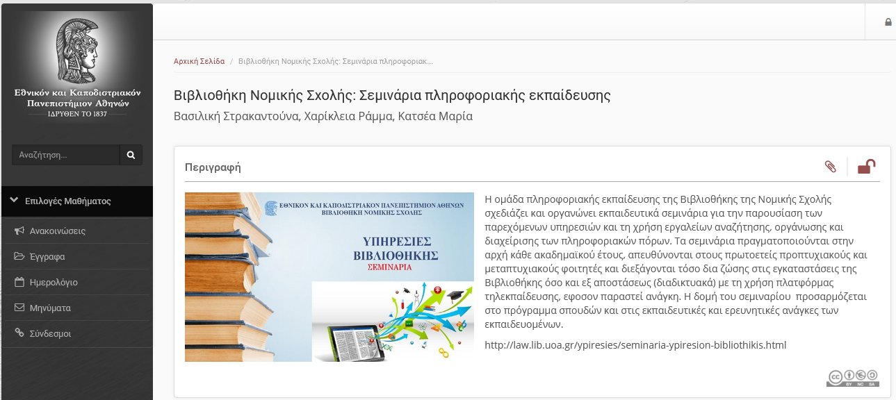
The PowerPoint presentation will be uploaded to eClass

Slide 28

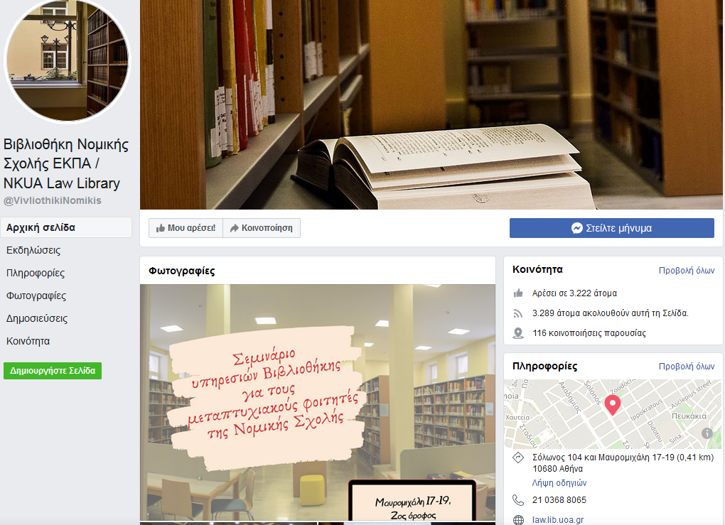
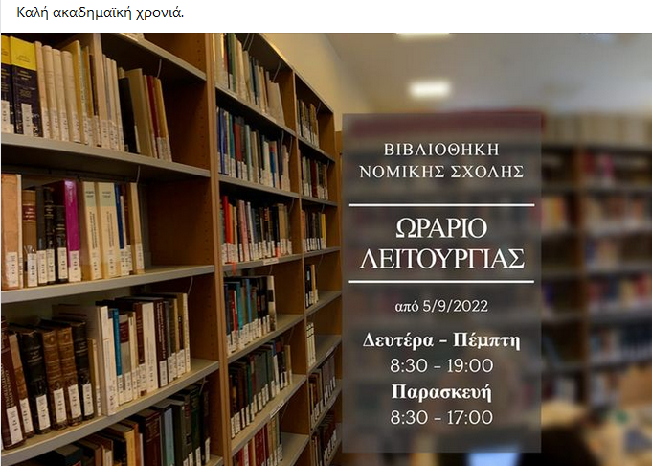

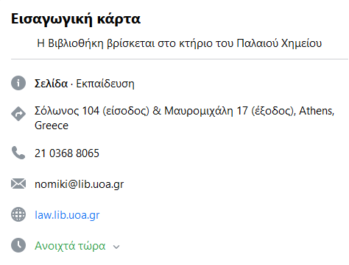
NKUA Law Library / Βιβλιοθήκη Νομικής Σχολής ΕΚΠΑ
Notes:
Do not forget to “like“us on facebook…

Slide 29


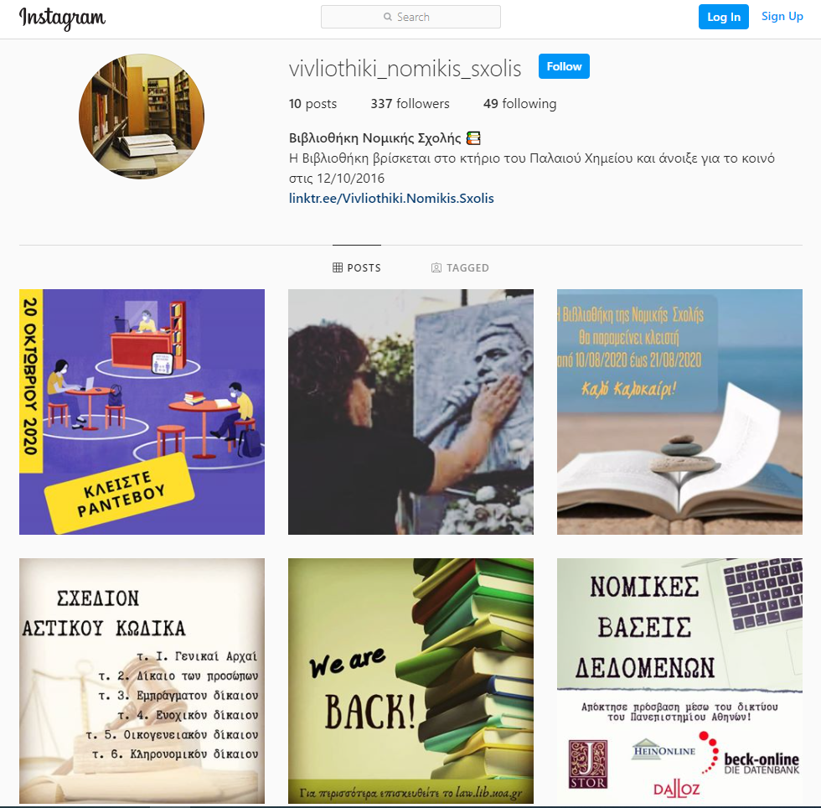
@vivliothiki_nomikis_sxolis_uoa
Notes:
…or follow us on Instagram.

Slide 30
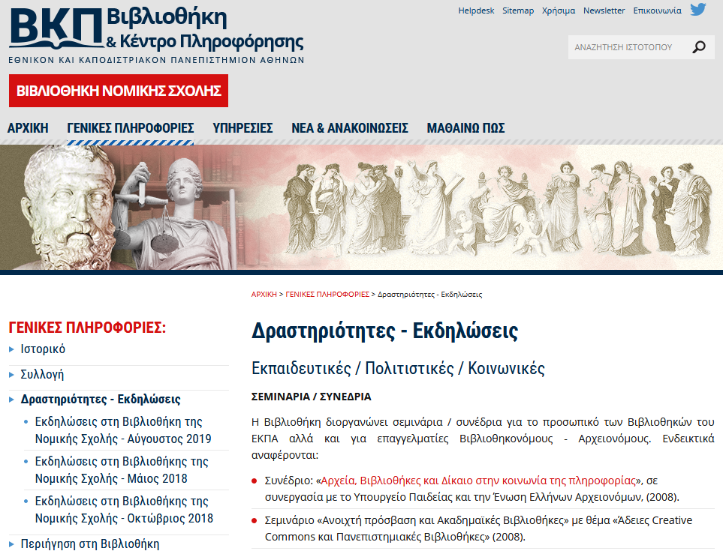

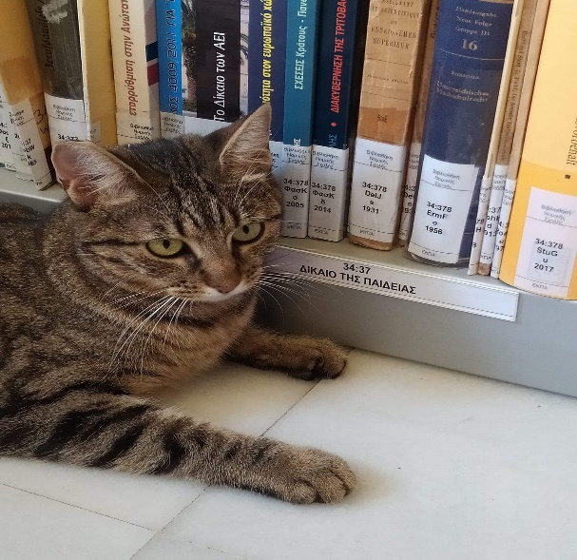
The Library supports the educational, social and cultural work of the University
Seminars- workshops
Cultural activities
Social connection
Notes:
The Library is an active contributor to the educational, social and cultural work of the University. Among others, it has organized special seminars and conferences on legal subjects, such as intellectual property and data protection. Since 2011 it has been coordinating the “Law and Art” team, a collaboration between students, professors and the Library, with the purpose of exploring the relation between art and the law.

Slide 31
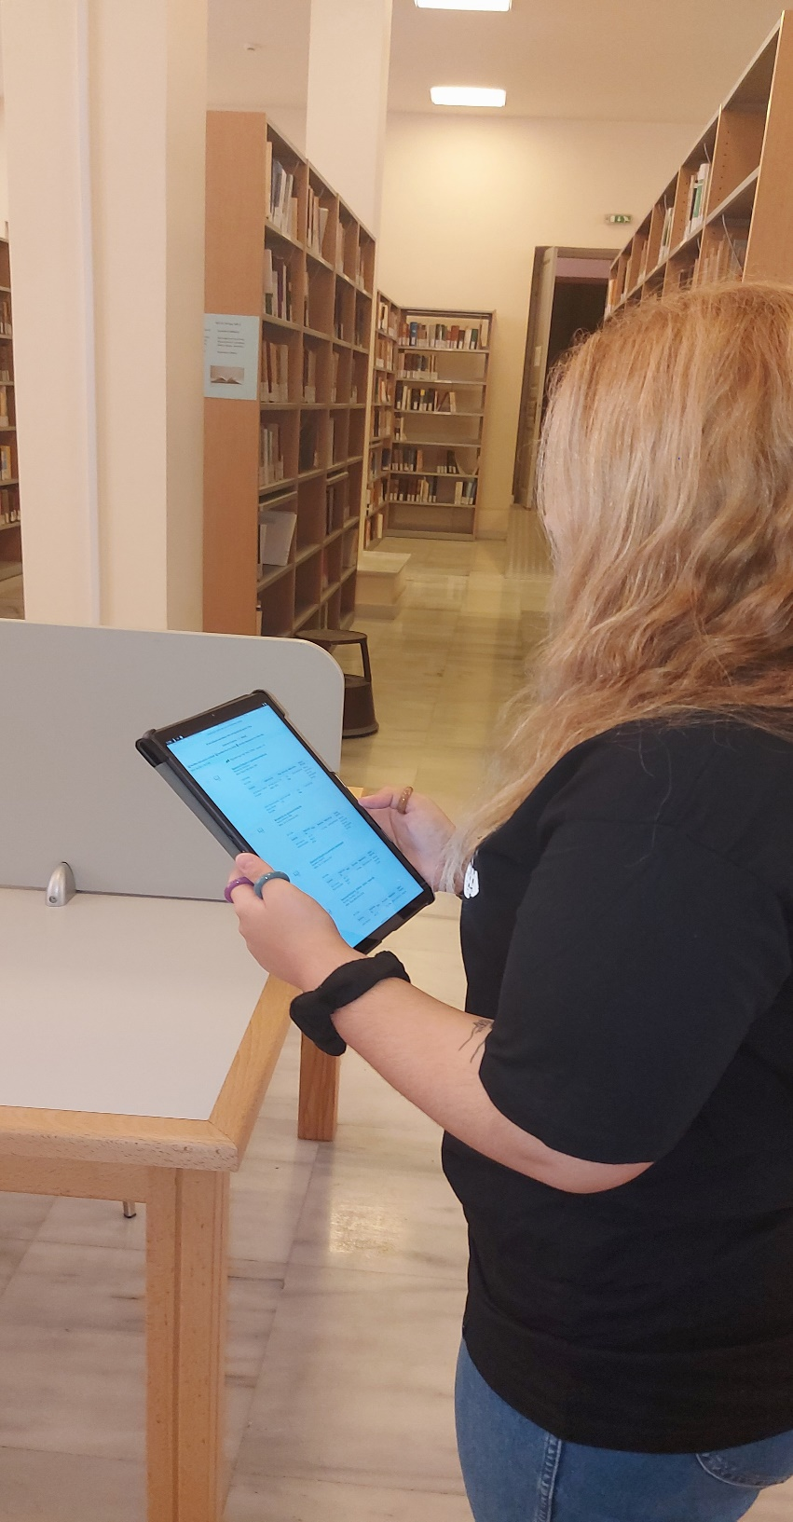
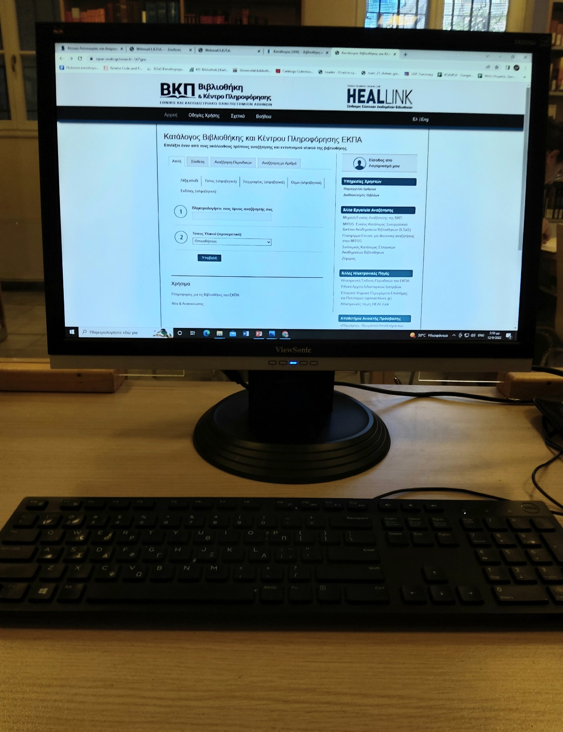
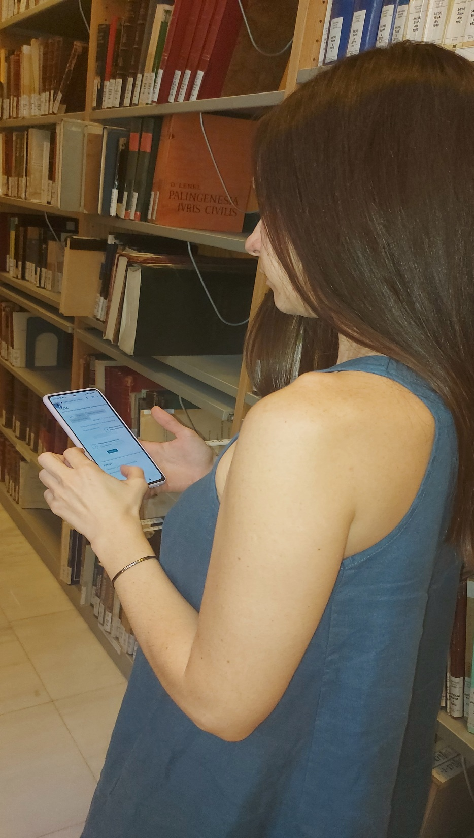
Search OPAC to locate books in the library https://opac.seab.gr/search~S6*gre

Slide 32
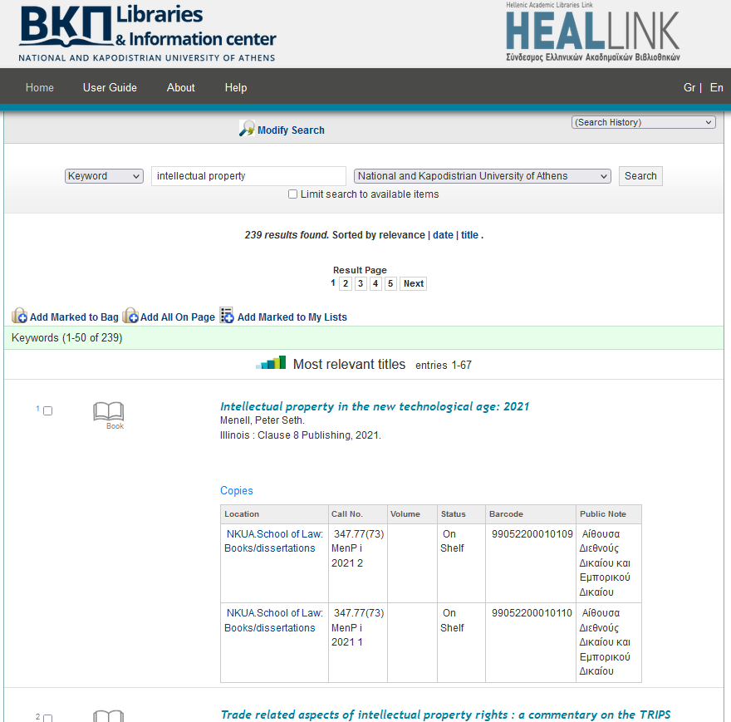
Use the Online Public Access Catalogue (OPAC) to locate library items:
Choose Basic Search: Keyword
Enter the search term (title, author, subject)
Constitutional law in Greece / Spyropoulos F.
The aims of punishment : theoretical, international and law comparative approaches / Papacharalambous C.
General principles of EU civil law / Reich Norbert.
Company law / Hannigan Brenda

Slide 33
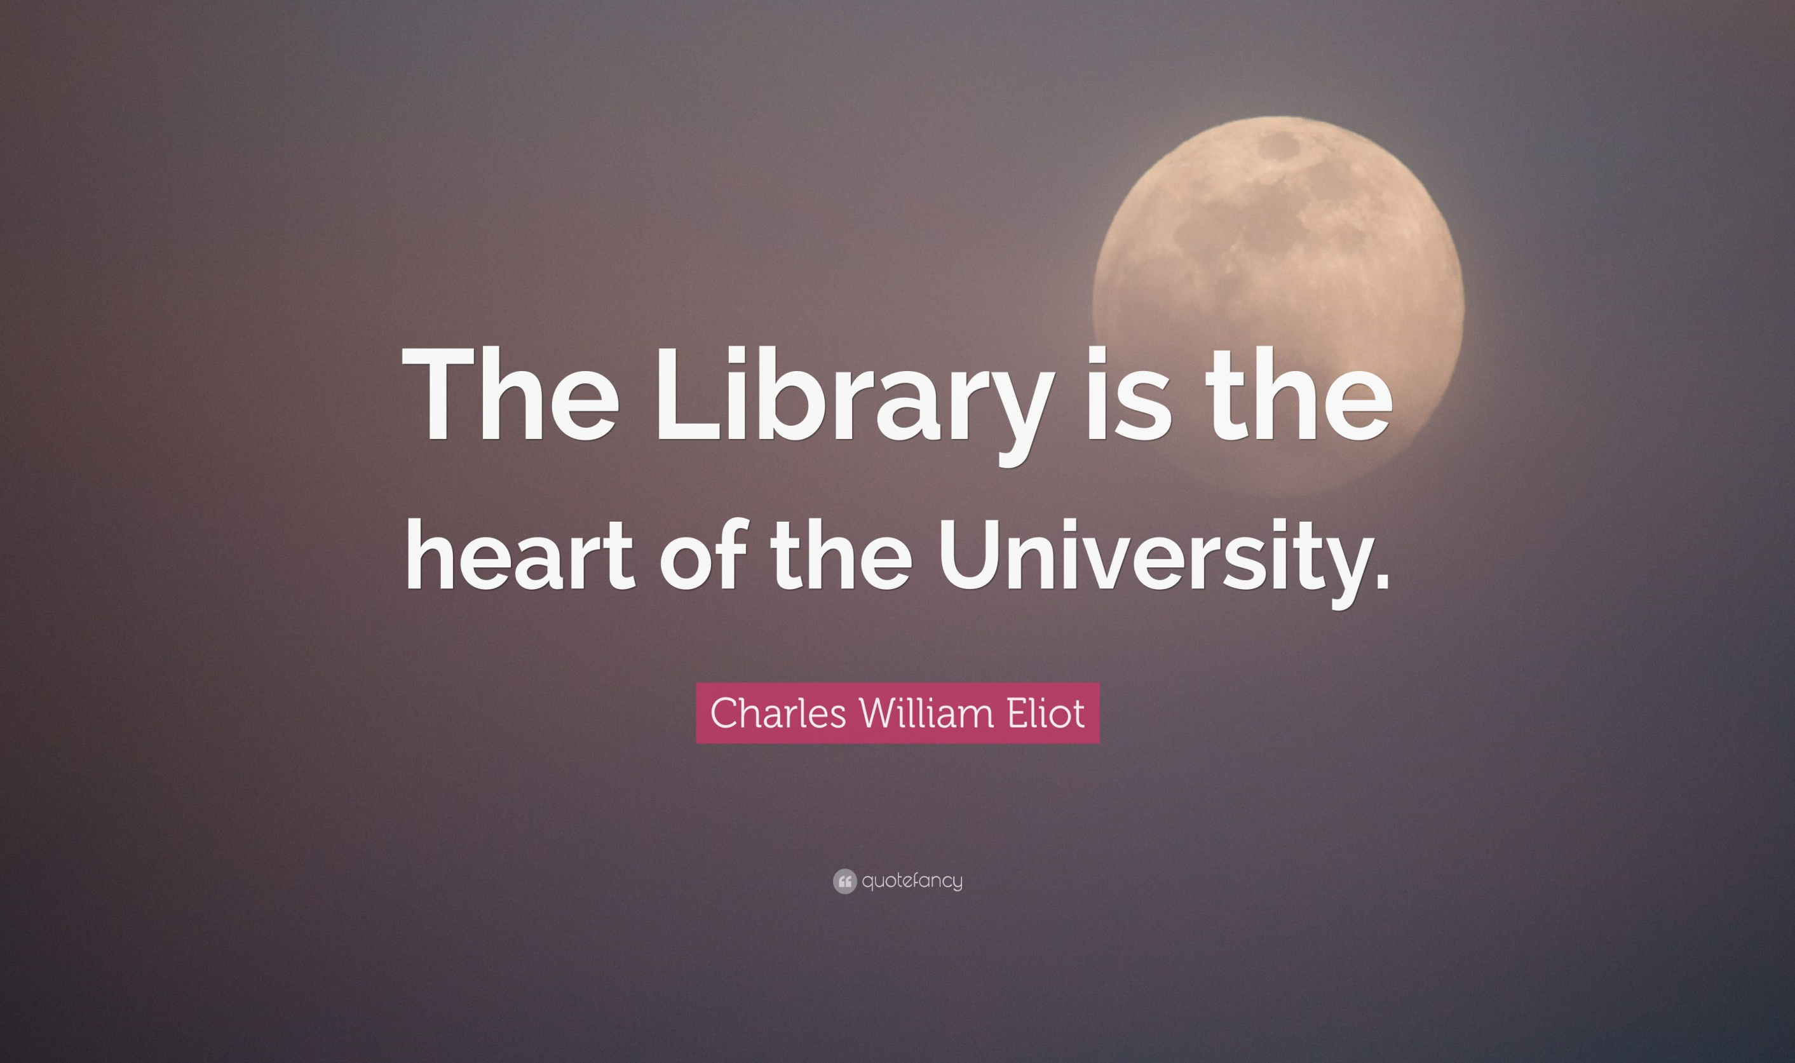
Notes:
Having established its position as a major cultural and educational institution in the Greek academic community, the Law Library of the National and Kapodistrian University of Athens remains open to the new challenges of the digital era in an unceasing mission to provide the best possible services.

Slide 34



Notes:
The library staff makes the best effort to cater for the users needs.

