Slide 1
The Definition of Permanent Establishment (PE)
LL.M. IELS 2025-2026
International and European Tax Law
Stefania Kalogeropoulou

Slide 2

The concept of existence
First references → the International Agreement for the avoidance of double taxation between the Austro-Hungarian Empire and Prussia, which goes back to 1899.
Found in the early model conventions, including the 1928 model conventions of the League of Nations.
The most important threshold for source taxation, facilitating cross-border activities and determining the right of a State to tax the business profits of a non-resident enterprise.
Efforts to modify the permanent establishment concept for the digital economy resulted in amendments to the OECD Model Tax Convention and new Commentary, leading to the tenth version of the 2017 update that included several proposals from the BEPS reports.
Article 5 of the OECD MC → Definition
Permanent Establishment (PE): a distinct “situs”, a “fixed place of business” through which the business of an enterprise is wholly or partly carried on.

Slide 3
Definition Paragraph 1
Paragraph 1 →What are the key elements required for a PE to exist ?
The existence of a “place of business”→ broad meaning
A certain amount of space at the disposal of the enterprise, e.g., premises, land, building (power of disposition-effective power to use it on a continuous basis during an extended period of time, not intermittent or incidental use),
2 cases: American Income Life Insurance Company v Canada and Knights of Columbus v R,
constituting a coherent whole commercially and geographically (no formal right of ownership or leasing is required- tangible objects, not intangible).
“Fixedness” of the place of business→ distinct place with a certain degree of permanence, not of a purely temporary nature.
A sufficient a link-nexus between the business and a specific geographical location, even if activities are mobile.
Continuous physical presence for a fixed period is not essential, a recurrent or seasonal presence e.g. operations in arctic places, may suffice, provided there is a strong and exclusive connection with a particular State’s territory.
The “carrying on of the enterprise’s business” through the fixed place of business →different ways in which an enterprise may carry on its business, not a decisive criterion of its productive character.

Slide 4
Definition Paragraph 2
Paragraph 2 provides a non-exhaustive list of positive examples of places of business, each of which must meet the requirements of Paragraph 1 to constitute a permanent establishment.
Included Locations
Critical Requirements
Place of management (not necessarily an "office")
Permanence and duration are essential.
Short-term or temporary use does not create a PE.
Branch, office, factory, workshop
Mine, oil or gas well, quarry
Example
A lawyer resident in State A temporarily rents a small office in State B for a couple of weeks while visiting family. Although an office is listed in Article 5(2) as an example of a PE, this arrangement would likely not constitute a PE because of its very short duration.
Any other place of extraction of natural resources
Exploration activities are not explicitly mentioned, suggesting a broad interpretation of Paragraph 2.

Slide 5
Definition Paragraph 3
Construction Permanent Establishment
A building site or construction or installation project constitutes a PE only if it lasts more than 12 months. No precise definition, so the terms are interpreted broadly.
Included activities → Construction or renovation of buildings, roads, bridges, canals, pipelines, excavating, dredging, and installation of new equipment (indoors or outdoors).
Excluded activities → Limited to mere maintenance or redecoration.
A project may be treated as a single site even if based on multiple contracts, provided it forms a commercially and geographically coherent whole (e.g. multiple rows of houses under one permit).
Temporary interruptions→do not cause a permanent establishment to cease to exist.
The 12-month test applies separately to each site or project and counts only the actual duration of activities.
The 12-Month Rule

Slide 6
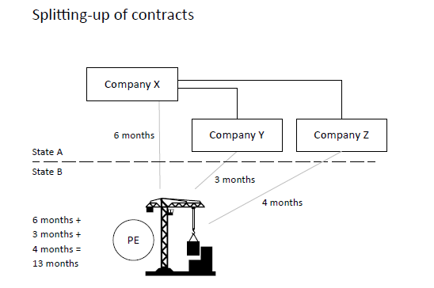
To prevent abuse, the OECD Commentary includes an optional anti-fragmentation rule:
Time spent by closely related enterprises on connected activities at the same site is aggregated, preventing artificial splitting of contracts to avoid the 12-month threshold.

Slide 7
Paragraph 4 → for a list of activities that are treated as exceptions to the general definition, even if carried on through a fixed place of business.
V
Typical Excluded Activities
The Key Test: Nature of Activity
Core Activity Exception
- Storage, display, or delivery of goods
Preparatory: Activities that precede and are carried out in contemplation of a core activity (e.g., training employees at one location before deployment at work sites elsewhere).
If the activity forms an essential and significant part (core activity) of the business, the exception does not apply. Management activities, for instance, are typically considered core functions.
- Maintenance of stock
- Purchasing or information gathering
- Use of cables or pipelines for
exclusive transport of own products
Auxiliary: Activities carried on simultaneously and only in support of the core activity, without requiring significant resources (assets or employees).
Example
A company resident in State A runs an e-commerce business and operates a large, well-staffed warehouse in State B to store goods and ensure fast local delivery. Although the warehouse is used only for storage and delivery, these activities are not auxiliary because they are essential to the business and involve substantial resources.

Slide 8
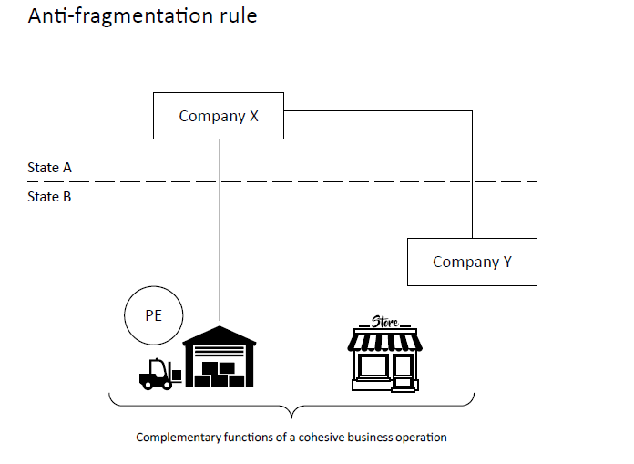
DEFINITION PARAGRAPH 4.1
Aim→ preventing an enterprise or a group of closely related enterprises (Company X and Company Y→ Example 1) from fragmenting a cohesive business operation to take inappropriate advantage of the list of activity exemptions of paragraph 4.
Without such a rule, businesses could easily split their operations among several fixed places, each claiming an activity exemption, even though together these activities form a core business operation and would effectively amount to a permanent establishment.
A new antifragmentation rule was introduced with BEPS→ known as Amazon’s “permanent establishment example .

Slide 9
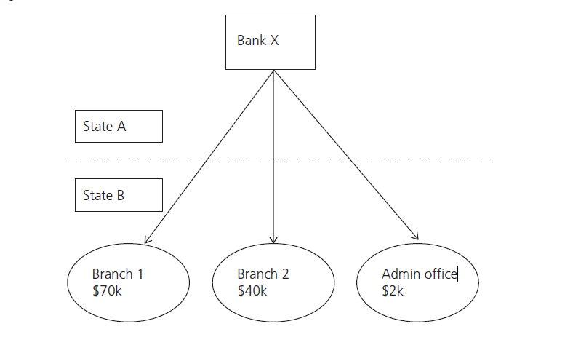
DEFINITION PARAGRAPH 4.1
Example 2
A bank in State A operates branches in State B and a separate administrative office performing loan screening.
Prior to the 2017 amendments to Article 5 of the OECD Model, the activities of the administrative office would have been regarded as preparatory or auxiliary and therefore excluded from PE status.
Introduction of the anti-fragmentation rule →the administrative office is treated as part of a cohesive business operation.
Its activities are aggregated with those of the branches, allowing State B to tax the full profits of the combined activities.

Slide 10
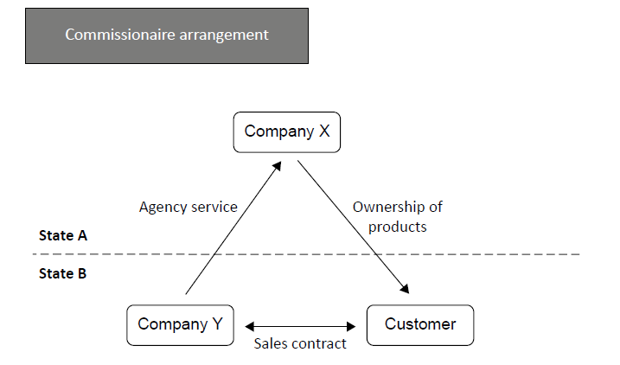
Definition Paragraph 5
Paragraph 5 → provides the definition of a dependent agent permanent establishment (Agency PE).
Dependent agent:
-a legally separate company or individual from the enterprise, acting on behalf and involving that enterprise to a particular extent.
-creates a deemed PE without there being a fixed place of business.
Key →If the enterprise is directly or indirectly affected by the actions of the agent in business activities e.g. binding contracts.
“Principal role” leading to the conclusion ofcontracts and is typically associated with the actions of the agent (e.g. a sales representative).

Slide 11
Definition Paragraph 6
Two exceptions to the definition of dependent agent permanent establishment:
A dependent agent permanent establishment does not exist where the qualifying agent carries on preparatory or auxiliary activities (list of activity exemptions provided by article 5 par.4 of the OECD Model).
The second exception to the dependent agent permanent establishment, is the independent agent (a broker, a general commission agent or any other agent of an independent status, Article 5 par.6).
Criteria to determine the Agent’s Independence:
subject to detailed instructions or comprehensive control,
number of principals represented or the related entrepreneurial risk is borne by the enterprise,
the agent cannot be regarded as independent of the enterprise,
working for several different clients,
skill and knowledge on which the enterprise relies.
The level of dependency is determined by measuring the extent of the freedom the agent enjoys in conducting business on behalf of the principal, acting exclusively or not exclusively.
Only dependent agents lead to a PE ≠ Independent Agents do not constitute PE.

Slide 12
Definition Paragraphs 7-8
Paragraph 7→ Parent–Subsidiary Relationship
Parent and subsidiary companies resident in different States are separate and independent entities
Control or factual influence over another company does not, by itself, create a PE
A PE may arise if:
the enterprise carries on business through the fixed place of business of another company, or
the other company acts as a dependent agent (Art. 5 par.5).
Paragraph 8→ Definition of a person “closely related” to an enterprise
Important for the application of paragraph 4.1 and paragraph 6 regarding the splitting up of contracts.
Optional provision to be included in the States’s tax agreements.

Slide 13
Recent amendments beps (Base Erosion And Profit Shifting) Project
Two Actions within the BEPS Project in the OECD Final Report
Action 1 considered whether the concept of PE is suitable for modern business models in a digital age.
Action 7 was designed to prevent the artificial avoidance of PE status → Amendments on Article 5 paragraph 3, 4, 5, 6 regarding the definition of PE in the 2017 MTC in order to :
Prevent the division of construction or installation projects between closely related enterprises or into multiple contracts avoidance of the time threshold for a construction PE (Art. 5 par.3).
Prevent treating core business functions of Art.5 par. 4 as non-PE activities and prevention of artificial splitting of a cohesive business operation into several smaller, each characterized as preparatory or auxiliary (e.g. large e-commerce warehouses).
Expanded dependent agent rule (Art. 5 par.5): A permanent establishment may exist even where an agent does not formally conclude contracts, but habitually plays the principal role leading to their conclusion on behalf of the enterprise.
Restricted independent agent status (Art. 5 par.6): Commissionaires and similar agents working mainly or exclusively for a closely related enterprise (e.g. a parent company) are no longer treated as independent agents.

Slide 14
ARTICLE 7 of the OECD Model Attribution of profits to the PE
Applies only if an enterprise has a permanent establishment under Article 5. Without a PE → no source-state taxation.
Τhe profits of an enterprise are only taxable in another state if attributable to a PE of the enterprise situated there.
Source State→ is entitled to tax only the portion of profits attributable to the activities carried out by that permanent establishment
Profits determined according to the arm’s length principle, as PE was hypothetically an independent, different enterprise.
Based on the Authorized OECD Approach (AOA)
Two-step analysis:
Functional and factual analysis of the PE
Attribution of profits based on functions, assets, and risks
Ensures consistency with transfer pricing principles

Slide 15
OECD vs UN Model Article 7
General approach
OECD Model Convention: emphasis on residence-state taxation.
United Nations Model Convention: strengthens source-state taxing rights.
Article 7 – Business Profits
Core rule in both Models:
Profits taxable only in the residence State unless a PE exists.
Source State may tax only profits attributable to the PE.
UN Model difference
Permits a limited force of attraction.
PE may justify taxing related activities not directly carried out through the PE.
Fees for Technical Services (UN Model)
Article 12A UN Model introduces a specific distributive rule.
Lex specialis overriding Article 7.
Priority confirmed by Article 7(6) UN Model.
If fees are:
Effectively connected to a PE → Article 7 applies
Not effectively connected → Article 12A applies
Independent Personal Services
UN Model retains Article 14.
OECD Model deletes Article 14, covering such cases under Article 5 (PE).

Slide 16
OECD vs UN Model Article 5
Construction PE (§3)
OECD Model: 12-month threshold
UN Model: 6-month threshold including:
-Assembly projects
-Supervisory activities
Services PE (UN Model only)
-Furnishing services through employees or personnel.
-More than 183 days in any 12-month period.
-No fixed place of business required.
Preparatory / Auxiliary Activities (§4)
Delivery excluded from the exemption under the UN Model.
Delivery may therefore create a PE under the UN Model but not under the OECD Model.
Dependent Agent PE (§5)
UN Model broader:
-PE may arise where an agent maintains stock and regularly makes deliveries.
-Authority to conclude contracts not always required.
Insurance PE
UN Model includes a special insurance PE provision.
PE more likely to exist compared to the OECD Model.

Slide 17
Permanent Establishment and the Digital Economy:
A Critical Assessment
Development of E-Commerce
1
The rise of e-commerce exposed the inadequacy of the traditional PE concept, which was designed for a physical economy based on tangible presence and activities.
2
Physical Presence Problem
Article 5 is based on physical presence—fixed place of business or personnel—not designed for virtual activities that characterize the digital economy.
Taxation Gap
3
Digital businesses can generate significant profits in a market without physical presence.
Result: no PE → no taxation in the source State, creating perceived unfairness.
4
Alternative Nexus Concepts
New nexus concepts are emerging: Digital PE, significant economic or digital presence, income level thresholds, use of digital elements, and relationships with users as alternative connecting factors.
Proposed Solutions
5
Solutions include amending Article 5 to cover digital economy realities or introducing specific digital services taxes (the so-called "Google tax") outside the treaty framework.

Slide 18
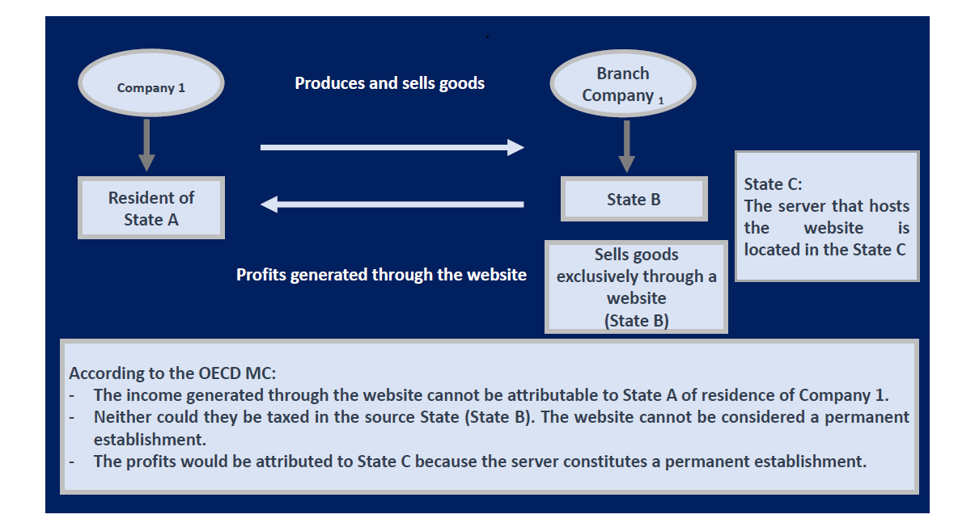
Example
Intangible property (website or computer code-software) can not qualify as a PE e.g.,selling customized beauty products through a dedicated website.
Tangible property (computer equipment, server-hardware) may constitute a PE if it is at the disposal of the enterprise and the business is carried on at the location of the equipment.

Slide 19
Bibliographic references
Βrettas, E., Permanent Establishment of Foreign Companies and Income Taxation, Nomiki Bibliothiki, 2024.
Claire Estebanez, Martin Sumper, Digitization and new business models: the concept of the permanent establishment today and tomorrow, SSRN, July, 2017.
Craig Elliffe, Meaning of “Permanent establishment” in Article 5 of Double Tax Conventions, Knights of Columbus, American Income Life Insurance Company v Canada.
Georgopoulou, Ch. (N.B.), Permanent establishment and taxation of the digital economy, Nomiki Bibliothiki, 2025.
Kuan Hua PHUA, Modernising the Permanent Establishment Concept: Evaluating Its Relevance in a Changing Business Environment and the Sufficiency of Recent Amendments, SSRN, April, 2023.
Lynne Oats PhD, Principles of International Taxation, Eighth Edition, Bloomsbury Professional, Chapter 9.
Model Tax Convention on Income and on Capital, OECD Model: Commentary on Article 5, 2017.
Montserrat Hermosín Álvarez, Permanent Establishment. The Crisis of the Article 5 OECD MC in the Digital Economy, December 2020, https://dx.doi.org/10.47092/CT.21.3.4, p.105.
Rohatgi R., Principles of International Taxation, Vol. 1, IBFD, Amsterdam 2021, Chapter 11.
Savvidou Aik., The OECD Action Plan (BEPS project) to combat tax avoidance and its implementation in the European Union, Nomiki Bibliothiki, 2022.

Slide 20
THANK YOU FOR YOUR ATTENTION!

