Slide 1
Special issues on the analyses of epidemiological data
“The issues of confounding, interaction, and effect modification revisited: multiplicativity and additivity of effects
and deviations from those”

Slide 2
STRUCTURE
The concept of interaction
Multiplicativity/additivity of effects
The multiplicative model (for rate or odds ratios)
Indexes of additivity
Multiplicative vs. additive estimates of effects
6. Statistical and biological considerations

Slide 3
‘‘…as more risk factors become established as probable causes in the elaboration of disease etiology, scientists will turn their attention increasingly to the question of interaction (synergy or antagonism) of the causes”
Kenneth Rothman
Interaction: an old concept

Slide 4
Interaction: recent use
Interaction – effect modification between >2 genetic variables
Interaction – effect modification between >2 exposures (e.g. smoking and alcohol in the risk of HCC)
Interaction – effect modification between a genetic variable and an environmental exposure (gene profile and high BMI in breast cancer risk)
Interaction – synergy help to understand the underlying mechanisms for observed associations

Slide 5
Background on statistical modeling
Start with the simplest model conceptually and statistically
(e.g H₀ – the null hypothesis)
And then test evidence against it
(e.g. H₁ – the alternative hypothesis)
Simple hypothesis and modeling:
Easy interpretation
Less parameters to estimate and communicate
BUT…
parsimonious model (optimal):
simplest (the least number of parameters and thus easy interpretation) model which captures the variability of the observed data

Slide 6
Simplicity and complexity
Concept | Modeling
 | Simple model (H_{o}) | More complex model (H₁)
Is exposure (ex) associated with outcome (case)?
No | H_{o}: xi: logistic case
Yes |  | H₁: xi: logistic case ex
Departures from linearity?
No | H_{o}: xi: logistic case ex
Yes |  | H₁: xi: logistic case i.ex
Confounding (e.g by age)?
No | H_{o}: xi: logistic case i.ex
Yes |  | H₁: xi: logistic case i.ex i.age
Interaction between ex and age?
No | H_{o}:xi: logistic case i.ed i.age
Yes |  | H₁: xi: logistic case i.ex*i.age

Slide 7
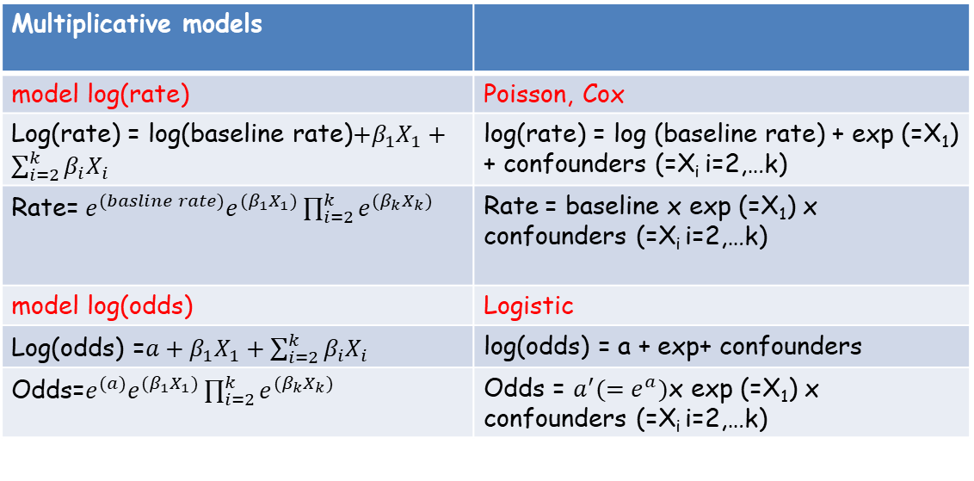
Models usually assume multiplivativity of associations (effects?)
Multiplicative models
model log(rate) | Poisson, Cox
Log(rate) = log(baseline rate)$+β_{1}X_{1}+\sum_{i=2}^{k}{β_{i}X_{i}}$ | log(rate) = log (baseline rate) + exp (=X₁) + confounders (=X_{i} i=2,…k)
Rate= $e^{(basline rate)}e^{(β_{1}X_{1})}\prod_{i=2}^{k}{e^{(β_{k}X_{k})}}$ | Rate = baseline x exp (=X₁) x confounders (=X_{i} i=2,…k)
model log(odds) | Logistic
Log(odds) =$a+β_{1}X_{1}+\sum_{i=2}^{k}{β_{i}X_{i}}$ | log(odds) = a + exp+ confounders
Odds=$e^{(a)}e^{(β_{1}X_{1})}\prod_{i=2}^{k}{e^{(β_{k}X_{k})}}$ | Odds = ${a^{′}(=e}^{a})$x exp (=X₁) x confounders (=X_{i} i=2,…k)
Estimates of ratio measures of associations
log(rate) rate ratio
log(odds) odds ratio
Associations combine by multiplying

Slide 8
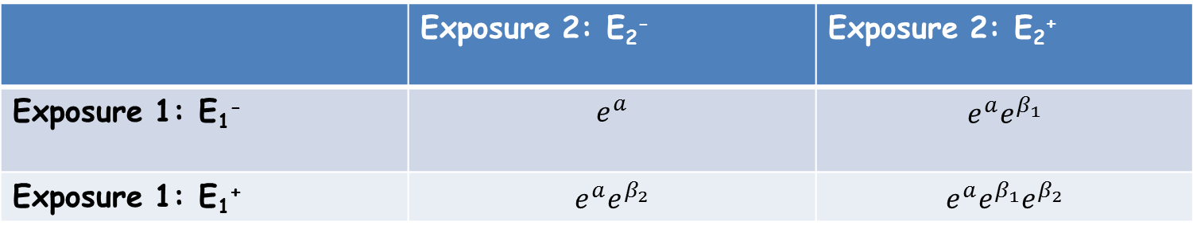

Multiplicative model: the parameters multiply
Predicted risk (e.g. odds) of disease for combinations of E1 & E2
Log (odds) = α + β₁x₁ + β₂x₂
 | Exposure 1: E₁⁻ | Exposure 1: E₁⁺
Exposure 2: E₂⁻
Exposure 2: E₂⁺
Assumption: the “effect” of E₁⁺ & E₂⁺ ON THE ODDS OF DISEASE as compared to E₁⁻ & E₂⁻ is assumed a multiplication of the effects ON THE ODDS OF DISEASE of each exposure when they do not interact with each other as compared to E₁⁻ & E₂⁻
Odds (disease) =$e^{(a)}e^{(β_{1}X_{1})}e^{(β_{2}X_{2})}$

Slide 9
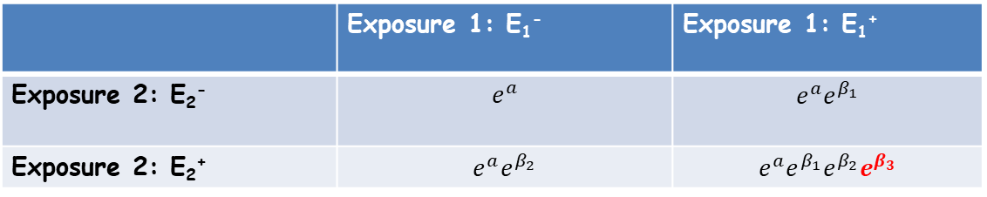
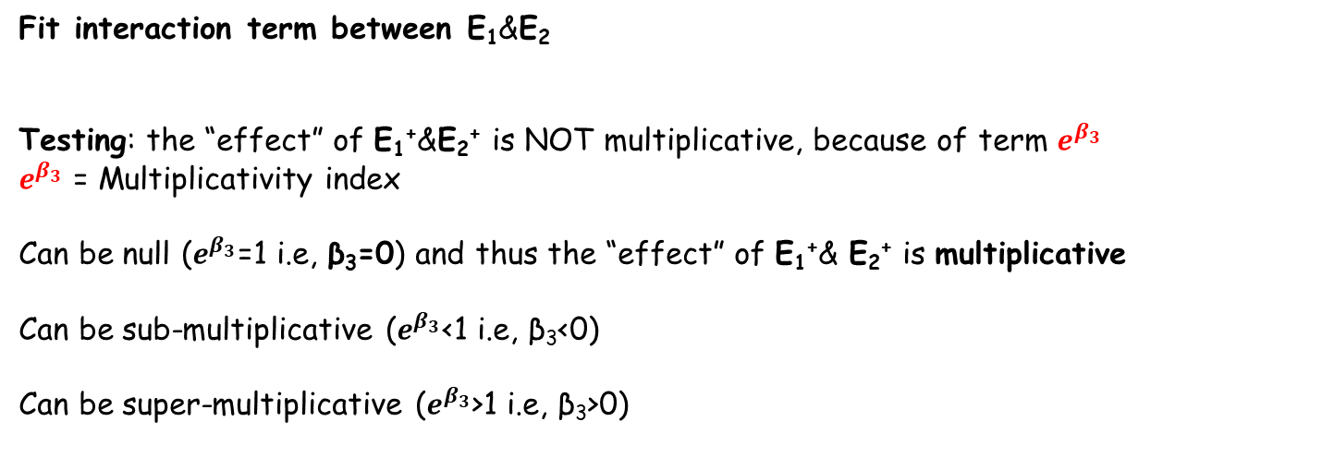
Multiplicative model: deviations from multiplicativity
Log (odds) = α + β₁x₁ + β₂x₂+ β₃x₁ x₂
 | Exposure 1: E₁⁻ | Exposure 1: E₁⁺
Exposure 2: E₂⁻ | $$e^{a}$$ | $$e^{a}e^{β_{1}}$$
Exposure 2: E₂⁺ | $$e^{a}e^{β_{2}}$$ | $$e^{a}e^{β_{1}}e^{β_{2}}e^{β_{3}}$$
Fit interaction term between E₁&E₂
Testing: the “effect” of E₁⁺&E₂⁺ is NOT multiplicative, because of term $e^{β_{3}}$
$e^{β_{3}}$ = Multiplicativity index
Can be null ($e^{β_{3}}$=1 i.e, β₃=0) and thus the “effect” of E₁⁺& E₂⁺ is multiplicative
Can be sub-multiplicative ($e^{β_{3}}$<1 i.e, β₃<0)
Can be super-multiplicative ($e^{β_{3}}$>1 i.e, β₃>0)
Odds (disease) =$e^{(a)}e^{(β_{1}X_{1})}e^{(β_{2}X_{2})}e^{(β_{3}X_{1}X_{2})}$

Slide 10
Example
Example
subjects aged 50-74 in the cohort study: Whitehall study
Outcome: Mortality
Exposure: Smoking
Additional variable: Age
Interest is in how the effects of age group and smoking status
combine with each other
Is the association between smoking and mortality different according to age?
OBSERVED DEATHS / PERSON YEARS BY X1 & X2
 | Age-group (X2)
 |  | 0 = 50-64 | 1 = 65-74
Smoking (X1) | 0 = No/ex | (240/86863)= 2.8/1000 | (243/27692) 8.8/1000
 | 1 = Yes | (207/37131) 5.6/1000 | (293/23786) 12/1000

Slide 11
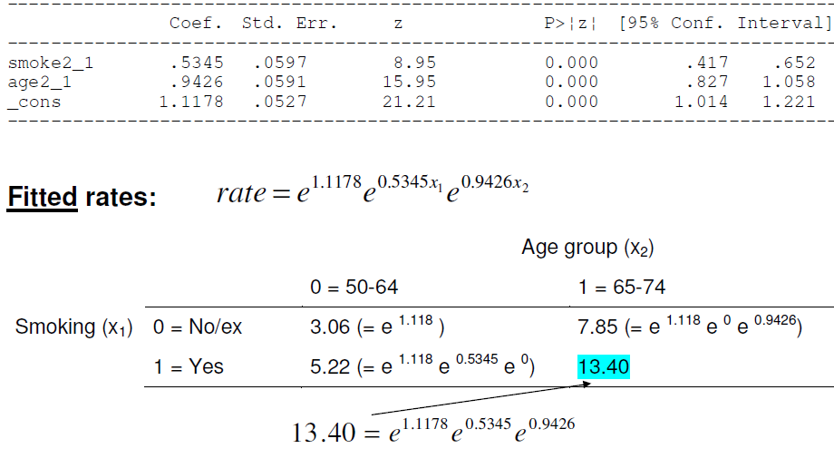
Fitting a multiplicative model to the data
Fitting the simplest model for the study hypothesis
Log (rate) = α + β₁smoke + β₂age

Slide 12
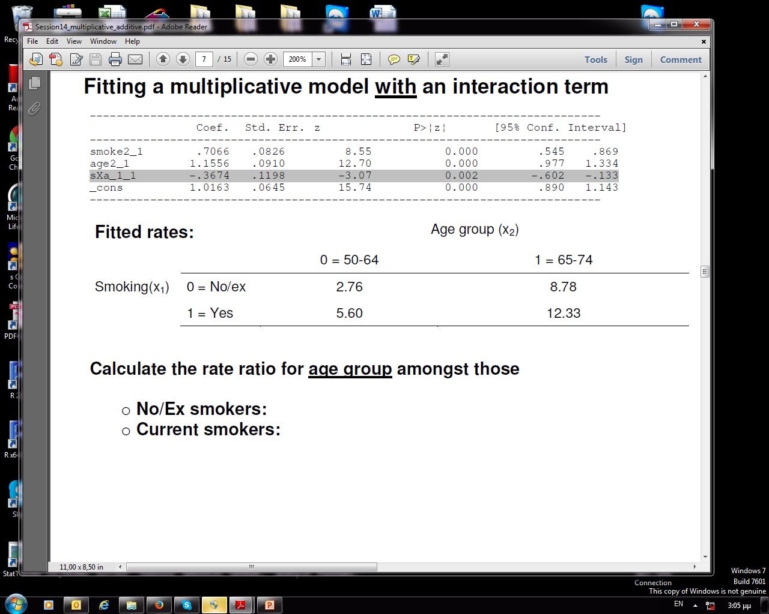
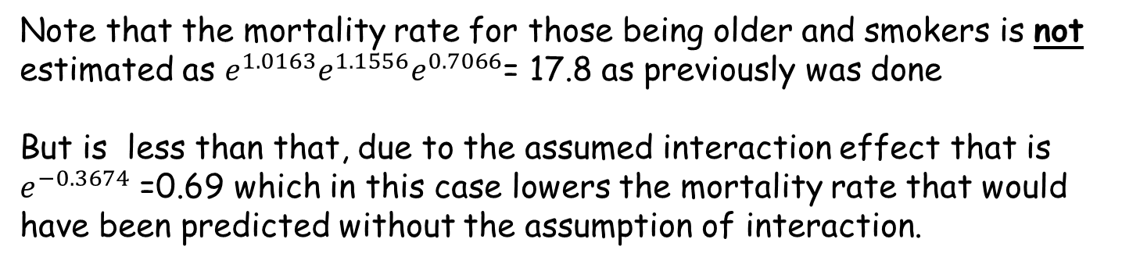
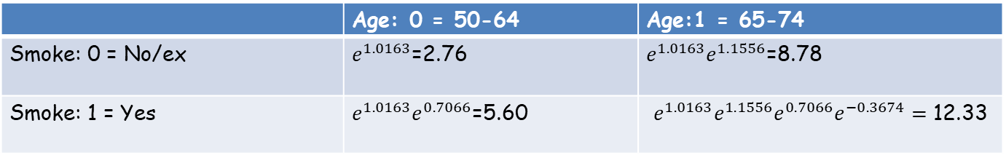
Fitting a multiplicative model to the data
Fitting the more complex model model for the study hypothesis
Log (rate) = α + β₁x₁ + β₂x₂+ β₃x₁ x₂
 | Age: 0 = 50-64 | Age:1 = 65-74
Smoke: 0 = No/ex | $e^{1.0163}$=2.76 | $e^{1.0163}e^{1.1556}$=8.78
Smoke: 1 = Yes | $e^{1.0163}e^{0.7066}$=5.60 | $$e^{1.0163}{e^{1.1556}e}^{0.7066}e^{−0.3674}=\text{12.33}$$
Note that the mortality rate for those being older and smokers is not estimated as $e^{1.0163}{e^{1.1556}e}^{0.7066}$= 17.8 as previously was done
But is less than that, due to the assumed interaction effect that is $e^{−0.3674}$ =0.69 which in this case lowers the mortality rate that would have been predicted without the assumption of interaction.

Slide 13
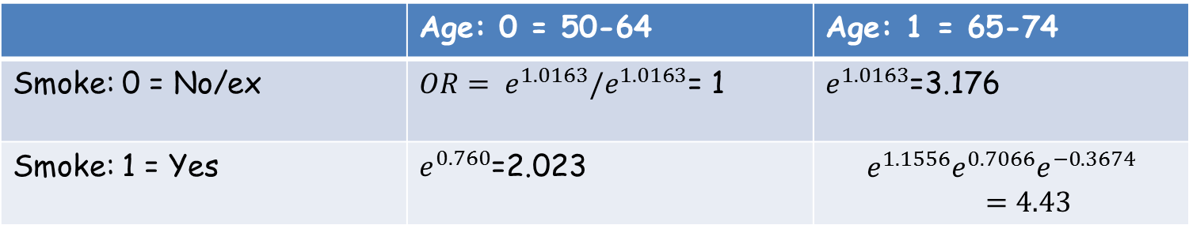
Interpretation
Estimated ORs for combinations of smoking and age
 | Age: 0 = 50-64 | Age: 1 = 65-74
Smoke: 0 = No/ex
Smoke: 1 = Yes
6.425
The relative risk due to age=65-74 for non smokers is 3.175 – increased mortality for older as compared to younger non smokers by 3.176 – 1 = 2.17 = 217%
The relative risk due to smoking for 50-64 years old is 2.023 – increased mortality for smokers as compared to non smokers individuals of 50-64 by 2.023 – 1 = 1.023 = 102%
The relative risk due to smoking and being 65-74 years old is 4.43 – increased mortality for older smokers as compared to younger non smokers by 4.43 – 1 = 3.43 = 343% AND NOT ….
6.425 (3.176X2.023) (increased mortality by 543%) as it would have been had interaction being absent.

Slide 14
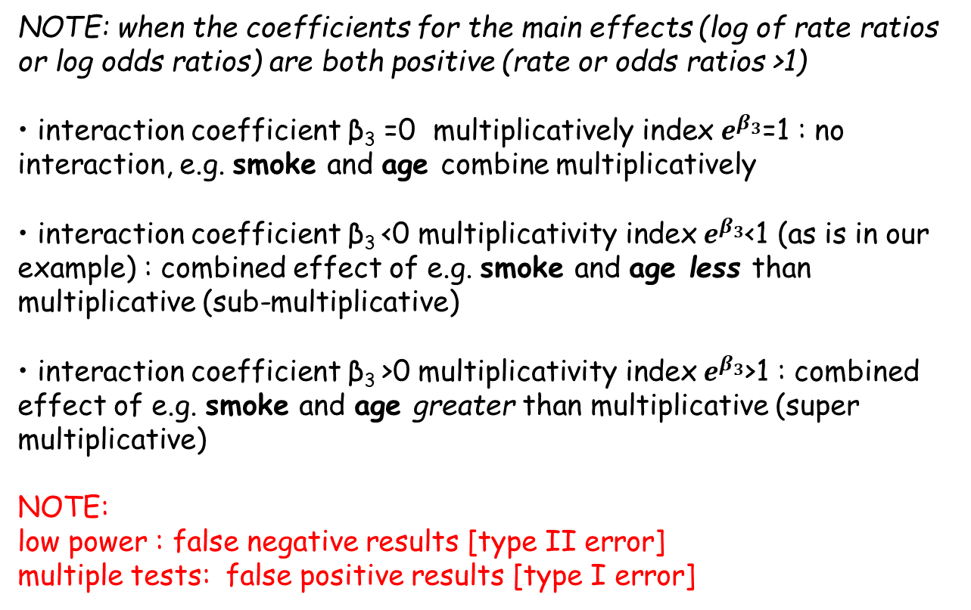
INTERPRETATION OF INTERACTION ON MULTIPLICATIVE SCALE
NOTE: when the coefficients for the main effects (log of rate ratios or log odds ratios) are both positive (rate or odds ratios >1)
• interaction coefficient β₃ =0 multiplicatively index $e^{β_{3}}$=1 : no interaction, e.g. smoke and age combine multiplicatively
• interaction coefficient β₃ <0 multiplicativity index $e^{β_{3}}$<1 (as is in our example) : combined effect of e.g. smoke and age less than multiplicative (sub-multiplicative)
• interaction coefficient β₃ >0 multiplicativity index $e^{β_{3}}$>1 : combined effect of e.g. smoke and age greater than multiplicative (super multiplicative)
NOTE:
low power : false negative results [type II error]
multiple tests: false positive results [type I error]

Slide 15
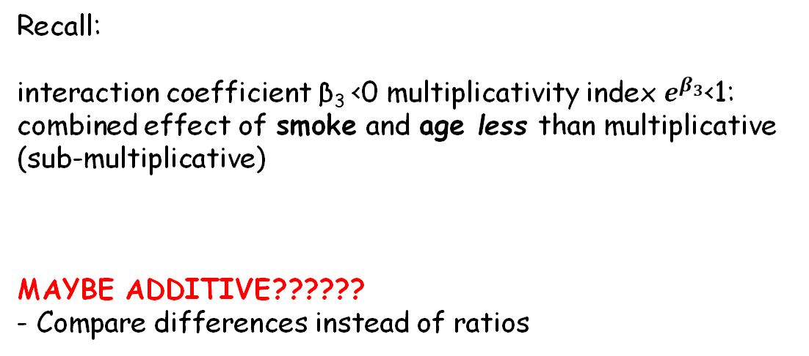
Interaction on additive scale
Recall:
interaction coefficient β₃ <0 multiplicativity index $e^{β_{3}}$<1: combined effect of smoke and age less than multiplicative (sub-multiplicative)
MAYBE ADDITIVE??????
- Compare differences instead of ratios

Slide 16
Interaction on additive scale
 |  | Depression
Prior Vulnerability | Stress | No | Yes | Risk of depression
No | No | 191 | 2 | 0.010 | p₀₀
 | Yes | 79 | 9 | 0.102 | p₀₁
Effect of stress given no vulnerability |  | OR = 10.9 (2.3, 51.5) |  | Risk Difference (RD)= 0.092 (0.027,0.157)
 |  | RR = 9.9 (2.2, 44.7)
Prior Vulnerability
Yes | No | 60 | 2 | 0.032 | p₁₀
 | Yes | 52 | 24 | 0.316 | p₁₁
Effect of stress given vulnerability |  | OR = 13.8 (3.1,61.4) |  | RD=0.284 (0.170,0.397)
 |  | RR = 9.8 (2.4, 39.8)

Slide 17
Effects on additive scale
OR = Odds Ratio (95% Confidence Interval) <-compare to 1
RR = Risk Ratio (95% Confidence Interval) <-compare to 1
RD = Risk Difference (95% Confidence Interval) <-compare to 0

Slide 18
Interaction on additive scale
Does Vulnerability Modify the Effect of Stress on Depression?
On the multiplicative Odds Ratio scale, is 10.9 sig different from 13.8?
  Test whether the ratio of the odds ratios (i.e. 13.8/10.9 = 1.27) is significantly different from 1.
On the multiplicative Risk Ratio scale, is 9.9 sig different from 9.8?
  Test whether the ratio of the risk ratios (i.e. 9.8/9.9 = 0.99) is significantly different from 1.
On the additive Risk Difference scale, is 0.092 sig different from 0.284?
  Test whether the difference in the risk differences (i.e. 0.28-0.09 = 0.19) is significantly different from 0

Slide 19
Interaction on additive scale
 |  | Exposure A
 |  | No(A=0) | Yes (A=1)
Exposure B | No(B=0) | p₀₀ | p₁₀
 | Yes (B=1) | p₀₁ | p₁₁
P_{ij}= incidence/prevalence of disease
Examine interaction between A and B
Compare (p₁₁- p₀₀) to (p₀₁- p₀₀) + (p₁₀- p₀₀)
If (p₁₁- p₀₀) = (p₀₁- p₀₀) + (p₁₀- p₀₀) the effect of A=1 & B=1 on p₀₀ equals the effect of (A=1, B=0) + the effect of (A=0, B=1) on p₀₀
No interaction on the additive scale
Otherwise, evidence for additive interaction

Slide 20
Interaction on additive scale
 |  | Exposure A
 |  | No(A=0) | Yes (A=1)
Exposure B | No(B=0) | p₀₀ | p₁₀
 | Yes (B=1) | p₀₁ | p₁₁
P_{ij}= incidence/prevalence of disease
Examine additive interaction between A and B
Equivalently estimate:
(p₁₁- p₀₀) – [(p₀₁- p₀₀)+ (p₁₀- p₀₀)]= p₁₁-p₁₀- p₀₁+ p₀₀
The effect of both factors together compared to the reference category of both factors absent and the sum of the effects of each factor acting separately.
A contrast between the effects of both factors together versus the sum of each considered separately.
Rothman calls this difference in the risk differences the “interaction contrast (IC)”

Slide 21
Evaluating additive interaction
p₁₁-p₁₀- p₀₁+ p₀₀=0 : A & B additive effects, no evidence for additive interaction
p₁₁-p₁₀- p₀₁+ p₀₀ > 0 : Deviation from additivity of effects of A & B, positive additive interaction, super-additive effects
p₁₁-p₁₀- p₀₁+ p₀₀ < 0 : Deviation from additivity of effects of A & B, negative additive interaction, sub-additive effects

Slide 22
Evaluating additive interaction (example)
 |  | Exposure A
 |  | No(A=0) | Yes (A=1)
Exposure B | No(B=0) | p₀₀=0.008 | p₁₀=0.015
 | Yes (B=1) | p₀₁=0.016 | p₁₁=0.025
p₁₁-p₁₀- p₀₁+ p₀₀=0.025-0.015-0.016+0.008=0.002>0
A & B : very small positive additive interaction close to zero , the effects of A & B combine in an additive way.

Slide 23
Evaluating additive interaction through GLM i.e. relative risks estimates
 |  | Exposure A
 |  | No(A=0) | Yes (A=1)
Exposure B | No(B=0) | RR₀₀=p₀₀/p₀₀=1 | RR₁₀=p₁₀/p₀₀=1.875
 | Yes (B=1) | RR₀₁=p₀₁/p₀₀=2.00 | RR₁₁=p₁₁/p₀₀=3.125
But usually we do not have estimates of incidence or prevalence rates but relative risks such as rate ratios or odds ratios.
Previous equation can be re-expressed as :
RR₁₁- RR₁₀- RR₀₁+ RR₀₀= RR₁₁- RR₁₀- RR₀₁+ 1
Relative Excess Risk due to Interaction (RERI) [Rothman, 1986]
RERI = RR₁₁-RR₁₀- RR₀₁+ RR₀₀=3.125 - 2 - 1.875 + 1 = 0.25 > 0
Synergy index S:
S = (RR₁₁-1)/(RR₁₀+ RR₀₁-2) = 2.125/1.875 =1.13 > 1

Slide 24
Indices for additive interaction
RERI & S
RERI>0 S>1 (super-additivity – additive interaction)
RERI=0 S=1 (additive interaction)
RERI<0 S<1 (sub-additive interaction )
INTERPRETATION
RERI: The actual amount (difference) of excess relative risk for disease D due to the combined effect of factors A and B that is added to or substracted from the sum of excess relative risk for disease D due to factor A only and factor B only (acting separately)
S: the excess relative risk for disease D caused by the combined presence of factors A and B, relative to the sum of excess relative risk for disease D due to factor A only and factor B only (acting separately)

Slide 25
Estimation of RERI and S using a logistic regression model
Model for A and B including their interaction
ln(p/(1-p))=b₀+b₁*A+b₂*B+b₃*AB
p = incidence of disease D,
Recall the estimated OR for A=1 & B=1 compared to A=0 & B=0 is: exp(b₁+b₂+b₃)
The corresponding excess relative risk is exp(b₁+b₂+b₃)-1
RERI = [exp(b₁+b₂+b₃) - exp(b₂)- exp(b₁)+1]
S =(exp(b₁+b₂+b₃) -1)/(exp(b₂) + exp(b₁)-2)

Slide 26
Estimation of RERI and S using logistic regression models (example)
A: Adherence to Mediterranean Diet (MDscale) (0:>5 ;1< 5),
Β: BMI (0: <30 kg/m² ;1 ≥ 30 kg/m²)
ln(p/(1-p))=b₀+b₁*A+b₂*B+b₃*AB, p= probability of hypertension
 | b | se | OR=e^{b} | 95% Conf. Interval (OR) | P-value
A (1: < 5 vs 0: >5 ) for B=0 | 0.96 | 0.76 | 2.61 | (0.59 – 11.56) | 0.206
B (1: >30 kg/m² vs 0: ≤30 kg/m² ; ) for A=0 | 0.44 | 0.95 | 1.55 | (0.24 – 9.88) | 0.645
AB (1: < 5 & 1: >30 kg/m² vs 0: >5 & 0: ≤30 kg/m² | -0.06 | 1.01 | 0.94 | (0.13 – 6.85) | 0.949
OR_{A=1,B=0}= exp(b₁) = 2.61
OR_{A=0,B=1}= exp(b₂) = 1.55
OR_{A=1,B=1}= exp(b₁+b₂+b₃)= 3.82
All ORs in comparison to A=0 & B=0

Slide 27
Estimation of RERI and S using logistic regression models (example)
RERI= OR_{A=1,B=1}- OR_{A=1,B=0}- OR_{A=0,B=1}+1
= exp(b₁+b₂+b₃) - exp(b₁) - exp(b₂) +1 = 0.6 > 0
S =(ΟR_{A=1,B=1}-1)/(ΟR_{A=1,B=0}+ ΟR_{A=0,B=1}-2) = 1.3 >1
Interpretation:
RERI: The combined effect (relative excess risk) of low MDScale and high BMI is 0.6 more from the sum of the relative excess risks due to a) low MDScale but low BMI and b)the presence of high BMI but high MDScale (individual effects)
  Being obese and NOT adhering to MD results in added risk of hypertension than having each bad habit separately
S: The combined presence of low MDScale and high BMI results in a 30% increased excess relative risk, as compared to the excess relative risk due to low MDScale but low BMI and the presence of high BMI but high MDScale

Slide 28
Comments
Exposures should be coded in such a way that Α & Β are risk (detrimental) factors for disease D and not preventive [Knol et al, 2012].
  E.g. exposure diet: healthy/unhealthy in relation to CVD: Should be coded as 0 = healthy 1 = unhealthy so that the unhealthy diet is compared to healthy diet with respect to CVD
  P levels: high levels beneficial for prevention of hypertension. Therefore P intake is coded as (0: >20 gr/d ; 1: ≤20 gr/d)
Standard errors, Confidence intervals and p values can be estimated through suitable statistics (Taylor series, bootstrap methods) (Epidemiology 1992;3:452-6)

Slide 29
Summary of additive interaction
Interpreting additive interaction between A and B indices (such as RERI)
[when the relative risks for the main effects of A and B are both >1]
RERI = 0 A and B effects: combination additive
RERI < 0 A and B effects: combination less than additive
RERI > 0 A and B effects: combine greater than additive (multiplicative perhaps)

Slide 30

Example of interaction evaluation

Slide 31
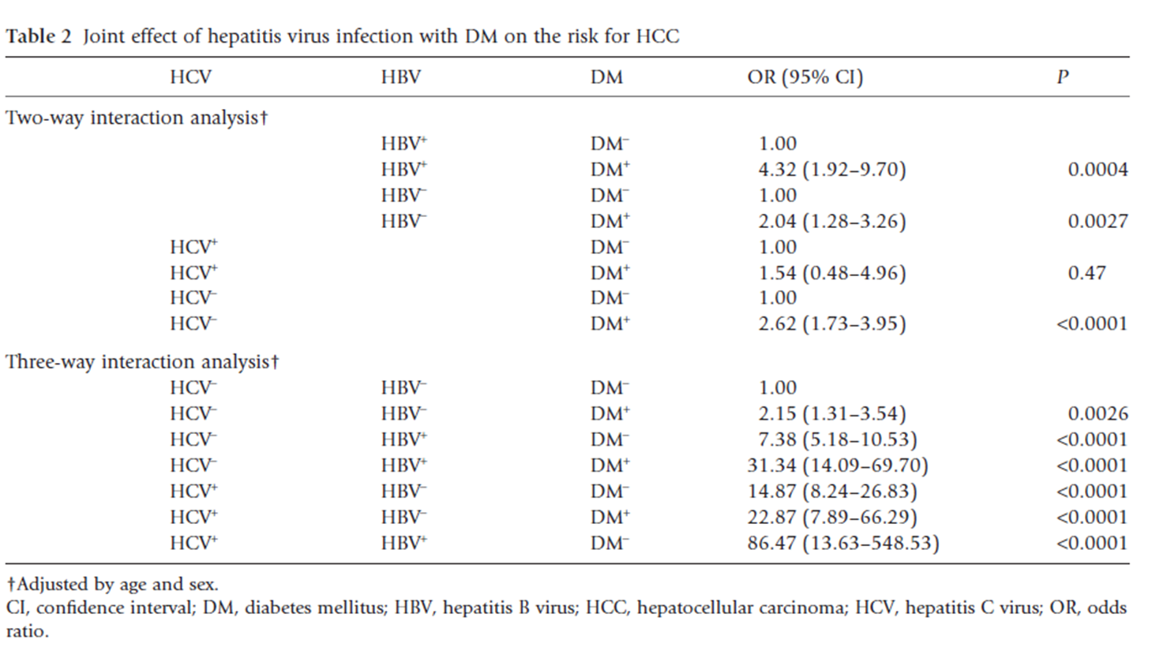
A statistically significant positive association of DM with HCC was noted for HCV negative patients (OR = 2.62, 95% CI = 1.73–3.95; p<0.0001) but not for HCV positive patients (OR = 1.54, 95% CI = 0.48–4.96;p=0.470)
Wei-Hsu et al, 2012

Slide 32
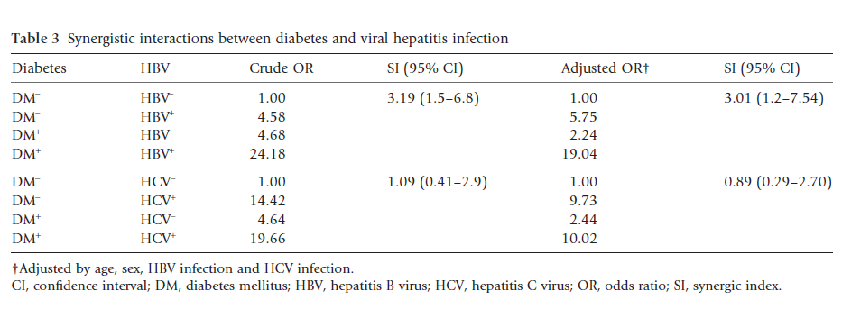
Ko Wei-Hsu et al, 2012
…For crude estimates, synergistic interactions between DM and HBV infection were statistically significant (SI = 3.19; 95% CI = 1.50–6.80) whereas the synergy between DM and HCV infection was absent (SI = 1.09; 95% CI = 0.41–2.90).
the excess relative risk for HCC caused by the combined presence of DM and HBV is 3.19 times higher the sum of excess relative risk for disease D due to DM only and HBV only (acting separately)

Slide 33
Estimation of RERI and S using logistic regression models (example)
A: Adherence to Mediterranean Diet (MDscale) (0:>5 ;1< 5),
Β: BMI (0: <30 kg/m² ;1 ≥ 30 kg/m²)
ln(p/(1-p))=b₀+b₁*A+b₂*B+b₃*AB, p= probability of hypertension
 | b | se | OR=e^{b} | 95% Conf. Interval (OR) | P-value
A (1: < 5 vs 0: >5 ) for B=0 | 0.96 | 0.76 | 2.61 | (0.59 – 11.56) | 0.206
B (1: >30 kg/m² vs 0: ≤30 kg/m² ; ) for A=0 | 0.44 | 0.95 | 1.55 | (0.24 – 9.88) | 0.645
AB (1: < 5 & 1: >30 kg/m² vs 0: >5 & 0: ≤30 kg/m² | -0.06 | 1.01 | 0.94 | (0.13 – 6.85) | 0.949
OR_{A=1,B=0}= exp(b₁) = 2.61
OR_{A=0,B=1}= exp(b₂) = 1.55
OR_{A=1,B=1}= exp(b₁+b₂+b₃)= 3.82
All ORs in comparison to A=0 & B=0

Slide 34
Comparison of additive indices and multiplicative index
The existence of multiplicative interaction is indicated by the multiplicative index which is in this case (where a logistic regression is used)
exp(b₃)=0.94<1
Note that this index is slightly less that 1 indicating that the combination of MDScale <5 and high BMI combine rather multiplicatively since the index showing deviations from multiplicativity is around 1.
Overall it seems that the effect of simultaneously having MdScale <5 and high BMI results in more-than-additive excess relative risk. Furthermore it seems that this super-additivity may be expressed through a multiplicative combination of the respective effects

Slide 35
Comparison of additive indices and multiplicative index
It can be shown (Greenland et al., 2008) that if both of the two exposures have an effect on the outcome, then
  The absence of interaction on the additive scale implies the presence of multiplicative interaction for relative risks
  and
  The absence of multiplicative interaction for relative risks implies the presence of additive interaction.
In other words, if both of the two exposures have an effect on the outcome, then there must be interaction on some scale.

Slide 36
Why additive interaction?
 | E=0 | E=1
G=0 | 0.02 | 0.05
G=1 | 0.04 | 0.10
Suppose that the outcome probabilities in the above table represent the probability of a disease being cured for a drug (E) stratified by genotype status (G).
If we had to treat only one group, which one would we treat?
RR₀₀=0.02/0.02=1
RR₀₁=0.05/0.02=2.5
RR₁₀=0.04/0.02=2
RR₁₁=0.10/0.02=5
Is there a violation of the multiplicativity (i.e. is there a multiplicative interaction)?
RR₁₁/(RR₀₁*RR₁₀)=5/(2*2.5)=1 => No
but….
RERI=p₁₁-p₀₁-p₁₀-p₀₀= (p₁₁-p₀₁)+(p₁₀-p₀₀)= (0.10-0.04)-(0.05+0.02)=0.06-0.03=0.03
Άρα σε risk difference scale, η επίδραση του φαρμάκου στους G=1 είναι 0.06 (δηλαδή στα 100 άτομα θεραπεύεις 6) ενώ στους G=0 είναι 0.03 (δηλαδή στα 100 άτομα θεραπεύεις 3). Άρα έχουμε πολλαπλασιαστική αλλά υπεραθροιστική αλληλεπίδραση.

Slide 37
Why additive interaction?
 | E=0 | E=1
G=0 | 0.02 | 0.05
G=1 | 0.04 | 0.09
Suppose that the outcome probabilities in the above table represent the probability of a disease being cured for a drug (E) stratified by genotype status (G).
If we had to treat only one group, which one would we treat?
RR₀₀=0.02/0.02=1
RR₀₁=0.05/0.02=2.5
RR₁₀=0.04/0.02=2
RR₁₁=0.09/0.02=4.5
Is there a violation of the multiplicativity?
RR₁₁/(RR₀₁*RR₁₀)=4.5/(2*2.5)=0.9 => submultiplicative
but….
RERI=p₁₁-p₀₁-p₁₀-p₀₀= (p₁₁-p₀₁)+(p₁₀-p₀₀)= (0.09-0.04)-(0.05+0.02)=0.05-0.03=0.02
Άρα σε risk difference scale, η επίδραση του φαρμάκου στους G=1 είναι 0.05 (δηλαδή στα 100 άτομα θεραπεύεις 5) ενώ στους G=0 είναι 0.03 (δηλαδή στα 100 άτομα θεραπεύεις 3), Άρα έχουμε υποπολλαπλασιαστική αλλά υπεραθροιστική αλληλεπίδραση.

Slide 38
Summary for Interactions
 | Multiplicative scale | Additive scale
No interaction implies | A and B combine multiplicatively | A and B combine additively
Large positive value for index for interaction | A and B effects combine in a greater-than-multiplicative way | A and B effects combine in a greater-than-additive way (multiplicative perhaps)
Large negative value for index for interaction | A and B effects combine in a less-than-multiplicative way (additive perhaps) | A and B effects combine in a less-than-additive way
  If we find that two risk factors are interacting sub-multiplicatively, then the relationship could by supper-additive, additive, or sub-additive.

Slide 39
Multiplicative or additive models?
Statistical considerations
Simple model but with adequate fit to the data
Evaluating both type of interactions if biological justification exists is valuable
but:
- often difficult to decide….
Biological considerations
Transmission paths
- effects of exposures relating to independent routes of “causing” the disease
likely to add (and not multiply)
- effects of exposures relating to same route might multiply
Example: HIV incidence
- blood transfusion and sexual exposure ~ additive model more appropriate (?)
- condom use and # of sexual partners ~ multiplicative model more appropriate (?)

Slide 40
Exercise: Multiplicative Interaction
Testing for effect modification
Assume a Poisson model
  In its simple form assumes no interaction between explanatory variables
But we can check whether the effect of the exposure (e.g. smoke) differs according to the levels of the potential confounder (e.g. age)
1. Wald test (given directly in STATA output)
2. the likelihood ratio test.

Slide 41
The model in full
The model in full
In multiplicative form
Exposure (X)
Stratum (Z=0,1,2) | 0 | 1
0 | a | a + β
1 | a + γ₁ | a + γ₁ + β
2 | a + γ₂ | a + γ₂ + β
Exposure (X)
Stratum (Z=0,1,2) | 0 | 1
0 | λ_{c} | λ_{c} θ
1 | λ_{c} φ₁ | λ_{c} θ φ₁
2 | λ_{c} φ₂ | λ_{c} θ φ₂
Log rates of outcome
rates of outcome
Log (λ) = α + βx + γ₁z₁ ₊ γ₂z₂
What is the difference in the log rates in stratum 0 between exposed and unexposed?
In stratum 1?
What do we assume here?

Slide 42
Interactions (effect modification)
Log (λ) = α + βx + γ₁z₁ ₊ γ₂z₂ ₊ δ₁ (xz₁) + δ₂ (xz₂)
Exposure
Stratum | 0 | 1
0 | a | a + β
1 | a + γ₁ | a + γ₁ + β + δ₁
2 | a + γ₂ | a + γ₂ + β + δ₂
What is the difference in the log rates in stratum 0 between exposed and unexposed?
In stratum 1?
What do we assume here?
In multiplicative form
Exposure
Stratum | 0 | 1
0 | λ_{c} | λ_{c} θ
1 | λ_{c} φ₁ | λ_{c} θ φ₁ρ₁
2 | λ_{c} φ₂ | λ_{c} θ φ₂ρ₂

Slide 43
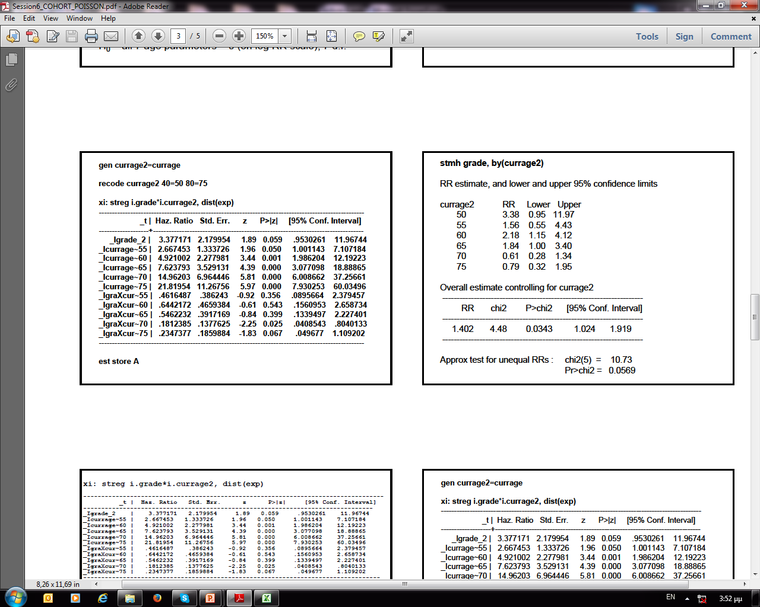
Poisson regression - Stratification
Remember the Whitehall Study with grade of work (exposure)
and age (confounder)
xi : poisson deaths i. grade*agegrp, e (pyrs) irr
Deaths RR SE z p-value 95% CI
Test for interaction
xi : poisson deaths i. grade i. agegrp, e (pyrs)
est store B
lrtest A B
likelihood-ratio test chi2(5) = 10.43, (Assumption: B nested in A) Prob > chi2 = 0.0640

Slide 44
Exercise
Έστω επιδημιολογική μελέτη κοορτής η οποία στοχεύει στην εκτίμηση της επίδρασης της κατανάλωσης του καφέ στην ανάπτυξη καρκίνου του ήπατος.
Έστω:
  Υ_{i} ο χρόνος παρακολούθησης για κάθε άτομο i της κοορτής
  λ_{i} ο ρυθμός ανάπτυξης του καρκίνου του ήπατος για το άτομο i.
Θεωρείστε επίσης πιθανό συχγυτικό παράγοντα την κατανάλωση αλκοόλ .

Slide 45
Exercise
Εάν η ανάλυση πραγματοποιηθεί με το παρακάτω μοντέλο Poisson:
Μοντέλο Poisson:
Log (λ) = α + βX + γ₁Z₁ ₊ γ₂Z₂ ₊ δ₁ (XZ₁) + δ₂ (XZ₂), όπου:
Χ= κατανάλωση καφέ κατά την είσοδο στην μελέτη: 0 = < 1 φλυτζάνι την ημέρα; 1 = > 1 φλυτζάνι την ημέρα,
Ζ= ημ/σια κατανάλωση αλκοόλ κατά την είσοδο στην μελέτη: 0=χαμηλή; 1=μέτρια; 2=υψηλή, και Z₁ , Z₂ μεταβλητές-δείκτες (dummy variables) για τον παράγοντα «κατανάλωση αλκοόλ», με:
Z₁ (1=μέτρια ημ/σια κατανάλωση αλκοόλ, 0 = άλλο),
Z₂ (1=υψηλή ημ/σια κατανάλωση αλκοόλ, 0 = άλλο)
Δώστε την εκτίμηση του ρυθμού ανάπτυξης καρκίνου του ήπατος σε κάθε μια από τις κατηγορίες του παράγοντα κατανάλωση αλκοόλ
Τι υποθέτει το παραπάνω μοντέλο για τον ρόλο της κατανάλωσης αλκοόλ όσον αφορά την επίδρασή του στην εκτίμηση του σχετικού κινδύνου για ανάπτυξη καρκίνου του ήπατος σε σχέση με την κατανάλωση καφέ;

Slide 46
References
Hosmer DW, Lemeshow S. Confidence interval estimation of interaction. Epidemiology 1992;3:452-6
Hunter DJ. Gene-environment interactions in human diseases. Nature Reviews Genetics 2005, 6:287-298.
Knol MJ. and VanderWeele TJ. Guidelines for presenting analyses of effect modification and interaction. Int J Epidemiol 2012, 41:514-520.
Knol MJ, Vandelweele TJ, Groenwold RH, Klungel OH, Rovers MM, Grobbee DE. Estimating measures of interaction on an additive scale for preventive exposures. Eur J Epidemiol 2011;26:433-8.

Slide 47
References
Lawlor DA. Biological interaction: time to drop the term? Epidemiology, 2011;22:148-50
Rothman KJ. Modern Epidemiology. Boston/Toronto: Little: Brown and Company, 1986
VanderWeele TJ. A word and that to which it once referred: assessing "biologic" interaction. Epidemiology, 2011; 22:612-613
VanderWeele TJ. Reconsidering the denominator of the attributable proportion for interaction. Eur J Epidemiol, 2013; 28(10): doi: 10.1007/s10654-013-9843-6
VanderWeele TJ., Tchetgen Tchetgen EJ. Attributing effects to interactions. Epidemiology, 2014; ;25(5):711-22
VanderWeele TJ. and Knol MJ. A Tutorial on Interaction. Epidemiol. Methods 2014; 3(1): 33–72

