Slide 1
Clinical Trials 2015
Practical Session 1

Slide 2
Q1: List three parameters (quantities) necessary for the determination of sample size (n) for a Phase III clinical trial (once you have decided on the endpoint you will use to make the statistical comparison at the end of the trial).
A1:
    Type I error rate (α= Ρ(απόρριψης της Η0| Η0 αληθής )).
    Type II error rate (β = Ρ(μη απόρριψης της Η0| Η0 λανθασμένη ))
    (Ισχύς = Ρ(απόρριψης της Η0 | Η0 λανθασμένη) = 1-β )
    Τhe least clinically significant difference (Δ)

Slide 3
Q2: Describe whether the overall sample size (n) will increase or decrease when each of the three parameters in Question 1 is increased (keeping the other two parameters constant).
A2:
α increased→ overall sample size decreased
β increased→ overall sample size decreased
Δ increased→ overall sample size decreased

Slide 4
Q3: List three advantages of randomization in a clinical trial designed to compare two treatment groups.
A3:
  Eliminate systematic error (Bias)
  Minimize random error (Precision)
  Ensure the generalizability of study results

Slide 5
Q4: List three disadvantages of randomization in a clinical trial designed to compare two treatment groups.
A4:
Patient or physician may not care to participate in experiment involving a chance mechanism to decide treatment.
May interfere with physician-patient relationship
Increases the level of difficulty/cost

Slide 6
Explain the aim of the following:
    Blinding- to avoid conscious bias
    A random permuted block design- to maintain balance between treatment arms
    (power, confounding– problem in small samples)
    A crossover design- each individual acts as his own control
    A factorial design- allows simultaneous tests of two hypotheses in the same population

Slide 7
Randomization

Slide 8


Slide 9
Simple Randomization
A randomization list may be generated by using the digits, one per treatment assignment, starting with the top row and working downwards. For two treatments assign A for digits 0-4 and B for digits 5-9. What is the resulting randomization list for 24 patients? Also calculate how many patients are in each treatment group.
Now assign even numbers to treatment A and odd numbers to treatment B. In this case what is the randomization group?

Slide 10
Random Permuted Blocks
For two treatments, blocks of two patients assign AB for digits 0 – 4 and BA for digits 5 – 9. Construct the randomization list for 24 patients and start from the last row (4 8 3 …).
  The smaller the choice of block size the greater is the risk of randomization becoming predictable so that one should particularly avoid a block size of two.
This time consider a block of four patients and two treatments so we have 6 combinations. Assign AABB for 1, ABAB for 2, ABBA for 3, BBAA for 4, BABA for 5, BAAB for 6 and ignore 0 and 7 – 9. Again for 24 patients but start from the 6th row (7 3 6 …).

Slide 11
The Biased Coin Method
At each point: Check whether one arm has less patients so far.
If yes (i.e unbalance is discovered): Assigned to the next patient this treatment with probability p > ½ to the next patient.
If no (i.e. the two treatments have equal number of patients): simple randomization is used for the next patient.
Disadvantage: treatment assignment becomes predictable in case of use of the “biased coin”.

Slide 12
Phase I
Dose Escalation Method
Aim: to determine the Maximum Tolerated Dose
Dose escalation based on the Fibonacci search scheme
Δόση Φαρμάκου (mg/m²) | % αύξηση επί της προηγούμενης δόσης
n | (-)
2.0 n | 100
3.3 n | 67
5.0 n | 50
7.0 n | 40
9.0 n | 33
12.0 n | 33
16.0 n | 33

Slide 13
Phase I
Sample Size Calculation
Design A (traditional): Groups of three patients are treated. Escalation occurs if no toxicity is observed in all three; otherwise, an additional three patients are treated at the same dose level. If only one of six has toxicity, escalation again continues; otherwise, the trial stops.
B.E. Storer: Design and Analysis of Phase I Clinical Trials. Biometrics, Vol. 45, No. 3 (Sep., 1989), pp. 925-937

Slide 14
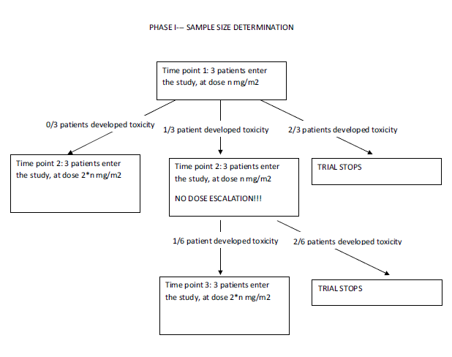

Slide 15
Phase II- Simon’s two-stage design
Aim: To determine whether it has sufficient biological activity against the disease under study to warrant more extensive development.
Ho:p<p0 --- the true response probability is less than some level P0.
H1:p ≥ p1 --- the true response probability is at least some desirable target level p1 is true
R. Fisher: Optimal Two-Stage Designs for Phase II Clinical Trials. Control Clin Trials. 1989 Mar;10(1):1-10.

Slide 16
The design approach considered here is to specify the parameters p0, p1, α and β.
Τhen determine the two-stage design that satisfies the error probability constraints and minimizes the expected sample size when the response probability is p0.

Slide 17
Sample size based on the response rate
According to Simon's two-stage minimax design, with a minimum expected response rate of 10% and an average expected response rate of 30%, a sample of 22 patients was required in the first step. If a minimum of three responses were observed it was planned to accrue a total of 33 patients. At the second phase, if at least seven responses occurred the probability of accepting an ineffective treatment would be 5%. On the other hand, the risk of rejecting a treatment with a response rate of more than 30% would be 10% .

