Slide 1

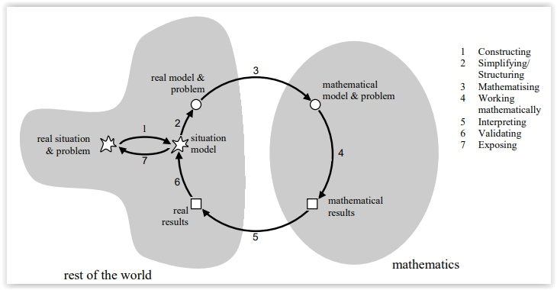

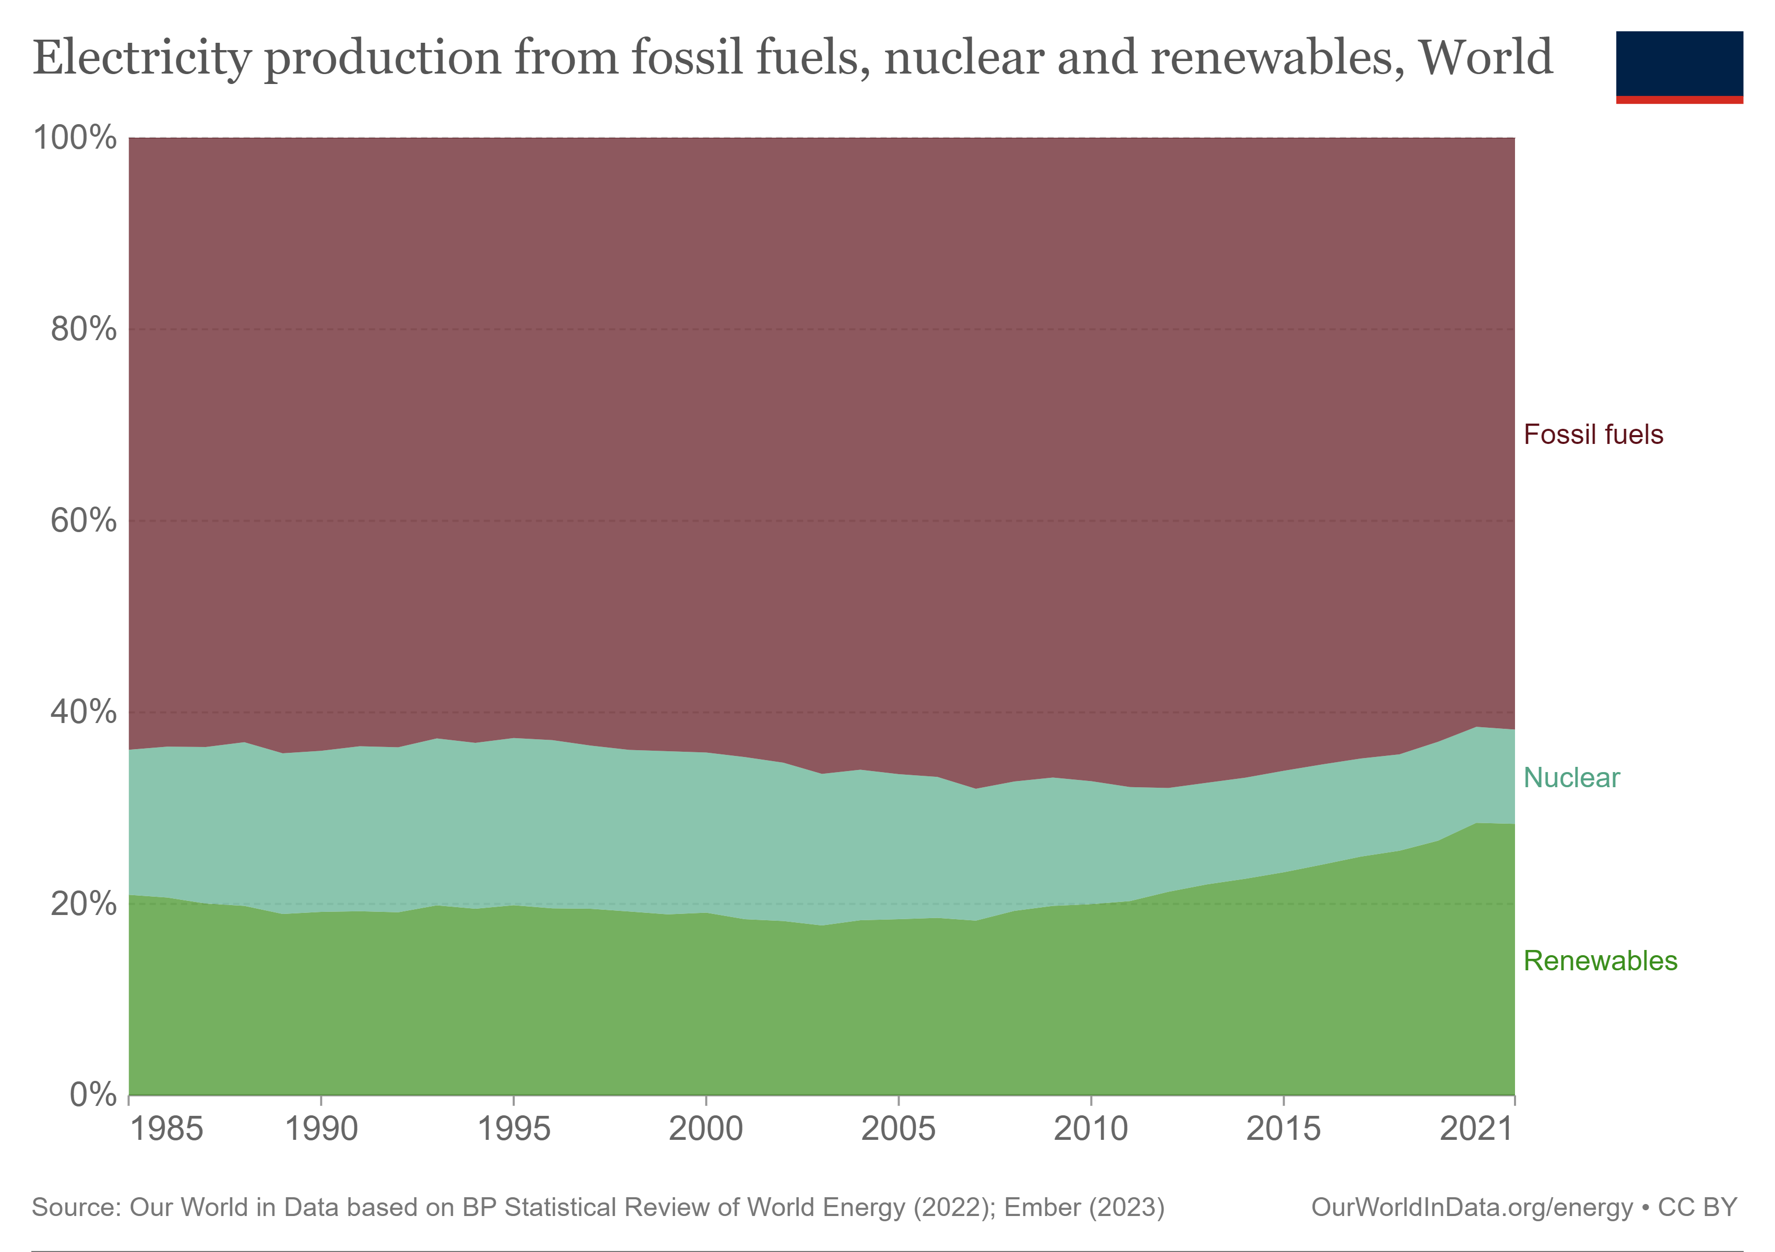
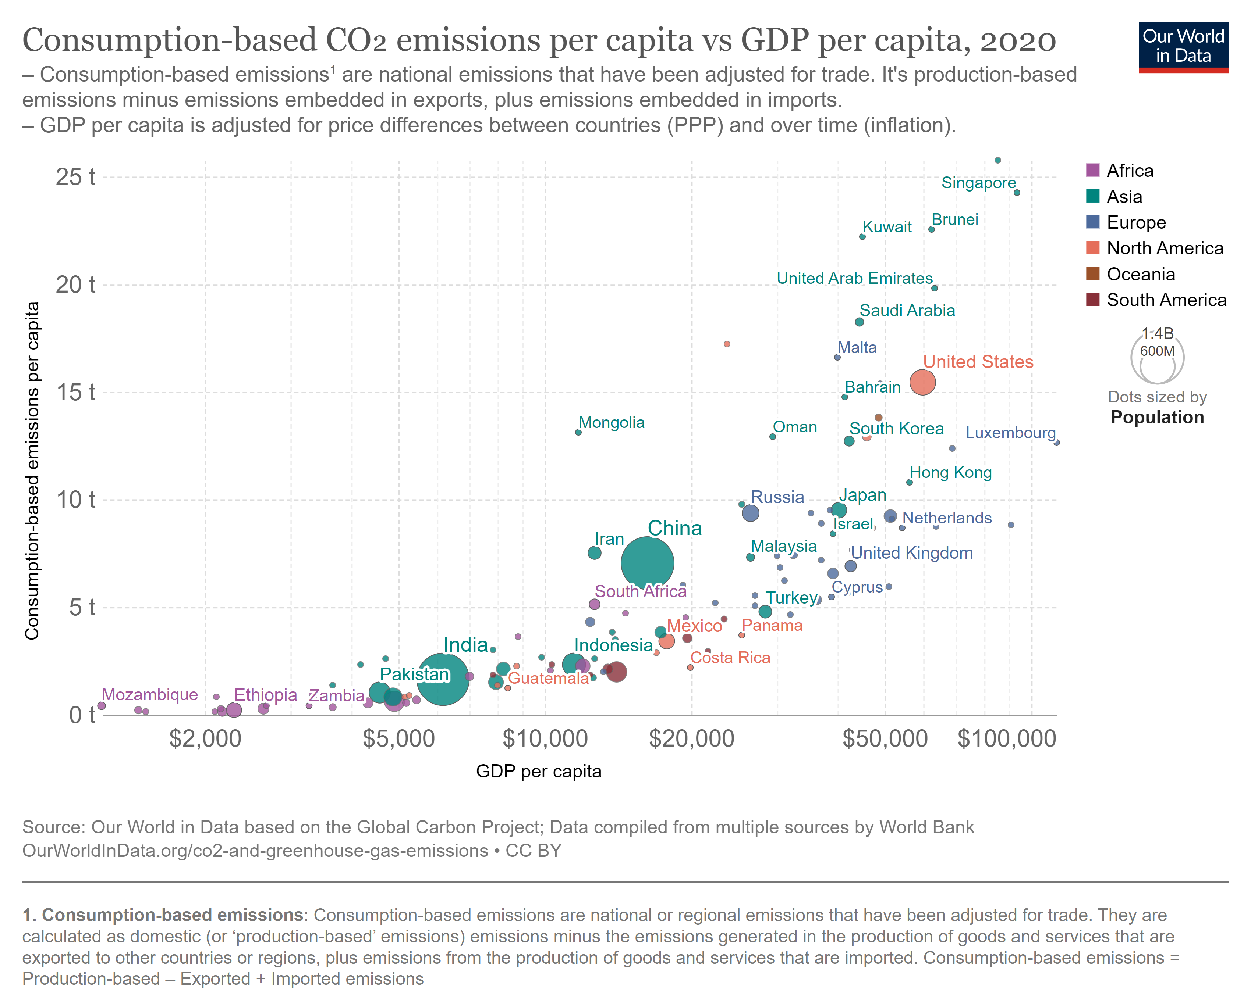
Environmental issues in Mathematics education
Hana Honsejková and Vojtěch Kielkovský
National and Kapodistrian University of Athens
Department of Mathematics
Introduction
Environmental issues pose significant challenges to our planet, requiring interdisciplinary approaches for effective solutions. Our target was to explore the relationship between mathematics and environmental issues, highlighting the contributions of mathematical modelling in tackling environmental problems. By integrating environmental issues into mathematics education, we can foster environmental awareness and empower students to become active participants in creating a more sustainable future.
Ad 1) This task can be found in Mathematics textbook for 6th grade in the unit „Decimal numbers: Arithmetic mean“.
Ad 2) The task is directly related with the environmental issue of waste of electricity and indirectly related with electricity shortage and electrical pollution.
Waste of electricity
Waste of electricity refers to the inefficient and unnecessary consumption of electrical energy. It can include leaving lights or electronic devices on when they are not in use, using outdated and energy-inefficient appliances, or inefficient energy management systems in buildings.
„Energy and environmental problems are closely related, since it is nearly impossible to produce, transport, or consume energy without significant environmental impact. The environmental problems directly related to energy production and consumption include air pollution, climate change, water pollution, thermal pollution, and solid waste disposal. The emission of air pollutants from fossil fuel combustion is the major cause of urban air pollution. Burning fossil fuels is also the main contributor to the emission of greenhouse gases.“
(EEA, 2004)
Electricity shortage
Electricity shortage refers to a situation where the demand for electrical energy exceeds the available supply. It can occur due to various factors such as inadequate power generation capacity, transmission and distribution system limitations, natural disasters, or high energy demand during peak periods.
The task
„Sleduj a zapisuj denní spotřebu elektrické energie v domácnosti po dobu jednoho týdne. Vypočti průměrnou denní spotřebu elektřiny. Zjisti cenu 1 kWh a vyjádři spotřebu v penězích.“ (Votípková and Václavíková, 2011)
„Monitor and document the daily electricity consumption in a residential household for one week. Calculate the average daily electricity consumption. Determine the cost of 1 kWh and express the consumption in monetary terms.“ (Votípková and Václavíková, 2011 – translated)
Electrical pollution
Electrical pollution refers to the presence of electromagnetic fields that can negatively impact the environment and human health. It can arise from sources such as power lines, transformers, electrical appliances, wireless communication devices, and electromagnetic radiation emitted by electronic equipment. Prolonged exposure to high levels of electromagnetic fields can have adverse effects on living organisms.
Ad 3) We could add another question directly connected with electricity shortage. That question would be: „How many households is the power station in the city able to supply with electricity if it generates x kWh during the day and y kWh during the night and when one household consumes z kWh per day? How do you think the households could lower their electricity consumptions? What happens with the surplus electricity? Have you ever heard about phantom power?“
„Explore the second graph below and think about the connection between CO₂ emissions and usage of elektricity.“
„How is the GDP connected with CO₂ emissions?“
„See the first graph, discuss the changes between the year 2000 and 2020 and try to predict how the graph will evolve in the future.“
These additional questions could help the students to start thinking about their own consumption of electricity, they could learn something new about electricty shortage and waste of electricity.
Figure 1: Modelling cycle (Blum, W. and R. B. Ferri. Mathematical modelling, 2009)
Graph 1: Electricity production from fossil fuels, nuclear and renewables
Graph 2: Consumption-based CO₂ emissions vs GDP
References
VOTÍPKOVÁ, Michaela a Radka VÁCLAVÍKOVÁ. Matematika: pro 6. ročník. Brno: Tvořivá škola, c2010-c2011, str. 74. ISBN 978-80-87433-00-3.
BLUM, W. and R. B. FERRI. Mathematical modelling: Can it be taught and learnt?. Journal of mathematical modelling and application. 2009, (1), 45-58.
European Environmental Agency, 2004. https://www.eea.europa.eu/help/glossary/eea-glossary/environmental-impact-of-energy
ROSER, M. The world‘s energy problem, 2020. https://ourworldindata.org/worlds-energy-problem

