Slide 1

Teaching and learning mathematics through problem solving
Chrissavgi Triantafillou
Department of Mathematics,
Graduate studies: Mathematics Education
NKUA

Slide 2
Environmental issues in
Mathematics education
PART A
Examples of environmental issues
How they could be connected with mathematics teaching?

Slide 3
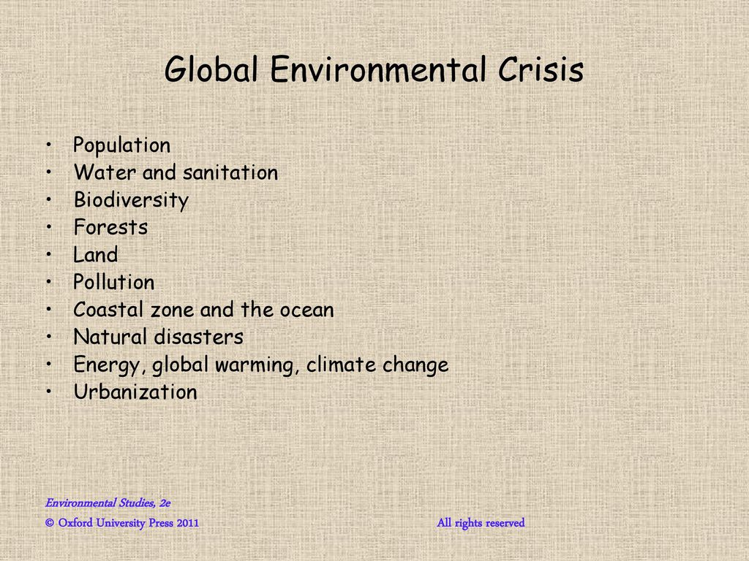
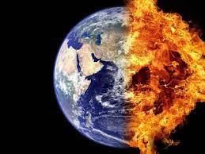
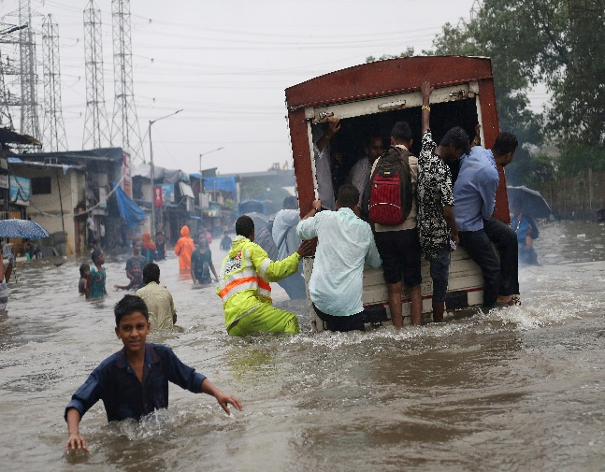
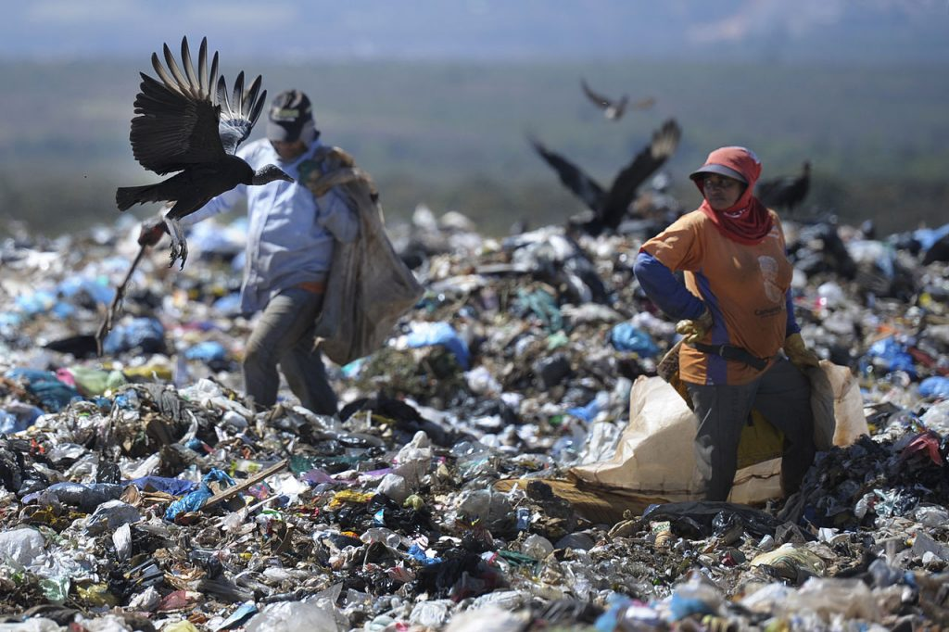
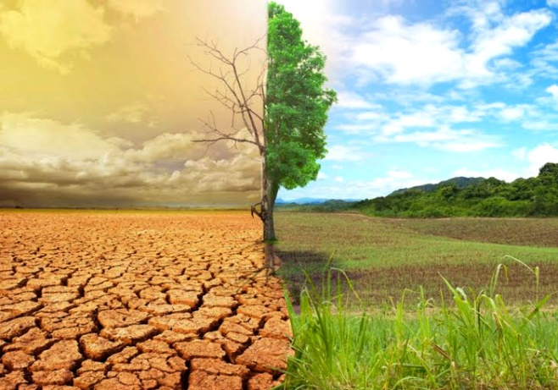
Global Environmental/ ecological crisis

Slide 4
What is the role of mathematics education in the global environmental crisis?
Boylan & Coles (2017) address this question to mathematics education research and school community: What is the role of mathematics education in the global environmental crisis?
In recent years in mathematics education, many
researchers admit that environmental/ecological crisis challenges mathematics education ethics and values.
Q) What do researchers’ mean by “environmental/ecological crisis challenges mathematics education ethics and values.”?
Can you provide specific examples of such “challenges”?

Slide 5
Mathematics education values and ethics vs ethics about environmental issues
Mathematics is
  a context-free subject of knowledge.
  a universal subject
  has a unitary ethics for every one that fits all situations and all circumstances
  Are politically neutral
Environmental issues
  are not predictable
  Their ethics is not universal
  Have political dimensions

Slide 6
Challenges for Mathematics education
  Lack of Teachers’ Content knowledge
Teachers lack generally specific knowledge about science content relevant to environmental issues, or appropriate skills to address scientific as well as non-scientific dimensions related to these issues (e.g., cultural, political, economic, …)
  Teaching challenges
They often express difficulties in teaching issues with no one right solution or for which they don’t have all the information,
  may find it difficult to identify the mathematics side of these issues.
  Systemic challenges
  Lack of tasks related to environmental issues
  In the case that these tasks exist, usually emphasis is given to concept understanding,
  rather than
    consideration of their social and ethical dimensions ,
    discussing dilemmas, organizing debates and supporting students' argumentation activities.

Slide 7
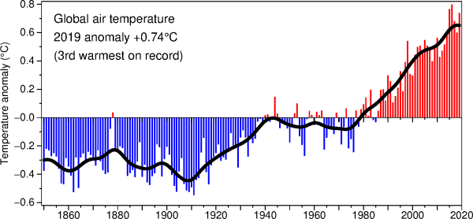
Environmental issue:
Global Warming
A temperature anomaly is the difference from an average, or baseline, temperature.
The baseline temperature is typically computed by averaging 30 or more years of temperature data.
Look at the graph.
Q1) How could you argue that ‘global warming’ exists?
Q2) Did you use any mathematics to respond to the above question? If yes, please explain.
Source: http://www.cru.uea.ac.uk/

Slide 8
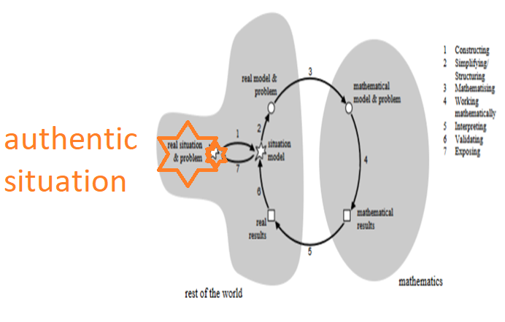
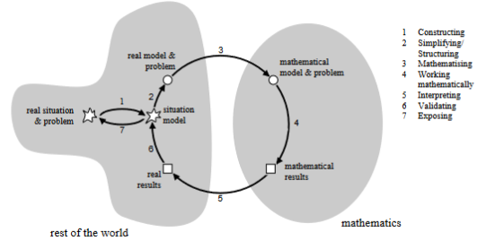
Relating problem solving with environmental issues
According to Vos (2018) the environmental issues possess the two essential authentic task characteristics:
the out-of-school origin and
the certification of originality,
thus they could engage students in authentic, meaningful and context-driven mathematics thinking processes that address issues of societal concerns (Yaro et al, 2020).
The modelling circle
(students’ processes while
translating between the real world and mathematics in both directions)

Slide 9
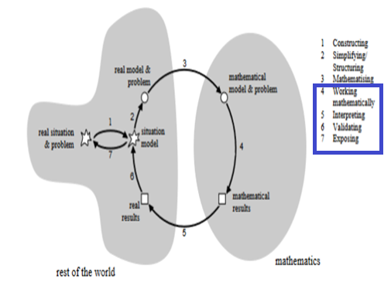
Q: Where do you place the ‘global warming task’ in relation to the modelling circle?

Slide 10
Group task Α (20 mins)
Two classroom tasks are provided in the next slides. These tasks are related to two well known environmental issues.
Read the classroom tasks and try to respond in the following questions:
Q1: Compare these tasks with standard/typical school tasks
Q2: Which one you could use in your classroom?
Possible choices: None, Both, One (specify).
Reason on your choice (including/excluding a task)

Slide 11
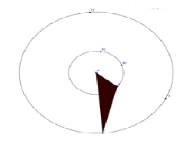
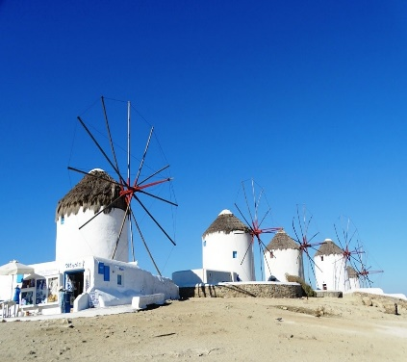
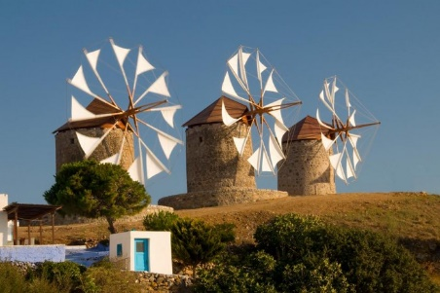
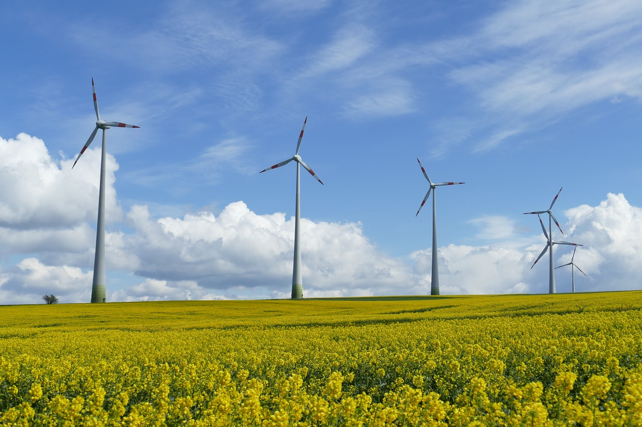
Environmental issue 1:
Should wind power plants be set up everywhere?
Classroom TASK 1
Q1) From windmills to wind power plants: Identify differences between windmills and wind power generators/turbines.
Q2) Design various types of windmill blades as well the blade of one power turbine.
Q3) Provide scientific based arguments favoring or opposing the use of wind power plants.
  What other aspects influence the decision on setting up wind power plants?
The construction of wind turbines, especially near residential areas, divides our society.

Slide 12
Environmental issue 2: Global warming
Classroom TASK 2
Look at the graph.
Q1. How could you argue that there is a ‘global warming’ issue?
Q2. Strengthen your argument by presenting similar representations from various resources (e.g., school texts, internet, scientific articles).
Source: http://www.cru.uea.ac.uk/

Slide 13
Group task Β (10 mins)

Slide 14
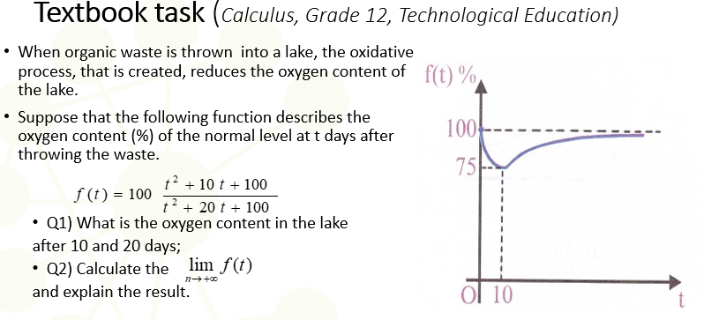
Environmental issues
(hidden) in the school mathematics texts
Q1) What is the environmental issue that is directly or indirectly related with this task?
Q2) How could you change this textbook task in order to make transparent its environmental dimensions?
Q3) Where to you place the textbook task and your new developed task in relation to the modelling circle?

Slide 15
5th Weekly assignment
Look in school (mathematics and/or other subjects) textbooks for problems related to environmental issues.
1) Choose and present one textbook task as it appears in the textbook, by citing your source (e.g., Mathematics, Grade 1, Unit: Fractions)
2) What is the environmental issue that is directly or indirectly related with this task?
3) How could you change this textbook task in order to make transparent its environmental dimensions?

Slide 16
Selected references
Boylan, M., & Coles, A. T., 2017, ‘Is another mathematics education possible? an introduction to a Special Issue on Mathematics Education and the Living world, Philosophy of Mathematics Education Journal.
Evagorou, M., 2011, ‘Discussing a socioscientific issue in a primary school classroom: The case of using a technology-supported environment in formal and nonformal settings.’ In T. Sadler (Ed.), Socio-scientific issues in the classroom, 133-160.
Hauge, K. H., & Barwell, R. (2022). Education for post-normal times. In R. Herheim, T. Werler, & K. H. Hauge (Eds.), Lived democracy in education: Young citizens’ democratic lives in kindergarten, school and higher education (pp. 65–76). Routledge.
Maass, K., Doorman, M., Jonker, V., &Wijers, M., 2019, “Promoting active citizenship in mathematics teaching.”, ZDM, 51(6), 991-1003. https://doi.org/10.1007/s11858-019-01048-6
Owens, D. C., Herman, B. C., Oertli, R. T., Lannin, A. A., & Sadler, T. D. (2019). Secondary science and mathematics teachers’ environmental issues engagement through socio-scientific reasoning. Eurasia Journal of Mathematics, Science and Technology Education: Special Issue on Enhancing Environmental Literacy in K-12 Science Classrooms, 15(6) https://doi.org/10.29333/ejmste/103561
Vos, P. (2018). “How real people really need mathematics in the real world”—Authenticity in mathematics education. Education Sciences, 8(4), 195. https://doi.org/10.3390/educsci8040195
Yaro, K., Amoah, E., & Wagner, D. (2020). Situated perspectives on creating mathematics tasks for peace and sustainability. Canadian Journal of Science, Mathematics and Technology Education, 20, 218-229. https://doi.org/10.1007/s42330-020-00083-w

