Slide 1
Συμπεριληπτική αξιολόγηση
Notes:
Maria

Slide 2
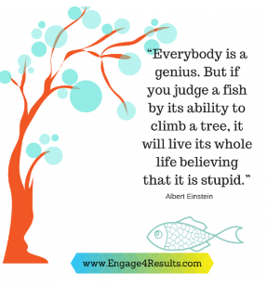
Equity and assessment
While there are multiple ways for students to learn,
students need to demonstrate learning in specific ways for it to count.
“An assessment process that is not mindful of equity can risk becoming a tool that promotes inequities, intentionally or not.”
Montenegro & Jankowski, 2020, p. 6.
https://www.google.com/search?q=Everybody%27s+a+Genius+but+If+You+Judge+a+Fish+By+Its+Ability+to+Climb+a+Tree%2C+It+Will+Live+Its+Whole+Life+Believing+It+Is+Stupid&rlz=1C1GCEA_enGR947GR947&oq=Everybody%27s+a+Genius+++but+If+You+Judge+a+Fish+By+Its+Ability+to+Climb+a+Tree%2C+It+Will+Live+Its+Whole+Life+Believing+It+Is+Stupid&gs_lcrp=EgZjaHJvbWUyBggAEEUYOdIBCTMxNjZqMGoxNagCALACAA&sourceid=chrome&ie=UTF-8#vhid=Ae-3Rzp3iFkFhM&vssid=l

Slide 3
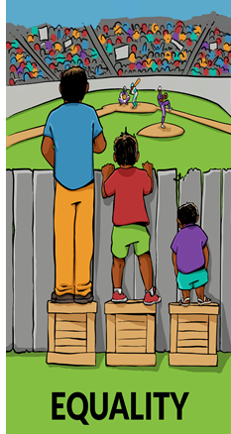
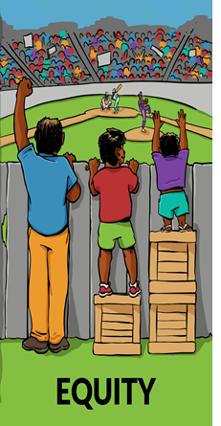
10^{η} εργασία στην τάξη
Τι παρατηρείτε;
Αν το πλαίσιο της εικόνας ήταν η αξιολόγηση τι αντιπροσωπεύει ο φράκτης;

Slide 4
Equity
Equity addresses ways to remove barriers to participation in STEM disciplines and increase students’ achievement

Slide 5
Equity and assessment
Equity in assessment of STEM learning includes assessment designs
  that create more expansive space for learners to show what they know and are able to do;
  Are contextualized with authentic problems relevant to learners’ lives/interests & funds of knowledge
  are accessible for students with disabilities
  allow and encourage translanguaging (combining linguistic terms from different languages) for multilingual learners

Slide 6
Assessment strategies that support equity issues

Slide 7
Str 1: Promoting equity through formative assessment
Formative assessment can open more opportunities to promote equity for learners with diverse needs and experiences in the classroom
A formative assessment classroom practice should build on specific students’ strengths and weaknesses
Some key strategies
    Providing feedback that moves learners forward.
    Activating students as instructional resources for one another.
    Activating students as the owners of their own learning.
    Andersson, C. (2020).

Slide 8
Str 2: Promoting equity by considering “The Rights of the learners’ framework”
The learner in the classroom
(1) has the right to be confused;
(2) has the right to claim ‘not understanding’;
(3) has the right to speak, listen and be heard; e.g., Engage in classroom conversations; ask Questions; share Ideas, and Listen to the Thinking of Others
(4) has the right to write, do (model with gestures and manipulate with tools); and represent only what makes sense to her/him.
Kalinec-Graig, 2017

Slide 9
Str 3: Promoting equity by creating ‘Learners’ profiles’ Diaries
The learners’ profile describes the ways in which a student learns best.
The teachers can keep a ‘learner’s profiles’ diary that could include information on students’
  interests (e.g., reading, listening to music, playing sports)
  learning styles (e.g., Analytic that involves the linear type of learning found most often in schools; Practical that involves seeing how and why things work as people actually use them; Creative that involves making new connections and seeking innovation)
  Differences based on their gender/culture/personality (e.g., being expressive or reserved in class interactions; preferring competition or collaboration; preferring to work individually or in a group)
  learning strengths and needs
  types of supports that have been successful in the past.
  A learner profile needs to be dynamic, as individual learners are constantly growing and changing.
    Thomas, et al., 2023; Tolminson et al., 2003

Slide 10
Group activity 1-reporting in a Google doc
Watch the video clip and comment on its proposed ideas https://elvlc.educ.ubc.ca/culturally-responsive-mathematics-assessment/
50:43-1:10:00
Session 2 – Looking to Nature: Math education assessment as cycles of feedback

Slide 11
Special cases
  Cultural responsive assessment
    Culture refers to explicit elements that makes people identifiable as a specific group(s) including background; language; religion; heritage, race/ethnicity
    Responsive means an action-based, urgent need to create contexts and curriculum that responds to the social, political, cultural, and educational needs of students (Khalifa, Gooden, & Davis, 2016).
  Assessment accommodations for students with learning disabilities
      Mild learning disabilities (e.g., dyslexia) or severe learning disabilities (e.g., physical, sensory or cognitive)
    Accommodations are tools and procedures that provide equal access to instruction and assessment for students with disabilities.

Slide 12
Strategies for Culturally responsive assessment
It is a process that requires reflection and planning.
  Be mindful of the student population(s) being served and involve students in the process of assessing learning;
  Use appropriate student-focused and cultural language in learning outcomes statements to ensure students understand what is expected of them;
  use multiple sources of evidence appropriate for the students being assessed and their assessment efforts;

Slide 13
Assessment accommodations for students with learning disabilities
Accommodations are generally grouped into the following categories:
Presentation (e.g., repeat directions, read aloud, use of larger bubbles on answer sheets etc.)
• Response (e.g., mark answers in book, use reference aids, point to specific answers etc.)
• Timing/Scheduling (e.g., extended time, frequent breaks)
• Setting (e.g., study carrel, special lighting, separate room)
Cortiella, C. (2005).

Slide 14
Summing up: How do I ensure my assessments are equitable for all students?
Use multiple assessment types
Provide reasonable accommodations and deadline expectations
Provide options/choices for students to demonstrate their learning
Ensure your materials are accessible
Use clear language that is understood by all
Be specific and transparent about student expectations
counter any implicit biaseshttps://cei.umn.edu/teaching-resources/assessments/equitable-assessments when creating and grading assessments

Slide 15
Selected References
Andersson, C. (2020). Formative assessment – from the view of special education teachers in mathematics. Nordic Studies in Mathematics Education,25 (3-4), 73–93.
Cortiella, C. (2005). No Child Left Behind: Determining Appropriate Assessment Accommodations for Students with Disabilities. National Center for Learning Disabilities.
Harris, C. J., Wiebe, E., Grover, S., & Pellegrino, J. W. (2023). Classroom-Based STEM Assessment: Contemporary Issues and Perspectives. Community for Advancing Discovery Research in Education (CADRE).
Kalinec-Craig, C. A. (2017). The rights of the learner: A framework for promoting equity through formative assessment in mathematics education. Democracy and Education, 25(2), 5.
Khalifa, M. A., Gooden, M. A., & Davis, J. E. (2016). Culturally responsive school leadership: A synthesis of the literature. Review of Educational Research, 86(4), 1272-1311.
Montenegro, E., & Jankowski, N. A. (2017). Equity and assessment: Moving towards culturally responsive assessment. (Occasional Paper No. 29). Urbana, IL: University of Illinois and Indiana University, National Institute for Learning Outcomes Assessment (NILOA
Montenegro, E., & Jankowski, N. A. (2020). A new decade for assessment: Embedding equity into assessment praxis (Occasional Paper No. 42). Urbana, IL: University of Illinois and Indiana University, National Institute for Learning Outcomes Assessment (NILOA).
Nortvedt, G. A., & Buchholtz, N. (2018). Assessment in mathematics education: Responding to issues regarding methodology, policy, and equity. ZDM, 50(4), 555-570.
Thomas, R. K., Strekalova-Hughes, E., Nash, K. T., Holley, M., Warner, C. K., Enochs, B., ... & Ricklefs, M. (2023). The learner profile: piloting a tool to support contextualized understanding of the learner. Journal of Early Childhood Teacher Education, 44(3), 349-372.
Tomlinson, C. A., Brighton, C., Hertberg, H., Callahan, C. M., Moon, T. R., Brimijoin, K., ... & Reynolds, T. (2003). Differentiating instruction in response to student readiness, interest, and learning profile in academically diverse classrooms: A review of literature. Journal for the Education of the Gifted, 27(2-3), 119-145.

