Slide 1

1st unit: Polya
Assignment #1

Slide 2
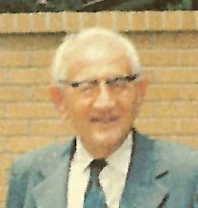
“Teaching is giving opportunities to students to discover things by themselves"﻿
George Pólya (1887-1985)
How is this related to problem solving?

Slide 3
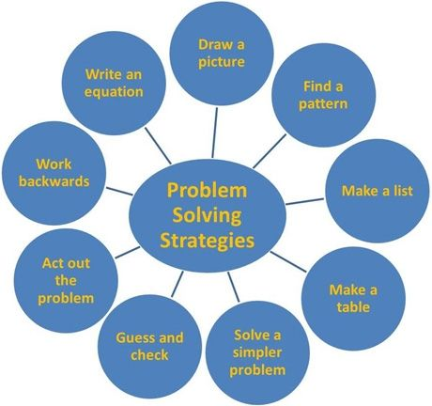
Heuristic strategies

Slide 4
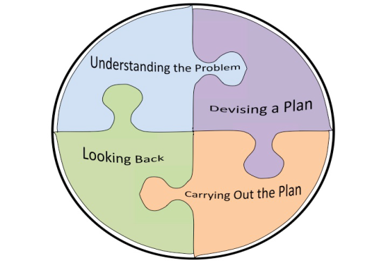
Tα 4 stages of problem solving

Slide 5
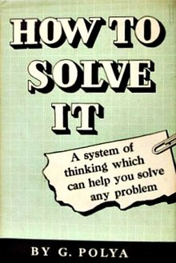
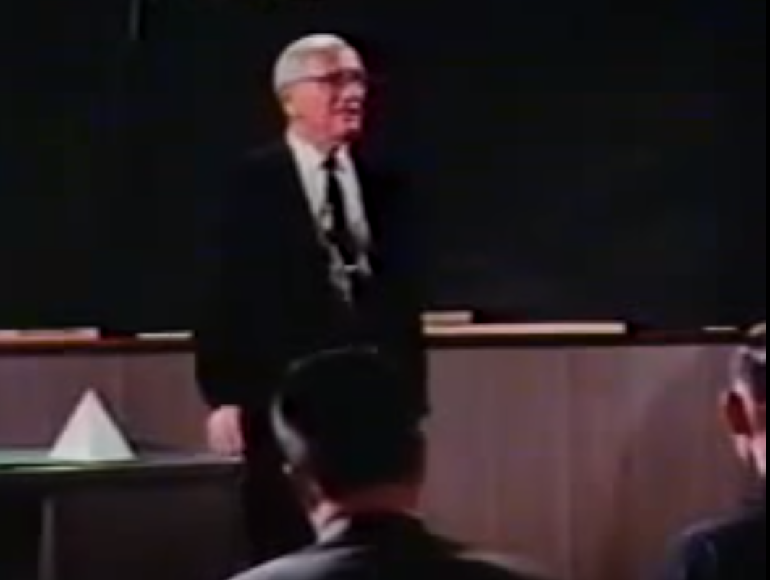

Slide 6
Watch the video and respond to the following questions
  The problem Polya teaches in his classroom
  ‘in how many parts 5 planes divide the space’
https://www.youtube.com/watch?v=h0gbw-Ur_do
What are the main heuristic strategies Polya uses in his teaching? How do they contributed in the problem solution?
What aspect of Polya’s teaching you find as the most interesting?

