Slide 1


Εθνικό και Καποδιστριακό Πανεπιστήμιο Αθηνών
Ιατρική Σχολή
ΕΡΓΑΣΤΗΡΙΟ ΒΙΟΪΑΤΡΙΚΗΣ ΤΕΧΝΟΛΟΓΙΑΣ
Τεχνητή Νοημοσύνη και Ιατρική
Θεόδωρος Γ. Παπαϊωάννου
Καθηγητής Βιοϊατρικής Τεχνολογίας

Slide 2
Τεχνητή Νοημοσύνη
֍
Thinking humanly
֍
Thinking rationally
֍
Acting humanly
֍
Acting rationally

Slide 3
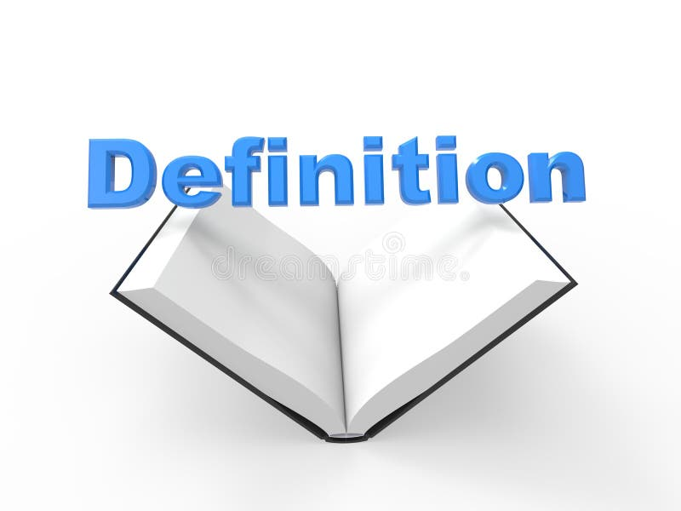

Νοημοσύνη - Intelligence ?
Τεχνητή Νοημοσύνη - Artificial Intelligence (AI) ?
Αυτόνομα συστήματα - Autonomous systems ?
Μηχανική Μάθηση - Machine Learning (ML) ?
Βαθιά μάθηση - Deep Learning (DL) ?
Αλγόριθμος - Algorithm ?
Μεγάλα γλωσσικά μοντέλα – Large Language Models (LLM) ?
https://hai.stanford.edu/sites/default/files/2020-09/AI-Definitions-HAI.pdf

Slide 4


Slide 5
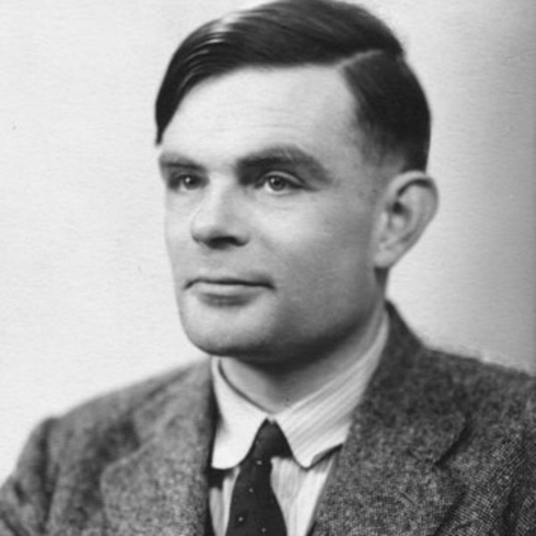
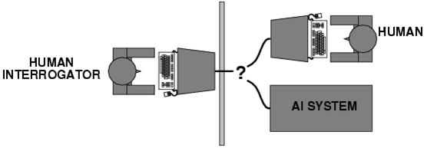
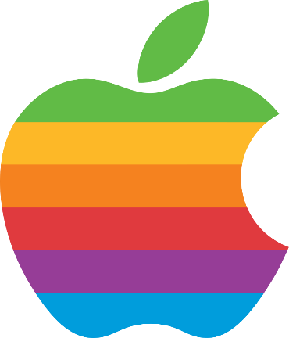
Turing τεστ (1950)
Άνθρωπος
Alan Turing (1912-1954)
Άνθρωπος
«Ανακριτής»
ΑΙ
DIFFICULT TO DECODE: ALAN TURING’S LIFE AND ITS IMPLICATIONS
https://sitn.hms.harvard.edu/flash/2012/turing-biography/

Slide 6
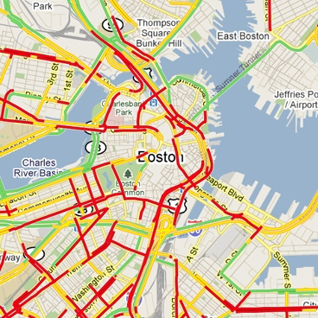
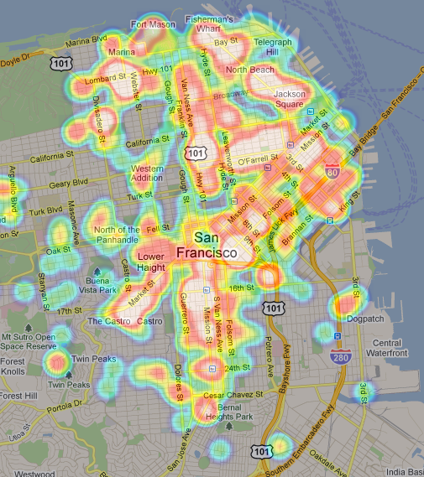
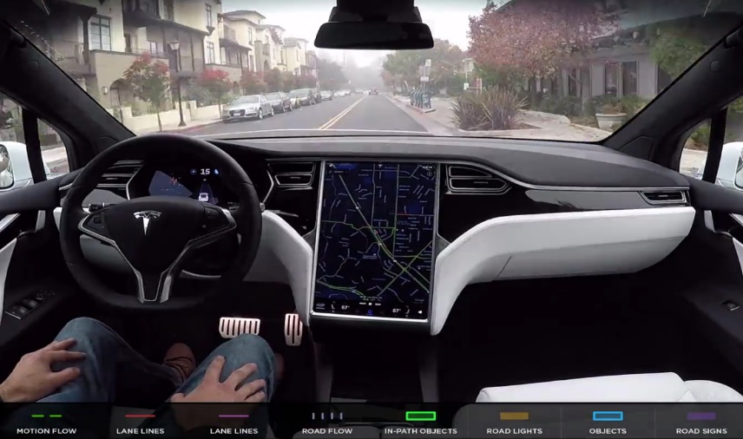
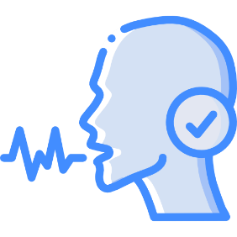
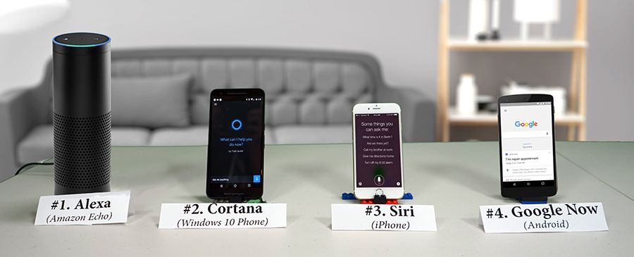



AI στη ζωή μας . .
UBER
Virtual Transportation App
Prediction of Trip’s Performance
TESLA - Auto-Pilot
Driverless Automotives
Surrounding Imaging-Object Analytics
WAZE
Prediction of Traffic Patterns
Apple (Siri)
Google (Google Assistant)
Amazon (Alexa)

Slide 8
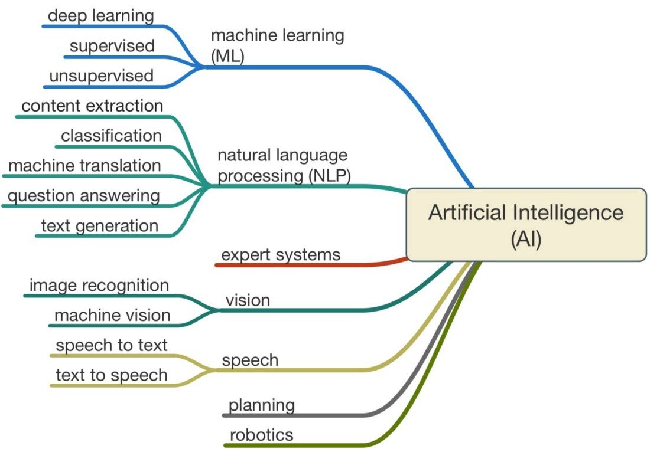

Slide 9
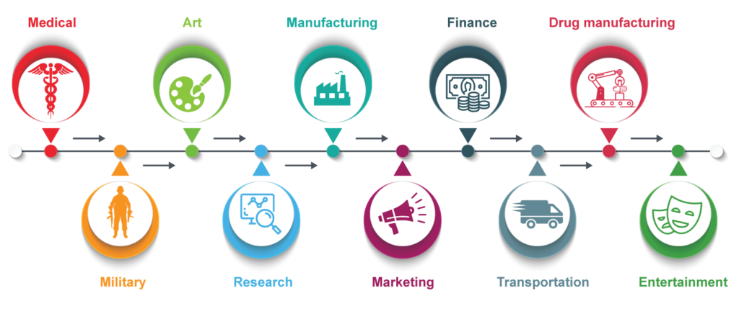

Slide 10
Εφαρμογές
Διάγνωση
Diagnosis
Παρακολούθηση
Screening
Κατηγοριοποίηση
Classification
Γενομική ανάλυση
Genomics
ΑΙ / ML
Πρόγνωση
Prognosis
Πρόβλεψη
Prediction
Έρευνα - Ανάπτυξη φαρμάκων
Research – Drug development

Slide 11
ακριβή πρόβλεψη των καρδιαγγειακών συμβαμάτων
μη επεμβατική διάγνωση της στεφανιαίας νόσου
ανίχνευση αρρυθμιών
διάγνωση, θεραπεία, πρόβλεψη
στην καρδιακή ανεπάρκεια

Slide 13
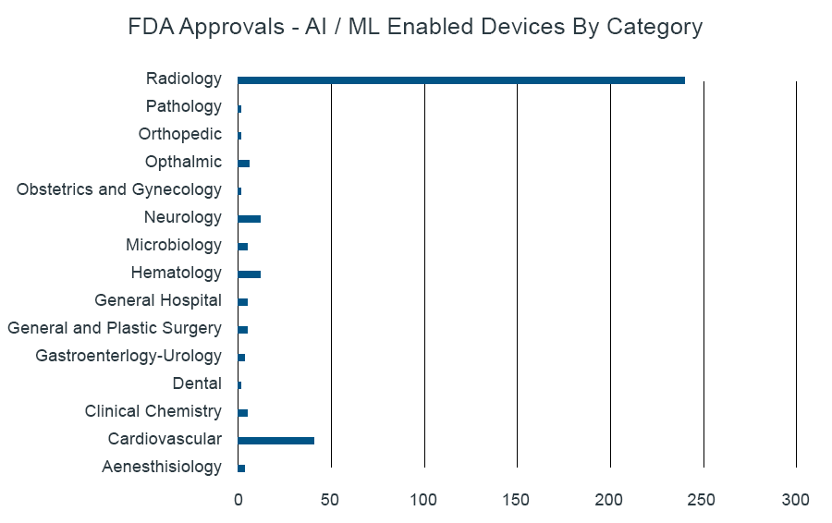
Αμερικανικός Οργανισμός Τροφίμων και Φαρμάκων
70,3%
3,5%
3,8%
12%

Slide 14
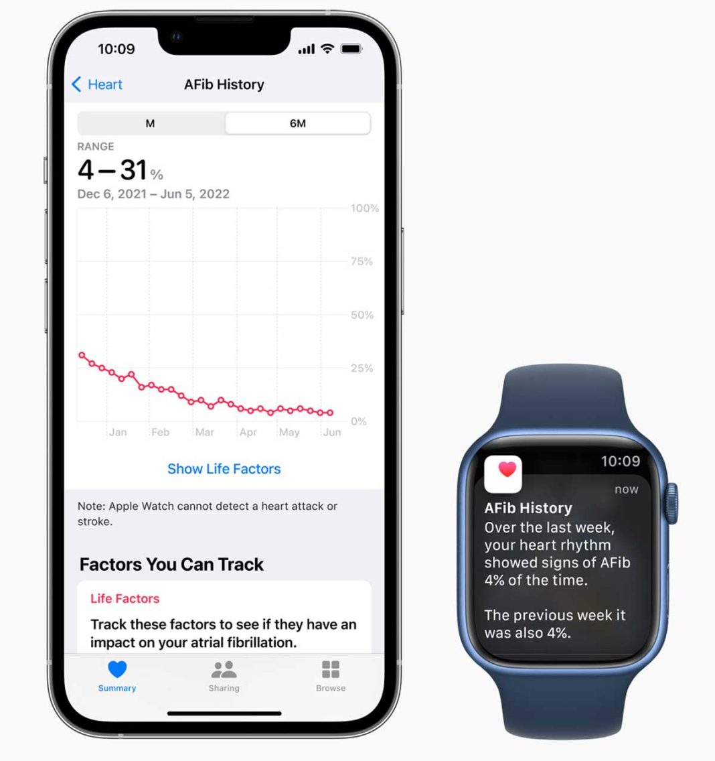
Η εφαρμογή (app) “AFib History Feature (AFH)” μετρά τη συχνότητα του ακανόνιστου ρυθμού για να παρέχει μια εκτίμηση της επιβάρυνσης από κολπική μαρμαρυγή. Η επιβάρυνση AFib μπορεί να οριστεί ως το ποσοστό του χρόνου που η καρδιά ενός ατόμου βρίσκεται σε AFib κατά τη διάρκεια μιας συγκεκριμένης χρονικής περιόδου παρακολούθησης.
Apple Inc received FDA’s 510(k) clearance in 2022
for a novel AFib feature that’s available on Apple Watch

Slide 15
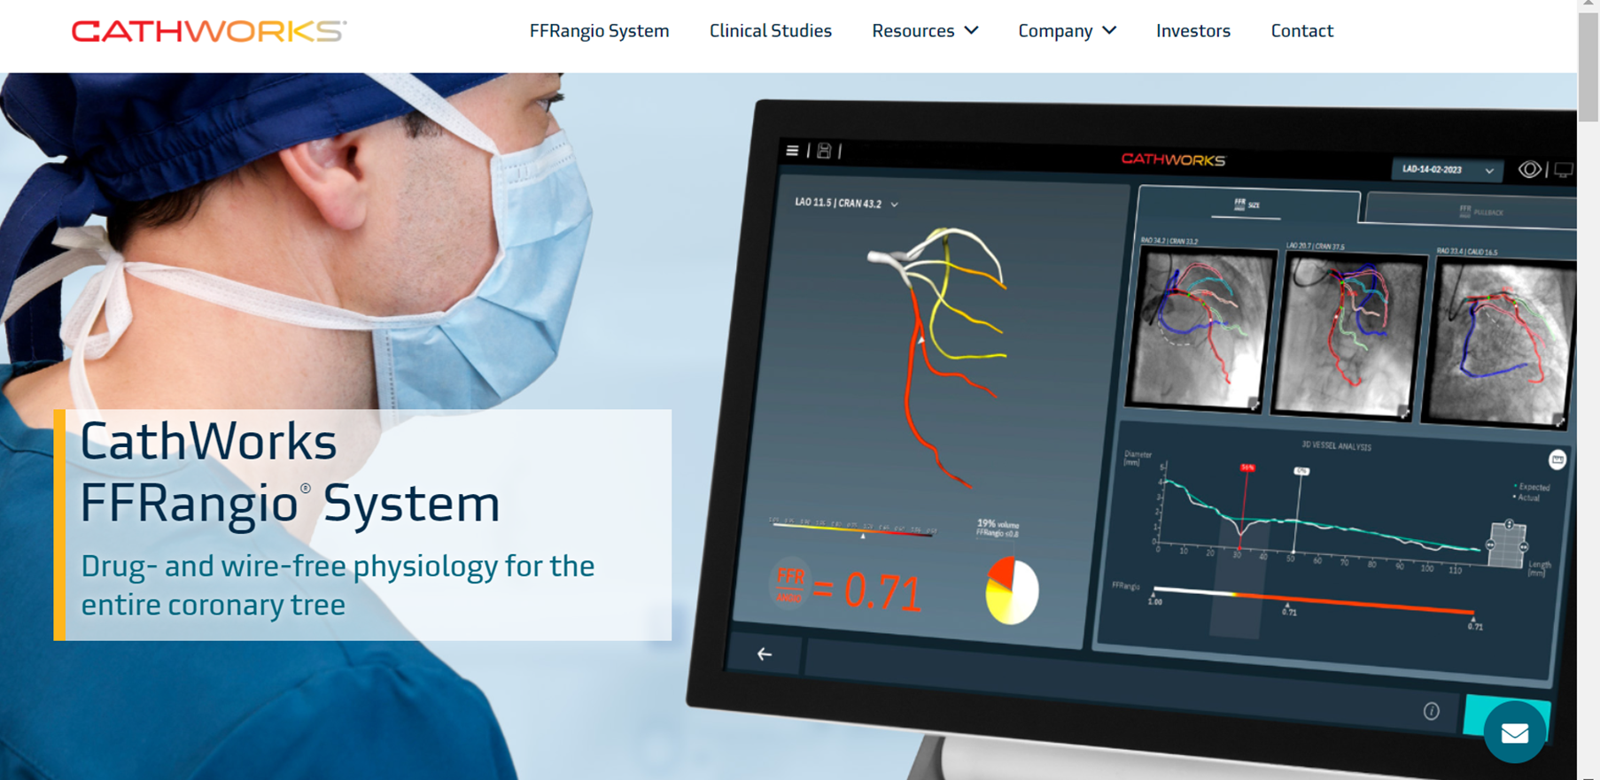
FDA 510(k) premarket notification, 09/12/2019

Slide 16
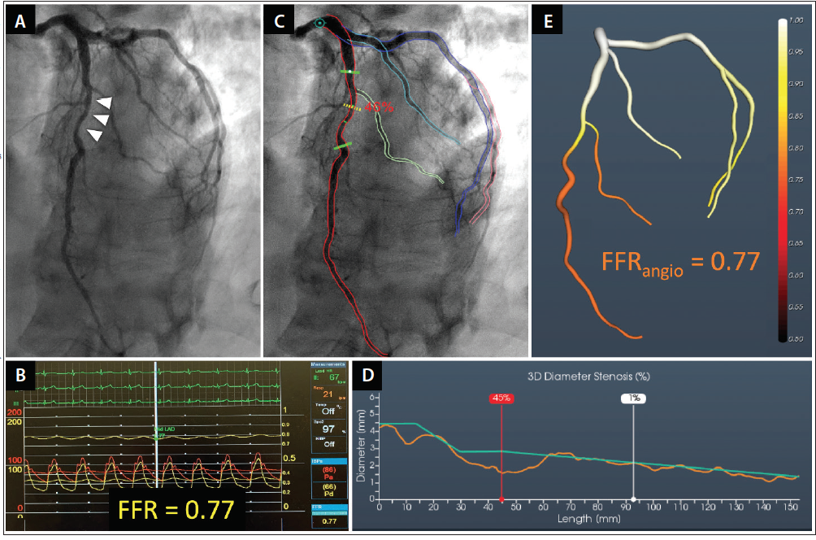

Slide 17
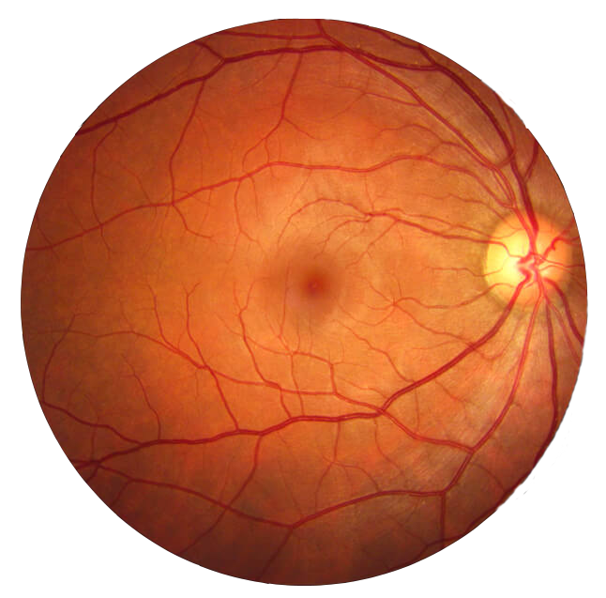
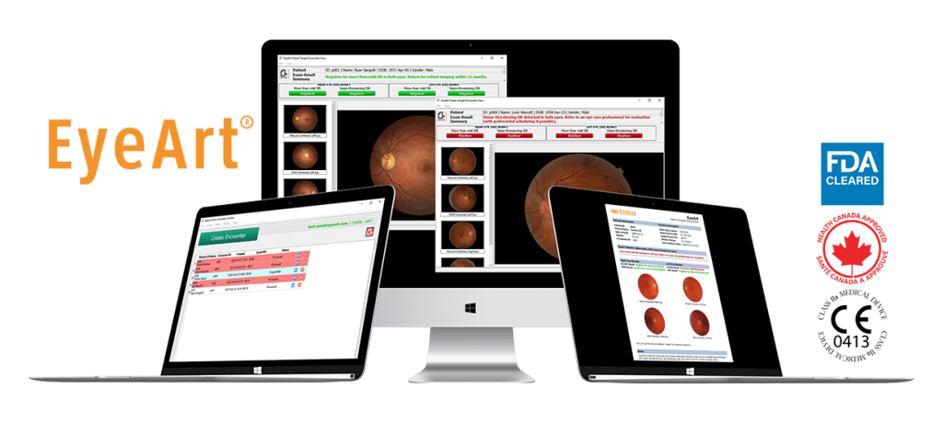
EyeArt is the First FDA Cleared AI Technology for Autonomous Detection of Both More than mild and Vision-Threatening Diabetic Retinopathy
The EyeArt AI Eye Screening System makes in-clinic, real-time diabetic retinopathy (DR) screening possible for primary care practices, diabetes centers and optometric offices by allowing physicians to quickly and accurately identify referable DR patients during a diabetic patient’s regular exam.
https://www.eyenuk.com/

Slide 18
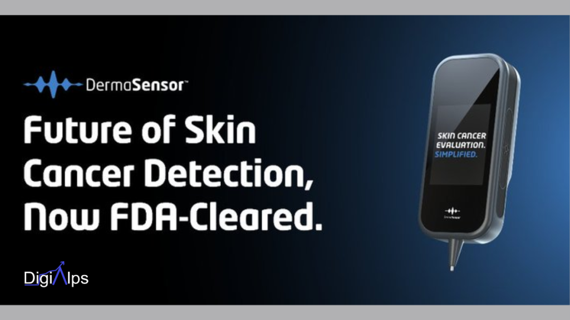

Slide 19
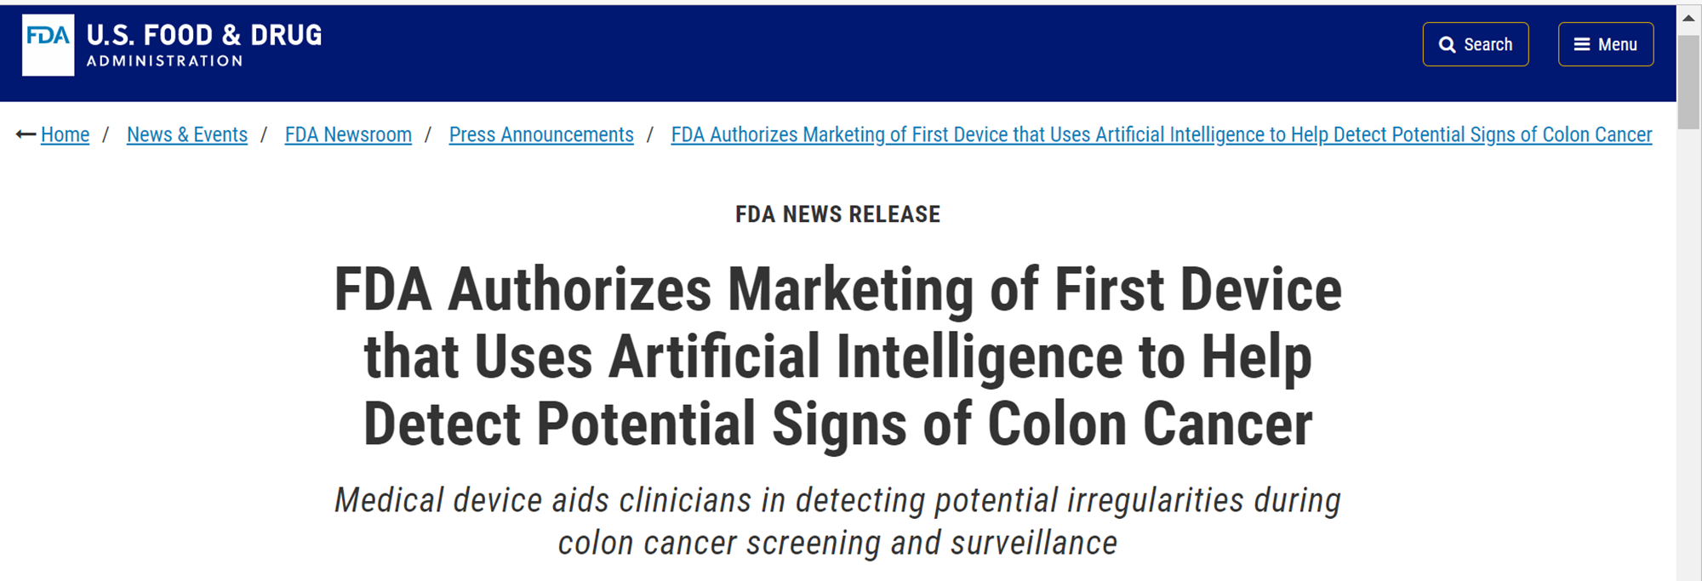
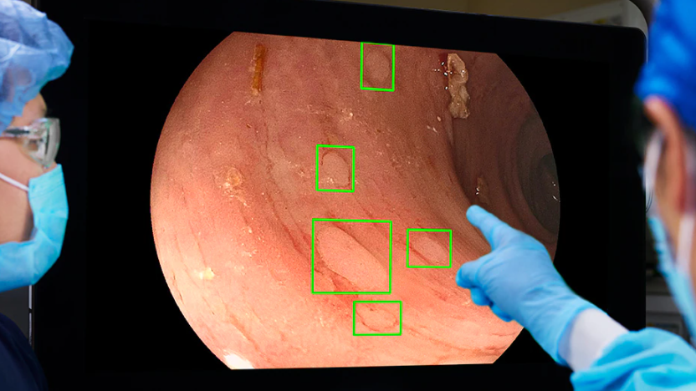
2021, Medtronic

Slide 20
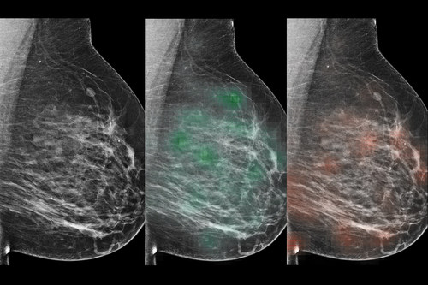
Deep Neural Networks Improve Radiologists’ Performance in Breast Cancer Screening
Wu et al. IEEE Transactions on Medical Imaging ( Volume: 39, Issue: 4, April 2020)

Slide 21
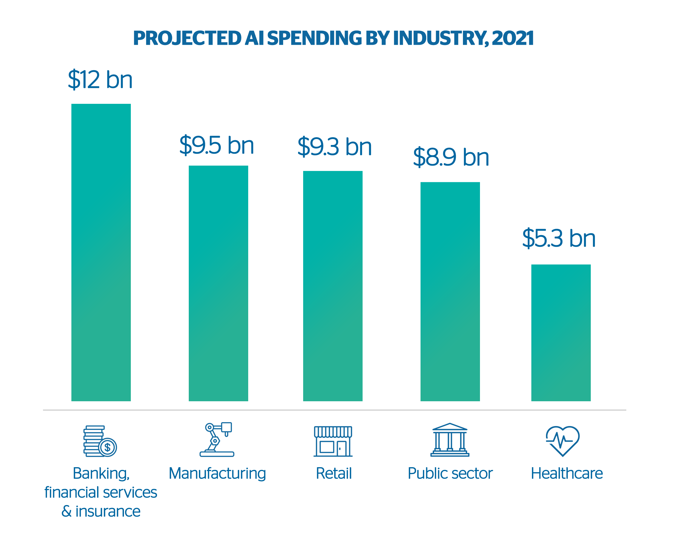
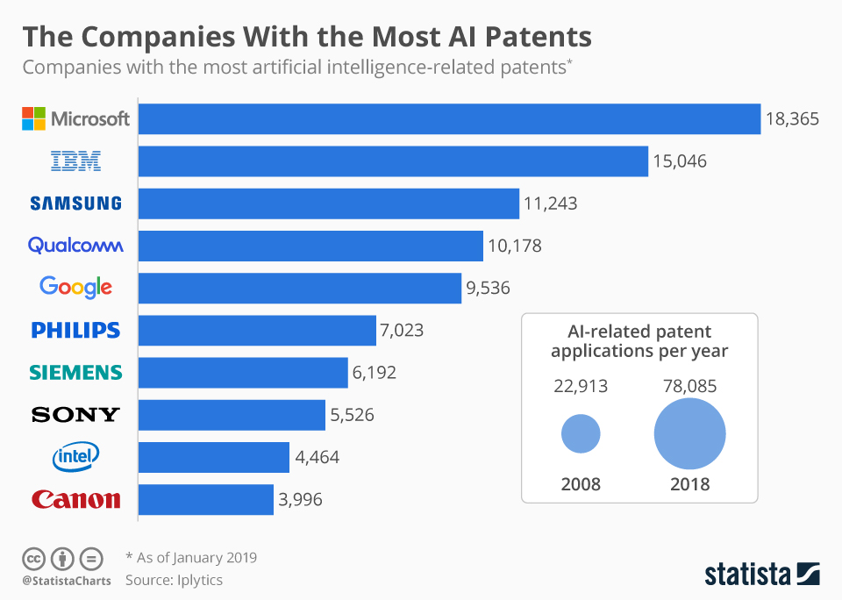

Slide 22
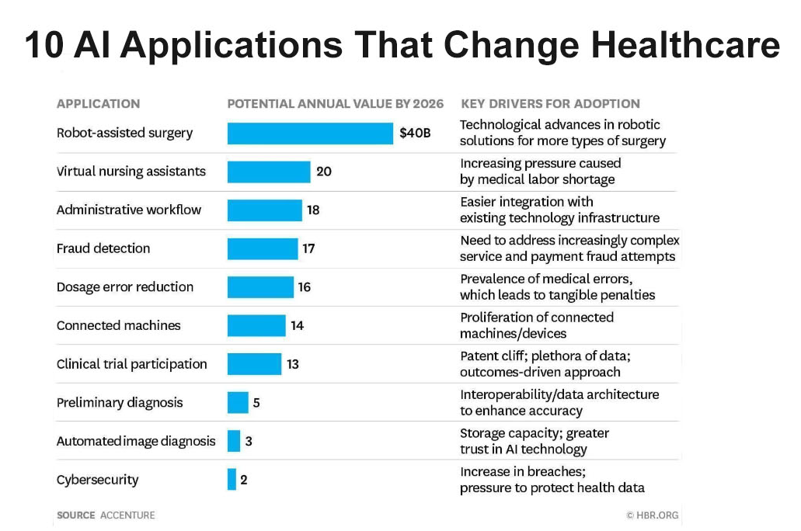

Slide 23
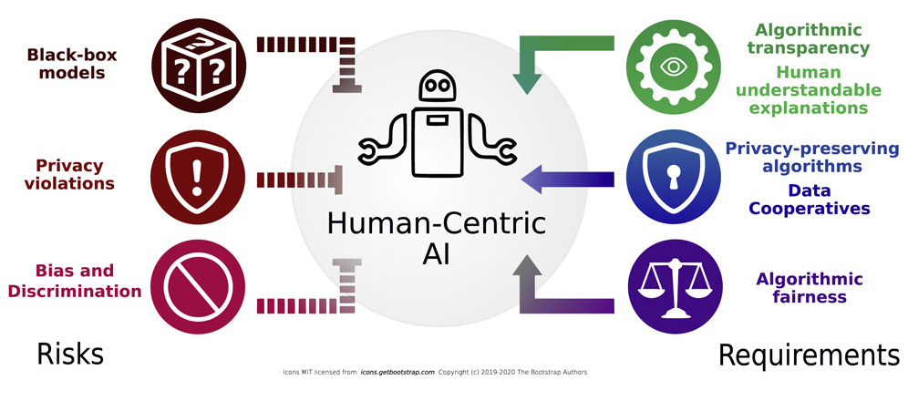
https://www.sciencedirect.com/science/article/pii/S2589004221002170

Slide 24
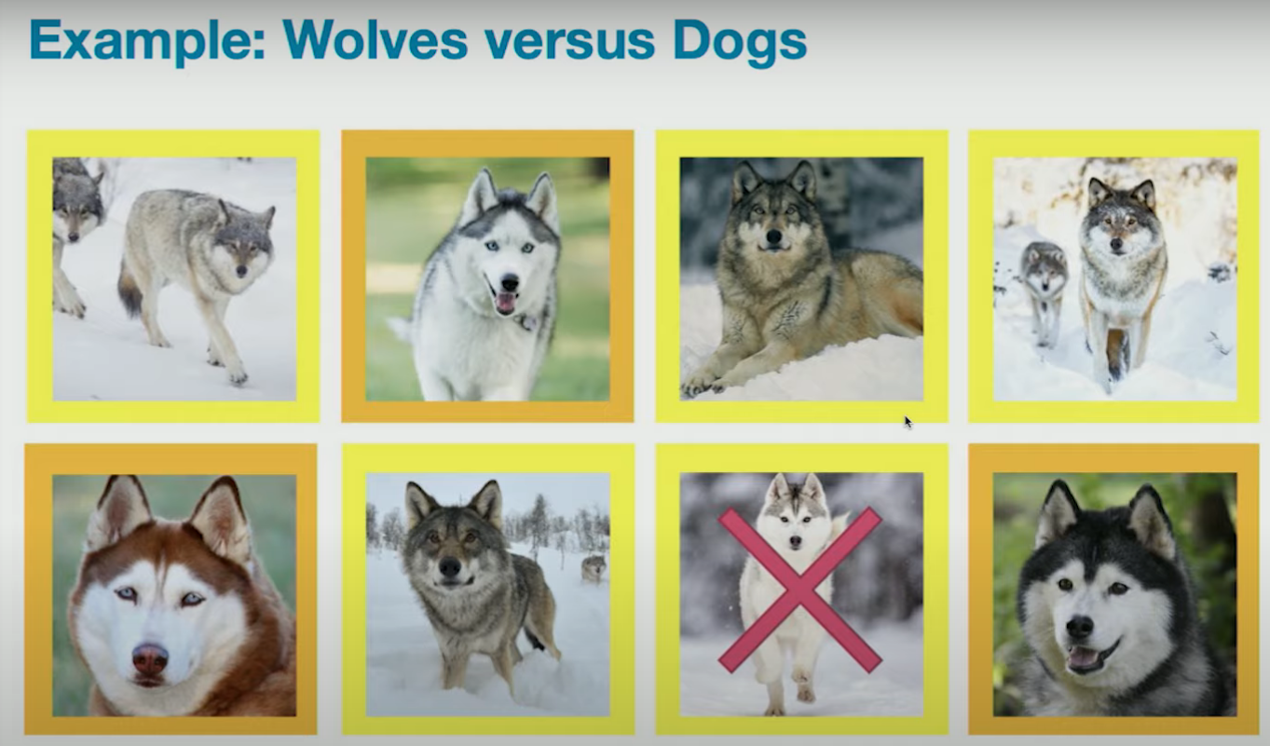
“Why Should I Trust You?”: Explaining the Predictions of Any Classifier
Marco Ribeiro, Sameer Singh, and Carlos Guestrin. 2016
https://aclanthology.org/N16-3020
DOI:10.18653/v1/N16-3020

Slide 25


Slide 26


Slide 27


Slide 28
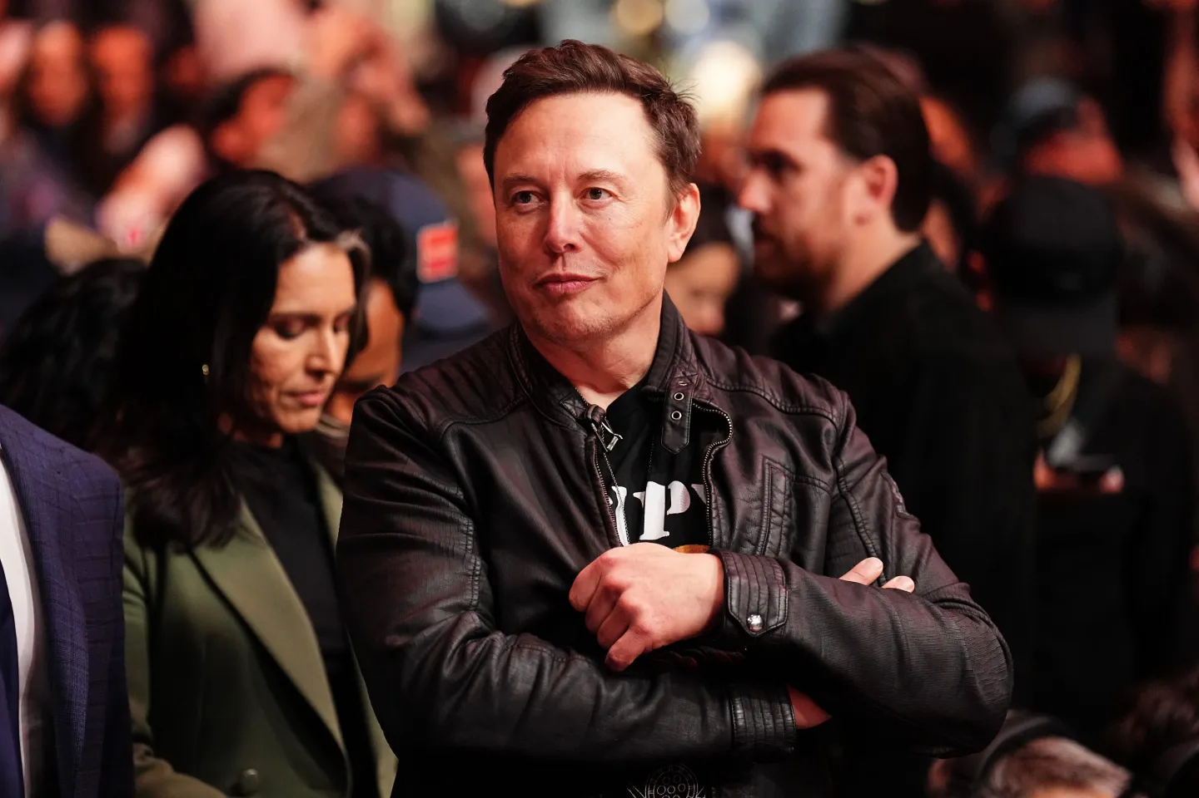
Elon Musk asked people to upload their medical data to X so his AI company could learn to interpret MRIs and CT scans
Elon Musk told X users to upload their medical information to train AI bot Grok | Fortune

Slide 29

Deepfakes

Slide 30
Embracing deepfakes and AI-generated images in neuroscience research.
Becker C, Laycock R. Eur J Neurosci. 2023 Aug;58(3):2657-2661.
Can Deepfakes Improve Therapy?
Wiederhold BK. Cyberpsychol Behav Soc Netw. 2021 Mar;24(3):147-148.
Deepfakes and doctors: How people are being fooled by social media scams.
Stokel-Walker C. BMJ. 2024 Jul 17;386:q1319.
Photographic and Video Deepfakes Have Arrived: How Machine Learning May Influence Plastic Surgery.
Crystal DT, et al. Plast Reconstr Surg. 2020 Apr;145(4):1079-1086.

Slide 31
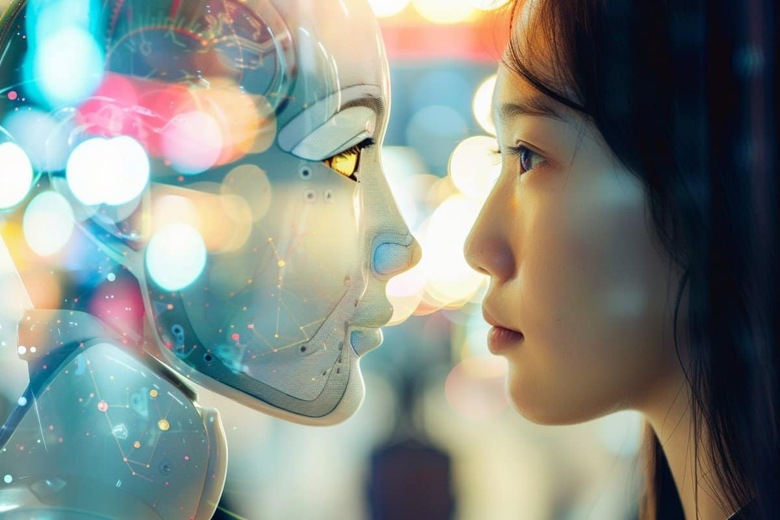
AI vs. Human Empathy: Machine Learning More Empathetic
Yidan Yin et al. “AI can help people feel heard, but an AI label diminishes this impact”
PNAS 2024 Apr 2;121(14):e2319112121.

Slide 32
AI vs. Human Empathy: Machine Learning More Empathetic
We found that AI-generated messages made recipients feel more heard than human-generated messages and that AI was better at detecting emotions. However, recipients felt less heard when they realized that a message came from AI (vs. human).
Finally, in a follow-up study where the responses were rated by third-party raters, we found that compared with humans, AI demonstrated superior discipline in offering emotional support, a crucial element in making individuals feel heard, while avoiding excessive practical suggestions, which may be less effective in achieving this goal.
Yidan Yin et al. “AI can help people feel heard, but an AI label diminishes this impact”
PNAS 2024 Apr 2;121(14):e2319112121.

Slide 33

Ευχαριστώ

