Slide 1




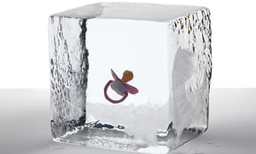


Κατάψυξη ωαρίων:
Μόδα η Ιατρική αναγκαιότητα;
Νικόλαος Φ. Βλάχος MD. PhD, FACOG
Καθηγητής Μαιευτικής, Γυναικολογίας και Υποβοηθούμενης Αναπαραγωγής
B’Μαιευτική και Γυναικολογική Κλινική, Αρεταίειο Νοσοκομείο.

Slide 2
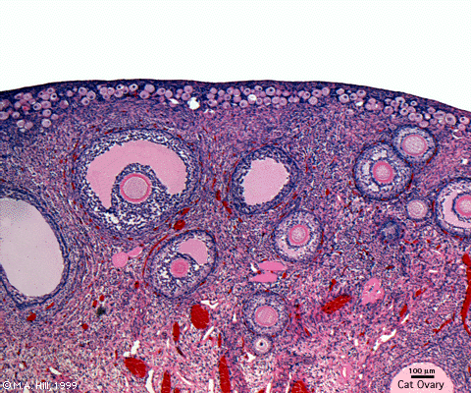
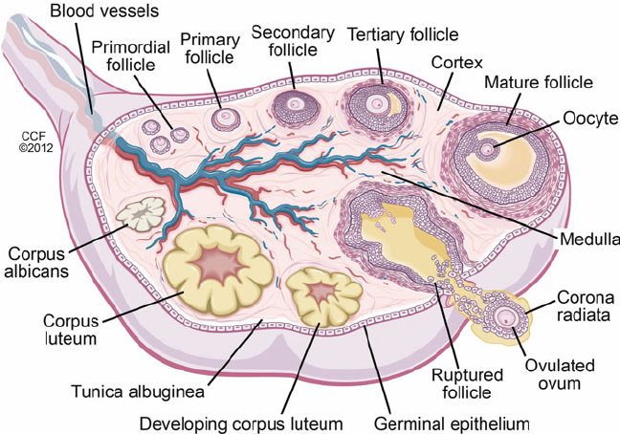
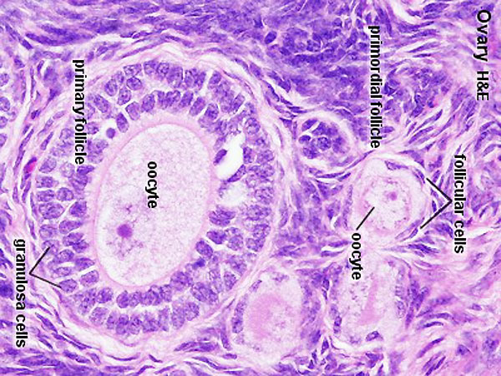
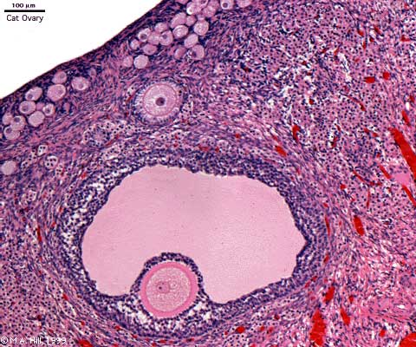
^{What is Ovarian Reserve?}
The pool (number) of follicles in the ovaries that are capable of growing in the presence of gonadotrophins.

Slide 3
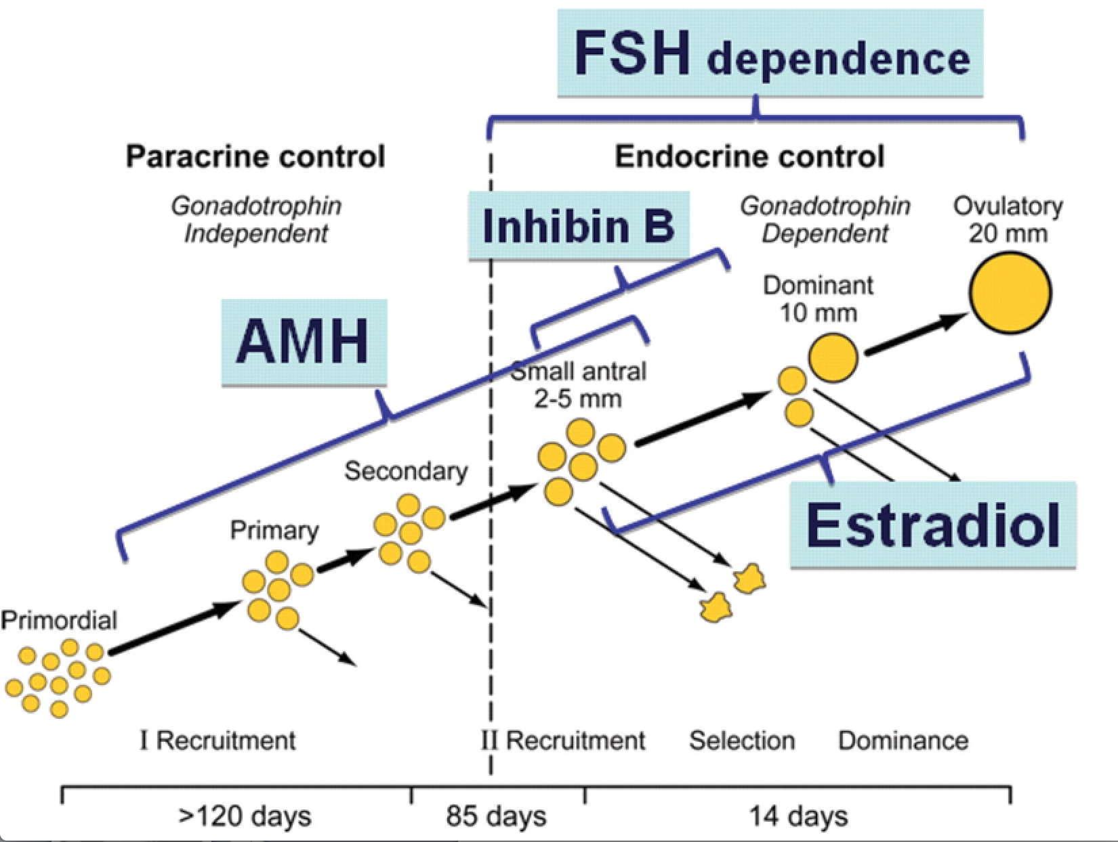
Κατάψυξη ωαρίων:
Μόδα η Ιατρική αναγκαιότητα;
AGE

Slide 4

A history of oocyte cryopreservation
Successful pregnancies from frozen oocytes were first achieved in the late 1980s, using slow-freeze and rapid-thaw cryopreservation techniques ( Chen, 1986 , 1988 ; Van Uem et al., 1987 ).
Oocytes are notoriously difficult cells to cryopreserve, due to their low surface area to volume ratio and high susceptibility to intracellular ice formation ( Paynter et al. , 1999 ).
Studies also revealed the negative effects of cryopreservation on the stability of microtubules and microfilaments in mammalian oocytes ( Pickering and Johnson, 1987 ; Sathananthan et al. , 1988 ; Vincent et al. , 1989 ; Pickering et al. , 1990 ; Joly et al. , 1992 ), which are vital for normal chromosomal segregation ( Glenister et al. , 1987 ).

Slide 5
A history of oocyte cryopreservation
Research into oocyte cryopreservation was accelerated by legislative restrictions surrounding the storage of embryos, particularly those in Italy that prevented the cryopreservation of excess embryos ( Benagiano and Gianaroli, 2004 ).
The introduction of vitrification as an alternative to slow freezing reduced damage to internal structures and led to superior success rates ( Antinori et al. , 2007 ; Cao et al. , 2009 ; Fadini et al. , 2009 ; Smith et al. , 2010 ).
Further, the use of intracytoplasmic sperm injection (ICSI) as an insemination method for vitrified oocytes was found to rectify fertilization issues due to zona pellucida hardening ( Kazem et al. , 1995 ; Porcu et al. , 1997 ; Fabbri et al. , 1998 ).

Slide 6
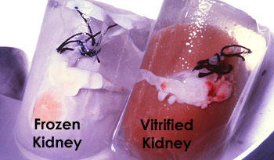
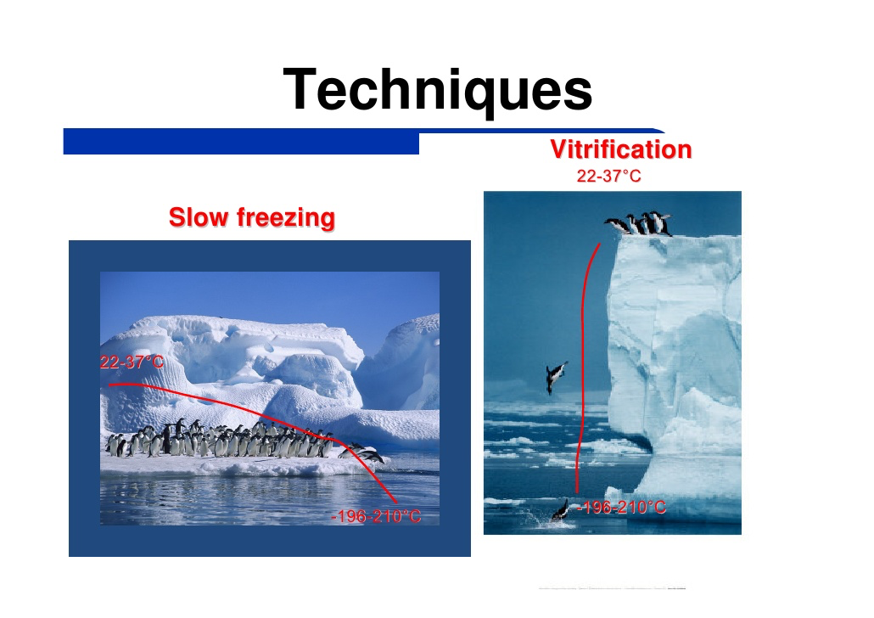

Cryopreservation of eggs and embryos

Slide 7
A history of oocyte cryopreservation
In 2013, the American Society for Reproductive Medicine (ASRM) lifted the experimental label applied to oocyte freezing, following four randomized controlled trials that suggested that in-vitro fertilization (IVF) using vitrified/warmed oocytes could produce similar fertilization and pregnancy rates to IVF with fresh oocytes
(Cobo et al. , 2008 , 2010a , Rienzi et al. , 2010 ; Parmegiani et al. , 2011 )
There are two main classes of vitrification protocol:
Open vitrification involves direct contact between oocytes and liquid nitrogen, using low volume devices such as capillary glasses, cooper devices, pulled straws, and loops
Closed vitrification involves indirect contact between oocytes and liquid nitrogen using tubing systems
Glujovsky et al. , 2014.

Slide 8

Fertility preservation after puberty?
Few years ago Now……………
Embryo cryopreservation represents the most efficacious method for fertility preservation in women with cancer
But………
Sperm is also required!!!!!
Oocyte cryopreservation equally successful to embryo cryopreservation

Slide 9
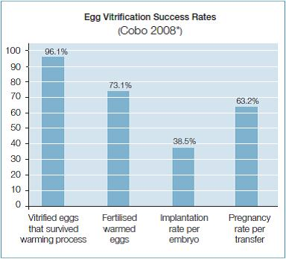
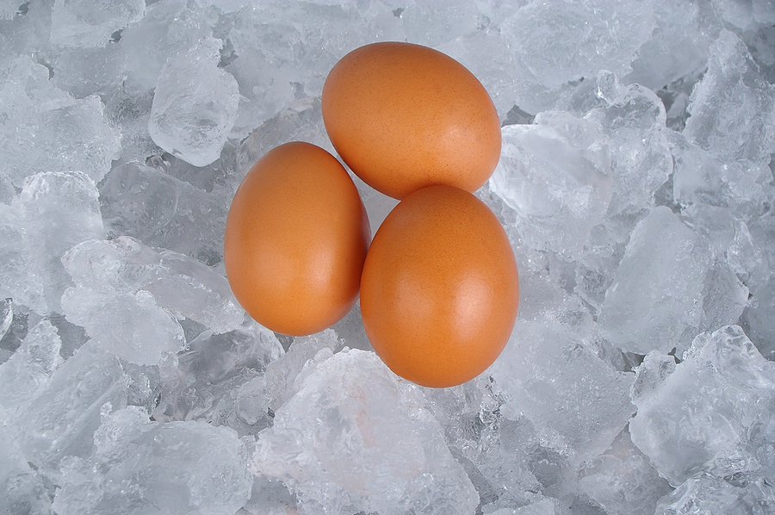
Oocyte Vitrification

Slide 10
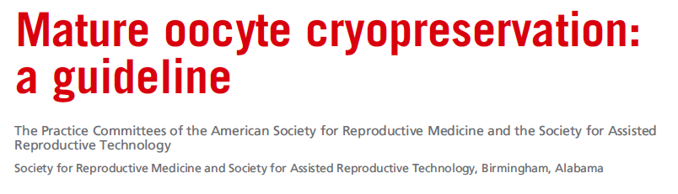

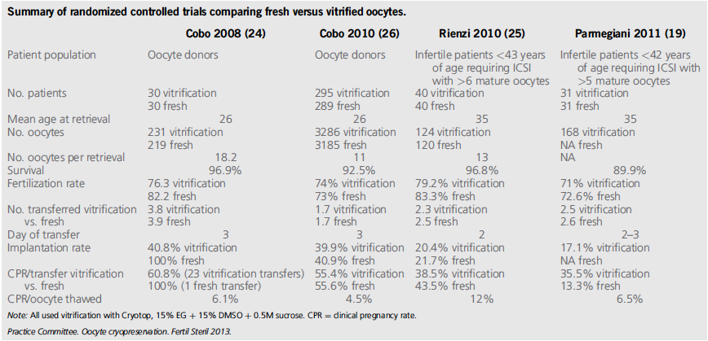

Slide 11
Κατάψυξη ωαρίων:
Μόδα η Ιατρική αναγκαιότητα;
Medical
Social
Risks and benefits
How it is done?
Medical indications for fertility preservation

Slide 12


Slide 13
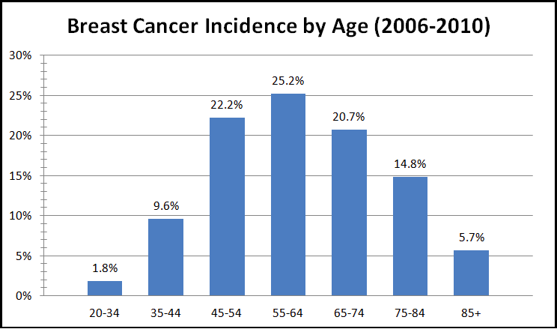
Breast cancer age distribution.

Slide 14

Time is important!!!
Κατάψυξη ωαρίων:
Μόδα η Ιατρική αναγκαιότητα;
Cancer diagnosis
Fertility preservation
Treatment

Slide 15
Κατάψυξη ωαρίων:
Μόδα η Ιατρική αναγκαιότητα;
Medical
Social
Why do we need fertility preservation for social reasons
Ethics involved in this process
How it is done?

Slide 16

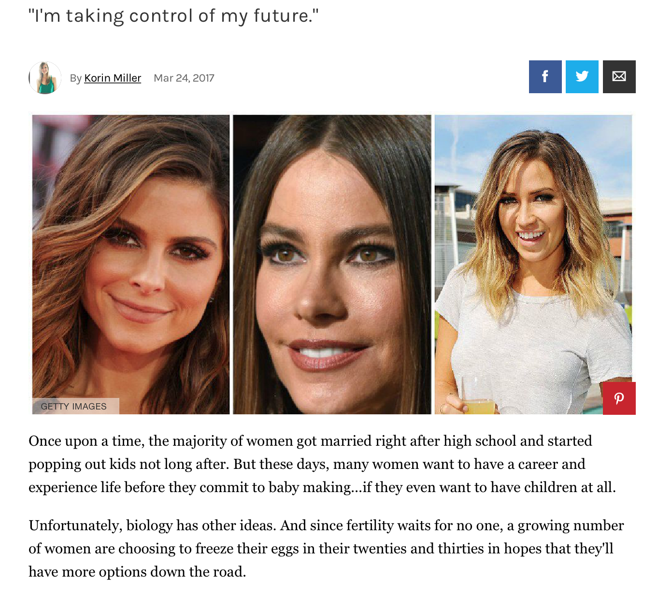

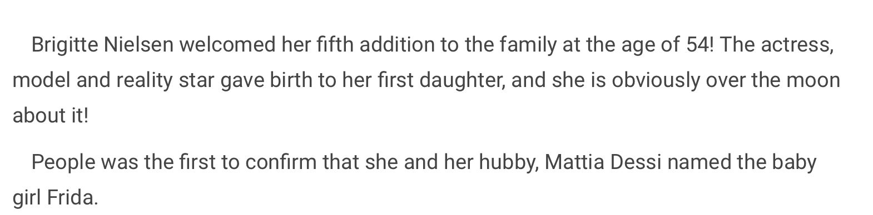

Slide 17
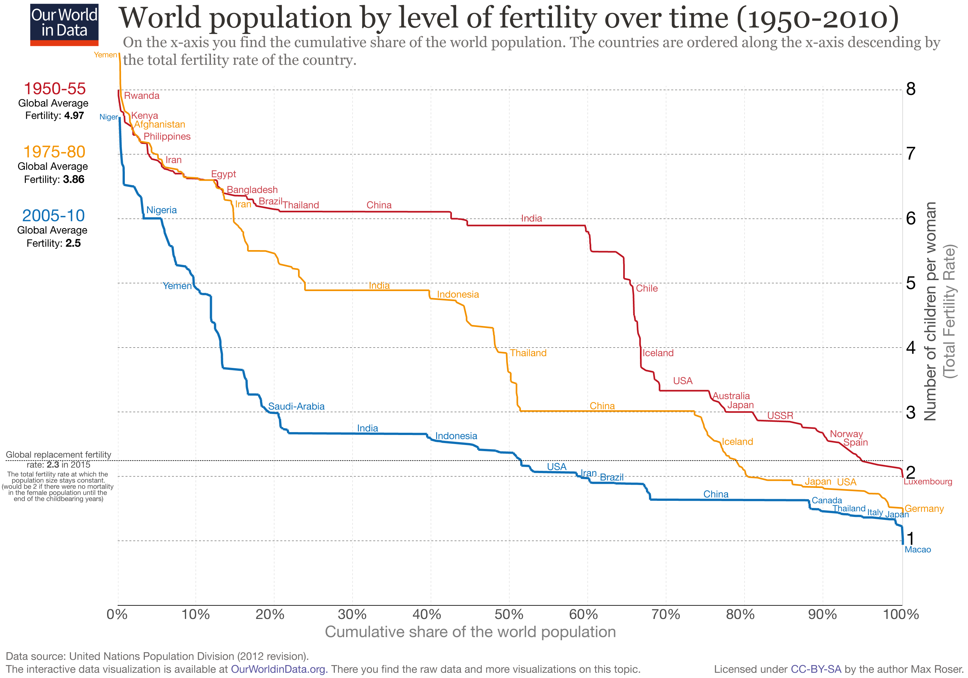
Reproductive Performance

Slide 18
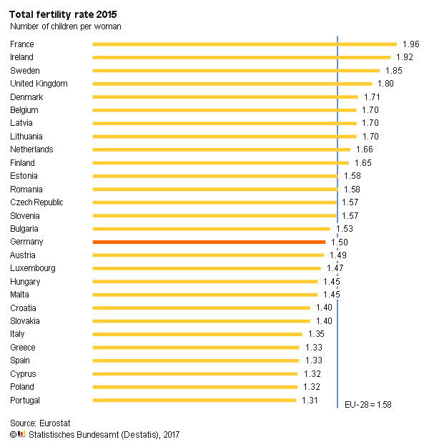
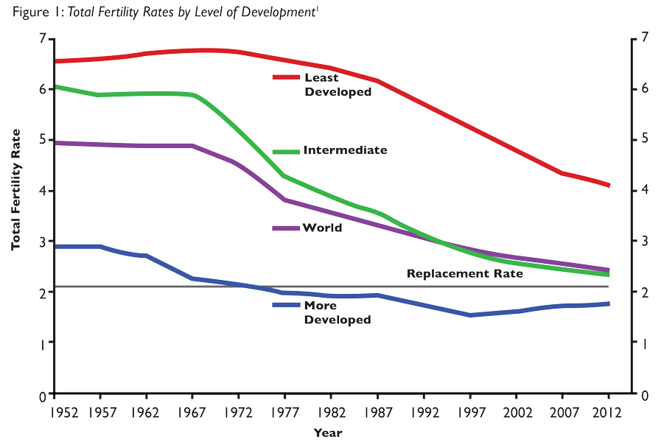
Reproductive Performance

Slide 19
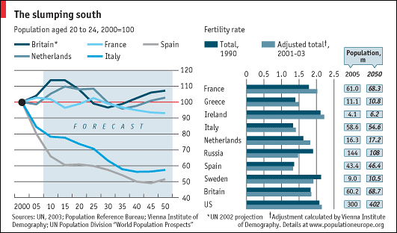
Κατάψυξη ωαρίων:
Μόδα η Ιατρική αναγκαιότητα;
The economist 2008

Slide 20
European drop in fertility rates
Feminism
Contraception
War

Slide 21
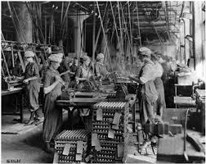





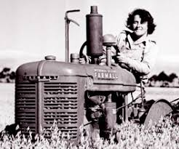

Slide 22
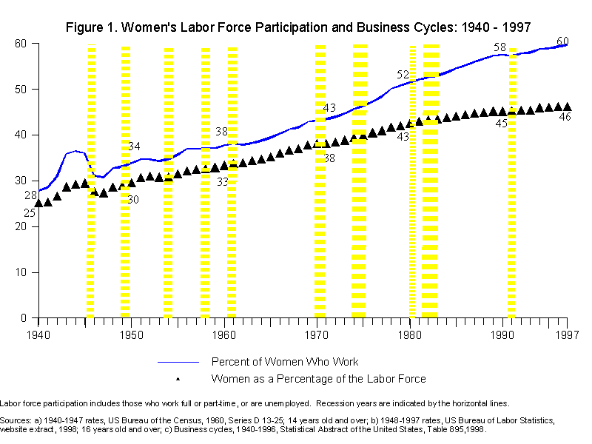

Slide 23
Ανάγκη και δυνατότητες της διατήρησης της αναπαραγωγικής λειτουργίας σήμερα
Global problem!
European problem !!
Greek problem!!!

Slide 24

ΕΛΣΤΑΤ
Μέση ηλικία Κυησης στην Ελλάδα
1975 | 26,82
1980 | 26,10
1985 | 26,24
1990 | 27,18
1995 | 28,27
2000 | 29,10
2005 | 29,91
2010 | 30,39
2011 | 30,49
2012 | 30,68
2013 | 30,90
2014 | 30,97
2015 | 31,31
2016 | 31,32
2017 | 31,45
Δείκτης Γονιμότητας
1950 | 2,57
1955 | 2,39
1960 | 2,23
1965 | 2,32
1970 | 2,43
1975 | 2,33
1980 | 2,23
1985 | 1,68
1990 | 1,39
1995 | 1,28
2000 | 1,25
2005 | 1,34
2010 | 1,48
2015 | 1,35

Slide 25
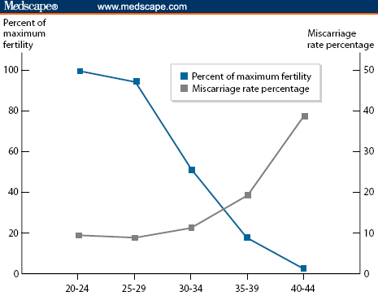
Κατάψυξη ωαρίων:
Μόδα η Ιατρική αναγκαιότητα;
35% drop

Slide 27


Slide 28
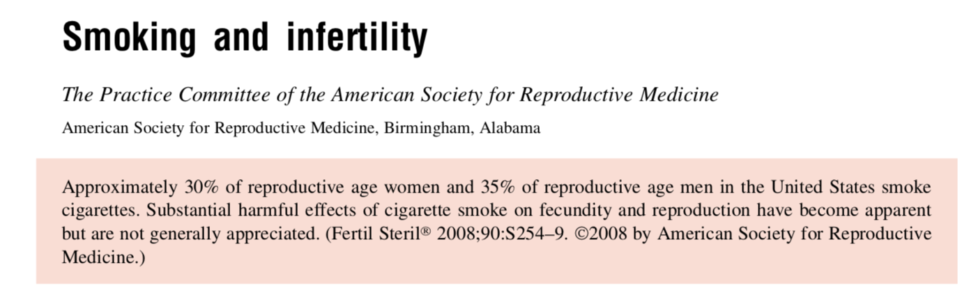
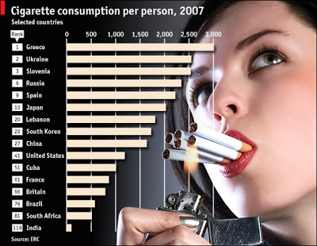
Up to 13% of female infertility may be caused by smoking,
Augood C, Duckitt K, Templeton AA. Smoking and female infertility: a systematic review and meta-analysis. Hum Reprod 1998;13:1532–9.

Slide 29
Time is important!!!
Education
Fertility preservation
Career

Slide 30
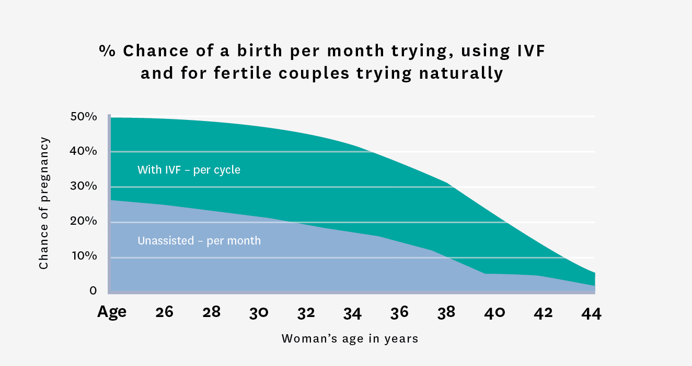
MEDICINE: BEATING THE ODDS
COMBATING LOW BIRTH RATE THROUGH SCIENCE
Classic IVF
Sperm and Egg donation
Egg Freezing

Slide 31


Social egg Freezing

Slide 32


Slide 33
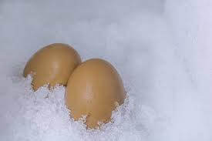
On the ethics of egg Freezing
Is Infertility a disease ?
WHO definition of health?
Health is a state of complete physical, mental and social well-being and not merely the absence of disease or infirmity.
The World Health Organization considers infertility to be “a disease of the reproductive system
The influential 1984 Warnock Report states that “an inability to have children is a malfunction and should be considered in exactly the same way as any other”.
If one of the most common causes of female infertility is advanced reproductive age……………
Then egg freezing is the treatment for age-related infertility

Slide 34
???????????
Should it matter, morally, if the infertility is caused by illness or age?
Should it matter if a woman anticipates infertility in the future but does not experience it in the present, and seeks preventive steps to address it preemptively?
Preventing infertility is the same as preventing lung cancer by stop smoking or cervical cancer by doing pap smears or Breast cancer by doing mammograms?

Slide 35
However, the tide may be turning toward conceptualizing age-related fertility loss as a medical reason for egg freezing.
In some of the literature, egg freezing is characterized as “preventive medicine” for age-related fertility decline.
The European Society of Human Reproduction and Embryology, for example, makes the case that fertility preservation for natural ovarian aging “cannot so easily be dismissed as a non-health-related preference.”15

Slide 36
Many of the ethical arguments in favor of egg freezing for nonmedical reasons focus on the liberating potential of egg freezing for women.
If biological difference is the root of inequality between men and women, then egg freezing can help level the playing field by lengthening the time during which a woman can become pregnant.

Slide 37
Egg freezing for nonmedical reasons promotes sex equality.
Among its many benefits, egg freezing promotes
equal participation in employment,
equal participation in educational endeavors, and
a more equal amount of time to find a partner.
Other benefits include more time to become emotionally and psychologically ready to be a parent, something appreciated by men and women alike.
Firestone S. The Dialectic of Sex: The Case for Feminist Revolution. New York: Morrow; 1970.
Savulescu J, Imogen G. Freezing eggs for lifestyle reasons. Am J Bioeth. 2008;8(6):32–35.
Goold I, Savulescu J. In favour of freezing eggs for non-medical reasons. Bioethics. 2009;23(1):47–58.

Slide 38

Others wonder more skeptically whether egg freezing may do more harm than good.
short-term fix that leaves sexist structures fundamentally unchanged.
opening the door to the option creates a pressure to use it.
In an environment where genetic intervention is the norm, it would no longer be a misfortune if your child was short or nearsighted or hemophiliac; it would now be the parents’ fault for not taking advantage of an available technology proactively.
Similarly, as pointed out when Apple and Facebook made their generous offers, the option to freeze eggs might quickly become an obligation to freeze eggs, a way to demonstrate one’s seriousness about one’s career, or a way to avoid self- blame.19
Harwood K. Egg freezing: a breakthrough for reproductive autonomy? Bioethics. 2009;23(1):39–46.
Sandel MJ. The case against perfection: what’s wrong with designer children, bionic athletes, and genetic engineering. Atl Mon. 2004;293(3):50–54, 56–60, 62.
O’Neill O. Autonomy and Trust in Bioethics. Cambridge: Cambridge University Press; 2000.

Slide 39
Στην Ελλάδα του 2020 η υποστήριξη της αναπαραγωγικής ικανότητας των Ελληνίδων είναι πιο επιτακτική από ποτέ !
Διαμόρφωση Πολιτικής
Επιστήμη
Ενημέρωση

Slide 40

Ελληνική Εταιρία Διατήρησης Αναπαραγωγής
Hellenic Society for Fertility Preservation
( www. hsfp.gr)

Slide 41

Aravantinos L.
Vakas P.
Eleutheriadis M.
Lambrinoudaki I.
Oikonomou E.
Panoskaltsis T.
Panoulis K.
Papapetrou Ch.
Rizos D
Salakos N.
Simopoulou M.
Siristratidis H.
Tzanakaki D
Σας Ευχαριστώ

Slide 42
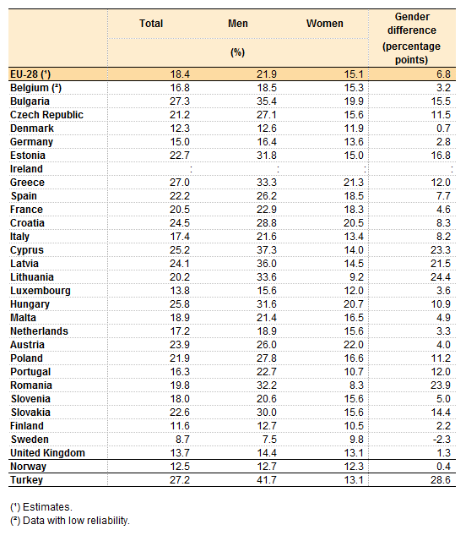
Greek statistics 2014 !!!!!

Slide 43
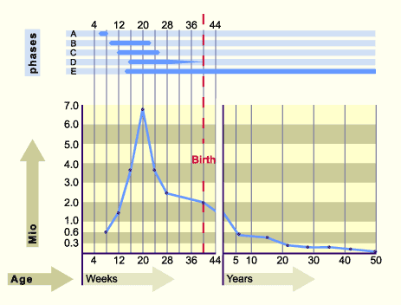
Ovarian reserve

Slide 44
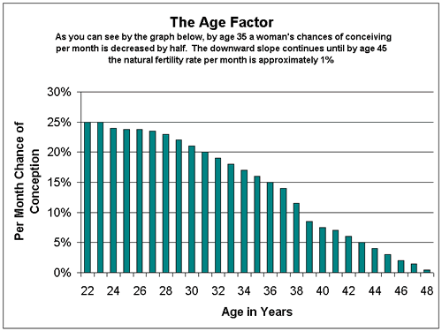
Age and Fertility
17% drop in conception rates
From the age of 26 to the age or 31

Slide 45
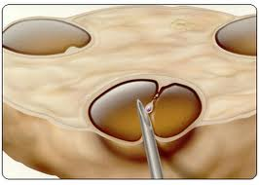
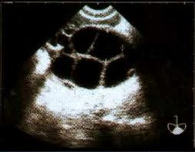
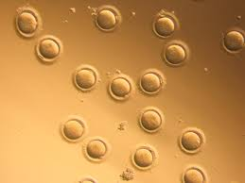
Ovarian stimulation protocol
(GnRH antagonists)
Day 9 of Cycle
Day of hCG
(Day 13)
Egg collection
( Day 15)
GnRH Antagonist
Ovarian stimulation with gonadotropins
menses
Day 3 of cycle
Duration of stimulation: 10-12 days

Slide 46
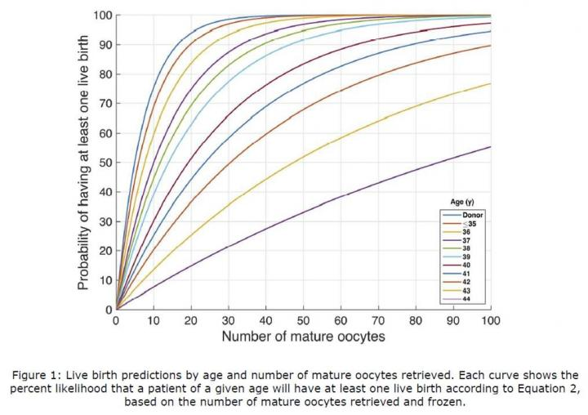
38-39

Slide 47
How many eggs should I store to achieve a pregnancy?
Surgival rates after thawing 75% and
fertilization rates of 75% are anticipated in women up to 38 years of age.
.
10 eggs are frozen,
7 are expected to survive the thaw,
5 to 6 are expected to fertilize and become embryos.
Usually 2-3 embryos are transferred in women up to 38 years of age.
10 eggs should be stored for each pregnancy attempt.

Slide 48
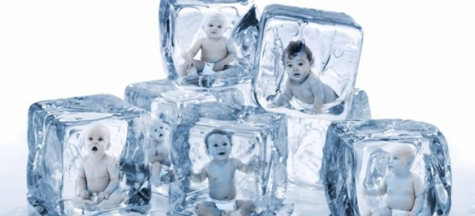
Σας Ευχαριστώ
Aravantinos L.
Vakas P.
Eleutheriadis M.
Lambrinoudaki I.
Oikonomou E.
Panoskaltsis T.
Panoulis K.
Papapetrou Ch.
Rizos D
Salakos N.
Simopoulou M.
Siristratidis H.
Tzanakaki D
Νικόλαος Φ. Βλάχος MD. PhD, FACOG
Καθηγητής Μαιευτικής, Γυναικολογίας και Υποβοηθούμενης Αναπαραγωγής
B’Μαιευτική και Γυναικολογική Κλινική, Αρεταίειο Νοσοκομείο.

Slide 49
Age and Fertility
17% drop in conception rates
From the age of 26 to the age or 31

Slide 50
Fertility preservation in women is feasible and successful because………..
Vitrification
Aromatase inhibitors
Random start COH
There is no excuse not to offer this option to our patients

Slide 51
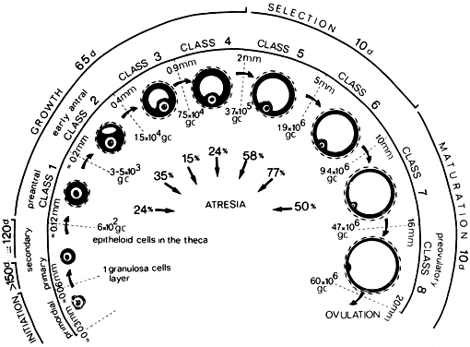
From Gougeon A: Dynamics of follicular growth in the human: A model from preliminary results. Hum Reprod 1:81, 1986.

Slide 53
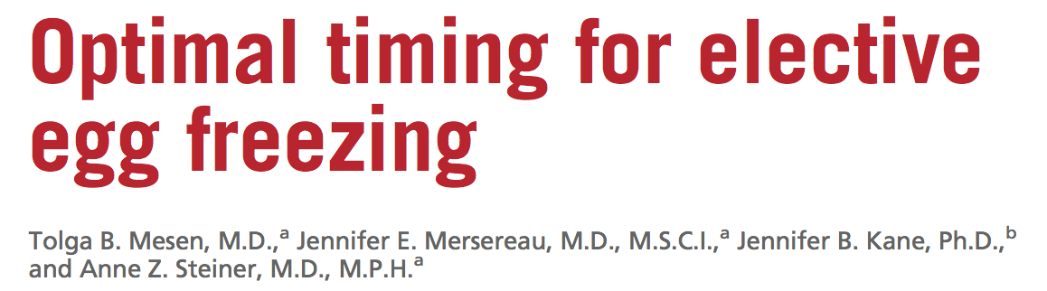
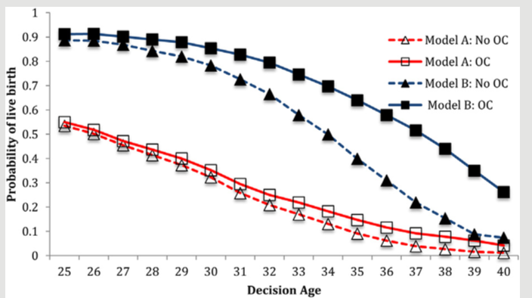
Mesen. Timing of elective egg freezing. Fertil Steril 2015.
Notes:
Objective: To estimate the optimal age to pursue elective oocyte cryopreservation.
Design: Adecision-treemodelwasconstructedtodeterminethesuccessandcost-effectivenessofoocytepreservationversusnoaction when considered at ages 25–40 years, assuming an attempt at procreation 3, 5, or 7 years after initial decision.
Setting: Not applicable.
Patient(s): Hypothetical patients 25–40 years old presenting to discuss elective oocyte cryopreservation.
Intervention(s): Decision to cryopreserve oocytes from age 25 years to age 40 years versus taking no action.
Main Outcome and Measure(s): Probability of live birth after initial decision whether or not to cryopreserve oocytes.
Result(s): Oocyte cryopreservation provided the greatest improvement in probability of live birth compared with no action (51.6% vs. 21.9%) when performed at age 37 years. The highest probability of live birth was seen when oocyte cryopreservation was performed at ages <34 years (>74%), although little benefit over no action was seen at ages 25–30 years (2.6%–7.1% increase). Oocyte cryopreservation was most cost-effective at age 37 years, at $28,759 per each additional live birth in the oocyte cryopreservation group. When the probability of marriage was included, oocyte cryopreservation resulted in little improvement in live birth rates.
Conclusion(s): Oocyte cryopreservation can be of great benefit to specific women and has the
highest chance of success when performed at an earlier age. At age 37 years, oocyte cryopreservation has the largest benefit over no action and is most cost-effective. (Fertil Steril!
2015;103:1551–6. !2015 by American Society for Reproductive Medicine.)
Key Words: Elective oocyte cryopreservation, egg freezing, fertility preservation

Slide 54
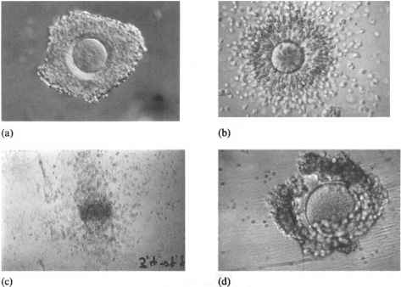

Slide 55

Social Egg Freezing

Slide 56
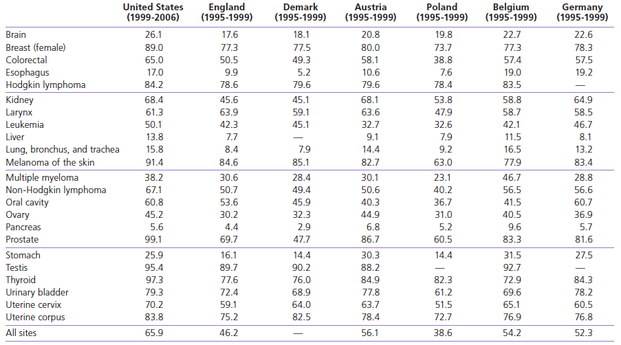
Five-year Relative Survival Rates*(%) for Selected Cancers among Individuals† Aged 15 and Older in Select Countries

Slide 57
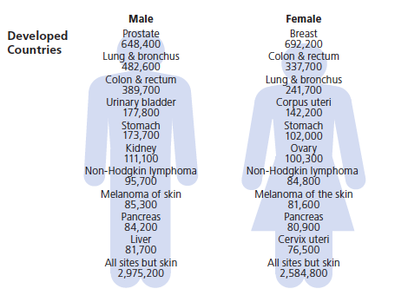

Estimated New Cancer Cases for Leading Cancer Sites

Slide 58

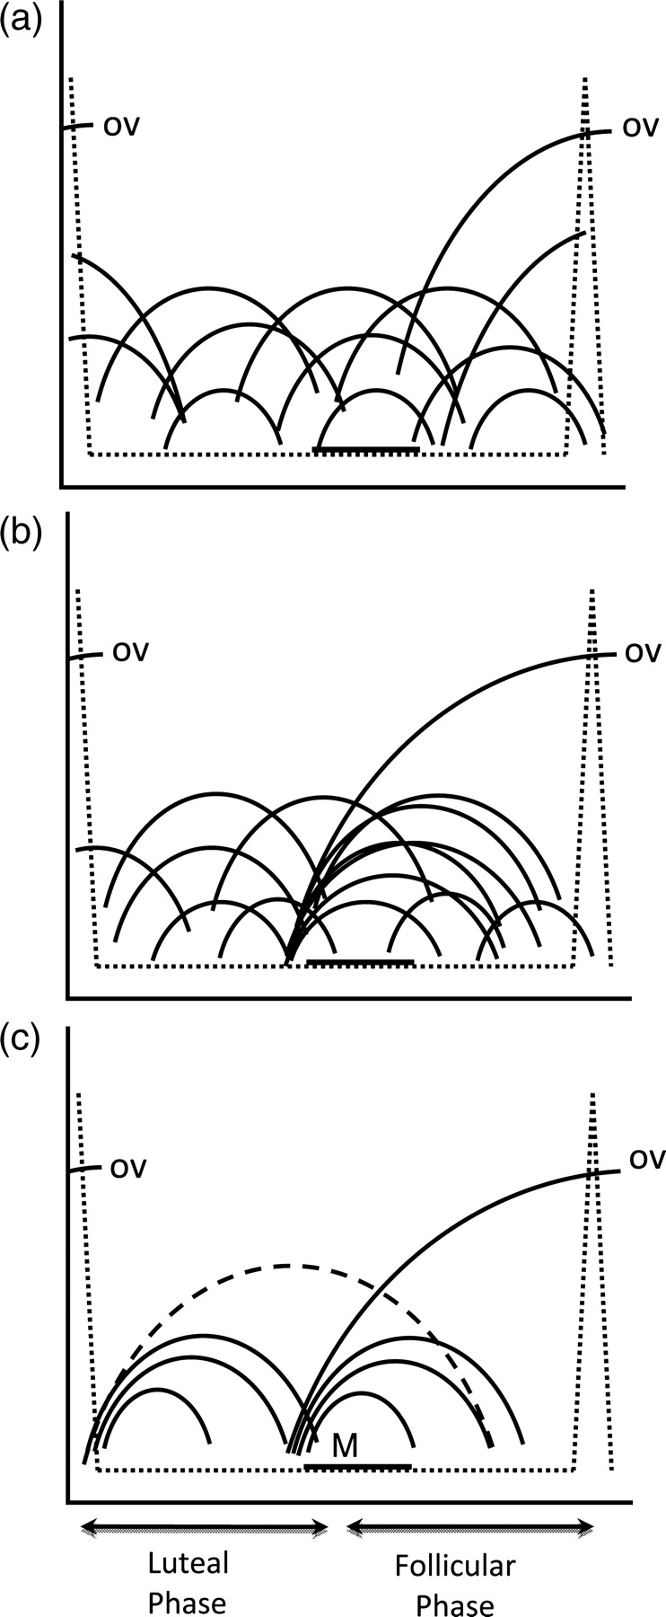
Continuous recruitment
Single recruitment episode
Wave theory of recruitment
Notes:
Schematic illustrations of the three different theories of ovarian follicular recruitment during the menstrual/estrous cycle. The theory of continuous recruitment (a) suggests that small antral follicles grow and regress constantly throughout the interovulatory interval and the dominant ovulatory follicle is selected, by chance, from the pool following luteal regression. The theory of a single recruitment episode (b) suggests that an ovulatory follicle is selected from a single follicular cohort that emerges following luteal regression. The wave theory of fol- licle recruitment (c) suggests that two or more cohorts (i.e. waves) of antral follicles are recruited (i.e. emerge) during the ovarian cycle. The dominant follicle that develops in the final wave of the IOI ovulates while preceding waves are anovulatory; dominant follicles develop in a minority of anovulatory waves (dotted line). M, menses.

Slide 59
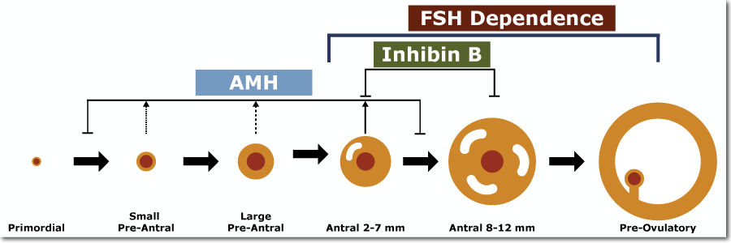
Biomarkers of ovarian reserve

Slide 60
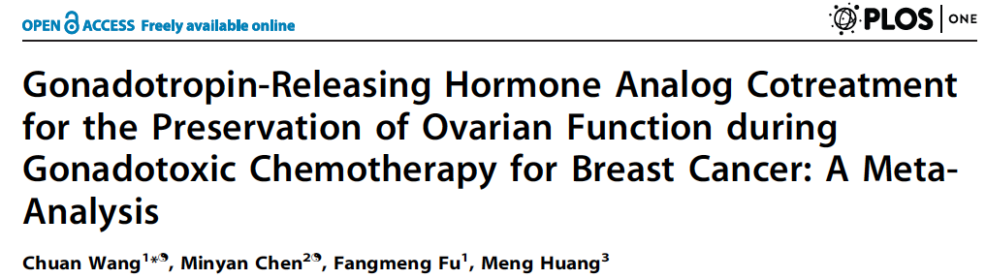
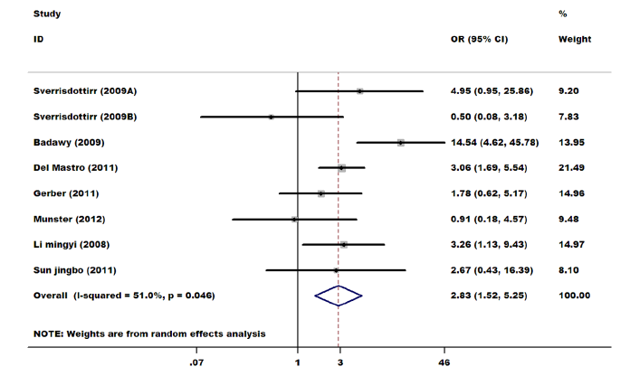
Notes:
2013 publication Results: Seven studies with a total of 677 participants met the inclusion criteria. The outcome of meta-analysis implied that,
compared with adjuvant chemotherapy alone, the number of patients with resumption of spontaneous menstruation was
statistically greater in the GnRH cotreatment patients (OR 2.83; 95% CI, 1.52–5.25).
Conclusions: Evidence from RCTs suggests a potential benefit of GnRH cotreatment with chemotherapy in premenopausal
women, producing higher rates of spontaneous resumption of menses.

Slide 61
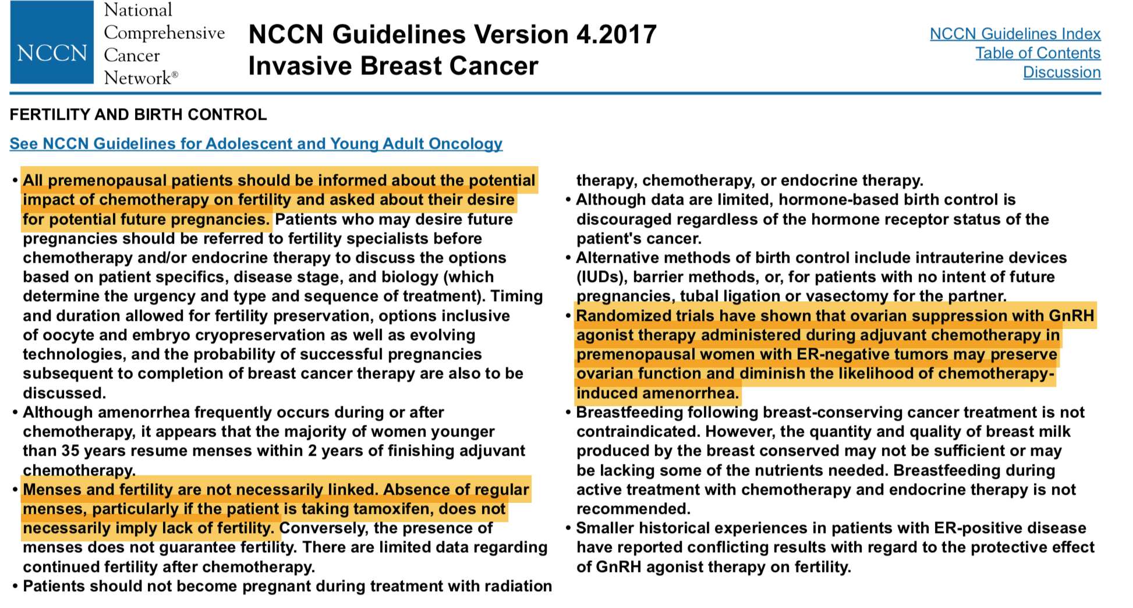

Slide 62
Fertility preservation in patients with cancer. Options for management
Assisted reproductive technologies
Ovarian stimulation prior to chemo
Oocyte or embryo freezing
Ovarian cryopreservation
Oocyte donation

Slide 63
Time from diagnosis to egg harvesting
Oocyte harvesting
Diagnosis of Cancer
Ovarian stimulation
Day 1
Day 28
Day15
28 to 45 days

Slide 64
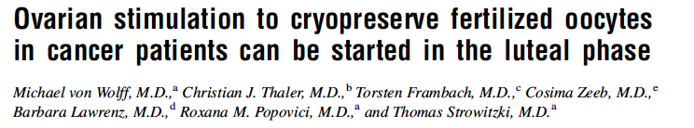
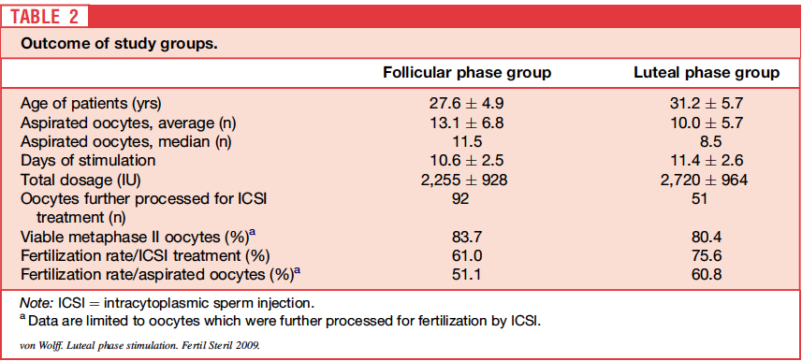
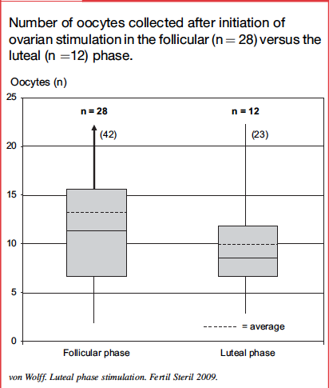
Notes:
Objective: To analyze if oocytes can be obtained in all patients before cancer treatment within 2 weeks by initiating ovarian stimulation during the follicular or luteal phase.
Design: Prospective controlled multicenter trial.
Setting: Four university-based centers.
Patient(s): Forty cancer patients before chemotherapy.
Intervention(s): Twenty-eight patients were stimulated with gonadotropins in the follicular phase (group I). In 12 patients (group II), ovarian stimulation was initiated in the luteal phase, and these received GnRH antagonists and recombinant FSH. In 14 patients, 143 oocytes were further processed for fertilization by intracytoplasmic sperm injection (ICSI).
MainOutcomeMeasure(s): Numberofoocytesaspiratedafterovarianstimulation,cumulativeFSH/hMGdosage, viability and maturity of oocytes, and fertilization rate by ICSI.
Result(s): Patients in group I (age 27.6 􏰀 4.9 yrs) were stimulated on average for 10.6 days, and patients in group II (age 31.2 􏰀 5.7 yrs) for 11.4 days. Total amount of FSH was on average 2,255 IU (I) and 2,720 IU (II) per patient. Average and median numbers of aspirated oocytes were, respectively, 13.1 and 11.5 (I) versus 10.0 and 8.5 (II); 83.7% (I) and 80.4% (II) of the oocytes were mature and viable and could be treated by ICSI. Fertilization rate was 61.0% (I) versus 75.6% (II).
Conclusion(s): This pilot study suggests that oocytes can be obtained before cancer treatment efficiently irrespec- tive of the phase of the menstrual cycle. (Fertil SterilÒ 2009;92:1360–5. Ó2009 by American Society for Repro- ductive Medicine.)

Slide 65
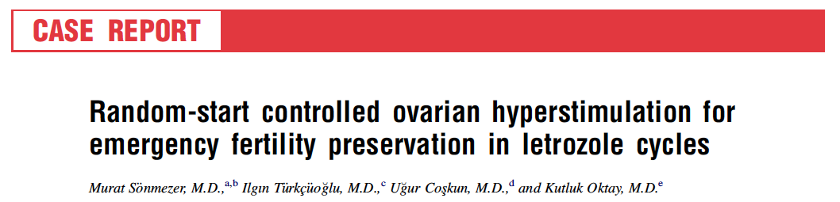

Notes:
Patients with breast cancer 2011
Femara 2.5
Recomb FSH
Antagonists

Slide 66



Slide 67



Fertil Steril 2012;98:1363–9.

Slide 68
Evidence indicates that oocyte vitrification and warming should no longer be considered experimental.
This document replaces the document last published in 2008 titled, ‘‘Ovarian Tissue and Oocyte Cryopreservation,’’
Fertil Steril 2008;90:S241-6.
Fertil Steril 2013;99:37–43.

Slide 69


Notes:
Original data from 10 studies including 2,265 cycles from 1,805 patients were obtained. Live birth success rates declined with
age regardless of the freezing technique. Despite this age-induced compromise, live births continued to occur as late as ages 42 and 44
years with slowly frozen and vitrified oocytes, respectively. Estimated probabilities of live birth for vitrified oocytes were higher than
those for slowly frozen.

Slide 70

Ovarian damage after chemotherapy
Anderson RA, Rosendahl M, Kelsey TW, Cameron DA. Pretreatment anti-Mu ̈llerian hormone predicts for loss of ovarian function after chemotherapy for early breast cancer. Eur J Cancer 2013;49:3404–3411.

Slide 71
Βιοδείκτες ωοθηκικού αποθέματος
Day 2 FSH combined with Estradiol
Inhibin B
AMH
Antral follicle count (AFC)
Δυναμικοί δείκτες ωοθηκής απόκρισης
Clomiphene challenge test
GnRH analog stimulation test
Previous response to stimulation

Slide 72


Fang et al. Reproductive Biology and Endocrinology (2015) 13:63
Notes:
Abstract
Background: Most of infertile women with normal follicle stimulating hormone (FSH) levels and antral follicle count (AFC) at day 2–3 of the period, but poor IVF outcomes may occur when use of routine controlled ovarian stimulation. This paper is to evaluate the predictive value of age-specific FSH levels for IVF-ET outcomes in women with normal ovarian function.
Methods: A total of 1287 women undergoing their first IVF cycles were enrolled in this retrospective study. The FSH levels and AFC of all of the women were within normal ranges (FSH ≤ 12 IU/L;AFC ≥ 5). The patients were grouped by age (younger: < 33 years, medium-aged:33–37years and older:38–41years), and within each age group, the patients were subdivided by the upper limit of the 95 % confidence interval (CI) for mean FSH levels. Patients with FSH levels equal to or greater than the upper 95 % CI of FSH in each age group were included into a premature ovarian aging (POA) subgroup (younger:FSH ≥ 7.84, medium-aged: ≥8.12 and older: FSH ≥ 8.47),the remaining patients in each age group were included into a control subgroup. The outcomes of IVF-ET were compared between the POA subgroup and the control subgroup in each age group.
Results: In each age group, the total dose of gonadotropin(Gn) in the POA subgroups were significantly higher than those of the corresponding control subgroups. In the younger and medium-aged groups, women in the POA subgroups had significantly lower oocyte yields, frozen embryos, and higher rates of poor ovarian response(POR) than those in the corresponding control subgroups. When controlling for age, BMI and AFC, the multiple logistic regression analysis indicated the following: In each age group, the total dose of Gn was significantly correlated with POA; the oocyte yield was significantly related to POA only in the younger group; and in the whole age groups, the incidence of POR in the POA group was 2.719 times greater than in the control group (OR = 2.719, 95 % CI [1.598–4.625], P < 0.001).
Conclusion: Basal FSH levels combined with age (age-specific FSH levels) can be used as a more accurate marker for the ovarian response in women with normal ovarian reserves undergoing IVF-ET, particularly in women ≤37 years old.
Keywords: Age, FSH, Premature ovarian aging (POA), IVF-ET

Slide 73


Gingold et al. Reproductive Biology and Endocrinology (2015) 13:91
Notes:
Abstract
Background: Elevated follicle stimulating hormone (FSH) is associated with poor vaginal oocyte retrieval (VOR) outcomes and cycle cancellations but intercycle variability in basal FSH reportedly does not predict ovarian response.
Methods: We conducted a retrospective cohort study of basal FSH (n = 15573 cycles) in couples (n = 9132) who initiated IVF cycle(s) with basal estradiol (E2) <100 pg/mL between 2002 and 2014 to reevaluate this hypothesis.
The most recent (current) FSH, maximum FSH (Max FSH) and prior cycle maximum basal FSH (PMax FSH) were computed for each cycle. Metaphase II (MII) oocyte counts were modeled by age, stimulation type, prior peak E2 level, prior MII count, Max FSH, PMax FSH and current FSH. Antral follicle counts, pregnancy, clinical pregnancy and live birth rates were modeled as secondary outcomes.
Results: Max FSH level distinguished completed cycles from cancelled cycles better than PMax FSH or current FSH (AUC of 0.72, 0.71 and 0.61, respectively, p < 0.001). Fewer MIIs were retrieved (5.7 ± 3.8) in cycles with Max FSH >13 mIU/mL (n = 1475) than those with ≤13 mIU/mL (n = 11978) (11.6 ± 7.1) (p < 0.001). Max FSH was a better predictor of MII count than PMax FSH or current FSH after controlling for age, stimulation type, prior peak E2 level and prior MII count.
Additional MIIs were retrieved on average in cycles with PMax FSH >13 mIU/mL (n = 1930) whose current FSH was ≤13 mIU/ml rather than >13 mIU/ml (p < 0.01) after controlling for age, cycle number and stimulation type. However, no improvement in pregnancy or live birth rate was detected.
Conclusions: Max FSH is the best FSH-based predictor of ovarian reserve. Retrieval benefits from waiting for a "better" month appear to exist but are limited.

Slide 74

Inhibin and Activins

Slide 75
Inhibin beta
Whereas AMH is primarily secreted by primary, preantral, and antral follicles, inhibin B is secreted primarily by pre-antral follicles.
As the number of ovarian follicles declines with age, both AMH and early follicular phase inhibin B concentrations decline.
Decreased inhibin B secretion lowers the level of central negative feedback, resulting in increased pituitary FSH secretion and in higher late luteal and early follicular FSH concentrations (an ‘‘indirect’’ measure).
In turn, the earlier increase in FSH levels stimulates an earlier onset of new follicular growth and increase in estradiol concentrations, ultimately decreasing the length of the follicular phase and the overall cycle.
^{Early} ^{follicular recruitment}

Slide 76

Inhibin B and ovarian reserve

Slide 77

AMH
AMH is a glucoprotein which belongs to the TGF beta superfamily closely related to inhibin and activin.
AMH is also a product of granulosa cells of the pre-antral and small antral follicles.
The gene for AMH is located on the chromosome 19 while the gene for the AMH receptor on chromosome 12.
As the product of gralnulosa cells surrounding the egg within the follicle it can serve as a molecular biomarker of the size of the follicular cohort and thus the ovarian reserve.

Slide 78

AMH levels through out the reproductive life

Slide 79

AMH and PCOs

Slide 80
Limitations to AMH measurements
^{The} first reliable assay expected to measure total AMH, and was commercially available through Diagnostic Systems Lab (DSL), with a detection limit of 6.3 pg/ml (Kevenaar et al., 2006).
A further improvement in sensitivity to 0.1 ng/ml was reached by the use of two different monoclonal antibodies (Long et al., 2000). This ultrasensitive assay, known as the IOT assay, became commercially available through Beckman-Coulter
With the acquisition of DSL by Beckman-Coulter, the two existing assays were replaced by a new ELISA. This Beckman-Coulter AMH Gen II assay continues
Still measurements of AMH with the new Gen II assay many affected by the time of storage , Temperature, measurements in the blood or serum
Therefore, results published so far with the AMH Gen II assay have to be taken with caution and will probably need to be revisited once the technical issues are resolved.

Slide 81
Antral follicle count ( AFC)
Antral follicle count is the sum of antral follicles in both ovaries, as observed with transvaginal ultrasonography during the early follicular phase.
Most studies have defined antral follicles as those measuring 2–10 mm in mean diameter in the greatest two-dimensional (2D) plane; some have defined antral follicles as those measuring 3–8 mm in mean diameter.
Antral follicle count has good inter-cycle reliability and inter- observer reliability in experienced centers
As suggested by a meta-analysis evaluating AFC as a predictor of poor ovarian response and pregnancy after IVF, a low AFC is considered to be 3–6 total antral follicles (mean of 5.2 with SD 2.11) and is associated with poor response to ovarian stimulation during IVF, but does not reliably predict failure to conceive .

Slide 82

Changes in FSH , AMH and AFC during reproductive life
Notes:
Original Article
The Correlations of Anti-Mullerian Hormone, Follicle-Stimulating Hormone and Antral Follicle Count in Different Age Groups
of Infertile Women
Ludmila Barbakadze, M.D.1*, Jenara Kristesashvili, M.D., Ph.D.1, Natalia Khonelidze, M.D., Ph.D.2, Gia Tsagareishvili, M.D., Ph.D.2
Materials and Methods: In this prospective study, 112 infertile women were assessed. Subjects were divided into three age groups: group I <35 years (n=39), group II 35-40 years (n=31), and group III 41-46 years (n=42). AMH, FSH and AFC were determined on days 2-3 of the patients’ menstrual cycles.

Slide 83
Factors influencing the relationship between, and the predictability of, AMH and AFC
The follicular pool that influences serum AMH levels the most probably is that of 1 – 2 mm follicles, although some analyses have suggested a slightly larger size (Jeppesen et al., 2013).
According to recent guidelines (Broekmans et al., 2010) and current clinical practice worldwide, ultrasonographic counting considers antral follicles whose diameter varies considerably, from 2 to 10 mm.
^{It is} ^{also noteworthy that} ultrasound technology cannot distinguish healthy ^{from atretic follicles.}
(Jeppesen et al., 2013). Broekmans et al., 2010

Slide 84


Notes:
bstract
Background: There are comparatively few data on the value of different ovarian response predictors in conjunction with a gonadotropin-releasing hormone (GnRH) antagonist controlled ovarian stimulation (COS) protocol. This study assessed the predictive value of AMH, FSH and AFC for determining poor and high ovarian responses in Vietnamese patients (n=820) undergoing GnRH antagonist protocol COS.
Methods: Poor, normal and high response were de ned as ≤ 3, 4-15 and >15 oocytes retrieved, respectively. AMH, FSH and AFC were assessed on cycle day 2. Cut-off predictive values were identi ed, and poor and high response models developed.
Results: AMH had the highest accuracy for predicting both poor and high ovarian response (cut-off values ≤1.25 and >3.57 ng/mL, respectively) and was signi cantly better than AFC (cut-offs ≤5 and >12), and both AMH and AFC were signi cantly better than FSH (cut-offs >8.94 and ≤7.36 IU/mL). For prediction of poor ovarian response, a model including AMH+AFC (AUC 0.93, 95%CI 0.91, 0.96) was equivalent to one using AMH only (AUC 0.92, 95%CI 0.90, 0.95; p=0.131), and both were better than AFC alone (AUC 0.89, 95%CI 0.86, 0.92; p<0.001). For high ovarian response, AMH+AFC (AUC 0.90, 95%CI 0.88, 0.92) was signi cantly better than AMH alone (AUC 0.89, 95%CI 0.87, 0.91; p=0.03), and AMH+AFC and AMH were better than AFC alone (AUC 0.86, 95%CI 0.83, 0.89; p<0.001).
Conclusions: In Vietnamese women undergoing GnRH antagonist COS, the best single biomarker was AMH, while a model including AMH+AFC had the highest predictive value for high ovarian responses.

Slide 85

Notes:
bstract
Background: There are comparatively few data on the value of different ovarian response predictors in conjunction with a gonadotropin-releasing hormone (GnRH) antagonist controlled ovarian stimulation (COS) protocol. This study assessed the predictive value of AMH, FSH and AFC for determining poor and high ovarian responses in Vietnamese patients (n=820) undergoing GnRH antagonist protocol COS.
Methods: Poor, normal and high response were de ned as ≤ 3, 4-15 and >15 oocytes retrieved, respectively. AMH, FSH and AFC were assessed on cycle day 2. Cut-off predictive values were identi ed, and poor and high response models developed.
Results: AMH had the highest accuracy for predicting both poor and high ovarian response (cut-off values ≤1.25 and >3.57 ng/mL, respectively) and was signi cantly better than AFC (cut-offs ≤5 and >12), and both AMH and AFC were signi cantly better than FSH (cut-offs >8.94 and ≤7.36 IU/mL). For prediction of poor ovarian response, a model including AMH+AFC (AUC 0.93, 95%CI 0.91, 0.96) was equivalent to one using AMH only (AUC 0.92, 95%CI 0.90, 0.95; p=0.131), and both were better than AFC alone (AUC 0.89, 95%CI 0.86, 0.92; p<0.001). For high ovarian response, AMH+AFC (AUC 0.90, 95%CI 0.88, 0.92) was signi cantly better than AMH alone (AUC 0.89, 95%CI 0.87, 0.91; p=0.03), and AMH+AFC and AMH were better than AFC alone (AUC 0.86, 95%CI 0.83, 0.89; p<0.001).
Conclusions: In Vietnamese women undergoing GnRH antagonist COS, the best single biomarker was AMH, while a model including AMH+AFC had the highest predictive value for high ovarian responses.

Slide 86


^{VOL. 103 NO. 3 / MARCH 2015}

Slide 87

^{VOL. 103 NO. 3 / MARCH 2015}

Slide 88
Take home message
Biomarkers for ovarian reserve can provide a reliable estimation for success in the process of oocyte harvesting.
In contrast they are not as reliable to predict poor response and therefore exclude patients from ovarian stimulation if they desire to do so.
Ovarian response is not synonymous to fecundity and ability to produce pregnancy.
The age factor should be also included in the equation.

Slide 89



^{Vlahos N} Reproductive BioMedicine Online (2015) 30, 191–196

Slide 90



Slide 91
Hum Reprod. 2016 Apr;31(4):750-62. doi: 10.1093/humrep/dew007. Epub 2016 Feb 4.
Cryopreservation of in vitro matured oocytes in addition to ovarian tissue freezing for fertility preservation in paediatric female cancer patients before and after cancer therapy.
Abir R1, Ben-Aharon I2, Garor R3, Yaniv I4, Ash S4, Stemmer SM2, Ben-Haroush A3, Freud E5, Kravarusic D5, Sapir O3, Fisch B3.

Slide 92
The role of GnRH agonists during chemotherapy in fertility preservation
121. Blumenfeld Z, Evron A. Preserving fertility when choosing chemotherapy regimens - the role of gonadotropin-releasing hormone agonists. Expert Opin Pharmacother 2015;16:1009-1020. Available at: http://www.ncbi.nlm.nih.gov/pubmed/25826240.
122. Del Mastro L, Lambertini M. Temporary Ovarian Suppression With Gonadotropin-Releasing Hormone Agonist During Chemotherapy for Fertility Preservation: Toward the End of the Debate? Oncologist 2015;20:1233-1235. Available at: http://www.ncbi.nlm.nih.gov/pubmed/26463868.
123. Lambertini M, Peccatori FA, Moore HC, Del Mastro L. Reply to the letter to the editor 'Can ovarian suppression with gonadotropin releasing hormone analogs (GnRHa) preserve fertility in cancer patients?' by Rodriguez-Wallberg et al. Ann Oncol 2015. Available at: http://www.ncbi.nlm.nih.gov/pubmed/26646756.

Slide 93

AFC
Human Reproduction, Vol.32, No.12 pp. 2506–2514, 2017

Slide 94
Ovarian stimulation protocol
(GnRH antagonists)
Day 9 of Cycle
Day of hCG
(Day 13)
Egg collection
( Day 15)
GnRH Antagonist
Ovarian stimulation with gonadotropins
menses
Day 3 of cycle
Duration of stimulation: 10-12 days

Slide 95
Facts and Fiction in ovarian physiology
Tradition and Innovation in Assisted Reproduction
Common belief
Reality
Ovarian stimulation should start the first 2-3 days of the cycle
The presence of a corpus luteum may compromise oocyte quality
The presence of a dominant follicle precludes gonadotropin stimulation
Ovarian stimulation can start any time in the cycle

Slide 96


Slide 97
Problem #2
Ovarian stimulation may increase estradiol levels

Slide 98

Fertil Steril 2012;98:1363–9.

Slide 99

Fertil Steril 2012;98:1363–9.
Notes:
To further characterize the risk of COH using letrozole and
FSH on the risk of breast cancer recurrence, we enrolled 215
breast cancer patients into a prospective nonrandomized controlled
study from January 2002 to April 2007. Seventy-nine
women elected to undergo COH with letrozole and FSH, and
the remaining 136 women declined fertility preservation
and served as control subjects. Letrozole (5 mg) was start on
cycle day 2 or 3.

Slide 100



Ovarian cryopreservation for subsequent re-implantation
Donnez. Transplantation of ovarian tissue. Fertil Steril 2013.

