Slide 1
Καρδιοτοκογράφημα
Περγιαλιώτης Βασίλης
Πανεπιστημιακός Υπότροφος Γ` Μ/Γ

Slide 2
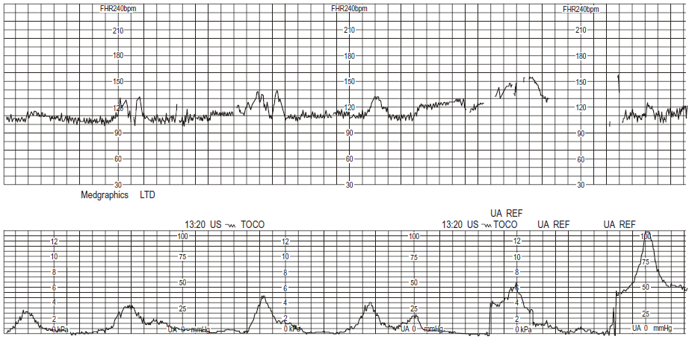
24-year-old gravida 4, para 1
Past history
Previous normal delivery.
Deep-vein thrombosis 6 years ago, on Fragmin (dalteparin sodium).
Antenatal period
Normal.
Admitted at 39 weeks’ gestation in spontaneous labour.
Labour
Vaginal assessment on admission revealed cervix to be thin and well applied to presenting part; cervical os was 5 cm dilated.
Membranes intact.
Fetal heart monitored by external transducer.
No analgesia.

Slide 3
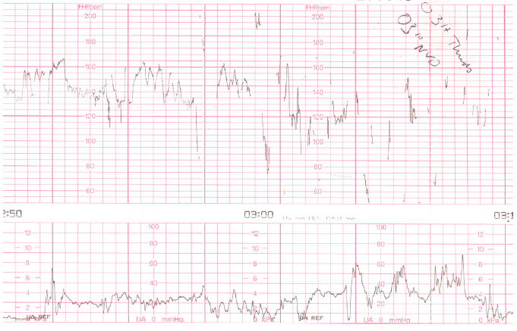

Slide 4
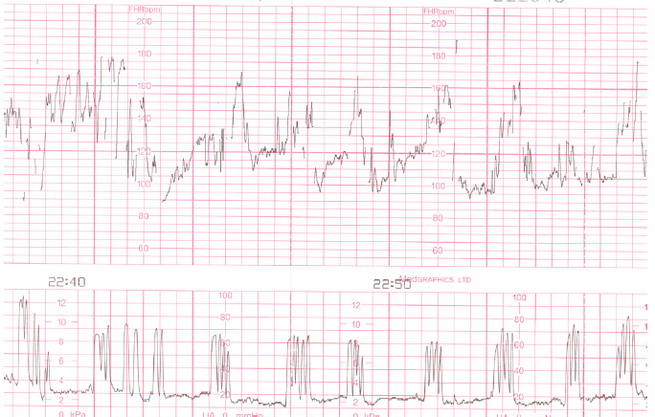
19-year-old gravida 1, para 0.
Past history
No problems identified.
Antenatal period
Low risk, under midwife-led care.
Good growth, baby on 90th centile on symphysiofundal height measurement.

Slide 5
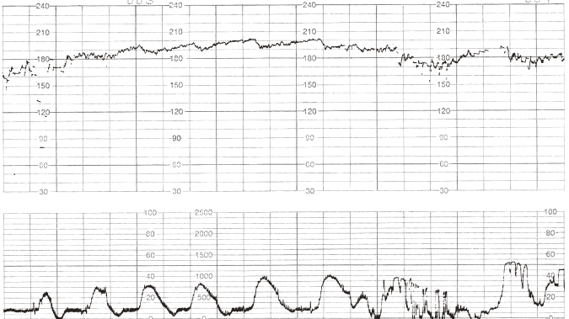
25-year-old gravida 1, para 0.
Past history
Nil relevant.
Antenatal period
Normal.
Admitted at 40 weeks, contracting 1 in 5 minutes for 2 hours.
Labour
19.30 hours
Cervical os 3 cm dilated.
Artificial rupture of membranes – clear liquor draining.
Fetal scalp electrode applied.
Contractions monitored externally.

