Slide 1

An Introduction to Genome Wide Association Studies (GWAS)

Slide 2
Complex Traits: Multifactorial Inheritance
Complex traits/disorders vs. Mendelian inherited disorders
Complex disorders:
  No Mendelian mode of inheritance
  Multiple susceptibility loci
Incomplete penetrance
Major environmental risk factors
Genetic Variants
Trait / Disease
Non-genetic factors
Public health importance
Notes:
Σύνθετα χαρακτηριστικά/διαταραχές vs. Μεντελικές (Μονογονιδιακές) κληρονομούμενες διαταραχές

Slide 3
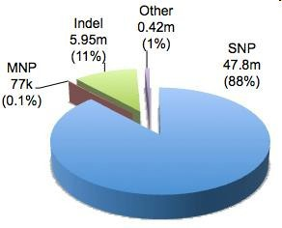
Types of genetic variations
Copy number variations (CNVs): Interindividual variations in the number of copies of a speciﬁc gene or chromosomal region.
Insertions and deletions (Indels): Regions of DNA that are either inserted into or deleted from the genome.
Single nucleotide polymorphisms (SNPs): Single base pair changes in the genome in a population.

Slide 4
Single Nucleotide Polymorphisms: SNPs
SNPs – DNA sequence variations that occur when a single nucleotide is changed
A |  | T |  | G |  | A |  | C |  | A | G |  | G |  | C
A |  | T |  | G |  | A |  | C |  | A | T |  | G |  | C
Alleles at this SNP are “G” and “T”
SNPs are the most common form of variation in the human genome
SNPs are catalogued in several databases

Slide 5
https://www.ncbi.nlm.nih.gov/snp/

Slide 6
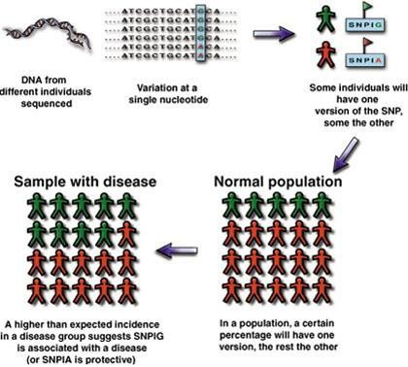
Using SNPs to Track Predisposition to Disease
© Gibson & Muse, A Primer of Genome Science

Slide 7
Scope of a Genetic Association Study
Candidate gene
  Known functional variants
  Variants with unknown function in exons, regulatory regions
Genome-wide
  Test for association with hundreds of thousands (millions) of SNPs spread across the entire genome.
  Many design strategies possible for distributing markers

Slide 8
Genome-Wide Association Studies
Candidate-gene association
  Greater power to identify smaller genetic eﬀects
  Rely on a priori knowledge about disease etiology
  Low replication rate.
Genome-wide association studies
  Agnostic search
  Needs large sample size
  Robust ﬁndings

Slide 9
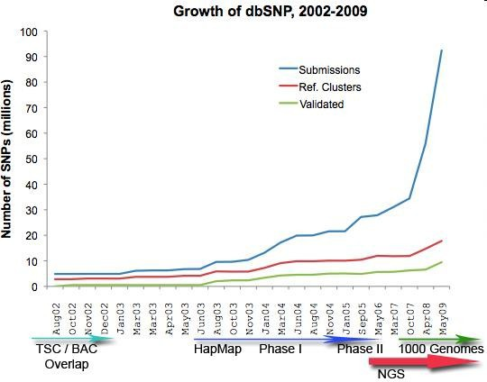
How many SNPs should be studied?

Slide 10
Costs of a Genome-wide association study in 2,000 individuals
Year | Number of SNPs | Costs per SNP | Total costs
2001 | 10,000,000 | $ 1.00 | $20,000,000,000

Slide 11


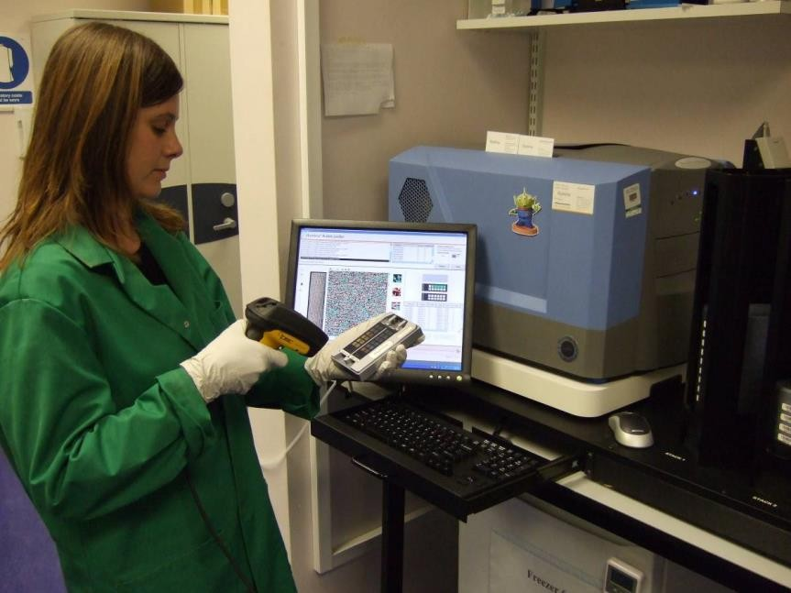
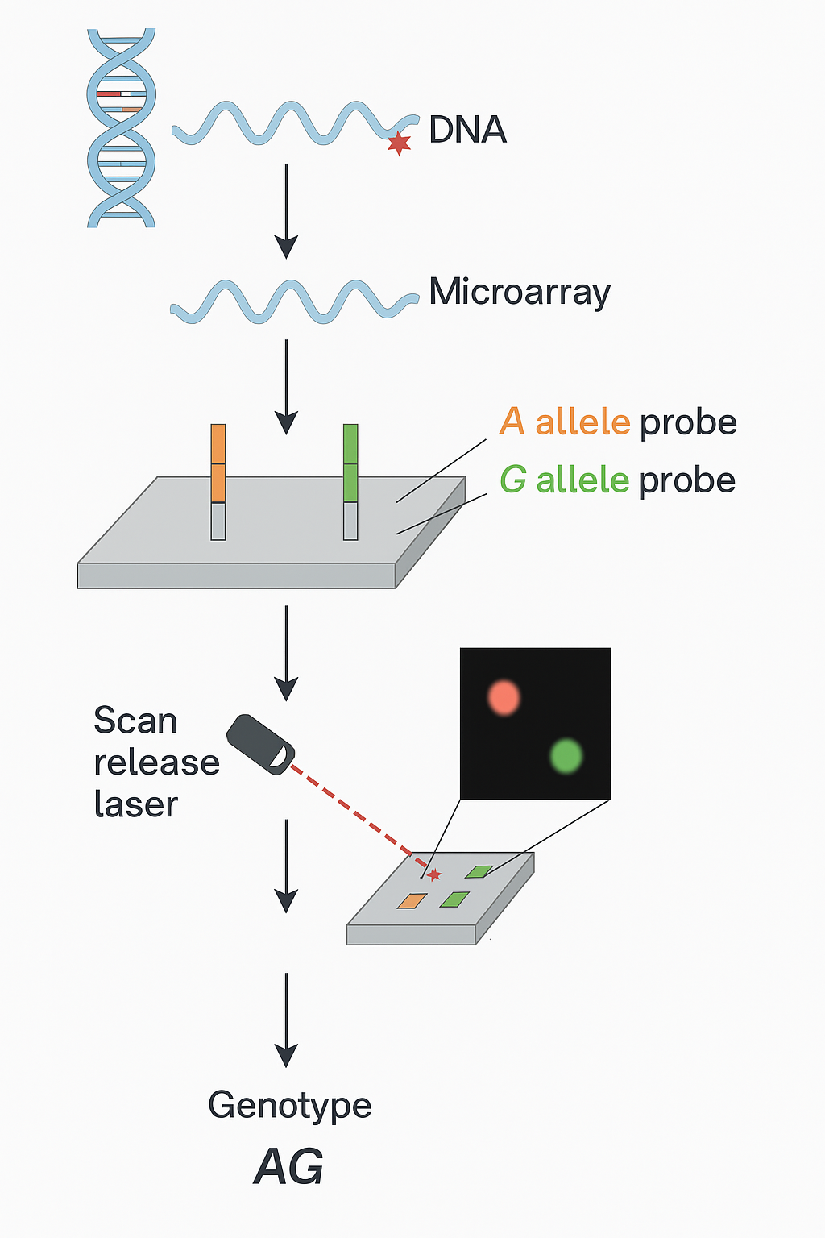

Microarray technology

Slide 12
SNP Chips: Number and Placement of SNPs
A “typical” SNP chip has at least 300,000 SNPs distributed across the genome. Nowadays even >1 million.
The new chips can also measure some types of copy number variation.
Notes:
1. Απομόνωση και Επισήμανση DNA
Το DNA εξάγεται από το βιολογικό δείγμα (π.χ. αίμα ή σάλιο).
Το DNA σημειώνεται με φθορίζουσα ετικέτα (fluorescent label) για να μπορεί να ανιχνευθεί αργότερα.
2. Υβριδισμός με την Microarray
Η μικροσυστοιχία (chip) περιέχει χιλιάδες ολιγονουκλεοτιδικές ανιχνεύσεις (probes) που είναι συγκεκριμένες για κάθε SNP και τοποθετημένες σε συγκεκριμένες θέσεις.
Το σημασμένο DNA επωάζεται πάνω στο chip, και αν το DNA περιέχει το συμπληρωματικό αλληλόμορφο, υβριδίζεται με την ανίχνευση.
3. Ανάγνωση του Σήματος
Ένας σαρωτής laser διαβάζει το chip και μετρά τη φθορίζουσα ένταση σε κάθε σημείο.
Η ένταση του σήματος για κάθε αλληλόμορφο επιτρέπει τον προσδιορισμό του γονοτύπου:
Υψηλό σήμα μόνο για το Α → ομόζυγος AA
Υψηλό σήμα και για Α και για G → ετερόζυγος AG
Υψηλό σήμα μόνο για το G → ομόζυγος GG
4. Ανάλυση και Κατηγοριοποίηση (Genotype calling)
Εξειδικευμένο λογισμικό μετατρέπει το φθορίζον σήμα σε κατηγορίες γονοτύπων (AA, AG, GG) για κάθε SNP.

Slide 13
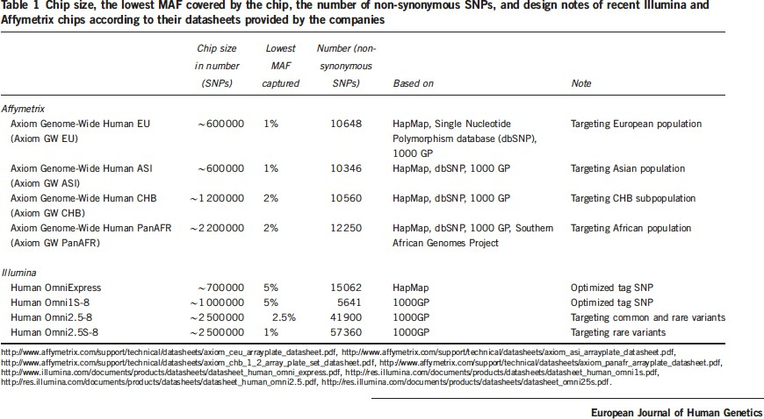
Coverage and eﬃciency in current SNP chips

Slide 14
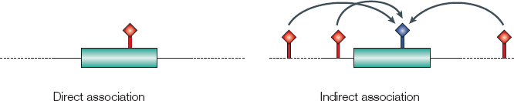
Can we skip some of the SNPs?
Hirschhorn & Daly, Nat Rev Genet 2005

Slide 15
Linkage Disequilibrium (LD)
LD is the correlation between SNPs
LD is observed in various regions of the genome, not only nearby the genes causing the diseases or in coding regions
Measure of LD: r², D’
r² gets values from 0 to 1; 0 denotes independent variants whereas 1 denotes that variants are in total LD

Slide 16
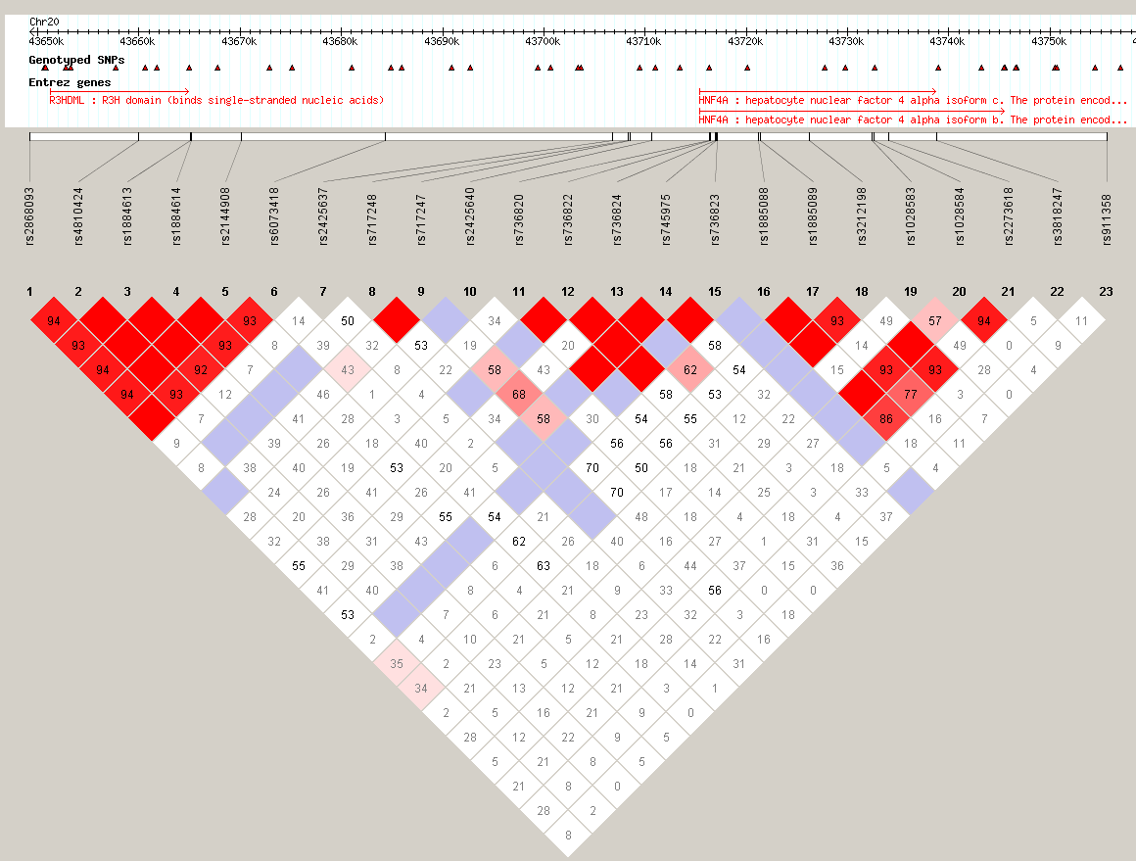
Linkage Disequilibrium (LD)
LD varies depending on region of genome
LD between two SNPs decreases with distance
16

Slide 17
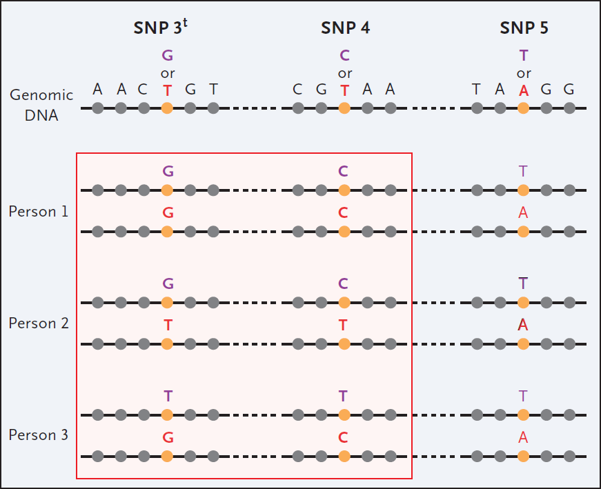
LD and Proxy
Due to LD, one SNP may serve as proxy for others
Christensen and Murray, N Engl J Med 2007; 356:1094-1097

Slide 18












































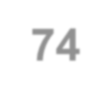

Can one SNP tag others?
A/T 1
G/A G/C T/C G/C
2 3 4 5
A/C 6
Tags:
SNP 1
SNP 3
SNP 6
A G G T G
A G C C C
T A G C G
T A C C C
A C C C
3 in total
Test for association:
high r²
high r²
high r²
SNP 1
SNP 3
SNP 6
After Carlson et al. (2004) AJHG 74:106

Slide 19
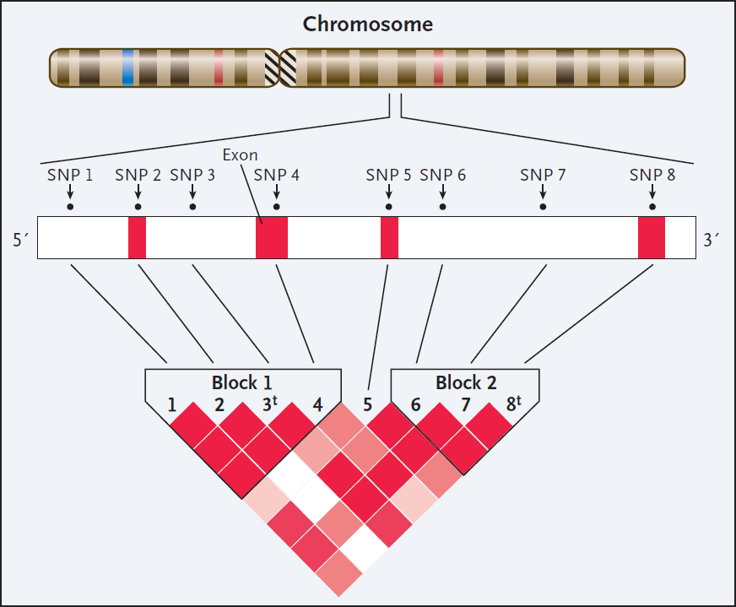
Map of the tagging SNPs
Map of the relationships among SNPs is useful
Such a map varies by ethnic groups
Christensen and Murray, N Engl J Med 2007; 356:1094-1097

Slide 20

www.hapmap.org

Slide 21







Genomic information in mapping complex disease genes
2009
2015

Slide 22
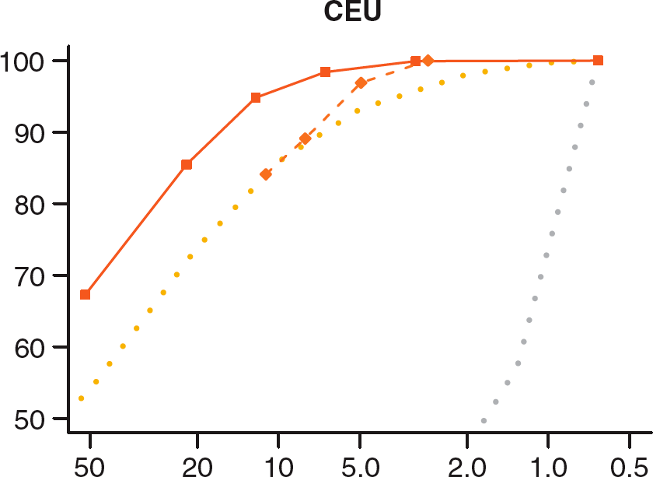








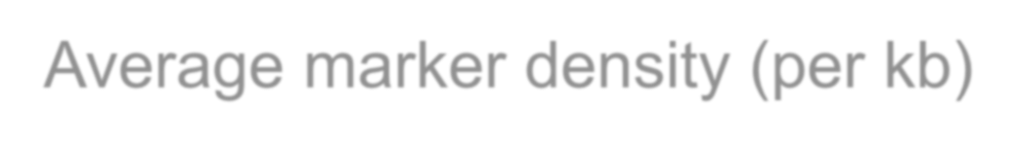




Eﬃciency and power
tag SNPs
Relative power (%)
~300,000 tag SNPs needed to cover common variation in whole genome in CEU
random SNPs
Average marker density (per kb)
P.I.W. de Bakker et al. (2005) Nat Genet

Slide 23
Why are They Possible Now?
Genotyping Technology:
  Now have ability to type hundreds of thousands (or millions) of SNPs in one reaction on a “SNP chip.”
  The cost can be as low as £19 per person.
Design and analysis:
  Availability of SNP databases, HapMap, 1000KG and other resources to identify the SNPs and design SNP chips.
  Faster computers to carry out the millions of calculations make implementation possible.

Slide 24
Costs of a Genome-wide association study in 2,000 individuals
Year | Number of SNPs | Costs per SNP | Total costs
2001 | 10,000,000 | $ 1.00 | $20,000,000,000
2007 | 500,000 | $ 0.001 | $1,000,000

Slide 25
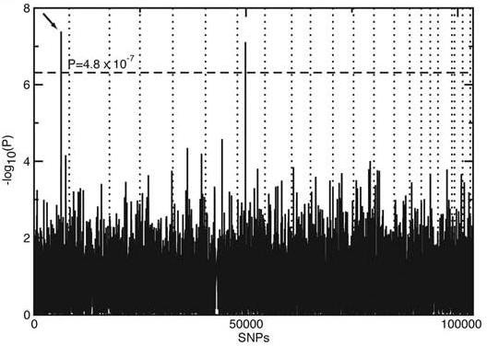
First GWAs in 2005
The ﬁrst successful GWA study was published in 2005
Among 116,204 single- nucleotide polymorphisms genotyped, an intronic and common variant in the complement factor H gene (CFH) was strongly associated with AMD
Klein Rj et al. Science 2005

Slide 26
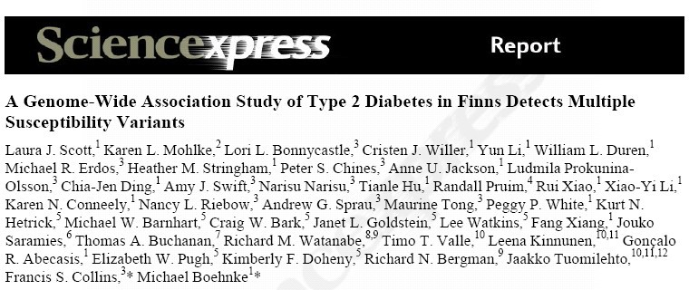
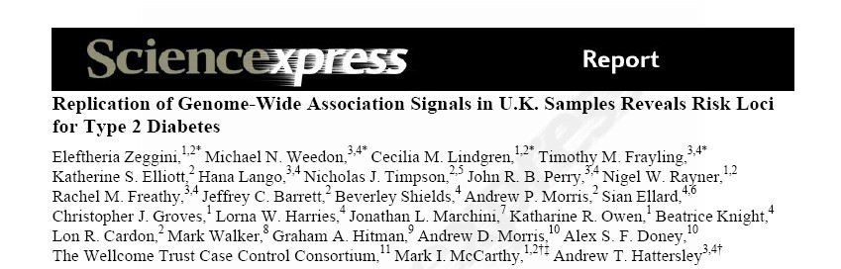

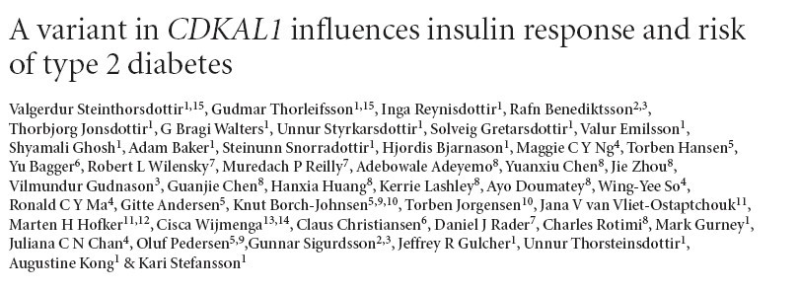
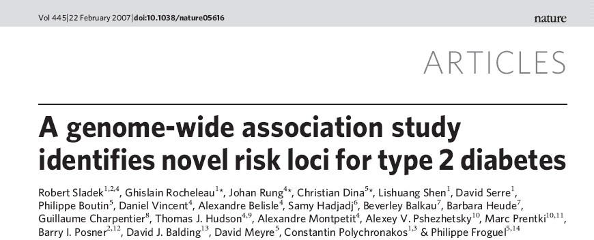
T2D GWA studies in 2007

Slide 27
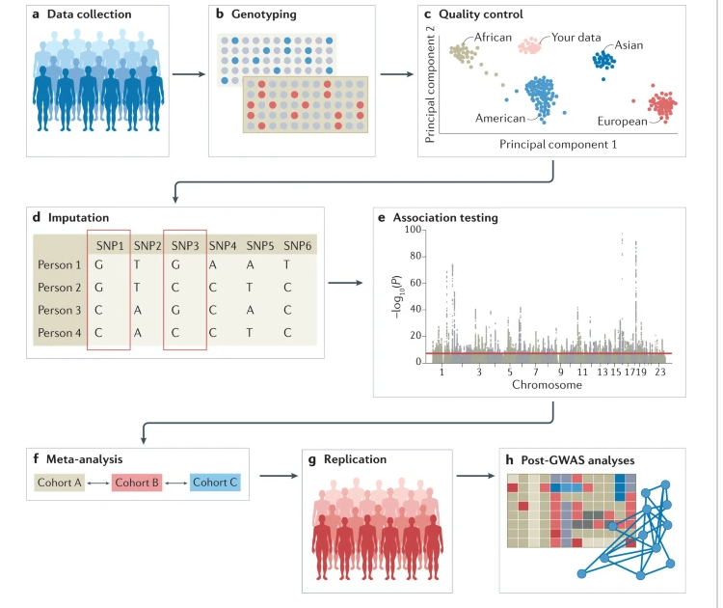


Steps for conducting a GWAS

Slide 28
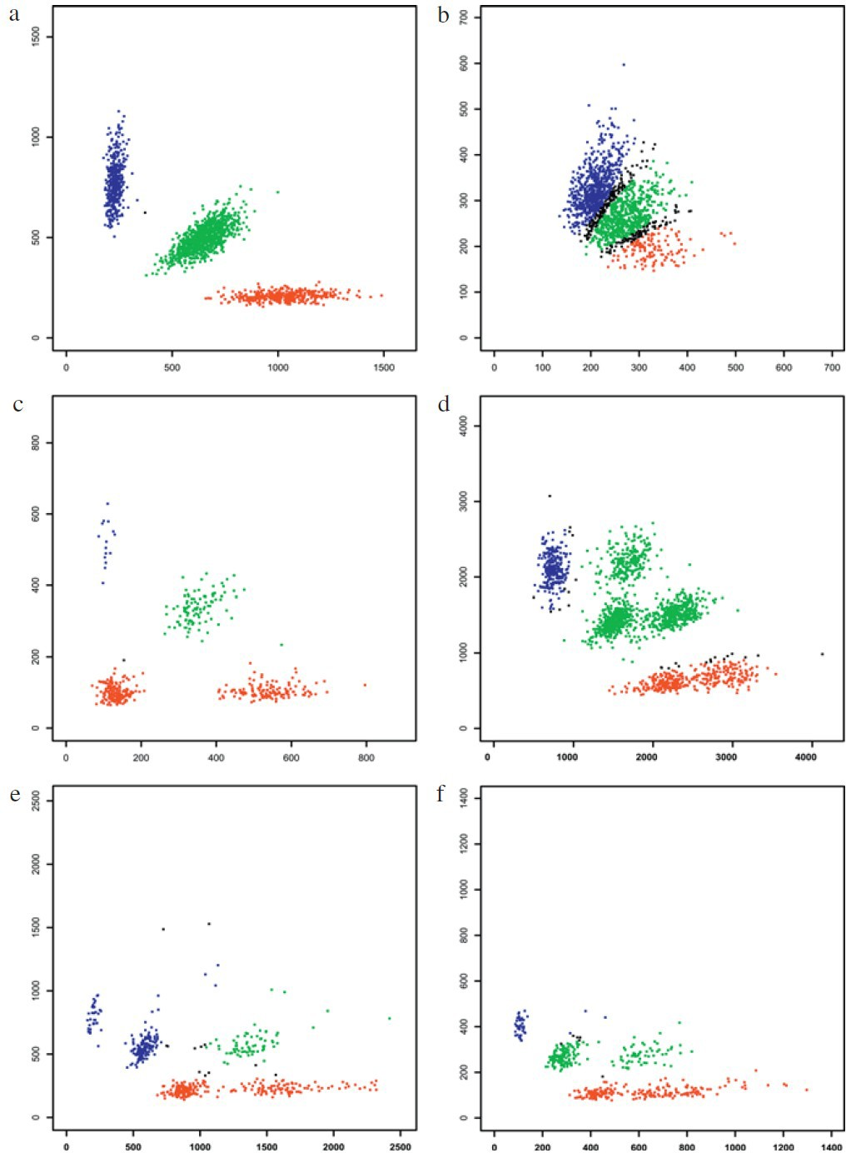



Calling of genotypes
Ziegler A, et al. Biometrical J 2008;8-28

Slide 29
GWA QC procedure steps (1)
Genotype call rate (i.e., assignment of genotypes to subjects): 95% cut-oﬀ for missing data for each SNP
Reproducibility across genotyping plaoorms and technologies: 99% within platform, 95% across platforms
MAF: threholds based on interest, imputation quality etc
HWE in the controls: exclude SNPs if P<10-6

Slide 30
GWA QC procedure steps (2)
Sample call rate: exclude subjects with many SNPs missing (e.g., >10%)
Autosomal heterozygosity
Relatedness check
Gender check

Slide 31
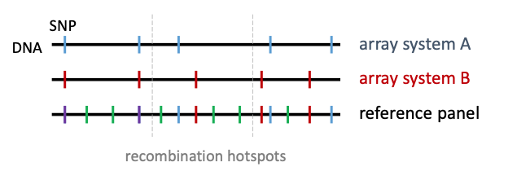
Imputation of SNPs
Genotyping arrays include a limited number of SNPs
Imputation is to estimate the unmeasured or missing SNPs
Estimation is based on measured SNPs and external info
Why imputation?
  Increase GWAS power
  Improves ﬁne-mapping
  Imputes Indels

Slide 32
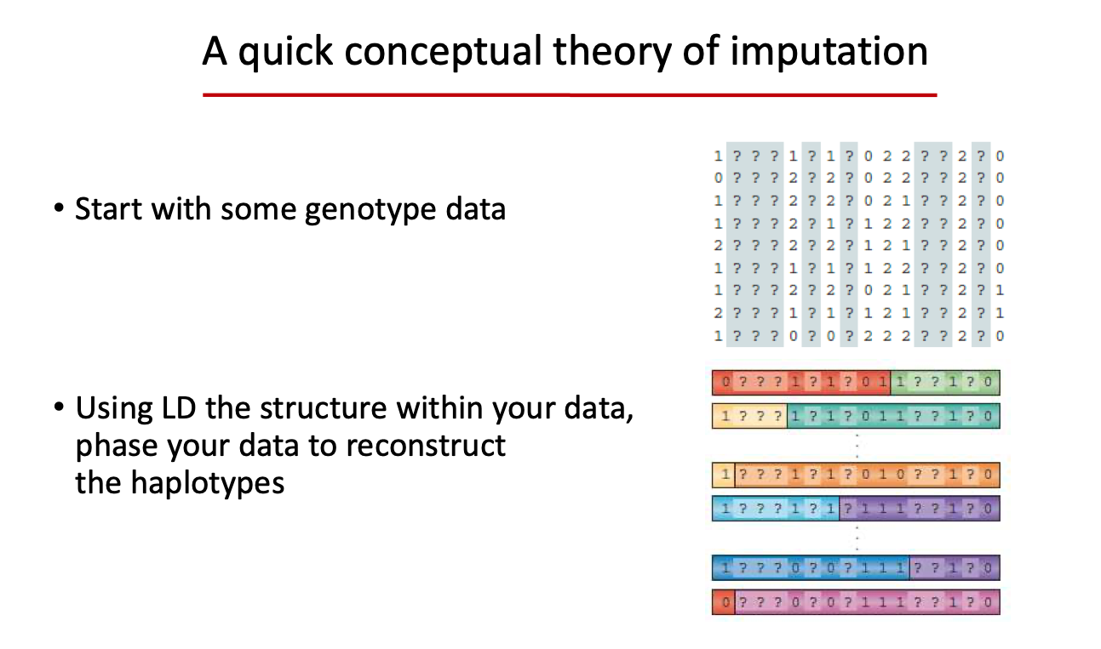

Slide 33
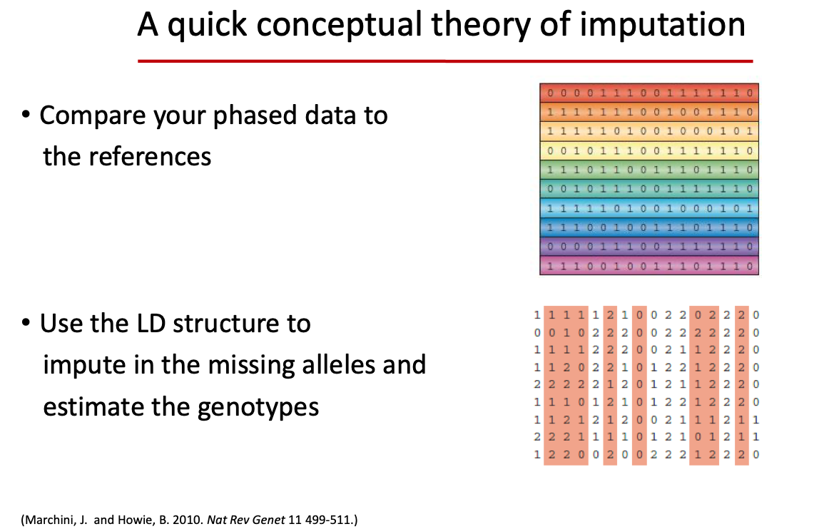

Slide 34
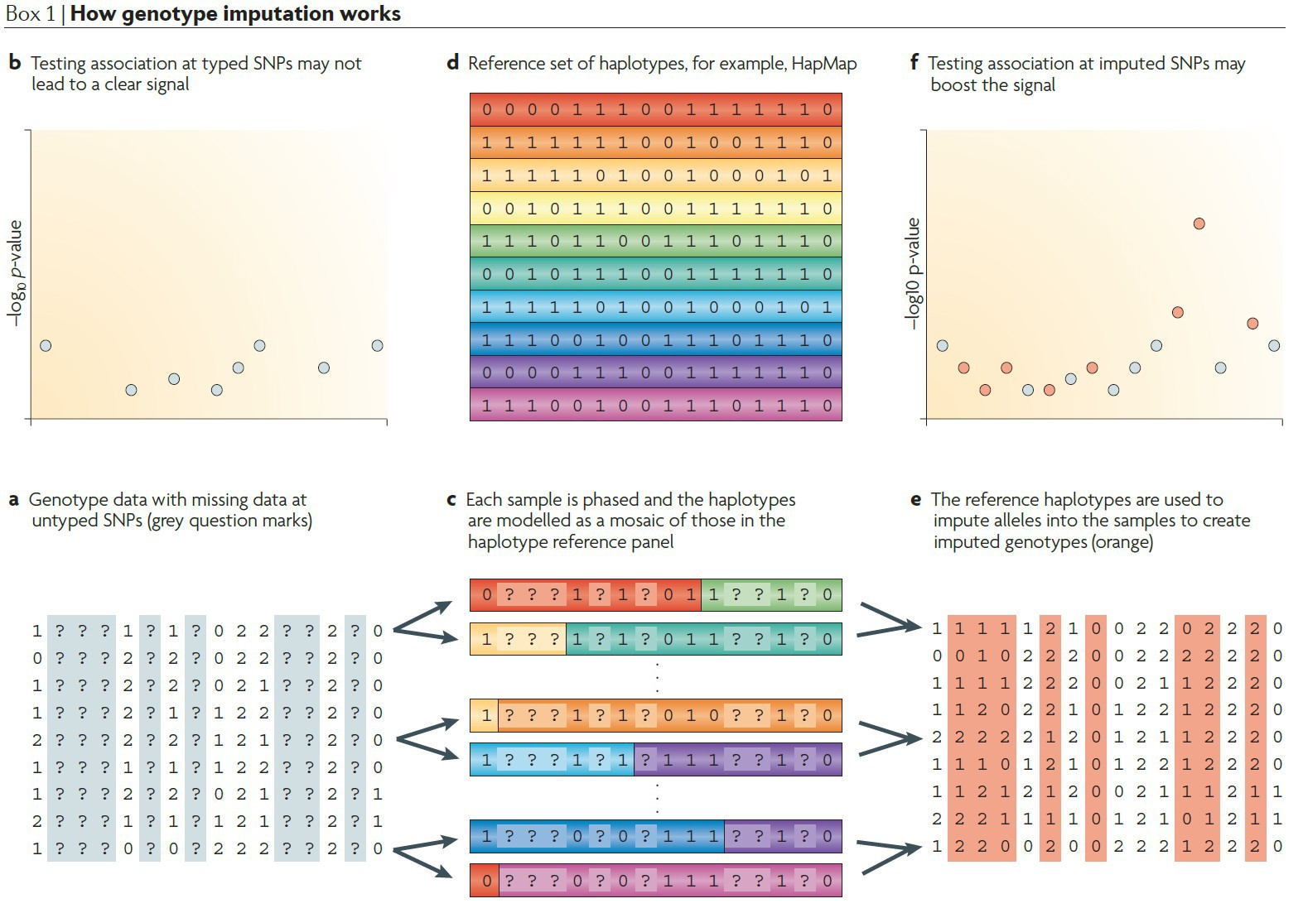



Genotype imputation in GWAS
Marchini J, et al. Nat Rev Gen 2010;499-5

Slide 35
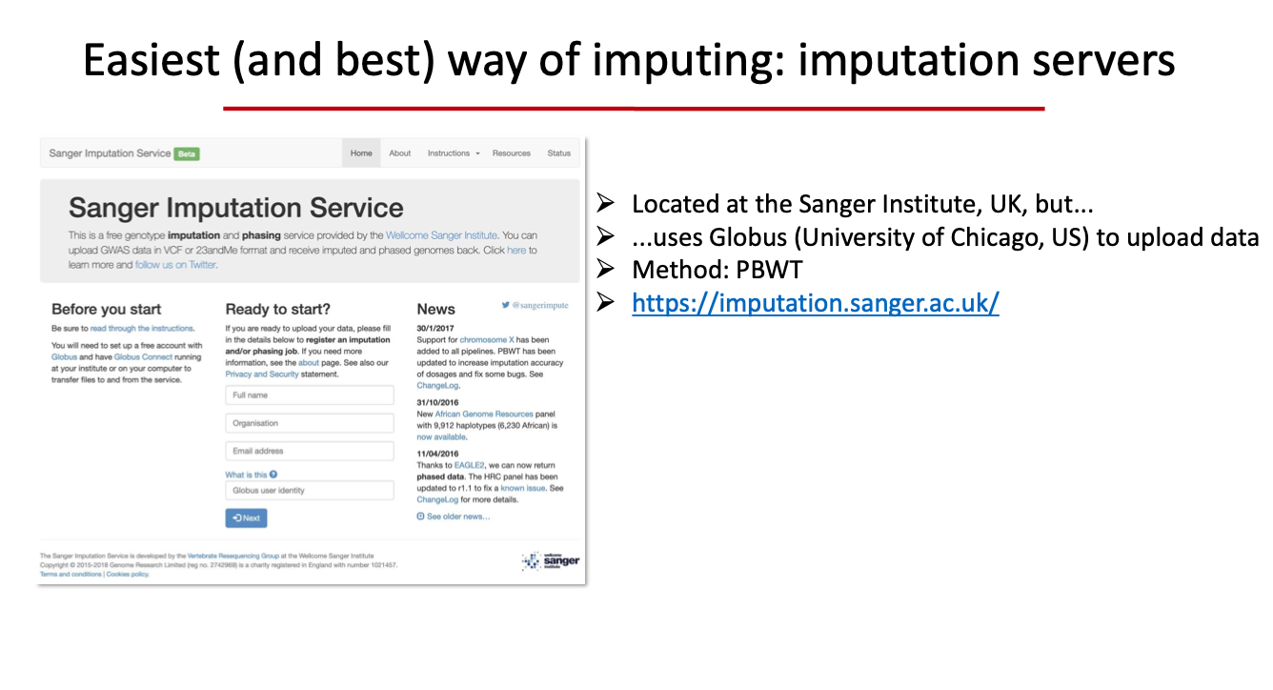

Slide 36

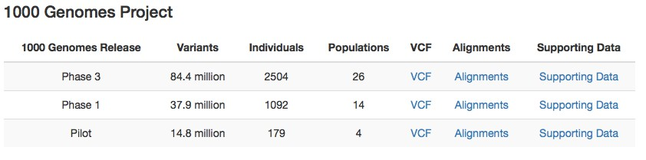
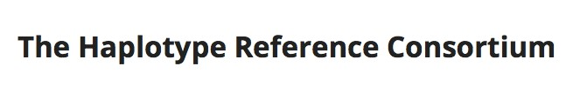
Reference Panels
~90M variants
hqp://www.internationalgenome.org
~39M variants hqp://www.haplotype-reference-consortium.org

Slide 37

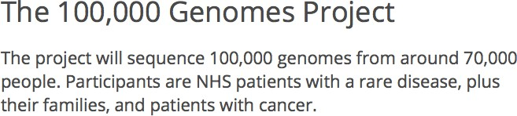


Other Reference Panels

Slide 38
Spurious association due to population stratiﬁcation
Distribution of
genotypes diﬀers between cases and controls
Cases Controls
Genotype
Might conclude that allele A (or genotype AA) related to disease
T T AT AA

Slide 39
Population Stratiﬁcation
Unequal distribution of non-disease-related alleles between cases and controls
Any allele more common in population with increased risk of disease may appear to be associated with disease
Cases Controls
Pop 1
Pop 1
Pop 2
Pop 2
Genotype
T T AT AA

Slide 40
Using the GWA Data to Avoid Population Stratiﬁcation
The information on the genome-wide markers could be used to:
  Estimate ancestry groups and remove extreme outliers
  Estimate inﬂation of test statistic and adjust for it

Slide 41
Identifying and correcting for population stratiﬁcation
Genomic control
  SNPs are used to calculate background inﬂation in test statistic (due to population stratiﬁcation)
  Signiﬁcant associations are excluded
  Diminishes the statistical power
Adjustment for population stratiﬁcation
  Principal components analysis, adjustment/matching for top PC’s

Slide 42
Run GWAS analysis
Running GWAS is actually repeatedly running a regression model for all SNPs
Normally a QQ-plot is used to check the distribution of the pvalues
Manhatan plots are used to get an overview of the ﬁndings
Regional plots are used to take a close look at every locus

Slide 43
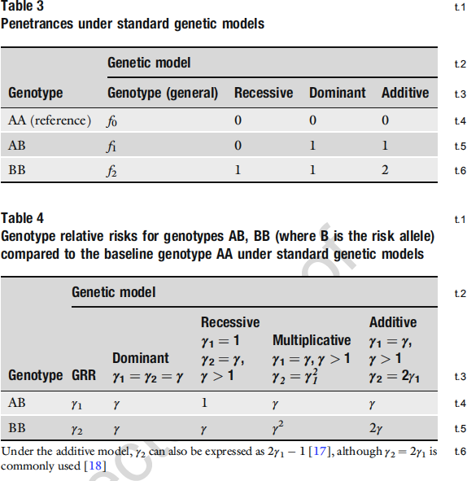
Models of inheritance
Genetic Epidemiology: Methods and Protocols. Evangelou (ed) Ch. 2: Key concepts in genetic epidemiology

Slide 44
Estimate inﬂation of test statistic
Q-Q plot is a plot to compare two probability distributions
In GWA studies, QQ-plots compare the distribution of p- values of GWAS with a distribution when no associations
When no real association is found the two distributions are similar and the points will lie on the identity line (y = x)
Deviations from the identity line could be due to:
  True associations
  Population stratiﬁcation

Slide 45
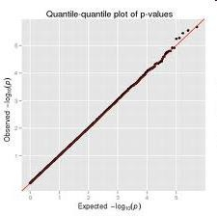
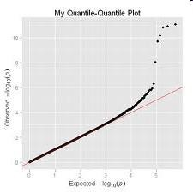
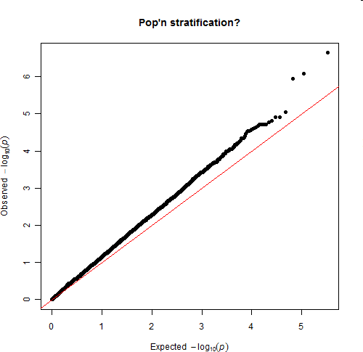
QQ-plots in GWAS

Slide 46
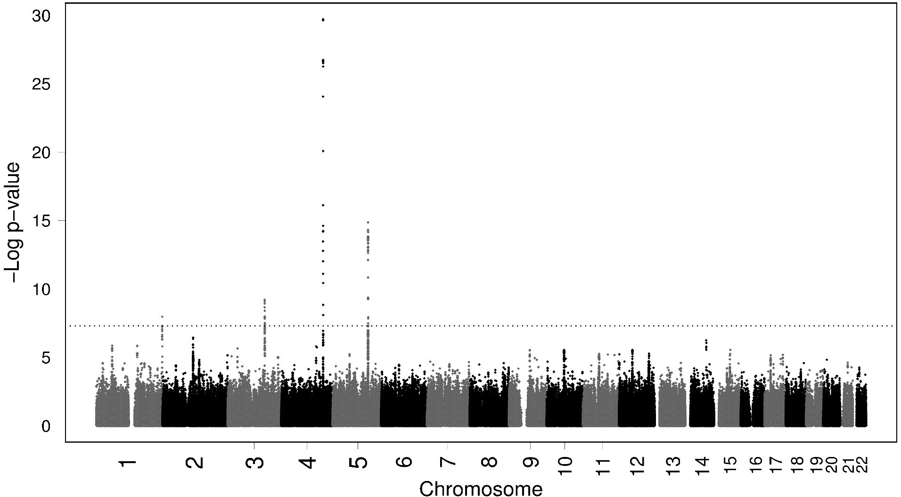








-log plot (Manhaqan plot)
FGB
IRF1
PCCB
NLRP3
Dehghan et al. Circ Cardiovasc Genet. 2009

Slide 47
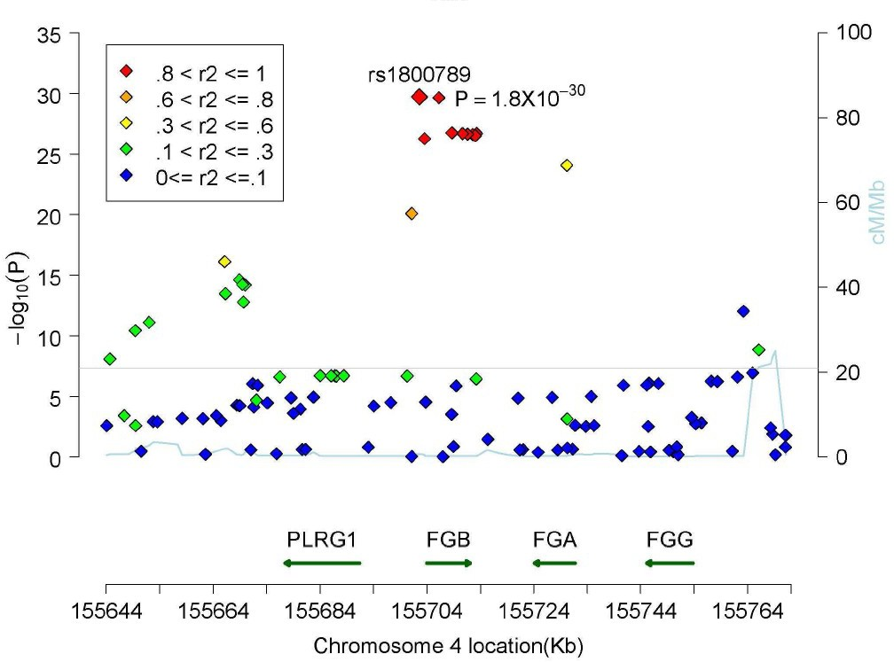
Regional plot
Dehghan et al. Circ Cardiovasc Genet. 2009

Slide 48
Multiple Testing Issue
Bonferroni correc5on
Assume all tests performed are independent
Estimate number of independent polymorphisms in genome
Threshold oyen considered appropriate: 5x10⁻⁸
Recently more conservative thresholds are used such as 1x10⁻⁸ or 1x10⁻⁹

Slide 49
Multiple Testing Issue
Permutation
Permute case and control status, perform all tests, record the most signiﬁcant p-value among those tests and then re-permute case-control status and test again. Repeat many times.
P-value for most signiﬁcant test is the proportion of permutations that had a “best” p-value as small or smaller than the one you observe with the observed data (the data with the right case and control labels).

Slide 50
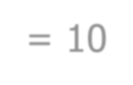

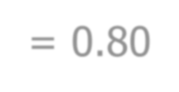



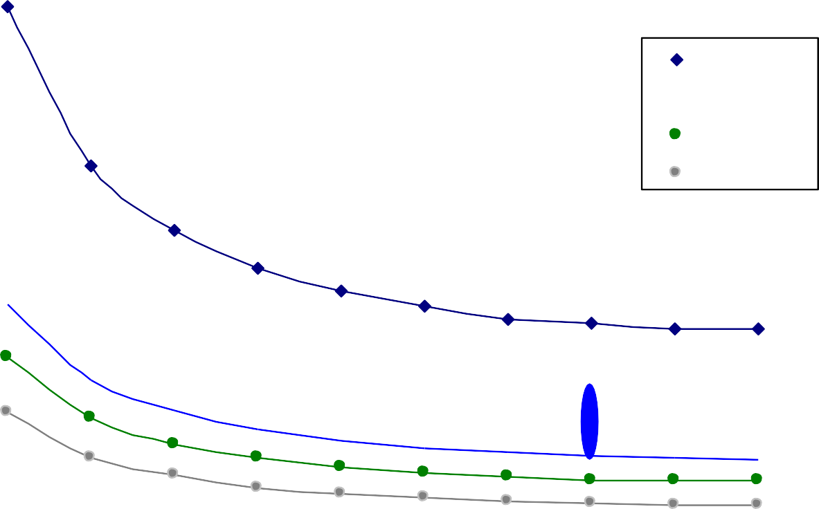
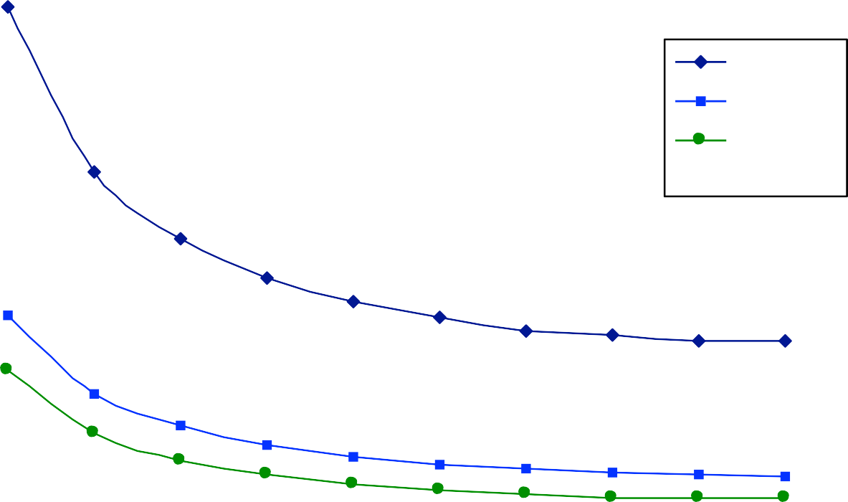




Eﬀect size – MAF - Power
α = 10⁻⁶
power = 0.80
0.4
0.35
n = 2500
n = 11000
n = 17000
n = 30000
n = 2500
n = 11000
n = 17000
n = 30000
0.3
Effect size
z-score
0.25
0.2
0.15
FTO
0.1
0.05
0
0% 5% 10% 15% 20% 25% 30% 35% 40% 45% 50%
Minor allele frequency (%)
Loos, Lindgren, Li, unpublished data

Slide 51
Meta-analysis
Large sample sizes are needed
Combine multiple studies to increase power
Either combine p-values (Fisher’s test), or coeﬃcient estimates ti standard error (beqer)

Slide 52







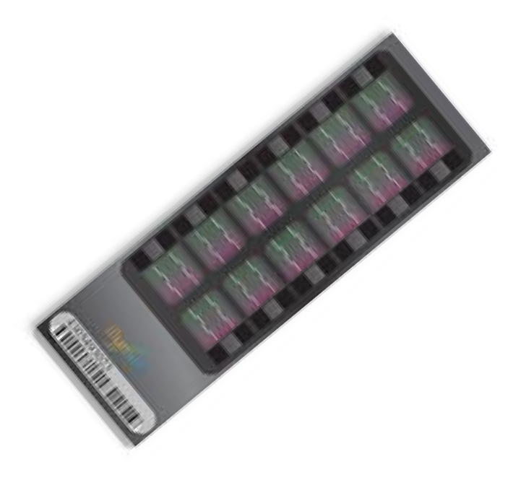





























Meta-analysis of genome-wide association studies
DIAGRAM (DIAbetes Gene5cs Replica5on And Meta-analysis)consor5um
WTCCC
T2D Cases
DGI
T2D Cases
Controls
Controls
Fusion
Vs.
Vs.
T2D Cases
Controls
Vs.
imputation
imputation
imputation
Meta-analysis

Slide 53
Interpreting the Statistical Results
If you identify a SNP that is signiﬁcantly associated with disease, there are three possibilities:
  There is a causal relationship between SNP and disease
  The marker is in linkage disequilibrium with a causal locus
  False positive
Many potential sources of systematic errors that might lead to false positive results.
  Genotyping quality control issues particularly important
  Population stratiﬁcation

Slide 54
False positive
This may occur specially when the pvalue is borderline.
Most of the highly signiﬁcant ﬁndings are true
Heterogeneity should be considered

Slide 55
Replication
GWA studies are hypothesis-generating (agnostic approach)
The hypothesis should be tested in an independent sample
When you have not reached genome-wide signiﬁcance level

Slide 56
Replication
To replicate:
  Signiﬁcance threshold
  Same genetic model (e.g. additive, dominant)
  Same direction
  Suﬃcient sample size for replication
  Control for population stratiﬁcation in replication samples

Slide 57
Non-replications
Not necessarily a false positive
  Underpowered (Winner’s curse)
  Ethnic background (LD structures)
  Phenotype deﬁnition (subphenotype/phenotype)
  Population stratiﬁcation
  Diﬀerent covariates
  .
  .
  False positive!

Slide 58
Replication challenges and solutions
Providing enough sample size is challenging
Harmonized phenotyping is not always possible
Split the sample?

Slide 59
One-stage designs
Increase power by combining all available resources
Replication sample may not have enough
power to replicate signals
P-value threshold?

Slide 60
Collaboration is the key to successful GWAS
Large consortia were formed to provide the infrastructure for replication and pooling the data
Building trust and agreeable regulations were the initial challenges
Diﬀerent genotyping platforms and measurement methods are still a challenge is all collaborative projects

Slide 61


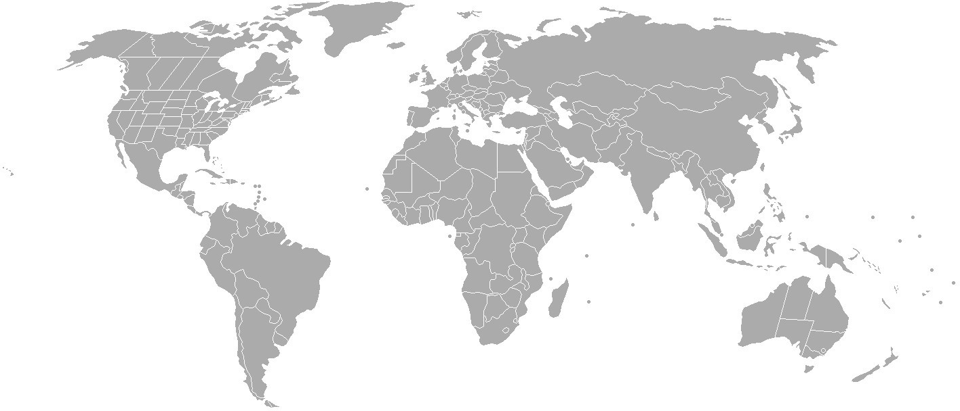



General consortia
The Cohorts for Heart and Aging Research in Genomic Epidemiology
Age, Gene, Environment, Susceptibility (AGES) Study
The Rotterdam Study
Cardiovascular Health Study (CHS)
The Framingham Heart Study
The Atherosclerosis Risk in Communities (ARIC) Study

Slide 62

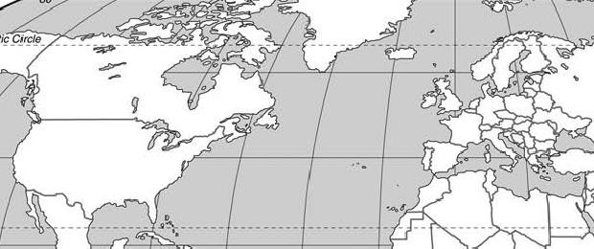



















Disease Consortia
The DIAGRAMti consortium
c
UK
FUSION (US/Finland)
DGI (US/Sweden/Finland) DeCODE
EASD, Vienna, September 2009
KORA
Roqerdam
DGDG (France/Canada) EUROSPAN

Slide 63
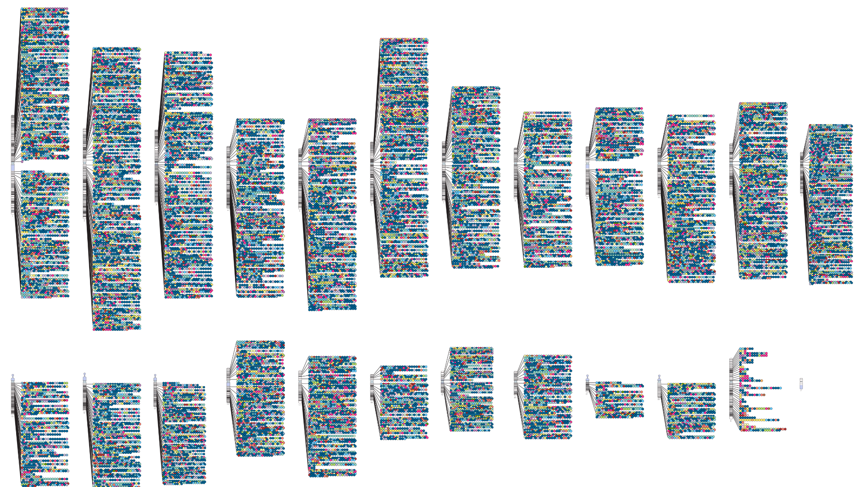
Were GWAS successful?
https://www.ebi.ac.uk/gwas/docs/diagram-downloads
Manolio et al., J Clin Invest 2008; 118:1590-605.

Slide 64
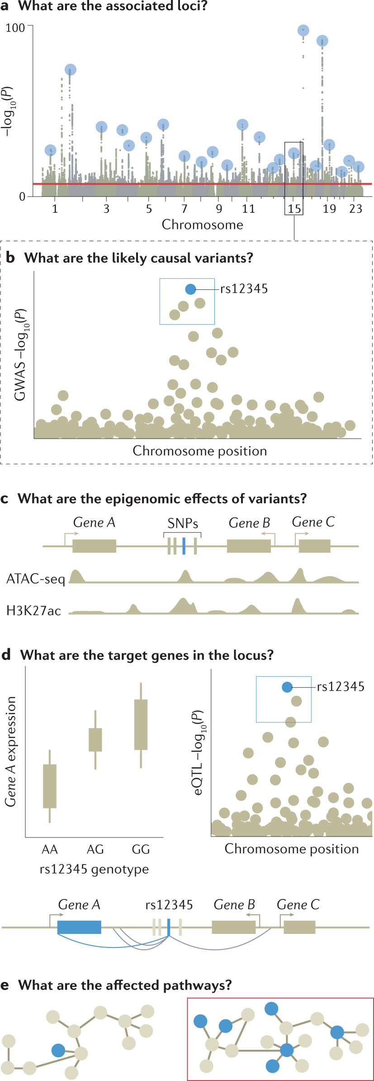

Slide 65
Genetic analysis of over one million people identiﬁes 535 novel loci associated with blood pressure traits
Going beyond the 1 M participants

Slide 66
Study design
Data
UK Biobank data
N=502,620 with genetic & phenotypic data
ICBP data
N=299,024 from 77 different cohorts
Genetic/phenotypic data QC → N=458,577 Exclude samples with high missingness/heterozygosity,
sex discordance, QC failures, missing covariates, pregnant, retracted informed consent
restrict to Europeans using PCA
Genetic/phenotypic data QC → N=299,024 150,134 previously published (54 cohorts), centrally QC-ed
Plus 148,890 samples from 23 newly QC-ed cohorts.
Including study-level GC-adjustment European samples only
QC
UK Biobank GWAS analysis
UKB GWAS of HRC imputed SNPs
BP ~ SNP ti sex ti age ti age² ti BMI ti array
using BOLT-LMM
→ LD Score Regression → GC-adjustment
ICBP-Plus meta-analysis
ICBP-GWAS of imputed SNPs (1000G or HRC panels) Fixed effects inverse variance weighted meta-analysis;
stringent meta-level QC-filtering
Discovery
UKBtiICBP- GWAS Discovery meta-analysis (N=757,601)
Exclude all SNPs in 274 known BP loci, using SNPs previously reported at time of analysis
Locus Definition: (r² ≥ 0.1; 1Mb region ±500kb from sentinel SNP) (also fully exclude HLA region: chr6:25-34 Mb)
Two-stage analysis
Follow-up SNPs with P < 1 × 10⁻⁶ for any BP trait (with concordant direction of effect for UKB vs ICBP)
One-stage analysis
Consider any novel sentinel lookup SNPs which do not replicate from 2-stage analysis
Replication
Independent Replication meta-analysis
→ Lookups of sentinel SNPs
in MVP (N=220,520) and EGCUT (N=28,742)
→ combined meta-analysis (N=1,006,863)
→ UKB-ICBP Internal Replication
P < 5 × 10⁻⁹ from UKBtiICBP discovery meta
P < 0.01 in UKB GWAS
P < 0.01 in ICBP GWAS meta-analysis
concordant direction of effect UKB vs ICBP
genome-wide significant (P < 5 × 10⁻⁸) in combined meta
P < 0.01 in replication meta-analysis
concordant direction of effect
Validation
325 novel replicated loci from two-stage analysis
SBP (130), DBP (91), PP (104)
92 newly replicated loci (previously published without independent replication)
210 novel loci from one-stage analysis
(internally replicated) SBP (60), DBP (103), PP (47)
535 novel loci

Slide 67
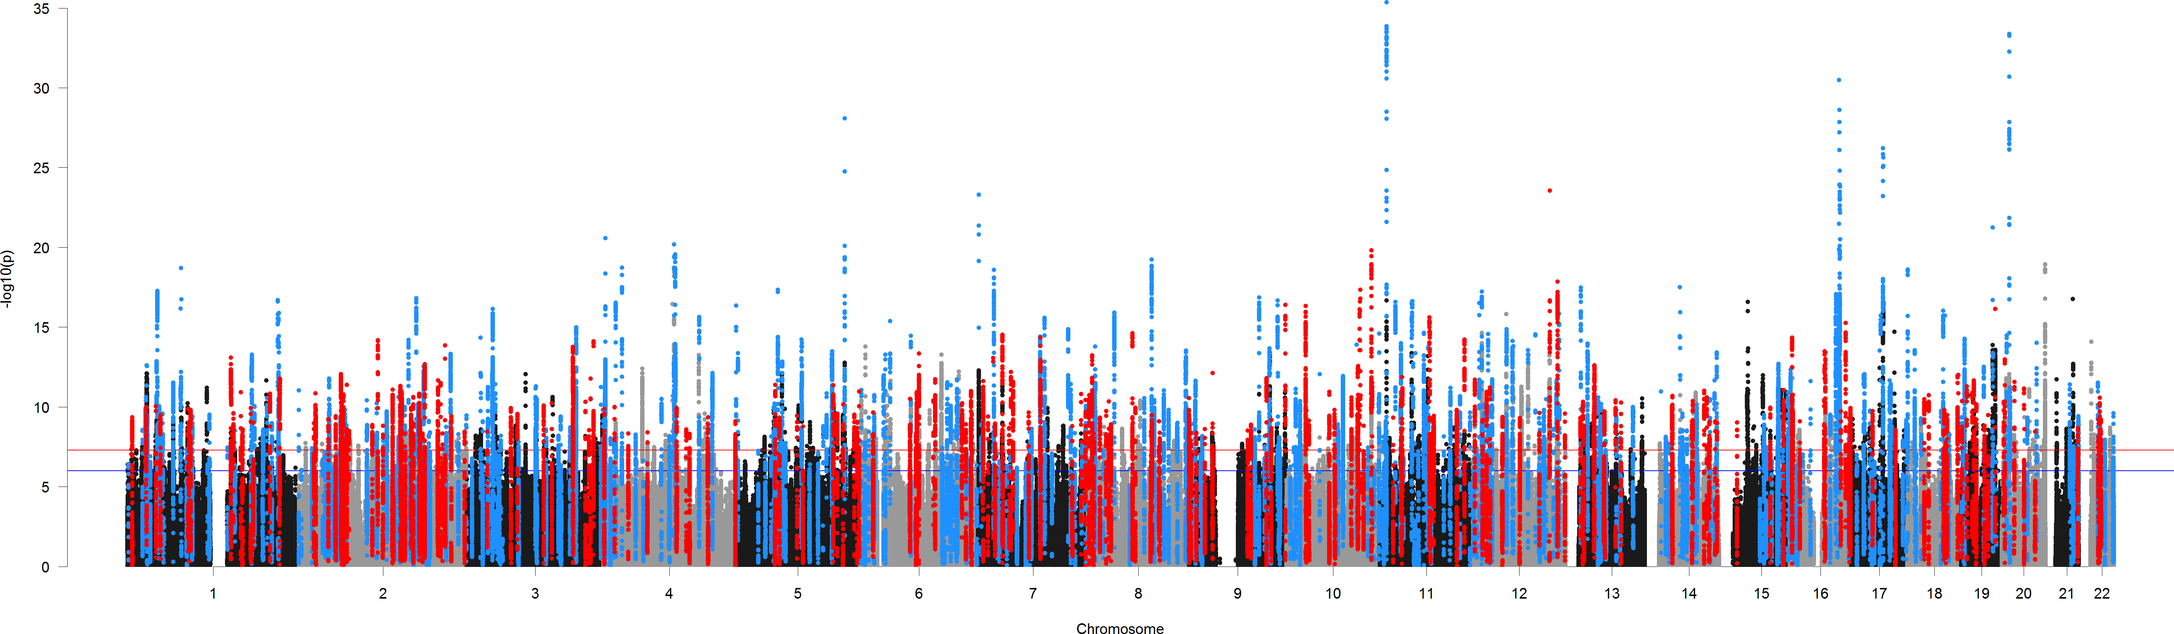
Manhaqan Plot excluding known variants

Slide 68
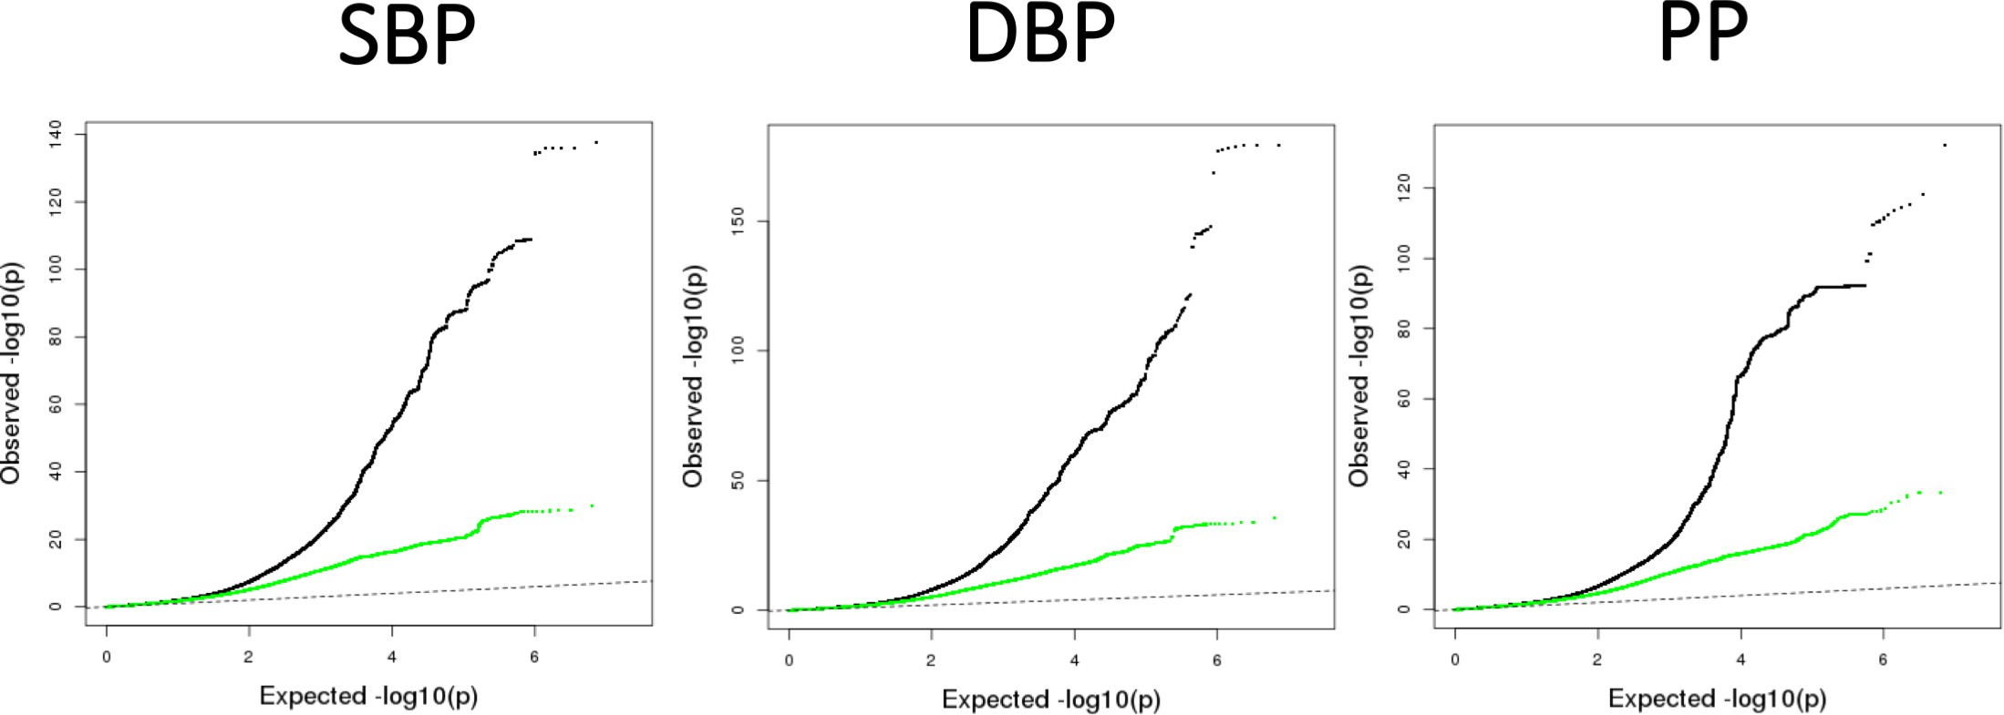
Early deviation due to large power

Slide 69
How could the genetic data be used in clinic?
Drug target
Precision medicine

Slide 70

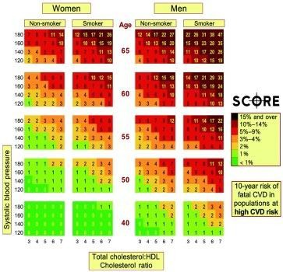
Risk prediction
Risk prediction is widely used for clinical practice e.g. in cardiology
Various risk scores have so far been developed

Slide 71
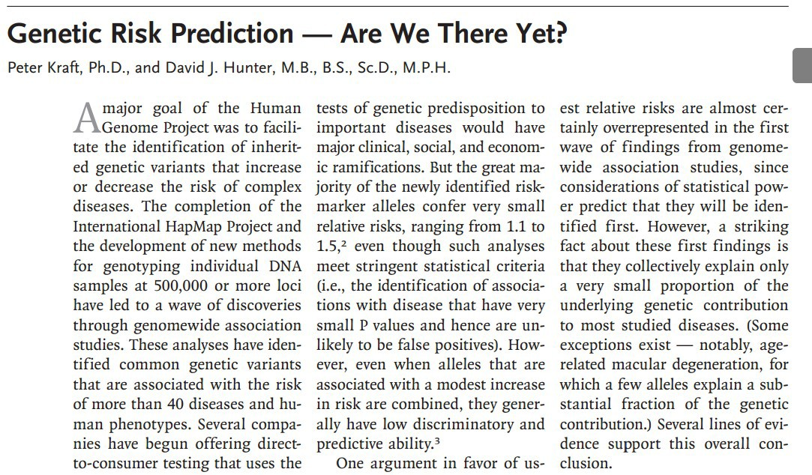
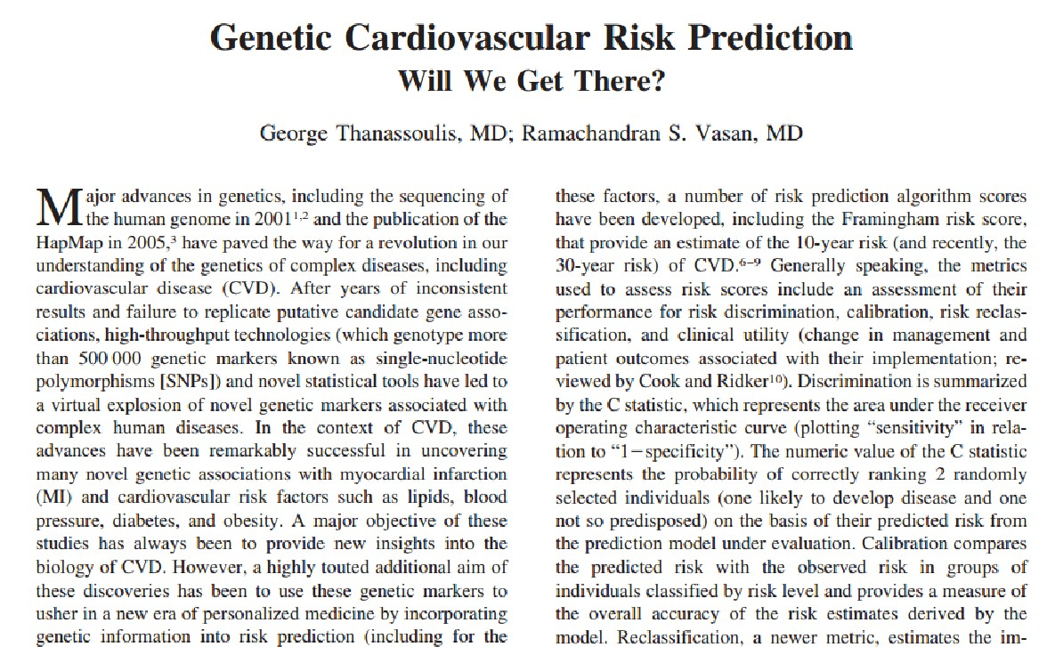
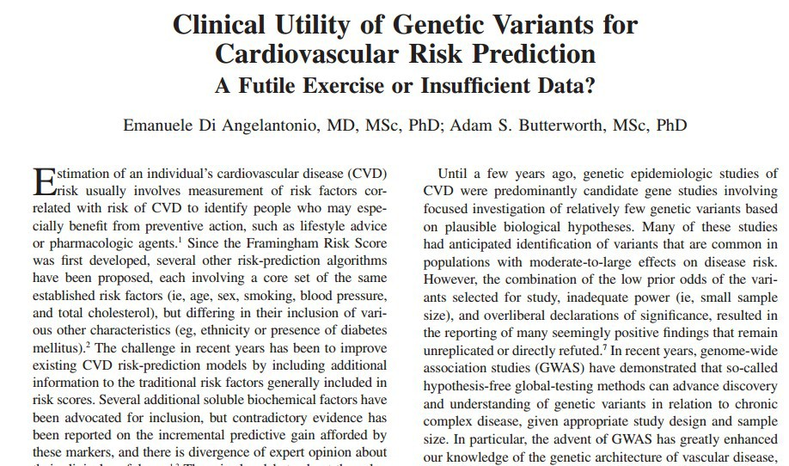
New England Journal of Medicine 2009
Circulation 2010
Circ Cardiovasc Genet. 2012

Slide 72


Slide 73

Missing Heritability?

Slide 74
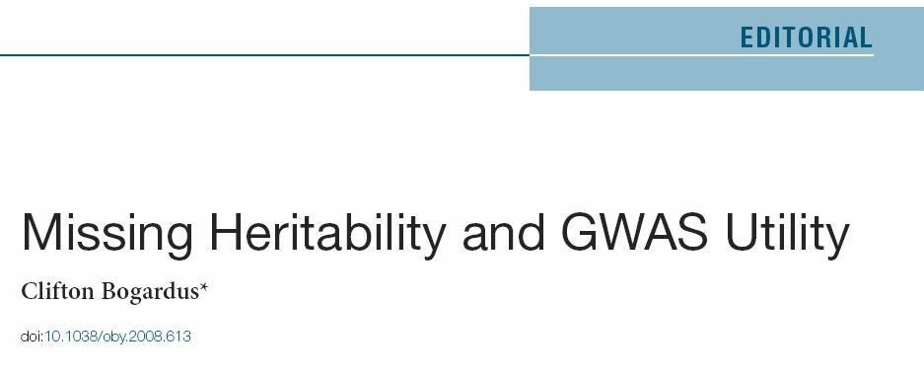

Missing Heritability?

Slide 75
Variation explained
The variation explained is yet very small for many traits
By doubling the sample size, the number of identiﬁed loci is more than double, however, the % variance explained is little increased

Slide 76
Reasons for missing heritability
“Common disease, common variant” is incorrect – study rarer variants
Calculation of heritability eﬀects is wrong?
Not enough common variants of small eﬀect detected
Structural or other genomic variants more important
Diﬃcult to analyse gene-gene/gene-environment interactions and in general high-dimensional and systems biology data (i.e., combination of genomic, transcriptomic, proteomic, metabolomic data)

Slide 77













Reasons for missing heritability
Low power to detect small effects
Low coverage of the rare variants
Complex interaction between genes
Missing heritability

Slide 78

Gene-Gene interactions
Αλληλεπίδραση γονιδίων
Large sample sizes are required to support evidence of gene-gene interactions

Slide 79




Clinical assessment incorporating a personal genome
Euan A Ashley, Atul J Butte, Matthew T Wheeler, Rong Chen, Teri E Klein, Frederick E Dewey, Joel T Dudley, Kelly E Ormond, Aleksandra Pavlovic, Alexander A Morgan, Dmitry Pushkarev, Norma F Neﬀ, Louanne Hudgins, Li Gong, Laura M Hodges, Dorit S Berlin, Caroline F Thorn,
Katrin Sangkuhl, Joan M Hebert, Mark Woon, Hersh Sagreiya, Ryan Whaley, Joshua W Knowles, Michael F Chou, Joseph V Thakuria, Abraham M Rosenbaum, Alexander Wait Zaranek, George M Church, Henry T Greely, Stephen R Quake, Russ B Altman
Smoking
Disorder n
Obesity 13
Coronary artery disease 10
Type 2 diabetes 42
Depression 4
Prostate cancer 18
Asthma 2
Hypertension 2
Myocardial infarction 7
Pseudoexfoliation glaucoma 2
Psoriasis 13
Non-Hodgkin lymphoma 8
Rheumatoid arthritis 12 Age-related macular degeneration 2 Colorectal cancer 12
Multiple sclerosis 9
Lung cancer 5
Bladder cancer 11
Malignant melanoma 2
Alzheimer’s disease 25
Schizophrenia 8
Kidney cancer 9
Periodontitis 4
Stroke 3
Oesophageal cancer 2
Multiple myeloma 2
Migraine 3
Bipolar disorder 4
Type 1 diabetes 10
Ulcerative colitis 4
Crohn’s disease 19
Systemic lupus erythematosus 8
Graves’ disease 4
70% 100%
Stress
Pesticides
Alcohol
NSAID
Parkinson's Disease
MAO inhibitors
Cocaine
Sodium
Anticoagulants
Abdominal aortic aneurysm
Interferon-α
Statins
Myocardial infarction
Antihypertensives
Hypertension
Depression
Coronary artery disease
Type 2 diabetes
Exercise
Obesity
Osteoarthritis
Asthma
Air pollution
Diet
Allergens
Antipsychotics
Prostate cancer
Injury
0% 10% 20% 30% 40% 50% 60%
Clinical risk (%)
Figure 3: Clinical risk incorporating genetic-risk estimates for major diseases
Figure 5: Gene-environment interaction

Slide 80



Slide 81
Ways forward…
Further genetic discovery (larger sample size)
Denser genotyping
Whole genome sequencing
Systems biology approaches
Development of clinically useful risk prediction models
Other translation

Slide 82


UK biobank
A cohort study of 500,000 people, 40-69 years old across the UK
→ separate and combined effects of genetic, environmental and lifestyle factors on major morbidity, mortality and health

Slide 83


UK Biobank – unique features
SIZE Large sample size
DEPTH Extensive baseline data – questionnaire - physical measures - blood & urine
Repeat assessments to allow for imprecision
Potential for enhancements
DURATION Single healthcare system with long-term follow up via electronic medical records
Laboratory & Sample archiving: Automation & Information Management
General consent for unspecified future research
ACCESSIBILITY

Slide 84




Unprecedented scale genetic data
Custom built genotyping array (850K variants) with imputed measures for 90M variants for 500,000 participants
Massive scale exome sequencing (CRAMS and joint calls available) → discovery-based gene burden analysis
Massive scale whole genome sequencing (CRAMS and joint calls available) → rare and very rare gain and loss of function variants, functional impact of structural variation, gene regulation
Notes:
Scientifically unparalleled

Slide 85


Biobank effect –
Large sample sizes
Genetic determinants of C- Reactive Protein (CRP)
N~21,000, 5 genetic loci
Elliott Tzoulaki et al. JAMA 2009
N~700,000, 266 genetic loci
Said Nat Comm 2022/ Koskeridis Nat Comm 2023

