Slide 1

Post GWAS analyses
Ioanna Tzoulaki itzoulaki@bioacademy.gr
Director of Research, Biomedical Research Institute Academy of Athens
Professor in Chronic Disease Epidemiology, School of Public Health, Imperial College London
Thanks to Devendra Meena for sharing some of these slides.

Slide 2
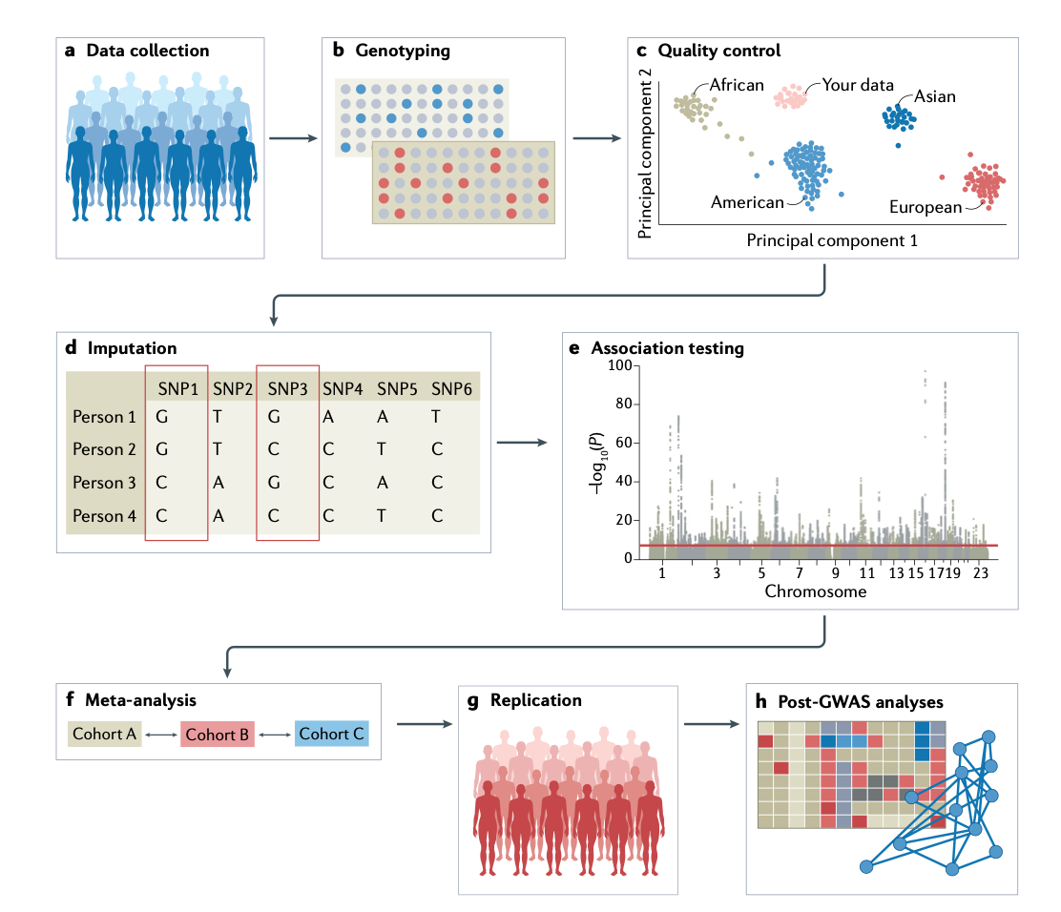
Genome-wide association study: steps
— P=5x10⁻⁸
https://doi.org/10.1038/s43586-021-00056-9

Slide 3
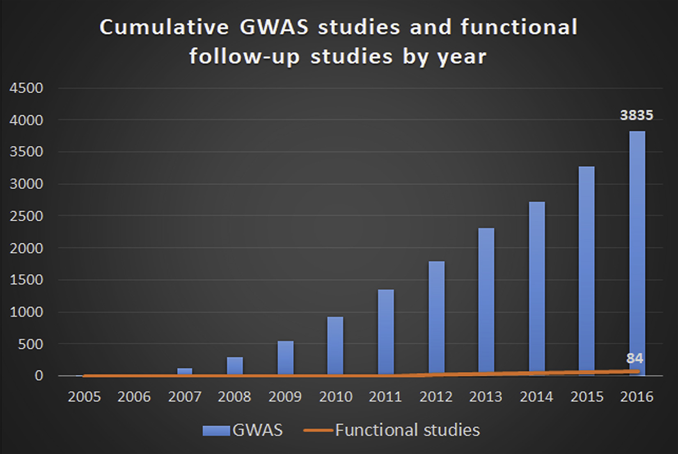
GWAS studies and functional follow-up studies by year
https://doi.org/10.1016/j.ajhg.2018.04.002

Slide 4

Post GWAS analysis: basic questions
What are the associated loci?
What are the likely causal variants?
What are the target genes in the locus?
What are the epigenetic effects of the associated loci?
What are the affected tissues and pathways?

Slide 5

Post GWAS analysis
SNP to gene mapping
gene to function mapping
pathway analysis
fine-mapping
genetic correlation analysis
Mendelian randomization
polygenic risk prediction

Slide 6
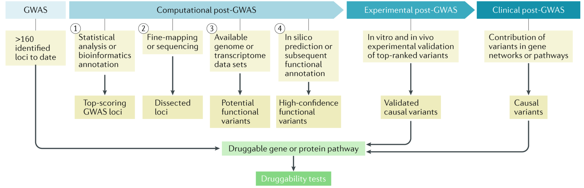
Post GWAS analysis pipeline: an example
https://doi.org/10.1038/ s41568-018-0087-3

Slide 7
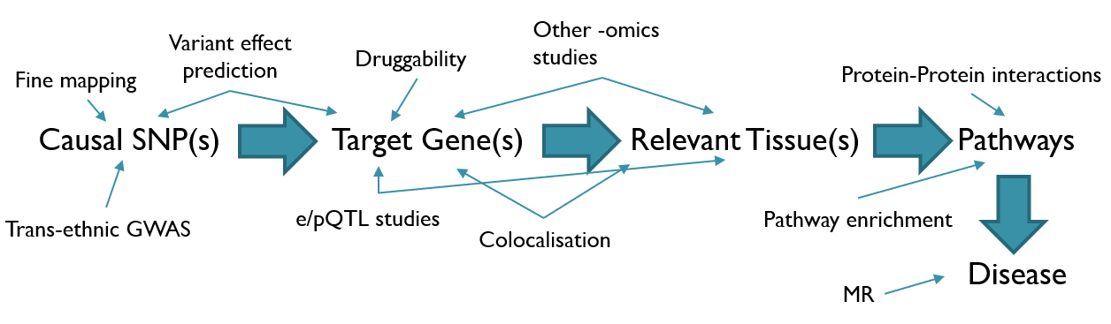
Post GWAS analysis pipeline: an example
https://mesuturkey.wordpress.com

Slide 8
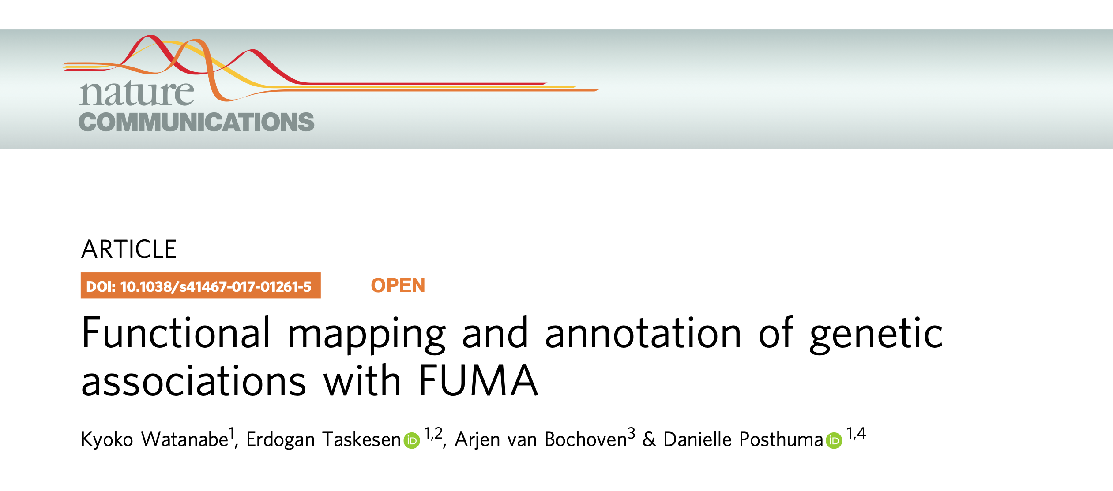
Functional Mapping and Annotation of GWAS: FUMA
https://fuma.ctglab.nl
DOI: 10.1038/s41467-017-01261-5

Slide 9
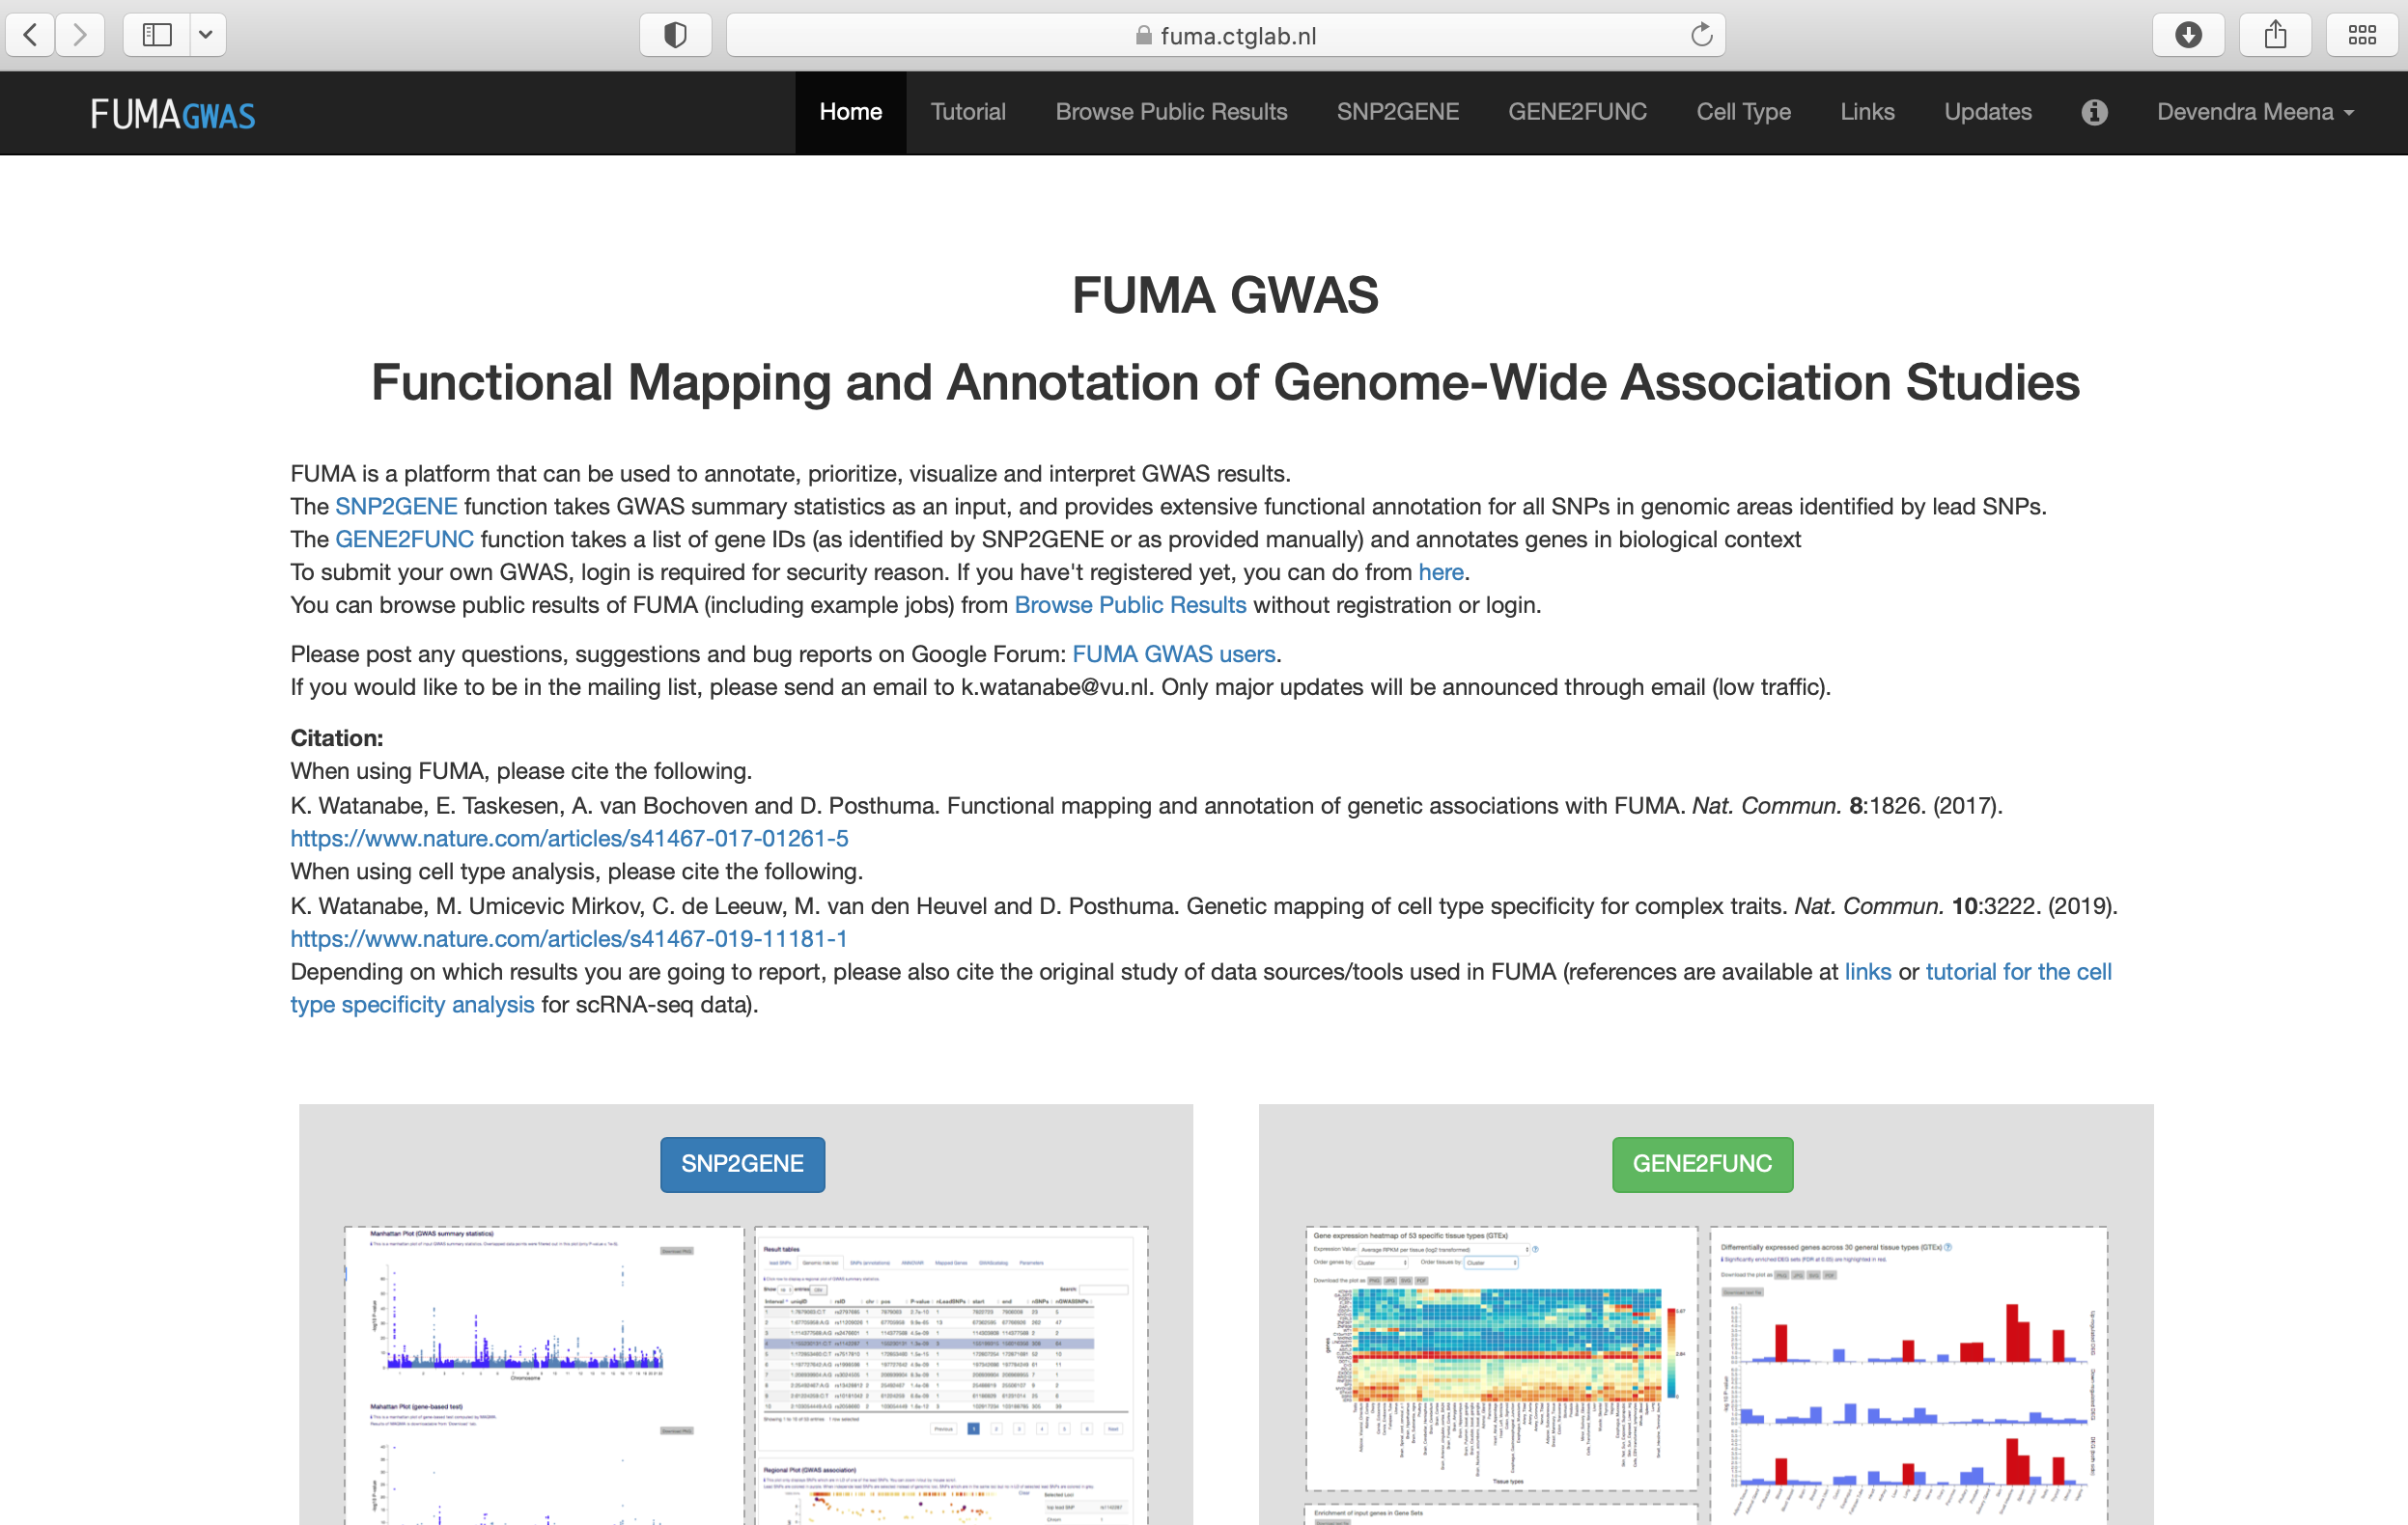

Slide 10
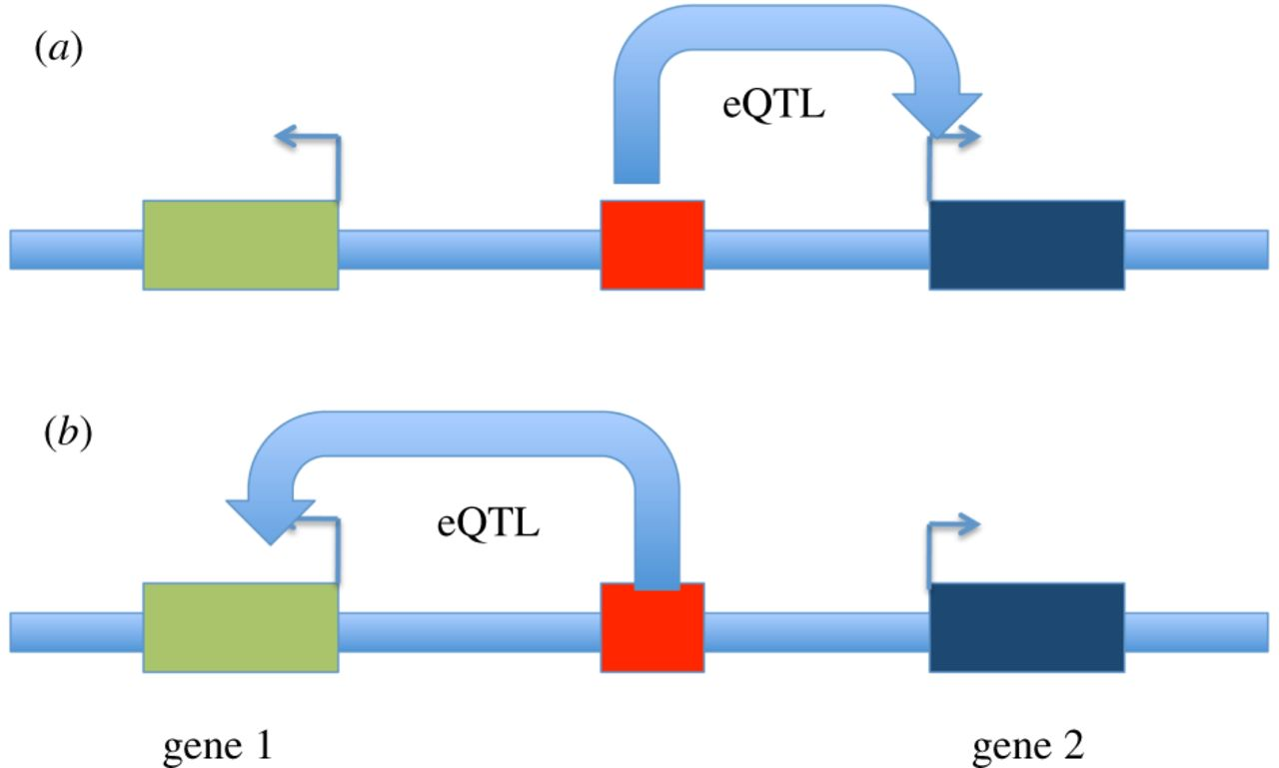
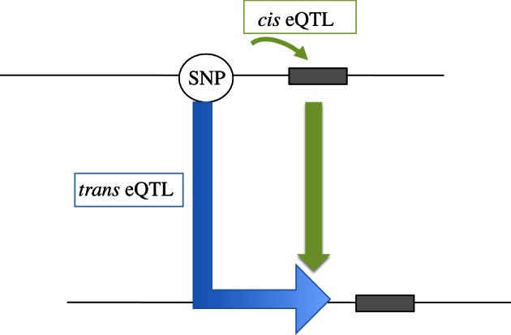
Expression quantitative trait locus: eQTL
Alexandra C. Nica, and Emmanouil T. Dermitzakis Phil. Trans. R. Soc. B 2013;368:20120362
Notes:
genetic variants that explain variation in gene expression levels
Figure 3. The same regulatory regions and variant could be an eQTL for gene 2 in (a) tissue 1 and for gene 1 in (b) tissue 2, suggesting that limited interrogation of tissues would be misleading for the biological signal underlying disease.
Genome-wide association studies (GWAS) [1] have demonstrated that the majority of such variants are found in non-coding regions of the genome and are therefore likely to be involved in gene regulation.

Slide 11
Combined Annotation Dependent Depletion Score: CADD
CADD is a tool for scoring the deleteriousness of SNPs in the human genome.
‘meta-annotation’ tool that uses information from many functional annotation tools that are around.
evolutionary, epigenetic measurements and functional predictions
A scaled CADD score >=10 indicates that these SNPs are predicted to be the 10% most deleterious substitutions; a score >=20 indicates that a variant is amongst the top 1% of deleterious variants in the human genome.
Higher the score, the more deleterious the SNP is.

Slide 12
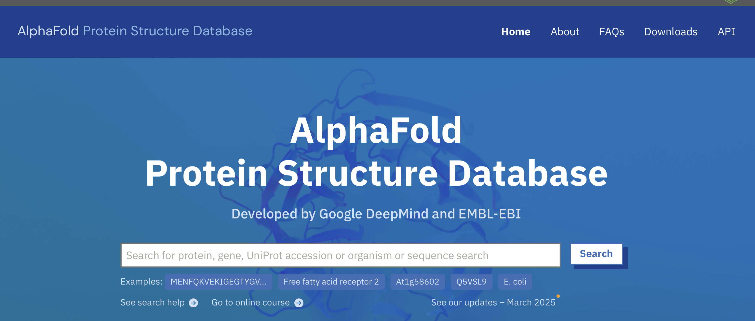

Slide 13
Functional Mapping and Annotation of GWAS: FUMA
Demo

Slide 14
FUMA workflow
Upload GWAS summary statistics
Annotates all SNPs in genomic risk loci
  Positional mapping
  eQTL mapping
  Chromatin interactions mapping
Prioritizes genes based on user-defined filters
Conducts gene-based and pathway analyses (MAGMA & enrichment)
Provides interactive plots to visualize results
All generated results can be downloaded

Slide 15
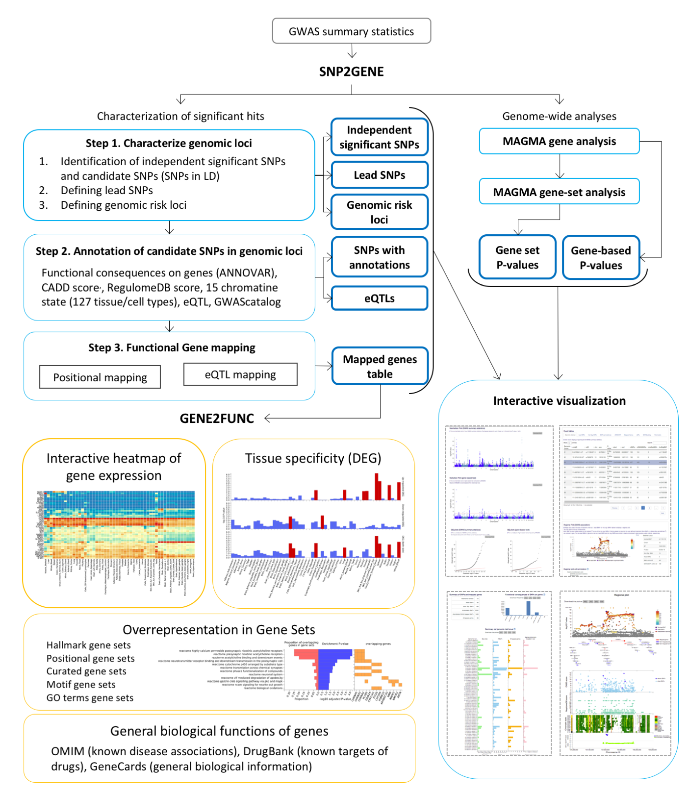
FUMA workflow

Slide 16
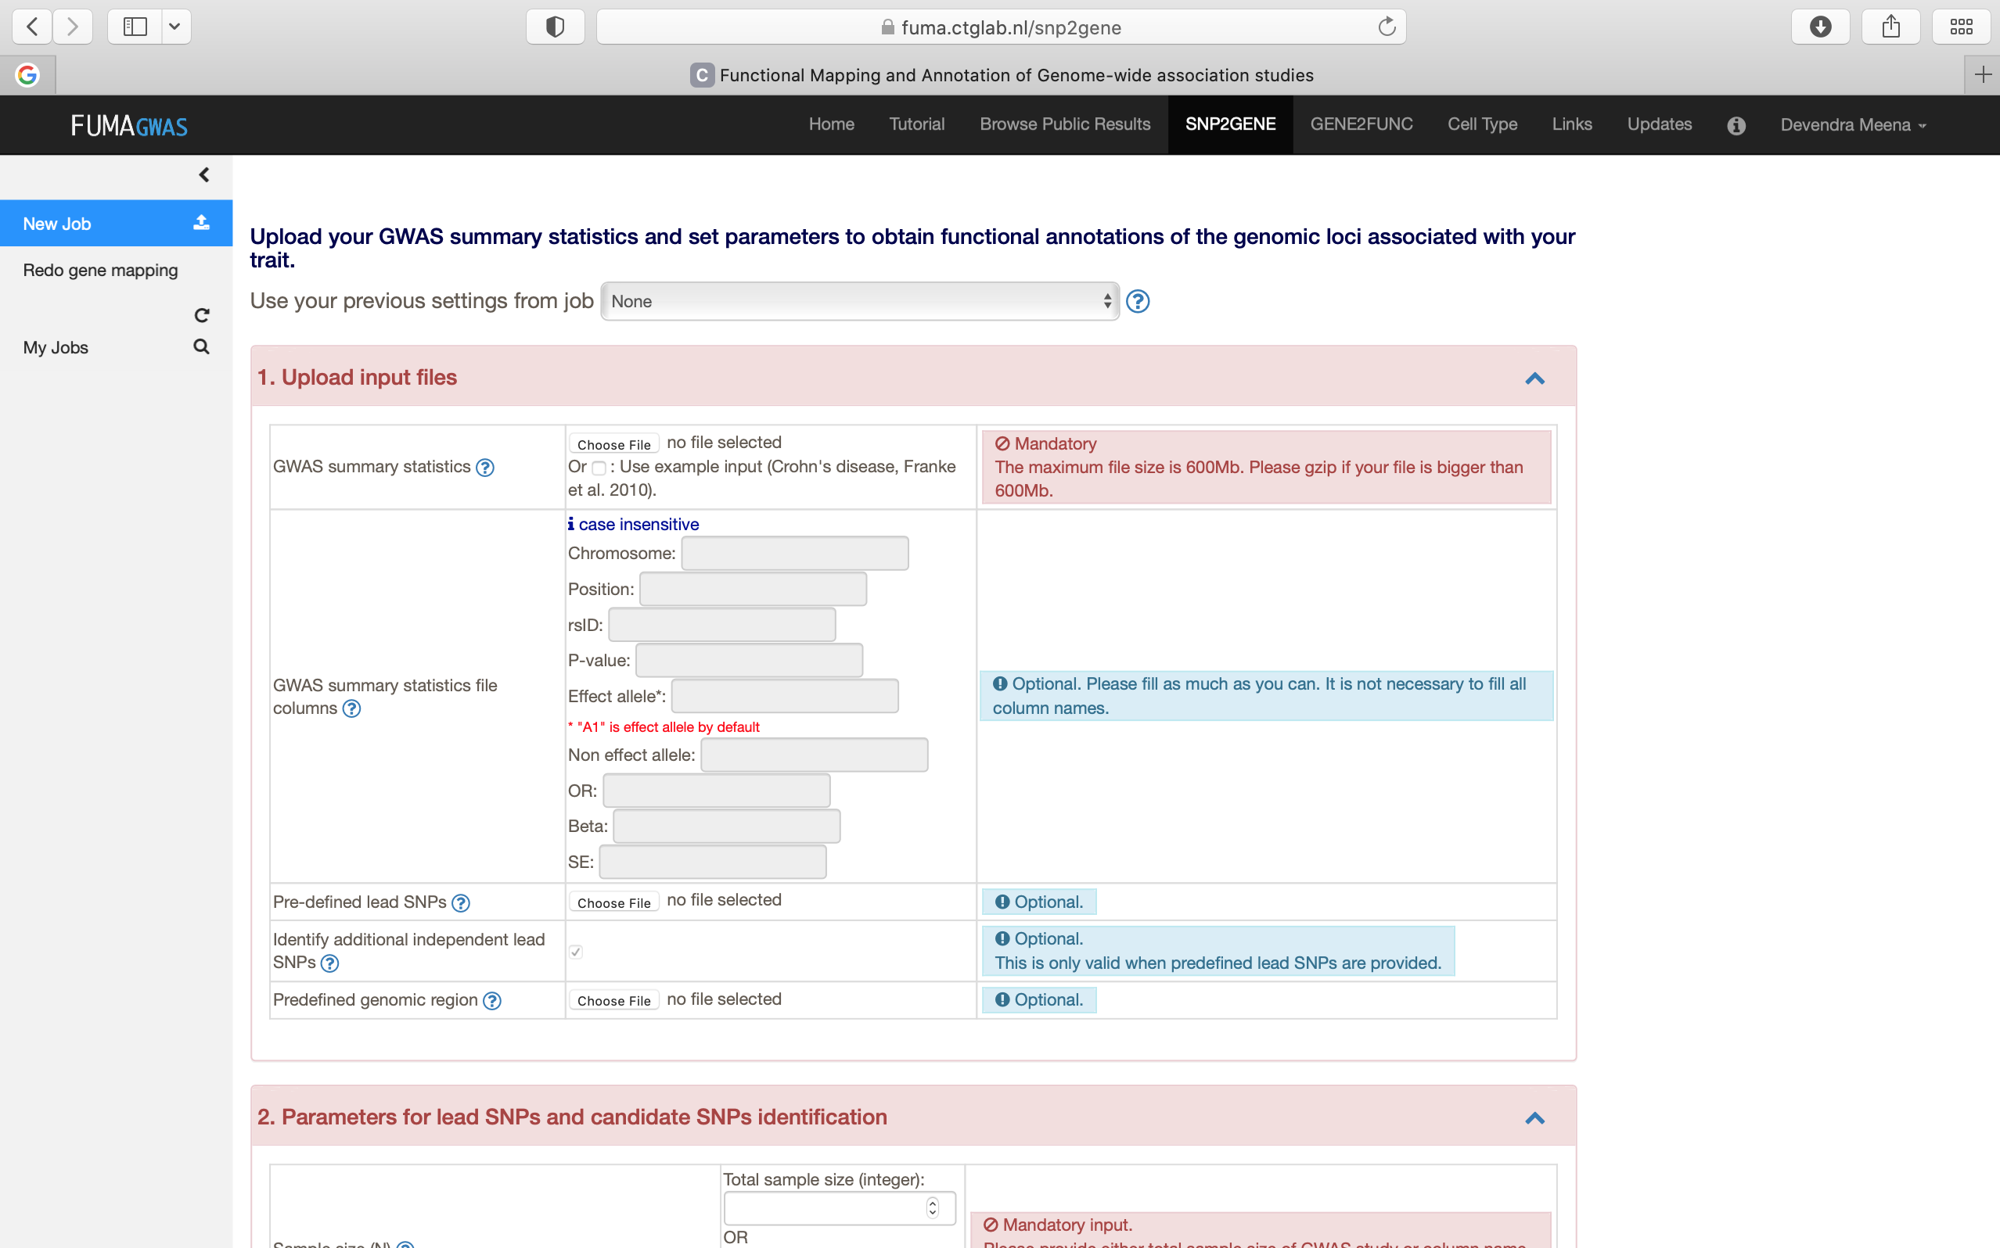

Slide 17
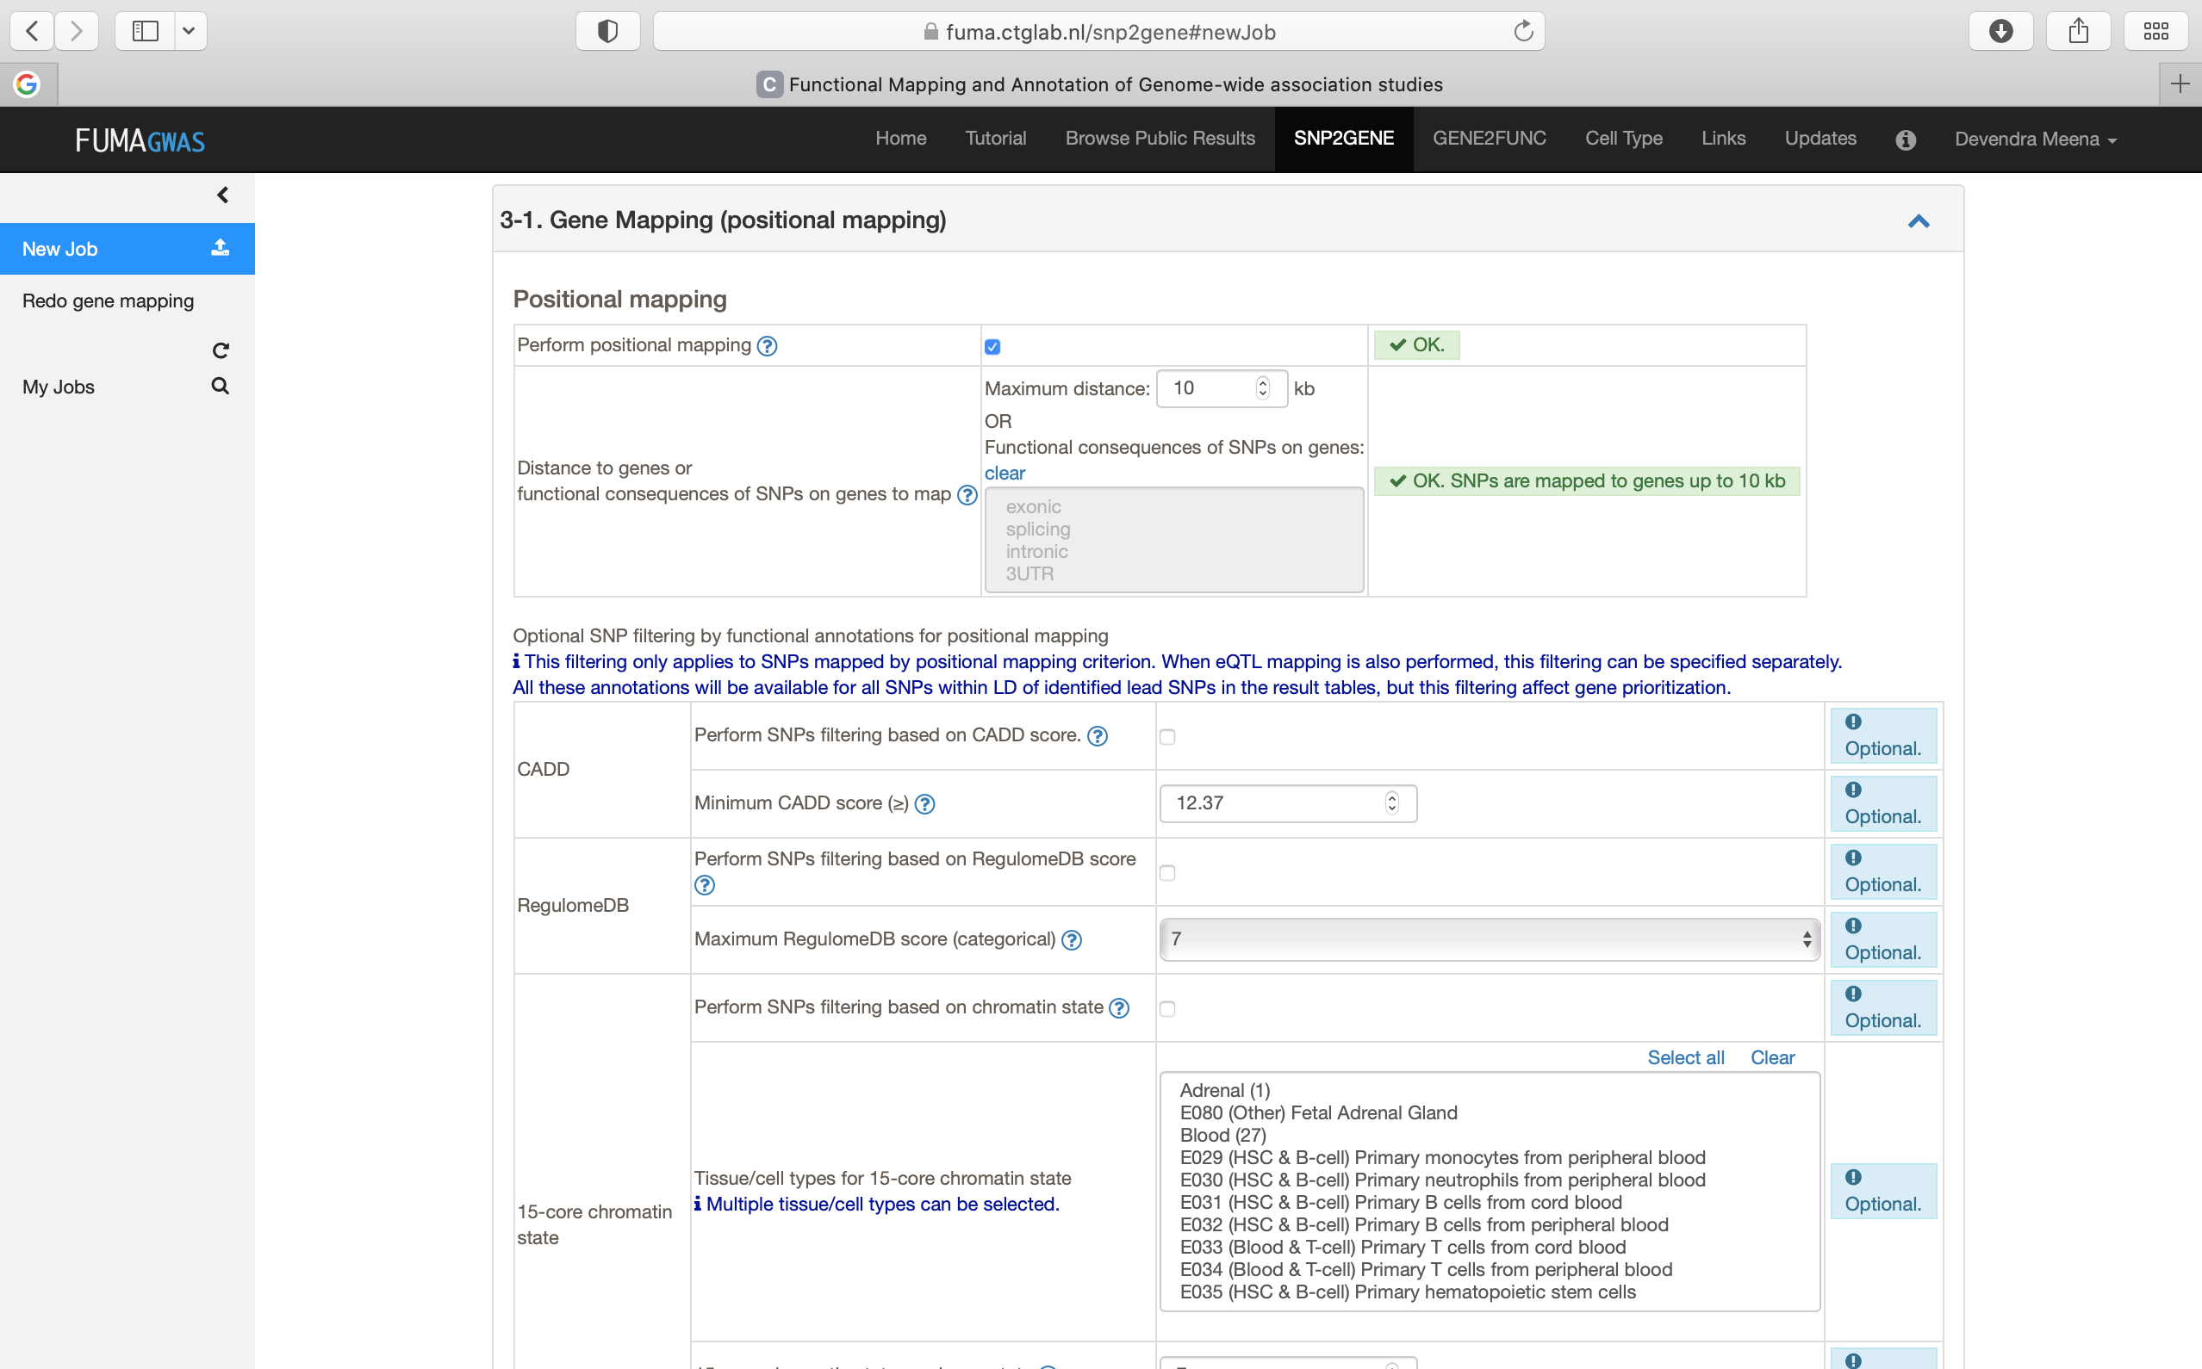

Slide 18
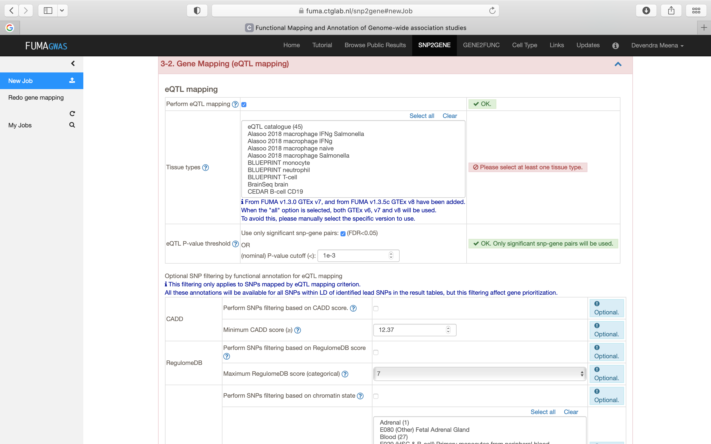

Slide 19
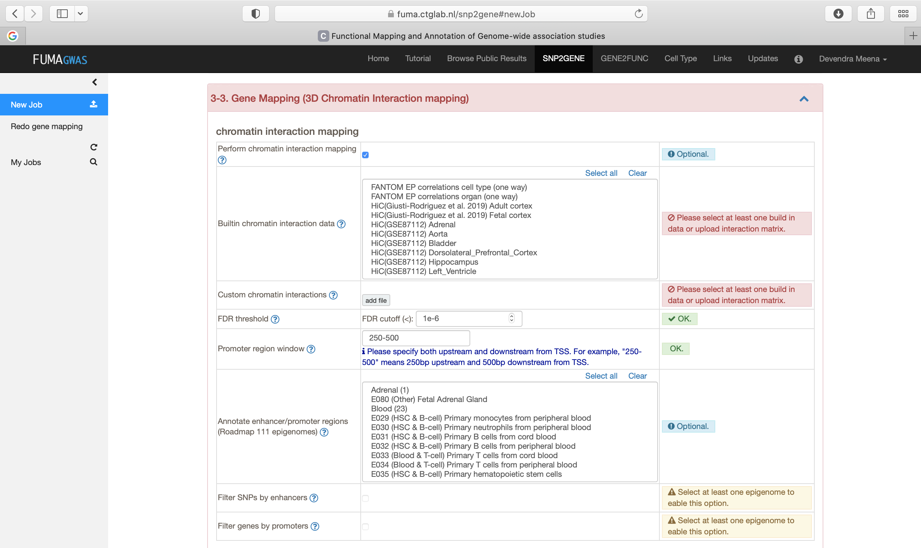

Slide 20
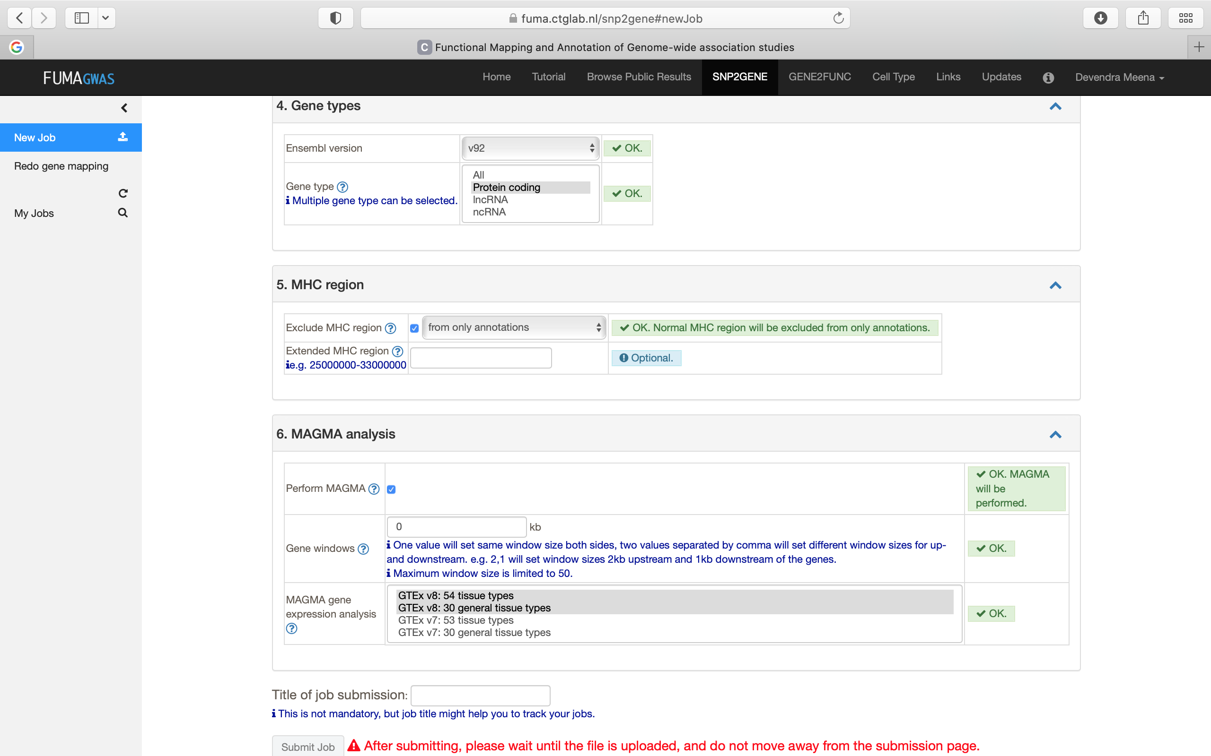

Slide 21
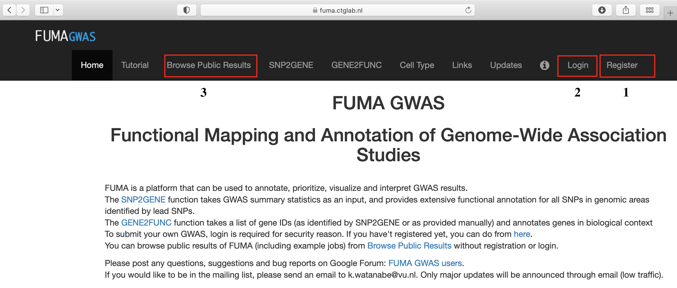
FUMA: registration/login

Slide 22
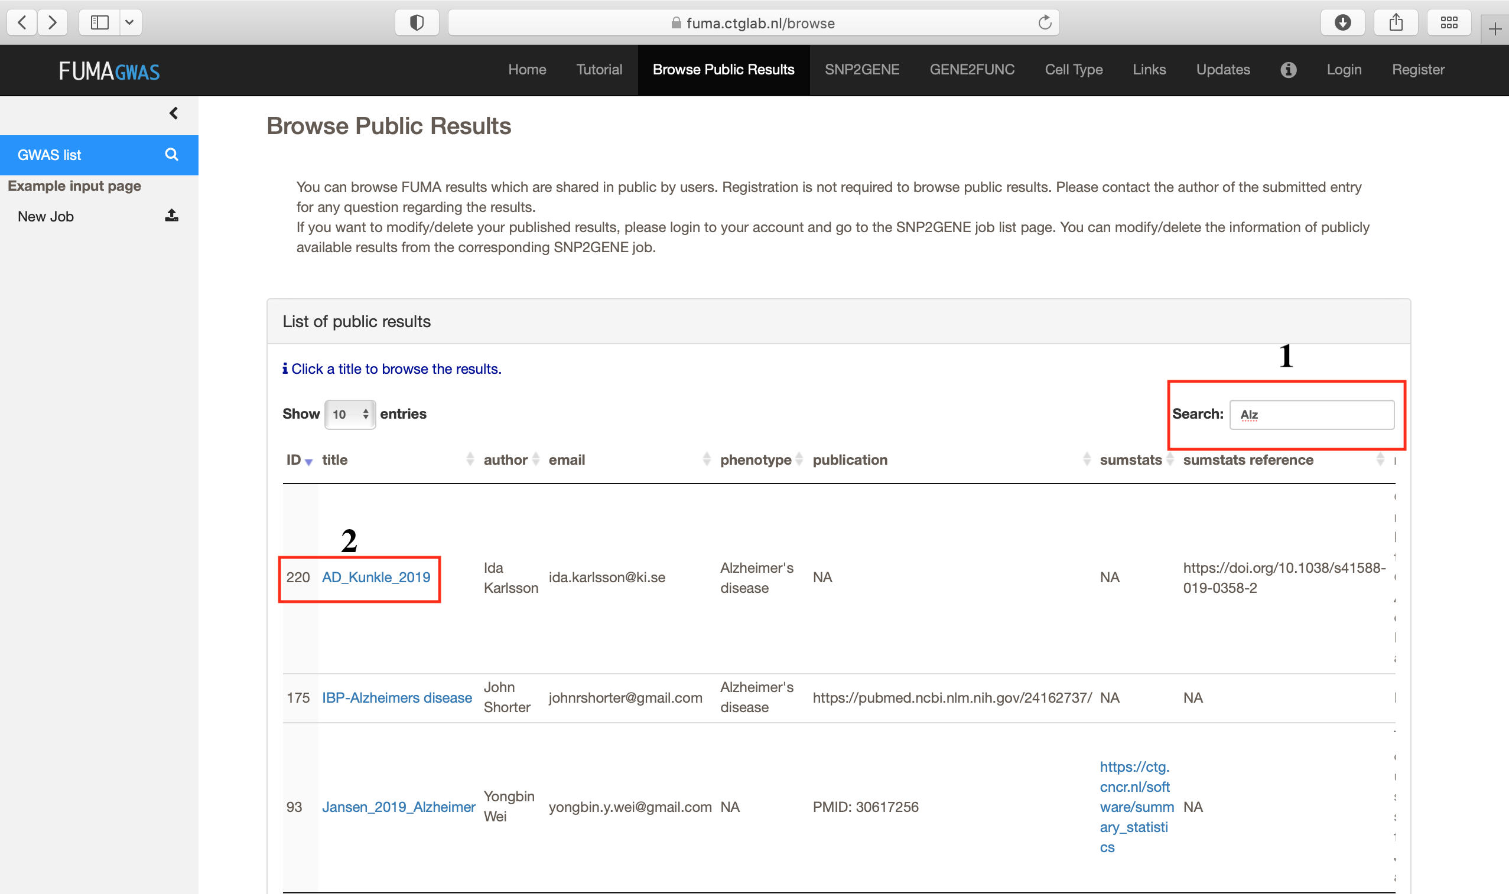

Slide 23
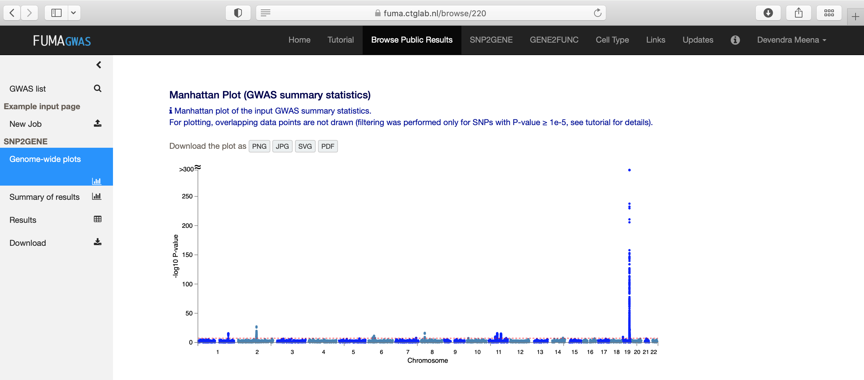

Slide 24
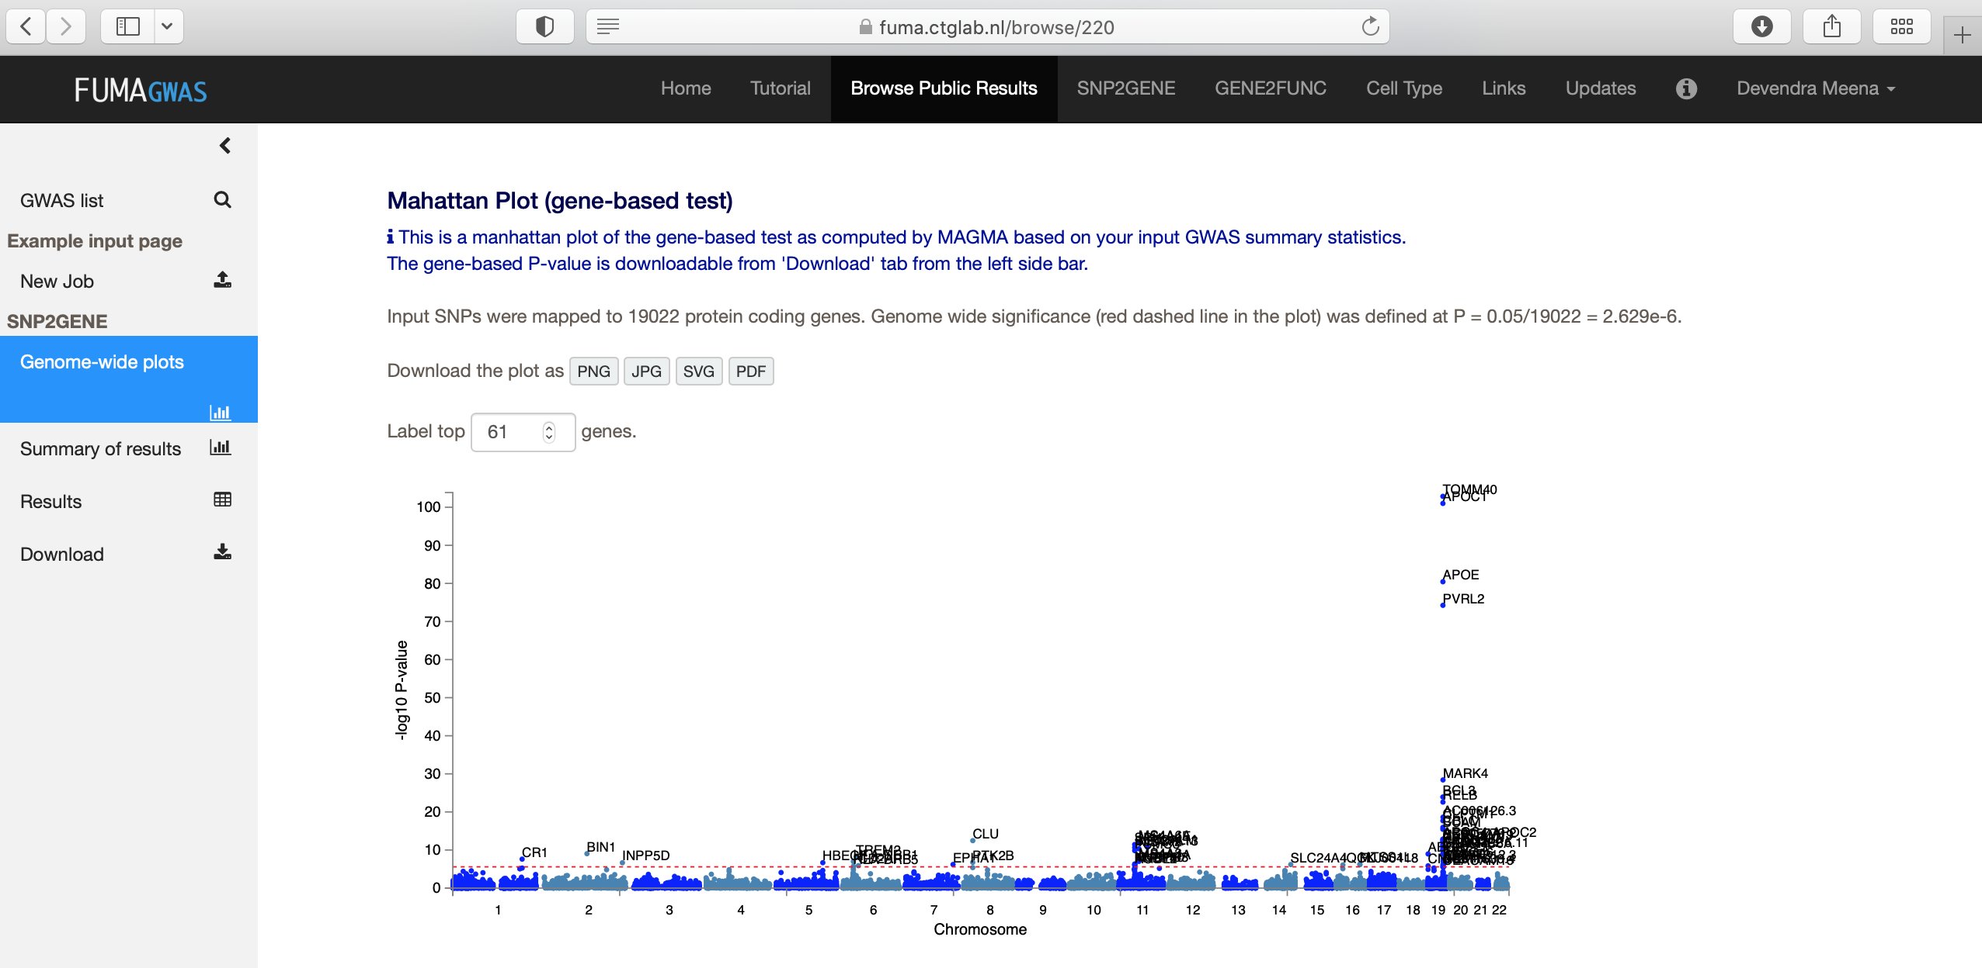

Slide 25
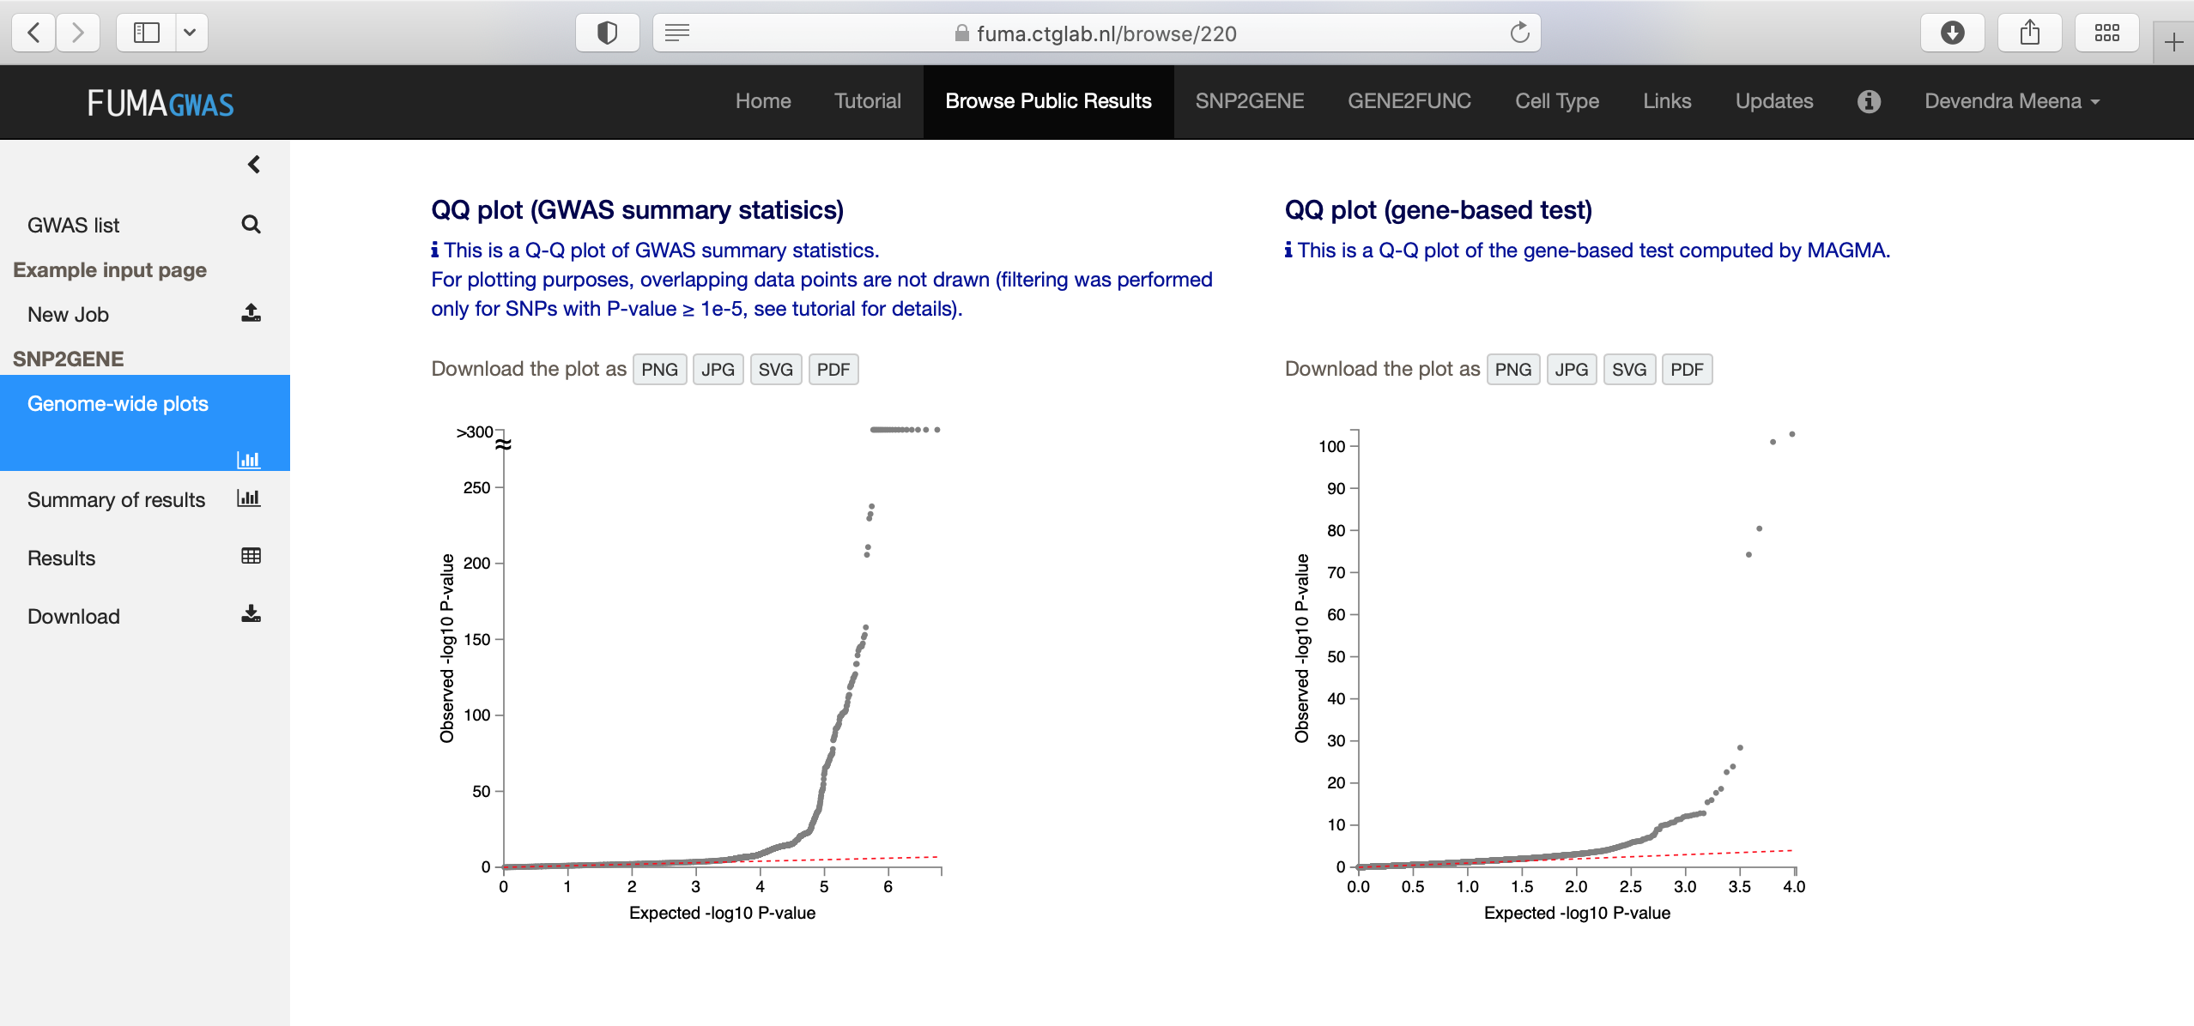

Slide 26
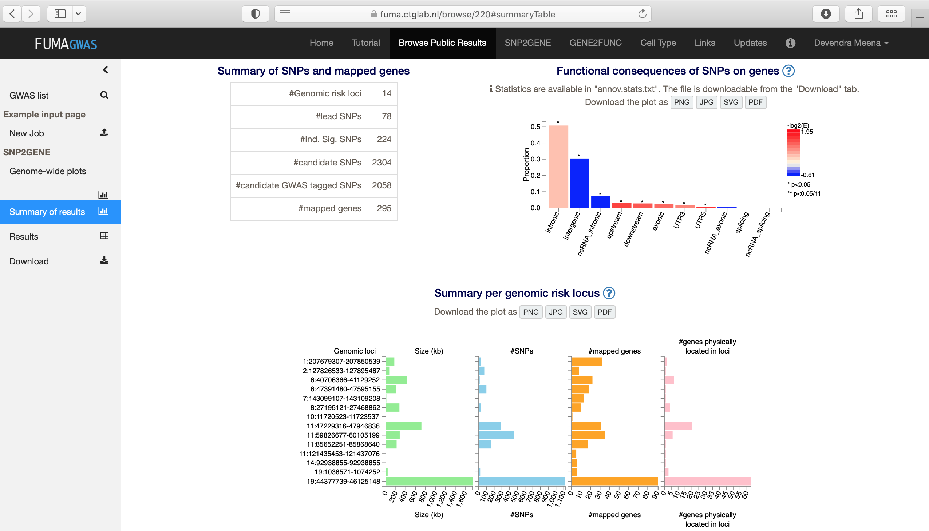

Slide 27
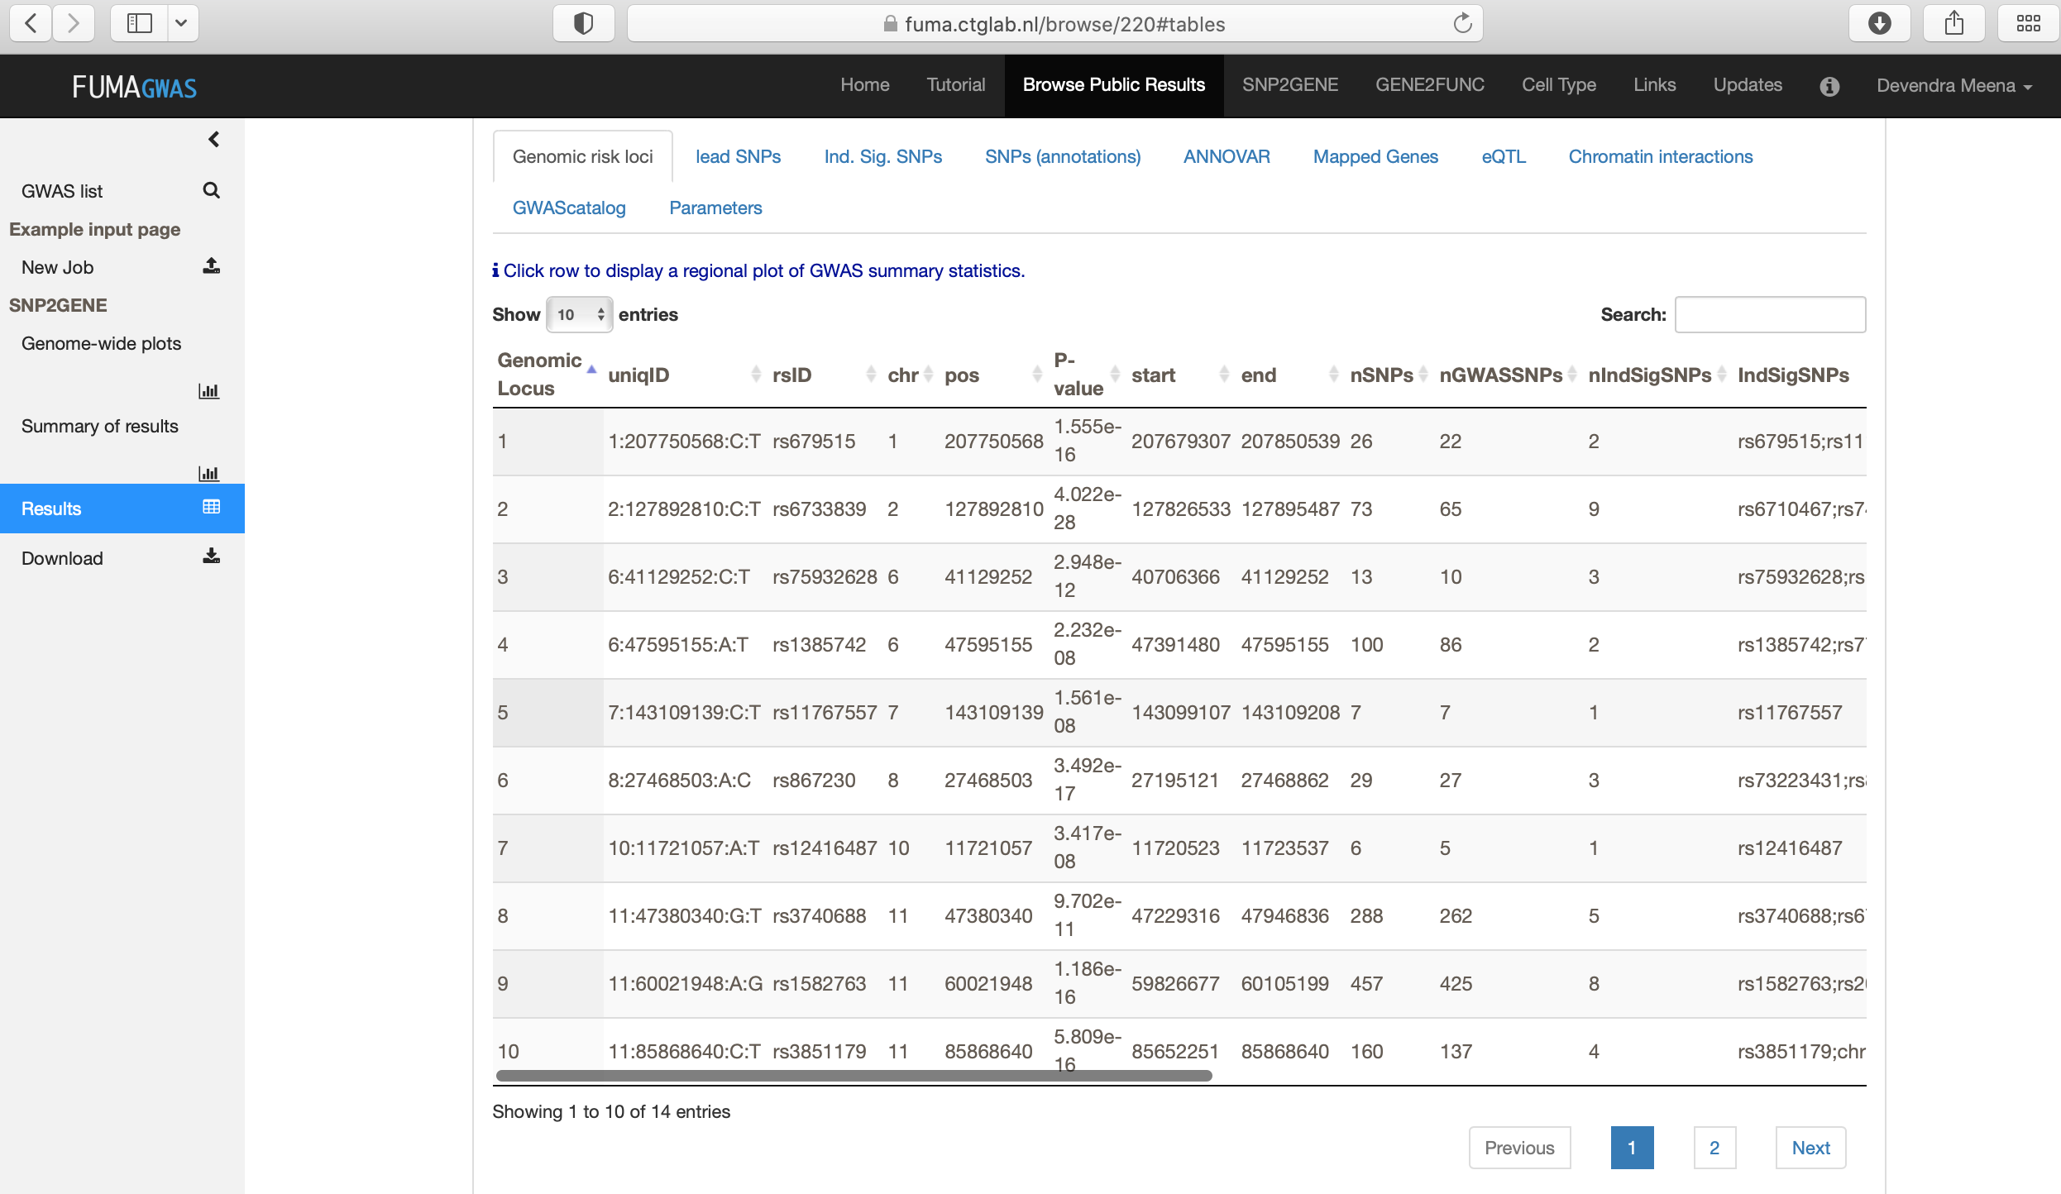

Slide 28
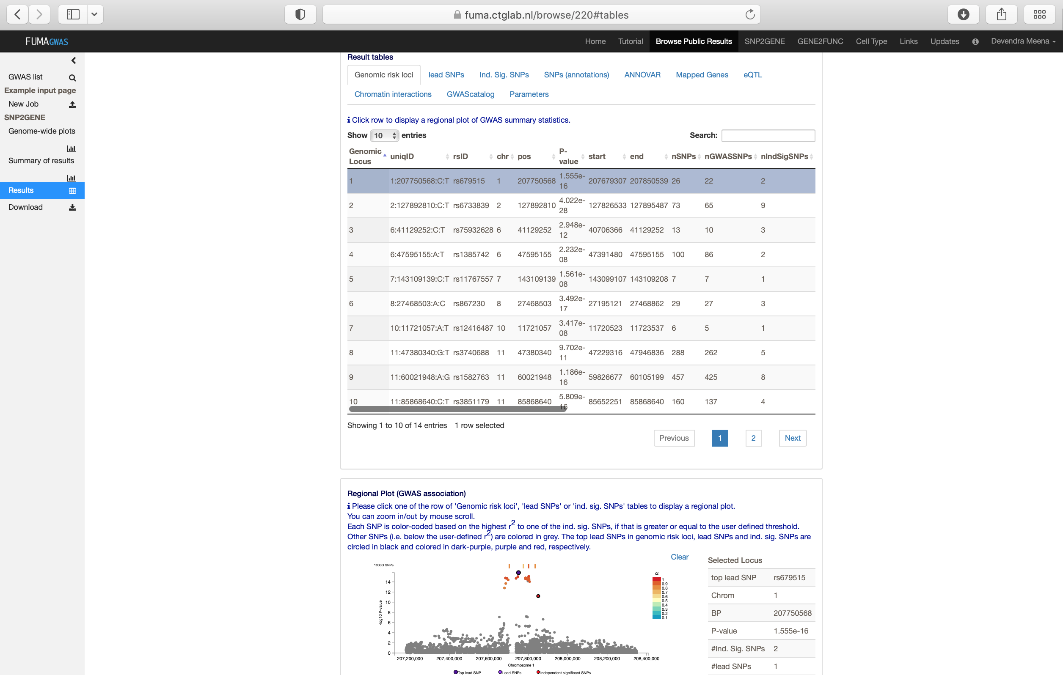

Slide 29
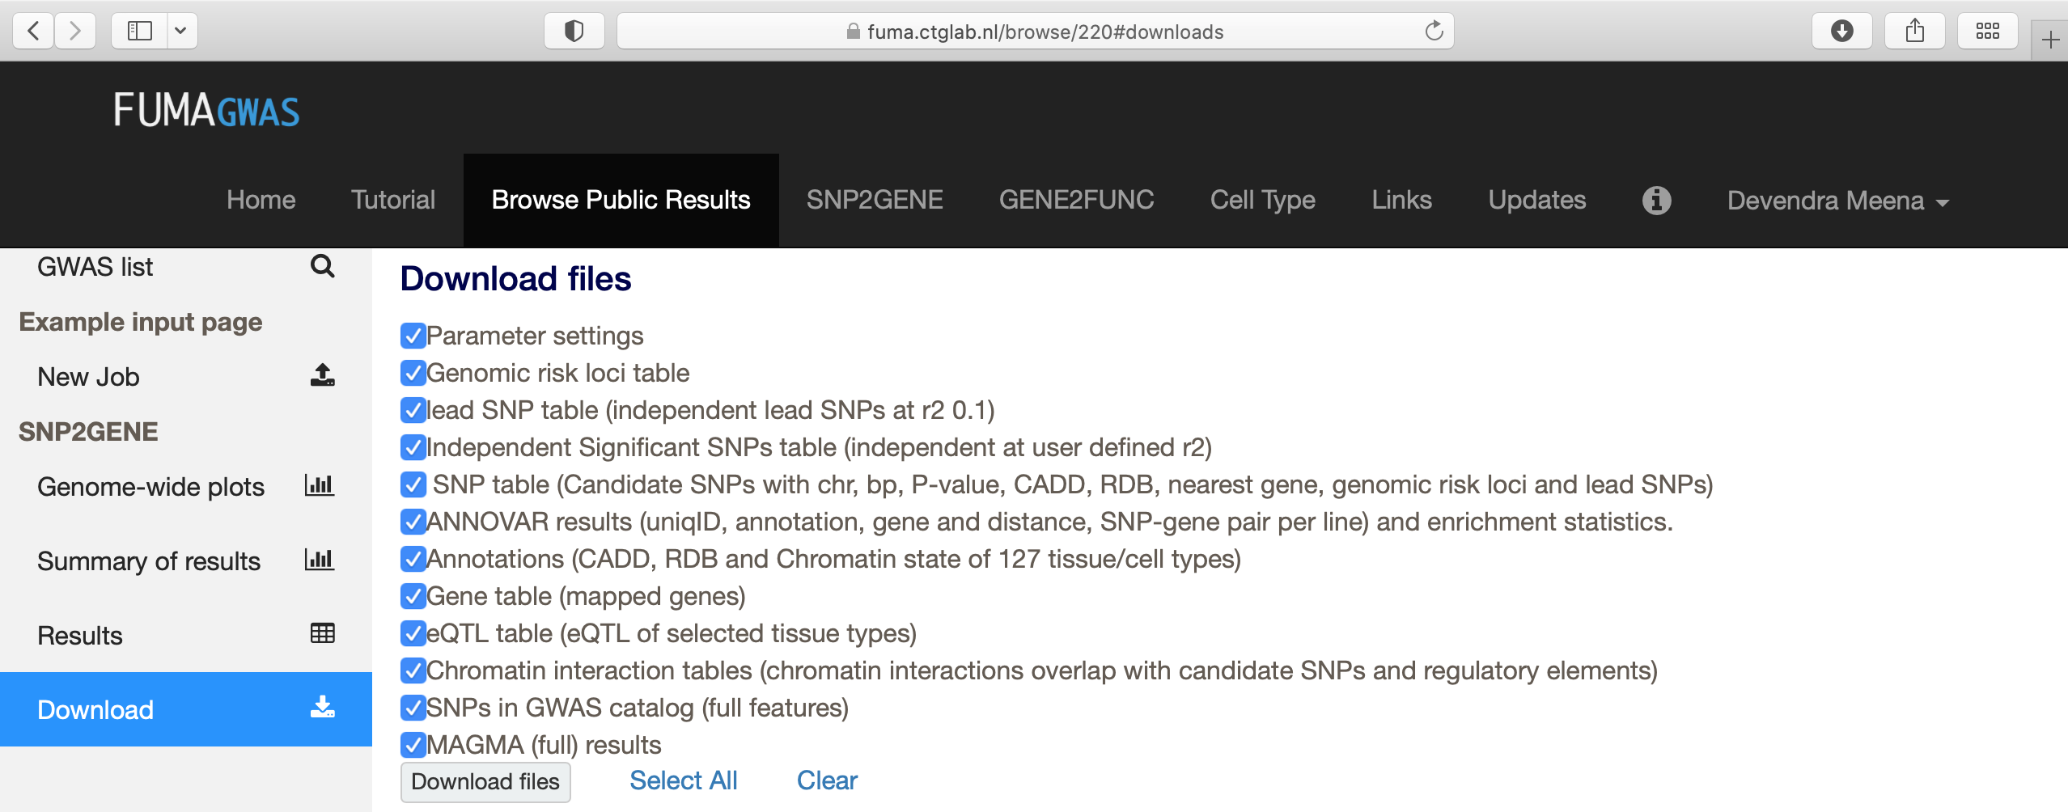

Slide 30
Suggested readings
Genome-wide association studies
  https://www.nature.com/articles/s43586-021-00056-9
Functional mapping and annotation of genetic associations with FUMA
  https://www.nature.com/articles/s41467-017-01261-5

