Slide 1

Study designs in molecular epidemiology
Ioanna Tzoulaki itzoulaki@bioacademy.gr
Director of Research, Biomedical Research Institute Academy of Athens
Professor in Chronic Disease Epidemiology, School of Public Health, Imperial College London

Slide 2
Study design in molecular epidemiology
Snapshot (cross-sectional) and short-term longitudinal studies
Case-Control Studies
Prospective (Cohort) Studies
Studies within prospective designs (e.g., nested case-control, case-cohort)
Studies limited to cases (case-only approaches)

Slide 3
Cross-sectional
Can assess whether a population been exposed to particular compound (level, range, internal/external determinants of exposure)
Evaluate intermediate biological effects (exposure-biomarker relationships), changes in exposure on intermediate endpoints
Can be used to identify early biological effects caused by new exposures

Slide 4
Case-control
Cases reflects all who develop the condition
Controls should represent individuals who would qualify as cases if they developed the disease (not necessarily individuals representative of the entire non-diseased population).
Selection of both groups must be independent of exposure history
Controls: study base, data collection accuracy is uniform, account for confounding through design and analysis, efficiency
Notes:
The study base is the target or source population, a subset of
the general population that is at risk of the exposure and
development of the disease.
Cases and controls should be representative of the same study
base.
• Primary base (e.g., population-based studies)
• Secondary base (e.g., convenience-based ascertainment)
• Studies are not necessarily representative of the general
population
• Membership of the base is dynamic
• Typically a source of cases is identified first, that is used to
define the study base from which controls can be recruited
Need to control for potential confounding effects in
case-control comparisons
• Individual matching
• Frequency matching
• Restriction
• Statistical adjustment
• Matching can reduce the variance of the factors under
study as well as other factors of interest resulting in
inefficiency.
• Finding matches can make enrollment difficult and time
consuming.
• It is generally not possible to study the effects of the
variables used in matching, possibly making the study less
informative.
• Matching on a factor in the causal pathway can result in
inefficiency and (statistical) bias.
All sources of measurement error should be similar for cases
and controls.
For molecular studies, this requires standardisation of:
• Sample collection
• Sample processing
• Sample storage.
Different procedures for cases and controls undermines the
principle of comparable accuracy.
For example, if biosamples for several controls are taken over
the course of a day, and processed as a batch at the end of the
day, this will not be comparable to biosamples taken from
cases and processed immediately.
Case-control comparisons are more efficient when:
• There is a broad distribution of values for the major
exposure variable(s)
• A narrow range of values for nuisance variables, or a
balance in cases and controls
Matching should be used with caution (can reduce variance of
the exposure as well as nuisance variables).
Standardised protocols for sample collection, processing, and
storage reduce nuisance variation.

Slide 5
Case control advantages
• Can be used to assess aetiology/disease risk-factors
• Efficient: The study sample has an over-representation of
participants with the disease of interest. No need to
follow individuals over a long period of time
• Able to obtain detailed data (e.g., expensive assay data) on
mostly informative individuals
Can be useful in the study of rare diseases/outcomes

Slide 6
Case control limitations
Inability to assess temporality in any direct way
Length biased sampling – overrepresentation of cases with long duration (e.g., less severe disease).
Non-participation bias if differential in relation to exposure and case-control status
Inaccurate measure of exposure, as it is measured at time of disease (reverse causality and inaccuracy)

Slide 7
Cohort studies
Begin with disease-free individuals and track over time
Compare disease development across exposure levels
Ideal for capturing time-based risk relationships in observational research
Combine biospecimen collection with long-term follow-up
Enable integration of data science, lab techniques, and epidemiology
Require forward-looking planning for sample use and lab compatibility

Slide 8
Nested case-control and case-cohort
Typically molecular studies are not conducted using entire cohort studies.
Inefficient and too expensive to run assays on an entire cohort
Excessive use of precious biological samples

Slide 9
Nested case control
Identify cases from a cohort over time
Match each case to one or more disease-free controls from the same timeframe
Often used with incidence density sampling
Matching factors can include age, sex, etc.
Use conditional logistic regression
each case is compared only with their matched control(s). Since the matched controls are representative of the risk set at the time of diagnosis of the case, conditional logistic regression estimates (log) incidence rate ratios.
Notes:
Cases of a disease that occur within a cohort are identified
and, for each case, an individual or individuals are
identified as controls from among other participants in
the cohort who at that same period of follow-up were
disease free; i.e., individually matched to the case based
on time. Controls are selected using random sampling
without replacement from each risk set.

Slide 10
Case cohort I
Cases are all incident cases in the cohort (or a random sample of cases)
Reference group is a random sample of all participants in the cohort defined at baseline
Sampling Fractions are the proportions of the eligible cohort selected for inclusion in the reference group. Because the sampling fractions are known, it is possible to stratify the selection of subjects (e.g., using stratified random sampling), to over-sample on relevant characteristics (e.g., sex or race), to have adequate power to address relevant questions.

Slide 11
Case cohort II
Survival/time to event models (Cox models)
There are different ways of weighting the data to account for the design.
Use a single representative subsample as the reference group for multiple case groups (different types of disease outcomes)
Case-cohort includes a representative sample of the full cohort, so it can be used to estimate e.g. the distribution of a biomarker in the population
Care needs to be taken around biomarker measurement in both study designs
Notes:
if
the reference group is assayed all at once at the beginning
of the study, and the cases are assayed after a sufficient
number have accrued during follow-up.

Slide 12
Case-series
Studies which include only cases of a disease can be used to study disease outcomes, or factors associated with different disease features. These studies can be referred to as case-series and clinical cohort studies, among other names.
Can be analogous to cross-sectional or cohort studies

Slide 13
An introduction to omics
Ioanna Tzoulaki itzoulaki@bioacademy.gr
Director of Research, Biomedical Research Institute Academy of Athens
Professor in Chronic Disease Epidemiology, School of Public Health, Imperial College London

Slide 14
Understand the importance of newly emerging technologies that are being currently applied in population-based study designs
Describe the application of newly emerging ‘omics’ technologies in molecular epidemiology research
Understand some of the major issues relating to the generation and analysis of high-density molecular data
Understand that biomarker studies often lead to the generation of high density data sets and are prone to false positive/negative findings
Understand that the false discovery rate is an important concept for molecular epidemiology research and the design of studies that limit its impact is an important issue for researchers
Learning Outcomes

Slide 15
Emerging Biomarkers in Epidemiologic Research
Until recently most molecular epidemiologic research was restricted to assessment of several individual biomarkers in relation to particular exposure/endpoint.
Major developments in molecular biology and technologies (and decreasing costs) have enabled measurement of hundreds and thousands of biological measurements in high throughput manner....’omics’
Presents new challenges to epidemiologists and statisticians
Notes:
Τα τελευταία χρόνια, ραγδαίες τεχνολογικές εξελίξεις έχουν διαμορφώσει πειραματικές και υπολογιστικές μετρητικές τεχνολογίες υψηλής απόδοσης με συνακόλουθη συγκέντρωση μεγάλου όγκου πολύτιμων πειραματικών δεδομένων μεγάλης διαστασιμότητας, προερχόμενων από διαφορετικά ιεραρχικά επίπεδα βιολογικής οργάνωσης.

Slide 16
Emerging Biomarkers in Epidemiologic Research
Only tiny fraction of all information obtained from ‘omics’ analyses likely to have relevance to end-point under study
Sorting out signal from noise is major focus...’data-mining algorithms’....test-retest procedures
Deviation from hypothesis-driven research -> agnostic/data-driven research
Notes:
Διαχωρισμός σήματος από το θόρυβο..."αλγόριθμοι εξόρυξης δεδομένων"...διαδικασίες δοκιμής-επανεξέτασης
Απόκλιση από έρευνα με γνώμονα την υπόθεση -> αγνωστική/δεδομένη έρευνα

Slide 17

Complex (or multifactorial) diseases
• Multifactorial Diseases are different from:
• Genetic disorders: risk is not only driven by genetic variation
• Infectious diseases: not induced by a pathogen
• Multifactorial Diseases :
• Do not have a single genetic cause
• Their risk is not only driven by genetic variation
• Are likely associated with the effect of:
• Multiple genes
• Lifestyle and environmental factors
• Foetal programming (?)

Slide 18
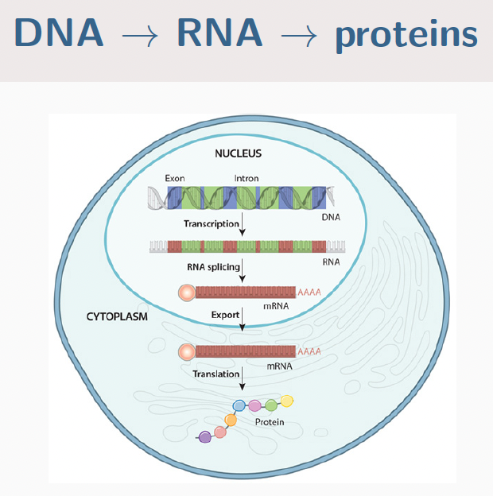
The ‘central dogma’ of molecular biology
Research question: How to explore gene expression and its regulation?
General view: ‘DNA makes RNA makes proteins’
How does the information can be transmitted and possibly distorted?
General transfers of information
1. Replication (DNA → DNA)
2. Transcription (DNA → RNA)
3. Translation (RNA → proteins)

Slide 19
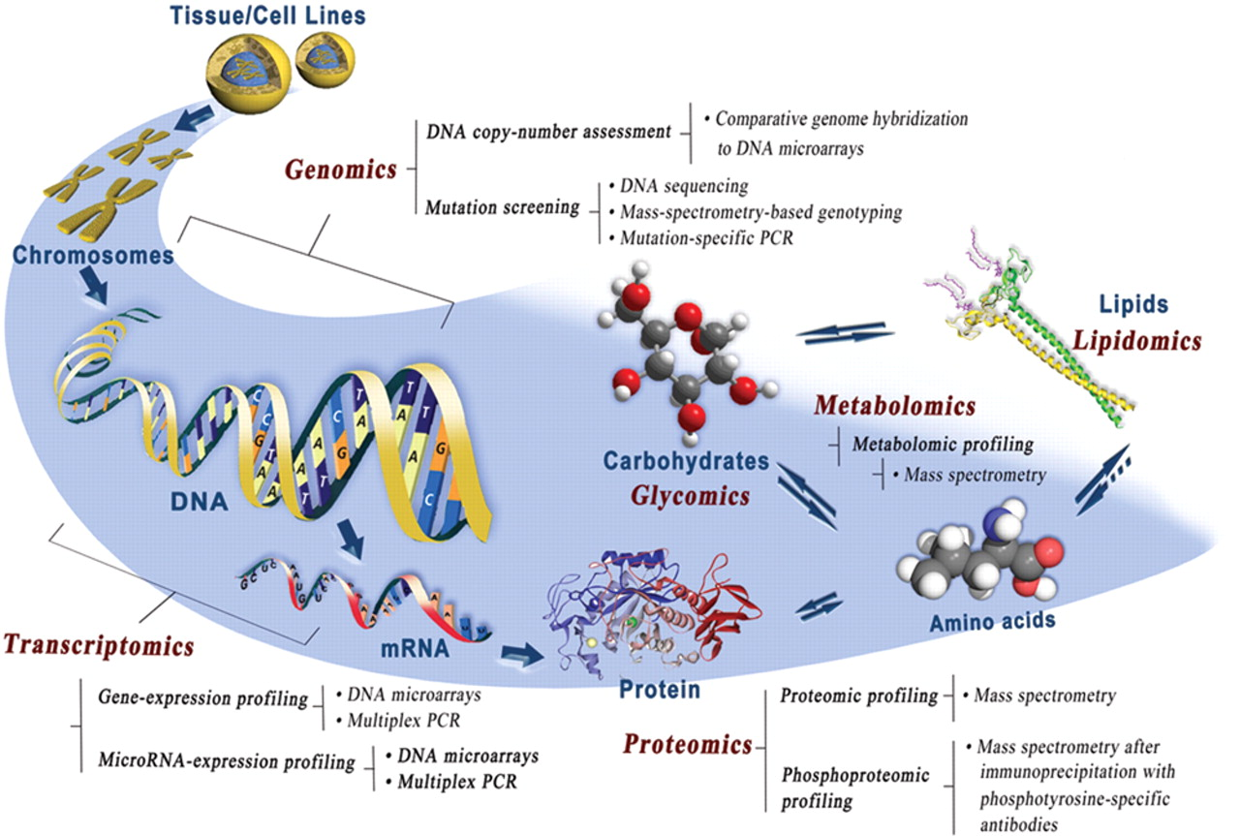

Slide 20
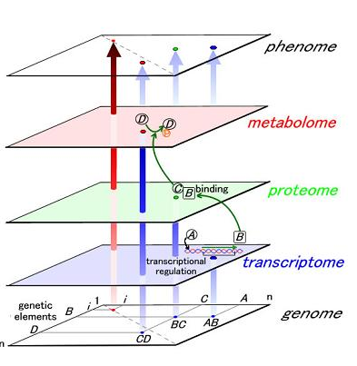
Notes:
Ο όρος -ομικές επιστήμες(x-omics)περιγράφει πειραματικές τεχνολογίες υψηλής απόδοσης και ολοκλήρωσης που παρέχουν δεδομένα σε μοριακό επίπεδο, και υπαινίσσεται μεγάλο όγκο δεδομένων και ολιστική θεώρηση.
Γεφυρα μεταξυ φονοτυπου και φαινοτυπου
διαφορετικά ιεραρχικά επίπεδα βιολογικής οργάνωσης

Slide 21
Definition of “Omics” Terms
Genome. The complete set of genetic material of a cell or organism.
Genomics The study of the genome.
Proteomics The study of the entire set of proteins in a cell or organism.
Metabolomics The study of the complete set of low-molecular weight metabolites in a cell or organism at any one time.
Transcriptomics. The study of mRNAs produced by a cell or a population of cells. This is the total expression of the genes in that cell or population of cells.
Epigenetics Changes in gene expression that are NOT due to changes in DNA sequence. Epigenetic changes include methylation of DNA (which represses gene expression), acetylation of histones (which enhances gene expression), and micro-RNAs (22-base RNAs).
Proteome, metabolome, transcriptome

Slide 22
Genomics
Methods
• Targeted: pre-identified variable regions
• Single-nucleotide polymorphisms (SNPs): known DNA loci where there is some genetic variation
• Copy-number variations (CNVs): repeated sequences and the number of copies may vary across individuals
• Partly targeted: exome sequencing
• Untargeted: whole genome sequencing
→ enables the identification of novel variants (e.g. useful for rare diseases)
Notes:
Γονιδίωμα αναφοράς
Υψηλή αναπαραγωγιμότητα

Slide 23
Genomics
Outputs
•Targeted: alleles or copy number
Statistical analysis is straightforward
Partly targeted and untargeted: sequence reads
→ Must map to reference genome
Feasibility
• Low price
• High reproducibility
→ Targeted Genomics (10⁹ variables) can be pooled and measures in huge populations

Slide 24
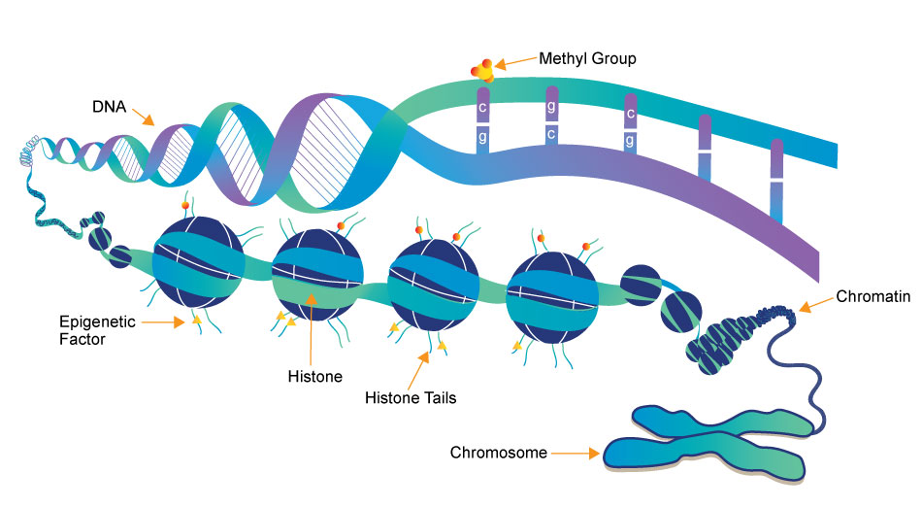
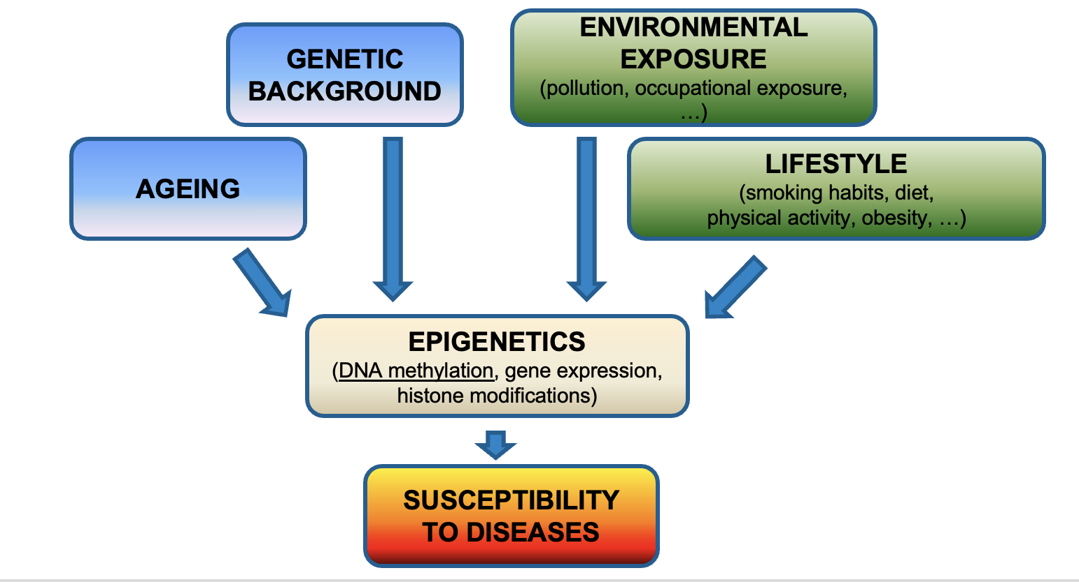
Epigenetics
DNA methylation:
Methyl groups (–CH3) attached to cytosines
Usually (but not exclusively) in C followed by G (CpG loci)
Most CpG loci clustered in dense ‘CpG islands’
Effect on transcription dependent on location
Notes:
Η επιγενετική, όπως και η γενετική πληροφορία, κληρονομείται, αλλά σε αντίθεση με τη γενετική πληροφορία, είναι αναστρέψιμη (επιγενετική πλαστικότητα) και δύναται να επηρεαστεί από διάφορα ερεθίσματα ή περιβαλλοντικούς παράγοντες
Η επιγενετική κατάσταση του γονιδιώματος (επιγονιδίωμα) μεταβάλλεται δυναμικά στα κύτταρα των διάφορων ιστών, σε αντίθεση με την ακολουθία του DNA, που παραμένει σταθερή, και χρησιμοποιώντας ένα μεγάλο αριθμό ενζύμων σε συντονισμό μεταξύ τους, ρυθμίζει την έκφραση των γονιδίων και διαμορφώνει διαφορετικούς φαινοτύπους σε διαφορετικά κύτταρα.
Οι κύριοι επιγενετικοί μηχανισμοί που διαμορφώνουν την επιγενετική κατάσταση του γονιδιώματος περιλαμβάνουν:
❖ τη μεθυλίωση του DNA
❖ την τροποποίηση των ιστονών
❖ τα μη κωδικοποιούντα RNAs
Mετατροπή της κυτοσίνης του DNA σε 5-μεθυλοκυτοσίνη με τη δράση του ενζύμου DNA μεθυλάση
Στους υποκινητές των γονιδίων (νησίδες CpGs) έχει ως αποτέλεσμα τη μεταγραφική τους σιγή και την αναστολή έκφρασης της γενετικής πληροφορίας, διαδραματίζοντας βασικό ρόλο στην κυτταρική διαφοροποίηση και την ανάπτυξη του εμβρύου, στην απενεργοποίηση του Χ χρωμοσώματος και στο μηχανισμό της γονιδιακής αποτύπωσης
methylation turns genes “off”

Slide 25
Epigenomics: DNA methylation
Method
Create polymorphisms at methylated cytosines using bisulphite conversion (C → U/T, me-C → C). Then sequenced using genomic methods
Output:
Percentage of methylated cytosines at CpG loci of interest
Average over many cells, possibly of different types
Sequence reads must again be mapped to reference genome
Commercially available microarrays can measure DNA methylation at 100 thousands of CpG loci at feasible costs (~£300/sample) enabling increasing use in epidemiology
Notes:
Gene‐specific analysis
– How much methylation at or nearby a candidate gene
Global methylation content
– How much methylation in a test DNA, regardless of the position
Genome‐wide scans – Microarrays, Next Generation Sequencing
Μικροσυστοιχίες

Slide 26
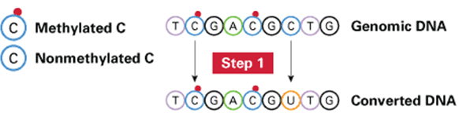
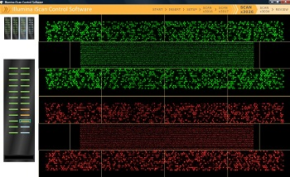
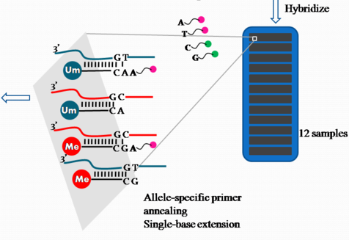

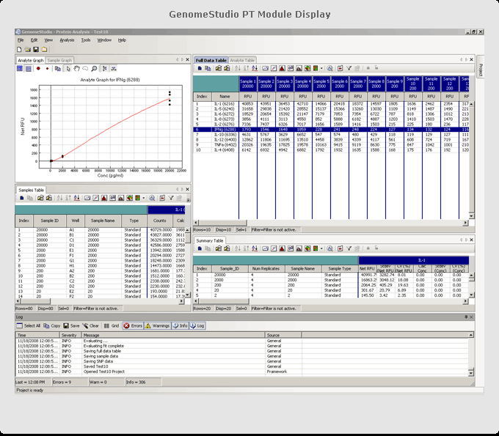
Measuring Genome-Wide DNA Methylation using Illumina arrays
Bisulfite conversion
Infinium HD 450K methylation array:
Single experiment -> DNA methylation percentage of ~450k markers simultaneously

Slide 27
Epigenomics: DNA methylation
Output
Percentage of methylated cytosines at each CpG locus
Statistical analysis is (more or less) straightforward, Epigenome wide association studies, Data reduction methods to reduce number of features, Variable selection procedures
Feasibility
• Good reproducibility
• However tissue heterogeneity may confound measurements
→ possibility to pool data
Notes:
Data reduction methods to reduce number of features:
a priori select CpGs of interest
group CpGs by biological pathway or “differentially methylated region”
data driven methods to reduce to fewer ‘latent variables(Principal Component Analysis, Partial Least Squares)
summary scores (eg Hovarth’s biological age score)
Variable selection procedures:
Algorithms to select features into single models e.g. penalised regression techniques (Lasso, ridge regression, elastic net) -> ”surrogate markers”

Slide 28
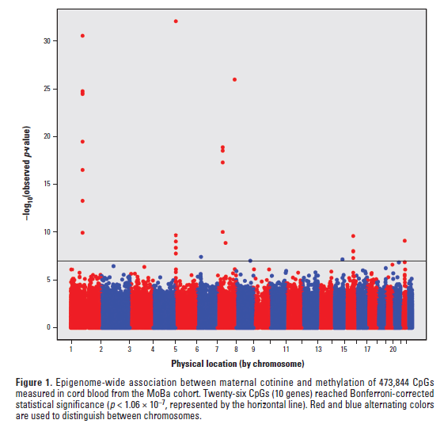
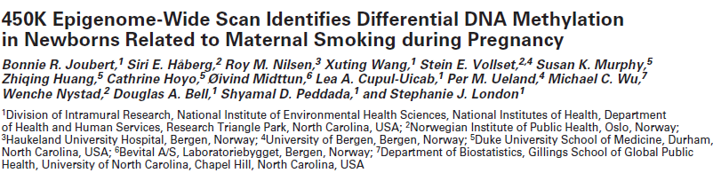
Effects of smoking on DNA methylation
450K scan in 1062 MOBA blood cord samples with maternal plasma cotinine.
Identified and replicated methylation of 3 genes: AHRR, CYP1A and GF11
Notes:
https://www.ncbi.nlm.nih.gov/pmc/articles/PMC3491949/

Slide 29
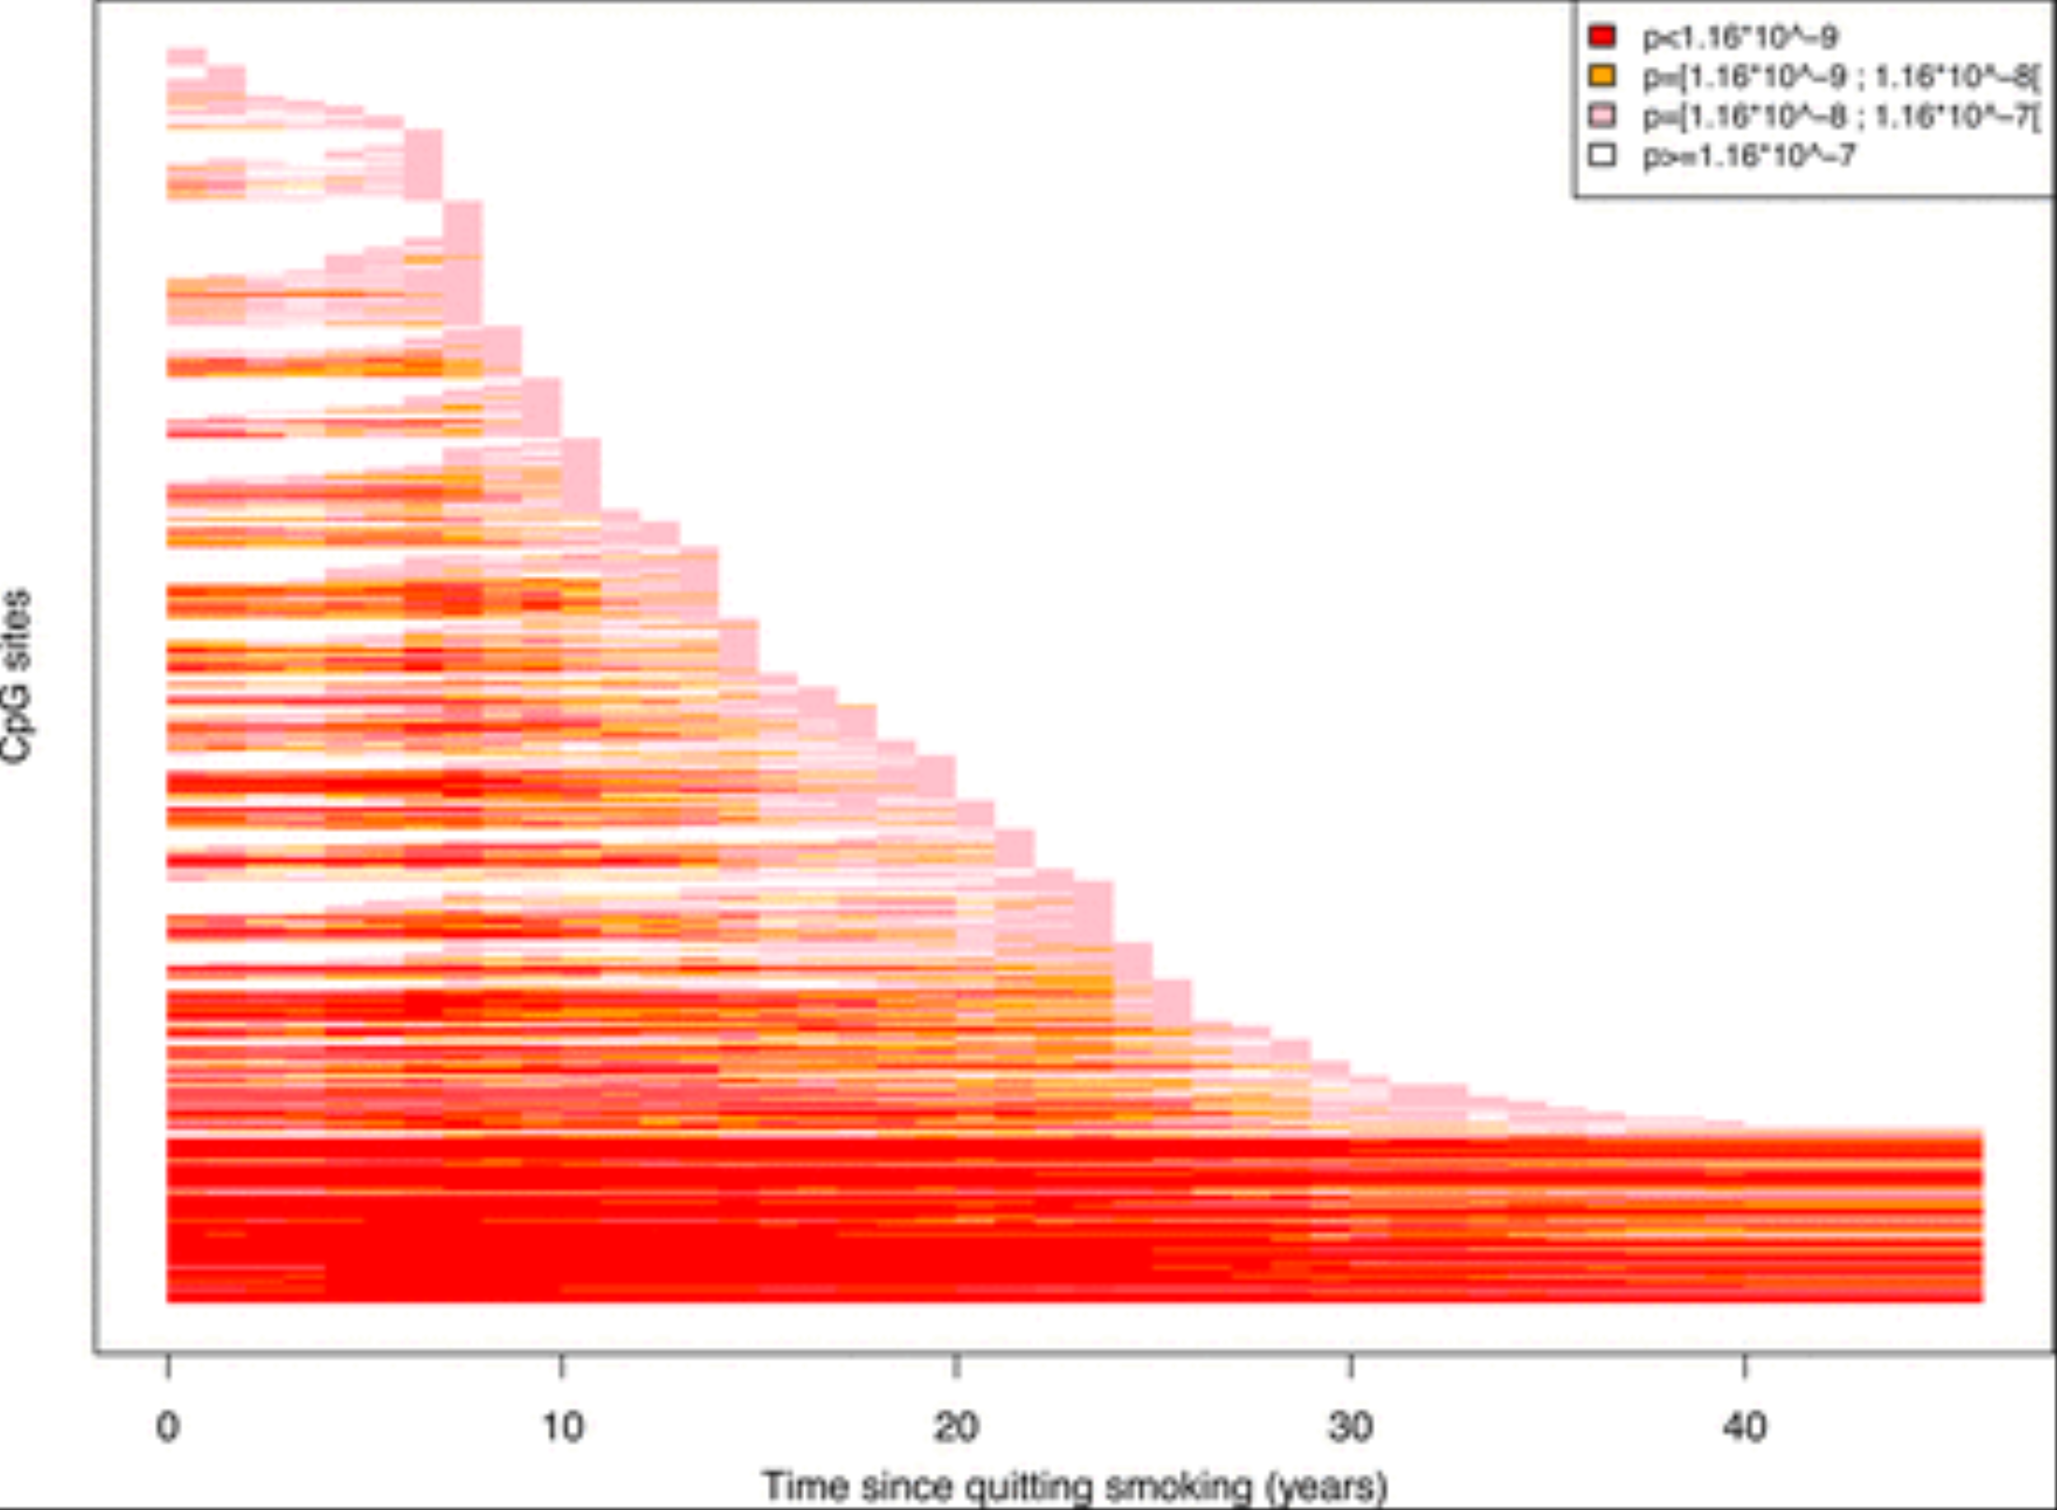
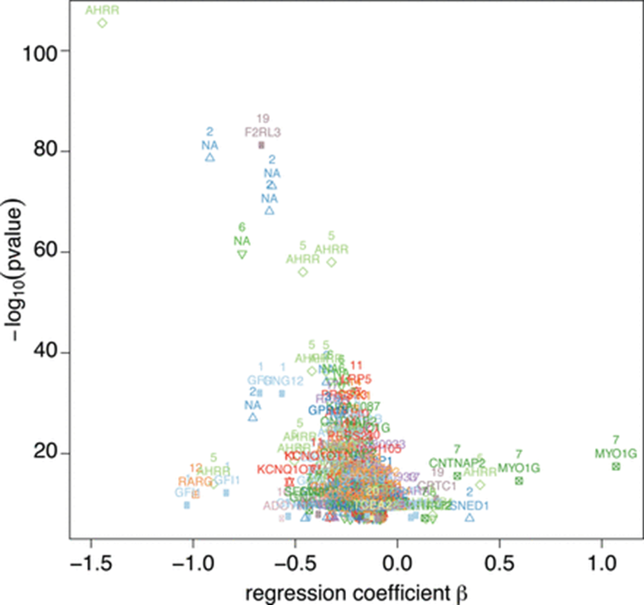
Effects of smoking on DNA methylation
745 blood samples from Italian EPIC-Italy cohort and the Norwegian NOWAC cohort),
From: Dynamics of smoking-induced genome-wide methylation changes with time since smoking cessation
Hum Mol Genet. 2015;24(8):2349-2359. doi:10.1093/hmg/ddu751
Hum Mol Genet | © The Author 2015. Published by Oxford University Press. All rights reserved. For Permissions, please email: journals.permissions@oup.com
Notes:
Description of CpG sites significantly associated with smoking status. Summary of the significant associations found at a Bonferroni 5% level (significant threshold is 0.05/432 414 = 1.16 × 10⁻⁷). Each significant association is represented by its strength as measured by its P-value (Y-axis on the −log₁₀ scale), and its effect size (X-axis, linear regression coefficient β). Associations are colour-coded with reference to the chromosome the CpG sites are located on. Results are presented for the analyses comparing current with never smokers.
Figure 2. Evolution of the strength of association between methylation level and dichotomized smoking status. Only P-value for probes found at least once differentially methylated between smokers and non-smokers across the >40 models (one for each t) are plotted (N = 751 probes, represented in lines). The colour of each segment indicates the strength of association between methylation level and binary smoking status found for the dataset corresponding to the given t. For clarity, P-values greater than the Bonferroni-corrected threshold are omitted from the plot. https://pubmed.ncbi.nlm.nih.gov/25556184/
29

Slide 30
Transcriptomics
Methods
Targeted: micro-arrays
Untargeted: RNA sequencing (RNA-seq)
Single-cell RNA-seq (scRNA-seq)
Outputs
Targeted: intensities proportional to RNA abundances
→Statistical analysis is straightforward
Untargeted: sequence reads
→ Must map to reference transcriptome
Feasibility
Reproducible measurements
However, platform specificity, sensitivity to sample quality, and individual heterogeneity
→ careful pooling of the data
Notes:
—differential gene expression—changes in the levels of protein-coding mRNAs in experimental samples versus controls
η μεταγραφική
ανάλυση μας επιτρέπει να εκτιμήσουμε την διαφορική
έκφραση του γονιδιώματος στο επίπεδο της μεταγρα φής [2]. Η μεταγραφωματική αποτέλεσε βασικό αντικείμενο στις Επιστήμες Ζωής και υγείας στην εποχή μετά
την αποκωδικοποίηση του γονιδιώματος καθώς αντικατοπτρίζει τις δυνατότητες έκφρασης αυτού [8]. Ο όρος
«μεταγράφωμα» (transcriptome) χρησιμοποιήθηκε για
πρώτη φορά τη δεκαετία του 1990 [9, 10] και περιγρά φει το σύνολο των προϊόντων μεταγραφής σε RNA που παράγονται από το γονιδίωμα ενός συγκεκριμένου κυτ
ταρικού τύπου ή ιστού. Υπάρχουν πολλά είδη RNA που
έχουν σημαντικούς ρόλους στη γονιδιακή έκφραση
και στη ρύθμιση πολλών κυτταρικών διεργασιών [11].
Πάνω από το 90% του ανθρώπινου γονιδιώματος με-
ταγράφεται σε RNA, με μόνο το 2% να προέρχεται από
τα εξώνια [2, 12]. Με την αξιολόγηση της μεταγραφής
αποκαλύπτεται το δίκτυο ρύθμισης των βιολογικών δι
-
εργασιών και τελικά θα δοθεί κάποια καθοδήγηση για
την πρόβλεψη και πρόληψη ασθενειών
Targeted (older):
Microarrays ▸ Use predefined probes for known transcripts. ▸ Limited to detecting known genes. ▸ Relatively cheap and fast, but lacks depth and flexibility.
Untargeted (modern gold standard):
RNA-sequencing (RNA-seq) ▸ Captures all RNA transcripts, including novel isoforms, non-coding RNAs, etc. ▸ Can detect both abundant and rare transcripts. ▸ High sensitivity and resolution.
New development:
Single-cell RNA-seq (scRNA-seq) ▸ Measures gene expression in individual cells. ▸ Allows assessment of cellular heterogeneity.

Slide 31
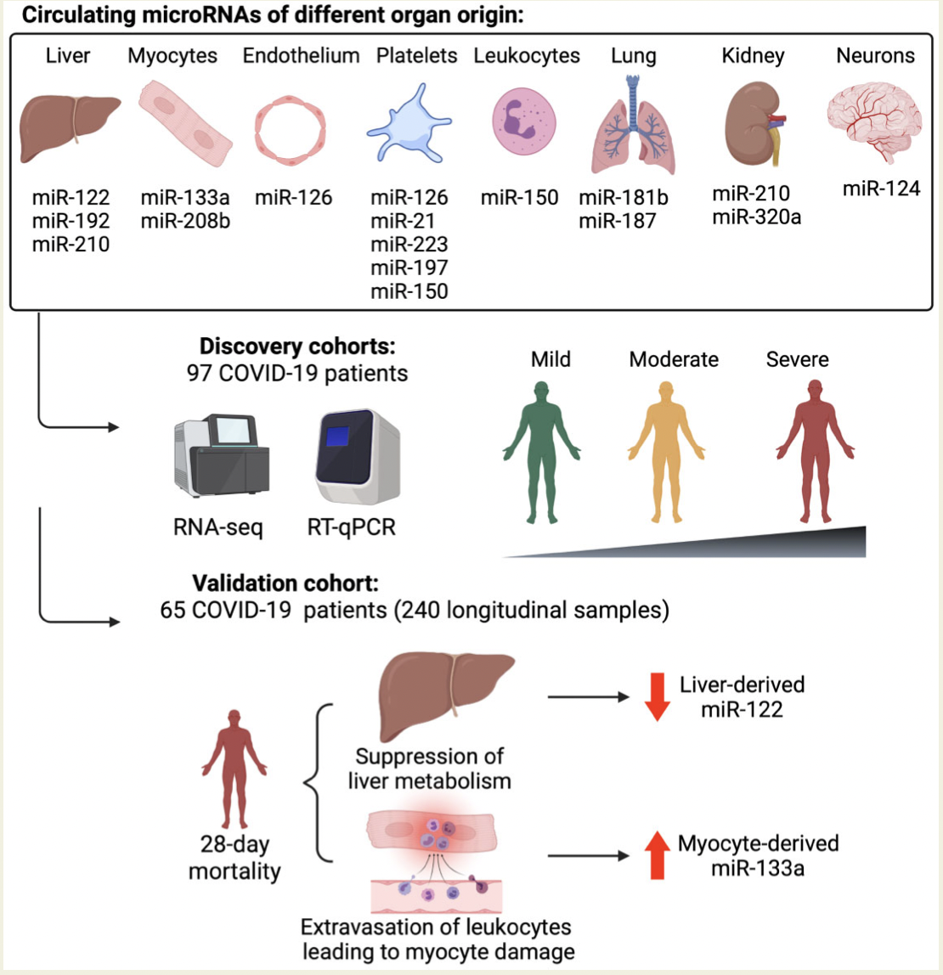

MicroRNAs (miRNAs) in blood reflect cell activation and tissue injury.
Circulating miRNAs of different tissue origin, including several known cardiometabolic biomarkers, rise with COVID-19 severity.

Slide 32
Metabolomics
Comprehensive characterization of the small low-molecular-weight metabolites in biological samples
Metabolites are produced in the body as the result of chemical processes and also come from exogenous sources (e.g., diet, drugs, xenobiotics, or gut microbe-host co-metabolism)
Metabolomics may provide a comprehensive assessment of gene actions, intrinsic metabolism, and environmental exposures ranging from dietary, gut microbial, and xenobiotic sources and their interplay
Notes:
Η μεταβολομική μπορεί να παρέχει μια ολοκληρωμένη αξιολόγηση των γονιδιακών δράσεων, του εγγενούς μεταβολισμού και των περιβαλλοντικών εκθέσεων που κυμαίνονται από διατροφικές, μικροβιακές και ξενοβιοτικές πηγές του εντέρου και την αλληλεπίδρασή τους

Slide 33
Metabolomcis
Methods
Targeted/ Untargeted NMR or MS
Targeted profiling separates a limited number of specific metabolites of known identity, is optimized for these metabolites, and is based on a priori hypotheses
Untargeted profiling involves multiple assays (NMR, MS) to measure as many metabolites as possible. The chemical identity of the peaks are not known a priori (with a few exceptions) and post hoc analyses are required for identification
Untargeted profiling is used for novel metabolic biomarker discovery. Data output is high and metabolite identification is not guaranteed.

Slide 34
Metabolomics
Outputs
Targeted: quantified metabolites
Untargeted: mass and retention times, or spectra
Statistical analysis is straightforward, but unknown compounds from untargeted studies may be very difficult to identify
Feasibility
• Large experimental variability
• Technical specificity
→ Pooling difficult but doable
Notes:
Μεγάλη πειραματική μεταβλητότητα

Slide 35
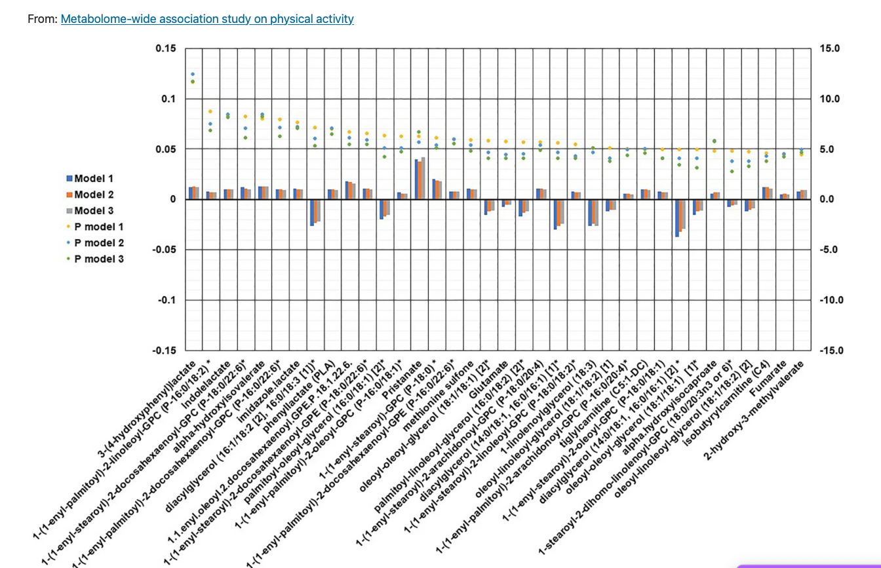

Slide 36
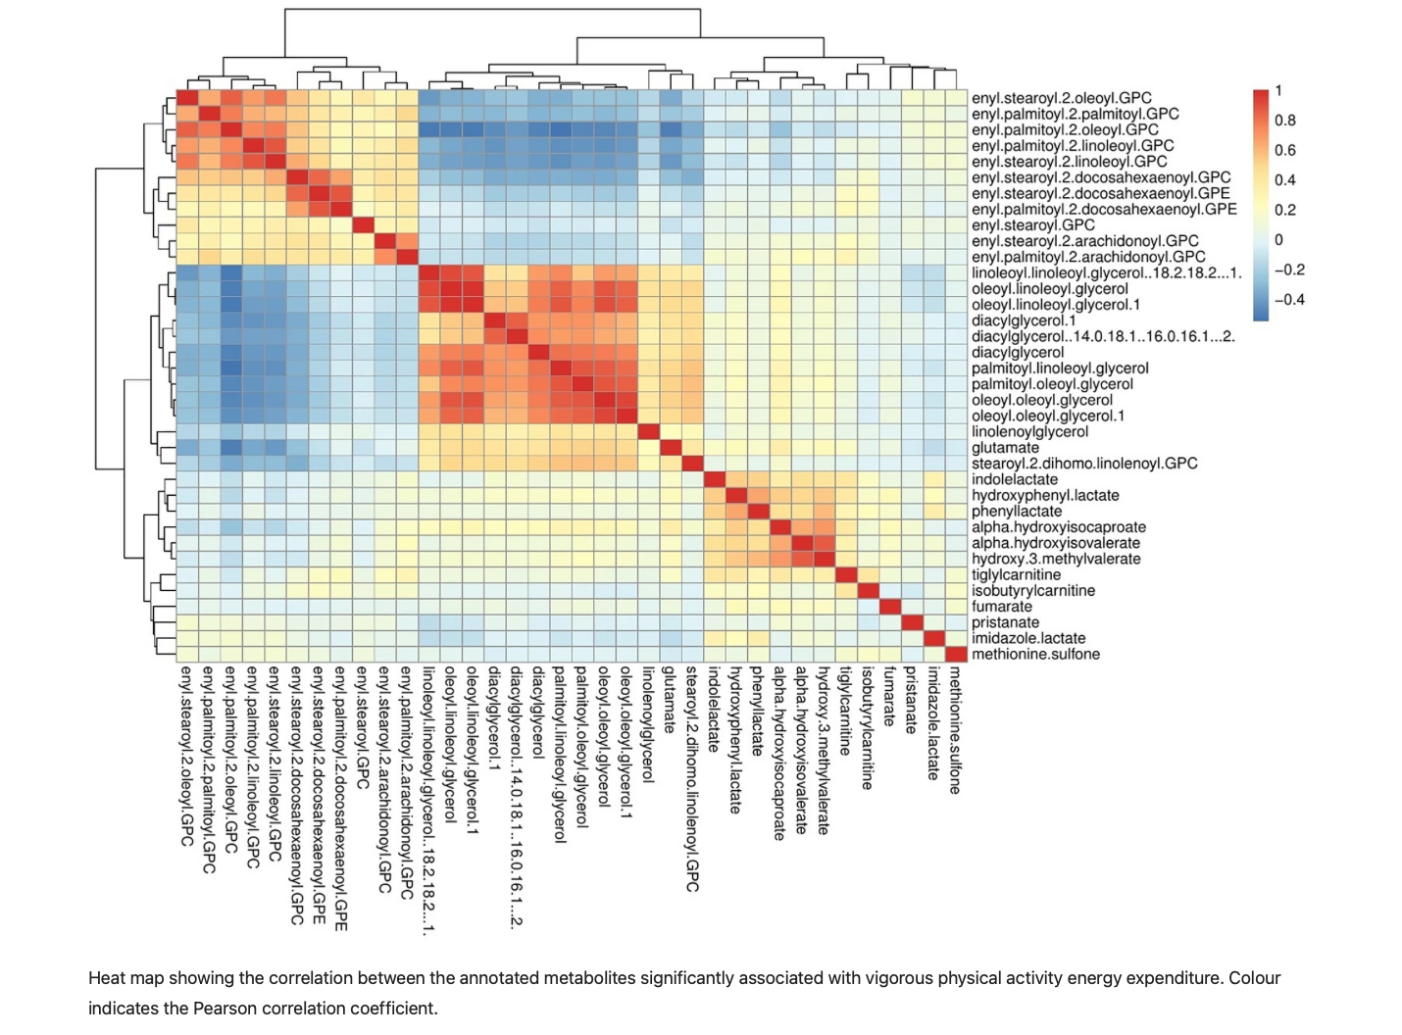

Slide 37


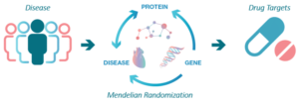
Proteomics
Methods
Targeted/ Untargeted Mass Spectrometry
or Affinity-based assays
→Statistical analysis is straightforward
Outputs
Quantified metabolites
Feasibility
Large experimental variability

Slide 38
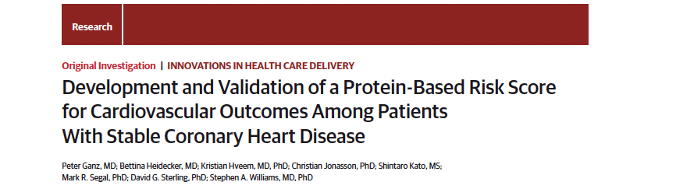
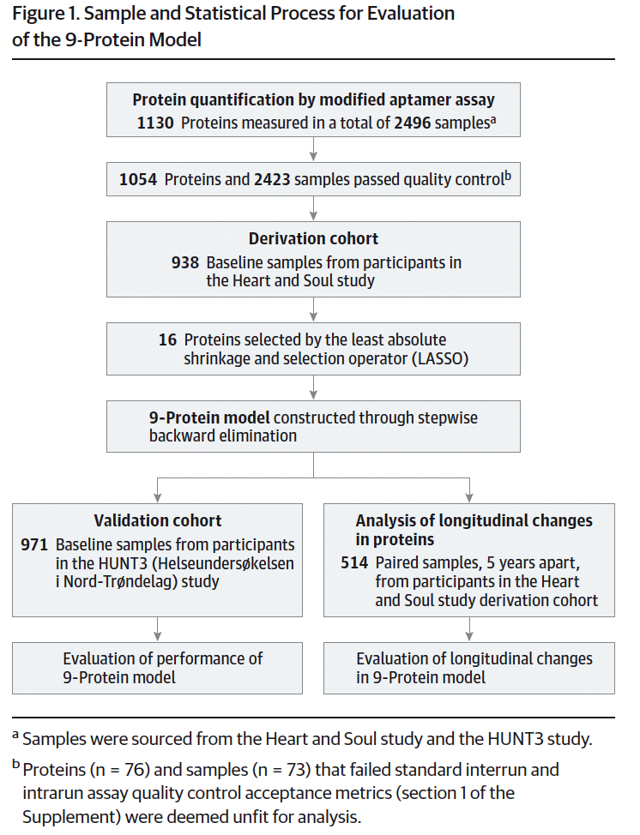

Slide 39
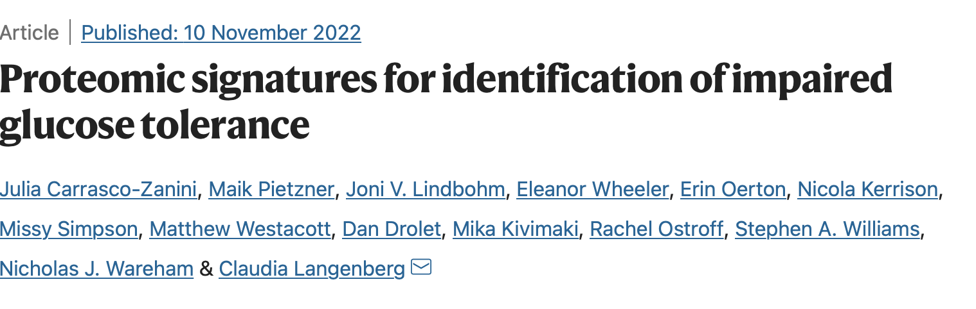
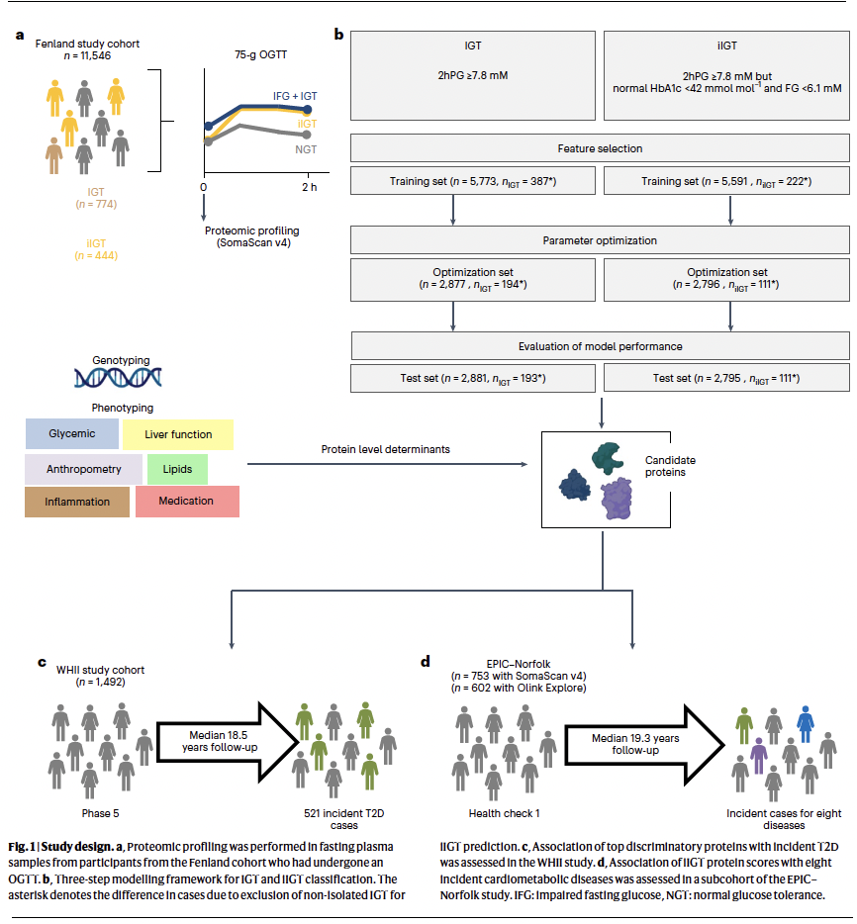
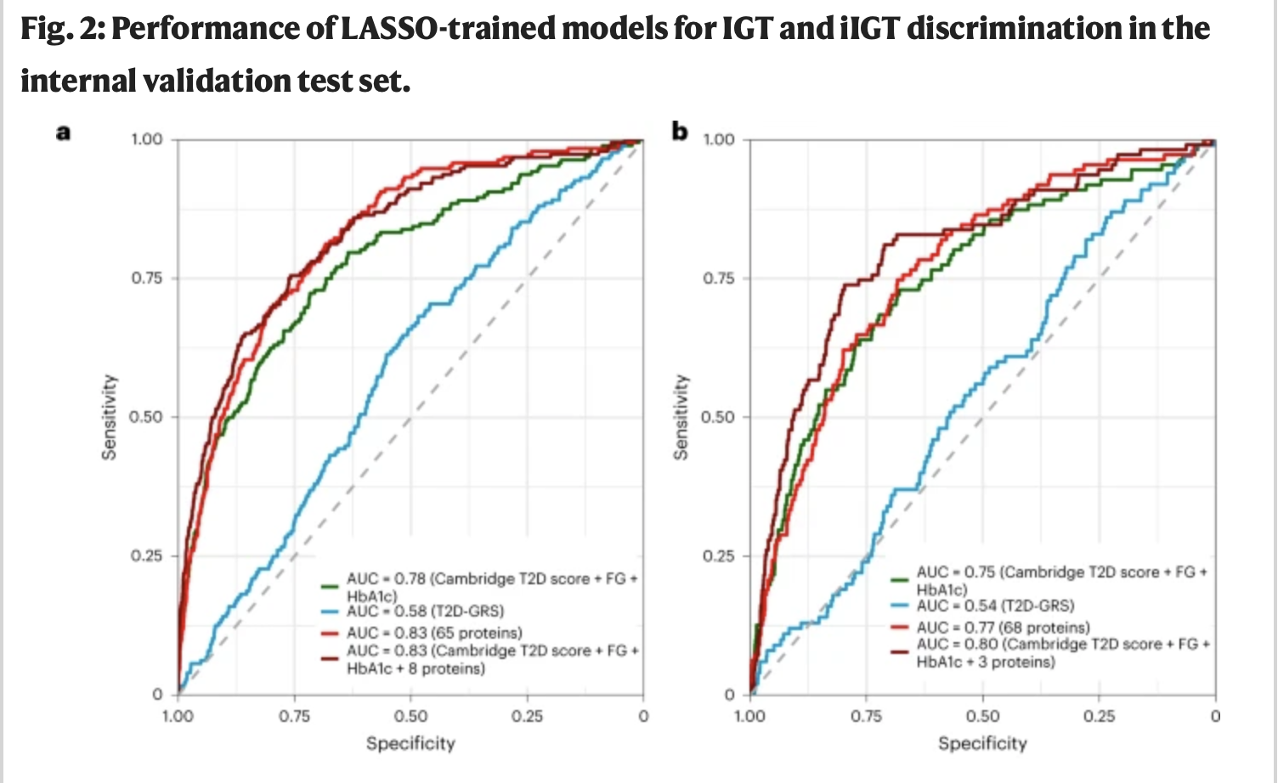

Slide 40
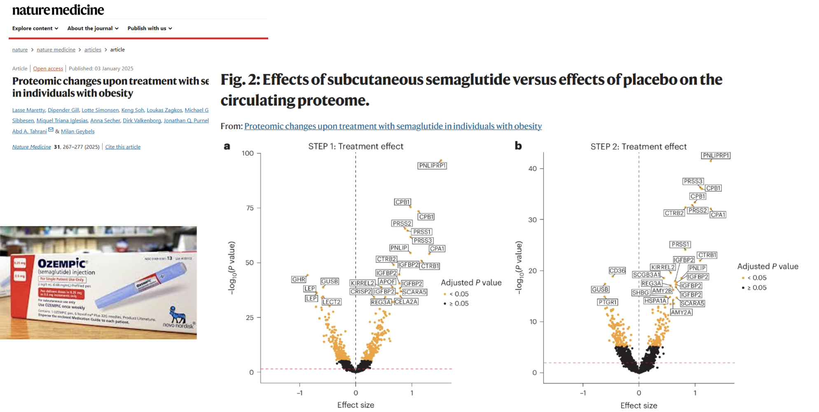
Impact of interventions on the circulating proteome

Slide 41
Know your technology
You need some knowledge of the measurement procedure if you are to model it meaningfully
Understand what is being measured, and how
Protocols are tedious and involve many complex (and often complicated) steps that will introduce nuisance variation
1. Record as much information as possible
2. Identify influential factors (QC)
3. Attenuate by means of preprocessing
4. Model any residual confounding

Slide 42
Know your statistics
You need some knowledge of statistical modelling if you are to write down a model
What is your question?
What assumptions can you reasonably make (and verify)?
What type of data do you have at hand?
Explore different options, but be careful when borrowing methods from other fields

Slide 43
Trust, but verify
Women with Y chromosome
Controls with date of diagnosis
‘Matched’ pairs with huge age differences
Technical replicates with different genotype
Always check: it takes little time, and saves future headaches
Given the sheer amount of data, we must standardise and automate statistical analysis as much as possible

Slide 44
Validation and replication
No matter how stringent your QC and preprocessing, and how accurate your models, false positive results will still occur
Validation
Are results reliable? Repeat the experiment using the same samples, but a different lab technique
Replication
Are results generalisable? Reproduce the findings using different samples, and possibly a different lab technique

Slide 45

Opportunities
Identification of novel biomarkers for:
Disease risk
Exposures
Understanding at a molecular level of:
Disease states
Exposures
Characterisation of dynamic molecular environment
→ towards better understanding of complex diseases and refined risk stratification

Slide 46
Biomedical challenges
Holistic view
What is the effect of multiple ‘–omics’ markers?
Tissue heterogeneity
What is the value of ‘–omics’ measurements in samples that contain multiple, heterogeneous cell types?
Surrogate tissues
What is the value of ‘–omics’ measurements in surrogate tissues, e.g. in blood, for localised diseases?
Effect sizes
What is the magnitude of clinically significant changes?

Slide 47
Statistical challenges
Multiple comparisons
What significance threshold should be used when performing millions of tests simultaneously?
Nuisance variation
How can we distinguish between biological and technical variation?
Combined effects
How can we model the combined effect of multiple ‘–omics’ markers?
‘Crossomics’
How can we analyse multiple ‘–omics’ datasets jointly?

Slide 48

Focus on metabolomics

Slide 49
Metabolomics
Comprehensive characterization of the small low-molecular-weight metabolites in biological samples
Metabolites are produced in the body as the result of chemical processes and also come from exogenous sources (e.g., diet, drugs, xenobiotics, or gut microbe-host co-metabolism)
Metabolomics may provide a comprehensive assessment of gene actions, intrinsic metabolism, and environmental exposures ranging from dietary, gut microbial, and xenobiotic sources and their interplay

Slide 50
Metabolome
Complete complement of metabolites found in or produced by an organism
No single technology can measure the complete metabolome
500 different histological cell types in the human body, and each one has its own gene expression, proteome, and metabolome

Slide 51
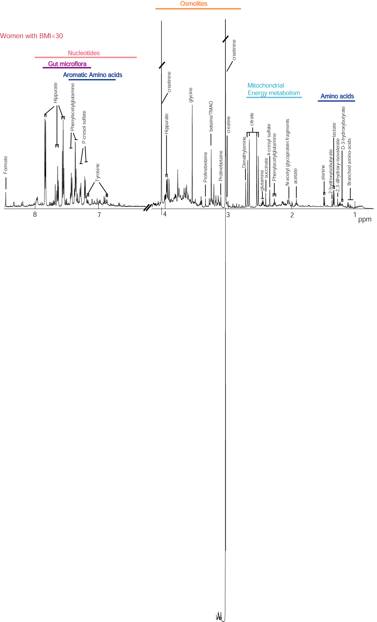
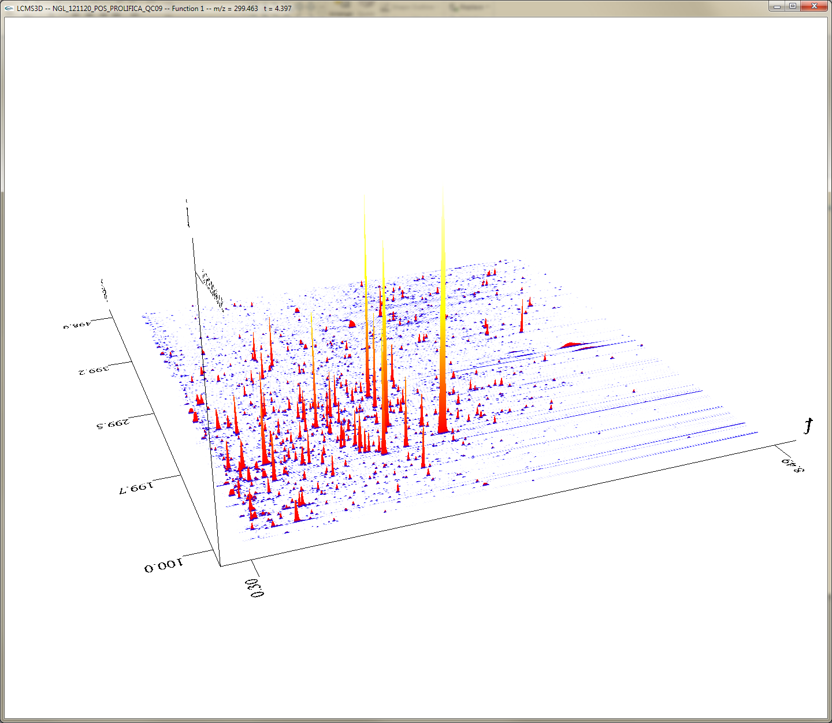
Analytical methods
Nuclear magnetic resonance (NMR) spectroscopy or mass spectrometry (MS)
separate individual signals or analytes by their resonance frequencies in a magnetic field or by their mass-to-charge ratio
Intensity
m/z
Retention time
Urinary NMR spectrum
LC-MS
Notes:
Διαχωρίστε μεμονωμένα σήματα ή αναλυτές με βάση τις συχνότητες συντονισμού τους σε ένα μαγνητικό πεδίο ή με την αναλογία μάζας προς φορτίο

Slide 52
Tzoulaki et al Curr Hypertens Rep. 2018; 20(9): 78.

Slide 53
Metabolic profiling can run in either targeted or untargeted modes
Targeted profiling separates a limited number of specific metabolites of known identity, is optimized for these metabolites, and is based on a priori hypotheses
Untargeted profiling involves multiple assays (NMR, MS) to measure as many metabolites as possible. The chemical identity of the peaks are not known a priori (with a few exceptions) and post hoc analyses are required for identification
Untargeted profiling is used for novel metabolic biomarker discovery. Data output is high and metabolite identification is not guaranteed.

Slide 54
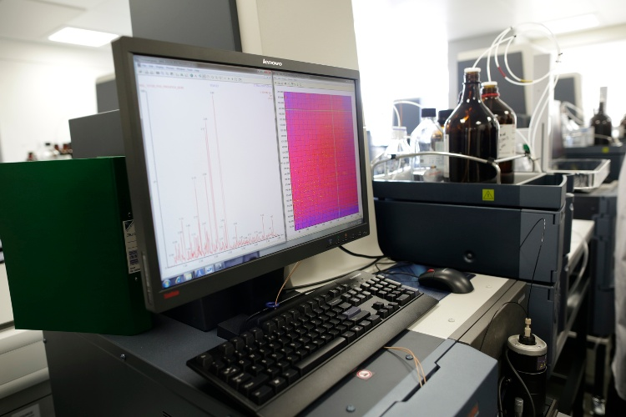
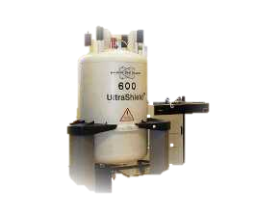
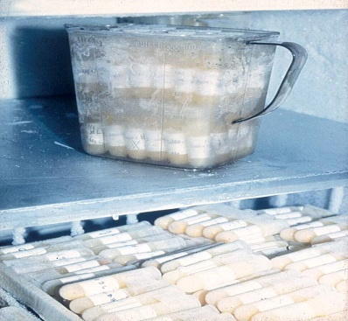
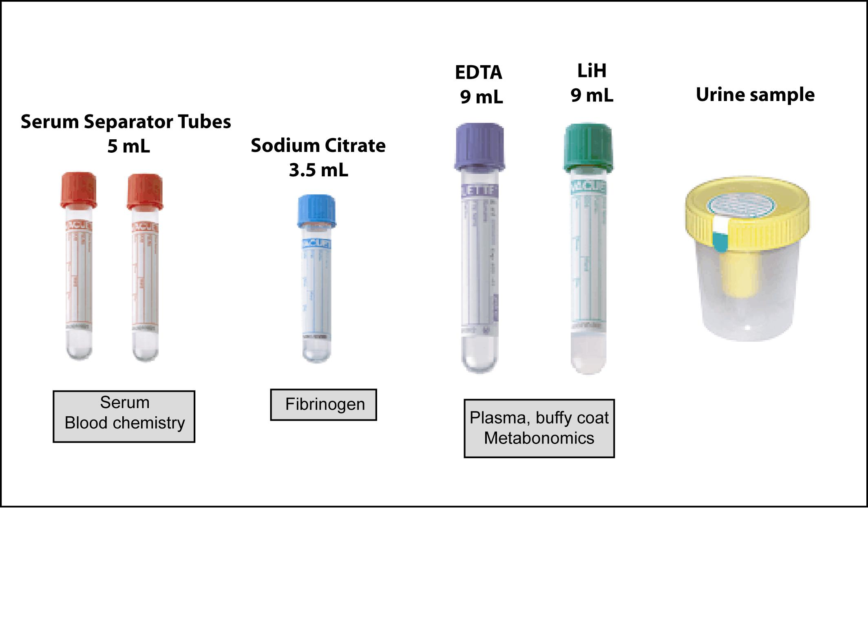
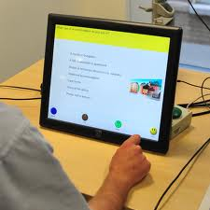
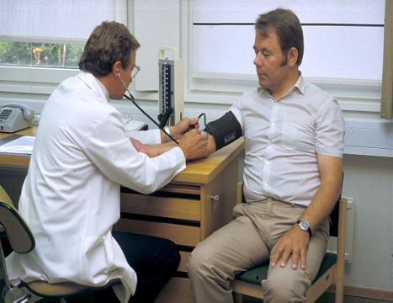
Cohort /prognostic study
Baseline
Biomarkers of exposure
Biomarkers of early effect
Disease
Genetic susceptibility
Biological samples
Questionnaire & measurements

Slide 55
Challenges in Metabolomics Data Analysis: study design
Detailed sample collection protocol
Sample contamination
Freeze thaw cycles
Different analytical platforms, targeted vs untargeted mode
Power calculation when N metabolites is unknown

Slide 56
Challenges in Metabolomics Data Analysis: study reporting/ replication
Preprocessing and QC
Outliers
Missing data
Data transformation
Multiple testing and collinearity
Replication/ validation
Metabolite identification
Difficult to pool across cohorts

Slide 57
Main steps in data analysis
Metabolomic data have unique characteristics that pose special challenges in epidemiologic data analysis:
High dimensionality,
Multiple analytical methods (NMR, liquid chromatography MS, etc.)
High degree of collinearity
…...
Notes:
Υψηλή διάσταση
Υψηλός βαθμός συγγραμμικότητας

Slide 58
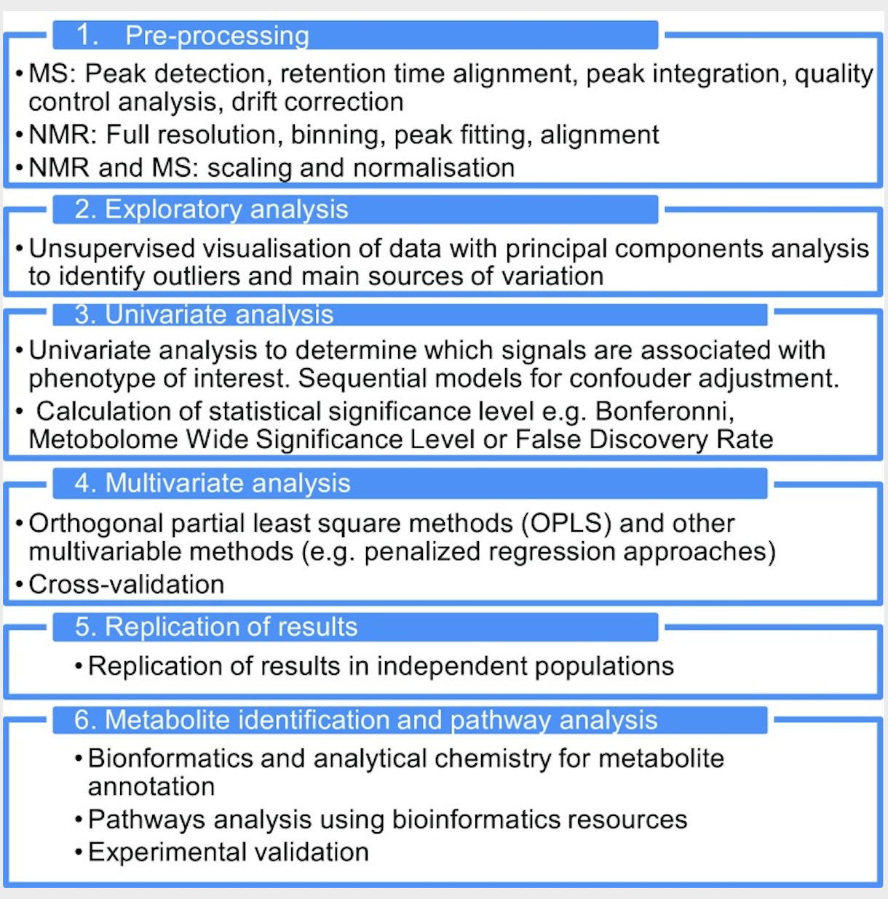
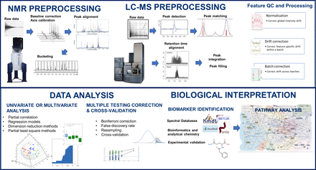

Slide 59
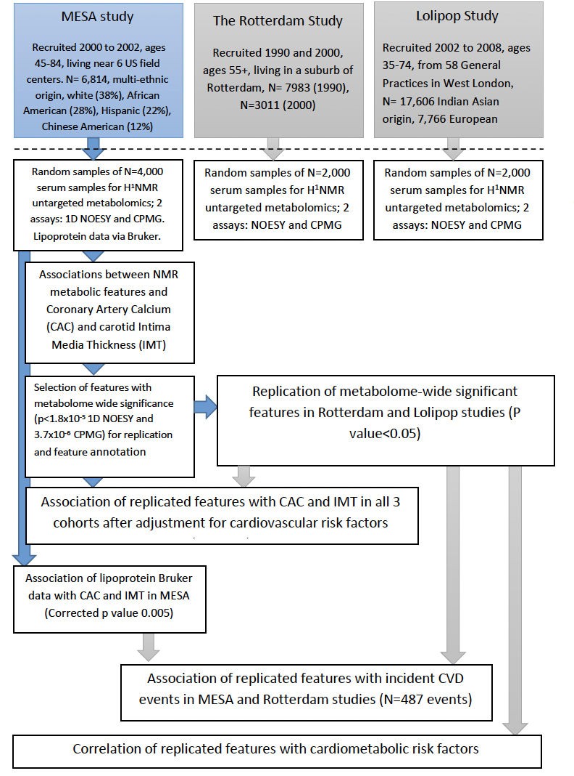
Metabolites associated with atherosclerosis
Tzoulaki et al. European Heart Journal (2019) 40, 2883–2896

Slide 60
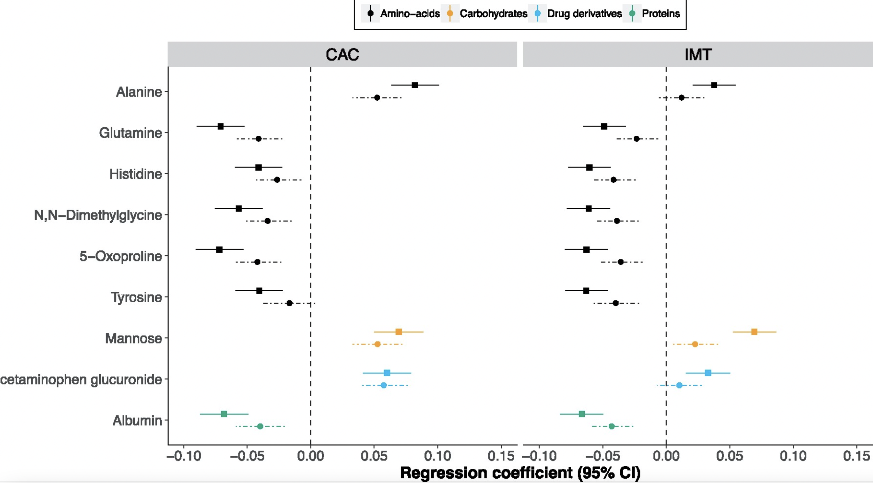

Slide 61
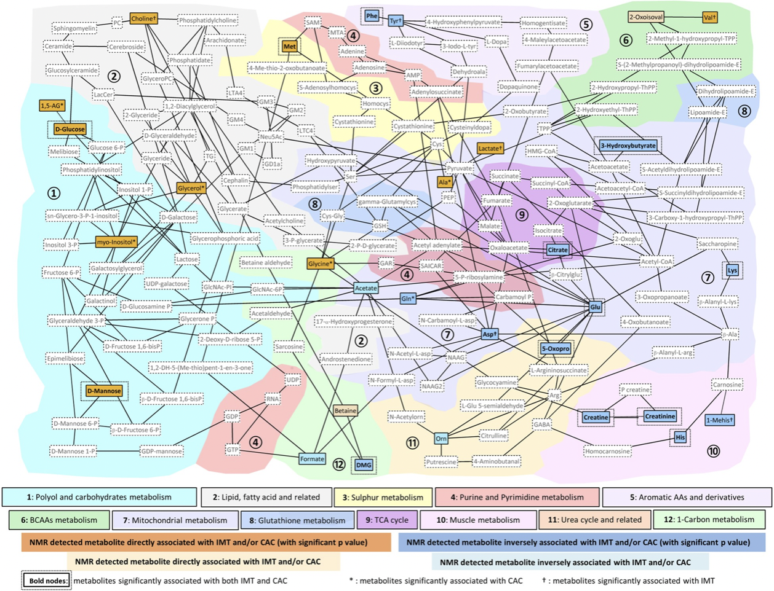

Slide 62
Summary
Metabolomics presents a powerful and promising approach for an in-depth molecular characterization of health and disease
Advances in analytical technologies and informatics have made possible the generation and analysis of high-dimensional complex metabolic phenotyping data in large population studies
Consideration of the special nature of metabolomics data needs to be take into account in study design, analysis and reporting

Slide 63
Statistical considerations

Slide 64
The metabolomics data
How to analyse?
High throughput
High degree of collinearity
Multiple analytical methods
Sensitive to many effects
Unknown number and identity of metabolites
NMR, LC-MS, GC-MS, CE-MS…
Contrast with microarray/sequence data
Error & bias
Confounders
Biological / analytical correlations
High dimensionality
N variables >> N samples
Data ≠ Information
Need reliable, predictive information
Ignore noise
Handle missingness
Need ways to extract information

Slide 65
Metabolome-wide association study (MWAS)
Powerful to identify biomarkers of a disease risk.
Data ≠ Information
Need ways to extract information
Need reliable, predictive information
Ignore noise
Handle multicollinearity
Minimize risk of false positives

Slide 66
Limitations of x-WAS studies
The n < p situation:
◦ More predictors than observations
→ numerically intractable statistical inferences
◦ n > p
→ univariate approaches
dimension reductions techniques
variable selection methods
Notes:
• Univariate approaches: look at each predictor in X separately
• Dimension reduction techniques: summarize X into a lower dimension
matrix
• Variable selection approach: define the best combination of variables in
X to predict Y

Slide 67
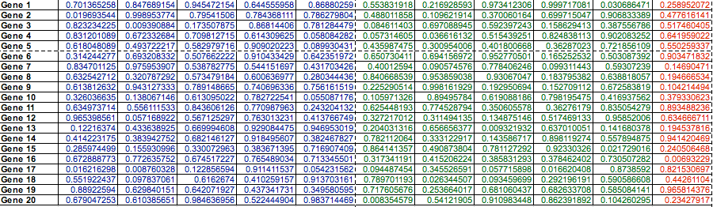
Multiple Comparison Problem in ‘Omics’ studies
Normal
Disease
Gene by gene 2-tailed t-test; P<0.05 significant

Slide 68
Multiple Comparison Problem in ‘Omics’ studies
Normal
Disease
Conclude: Gene 16 associated with disease

Slide 69
Multiple Comparisons
However….need to consider the number of tests performed-P<0.05 means we accept the risk of erroneously rejecting H₀ in 5% of the cases (i.e. willing to accept 5% false positives)
Each comparisons carries a 5% error probability so if we perform 20 tests, likely to detect 1 false positive
The association between gene 16 and disease may be real but we do not have sufficient data to make that claim
Notes:
each conclusion is drawn with the risk α to wrongly rejecting H0
the type I error

Slide 70
Multiple Comparison Problem in ‘Omics’ studies
On the ‘omics’ scale problem is magnified..
~10,000 genes on an array
Each gene-disease association has 5% chance of being false positive (Type I error)
So by chance alone, we should detect 500 significant associations…..
For α=0.05 and 2.5x10⁶ SNPs: 125,000 FP

Slide 71
Univariate approaches
Each X with each Y
Each measurement with the outcome
Common in GWAS

Slide 72
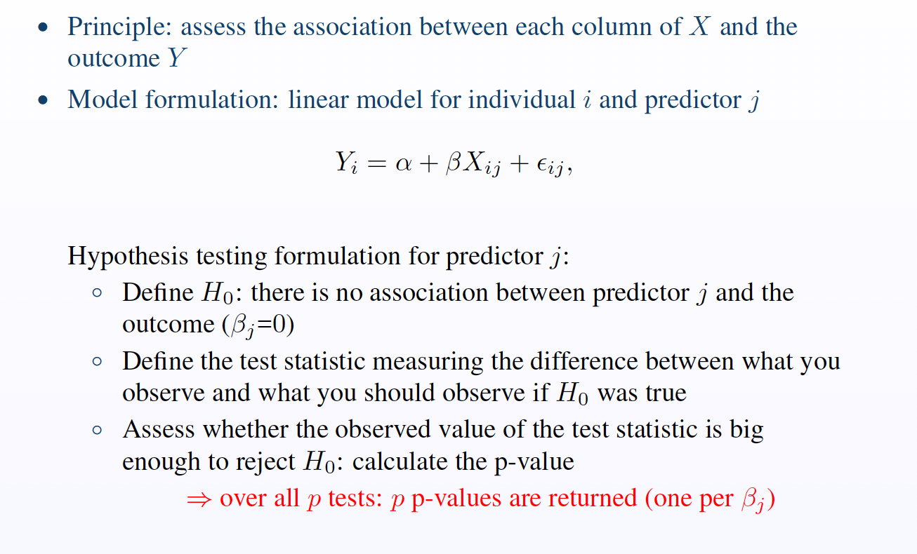
Univariate approaches

Slide 73
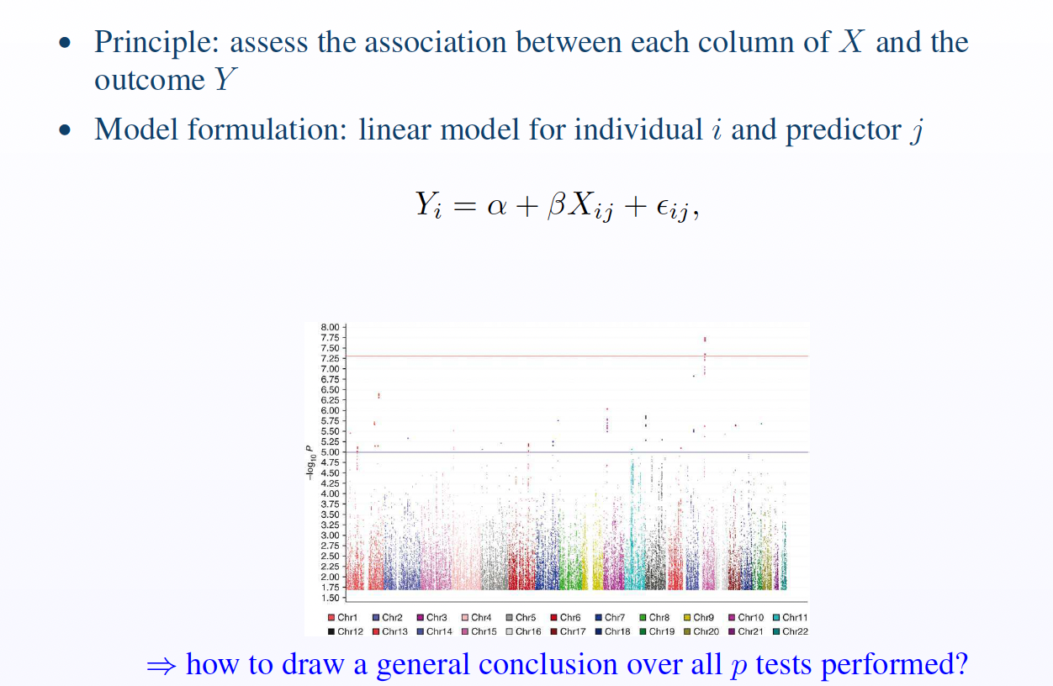
Univariate approaches

Slide 74
Correction for Multiple Comparisons
Major research issue for biostatisticians…debate as to the best approach
Two ways to control for multiple testing:
Controlling the Family-Wise Error Rate (FWER)
Traditional methods for controlling for multiple testing such as Bonferroni correction (α/n)
may be too conservative (↑ false negatives)
Controlling the False Discovery Rate (FDR)
False discovery rate (FDR; Benjamin-Hochberg Test) now more commonly applied to ‘omics’ data sets
→multiple testing correction is achieved by either adjusting the p-value, or by altering the cut-off value

Slide 75
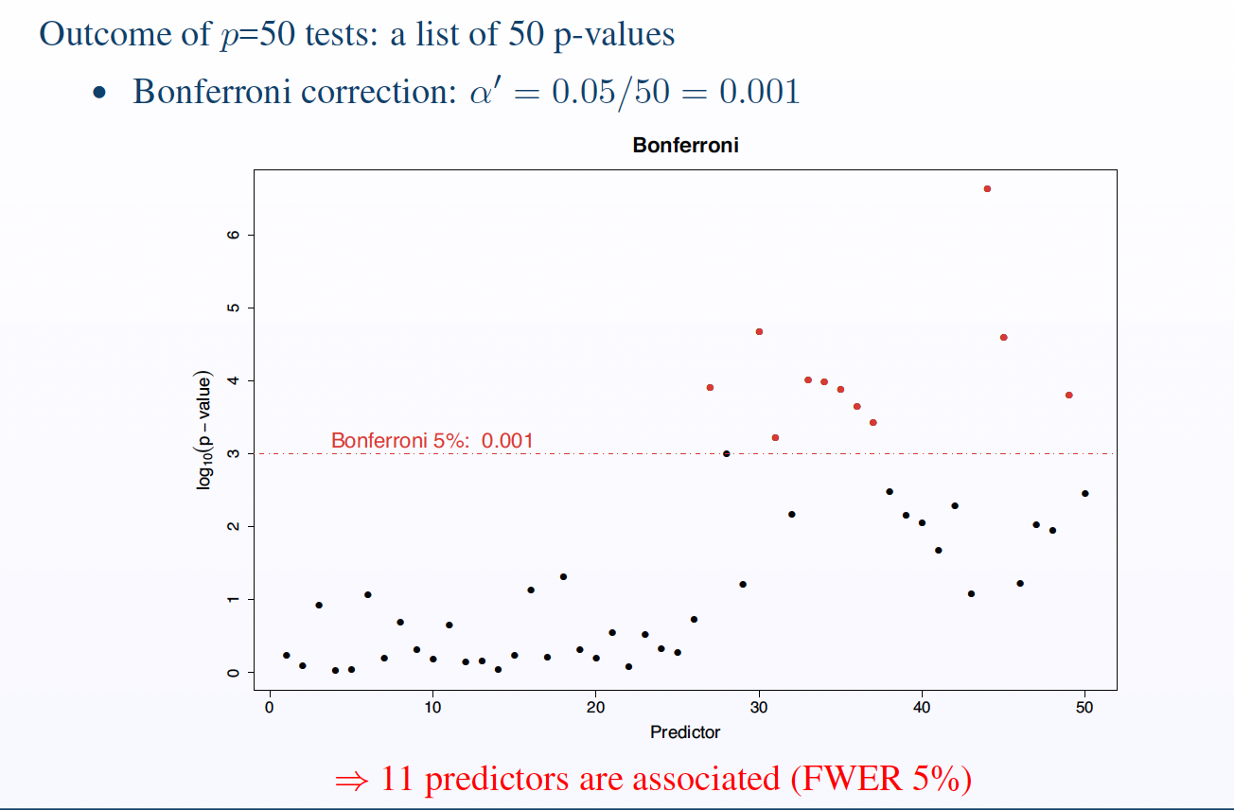
Correction for Multiple Comparisons
Notes:
We are basically guaranteed to commit at least one type I error!

Slide 76
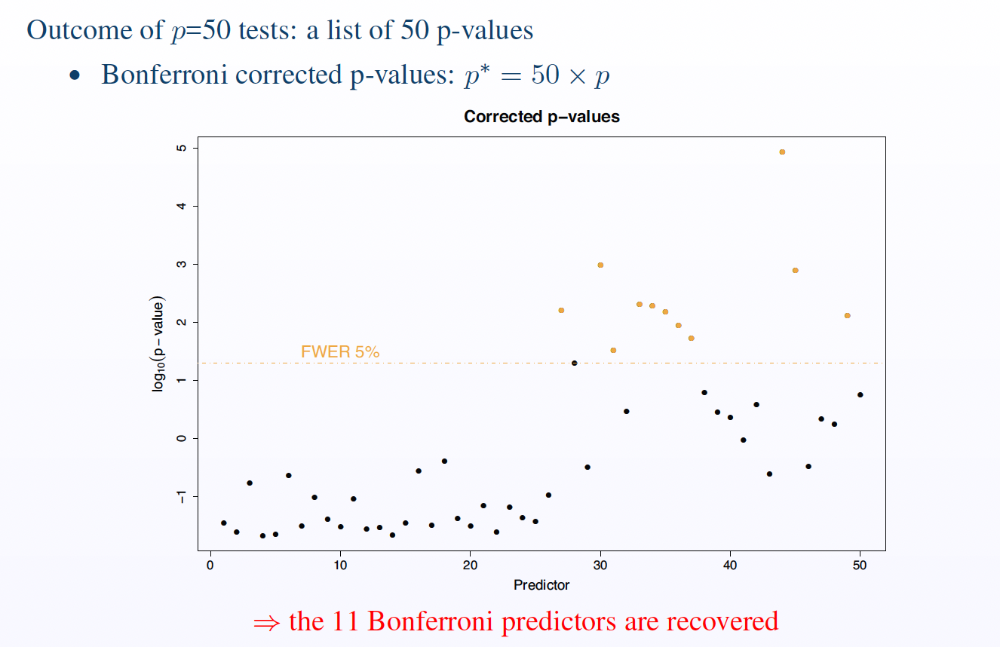
Correction for Multiple Comparisons
Notes:
We are basically guaranteed to commit at least one type I error!

Slide 77
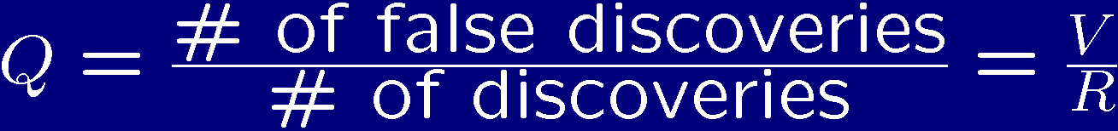
False Discovery Rate (FDR)
Q is set to be 0 when R=0
FDR = expectation of Q = E(V/R; R>0)
Benjamin-Hochberg Test (rank all P-values)
FDR is less stringent than FWER
FWER control at 5% ensures that over 100 experiments <5 contain one FP
FDR control: over the 100 experiments the average #FP ≤ 5
⇒ FDR control may be preferred in an exploratory context
Notes:
Expected – rank p values
Denominator, anything significant

Slide 78
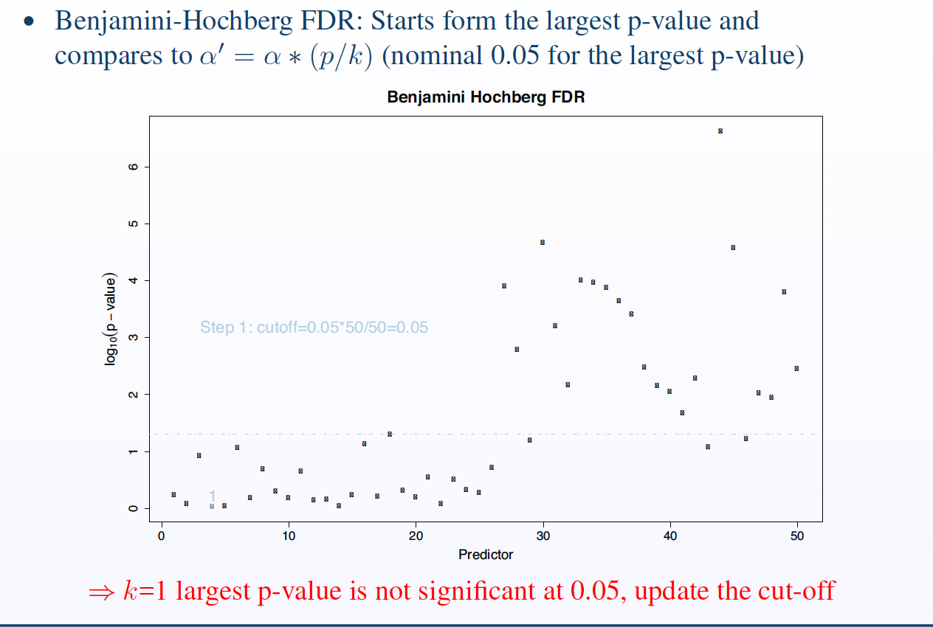
Benjamin-Hochberg FDR
Order p values – start with smallest
Calculate critical value α(k/p)
Find largest p value that is smaller than critical value
Notes:
Order p-values from smallest to largest.
You test multiple hypotheses and get p-values for each.
Calculate the critical value for each p-value:
critical value=α⋅(kp)critical value=α⋅(pk​)Where:
αα is the desired FDR level (commonly 0.05),
kk is the rank (1 for smallest, up to total number pp),
pp is the total number of tests.
Find the largest p-value that is less than or equal to its corresponding critical value.
All p-values smaller than or equal to this one are declared significant.

Slide 79
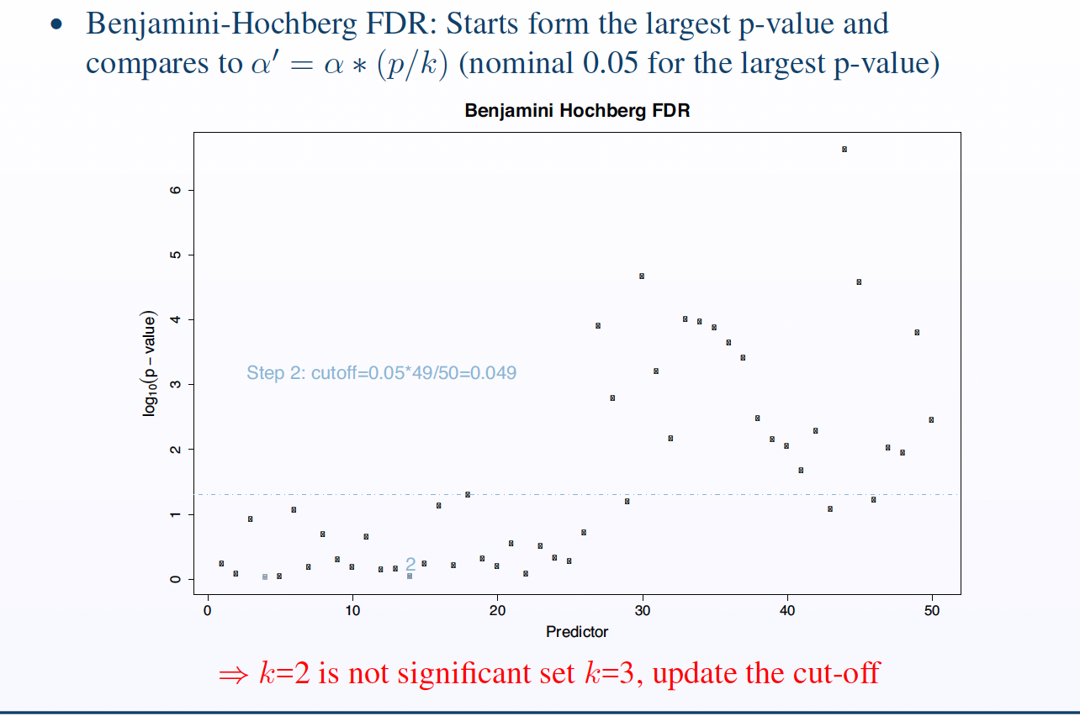

Slide 80
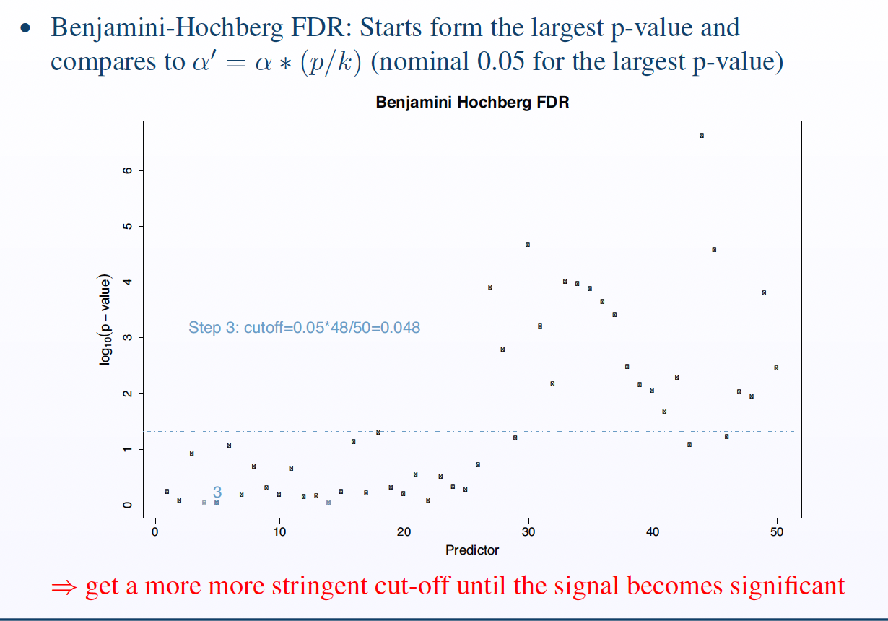

Slide 81
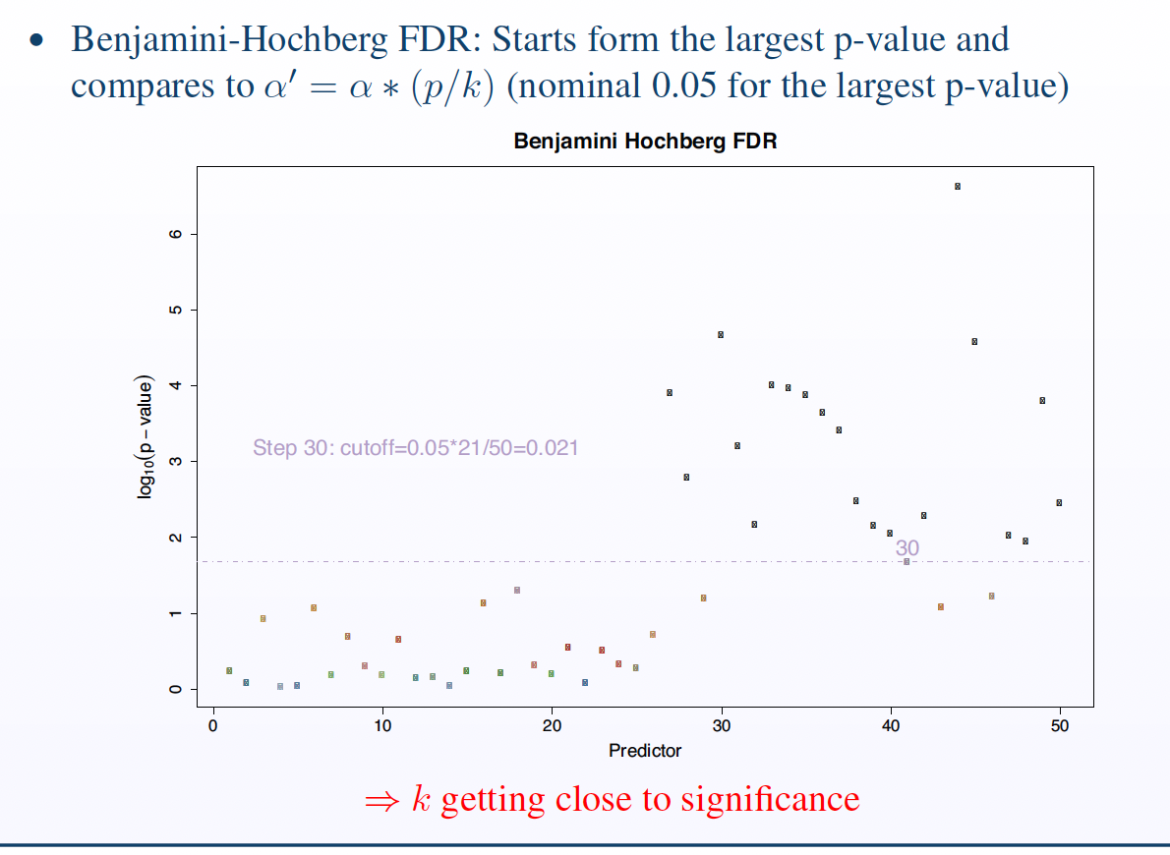

Slide 82
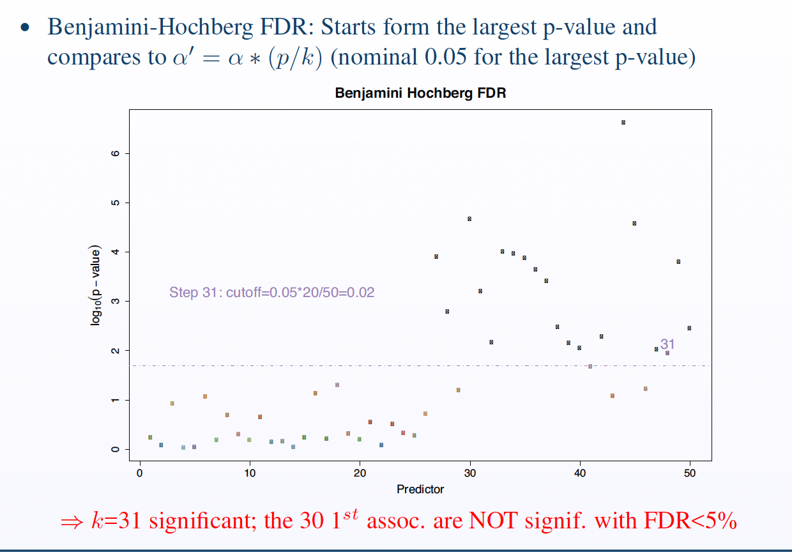

Slide 83
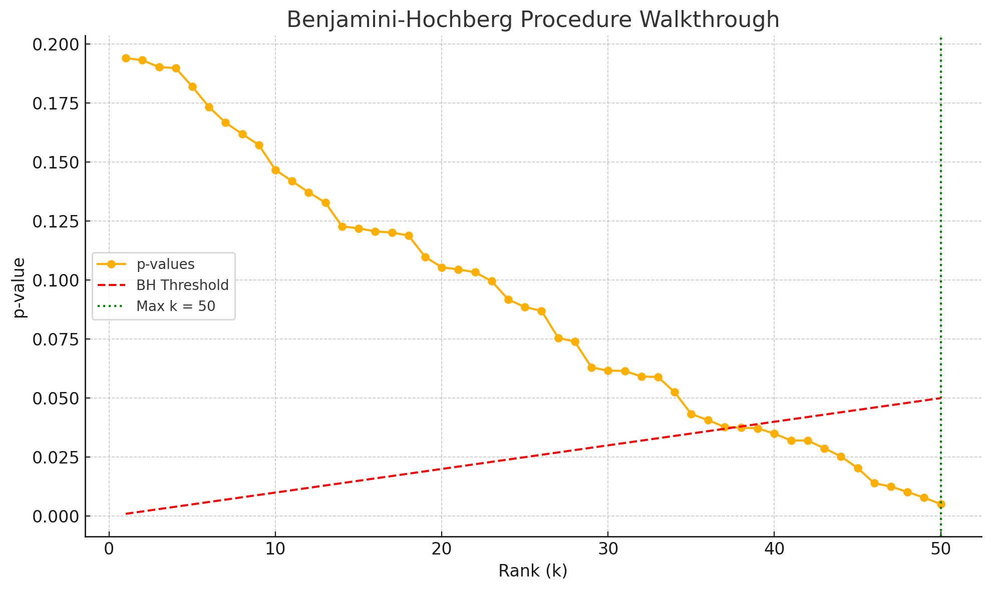

Slide 84
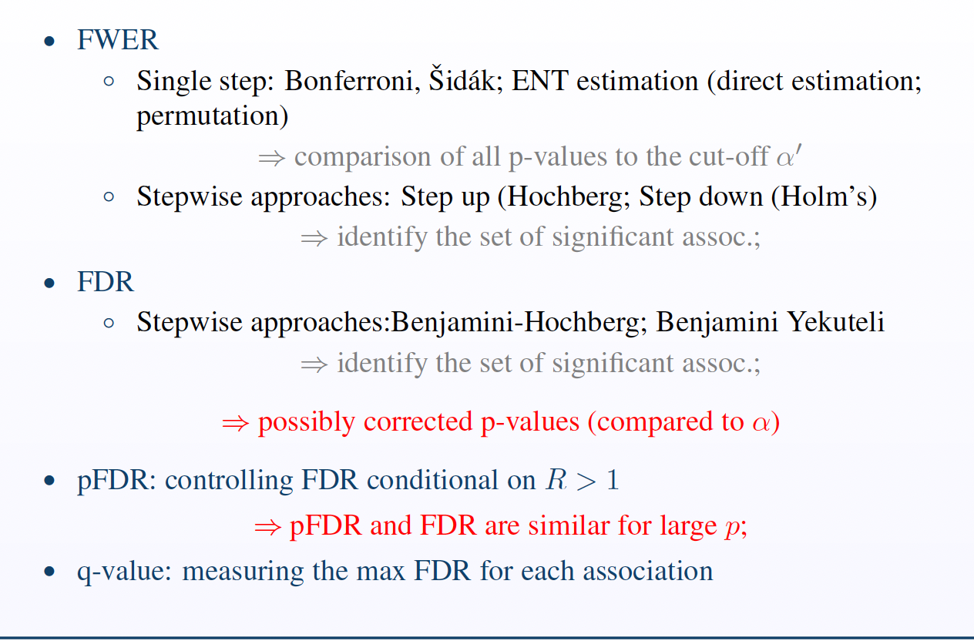
Multiple Testing in practice: summary

Slide 85
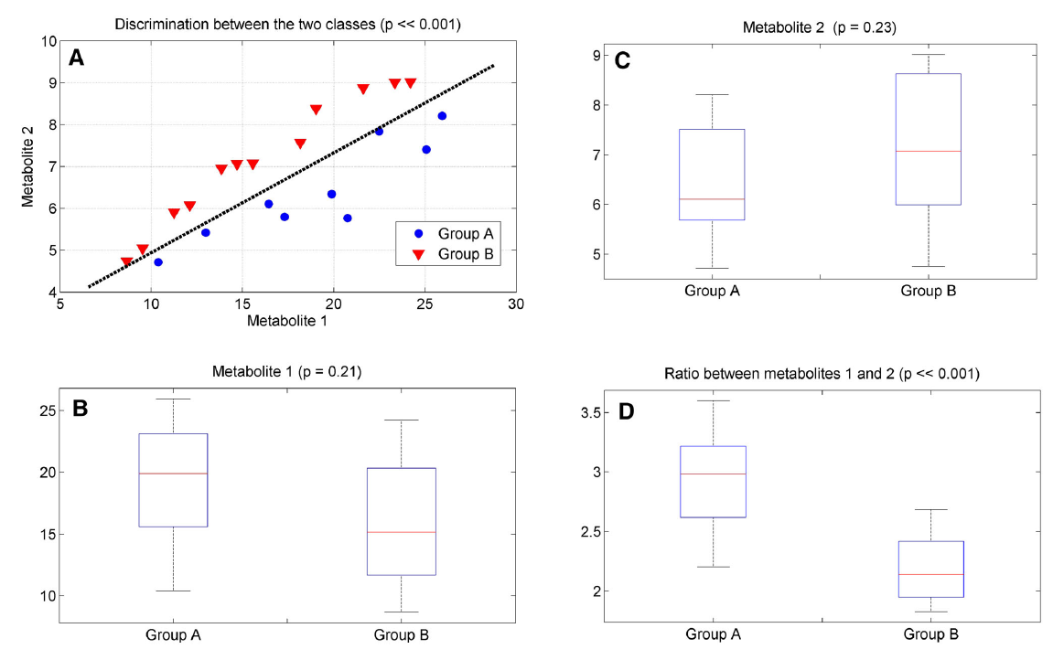
Transition to Multivariate Approaches
Independent variables may complement each other
Saccenti et al., Metabolomics (2014) 10:361–374, DOI 10.1007/s11306-013-0598-6

Slide 86
Two-Stage Study Designs
Most widely accepted designs for ‘omics’ studies now….
Discovery (training set): large sample size, identify discoveries (FDR)
Validation (test set): independent from discovery set

Slide 87
Univariate approaches
Advantages
Computational efficiency
Model Flexibility
Generalized linear models
No need to model correlation structure in x
Adjustment for confounders easy
Limitations
Models do not account for potential combined effects of X factors
Multivariate approaches

Slide 88
Multivariate approaches
Dimension Reduction techniques:
Aim: Identify summary covariates (components) constructed as linear combinations of original variables which accurately reconstruct in a lower dimension the structure of the original data
Main approaches: unsupervised (e.g. PCA) and supervised (e.g. PLS-based approaches)
Main limitation: results may not guarantee easy interpretability
Variable selection techniques:
Aim: identify a sparse set of predictors that jointly predicts Y
Two main approaches: penalised regression (e.g. lasso approaches), and Bayesian Variable Selection approaches (BVS)
⇒variable selection approaches implicitly correct for multiple testing
Notes:
Πολυμεταβλητές Προσεγγίσεις
• Τεχνικές Μείωσης Διαστάσεων:
Σκοπός: Να εντοπιστούν περιληπτικές μεταβλητές (συστατικά), που κατασκευάζονται ως γραμμικοί συνδυασμοί των αρχικών μεταβλητών, και οι οποίες αναπαριστούν με ακρίβεια τη δομή των δεδομένων σε μικρότερη διάσταση.
Κύριες προσεγγίσεις:
Ανάλυση χωρίς επίβλεψη (π.χ. PCA - Ανάλυση Κύριων Συνιστωσών)
Με επίβλεψη (π.χ. μέθοδοι βασισμένες στο PLS - Partial Least Squares)
Κύριος περιορισμός: Τα αποτελέσματα δεν εγγυώνται πάντα εύκολη ερμηνευσιμότητα.
• Τεχνικές Επιλογής Μεταβλητών:
Σκοπός: Να επιλεγεί ένα "σπάνιο" (μικρό) σύνολο μεταβλητών που από κοινού προβλέπουν τη μεταβλητή απόκρισης Υ.
Δύο κύριες προσεγγίσεις:
Τιμωρητική παλινδρόμηση (π.χ. lasso - Least Absolute Shrinkage and Selection Operator)
Bayesian Μέθοδοι Επιλογής Μεταβλητών (BVS)
🔍 Σημαντικό: Οι τεχνικές επιλογής μεταβλητών διορθώνουν έμμεσα για το πρόβλημα των πολλαπλών ελέγχων (multiple testing), δηλαδή μειώνουν τον κίνδυνο ψευδώς θετικών ευρημάτων.

Slide 89
Transition to Multivariate Approaches
Why do I see something univariately when I see nothing multivariately?
Masking of information by uninformative variables
the biological information is contained in a limited subset of measured metabolites
Covariances and correlations are difficult to estimate
the true covariance matrix of the population from which the samples are drawn needs to be known
Univariate and multivariate testing procedures may not overlap
Saccenti et al., Metabolomics (2014) 10:361–374, DOI 10.1007/s11306-013-0598-6

Slide 90

M. Chadeau-Hyam et al. Deciphering the Complex: Methodological Overview of Statistical Models to Derive OMICS-Based Biomarkers. Environ Mol Mutagen, 2013 Aug;9(8).

Slide 91
Overall Summary
Metabolomics datasets are complex and highly correlated, therefore need special treatments.
MWAS provide powerful to identify biomarkers of a disease risk.
Univariate and multivariate approaches are useful for biomarker discovery and they are complementary.
Convenient multiple testing is important for univariate analyses.
Model validation is crucial for multivariate analyses.

