Slide 1
Genetic risk scores and risk prediction
Ioanna Tzoulaki

Slide 2
Outline
  Introduction to risk prediction models
  Introduction to genetic risk scores
  Μethods for PRS calculation
  Examples

Slide 3
What is prognosis
Prognosis = foreseeing / foretelling / predicting
Weather forecasts/ Banks going bankrupt
Medical textbooks: (average) course of an illness
Myocardial infarction, Alzheimer disease etc.

Slide 4
Prognosis in practice
Patient not only has illness but also particular age, gender, symptoms, signs, test results, biomarkers, etc.
Prognosis in medicine not only in patients or ill individuals
  risk of pre-eclampsia in pregnant women
  prediction of heart disease in general population (Framingham risk score)
  prognosis of newborns (Apgar score)

Slide 5
Prognosis and prognostic research
Probability (risk) of developing a condition (outcome) over a period of time based on clinical and non clinical profile
  Events, disease progression, quality of life etc.
  Time: hours, months, years
  Predictors: history taking, physical examination, tests (imaging, ECG, biomarkers, genetic ‘markers’), disease state, etc.
Multiple predictors to estimate an individual’s prognosis: prediction models, prediction rules, risk scores, clinical decision rules
The ability to make accurate predictions about the future course of disease is fundamental to decision making in medicine and public health

Slide 6
Why predict?
Inform individuals about the future course of their illness
  Raise risk awareness
  Improve adherence
  Promote lifestyle changes
Guide doctors and patients in informed decisions on treatment/ further tests
  Treatment at high risk
  Targeted screening
Select patient groups for RCT
Compare differences in performance between hospitals

Slide 7
Why predict?
Clinical experience provides us with an intuitive sense of which findings on medical history, physical examination, and laboratory or imaging investigation are critical in making an accurate diagnosis or an accurate assessment of a patient’s likely fate.
Clinician’s intuition may be misleading.
Predictive models attempt to increase the accuracy of clinicians’ diagnostic and prognostic assessments

Slide 8
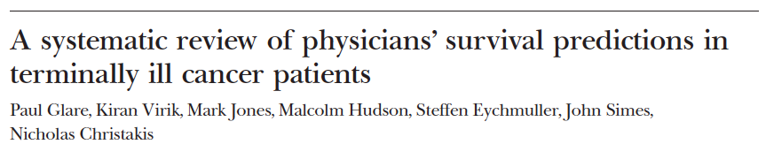

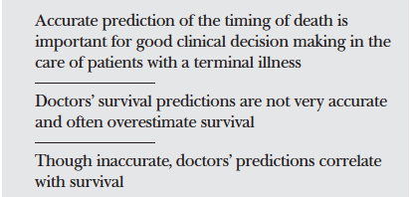
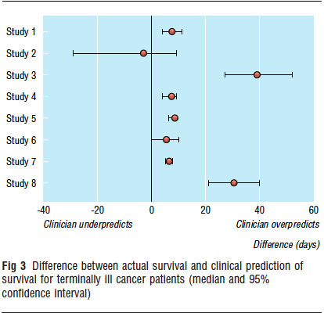
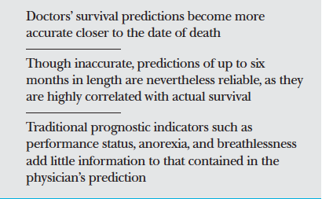

Slide 9
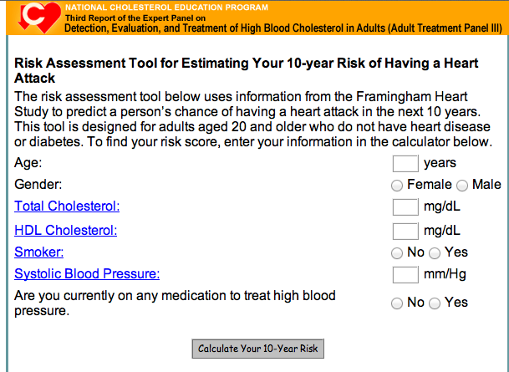
Some examples: Targeting Preventive Interventions
Framingham Risk Score estimates 10 year probability of CHD in healthy individuals
Offer preventive treatment (statins) for those >20% risk

Slide 10
Some examples: Targeting Preventive Interventions
Gail risk prediction model for developing breast cancer
  Age at menarche, age at first live birth, number of previous biopsies, and number of first-degree relatives with breast cancer.
  Offer preventive treatment e.g. behavior (e.g. exercise, weight control, alcohol intake) or medical interventions (e.g. tamoxifen use)

Slide 11
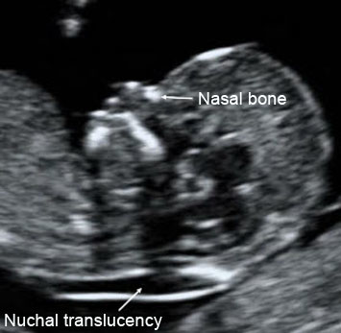
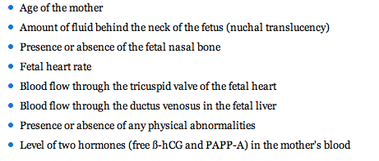
Some examples: Decision Support on Test Ordering
10-14 weeks ultrasound estimates risk of trisomy 21
Offer chorion villus sampling (CVS) or amniocentesis

Slide 12
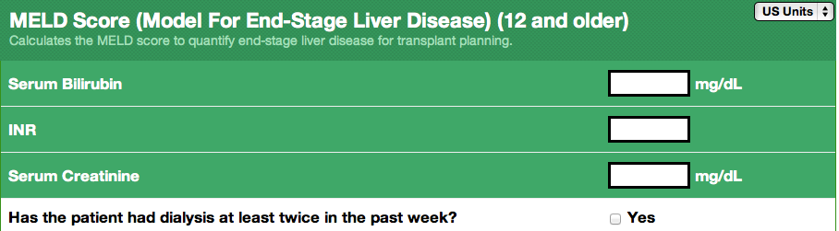
Some examples: prioritization
Model for End-Stage Liver Disease (MELD) score
  Scoring system for assessing the severity of chronic liver disease
  Predict death within three months of surgery
  Useful for prioritizing for receipt of a liver transplant

Slide 13
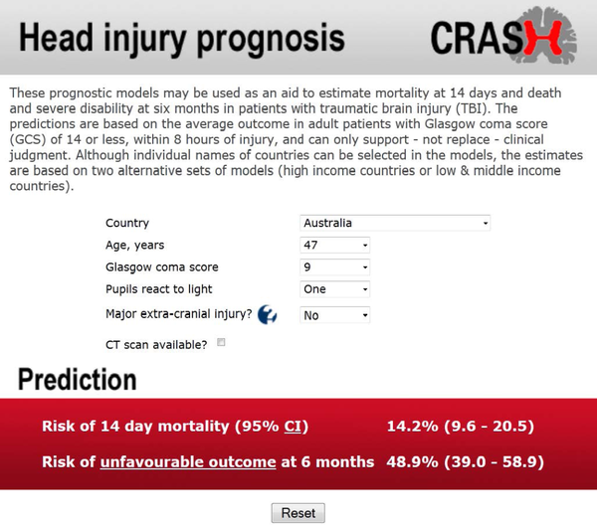
Some examples: Head Injury Prognosis

Slide 14
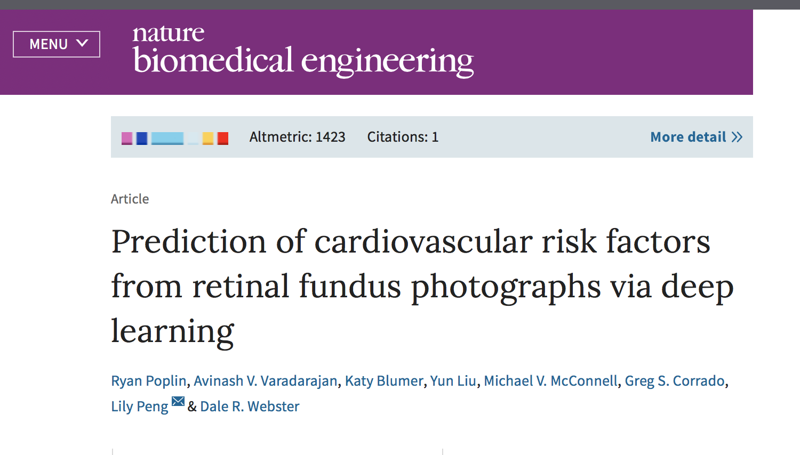

Slide 15
Differences from aetiological research
Different aims
  Predicting outcomes different to explaining their cause
  Aetiological: explain whether outcome occurrence can attributed to particular risk factor
  Prognostic: Use multiple variables to predict, as accurately as possible, the risk of future outcomes

Slide 16
Differences from aetiological research
Different requirements for predictors under study
  “Every causal factor is a predictor—albeit sometimes a weak one—but not every predictor is a cause.”
    Often weak: e.g. genetics
    Not vice versa: e.g. skin colour
  Prognostic: all variables potentially related to outcome can be considered
  Aetiological: risk factor must be in causal chain
Discrimination, calibration and validation

Slide 17
Differences from aetiological research
Different in analysis presentation
  Both use multivariable models
  Discrimination, calibration and validation
  Relative risk estimates
  Absolute not relative probabilities

Slide 18
Absolute vs. relative risk
Physicians and patients often have difficulty interpreting relative risk estimates
  A relative risk for disease of 10 might seem very high, but if the incidence rate in the referent group is close to 0, it will also be close to 0 in the group with the relative risk of 10
  Similarly, a relative risk of 1.3 might be very important when a disease is common
10-year risk estimate of 7%
  given 100 similar individuals, we expect that 7 will experience an event in the next 10 years and 93 will not
Lifetime risk different to 10 year risk

Slide 19
How to study prognostic models
Cohort studies
Cohort studies
RCTs

Slide 20
Assessing prognostic performance
Classical Statistical Methods (linear/ logistic regression, Cox regression)
Regularized Regression (LASSO, Ridge, Elastic Net – handle high-dimensional data, feature selection)
Decision Tree-Based Methods (Recursive partitioning / CART, Random Forests)
Machine learning (deep learning, neural network)
Notes:
Statistically optimal splitting (“partitioning”) of the patients into pairs of smaller subgroups
The predictor causing the largest separation is situated at the top of the tree, followed by the predictor causing the next largest separation, and so on
Splitting continues until the subgroups reach a minimum size or until no improvement can be obtained

Slide 21
Discrimination
Do patients with outcome have higher risk predictions than patients without?
  Discriminate between those with and without the outcome
AUC or C-index
  probability that a randomly selected patient who develops the disease (a “case”) will have a higher risk score than a randomly selected non-case
  0.75 for a given model would indicate that a randomly selected case has a higher score than a randomly selected non-case 75% of the time
  1: perfect discrimination, 0.5: no discrimination
  <0.70 are thought to indicate inadequate discrimination by current convention
  0.80 and 0.90 are considered excellent

Slide 22
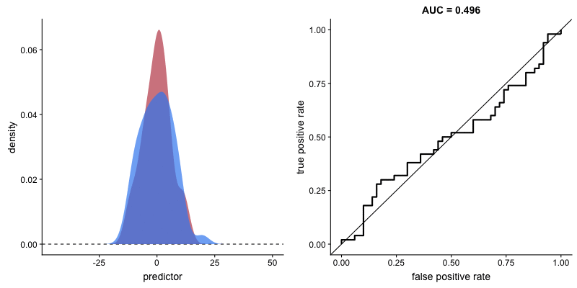
Discrimination

Slide 23
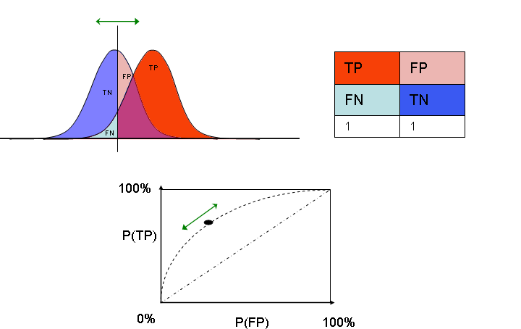
Discrimination

Slide 24
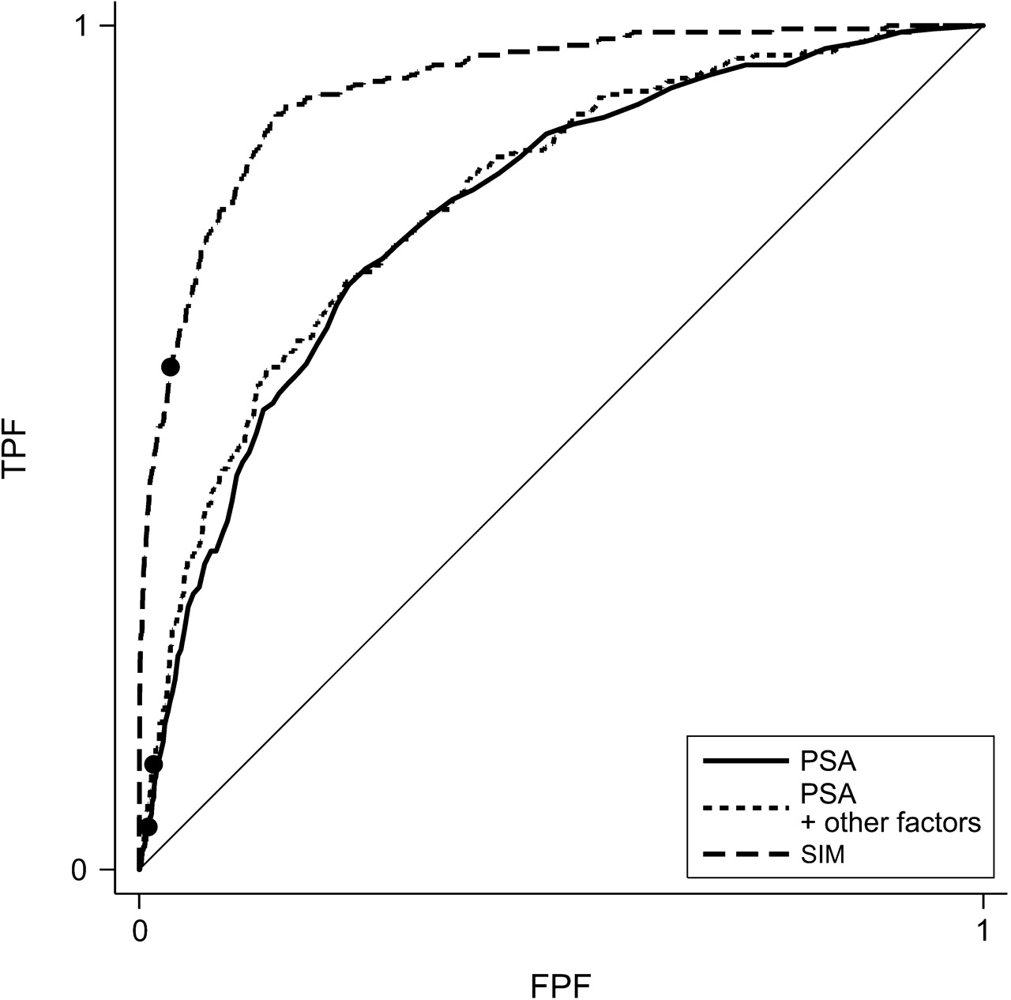
Receiver operating characteristic (ROC) curves for risk models based on prostate-specific antigen (PSA) alone, PSA and other risk factors, and the simulated marker (SIM), Prostate Cancer Prevention Trial, 1993–2003.
Pepe M S et al. Am. J. Epidemiol. 2007;167:362-368
Notes:
Receiver operating characteristic (ROC) curves for risk models based on prostate-specific antigen (PSA) alone, PSA and other risk factors, and the simulated marker (SIM), Prostate Cancer Prevention Trial, 1993–2003. These ROC curves correspond to the predictiveness curves in figure 2. False positive fraction (FPF) and true positive fraction (TPF) points corresponding to the high-risk designation (risk: ≥0.20) are displayed for each model.

Slide 25
Calibration
Ability to predict accurately the absolute level of risk that is subsequently observed
Observed vs. predicted risk
  A risk prediction model is well calibrated: observed event rate is close to 7% and model estimates that the risk for a certain subgroup of individuals is 7% over 10 years
Assessed visually or by the Hosmer-Lemeshow χ² test
  Dividing population into quantiles (e.g. deciles) of predicted risk and plotting the predicted risk versus the observed event rate for each quantile
  A value of P<0.05: poor calibration

Slide 26
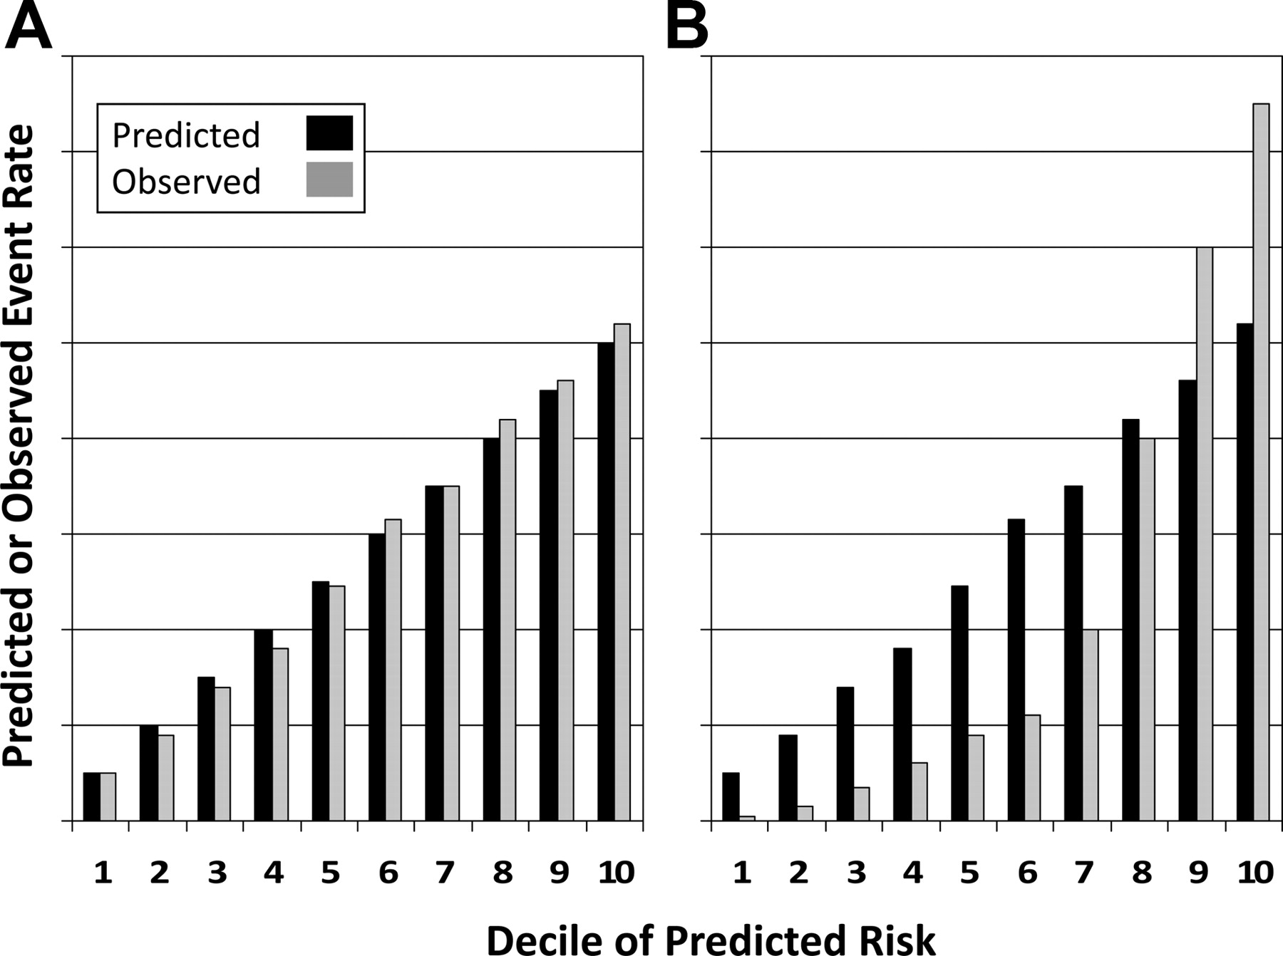
Examples of 2 theoretical risk prediction models with good (A) or poor (B) calibration
Lloyd-Jones D M Circulation 2010;121:1768-1777

Slide 27
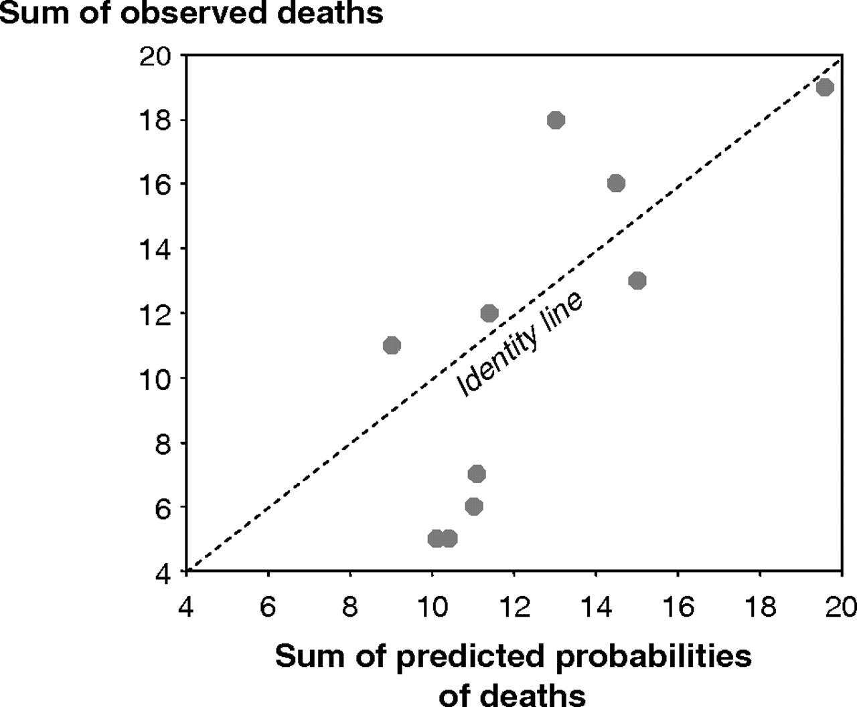
Scatter plot of observed and predicted probabilities
Tripepi G et al. Nephrol. Dial. Transplant. 2010;25:1402-1405
Notes:
Scatter plot of observed and predicted probabilities (see the text for details).

Slide 28
Discrimination vs. calibration
Discrimination reflects the ability of a prognostic model to distinguish a status (died/survived, event/non-event)
Calibration measures how much the prognostic estimation of a predictive model matches the real outcome probability (that is, the observed proportion of the event)
100 patients with end-stage renal disease (ESRD) followed up for 3 years with an observed mortality rate of 30%
  Prognostic predicts a 30% probability of death at 3 years in the whole cohort is perfectly calibrated
  Prognostic model attributing 15% probability of death to survivors and 16% probability to non-survivors perfect but very poorly calibration

Slide 29
Reclassification
Recent paradigm for assessing the utility of risk prediction models
Useful for comparison of nested models
  Measurement of the proportion of individuals who are reclassified from 1 risk category (based on estimated risk provided from a first model) to a different risk category (based on a model that has additional variables compared with the first model)
  Only some of these reclassifications are appropriate

Slide 30
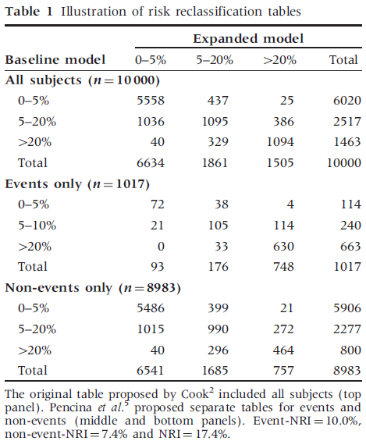
Reclassification
NRI: net reclassification improvement
Event NRI: difference between proportion of subjects above vs. below the diagonal
Non-event NRI: difference between proportion of subjects below vs. above the diagonal
NRI: event NRI + non-event NRI

Slide 31
Clinical usefulness
False negative and false positive classifications are not equally harmful
Harms and benefit need to be weighted to decide optimal decision threshold
  Weight false positive and false negative classifications
  Harm of unnecessary treatment? (false positive decision)

Slide 32
Genetic risk scores

Slide 33
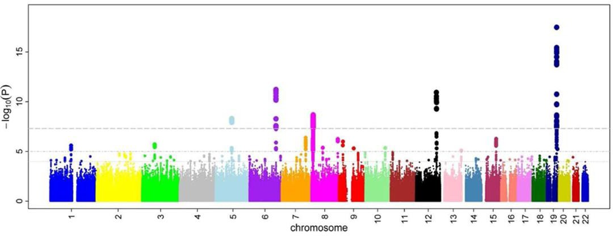
GWAS
GWAS is a tool to discover genetic variants associated with a certain trait
The trait can be
  quantitative (continuous, e.g. height, BMI) usually measured in healthy people
or
  binary (usually case/control status for a disease
picture credit:
M. Kamran Ikram et al - Ikram MK et al (2010) Four Novel Loci (19q13, 6q24, 12q24, and 5q14) Influence the Microcirculation In Vivo

Slide 34

Cumulative genetic predisposition to a trait
Can we use GWAS results to produce a simple numerical score that summarises an individual’s predisposition to a certain trait?
Continuous
e.g. height
continuous estimate
not a risk
Binary
e.g. obesity
>
<
~
odds ratio compared
to a baseline
disease risk

Slide 35
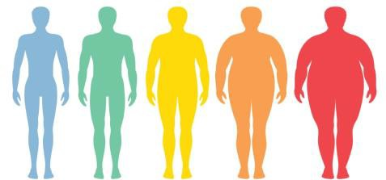
A very simple example
Suppose we have identified 5 SNPs across the genome associated with obesity
Let’s assume the SNPs are independent (not correlated)
Each SNP has a risk allele
We could count how many risk alleles a person carries
Our genetic score would be a number 0 – 10
The higher the number the higher the risk for that person becoming obese
Can we do better?
Each risk allele might have a different odds ratio for obesity, some conferring more some less risk
0
5
10
We could weigh each risk allele by its OR!

Slide 36


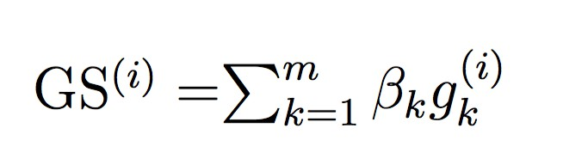
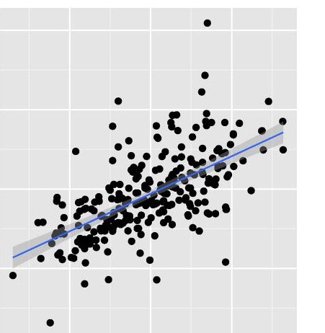
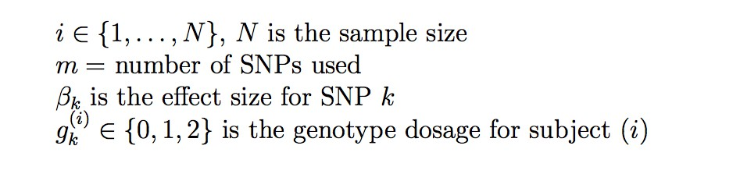
Genetic score definition
Pearson’s R coefficient of correlation
Trait
PGS
Note: In this example the trait is continuous

Slide 37
SNP/Variant selection problem
5
2
4
1
3

Slide 38
SNP/variant selection problem
What would you choose?
5
2
4
1
3
7
8
₉10₁₁
15
6
₁₂ 13
14
SNPs 1-5 (genome-wide significant)
SNPs 1-15 (suggestive)
all SNPs with p-val < 0.001
all SNPs with p-val < 0.05
all SNPs

Slide 39
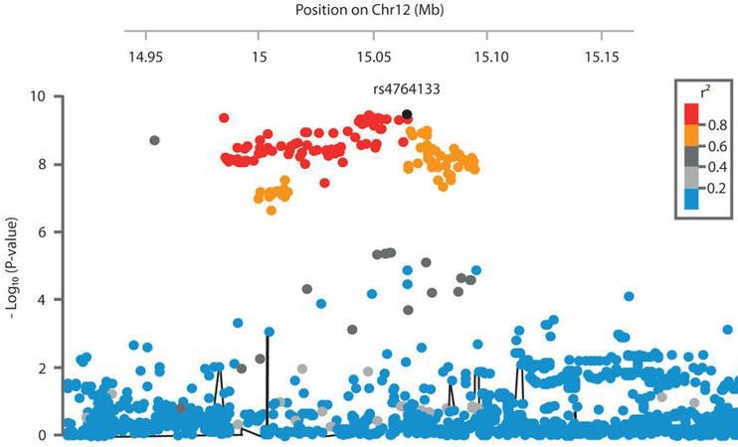
“Clumping and thresholding” method (C+T)
All the previous solutions might be the best variant selection depending on the trait
A common approach is to test different p-value thresholds (“thresholding”) and choose the resulting score that correlates best with the trait or is most predictive of the outcome
The ”clumping” part refers to the need to select independent SNPs otherwise we are double counting the same signal
The term “pruning” is often used and the method is abbreviated as “P+T”

Slide 40
Terminology
Term | Common definition
Genetic score (GS) | A score that uses a limited number of SNPs, for example only the genome-wide significant ones
Genetic risk score (GRS) | As above, when calculated for a disease
Polygenic score (PGS) | A score that uses many SNPs, potentially all genome-wide SNPs
Polygenic risk score (PRS) | As above, when calculated for a disease
Other terms (less used): polygenic index, genome-wide score, genome-wide polygenic score (GPS)

Slide 41
Selection, effect size estimate, validation
To build a polygenic score, we need to:
  select a set of SNPs
  calculate effect sizes
  build and test the polygenic score
Ideally each component is executed in an independent dataset
Alternatively, we can partition an existing dataset, but this could be problematic due to massively reducing sample size
We could use publicly available summary statistics
Steps 1 and 2 are sometimes performed in the same GWAS

Slide 42
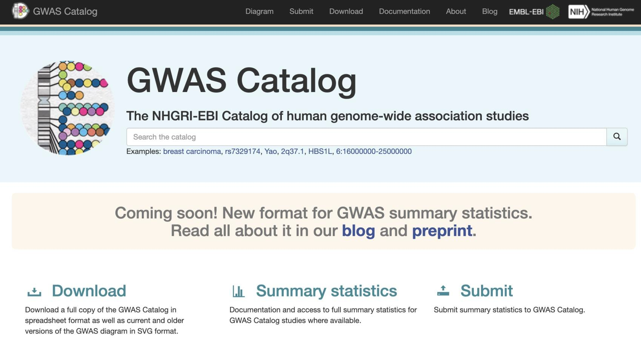
GWAS catalog
A useful place to look for GWAS summary statistics

Slide 43
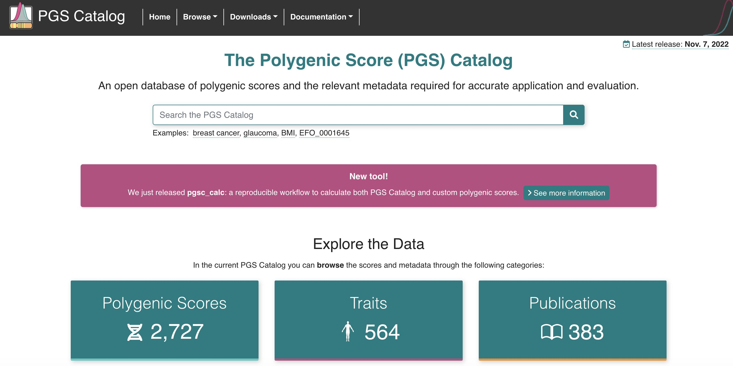
PGS catalog

Slide 44
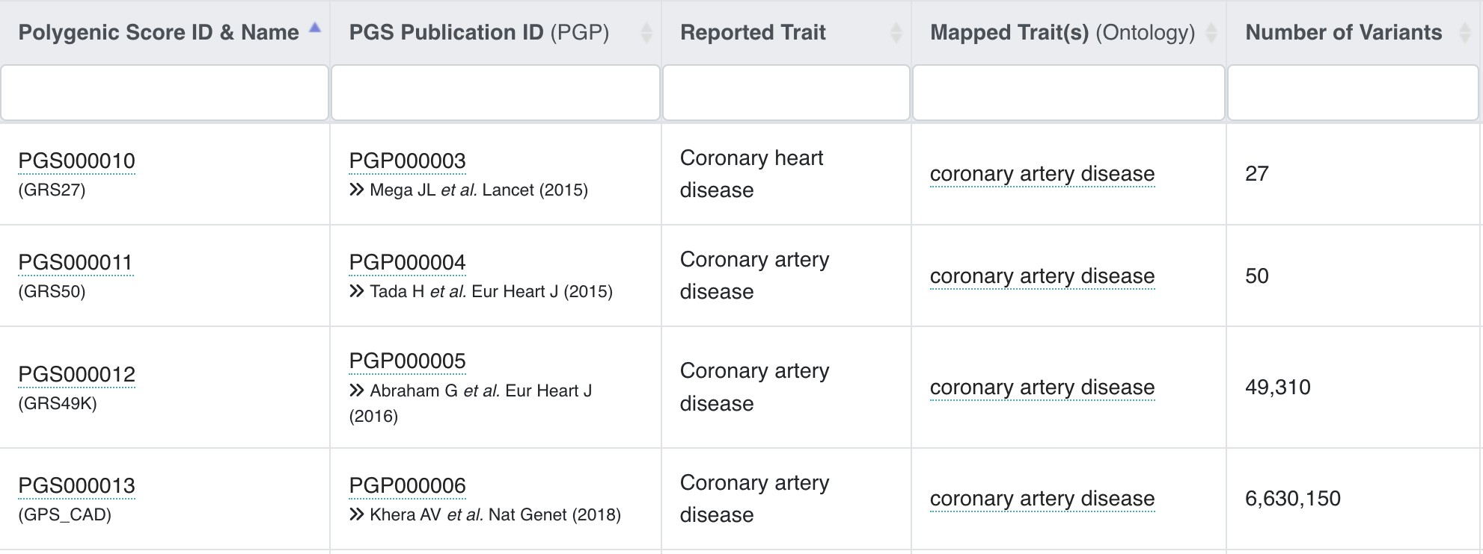
From genetic to polygenic scores
Is bigger better? Are we supposed to include as many variants as possible to improve a (polygenic) score?

Slide 45
Alternative methods for PRS calculation

Slide 46
LDpred background
The previous method does not take into account the linkage disequilibrium (LD), i.e. the natural correlation between genetic variants.
The clumping/pruning part is meant to get rid of correlation and select independent SNPs,
however this might reduce accuracy by getting rid of important signals
LDpred aims to overcome this issue by taking into account LD
INPUT:
GWAS summary statistics
A reference LD panel from the same population

Slide 47
LDpred / LDpred2 algorithm
LDpred is an approximate Bayesian approach
It estimates posterior mean effects using
  GWAS summary statistics
  A prior distribution modelled on two parameters: the genetic heritability and the
proportion of causal SNPs
The genetic heritability can be estimated from the GWAS data
The proportion of causal SNPs is allowed to vary and optimized on a validation dataset as before
LDpred2 is a new version from the same team, which is more efficient and adds two new features:
  a sparse option to set irrelevant variants to weight=0
  an auto option to automatically select the parameters

Slide 48
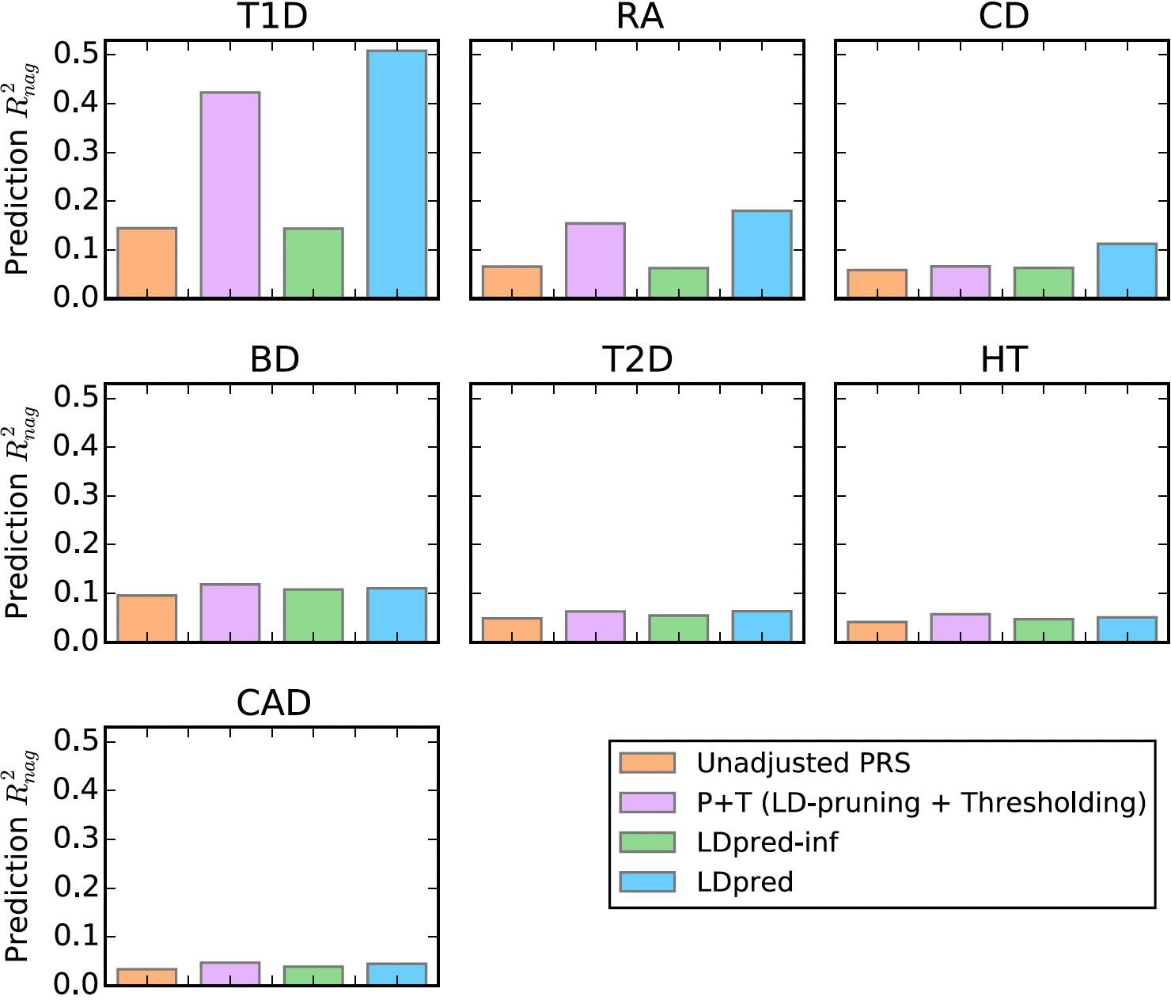
LDpred results comparison on real data
*
*
*
Legend: type 1 diabetes (T1D), rheumatoid arthritis (RA), Crohn disease (CD),
bipolar disease (BD), type 2 diabetes (T2D), hypertension (HT),
and coronary artery disease (CAD).
* = significant improvement

Slide 49
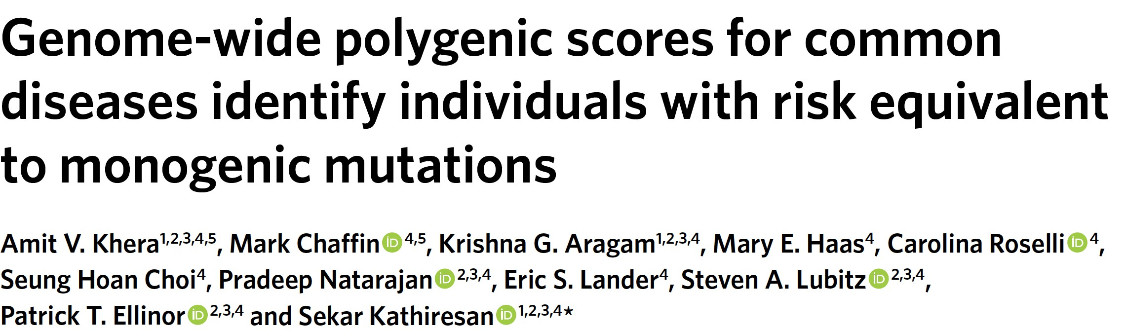
Example: a PRS for coronary artery disease (CAD)

Slide 50
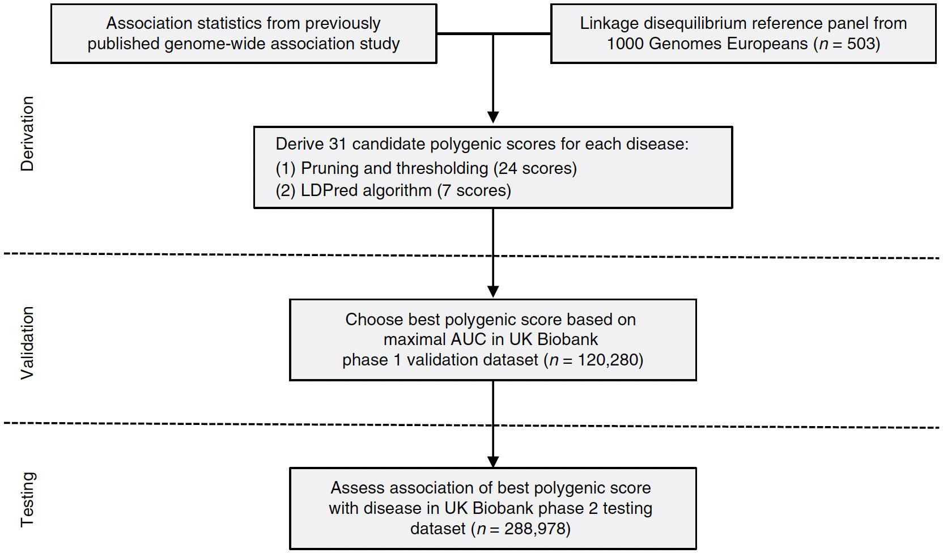
Methods
LD Pred with 7 different levels of parameter 𝜌
Validation in a
portion of UKB
Testing in the remining samples in UKB

Slide 51
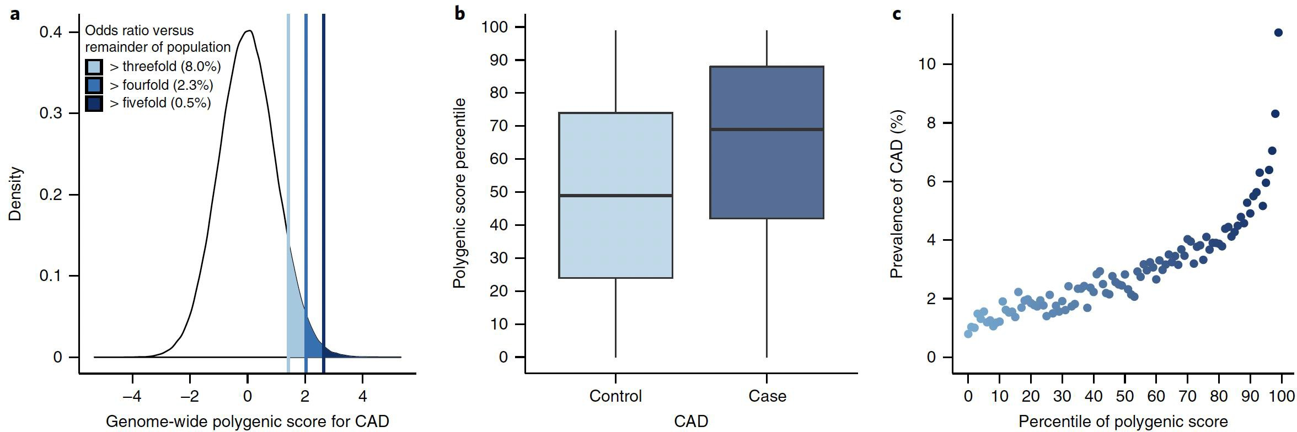
Results
The best score was an LDpred score involving more than 6 million variants

Slide 52
Lassosum algorithm
Similar to LDpred, lassosum aims to incorporate LD information in PRS estimates
It is an approach based on regularised (penalised) regression, equivalent to an elastic net
There are two parameters to optimise (lambda (λ): strength of regularisation and a
shrinkage factor (S): LD adjustment)
Weights are shrunk or set to zero (variant selection)
Compared to LDpred:
it does not have convergence issues
it is much faster to run

Slide 53
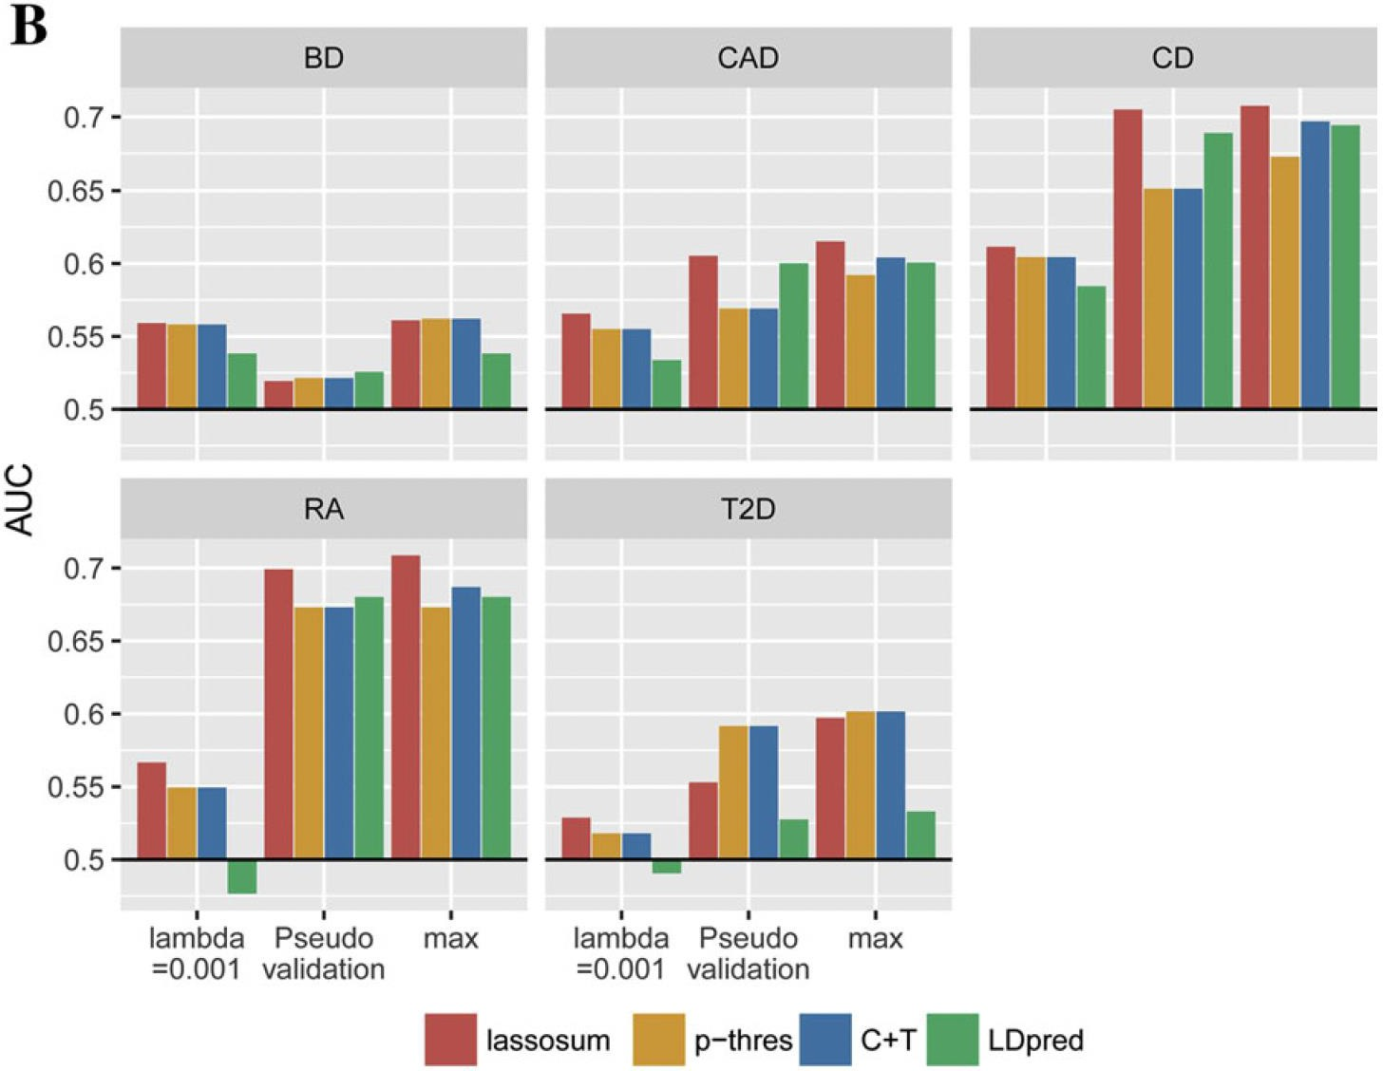
Lassosum performance comparison

Slide 54
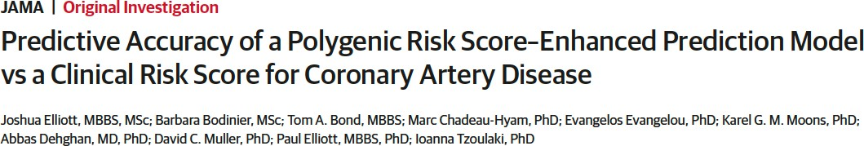
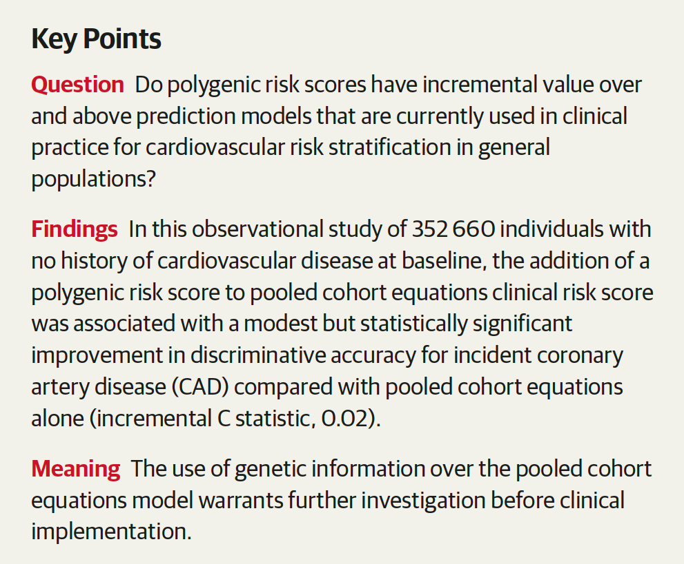
Example: Lassosum for building a polygenic score for CAD prediction

Slide 55
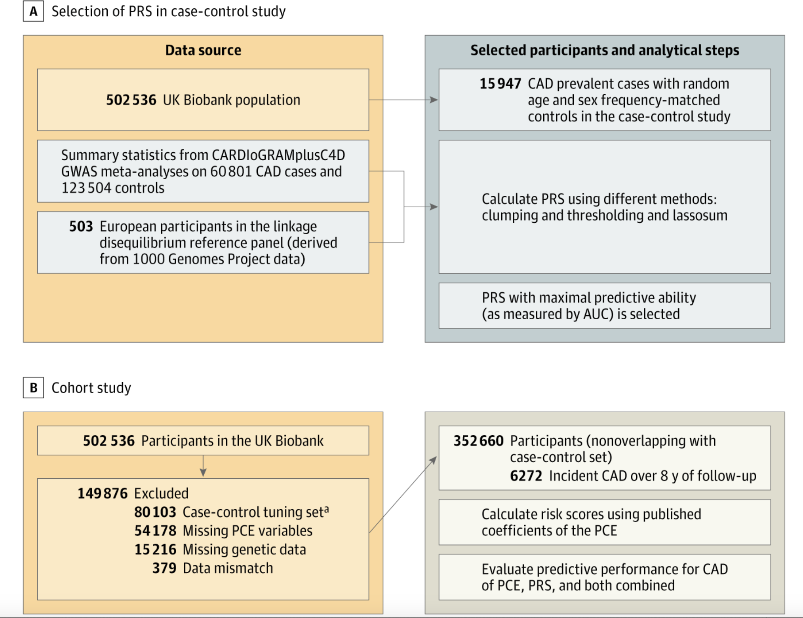

Slide 56
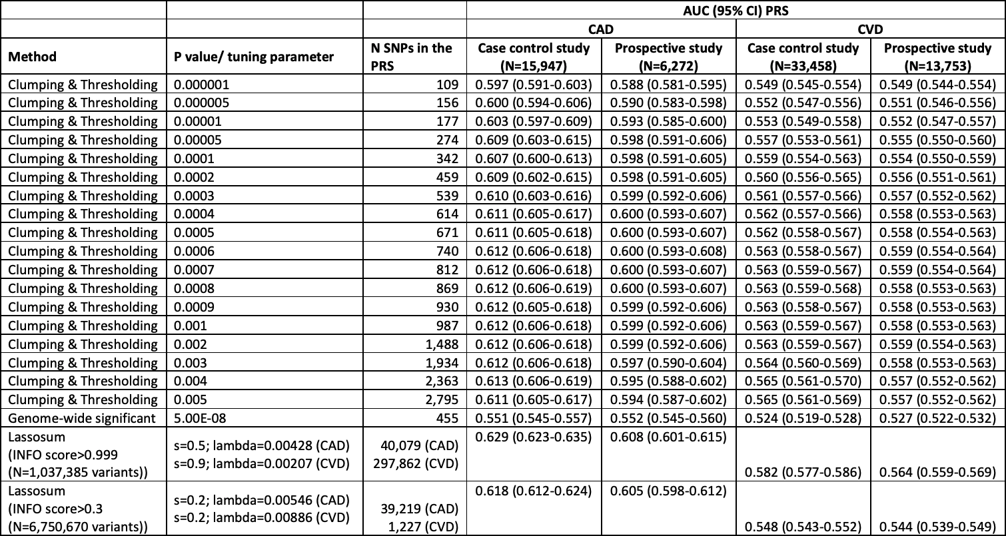
Lassosum vs C+T
To answer their main question, the authors first need to calculate the optimal polygenic score for CAD. They compare C+T and Lassosum and find Lassosum to be the best performing.
standard weighted sum with different variable selection criteria
Lassosum

Slide 57
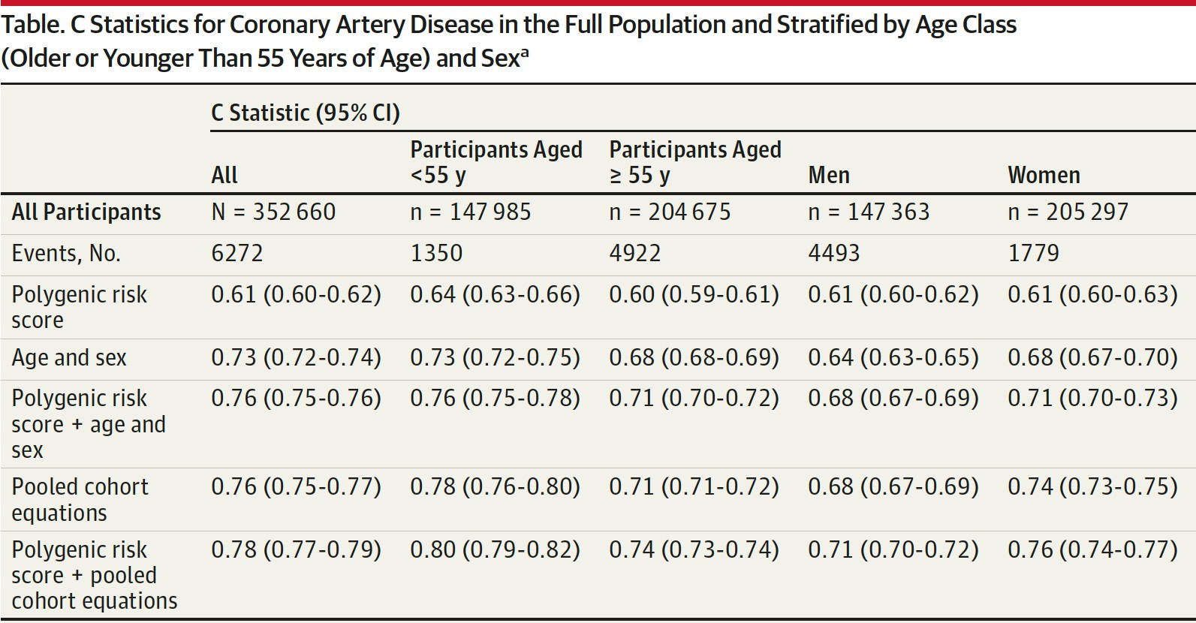
Predicting CAD - results
CAD is considered as a binary outcome
Participants are split in different categories because sex and age are known relevant covariates (sensitivity analysis)
These are “standard” risk factors used in the clinic (not including genetics)

Slide 58
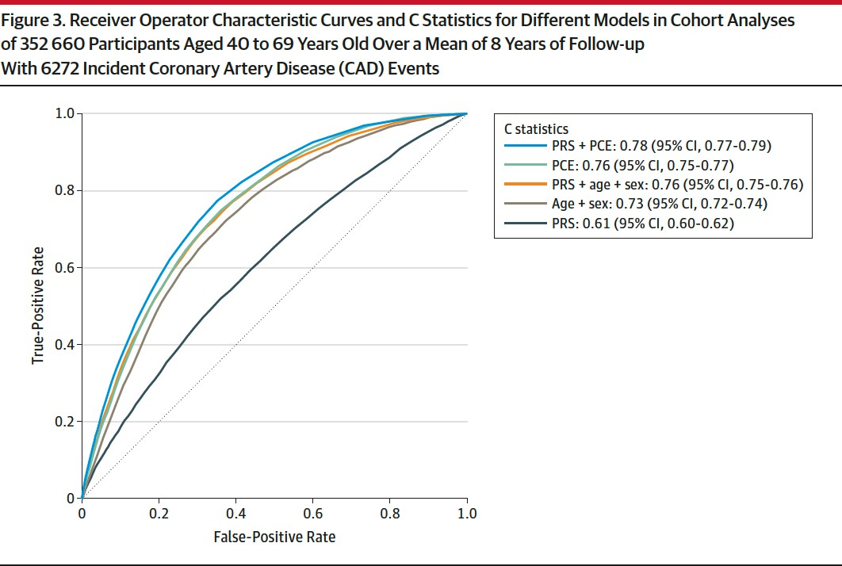
Predicting CAD - results

Slide 59
Machine learning based methods
So far, we have seen knowledge-driven approaches following GWAS results
Most are linear methods
However, the optimal PRS/PGS can be seen as a modelling/prediction problem
We want to find a way to model the outcome using genetic variables
MACHINE LEARNING APPROACHES
  non-linear complex modelling is possible
    computationally expensive
    can not handle millions or predictor variable
Still not a very common approach

Slide 60
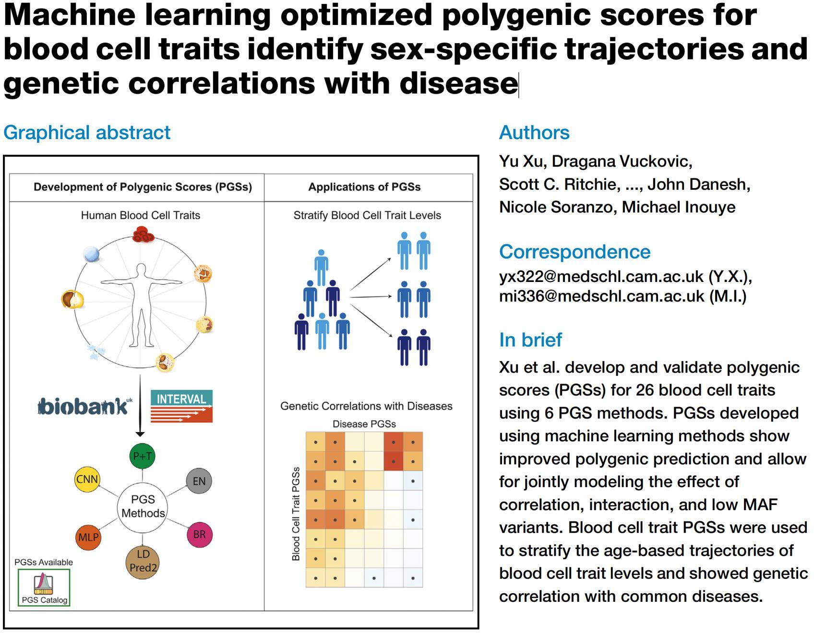

Slide 61
Methods
Variant selection:
conditionally significant
P+T type approach
cross-validation
approach
Methods*:
EN = Elastic Net
BR = Bayesian Ridge MLP = multi-layer perceptron
CNN = convolutional neural network

Slide 62
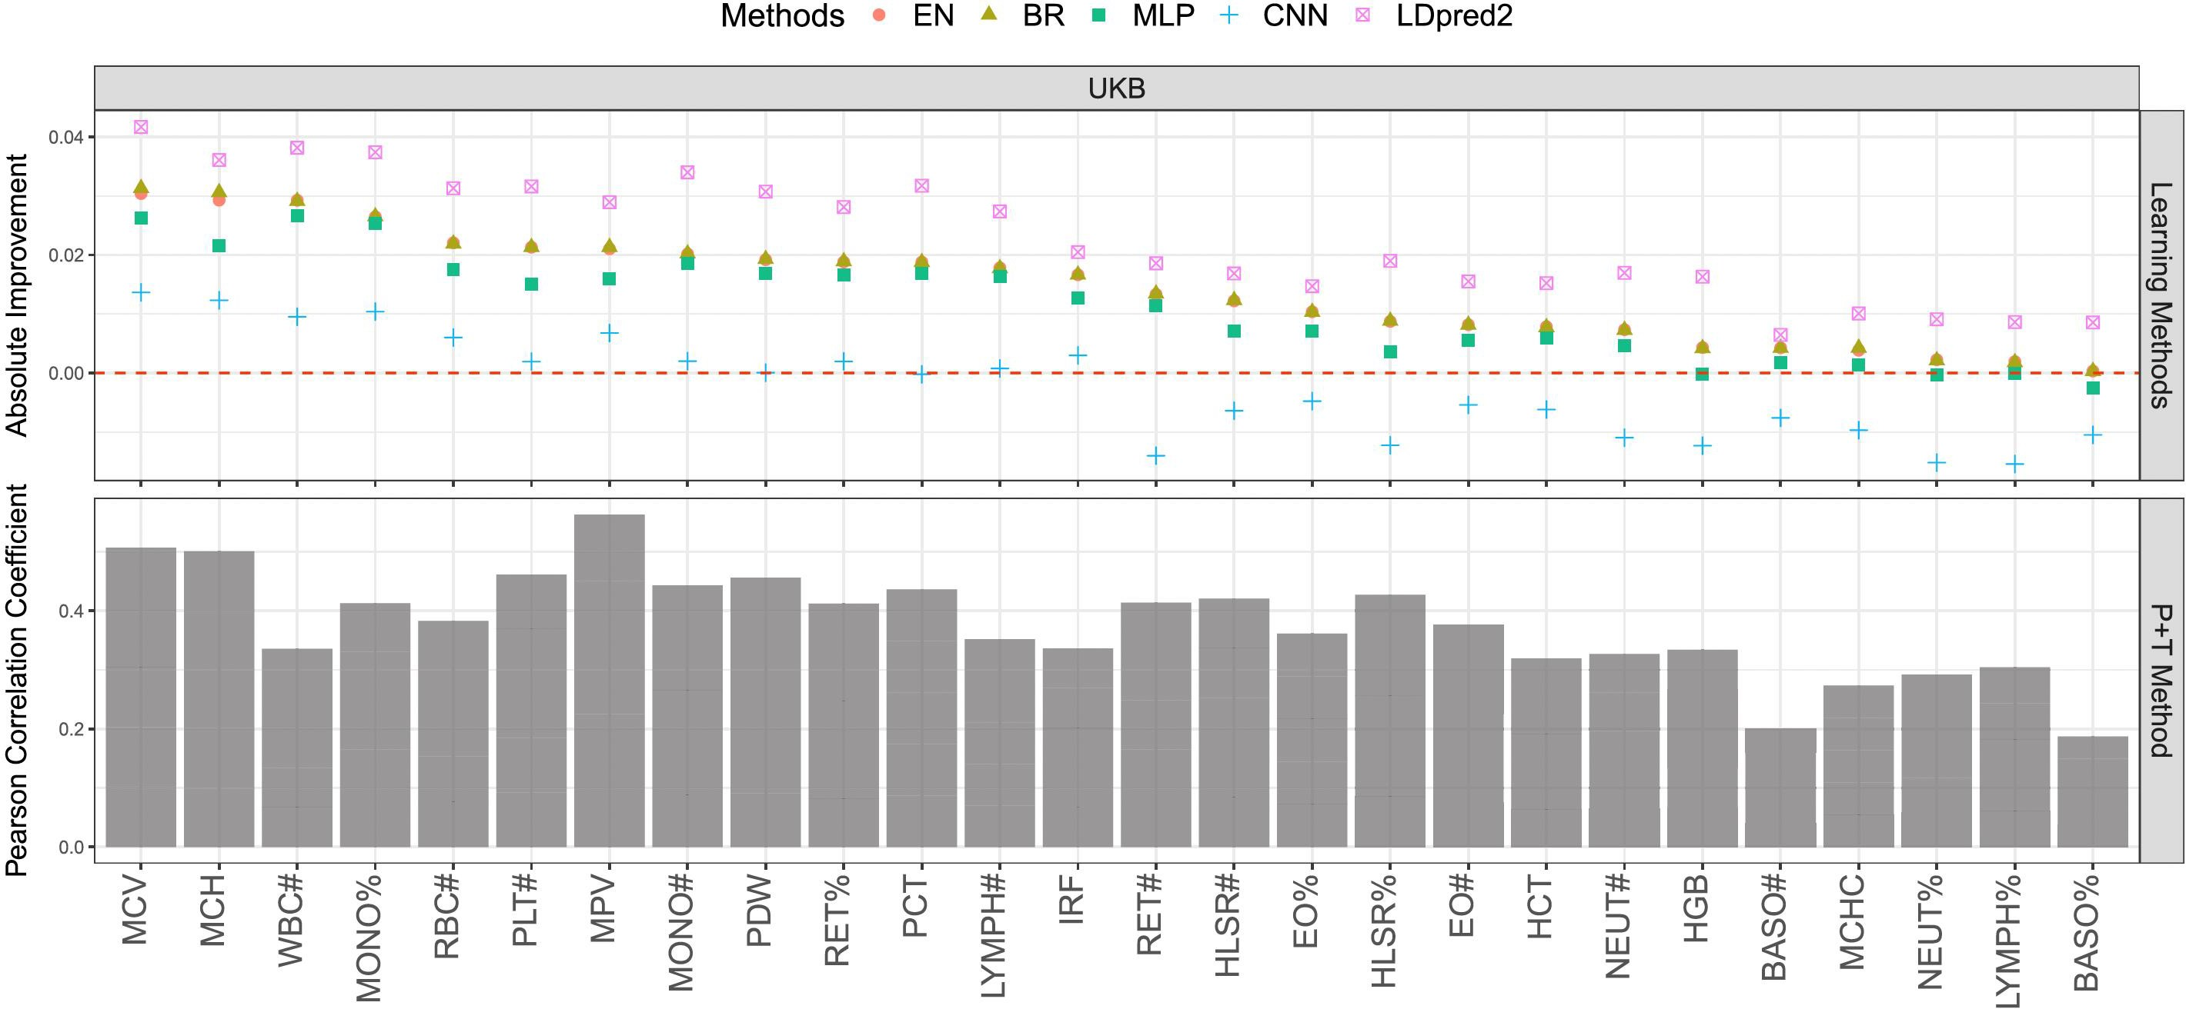
Results

Slide 63
Conclusions from alternative methods for PRS
Methods incorporating LD structure generally perform better than P+T
However more data and more computational resources are needed
The genome-wide scores include millions of SNPs making them more difficult to employ in practice (clinics)
The performance improvement given by ML methods is also limited and might not be worth the computational expense
Some ML approaches are difficult to implement without raw data

Slide 64
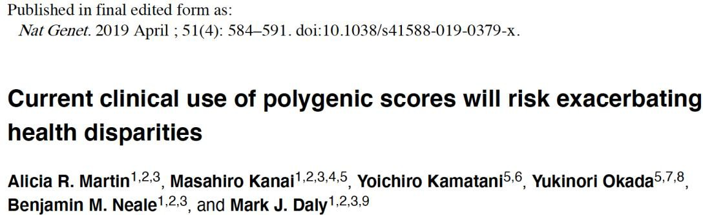
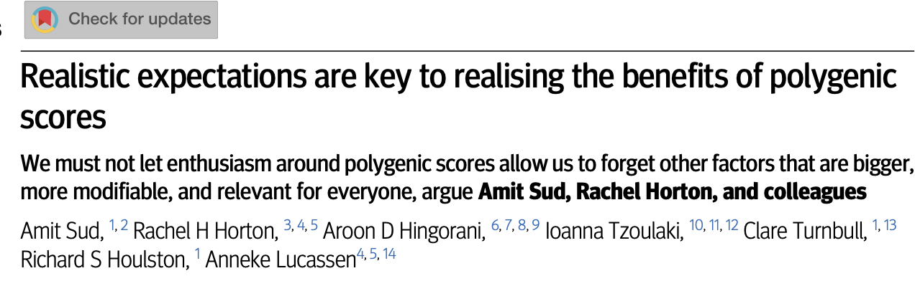
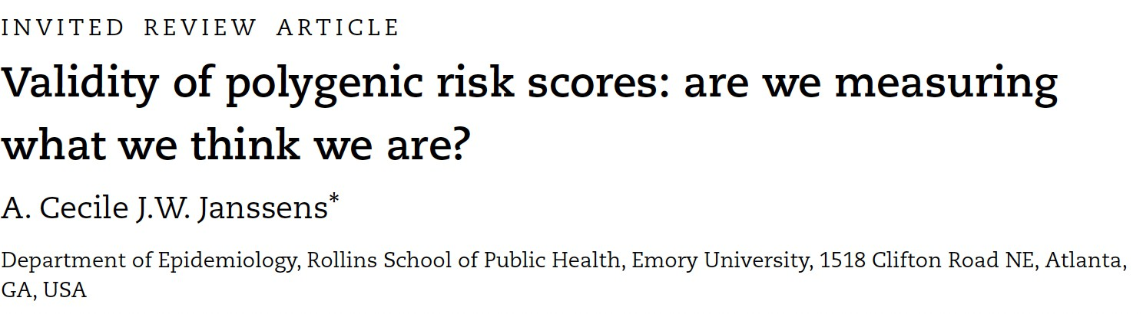
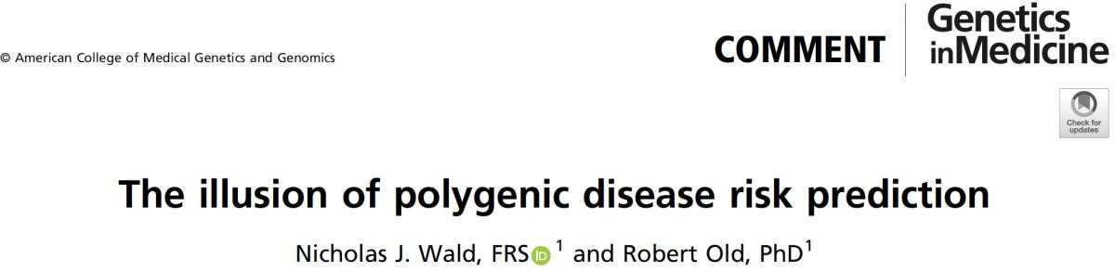
Critiques: prediction, utility and equality issues
Several researchers have voiced concerned about “over-selling” PRSs and their limited predictive
power
A good correlation does not imply good predictive power
Current PRS performance is not good enough for any diagnostic/screening use in clinics (although this considers one disease at a time, while multiple PRSs can be built from a single genetic assay)
Quintile/decile representation can sometimes be misleading
There is still a limited representation of different ancestry groups

Slide 65
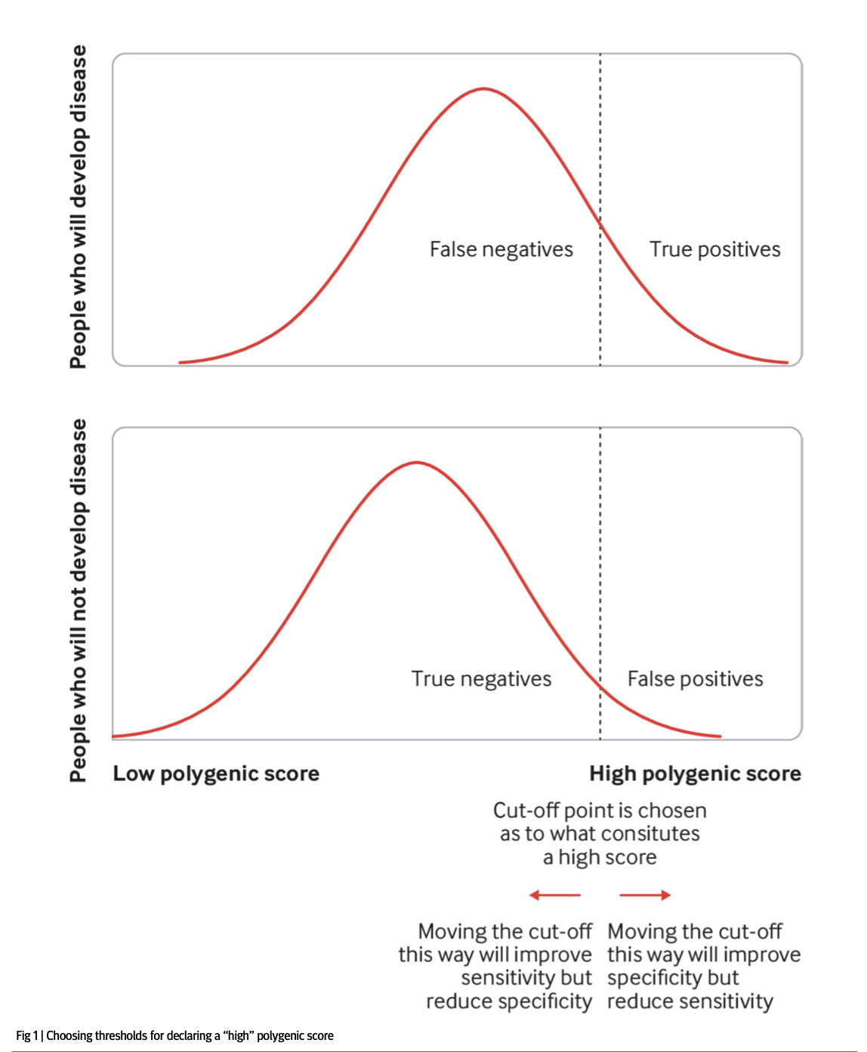
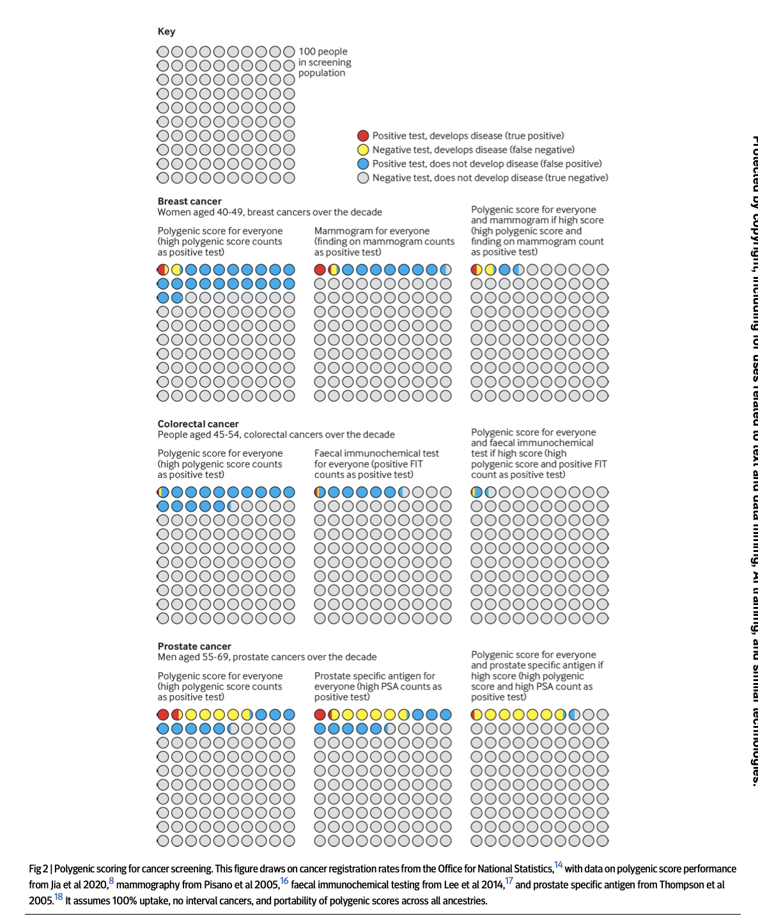
Notes:
Many hope that polygenic scores will improve cancer screening programmes through early or more frequent screening for those at higher polygenic risk. It has been proposed, for example, that annual mammography should be offered to women aged 40-50 with polygenic scores that indicate they are at moderate or high risk of breast cancer.3 This has the potential to detect 1700 more cancers, but at the cost of 5722 false positive results and with 4112 cancers still being missed.8141516Figure 2 uses 100 person diagrams to indicate how polygenic scores might perform for cancer detection in people not currently offered cancer screening in the UK.

Slide 66
Polygenic scores will always be limited in their ability
to predict disease, as much of a person’s disease risk
is determined by factors that polygenic scores cannot
measure
• If we do not effectively communicate this limitation,
we risk overemphasising the role of polygenic scores,
which could undermine current effective screening
programmes
• The enthusiasm around polygenic scores must not
distract from efforts to tackle modifiable risk factors
for disease

Slide 68
Summary
We have defined the polygenic/genetic (risk) scores
Methods for PRS calculation include:
  Clumping/Pruning and Thresholding
  LDpred/LDpred2
  lassosum
  metaGRS
  machine learning algorithms
PRSs have the ability to capture risk equivalent to that of rare monogenic mutations
PRSs act independently and additively on top of monogenic mutations, hence
potentially conferring a significant risk modifier
PRSs have the potential to influence prevention and risk estimates in the clinics although some concerns still need to be addressed

