Slide 1
Inherited Bone Marrow Failure Syndromes
Lydia Kossiva,
Prof. of Pediatrics-Pediatric Hematology-Oncology
National and Kapodistrian University of Athens, Greece

Slide 2
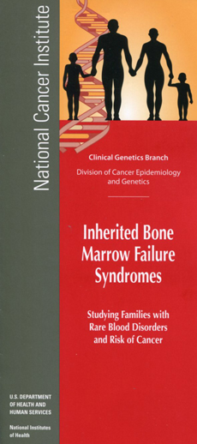
Bone marrow failure syndromes ‘Heterogeneous group of diseases characterized by progressive bone marrow failure & increased predisposition to cancer’
Idiopathic (70%) – of unknown etiology
Inherited (20%)
Secondary (10%)
Radiation / medication
Viral agents
Autoimmune diseases (SLE)
Inherited bone marrow failure syndromes (IBMFs)
Eterogenous group of diseases characterized by:
Progressive BM failure
Predisposition to malignancies (leukemia, solid tumors)
Morphological stigmata
Several well – described syndromes
Others are harder to classify

Slide 3
IBMFs
They are considered pediatric diseases
Rarely the diagnosis is made in adulthood.
Inability to determine their exact incidence
>25% of children and 10% of young adults characterized as "acquired" aplastic anemia have IBMFS
HSCT: AA (5%), MDS (14%) germline mutations IBMF
Different severity of clinical manifestations even in the members of the same family
40% of patients do NOT have morphological stigmata
Floglesong JS et al, Europ Med J 2017
Diagnosis
Patients with:
characteristic findings from the clinical examination and blood test the
Patients with:
"Acquired" aplastic anemia MDS/AML
Cancer at a young age
Definite diagnosis: Presence of characteristic mutations

Slide 4
IBMFs
Fanconi anemia (FA)
Dyskeratosis Congenita (DC)
Shwachman – Diamond syndrome (SDS)
Diamond - Blackfan anemia (DBA)
Congenital Amagakaryocytic thrombocytopenia (CAMT)
TAR syndrome (Thrombocytopenia –Absent Radius)
Severe congenital neutropenia (SCN)
Congenital dyserythropoietic anemias (CDA)
GATA 2 deficiency
SAMD9/SAMD9L

Slide 5
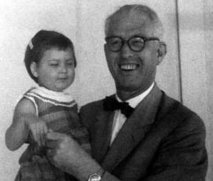
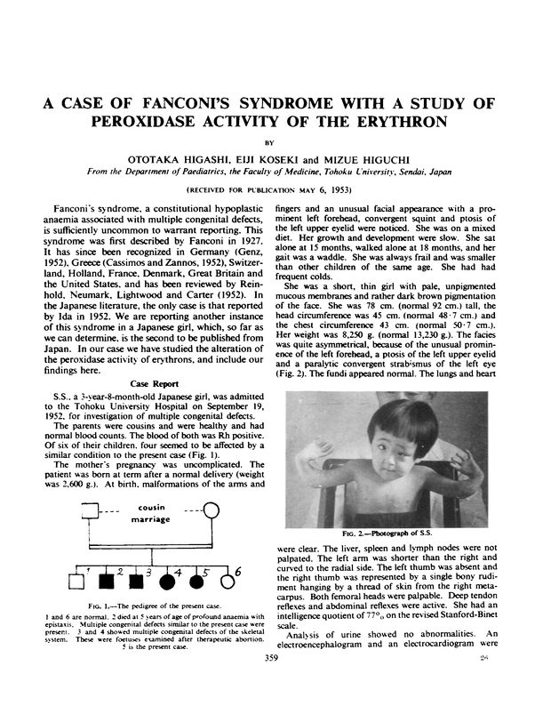
Fanconi anemia
Guido Fanconi
(Swiss pediatrician,1892-1979)
1927, 3 siblings:
Pancytopenia
Short stature
café au lait spots
Alter, FA101 (2006)

Slide 6
Fanconi anemia
23 genes
Inherited with:
Autosomal recessive trait
X-linked recessive trait (FANCB)
Autosomal dominant trait (RAD51)
First haematological manifestation: cytopenia
It is characterized by chromosomal instability and an increased predisposition to malignancy
Diagnosis: the first decade of life (6.5 years)
Prevalence 1 – 5/10⁶ population
Europ Registry: Prevalence 4 – 7/10⁶ live births
M/F: 1.2/1

Slide 7
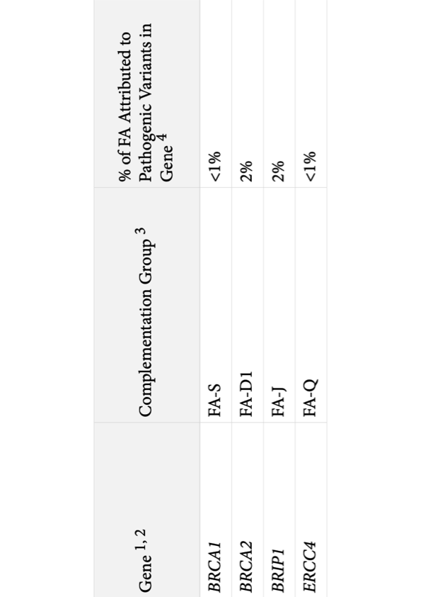
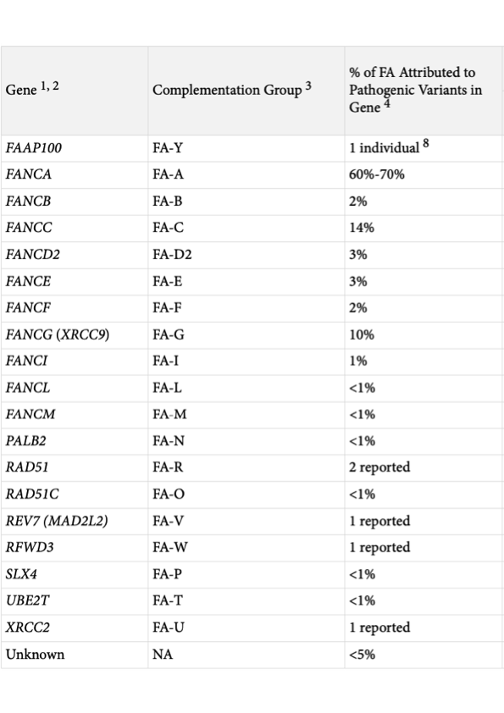
Gene Reviews 2021

Slide 8
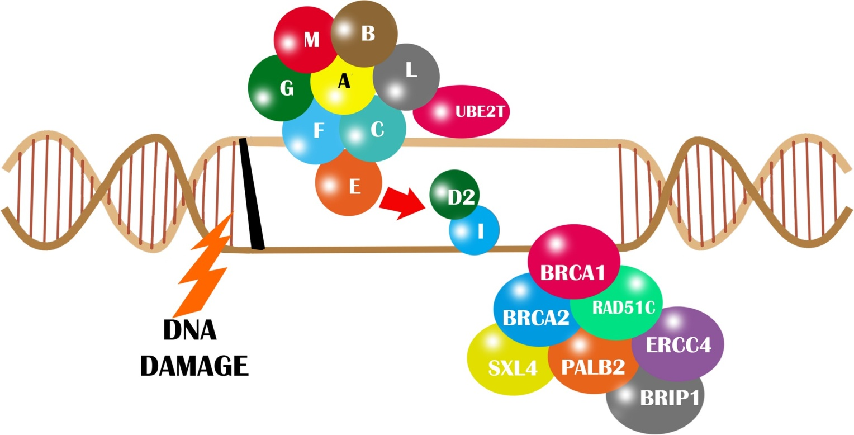
Pathophysiology FA
Chromosomal instability (fragility of chromosomes) Abnormal cell cycle kinetics (prolonged G2 phase) Increased apoptosis
Heterozygotes’ frequency: 1/300 -1/181 (US) (1/100 in Ashkenazi)
Complementation studies:
23 groups (A-Q, D1-D2)
Autosomal recessive
X-linked: FANC-B
Autosomal dominant: FANC-R
British Journal of Haematology, 2017

Slide 9
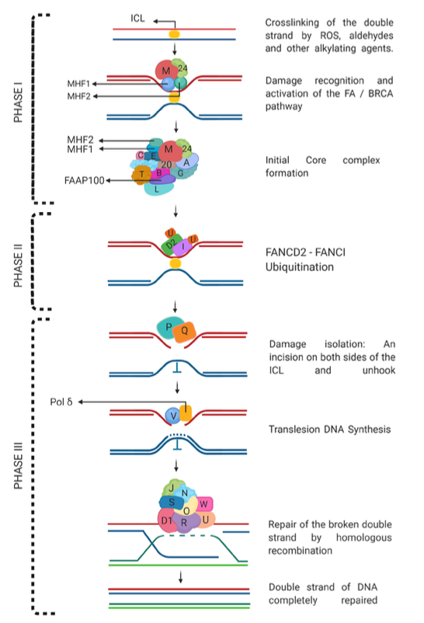

Cellular Consequences of Pathway Disruption
Genomic Instability
Chromosomal breakage and radial formations
Cell Cycle Arrest
G2/M phase accumulation and checkpoint activation
Increased Apoptosis
Elevated HSC death causing bone marrow failure
Hypersensitivity
Extreme sensitivity to DNA crosslinking agents
Moreno OM, et al.
Biomedical Reports, 2021

Slide 10


Diagnosis
Physical examination
Personal /Family history
Laboratory evaluation
Peripheral blood:
↓PLTs, ↓WBC, AA
↑Hb F, ↑a-feto, ↑i
BM aspirate/biopsy
Decreased cellularity
Karyotypic analysis
Screening tests:
Fragility test (DEB, MMC)(stress test) – elevated percentage of chromosomal breaks
Flow cytometry: prolonged G2 phase (lymphocytes)

Slide 11
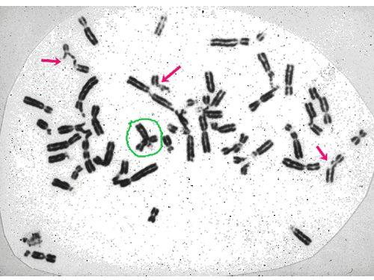
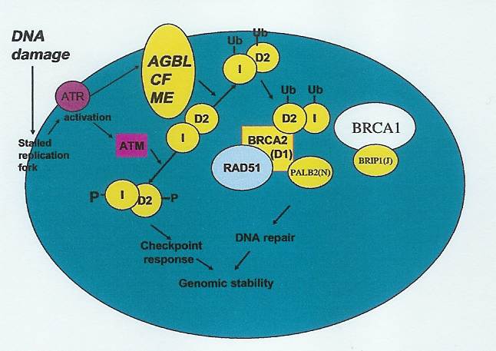
Chromosome
breaks
Screening test
Radial formation
Chromosome breakage in Fanconi Anemia cells
Definitive diagnosis:Molecular analysis

Slide 12
Clinical characteristics (60% of the pts)
Café au lait spots
Short stature
Abnormal thumbs +/- radial hypoplasia Microcephaly/microophthalmia
Hypogonadism, GH deficiency, insulin resistance, metabolic syndrome, hypothyroidism
Horseshoe kidney,
Duodenal atresia
Cardiac abnormalities

Slide 13
Clinical evaluation - stigmata
VACTERL-H (5-10% FA)
(FANC B, FANC I)
Vertebral anomalies
Anal atresia
Cardiac anomalies
Trachea-esoph.fistula
Esoph. Atresia
Renal anomalies
Limb abnormalities
Hydrocephalus
PHENOS
(FANCD2)
Skin Pigmentation
Small Head
Small Eyes
Nervous system
Otology
Short Stature
40% without stigmata

Slide 14

Genotype – phenotype correlation
BRCA2 (FANC-D1)
Early manifestation of AML/Solid tumors
CR 97% until the age of 6 yrs.(AML, Medulloblastoma, Wilms tumor)
FANCB
Early onset of BMF, congenital anomalies, VACTERL-H
FANCG
Early onset of BMF, increased incidence of AML
PALB2
Solid tumors (Μedulloblastoma, Wilms)tumor)
FANCA
Late onset BMF with slow progression
FANCC
Early onset of BMF, increased incidence of AML
FANC-O/FANC-S
Lack of BMF (FA-like syndrome)
FANC B, D1, D2, J, N: 90% pts with congenital anomalies
FANC-D1 (BRCA2),FANC-N,FANC-J, FANC- G, FANC- R
⬇
Breast / ovary cancer

Slide 15
Risk of carcinogenesis
AML (✕ 500 ) (15-35 yrs)
ΜDS (monosomy 7)/7q deletions
Solid tumors
First manifestation of the disease
Squamous cell cancer of head /neck (✕500 -700) , 20-40 yrs, poor prognosis
Secondary malignant tumors (skin, genitourinary tract)
Liver cancer (androgens)

Slide 16
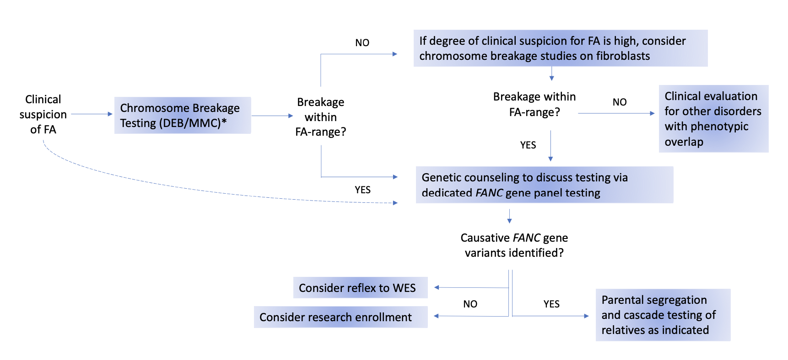
Fanconi Anemia Clinical Care Guidelines 2023

Slide 17
Disease progression
Marrow failure: usually occurs in the first decade of life
50% of patients with thrombocytopenia → pancytopenia (within 3-4 years)
Pancytopenia: 84% of at age 20
MDS (6%), AML (600 ✕)
Solid tumors
First manifestation of the disease
Squamous cell cancer of head /neck (✕500 -700) , 20-40 yrs, poor prognosis
Secondary malignant tumors (skin, genitourinary tract)
Liver cancer (androgens)
Causes of death:
Marrow failure (CR 50%)
AML / MDS (CR 25%)
Solid tumors (epithelial tumors of the head, neck, gynecological cancers (HPV), cancer of the esophagus, liver, skin, etc. (CR10%)
25% of patients the solid tumor precedes the diagnosis of FA
Average life expectancy: 29 yrs

Slide 18
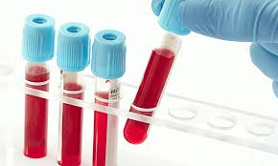
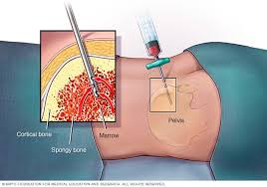
Follow up
FBC /3 months
BM aspirate-biopsy/yr
BM cytogenetic analysis/yr
ENT/ yr (>10 yrs)
Gynecological examination / yr from the initiation of menarche

Slide 19

Treatment
Steroids
Androgens
HSCT
Gene therapy

Slide 20





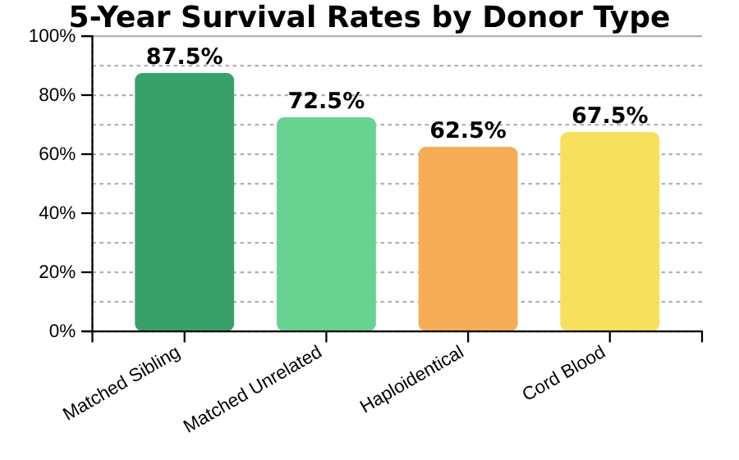
















HSCT for Fanconi Anemia
HSCT Success Rates by Donor Type
HSCT Complications in FA
Conditioning Toxicity
Infectious Complications
Mucositis (severe)
CMV reactivation (25%)
Organ damage (liver, lung)
Invasive fungal infections
Prolonged immune recovery
Graft-vs-Host Disease
Long-term Risks
Acute: 25-40% (grades II-IV)
Secondary malignancies (20%)
Treats bone marrow failure ONLY.
It does NOT reduce the risk of other cancers
Chronic: 15-25%
Endocrine dysfunction
Matched Sibling
85-90%
Matched Unrelated
70-75%
Infertility (>90%)
5-year survival
5-year survival
Haploidentical
60-65%
Cord Blood
65-70%
FA-Specific Transplant Considerations
5-year survival
5-year survival
Reduced intensity conditioning (RIC) essential due to DNA repair defect
T-cell depletion reduces GVHD risk in alternative donor transplants
HSCT Outcome Determinants
Age at transplant:
Better outcomes when performed before age 10
Enhanced supportive care and antimicrobial prophylaxis required
Pre-transplant MDS/AML:
Worse prognosis if clonal evolution present
Long-term cancer surveillance critical post-transplant
FA complementation group:
FANCD1/BRCA2 has worse outcomes
Prior androgen exposure:
May increase risk of hepatic complications

Slide 21






Key Clinical Trials
Gene Therapy Approaches for Fanconi Anemia
FANCOLEN-I Trial
Completed
Objective: To provide a proliferative advantage of the modified cells over the rest of the marrow subcellular population Encouraging results
Phase 1/2 | NCT03157804
Vector:
Lentiviral (LV-FANCA)
Target Cells:
CD34+ HSCs
Outcomes:
Progressive improvement in 7/9 patients
FANCOLEN-II Trial
Active
Phase 2 | NCT04069533
Vector:
Improved lentiviral design
Target Cells:
CD34+ HSCs
Patients:
Pediatric FA-A patients
Stanford/UCSF Trial
Recruiting
Phase 1 | NCT04248439
Vector:
Lentiviral (pCCL-FANCA)
Ages:
1-40 years
Conditioning:
None (non-conditioned)
Common Features Across Trials
Safety issues ???
No conditioning regimen
Primarily target FA-A subtype
CD34+ hematopoietic stem cells
Rio P et al. Nat Med. 2019

Slide 22
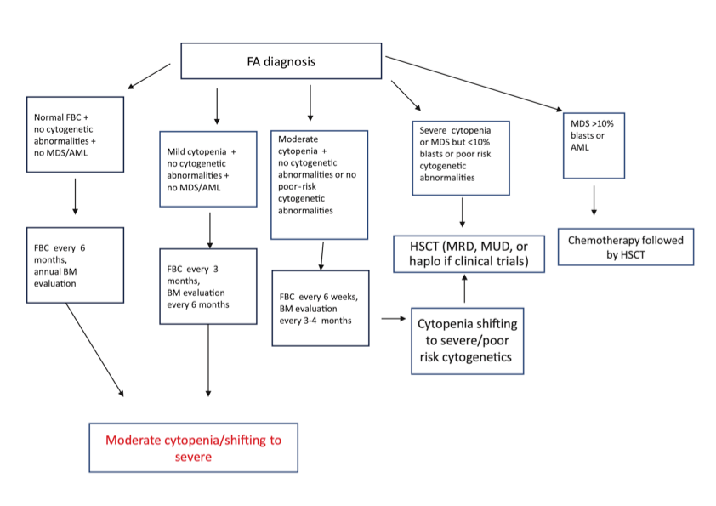
Hematology 2022 | ASH Education Program

Slide 23
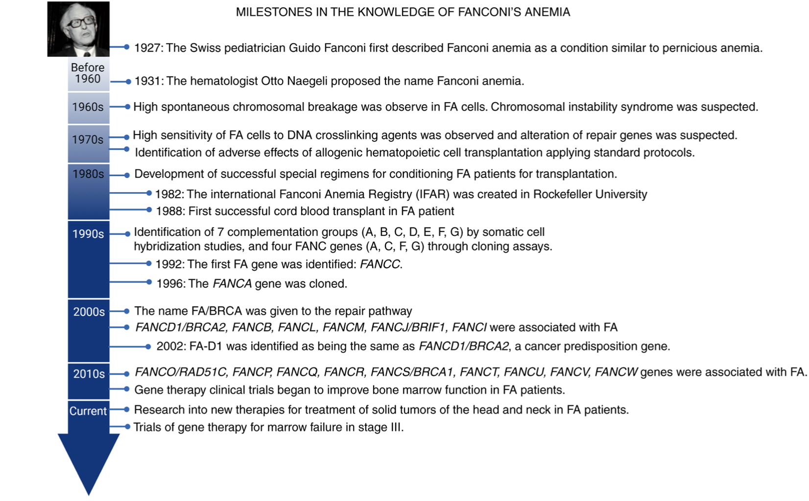

Slide 24
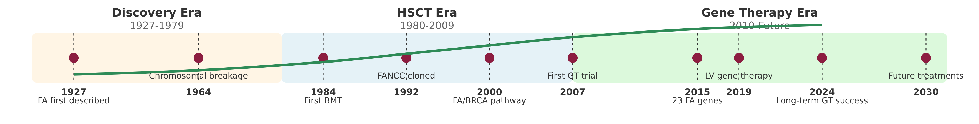





Evolution of Fanconi Anemia Treatments
Discovery Era (1927-1970s)
HSCT Era (1980s-2000s)
Gene Therapy Era (2010s-Future)
Initial identification and characterization of FA as a clinical entity.
Development of HSCT protocols specific for FA patients.
Molecular understanding enabling targeted genetic interventions.
1927: First reported by Dr. Guido Fanconi
1984: First successful matched sibling HSCT
23+ FANC genes identified and cloned
1964: Chromosomal breakage test established
1990s: High mortality with standard conditioning
2010: First gene therapy trials using γ-retrovirus
Mainly supportive care: transfusions
2000s: Reduced intensity conditioning
2016+: Lentiviral vector approaches
Androgen therapy introduced (oxymetholone)
T-cell depletion for alternative donors
2020s: Base editing and CRISPR/Cas9 approaches
Poor long-term outcomes
Fludarabine-based protocols improved survival
iPSC-derived HSCs under development
Historical Progress
Key Treatment Paradigm Shifts
Current Clinical Challenges
1980s: 20-30% overall survival
From myeloablative to reduced intensity conditioning
Development of malignancies post-transplant
1990s: ~40-50% overall survival
From matched sibling to alternative donor sources
Limited HSC collection for gene therapy
2000s: ~60-70% with RIC regimens
From allogeneic HSCT to autologous gene therapy
Gene therapy vector copy number optimization
2010s: >80% with modern protocols
From viral vectors to gene editing technologies
Managing non-hematologic manifestations

Slide 25
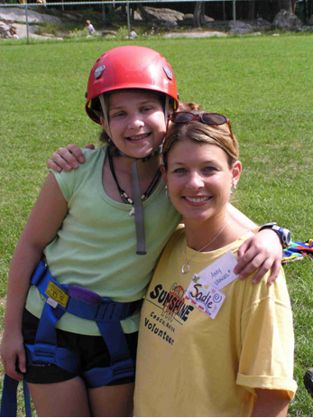
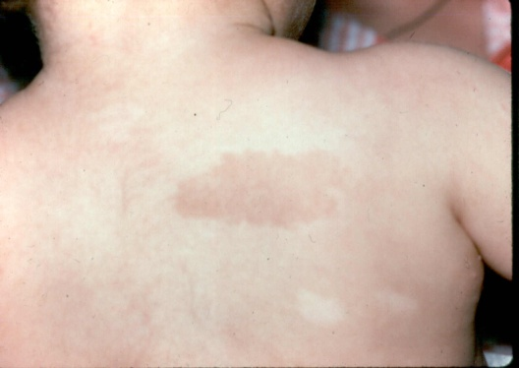
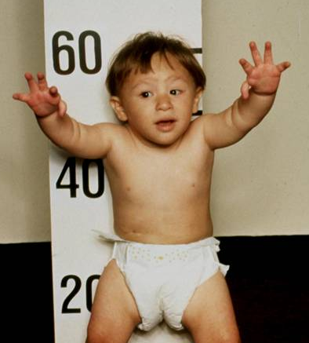

Slide 26
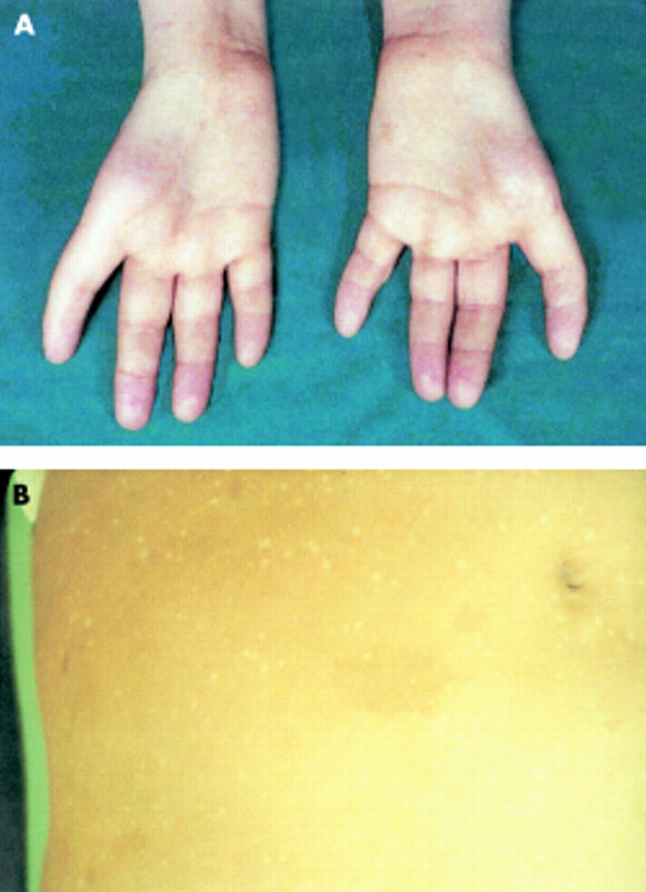

Slide 27
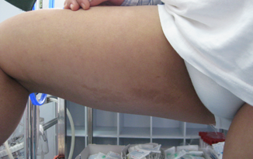
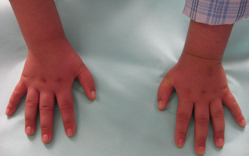

Slide 28
Dyskeratosis Congenita
Characteristic triad:
Skin pigmentation
Onychodystrophy
Oral leukoplakia
1910-1930: first dermatological reports (75% of patients with DC)
1960: report of hematological manifestations along with skin anomalies
Incidence: 1/10⁶ people
M/F 3.2/1
Additional clinical manifestations
Atresia of lacrimal ducts (30%)
Learning disabilities, developmental / mental retardation (25.4%)
Pulmonary disease (20.3%)
Short stature (19.5%)
Severe dental caries (16.9%)
Esophageal stenosis (16.9%)
Premature graying of hair (16.1%)
Hyperhidrosis (15.3%)
Malignancy (9.8%)
Liver disease, enteropathy (7.3%)

Slide 29
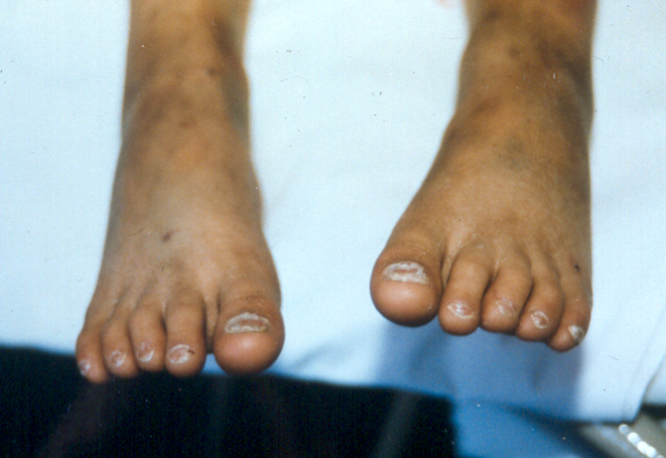
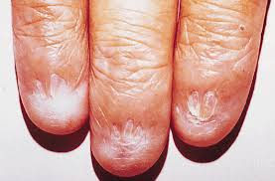
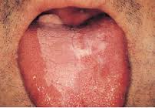
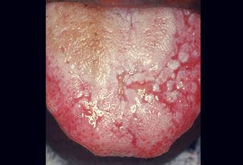

Slide 30
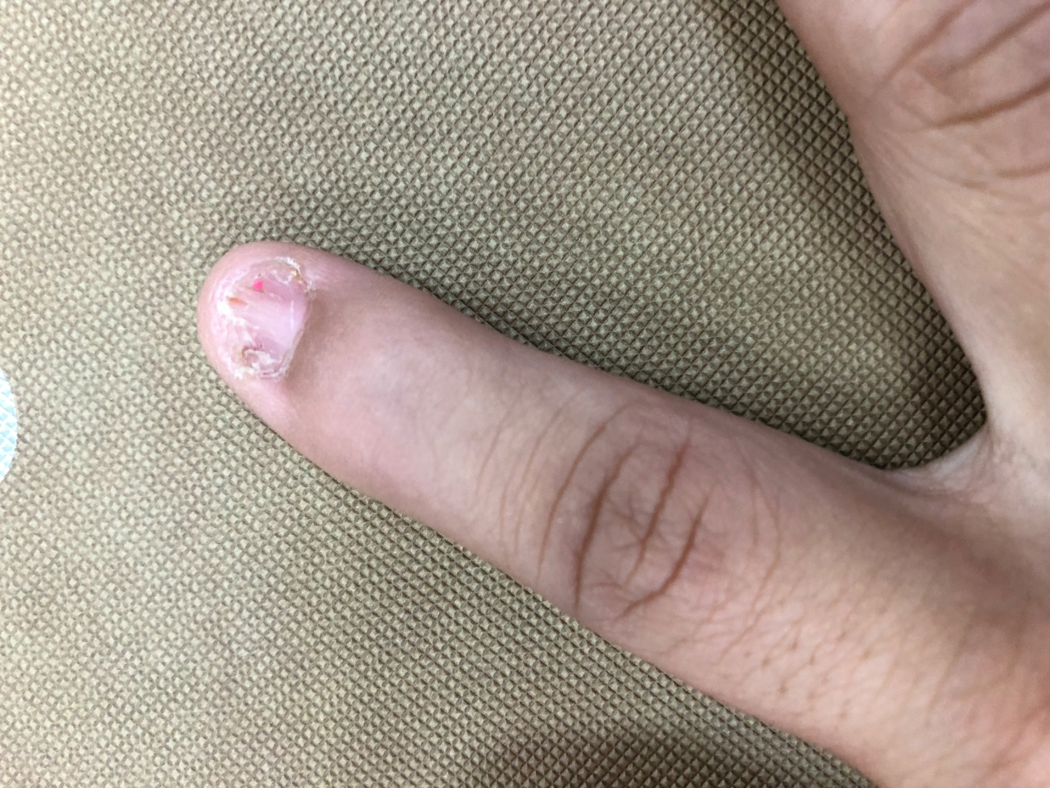


Slide 31












Telomere Biology and Pathophysiology
Understanding the Basics of Telomere Maintenance
What are Telomeres?
The End Replication Problem
Nucleoprotein structures at chromosome ends
DNA polymerase causes telomere shortening with each division
Protect chromosomes from degradation
Composed of repetitive DNA (TTAGGG in humans)
Essential for rapidly dividing cells (stem cells, skin cells)
Without telomerase, telomeres become critically short
Telomerase Function
Ribonucleoprotein DNA polymerase enzyme
Adds telomeric repeats to chromosome ends
Defects in Telomere Maintenance
Maintains telomere length and replicative capacity
DC defects lead to abnormally short telomeres
Triggers senescence or apoptosis in rapidly dividing tissues
Results in bone marrow failure, fibrosis, and increased cancer risk

Slide 32






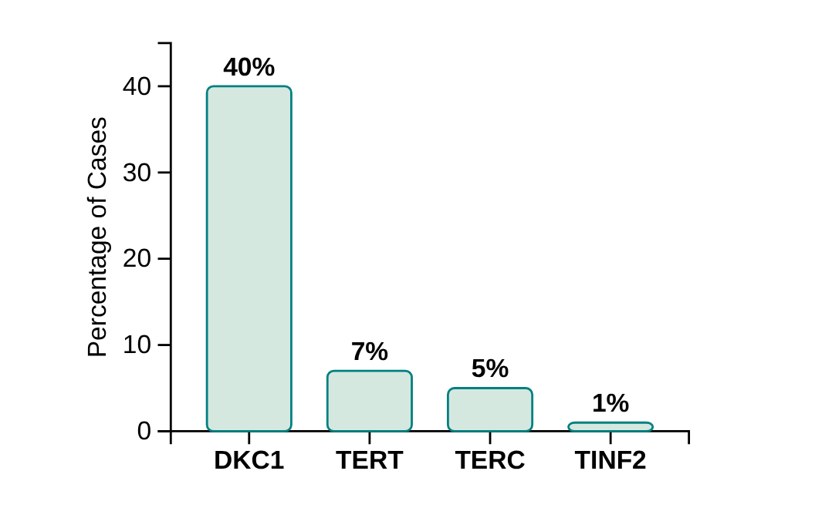




Genetic Basis and Key Mutations
Major genes involved in telomere maintenance
DKC1
TERT
Mutation Frequency
Location: X chromosome
Function: Telomerase reverse transcriptase
Function: Encodes dyskerin
Role: Essential for telomere maintenance
Role: Catalytic subunit of telomerase
Impact: Reduces telomerase activity
TERC
TINF2
Function: Telomerase RNA component
Function: TIN2 protein
Role: Component of shelterin complex
Role: Template for telomeric DNA
Impact: Impairs telomerase function
Impact: Severe forms with short telomeres
Dyskeratosis Congenita: A Rare Telomere Biology Disorder
4/10

Slide 33








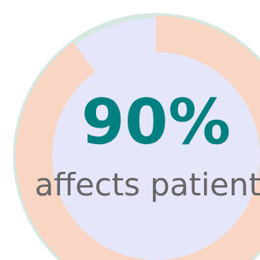





Systemic Complications
Major life-threatening complications of Dyskeratosis Congenita
Bone Marrow Failure
Pulmonary Fibrosis
Cancer Predisposition
Most common and life-threatening complication
Scar tissue buildup in lungs
Increased risk of various cancers
Decreases oxygen transport
Hematological: MDS, AML
Leading cause of mortality
Common cause of mortality in adults
Solid tumors: Squamous cell carcinomas
Results in pancytopenia
Manifests as aplastic anemia, MDS, or AML
Can be early symptom without classic features
Head, neck, anus, and genitals
Dyskeratosis Congenita: A Rare Telomere Biology Disorder
7/10

Slide 34














Diagnosis and Testing
Diagnostic Approach for Dyskeratosis Congenita
Clinical Suspicion
Telomere Length Measurement
Genetic Testing
Based on classic mucocutaneous triad
Flow-FISH Method:
Identifies specific gene mutations
Primary screening tool
Abnormal skin pigmentation
Measures telomere length in leukocytes
Targeted sequencing for common DC genes
Nail dystrophy
Oral leukoplakia
CGH/ SNP array for copy number variations
Other systemic manifestations
Whole exome sequencing for negative cases
97% sensitivity and 91% specificity when below 1st percentile for age
~50% of patients have identifiable germline mutations
Dyskeratosis Congenita: A Rare Telomere Biology Disorder
8/10

Slide 35














Management and Surveillance
Multi-disciplinary Approach for DC
Lifelong, multidisciplinary surveillance is crucial for managing DC due to its multisystemic nature.
Type of Screening
Frequency
Purpose
Complete Blood Count
Regular basis
Monitor for bone marrow failure
Pulmonary Function Tests
Regular basis
Detect pulmonary fibrosis
Bone Marrow Biopsy
As needed
Assess for myelodysplastic syndrome
Treatment Considerations
Hematologic Complications
Pulmonary Fibrosis
Cancer Screening
Androgen therapy or allogeneic stem cell transplantation
Pulmonary rehabilitation and lung transplantation
Regular surveillance for hematological malignancies
Dyskeratosis Congenita: A Rare Telomere Biology Disorder
9/10

Slide 36
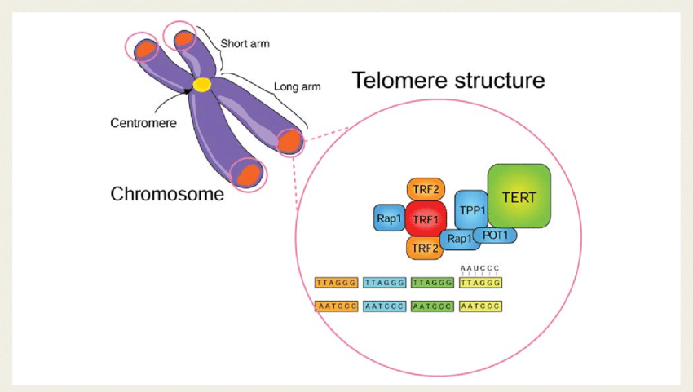
Pathophysiology
Telomeres
Short telomeres
↓
Activation of p53
↓
Early apoptosis
New somatic mutation → malignancy
Characteristic amino acid repeats (TTAGGG) at chromosome ends
They protect the integrity of chromosomes during the replication phase
Telomere length is kept unaffected by the action of telomerase

Slide 37
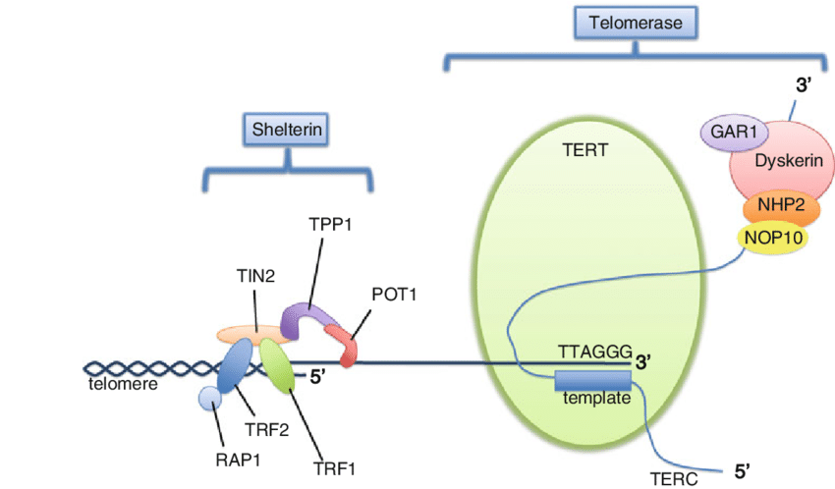
Telomerase
Enzyme complex of ribonucleoproteins, responsible for maintaining the length of telomeres.
↑ expression in tissues with intense regenerative activity
It consists of 5 components: TERC, TERT, Dyskerin, NOP10, NHP2

Slide 38
Prognosis
Average life expectancy: 49 years
Cause of death:
Marrow failure (70% - third decade)
Development of malignancies (10 - 15%)
Pulmonary disease (10%)

Slide 39
Inheritance
18 genes
Types of inheritance
X-linked DKC1
Autosomal dominant TERC, TINF2
Autosomal recessive CTC1, NHP2, NOP10, PARN, WRAP53 Autosomal recessive or dominant ACD, RTEL1, and TERT
De novo mutations
Severe clinical phenotype: DKC1, TINF2, RTEL1
Delayed diagnosis: TERC, TERT (mucosal manifestations may be absent)

Slide 40
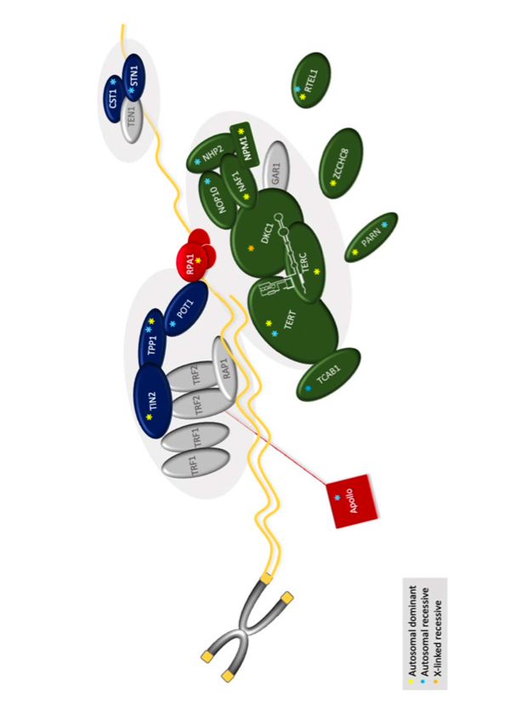
X-linked recessive
The most severe form with early clinical manifestations
DKC1 gene (Xq28)→Dyskerin
It is expressed in all tissues and along with snoRNAs: uracil→pseudouracil conversion of rRNA
Process important for the synthesis of ribosomes
It interacts with the RNA component of telomerase (TERC)
Savage, Hematology 2022

Slide 41
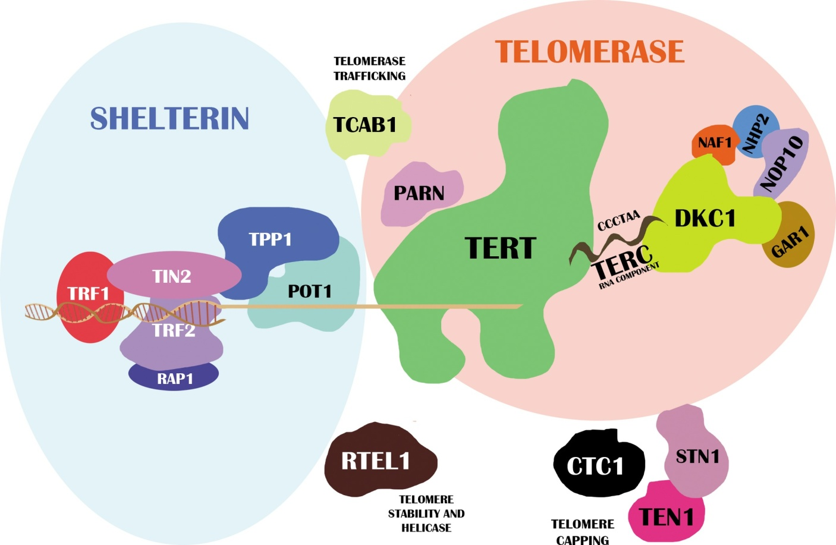
Autosomal recessive inheritance
Homozygous mutation in TERT (S.Hoyeraal-Hreidarsson)
growth disorders
neurological disorders
bone marrow failure
Immunodeficiency

Slide 42
Sporadic cases- Shelterin
Complex of 6 proteins
Protection of telomeres from unnecessary action of the DNA-repair mechanism
A mutation in a protein of the Shelterin complex (TINF2) has been found in DC patients.
This particular mutation leads to the creation of extremely short telomeres and is accompanied by a severe clinical picture:
Hoyeraal-Hreidarsson s
Growth disorders
Neurological disorders bone
Bone marrow failure
Immunodeficiency
Revesz. S
Retinopathy (exudations)
IUGR
Bone marrow failure
CNS calcifications

Slide 43
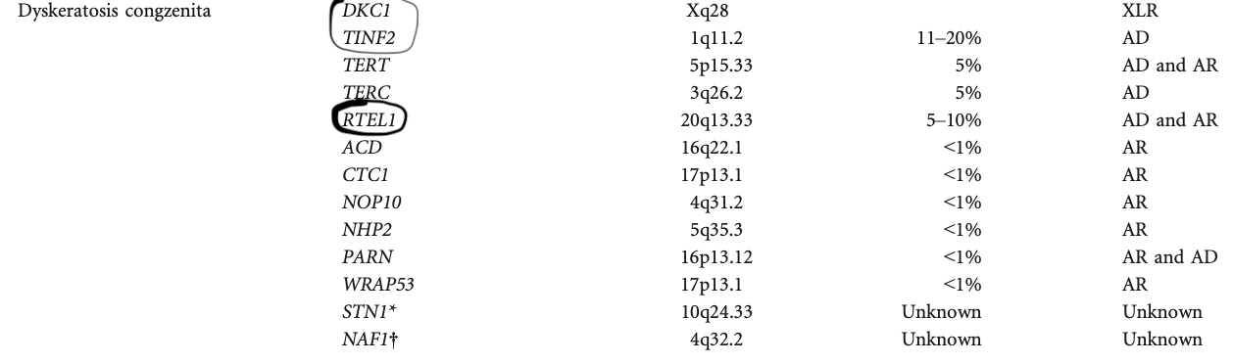
20-25%

Slide 44


Progression of the disease
Diagnosis
First decade: nail-skin disorders
Second decade: bone marrow failure (90% of patients by age 30)
Rarely, bone marrow failure precedes skin manifestations
They do not have an increased risk of AA during adolescence but the risk increases with age (CR AA 50% at age 50)
Classic presentation:
Triad +/- hematological manifestations
1 stigma from the triad + two of the remaining morphological stigmata + hypocellular BM
'Silent carriers': people with no stigmata or hematological abnormalities who carry the same mutation as a patient in the family – need follow-up
Adults with "AA" with mutations of the TERC, TERT genes
Patients with a family history of pulmonary fibrosis (TERT)

Slide 45
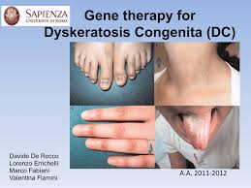
Diagnostic tests
Treatment-follow up
Determination of telomere length (FISH-flow cytometry) in peripheral blood lymphocytes (screening test)
BM aspiration /biopsy/ bone marrow cytogenetic test: cannot distinguish DC from other BFMs or MDS (not a specific diagnostic test but necessary)
Definite diagnosis: disease-related genes
Oxymetholone (0.5-1.0 mg/kg/day)
EPO, G-CSF (without oxymetholone – splenic rupture)
FBC, imaging and biochemical evaluation of liver function every 3 months
Annual check-up with BM aspirate/biopsy/cytogenetics
Screening for epithelial cancers
Allogeneic HSCT
serious respiratory complications, avoid use of busulphan and radiation (annual check-up of pulmonary functions)
Ideal candidate: no pulmonary involvement, available compatible relative donor
Gene therapy ???
Niewisch and Savage, Expert Rev Hematol 2022

Slide 46
Shwachman – Diamond s.
1964 : Children with malabsorption and neutropenia
Autosomal recessive inheritance
M/F 1.48:1
Incidence: 1/350000 births
It is characterized by:
Pancreatic exocrine insufficiency
Neutropenia
Bone marrow failure (20% pancytopenia), MDS, AML (25%, M:F=3:1)
Physical abnormalities
short stature (50%)
metaphyseal chondrodysplasia (25%)

Slide 47
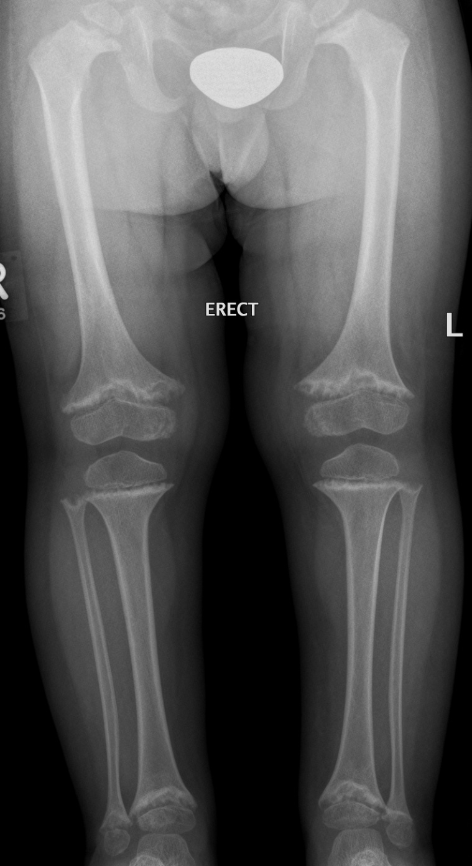

Slide 48
Clinical presentation
Delayed growth from infancy
Short stature
Hepatomegaly
Abnormalities of the ribs
Syndactyly
Abnormalities of the palate
Tooth dysplasia
Neurodevelopmental disorders

Slide 49
Diagnosis
Neutropenia: persistent stable in 1/3, intermittent 2/3 of patients (+/- other cytopenias, ↑HbF, ↑MCV)
20% pancytopenia
Exocrine pancreatic function
Serum trypsinogen ↓(<3 years)
Serum Isoamylase ↓ (>3 years)
Fatty infiltration of the pancreas
Molecular testing

Slide 50
Inheritance - genes
Autosomal recessive
(2003) SBDS gene (7q11)
>90% of patients carry SBDS mutations
DNAJC21, EFL1
Autosomal dominant
SRP54
All genes are related to ribosomal function
GENE | FREQUENCY
SBDS | 92%
EFL1 | <1%
DNAJC21 | <1%
SRP54 | <1%
Unknown mutation | <10%
SBDS gene
Production of a protein involved in the maturation of the 60s ribosomal subunit
↓
Increased apoptosis and short telomeres
↓
Ribosome dysfunction
Nelson A, GeneReviews, 2018

Slide 51
SBDS gene (7q11)
Protein of the 60s ribosomal subunit
↓
Ribosomal dysfunction
↓
Increased apoptosis & short telomeres

Slide 52
Progression of the disease
Average life expectancy: 36 yr
Causes of death
AML / MDS
AA
Infections
Treatment
Malabsorption → administration of pancreatic enzymes (remission in 50% of patients after 5 years of age)
Neutropenia → G-CSF
Treatment of infections
Oxymetholone
Allogeneic HSCT (58% 2-year survival)
Malignancies: Hematological only (MDS/AML)

Slide 53
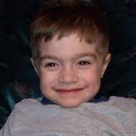

Diamond – Blackfan anemia
First described in 1938 (congenital aplasia of the red cell line)
Ribosomopathy
Annual incidence: ≈ 5/10⁶ live births
It manifests during early infancy with characteristic: selective reduction of red cell precursors, orthochromic macrocytic anemia, reduced %rets

Slide 54

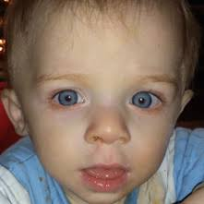
Clinical picture (50% congenital anomalies)
Craniofacial malformations
Thumb malformations (RPL5, RPL11)
Cardiac abnormalities
Abnormalities of the genitourinary system
Short stature
Hydrops fetalis – mild anemia adult life, 20% premature birth
28 %IUGR
Genotype-phenotype correlation:
RPS19: fewer stigmata
RPL5: more stigmata

Slide 55
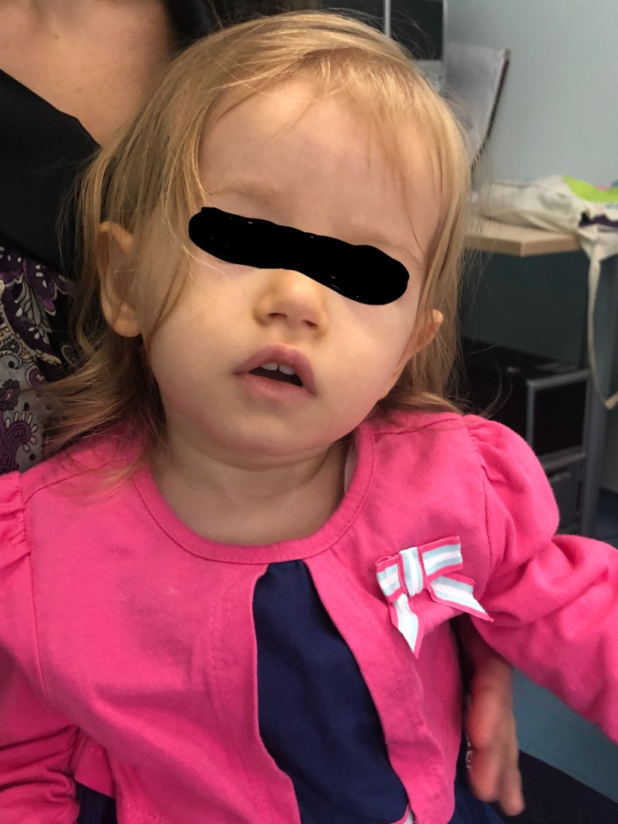
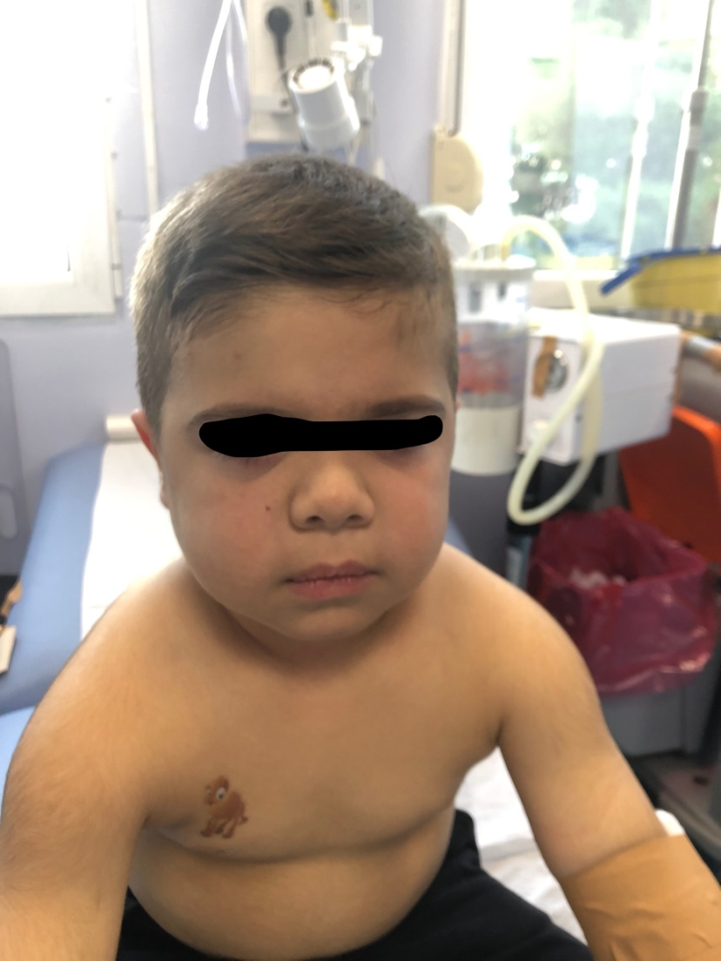

Slide 56
Diagnostic criteria
Orthochromic, macrocytic anemia
↓ Rets
Normal bone marrow cellularity with red cell line reduction only (EB<5%)
WBC: Normal or ↗
Platelets Normal or ↗
↑ eADA activity (75-90% of non-transfused patients)
↑Hb F
↑ EPO

Slide 57
Pathophysiology
Disorder of ribosomal subunit assembly and function
40S - RPS19, RPS17, RPS24
60S -RPL35A, RPL5, RPL11
p53 gene activation and cell destruction
Unbalanced globulin/heme ratio
↓
EARLY APOPTOSIS

Slide 58
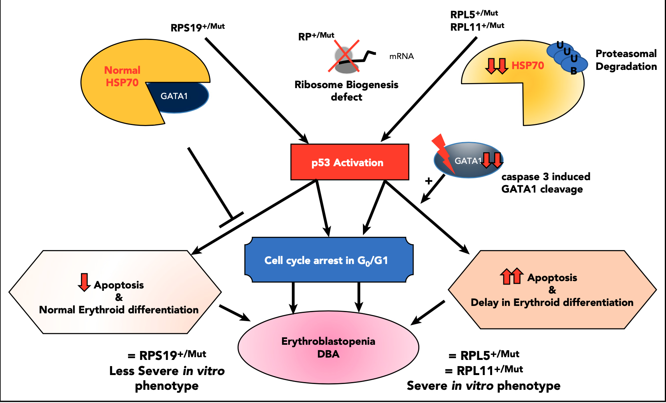
Da Costa L, et al. Blood 2020

Slide 59
Inheritance
Autosomal dominant trait (20 gen.)
RPS19 (DBA 1) - 25% of patients
RPL5, RPL11, RPS10, RPL35A, RPS26, RPS 24, RPS 17, RPS 7, RPL 19, RPL 26
70% of patients carry mutations in 6 RP genes (RPS19, PRL5, RPS26, RPL11, RPL35a, RPS24)
X-linked Inheritance:
GATA 1: Transcriptional hemopoietic factor that regulates the maturation of the red and MGC series. Only hematologic manifestations without morphological stigmata (a few cases)
De novo mutations
25-40% of patients: unknown mutations

Slide 60
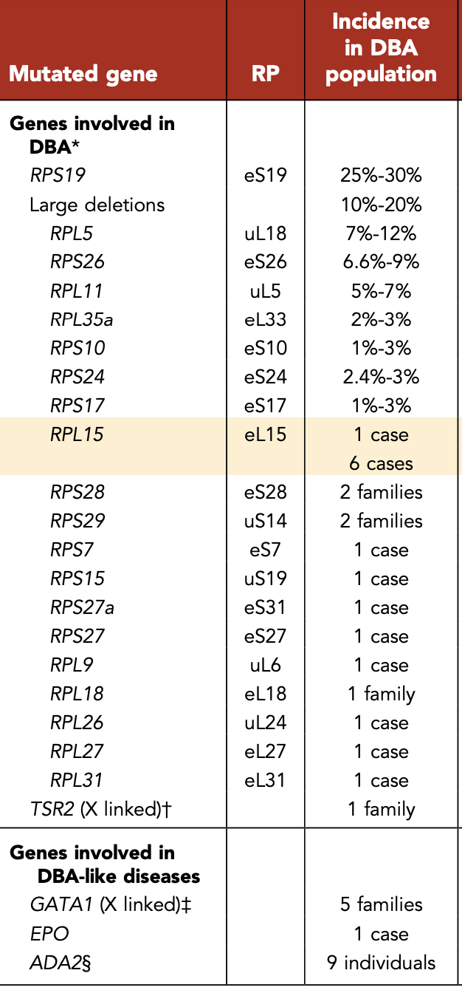
Da Costa L, et al. Blood 2020

Slide 61
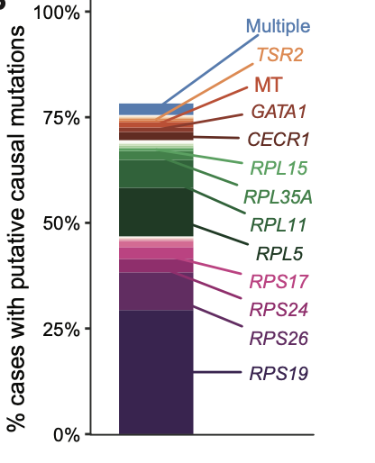
Genetics
19q13.2 →RPS19 (1999)
25% of cases in the West
Encodes the RPS19 protein (145 aa) component of the 40s ribosomal subunit
Heterozygotes for this protein can be:
Patients
Relatives of patients without clinical manifestations who show isolated ↑e ADA
Ulirsch JC, et al. The American J of Human Genetics, 2018

Slide 62
Complications
Diagnosis
Cumulative risk of developing malignancies: 20%
Development of MDS, AML
Development of non-haematological malignancies (osteosarcoma)
Aplastic anemia (Studies in cell cultures showed damage to all three cell lines and not just the erythrocyte)
Definitive diagnosis 50-70% of patients (known mutations)
For the rest, the diagnosis is based on:
clinical picture
hematologic findings
Family screening for 'silent carriers’
FBC ↑ MCV
↑ HbF
↑ eADA
Genetic analysis

Slide 63
Treatment
Corticosteroids (35% resistance)
Transfusion program for corticosteroid-resistant patients
Allogeneic HSCT
5 years - survival: 70%
Best donor: compatible sibling
10-25% of patients: spontaneous remission
Gene therapy ???
Depnath S, et al. Mol Ther 2017

Slide 64
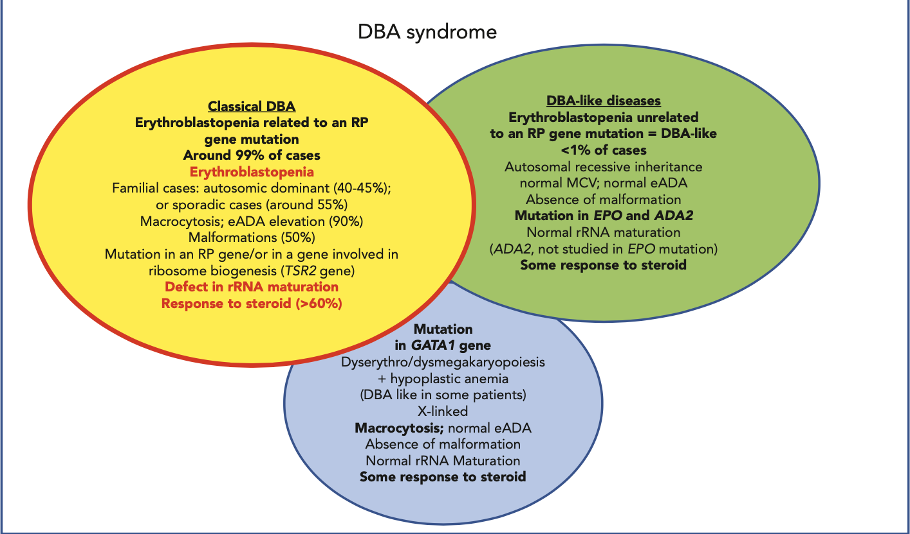

Slide 65
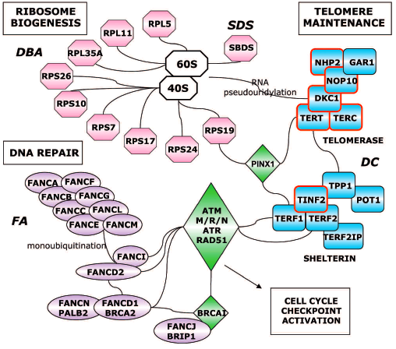

Slide 66
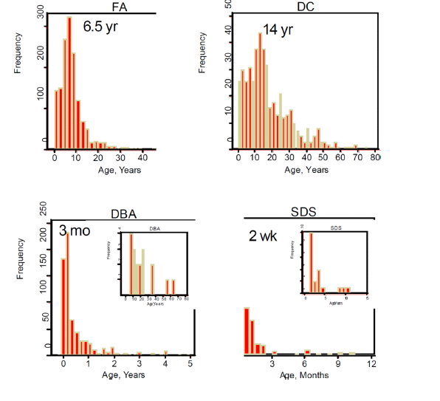

Slide 67
Congenital Amegakaryocytic thrombocytopenia (CAMT)
Thrombocytopenia during the first year of life due to decreased production of PLTs by the bone marrow
Physical appearance normal
BM aspirate: absence of megakaryocytes
50% of the patients develop AA by the age 5 yrs
Increased risk of MDS/AML
Both sexes equally affected
Germilne mutations of the 1p34 gene (c-MPL), encoding the thrombopoietin receptor (c-MPL)
It is characterized by genetic heterogeneity
Autosomal recessive inheritance in some patients
Other cell lines may be affected, CNS, heart defects, mental retardation

Slide 68
Types of CAMT
I – CAMT (Severe clinical picture)
Complete loss of function of the TPO receptor (nonsense, frameshift mutation of MPL)
Severe thrombocytopenia from birth
Early onset pancytopenia, MDS (2 years)
II – CAMT (Moderate clinical picture)
Missense mutation of the MPL gene
Transient increase of PLTs in the first years of life and delayed onset of AA (5 years) or no occurrence
Probability of no progression to pancytopenia
III – CAMT
Damage to a gene other than MPL (RUNX1 haplo)

Slide 69
DIAGNOSIS
Thrombocytopenia
Elevated serum TPO levels
Normal MPV
Absence of MGC in the marrow
Detection of TPO receptor mutations
PROGNOSIS
30% death due to bleeding
20% death after HSCT
TREATMENT
HSCT
Antifibrinolytic agents
PLTs transfusions

Slide 70
TAR (Thrombocytopenia –Absent Radius)
Thrombocytopenia from birth
Absence of radius (thumbs present dd of FA)
Other skeletal abnormalities, heart, kidney abnormalities
50% of patients are allergic to cow's milk
L/W: Increased plasma TPO with decreased MGC presence in the marrow
50-75% inherited with autosomal recessive / dominant inheritance
25% de novo mutations
Thrombocytopenia improves after 1 year of life (rare ALL, AML)
Genetic analysis: mutation in the RBM8A gene (protein synthesis – RNA-binding motif protein 8A)
Treatment: PLT transfusions, HSCT

Slide 71
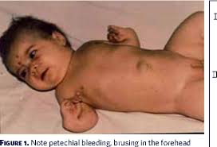
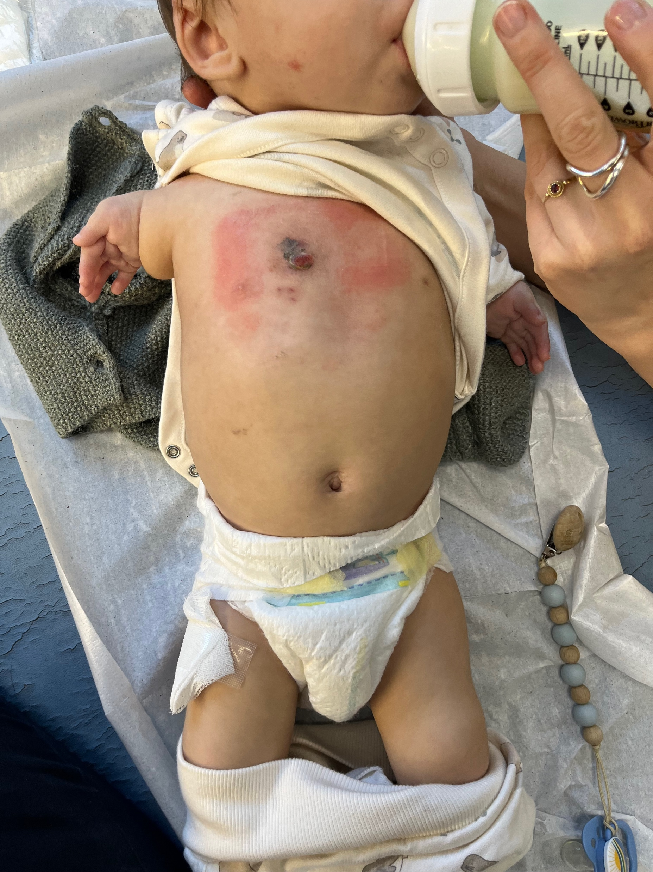
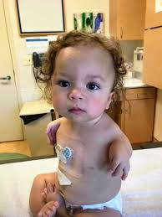

Slide 72
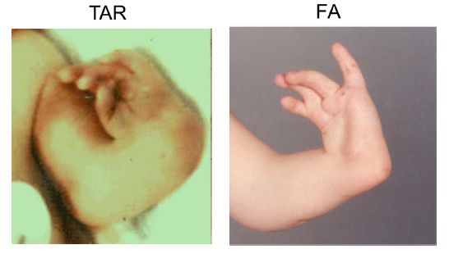

Slide 73
Severe Congenital Neutropenia (SCN)
Prevalence: 3-8.5/10⁶ population
It is characterized by:
Frequent bacterial infections from early infancy
ANC < 0.5-0.2× 10⁹/L
Maturation arrest at the promyelocyte / myelocyte stage
Considered a preleukemic condition (21% develop leukemia after 10 years)
Inheritance:
Autosomal dominant:
Mutations in the ELANE gene (60% of cases).
Other cases are sporadic
Autosomal recessive (Kostmann):
Mutations in the HAX1 gene (30% of cases)
X-linked
Sporadic cases

Slide 74
Pathophysiology
Mutations of ELANE, HAX1
↓
Decreased expression of transcriptional factors of granulocytes
The type of mutation is related to the severity of the manifestations
↓
Early apoptosis of progenitor granulocyte cells

Slide 75
Elastase 2 (ELANE)
Serine protease produced at the promyelocyte stage
It is stored in the primary granules of neutrophils
>200 mutations have been described
Specific mutations (p.C151Y, p.G214R) are associated with poor prognosis
Hax 1 (Kostmann s.)
Mitochondrial protein
Antiapoptotic action
Mutations of the HAX1 gene lead to inactivation of the related protein, depolarization of mitochondrial membrane and release of pro-apoptotic proteins resulting in early apoptosis
Neutropenia, neurological symptoms (epilepsy, mental retardation)

Slide 76
Growth factor-independent protein 1
Transcription protein
Its mutations lead to:
overexpression of ELA 2 and early apoptosis
overexpression of CSF-1 and conversion of granulocytic progenitors to macrophages
G6PC3
Increased apoptosis
Severe neutropenia
Heart and genitourinary system defects
WAS
Mutations in the WAS gene lead to: disorders in mitosis, decreased proliferation & increased apoptosis of progenitor cells of the granulocytic cell line
Inheritance:X-linked
Other proteins: CD40 ligand, MAPBPIP, AP3B1, CHS1/LYST

Slide 77
GATA 2 deficiency
Hematopoietic transcription factor that affects the number and quality of primitive hematopoietic cells
Autosomal dominant inheritance
Susceptibility to infections
Respiratory infection
Lymphedema
Autoimmune manifestations
Predisposition to malignancy
Neutropenia and monocytopenia ↓B, NK
BM: reduced cellularity with fibrosis, MGC line with atypias

Slide 78


Slide 79

Skokowa et al. Nat Rev Dis Primers 2018

Slide 80

Skokowa et al. Nat Rev Dis Primers 2018

Slide 81
Diagnosis of SCN
Medical history
Clinical picture
Neutropenia on the context of a syndrome
Heart (G6PC3, TAZ)
Genitourinary (G6PC3)
Skeletal Abnormalities, Pancreatic Dysfunction (SBDS)
Neutropenia without other abnormalities
ANC < 500/μL
Typical image of bone marrow aspirate
Search for specific mutations (ELANE, HAX1)
Genetic panel

Slide 82
Therapy
Treatment of infections
Administration of G-CSF
Increased risk of leukaemia:
ELANE, acquired mutations of the G-CSF receptor (CSF3R)
80% of patients who develop AML carry these mutations
HSCT: unresponsive to G-CSF, AML/MDS
Gene therapy ???

Slide 83

Neutropenia algorithm
ASH, 2022 Educational program

Slide 84
Congenital dyserythropoietic anemias (CDA)
Anemia and ineffective erythropoiesis:
Increased marrow cellularity and Fe deposition
Dyserythopoietic EB with increased apoptosis of red lineage progenitor cells
Reduced %Rets
Degree of hemolysis (jaundice, LDH)
Splenomegaly
Types (I-VII) (often based on case reports)

Slide 85

Iolascon et al, Blood 2020

Slide 86

CDA categorization
CDA I
CDAN-1 protein
C15orf41
DNA repair
Chromatin formation
Inheritance: autos. rec.
PB: anisopoikilocytosis (micro, macroovalocytes),
↑ MCV, NRBC, basophilic stippling
BM: >20% binucleated EBs, megablastic lesions and internuclear bridges
Splenomegaly and anemia
+/-Skeletal anomalies

Slide 87


CDA II (most common type)
SEC23B protein
Appears in late childhood and adolescence
Inheritance: AR.
PB: normochromic anemia, Ret n/ ↑
BM: >10% binucleated EB & >2% karyoblasts
Jaundice, liver/splenomegaly Iron accumulation (20% liver cirrhosis)
CDA III (rare),
KIF 23 protein (mitosis, intrac. trafficking)
Ihneritance: AD
PB: mild anemia, Ret↓
BM: Multinucleated EB Jaundice, ↑LDH, ferritin n.
Other mutations:
GATA 1, KLF1

Slide 88
CDA variants
ALAS (X-linked)
Macrocytic anemia with iron overload
LPIN2
Multifocal osteomyelitis
Hypochromic anemia with dyserythropoiesis
CAD
Neurodegenerative disease
COX412
Exocrine pancreatic insuf
Dyserythropoiesis
CDA IV
Severe haem. Anemia
Ret% n/↑
↑ HbF
BM: ↑cellularity, bi/multi -nucleated EB
KLF1 transcription factor (AD inheritance)
GATA 1 (transcriptional factor, X-linked inheritance)

Slide 89

Diagnosis
Compatible hematological findings
Molecular testing
Treatment
Transfusions
Splenectomy / cholecystectomy
HSCT

Slide 90
SAMD9/SAMD9L Syndromes
Germline gain-of-function variants of SAMD9/SAMD9L genes (7yrs)
MIRAGE syndrome (MDS, infection, restriction of growth, adrenal hypoplasia, genital problems, enteropathy)(SAMD9)
ATXPC (Ataxia-pancytopenia syndrome (SAMD9L)
SAMD9/SAMD9L & GATA 2= 50% pediatric MDS
BMF syndromes
Clinical manifestation
Mild/transient dyserythropoietic alterations to severe and rapidy progressive MDS/AML with monosomy 7
Tretment:
Watch and wait – remission without treatment
HSCT: severe cases

Slide 91


Slide 92

Dokal I et al. Blood 2022

Slide 93

Screening panel
Blood Res 2022

Slide 94
Who must be checked for IBMFs?
Personal history
Cytopenias
Short stature
Congenital anomalies
Other features of IBMFs
Excessive treatment-related toxicity after cancer treatment
Family history
Cytopenias
Congenital anomalies
Other features of IBMFs
Cancers at young age
Multiple 1st-2nd degree relatives with malignancy
Laboratory testing
Cytopenias
Elevated MCV
Elevated HbF
Low trypsinogen/pancr isoalmylase
Elevated eADA activity
Low Igs
Abnormal lymphocyte subsets

Slide 95
In conclusion...
IBMFs are rare and fatal without treatment
The clinical picture varies both in terms of severity and age of first manifestation
Young adults with epithelial cancers may have IBMFs
In recent years, with the help of genetics, important steps have been taken in understanding the molecular basis of IBMFs that help diagnose when the picture is not typical
Successful HSCT solves the hematological problem but does not remove the risk of other malignancies...
Gene therapy will be the definitive therapeutic solution ???

Slide 96

Thank you!!!

