Slide 1
Neuroblastoma

Slide 2
Introduction
Neuroblastoma is the most common tumor of the sympathetic nervous system
It arises from the developing sympathetic nervous system from neural crest cells, usually resulting in tumors in the adrenal glands or the sympathetic ganglia
Most common malignancy of infancy
Median age of diagnosis is 17 months
It accounts for 15% of pediatric cancer-related deaths
While an overall improvement in five-year mortality has been noted between 1975 through 2005, subgroup-specific mortality paints a different picture
Spectrum of disease ranges from spontaneous maturation to rapid metastatic disease progression

Slide 3
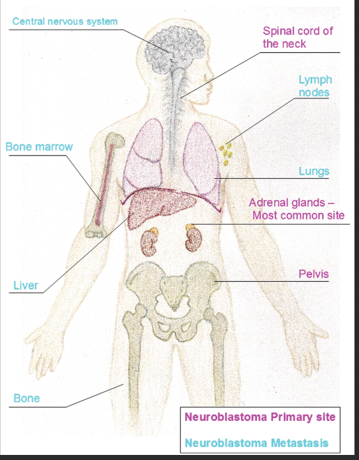
Location
Adrenal medulla 35%
Para-spinal ganglia (30%)
Posterior mediastinum (19%)
Pelvic ganglia (2%)
Cervical ganglia (1%)
Metastasis: bones, bone marrow, lymph nodes, liver, skin and lungs

Slide 4
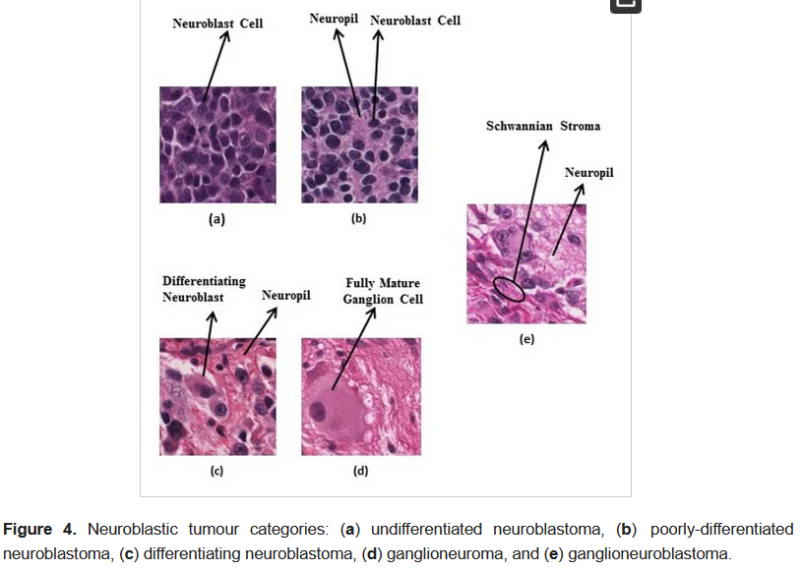
Histopathology
Classic subtypes
  Neuroblastoma
  Ganglioneuroblastoma
  Ganglioneuroma
Neuroblastoma
  Small uniform cells
  Hyperchromatic nuclei & scant cytoplasm
  Pseudorossetes
  Necrosis & calcification
  Mature & intermediate differentiation ganglion cells

Slide 5
Pathophysiology
Many biological markers of neuroblastoma have been discovered,
  The most important is MYCN.
  This oncogene is overexpressed in nearly 25% of patients with neuroblastoma.
  The gene is also commonly found in patients with advanced cancer.
  Patients with the MYCN gene tend to have rapid progression of cancer and poor outcomes.
Close to 90% of patients have elevations in vanillyl mandelic acid (VMA) and homovanillic acid (HVA) in the urine.
Neuroblastomas can develop in the adrenal gland (most common), paraspinal ganglia, and less often in the thorax, pelvis, and cervical areas.
  Infants commonly present with neck or thoracic masses,
  older children tend to present with abdominal masses.

Slide 6
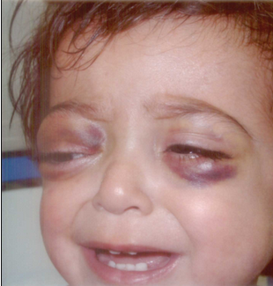
Symptoms & signs at presentation
Non-specific clinical signs include fever, weight loss, and fatigue
With the most frequent site of origin being the adrenal medulla, patients often present with a solid abdominal mass
With the involvement of the superior cervical ganglia, aside from a neck mass, Horner syndrome (ptosis, miosis, anhydrosis) can be observed
If the tumor involves the spinal cord, cord compression, or paralysis may be seen
The raccoon eyes appearance in NB is probably related to obstruction of the palpebral vessels {branches of the ophthalmic and facial vessels} by tumor tissue in and around the orbits

Slide 7
Symptoms & signs at presentation
Hypertension is rare and is often caused by compression of the renal artery rather than the catecholamine excess
Chronic diarrhea due to the secretion of vasoactive intestinal peptide may be the initial presentation
When the bone is involved, pain and a limp may be present
In rare cases, the patient may present with myoclonus and opsoclonus
  These patients tend to have localized disease and good outcomes
  However, the neurological deficit can be disabling
Signs and symptoms, can range from an asymptomatic palpable mass to significant critical illness

Slide 8
Clinical Evaluation
Diagnostic evaluation relies on a careful history and physical examination and on biochemical, histologic, and radiographic analyses
Laboratory studies should include the following:
  CBC
  Renal function
  Liver function
  Electrolytes
  LDH
Histologic confirmation is required to establish a diagnosis of neuroblastoma
Elevation of urine homovanillic acid (HVA) and vanillylmandelic acid (VMA) in 90% of patients
Preliminary imaging is preferentially conducted with MRI for good resolution and surgical excision planning
mIBG scan(metaiodobenzylguanidine) delineates the extent of neuroblastoma metastasis
Bone marrow biopsies & trephines to complete the staging
CT scan of the abdomen and chest are recommended to look for calcifications and metastatic lesions
MRI of the spine is required if cord compression and Horner syndrome are suspected
Baseline ECG and echocardiogram are necessary
Baseline hearing is recommended before initiating cisplatinum treatment

Slide 9
Staging
Two main Staging Systems
  INSS INRG

Slide 10
INSS
The International Neuroblastoma Staging System (INSS) based on surgical resection is used to stage neuroblastomas in the United States
Stage 1: Localized lesion with complete gross excision
Stage 2: Localized tumor with obvious gross tumor not completely excised/Ipsilateral lymph nodes are negative for cancer
Stage 2B: Localized tumor with complete gross excision but ipsilateral lymph nodes are positive for tumor/ Contralateral lymph nodes negative for cancer
Stage 3: Unresectable cancer crossing the midline, with regional lymph node involvement or
a localized unilateral lesion with positive contralateral lymph nodes
Stage 4: Any primary lesion that has spread to distant lymph nodes, liver, bone marrow or skin
Stage 4s: Localized primary tumor with spread limited to liver, skin or bone marrow-Limited to infants

Slide 11
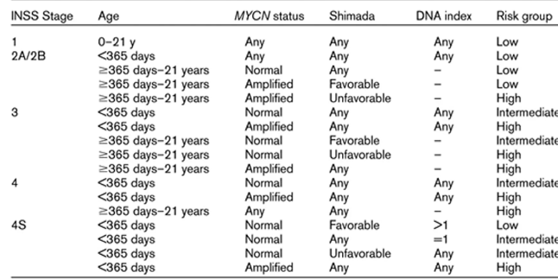
INSS Subgroup Classification
Classic prognostic categorization by Children’s Oncology Group (COG) divides patients into four groups based on patient age, post-surgical stage, MYCN amplification, histology, and DNA ploidy :
Low risk: localized tumor only, greater than 90% survival
Intermediate risk: localized tumor with regional extension and/or metastases to bone and bone marrow, 90% to 95% survival
High risk: widely disseminated disease (excluding infants), 40% to 50% survival
Tumor stage 4S: widely disseminated disease in infants, greater than 90% survival due to spontaneous regression of the tumor

Slide 12
Limitations of INSS
Postoperative system
  Pre –operative staging/prognostication cannot be done
Many patients may receive neoadjuvant chemotherapy
Upfront surgery may not be possible due to extensive local disease and/or metastases

Slide 13
INRG staging system-International Consensus
In 2004, the International Neuroblastoma Risk Group (INRG), a task force of pediatric neuroblastoma experts worldwide, met with the primary aim of developing a consensus approach to neuroblastoma risk stratification pre-treatment
Using patient age, tumor stage, tumor grade, and differentiation, tumor histology, MYCN amplification, cytogenetic aberrations in 11q, and DNA ploidy, the group defined 16 pre-treatment groups broadly divisible into four prognostic subgroups based on five-year event-free survival (EFS)

Slide 14
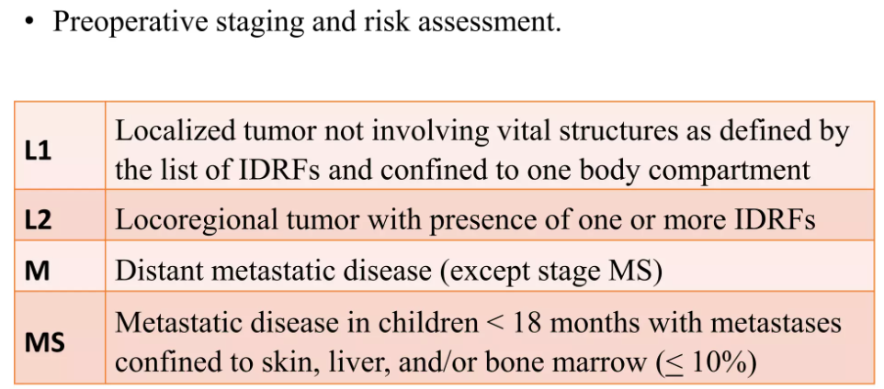
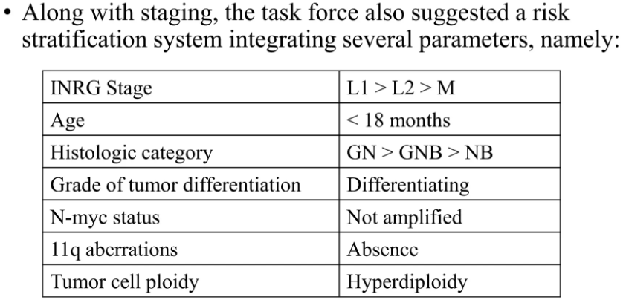

Slide 15
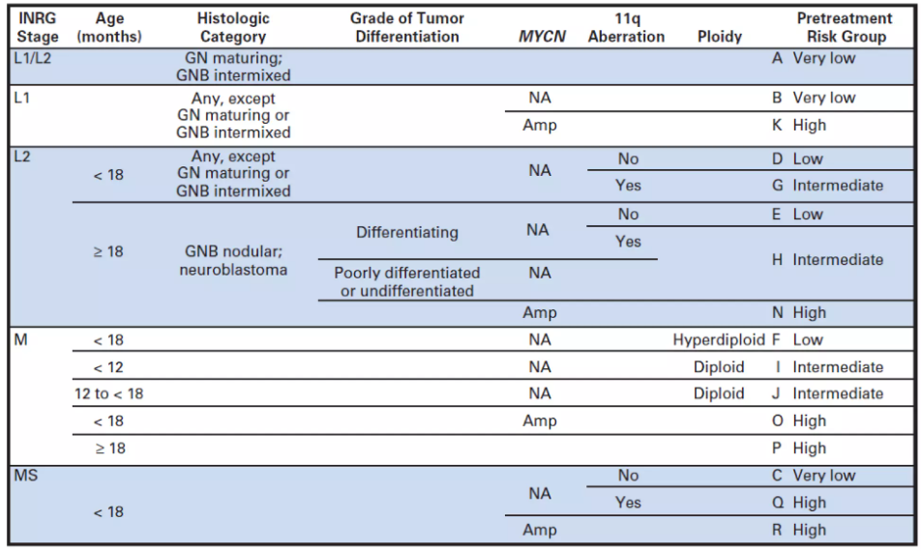
INRG Staging System

Slide 16
INRG-Risk groups
Very low risk: 5-year EFS > 85%
Low risk: 5-year EFS 75% to 85%
Intermediate risk: 5-year EFS 50% - 75%
High risk: 5-year EFS < 50%

Slide 17
Prognostic factors
Over 50% of newly diagnosed neuroblastoma are very-low or low-risk.
Negative prognostic markers include
  age older than 18 months,
  metastasis at diagnosis,
  presence of MYCN amplification,
  1p loss, 11q loss, 17q gain,

Slide 18
Treatment
Simple observation, surgical resection, chemotherapy, radiation therapy, stem cell transplantation, and immunotherapy
Patients with low-risk NB have localized tumors, some (infants) with a high propensity for spontaneous tumor regression.
  Children with tumors <5 cm can be observed with imaging done every 6-12 weeks
  For larger, localized tumors, in patients' past infancy, surgical resection is pursued
  For children who present with symptoms, chemotherapy is given without surgery or radiation therapy
The intermediate-risk group presents with localized metastasis, i.e., to the lymph nodes
  Usually managed with chemotherapy alone, possible surgical resection if able & radiotherapy in some cases
The high-risk group has the worst prognosis and presents with widespread metastases
  Induction chemotherapy to reduce tumor burden at both the primary and metastatic locations,
  Maximal surgical resection,
  Myeloablative chemotherapy and stem-cell transplantation,
  Maintenance therapy (Retinoic acid and immunotherapy with anti-GD2 ab, Dinutuximab.
A monoclonal antibody, dinutuximab, attaches to a carbohydrate molecule (GD2) on the surface of neuroblastoma cells,
  used as an immunotherapy drug for neuroblastoma treatment.
  improved the 2-year EFS of high-risk neuroblastoma patients from 46% to 66%.

Slide 19
Conclusion
Neuroblastoma is a highly heterogeneous disease
It ranges from tumors that regress spontaneously to highly aggressive, metastatic disease
Hence, the diagnosis and treatment of neuroblastoma are best managed by an interprofessional team that includes a team dedicated to childhood cancers, as these patients have special needs
Over the past decade, the survival of these patients has slightly improved for early-stage lesions, but for late stages, the survival remains abysmal
Thus, the need for the development of new targeted therapeutics in the intensive management of high-risk groups is strong

