Slide 1
ΑΔΕΝΟΜΥΩΣΗ
Συριστατίδης Χαράλαμπος
Μαιευτήρας – Χειρουργός Γυναικολόγος
Αναπληρωτής Καθηγητής
Μονάδα Υποβοηθούμενης Αναπαραγωγής
Β Μαιευτική & Γυναικολογική Κλινική
Νοσοκομείο Αρεταίειο
Ιατρική Σχολή
Εθνικό και Καποδιστριακό Πανεπιστήμιο Αθηνών

Slide 2
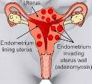
DEFINITION
Η αδενομύωση είναι μια καλοήθης διαταραχή της μήτρας στην οποία οι ενδομητρικοί αδένες και το στρώμα παρουσιάζονται παθολογικά στο μυομήτριο της μήτρας και θεωρείται συγκεκριμένη οντότητα στο PALM-COEIN FIGO

Slide 3
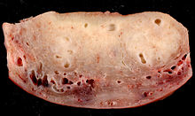
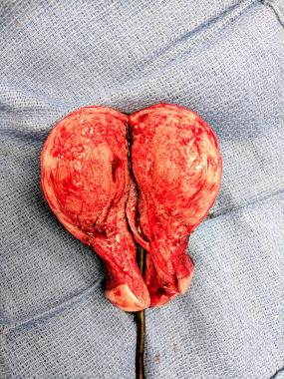
HISTOLOGICAL APPEARANCE
gold standard to make the final diagnosis

Slide 4
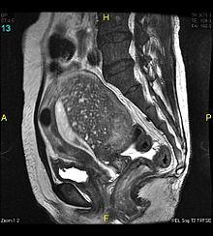
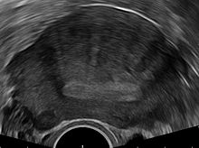
IMAGING

Slide 5
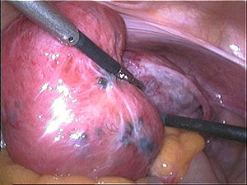
LAPAROSCOPIC APPEARANCE
sex steroid hormone receptors, inflammatory molecules, extracellular matrix enzymes, growth factors, and neuroangiogenic factors

Slide 6
SYMPTOMS
Chronic pelvic pain (77%)
Heavy menstrual bleeding (40-60%),
anemia, with associated symptoms of fatigue, dizziness, and moodiness.
Abnormal uterine bleeding
Painful cramping menstruation (15-30%)
Painful vaginal intercourse (7%)
A 'bearing' down feeling
Pressure on bladder
Dragging sensation down thighs and legs

Slide 7
CO MORBIDITIES
Uterine fibroids (50%)
Endometriosis (11%)
Endometrial polyp (7%)

Slide 8
TREATMENT - MEDICATIONS
Nonsterioidal anti-inflammatory drugs
Levonorgestrel-releasing intrauterine devices
Oral contraceptives
Progesterone or Progestins
Gonadotropin-releasing hormone (GnRH) Agonists and danazol

Slide 9
TREATMENT - SURGERY
Uterine artery embolization (UAE)
Myometrium or adenomyoma resection:
MRI-guided focused ultrasound surgery
Endometrial ablation techniques
Hysteroscopic procedures
Hysterectomy, or surgical removal of the uterus

Slide 10
ΕΝΔΟΜΗΤΡΙΩΣΗ
Συριστατίδης Χαράλαμπος
Μαιευτήρας – Χειρουργός Γυναικολόγος
Αναπληρωτής Καθηγητής
Μονάδα Υποβοηθούμενης Αναπαραγωγής
Β Μαιευτική & Γυναικολογική Κλινική
Νοσοκομείο Αρεταίειο
Ιατρική Σχολή
Εθνικό και Καποδιστριακό Πανεπιστήμιο Αθηνών

Slide 11
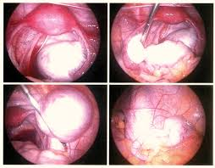
SOME IMAGING

Slide 12
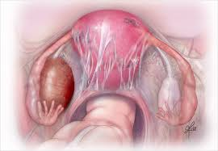

Slide 13
EPIDEMIOLOGY
Endometriosis affects an estimated
1 in 10 women during their reproductive years
1,761,687,000 women in the world aged 15 - 49
World Bank Population Projection Tables by Country
176 million women worldwide

Slide 14
HYPOTHESES
hypothesis for the pathophysiology of endometriosis is that endometrial cells are transported from the uterine cavity during menstruation and subsequently become implanted at ectopic sites. Retrograde flow of menstrual tissue through the fallopian tubes is common and could transport endometrial cells intra-abdominally; the lymphatic or circulatory system could transport endometrial cells to distant sites (eg, the pleural cavity).
Another hypothesis is coelomic metaplasia: Coelomic epithelium is transformed into endometrium-like glands.
NEW HYPOTHESIS DURING NEONATAL LIFE

Slide 15
RISK FACTORS
Family history of 1st-degree relatives with endometriosis
Delayed childbearing or nulliparity
Early menarche
Late menopause
Shortened menstrual cycles (< 27 days) with menses that are heavy and prolonged (> 8 days)
Müllerian duct defects
Exposure to diethylstilbestrol in utero

Slide 16
DIAGNOSIS
Positive histology confirms the diagnosis of endometriosis;
negative histology does not exclude it.
Whether histology should be obtained if peritoneal disease alone is present is controversial: visual inspection is usually adequate but histological confirmation of at least one lesion is ideal.
In cases of ovarian endometrioma (>4 cms in diameter), and in deeply infiltrating disease, histology
should be obtained to identify endometriosis and to
exclude rare instances of malignancy.

Slide 17
SUSPECT ENDOMETRIOSIS
in young women aged 17 and under) with 1 or more of:
• chronic pelvic pain
• period -related pain (dysmenorrhoea) affecting daily activities and quality of life
•deep pain during or after sexual intercourse
•period -related or cyclical gastrointestinal symptoms, in particular, painful bowel movements
• period - related or cyclical urinary symptoms, in particular, blood in the urine or pain passing urine
• infertility in association with 1 or more of the above.

Slide 18
SYMPTOMS
Cyclic midline pelvic pain, specifically pain preceding or during menses (dysmenorrhea) and during sexual intercourse (dyspareunia), is typical and can be progressive and chronic (lasting > 6 months). Adnexal masses and infertility are also typical. Interstitial cystitis with suprapubic or pelvic pain, urinary frequency, and urge incontinence is common. Intermenstrual bleeding is possible.

Slide 19
Stages of Endometriosis
I Minimal
A few superficial implants
II Mild
More and slightly deeper implants
III Moderate
Many deep implants, small endometriomas on one or both ovaries, and some filmy adhesions
IV Severe
Many deep implants, large endometriomas on one or both ovaries, and many dense adhesions, sometimes with the rectum adhering to the back of the uterus

Slide 20
INITIAL MANAGEMENT
Be aware that endometriosis can be a long
-term condition and can have a significant physical, sexual, psychological and social impact.
Women may have complex needs and may require long term support.
Offerinitial management with:
a short trial (for example, 3 months) of paracetamol or a nonsteroidal anti-
inflammatory drug (NSAID) alone or in combination
•hormonal treatment (combined contraceptive pill or a progestogen)
•refer to the NICE guideline on neuropathic pain for treatment with neuromodulators.If fertility is a priority,
multidisciplinary team involvement with input from a fertility specialist. This should include recommended diagnostic fertility tests or preoperative tests and other recommended fertility treatments such as assisted
reproduction.

Slide 21
INITIAL ASSESSMENT
Do not use pelvic MRI or CA 125 to diagnose endometriosis.
Consider transvaginal / transabdominal ultrasound •
to investigate suspected endometriosis even if pelvic and/or abdominal examinations are normal
• for endometriomas and deep endometriosis involving the bowel, bladder or ureter.
Do not exclude the possibility of endometriosis if examinations or
Ultrasound or MRI are normal
Consider referral for assessment & investigation If clinical suspicion remains or symptoms persist.
Consider laparoscopy to diagnose endometriosis, even if the ultrasound was normal.

Slide 22
LAPAROSCOPY
Discuss surgical management options with women with suspected/confirmed endometriosis:
•what laparoscopy involves, and that it may include surgical treatment (with prior patient consent)
•how laparoscopic surgery could affect endometriosis symptoms
•the possible benefits and risks of laparoscopic surgery
•the possible need for further surgery, including the possible need for further planned surgery for deep endometriosis involving the bowel, bladder or ureter.
During diagnostic laparoscopy, a gynaecologist with training and skills in laparoscopic surgery for endometriosis should perform a systematic inspection of the pelvis.
DIFFERENCE IF WOMAN WNTS TO CONCEIVE

Slide 23
Guideline on the management of women with endometriosis
The App managing endometriosis
ENDOMETRIOSIS GUIDELINE DEVELOPMENT GROUP

Slide 24
When more is not better: 10 ‘don’ts’ in endometriosis management. An ETIC* position statement
ETIC Endometriosis Treatment Italian Club
Do not suggest laparoscopy to detect and treat superficial peritoneal endometriosis in infertile women without pelvic pain symptoms (quality of the evidence, high; strong suggestion)
Do not recommend controlled ovarian stimulation and IUI in infertile women with endometriosis at any stage (quality of the evidence, moderate; weak suggestion)
Do not remove small ovarian endometriomas (diameter <4 cm) with the sole objective of improving the likelihood of conception in infertile patients scheduled for IVF (quality of the evidence, high; strong suggestion)
Do not remove uncomplicated deep endometriotic lesions in asymptomatic women, and also in symptomatic women not seeking conception when medical treatment is effective and well tolerated (quality of the evidence, moderate; weak suggestion)

Slide 25
When more is not better: 10 ‘don’ts’ in endometriosis management. An ETIC* position statement
ETIC Endometriosis Treatment Italian Club
Do not systematically request second-level diagnostic investigations in women with known or suspected non-subocclusive colorectal endometriosis or with symptoms responding to medical treatment (quality of the evidence, low; weak suggestion)
Do not recommend repeated follow-up serum CA-125 (or other currently available biomarkers) measurements in women successfully using medical treatments for uncomplicated endometriosis in the absence of suspicious ovarian cysts (quality of the evidence, low; weak suggestion)
Do not leave women undergoing surgery for ovarian endometriomas and not seeking immediate conception without post-operative long-term treatment with estrogen–progestins or progestins (quality of the evidence, high; strong suggestion)
Do not perform laparoscopy in adolescent women (<20 years) with moderate–severe dysmenorrhea and clinically suspected early endometriosis without prior attempting to relieve symptoms with estrogen–progestins or progestins (quality of the evidence, low; weak suggestion)
Do not use robotic-assisted laparoscopic surgery

