Slide 1


^{Εγκυμοσύνη και Θρόμβωση}
Νικόλαος Φ. Βλάχος MD. PhD, FACOG
Καθηγητής Μαιευτικής, Γυναικολογίας και Υποβοηθούμενης Αναπαραγωγής

Slide 2
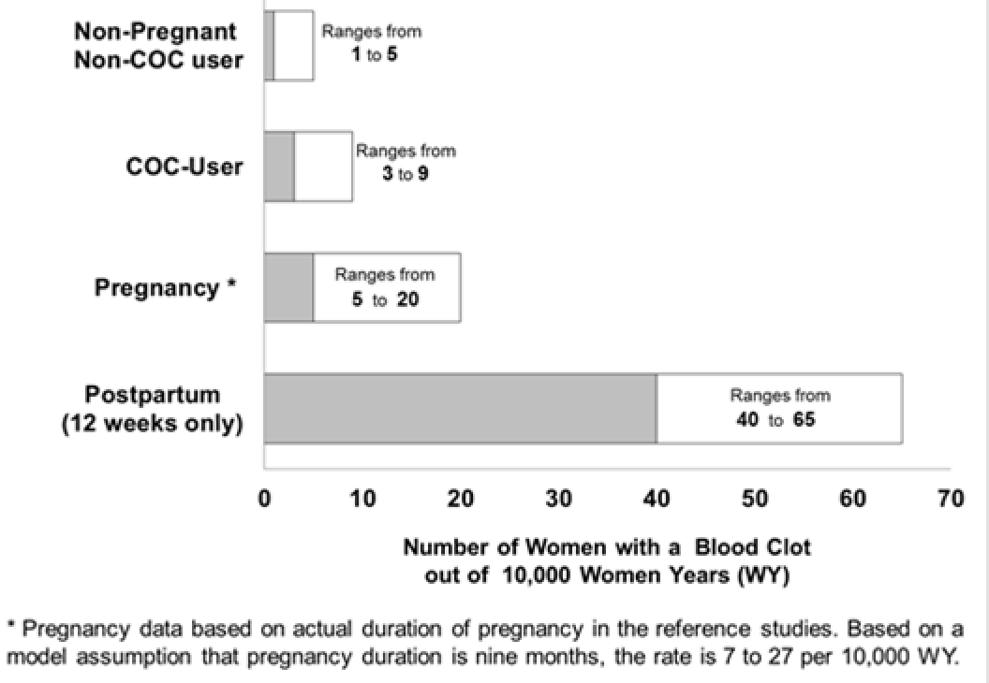
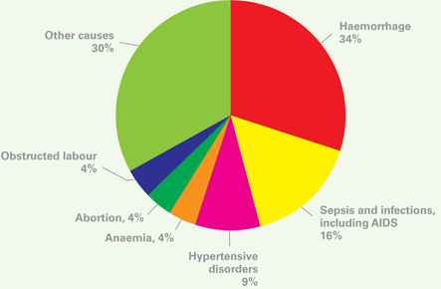
Κύηση = υπερπηκτικότητα

Slide 3
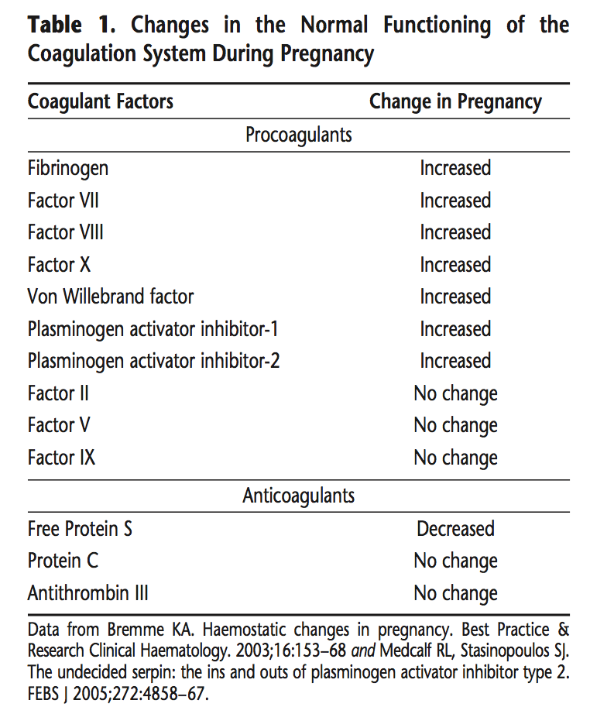
^{Φλεβοθρομβοεμβολική νόσος} ^{και κύηση}
^{increased clotting potential,}
decreased anticoagulant activity
^{decreased fibrinolysis .}
1/ 1600 pregnancies,
9% maternal deaths in USA
Risk of DVT during pregnancy x5
Obstet Gynecol 1999;94:730–4., Semin Thromb Hemost 2003;29:125–30.

Slide 4
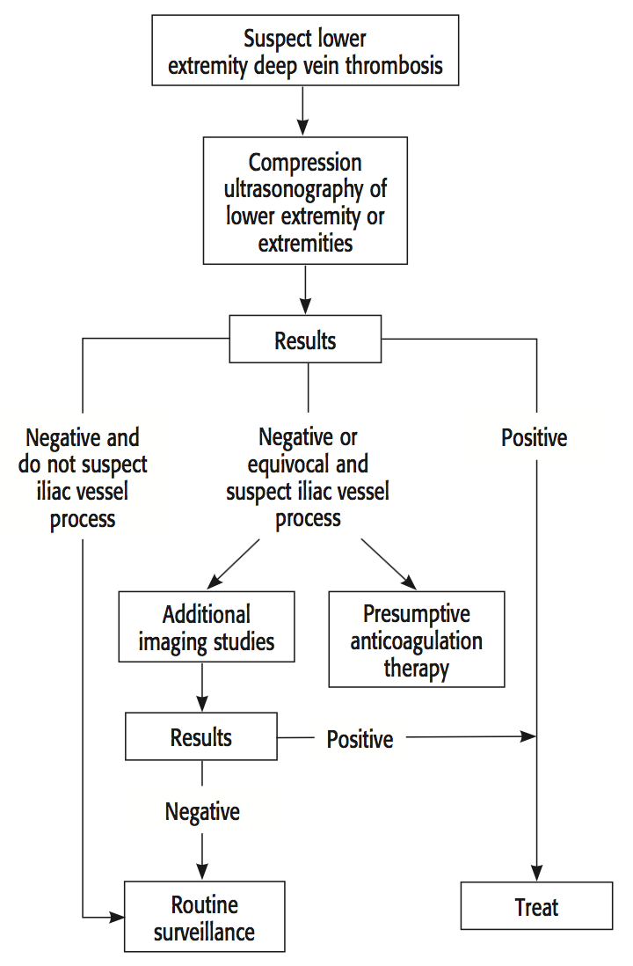
Diagnosis of DVT during pregnancy
Although measurement of D-dimer levels is a useful screening tool to exclude venous thromboembolism in the non-pregnant population, pregnancy is accompanied by a progressive increase in D-dimer levels,
even a high D-dimer level does not predict venous thromboembolism in pregnancy.
The diagnosis of new-onset PE is similar to that in the nonpregnant individual.
Both ventilation–perfusion scanning and computed tomographic (CT) angiography are associated with relatively low radiation expo- sure for the fetus.
Chunilal SD, Bates SM. Venous thromboembolism in pregnancy: diagnosis, management and prevention. Thromb Haemost 2009;101:428–38.

Slide 5


^{Φλεβοθρομβοεμβολική νόσος} ^{και κύηση}
The risk of venous thromboembolism may be higher in the third trimester compared with the first and second trimesters but the increased risk of venous thromboembolism is present from the first trimester.
The risk of venous thromboembolism is higher during the postpartum period than it is during pregnancy, especially during the first week postpartum.
The most important individual risk factor for venous thromboembolism in pregnancy is a personal history of thrombosis.
The next most important individual risk factor for venous thromboembolism in pregnancy is the presence of a thrombophilia.
Thrombophilia is present in 20–50% of women who experience venous thromboembolism during pregnancy and the postpartum period . Both acquired and inherited thrombophilias increase the risk of venous thromboembolism .
The risk of recurrent venous thromboembolism during pregnancy is increased threefold to fourfold
15–25% of all cases of venous thromboembolism in pregnancy are recurrent events.
Νικόλαος Φ. Βλάχος MD. PhD, FACOG
Καθηγητής Μαιευτικής, Γυναικολογίας και Υποβοηθούμενης Αναπαραγωγής

Slide 6
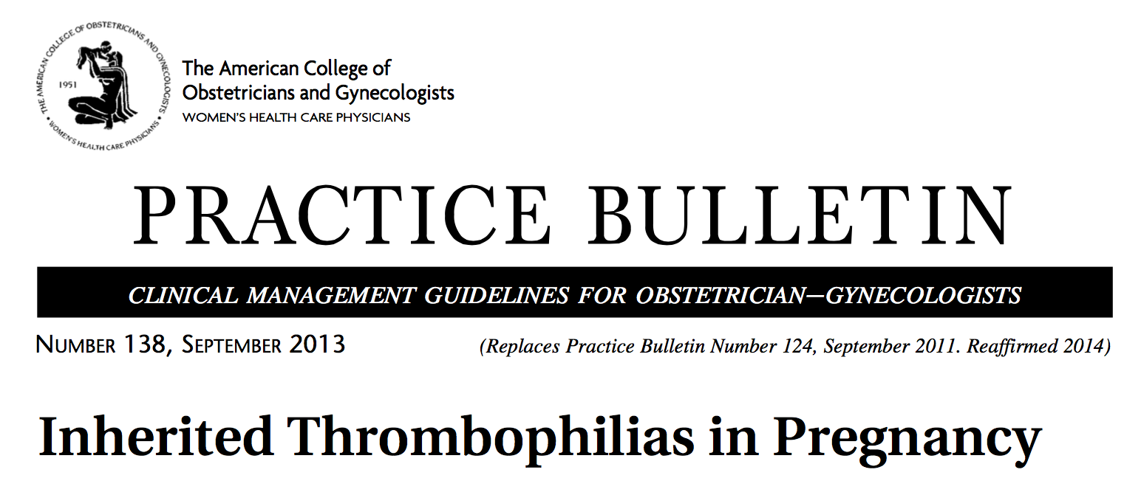
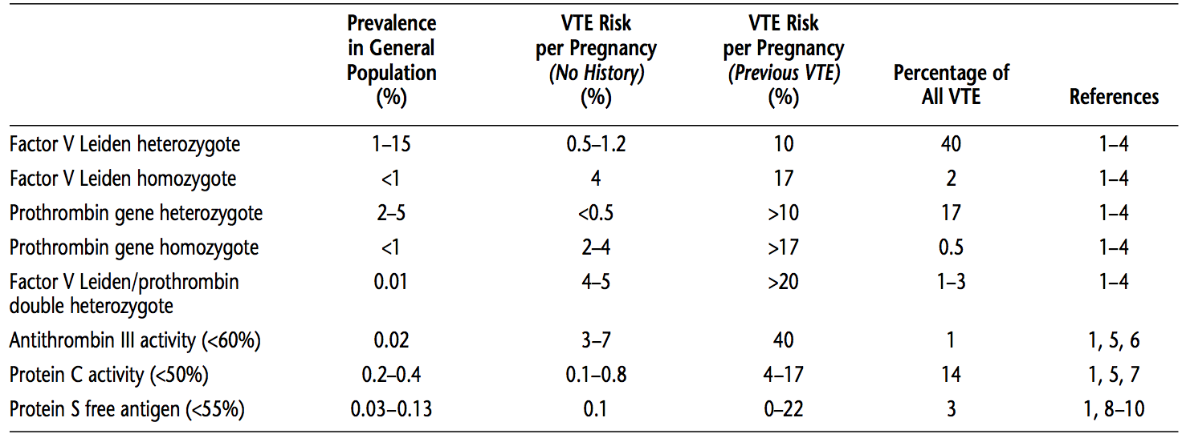

Slide 7
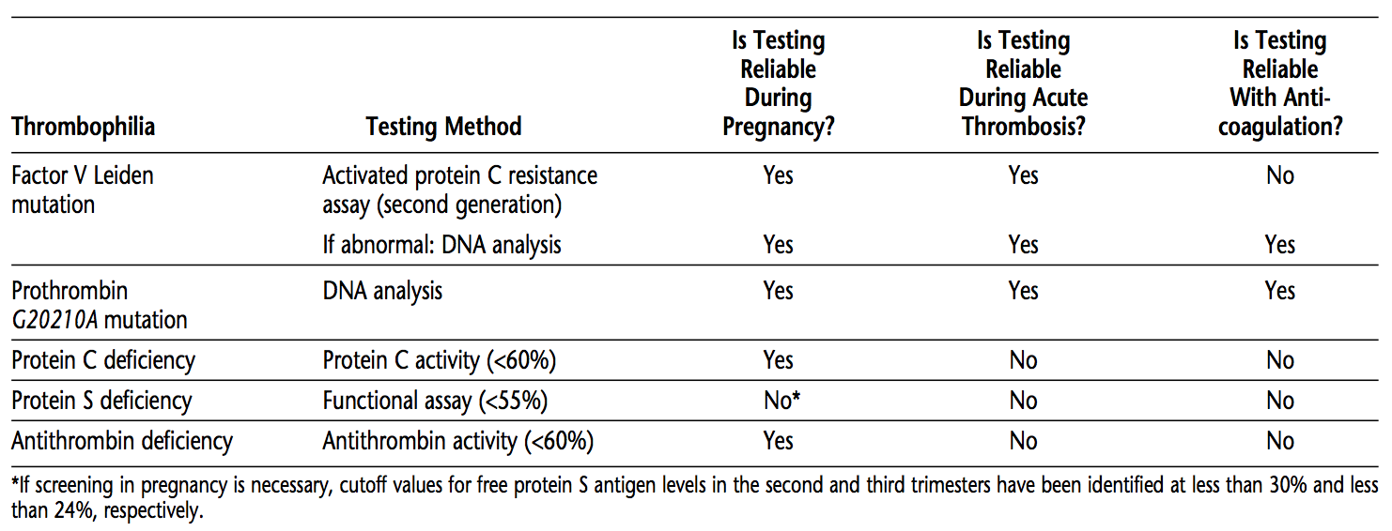

Slide 8
MTHFR mutation and risk of thrombosis
Homozygosity for the methylenetetrahydrofolate reductase (MTHFR) gene mutations is the most common cause of hyperhomocysteinemia.
Homozygosity for the MTHFR C677T and A1298C polymorphisms is present in 10–16% and 4–6% of all Europeans, respectively.
MTHFR mutations by themselves do not appear to convey an increased risk for venous thromboembolism in either nonpregnant or pregnant women.
Although hyperhomocysteinemia was previously reported to be a modest risk factor of venous thromboembolism, recent data indicate that elevated homocysteine levels are a weak risk factor of venous thromboembolism.
^{Int J Mol Med 2001; 8:509–11.}
Blood Coagul Fibrinolysis 2002;13:423–31.
^{J Thromb Haemost 2005;3:292–9.}
^{BJOG 2000;107:565–9.}

Slide 9
Other thrombophilias
A variety of other thrombophilias have been described,
  including alternative mutations in the factor V gene,
  a promoter mutation in the PAI-1 gene,
  protein Z deficiency, and
  activity-enhancing mutations in various clotting factor genes.
Although they appear to exert little independent risk of venous thromboembolism, they may exacerbate risk among patients with the aforementioned mutations.
However, there is insufficient evidence to recommend screening for these thrombophilias.

Slide 10
^{Low-risk thrombophilia:}
^{Additional risk factors}
^{High-risk thrombophilia:}
protein C or protein S deficiency.
^{factor V Leiden heterozygous;}
prothrombin G20210A heterozygous;
double heterozygous for prothrombin G20210A mutation and factor V Leiden;
prothrombin G20210A mutation homozygous.
^{antithrombin deficiency;}
First-degree relative with a history of a thrombotic episode before age 50 years, or
other major thrombotic risk factors (eg, obesity or prolonged immobility).
^{factor V Leiden homozygous or}

Slide 11
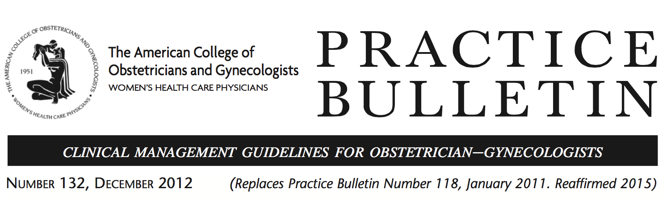
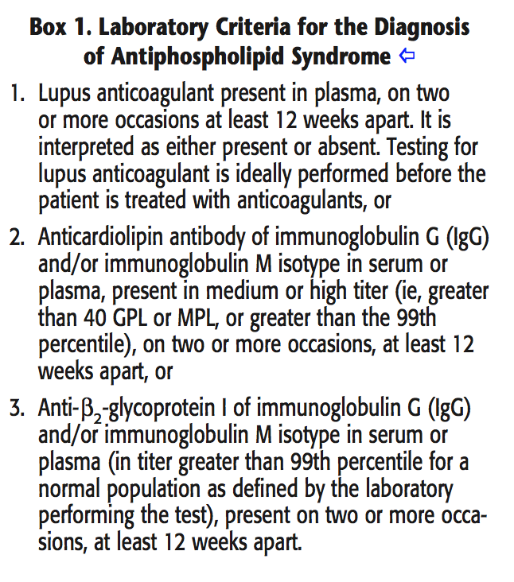
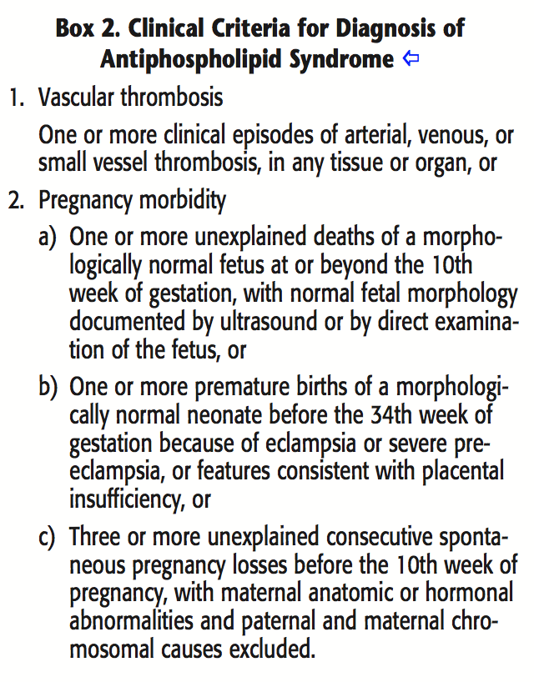
Diagnosis requires that at least one clinical and one laboratory criterion are met.
5–12% risk of thrombosis during pregnancy or the puerperium

Slide 12

Anti-phospholipid antibodies and adverse pregnancy outcome
Inherited Thrombophilias and adverse pregnancy outcome
Fetal loss (5-20%)
Preeclampsia (11-17%)
Fetal growth restriction (15-30%)

Slide 13
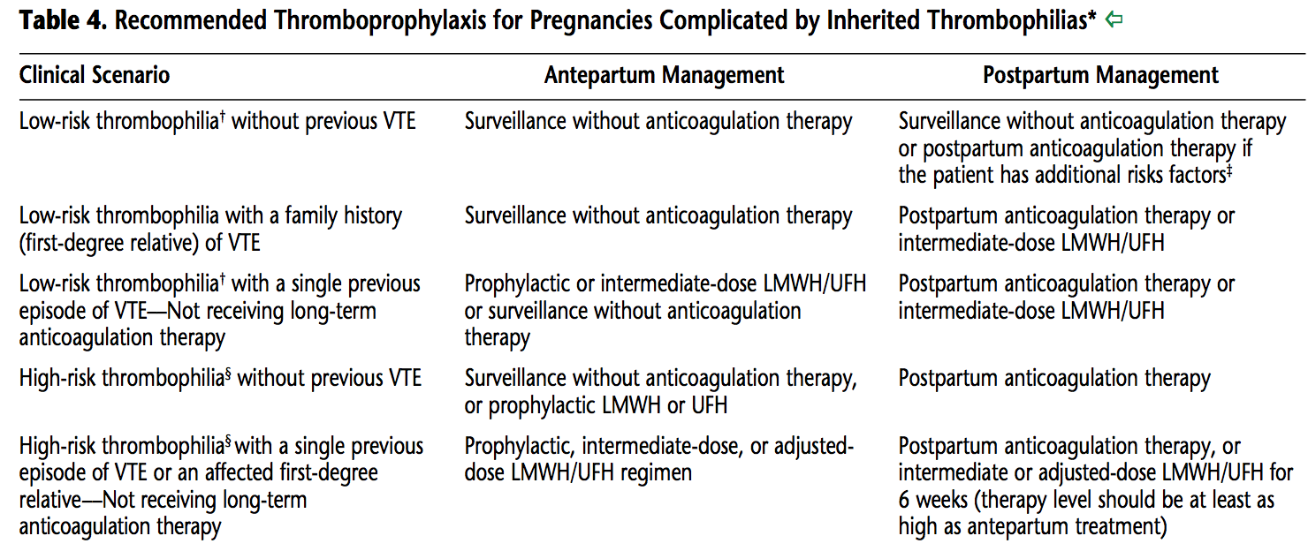
^{Φλεβοθρομβοεμβολική νόσος} ^{και κύηση}

Slide 14
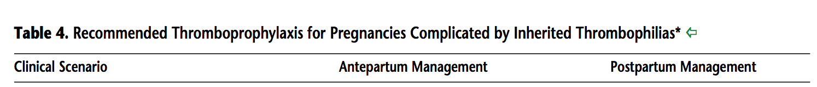
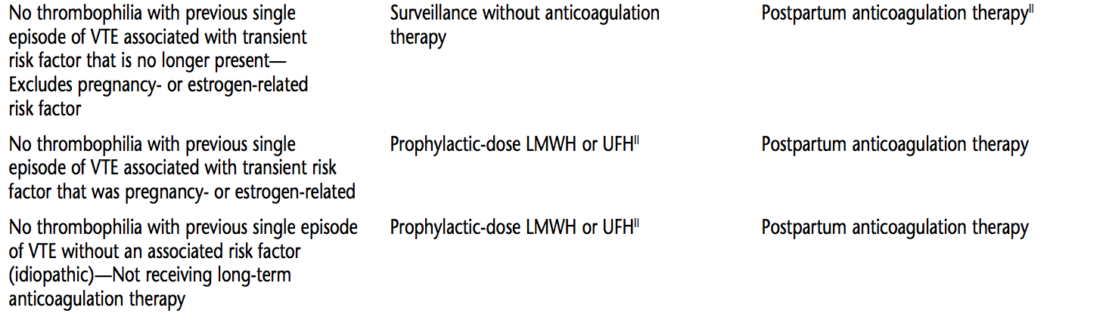
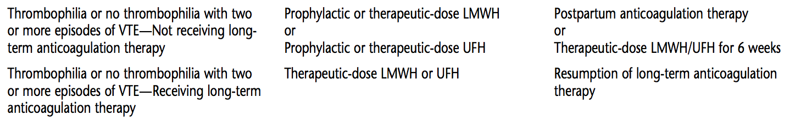

Slide 15
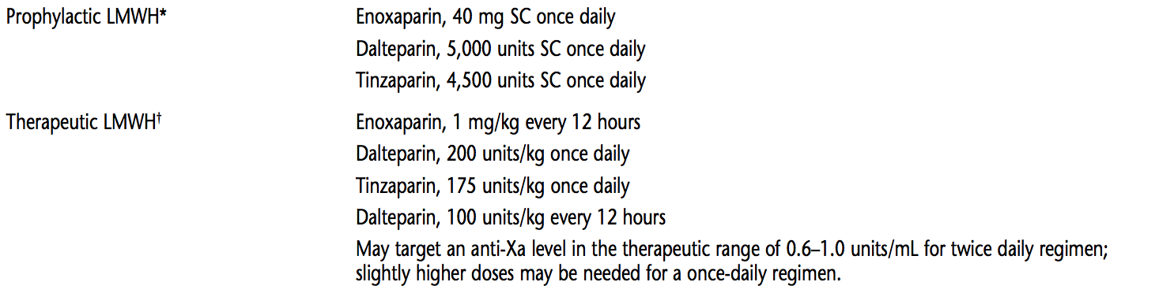
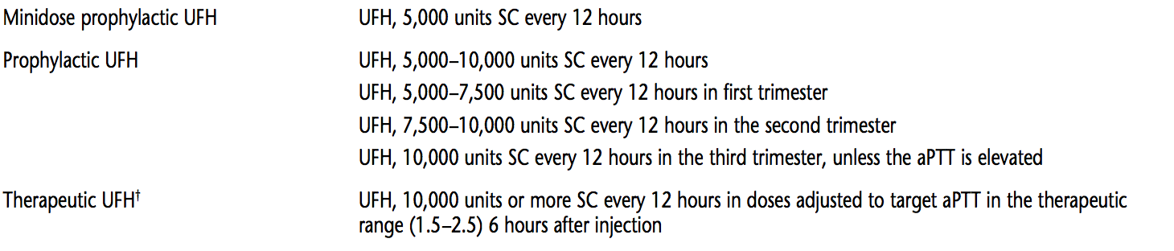

Slide 16
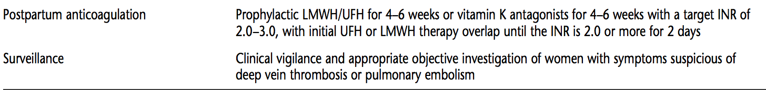

Slide 17
^{Φλεβοθρομβοεμβολική νόσος} ^{και κύηση}
How should antiphospholipid syndrome be managed during pregnancy and the post- partum period?
The goals of treatment for APS during pregnancy are to improve maternal and fetal–neonatal outcome.
1) Those with a history of thrombotic events and
2) Those without a history of thrombotic events.
^{Expert Opinion:}
For women with APS who have had a thrombotic event, prophylactic anticoagulation with heparin through- out pregnancy and 6 weeks postpartum .
For women without thrombotic event clinical surveillance or prophylactic heparin use antepartum in addition to 6 weeks of postpartum anticoagulation may be warranted
Women with recurrent pregnancy loss and antiphospholipid antibodies, prophylactic use of heparin and low-dose aspirin may reduce pregnancy loss by 50%.

Slide 18
^{Φλεβοθρομβοεμβολική νόσος} ^{και κύηση}
The following recommendations and conclusions are based on limited or inconsistent scientific evidence (Level B):
The preferred anticoagulants in pregnancy are heparin compounds.
A reasonable approach to minimize postpartum bleeding complications is resumption of anticoagulation therapy no sooner than 4–6 hours after vaginal delivery or 6–12 hours after cesarean delivery.
Because warfarin, LMWH, and unfractionated heparin do not accumulate in breast milk and do not induce an anticoagulant effect in the infant, these anticoagulants are compatible with breastfeeding.

Slide 19
^{Φλεβοθρομβοεμβολική νόσος} ^{και κύηση}
^{Heparin Compounds}
Neither unfractionated heparin nor LMWH crosses the placenta and both are considered safe in pregnancy.
Unique considerations regarding the use of anticoagulation therapy in pregnancy include a 40–50% increase in maternal blood volume; an increase in glomerular filtration, which results in increased renal excretion of heparin compounds; and an increase in protein binding of heparin .
During pregnancy, both unfractionated heparin and LMWH have shorter half-lives and lower peak plasma concentrations, usually necessitating higher doses and more frequent administration in order to maintain effective concentrations .
Potential advantages of LMWH include fewer bleeding episodes, a more predictable therapeutic response, a lower risk of heparin-induced thrombocytopenia, a longer half-life, and less bone mineral density loss.
Unfractionated heparin, is associated with increased bruising at the injection sites, also has been associated with other skin reactions and serious allergic reactions
A relative disadvantage of LMWH at the time of delivery is its longer half-life, which is an important consideration for both neuraxial anesthesia and peripartum bleeding risk.

Slide 20
^{Φλεβοθρομβοεμβολική νόσος} ^{και κύηση}
Which anticoagulants should be used in cases of heparin allergy?
In cases of severe cutaneous allergies or heparin- induced thrombocytopenia in pregnancy, fondaparinux (a synthetic pentasaccharide) may be the preferred anti- coagulant because danaparoid, an LMWH with minimal cross-reactivity in heparin-sensitive patients, is currently unavailable in the United States .
However, there are insufficient data to justify the routine use of fondaparinux as an alternative to heparins for prophylaxis of venous thromboembolism in pregnancy.
Although a recent retrospective study comparing fondaparinux with enoxaparin administered between day 6 of the conception cycle and continued until 12 weeks of gestation found no untoward effects of fondaparinux on mother or infant, anticoagulant activity has been detected in umbilical cord blood of exposed fetuses.
J Thromb Haemost 2010;8:1876–9.
N Engl J Med 2004;350:1914–5.

Slide 21
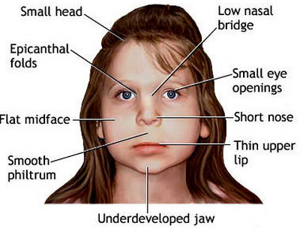
^{Φλεβοθρομβοεμβολική νόσος} ^{και κύηση}
^{Warfarin}
Warfarin embryopathy has been linked with exposure at 6–12 weeks of gestation,
LMWH be used in place of warfarin.
Although rarely prescribed in pregnancy, warfarin is still considered in pregnancy for women with mechanical heart valves because of their high risk of thrombosis even with heparin or LMWH anticoagulation therapy

Slide 22
^{Φλεβοθρομβοεμβολική νόσος} ^{και κύηση}
Who are candidates for thrombophilia evaluation?
• Personal history of venous thromboembolism that was associated with a non- recurrent risk factor (eg, fractures, surgery, and prolonged immobilization).
The recurrence risk among untreated pregnant women with such a history and a thrombophilia was 16%
A first-degree relative (eg, parent or sibling) with a history of high-risk thrombophilia.
Testing for inherited thrombophilias in women who have experienced recurrent fetal loss or placental abruption is not recommended because it is unclear if anticoagulation therapy reduces recurrence.
Although there may be an association in these cases, there is insufficient clinical evidence that ante- partum prophylaxis with unfractionated heparin or low molecular weight heparin (LMWH) prevents recurrence in these patients (56).
However, screening for antiphospholipid antibodies may be appropriate in patients experiencing fetal loss

Slide 23


Slide 24
^{Φλεβοθρομβοεμβολική νόσος} ^{και κύηση}
Pregnant women have a fourfold to fivefold increased risk of thromboembolism compared with nonpregnant women
Venous thromboembolism, including pulmonary embolism, accounts for 1.1 deaths per 100,000 deliveries), or 9 % of all maternal deaths in the United States .
In the developing world, the leading cause of maternal death is hemorrhage
In developed nations, where hemorrhage is more often success- fully treated and prevented, thromboembolic disease is one of the leading causes of death .
Νικόλαος Φ. Βλάχος MD. PhD, FACOG
Καθηγητής Μαιευτικής, Γυναικολογίας και Υποβοηθούμενης Αναπαραγωγής

Slide 25
^{Φλεβοθρομβοεμβολική νόσος} ^{και κύηση}
Deep vein thrombosis (DVT) and pulmonary embolism (PE) are collectively referred to as venous thromboembolic events. 0.5-2 per 1000
Approximately 75–80% of cases of pregnancy-associated venous thromboembolism are caused by DVT, and 20–25% of cases are caused by PE.
One half of these events occur during pregnancy and one half occur during the postpartum period.

Slide 26
^{Φλεβοθρομβοεμβολική νόσος} ^{και κύηση}
What is the appropriate evaluation of women with a prior venous ^{thromboembolism?}
Women with a history of thrombosis who have not had a complete evaluation of possible underlying etiologies should be tested for both antiphospholipid antibodies and for inherited thrombophilias.
The results of thrombophilia testing in women with a prior venous thromboembolism may alter the need for treatment or the intensity of treatment from a prophylactic to a therapeutic dose (also known as adjusted-dose or weight- based dose) of LMWH or unfractionated heparin.

