Slide 1


Conventional laparoscopy vs. Robotics
Nikos F. Vlahos. MD.PhD , FACS, FACOG
Associate professor of Gynecology and Obstetrics
University of Athens School of Medicine

Slide 2

Evidence Based Medicine

Slide 3

When there is no evidence
At least these should be common sense

Slide 4
Quiz????
How many of you have seen the DaVinci System?
How may have seen surgery with the DaVinci? (real time….. in the room )
How many have you done surgery with the DaVinci?

Slide 5
Quiz????
How many believe that robotic surgery is better than conventional laparoscopy?

Slide 6
Ergonomics= ergon+ nomos
Ergonomics
Safety
Efficiency
Comfort
The set of rules that control the interaction between the human and his environment, in order to make the performance of tasks safe, comfortable and efficient.

Slide 7

This is not Ergonomics!!!

Slide 8
My mission
Use of the robotic system for Gynecologic surgery at this time is:
  Waste of money!
  Waste of time!
  Does not offer any benefit to the patient!

Slide 9
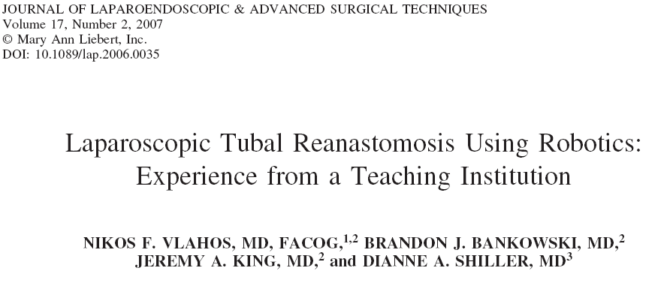
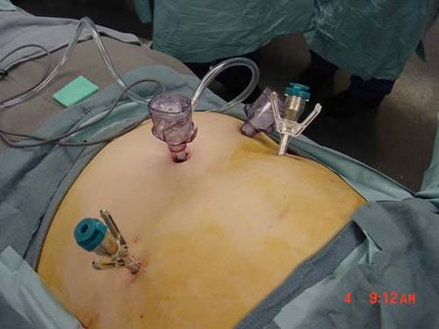
Johns Hopkins Hospital (October 2003- March 2004)
5 patients ( 28 - 35 years of age.
Four surgical ports (12 mm, two 8 mm, 5 mm.

Slide 10
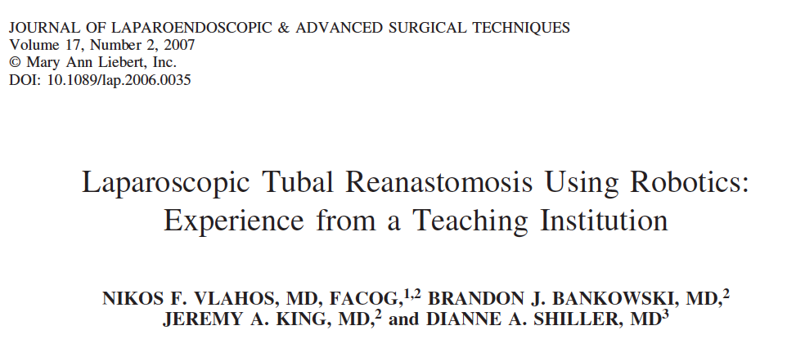
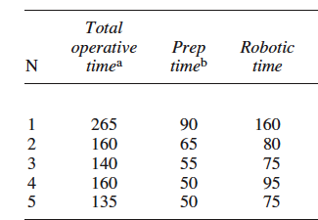
Time (minutes)
The mean ( standard deviation) time of the procedure was 172 (53) min.
The mean time for docking the robotic arms to the patient was 62 (16.8) min
The mean robotic time was 97 (36 min. )
Notes:
Methods: From October of 2003 to September 2004 five patients with previous tubal sterilization who requested tubal reanastomosis underwent laparoscopic tubal reanastomosis with the use of the daVinci robotic system.
Result(s): Ten fallopian tubes were successfully reconstructed as confirmed by chromopertubation at the end of the procedure. Patency was confirmed by hysterosalpingogram in seven out of eight tubes. The mean (+ SD) time of the procedure was 172+53 min. The mean time for docking the robotic arms to the patient was 62+16.8 min. and the mean robotic time was 97+36min. There were two live births, one ectopic pregnancy and one biochemical pregnancy. The mean (+ SD) time to conception was 5.5+2

Slide 11
Advantages
Drawbacks
Superb optics
  3-D vision
Enhanced motor control
  Elimination of tremor
  7 degrees of freedom in motion
Minimal manipulation of tissues
Laparoscopic approach by a single skilled surgeon
All other benefits of laparoscopy
Preparation time (docking time)
Requirement for specially trained OR personnel
Absence of tactile sensation
Bulky equipment
Positioning between the legs
Difficulty to use a uterine manipulator
High cost of equipment and disposables
Robotic room may be necessary

Slide 12
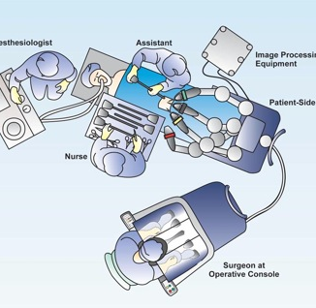
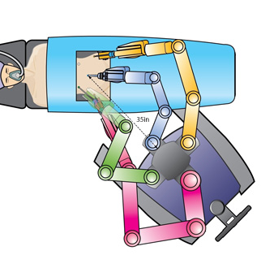
Use of Robotics in Ovarian Surgery
Between the legs docking
Side- docking

Slide 13
Robotics vs Conventional laparoscopy
Morcellation
Suturing
Use of Endobag

Slide 14
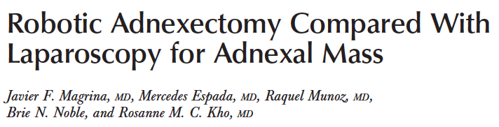
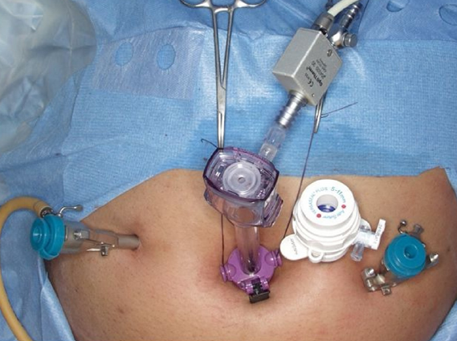
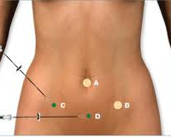
Robotic adnexectomy compared with laparoscopy for adnexal mass.
12 mm umbilical trocar
8 mm trocar 10 cm R. at RLQ or the level of the umbilicus
8 mm trocar 10 cm L. at LLQ or the level of the umbilicus
10 mm trocar 3cm cranially between the umbilical and the left robotic arms .
Obstet Gynecol 2009;114:581–4

Slide 15
Robotic adnexectomy compared with laparoscopy for adnexal mass.
Laparoscopy and robotics provided similar results for the performance of adnexectomy, with similar blood loss, intraoperative and postoperative complications, and length of hospital stay.
HOWEVER
12 min increase in surgical time
Docking time was not included in the estimation of surgical time.
Specimen extraction was not discussed
Cost analysis was not performed.
Obstet Gynecol 2009;114:581–4

Slide 16
Large adnexal masses are preferably approached by laparoscopy, because trocar placement is not restricted as in robotics, manipulation of large masses is easier, and intraoperative drainage of large benign cystic masses can be performed laparoscopicaly and not with robotic instruments.
In the presence of a malignant adnexal mass discovered at adnexectomy, a complete staging can be expeditiously performed with the addition of one to three trocars in laparoscopy.
In robotics, five additional trocars, rotation of 180 degrees of the operating table, and undocking and re-docking are necessary.
In contrast to conventional laparoscopy, the present robotic system does not provide access to the upper abdomen without rotation of the operating table.
Obstet Gynecol 2009;114:581–4

Slide 17
Use of Robotics in Gyn Surgery
Pros
Cons
Better visualization
Better handling (7 degrees of freedom )
Elimination of tremor
Time requirements
  docking
  exchange instruments
Removal of the specimen
Suturing
Morcelation
Number and size of the ports used.
Operational expenses.

Slide 18
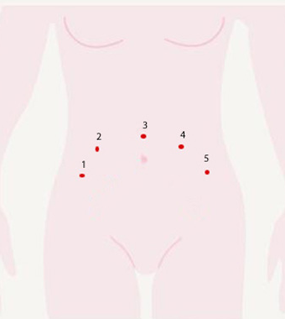
Use of Robotics in Gynecologic Surgery
Ports and Instruments used for standard robotic hysterectomy
Ports
Assistance port 12mm - suction and needle insertion (Port 4)
3 da Vinci trocars. (Ports 1,2 and 5)
Instruments
Monopolar scissors (Port 2 Robot arm 1)
Gyrus bipolar (Port 5 Robot arm 2)
Vault suturing change the monopolar scissors for a needle grasper (Port 2 Robot arm 1)
Camera port 12mm (Port 3)
Maryland grasper (Port 1 Robot arm 3)

Slide 19
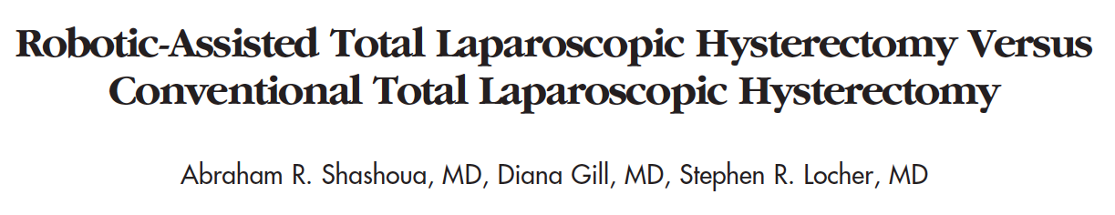
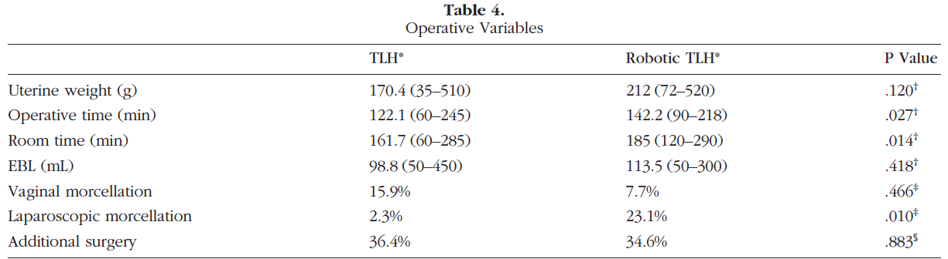
JSLS 2009

Slide 20
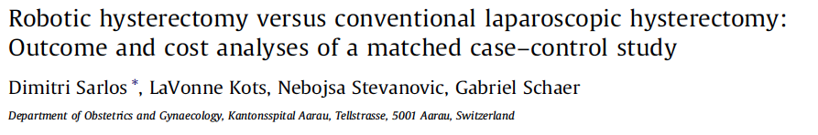
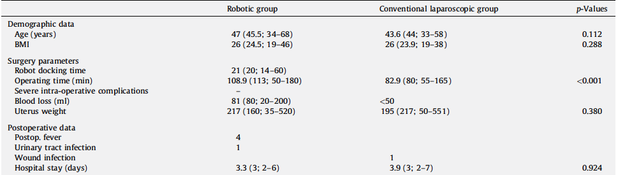

Slide 21

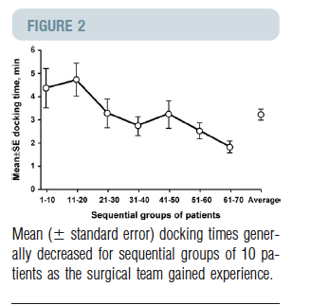

Slide 22
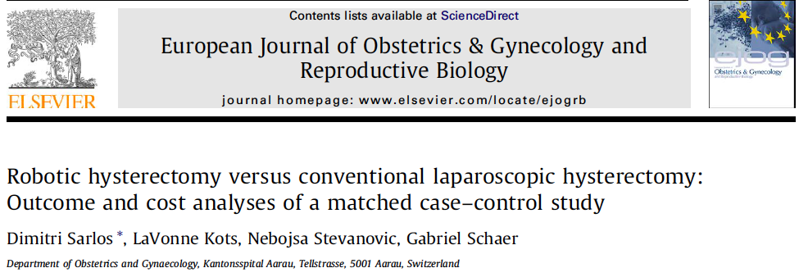

§

Slide 23
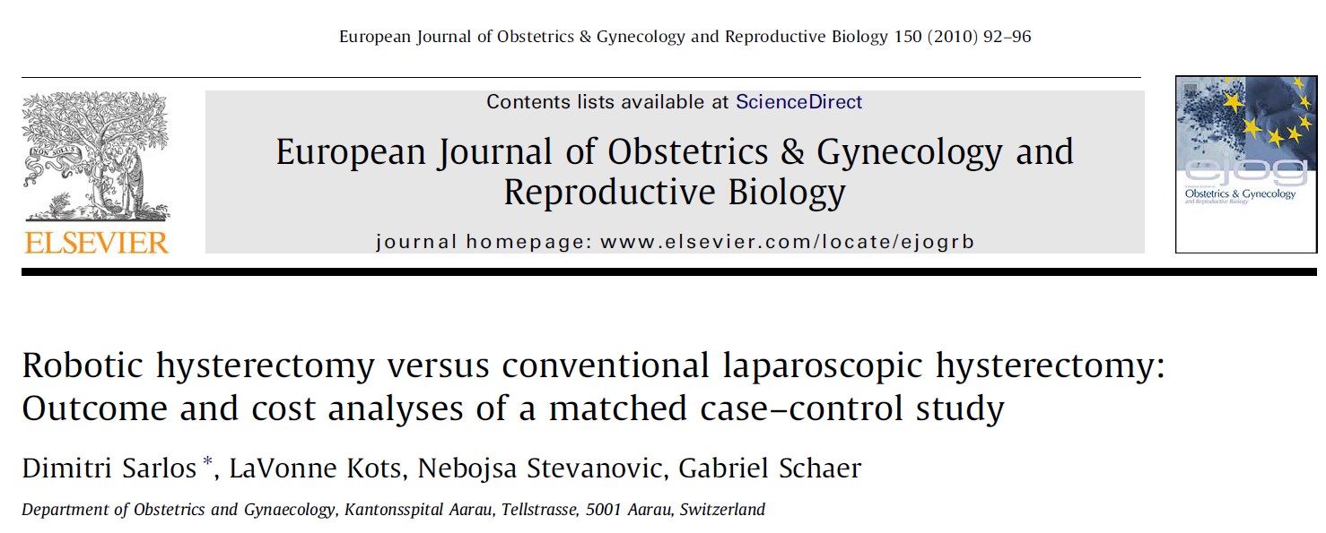
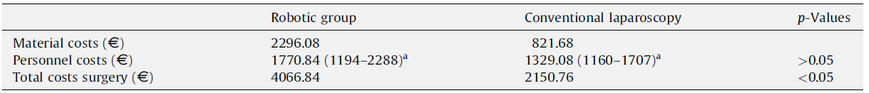
1.6 Million Euros and 150.000 annually operating costs.

Slide 24
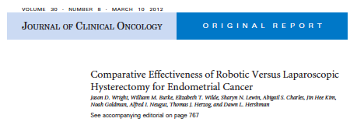
Results
We identified 2,464 women, including 1,027 (41.7%) who underwent laparoscopic hysterectomy and 1,437 (58.3%) who underwent robotic hysterectomy.
The mean cost for robotic hysterectomy was $10,618 versus $8,996 for laparoscopic hysterectomy (P .001).
Conclusion
Despite claims of decreased complications with robotic hysterectomy, we found similar morbidity but increased cost compared with laparoscopic hysterectomy.

Slide 25
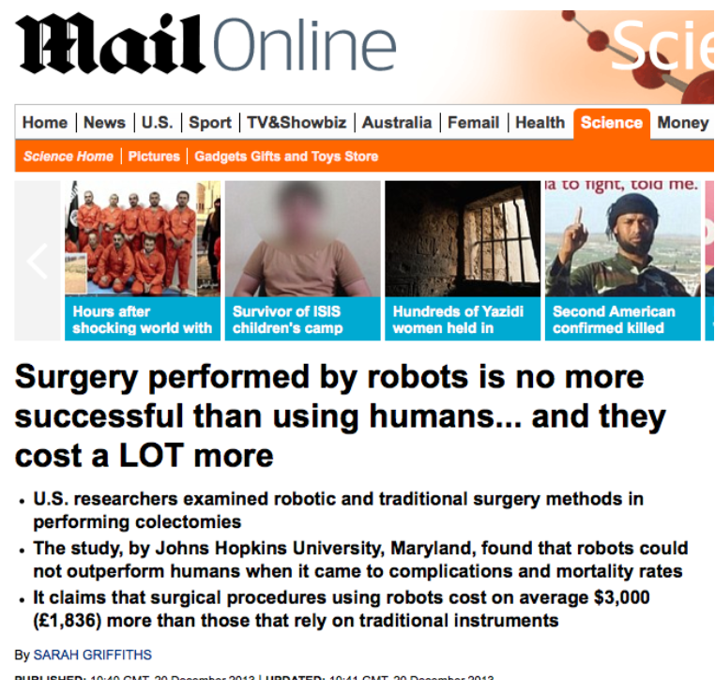

Slide 26


Slide 27
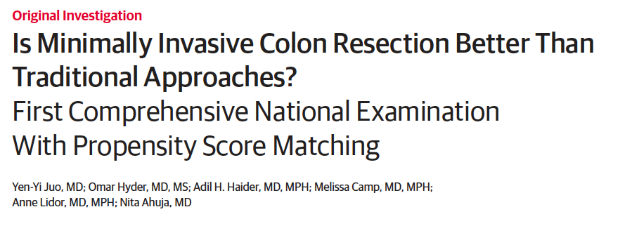
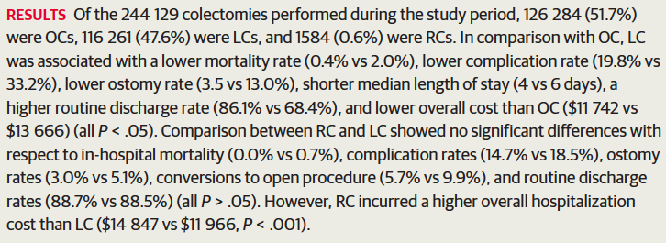
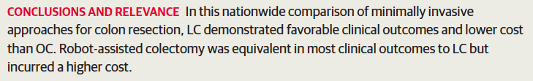


Slide 28

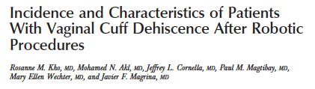

Twenty-one of 510 patients were identified with vaginal cuff dehiscence (incidence 4.1%, 95% confidence interval 2.3–5.8%).
Increased risk of vaginal cuff dehiscence and evisceration during Robotic Surgery .

Slide 29
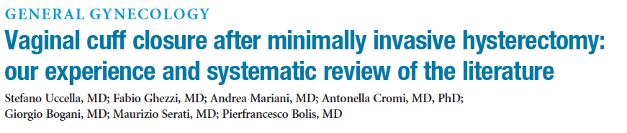

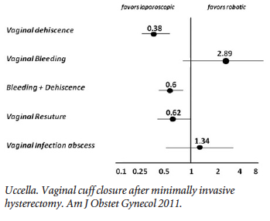

Slide 30
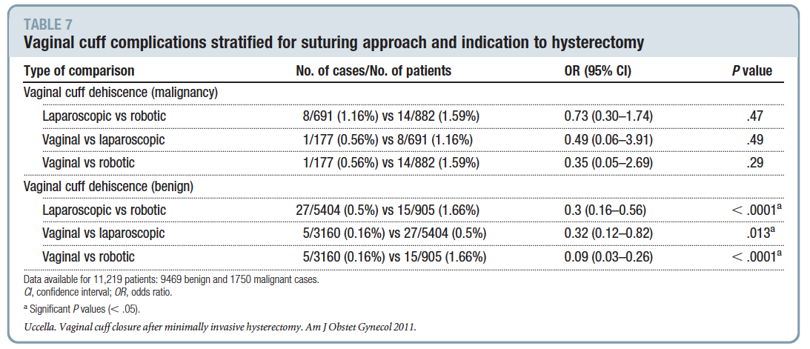

Slide 31
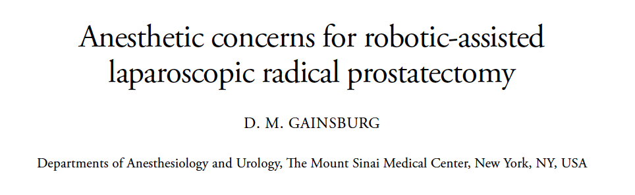
1. The significant anesthetic concerns of RALP
are the physiological effects of pneumoperitoneum in the Trendelenburg position,
Restricted access to the patient secondary to the robotic equipment set over the patient, and prevention and/or treatment of complications.
2. The non-surgical risks of RALP include
subcutaneous emphysema, brachial plexus injuries, corneal abrasions, laryngeal edema, venous gas embolisms, and posterior ischemic optic neuropathy.
0. Gainsburg DM. Anesthetic concerns for robotic-assisted laparoscopic radical prostatectomy. Minerva Anestesiol. 2012;78:596– 604.

Slide 32
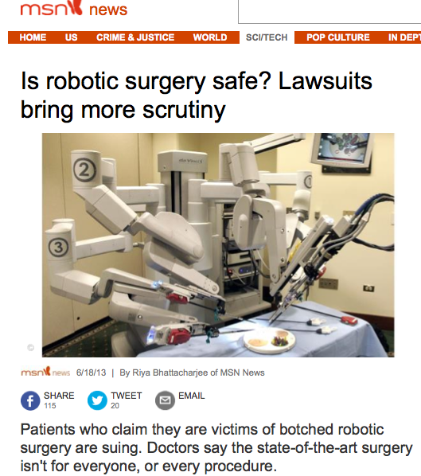

Slide 33
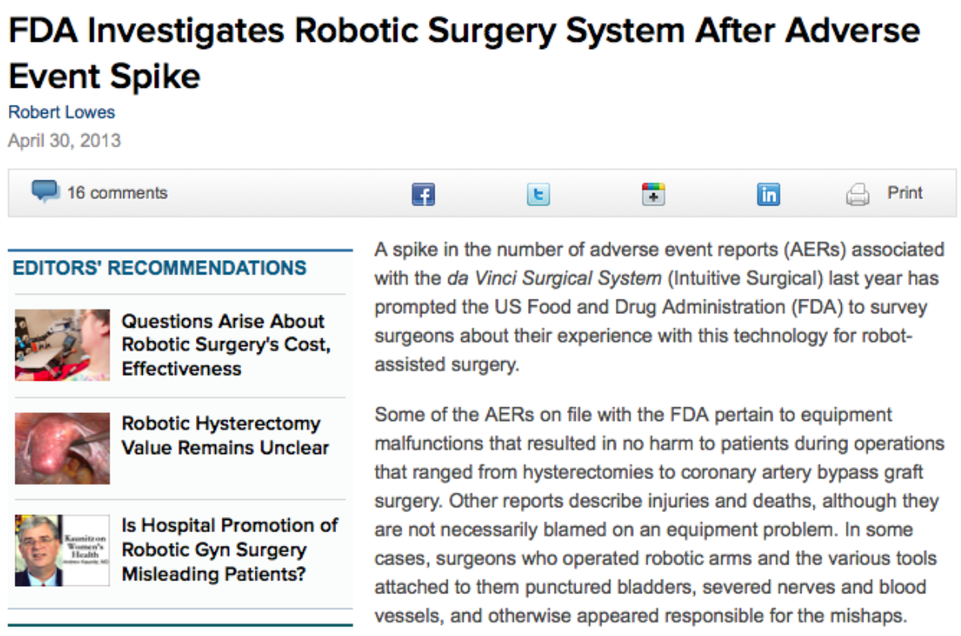

Slide 34
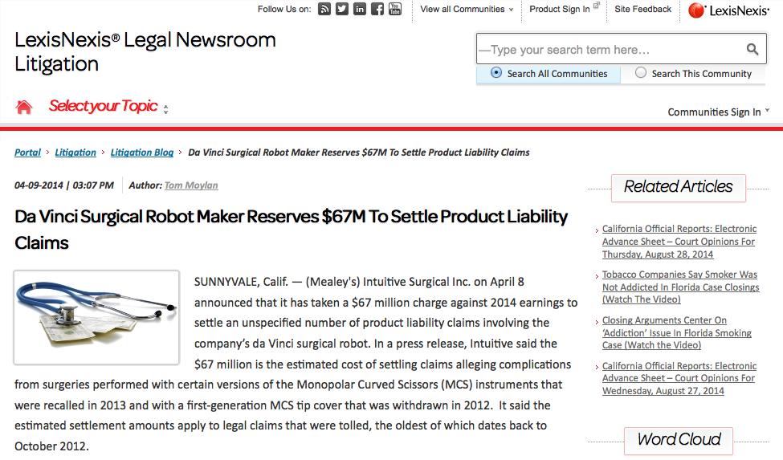

Slide 35


Slide 36
TODAY
There is no evidence to support the use of robotic surgery for gynecological patients
  The use of robot is associated with increased costs and increased operating times.
  In addition there are specific complications associated with the use of the robot.
  The current technology in the robotic surgery is still primitive and for the past 10 years has not solved specific problems

Slide 37

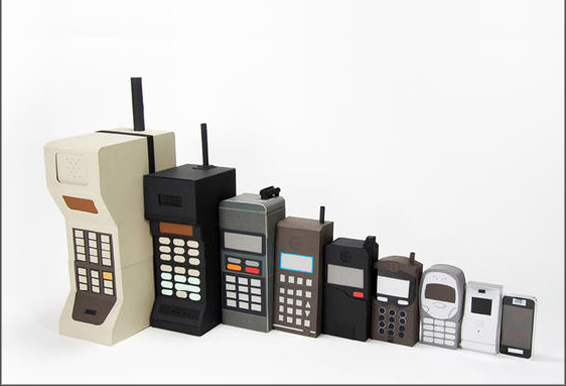
Evolution!!!!
Notes:
Prior to 1973, mobile telephony was limited to phones installed in cars and other vehicles.[17] Motorola was the first company to produce a handheld mobile phone. On 3 April 1973 when Martin Cooper, a Motorola researcher and executive, made the first mobile telephone call from handheld subscriber equipment, placing a call to Dr. Joel S. Engel of Bell Labs.[23][24] The prototype handheld phone used by Dr. Cooper weighed 1.1 kg and measured 23 cm long, 13 cm deep and 4.45 cm wide. The prototype offered a talk time of just 30 minutes and took 10 hours to re-charge.[25]

Slide 38
However !!!!!!!
Technology is here to stay:
We need better robots.
The robotic arms should be mounted on the ceiling.
Allocated robotic room in each hospital.
Dedicated robotic personnel.
Acquisition and operational expenses should be reduced.
Competition= Evolution

Slide 39


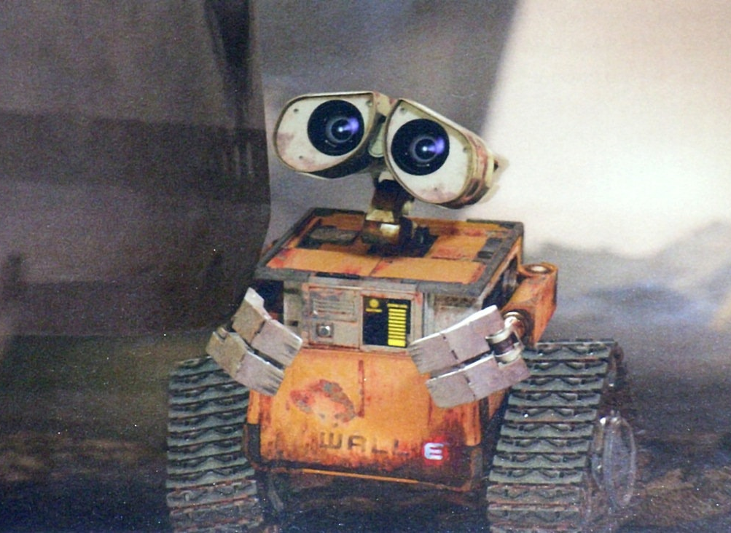
Notes:
Wall.E and EVE

Slide 40

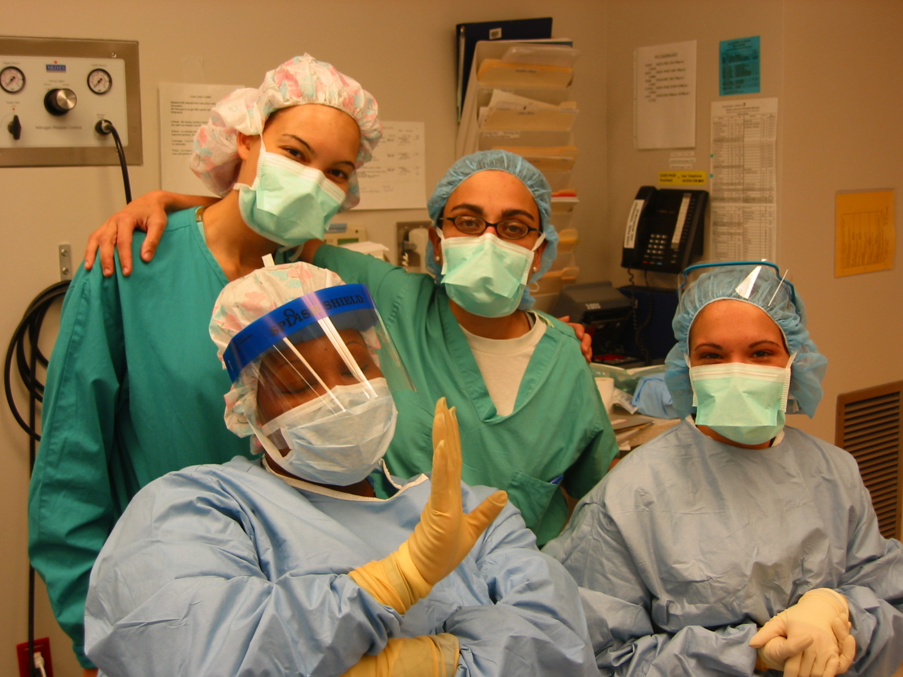
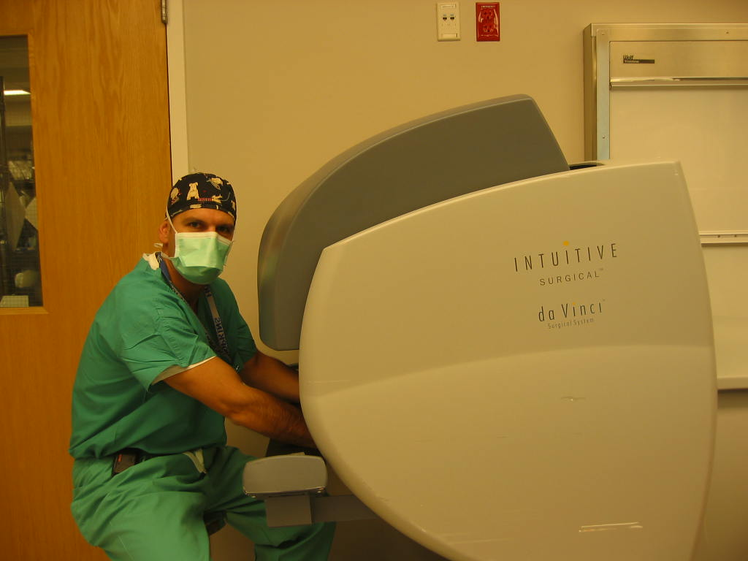
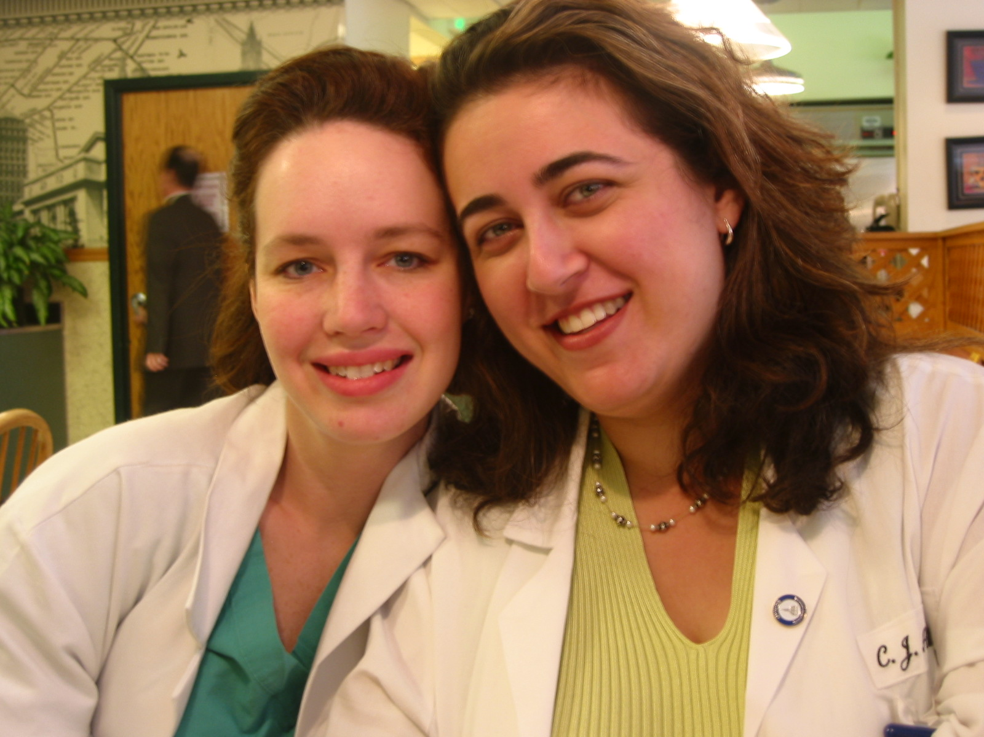
Thank you

Slide 42
Robotics: the future?

Slide 43
Hysterectomies – A Journal of the American Medical Association study found that robotic surgeries added $2,000 to the cost of the procedure, with no significant clinical advantages in pain, healing time or reducing complications compared to laparoscopic surgery. Intuitive Surgical states that the results should be compared to open surgeries, rather than other minimally-invasive techniques. However, a 2011 analysis published in the American Journal of Obstetrics & Gynecology reported double the complication rate with robotic surgery compared to traditional surgery.

Slide 44
Quiz????
How many believe that robotic surgery is better than conventional laparoscopy
TODAY ?

Slide 45
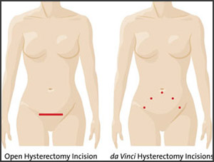
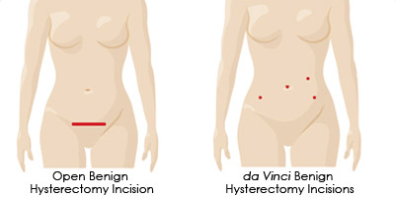
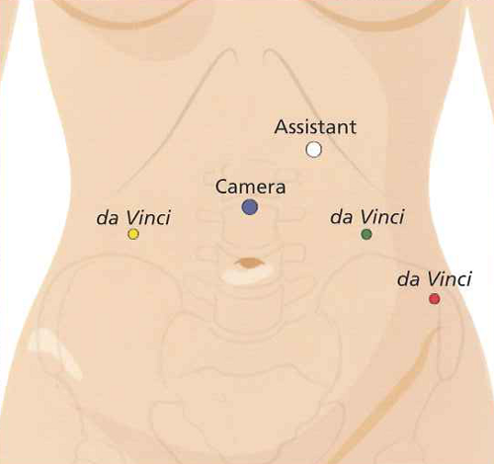

Slide 46
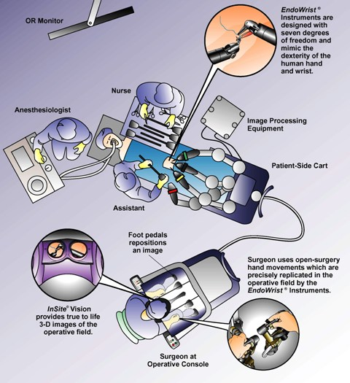

Slide 47
Future of Robotic surgery
Reduce size and bulk of the instrument
Improve haptics and introduce palpation
Decrease/eliminate delay in signal transmission
Use wireless transmission
Integration with real time US, CT , MRI, PET
Space navigation and 3D positioning
Computer animation of 3D reconstruction.
Make it less expensive

Slide 48

Use of Robotics in Ovarian Surgery
Nikos F. Vlahos, FACOG, FACS
Associate Professor of Gynecology and Obstetrics,
Johns Hopkins Hospital School of Medicine
Associate Professor of Gynecology and Obstetrics,
University of Athens School of Medicine

Slide 49
Evidence-Based Medicine:
Επιστημονικά τεκμηριωμένη Άσκηση της Ιατρικής.
Συνδυάζει τα καλύτερα βιβλιογραφικά δεδομένα με την κλινική εμπειρία του Ιατρού για να προσφέρει την καλύτερη δυνατή λύση στα προβλήματα του συγκεκριμένου ασθενούς.

Slide 50
June 14, 2007
Intuitive surgical purchases position tracking software
Luna Innovations Signs Multi-Year Development and Supply Agreement with Intuitive Luna's Sensing Technology to be Integrated into Intuitive's Surgical Products
June 10, 2007
The Canadians are leading the way in telerobotic surgery
UroToday - Remote Telepresence Surgery: The Canadian Experience
This important report from Canada presents 22 telerobotic general surgery laparoscopy cases performed by two surgeons over a distance of 400 kilometers; from a teaching hospital in Hamilton, Ontario to a community hospital in rural Northern Ontario.

Slide 51

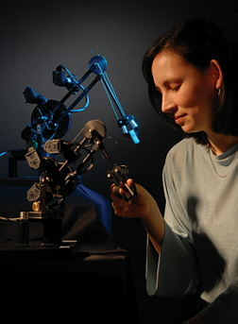
 | More Than a Feeling Allison Okamura's engineering lab infuses robots with a sense of touch, for the sake of health. By Michael Anft Illustration by Mike Ciesielski

Slide 52
High-resolution touch sensor could be boon to cancer surgeons Released on 6/8/2006 Office of University Communications University of Nebraska-Lincoln
Lincoln, Neb., June 8, 2006 -- One of the trickiest decisions facing a cancer surgeon today is where to stop cutting. The surgeon doesn't want to stop too soon and leave cancer cells in the patient's body, but he or she also doesn't want to take too many cells and do unnecessary damage to organs. That decision could soon be made much easier, though, thanks to a high-resolution touch sensor developed by chemical engineers at the University of Nebraska-Lincoln that may allow surgeons to tell at the level of a single layer of cells whether or not they have excised a tumor in its entirety. Ravi F. Saraf, and his doctoral student, Vivek Maheshwari, report in the June 9 issue of Science, the international weekly journal of science, that they have developed a self-assembling nanoparticle device that has touch sensitivity comparable to that of the human finger, a capability far beyond any mechanical devices now available. "The touch resolution of the human finger is 40 microns (40 millionths of a meter)," said Saraf, the Lowell E. and Betty Anderson professor of chemical engineering. "Using nanoparticles, we can attain resolution close to human touch, which is about 50 times better than what is out there today."

Slide 53
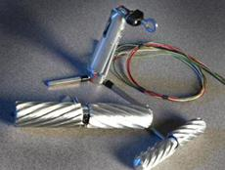
Researchers at the University of Nebraska-Lincoln have developed a tiny silver robot to aid in remote surgery.
The silver robot is slightly larger than a lipstick tube and it’s got wheels to roam over a liver or rumble through bumpy bowels inside the abdominal cavity of a pig — and someday maybe a person.
Equipped with a video camera no bigger than a penny, the robot could allow a surgeon to search for bleeding or disease, even though he or she may be thousands of miles away. Surgical tools could be added to perform a biopsy or repair a blood vessel.

Slide 54
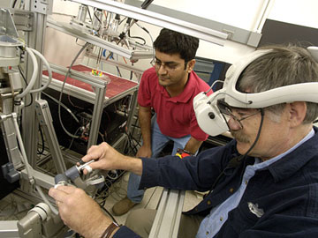
Medical Robotics at Johns Hopkins University
A Peek into the Operating Room of the Future

Slide 55
November 12, 2006
Truly "robotic" surgery in the future?
MTB Europe - Robotic surgery guided by 3-D ultrasound scanner
Durham, N.C. USA. Duke University engineers have shown that a three-dimensional ultrasound scanner they developed can successfully guide a surgical robot."

Slide 56
Evidence based medicine
RCT
Well designed case control trials
Case reports and expert opinion
Level A evidence
Level C
evidence
Junk
Level B evidence

