Slide 1
Μη μικροκυτταρικός καρκίνος του πνεύμονα (Non Small Cell Lung Carcinoma-NSCLC)
Ζιώγας Δημήτριος, MD, PhD
Παθολόγος Ογκολόγος
Πανεπιστημιακός υπότροφος/Επιστημονικός συνεργάτης
Α’ΠΑΘΟΛΟΓΙΚΗ ΚΛΙΝΙΚΗ
ΓΝΑ ΛΑΙΚΟ
Notes:
Καλημέρα, λέγομα ΔΖ και Θα προσπαθήσουμε να αναπτύξουμε όσο καλύτερα μπορούμε

Slide 2
Overview of NSCLC presentation
Epidemiology
Histology
Clinical presentation
Diagnostic techniques
Staging
Therapy
Treatment for stage I,II
Treatment for stage IIIA
Treatment for stage IIIB
Treatment for stage IV:
Questions & Answers
EGFR/ALK/ROS1
Adeno vs. Squamous
Nivolumab/pembrolizumab trials
Notes:
Απο την επιδημιολογία μεχρι την θεραπεία

Slide 3
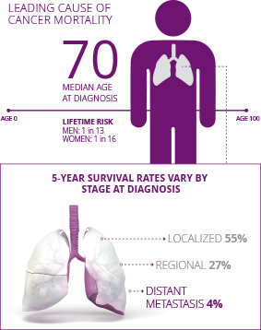
Epidemiology of NSCLC
83-85% of lung cancer,
the leading cause of cancer mortality in the US
New cases, 2015: US, 221,200; global, 2M
Deaths, 2015: US, 158,040; global, 1.5M
~ 85% of lung cancers in the US are associated with smoking
In nonsmokers is most often adenocarcinoma and
disproportionately affects women vs men
Incidence of lung cancer varies among racial, ethnic,
and socioeconomic groups
5-year OS rate for NSCLC is 21%, varies widely by stage
Overall: 18%
Metastatic: 4%
55% of NSCLC patients are diagnosed with advanced disease
Contributes to more deaths than breast, colon, and prostate cancer combined
1. Cancer statistics, 2016. CA Cancer J Clin. 2016;66:7-30.
2. American Cancer Society. Cancer facts and figures 2016.
http://www.cancer.org/acs/groups/content/@research/documents/document/acspc-047079.pdf
Notes:
----- Meeting Notes (4/5/20 17:52) -----
Αποτελει το 83-85% των περιπτώσεων
----- Meeting Notes (4/5/20 18:03) -----
και την κύρια αιτια θανατου στην αμερικη
το 85% των περιπτώσεων οφείλεται στο κάπνισμα ενώ στους μη καπνιστές ο ποιο συχνος τύπος είναι το αδενοκαρκίνωμα προσβαλοντας κυρίως γυναικες

Slide 4
Notes:
----- Meeting Notes (4/5/20 18:03) -----
Αποτελεί έναν καρκίνο φονια

Slide 6
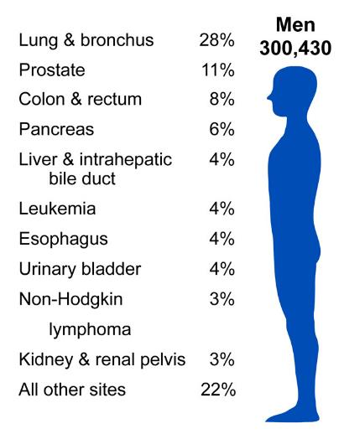
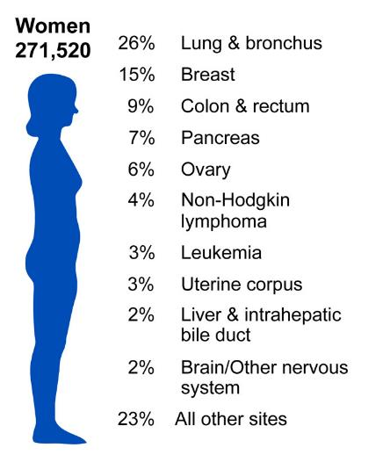
2011, American Cancer Society
Notes:
Lung cancer is by far the most common fatal cancer in men (28%), followed by prostate (11%), and colon & rectum (9%). In women, lung (26%), breast (15%), and colon & rectum (9%) are the leading sites of cancer death.

Slide 7
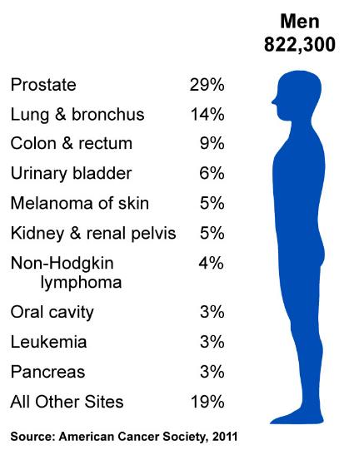
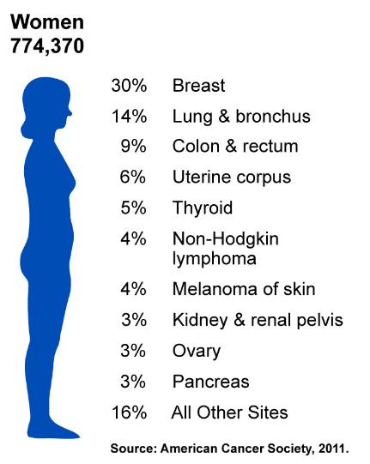
2011, American Cancer Society
Notes:
Now we will turn our attention to the number of new cancers anticipated in the US this year. It is estimated that almost 1.6 million new cases of cancer will be diagnosed in 2011. The most common cancers are prostate in men and breast in women; lung and colorectal cancers are the second and third most common cancers in both men and in women.

Slide 10
ΑΙΤΙΟΛΟΓΙΚΟΙ ΠΑΡΑΓΟΝΤΕΣ / ΠΑΡΑΓΟΝΤΕΣ ΚΙΝΔΥΝΟΥ
Κάπνισμα (+ παθητικό κάπνισμα)
Ιονίζουσα ακτινοβολία (x, γ, ραδόνιο)
Φυματίωση
Πνευμονοκονιώσεις (επαγγελματικές παθήσεις του πνεύμονα)
Αμιάντωση (Asbestosis)
Πυριτίαση (Silicosis)
Έκθεση σε: αρσενικό, αιματίτη, βηρύλλιο, κάδμιο, χρώμιο, άνθρακα
Αρωματικοί υδρογονάνθρακες
Ατμοσφαιρική ρύπανση
Notes:
asbestos and combustion fumes, Chronic exposure to high levels of fibres and dusts might result in lung fibrosis (e.g. Silicosis and asbestosis), include occupational (e.g. asbestos, heavy metals) and environmental exposures (e.g. secondhand smoke, radon decay products)

Slide 11
Clinical presentation
Cough,
Fatigue,
Dyspnea,
Pain,
Weight loss
• Metastasis common in lung, adrenal glands, liver, brain, bones; symptoms are site specific
• Diagnosis requires lesion assessment via x-ray, CT, or PET imaging, molecular testing in combination with pathologic assessment
• Histologic and biomarker assessment may assist in predicting treatment response and guide therapeutic selection
• Mutational status, histology, cancer stage, patient age, and PS
Slide credit: clinicaloptions.com

Slide 12
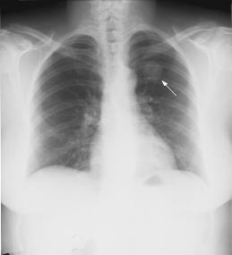
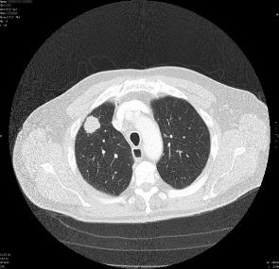
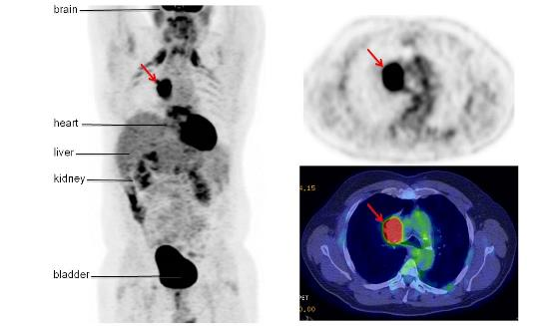
Imaging tests
Για την σταδιοποίηση της νόσου το PET έχει 96% ευαισθησία και 93% ειδικότητα, ενώ η CT 68% και 65% αντίστοιχα.
Notes:
Often presents as a solitary pulmonary nodule on routine chest imaging.
Για την σταδιοποίηση της νόσου το PET έχει 96% ευαισθησία και 93% ειδικότητα, ενώ η CT 68% και 65% αντίστοιχα.
Histologic confirmation of disease remains the gold standard for lung cancer diagnosis
Before obtaining tissue for diagnosis, several imaging modalities may be used to evaluate a suspicious lesion
CT and PET scans are standard; MRI can also be considered
After distant metastases have been ruled out, a more detailed locoregional staging is mandatory to distinguish early stages (I/II) from potentially resectable stage IIIA and from unresectable stage III, according to the seventh TNM staging System

Slide 13
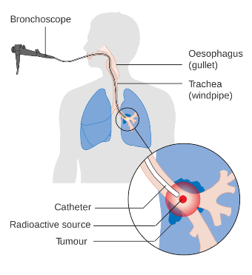
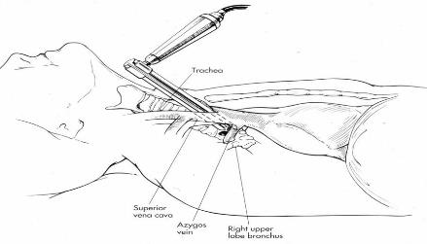
Diagnostic techniques
Notes:
Bronchoscopy is the recommended method of obtaining a pathological diagnosis of centrally located tumours
Minimally invasive and surgical procedures can be employed in the evaluation and staging process
Mediastinoscopy has traditionally been viewed as the gold standard for mediastinal lymph node staging
Endobronchial ultrasound with transbronchial needle aspiration and endoscopic ultrasound with fine-needle aspiration have become the standard of care

Slide 14
Histology
Καρκίνος Πνεύμονα
*NSCLC
Πλακώδες καρκίνωμα
Αδενοκαρκίνωμα
**SCLC
Μεγαλοκυτταρικό καρκίνωμα
Σαρκωματοειδές καρκίνωμα
Αδενοπλακώδες καρκίνωμα
*Μη μικροκυτταρικός καρκίνος του πνεύμονα
(Non Small Cell Lung Carcinoma-NSCLC)
**Μικροκυτταρικός καρκίνος του πνεύμονα
(Small Cell Lung Carcinoma-SCLC)
80-85%
15-20%

Slide 15
Traditional View of Lung Cancer
20%
45
40%
40
10% to 15%
35
30
25% to 30%
25
Cancer Incidence (%)
20
15
10
Adenocarcinoma
Squamous cell carcinoma
Large cell carcinoma
Other or not otherwise specified
5
0
1980
1982
1984
1986
1988
1990
1992
1994
1996
1998
2000
2002
Yr of Diagnosis (3-Yr Moving Average)
85% of lung cancers are NSCLC
Adenocarcinoma Squamous cell Large cell
American Cancer Society database.
Wahbah M, et al. Ann Diagn Pathol. 2007;11:89-96.
Slide credit: clinicaloptions.com
Notes:
NSCLC, non-small-cell lung cancer.

Slide 16
Evolution of NSCLC Subtyping to a Multitude of Molecular-Defined Subsets
Adenocarcinoma
NSCLC
as one disease
ALK
HER2
BRAF
PIK3CA
AKT1
MAP2K1
NRAS
ROS1
RET
EGFR
KRAS
Unknown
First-targeted tx
ALK
EGFR
Other
11%
EGFRvIII
PI3KCA
EGFR
DDR2
FGFR1 Amp
Unknown
Squamous
34%
Adenoca
55%
Histology-Based Subtyping
Squamous Cell Cancer
Li T, et al. J Clin Oncol. 2013;31:1039-1049.
Slide credit: clinicaloptions.com
Notes:
NSCLC, non-small-cell lung cancer; tx, treatment

Slide 17
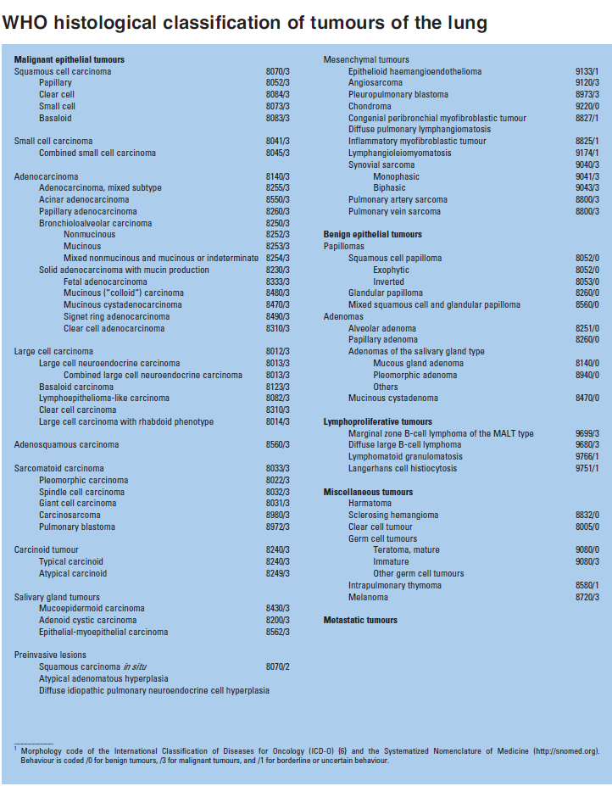
(2004)

Slide 18
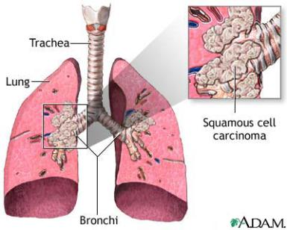
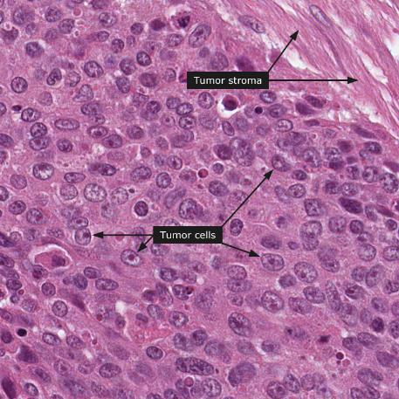
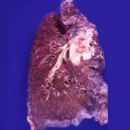
Squamous cell carcinoma of lung (Πλακώδες καρκίνωμα πνεύμονα)
TTF-1 (-)
P63(+)
CK5/6(+)
Modern Pathology (2011) 24, 1348–1359
http://www.proteinatlas.org

Slide 19
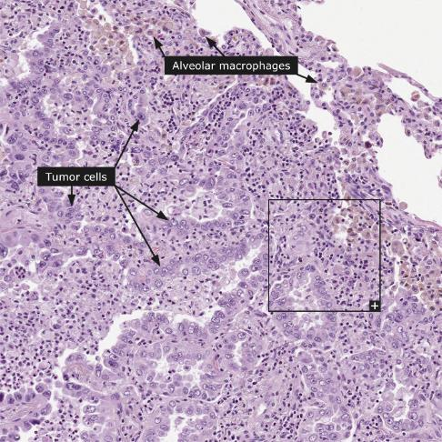
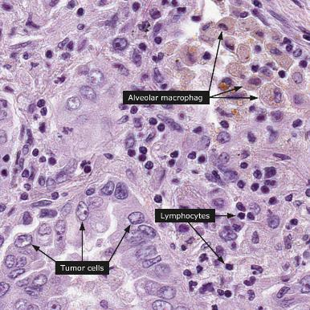
Lung adenocarcinoma (αδενοκαρκίνωμα πνεύμονα)
TTF-1 (+)
p63(-)
CK5/6(-)
Modern Pathology (2011) 24, 1348–1359
http://www.proteinatlas.org

Slide 20
Staging of lung cancer
Tumor
Nodes
Metastasis
1942-1952 Dr Pierre de Noix
1968 Union Internationale Contre le Cancer , Committee
2002 6th edition
2010 7th edition IASLC
(100.869 pts lung cancer/67.725 NSCLC, 1990 – 2000, 19 countries)

Slide 21
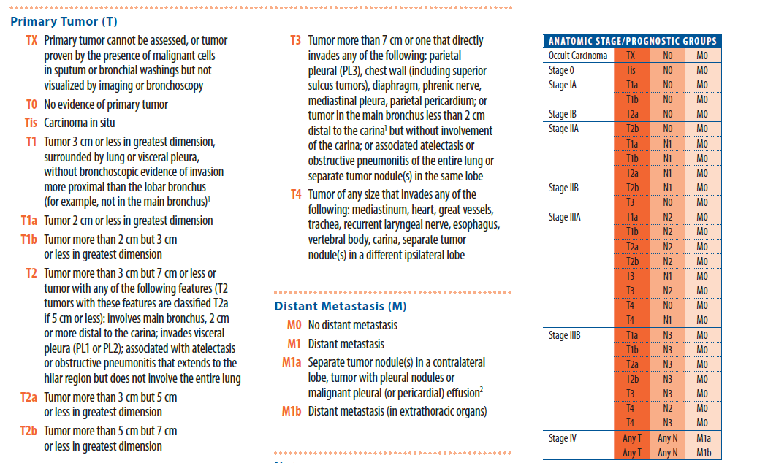
7th EDITION of ΤΝΜ staging system

Slide 22
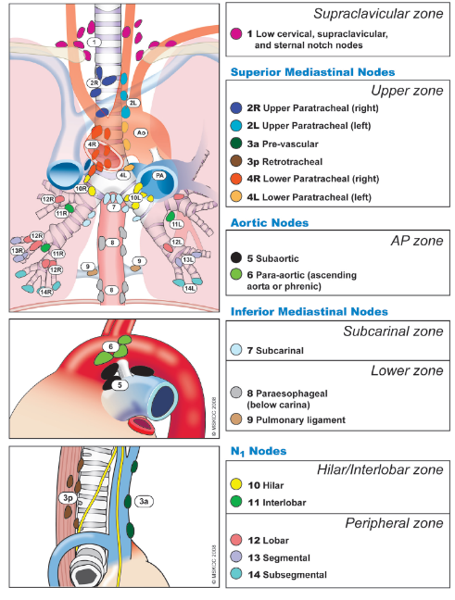
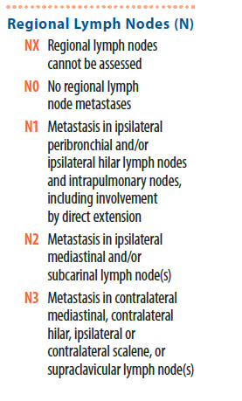
7th EDITION of ΤΝΜ staging system

Slide 23
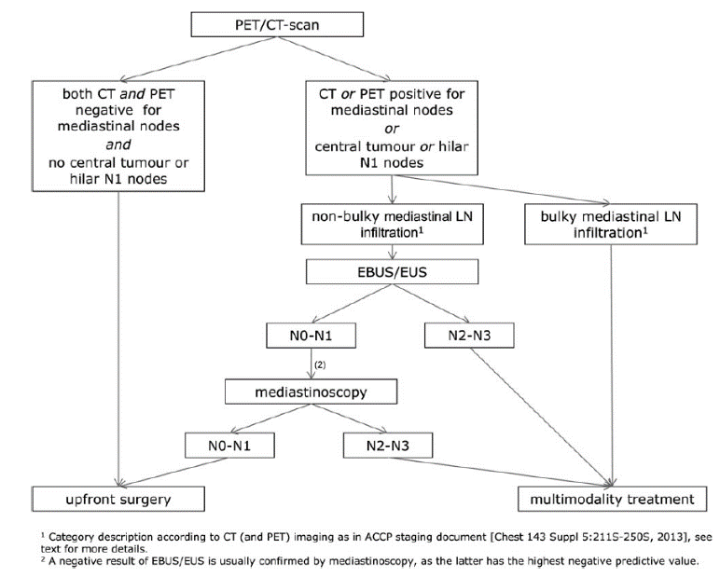
Algorithm for locoregional lymph node staging in NSCLC
Notes:
Absence of suspect mediastinal lymph node (LN) metastasis on both CT and positron emission tomography (PET) images
has a high negative predictive value, and these patients can in general proceed to surgery, except in the case of a centrally
located tumour or hilar LNs [I, A]. In these cases the probability of mediastinal LN disease is
increased and may also be obscured on imaging [10].

Slide 24
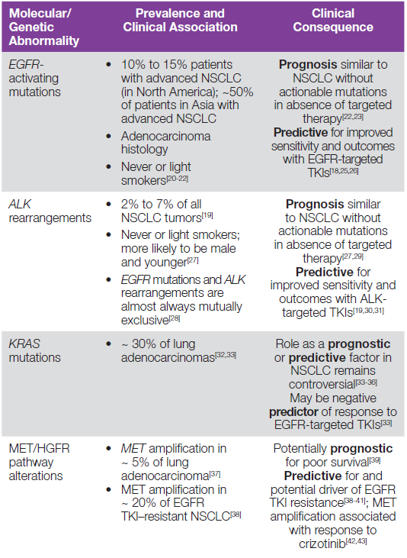
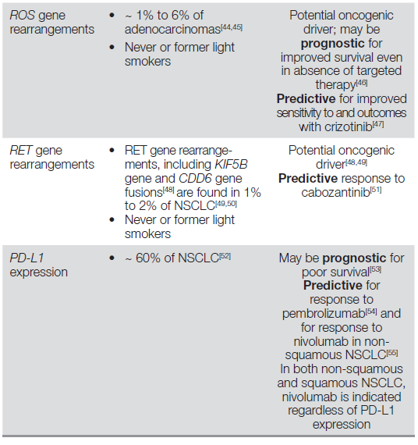
Molecular testing in NSCLC
Slide credit: clinicaloptions.com
Notes:
Clinical guidelines recommend routine testing for EGFR mutations and ALK translocation in patients with advanced NSCLC adenocarcinoma as part of multiplex testing to guide treatment selection EGFR/ALK molecular testing suggested regardless of sex,race, smoking history, or other clinical risk factors
Testing for ROS1 rearrangements should be considered in select patients (eg, EGFR/ALK negative or unknown)
• EGFR-mutated tumors respond better to treatment with EGFR TKIs
FDA-approved EGFR mutation companion diagnostic tests are available for prediction of response to erlotinib, afatinib,
and gefitinib
• ALK rearrangements result in ALK fusion oncogenes that
respond to ALK TKIs
  Required for treatment with crizotinib or ceritinib
  Rearrangements detected via FDA-approved FISH assay[19]
or IHC
• Current NCCN guidelines recommend broader molecular
profi ling to identify rare genetic abnormalities that may be
treated with targeted therapy, including ROS1 and RET
rearrangements, MET amplifi cations, and BRAF V600E or HER2
mutations[16]
• KRAS testing not recommended as a single criterion to guide
EGFR-based treatment but can be used as a prognostic marker
of poor survival[17]
Activating (sensitising) epidermal growth factor receptor
(EGFR) mutations are predictive for response to the EGFR tyrosine
kinase inhibitors (TKIs) gefitinib, erlotinib, and afatinib
resulting, in this context, in an improved response rate (RR),
progression-free survival (PFS), and quality of life (QoL) as well
as a better tolerability when compared with first-line chemotherapy,
as demonstrated in several phase III randomised trials.
The incidence of EGFR mutations in the Caucasian population
is about 10% and is higher in never smokers, adenocarcinoma
subtype, and women. Prevalence has also been shown to be
higher in East-Asian patients. EGFR mutation testing is recommended
in all patients with advanced NSCLC of a non-squamous
subtype [I, A]. Testing is not recommended in patients
with a confident diagnosis of squamous cell carcinoma, except
in never/former light smokers (<15 packs per year) [IV, A] [13].
It should be systematically analysed—with a validated mutation
detection platform in a laboratory participating in an external
quality assurance scheme—in all such patient subgroups [V, A].
Choice of methodology will vary but should provide the test
sensitivity required for the tumour content of the sample, and
provide an adequate coverage of all clinically relevant mutations
[11]. Laboratories should validate their practice internally and
through external quality assurance programmes.
The anaplastic lymphoma kinase (ALK) fusion genes have
been identified as important oncogenic drivers [14]. ALK fusion
is encountered more frequently in never smokers, the adenocarcinoma
subtype, and in younger patients, representing an incidence
of around 5% in adenocarcinomas [15]. ALK activity can
be effectively targeted by the ALK TKIs, and routine testing for
ALK rearrangements is now a standard of care. Testing should
focus on the same group of patients selected as for EGFR mutation
[II, A]. Testing should be carried out, if at all possible, in
parallel with EGFR mutation analysis. Currently, the standard
test for detecting ALK fusion remains the break-apart fluorescence
in situ hybridisation (FISH) test. A multiplex polymerase
chain reaction (PCR) approach may be successful but requires
an adequate coverage of the many possible fusion genes now recognised
and is challenged by the availability of adequate quality
nucleic acid from typical samples, and by the methodology itself.
High sensitivity IHC has been shown to have a high positive and
negative predictive value for the presence and absence, respectively,
of ALK fusion and, while not a recognised primary biomarker
for ALK TKI therapy, it is widely used to screen patients for possible
ALK FISH testing. Next-generation sequencing approaches
for detecting fusion genes are in development.

Slide 25
Screening for NSCLC
The National Lung Screening Trial (NLST) compared LDCT with chest X-ray in 53 454 current or former heavy smokers (≥30 pack-years or ≤15 years since smoking cessation) aged between 55 and 74 years. In this high-risk group, a 20% reduction in lung cancer related deaths, from 425 to 326 (P = 0.004), was reported. Not ready for large-scale
population-based implementation because of remaining questions surrounding the definition of the at-risk population, timing, interval and method of CT (particularly 2D versus 3D nodule interpretation), how to handle (false) positive findings and, especially, cost-effectiveness when compared with, e.g. smoking cessation alone.
N Engl J Med 2011; 365: 395–409.
N Engl J Med 2009; 361: 2221–2229.
J Clin Oncol 2013; 31: 1002–1008.

Slide 26
Management of early and locally advanced NSCLC
(I, II and IIIA)
Surgery=the cornerstone for stage I or II NSCLC
Lobectomy is the current treatment of choice
More limited resections (segmentectomy and wedge resection) are associated with increased local recurrence
LN sampling vs systematic nodal dissection: The extent of LN dissection is mainly dictated by staging requirements for guaranteed ‘R0 resection’ status. IASLC: a minimum of six nodes/stations, three of which should be mediastinal including the sub-carinal station, with negativity of the highest resected node.
Minimal access surgery (VATS lobectomy): improved 5-year survival and reduced systemic recurrences, lower in-hospital complications (non-randomised)

Slide 27
Adjuvant chemotherapy for early and locally advanced NSCLC
Cisplatin-based doublet (300 mg/m²), delivered in 3-4 cycles.
Most frequently used regimen: cisplatin–vinorelbine.
Recommended for patients with resected stage II or III
No adjuvant chemo recommended in stage IA.
In stage IB, no OS benefit, except for tumours >4 cm in the CALGB 9633 study, or tumours >5 cm in the JBR.10 study.
Smoking-induced cardiopulmonary co-morbidity, PS, time since surgery, ERCC status: individual indications according to the risk-benefit ratio.
Results of adjuvant vs. neo-adjuvant chemotherapy using indirect comparison meta-analysis or directly as in the NATCH trial, no clinically important differences in OS were discerned.

Slide 28
Adjuvant chemotherapy for early and locally advanced NSCLC
In view of the equivalence of neo-adjuvant and adjuvant chemotherapy for overall survival, the consistent results and broad evidence base support adjuvant chemotherapy as the timing of choice
Given the current state of knowledge, targeted agents should not be used in the adjuvant setting

Slide 29
Primary radiotherapy: stereotactic ablative radiotherapy (SABR)
In patients unfit for surgery, SABR=the treatment of choice for peripherally located stage I NSCLC: improved population-based survival in elderly patients, and the convenience of this outpatient therapy over three to eight visits has also led to a reduction in the proportion of untreated patients.
SABR dose:a biologically equivalent tumour dose of ≥100 Gy, prescribed to the encompassing isodose.
SABR vs. surgery in patients with severe COPD revealed a higher 30-day mortality following surgery but similar OS at 1 and 3 years.
For tumours with a size >5 cm and/or central location, preferentially treated with radical radiotherapy using more conventional daily or accelerated schedules.
Adding chemotherapy to radiotherapy for patients with stage II-N1 disease may be considered. Although this was not properly assessed in clinical studies, there may be a similar benefit as for resected patients with stage II-N1 disease.

Slide 30
Chemotherapy of locally advanced NSCLC stage III
Should be offered to all patients with LA-NSCLC who can tolerate it
Improves survival in all subgroups of patients, whether treated with surgery or radiotherapy
2-4 cycles with cisplatin-based doublets (e.g. cisplatin–etoposide or cisplatin–vinorelbine) delivered concurrently with radiotherapy have been studied most extensively, and are therefore recommended
The most commonly used drugs together with cisplatin are etoposide (at full systemic dose 100–120 mg/m²) and vinorelbine (at 60% of systemic dose, 15 mg/m²).
On average, a cisplatin dose of 80 mg/m2 per cycle was administered.
Carboplatin-based induction chemotherapy before concurrent chemoradiotherapy can generally not be recommended.
Consolidation treatment with, e.g. docetaxel or an EGFR-tyrosine kinase inhibitor after concurrent chemoradiotherapy is not recommended.

Slide 31
Treatment of unresectable locally advanced NSCLC stage III
Concurrent chemoradiotherapy is the treatment of choice in patients evaluated as unresectable in stage IIIA and IIIB. If concurrent chemoradiotherapy is not possible—for any reason - sequential approaches of induction chemotherapy followed by definitive radiotherapy represent a valid and effective alternative
Definitive thoracic radiotherapy should be no less than the biological equivalent of 60 Gy in 2.0 Gy fractions.
In non-concurrent schedules, radiotherapy delivered in a short overall treatment time is recommended.
For resectable LA-NSCLC, especially single nodal stage N2 disease, both definitive chemoradiotherapy and induction therapy followed by surgery are options
Surgery is preferably considered in patients in whom a complete resection by lobectomy is expected. More complex surgical resections after induction treatment should be carried out in experienced centers.

Slide 32
Postoperative radiotherapy (PORT)
No indication that improves outcome in patients with completely resected N0 or N1 disease.
For patients in whom unsuspected mediastinal nodal metastases are discovered during surgery, no improvement OS.
Not recommended PORT in completely resected early-stage NSCLC
Routine use of PORT in resectable stage III is, as yet, unproven but it may be considered in N2 patients after resection. In these cases, radiotherapy was delivered after chemotherapy in randomised studies.
PORT is indicated after incomplete surgery

Slide 33
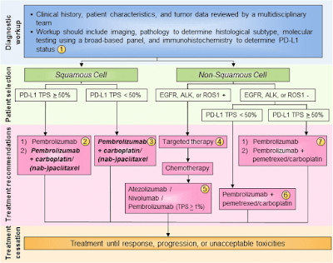
Treatment algorithm for advanced NSCLC
Slide credit: clinicaloptions.com

Slide 34
Treatment for stage IV NSCLC: 1st line
Standard=a platinum-based doublet (4 cycles when maintenance is considered, with a maximum of six cycles)
Several regimens have shown comparable efficacy
Selection of 1st line regimen, taking into account that:
In the subgroup of non-squamous and in patients treated with 3rd generation regimens, including gemcitabine and taxanes, cisplatin (≥75 mg/m² q3wks) should be the treatment of choice. Meta-analyses have shown superior OS and higher RRs for cisplatin combinations when compared with carboplatin combinations.
Cisplatin-based chemotherapy is associated with more digestive, neuro-, and nephrotoxicity, while hematotoxicity is more often observed with carboplatin.
Pemetrexed is preferred to gemcitabine or docetaxel in patients with non-squamous tumours. Pemetrexed-based combination: should be restricted to non-squamous NSCLC in any line of treatment
No standard doublet for 1st jine in NSCLC
Ann Oncol 2014; 25 (Sup 3): iii27–iii39.
J Clin Oncol 2007; 25: 5233–5239.
N Engl J Med 2002; 346: 92–98.
J Natl Cancer Inst 2007; 99: 847–857.
PLoS One 2012; 7: e37229.
J Clin Oncol 2008; 26: 3543–3551.

Slide 35
Treatment for stage IV NSCLC: 1st line
Bevacizumab combined with other platinum-based chemotherapies may be considered in eligible patients (non-squamous histology and PS 0-1).
Non-platinum-based combination chemotherapy with 3rd generation agents should be considered only if platinum therapy is contraindicated.
PS ≥2 patients and elderly:
Chemotherapy prolongs survival and possibly improves the QoL in NSCLC patients with PS 2, when compared with BSC.
Single-agent chemotherapy with gemcitabine, vinorelbine, and taxanes remain the recommended treatment for unfit or comorbid patients, who are more likely to present with significantly more treatment-related adverse events
Carboplatin-based combination chemotherapy should be considered in eligible PS=2 patients.
Poor PS (3–4) patients should be offered
BSC in the absence of documented activating (sensitising)
EGFR mutations.
Ann Oncol 2014; 25 (Sup 3): iii27–iii39.
PLoS One 2011; 6: e22681.
Ann Oncol 2013; 24: 20–30.
Ann Oncol 2004; 15: 419–426.
Lancet 2011; 378: 1079–1088.
J Clin Oncol 2013; 31: 2849–2853.

Slide 36
Use of tyrosine kinase inhibitors (TKIs)
First-line treatment with a TKI (erlotinib, gefitinib, or afatinib) is the preferred treatment of patients with tumours bearing an activating (sensitising) EGFR mutation (longer PFS, significantly higher RRs and better QoL when compared with first-line chemotherapy)
No large RCTs comparing the efficacy of different EGFR TKIs in patients carrying tumours with EGFR mutations has been reported as yet.
Patients with EGFR mutation and PS 3–4 may also be offered an EGFR TKI.
In EGFR WT patients, EGFR TKIs are not recommended as first-line therapy, being inferior to chemotherapy.
Patients with NSCLC harbouring an ALK fusion should be offered treatment with crizotinib during the course of their disease.
Ann Oncol 2014; 25 (Sup 3): iii27–iii39.
J Natl Cancer Inst 2013; 105: 595–605.
N Engl J Med 2009; 361: 947–957.
J Clin Oncol 2013; 31: 3342–3350.
Lancet Oncol 2012; 13: 1161–1170.
J Clin Oncol 2012; 30: 3002–3011.
Lancet Oncol 2011; 12: 1004–1012.

Slide 37
Treatment for stage IV NSCLC: Maintenance
“Continuation maintenance”: the maintained use of an agent included in first-line treatment
pemetrexed versus placebo after 4 cycles of cisplatin plus pemetrexed demonstrated a PFS and OS improvement in patients with an PS: 0–1 . (PARAMOUNT trial)
bevacizumab, with or without pemetrexed, after induction with bevacizumab, cisplatin, and pemetrexed showed a benefit of PFS for the pemetrexed-bevacizumab combination, but no significant OS benefit, (analysing 58% of events of 253 pts)
“Switch maintenance”: the introduction of a new agent after four cycles of platinum-based chemotherapy
Improvements in PFS and OS when compared with placebo following four cycles of platinum-based chemotherapy
for pemetrexed: only in patients with non-squamous histology
and erlotinib: the highest benefit in efficacy in patients with SD after induction compared with patients with confirmed response.
Recommended in patients with non-squamous histology, tumour stabilisation, or response after first-line chemotherapy and recovery from previous toxicity.

Slide 38
Treatment for stage IV NSCLC: 2nd line
Patients clinically or radiologically progressing after first-line chemotherapy, irrespective of administration of maintenance chemotherapy, with a PS 0–2
Combination regimens failed to show any OS benefit over single-agent treatments
Single agents improve disease-related symptoms and OS.
Comparable options in the second line consist of pemetrexed—for non-squamous histology only or docetaxel.
Erlotinib was shown to improve OS in second line or in third line in all NSCLC histological subtype patients, not eligible for further chemotherapy, including patients with PS 3.
Erlotinib =pemetrexed or docetaxel in refractory (progression during the four cycles of a standard platinum-based chemotherapy doublet) patients unselected for EGFR status.
Gefitinib was proven non-inferior to docetaxel in a large RCT, in molecularly unselected patients, with a better toxicity profile and QoL.

Slide 39
Treatment for stage IV NSCLC: 2nd line
Erlotinib represents a potential second-line treatment option in pre-treated patients with undetermined or WT EGFR status.
Any patient with a tumour bearing an activating (sensitising) EGFR mutation should receive an EGFR TKI as second-line, if not received previously.
In the presence of an ALK rearrangement, second-line treatment with crizotinib should be considered, as a large phase III trial comparing crizotinib with docetaxel or pemetrexed (based on investigator’s preference) has demonstrated significant ORR and PFS advantages for crizotinib.
Second-line treatment duration should be individualised, as the registration trials did not limit therapy to a set number of treatment cycles.
Notably, treatment may be prolonged if disease is controlled and toxicity acceptable.

Slide 40
Treatment for stage IV NSCLC: subsequent lines
Any patient with a tumour bearing an activating EGFR mutation should receive an EGFR TKI in third or subsequent lines, if not received previously .
Treatment for oligometastatic NSCLC
At maximum five metastatic lesions in the body.
Synchronous oligometastases: when diagnosed within 1 month before or after the primary
tumour was identified (in about 15%)
Stage IV patients with one to three synchronous metastases may experience long-term DFS after systemic therapy and a radical local treatment (high-dose radiotherapy or surgery).
Because only one non-randomised phase II trial is available, inclusion in trials is preferred.
Metachronous oligometastases: when they appear after treatment of the primary.
Stage IV patients with a few metachronous metastases may be treated with a radical local treatment and experience long-term DFS. However, this is based only on retrospective data.
Solitary lesions in the contralateral lung should, in most cases, be considered as synchronous secondaryprimary tumours and, if possible, treated with radical intent.
Notes:
Apart from a stereotactic body radiotherapy
(SBRT) dose-escalation study, data from only one prospective
single-arm phase II trial is available [60]. Nearly all patients
had a single metastatic lesion and 75% had ‘locally advanced
stage III’ disease. With systemic treatment and radical local
radiotherapy (SBRT or high-dose fractionated irradiation) or
surgery of all tumour lesions, 13% of patients remained diseasefree
at three years. All other studies are retrospective but suggest
that a yet to be defined subgroup of stage IV patients with a few
metastases at diagnosis may be cured with a radical approach
[61–63].

Slide 41
Treatment of brain metastases
Depends heavily on the prognosis:
Recursive partitioning analysis (RPA) class I: <65 years old, a good Karnofsky Index (KI) ≥70%, no other extra-cranial metastases and a controlled primary tumour
RPA class II: all other patients
RPA class III are all patients with a KI<70%: no treatment, only BSC is recommended, with a median survival of <2 months.
RPA class I/II patients with more than three brain metastases: WBRT (20 Gy in 5 fractions or 30 Gy in 10 fractions, with no difference in outcome)
SRS in 2-3 metastases or with either SRS or resection when a single brain metastasis is diagnosed (a follow-up brain MRI scan every 3 months after resection or SRS)
Asymptomatic brain metastases should not be treated with RT. Systemic therapy for patients with no or relatively minor symptoms from brain metastases with early RT in the case of progression of symptoms while on treatment.
For most patients with symptomatic brain metastases and/or significant oedema, dexamethasone of 4 mg/day or an equivalent dose of another corticosteroid is recommended with early tapering off after RT.

Slide 42
Supportive care
Μinimally invasive procedures in stage IV NSCLC (endoscopic debulking by laser, cryotherapy, or stent placement, endobronchial or by guiding
endovascular embolisation in cases of haemoptysis)
Vascular stenting might be useful in NSCLC-related superior
vena cava obstruction.
Palliative surgery in stage IV NSCLC: pleurodesis with talc, which is more effective than bleomycin or tetracycline
Radiotherapy in symptom control: bone and brain metastases, in treating pain related to chest wall, soft tissue, or neural invasion, neurological symptoms of spinal compression, in cases of haemoptysis, symptomatic airway compression or obstruction, and following CNS and, sometimes, bone surgery.
Bone metastases modifying agents: Zoledronic acid reduces SRE (pathological fracture, radiation/surgery to bone, or spinal cord compression) and is recommended in stage IV bone metastatic disease.
Denosumab is not inferior, and shows a trend toward superiority, to zoledronic acid in lung cancer in terms of SRE prevention.
Annals of Oncology 25 (Sup 3): iii27–iii39, 2014

Slide 43
Response evaluation and follow-up
After two to three cycles of chemotherapy using the same initial radiographic investigation which demonstrated tumour lesions.
Measurements and response reporting should follow RECIST criteria v1.1.
The adequacy of RECIST in evaluating the response to EGFR or ALK TKI in respective genetically driven NSCLC is debatable.
Close follow-up, at least every 6 weeks after first-line therapy, is advised but should depend on individual retreatment options.
Radiological follow-up: every 6–12 weeks to allow for early initiation of second-line therapy.
• Follow-up with PET is not routinely recommended, due to its high sensitivity and relatively low specificity.

Slide 44
PD-1 as a Target in Cancer Therapy
Tumor
or APC
Exhausted T cell
Persistent antigen stimulation
Tumor
or APC
Activated T cell
Initial immune response
CD80
CD86
CD28
Cytokines
Proliferation
Activation
CD80
CD86
CD28
PD-1
PD-L1
Atezolizumab
Durvalumab
MSB0010718C
Nivolumab
Pembrolizumab
Pidilizumab
McDermott DF, et al. Cancer Med. 2013;2:662-673.
Slide credit: clinicaloptions.com
Notes:
APC, antigen-presenting cell.

Slide 45
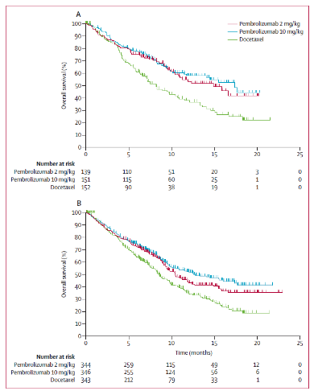
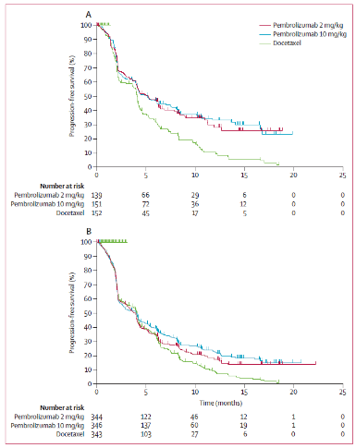
Immunotherapy: Pembrolizumab versus docetaxel for previously treated, PD-L1-positive, advanced NSCLC (KEYNOTE-010)
Lancet. 2015 Dec 18. pii:S0140-6736(15)01281-7.
Notes:
Background Despite recent advances in the treatment of advanced non-small-cell lung cancer, there remains a need for effective treatments for progressive disease. We assessed the efficacy of pembrolizumab for patients with previously treated, PD-L1-positive, advanced non-small-cell lung cancer.
Methods We did this randomised, open-label, phase 2/3 study at 202 academic medical centres in 24 countries. Patients with previously treated non-small-cell lung cancer with PD-L1 expression on at least 1% of tumour cells were randomly assigned (1:1:1) in blocks of six per stratum with an interactive voice-response system to receive pembrolizumab
2 mg/kg, pembrolizumab 10 mg/kg, or docetaxel 75 mg/m. every 3 weeks. The primary endpoints were overall survival and progression-free survival both in the total population and in patients with PD-L1 expression on at least 50% of tumour cells. We used a threshold for significance of p<0.00825 (one-sided) for the analysis of overall survival and a
threshold of p<0.001 for progression-free survival. This trial is registered at ClinicalTrials.gov, number NCT01905657.
Findings Between Aug 28, 2013, and Feb 27, 2015, we enrolled 1034 patients: 345 allocated to pembrolizumab 2 mg/kg,
346 allocated to pembrolizumab 10 mg/kg, and 343 allocated to docetaxel. By Sept 30, 2015, 521 patients had died. In
the total population, median overall survival was 10.4 months with pembrolizumab 2 mg/kg, 12.7 months with
pembrolizumab 10 mg/kg, and 8.5 months with docetaxel. Overall survival was signifi cantly longer for pembrolizumab
2 mg/kg versus docetaxel (hazard ratio [HR] 0.71, 95% CI 0.58–0.88; p=0.0008) and for pembrolizumab 10 mg/kg
versus docetaxel (0.61, 0.49–0.75; p<0.0001). Median progression-free survival was 3.9 months with pembrolizumab
2 mg/kg, 4.0 months with pembrolizumab 10 mg/kg, and 4.0 months with docetaxel, with no signifi cant diff erence
for pembrolizumab 2 mg/kg versus docetaxel (0.88, 0.74–1.05; p=0.07) or for pembrolizumab 10 mg/kg versus
docetaxel (HR 0.79, 95% CI 0.66–0.94; p=0.004). Among patients with at least 50% of tumour cells expressing
PD-L1, overall survival was signifi cantly longer with pembrolizumab 2 mg/kg than with docetaxel (median
14.9 months vs 8.2 months; HR 0.54, 95% CI 0.38–0.77; p=0.0002) and with pembrolizumab 10 mg/kg than with
docetaxel (17.3 months vs 8.2 months; 0.50, 0.36–0.70; p<0.0001). Likewise, for this patient population, progressionfree
survival was signifi cantly longer with pembrolizumab 2 mg/kg than with docetaxel (median 5.0 months vs
4.1 months; HR 0.59, 95% CI 0.44–0.78; p=0.0001) and with pembrolizumab 10 mg/kg than with docetaxel
(5.2 months vs 4.1 months; 0.59, 0.45–0.78; p<0.0001). Grade 3–5 treatment-related adverse events were less
common with pembrolizumab than with docetaxel (43 [13%] of 339 patients given 2 mg/kg, 55 [16%] of 343 given
10 mg/kg, and 109 [35%] of 309 given docetaxel).
Interpretation Pembrolizumab prolongs overall survival and has a favourable benefi t-to-risk profi le in patients with
previously treated, PD-L1-positive, advanced non-small-cell lung cancer. These data establish pembrolizumab as a
new treatment option for this population and validate the use of PD-L1 selection.

Slide 46
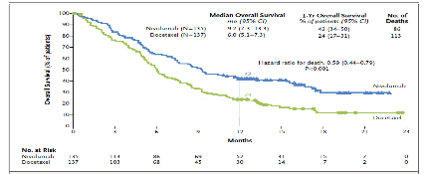
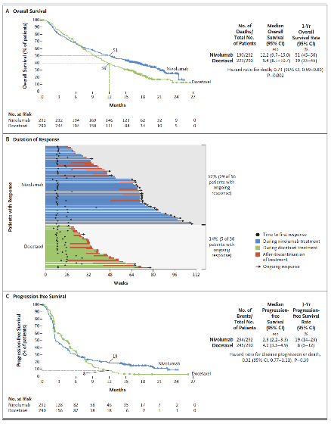
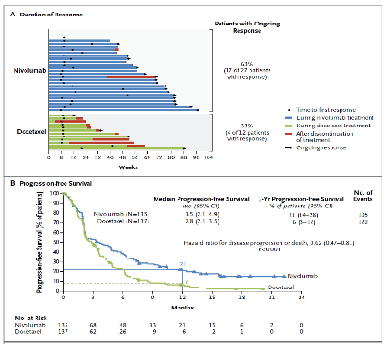
Immunotherapy: Nivolumab
Advanced Squamous NSCLC
Advanced Non-Squamous NSCLC
N Engl J Med. 2015 Jul 9;373(2):123-35.
N Engl J Med. 2015 Oct 22;373(17):1627-39.
Notes:
BACKGROUND
Patients with advanced squamous-cell non–small-cell lung cancer (NSCLC) who
have disease progression during or after first-line chemotherapy have limited treatment
options. This randomized, open-label, international, phase 3 study evaluated
the efficacy and safety of nivolumab, a fully human IgG4 programmed death 1 (PD-1)
immune-checkpoint–inhibitor antibody, as compared with docetaxel in this patient
population.
METHODS
We randomly assigned 272 patients to receive nivolumab, at a dose of 3 mg per kilogram
of body weight every 2 weeks, or docetaxel, at a dose of 75 mg per square meter
of body-surface area every 3 weeks. The primary end point was overall survival.
RESULTS
The median overall survival was 9.2 months (95% confidence interval [CI], 7.3 to
13.3) with nivolumab versus 6.0 months (95% CI, 5.1 to 7.3) with docetaxel. The
risk of death was 41% lower with nivolumab than with docetaxel (hazard ratio,
0.59; 95% CI, 0.44 to 0.79; P<0.001). At 1 year, the overall survival rate was 42%
(95% CI, 34 to 50) with nivolumab versus 24% (95% CI, 17 to 31) with docetaxel.
The response rate was 20% with nivolumab versus 9% with docetaxel (P = 0.008).
The median progression-free survival was 3.5 months with nivolumab versus 2.8
months with docetaxel (hazard ratio for death or disease progression, 0.62; 95% CI,
0.47 to 0.81; P<0.001). The expression of the PD-1 ligand (PD-L1) was neither
prognostic nor predictive of benefit. Treatment-related adverse events of grade 3
or 4 were reported in 7% of the patients in the nivolumab group as compared with
55% of those in the docetaxel group.
CONCLUSIONS
Among patients with advanced, previously treated squamous-cell NSCLC, overall
survival, response rate, and progression-free survival were significantly better with
nivolumab than with docetaxel, regardless of PD-L1 expression level. (Funded by
Bristol-Myers Squibb; CheckMate 017 ClinicalTrials.gov number, NCT01642004.)
Background
Nivolumab, a fully human IgG4 programmed death 1 (PD-1) immune-checkpoint–
inhibitor antibody, disrupts PD-1–mediated signaling and may restore antitumor
immunity.
METHODS
In this randomized, open-label, international phase 3 study, we assigned patients
with nonsquamous non–small-cell lung cancer (NSCLC) that had progressed during
or after platinum-based doublet chemotherapy to receive nivolumab at a dose
of 3 mg per kilogram of body weight every 2 weeks or docetaxel at a dose of 75 mg
per square meter of body-surface area every 3 weeks. The primary end point was
overall survival.
RESULTS
Overall survival was longer with nivolumab than with docetaxel. The median overall
survival was 12.2 months (95% confidence interval [CI], 9.7 to 15.0) among 292 patients
in the nivolumab group and 9.4 months (95% CI, 8.1 to 10.7) among 290
patients in the docetaxel group (hazard ratio for death, 0.73; 96% CI, 0.59 to 0.89;
P = 0.002). At 1 year, the overall survival rate was 51% (95% CI, 45 to 56) with
nivolumab versus 39% (95% CI, 33 to 45) with docetaxel. With additional follow-up,
the overall survival rate at 18 months was 39% (95% CI, 34 to 45) with nivolumab
versus 23% (95% CI, 19 to 28) with docetaxel. The response rate was 19% with
nivolumab versus 12% with docetaxel (P = 0.02). Although progression-free survival
did not favor nivolumab over docetaxel (median, 2.3 months and 4.2 months,
respectively), the rate of progression-free survival at 1 year was higher with
nivolumab than with docetaxel (19% and 8%, respectively). Nivolumab was associated
with even greater efficacy than docetaxel across all end points in subgroups
defined according to prespecified levels of tumor-membrane expression (≥1%, ≥5%,
and ≥10%) of the PD-1 ligand. Treatment-related adverse events of grade 3 or 4 were
reported in 10% of the patients in the nivolumab group, as compared with 54% of
those in the docetaxel group.
CONCLUSIONS
Among patients with advanced nonsquamous NSCLC that had progressed during or
after platinum-based chemotherapy, overall survival was longer with nivolumab than
with docetaxel. (Funded by Bristol-Myers Squibb; CheckMate 057 ClinicalTrials.gov
number, NCT01673867.)

Slide 47
Questions & Answers
Παθολογοανατομική διαφοροδιάγνωση αδενοCa vs. πλακώδους
Ενδείξεις adjuvant chemotherapy
Ενδείξεις postoperative RT
Άκτινο-χημειοθεραπεία στο IIIA/IIIB. Προτεινόμενα σχήματα χημειοθεραπείας
Ενδείξεις μεταστατεκτομής στο NSCLC

Slide 48
Question 1
A 60-year-old man with a 70-pack per year smoking history presents with cough and weight loss. Computed tomography (CT) reveals a right upper lobe lung mass, mediastinal lymphadenopathy, and three liver lesions. Biopsy of a liver lesion shows a poorly differentiated squamous cell carcinoma. His performance status (PS) is 1. The patient is motivated for therapy.
Which of the following is the best treatment option for this patient?
A. Carboplatin/paclitaxel
B. Carboplatin/paclitaxel/bevacizumab
C. Cisplatin/pemetrexed
D. Erlotinib
E. Chemoradiation

Slide 49
Answer 1
Platinum-based doublet chemotherapy has been demonstrated to improve survival in patients with advanced-stage NSCLC, with a variety of regimens showing similar results.
However, pemetrexed-based regimens have shown inferior efficacy in squamous histology NSCLC.
The anti-vascular endothelial growth factor (VEGF) antibody bevacizumab is contraindicated in squamous NSCLC because of increased life-threatening and fatal
hemoptysis in squamous cell lung cancer.
Erlotinib is approved for first-line treatment of patients with tumors harboring EGFR-activating mutations but only approved past first-line as maintenance therapy and as treatment after progression on one or two previous lines of chemotherapy based on trials such as SATURN and BR21, which demonstrated a modest OS benefit seen in patients with NSCLC regardless of EGFR mutation status.

Slide 50
Question 2
A 54-year-old woman with a five-pack per year smoking history presents to the
emergency department with cough and shortness of breath. CT-angiogram to rule out
pulmonary embolism reveals a central right main-stem bronchus lung mass within 2
cm of the carina and mediastinal adenopathy. PET-CT shows the lung mass as well
as an FDG-avid 3-cm right paratracheal node and a 2-cm subcarinal node, with no
evidence of distant metastases. Bronchoscopy with endobronchial ultrasound biopsy
of both the R4 and the subcarinal node confirms lung adenocarcinoma. Magnetic
resonance imaging (MRI) of the brain is negative for intracranial metastases. EGFR
mutation testing is positive for an L858R point mutation. Clinical stage (according to
the AJCC 7th edition staging manual) is IIIA (T3N2M0). At tumor board, your thoracic surgeon determines right pneumonectomy is the only surgical option. At follow-up in clinic, the patient is clinically stable and she has a PS of 1.
Which of the following is the best treatment option for this patient with stage IIIA NSCLC?
A. Right pneumonectomy followed by adjuvant chemotherapy
B. Concurrent chemoradiation
C. Erlotinib
D. Sequential chemotherapy followed by radiation
E. Chemoradiation followed by right pneumonectomy

Slide 51
Answer 2
Concurrent administration of platinum-based chemotherapy and thoracic radiation is
considered standard of care for patients with stage III multistation N2 NSCLC, although
trimodality approaches (preoperative chemoradiation followed by surgery) have also been employed in this setting. In the intergroup phase III trial by Albain et al comparing
trimodality therapy with chemoradiation, PFS was superior in the surgical arm, but OS was equivalent. In a retrospective analysis, OS in those patients requiring pneumonectomy favored chemoradiation, whereas the reverse was true in patients treated with lobectomy.
Thus, in this patient with a central lesion requiring pneumonectomy and multistation N2 disease, chemoradiation is the most appropriate therapy.

Slide 52
Question 3
A 66-year-old woman with a 50-pack per year smoking history presents to your
clinic. She was recently diagnosed with lung adenocarcinoma metastatic to the liver
and bone. PS is 2 based on bone pain, weight loss, and declining activity
level. Molecular testing for an EGFR-activating mutation and ALK gene
rearrangement was negative.
Which of the following is the best treatment option for this patient?
A. Navelbine
B. Cisplatin and etoposide
C. Carboplatin and pemetrexed
D. Pemetrexed alone
E. Docetaxel

Slide 53
Answer 3
Patients with a PS of 2 fare poorly compared with those with a PS of 0 to 1, regardless of
the therapeutic approach. Nevertheless, recent studies suggest that platinum-based
combination chemotherapy is still preferable for first-line therapy. In a recent clinical trial, patients with PS of 2 were randomly assigned to receive carboplatin (AUC
5) and pemetrexed compared with pemetrexed alone.
OS and PFS were prolonged with carboplatin and pemetrexed followed by pemetrexed maintenance therapy compared with pemetrexed alone.

Slide 54
Question 4
A 45-year-old man presents to your clinic. He recently had progression of his
metastatic lung adenocarcinoma on carboplatin, paclitaxel, and bevacizumab. You
order a repeat biopsy of his large peripheral lung lesion. Molecular testing is positive for an ALK gene rearrangement. His PS is 1.
What is the best next treatment for this patient?
A. Pemetrexed
B. Docetaxel
C. Crizotinib
D. Erlotinib
E. Gemcitabine

Slide 55
Answer 4
A patient whose disease progressed on first-line chemotherapy and whose tumor harbors an ALK translocation should be treated with crizotinib based on high response rates and prolongation of PFS when compared with pemetrexed or docetaxel in a recent randomized phase III trial.

Slide 57
AJCC Staging Moments
AJCC TNM Staging 7th Edition
Contributors:
Valerie W. Rusch, MD Memorial Sloan-Kettering Cancer Center, New York, New York
Peter Goldstraw, MD Royal Brompton Hospital, London, England
Kelly J. Butnor, MD University of Vermont Medical Center, Burlington, Vermot
Thomas W. Rice, MD Cleveland Clinic, Cleveland, Ohio

Slide 58
Lung Case # 1 History, Physical & Imaging results
75 yr old male who presented with an abnormal CXR during workup for another condition, no symptoms
50 yr smoking history
Chest x-ray- 1.8cm mass density right lower lobe (RLL) lung
CT chest- 2cm mass RLL lung, no hilar or mediastinal lymphadenopathy
PET/CT- RLL lung nodule with a maximum SUV of 22.7, suspicious for lung malignancy; there was no evidence of distant disease

Slide 59
Lung Case # 1 Diagnostic Procedure
Procedure
CT guided biopsy RLL lung
Pathology Report
Adenocarcinoma
Grade 2

Slide 60
Lung Case # 1 Clinical Staging
Synopsis- elderly patient with 2cm adenoca lesion, nodes neg on imaging
What is the clinical stage?
T____
N____
M____
Stage Group______

Slide 61
Lung Case # 1 Clinical Staging
Clinical Stage correct answer
T1a
N0
M0
Stage Group IA
Based on stage, treatment is selected
Review NCCN treatment guidelines for this stage

Slide 62
Lung Case # 1 Clinical Staging
Rationale for staging choices
T1a for ca <2cm
N0 because nodes were clinically negative on imaging
M0 because there was nothing to suggest distant metastases; if there was, appropriate tests would be performed before developing a treatment plan

Slide 63
Lung Case # 1 Presentation after Surgery
The procedure chosen based on the small lesion and clinically negative nodes in an elderly patient, Stage IA, is resection and node sampling
Presentation at Cancer Conference for adjuvant treatment recommendations and pathologic staging

Slide 64
Lung Case # 1 Surgery & Findings
Procedure
RLL lobectomy
Hilar & mediastinal node resection
Operative findings
No additional information

Slide 65
Lung Case # 1 Pathology Results
Adenocarcinoma
Size of tumor – 3.4cm
Grade - Moderately differentiated
Visceral pleural involvement, PL2
Margins negative
4 peribronchial, 1 paraesophageal, 1 paratracheal, and 1 subcarinal nodes negative

Slide 66
Lung Case # 1 Pathologic Staging
Synopsis- patient with 3.4cm adenoca into visceral pleura, PL2, intrapulmonary and mediastinal nodes negative
What is the pathologic stage?
(remember, clinical M may be used in pathologic staging)
T____
N____
M____
Stage Group______

Slide 67
Lung Case # 1 Pathologic Staging
Pathologic Stage correct answer
pT2a
pN0
cM0
Stage Group IB
Based on pathologic stage, there is more information to estimate prognosis and discuss adjuvant treatment

Slide 68
Lung Case # 1 Pathologic Staging
Rationale for staging choices
pT2a based on size and invading the visceral pleura
pN0 because intrapulmonary and mediastinal nodes were negative
6 nodes/stations should be examined
cM0 - use clinical M with pathologic staging unless there is pathologic confirmation of distant metastases

Slide 69
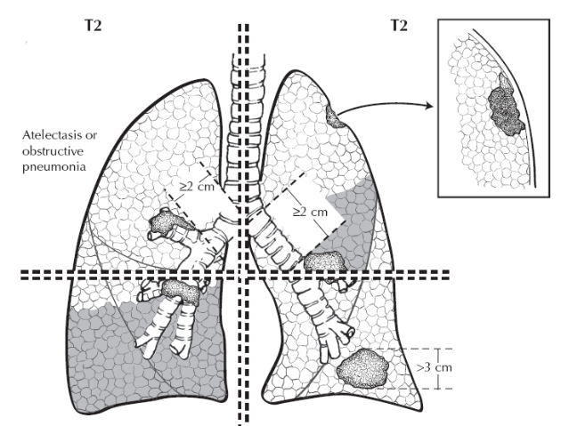
AJCC Cancer Staging Atlas T2 >3cm-<7; invades visceral pleura; main bronchus >2cm from carina; lobar atelectasis

Slide 70
Lung Case # 1 Recap of Staging
Summary of correct answers
Clinical stage T1a N0 M0 Stage Group IA
Pathologic stage T2a N0 cM0 Stage Group IB
The staging classifications have a different purpose and therefore can be different. Do not go back and change the clinical staging based on pathologic staging information.

Slide 71
Lung Case # 2 History, Physical & Imaging results
69 yr old female who presented with an abnormal routine CXR, no symptoms
25 pack year smoking history
Chest x-ray-5cm right upper lobe (RUL) lung mass
CT chest-4.5x5.3cm mass RUL lung, right paratracheal node, no hilar nodes
PET/CT-RUL lung mass, right paratracheal & right hilar lymphadenopathy
Bone scan-neg

Slide 72
Lung Case # 2 Diagnostic Procedure
Procedures
CT guided biopsy RUL lung
Mediastinoscopy with biopsy right paratracheal nodes
Pathology Reports
Poorly differentiated adenocarcinoma, bx RUL lung
Met adenocarcinoma, 2 right paratracheal nodes

Slide 73
Lung Case # 2 Clinical Staging
Synopsis- patient with 5.3cm adenoca lesion RUL lung, also clinically positive and biopsy proven mediastinal nodes
What is the clinical stage?
T____
N____
M____
Stage Group______

Slide 74
Lung Case # 2 Clinical Staging
Clinical Stage correct answer
T2b
N2
M0
Stage Group IIIA
Based on stage, treatment is selected
Review treatment guidelines for this stage

Slide 75
Lung Case # 2 Clinical Staging
Rationale for staging choices
T2b for ca >5cm but <7cm
N2 because ipsilateral mediastinal nodes were clinically positive on imaging, and the diagnostic biopsy confirms the clinical category of N2 (per new rules in AJCC 7th)
M0 because there was nothing to suggest distant metastases; if there was, appropriate tests would be performed before developing a treatment plan

Slide 76
Lung Case # 2 Initial Treatment
Presentation at Cancer Conference for initial treatment recommendations
The treatment chosen based on the single lesion and clinically positive nodes in the patient, Stage IIIA, is neoadjuvant chemotherapy & radiation therapy

Slide 77
Lung Case # 2 Response To Therapy
Evaluation by imaging tests after neoadjuvant Rx showed no progression
Patient underwent surgical resection
Presentation at Cancer Conference for adjuvant treatment recommendations and pathologic staging

Slide 78
Lung Case # 2 Surgery & Findings
Procedure
RUL lung resection
Hilar and mediastinal node resection
Operative findings
No additional information

Slide 79
Lung Case # 2 Pathology Results
Adenocarcinoma, RUL lung
Tumor size - 3.8cm
Grade 3
Tumor largely necrotic and inflammatory, consistent with chemo radiation effect
No pleural involvement by ca
Margins negative
3 hilar and 3 mediastinal nodes negative

Slide 80
Lung Case # 2 Pathologic Staging
Synopsis- patient with residual 3.8cm tumor and negative nodes after chemo & radiation therapy followed by surgery
What is the pathologic stage?
(remember, clinical M may be used in pathologic staging)
T____
N____
M____
Stage Group______

Slide 81
Lung Case # 2 Pathologic Staging
Pathologic Stage correct answer
ypT2a
ypN0
cM0
ypStage Group IB
Based on pathologic stage, there is more information to estimate prognosis and adjuvant treatment recommendations

Slide 82
Lung Case # 2 Pathologic Staging
Rationale for staging choices
ypT2a for ca >3cm but <5cm
ypN0 because hilar and mediastinal nodes were negative
cM0 – classified by M status prior to therapy
y prefix used to show stage during or following neoadjuvant therapy

Slide 83
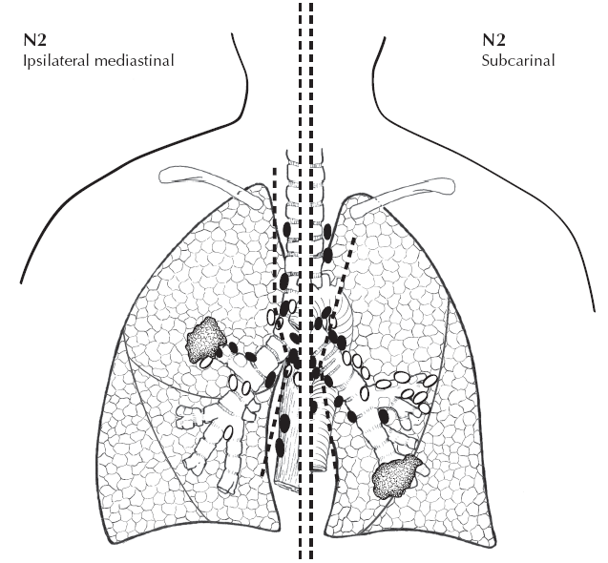
AJCC Cancer Staging Atlas N2 ipsilateral mediastinal and/or subcarinal lymph nodes

Slide 84
Lung Case # 2 Recap of Staging
Summary of correct answers
Clinical stage T2b N2 M0 Stage Group IIIA
Pathologic stage ypT2a ypN0 cM0 ypStage Group IB
The staging classifications have a different purpose and therefore can be different. Do not go back and change the clinical staging based on pathologic staging information.

Slide 85
Lung Case # 3 History & Physical
65 yr old female who presented with inappropriate behavior and thoughts
Current smoker, using nicotine patch to quit

Slide 86
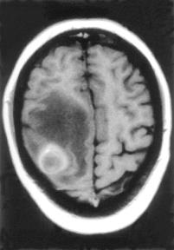
Lung Case # 3 Imaging Results
Chest x-ray- infiltrate
CT & MRI brain- 2cm mets in each left frontal & left occipital lobes
CT chest- 2.4cm LUL lung mass, bilateral mediastinal nodes
Used with permission. Schuchert M, Luketich J: Solitary Sites of Metastatic Disease in Non-Small Cell Lung Cancer. Current Treatment Options in Oncology. 4(1):65-79. Current Science, Inc.

Slide 87
Lung Case # 3 Diagnostic Procedure
Procedure
CT guided biopsy LUL lung
Pathology Report
Adenocarcinoma

Slide 88
Lung Case # 3 Clinical Staging
Clinical staging
Uses information from the physical exam, imaging, and diagnostic biopsy
Purpose
Select appropriate treatment
Estimate prognosis

Slide 89
Lung Case # 3 Clinical Staging
Synopsis- patient with 2.4cm LUL lung mass, bilat mediastinal nodes, and brain mets
What is the clinical stage?
T____
N____
M____
Stage Group______

Slide 90
Lung Case # 3 Clinical Staging
Clinical Stage correct answer
T1b
N3
M1b
Stage Group IV
Based on stage, treatment is selected

Slide 91
Lung Case # 3 Clinical Staging
Rationale for staging choices
T1b for ca >2cm but <3cm
N3 because contralateral mediastinal nodes were clinically positive on imaging
M1b because distant metastases (brain) were found on imaging; if additional mets were suspected, appropriate tests would be performed before developing a treatment plan

Slide 92
Lung Case # 3 Presentation after Surgery
The procedure chosen based on the 2.4cm LUL lung mass, bilat mediastinal nodes, and brain mets, Stage IV, is resection of metastases
Presentation at Cancer Conference for adjuvant treatment recommendations and pathologic staging

Slide 93
Lung Case # 3 Surgery & Findings
Procedure
Gross resection brain mets left frontal and occipital lobes
Operative findings
No additional information

Slide 94
Lung Case # 3 Pathology Results
Met adenocarcinoma in left frontal and occipital lobes

Slide 95
Lung Case # 3 Pathologic Staging
Synopsis- patient with 2.4cm LUL lung mass, bilat mediastinal nodes, brain mets
What is the pathologic stage?
(remember, clinical M may be used in pathologic staging)
T____
N____
M____
Stage Group______

Slide 96
Lung Case # 3 Pathologic Staging
Pathologic Stage correct answer
pTX
pNX
pM1b
Stage Group IV
Based on pathologic stage, there is more information to estimate prognosis and adjuvant treatment is selected

Slide 97
Lung Case # 3 Pathologic Staging
Rationale for staging choices
pTX because the primary tumor was not removed, pathologic staging cannot be completed
pNX because regional nodes were not removed, pathologic staging cannot be completed
pM1b because the brain mets were proven histologically

Slide 98
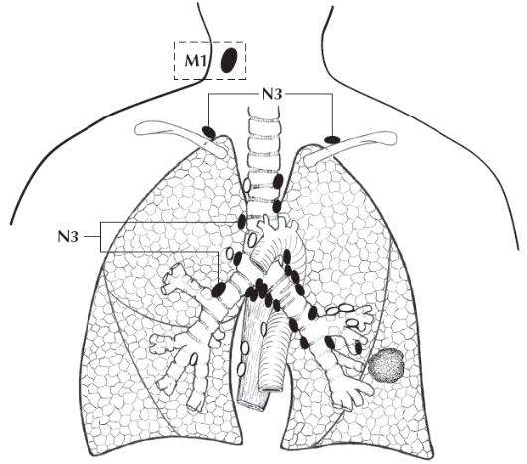
AJCC Cancer Staging Atlas N3 Contralateral mediastinal or hilar; ipsilat/contralat scalene; supraclavicular LN

Slide 99
Lung Case # 3 Recap of Staging
Summary of correct answers
Clinical stage T1b N3 M1b Stage Group IV
Pathologic stage TX NX M1b Stage Group IV
The staging classifications have a different purpose and therefore can be different. Do not go back and change the clinical staging based on pathologic staging information.

