Slide 1
Bασικές Αρχές Στοχεύουσας Θεραπείας
ELECTIVE ΠΑΘΟΛΟΓΙΚΗΣ ΟΓΚΟΛΟΓΙΑΣ 2026
Αναστάσιος Κυριαζόγλου MD,PhD
Β ΠΠΚ Αττικό

Slide 2
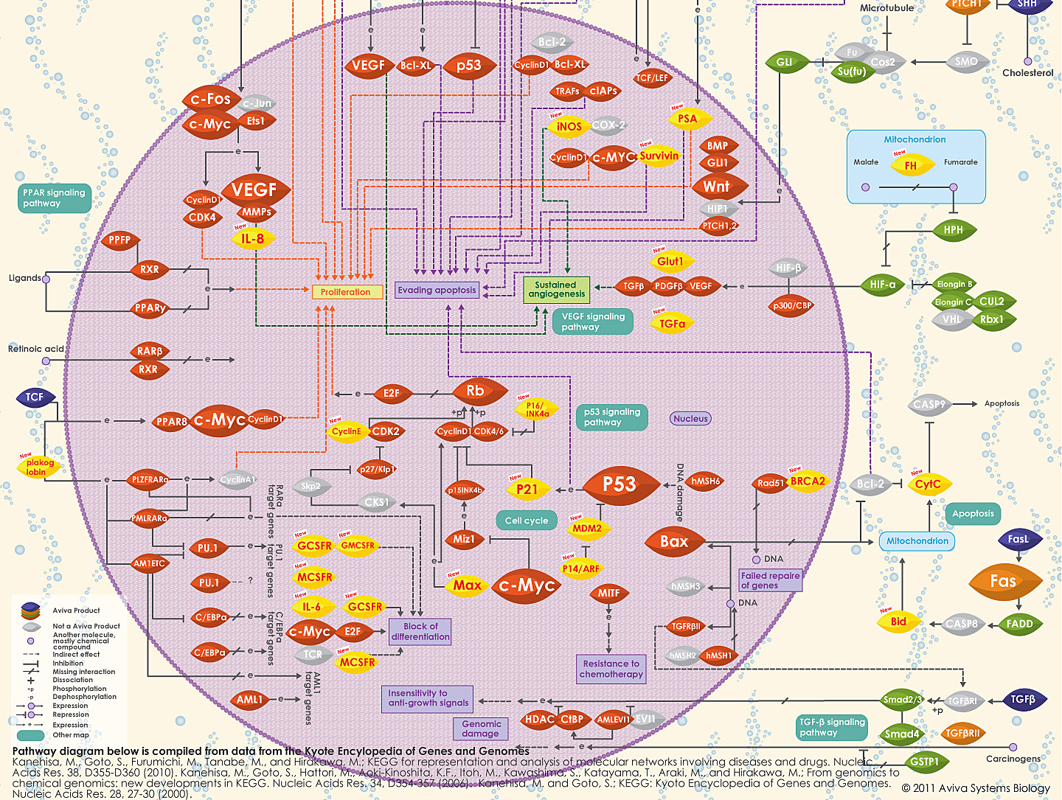

Slide 3
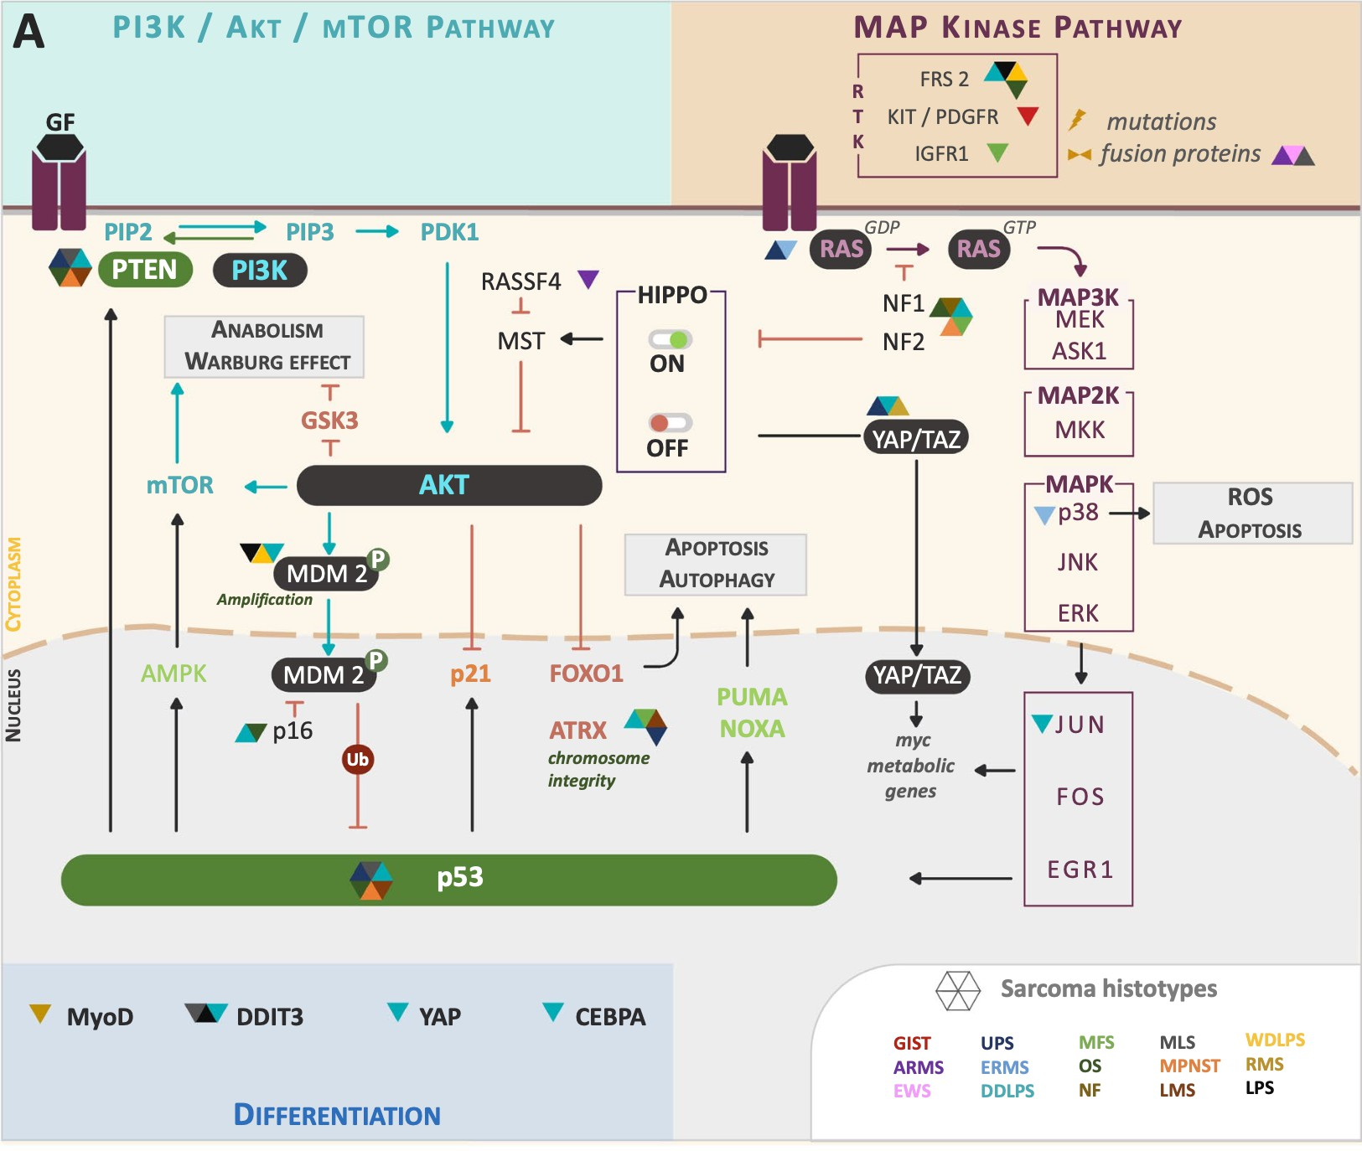
Why is it so difficult to hit the target?
Molecular complexity underlying therapeutic resistance in STS
Rare, highly heterogeneous, > 70 distinct subtypes
Few actionable drivers, lack clear targets
Intrinsic resistance - redundant signaling networks, tumor-suppressor loss
Small, highly limited patient populations - trial design, biomarker identification
Miallot R et al. J Hematol Oncol 2021;14:114
Content of this presentation is copyright and responsibility of the author. Permission is required for re-use.

Slide 4

When a spear hits the mark ....
Targeted therapies in STS - success stories of molecularly defined treatment

Slide 5
Agent | Target(s) | FDA-approved indication(s)
Ado-trastuzumab emtansine (Kadcyla) | HER2 (ERBB2/neu) | Breast cancer (HER2+)
Afatinib (Gilotrif) | EGFR (HER1/ERBB1), HER2 (ERBB2/neu) | Non-small cell lung cancer (with EGFR exon 19 deletions or exon 21 substitution (L858R) mutations)
Aldesleukin (Proleukin) |  | Renal cell carcinoma Melanoma
Alectinib (Alecensa) | ALK | Non-small cell lung cancer (with ALK fusion)
Alemtuzumab (Campath) | CD52 | B-cell chronic lymphocytic leukemia
Atezolizumab (Tecentriq) | PD-L1 | Urothelial carcinoma Non-small cell lung cancer
Avelumab (Bavencio) | PD-L1 | Merkel cell carcinoma Urothelial cancer
Axitinib (Inlyta) | KIT, PDGFRβ, VEGFR1/2/3 | Renal cell carcinoma
Belimumab (Benlysta) | BAFF | Lupus erythematosus
Belinostat (Beleodaq) | HDAC | Peripheral T-cell lymphoma
Bevacizumab (Avastin) | VEGF ligand | Cervical cancer Colorectal cancer Fallopian tube cancer Glioblastoma Non-small cell lung cancer Ovarian cancer Peritoneal cancer Renal cell carcinoma
Blinatumomab (Blincyto) | CD19/CD3 | Acute lymphoblastic leukemia (precursor B-cell)
Bortezomib (Velcade) | Proteasome | Multiple myeloma Mantle cell lymphoma
Bosutinib (Bosulif) | ABL | Chronic myelogenous leukemia (Philadelphia chromosome positive)
Brentuximab vedotin (Adcetris) | CD30 | Hodgkin lymphoma Anaplastic large cell lymphoma
Brigatinib (Alunbrig) | ALK | Non-small cell lung cancer (ALK+)
Cabozantinib (Cabometyx [tablet], Cometriq [capsule]) | FLT3, KIT, MET, RET, VEGFR2 | Medullary thyroid cancer Renal cell carcinoma
Canakinumab (Ilaris) | IL-1β | Juvenile idiopathic arthritis Cryopyrin-associated periodic syndromes
Carfilzomib (Kyprolis) | Proteasome | Multiple myeloma
Ceritinib (Zykadia) | ALK | Non-small cell lung cancer (with ALK fusion)
Cetuximab (Erbitux) | EGFR (HER1/ERBB1) | Colorectal cancer (KRAS wild type) Squamous cell cancer of the head and neck
Cobimetinib (Cotellic) | MEK | Melanoma (with BRAF V600E or V600K mutation)
Crizotinib (Xalkori) | ALK, MET, ROS1 | Non-small cell lung cancer (with ALK fusion or ROS1 gene alteration)
Dabrafenib (Tafinlar) | BRAF | Melanoma (with BRAF V600 mutation) Non-small cell lung cancer (with BRAF V600E mutation)
Daratumumab (Darzalex) | CD38 | Multiple myeloma
Dasatinib (Sprycel) | ABL | Chronic myelogenous leukemia (Philadelphia chromosome positive) Acute lymphoblastic leukemia (Philadelphia chromosome positive)
Denosumab (Xgeva) | RANKL | Giant cell tumor of the bone
Dinutuximab (Unituxin) | B4GALNT1 (GD2) | Pediatric neuroblastoma
Durvalumab (Imfinzi) | PD-L1 | Urothelial carcinoma Non-small cell lung cancer
Elotuzumab (Empliciti) | SLAMF7 (CS1/CD319/CRACC) | Multiple myeloma
Enasidenib (Idhifa) | IDH2 | Acute myeloid leukemia (with IDH2 mutation)
Erlotinib (Tarceva) | EGFR (HER1/ERBB1) | Non-small cell lung cancer (with EGFR exon 19 deletions or exon 21 substitution (L858R) mutations) Pancreatic cancer
Everolimus (Afinitor) | mTOR | Pancreatic, gastrointestinal, or lung origin neuroendocrine tumor Renal cell carcinoma Nonresectable subependymal giant cell astrocytoma associated with tuberous sclerosis Breast cancer (HR+, HER2-)
Gefitinib (Iressa) | EGFR (HER1/ERBB1) | Non-small cell lung cancer (with EGFR exon 19 deletions or exon 21 substitution (L858R) mutations)

Slide 6
Palbociclib (Ibrance) | CDK4, CDK6 | Breast cancer (HR+, HER2-)
Panitumumab (Vectibix) | EGFR (HER1/ERBB1) | Colorectal cancer (KRAS wild type)
Panobinostat (Farydak) | HDAC | Multiple myeloma
Pazopanib (Votrient) | VEGFR, PDGFR, KIT | Renal cell carcinoma
Pembrolizumab (Keytruda) | PD-1 | Classical Hodgkin lymphoma Colorectal cancer (MSI-H/dMMR) Gastric cancer Melanoma Non-small cell lung cancer (PD-L1+) Head and neck squamous cell carcinoma Urothelial cancer Solid tumors (MSI-H/dMMR)
Pertuzumab (Perjeta) | HER2 (ERBB2/neu) | Breast cancer (HER2+)
Ponatinib (Iclusig) | ABL, FGFR1-3, FLT3, VEGFR2 | Chronic myelogenous leukemia Acute lymphoblastic leukemia (Philadelphia chromosome positive)
Ramucirumab (Cyramza) | VEGFR2 | Colorectal cancer Gastric cancer or Gastroesophageal junction (GEJ) adenocarcinoma Non-small cell lung cancer
Regorafenib (Stivarga) | KIT, PDGFRβ, RAF, RET, VEGFR1/2/3 | Colorectal cancer Gastrointestinal stromal tumors Hepatocellular carcinoma
Ribociclib (Kisqali) | CDK4, CDK6 | Breast cancer (HR+, HER2-)
Rituximab (Rituxan, Mabthera) | CD20 | Non-Hodgkin’s lymphoma Chronic lymphocytic leukemia Rheumatoid arthritis Granulomatosis with polyangiitis
Rituximab/hyaluronidase human (Rituxan Hycela) | CD20 | Chronic lymphocytic leukemia Diffuse large B-cell lymphoma Follicular lymphoma
Romidepsin (Istodax) | HDAC | Cutaneous T-cell lymphoma Peripheral T-cell lymphoma
Rucaparib (Rubraca) | PARP | Ovarian cancer (with BRCA mutation)
Ruxolitinib (Jakafi) | JAK1/2 | ​Myelofibrosis
Siltuximab (Sylvant) | IL-6 | Multicentric Castleman's disease
Sipuleucel-T (Provenge) |  | Prostate cancer
Sonidegib (Odomzo) | Smoothened | Basal cell carcinoma
Sorafenib (Nexavar) | VEGFR, PDGFR, KIT, RAF | Hepatocellular carcinoma Renal cell carcinoma Thyroid carcinoma
Temsirolimus (Torisel) | mTOR | Renal cell carcinoma
Tocilizumab (Actemra) | IL-6R | Rheumatoid arthritis Juvenile idiopathic arthritis
Tofacitinib (Xeljanz) | JAK3 | Rheumatoid arthritis
Tositumomab (Bexxar) | CD20 | Non-Hodgkin's lymphoma
Trametinib (Mekinist) | MEK | Melanoma (with BRAF V600 mutation) Non-small cell lung cancer (with BRAF V600E mutation)
Trastuzumab (Herceptin) | HER2 (ERBB2/neu) | Breast cancer (HER2+) Gastric cancer (HER2+)
Vandetanib (Caprelsa) | EGFR (HER1/ERBB1), RET, VEGFR2 | Medullary thyroid cancer
Vemurafenib (Zelboraf) | BRAF | Melanoma (with BRAF V600 mutation)
Venetoclax (Venclexta) | BCL2 | Chronic lymphocytic leukemia (with 17p deletion)
Vismodegib (Erivedge) | PTCH, Smoothened | Basal cell carcinoma
Vorinostat (Zolinza) | HDAC | Cutaneous T-cell lymphoma
Ziv-aflibercept (Zaltrap) | PIGF, VEGFA/B | Colorectal cancer

Slide 7
Ibritumomab tiuxetan (Zevalin) | CD20 | Non-Hodgkin's lymphoma
Ibrutinib (Imbruvica) | BTK | Mantle cell lymphoma Chronic lymphocytic leukemia Waldenstrom's macroglobulinemia
Idelalisib (Zydelig) | PI3Kδ | Chronic lymphocytic leukemia Follicular B-cell non-Hodgkin lymphoma Small lymphocytic lymphoma
Imatinib (Gleevec) | KIT, PDGFR, ABL | GI stromal tumor (KIT+) Dermatofibrosarcoma protuberans Multiple hematologic malignancies including Philadelphia chromosome-positive ALL and CML
Ipilimumab (Yervoy) | CTLA-4 | Melanoma Renal cell carcinoma
Ixazomib (Ninlaro) | Proteasome | Multiple Myeloma
Lapatinib (Tykerb) | HER2 (ERBB2/neu), EGFR (HER1/ERBB1) | Breast cancer (HER2+)
Lenvatinib (Lenvima) | VEGFR2 | Renal cell carcinoma Thyroid cancer
Midostaurin (Rydapt) | FLT3 | acute myeloid leukemia (FLT3+)
Necitumumab (Portrazza) | EGFR (HER1/ERBB1) | Squamous non-small cell lung cancer
Neratinib (Nerlynx) | HER2 (ERBB2/neu) | Breast cancer (HER2 overexpressed/amplified)
Nilotinib (Tasigna) | ABL | Chronic myelogenous leukemia (Philadelphia chromosome positive)
Niraparib (Zejula) | PARP | Ovarian cancer​ Fallopian tube cancer​ Peritoneal cancer​
Nivolumab (Opdivo) | PD-1 | Colorectal cancer (dMMR and MSI-H) Head and neck squamous cell carcinoma Hepatocellular carcinoma Hodgkin lymphoma Melanoma Non-small cell lung cancer Renal cell carcinoma Urothelial carcinoma
Obinutuzumab (Gazyva) | CD20 | Chronic lymphocytic leukemia Follicular lymphoma
Ofatumumab (Arzerra, HuMax-CD20) | CD20 | Chronic lymphocytic leukemia
Olaparib (Lynparza) | PARP | Ovarian cancer (with BRCA mutation)
Olaratumab (Lartruvo) | PDGFRα | Soft tissue sarcoma
Osimertinib (Tagrisso) | EGFR | Non-small cell lung cancer (with EGFR T790M mutation)

Slide 8
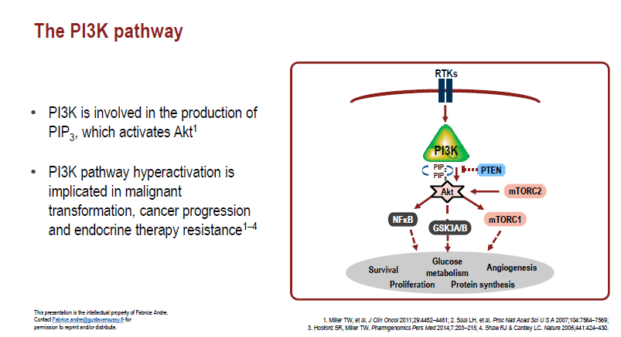
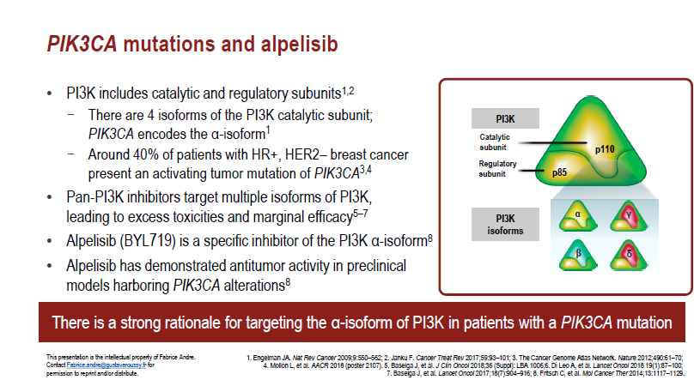

Slide 9
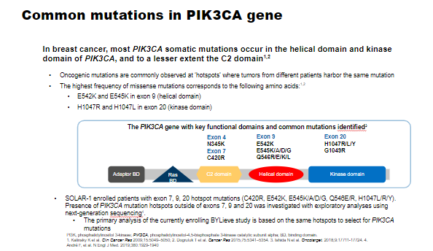
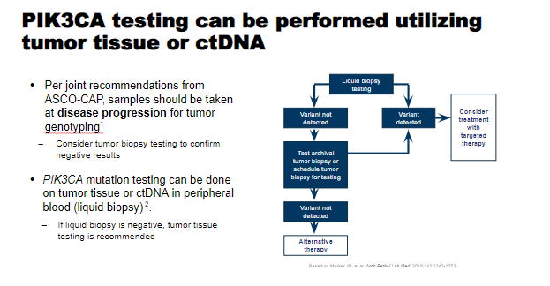

Slide 10
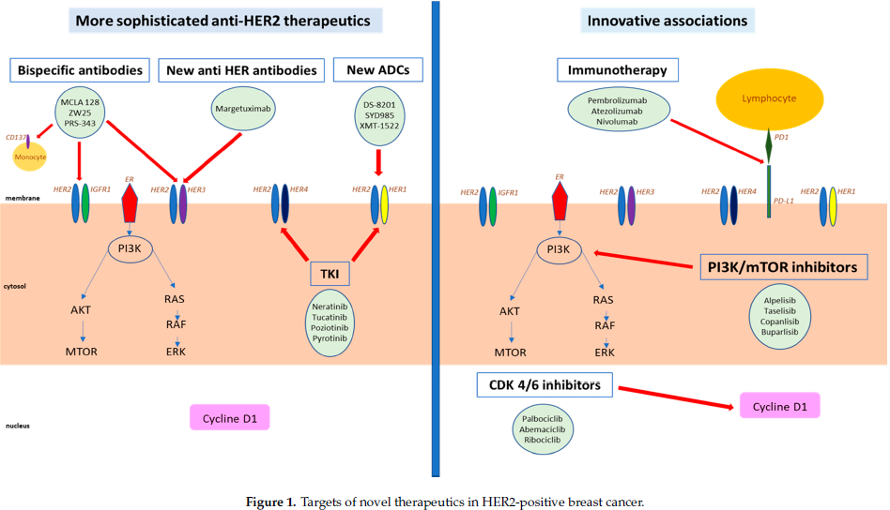
Targets of novel therapeutics in HER2-positive breast cancer

Slide 11

What’s New in HER2-Targeted Agents?
HER2 TKIs
  Neratinib
  Tucatinib (under FDA priority review as of 3/2020)
HER2 ADCs
  Trastuzumab deruxtecan (T-DXd; approved 12/2019)
  Trastuzumab duocarmazine/trastuzumab-vc-seco-DUBA (SYD985)
Re-engineered HER2 mAb
  Margetuximab
Slide credit: clinicaloptions.com
Notes:
ADC, antibody–drug conjugate; mAb, monoclonal antibody; TKI, tyrosine kinase inhibitor.

Slide 12
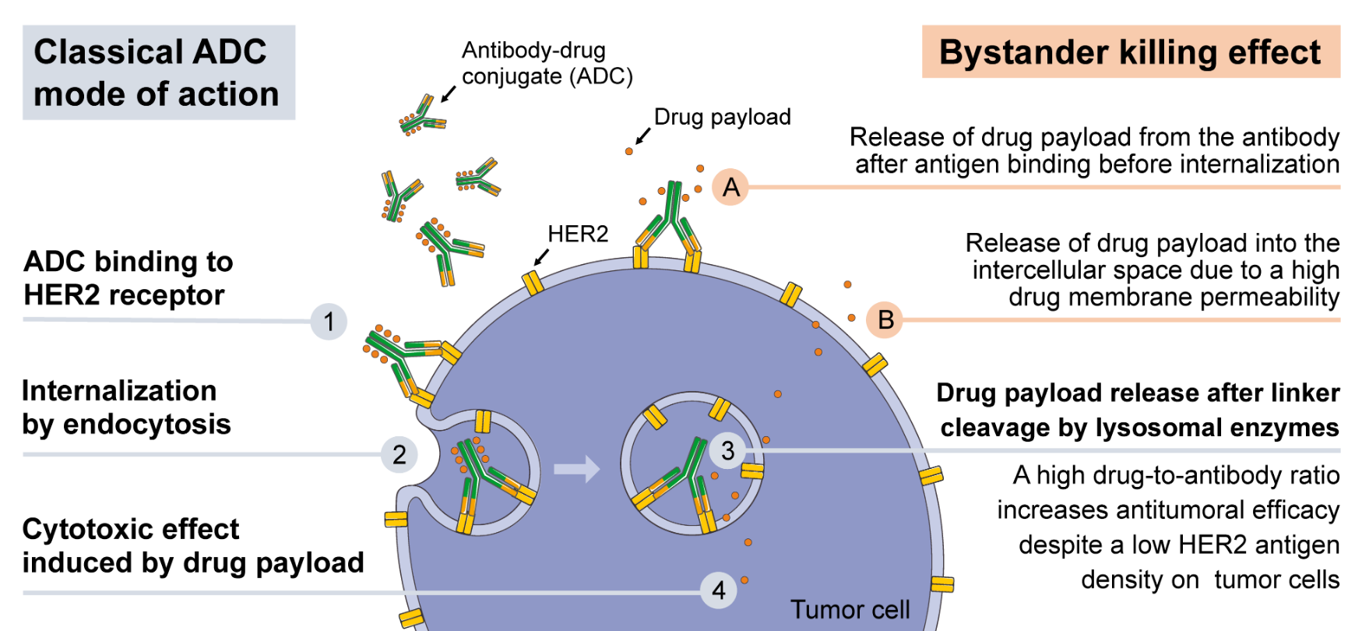
Mechanism of Action of HER2-Directed ADCs
Image from Rinnerthaler. Int J Mol Sci. 2019;20:1115. HER2 directed antibody-drug-conjugates beyond T-DM1 in breast cancer. Licensed under Creative Commons Attribution 3.0 Unported License (CC BY 3.0).
Slide credit: clinicaloptions.com
Notes:
ADC, antibody–drug conjugate.

Slide 13


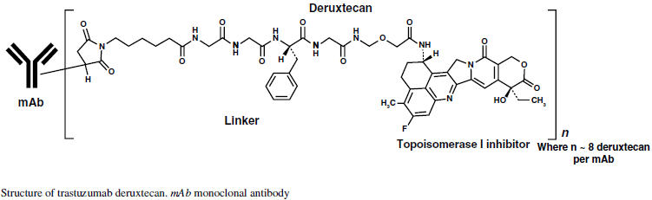
2.1. Antibody-Drug Conjugates (ADC)
To Trastuzumab-deruxtecan (T-DXd, DS-8201) αποτελεί έναν φαρμακευτικό παράγοντα αποτελούμενο από
ένα εξανθρωπισμένο anti-HER2 μονοκλωνικό αντίσωμα που έχει παρόμοια ακολουθία αμινοξέων με το
trastuzumab, καθώς και έναν αναστολέα τοποϊσομεράσης I (deruxtecan, παράγωγο της exatecan-10 φορές
πιο ισχυρό από τον μεταβολίτη της ιρινοτεκάνης)
(Modi S, et al. N Engl J Med. 2020)

Slide 14

HER2-Targeted ADC: Trastuzumab Deruxtecan (DS-8201)
Humanized anti-HER2 IgG1 mAb with same AA sequence as trastuzumab
High drug:antibody ratio: ~ 8
Stable linker-payload
Tumor-selectable cleavable linker
High potency, membrane-permeable payload with short systemic half-life
Bystander killing effect
O
Tetrapeptide-based cleavable linker
O
OH
O
O
N
Cys
O
H
O
H
O
H
N
N
N
N
N
N
N
O
N
O
H
O
H
O
✄
H
O
F
Cysteine residue
HO
O
NH
Drug/linker
O
N
F
N
O
Topoisomerase I inhibitor (DXd) payload
(exatecan derivative)
OH
O
Nakada. Chem Pharm Bull (Tokyo). 2019;67:173. Trail. Pharmacol Ther. 2018;181:126. Ogitani. Cancer Sci. 2016;107:1039.
Slide credit: clinicaloptions.com
Notes:
AA, amino acid; mAb, monoclonal antibody.
Figure:
1/Nakada/2019/p178/Figure8/col1/para1/
all/p183/col2/para2/
L1-8;
2/Ogitani/ClinCanRes/2016/p5098/col2/para1/ln1-2/
p5100/Figure1A
3/Trail/2018/
p127/fig 1
All boxes: 1/Nakada/2019/p178/Figure 8/
box 1: 2/Ogitani/ClinCanRes/2016/p5098/col1/para2/ln4;
box 2: 2/Ogitani/ClinCanRes/2016/p5100/col1/para1/all; Figure 1C;
box 3: 2/Ogitani/ClinCanRes/2016/p5100/Figure 1 B;
box 4: 1/Nakada/2019/p180/col2/para1/ln1-3; 3/Ogitani/ClinCanRes/2016/p5105/Figure 5 D;
box 5: 2/Ogitani/ClinCanRes/2016/p5100/col2/para2/ln4-8; p5101/Figure 2 E;
box 6: 2/Ogitani/ClinCanRes/2016/p5098/col1/para2/ln3-4;
box 7: 4/Ogitani/CaSci/2016/p1044/col1/para1/ln28-32;
3 components:
1/Nakada/2019/p178/Figure 8/ col1/para1/all;
2/Ogitani/ClinCanRes/2016/p5098/col1/para2/ln2-4

Slide 15
DESTINY-Breast01: Trastuzumab Deruxtecan (T-DXd) in Advanced HER2+ Breast Cancer
Open-label, multicenter, randomized, 2-part phase II study
Part 1
Part 2
Adult patients with HER2+ unresectable and/or metastatic BC; prior T-DM1; ECOG PS 0/1; stable, treated brain metastases allowed; history of significant ILD excluded
Pharmacokinetics (n = 65)
Dose Finding* (n = 54)
Continuation (n = 134)
T-DXd 5.4 mg/kg
(n = 22)
T-DXd 5.4 mg/kg
(n = 28)
T-DM1
R/R
(n = 249)
Newly enrolled patients
T-DXd 6.4 mg/kg
(n = 22)
T-DXd 5.4 mg/kg
(n = 130)
T-DXd 6.4 mg/kg
(n = 26)
T-DXd 7.4 mg/kg
(n = 23)
T-DM1
Intolerant
(n = 4)
*5.4 mg/kg confirmed as RP2D.
T-DXd 5.4 mg/kg
(n = 4)
Total enrolled at 5.4 mg/kg: n = 184
Primary endpoint: ORR by ICR (RECIST v1.1)
Secondary endpoints: investigator-assessed ORR, DCR, DoR, CBR, PFS, OS, PK, safety
Data cutoff: August 1, 2019
  79 (42%) continuing treatment
  105 (57.1%) d/c (mostly for PD, 28.8%)
Slide credit: clinicaloptions.com
Krop. SABCS 2019. Abstr GS1-03. Modi. NEJM. 2020;382:610.
Notes:
BC, breast cancer; CBR, clinical benefit rate; d/c, discontinuation; DCR, disease control rate; DoR, duration of response; ECOG, Eastern Cooperative Oncology Group; ICR, independent central review; ILD, interstitial lung disease; PD, progressive disease; PK, pharmacokinetics; PS, performance status; RP2D, recommended phase II dose; RECIST, Response Evaluation Criteria in Solid Tumors; R/R, resistant/refractory; T-DM1, trastuzumab emtansine; T-DXd, trastuzumab deruxtecan.

Slide 16
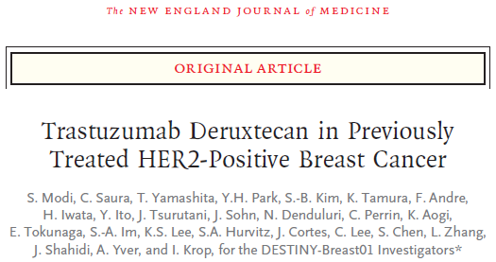
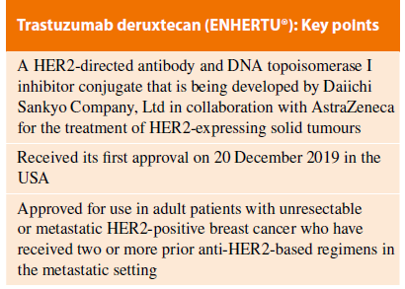
A dose of 5.4 mg/kg q3weeks was recommended
After a median follow-up of only 11 months, ORR was 60.9% (95% CI, 53.4–68.0); with 6% of complete
response, and 54.9% of partial response.
The median response duration was 14.8 months (95% CI, 13.8–16.9), PFS was 16.4 months (95% CI, 12.7 to
not reached)
The OS was estimated at 93.9% (95% CI, 89.3–96.6) at 6 months and 86.2% (95% CI, 79.8–90.7)
at 12 months; the median OS was not reached.

Slide 17
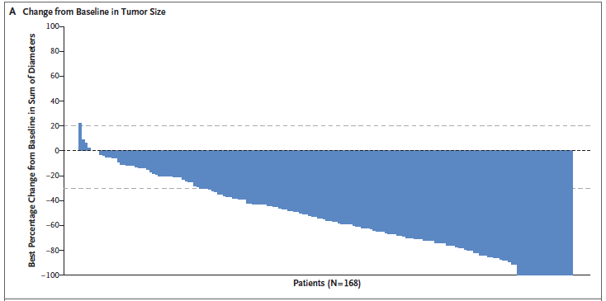
Response (ITT) | T-DXd 5.4 mg/kg (N = 184)
ORR* (by ICR; n = 112), % (95% CI) | 60.9 (53.4-68.0)
CR (n = 11) | 6.0
PR (n = 101) | 54.9
SD (n = 67) | 36.4
PD (n = 3) | 1.6
Not evaluable (n = 2) | 1.1
DCR, % (95% CI) | 97.3 (93.8-99.1)
6-mo CBR, % (95% CI) | 76.1 (69.3-82.1)
Median DoR, mos (95% CI) | 14.8 (13.8-16.9)
Median time to response, mos (95% CI) | 1.6 (1.4-2.6)
(Modi S, et al. N Engl J Med. 2020)

Slide 18
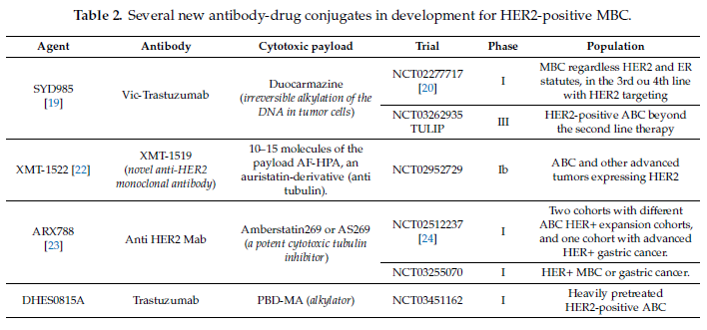

Slide 19
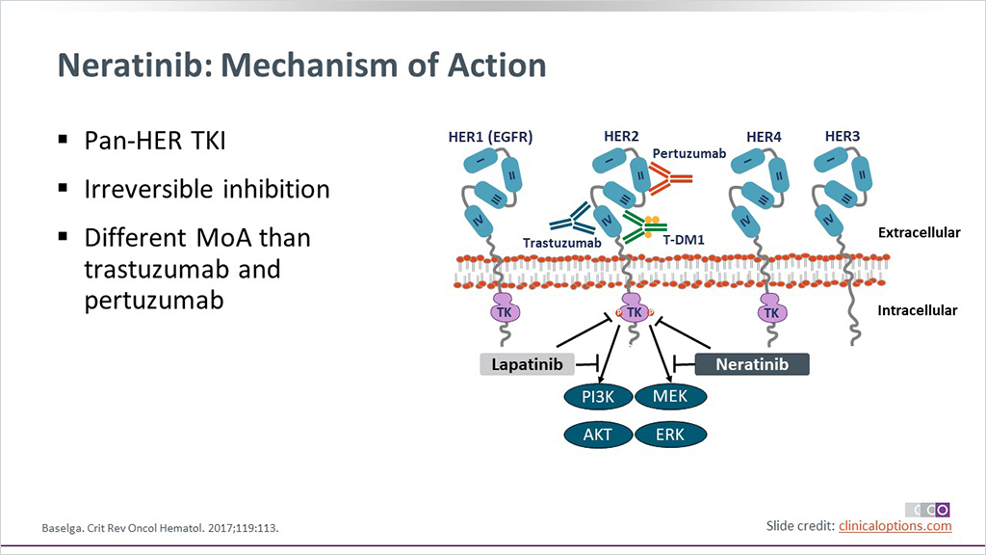
2.4. Ειδικοί και δραστικοί HER2 TKIs
2.4.1. Neratinib
- Αποτελεί έναν από του στόματος, μη αντιστρεπτό pan-HER TKI, που στοχεύει τα HER1 (EGFR),
HER2, και HER4 μόρια μέσω της σύνδεσης στην ATP θήκη του υποδοχέα. Αλληλεπιδρά επίσης με τα
PI3K/MAPK μοριακά μονοπάτια και αναστέλλει την έκφραση της cyclin D1 in vivo

Slide 20
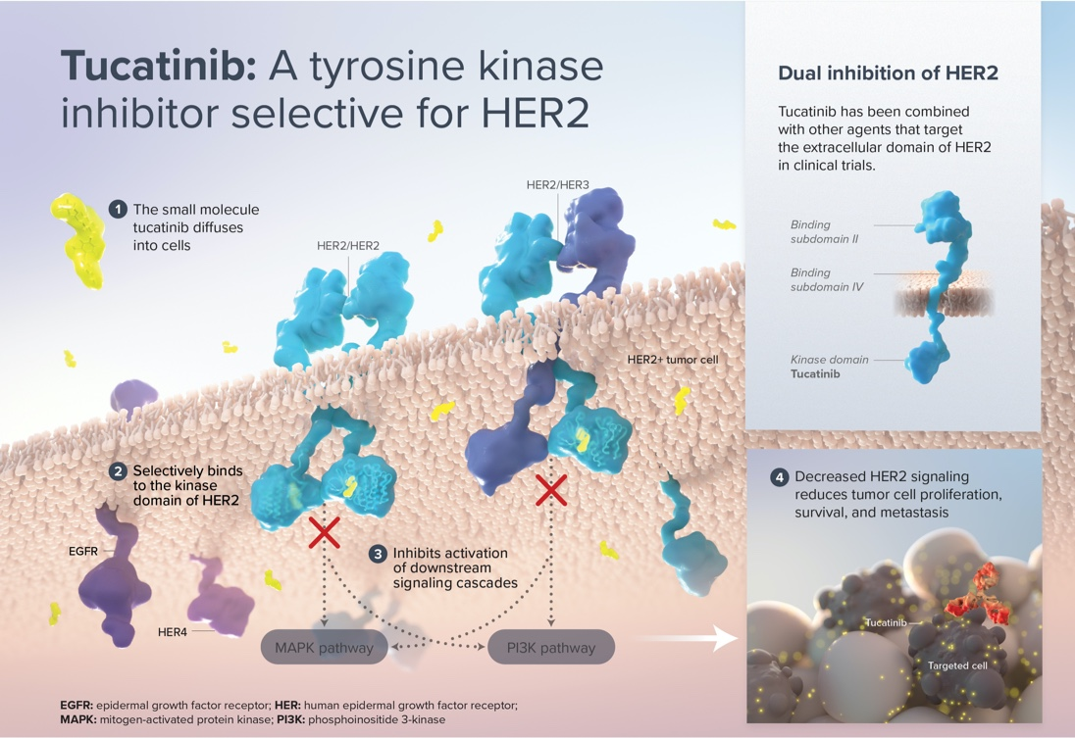
2.4.2. Tucatinib (ONT-380)
Το Tucatinib αποτελεί έναν από του στόματος βιοδιαθέσιμο, μικρού μοριακού βάρους TKI, με δύο ετεροκυκλικά
σχήματος δακτυλιδιού συστατικά που στοχεύουν τον HER. Μπλοκάρει τον πολλαπλασιασμό και την
φωσφορυλιωση του HER2. Επίσης λόγω του πολύ μικρού μεγέθους του διαπερνά τον αιματοεγκεφαλικό φραγμό

Slide 21
HER2CLIMB: Phase II Study Design
Randomized, double-blind, placebo-controlled, active comparator phase II trial at 155 sites in
15 countries (February 2016 to May 2019); data cutoff: September 4, 2019; median f/u: 14.0 mos
Stratified by brain mets (yes vs no), ECOG PS (0 vs 1), and region (US or Canada vs rest of world)
21-day cycles
Tucatinib 300 mg PO BID +
Trastuzumab 6 mg/kg Q3W (loading dose: 8 mg/kg C1D1) +
Capecitabine 1000 mg/m² PO BID on Days 1-14
(n = 410)
Patients with HER2+ MBC;
prior trastuzumab, pertuzumab, and T-DM1; ECOG PS 0/1;
brain mets allowed*
(N = 612)
Placebo PO BID +
Trastuzumab 6 mg/kg Q3W (loading dose: 8 mg/kg C1D1) +
Capecitabine 1000 mg/m² PO BID on Days 1-14
(n = 202)
*Including previously treated stable mets, untreated mets not needing immediate local therapy, and previously treated progressing mets not needing immediate local therapy.
Primary endpoint: PFS (RECIST v 1.1 by BICR) among first 480 randomized patients
  90% power with 288 events at α = 5%, HR: 0.67
Secondary endpoints (total population): OS, PFS in patients with brain mets, ORR in patients with measurable disease, safety in patients who received ≥ 1 dose of study tx
Murthy. SABCS 2019. Abstr GS1-01. Murthy. NEJM. 2019;382:597.
Slide credit: clinicaloptions.com
Notes:
BICR, blinded independent central review; ECOG, Eastern Cooperative Oncology Group; f/u, follow-up; MBC, metastatic breast cancer; mets, metastases; RECIST, Response Evaluation Criteria in Solid Tumors; PS, performance status; T-DM1, trastuzumab emtansine; tx, treatment.

Slide 22
HER2CLIMB: PFS (Primary Endpoint Population)
100
Events,
n/N
Median PFS,
Mos (95% CI)
1-Yr PFS,
% (95% CI)
80
Tucatinib + Trastuzumab/Cape
Placebo + Trastuzumab/Cape
178/320
97/160
7.8 (7.5-9.6)
5.6 (4.2-7.1)
33 (27-40)
12 (8-21)
62.9
60
HR: 0.54 (95% CI: 0.42-0.71; P < .00001)
Patients Alive and Free From
Disease Progression (%)
46% reduction in risk of disease progression
40
46.3
33.1
20
12.3
0
0
3
6
9
12
15
18
21
24
27
30
33
36
Patients
at Risk, n
Tucatinib arm
Placebo arm
Mos Since Randomization
320
160
235
94
152
45
98
27
40
6
29
4
15
2
10
1
8
1
4
0
2
0
1
0
0
0
Murthy. SABCS 2019. Abstr GS1-01. Murthy. NEJM. 2019;382:597.
Slide credit: clinicaloptions.com
Notes:
Cape, capecitabine.

Slide 23
HER2CLIMB: OS (Total Population)
Events,
n/N
Median OS,
Mos (95% CI)
2-Yr OS,
% (95% CI)
100
Tucatinib + trastuzumab/cape
Placebo + trastuzumab/cape
130/410
85/202
21.9 (18.3-31.0)
17.4 (13.6-19.9)
45 (37-53)
27 (16-39)
80
75.5
60
62.4
HR: 0.66 (95% CI: 0.50-0.88); P = .0048)
Patients Alive (%)
44.9
34% reduction in risk of death
40
20
26.6
0
0
3
6
9
12
15
18
21
24
27
30
33
36
Patients
at Risk, n
Tucatinib Arm
Placebo Arm
Mos Since Randomization
410
202
388
191
322
160
245
119
178
77
123
48
80
32
51
19
34
7
20
5
10
2
4
1
0
0
Murthy. SABCS 2019. Abstr GS1-01. Murthy. NEJM. 2019;382:597.
Slide credit: clinicaloptions.com
Notes:
Cape, capecitabine.

Slide 24
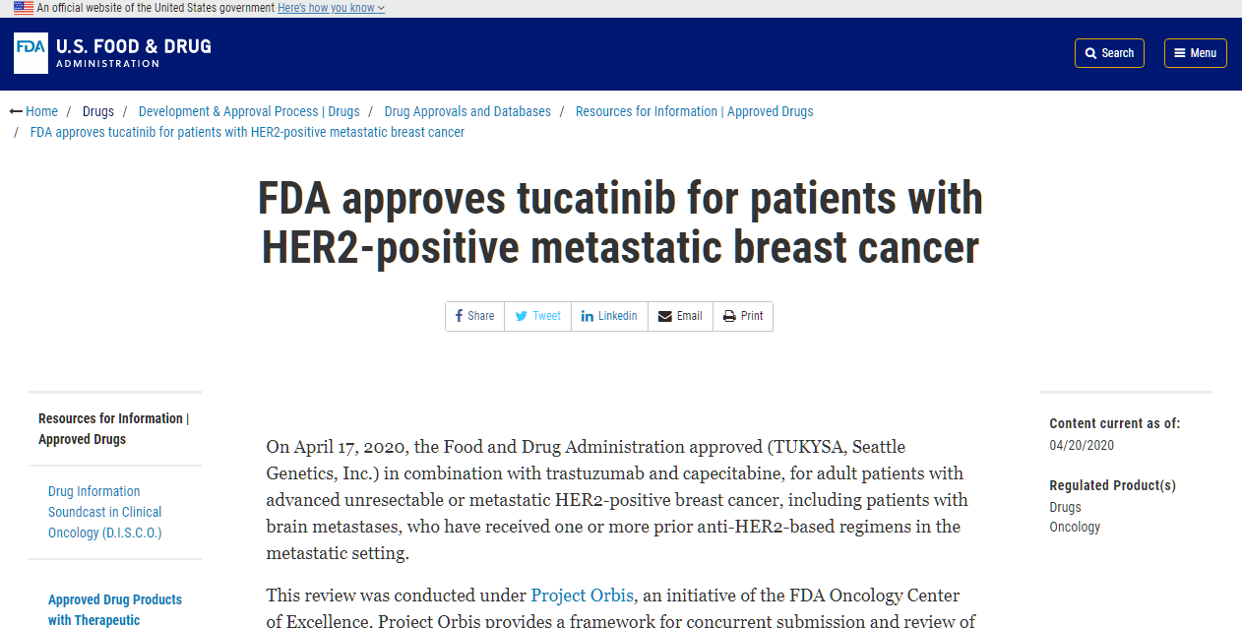
2.4.2. Tucatinib (Tukysa)

Slide 25
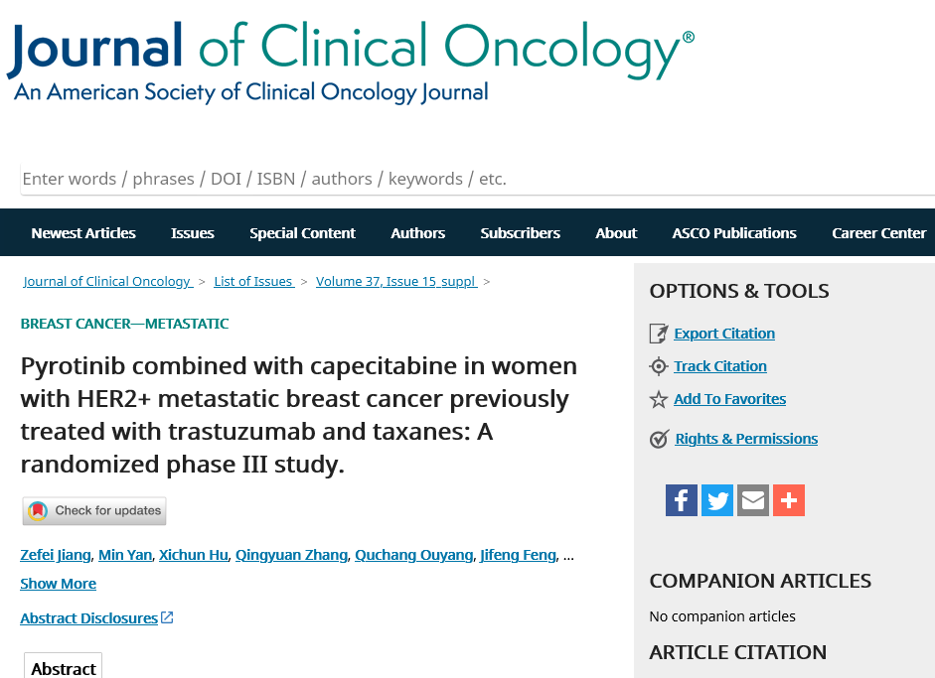
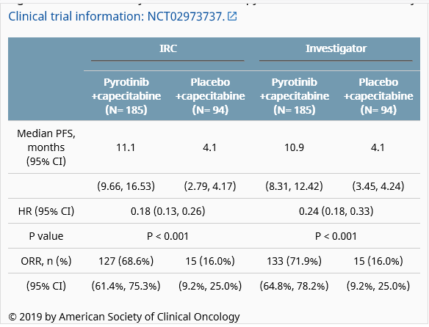
2.4.3. Pyrotinib
Το Pyrotinib αποτελεί έναν από του στόματος χορηγούμενο μη αντιστρεπτό TKI, που έχει ως στόχο τα σύμπλοκα
EGFR/HER1, HER2 και HER4. Επίσης εμποδίζει την φωσφορυλίωση του HER2 καθώς και το μονοπάτι σηματοδότησης
AKT/ERK και μπλοκάρει τα καρκινικά κύτταρα G1 φάση του κυτταρικού κύκλου.
Conclusions: In women with HER2+ MBC previously treated with taxanes and trastuzumab, pyrotinib plus capecitabine yield statistically significant better PFS. Pyrotinib monotherapy showed anti-tumour activity.

Slide 26
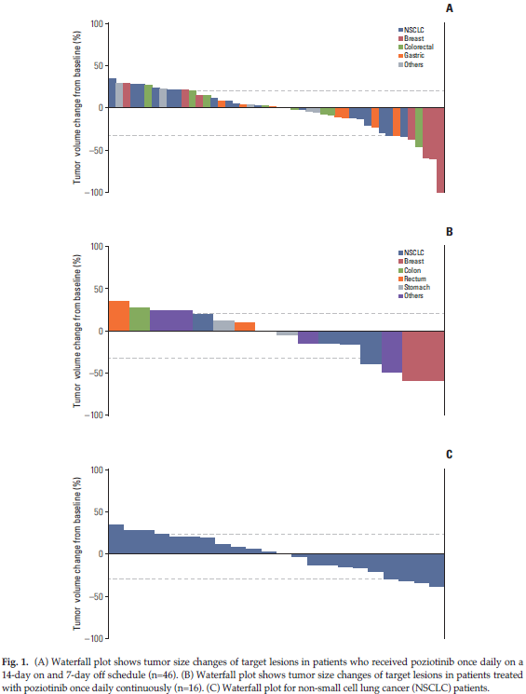

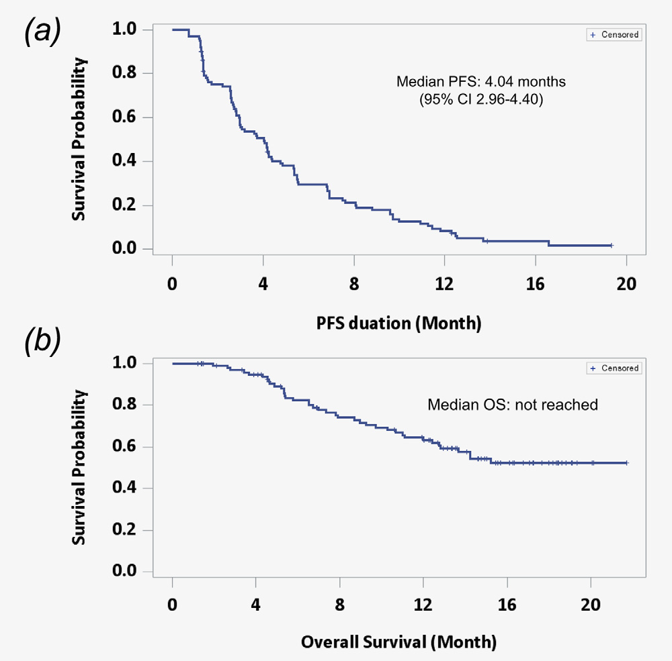
2.4.4. Poziotinib (NOV120101)
Το Poziotinib είναι ένας σύγχρονος pan-HER αναστολέας τυροσινικής κινάσης υψηλής δραστικότητας-
συνδεόμενος μη αντιστρεπτά με πολλαπλές πρωτεϊνικές κινάσες συμπεριλαμβανομένων των HER1, HER2
και HER4. Επίσης παρουσιάζει δραστικότητα και έναντι EGFR μεταλλαγμένων όγκων (EGFR T790 και
L858R/T790)
- Disease control rate was reported in 75.5% (77/102,
including 20% partial
response). Reported median PFS was 4 months

Slide 27
ALK Rearrangements

Slide 28
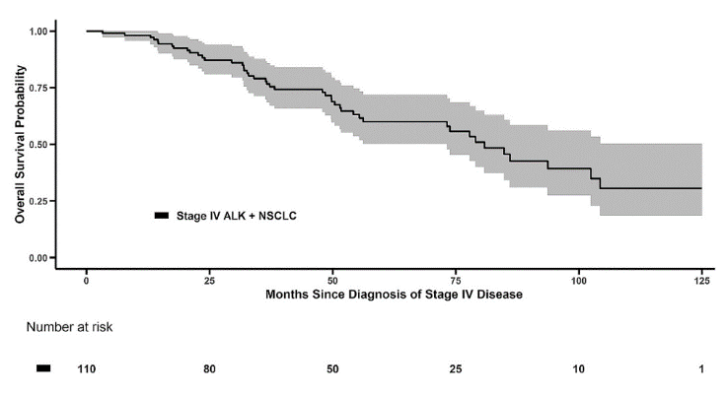
Survival in Advanced ALK+ NSCLC
Retrospective study of patients with ALK+ stage IV NSCLC treated with an
ALK inhibitor at University of Colorado Cancer Center, 2009-2017 (N = 110)
  Majority received first-line crizotinib (n = 105)
OS From Diagnosis of ALK+ Stage IV NSCLC
Median OS: 81 mo (6.8 yr)
Pacheco. J Thorac Oncol. 2019;14:691.
Slide credit: clinicaloptions.com
Notes:
NSCLC, non-small-cell lung cancer; OS, overall survival.

Slide 29
Initial Management of Advanced ALK+ NSCLC
Not immunotherapy responsive
Chemotherapy is effective
Preferred initial treatment is with an ALK TKI
  Several TKIs approved in first-line setting
    Crizotinib, ceritinib superior to chemotherapy
    Alectinib, brigatinib, lorlatinib superior to crizotinib
How do we select among available TKI options?
Slide credit: clinicaloptions.com
Notes:
NSCLC, non-small-cell lung cancer; TKI, tyrosine kinase inhibitor.

Slide 30
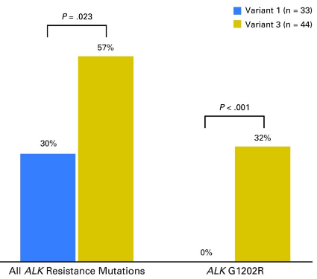
ALK Fusion Variants and Development of Resistance to ALK TKI Therapy
ALK Resistance Mutations Identified
After Progression on ALK TKI According
to Baseline EML4-ALK Variant (n = 77*)
Retrospective study of ALK resistance mutation development to ALK TKI therapy by known ALK variant in patients with ALK+ NSCLC (N = 129)
EML4 is most common fusion partner for ALK; >15 variants described
  Variant 1 most common (43%)
  Variant 3 next most common (40%)
    Worse outcomes with variant 3
  Variants impact protein stability
  Variants impact resistance (G1202R)
    32% with variant 3; not seen with variant 1
†
*With repeat biopsy after PD on ALK TKI.
†Confers high-level resistance to first- and second-gen ALK TKIs.
Lin, JCO 2019
Lin. JCO. 2018;36:1199.
Slide credit: clinicaloptions.com
Notes:
gen, generation; NSCLC, non-small-cell lung cancer; PD, progressive disease; TKI, tyrosine kinase inhibitor.

Slide 31
RET Fusions

Slide 32
RET Fusions in Advanced NSCLC
Fusions in RET occur in ~1% to 2% of advanced NSCLC
  Multiple partners, including KIF5B, CCDC6, NCOA4
  Mutations in RET associated with medullary thyroid cancer
Historic multikinase TKIs with modest efficacy
Response, n (%) | All (n = 53) | Cabozantinib (n = 21) | Vandetanib (n = 11) | Sunitinib (n = 10) | Sorafenib (n = 2) | Alectinib (n = 2) | Lenvatinib (n = 2) | Nintedanib(n = 2) | Ponatinib (n = 2) | Regorafenib (n = 1)
CR | 2 (4) | 1 (5) | 0 | 0 | 0 | 0 | 0 | 1 | 0 | 0
PR | 11 (22) | 6 (32) | 2 (18) | 2 (22) | 0 | 0 | 1 | 0 | 0 | 0
SD | 16 (32) | 5 (26) | 3 (27) | 3 (33) | 2 | 0 | 0 | 1 | 2 | 0
PD | 20 (40) | 7 (37) | 6 (55) | 3 (33) | 0 | 2 | 1 | 0 | 0 | 1
NE | 1 (2) | 0 | 0 | 1 (11) | 0 | 0 | 0 | 0 | 0 | 0
Missing | 3 | 2 | 0 | 1 | 0 | 0 | 0 | 0 | 0 | 0
Takeuchi. Nat Med. 2012;18:378. CGARN. Nature. 2014;511:543. Gautschi. JCO. 2017;35:1403.
Slide credit: clinicaloptions.com
Notes:
CR, complete response; NE, not estimable; NSCLC, non-small-cell lung cancer; PD, progressive disease; PR, partial response; SD, stable disease; TKI, tyrosine kinase inhibitor.

Slide 33
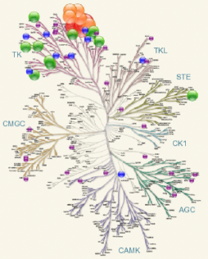
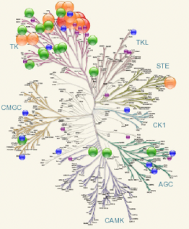
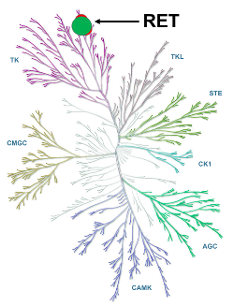
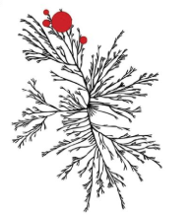
RET Inhibitors
Efficacy of RET inhibitors balanced with toxicity (largely off target)
Lenvatinib
Sunitinib
Selpercatinib
Pralsetinib
RET
Multikinase Inhibitors
Selective RET Inhibitors
Gautschi. JCO. 2017;35:1403. Stjepanovic. Biologics. 2014;8:129. Drilon. WCLC 2019. Abstr PL02.08. Gainor. ASCO 2019. Abstr 9008.
Slide credit: clinicaloptions.com

Slide 34
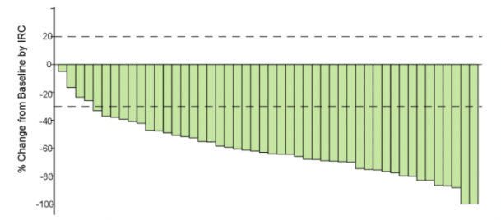
Selpercatinib
Best Tumor Response by IRC in Patients With
Treatment-Naive RET Fusion–Positive NSCLC (n = 48)
Phase I/II LIBRETTO trial: selpercatinib in RET-altered cancers, including
RET fusion–positive NSCLC
Previously treated with plt-based CT
  RR: 64%
  Median DoR: 17.5 mo
  Median PFS: 19.3 mo
Treatment naive
  RR: 85%
  Median PFS: not reached
In May 2020, the FDA granted selpercatinib accelerated approval for the treatment of adult patients with metastatic RET fusion–positive NSCLC
Besse. ASCO 2021. Abstr 9065. Selpercatinib PI.
Slide credit: clinicaloptions.com
Notes:
CT, chemotherapy; DoR, duration of response; IRC, independent review committee; NSCLC, non-small-cell lung cancer; PFS, progression-free survival; plt, platinum; RR, response rate.

Slide 35
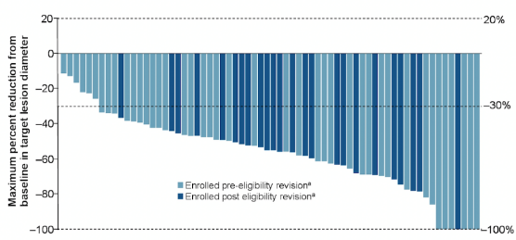
Pralsetinib
Phase I/II ARROW trial: pralsetinib in RET-altered cancers, including RET fusion–positive NSCLC
Previously treated with plt-based CT
  RR: 62%
  Median DoR: 22.3 mo
  Median PFS: 16.5 mo
Treatment naive (n = 25; postrevision*)
  RR: 88%
  Median PFS: not reached
Best Tumor Response by BICR in Patients With
Treatment-Naive RET Fusion–Positive NSCLC* (n = 68†)
In September 2020, the FDA granted pralsetinib accelerated approval for
the treatment of adult patients with metastatic RET fusion–positive NSCLC
*Protocol amended in July 2019 to allow tx-naive patients eligible for std plt-based CT. †Of 68 with measurable disease, 2 not shown in waterfall plot.
Slide credit: clinicaloptions.com
Curigliano. ASCO 2021. Abstr 9089. Pralsetinib PI.
Notes:
BICR, blinded independent central review; CT, chemotherapy; DoR, duration of response; NSCLC, non-small-cell lung cancer; PFS, progression-free survival; plt, platinum; RR, response rate; std, standard; tx, treatment.

Slide 36
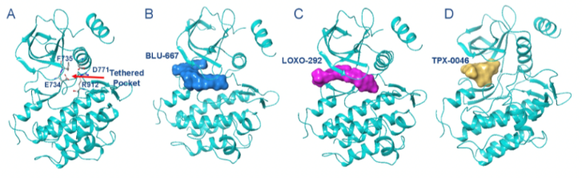
Next-Generation RET TKIs Under Development
BOS172738: highly potent and selective oral RET inhibitor
  Preclinical efficacy in presence of gatekeeper mutations
  RR: 31% (heavily pretreated,
  no prior selective TKIs)
TPX-0046: structurally distinct next-generation RET inhibitor
  Retains potency with solvent front mutations (G810X)
  Phase I trial ongoing
Modeling of
RET Inhibitors
in Complex With
RET Kinase
Schoffski. ASCO 2021. Abstr 3008. Drilon. ASCO 2020. Abstr 3616.
Pralsetinib
Selpercatinib
TPX-0046
Slide credit: clinicaloptions.com
Notes:
RR, response rate; TKI, tyrosine kinase inhibitor.

Slide 37
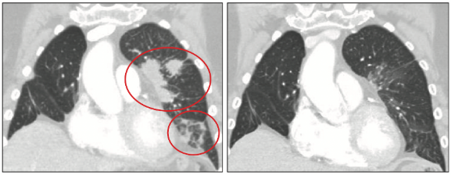
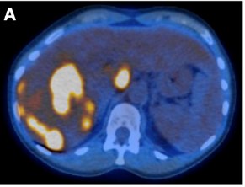
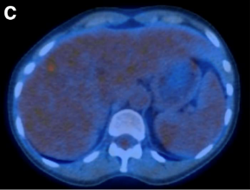
Acquired RET Fusions in Advanced EGFR-Mutant NSCLC
Acquired RET fusions mediating resistance to osimertinib described in advanced EGFR-mutant NSCLC
  Pralsetinib or selpercatinib can be effectively added to osimertinib
  (case reports/series)
Response to Osimertinib + Pralsetinib in Patient With EGFR+ NSCLC and a RET Fusion Post Afatinib/Cetuximab
Response to Osimertinib + Selpercatinib in Patient With EGFR+ NSCLC and a RET Fusion Post Osimertinib
Baseline
Wk 8
Baseline
Mo 1
Piotrowska. Cancer Discov. 2018;8:1529. Rehman. JCO Precis Oncol. 2021;5:939.
Slide credit: clinicaloptions.com
Notes:
NSCLC, non-small-cell lung cancer.

Slide 38
KRAS G12C Mutations

Slide 39
KRAS Mutations in Advanced NSCLC
Most common oncogenic driver in NSCLC
  Present in ~25% nonsquamous,
  3% squamous
  Significant heterogeneity with specific mutations, comutations
KRAS G12C most common variant
  Comprise 40% to 50% of KRAS mutations overall
  ~13% incidence in adenocarcinoma
Incidence of KRAS Mutation Variants
in Advanced NSCLC
2%
KRAS Categories
N
1882
915
684
327
313
298
210
77
4%
G12C
G12V
G12D
G13 Any
Q61 Any
G12A
G12 Other
Other
6%
7%
7%
40%
15%
19%
Liu. ASCO 2020. Abstr 9544.
Slide credit: clinicaloptions.com
Notes:
NSCLC, non-small-cell lung cancer.

Slide 40
CodeBreaK100: Sotorasib in Pretreated Advanced
KRAS G12C Mutation–Positive NSCLC
Phase II trial evaluating sotorasib 960 mg PO daily in patients with KRAS G12C mutation–positive NSCLC who progressed on 1-3 prior standard therapies
  81% with both prior platinum-based CT and IO
Outcome | Sotorasib 960 mg QD (N = 124)
Confirmed ORR, % (95% CI)* CR, n (%) PR, n (%) SD, n (%) PD, n (%) NE or missing scan, n (%) | 37.1 (28.6-46.2) 4 (3.2) 42 (33.9) 54 (43.5) 20 (16.1) 4 (3.2)
DCR, % (95% CI) | 80.6 (72.6-87.2)
Median DoR, mo (95% CI) | 11.1 (6.9-NE)
Median TTR, mo (range) | 1.35 (1.2-10.1)
PFS With Sotorasib 960 mg QD (N = 124)
1.0
0.8
Median PFS:
6.8 mo
0.6
Probability of PFS
0.4
0.2
0.0
0
1
2
3
4
5
6
7
8
9
10
11
12
13
14
15
Patients at Risk, n
Mo
124
119
96
77
75
65
54
50
46
37
35
34
27
24
4
0
*Assessed by central review.
Skoulidis. ASCO 2021. Abstr 9003. Skoulidis. NEJM. 2021[Epub ahead of print].
Slide credit: clinicaloptions.com
Notes:
CR, complete response; CT, chemotherapy; DCR, disease control rate; DoR, duration of response; IO, immunotherapy; NE, not estimable; NSCLC, non-small-cell lung cancer; ORR, overall response rate; PD, progressive disease; PFS, progression-free survival; PR, partial response; SD, stable disease; TTR, time to response.

Slide 41
CodeBreaK100: OS
OS With Sotorasib 960 mg QD (N = 126)
1.0
0.8
Median OS: 12.5 mo
0.6
Probability of OS
0.4
0.2
0.0
0
1
2
3
4
5
6
7
8
9
10
11
12
13
14
15
16
17
18
19
Patients
at Risk, n
Mo
126
126
118
110
102
95
90
83
78
74
68
63
58
55
54
45
14
9
3
0
Skoulidis. ASCO 2021. Abstr 9003. Skoulidis. NEJM. 2021[Epub ahead of print].
Slide credit: clinicaloptions.com
Notes:
OS, overall survival.

Slide 42
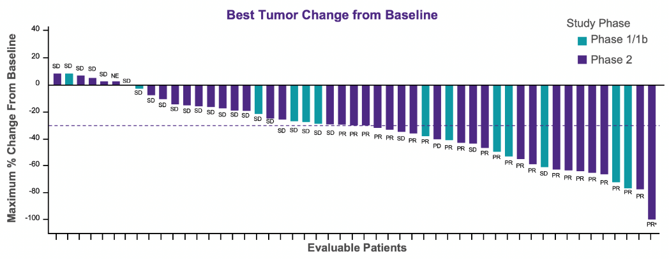
KRYSTAL-1: Adagrasib in Pretreated Advanced
KRAS G12C Mutation–Positive NSCLC
Phase I/II trial evaluating adagrasib 600 mg PO BID in patients with pretreated
KRAS G12C mutation–positive NSCLC; 92% with prior IO
ORR: 45% (23/51)
DCR: 96% (49/51)
Janne. EORTC NCI AACR 2020. Abstr LBA 3. Riely. ELCC 2021. Abstr. 990_PR.
Slide credit: clinicaloptions.com
Notes:
DCR, disease control rate; IO, immunotherapy; NSCLC, non-small-cell lung cancer; ORR, overall response rate.

Slide 43
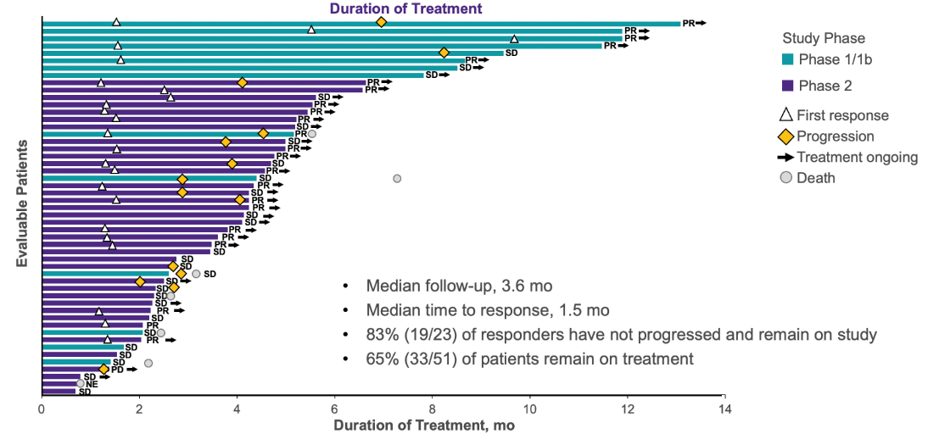
KRYSTAL-1: Duration of Treatment
Janne. EORTC NCI AACR 2020. Abstr LBA 3.
Slide credit: clinicaloptions.com

Slide 44
MET Exon 14 Skipping Mutations

Slide 45
GEOMETRY mono-1: Capmatinib in Advanced
METex14-Mutated NSCLC
Single-arm, multicohort phase II study
Cohort 4: Pretreated (2L/3L)
(n = 69)
Adult patients with
stage IIIB/IV NSCLC; WT for ALK
and EGFR L858R/ex19del;
METex14 mutation (regardless of
MET amplification*); ECOG PS 0/1;
≥1 measurable lesion per RECIST v1.1;
stable or asymptomatic
brain mets allowed
(N = 373)
Cohort 5B: Treatment naive (1L)
(n = 28)
Capmatinib
400 mg PO BID†
Until
PD
Cohort 6: Pretreated (2L)
(n = 31)
*Some cohorts included patients with
MET amplification. †Food restrictions lifted for new cohorts 6-7; no food restrictions with current dosing. ‡BICR included 2 parallel independent radiology reviewers and an additional one for adjudication.
Cohort 7: Treatment naive (1L)
(n = 32)
Primary endpoint: ORR per BIRC‡
Key secondary endpoint: DoR per BIRC‡
Other secondary endpoints: ORR, DoR per inv; DCR, TTR, PFS per BICR/inv; OS, safety, PK
Wolf. ASCO 2021. Abstr 9020.
Slide credit: clinicaloptions.com
Notes:
BIRC, blinded independent review committee; DCR, disease control rate; DoR, duration of response; ECOG, Eastern Cooperative Oncology Group; GCN, gene copy number; mets, metastases; NSCLC, non-small-cell lung cancer; PK, pharmacokinetics; PS, performance status; RECIST, Response Evaluation Criteria in Solid Tumors; TTR, time to response; WT, wild type.

Slide 46
GEOMETRY mono-1: Updated Efficacy
Key Efficacy Outcomes | Treatment Naive |  |  | Pretreated
 | Cohort 5b (n = 28) | Cohort 7 (n = 32) | All Patients (n = 60) | Cohort 4 (2/3L) (n = 69) | Cohort 6 (2L) (n = 31) | All Patients (n = 100)
Best overall response, n (%) CR PR SD Non-CR/non-PD PD NE | 1 (3.6) 18 (64.3) 7 (25) 1 (3.6) 1 (3.6) 0 | 0 21 (65.6) 11 (34.4) 0 0 0 | 1 (1.7) 39 (65.0) 18 (30.0) 1 (1.7) 1 (1.7) 0 | 0 28 (40.6) 25 (36.2) 1 (1.4) 6 (8.7) 9 (13.0) | 0 16 (51.6) 11 (35.5) 1 (3.2) 0 3 (9.7) | 0 44 (44.0) 36 (36.0) 2 (2.0) 6 (6.0) 12 (12.0
ORR, % (95% CI) | 67.9 (47.6-84.1) | 65.6 (46.8-81.4) | 66.7 (53.3-78.3) | 40.6 (28.9-53.1) | 51.6 (33.1-69.8) | 44.0 (34.1-54.3)
DCR, % (95% CI) | 96.4 (81.7-99.9) | 100.0 (89.1-100.0) | 98.3 (91.1-100.0) | 78.3 (66.7-87.3) | 90.3 (74.2-98.0) | 82.0 (73.1-89.0)
Median DoR, mo (95% CI) | 12.6 (5.6-NE) | NE (5.5-NE) | 12.6 (8.4-NE) | 9.7 (5.6-13.0) | 8.4 (4.2-NE) | 9.7 (5.6-13.0)
Median PFS, mo (95% CI) | 12.4 (8.2-23.4) | 10.8 (6.9-NE) | 12.3 (8.2-21.6) | 5.4 (4.2-7.0) | 6.9 (4.2-13.3) | 5.5 (4.2-8.1)
Wolf. ASCO 2021. Abstr 9020.
Slide credit: clinicaloptions.com
Notes:
2L, second line; 3L, third line; CR, complete response; DoR, duration of response; NSCLC, non-small-cell lung cancer; NE, not estimable; ORR, overall response rate; PD, progressive disease; PFS, progression-free survival; PR, partial response; SD, stable disease.

Slide 47
VISION: Tepotinib in Patients With NSCLC and
METex14 Alterations
Single-arm, multicohort phase II study
Patients with advanced/metastatic NSCLC; any histology, including
squamous and sarcomatoid;
MET alteration (METex14 skipping mutation [cohort A] or MET amplification [cohort B]);
0-2 lines prior lines of tx;
no prior MET-targeted tx; patients with active brain mets or brain met as only measurable lesion excluded
(N = up to 280)
Cohort A
METex14 skipping mutations*
(n = 152†)
Tepotinib
500 mg QD
21-day cycle
Until PD, withdrawal,
or unacceptable toxicity
*Central lab detection of METex14 mutations by DNA-based testing in plasma or RNA-based testing in tissue biopsy.
†Number of patients having received tepotinib at data cutoff of January 1, 2020; n = 99 with ≥9 mo f/u.
Primary endpoint: ORR by IRC
Secondary endpoints: ORR by investigator, DoR, PFS
Paik. NEJM. 2020;383:931.
Slide credit: clinicaloptions.com
Notes:
DoR, duration of response; f/u, follow-up; HRQoL, health-related quality of life; IO, immunotherapy; mets, metastases; NSCLC, non-small-cell lung cancer; ORR, overall response rate; OS, overall survival; PD, progressive disease; PFS, progression-free survival; tx, therapy.

Slide 48
VISION: Responses
Response Rate and Change From Baseline in Tumor Burden by IRC
60
Combined Biopsy
(N = 99)
46 (36-57)
Liquid Biopsy
(n = 66)
48 (36-61)
Tissue Biopsy
(n = 60)
50 (37-63)
40
ORR: % (95% CI)
20
0
Best Percent Change in Sum of Target Lesion Diameters
-20
-40
CR
PR
SD
PD
Could not be evaluated
Ongoing treatment
-60
-80
-100
Tissue Biopsy
Liquid Biopsy
Therapy Line
1
2
≥3
Investigator-Assessed
Best Overall Response
Median follow-up in efficacy population: 17.4 mo.
Slide credit: clinicaloptions.com
Paik. NEJM. 2020;383:931.
Notes:
IRC, independent review committee; NSCLC, non-small-cell lung cancer; ORR, overall response rate.

Slide 49
ROS1 Rearrangements

Slide 50
TRIDENT-1: Phase I/II Study of Repotrectinib in Patients With ROS1+ or NTRK+ Advanced Solid Tumors
Current analysis focused on patients with ROS1 TKI–naive, advanced ROS1+ NSCLC (data cutoff: December 31, 2020)
  Median age: 58 yr (range: 30-76); ECOG PS 1: 60%; prior chemotherapy: 20%
Study Design and Early Interim Phase II Data as of August 2020
ROS1+ Advanced NSCLC
NTRK+ Advanced Solid Tumors
EXP-1
ROS1 TKI naive
(n = 55)
EXP-2
1 prior ROS1 TKI
AND
1 prior platinum-based CT
(n = 60)
EXP-3
2 prior ROS1 TKIs
AND
no prior CT
(n = 40)
EXP-4
1 prior ROS1 TKI
AND
no prior CT
(n = 60)
EXP-5
TRK TKI naive
(n = 55)
EXP-6
TRK TKI pretreated
(n = 40)
ORR
86% (6/7)
(95% CI: 42-100)
ORR
40% (2/5)
(95% CI: 5-85)
ORR
40% (2/5)
(95% CI: 5-85)
ORR
67% (4/6)
(95% CI: 22-96)
ORR
Not reported
ORR
50% (3/6)
(95% CI: 12-88)
Cho. ESMO 2020. Abstr 3255.
Slide credit: clinicaloptions.com
Notes:
CT, chemotherapy; ECOG PS, Eastern Cooperative Oncology Group performance status; NSCLC, non-small-cell lung cancer; ORR, overall response rate; TKI, tyrosine kinase inhibitor.

Slide 51
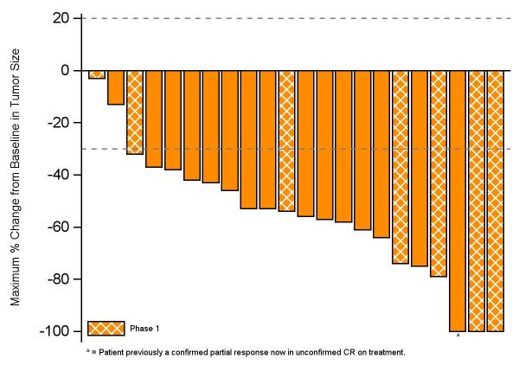
TRIDENT-1: Clinical Activity With Repotrectinib in
TKI-Naive Advanced NSCLC
Best Change From BL in Target Lesion Size (n = 22*)
 | Phase II (n = 15) | Phase I†/II (n = 22*)
Confirmed ORR, % (95% CI) | 93 (68-100) | 91 (71-99)
Phase I Data with Repotrectinib in
TKI-Naive Advanced NSCLC (n = 11)‡
ORR: 91% (10/11) (95% CI: 59-100)
ORR at or above RP2D: 86% (6/7)
Median DoR: 23.1 mo (95% CI: 5.6-NR)
Median PFS: 24.6 mo (95% CI: 7.2-NR)
*Includes patients with BL and ≥2 post-BL scans.
†Phase I patients treated at or above RP2D. ‡Previously reported.
Cho. ESMO 2020. Abstr 3255.
Slide credit: clinicaloptions.com
Notes:
BL, baseline; DoR, duration of response; NR, not reached; NSCLC, non-small-cell lung cancer; ORR, overall response rate; PFS, progression-free survival; RP2D, recommended phase II dose; TKI, tyrosine kinase inhibitor.

Slide 52
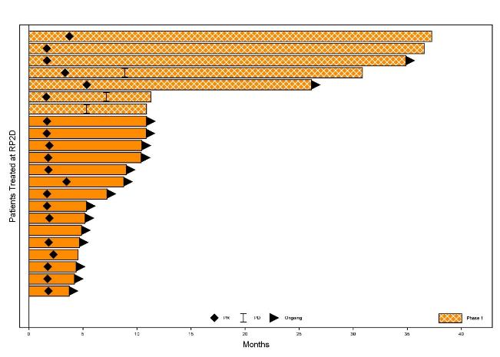
TRIDENT-1: Duration of Repotrectinib Treatment in
TKI-Naive Advanced NSCLC
Duration of Treatment (n = 22*)
Parameter | Phase II (n = 7) | Phase I†/II (n = 15)
Remain on tx, n (%) | 2 (29) | 14 (93)
On tx >30 mo, n (%) | 4 (57) | --
Median time on tx, mo (range) | 30.9 (10.9 to 37.3) | 5.3 (3.7+ to 10.9+)
*Includes patients with BL and ≥2 post-BL scans.
†Phase I patients treated at or above RP2D.
Cho. ESMO 2020. Abstr 3255.
Slide credit: clinicaloptions.com
Notes:
BL, baseline; NSCLC, non-small-cell lung cancer; RP2D, recommended phase II dose; TKI, tyrosine kinase inhibitor; tx, treatment.

Slide 53
Treatment Options for Metastatic UC:
2020-2021
Erdafitinib
Eligible for cisplatin-based therapy
Platinum-based chemo
x 4-6
PD-1/PD-L1 blockade
Enfortumab Vedotin
Ineligible for cisplatin-based therapy
Sacituzumab
Govitecan
1st line Maintenance or 2nd line 3rd line +
Notes:
EV, enfortumab vedotin

Slide 54
Erdafitinib

Slide 55
Rationale for Targeting FGFR in UC
FGFR alterations present in 15% to 20% of advanced UC¹⁻⁵
  Mutated FGFR3 present in 37% of upper-tract UC vs 22% in all UC⁵
  Mutated FGFR3 more common in low-grade vs high-grade UC⁶
FGFR alterations occur in 7% of all tumor types⁷
  FGFR1 amplifications most common, followed by FGFR point mutations
FGFR3
P
P
Point mutations in exons 7 or 10, fusions in FGFR3 can cause constitutive phosphorylation and downstream signaling
P
P
RAS/MAPK
PLCγ
PI3K-AKT
1. The Cancer Genome Atlas (TCGA) genomic alteration database: tcga-data.nci.nih.gov/docs/publications/tcga/ 2. Genomics Evidence Neoplasia Information Exchange (GENIE) genomic alteration database. aacr.org. 3. Knowles. Nat Rev Cancer. 2015;15:25. 4. Tomlinson.
J Path. 2007;213:91. 5. Li. Curr Urol Rep. 2016;17:12. 6. Pandith. Urol Oncol. 2013;31:398. 7. Porta. Crit Rev Oncol Hematol. 2017;113:256.
Notes:
FISH, fluorescence in situ hybridization; UC, urothelial carcinoma.

Slide 56
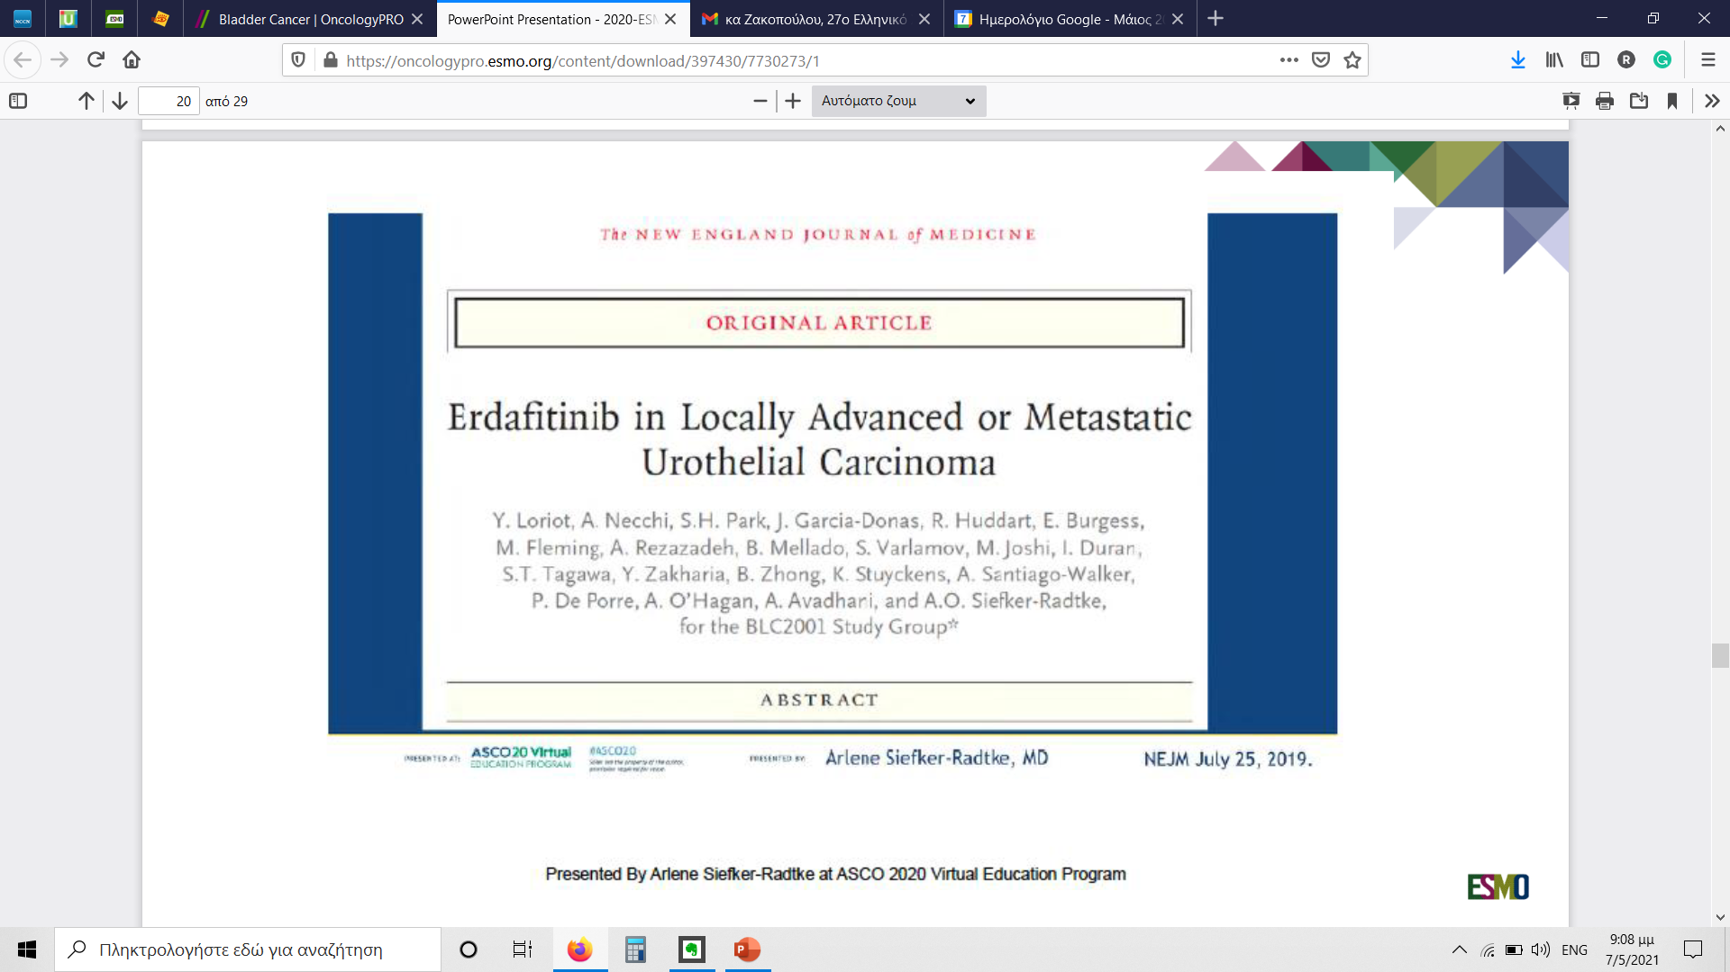

Slide 57
Pivotal Phase II BLC2001 Study: Erdafitinib in FGFR-Altered Metastatic UC After ≥ 1 Line of Platinum-Based CT
International, open-label phase II trial
Patients with metastatic or unresectable locally advanced
FGFR-altered UC; PD on ≥ 1 line prior systemic CT or within 12 mo (neo) adjuvant CT, or cisplatin ineligible* and CT naive; prior IO therapy permitted
(N = 99)
Regimen 1: Erdafitinib 10 mg/day x 7 days on/7 days off
Central screening for FGFR fusions or mutations
Regimen 3: Erdafitinib
8 mg QD†
Until PD
Regimen 2: Erdafitinib
6 mg QD
*Defined as peripheral neuropathy or impaired renal function. †Titration up to 9 mg QD if target not reached for serum phosphate (≥5.5 mg/dL) by Day 14 and no TRAEs.
Primary endpoint: ORR
Secondary endpoints: PFS, OS, safety, DoR, PK, predictive biomarker evaluation
Loriot. NEJM. 2019;381:338. Siefker-Radtke. ASCO 2020. Abstr 5015.
Notes:
CT, chemotherapy; DoR, duration of response; IO, immunotherapy; ORR, objective response rate; OS, overall survival; PD, progressive disease; PFS, progression-free survival; PK, pharmacokinetics; UC, urothelial carcinoma; TRAE, treatment-related adverse event.

Slide 58
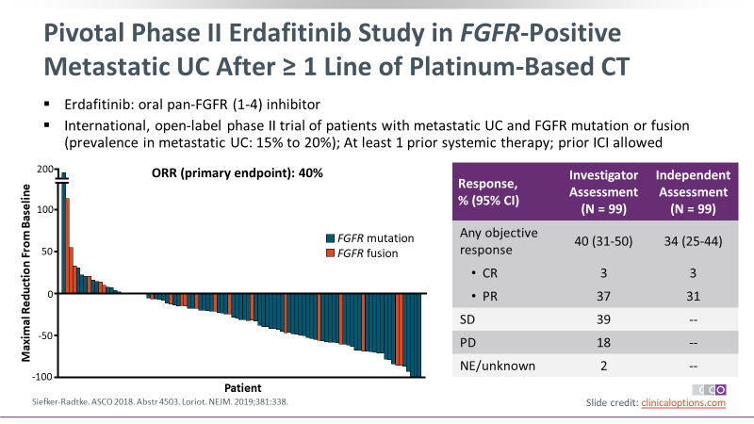
Pivotal Phase II Erdafitinib Study in FGFR-Positive Metastatic UC After ≥ 1 Line of Platinum-Based CT
Erdafitinib: oral pan-FGFR (1-4) inhibitor
International, open-label phase II trial of patients with metastatic UC and FGFR mutation or fusion (prevalence in metastatic UC: 15% to 20%); At least 1 prior systemic therapy; prior ICI allowed
Siefker-Radtke. ASCO 2018. Abstr 4503. Loriot. NEJM. 2019;381:338.
Notes:
CT, chemotherapy; ICI, immune checkpoint inhibitor; NE, not evaluated; NR, not reached; UC, urothelial carcinoma.

Slide 59
Pivotal Phase II BLC2001 Study: Updated PFS and OS
PFS
OS
100
8 mg
100
8 mg
Median PFS, all patients: 5.5 mos
  R/R after chemotherapy: 5.5 mos
  Prior immunotherapy: 5.7 mos
  1/2/3 prior lines: 5.5/5.5/5.7 mos
Median OS, all patients: 11.3 mos
  R/R after chemotherapy: 10.6 mos
  Prior immunotherapy: 10.9 mos
  1/2/3 prior lines: 11.3/8.0/11.2 mos
80
80
60
60
PFS (%)
OS (%)
40
40
20
20
0
0
0
3
6
9
12
15
18
21
24
27
30
33
0
3
6
9
12
15
18
21
24
27
30
33
36
Mos
Mos
Patients at Risk, n
Patients at Risk, n
101
67
39
26
19
14
10
8
4
1
1
0
101
90
76
60
46
37
33
30
28
15
8
1
0
Siefker-Radtke. ASCO 2020. Abstr 5015.
Notes:
OS, overall survival; PFS, progression-free survival; R/R, relapsed/refractory.

Slide 60
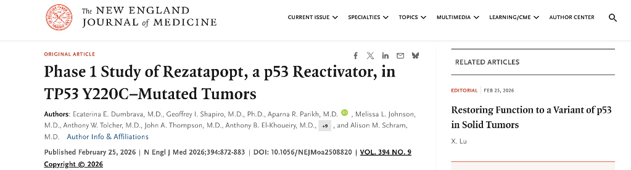
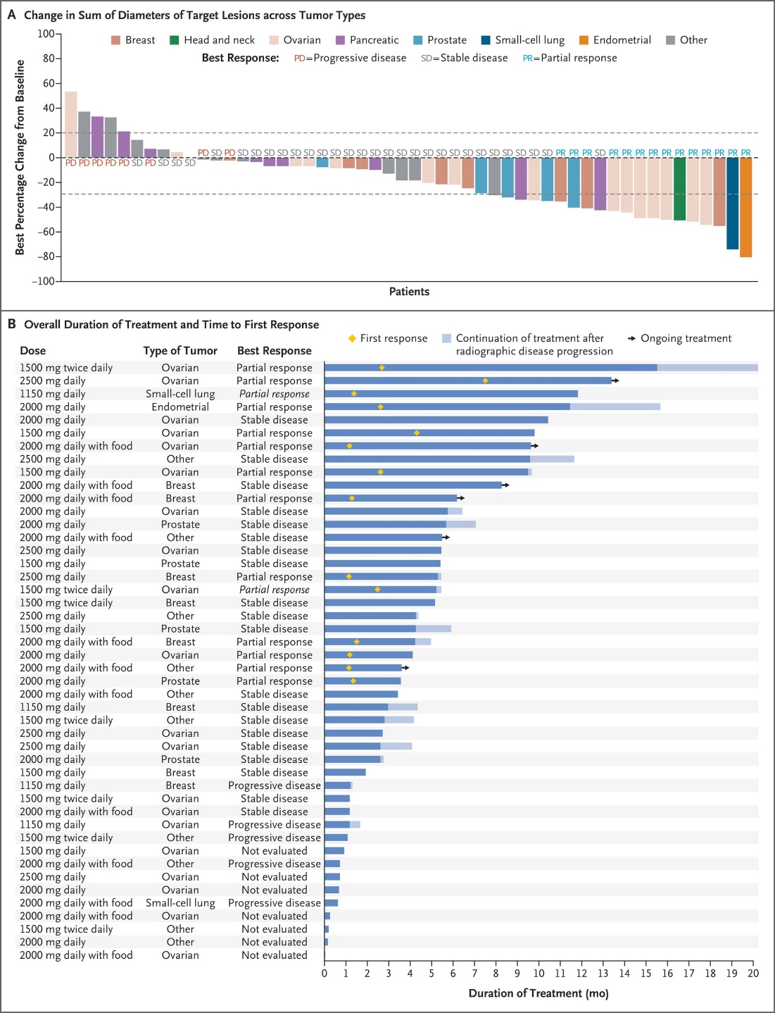
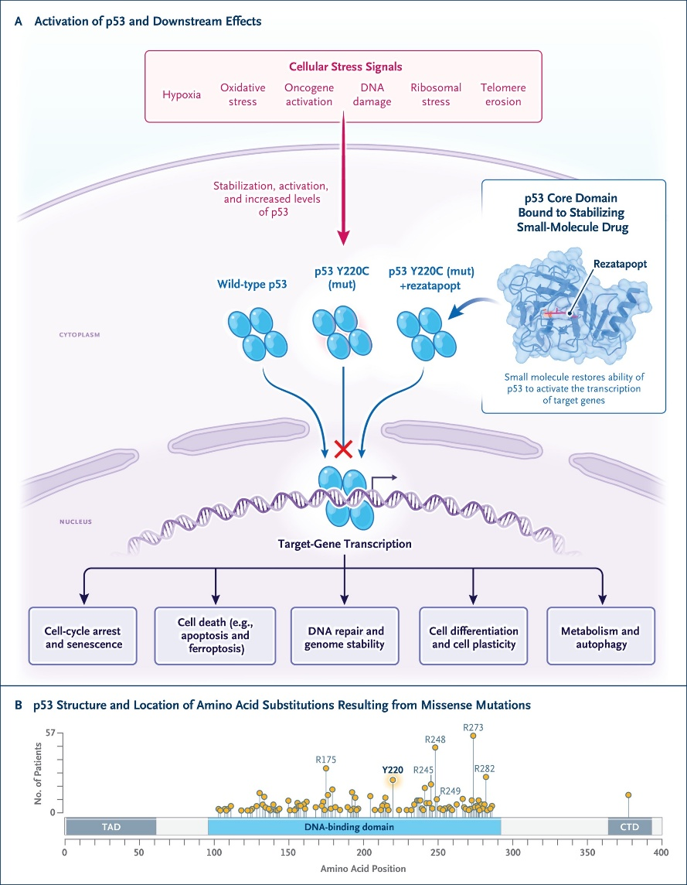

Slide 61
ENFORTUNAB VEDOTIN
EV binds to
nectin-4
Nectin-4
Complex internalized
and traffics to lysosome
Nectin-4–targeted
mAb
Cytotoxic agent:
MMAE
MMAE released
Protease-cleavable linker
Results in microtubule disruption
and cell cycle arrest, apoptosis
Notes:
EV, enfortumab vedotin; MMAE, monomethyl auristatin E; PD, progressive disease.

Slide 62
EV-201 Cohort 1: Enfortumab Vedotin in Patients With UC and Prior Platinum-Based Therapy and PD-(L)1 Inhibitor
International, open-label, single-arm, multicohort phase II trial
Cohort 1
Prior PD-(L)1 inhibitor and platinum-based tx
(n = 125)*
Enfortumab Vedotin 1.25 mg/kg IV on Days 1, 8, 15 of each 28-day cycles
Current analysis
Patients with previously treated locally advanced or metastatic UC who had previous PD-(L)1 tx; no ongoing grade ≥ 2 sensory or motor neuropathy, active CNS metastases, uncontrolled DM
(N = 219)
Cohort 2
Prior PD-(L)1 inhibitor, cisplatin ineligible,
no prior platinum
(n = 89)†
Enfortumab Vedotin 1.25 mg/kg IV on Days 1, 8, 15 of each 28-day cycles
*3 additional patient enrolled who did not receive enfortumab vedotin; 1 patient decision, 1 clinical deterioration, and 1 with low hemoglobin.
†2 additional patients enrolled who did not receive enfortumab vedotin due to hospital admission for PD and to enter hospice care, respectively.
Primary endpoint: confirmed ORR per BICR (RECIST v1.1)
Secondary endpoints: DoR, PFS, OS, safety
Balar. ASCO GU 2021. Abstr 394. NCT03219333.
Notes:
BICR, blinded independent central review; CNS, central nervous system; DM, diabetes mellitus; DoR, duration of response; RECIST, Response Evaluation Criteria in Solid Tumors; PD, progressive disease; tx, treatment; UC, urothelial carcinoma.

Slide 63
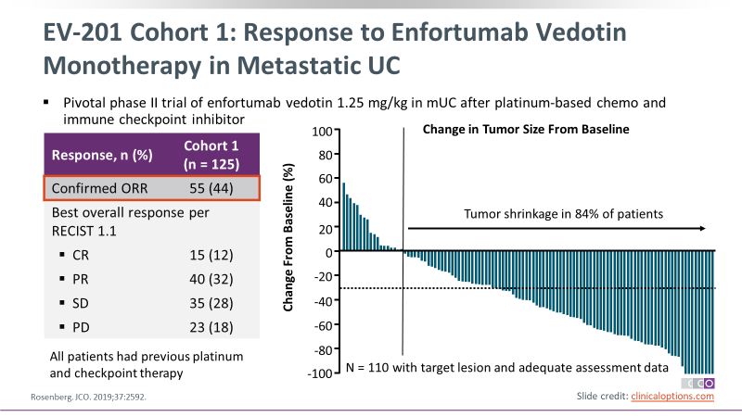
EV-201 Cohort 1: Response to Enfortumab Vedotin Monotherapy in Metastatic UC
Pivotal phase II trial of enfortumab vedotin 1.25 mg/kg in mUC after platinum-based chemo and immune checkpoint inhibitor
Response, n (%) | Cohort 1 (n = 125)
Confirmed ORR | 55 (44)
Best overall response per RECIST 1.1
CR | 15 (12)
PR | 40 (32)
SD | 35 (28)
PD | 23 (18)
All patients had previous platinum and checkpoint therapy
Rosenberg. JCO. 2019;37:2592.
Notes:
Chemo, chemotherapy; mUC, metastatic UC; PD, progressive disease; RECIST, Response Evaluation Criteria in Solid Tumors; SD, stable disease; UC, urothelial carcinoma.

Slide 64
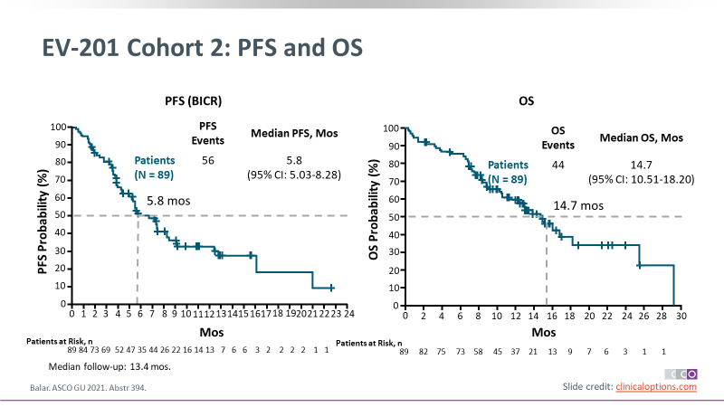
EV-201 Cohort 2: PFS and OS
100
100
90
90
80
70
70
60
60
50
50
40
40
30
30
20
20
10
10
0
0
5
6
7
8
9
14
18
19
15
16
17
21
20
22
24
0
1
2
3
10
11
13
23
12
0
2
4
6
8
10
12
14
16
18
20
22
24
26
28
30
Balar. ASCO GU 2021. Abstr 394.
Slide credit: clinicaloptions.com
Notes:
BICR, blinded independent central review.

Slide 65
EV-201 Cohort 2: Enfortumab Vedotin in Patients With UC and Prior PD-(L)1 Inhibitor
International, open-label, single-arm, multicohort phase II trial
Cohort 1
Prior PD-(L)1 inhibitor and platinum-based tx
(n = 125)*
Enfortumab Vedotin 1.25 mg/kg IV on Days 1, 8, 15 of each 28-day cycles
Patients with previously treated locally advanced or metastatic UC who had previous PD-(L)1 tx; no ongoing grade ≥ 2 sensory or motor neuropathy, active CNS metastases, uncontrolled DM
(N = 219)
Cohort 2
Prior PD-(L)1 inhibitor, cisplatin ineligible,
no prior platinum
(n = 89)†
Enfortumab Vedotin 1.25 mg/kg IV on Days 1, 8, 15 of each 28-day cycles
Current analysis
*3 additional patient enrolled who did not receive enfortumab vedotin; 1 patient decision, 1 clinical deterioration, and 1 with low hemoglobin.
†2 additional patients enrolled who did not receive enfortumab vedotin due to hospital admission for PD and to enter hospice care, respectively.
Primary endpoint: confirmed ORR per BICR (RECIST v1.1)
Secondary endpoints: DoR, PFS, OS, safety
Balar. ASCO GU 2021. Abstr 394. NCT03219333.
Notes:
BICR, blinded independent central review; CNS, central nervous system; DM, diabetes mellitus; DoR, duration of response; RECIST, Response Evaluation Criteria in Solid Tumors; PD, progressive disease; tx, treatment; UC, urothelial carcinoma.

Slide 66
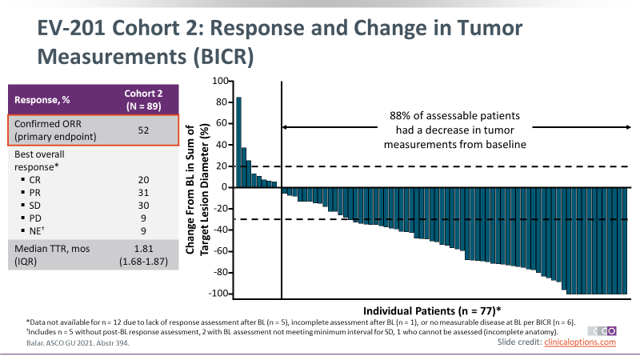
EV-201 Cohort 2: Response and Change in Tumor Measurements (BICR)
Response, % | Cohort 2 (N = 89)
Confirmed ORR (primary endpoint) | 52
Best overall response* CR PR SD PD NE† | 20 31 30 9 9
Median TTR, mos (IQR) | 1.81 (1.68-1.87)
*Data not available for n = 12 due to lack of response assessment after BL (n = 5), incomplete assessment after BL (n = 1), or no measurable disease at BL per BICR (n = 6). †Includes n = 5 without post-BL response assessment, 2 with BL assessment not meeting minimum interval for SD, 1 who cannot be assessed (incomplete anatomy).
Balar. ASCO GU 2021. Abstr 394.
Notes:
BICR, blinded independent central review; BL, baseline; IQR, interquartile range; NE, not estimable; PD, progressive disease; SD, stable disease; TTR, time to response.

Slide 67
EV-301: Enfortumab Vedotin vs Chemotherapy in LA or Metastatic UC After Platinum and Anti–PD-(L)1 Therapy
Interim analysis of international, randomized, open-label phase III trial of enfortumab vedotin, a Nectin-4–directed antibody–drug conjugate (data cutoff: July 15, 2020)
Stratified by liver mets (yes vs no), ECOG PS (0 vs 1), region (US/W Europe vs ROW)
Patients with locally advanced or metastatic histology/cytology confirmed UC; previously treated with platinum-containing CT*; radiographic progression or relapse on/after
PD-(L)1 tx; ECOG PS ≤ 1
(N = 608)
Enfortumab Vedotin 1.25 mg/kg IV on Days 1, 8, 15 of 28-day cycles
(n = 301)
Investigator’s choice of chemotherapy†
(n = 307)
Primary endpoint: OS
  Interim analysis planned after 285 (65%) deaths, final analysis after 439 deaths
Secondary endpoints: investigator-assessed PFS, DCR, and ORR (all per RECIST v1.1); safety
*If used in the adjuvant/neoadjuvant setting, PD must be ≤ 12 mos of completion. †Standard docetaxel (75 mg/m²), paclitaxel (175 mg/m²), or vinflunine (320 mg/m²) on Day 1 of each 21-day cycle.
Powles. ASCO GU 2021. Abstr 393. NCT03474107.
Notes:
CT, chemotherapy; DCR, disease control rate; ECOG PS, Eastern Cooperative Oncology Group performance status; LA, locally advanced; mets, metastases; PD, progressive disease; RECIST, Response Evaluation Criteria in Solid Tumors; ROW, rest of world; tx, treatment; UC, urothelial carcinoma.

Slide 68
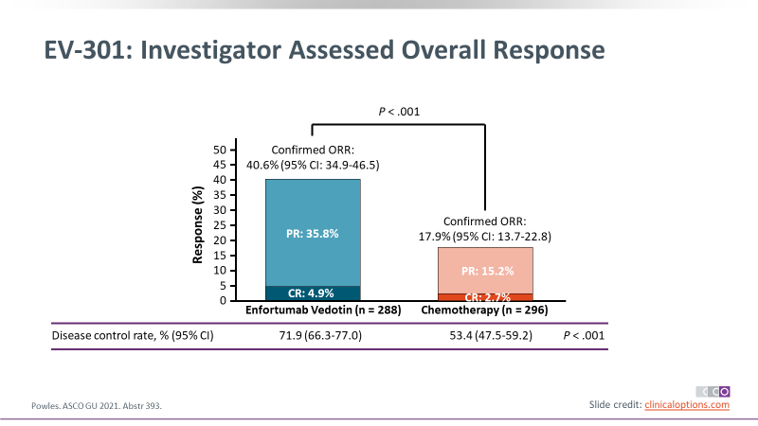
EV-301: Investigator Assessed Overall Response
0
45
40
35
30
Response (%)
25
PR: 35.8%
20
15
10
5
0
CR: 2.7%
Enfortumab Vedotin (n = 288)
Chemotherapy (n = 296)
Powles. ASCO GU 2021. Abstr 393.

Slide 69
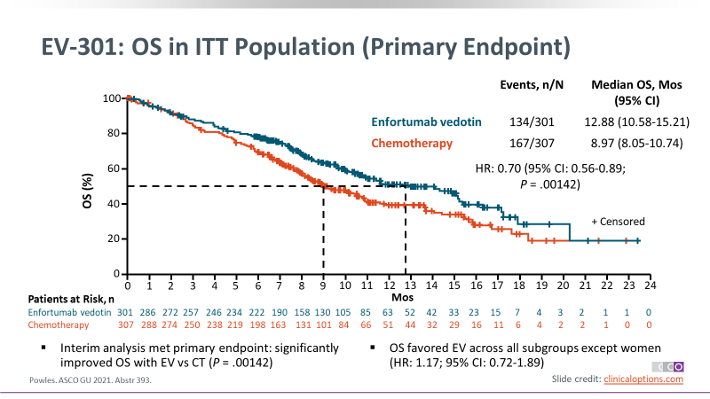
EV-301: OS in ITT Population (Primary Endpoint)
100
80
60
40
20
0
0
1
2
3
4
5
6
7
8
9
10
11
12
14
15
16
17
18
19
20
21
22
23
Interim analysis met primary endpoint: significantly improved OS with EV vs CT (P = .00142)
OS favored EV across all subgroups except women (HR: 1.17; 95% CI: 0.72-1.89)
Powles. ASCO GU 2021. Abstr 393.
Notes:
CT, chemotherapy; EV, enfortumab vedotin; ITT, intention-to-treat.

Slide 70

Sacituzumab Govitecan
SN-38 Payload
Active metabolite of irinotecan
FDA granted Fast Track Designation to sacituzumab govitecan for treatment of adults with locally advanced or metastatic UC previously treated with a PD-(L)1 inhibitor and previously treated with platinum-containing CT in the (neo)adjuvant, locally advanced, or metastatic setting
Hydrolyzable Linker
Humanized RS7 Antibody
Targets Trop-2, an epithelial cell surface antigen highly expressed in UC
Clin Cancer Res. 2015;21:3870. Cardillo. Bioconjugate Chem. 2015;26:919.
Notes:
CT, chemotherapy; mUC, metastatic urothelial carcinoma; UC, urothelial carcinoma.

Slide 71
TROPHY-U-01: Sacituzumab Govitecan in mUC After Platinum-Based or Anti–PD-(L)1–Based Therapy
International, single-arm, open-label phase II trial
Cohort 1
PD after platinum
and anti–PD-(L)1
(n = 100)
Sacituzumab govitecan 10 mg/kg IV on Days 1 and 8 of 21-day cycles
Patients with locally advanced or metastatic UC,
ECOG PS 0/1
Cohort 2
Platinum ineligible, PD after anti–PD-(L)1 (n = 40)
Until PD or unacceptable toxicity
Cohort 3
PD after platinum,
no prior anti–PD-(L)1
(n = 61)
Sacituzumab govitecan 10 mg/kg IV on Days 1 and 8 +
Pembrolizumab 200 mg IV on Day 1 of 21-day cycles
Primary endpoints: ORR, DoR, PFS, OS
Loriat. ASCO 2020. Abstr LBA24. Petrylak. ASCO 2020. Abstr 5027. NCT03547973.
Notes:
DoR, duration of response; ECOG, Eastern Cooperative Oncology Group; mUC, metastatic urothelial carcinoma; PD, progressive disease; PS, performance status; UC, urothelial carcinoma.

Slide 72
TROPHY-U-01 Cohort 1: Response With Sacituzumab Govitecan in Platinum-Refractory Patients
Outcome per BICR (RECIST 1.1) | Cohort 1 (n = 113)
Confirmed ORR, n (%) CR PR | 31 (27) 6 (5) 25 (22)
Median DoR, mos (range) | 5.9 (1.4-11.7)
Median TTR, mos (range) | 1.6 (1.2-5.5)
BICR-assessed ORR, median DoR, and median TTR were comparable to investigator-assessed outcomes
Loriat. ESMO 2020. Abstr LBA24.
Notes:
BICR, blinded independent central review; DoR, duration of response; RECIST, Response Evaluation Criteria in Solid Tumors; TTR, time to response.

Slide 73
TROPHY-U-01 Cohort 1: Decrease in Tumor Size in Platinum-Refractory Patients
Decrease in Tumor Size With Sacituzumab Govitecan
100
90
76%
80
70
60
50
40
30
20
10
0
0
0
0
Change From Baseline
-10
-20
-30
-40
-50
-60
-70
-80
-90
-100
Patients with ≥ 1 post-baseline tumor measurement and accepted for central review, 17/94; no post-treatment imaging, 14; poor image quality, 4; 1 patient lacked quantifiable lesions by central review
Loriat. ESMO 2020. Abstr LBA24.

Slide 74
TROPHY-U-01 Cohort 1: Responses and Survival Outcomes in Platinum-Refractory Patients
Response Outcomes With Sacituzumab Govitecan
Outcome, Mos | Cohort 1 (n = 113)
Median follow-up | 6.3
Median PFS | 5.4
Median OS | 10.5
Patients
27/31 of responders alive
8/31 patients have ongoing response and on treatment at data cutoff
Discontinued without event
Ongoing response
Onset of response
PD or death
PR
CR
0
1
2
3
4
5
6
7
8
9
10
11
12
13
14
Loriat. ESMO 2020. Abstr LBA24.
Mos
Notes:
PD, progressive disease.

Slide 75
TROPHY-U-01: Sacituzumab Govitecan in mUC After Platinum-Based or Anti–PD-(L)1–Based Therapy
International, single-arm, open-label phase II trial
Cohort 1
PD after platinum
and anti–PD-(L)1
(n = 100)
Sacituzumab govitecan 10 mg/kg IV on Days 1 and 8 of 21-day cycles
Patients with locally advanced or metastatic UC,
ECOG PS 0/1
Cohort 2
Platinum ineligible, PD after anti–PD-(L)1 (n = 40)
Until PD or unacceptable toxicity
Cohort 3
PD after platinum,
no prior anti–PD-(L)1
(n = 61)
Sacituzumab govitecan 10 mg/kg IV on Days 1 and 8 +
Pembrolizumab 200 mg IV on Day 1 of 21-day cycles
Primary endpoints: ORR, DoR, PFS, OS
Loriat. ASCO 2020. Abstr LBA24. Petrylak. ASCO 2020. Abstr 5027. NCT03547973.
Notes:
DoR, duration of response; ECOG, Eastern Cooperative Oncology Group; mUC, metastatic urothelial carcinoma; PD, progressive disease; PS, performance status; UC, urothelial carcinoma.

Slide 76
TROPHY-U-01 Cohort 2: Duration of Response in Platinum-Ineligible Patients With Prior Anti–PD-(L)1
Duration of Response With Sacituzumab Govitecan
Response | Cohort 2 (n = 21)
Median follow-up, mos | 6.8
Confirmed ORR, n /N (%) PR, n (%) | 6/21 (29) 6 (29)
Median DoR | NR
Median PFS, mos | 5.5
Median OS, mos | 11.1
Tumor size reduction, n/N (%) | 13/21 (62)
1
2
3
4
5
6
7
8
PR
SD
Onset of response
Ongoing response or SD at data cutoff (no PD or death)
Patient
9
10
11
12
13
14
15
16
0
1
2
3
4
5
6
7
8
9
10
11
12
13
Petrylak. ASCO 2020. Abstr 5027. NCT03547973.
Mos
Notes:
DoR, duration of response; NR, not reached; PD, progressive disease; SD, stable disease.

Slide 77
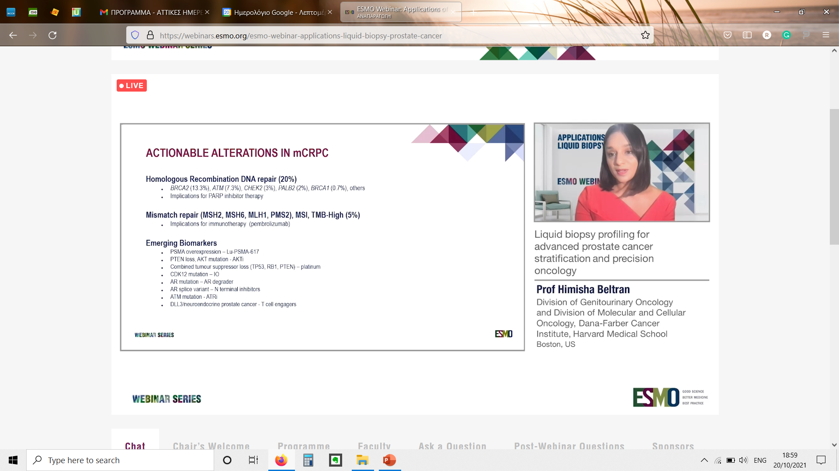
ACTIONABLE ALTERATIONS IN mCRPC

Slide 78
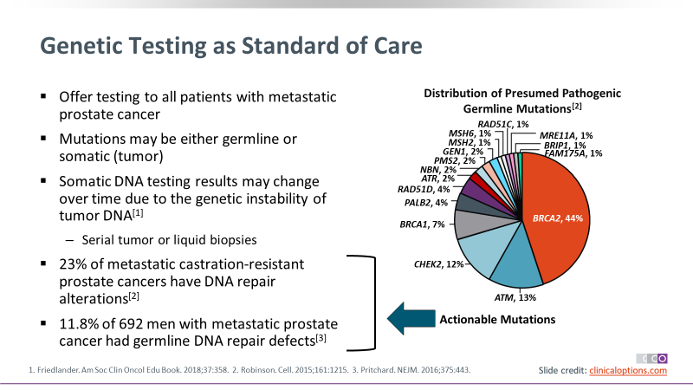
Genetic Testing as Standard of Care

Slide 79
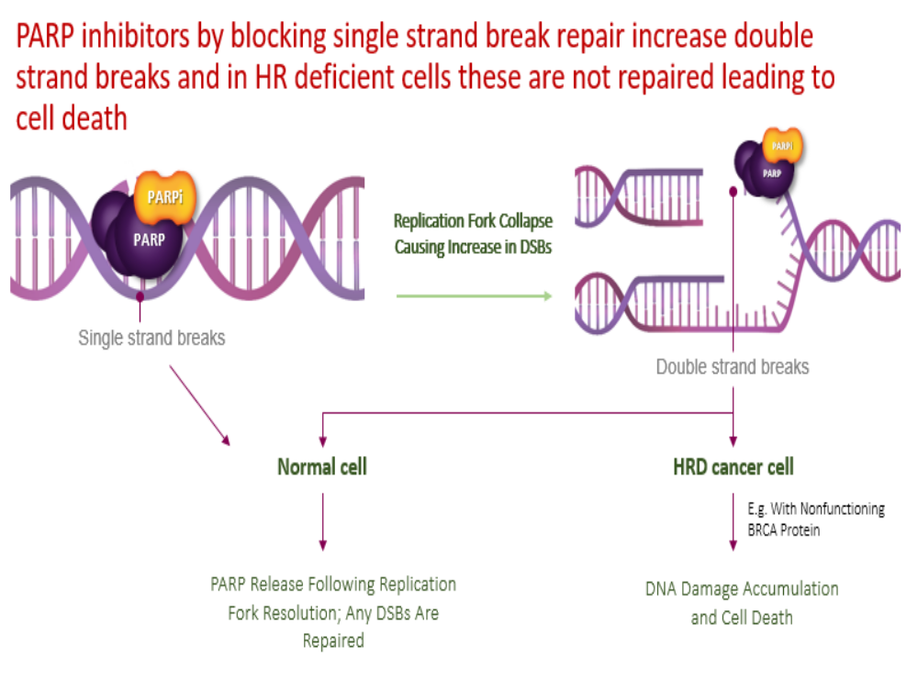
Μηχανισμός Δράση PARPi
O’Connor MJ. Mol Cell 2015;60:547-560

Slide 80
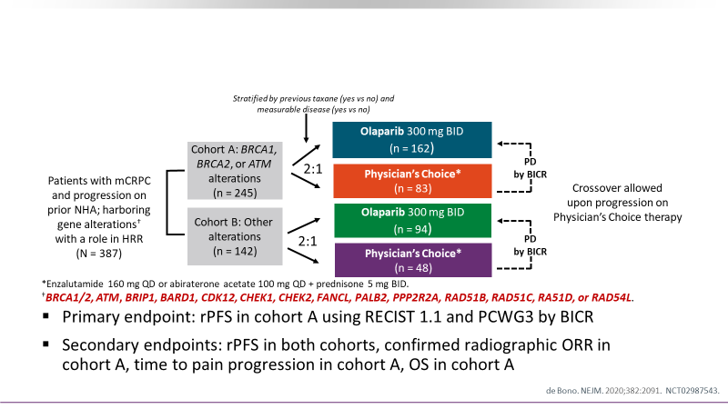
Phase III PROfound: Olaparib vs Physician’s Choice in Progressing mCRPC

Slide 81

Phase III PROfound: rPFS by BICR With Alterations in BRCA1, BRCA2, or ATM (Cohort A)

Slide 82

Phase III PROfound: Final OS in Cohort A

Slide 83

PI3K/Akt/mTOR στον καρκίνο προστάτη

Slide 84

IPATential150: Phase III Study of First-line Abiraterone + Ipatasertib or Placebo

Slide 85

IPATential150: rPFS in PTEN-loss Population

Slide 86

rPFS in the NGS-defined PTEN-loss population

Slide 87

NTRK inhibitors
First generation inhibitors
Larotrectinib (LOXO-101)
Entrectinib (RXDX-101)

Slide 88

Age>18
ECOG PS: 0-2
Metastatic or locally advanced NTRK fusion positive solid tumor
Primary endpoints: objective response (CR or PR) and duration of response
Secondary endpoints: PFS, clinical benefit rate (CR,PR, SD for >6months), time to CNS progression, safety

Slide 89


Slide 90

CNS metastases

Slide 91


Age 1-21
PS> 50%
Primary endpoint: safety of larotrectinib
Secondary endpoints: maximum tolerated dose, ORR
24 pts (17 NTRK positive)

Slide 92


Slide 93

F/up 8.2m (5.2-9.5) all pts except 1 remain on treatment!

Slide 94

Larotrectinib ORR in NTRK fused pediatric patients was 93% (14/15 pts)

Slide 95

Larotrectinib pooled analysis of 159 pts

Slide 96

Results
Median duration of response: 35.2months
mPFS: 25.8 months

Slide 97


RESPONSE!!!

Slide 98

Overall NTRK inhibitors

Slide 99


Second generation NTRK inhibitors: overcoming resistance
Selictrectinib (LOXO-195)
Repotrectinib (TPX-0005)

Slide 100

GISTs

Slide 101


GISTs(1)
Ripretinib (QINLOCK)
Switch-control TKI binds both to switch pocket and the activation loop
Ripretinib in patients with advanced gastrointestinal stromal tumours (INVICTUS): a double-blind, randomised, placebo-controlled, phase 3 trial. Blay JY, Serrano C, Heinrich MC, Zalcberg J, Bauer S, Gelderblom H, Schöffski P, Jones RL, Attia S, D'Amato G, Chi P, Reichardt P, Meade J, Shi K, Ruiz-Soto R, George S, von Mehren M. Lancet Oncol. 2020 Jul;21(7):923-934. doi: 10.1016/S1470-2045(20)30168-6. Epub 2020 Jun 5

Slide 102

GISTs (2)
Avapritinib (AYVAKIT) for PDGFRA Exon18 and/or D842V mutated GISTs
Multi TKI (CKIT and PDFGRA)
Avapritinib in advanced PDGFRA D842V-mutant gastrointestinal stromal tumour (NAVIGATOR): a multicentre, open-label, phase 1 trial. Heinrich MC, Jones RL, von Mehren M, Schöffski P, Serrano C, Kang YK, Cassier PA, Mir O, Eskens F, Tap WD, Rutkowski P, Chawla SP, Trent J, Tugnait M, Evans EK, Lauz T, Zhou T, Roche M, Wolf BB, Bauer S, George S. Lancet Oncol. 2020 Jul;21(7):935-946. doi: 10.1016/S1470-2045(20)30269-2

Slide 103

GIST treatment algorithm
Always perform CKIT, PDGFRA mutation analysis!!!!

Slide 104



Epithelioid sarcomas: epigenetic regulation
Tazemetostat is an oral inhibitor of EZH2
Loss of INI1 and/or SMARCB1 tumor suppressors, is the hallmark of epithelioid sarcomas and activates EZH2 to trimethylate histone H3
16/62 patients had disease control at 32 weeks
mPFS was 5.5 m (3.4-5.9)
mOS was 19 m (11-not estim)
Tazemetostat in advanced epithelioid sarcoma with loss of INI1/SMARCB1: an international, open-label, phase 2 basket study.Gounder M, Schöffski P, Jones RL, Agulnik M, Cote GM, Villalobos VM, Attia S, Chugh R, Chen TW, Jahan T, Loggers ET, Gupta A, Italiano A, Demetri GD, Ratan R, Davis LE, Mir O, Dileo P, Van Tine BA, Pressey JG, Lingaraj T, Rajarethinam A, Sierra L, Agarwal S, Stacchiotti S. Lancet Oncol. 2020 Nov;21(11):1423-1432. doi: 10.1016/S1470-2045(20)30451-4. Epub 2020 Oct 6

Slide 105

Novel targets: TAZ & YAP fusions - the molecular signature of epitheloid hemangioendothelioma (EHE)
WWTR1 (TAZ)::CAMTA1 (>90%)
YAP1::TFE3 (~10%, distinct morphology and IHC profile)
Both fusions - active YAP/TAZ oncoproteins
Seavey CN et al. Cancers 2022;14:2980; Nie Y et al. Front Oncol 2025;15:1478036
Content of this presentation is copyright and responsibility of the author. Permission is required for re-use.

Slide 106

Hippo signaling: from YAP/TAZ control to cancer
The Hippo pathway: conserved kinase cascade, regulates cell growth and apoptosis
Activation phosphorylates YAP/TAZ, causing cytoplasmic retention and degradation
Inactivation allows YAP/TAZ enter the nucleus, bind TEAD, and drive growth genes.
Dysregulation promotes cancer and other diseases
Honda D et al. Dev Growth Differ 2023;65:337-347; Fu M et al. Signal Transduct Target Ther 2022;7:376
Content of this presentation is copyright and responsibility of the author. Permission is required for re-use.

Slide 107

TEAD palmitoylation pocket: a novel therapeutic target
TEAD inhibitors: bind to the central pocket, block TEAD palmitoylation
Pocket binding: reduces TEAD’s transcriptional
activity
Suppresses YAP/TAZ-driven target genes and cell proliferation
VT-3989: central-pocket TEAD inhibitor, blocks TEAD palmitoylation, downstreams YAP/TAZ signalling
Kim JK et al. Bioorg Chem 2025:159:108425, Zhao B et al. Pharmaceuticals 2023;16:583
Content of this presentation is copyright and responsibility of the author. Permission is required for re-use.

Slide 108

VT3989, a multi-TEAD inhibitor, in patients with advanced EHE: a phase I/II study
Haddox CL et al. ESMO Rare Cancers;Volume 4:100074
Joanna Szkandera
Content of this presentation is copyright and responsibility of the author. Permission is required for re-use.

Slide 109


VT3989, a multi-TEAD inhibitor, in patients with advanced EHE: a phase I/II study
ORR 10%
PR 1 (10%)
SD 8 (80%)
PD 1 (10%)
AEs Grade ≥3: hypertriglyceridemia, lipase increase
Joanna Szkandera
Haddox CL et al. ESMO Rare Cancers;Volume 4:100074
Content of this presentation is copyright and responsibility of the author. Permission is required for re-use.

Slide 110

Targeting MDM2 in WDLPS/DDLPS
Lessons from MDM2 inhibition in WD/DDLPS - when strong biology fails to translate into clinical benefit
Joanna Szkandera
Content of this presentation is copyright and responsibility of the author. Permission is required for re-use.

Slide 111

When a spear misses the mark .....
MDM2 - most commonly amplified in WD/DDLPS (97%)
MDM2: negative regulator of p53, potentially promoting the oncogenesis of liposarcoma
Binh MBN et al. Am J Surg Pathol 2005;29:1340-7; Somaiah N et al. Cancer Treat Rev 2024;122:102668; Conyers R et al. Sarcoma 2011:2011:483154
Content of this presentation is copyright and responsibility of the author. Permission is required for re-use.

Slide 112



Encouraging results in phase 1 trials of the MDM2-p53 antagonist Brigamadlin and Milademetan in patients with DDLPS
Brigimadlin
Milademetan
Schöffski P et al. Ann Oncol 2023;34:708–718; Gounder MM et al. J Clin Oncol 2023;41:1714-1724
Content of this presentation is copyright and responsibility of the author. Permission is required for re-use.

Slide 113





Targeting MDM2-p53 axis alone seems not sufficient in
WD/DDLPS - MANTRA phase III
OS
PFS
ORR
Primary endopoint (PFS) not met!
Jones RL et al. Ann of Oncol (2023);34 (suppl_2):S1254-S1335
Content of this presentation is copyright and responsibility of the author. Permission is required for re-use.

Slide 114



Targeting MDM2-p53 axis alone seems not sufficient in WD/DDLPS - Brightline-1 phase III study
Primary endopoint (PFS) not met!
OS
PFS
ORR
PFS for Doxorubicin was much higher than reported in previous studies!
Schöffski P et al. CTOS 2024;paper 43
Content of this presentation is copyright and responsibility of the author. Permission is required for re-use.

Slide 115
Why MDM2 inhibition alone fails in WD/DDLPS
MDM2 amplification ≠ simple MDM2 dependency
MDM2 amplification - hallmark of WD/DDLPS, clinical responses to MDM2 inhibitors modest (intrinsic resistance)
12q13–15 co-amplification of other genes drive tumour growth via multiple parallel pathways
CDK4 amplification (>90%) strong MDM2-independent proliferative signal
Preclinical data: synergy of CDK4 + MDM2 inhibition; MDM2 blockade alone limited tumour suppression
Lesovaya EA et al. Cancers (Basel) 2024;16:271; Binh MBN et al. Am J Surg Pathol 2005;29:1340-7; Laroche-Clary A et al. J Hematol Oncol 2017;10:123
Content of this presentation is copyright and responsibility of the author. Permission is required for re-use.

Slide 116



Dual targeting of the MDM2 - p53 and CDK4/6 pathways in WD/DDLPS
Siremadlin and Ribociclib in the MEGAMOST phase II study
N=17
ORR 12% (PR 12%)
SD 76%
PD 12%
PFR-12w (95% CI): 78.9% (58.6, 93.6)
Dufrense A et al. CTOS 2024;paper 44
Primary endpoint met!
Joanna Szkandera
Content of this presentation is copyright and responsibility of the author. Permission is required for re-use.

Slide 117
Why MDM2 inhibition alone fails in WD/DDLPS
Beyond p53 Reactivation: Resistance, Dose Constraints, and Immune Modulation
MDM2 inhibitors induce strong p53-dependent cell-cycle arrest rather than apoptosis, limiting cytotoxic efficacy
Adaptive resistance: arises via MDMX upregulation and WIP1-mediated dampening of p53 signalling
Hematologic toxicity limits dosing
CDK4/6 inhibition: boosts antitumor immunity and enhances immune checkpoint inhibitor response, supporting combination strategies
Haronikova L et al. Cell Mol Biol Lett 2021;26:53; Zhang J et al. Nature 2018;553(7686):91-95
Joanna Szkandera
Content of this presentation is copyright and responsibility of the author. Permission is required for re-use.

Slide 118

When a single hit falls short....
Harnessing combination strategies to improve STS outcomes
Joanna Szkandera
Content of this presentation is copyright and responsibility of the author. Permission is required for re-use.

Slide 119

When epigenetics drives therapy: targeting HDAC in STS
Histone deacetylases (HDACs) regulate gene expression via histone deacetylation
HDAC inhibition reactivates tumor- suppressor pathways, inducing apoptosis and reducing proliferation, and enhances antitumor immunity, increasing PD-L1 and MHC expression
HDACs are frequently amplified in sarcoma (esp. liposarcoma)
Chidamide is an oral, subtype-selective HDAC inhibitor
Joanna Szkandera
Que Y et al., J Immunother Cancer. 2021;9:e001696. Tian J et al., Front Oncol. 2025:15:1576781.
Content of this presentation is copyright and responsibility of the author. Permission is required for re-use.

Slide 120




HDAC inhibitors and immune checkpoint inhibitors
Chidamide and Toripalimab in advanced sarcoma, phase II study
N = 69
ORR 30.4% - primary endpoint met! PR 21 (30.4%)
SD 30 (43.5%)
PD 18 (26.1%)
Zhang X et al., ESMO 2025, Ann Oncol, Volume 36, Supplement 2S1436
Content of this presentation is copyright and responsibility of the author. Permission is required for re-use.
.

Slide 121


HDAC inhibitors and immune checkpoint inhibitors
Chidamide and Toripalimab in advanced sarcoma, phase II study
PFS
OS
AEs Grade ≥3: : anemia, thrombocytopenia, leucopenia, neutropenia, nausea/vomiting
Zhang X et al., ESMO 2025, Ann Oncol, Volume 36, Supplement 2S1436
Content of this presentation is copyright and responsibility of the author. Permission is required for re-use.
.

Slide 122

Anlotinib: blocking growth and angiogenesis
Anlotinib is a multitarget TKI that inhibits VEGFR, FGFR, PDGFR, and c-Kit
Blocks tumor angiogenesis and suppresses tumor cell proliferation
Induces tumor necrosis and apoptosis in STS patient-derived xenograft models
Wang ZM et al., Cancer Med 2020;93344-3352
Joanna Szkandera
Content of this presentation is copyright and responsibility of the author. Permission is required for re-use.

Slide 123


VEGFR inhibitors and immune checkpoint inhibitors
Durvalumab and Pazopanib in advanced STS, phase II trial
N=46
ORR 30.4%
Primary endpoint met
1 (2.2%) CR
13 (28.3%) PR
27 (58.7%) SD
CD20+ B cell Infiltration (P = 0.0014) and vessel density (P = 0.023) were significantly associated
with improved PFS
Cho HJ et al. Nat Commun 2024;15:685
Content of this presentation is copyright and responsibility of the author. Permission is required for re-use.

Slide 124

VEGFR inhibitors and immune checkpoint inhibitors
Durvalumab and Pazopanib in advanced STS, phase II trial
N=46
1-year OS of 71.7%
Cho HJ et al. Nat Commun 2024;15:685
Content of this presentation is copyright and responsibility of the author. Permission is required for re-use.

Slide 125

TKIs and immune checkpoint inhibitors
Cabozantinib and Nivolumab in advanced angiosarcoma after taxane, phase II study
N=22
ORR 13 (59%) – primary endpoint met! Cutaneous scalp/face: 7 of 13 (54%)
Non-cutaneous: 6 of 9 (67%)
CR 2 (9%)
PR 11 (50%)
SD 3 (14%)
PD 6 (27%)
Grilley-Olson JE et al. J Clin Oncol 2023;41(16_suppl):11503-11503
Content of this presentation is copyright and responsibility of the author. Permission is required for re-use.

Slide 126


TKIs and immune checkpoint inhibitors
Cabozantinib and Nivolumab in advanced angiosarcoma after taxane, phase II study
mPFS=9.6mo (95% CI, 5.4-NR)
mOS=NR (95% CI, 14.4-NR)
Grilley-Olson JE et al. J Clin Oncol 2023;41(16_suppl):11503-11503
Content of this presentation is copyright and responsibility of the author. Permission is required for re-use.

Slide 127

Next-generation targeting in STS: how ADCs deliver the hit
Target binding & uptake: ADCs: bind overexpressed sarcoma antigens (PTK7, B7- H3, CD248, LRRC15, HER2), enter the cell via endocytosis
Payload release: Lysosomal cleavage releases highly potent DNA- or tubulin-acting toxins
Cell kill & bystander effect: Released toxins induce apoptosis and can diffuse to kill neighboring low-antigen cells
Polito L et al. Biomedicines 2021;9:978; He J et al. MedComm 2024;5:e671; Bertucci F et al. ESMO Open. 2025;10:105837
Content of this presentation is copyright and responsibility of the author. Permission is required for re-use.

Slide 128


Next-generation targeting options: ADCs
Samrotamab vedotin (ABBV-085, targeting LRRC15) in sarcomas, first-in-human phase I study
UPS (n=10): ORR 20%
PR 2 (20.0%)
SD 3 (30.0%)
PD 3 (30.0%)
unknown 2 (20.0%)
AEs Grade ≥3: fatigue, anemia, neutropenia, peripheral neuropathy, myalgia
Demetri GD et al. Clin Cancer Res 2021;27:3556-3566
Content of this presentation is copyright and responsibility of the author. Permission is required for re-use.

Slide 129

Next-generation targeting options: ADCs
High expression level of ERBB2/HER2 in desmoplastic small round cell tumours (DSRCTs)
Brahmi M et al. ESMO Open 2025;10:104133
Content of this presentation is copyright and responsibility of the author. Permission is required for re-use.

Slide 130

Next-generation targeting options: ADCs
Fam-trastuzumab deruxtecan (targets HER2) in DSRCT, off label use
ORR 56%
  PR in 9/16 patients (56%)
  SD in 7/16 (44%)
1 patient with PR: 2+ IHC staining for HER2
3 patients with PR: HER2 overexpression by RNAseq (< treshold 27 TPM)
IHC testing/RNAseq expression levels ≠ biomarkers in DSRCT
Slotkin EK et al. J Clin Oncol 2025;43(16_suppl):11504-11504
Content of this presentation is copyright and responsibility of the author. Permission is required for re-use.

Slide 131

Next-generation targeting options: ADCs
CD276 (B7-H3) is one of the most frequently and strongly over-expressed surface antigens across multiple STS subtypes
Bertucci F et al. ESMO Open 2025;10:105837
Content of this presentation is copyright and responsibility of the author. Permission is required for re-use.

Slide 132

Next-generation targeting options: ADCs
HS-20093 (targets B7-H3) in relapsed/refractory sarcoma, ARTEMIS-002 phase II study
Xie L et al. ESMO Rare Cancers;Volume 4,100048
Content of this presentation is copyright and responsibility of the author. Permission is required for re-use.

Slide 133


Next-generation targeting options: ADCs
HS-20093 (targets B7-H3) in relapsed/refractory sarcoma, ARTEMIS-002 phase II study
N=13
ORR 23.1%
PR 3 (23.1%)
SD 10 (76.9%)
Xie L et al. ESMO Rare Cancers;Volume 4,100048
Content of this presentation is copyright and responsibility of the author. Permission is required for re-use.

Slide 134


Next-generation targeting options: ADCs
HS-20093 (targets B7-H3) in relapsed/refractory sarcoma, ARTEMIS-002 phase II study
mPFS: 9.4mo (95% CI, 3.8- 16.4)
mOS: 22.6mo (95% CI, 8.9-NE)
AEs Grade ≥3: : neutropenia, leukopenia, anemia, thrombocytopenia
Xie L et al. ESMO Rare Cancers;Volume 4,100048
Content of this presentation is copyright and responsibility of the author. Permission is required for re-use.

Slide 135

Next-generation targeting options: ADCs
EDB+FN (extradomain-B of fibronectin) is broadly expressed across many sarcoma subtypes
Lewandowski S et al. CTOS 2024;poster 339
Content of this presentation is copyright and responsibility of the author. Permission is required for re-use.

Slide 136

Next-generation targeting options: ADCs
MICVOTABART PELIDOTIN (targeting EDB+FN), phase I first in human study
Cote GM et al. ESMO Rare Cancers;Volume 4,100051
Content of this presentation is copyright and responsibility of the author. Permission is required for re-use.

Slide 137


Next-generation targeting options: ADCs
MICVOTABART PELIDOTIN (targeting EDB+FN), phase I first in human study
N=11
ORR 18.2%
PR 2 (18.2%)
SD 7 (63.6%)
PD 2 (18.2%)
AEs Grade 3/4: rash, peripheral neuropathy, neutropenia
Cote GM et al. ESMO Rare Cancers;Volume 4,100051
Content of this presentation is copyright and responsibility of the author. Permission is required for re-use.

Slide 138


Next-generation targeting options: ADCs
MICVOTABART PELIDOTIN (targeting EDB+FN), phase I first in human study
EDB+FN expression showed no correlation with tumor response
ctDNA decreased on treatment
Cote GM et al. ESMO Rare Cancers;Volume 4,100051
Content of this presentation is copyright and responsibility of the author. Permission is required for re-use.

Slide 139

Conclusions & future perspectives
Targeted therapies show clear benefit in selected molecular STS subsets.
New pathways and ADCs broaden future treatment opportunities.
Combination strategies are essential to overcome resistance.
Future approaches may include triplet regimens, but require careful toxicity - efficacy balancing.
Progress will depend on identification of biomarkers, integrated molecular profiling, and collaboration through sarcoma networks and registries to enable meaningful trials in rare STS subtypes.
Content of this presentation is copyright and responsibility of the author. Permission is required for re-use.

Slide 140


Πού βαδίζουμε κύριοι;
Τα 'φτιαξε ο Μηνάς με την Ανέτα
Που τα 'χε με το Δήμο τον τρελό
Χώρισε ο Χρηστάκης με την Τέτα
Και τα 'φτιαξε ξανά με την Ζωζώ
Και τα' φτιαξε η Μάρη με τον Άρη και τον Χάρη
Που τα είχε με την Ρένα και μετά με την Νανά
Κι ο Μιχάλης με την Άννυ που τα είχε με το Γιάννη
Μπερδεύτηκαν και τα φτιάξανε ξανά
Τα 'φτιαξε η Μαίρη ξαφνικά με το Λευτέρη
Που γουστάριζε την Νένα πριν γνωρίσει τη Γωγώ
Που τα είχε με τον Άρη πριν τα φτιάξει με την Μάρη
Και που κάποτε τη γούσταρα κι εγώ
Χώρισε ο Θωμάς με την Βαρβάρα
Και ο Νίκος ο ψηλός με τη Φανή
Τα 'φτιαξε ο Κωστάκης με τη Μάρα
Και γνώρισε ο Δημήτρης τη Βιβή
Και τα 'φτιαξε η Αίμη με το φίλο του Αρτέμη
Και τον πήρε από τη Μάνια που κολλούσε στον Τοτό
Που φλερτάριζε τη Βάσω που τα είχε με τον Τάσο
Πριν τον κάνει με την Ράνια τσακωτό
Χώθηκε η Τασία στον Νικήτα και τη Σία
Που γουστάριζε τον Στάθη που αγαπούσε τη Γωγώ
Που τα είχε με τον Άρη πριν τα φτιάξει με τη Μάρη
Και που κάποτε τη γούσταρα κι εγώ

Slide 141
Απάντηση(εις)
Molecular tumor board
Μεταφραστική έρευνα
Κλινική έρευνα
Συμπερίληψη των μοριακών/γενετικών δεδομένων σε registries αλλά και ως παραγόντων διαστρωμάτωσης στις τρέχουσες κλινικές μελέτες

Slide 142


