Slide 1


Καρκίνος μαστού
Ηλίας Α. Κοττέας, M.D, Ph.D
Ογκολογική Μονάδα,
Γ’ Πανεπιστημιακή Παθολογική Κλινική,
Νοσοκομείο «Σωτηρία»

Slide 2

Επιδημιολογικά δεδομένα
1^{ος} σε συχνότητα στις γυναίκες
2^{η} αιτία θανάτου από καρκίνο

Slide 3
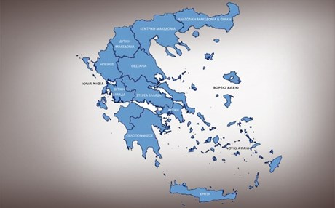
5,000/έτος
Κληρονομικότητα
10%

Slide 4
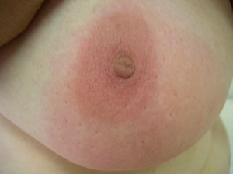
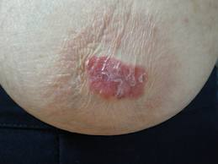
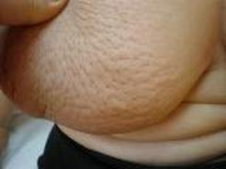
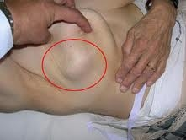
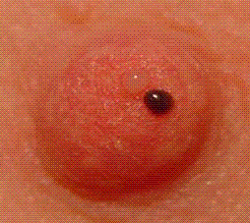
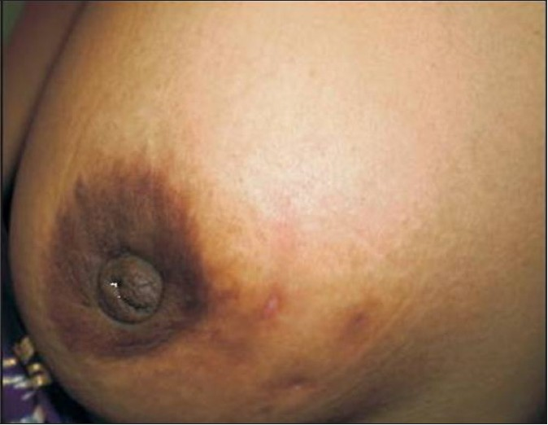

Slide 5
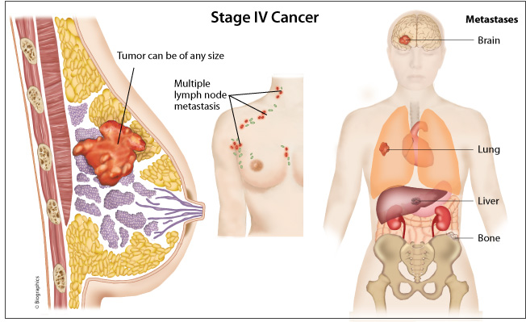

Slide 6
Stages

Slide 7
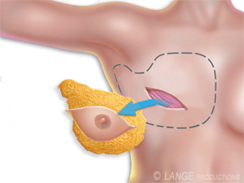
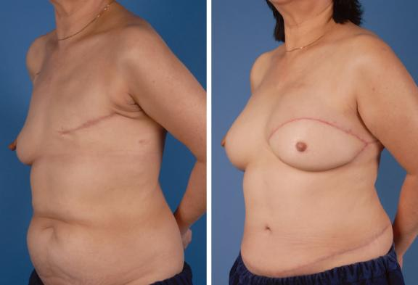
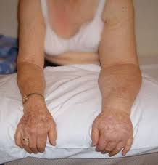
Mastectomy

Slide 8
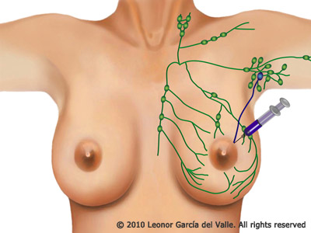
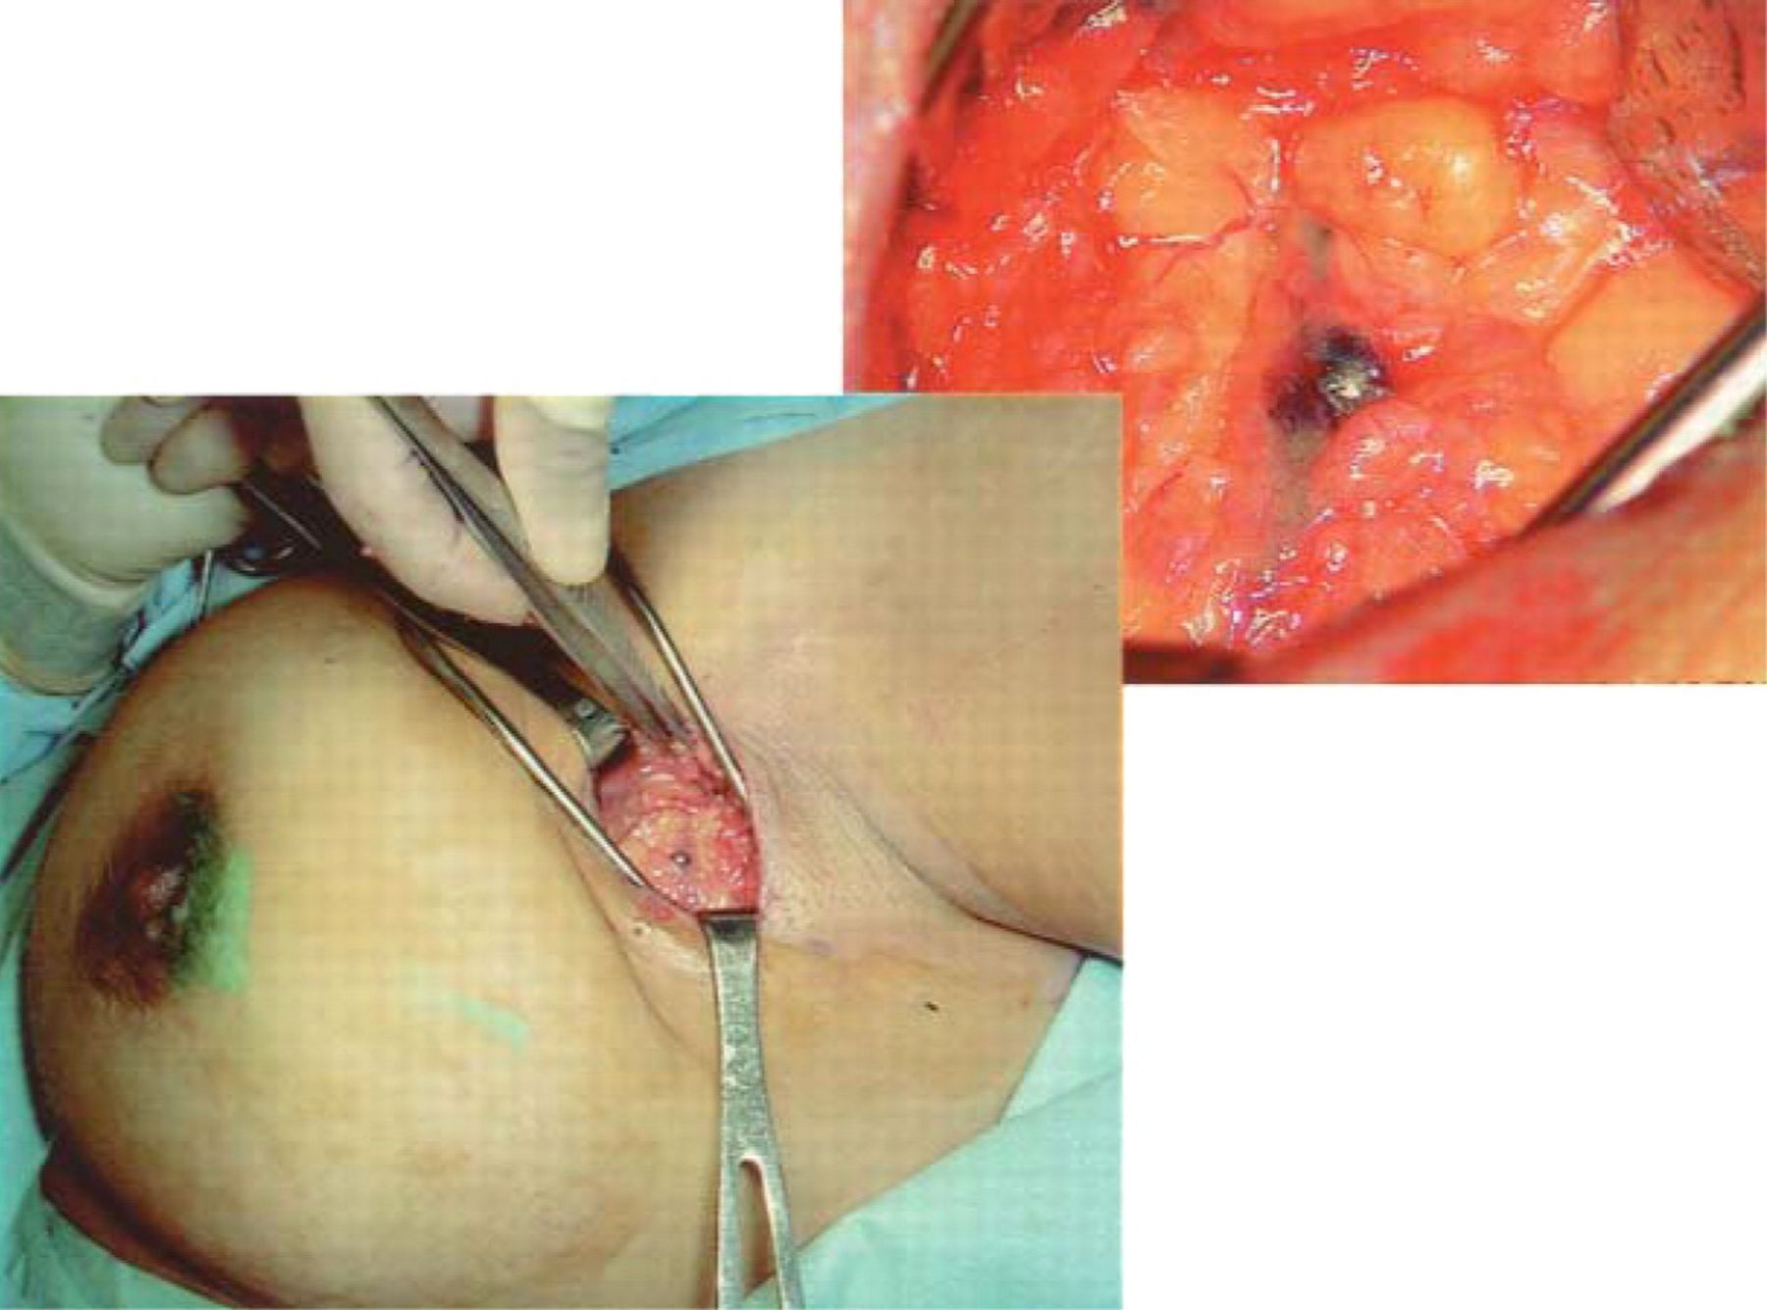
Sentinel Lymph Node Biopsy

Slide 9
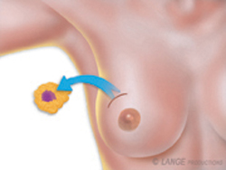
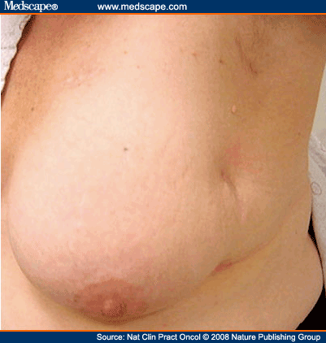
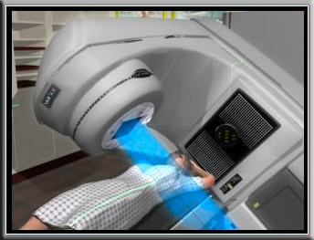
Lumpectomy

Slide 10
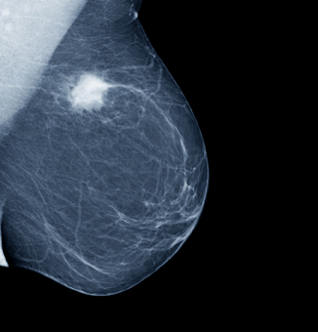
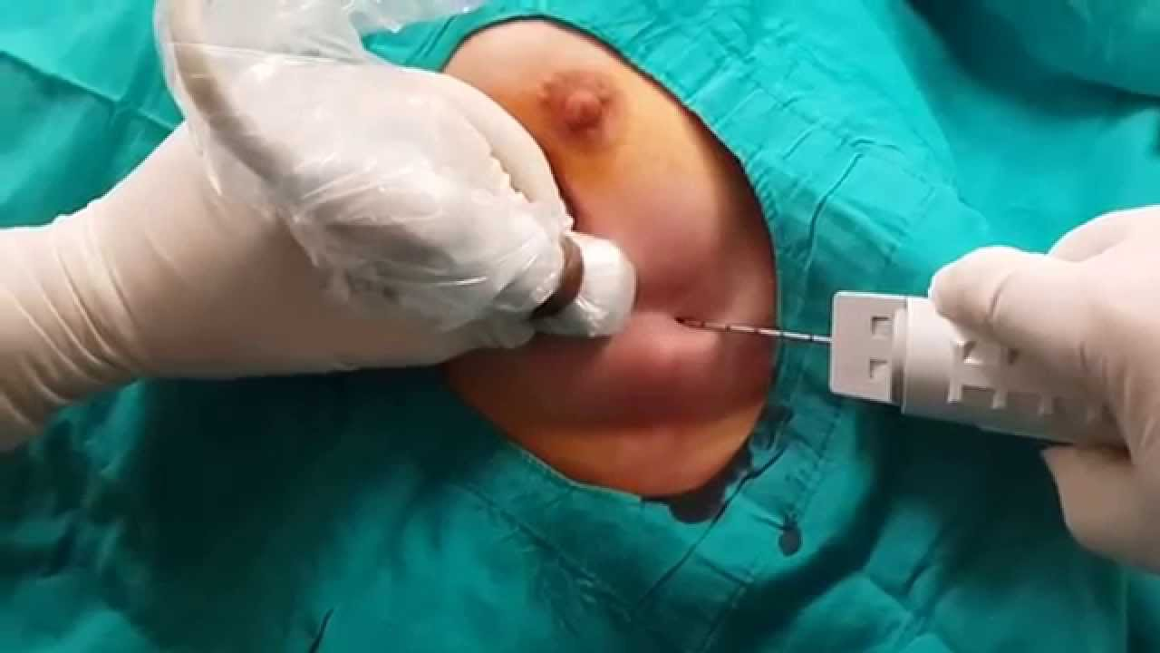
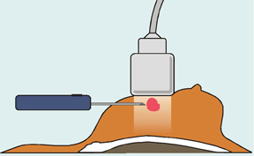

Slide 11
Προγνωστικοί Παράγοντες
Στάδιο
Έκφραση γονιδίου HER2
Διήθηση λεμφαδένων
Grade
ΕR/PR status

Slide 12
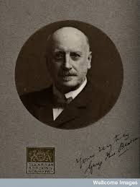
Beatson G. Lancet, 1896

Slide 13
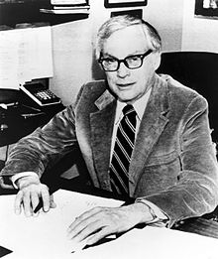

“A lady with growth neoplastic
thought castration was just a bit drastic
She preferred that her ill could be cured with a pill
Today it’s no longer fantastic”
Elwood Jensen
Craig Jordan

Slide 14
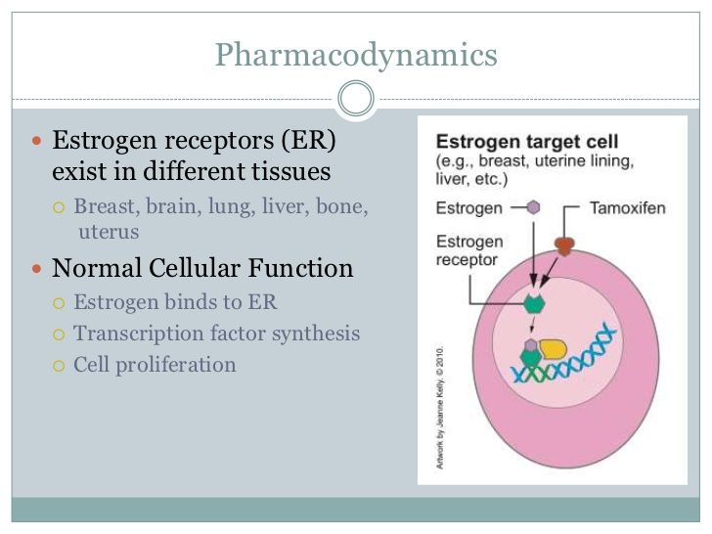

Slide 15
Tamoxifen: 5 years
Davies, et al. Lancet, 2011

Slide 16
Tamoxifen: 10 years
Davies, et al. Lancet, 2013

Slide 17
Toxicities
Davies, et al. Lancet, 2013

Slide 18
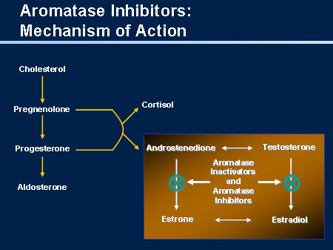
Aromatase inhibitors (Post-menopausal)
Letrozole
Anastrozole
Exemestane

Slide 19
Aromatase inhibitors vs Tamoxifen (Post-menopausal)
Reccurence
Recurrence
Contralateral BC
Cuzick, et al .Lancet 2010

Slide 20
Toxicities
Regan M, et al. Breast cancer Res, 2011

Slide 21
Aromatase inhibitors: 10 years
Letrozole
for 5 yrs
(n = 959)
Postmenopausal pts with ER+ breast cancer who completed 5 yrs of letrozole/Tamoxifen
(N = 1918)
Placebo
for 5 yrs
(n = 959)
Goss PE, et al. ASCO 2016. Abstract LBA1
Notes:
AI, aromatase inhibitor; CBC, contralateral breast cancer; DFS, disease-free survival; ER, estrogen receptor; PgR, progesterone receptor; QoL, quality of life.

Slide 22
DFS and OS After Median Follow-up of 6.3 Yrs
DFS benefit of extended letrozole in all prespecified subgroups
5-yr OS: 93% vs 94% (HR: 0.97; P = NS)
DFS Outcomes | Letrozole | Placebo | HR (95% CI) | P Value
Overall 5-yr DFS, % | 95 | 91 | 0.66 (0.48-0.91) | .01
Events, n (%) | 67 (7.0) | 98 (10.2)
New contralateral breast cancers, n (%) | 13 (1.4) | 31 (3.2) |  | .007
Locoregional recurrences, n | 19 | 30
Distant recurrences, n | 42 | 53
Bone recurrences, n | 28 | 37
LN+
Young age at diagnosis
Goss PE, et al. ASCO 2016. Abstract LBA1
Notes:
AI, aromatase inhibitor; DFS, disease-free survival; NS, not significant.

Slide 23
Fractures During Treatment
Bone Events, % | Letrozole (n = 959) | Placebo (n = 959) | P Value
Bone fracture | 14 | 9 | .001
Location of bone fracture Spine Wrist Pelvis Hip Femur Tibia Ankle Other | 1.8 2.8 0.1 0.7 0.9 0.5 2.0 7.1 | 0.9 1.7 0.7 0.6 0.4 0.4 1.2 5.0 | .12 .09 .08 .79 .17 .74 .14 .06
New-onset osteoporosis | 11 | 6 | < .0001
Goss PE, et al. ASCO 2016. Abstract LBA1

Slide 24
Exemestane with ovarian suppression (Pre-menopausal)
Pagani O, et al. NEJM 2014

Slide 25
Subgroup analysis
Exemestane + LHRH
Pre-menopausal after chemo
Age<35
LN+
Grade III
Regan M, et al. JCO 2016

Slide 26
Guidelines
Tam +- LHRH (5 years)
Tam (10 years)
Pre-menopausal
AI (5 years)
AI+ LHRH (5 years)
AI (5 years)
AI (10 years)
Post-menopausal
AI (5 years)
Tam (5 years)
Tam (10 years)

Slide 27
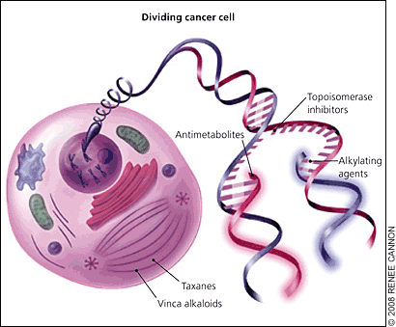
Chemotherapy
Adjuvant /Neo-adjuvant
Anthracyclines
Cyclophosphamide
Taxanes

Slide 28
Chemotherapy indications
LN+
Grade III
Highly proliferative tumors
ER-
HER2+

Slide 29

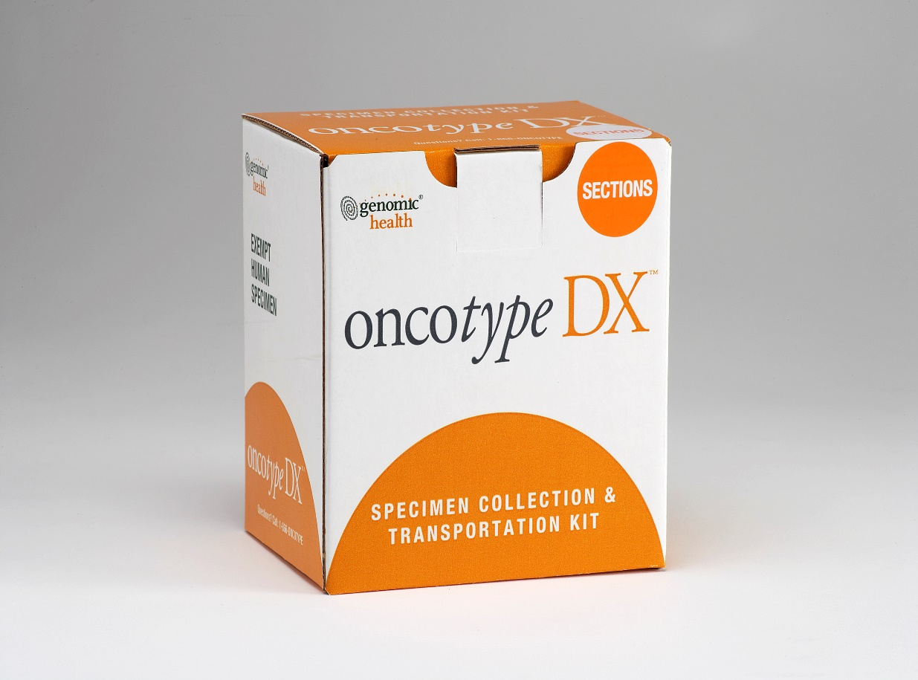
Oncotype
T1-2, Ν0, ER+

Slide 30
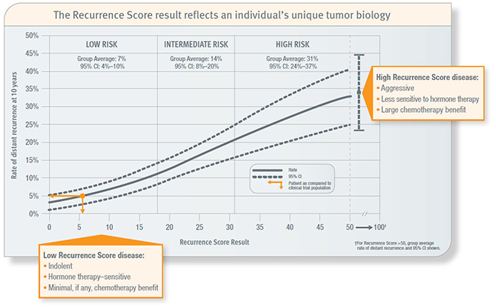
Chemotherapy
Age<50

Slide 31
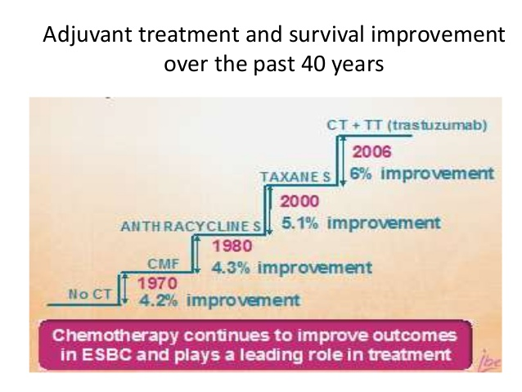
Toxicity
Benefit
Alopecia
Nausea
Diarrhea
Anemia
Neutropenia
Neuropathy
Heart failure
Leukemia

Slide 32
Outcomes
Chemotherapy
Radiotherapy
Hormone therapy
Cure
Relapse (30%-40%)

Slide 33
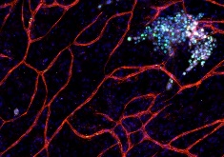
Tumor dormancy – Late relapses

Slide 34
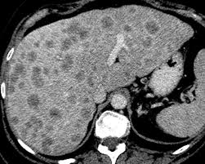
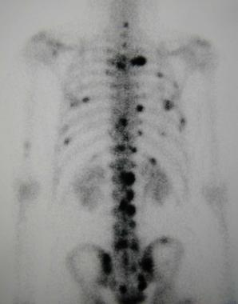
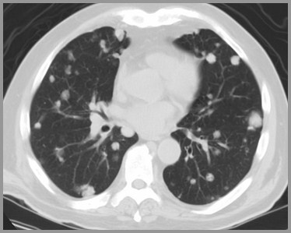
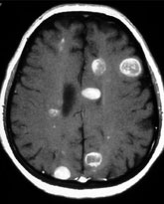
Metastatic breast cancer
Incurable
Survival: 2-3 years

Slide 35
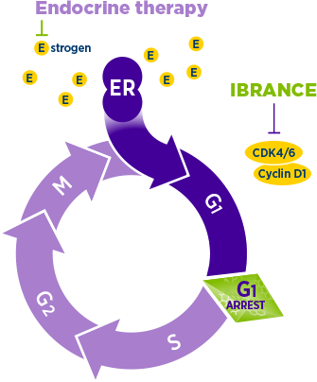
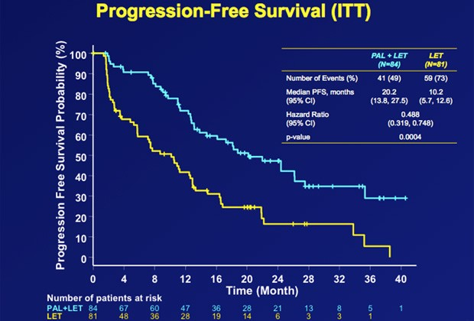
Letrozole + CDK inhibitor
Finn, et al. Presented at ASCO 2016

Slide 36
Endocrine resistance: Mutations & Alternative pathways
ESR mutations

Slide 37
Metastatic breast cancer
Hormone therapy
Hormone therapy
Chemotherapy
Notes:
DES αποNCCN τις κατηγοριες 1 σε 1^{η} γραμμη

Slide 38
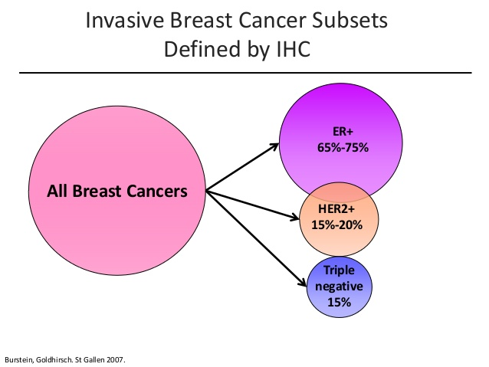

Slide 39
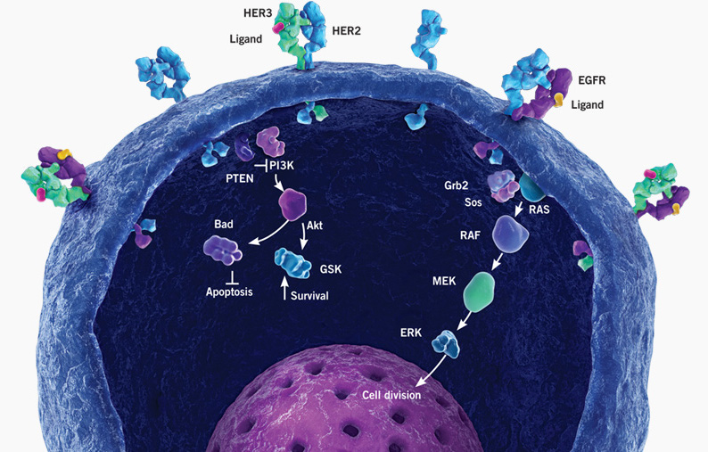
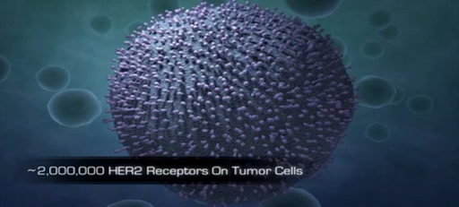
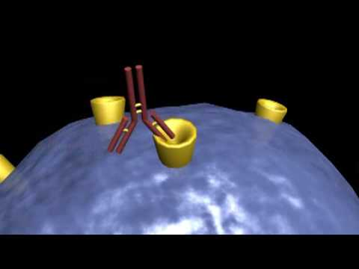
HERCEPTIN

Slide 40
Adjuvant Herceptin (HER2+ breast cancer)
Perez, et al. J Clin Oncol, 2011

Slide 41
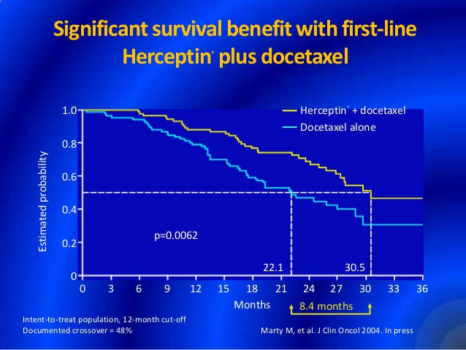
Herceptin: HER2+ metastatic breast cancer

Slide 42
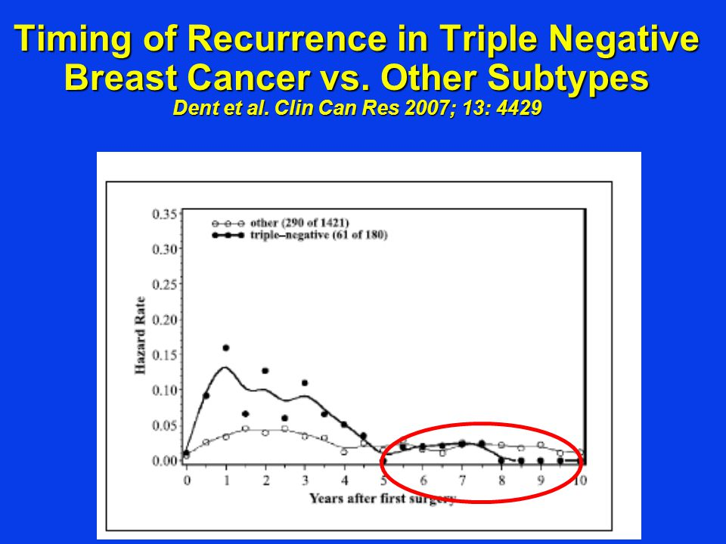
Triple negative breast cancer
Young women
Very aggressive
Early relapses
Poor prognosis
Limited treatment options (chemo only)

Slide 43
Screening
Annual mammogram
Age>40

Slide 44
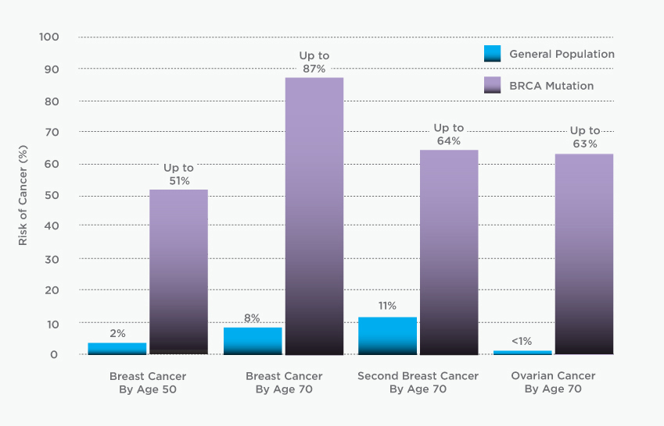
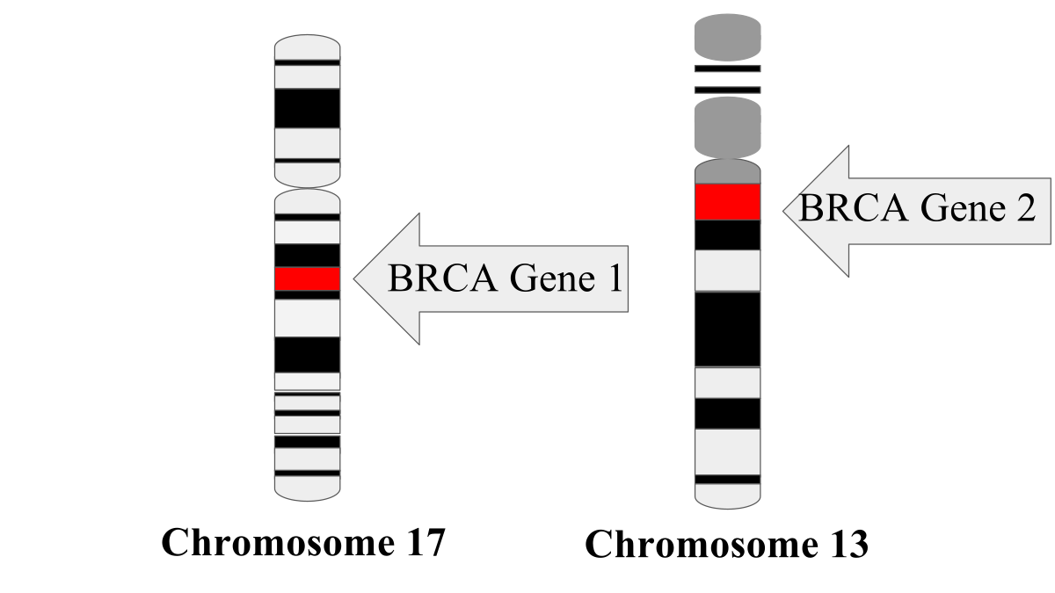
BRCA Mutations

Slide 45
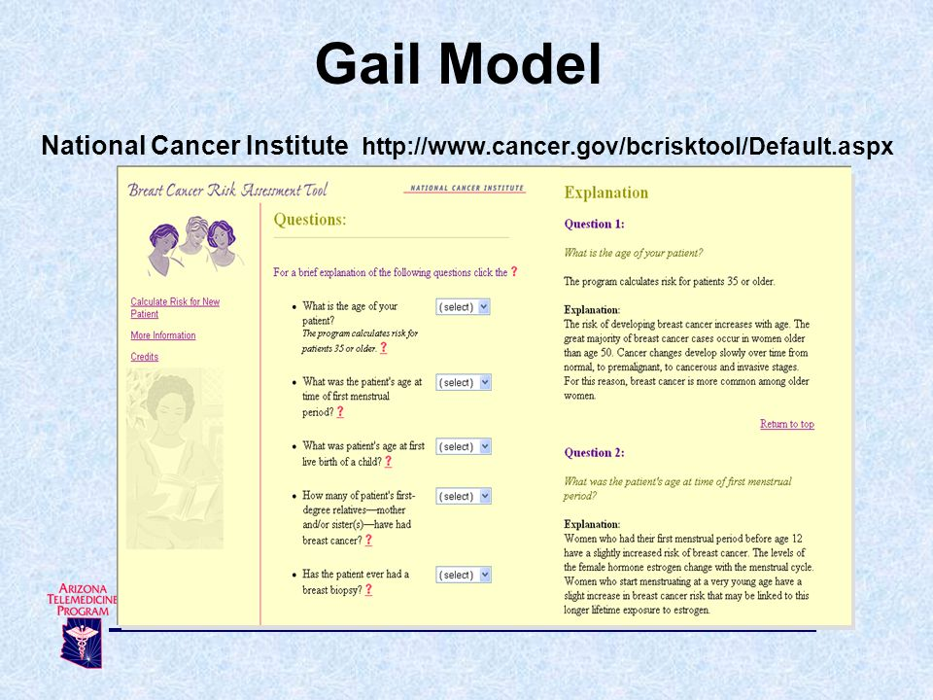

Slide 46


