Slide 1
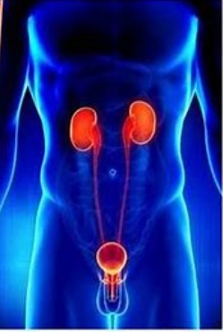
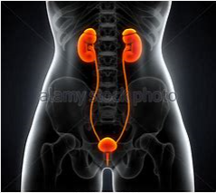

Καρκίνος Ουροποιητικού Συστήματος
Δέσποινα Νάση
Παθολόγος Ογκολόγος
Συνεργάτης Ιατρικού Κέντρου Αθηνών
Επιστημονικός Συνεργάτης Ογκολογικής Μονάδας Γ΄ Παθολογικής Κλινικής, Γ.Ν.Θ.Α. «Η ΣΩΤΗΡΙΑ»- Ιατρική Σχολή Αθηνών

Slide 2

Καρκίνος Νεφρού

Slide 3
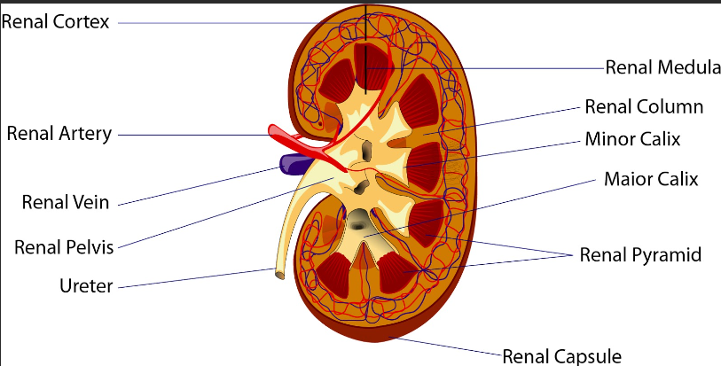
Renal Cell Carcinomas constitute 80-85% of primary renal neoplasms
Transitional cell carcinomas of the renal pelvis are the next most common (8%)
Other parenchymal epithelial tumors, such as oncocytomas, collecting duct tumors, and renal sarcomas, are rare.
Nephroblastoma or Wilms tumor is common in children (5-6% of all primary renal tumors)

Slide 4
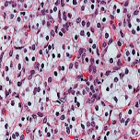
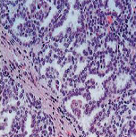
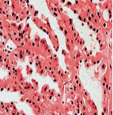
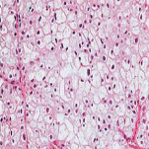
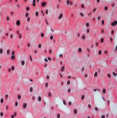

Ο καρκίνος του νεφρού δεν είναι ΜΙΑ νόσος
Proximal nephron
Distal nephron
Type | Clear cell | Papillary type 1 | Papillary type 2 | Chromophobe | Oncocytoma
Incidence (%)¹ | 75% | 5% | 10% | 5% | 5%
Hereditary mutations¹ | VHL | MET | FH | BHD | BHD
Sporadic mutations² | VHL (89%) | MET (13%) | TBD | TBD | TBD
5% των όγκων του νεφρού είναι αταξινόμητα/ αδιαφοροποίητα
Πολύ σπάνιοι οι όγκοι Bellini (Collecting Duct)
FLCN, folliculin; BHD, Birt-Hogg-Dubé; FH, fumarate hydratase; MET, mesenchymal epithelial transition factor;
VHL, von Hippel-Lindau.
1. Pfaffenroth EC, et al. Expert Opin Biol Ther 2008;8(6):779–790. 2. Linehan WM, et al. Semin Cancer Biol 2013;23(1):46–55.

Slide 5
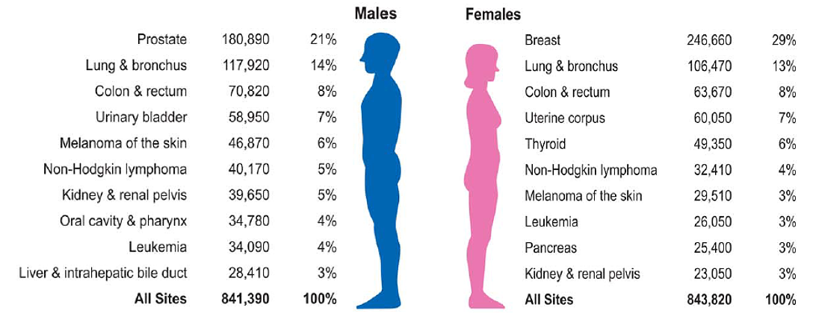
Renal cell cancer:
Fast facts
7th
9th
Global incidence RCC: 273,518/year in 2008
  72,019 deaths globally in 2008
USA incidence: 15.3/100,000/year in 2006–2010
  Deaths: 4.0/100,000/year in 2006–2010
M : F=2:1
Incidence rates increase with age in all racial groups until the age of 70 years
Median age at diagnosis: 64 y/o
1. Siegel RL, et al. CA J Clin. 2016;66:7–30. 2. Ridge CA, et al. Semin Intervent Radiol. 2014;31:3–8.

Slide 6
Γενικά Στοιχεία
Data from the SEER registry covering 2009 through 2015 show the extent of disease at presentation of patients with RCC:
Localized disease (ie, confined to the kidney): 65%
Regional disease (ie, spread to regional lymph nodes): 17 %
Metastatic disease: 16 %
Unstaged: 3 %
Σταθερή μείωση του μεγέθους του πρωτοπαθούς όγκου κατά τη διάγνωση, λόγω κυρίως της τυχαίας ανεύρεσής του σε απεικονιστικούς ελέγχους

Slide 7
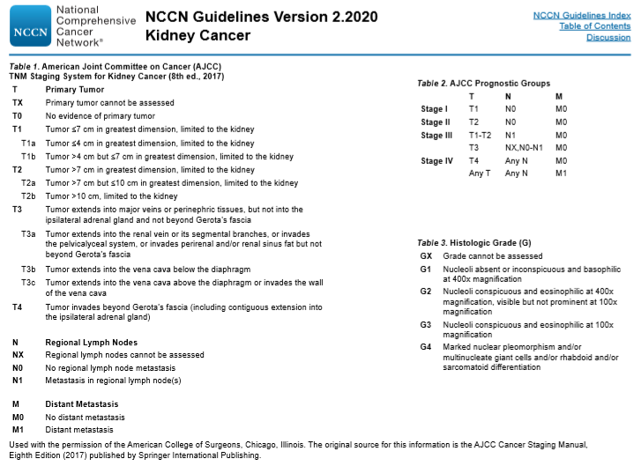
Επιδημιολογικά δεδομένα-Σταδιοποίηση RCC
Μεταστάσεις:
Πνεύμονες, Οστά, Ήπαρ, Λεμφαδένες, Επινεφρίδια, Εγκέφαλος
5ετής επιβίωση ανάλογη σταδίου (53% st III, 8% st IV)
Notes:
Although the prognosis for patients with metastatic renal-cell carcinoma has improved in the past decade, no curative treatment is currently available. Several adjuvant strategies, including cytokine therapy, radiotherapy, and hormone therapy, have been explored to decrease the rate of relapse, but none were successful.6
The proven efficacy of antiangiogenic therapies, including the vascular endothelial growth factor (VEGF) pathway inhibitors sunitinib10 and sorafenib

Slide 8
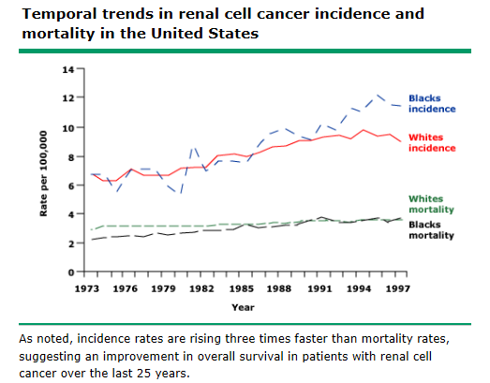
Επιδημιολογία
Τα ποσοστά 5ετούς επιβίωσης έχουν αυξηθεί σημαντικά (34%-62%-75%) από το 1954 -1996 -2015
Ο επιπολασμός έχει αυξηθεί 3 φορές περισσότερο από τη θνητότητα
Διάγνωση νωρίτερα
Βελτίωση χειρουργείων
Βελτίωση ογκολογικών θεραπειών

Slide 9

Παράγοντες Κινδύνου
Κάπνισμα
Υπέρταση
Παχυσαρκία
Κυστική νόσος των νεφρών- Χρόνια Νεφρική Ανεπάρκεια
Επαγγελματικοί παράγοντες (κάδμιο, άσβεστος, παράγωγα πετρελαιοειδών)
Αναλγητικά (φαινακετίνη, ασπιρίνη- ΜΣΑΦ)
Κυτταροτοξική χημειοθεραπεία (Cisplatin, κυρίως στην παιδική ηλικία, αυτοάνοσα νοσήματα, μεταμόσχευση μυελού των οστών- Translocation Renal Cell Cancer)
Χρόνια Ηπατίτιδα C
Νεφρολιθίαση
Αιμοσφαιρινοπάθειες

Slide 10
Τροποποιήσιμοι παράγοντες κινδύνου
Σακχαρώδης Διαβήτης
Πολυκυστική Νόσος των Νεφρών
Νιτρώδη από κατανάλωση κρέατος
Αναπαραγωγικοί παράγοντες (πολλαπλές κυήσεις αυξάνουν τον κίνδυνο- αντισυλληπτικά πιθανόν να τον μειώνουν)
Προηγηθείσα Ακτινοθεραπεία

Slide 11
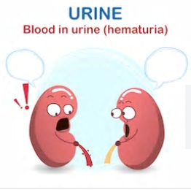
Συμπτώματα
«Κλασσική Τριάδα» (9%)
Αιματουρία (40%)
Ψηλαφητή Μάζα οσφύος/ νεφρική μάζα (κάτω πόλος νεφρού)
Άλγος οσφύος
Οστικά άλγη,Υπερασβεστιαιμία, βήχας, ψηλαφητή λεμφαδενοπάθεια (μεταστατική νόσος)
Πυρετός, απώλεια βάρους, αναιμία (29-88% των ασθενών με προχωρημένη νόσο)
Διήθηση κάτω κοίλης φλέβας: Οιδήματα κάτω άκρων, ασκίτης, ηπατική δυσλειτουργία, πνευμονική εμβολή

Slide 12
Συμπτώματα
Παρανεοπλασματικά Σύνδρομα: Κυρίως σχετιζόμενα με παραγωγή ορμονών (erythropoietin, parathyroid hormone-related protein [PTHrP], gonadotropins, human chorionic somatomammotropin, an adrenocorticotropic hormone [ACTH]-like substance, renin, glucagon, insulin)
Ηπατική δυσλειτουργία- Σύνδρομο Stauffer (απουσία ηπατικών μεταστάσεων)[GM-CSF?, IL-6?]
Ερυθροκυττάρωση, Θρομβοκυττάρωση

Slide 13
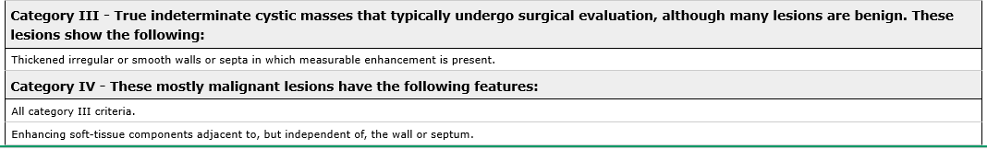
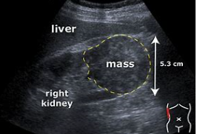
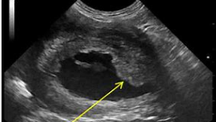
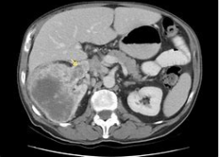
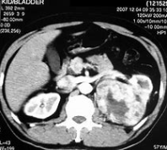
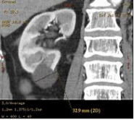
Διάγνωση
Υπερηχογράφημα Νεφρών
Αξονική τομογραφία

Slide 14
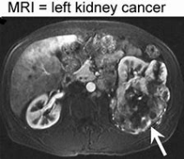
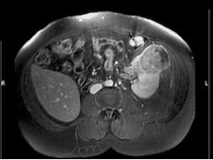
Διάγνωση
Μαγνητική Τομογραφία

Slide 15
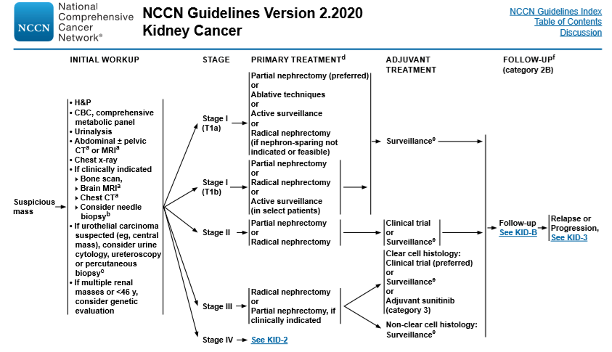
Διάγνωση

Slide 16
Διάγνωση
Bone scan is indicated only in patients with bone pain and/or an elevated serum alkaline phosphatase. Bone scan can be falsely negative since bone metastases are frequently lytic rather than blastic.
CT of the chest is useful to evaluate for evidence of pulmonary or mediastinal lymph node metastases.
MRI scanning with gadolinium is superior to CT for evaluation of the inferior vena cava and right atrium when tumor involvement is suspected.
PET scanning has high sensitivity and specificity for the primary lesion. Although PET or PET/CT may be more sensitive than radionuclide scanning for the detection of bone metastases, it is expensive and has limited use for routine staging.

Slide 17
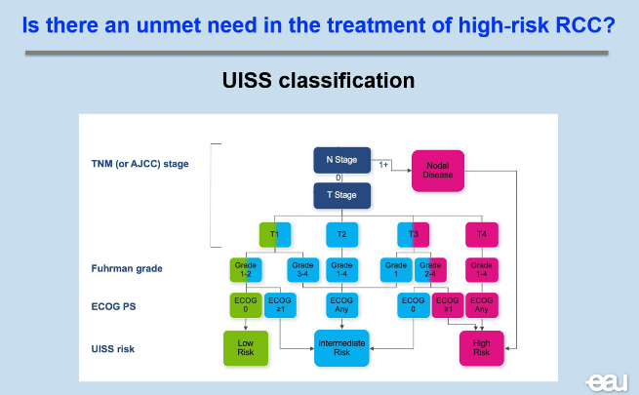
UCLA Integrated Staging System (UISS) for Renal Cell Carcinoma (RCC)
Classification UISS | Percentage of Patients | 5 years RFS post nephrectomy
Low risk | 20-36,6% =30% | 90,4%
Intermediate risk | 52,5-70%=60% | 61,8%
High risk | 6-14%=10% | 41,9%
J Clin Oncol 22:3316-3322

Slide 18
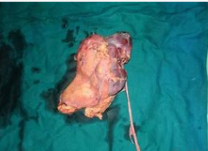
Κριτήρια Νεφρεκτομής
Stage I or II RCC (disease limited to the kidney).
Stage III RCC, which includes patients with tumor extension into major veins or perinephric tissues and/or enlarged retroperitoneal lymph nodes.
Involvement of the inferior vena cava (IVC) and/or the cardiac atrium (ie, cavoatrial tumor involvement).
RCC with direct extension into the ipsilateral adrenal gland (a subset of stage IV RCC), especially if there is no other evidence of metastatic disease.
The role of cytoreductive nephrectomy in other patients with stage IV RCC

Slide 19
Νεφρεκτομή- Ριζική ή μερική?
Radical nephrectomy in patients with tumors >7 cm in size or those involving a more central position of the kidney
In addition, a radical nephrectomy should be performed in patients with any of the following:
Suspected lymph node involvement
Tumor with associated renal vein or inferior vena cava (IVC) thrombus
Direct extension into the ipsilateral adrenal gland
Patients with a tumor ≤7 cm should undergo a partial nephrectomy when it is technically feasible in order to preserve renal function, especially in patients with any of the following :
A solitary kidney
Multiple, small, and/or bilateral tumors
Patients with or at risk for chronic renal disease

Slide 20

Ποιο το σκεπτικό εφαρμογής επικουρικής θεραπείας?
Χειρουργική αφαίρεση μόνη θεραπεία ίασης
Μεγάλο ποσοστό ασθενών έχουν υψηλό κίνδυνο υποτροπής
30-40% με υψηλού κινδύνου νόσο υποτροπιάζουν μετά από νεφρεκτομή
Στόχος της επικουρικής θεραπείας είναι
Μείωση υποτροπών (αύξηση DFS)
Βελτίωση OS

Slide 21
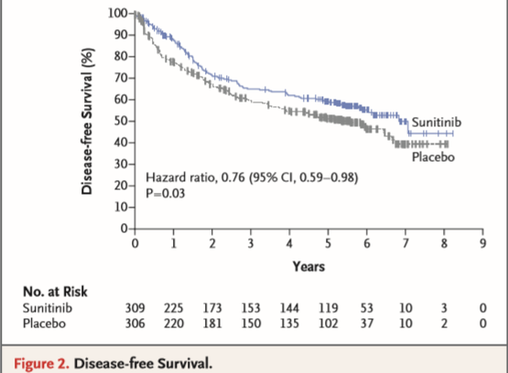
Επικουρική θεραπεία
There is no clear role for targeted systemic adjuvant therapy or immunotherapy after complete surgical resection
Sunitinib is approved after resection for nonmetastatic High Risk Disease only by FDA
Phase III S-TRAC trial: 615 patients with high-risk clear cell RCC were randomly assigned to sunitinib or placebo.
Median follow-up:5.4 year
DFS (the primary endpoint) was significantly increased in those receiving sunitinib (median 6.8 versus 5.6 years, 59.3% vs 51.3% 5-year DFS, HR 0.76, 95% CI 0.59-0.95)
Overall survival data were immature, although the number of deaths was equal among the treatment arms
Toxicity was increased significantly with sunitinib compared with placebo, including palmar-plantar erythrodysesthesia and hypertension.

Slide 22
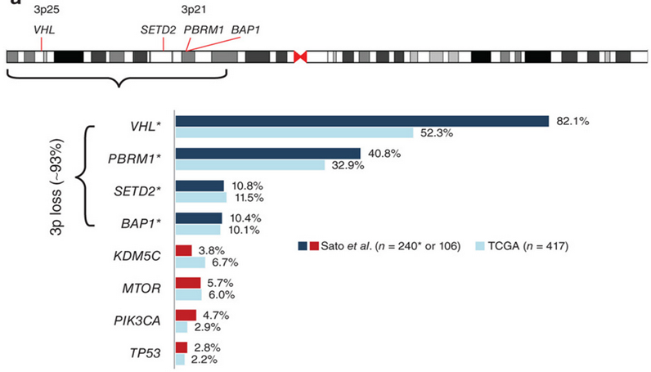

Genomic alterations in clear-cell RCC
Frequently mutated genes identified in studies by TCGA and Sato et al.
*Selective deep sequencing of frequently mutated tumour suppressors in additional samples in the study by Sato et al. (n = 240).
Figure adapted from: Hakimi AA, et al. Nat Genet 2013;45:849-50
Sato Y, et al. Nature Genet 2013;45:860–7. 2. TCGA. Nature 2013;499:supplementary information.
Notes:
Defective VHL-mediated proteolysis was a common feature of ccRCC, which was caused not only by VHL inactivation but also by new hotspot TCEB1 mutations, which abolished Elongin C–VHL binding, leading to HIF accumulation. Other newly identified pathways and components recurrently mutated in ccRCC included PI3K-AKT-mTOR signaling, the KEAP1-NRF2-CUL3 apparatus, DNA methylation, p53-related pathways and mRNA processing.

Slide 23
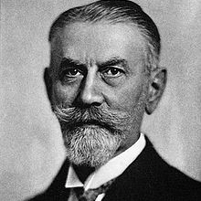
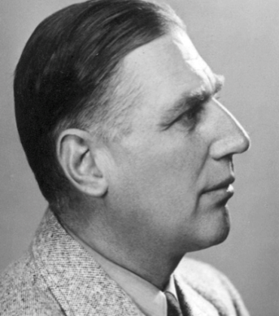
Molecular drivers of clear-cell RCC not yet “druggable”
Phenotypic consequences of VHL disruption described in the early
20th century¹
VHL gene mapped to chromosome 3 and associated with RCC in 1988¹
Yet still no true VHL-targeted therapy!¹
Eugen Von Hippel
circa 1922/3
(retinal angiomas)²
Arvid Lindau
1904
(cerebellar and cord angiomas)³
1. Bankhead C. Medpage Today 2014. Available at www.medpagetoday.com/meetingcoverage/mgucs/4414.
2. https://en.wikipedia.org/wiki/Eugen_von_Hippel#/media/File:Voit_206_Eugen_v._Hippel.jpg.
3. http://timerime.com/en/event/1311288/Life+of+Dr+Arvid+Lindau/. All Accessed February 2017.

Slide 24
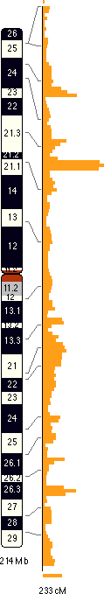
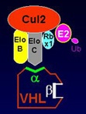
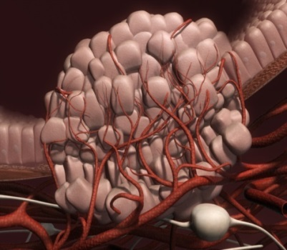
Clear-cell RCC: VHL gene disruption
X
VEGF, etc.
HIF
Ubiquitin
Ligase
Complex
Disrupted-
Defective Proteolysis
Of VHL
Hypoxia
Inducible
Factor (HIF)
Accumulation
Angiogenesis
Also…
Erythropoiesis
Cell proliferation & survival
Glucose metabolism
pH regulation
Proteolysis
Chr 3
1. Cowey CL, et al. Curr Oncol Rep 2009;11(2):94–101; 2. Gossage L, et al. Nature Rev Cancer 2015;15:55–64.
Notes:
24
Clear-cell RCC biology has been fairly well established. Biomarkers exploiting this biology would be of relevance!
We know that the majority of clear cell kidney cancers is characterized by disruption of the Von Hippel Lindau gene, either by mutation or silencing.
The consequences of VHL disruption include accumulation of HIF, subsequently resulting in increased expression of Vascular Endothelial Growth factor or VEGF, among others.
VEGF or VHL status appear to be good biomarker candidates for clear-cell RCC.

Slide 25
Hypoxia is the main driver of RCC growth and metastasis
VHL
disruption
(mutation or
silencing)
Unregulated
HIF expression
Hypoxic stress
response
Glycolysis
upregulated
(adaptation
to hypoxic
environment)
Tumour cell
proliferates
under conditions
of aerobic
glycolysis
Regional
acidosis (toxic to
local cell populations)
facilitates invasion
and metastasis
Adapted from Gillies RJ, et al. Cancer Metastasis Rev 2007;26:311.

Slide 26
RCC biology: Activation of mTOR signaling pathways
Glucose
Amino
Acids
IGFR-1
RTK
PTEN
PIP2
PIP3
PDK1
ATP
IRS-1
PI3K
ATP
LKB1
AKT
mTOR
RAS
GSK3a/b
Rictor
AMPK
MDM2
RAF
p53
TSC1
PRAS40
Vps34
TSC2
RHEB
mTOR
MEK
Raptor
ERK1/2
RSK
S6K
4EBP1
eIF4B
HIF1a
eIF4E
VHL
HIF2a
Meric-Bernstam F, et al. J Clin Oncol 2009;27:2278–87.
Notes:
mTOR signaling pathways are also relevant in RCC. This is a simplified diagram of the mTOR signalling pathways. Many of these effectors can be measured either in the serum or in patient tumour specimens and thus are candidate biomarkers for mTOR inhibitor therapy.

Slide 27
Disease Burden of Metastatic RCC:
Incidence at Diagnosis and Prognosis
About 30% of RCC patients present with metastases at diagnosis¹
Clinical prognostic factors have been identified (but no predictive factors)
Traditionally resistant to hormonal and cytotoxic chemotherapy; modestly responsive to immunotherapy
Cytoreductive nephrectomy has clinical benefit in specific populations
Another 20%–30% of organ-confined cancers relapse and develop metastases—42% of patients relapse after surgery in less than 12 months^{3,4}
1-year survival²:
36%
2-year survival²:
22%
5-year survival^{5a}:
12%
Most relapses occur within
3 years³
Diagnosis
Year 1
Year 2
Year 3
Year 5
Approximately 40% of RCC patients die of metastases¹
ªMetastatic RCC.
RCC, renal cell carcinoma.
1. Abe H et al. Int J Urol 2013;20:944–55. 2. Patil S et al. J Urol 2012;188:2095–2100. 3. Eggener SE et al. J Clin Oncol 2006;24:3101–6. 4. Fu X et al. Int J Oncol 2007;30:1561–67. 5. National Cancer Institute. SEER Program Cancer Stat Facts: Kidney and Renal Pelvis Cancer.
http://seer.cancer.gov/statfacts/html/kidrp.html#survival. Accessed November 9, 2016.

Slide 28
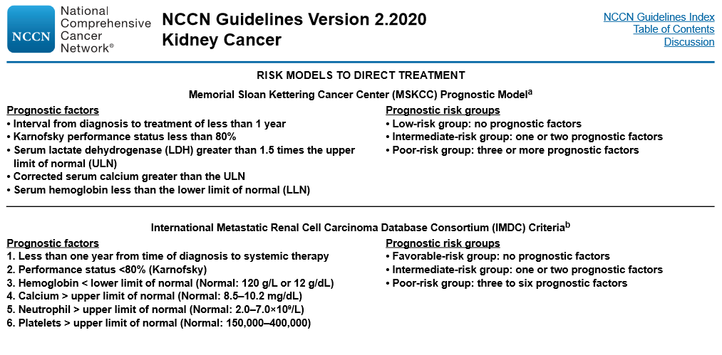
Prognostic Models to “guide” therapy

Slide 29
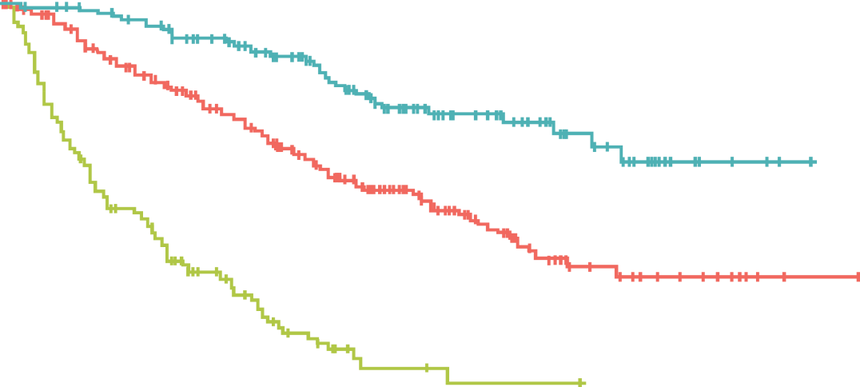
Risk stratification in mRCC
N=645 patients with mRCC treated with VEGF-targeted therapy
  Sunitinib (61%)
  Sorafenib (31%)
  Bevacizumab (8%)
Predictors for OS:
  Time from diagnosis
  to treatment*
  Haemoglobin*
  Calcium*
  Performance status*
  Neutrophil count
  Platelet count
Favourable: 0 factors
(OS 37 months)
Intermediate: 1–2 factors
(OS 28 months)
Poor: 3–6 factors
(OS 9.4 months)
Risk group | Number of risk factors | Median survival time
Favourable risk (n=133) | 0 | 37 months
Intermediate risk (n=292) | 1–2 | 28.5 months
Poor risk (n=139) | >2 | 9.4 months
*Components of MSKCC prognostic criteria
Heng DY, et al. J Clin Oncol 2009;27(34):5794–9.
Notes:
In at least one study that aimed to redefine prognostic groupings in the targeted therapies era, four of the five original MSKCC clinical criteria remained strongly prognostic. In addition, a couple of new prognostic variables (neutrophils and platelets) were identified. As before, the increasing number of risk factors resulted in worsening outcomes, although the numerical survival figures for this highly selected group appear better than in the cytokine era.

Slide 30
Cytoreductive nephrectomy prolongs survival in metastatic RCC:
Final results from the Phase III SWOG 8949 trial
100%
 | At risk | Death | Median in months
Nephrectomy+Intron-A | 120 | 114 | 11
Intron-A | 121 | 119 | 8
80%
60%
Hazard ratio = 0.74
(95% CI 0.57, 0.96)
40%
20%
0%
0
24
48
72
96
120
144
Months after randomisation
1. Lara PN Jr, et al., J Urol. 2009;181(2):512-517.

Slide 31
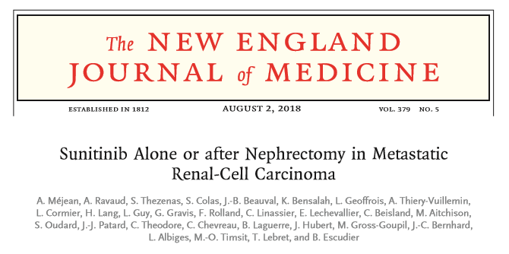
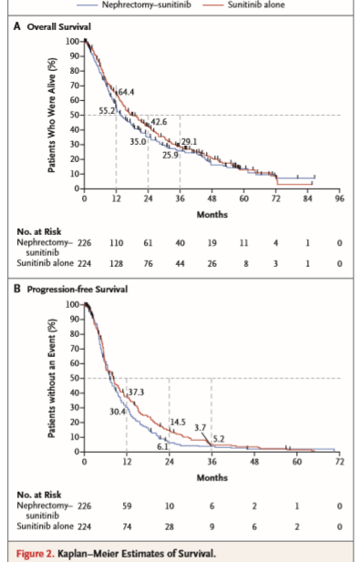
«Η χορήγηση Sunitinib χωρίς να έχει προηγηθεί νεφρεκτομή, δεν είναι λιγότερο αποτελεσματική σε ασθενείς ενδιάμεσης ή πτωχής πρόγνωσης»

Slide 32
Remarkable RCC drug development:
10 approvals in 10 years!
Sunitinib
VEGF directed
Temsirolimus
mTOR inhibitor
Bevacizumab
(+IFN-α)
Immunotherapy
2006 | 2007 | 2008 | 2009 | 2010 | 2011 | 2012 | 2013 | 2014 | 2015 | 2016
Sorafenib
Pazopanib
Axitinib
Nivolumab
Everolimus
Cabozantinib
Lenvatinib
(+ everolimus)
1. European Medicines Agency. http://www.ema.europa.eu/ (Last accessed February 2017).

Slide 33
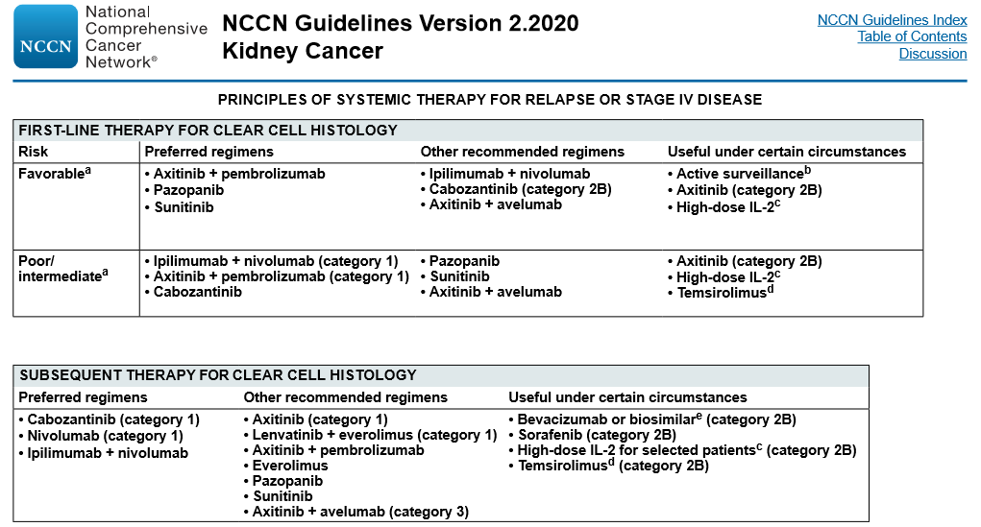

Slide 34
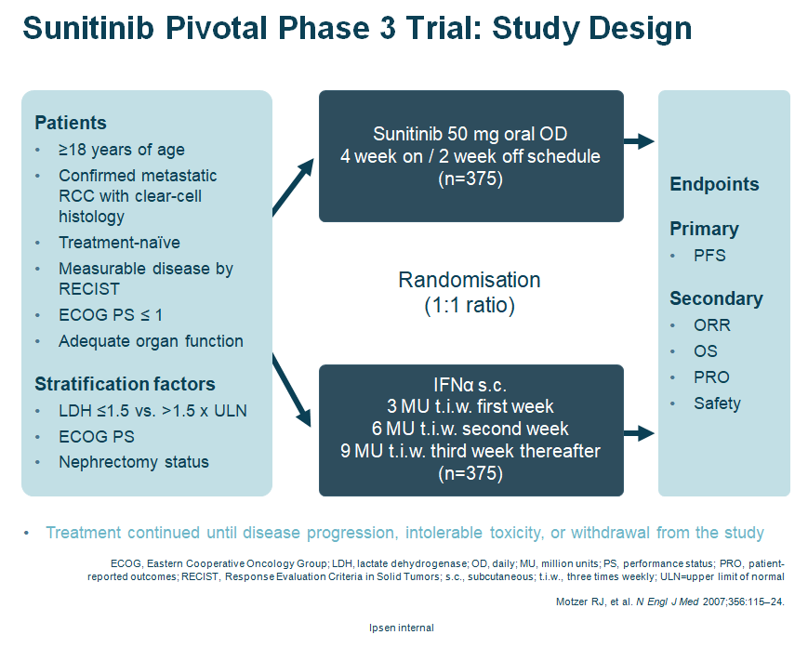
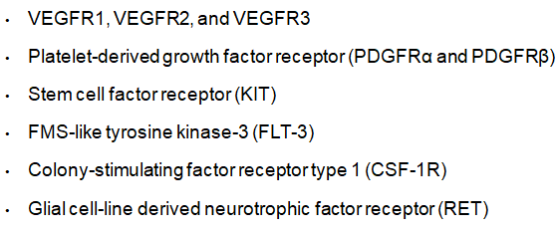
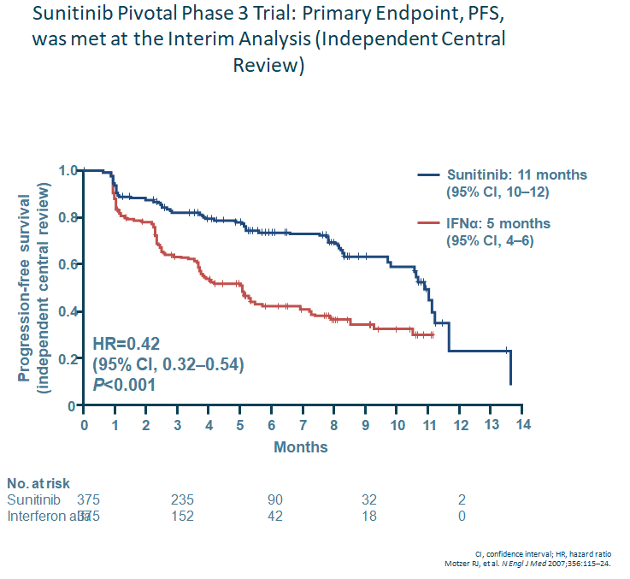
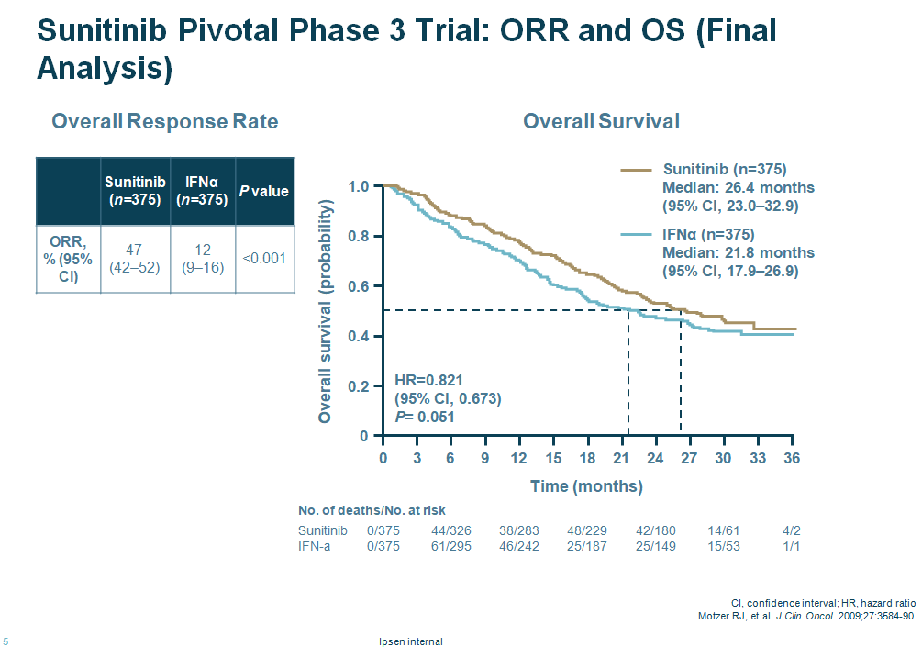

Slide 35
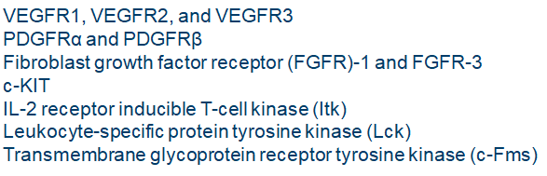
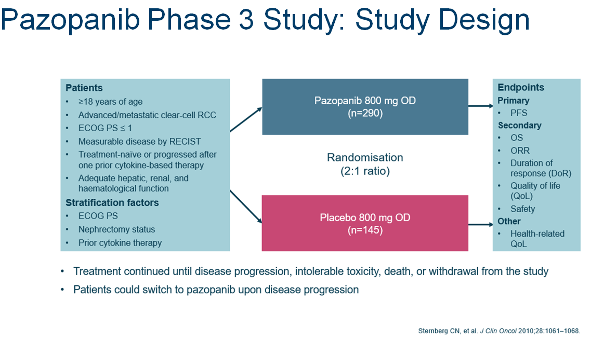
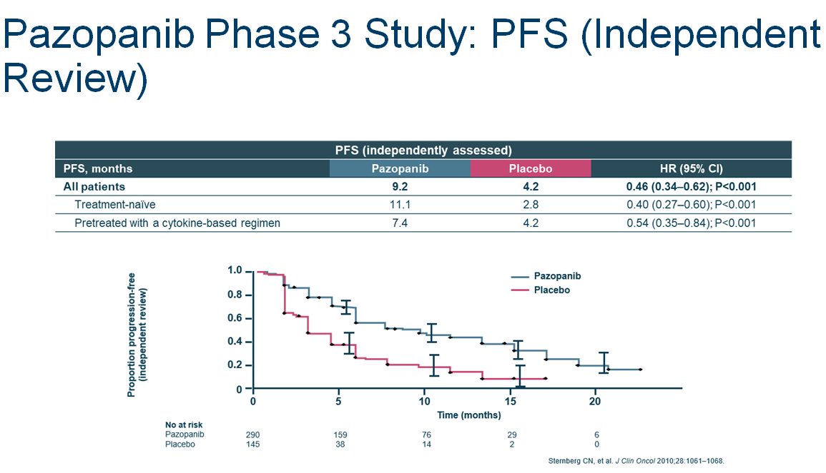
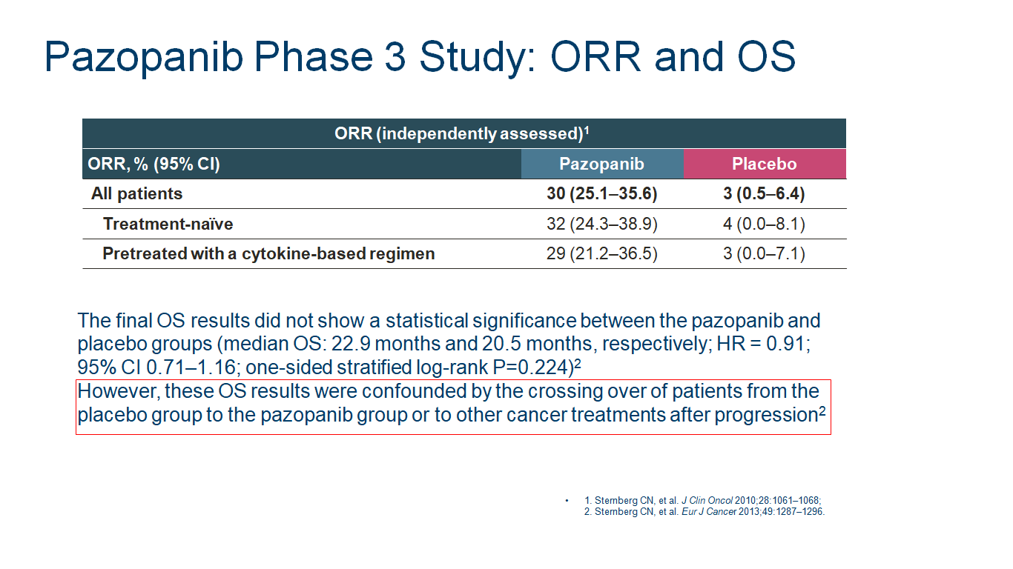
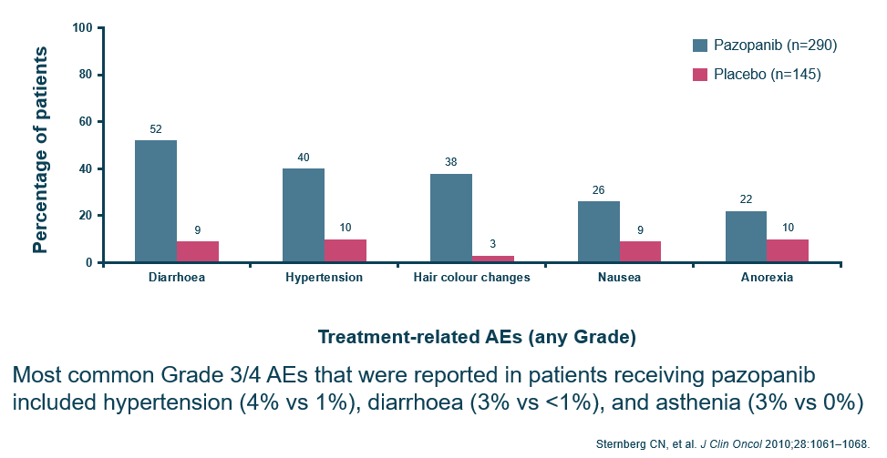

Slide 36

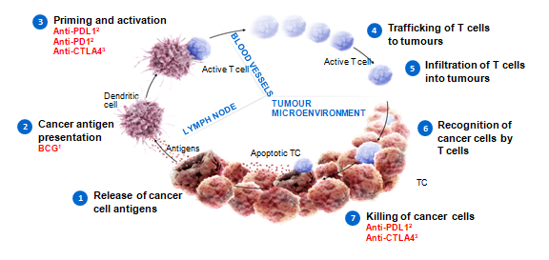
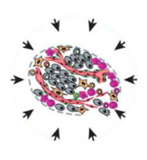
Avoiding immune destruction is a hallmark of cancer
Sustaining
proliferative
signalling
Cancer-immunity cycle²
Inducing
angiogenesis
Degrading
cellular
energetics
Evading
growth
suppressors
Resisting
cell
death
Avoiding
immune
destruction¹
Genome
instability
mutation
Enabling
replicative
immortality
Activating
invasion &
metastasis
Tumour-
promoting
inflammation
-Diminishing MHC-I expression, and hence CD8+ T cell activity
-Defective antigen processing and presentation, thereby causing reduced recognition by T cell
-Increasing the expression of co-inhibitory (i.e., immune checkpoint) molecules
1. Hanahan et al. Cell 2011
2. Chen et al. Immunity 2013
Notes:
Generally, cancer cells evade antitumor immunity by adopting active immune escape strategies as follows:
diminishing MHC-I expression, and hence CD8+ T cell activity
defective antigen processing and presentation, thereby causing reduced recognition by T cell
increasing the expression of co-inhibitory (i.e., immune checkpoint) molecules
-Since most cancers select the immune checkpoints to evade the immune systemattack by blocking the effector T-cell functions, antitumor immunity may be recovered by antibodies that inhibit the receptorligand interaction and deactivate the immune checkpoints

Slide 37
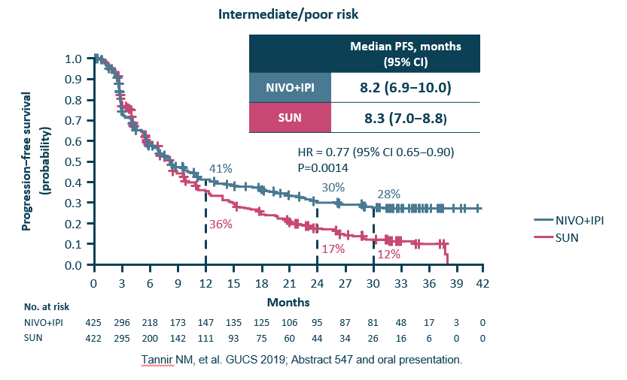
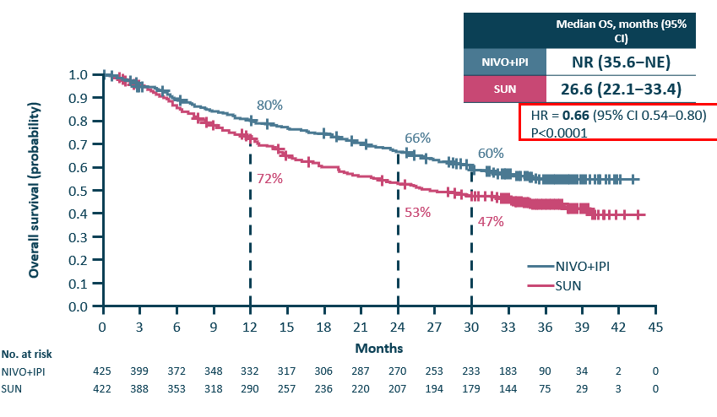
Nivolumab + Ipilimumab Phase 3 Study (CheckMate 214)
Co-Primary Endpoint: PFS in IMDC Intermediate/Poor Risk
30months follow Up
Co-Primary Endpoint: OS in IMDC Intermediate/Poor Risk
30 months follow up
*Investigator-assessed per RECIST v1.1 (median follow-up 32.4 months)
PFS, progression-free survival
*Investigator-assessed per RECIST v1.1 (median follow-up 32.4 months)
NE, not estimable; NR, not reached

Slide 38
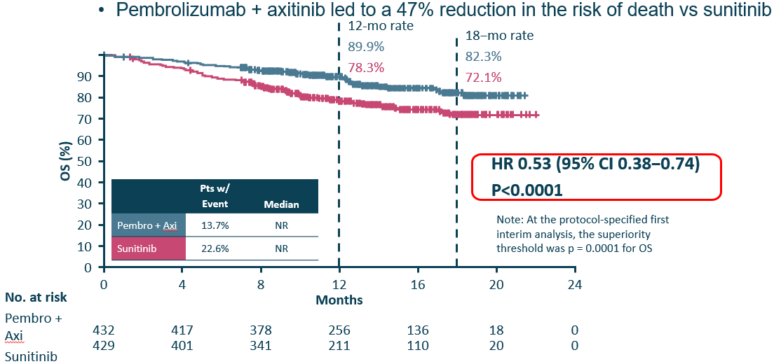
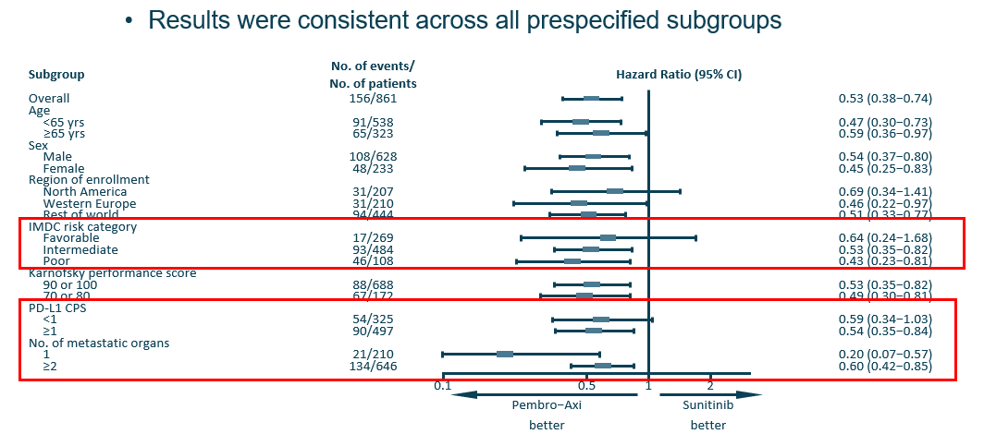
Pembrolizumab + Axitinib KEYNOTE-426: Phase 3
Overall Survival
HR, hazard ratio; NR, not reached.
CPS, combined positive score.
Powles T, et al. GUCS 2019;Abstract 543 and oral presentation.

Slide 39

Avelumab + Axitinib JAVELIN Renal 101:
Primary Endpoint – PFS per IRC in the PD-L1+ (≥1%) Group
Minimum follow-up 6 months. Median follow-up 9.9 months (avelumab + axitinib) and 8.4 months (sunitinib). The PFS analysis crossed the prespecified efficacy boundary based on the alpha-spending function (P=0.001). IRC, independent review committee; NE, not estimable
1. Motzer RJ, et al. ESMO 2018: abstract LBA6_PR and oral presentation

Slide 40

The Role of MET and AXL in Tumour Progression and Resistance to VEGF Receptor Inhibitors
In RCC, MET and AXL are thought to function as escape pathways potentially contributing to resistance to more selective VEGFR-targeted therapy
Zhou L, et al. Oncogene 2016
Notes:
In RCC, MET and AXL are thought to function as escape pathways potentially contributing to resistance to more selective VEGFR-targeted therapy
Reference
Zhou L, et al. Oncogene 2016;35:2687–97.

Slide 41


Cabozantinib-METEOR study: PFS
Choueiri TK, et al. Lancet Oncol 2016
Notes:
42%-49

Slide 42




Slide 43


Update of the Update…

Slide 44

Καρκίνος Ουροδόχου Κύστης

Slide 45


The Urothelium and Urothelial Cancers
The mucous membrane lining of the urinary tract is called the transitional cell urothelium, which begins in the renal pelvis and ends in the proximal urethra¹
Most cancers of the bladder, urethra, and renal pelvis are transitional cell carcinomas (also called urothelial carcinoma)¹
Bladder cancer is the predominant form of urothelial carcinoma, with a ratio of 50:3:1 vs ureter and renal pelvis cancer²
Urothelial carcinomas are often multifocal; patients with upper urinary tract cancer have a 30% to 50% chance of developing bladder cancer²
  Bladder cancer is associated with a lower risk of upper urinary tract cancer (2% to 3%)²
Renal pelvis
Ureter
Bladder
Urethra
Image adapted from: https://www.saintlukeshealthsystem.org/health-library/anatomy-pediatric-urinary-tract. Accessed August 22, 2017.
1. National Cancer Institute. Bladder cancer treatment. http://www.cancer.gov/types/bladder/hp/bladder-treatment-pdq. Accessed August 22, 2017. 2. Hurwitz M. 2016.
http://www.cancernetwork.com/cancer-management/urothelial-and-kidney-cancers. Accessed August 22, 2017.
Notes:
NCI Bladder Cancer Treatment, 2017/ pg1, 2
NCI Bladder Cancer Treatment, 2017/ pg1, 2
Hurwitz, 2016/pg1
Image adapted from: https://www.saintlukeshealthsystem.org/health-library/anatomy-pediatric-urinary-tract. Accessed March 1, 2017.

Slide 46



Επιδημιολογία
SEER Database 2019

Slide 47

Ιστολογικοί τύποι
TCC ~ 90%
Squamous Ca ~ 8%
Adenocarcinomas
Sarcomas
Lymphomas 2%
SCC
Carcinoid tumors

Slide 48
Urothelial carcinoma, also known as transitional cell carcinoma, is the predominant form of bladder cancer
Non-muscle-invasive bladder cancer (NMIBC)^{1,3}
Approximately 70% of urothelial carcinomas at diagnosis
No evidence of growth into deeper layers of bladder wall at diagnosis
Types of bladder cancer^{1,2,4}
Urothelial:
MIBC
Urothelial:
NMIBC
23%
Metastatic bladder cancer
4%
Muscle-invasive bladder cancer (MIBC)^{1,3}
Approximately 10%–25% of urothelial carcinomas will become muscle-invasive within the first year following diagnosis
Tumor has invaded deeper layers of bladder
wall at diagnosis
63%
10%
Non-urothelial
bladder cancers
1. Gandhi NM et al. In: Lerner SP et al. Bladder Cancer: Diagnosis and Clinical Management. Wiley-Blackwell. October 2015; 2. Chalasani V et al. Can Urol Assoc J 2009;3(Suppl. 4):S193–8; 3. American Cancer Society. What is bladder cancer? Available at: http://www.cancer.org/cancer/ bladdercancer/detailedguide/bladder-cancer-what-is-bladder-cancer (accessed July 2016); 4. SEER Stat Fact Sheets: Bladder cancer. Available at: http://seer.cancer.gov/statfacts/html/urinb.html (accessed January 2017).
Notes:
Gandhi, 2015 – A
ACS, What is… - A
ACS, What is… - A
Gandhi, 2015 – A
Gandhi, 2015 – A, B
SEERStatFact Sheet-B

Slide 49
Global incidence and mortality of bladder cancer
Bladder cancer is the ninth most common cancer worldwide,¹
and the fifth most common cancer in the USA²
Worldwide incidence (2012)¹
Worldwide mortality (2012)¹
Estimated new cases
of bladder cancer
Estimated deaths from
bladder cancer
*More developed regions classified as: Northern America, Europe, Australia/New Zealand, and Japan.¹
1. Ferlay J et al. Int J Cancer 2015;136:E359–86; 2. SEER Stat Fact Sheets: Bladder cancer. Available at: http://seer.cancer.gov/statfacts/html/urinb.html (accessed January 2017).
Notes:
Ferlay, 2015 - A
Ferlay, 2015 –
B, C, D, I
Ferlay, 2015 –
E, F, G, I
Ferlay, 2015 – H
SEER Fact Sheet– A

Slide 50
Bladder Cancer Occurs More Frequently in Male Patients
Global incidence and mortality, ASR per 100,000 (all ages)¹
Approximately 73% of diagnoses are made in patients age 65 years or older in the United States²
Bladder cancer is 4 times more common in men than women in the United States²
  Annual incidence is 34.9 men and 8.4 women per 100,000 individuals
ASR = age-standardized rate.
1. GLOBOCAN 2012: Estimated Cancer Incidence, Mortality and Prevalence Worldwide in 2012. Population fact sheet: World (both sexes). http://globocan.iarc.fr/Pages/fact_sheets_population.aspx. Accessed August 22, 2017. 2. National Cancer Institute. SEER stat fact sheets: bladder cancer. http://seer.cancer.gov/statfacts/html/urinb.html. Accessed August 22, 2017.
Notes:
GLOBOCAN 2012 online analysis of bladder cancer: p1A
NCI SEER data: p5 top
NCI SEER data: p5 bottom

Slide 51
Risk factors and causes of bladder Ca cancer
Modifiable risk factors¹
Non-modifiable risk factors¹
Smoking*
Chemical exposure
Certain medicines
Herbal supplements containing aristolochic acid
Arsenic in drinking water
Low fluid intake
Race/ethnicity (more common in white people)
Age (≈ 90% of cases are in those aged >55 years)
Gender (more common in men)
Chronic bladder infections (schistosomiasis and chronic urinary tract infections)
Personal history of bladder or other urothelial cancer
Genetics and family history
Bladder birth defects
Prior chemotherapy or radiation therapy
Causes
Chronic bladder irritation
and infections¹
Genetic drivers^{2–4}
Urinary infections
Kidney and bladder stones
Bladder catheters (chronic use)
Schistosomiasis
NMIBC is associated with mutations in FGFR-3, which may characterize good prognosis^{2,3}
Mutations in the TP53 gene have been observed in patients with MIBC⁴
* Most important risk factor: 50% of bladder cancers are caused by smoking and are >3 times more common in smokers than in non-smokers
1. American Cancer Society. Bladder cancer risk factors. Available at: www.cancer.org/cancer/bladdercancer/detailedguide/bladder-cancer-risk-factors (accessed July 2016). 2. Cappellen D et al. Nature Genet 1999;23:18–20; 3. Hernandez S et al. J Clin Oncol 2006;24:3664–71;
4. Fujimoto K et al. Cancer Res 1992;52:1393–8.
Notes:
ACS Bladder Risk… – A -E
ACS Bladder Risk… – F-N
ACS Bladder Risk… – I, J
Capellen, 1999 – A
Hernandez, 2006 - A
Fujimoto, 1992 – A, B
ACS Bladder Risk… – A

Slide 52

Συμπτώματα
Painless hematuria (grossly visible or microscopic)
Irritative voiding symptoms (frequency, urgency, dysuria) can be the initial manifestation
The diagnosis is often delayed due to the similarity of these symptoms to those of benign disorders (urinary tract infection, cystitis, prostatitis, passage of renal calculi), and delays can lead to a worsened prognosis due to more advanced stage at diagnosis

Slide 53
Φυσική Εξέταση
A solid pelvic mass may be felt in advanced cases.
Ιnduration of the prostate gland can sometimes be felt on digital rectal examination if the bladder cancer involves the bladder neck and invades the prostate. An attempt to palpate the base and lateral walls of the bladder should be made, looking for induration or fixation.
Inguinal adenopathy can be present, although the inguinal region is not a common site of node metastases.
Nodularity in the periumbilical region can be seen in advanced lesions involving the dome of the bladder. This is often seen with urachal cancers, which typically are adenocarcinomas rather than urothelial tumors.
Abdominal examination may reveal the presence of substantially enlarged para-aortic lymph nodes or hepatic metastases.

Slide 54

Διάγνωση
Transurethral resection of bladder tumor (TURBT) combined with pelvic examination under anesthesia is the initial step in the staging evaluation and is required in order to assess the histologic grade and depth of invasion.
Imaging of the upper urinary tract by computed tomography (CT) or magnetic resonance imaging (MRI) with intravenous contrast, or retrograde ureteropyelography performed at the time of TURBT is indicated to rule out a second primary lesion, even for patients with an established diagnosis of urothelial carcinoma of the bladder.
When the initial evaluation identifies muscle-invasive disease, cross-sectional imaging with CT or MRI and Bone Scan (if clinical suspicions) and laboratory evaluation is indicated to assess the extent of pelvic disease and exclude the presence of distant metastases.
An increasing body of data indicates that a positive positron emission tomography (PET) scan has a high predictive value for metastatic disease, and increasingly, fused CT-PET imaging is being used in the staging of patients (not indicated)

Slide 55
TNM Staging of Bladder Cancer
Nonmuscle-invasive
Muscle-invasive
Metastatic
T2a
T2b
T3
T4
Bladder
lumen
T1
Tis
Ta
Urothelium
Lamina
propria
Inner
muscle
Outer
muscle
Tumor invades subepithelial connective tissue
Tumor invades superficial muscle
Tumor invades deep muscle
Tumor invades adjacent tissues and organs
Carcinoma in situ
Noninvasive papillary carcinoma
Tumor invades perivesical tissue
Grade 1
Grade 2
Grade 3
1973 WHO
PUNLMP
Low grade
High grade
2004 WHO/ISUP
PUNLMP = papillary urothelial neoplasm of low malignant potential; TNM = tumor, node, metastasis; WHO = World Health Organization;
WHO/ISUP = World Health Organization/International Society of Urological Pathology.
Image from Knowles MA, Hurst CD. Nat Rev Cancer. 2015;15(1):25-41.
Notes:
Knowles MA 2015: p1A

Slide 56


Urothelial carcinomas are classified by location and growth pattern
Location of bladder cancer
Urothelial carcinomas are also classified by their growth pattern:
  Papillary tumors develop as finger-like growths from the inner surface of the bladder wall (transitional epithelium)
  Flat tumors develop within the inner surface of the bladder wall
Both types of tumor may become invasive if they penetrate beyond the transitional epithelium^{1,2}
1. American Cancer Society. What is bladder cancer? Available at: http://www.cancer.org/cancer/bladdercancer/detailedguide/bladder-cancer-what-is-bladder-cancer (accessed July 2016)
Notes:
ACS, What is… - B
ACS, What is… - C
ACS, What is… - D
ACS, What is… - E

Slide 57



Slide 58
Percentage of Cases and 5-Year Relative Survival by Stage at Diagnosis¹
Percentage of Cases
In situ (51%)
Only in originating layers of cells
Localized (34%)
Confined to primary site
Regional (7%)
Spread to regional lymph nodes
Distant (4%)
Cancer has metastasized
Unknown (3%)
Unstaged
5-Year Relative Survival
Percent
Stage
SEER 18 2007–2013, All Races, Both Sexes by SEER Summary Stage 2000.
1. National Cancer Institute. SEER stat fact sheets: bladder cancer. http://seer.cancer.gov/statfacts/html/urinb.html. Accessed August 22, 2017.
Notes:
NCI SEER pg 3

Slide 59


Non Muscle Invasive Disease
For patients with non-muscle invasive bladder cancer, conservative management may allow the preservation of a functional bladder based upon transurethral resection of bladder tumor (TURBT), potentially combined with adjuvant intravesical therapy. However, this approach must be balanced against the risk of recurrence or progression.
Patients with low-risk disease are usually managed by TURBT alone plus a single dose of perioperative intravesical chemotherapy given in the operating room or within a few hours of tumor resection . The chemotherapy is typically retained for one hour.
For patients with intermediate- or high-risk non-muscle invasive bladder tumors, intravesical therapy is generally recommended to decrease the risk of recurrence or progression to muscle invasive disease and the potential need for cystectomy.
Following initial TURBT with or without intravesical therapy, careful surveillance for recurrent or second primary tumors of the urinary tract is required for both low- and high-risk patients.

Slide 60

2017 EAU Guidelines: Management of T2–T4a N0M0 Urothelial Cancer¹
Diagnosis
Cystoscopy and tumor resection
Evaluation of urethraª
CT imaging of abdomen, chest, UUT
MRI can be used for local staging
Findings
pT2-4a, clinical N0M0 urothelial carcinoma of the bladder
pT2N0M0 selected patients
Multimodality bladder-sparing therapy can be considered for T2 tumors
(Note: alternative, not the standard option)
Neoadjuvant chemotherapy^{b}
Should be considered in
selected patients
5%–7% 5-year survival benefit
Radial cystectomy
Know general aspects of surgery
  Preparation
  Surgical technique
  Integrated node dissection
  Urinary diversion
  Timing of surgery
A higher case load improves outcome
Direct adjuvant chemotherapy
Not indicated after cystectomy
ªMales: biopsy of apical prostatic urethra or frozen section during surgery. Females: biopsy of proxima urethra or frozen section during surgery.
^{b}Neoadjuvant radiotherapy is not recommended
CT = computed tomography; EAU = European Association of Urology; MRI = magnetic resonance imaging; UUT = upper urinary tract.
1. EAU Guidelines on Muscle-invasive Bladder Cancer. http://uroweb.org/guideline/bladder-cancer-muscle-invasive-and-metastatic/#7 Accessed August 22, 2017.
Notes:
EAU MIBC guidelines: slide 1-4

Slide 61
MIBC Commonly Metastasizes Due to Bladder Wall Invasion
20% to 30% of urothelial bladder cancers present as MIBC¹
Metastases to the pelvic wall, lymph nodes, and other distal sites (image on right) are a common consequence of bladder wall invasion²
Survival rates are poor in MIBC or extra-vesical disease following treatment with radical cystectomy, radiation therapy, and/or platinum-based chemotherapy¹
The 5-year OS rate of MIBC is <50%, most often because of chemotherapy resistance or patient frailty^{1,3}
IV = intravenous; MIBC = muscle invasive bladder cancer; OS = overall survival.
Image from: https://www.cancer.gov/images/cdr/live/CDR749892-750.jpg.
1. Afonso JP, et al. J Cancer Metastasis Treat. 2015;1(2):57–66. 2. NCI Bladder cancer treatment professional version. https://www.cancer.gov/types/bladder/hp/bladder-treatment-pdq#link/_13_toc. January 20, 2017. Accessed August 22, 2017. 3. EAU Guidelines on Muscle-invasive Bladder Cancer. http://uroweb.org/guideline/bladder-cancer-muscle-invasive-and-metastatic/#7 Accessed August 22, 2017.
Notes:
Afonso, 2015/p57
NCI Bladder Cancer Treatment 2017/p5
Afonso, 2015/p57
Afonso, 2015/p57
EAU MIBC guidelines- Annotated/ slide 1
NCI, 2017/p13 (Figure)

Slide 62

Sites of metastasis
Lymph Nodes 69%
Bones 47%
Lungs 37%
Liver 26%
Peritoneum 16%
CNS
Skin
Shinagare et al. AJR 2011

Slide 63
Prognostic factors in 1st line
203 pts
Urothelial cancer
Stage IV
MVAC
Median survival time in patient cohorts: 9- 26 m

Slide 64



Practice changing trials in summary…
Responses in 1st line are seen in close to 50% but they are not durable → m OS: 13,8- 14,8 m
Aragon et al 2016 Future Oncol

Slide 65
Chemotherapy options for metastatic disease have limited durability and high levels of toxicity
 | 1L |  | 2L
 | HD-MVAC | GC
Median PFS (months) | 9.5¹ | 7.7² | 2.7‒4.1⁴
Median OS (months) | 15.1¹ | 14.0² | 7.0‒8.5⁴
ORR (%) | 64¹ | 49.4³ | 14.2–31.9⁴*
Safety: grade 3/4 toxicity in ≥10% of patients (%) | Improved safety profile and tolerability relative to MVAC^{1,3}
 | Platelet toxicity: 22%¹ WBC toxicity: 20%¹ | Neutropenia: 71³ Thrombocytopenia: 57³ Anemia: 27³ Nausea/vomiting: 22³ Alopecia: 11%³ Mucositis: 1%³ | Neutropenia: 12%^{4†} Anemia: 10%⁴*†
*Pooled ORR with single agents; † Pooled probability of occurrence with single agents
1. Sternberg CN et al. Eur J Cancer 2006;42:50–4; 2. von der Maase H et al. J Clin Oncol 2005;23:4602‒8; 3. von der Maase H et al. J Clin Oncol 2000;17:3068–77; 4. Raggi D et al. Ann Oncol 2016;27:49–61.
Notes:
Sternberg, 2006 – A,B,C
Sternberg, 2006 – D, E
Von der Maase, 2005 – A,B
Raggi, 2016 – A
Raggi, 2016 – B
Raggi, 2016 – C, D
Raggi, 2016 – C
Raggi, 2016 – F
Raggi, 2016 – E
Raggi, 2016 – F
Von der Maase, 2000 – A-D
Von der Maase, 2000 – E
Von der Maase, 2000 – F
Von der Maase, 2000 – Z
Sternberg, 2006 – Z

Slide 66

Carboplatin instead of Cisplatin?
50%: unfit for Cisplatin
  PS ≥ 2
  Cl Cr < 60 ml/min
  Sensory Neuropathy ≥ grade II
  Hearing impaired ≥ grade II
  CHF ≥ NYHA class III
MCaVi
Similar Efficacy,
Carbo/GMB: less toxic
Carboplatin/Gemcitabine
Taxanes
Gemcitabine
Abida et al Hematol Oncol N Am 29 (2015) 319-328
Notes:
M carbo Vimblastine anti toy MVAC
Multiple mechanisms have been attributed to explain this mechanism of nephrotoxicity including cellular toxicity, vasoconstriction in the renal microvasculature and pro-inﬂammatory effects.12 There are no consensus guidelines as to what degree of renal impairment that cisplatin is contraindicated. Many physicians believe that a serum creatinine of 1.5 mg/dL or a creatinine clearance of <50– 60 mL/min as calculated by the Cockcroft–Gault formula contraindicate the use of cisplatin.

Slide 67
Prognostic factors in 2nd line

Slide 68

370 ασθενείς
253 Vinflunine
117 BSC
 | Vinflunine | BSC
ORR | 9% (CR: 0%) | 0% * (CR: 0%)
PFS | 3.0 m | 1.5 m *
OS | 6.9 m | 4.6 m
Clinical Benefit
Survival benefit in fit pts
Bellmunt et al. JCO 2009

Slide 69

A high number of somatic mutations are observed in bladder tumors
Somatic mutation frequencies observed in exomes from 3,083 tumor-normal pairs¹
Reprinted by permission from Macmillan Publishers Ltd: Lawrence MS, et al. Nature. 2013;499(7457):214-218, copyright 2013.
1. Lawrence MS et al. Nature 2013;499:214–8.
Notes:
Lawrence, 2013 – A, B

Slide 70







Targeting PD-L1 and PD-1
Anti-PDL1
Anti-PD1
PD-1
T cell
PD-1
T cell
Anti-PDL1
Anti-PD1
X
X
PD-L1
B7.1
PD-L1
B7.1
TC
B7.1
PD-1
TC
PD-1
B7.1
X
Anti-PD1
Anti-PDL1
X
PD-L1
PD-L2
PD-L1
PD-L2
Macrophage
Macrophage
1. Chen et al. Clin Cancer Res 2012
2. Paterson et al. J Immunol 2011
3. Yang et al. J Immunol 2011
4. Brahmer et al. N Engl J Med 2012
Notes:
In addition to blocking the PD-L1 and PD-1 interaction, which can reinvigorate suppressed immune cells to eliminate cancer cells, atezolizumab blocks PD-L1 and B7-1 binding, which might further enhance immune responses.Furthermore, direct targeting of PD-L1 leaves the PD-L2 and PD-1 interaction intact and might minimise autoimmunity.
Chen DS, Irving BA and Hodi FS. Clin Cancer Res 2012;18:6580–7
Paterson AM, Brown KE, Keir ME, et al. J Immunol 2011;187:1097–105
Yang J, Riella LV, Chock S, et al. J Immunol 2011;187:1113–9
Brahmer JR, Tykodi SS, Chow LQM, et al. N Engl J Med 2012;366:2455–65

Slide 71


Immunotherapy in advanced/mUrothelial Cancer
Pembrolizumab
Nivolumab
Advanced/ metastatic Urothelial Cancer
Konala et al, American Journal of Therapeutics 0, 1–4 (2019)
Rouanne M et al, World Journal of Urology, June 2018
Notes:
PD-1/PD-L1 inhibitors act in late stages of T-cell activation, in contrast to CTLA-4 inhibitors that act in early stages of T-cell activation

Slide 72


PD-L1/PD-1 inhibitors are available for both
1L cisplatin-eligible and prior-platinum urothelial cancer
Pembrolizumab
Atezolizumab
1L
cisplatin-ineligible
Nivolumab
Pembrolizumab
Atezolizumab
Prior
platinum
Pembrolizumab
Atezolizumab
1L
cisplatin-ineligible
Nivolumab
Durvalumab
Avelumab
Pembrolizumab
Atezolizumab
Prior
platinum
FDA Approvals (http://www.accessdata.fda.gov/scripts/cder/drugsatfda/index.cfm); EMA Approvals (http://www.ema.europa.eu/ema/)
Notes:
FDA Approvals http://www.accessdata.fda.gov/scripts/cder/drugsatfda/index.cfm; last accessed 20 December 2017
EMA Approvals http://www.ema.europa.eu/ema/; last accessed 20 December 2017

Slide 73


Slide 74

Καρκίνος Προστάτη

Slide 75

Ανατομία και λειτουργία του προστάτη
Ανατομία και λειτουργία
Λεμφαδένες
Ο προστάτης είναι τμήμα του ανδρικού αναπαραγωγικού συστήματος. ¹
Πρόκειται για έναν αδένα σε σχήμα καρυδιού ο οποίος αποτελείται
από δύο λοβούς που περικλείονται από ένα εξωτερικό στρώμα ιστού. ^{1,2}
Βρίσκεται μπροστά από το ορθό,
ακριβώς κάτω από την ουροδόχο κύστη και περιβάλλει την ουρήθρα μέσω της οποίας αποβάλλονται τα ούρα από το σώμα. ¹
Ο προστάτης παράγει προστατικό υγρό, το οποίο συντελεί στη μεταφορά και στη θρέψη του σπέρματος. ²
Σπερματοδόχος κύστη
Ουροδόχος κύστη
Προστάτης
Ορθό
Ουρήθρα
Πέος
Όρχις
Σπερματοδόχος κύστη
Ουροδόχος κύστη
Προστάτης
Ορθό
Ουρήθρα
Εθνικό Αντικαρκινικό Ινστιτούτο
NIDDK Medical tests for prostate problems. Διατίθεται στη σελίδα:
http://kidney.niddk.nih.gov/kudiseases/pubs/medtestprostate/MedicalTestProstProb_508.pdf. Τελευταία πρόσβαση τον Αύγουστο 2018.
PCCNC. Prostate Function. Διατίθεται στη σελίδα: http://www.pccnc.org/public_awareness/prostate_function.shtml.
Notes:
Προέλευση εικόνας: http://visuals.nci.nih.gov/details.cfm?imageid=4280. Δεν απαιτείται άδεια για την αναπαραγωγή.
Κείμενο για αναδυόμενο πλαίσιο
Το ειδικό προστατικό αντιγόνο (PSA) περιέχεται στο προστατικό υγρό αλλά επίσης διαρρέει στην κυκλοφορία του αίματος όπου μπορεί να ανιχνευθεί μέσω εξέτασης PSA.
Παραπομπή
PCCNC. Prostate Function. Διατίθεται στη σελίδα: http://www.pccnc.org/public_awareness/prostate_function.shtml. Τελευταία πρόσβαση τον Ιανουάριο 2013.

Slide 76
Ζώνες του προστάτη
Ανατομία και λειτουργία
Ζώνες του προστάτη
5−10% των προστατικών καρκίνων εμφανίζονται στην κεντρική ζώνη
10−20% των προστατικών καρκίνων εμφανίζονται στη μεταβατική ζώνη (καρκινώματα μακρού πόρου)
α
β
α
ε
γ
ε
γ
β
60−70% των προστατικών καρκίνων εμφανίζονται στην περιφερική ζώνη, η οποία περιλαμβάνει το μεγαλύτερο μέρος προστατικού ιστού
δ
δ
α Κεντρική ζώνη
β Ινομυώδης ζώνη
γ Μεταβατική ζώνη
δ Περιφερική ζώνη
ε Περιουρηθρική ζώνη
Σπερματικός πόρος
Presti JC, et al. Chapter 22. Neoplasms of the Prostate Gland. Σε: Tanagho EA, eds. Smith’s General Urology 17e.
Notes:
Προέλευση εικόνας: De Marzo AM, et al. Nat Rev Cancer 2007;7:256–69 (Σχήμα 1). Να ζητηθεί άδεια για την αναπαραγωγή.
Σημειώσεις
Η περιφερική ζώνη είναι η περιοχή η οποία ψηλαφάται κατά τη δακτυλική εξέταση του ορθού (DRE).
Παραπομπή
Muruve NA. Prostate Anatomy. Medscape emedicine. Διατίθεται στη σελίδα http://emedicine.medscape.com/article/1923122-overview. Τελευταία πρόσβαση τον Ιανουάριο 2013.

Slide 77


Epidemiology
2ος συχνότερος συμπαγής όγκος στους άνδρες
Ο συχνότερος καρκίνος σε άνδρες στην Ευρώπη (1 στις 5 διαγνώσεις καρκίνου)
4ος συχνότερος ανάμεσα σε όλους τους τύπους καρκίνου: 1 στους 9 άνδρες θα εμφανίσει Ca προστάτη κατά τη διάρκεια της ζωής του
5η αιτία θανάτου λόγω κακοήθειας παγκόσμια
GLOBOCAN 2012 (IARC) Section of Cancer Information
Notes:
Μείωση της συχνότητας νέων διαγνώσεων αλλά αύξηση της συχνότητας διάγνωσης denovo μεταστατικών καρκίνου προστάτη-72% higher incidence of mCSPC cases in 2013 than in 2004

Slide 78
Καρκίνος του προστάτη:
Παράγοντες κινδύνου
Επιδημιολογία
Οι μόνοι καλά τεκμηριωμένοι παράγοντες κινδύνου για καρκίνο του προστάτη είναι η πάροδος της ηλικίας, η αφρικανική καταγωγή και το οικογενειακό ιστορικό. ¹
Ο καρκίνος του προστάτη είναι συχνός στη Βορειοδυτική Ευρώπη και στη Βόρεια Αμερική, αλλά λιγότερο συχνός στη Νότια Αμερική και στην Ασία. ¹
Παράγοντες κινδύνου¹⁻³
Ηλικία | 70–80% των περιπτώσεων διαγιγνώσκονται σε ασθενείς άνω των 65 ετών 97% των περιπτώσεων εμφανίζονται σε άνδρες ηλικίας 50 ετών και άνω.
Εθνικότητα | Υψηλότερος κίνδυνος για άτομα αφρικανικής καταγωγής Χαμηλότερος κίνδυνος για Ασιάτες
Οικογενειακό ιστορικό | Αύξηση του κινδύνου κατά 2 φορές για άνδρες με πάσχοντα συγγενή πρώτου βαθμού. Ο κίνδυνος αυξάνει με κάθε πάσχοντα συγγενή πρώτου βαθμού: κατά 5 φορές με δύο συγγενείς, κατά 11 φορές με τρεις συγγενείς. Μπορεί να υφίσταται γενετική σύνδεση στο 5–10% των περιπτώσεων.
Άλλοι παράγοντες | Διαιτολόγιο πλούσιο σε κορεσμένα λίπη Παχυσαρκία Έλλειψη δραστηριότητας
ACS Cancer Facts & Figures 2012. Διατίθεται στη σελίδα: http://www.cancer.org/acs/groups/content/@epidemiologysurveilance/documents/document/acspc-031941.pdf.
Τελευταία πρόσβαση τον Αύγουστο 2018.
Kutikov A, et al. Radiol Clin N Am 2006;44:649–63.
Damber JE, Aus G. Lancet 2008;371:1710–21.

Slide 79







Μονοπάτια ανδρογόνων
Ανατομία και λειτουργία
Τα ανδρογόνα (τεστοστερόνη και διϋδροτεστοστερόνη) ευθύνονται για πολλά ανδρικά χαρακτηριστικά, όπως, μεταξύ άλλων, την αύξηση
του προστάτη.
Σε φυσιολογικά κύτταρα, η σύνδεση των ανδρογόνων σε υποδοχείς ανδρογόνων οδηγεί σε μία ελεγχόμενη αύξηση.
Σε καρκινικά κύτταρα, η σύνδεση σε υποδοχείς ανδρογόνων οδηγεί σε μία μη ελεγχόμενη αύξηση.
Τα ανδρογόνα είναι, επομένως, οι βασικοί παράγοντες που προάγουν την εξέλιξη του καρκίνου του προστάτη.
LH
ACTH
Τεστοστερόνη
90–95%
Επινεφριδικά ανδρογόνα
ΚΥΤΤΑΡΙΚΗ ΑΥΞΗΣΗ
ACTH=φλοιοεπινεφριδιοτρόπος ορμόνη, LH= ωχρινοτρόπος ορμόνη.
Heinlein CA, Chang C. Endocr Rev 2004;25:276–308.
Notes:
Προέλευση εικόνας: Astellas US Prostate Cancer Εκπαιδευτικό Σύστημα: Εκπαιδευτική Ενότητα 1 Επισκόπηση (Σχήμα 4A)
Κείμενο για αναδυόμενο πλαίσιο
Το κείμενο θα εμφανίζεται μαζί με την εικόνα (η οποία θα μπορούσε να σκιτσάρεται).
Η ενεργοποίηση της μεταγωγής σημάτων μέσω ανδρογόνων αρχίζει με την έκκριση εκλυτικής ορμόνης της ωχρινοτρόπου ορμόνης (LHRH) από τον υποθάλαμο, η οποία (1) προκαλεί την έκκριση LH από την υπόφυση, η οποία με τη σειρά της κινητοποιεί κύτταρα των όρχεων να εκκρίνουν τεστοστερόνη και (2) προκαλεί την απελευθέρωση ACTH από την υπόφυση, η οποία κινητοποιεί την παραγωγή μικρών ποσοτήτων τεστοστερόνης και άλλων ανδρογόνων από τα επινεφρίδια. Στα προστατικά κύτταρα, ορισμένα ανδρογόνα μετατρέπονται από το ένζυμο 5-α-ρεδουκτάση σε διϋδροτεστοστερόνη, η οποία πιστεύεται ότι είναι το δραστικότερο ανδρογόνο στους άνδρες. Η διϋδροτεστοστερόνη, η τεστοστερόνη και άλλα ανδρογόνα συνδέονται σε πυρηνικούς υποδοχείς ανδρογόνων ενεργοποιώντας γονίδια-στόχος που διευκολύνουν την αύξηση των προστατικών κυττάρων.

Slide 80
Κλινική εικόνα του καρκίνου του προστάτη
Διάγνωση
Τα συμπτώματα κατά τη διάγνωση εξαρτώνται από το στάδιο ή την έκταση και το σημείο εξάπλωσης του καρκίνου του προστάτη.
Στάδιο | Συμπτώματα
Εντοπισμένη νόσος | Συνήθως ασυμπτωματική κατά την παρουσίαση Συχνά ανιχνεύεται με DRE και PSA
Τοπικά προχωρημένη νόσος | Συμπτώματα ουροποιητικού παρόμοια με της καλοήθους υπερπλασίας (BPH) Επιτακτική ούρηση, νυκτουρία, συχνουρία και επίσχεση ούρων
Μεταστατική νόσος | Τα συμπτώματα συνδέονται με τη θέση των μεταστάσεων Οστικό άλγος, παθολογικά κατάγματα, συμπίεση νωτιαίου μυελού Ηπατικές διαταραχές Νευρολογικά συμπτώματα
BPH=καλοήθης υπερπλασία του προστάτη. DRE=δακτυλική εξέταση του ορθού. PSA=ειδικό προστατικό αντιγόνο.
Scher HI, et al. Chapter 95. Benign and Maligant Diseases of the Prostate. Σε: Fauci AS, eds. Harrison’s Principles of Internal Medicine 18e.
Presti JC, et al. Chapter 22. Neoplasms of the Prostate Gland. Σε: Tanagho EA, eds. Smith’s General Urology 17e.

Slide 81
Συμπτώματα ουροποιητικού από τη διόγκωση του προστάτη
Διάγνωση
Συμπτώματα της κατώτερης ουροποιητικής οδού (LUTS) είναι συχνά στην προστατίτιδα, την καλοήθη υπερπλασία του προστάτη και τον προστατικό καρκίνο.
  Κατακράτηση ούρων
  Συχνουρία
  Επιτακτική ούρηση
  Ακράτεια ούρων
  Νυκτουρία (ανάγκη να σηκώνεται κανείς τη νύχτα για να ουρήσει)
  Δυσκολία στην έναρξη της ροής ούρων
  Ασθενής ή διακεκομμένη ροή ούρων
  Απόφραξη της ροής ούρων
  Ούρα με ασυνήθιστη απόχρωση ή οσμή
  Πόνος μετά την εκσπερμάτιση ή κατά τη διάρκεια της ούρησης
BPH=καλοήθης υπερπλασία του προστάτη. LUTS=συμπτώματα της κατώτερης ουροποιητικής οδού.
NIDDK Prostate Enlargement. Διατίθεται στη σελίδα: http://kidney.niddk.nih.gov/kudiseases/pubs/prostateenlargement/ProstateEnlargement_508.pdf. Τελευταία πρόσβαση τον Αύγουστο 2018.
Notes:
Παραπομπή
NIDDK Medical tests for prostate problems. Διατίθεται στη σελίδα: http://kidney.niddk.nih.gov/kudiseases/pubs/medtestprostate/MedicalTestProstProb_508.pdf. Τελευταία πρόσβαση τον Ιανουάριο 2013.

Slide 82
Εξέταση PSA
Διάγνωση
Το ειδικό προστατικό αντιγόνο (PSA) είναι μια πρωτεΐνη που παράγεται στα επιθηλιακά κύτταρα του προστάτη.¹
Τα επίπεδα του PSA στο αίμα μπορούν να χρησιμοποιηθούν για τον προληπτικό έλεγχο ή την παρακολούθηση ενός ασθενούς
με διάγνωση καρκίνου του προστάτη.¹
Υπάρχουν πολλά αίτια για την αύξηση των επιπέδων του PSA στο αίμα:¹
  Τα επίπεδα αυξάνουν με την ηλικία
  Προστατίτιδα
  Καλοήθης υπερπλασία του προστάτη
  Καρκίνος του προστάτη (κακοήθεια)
Τα οριακά επίπεδα του PSA ποικίλλουν ανάλογα με την δοκιμασία:²
  PSA >4 ng/mL για παραδοσιακά βαθμονομημένες δοκιμασίες
  PSA >3,1 ή 3,0 ng/mL για δοκιμασίες με διαβάθμιση κατά ΠΟΥ
Το σταθερά αυξημένο επίπεδο του PSA θα πρέπει να διερευνάται περαιτέρω,
π.χ. με βιοψία του προστάτη.²
Μια τιμή PSA >4 ng/mL δεν σημαίνει απαραίτητα την ύπαρξη καρκίνου του προστάτη, καθώς το επίπεδο του PSA είναι μια συνεχής παράμετρος: Όσο πιο υψηλή είναι η τιμή, τόσο πιο πιθανή είναι η παρουσία καρκίνου του προστάτη.²
BPH=καλοήθης υπερπλασία του προστάτη. PSA=ειδικό προστατικό αντιγόνο. WHO=Παγκόσμιος Οργανισμός Υγείας.
NCI. PSA Test Fact Sheet. Διατίθεται στη σελίδα: http://www.cancer.gov/cancertopics/factsheet/Detection/PSA. Τελευταία πρόσβαση τον Αύγουστο 2018.
Heidenreich A, et al. Eur Urol 2011;59:61–71.
Notes:
Σημειώσεις
Πλεονεκτήματα της εξέτασης PSA: σχετικά ανώδυνη, μη χρονοβόρα, οικονομική
Μειονεκτήματα: Το επίπεδο του PSA μπορεί να είναι αυξημένο και σε άλλες καταστάσεις, μπορεί να μην είναι αυξημένο στον προστατικό καρκίνο, διατίθενται πολλά κιτ εξέτασης PSA και όχι κάποιο αναγνωρισμένο πρότυπο
Παραπομπή
NCI. PSA Test Fact Sheet. Διατίθεται στη σελίδα: http://www.cancer.gov/cancertopics/factsheet/Detection/PSA. Τελευταία πρόσβαση τον Ιανουάριο 2013.

Slide 83
Παράμετροι της εξέτασης PSA
Διάγνωση
Άλλες παράμετροι του PSA είναι υπό έρευνα για να γίνει διάκριση ανάμεσα σε καλοήθεις, βραδέως αναπτυσσόμενους και ταχέως αναπτυσσόμενους καρκίνους.
Μέτρηση | Περιγραφή
Ελεύθερο προς ολικό PSA | Η ποσότητα του PSA στο αίμα που είναι ελεύθερη (μη συνδεδεμένη με άλλες πρωτεΐνες) προς την ολική ποσότητα PSA (ελεύθερο και συνδεδεμένο). Η χαμηλότερη αναλογία ελεύθερου PSA μπορεί να συσχετίζεται με πιο επιθετικό καρκίνο.
Πυκνότητα PSA | Το επίπεδο του PSA στο αίμα διαιρεμένο με τον όγκο της μεταβατικής ζώνης του προστάτη. Προτείνεται ότι είναι πιο ακριβής παράμετρος για τον εντοπισμό του καρκίνου του προστάτη σε σύγκριση με την τυπική εξέταση PSA.
Ειδικό προς την ηλικία PSA | Το επίπεδο του PSA τείνει να αυξάνει με την ηλικία. Ειδικά προς την ηλικία εύρη αναφοράς μπορεί να βελτιώσουν την ακρίβεια των εξετάσεων PSA, αν και γενικά δεν προτιμώνται καθώς μπορεί να καθυστερήσουν τον εντοπισμό.
Ταχύτητα PSA | Ο ρυθμός μεταβολής του επιπέδου PSA στον ορό σε συνάρτηση με τον χρόνο (ng/mL κατ' έτος), που μπορεί να επιταχύνεται όταν υπάρχει καρκίνος.
Χρόνος διπλασιασμού PSA | Η χρονική περίοδος στην οποία διπλασιάζεται το επίπεδο του PSA ενός ασθενούς.
PSA=ειδικό προστατικό αντιγόνο.
NCI. PSA Test Fact Sheet. Διατίθεται στη σελίδα: http://www.cancer.gov/cancertopics/factsheet/Detection/PSA. Τελευταία πρόσβαση τον Αύγουστο 2018.

Slide 84
Προληπτικός έλεγχος για καρκίνο του προστάτη
Διάγνωση
Ο προληπτικός έλεγχος του PSA επιτρέπει τον πρώιμο εντοπισμό καρκίνου του προστάτη.¹
Το βασικό μειονέκτημα του προληπτικού ελέγχου είναι η υπερδιάγνωση και η υπερθεραπεία.
  33−50% των ασθενών που υποβάλλονται σε προληπτικό έλεγχο PSA μπορεί να υπερδιαγνωσθούν, δηλ. δεν θα εμφάνιζαν κλινικά συμπτώματα στη διάρκεια της ζωής τους.²
  Η υπερδιάγνωση μπορεί να οδηγήσει σε υπερθεραπεία για ένα μέτριο όφελος ως προς τη θνητότητα με κόστος τις ανεπιθύμητες ενέργειες που μπορεί να υποβαθμίσουν την ποιότητα ζωής.^{2,3}
Δύο μεγάλες μελέτες παρέχουν αντικρουόμενα στοιχεία σχετικά με το όφελος που έχει ο προληπτικός έλεγχος του PSA για τη θνητότητα.
  PLCO: Ο ετήσιος προληπτικός έλεγχος του PSA σε άνδρες 55–74 ετών δεν είχε κανένα όφελος ως προς τη θνητότητα από προστατικό καρκίνο.⁴
  ERSPC: Ο προληπτικός έλεγχος του PSA κάθε 4 χρόνια σε άνδρες 55–69 ετών μείωσε τη θνητότητα από προστατικό καρκίνο κατά 21% σε διάστημα 11 ετών.⁵
ERSPC=European Randomised Study of Screening for Prostate Cancer. PLCO=Prostate, Lung, Colorectal and Ovarian Cancer Screening Trial. PSA=ειδικό προστατικό αντιγόνο. QoL=ποιότητα ζωής.
Heidenreich A, et al. Eur Urol 2011:59;61–71
Yao SL & Lu-Yao GL. JNCI 2011; 103;450–51.
Neppl-Huber C, et al. Ann Oncol 2012;23:1325–34.
Andriole GL et al. N Engl J Med 2009;360:1310–19.
Schroder FH, et al. N Engl J Med 2012;366:981–90.
Notes:
Σημειώσεις
Η μελέτη προληπτικού ελέγχου για καρκίνο PLCO διεξήχθη σε 76.693 άνδρες, οι οποίοι τυχαιοποιήθηκαν σε ετήσιο προληπτικό έλεγχο βάσει PSA και δακτυλικής εξέτασης του ορθού (DRE) ή σε καθιερωμένη φροντίδα (οριακό επίπεδο PSA >4,0 ng/mL). Μετά από 7 χρόνια παρακολούθησης, η σχετιζόμενη με καρκίνο θνητότητα ήταν πολύ χαμηλή και στις δύο ομάδες και δεν διέφερε σημαντικά μεταξύ των ομάδων.¹
Η ευρωπαϊκή μελέτη ERSPC διεξήχθη σε 162.388 άνδρες ηλικίας 55–69 ετών, οι οποίοι τυχαιοποιήθηκαν σε προληπτικό έλεγχο βάσει PSA κάθε 4 έτη ή σε ομάδα μαρτύρων. Η οριακή τιμή για περαιτέρω διερεύνηση ήταν ένα επίπεδο PSA ≥3,0 ng/mL²
Άλλα ευρήματα της ERSPC: Για την πρόληψη ενός θανάτου από καρκίνο του προστάτη: Αριθμός ασθενών που έπρεπε να εξεταστούν=936. Αριθμός περιπτώσεων που έπρεπε να εντοπιστούν=33.²
Παραπομπές
Andriole GL, et al. N Engl J Med 2009;360:1310–19.
Schroder FH, et al. N Engl J Med 2012;366:981–90.

Slide 85



Διάγνωση του καρκίνου του προστάτη
Διάγνωση
Ουροδόχος κύστη
Ορθό
Η διάγνωση του καρκίνου του προστάτη μπορεί να διεξαχθεί σε τρία βήματα, τα οποία περιλαμβάνουν ένα φάσμα διαγνωστικών και απεικονιστικών εξετάσεων.
  Η πρώιμη ανίχνευση του καρκίνου του προστάτη πραγματοποιείται μέσω δακτυλικής εξέτασης του ορθού και εξέτασης του ειδικού προστατικού αντιγόνου.
  Η καθοδηγούμενη με διορθικό υπερηχογράφημα (TRUS) βιοψία του προστάτη πραγματοποιείται για την επιβεβαίωση της διάγνωσης και τον καθορισμό του βαθμού διαφοροποίησης του όγκου.
  Απεικονιστικές μελέτες – CT, MRI και σπινθηρογράφημα οστών με ραδιονουκλεοτίδιο – μπορούν να διεξαχθούν εάν υπάρχει
  υποψία μεταστάσεων.
  PET-CT : όλο και περισσότερο χρησιμοποιούμενο- μεγάλη ευαισθησία και ακρίβεια
Προστάτης
Προστάτης
Βελόνα βιοψίας
Μάζα
Υπερηχογραφικός ανιχνευτής
Βελόνα βιοψίας
© Healthwise, Incorporated
CT=αξονική τομογραφία. DRE=δακτυλική εξέταση του ορθού. MRI=μαγνητική τομογραφία.
PSA=ειδικό προστατικό αντιγόνο. TRUS=διορθικό υπερηχογράφημα.
American Cancer Society. http://www.cancer.org/Cancer/ProstateCancer/DetailedGuide/prostate-cancer-diagnosis. Τελευταία πρόσβαση τον Αύγουστο 2018.
Notes:
Πηγές εικόνας:
DRE: http://visuals.nci.nih.gov/details.cfm?imageid=7136. Δεν απαιτείται άδεια για την αναπαραγωγή.
Βιοψία καθοδηγούμενη με TRUS: http://www.auanet.org/eforms/hpbrief/view.cfm?i=1088&a=2618. Να ζητηθεί άδεια για την αναπαραγωγή.
Ενισχυμένη CT: Nudell D, et al. Radiologic Clinics of North America 2000;38:213–229 (Σχήματα 6 και 14)
Διατίθεται στη σελίδα: http://www.sciencedirect.com/science/article/pii/S0033838905701573. Απαιτείται άδεια για την αναπαραγωγή.

Slide 86


Βιοψία του προστάτη
Διάγνωση
Προστάτης
Το διορθικό υπερηχογράφημα ή μια πλευρικώς καθοδηγούμενη βασική διαπερινεϊκή βιοψία αποτελεί τον καθιερωμένο τρόπο για τη λήψη υλικού για ιστοπαθολογική εξέταση. ¹
Μια 10–12πύρηνη συστηματική βιοψία που στοχεύει την άπω πλαγία πλευρά της περιφερικής ζώνης αποτελεί την καθιερωμένη πρακτική για την αρχική βιοψία.²
Η διορθική προσέγγιση έχει περιορισμούς όσον αφορά τη δειγματοληψία από τις πρόσθιες περιοχές του αδένα.²
Η διαπερινεϊκή προσέγγιση εφαρμόζοντας ένα σχέδιο χαρτογράφησης, επιτρέπει ακριβέστερη δειγματοληψία από ολόκληρο τον αδένα. ²
Καθοδηγούμενη με MRI βιοψία μπορεί να χρησιμοποιηθεί για τη διερεύνηση καρκίνου του προστάτη σε πρόσθια θέση. ¹
Η βιοψία κορεσμού είναι η προτιμότερη επιλογή μετά από αρχική αρνητική δειγματοληψία. ²
Ουροδόχος κύστη
Βελόνα
Ορθό
Υπερηχογραφικός ανιχνευτής
© 2005 Terese Winslow
Η κυβέρνηση των ΗΠΑ έχει ορισμένα δικαιώματα.
Δια του ορθού
Βελόνα βιοψίας για τη λήψη δειγμάτων από τον προστάτη
Καθετήρας στην ουρήθρα
Υπερηχογραφικός ανιχνευτής στο ορθό για καθοδήγηση της βελόνας
Πρότυπο για την υποστήριξη της ακριβούς τοποθέτησης της βελόνας βιοψίας
Δια του περινέου
MRI=μαγνητική τομογραφία. TRUS=διορθικό υπερηχογράφημα.
Heidenreich A, et al. Eur Urol 2011:59;61–71.
Dominguez-Escrig JL, et al. Prostate Cancer 2011; doi:10.1155/2011/386207.
Notes:
Προέλευση εικόνας: http://visuals.nci.nih.gov/details.cfm?imageid=7232 [απαιτείται δικαίωμα αναπαραγωγής]
Τί κάνουμε όταν τουλάχιστον μια συμβατική βιοψία προστάτη (καθοδηγούμενη με TRUS) είναι αρνητική για καρκίνο, αλλά το υψηλό PSA παραμένει; Η περινεϊκή βιοψία κορεσμού (saturation or template biopsy) λαμβάνει πολλαπλά (άνω των 20) ιστοτεμάχια με τη βοήθεια εξοπλισμού βραχυθεραπείας, δηλαδή διορθικής ηχοβόλου κεφαλής ευθείας εκπομπής τοποθετημένης σε βραχίονα με σταθερό βήμα κίνησης και ειδικό πλέγμα με οπές από όπου εισάγεται η βελόνη βιοψίας. Η βιοψία γίνεται υπό γενική αναισθησία στο χώρο του χειρουργείου, μετά από τοποθέτηση ουροκαθετήρα, σε θέση λιθοτομής και διαρκεί 30-40 λεπτά. Η βιοψία κορεσμού μπορεί να αυξήσει στο διπλάσιο τη διαγνωστική ακρίβεια της συμβατικής διορθικής βιοψίας και να βοηθήσει στη διάγνωση καρκίνων της πρόσθιας ζώνης του προστάτη με χαμηλή συχνότητα επιπλοκών (αιμορραγία, λοιμώξεις). Επιπλέον, η μαγνητική τομογραφία του προστάτη, είτε με εξωσωματικό, είτε με ενδοσωματικό (διορθικό) πηνίο, αποτελεί το μέλλον στη διαγνωστική απεικόνιση του καρκίνου του προστάτη παρέχοντας εικόνες υψηλής ευκρίνειας, και δυνατότητα διάκρισης μικρών (5mm) και ενεργών όγκων. Για να μάθετε περισσότερο, δείτε το πολύ ενδιαφέρον βίντεο.

Slide 87

Gleason grading system
Characterising the tumour
The Gleason grading system is based on glandular architecture,
divided into five patterns of growth with different levels of differentiation
The Gleason score is the sum of the two most common patterns
  e.g. 4 (most prevalent pattern) + 3 (secondary pattern) = 7
Histological appearance and Gleason pattern
Gleason score
2,3,4
5,6
7,8,9,10
Humphrey PA. Mod Pathol 2004;17:292–306.

Slide 88
New prostate cancer grading system
Characterising the tumour
A new grading system for prostate cancer has been developed:
  More accurate grade stratification than the current system by clearly separating 3+4 and 4+3 disease
  Simplified grading system of five scores
  Lowest grade of 1 with the potential to reduce overtreatment
To avoid confusion, the new grading system will be reported in conjugation with the Gleason score
  e.g. Gleason score 3+3=6 (Grade group 1)
New grading system | Gleason score
Grade group 1 | Gleason score 6
Grade group 2 | Gleason score 3+4=7
Grade group 3 | Gleason score 4+3=7
Grade group 4 | Gleason score 8
Grade group 5 | Gleason score 9–10
Epstein JI, et al. Eur Urol 2016;69:428–35.

Slide 89

Classification and staging: TNM system
Characterising the tumour
Primary tumour (T)
TX | Primary tumour cannot be assessed
T0 | No evidence of primary tumour
T1 | Clinically unapparent tumour neither palpable nor visible by imaging T1a: Tumour incidental histological finding in ≤5% of tissue resected T1b: Tumour incidental histological finding in >5% of tissue resected T1c: Tumour identified by needle biopsy (e.g. because of elevated PSA)
T2 | Tumour confined within prostate* T2a: Tumour involves ≤50% of one lobe T2b: Tumour involves >50% of one lobe but not both lobes T2c: Tumour involves both lobes
T3 | Tumour extends through the prostate capsule† T3a: Extracapsular extension (unilateral or bilateral) T3b: Tumour involves seminal vesicle(s)
T4 | Tumour is fixed or invades adjacent structures other than seminal vesicles, such as external sphincter, rectum, bladder, levator muscles, and/or pelvic wall
Regional Nodes (N)
NX | Regional lymph nodes were not assessed
N0 | No regional lymph node metastases
N1 | Metastasis in regional lymph node(s)
Distant Metastases (M)
M0 | No distant metastases
M1 | Distant metastases M1a: Non-regional lymph node(s) M1b: Bone(s) M1c: Other site(s) with or without bone disease
*Tumour found in one or both lobes by needle biopsy, but not palpable or reliably visible by imaging is classified as T1c.
†Invasion into the prostatic apex or into (but not beyond) the prostatic capsule is classified not as T3 but as T2.
PSA=prostate-specific antigen; TNM=tumour, lymph node, metastases.
AJCC: Prostate. In: Edge SB, eds. AJCC Cancer Staging Manual. 7th ed. New York, NY: Springer, 2010, p457–68.

Slide 90
Clinical practice:
Staging and risk assessment
Characterising the tumour
Clinical T staging of prostate cancer is based upon findings from DRE, supplemented when clinically relevant by ultrasound/MRI^{1,2}
Localised prostate cancer may be stratified by risk a guide to prognosis
and therapy¹
Category of localised prostate cancer | EAU criteria¹ | ESMO criteria²
Low risk | All of cT1–2a Gleason <7 PSA <10 ng/mL | All of T1–2a Gleason ≤6 PSA ≤10 ng/mL
Intermediate risk | cT2b or Gleason =7 or PSA 10–20 ng/mL | T2b and/or Gleason =7 and/or PSA 10–20 ng/mL
High risk | cT2c or Gleason >7 or PSA >20 ng/mL | ≥T2c or Gleason 8–10 or PSA >20 ng/mL
DRE=digital rectal examination; ESMO=European Society for Medical Oncology;
MRI=magnetic resonance imaging; PSA=prostate-specific antigen.
Mottet N, et al. EAU Guidelines on Prostate Cancer 2018. Available at: http://uroweb.org/guideline/prostate-cancer/. Last accessed August 2018.
Parker C, et al. Ann Oncol 2015:26(Suppl. 5);v69–77.
Notes:
Notes
Low-risk patients may be followed up with active surveillance¹
Patients with any level of risk may be followed up with watchful waiting with delayed hormone therapy if they are not suitable for, or unwilling to have, radical treatment¹
Patients who undergo local treatment with curative intent are usually followed for at least 10 years; a disease-specific history, serum PSA and DRE are recommended for routine follow-up performed at 3, 6 and 12 months after treatment then every 6 months until 3 years and then annually²
References
Horwich A, et al. Ann Oncol 2010:21(Suppl. 5);v129–33.
Heidenreich A, et al. Eur Urol 2011:59;61–71.

Slide 91


Staging and risk assessment

Slide 92
Η πορεία εξέλιξης του καρκίνου του προστάτη
N
mHSPC
(Νέα Διάγνωση)
ΡΙΖΙΚΗ ΘΕΡΑΠΕΙΑ
mHSPC
(Από υποτροπή)
Τοπικός ή Τοπικά προχωρημένος PCa
Βιοχημική Υποτροπή
mCRPC
Τελικά Στάδια
ADT
ADT
nmCRPC
Μη μεταστατικός PCa
Μεταστατικός Ορμονοευαίσθητος PCa
Μεταστατικός Ευνουχοάντοχος PCa
N De novo Μεταστατικός Ορμονοευαίσθητος PCa
Adapted from Scher HI, et al J Clin Oncol 2016 34 1402-18 Mottet Ν et al EAU/ESTRO/ESUR/SIOG Guidelines on Prostate Cancer 2017. Available from http://uroweb org/guideline/prostate-cancer, Accessed February 2018
Honq JH, Kim ΙΥ Korean.J.Urol. 1014, 55: 153-60

Slide 93
Ετεροχρονισμένη θεραπεία
Αρχική θεραπεία
Ενεργητική επιτήρηση (Active surveillance)
  Θεωρείται μια αποδεκτή επιλογή για ασθενείς με καρκίνους χαμηλού κινδύνου και προσδόκιμο ζωής <10 έτη.
  Στους ασθενείς με προστατικό καρκίνο πολύ χαμηλού κινδύνου αρχικώς δεν χορηγείται θεραπεία αλλά παρακολουθούνται με συχνές εξετάσεις PSA, δακτυλικές εξετάσεις του ορθού και βιοψίες.
  Στα κριτήρια καταλληλότητας περιλαμβάνονται:
  T1–T2
  Gleason≤6
  ≤ 3 βιοψίες με καρκινικά ευρήματα, ≤50% κάθε βιοψίας με καρκινικά ευρήματα, PSA <10 ng/mL
  Αν εμφανιστεί εξέλιξη, χορηγείται θεραπεία με σκοπό την ίαση.
Αναμονή σε Επαγρύπνηση (Watchful waiting)
  Βασίζεται σε καθυστερημένη, συμπτωματική, θεραπεία που δεν έχει στόχο την ίαση σε ασθενείς οι οποίοι δεν είναι υποψήφιοι για επιθετική, τοπική θεραπεία.
DRE=δακτυλική εξέταση του ορθού. PSA=ειδικό προστατικό αντιγόνο.
Heidenreich A, et al. Eur Urol 2011:59;61–71.
Notes:
Active surveillance (expectant management) for men with prostate cancer involves the postponement of immediate therapy, with definitive treatment used if there is evidence that the patient is at increased risk for disease progression. Active surveillance is an accepted option for the initial management of carefully selected men with localized, well-differentiated prostate cancer thought to be at low-risk for progression [1,2].
Active surveillance differs from the older concept of "watchful waiting", which was based upon the premise that some men would not benefit from definitive treatment of apparently localized prostate cancer because of the prolonged natural history of the disease [3]. For patients managed with watchful waiting, the decision was made at the outset to forego definitive treatment and to provide symptomatic treatment (either androgen deprivation therapy or local palliative maneuvers) if disease progressed locally or at distant metastatic sites. Watchful waiting was largely seen as an alternative to definitive local therapy for elderly men with a limited life expectancy and for those with substantial comorbidity.
The key considerations in choosing active surveillance for the initial patient management include:
●Selection of patients who are at low-risk of progression
●Frequency and type of monitoring during active surveillance

Slide 94
Θεραπείες με σκοπό την ίαση
Αρχική θεραπεία
Ριζική προστατεκτομή¹
  Χειρουργική επέμβαση για την αφαίρεση του προστάτη και μέρους του ιστού που τον περιβάλλει.
Ακτινοθεραπεία¹
  Χρήση ακτινοβολίας υψηλής ενέργειας για την καταστροφή των καρκινικών κυττάρων και τη συρρίκνωση των όγκων.
  Η ακτινοβολία μπορεί να προέρχεται από έξω από το σώμα - θεραπεία με εξωτερική δέσμη ακτίνων (EBRT)
  Ή από ραδιενεργό υλικό που τοποθετείται στο εσωτερικό του σώματος (βραχυθεραπεία)
Κρυοθεραπεία?
  Χρήση θερμοκρασιών κάτω από τη θερμοκρασία κατάψυξης για την καταστροφή ιστού¹
  Η αφαίρεση του προστάτη με κρυοχειρουργική (CSAP) έχει αναδυθεί ως μια εναλλακτική θεραπεία για ασθενείς που δεν είναι κατάλληλοι για ριζική προστατεκτομή.²
Εστιασμένος υπέρηχος υψηλής έντασης (HIFU) ?
  Μια ισχυρή δέσμη ηχητικών κυμάτων υψηλής συχνότητας κατευθύνεται προς τα καρκινικά
  κύτταρα για να τα θανατώσει.¹
  Μπορεί να χρησιμοποιηθεί σε ασθενείς που δεν είναι κατάλληλοι για ριζική προστατεκτομή.²
CRUK. Treating prostate cancer. Διατίθεται στη σελίδα: http://www.cancerresearchuk.org/cancer-help/type/prostate-cancer/treatment/.
Τελευταία πρόσβαση τον Αύγουστο 2018.
Heidenreich A, et al. Eur Urol 2011:59;61–71.

Slide 95
Θεραπείες με σκοπό την ίαση
Αρχική θεραπεία
Η επιλογή της καταλληλότερης θεραπείας (χειρουργείο, ακτινοθεραπεία, παρακολούθηση) γίνεται με βάση
Το προσδόκιμο επιβίωσης (5-10-20 έτη)
Την παρουσία συμπτωμάτων
Το στάδιο/ risk group
CRUK. Treating prostate cancer. Διατίθεται στη σελίδα: http://www.cancerresearchuk.org/cancer-help/type/prostate-cancer/treatment/.
Τελευταία πρόσβαση τον Αύγουστο 2018.
Heidenreich A, et al. Eur Urol 2011:59;61–71.

Slide 96
Θεραπευτικές επιλογές για προστατικό καρκίνο πρώιμου σταδίου
Αρχική θεραπεία
Χαμηλού κινδύνου, εντοπισμένη νόσος (T1–T2a)
  Ενεργητική παρακολούθηση
  Ριζική προστατεκτομή
  EBRT
  Βραχυθεραπεία με μόνιμα/προσωρινά εμφυτεύματα
  Δεν συνιστάται η άμεση ορμονική θεραπεία ως μονοθεραπεία.
Ενδιάμεσου κινδύνου (T2b–T2c)
  Ριζική προστατεκτομή
  EBRT
  Βραχυθεραπεία με μόνιμα εμφυτεύματα
  Δεν συνιστάται η άμεση ορμονική θεραπεία ως μονοθεραπεία .
  Η επαγρύπνηση με καθυστερημένη ορμονική θεραπεία είναι μια επιλογή για άνδρες που δεν είναι κατάλληλοι ή δεν δέχονται να υποβληθούν σε ριζική αντιμετώπιση.
EBRT=θεραπεία με εξωτερική δέσμη ακτίνων.
Horwich A, et al. Ann Oncol 2010:21(Suppl. 5);v129–33.

Slide 97
Θεραπευτικές επιλογές για καρκίνο του προστάτη προχωρημένου σταδίου
Αρχική θεραπεία
Υψηλού κινδύνου, τοπικά προχωρημένη νόσος (T3–T4)
  Ριζική προστατεκτομή
  EBRT και προεγχειρητική θεραπεία LHRHa
  Δεν συνιστάται η άμεση ορμονική θεραπεία ως μονοθεραπεία .
  Η επαγρύπνηση με καθυστερημένη ορμονική θεραπεία αποτελεί μια επιλογή.
Μεταστατική νόσος (κάθε T, κάθε N, M1)
  Η θεραπεία στέρησης ανδρογόνων με χρήση αμφοτερόπλευρης ορχεκτομής ή LHRHa είναι η θεραπεία πρώτης γραμμής.
  Για ασθενείς με νόσο ανθεκτική στον ευνουχισμό, στις οδηγίες της ESMO συνιστάται:
    Δοσεταξέλη για συμπτωματικούς ασθενείς με καλή φυσική κατάσταση
    Ορμονικοί χειρισμοί δεύτερης, τρίτης και τέταρτης γραμμής αποτελούν επιλογές για βραχυχρόνιες ανταποκρίσεις.
    Οι επιλογές μετά τη δοσεταξέλη περιλαμβάνουν:
      Καμπαζιταξέλη
      Αμπιρατερόνη
      Ενζαλουταμίδη
      Ράδιο-223*
*Η έγκριση του ραδίου-223 εκκρεμεί.
ADT=θεραπεία στέρησης ανδρογόνων. EBRT=εξωτερική θεραπεία με δέσμη ακτίνων. LHRHa=ανάλογο της εκλυτικής ορμόνης της ωχρινοτρόπου ορμόνης.
Horwich A, et al. ESMO guidelines. Ann Oncol 2013; [Epub ahead of print].

Slide 98

Ο ρόλος των ανδρογόνων στο φυσιολογικό προστατικό ιστό
Τα ανδρογόνα παράγονται :
Leydig κύτταρα των όρχεων (90%)
Φλοιό επινεφριδίων (10%)
Τα ανδρογόνα είναι απαραίτητα σε κάθε φάση ανάπτυξης και εξέλιξης του μη καρκινικού προστατικού κυττάρου
Η σύνδεση των ανδρογόνων στον AR προάγει :
Κυτταρική διαφοροποίηση
Μεταβολισμό
Πολλαπλασιασμό
Επιβίωση
Feldman Nat Rev Cancer 2001 1:34-44

Slide 99




Notes:
Κύρια δράση: μείωση της ενδοπροστατικής συγκέντρωσης DHT
GnRH antagonists: χρήση κυρίως όταν οι ασθενείς είναι symptomatic-locally advanced and metastatic disease and high risk of symptoms associated with testosterone flare
Bicalutamide and other AR inhibitors are less effective than LHRH agonists or orchiectomy
Ph II randomised trials:
Longer PFS with Enza vs Bicalutamide in CRPCa
Shore et al Lancet Oncol 2016 ;17:153-63

Slide 100
Χημικός ευνουχισμός: Τρέχοντες παράγοντες
Θεραπεία στέρησης ανδρογόνων
Κατηγορία | Διαθέσιμοι παράγοντες
Αγωνιστές LHRH | Βουσερελίνη (Suprefact), γοσερελίνη (Zoladex) , λευπρορελίνη – λευπρολίδη (Daronda, Leuprol, Eligard), τριπτορελίνη (Arvecap)
Ανταγωνιστές LHRH | Δεγαρελίξη Degarelix (Firmagon, Ferring)
Αντι-ανδρογόνα | Βικαλουταμίδη (Casodex), νιλουταμίδη (Anandron), φλουταμίδη (Flucinom)
Οιστρογόνα | Διαιθυλοστιλβεστρόλη (DES)
Heidenreich A, et al. Guidelines on Prostate Cancer.
Διατίθεται στη σελίδα: http://www.uroweb.org/gls/pdf/08%20Prostate%20Cancer_LR%20March%2013th%202012.pdf. Τελευταία πρόσβαση τον Αύγουστο 2018.

Slide 101
Ανεπιθύμητες ενέργειες της θεραπείας στέρησης ανδρογόνων
Θεραπεία στέρησης ανδρογόνων
Όλες οι μορφές θεραπείας στέρησης ανδρογόνων προκαλούν παρόμοιες ανεπιθύμητες ενέργειες που προκύπτουν από τις μεταβολές στα επίπεδα ορμονών, συμπεριλαμβανομένης της τεστοστερόνης και των οιστρογόνων.
Στις ανεπιθύμητες ενέργειες της θεραπείας στέρησης ανδρογόνων περιλαμβάνονται:
  Αναιμία
  Εξάψεις
  Απώλεια σεξουαλικής επιθυμίας
  Ανικανότητα
  Διαταραχές του γαστρεντερικού
  Οστεοπόρωση
  Απώλεια μυϊκού ιστού
  Εν τω βάθει φλεβική θρόμβωση
  Πνευμονικό οίδημα
  Αυξημένος κίνδυνος για καρδιαγγειακή νόσο, καρδιακή ανεπάρκεια, έμφραγμα του μυοκαρδίου
  Ευαισθησία μαστών και ανάπτυξη μαστικού ιστού (γυναικομαστία)
  Ψυχολογικές αλλαγές: Διαταραχή της διάθεσης και της πνευματικής λειτουργίας
ADT=θεραπεία στέρησης ανδρογόνων.
Chodak GW. Prostate Cancer Treatment and Management 2013 Available at: http://emedicine.medscape.com/article/1967731-treatment.
Τελευταία πρόσβαση τον Αύγουστο 2018..

Slide 102
Η πορεία εξέλιξης του καρκίνου του προστάτη
N
mHSPC
(Νέα Διάγνωση)
ΡΙΖΙΚΗ ΘΕΡΑΠΕΙΑ
mHSPC
(Από υποτροπή)
Τοπικός ή Τοπικά προχωρημένος PCa
Βιοχημική Υποτροπή
mCRPC
Τελικά Στάδια
ADT
ADT
nmCRPC
Μη μεταστατικός PCa
Μεταστατικός Ορμονοευαίσθητος PCa
Μεταστατικός Ευνουχοάντοχος PCa
N De novo Μεταστατικός Ορμονοευαίσθητος PCa
Adapted from Scher HI, et al J Clin Oncol 2016 34 1402-18 Mottet Ν et al EAU/ESTRO/ESUR/SIOG Guidelines on Prostate Cancer 2017. Available from http://uroweb org/guideline/prostate-cancer, Accessed February 2018
Honq JH, Kim ΙΥ Korean.J.Urol. 1014, 55: 153-60

Slide 103

Mechanisms of evolution to Castration Resistance
Notes:
AR amplification: 85% CRPC
AR gene mutations: 10% - usually point mutation at the ligand binding domain
AR gene amplification: 30%
Changes in Growth Factors (overexpression of Growth factors long with their receptors)– usually associated with aggressive phenotype
High levels of IL (eg IL-6)

Slide 104
Ορισμός του ευνουχοάντοχου καρκίνου του προστάτη
Τεστοστερόνη ορού σε επίπεδα ευνουχισμού (< 50 ng/dL ή < 1.7 nmol/L)
και ένα από τα κάτωθι:
3 διαδοχικές αυξήσεις του PSA με μεσοδιάστημα τουλάχιστον 1 εβδομάδας, οι οποίες να δείχνουν 2 αυξήσεις κατά 50% πάνω από τη χαμηλότερη τιμή (ναδίρ) και το PSA να είναι > 2 ng/mL | Απεικονιστική εξέλιξη: Εμφάνιση δύο ή περισσότερων οστικών βλαβών στο σπινθηρογράφημα οστών ή αύξηση του μεγέθους μάζας μαλακών ιστών (κριτήρια RECIST)
Η συμπτωματική πρόοδος της νόσου από μόνη της πρέπει να τίθεται σε αμφισβήτηση και δεν είναι ικανή για τη διάγνωση του ευνουχοάντοχου καρκίνου του προστάτη
Mottet N, et al. EAU Guidelines on Prostate Cancer 2018. Available from https://uroweb.org/wp-content/uploads/09-Prostate-Cancer_2018_web.pdf Last accessed: March 2018.

Slide 105
Prostate cancer: Treatment landscape
Death
ADT
Local
therapy
PSA levels
Therapies
after ADT
Hormone-sensitive disease
Castration-resistant disease
nmHSPC
mHSPC
nmCRPC
Asymptomatic
mCRPC
Symptomatic mCRPC
Docetaxelª
Cabazitaxel, Docetaxel
Abiraterone
Apalutamide
Abiraterone
Enzalutamide (FDA)
Enzalutamide
Apalutamide (FDA)
Sipuleucel-T
Radium-223
+ ADT
There are several treatment options for patients with prostate cancer depending on the stage of disease
Heidenreich A, et al. Eur Urol. 2013;64:260–265; US prescribing information (FDA) and EU Summary of Product Characteristics (EMA).

Slide 106


Chemotherapy in CRPrCa
Lorente D et al, European Urology Focus 2016
Notes:
SWOG 99-16: Doc+Prednisone+estramustine vs mitoxantrone + prednisone→ 770 pts→ OS: 17,5 VS 15,6 m- no difference in pain improvement – higher rate of grade3-4 toxicities and Aes
Αναδυόμενο παράθυρο: Chemotherapy and the current treatment landscape in PrCa

Slide 107


Docetaxel μηχανισμός δράσης…
Microtubules are dynamic structures responsible for
  Development and maintenance of cell shape
  Intracellular transport
  Cell division
Taxanes (eg, docetaxel, paclitaxel)
  Binds to b-tubulin (basic building block of microtubules) to inhibit the intrinsic dynamic instability of microtubules
  Provide potent tumor cytotoxicity
Notes:
AR binds to cellular microtubules via microtubule associated protein dynein to facilitate its nuclear translocation

Slide 108



Enzalutamide
Abiraterone
Cabazitaxel
Microtubule stabilization

Slide 109

Apalutamide: Μηχανισμός Δράσης
Αναστέλει την πρόσδεση των ανδρογόνων στον AR
Αναστέλει την μετατόπιση του AR στον πυρήνα
Αναστέλει το DNA-binding που διαμεσολαβείται απο τον AR
Μόριο δομικά παρόμοιο με την Enzalutamide, με παρόμοια in vitro αλλά μεγαλύτερη in vivo activity/ unit και per unit steady-state plasma level σε xenografts
Σε αντίθεση με τα αντιανδρογόνα πρώτης γενιάς (πχ bicalutamide), η απαλουταμίδη προσδένεται εκλεκτικά και μη αναστρέψιμα με τον AR με μεγάλη συνάφεια και επιδεικνύει ελάχιστη πρόσδεση σε άλλους ορμονικούς και νευροδιαβιβαστικούς υποδοχείς
Clegg NJ, et al. Cancer Res. 2012;72:1494-1503.
Papatsoris A. & Dellis A., Expert Opinion on Investigational Drugs
Notes:
Binds to the Ligand Binding Domain of AR- Μη στεροειδικό αντιανδρογόνο
Ανακαλύφθηκε με στόχο την εύρεση παράγοντα που να έχει full- antagonistic effect στον AR παρά την αυξημένη έκφρασή του (structure–activity relationship (SAR)-guided medicinal chemistry )
Aes: fatigue, rash , nausea
Unknown data for end stage renal disease- - severe renal impairment- severe hepatic impairment/ CYP3A strong inducer
Maximal antitumor effects occured in animals bearing CRPC tumors, at a 4-fold lower concentrations in CNS, 3-fold lower doses and about 9-fold lower plasma levels of apalutamide relative to enzalutamide → indication for higher tumor-to-plasma penetration.

Slide 110



Radium-223
Exclusion of patients with visceral meta
And Lymphadenopathy> 3 cm
40%: no prior chemotherapy
Notes:
Exclusion of pts ever having visceral meta and/or lymphadenopathy > 3cm, men who needed blood transfusions or EPO
40% of men had not received prior chemotherapy
Μείωση του κινδύνου θανάτου κατά 30%- Παράταση του χρόνουμέχρι την εμφάνιση του πρώτου σκελετικού συμβάματος-βελτίωση της ποιότητας ζωής

Slide 111
Choices in post-Docetaxel mCRPC
Cabazitaxel¹ TROPIC
Abiraterone² COU-301
100
Hazard Ratio 0.72
(95% CI, 0.61-0.84), P<0.0001
100
Hazard Ratio 0.74
(95% CI, 0.64-0.86), P<0.0001
80
80
60
Cabazitaxel+P
15.1 mo
60
ABI + P
15.8 mo
Overall survival, %
Overall Survival, %
40
Mitoxantrone+P
12.7 mo
40
Placebo+P
11.2 mo
20
20
0
0
6
12
18
24
30
0
6
12
18
24
30
Enzalutamide³ AFFIRM
Radium-223⁴ ALSYMPCA
100
Hazard Ratio 0.63
(95% CI, 0.53-0.75), P<0.001
100
Hazard Ratio 0.70
(95% CI, 0.58-0.83), P<0.001
80
ENZA
18.4 mo
80
60
Radium-223
14.9 mo
Overall survival, %
Placebo
13.6 mo
60
Overall survival, %
40
40
Placebo
11.3 mo
20
20
0
0
0
0
3
6
9
12
15
18
21
6
12
18
24
30
36
Time (months)
Time (months)
Notes:
AFFIRM: 37% reduction in the risk of death
Cabazitaxel: 30% reduction in the risk of death
Enzalutamide: Time to first skeletal related event (16,7 m vs 13,3 m)

Slide 112




Αλλά αποδεδειγμένη αποτελεσματικότητα και πριν από Docetaxel στον mCRPC
COU-AA-302
PREVAIL
mOS: 34,7 vs 30,5 mo
mOS: 35,3 vs 31,3 mo
Notes:
COUAA302: r PFS (16,5m vs 8,3 m)- mildly symptomatic or asymptomatic (coprimary endpoints: Radiographic PFS and OS)- Followup: 4 years-1088 pts- Stratification by PS
Subsequent therapy: placebo vs AA (80% vs 67%)
Benefit irrespective of Gleason Score, duration of previous ADT, ERG status, age- Στατιστικά σημαντική συσχέτιση σε post hoc αναλύσεις του OS με τη κινητική PSA
43% of pts > 75 y/o received no subsequent therapy (patient preference? PS deterioration?)
PREVAIL: όταν οι ασθενείς είχαν ηπατικέςμεταστάσεις +>4 οστικές μεταστασεις είχαν στατιστικάσημαντικό όφελος μόνο στο PFS και όχι στο OS
PREVAIL: 1717 pts- 12% with visceral meta
29% reduction in the risk of death
Predictive for response PREVAIL: PS, Anemia, High PSA
81% reduction in the risk of Radiographic progression
Time until the first skeletal related event: HR 0,72

Slide 113


Metastatic HSPCa

Slide 114

Non-metastatic Castration Resistant Prostate Cancer (nmCRPC) Definition
nmCRPC refers to a rising PSA level under ADT with a castration level of testosterone in the absence of clinically detectable metastatic disease¹
The PCWG3 defines PSA-only failure as follows:^{1,2}
  Starting value of PSA level of >1.0 ng/ mL
  A rising PSA that is 2 ng/mL higher than the nadir with a rise of at least 25% over nadir.
  The rise must be confirmed by a second PSA at least 3 weeks later.
  The patient must have castration levels of testosterone (＜50 ng/dL).
  No radiographic evidence of metastatic disease.
EAU Guidelines define biochemical progression (within CRPC definition):³
1, Hong JH, Kim IY. Korean J Urol. 2014 Mar;55(3):153-60; 2. Scher HI, et al. J Clin Oncol 2008;26:1148-59; 3. Mottet, N, et al. (2017). EAU - ESTRO - ESUR - SIOG Guidelines on Prostate Cancer. Available from: http://uroweb.org/guideline/prostate-cancer/ (Access Date: August 2017).
Notes:
PCWG3: + a minimum PSA level of 1 ng/mL

Slide 115


Non Metastatic CRPC
PROSPER TRIAL- ENZALUTAMIDE
SPARTAN TRIAL- APALUTAMIDE

Slide 116
Prostate cancer: Treatment landscape
Death
ADT
Local
therapy
PSA levels
Therapies
after ADT
Hormone-sensitive disease
Castration-resistant disease
nmHSPC
mHSPC
nmCRPC
Asymptomatic
mCRPC
Symptomatic mCRPC
Docetaxelª
Cabazitaxel, Docetaxel
Abiraterone
Apalutamide
Abiraterone
Enzalutamide (FDA)
Enzalutamide
Apalutamide (FDA)
Sipuleucel-T
Radium-223
+ ADT
There are several treatment options for patients with prostate cancer depending on the stage of disease
Heidenreich A, et al. Eur Urol. 2013;64:260–265; US prescribing information (FDA) and EU Summary of Product Characteristics (EMA).

Slide 117


Καρκίνος όρχεος

Slide 118
Καρκίνος όρχεος
Μόνο το 1% των νεοπλασιών σε άνδρες, αλλά η πιό συχνή κακοήθεια σε άνδρες 20-35 ετών (ιάσιμη σε ~ 85% ασθενών)
ΗΠΑ : 7.600 νέα περιστατικά / χρόνο
~ 350 θάνατοι / χρόνο
~ 3/100.000/ χρόνο
Λευκή / μαύρη φυλή: 4-5 / 1
(νεογνά), 25-40 και >60 ετών
Σεμίνωμα: 4η δεκαετία
Μή-σεμίνωμα: 3η δεκαετία
Αμφοτερόπλευρο: 3%
Lifetime risk: 0,5-1/200

Slide 119
Νεοπλάσματα Όρχεων
Παθολογοανατομία
Καρκίνος όρχεος
Όγκοι στρώματος σπερματικής χορδής
  Leydig cell tumor
  Sertoli cell tumor
  granulosa cell tumor (adult/juvenile)
Μεικτοί όγκοι
  Γοναδοβλάστωμα
Παρα-ορχικοί όγκοι
  Μεσοθηλίωμα
  Όγκοι μαλακών μορίων (π.χ. σάρκωμα)
Άλλοι
  Καρκινοειδές
  Λέμφωμα
  Μεταστατικοί όγκοι (νεφρός, προστάτης, SCLC, μελάνωμα, λευχαιμίες)
  Κύστεις

Slide 120




Slide 121



Slide 122

Παράγοντες Κινδύνου
Φυλή (Λευκή) (αύξηση Seminoma Tumors σε African Americans)
Κρυψορχία (Κοιλιακή > βουβωνική)
  Σχετικός κίνδυνος = 5-50
  5-20% περιπτώσεων στον «φυσιολογικό» όρχι ( one fourth of GCTs arising in patients with a history of cryptorchidism occur in the normal,descended testicle)
Σύνδρομο Klinefelter’s (47, XXY) (αυξημένος κίνδυνος για 1ο-παθές μεσοθωρακίου, Μ7 λευχαιμία, μυελοδυσπλαστικό σύνδρομο)
Χρήση DES / Αντισυλληπτικά από την μητέρα ?
Τραύμα?
ατροφία? T FSH πολλαπλασιασμός

Slide 123

Κλινική Εικόνα
Ανώδυνη μάζα όρχεος
Διάχυτος πόνος όρχεος, οίδημα (αιμορραγία, έμφρακτο)
Κοιλιακό άλγος, άλγος οσφύος, αίσθημα πληρώσεως στομάχου, απώλεια βάρους
Υπογονιμότητα
Βήχας, Αιμόπτυση, Δύσπνοια (Χοριοκαρκίνωμα)
Γυναικομαστία χωρίς γαλακτόρροια (Χοριοκαρκίνωμα)
Εξόφθαλμος / δερματικές μεταστάσεις (Χοριοκαρκίνωμα)

Slide 124
Διάγνωση
ΙΣΤΟΡΙΚΟ
Κλινική εξέταση, Υπερηχογράφημα όρχεων με color Doppler
Kαρκινικοί δείκτες (βHCG, αFP, LDH) ΠΡΙΝ ΑΛΛΑ ΚΑΙ ΜΕΤΑ το χειρουργείο
Ριζική ΒΟΥΒΩΝΙΚΗ ορχεκτομή για όλες τις συμπαγείς ενδο-ορχικές μάζες
  Ποτέ οσχεϊκή ορχεκτομή → λεμφαγγειακή διασπορά στους βουβωνικούς και πυελικούς λεμφαδένες
  Προηγούμενο χειρουργείο οσχέου /βουβώνων μπορεί να αλλάξει την λεμφαδενική παροχέτευση → τρόπο μεταστάσεων
Εξωγοναδική εντόπιση καρκίνου όρχεος: < 10% από όλα τα περιστατικά (μεσοθωράκιο η πιό συχνή εντόπιση,οπισθοπεριτόναιο, υπόφυση )

Slide 125

Διαγνωστική προσέγγιση - Σταδιοποίηση
Κλινική Εξέταση

Slide 126
Καρκίνος όρχεος -Βιολογία
Κύτταρα του σπερματικού (βλαστικού/ γεννητικού ) επιθηλίου των ορχικών σωληναρίων (95 % GCTs)
Υπερδιπλοειδικός όγκος (τρι-ή τετρα-πλοειδικός)
Most frequent genetic abnormality: i(12)p-the isochromosome of the short arm of chromosome 12 has been reported in up to 90% of GCT patients, is nearly a pathognomonic feature of GCT of all histologic types
This cytogenic abnormality has been reported in carcinoma in situ,suggesting : early marker,if not a cause,of germ cell tumorigenesis.
Retinoblastoma pathway: υπερρύθμιση Cyclin D2, p27- κατασταλτική ρύθμιση Rb1, CDKIs p16, p18, p19, p21
Υπερέκφραση K-ras, c- Kit
Deletions of the terminal portion of 12q have been observed in up to 44% of patients with GCT

Slide 127

Ιστογένεσις του καρκίνου όρχεος & Κλινική συμπεριφορά
Κλινικά χαρακτηριστικά
S: Λεμφαδενικές μεταστάσεις εν σειρά (πνευμονικές, οστικές αργά)
E: Μικρομεταστάσεις +
Τ: Χημειοάντοχο, τοπική εξάπλωση
EST: μέτρια μεταστατική ικανότης, 1ο-παθές μεσοθωρακίου
Chorio: (<0.5% αμιγώς), αιματογενής διασπορά νωρίς

Slide 128

The natural history of GCT
Lymphatic spread to the retroperitoneal lymph nodes early in the disease,with hematogenous dissemination developing later
Pure choriocarcinoma is an exception characterized by early dissemination to lungs,brain and viscera.
Seminoma usually spreads to first-station para-aortic nodes, although (as with nonseminotatous GCT) pelvic nodes may be involved if the scrotal sac has been violated
Epididymal lymphatics drain via external iliac chain
Distribution of retroperitoneal nodal metastases in early-stage nonseminoma germ cell tumor.

Slide 129




Σεμίνωμα
50% Ca όρχεος
Spread via lymphatics initially
Lung is the most common
Hematogenous spread
Do not produce AFP – Modest elevation of β- Hcg
Good or intermediate risk (presence or
Absence of non pulmonary visceral meta)
OS: 86%- 72%

Slide 130

Σεμίνωμα με συγκυτιοτροφοβλάστες
Απαραίτητη η διαφοροδιάγνωση απο χοριοκαρκίνωμα

Slide 131
Άτυπο Σεμίνωμα
Δέν υπάρχει λεμφοκυτταρική ή κοκκιωματώδης αντίδραση
Ιστική Νέκρωση: Συχνή
Υψηλό πηλίκο πυρήνα / κυτταροπλάσματος
Κερατίνη χαμηλού μοριακού βάρους (LMW Keratin) : θετική
Πρόγνωση: Ίδια με το κλασσικό σεμίνωμα

Slide 132
Αναπλαστικό σεμίνωμα
> 3 Μιτώσεις / οπτικό πεδίο
Δέν υπάρχει διαφορά στην πρόγνωση με τις σύγχρονες θεραπείες

Slide 133

Σπερματοκυτταρικό Σεμίνωμα
5- 10% of all seminomas
> 45 ετών
Ca κύτταρα ποικίλου μεγέθους (όχι ποικίλου σχήματος)
Δεν συνυπάρχει CIS- ITGCN ή
NSGCT.
More likely to be bilateral than typical seminoma (6% vs. 2%)
Δέν εκφράζει ΡLAP (placental alkaline phosphatase)
Μεθίσταται πολύ σπάνια → Δεν χρειάζεται συμπληρωματική θεραπεία σε στάδιο Ι.
Πιθανή σαρκωματώδης εξαλλαγή

Slide 134


Εμβρυϊκό καρκίνωμα
60% of NSGCTs are pure embryonal carcinomas
Μπορεί να παράγει βHCG και αFP

Slide 135

Καρκίνωμα από ενδοδερμικά κολποειδή (EST) ή λεκιθικού ασκού (Yolk sac)
O πιό συχνός καρκίνος όρχεος σε βρέφη και νεαρούς ενήλικες (καλύτερη πρόγνωση σε βρέφη)
Μακροσκοπικά μικρές κύστεις κ
αιμορραγίες
Ποικίλη αρχιτεκτονική δομή (macrocystic, papillary, solid, glandular/ alveolar)
Ενδοκυττάρια κ εξωκυττάρια σωμάτια υαλίνης
Παράγει α-FP

Slide 136


Χοριοκαρκίνωμα
Choriocarcinoma is the most aggressive of the nonseminoma GCTs, with early hematogenous dissemination to lungs, liver, brain, and other visceral sites
Η διάγνωση του χοριοκαρκινώματος απαιτεί 2 τύπους κυττάρων:
-Κυτταροτροφοβλάστη (1 πυρήνα & άφθονο διαυγές κυτταρόπλασμα)
-Συγκυτιοτροφοβλάστη (γιγάντια κύτταρα, υπερχρωματικοί πυρήνες & άφθονο ηωσινοφιλικό κυτταρόπλασμα)
++ HCG → συμπτ. υπερθυρεοειδισμού (ταυτόσημη με TSH-α subunit)
Γυναικομαστία / μαστοδυνία χωρίς γαλακτόρροια
Θετικό «τέστ εγκυμοσύνης» σε νεαρό άνδρα με μάζα όρχεος ή πνευμονικές εστίες / αιμόπτυση → χοριοκαρκίνωμα

Slide 137


Τεράτωμα
immature
Κυτταρικά στοιχεία και από τις 3 σειρές (εκτόδερμα, μεσόδερμα, ενδόδερμα)
Συνήθως συνυπάρχει με άλλες μορφές
Χημειοάντοχη νόσος → Η μάζα μπορεί να μεγαλώνει ενώ οι δείκτες πέφτουν.
Δεν παράγει βHCG ούτε α-FP
Εάν συνυπάρχουν στοιχεία μή-ορχικής προέλευσης (σάρκωμα, αδενοCa) → χειρότερη πρόγνωση
Μπορεί να υποτροπιάσουν πολύ αργά → παρακολούθηση δια βίου
mature

Slide 138



Slide 139



Slide 140

Σταδιοποίηση
pTx
pT0
pTis
pT1 όρχις, επιδιδυμίδα, tunica albuginea (ινωδης χιτώνας)
  ΟΧΙ λεμφαγγειακή/αγγειακή διήθηση/tunica vaginalis (ελυτροειδής χιτώνας)
pT2 Διήθηση αγγείων, λεμφαγγείων ή tunica vaginalis
pT3 Διήθηση σπερματικού τόνου
pT4 Διήθηση οσχέου
SERUM TUMOR MARKERS (S)
SX Marker studies not available or not performed
S0 Marker study levels within normal limits
S1 LDH < 1.5 × normal and HCG (mIU/mL) < 5000 and AFP (ng/mL) < 1000
S2 LDH 1.5–10 × normal or HCG (mIU/mL) 5000–50,000 or AFP (ng/mL) 1000–10,000
S3 LDH > 10 × normal or HCG (mIU/mL) > 50,000 or AFP (ng/mL) > 10,000
Nx
N0
N1 < 2 cm
N2 > 2, < 5 cm
N3 > 5 cm
Mx
M0
M1
M1a Μή-περιοχικοί λεμφαδένες, Πνευμονικές μεταστάσεις
M1b άλλες μεταστάσεις

Slide 141


Slide 142



Slide 143
Treatment algorithm for seminoma

Slide 144

Σεμίνωμα: Στάδιο I
Τ1-Τ4 (όγκος στον όρχι-όσχεο) χωρίς λεμφαδένες ή άλλες μεταστάσεις
70% of patients at diagnosis
Θεραπεία:
Βουβωνική ορχεκτομή +
  Παρακολούθηση (Υποτροπή : 15 %)
  (Excellent outcomes for pts later treated for recurrent disease)
  ή
  Προληπτική ΑΚΘ? [25-30 Gy (180 cGy/fx) στους παρα-αορτικούς και ομόπλευρους πυελικούς λεμφαδένες (10 cm wide field T12- L5)]
  ή ΧΜΘ
  12-32% will recur without other treatment
Notes:
144

Slide 145

Σεμίνωμα Σταδίου ΙΙ

Slide 146



Σεμίνωμα Σταδίου ΙΙ
Στάδιο ΙΙ: οπισθοπεριτοναϊκοί λεμφαδένες
ΙΙΑ < 2 εκ., < 6 λεμφαδένες
ΙΙΒ 2-5 εκ., > 6 λεμφαδένες
ΙΙC > 5 εκ.
Θεραπεία:
< 5 εκ. → ΑΚΘ ή ΧΜΘ
> 5 εκ. → ΧΜΘ

Slide 147


Slide 148
Σεμίνωμα Σταδίου ΙΙ - ΑΚΘ
Στάδιο % Υποτροπής Θέσεις υποτροπής Μεσοθ/υπερκλ. +άλλες
II A/B 5-15% ~ 20% 80%
>2, <5 cm
II C ~ 45% 27% 73%
> 5 cm
Γι αυτό σε IIC, εξωγοναδικό 1ο-παθές, ή έξωλεμφαδενική επέκταση → ΧΜΘ με Πλατίνα

Slide 149
Θεραπεία σταδίου ΙΙΙ- Σεμίνωμα
ΧΜΘ με πλατίνα-ετοποσίδη
  Δεν χρειάζεται μπλεομυκίνη στους περισσότερους:
    δεν είναι ασθενείς υψηλού κινδύνου
    Αυξημένος κίνδυνος πνευμονικής ίνωσης λόγω μεγαλύτερης ηλικίας
  Παρακολουθούμε στενά τους δείκτες (βHCG, LDH) στον ορό (εάν είναι αυξημένοι). Πρέπει να υποδιπλασιάζονται ανάλογα με το t ½
  Yπολειπόμενη νόσος μετά την ΧΜΘ
    < 3 εκ. → παρακολούθηση (< 2% τοπική υποτροπή) → εάν μικραίνει → είναι ίνωση
    > 3 εκ. → ΑΚΘ ή Χειρουργείο (27% έχουν υπολειπόμενο καρκίνο)

Slide 150


Παρακολούθηση: Υποτροπή: 25-30%
  Οι υποτροπές μπορεί να είναι μέσω λεμφαγγειακής ΚΑΙ αιματογενούς διασποράς
  Αυξημένος κίνδυνος σε εμβρυϊκό καρκίνωμα, παρουσία λεμφαγγειακής διηθήσεως

Slide 151




Slide 152

Treatment algorithm for non-seminoma stage II A/B

Slide 153
Treatment algorithm for advanced non-seminoma stage CS IIC–III

Slide 154
Θεραπεία σταδίου ΙΙΙ- Μή-σεμίνωμα
ΧΜΘ ανάλογα με τον διεθνή δείκτη κινδύνου
  Συνήθως αρχική θεραπεία με πλατίνα-ετοποσίδη-μπλεομυκίνη (ΒΕΡ)
  Παρακολουθούμε στενά τους δείκτες (βHCG, αFP, LDH) στον ορό (εάν είναι αυξημένοι). Πρέπει να υποδιπλασιά-ζονται ανάλογα με το t ½ τους. Αλλάζουμε ΧΜΘ εάν δεν υπάρχει επαρκής ανταπόκριση δεικτών.
  Yπολειπόμενη νόσος μετά την ΧΜΘ → Χειρουργείο (συχνά τεράτωμα, αλλά και υπολειπόμενος καρκίνος)

Slide 155
Λεμφαδενεκτομή μετά ΧΜΘ σε μή-σεμινωματώδεις όγκους
Νέκρωση / Ίνωση : 45-50%
Τεράτωμα: 35%
Καρκίνος: 15%
Το μέγεθος της υπολειπόμενης νόσου ΔΕΝ είναι προγνωστικό για την ύπαρξη υπολειπόμενου καρκίνου → όλοι οι ασθενείς χρειάζονται χειρουργείο

Slide 156
Παρατεταμένη τοξικότητα από θεραπεία
Στειρότητα συνήθως παροδική
  ολιγοσπερμία / αζωσπερμία πέραν των 2 ετών : 45-55%
  Δεν υπάρχει αυξημένος κίνδυνος γενετικών ανωμαλιών στα παιδιά
Καρδιαγγειακή νόσος
  ΗΤΝ, Αθηρωματική νόσος
  Φαινόμενο Raynaud’s (σισπλατίνα, μπλεομυκίνη)
Νεφρική & Πνευμονική τοξικότητα
  Ανάλογη της συνολικής δόσης σισπλατίνας και μπλεομυκίνης (>200 IU) αντίστοιχα
  > 25% Μεταβολικό σύνδρομο

Slide 157
Παρατεταμένη τοξικότητα από θεραπεία
Κακοήθειες
Καρκίνος όρχεος
  2ο πρωτοπαθές: 1-2%
  Άπω υποτροπή (> 5 χρόνια) : 1-2%
Δευτεροπαθείς κακοήθειες
  Λευχαιμία (ιδίως σε > 2 γραμ. Ετοποσίδης, υψηλές δόσεις σισπλατίνας και ΑΚΘ) <0,5%
  Μελάνωμα
  Γαστρεντερικού
  Ουροποιητικού

Slide 158

Σας ευχαριστώ για την προσοχή σας

